Slide 1
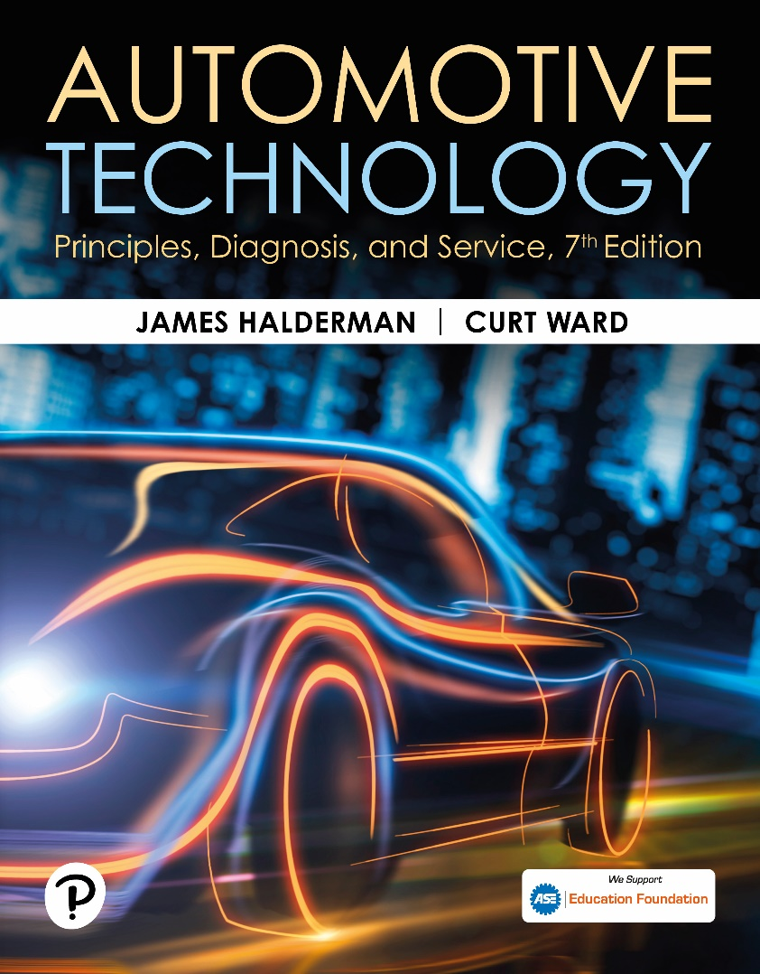
Automotive Technology: Principles, Diagnosis, and Service
Seventh Edition
Chapter 29
Variable Valve Timing and Displacement Systems
Copyright © 2023 Pearson Education, Inc. All Rights Reserved
Notes:
INSTRUCTOR NOTE: This presentation includes text explanation notes, you can use to teach the course. When in SLIDE SHOW mode, you RIGHT CLICK and select SHOW PRESENTER VIEW, to use the notes.

Slide 2
Learning Objectives
29.1 Explain the purpose and function of variable valve timing (VVT).
29.2 List the steps involved when diagnosing a VVT system.
29.3 Describe how a variable valve timing and lift electronic control (VTEC) system works.
29.4 Explain the operation of variable displacement systems.
29.5 Explain the diagnosis of variable displacement systems.
.

Slide 3
Variable Valve Timing
Changes the camshaft specifications during different operating modes.
The general types of variable valve timing include:
Intake valve timing only
Exhaust valve timing only
Both intake and exhaust valve timing
Operation
The camshaft position actuator oil control valve (O C V) directs oil from the oil feed in the head to the appropriate camshaft position actuator oil passages.

Slide 4
Figure 29.1 Exhaust-Only Timing
The exhaust-only variable cam timing systems allow the overlap period where both valves are open to be changed. The at-rest position provides little valve overlap, whereas the maximum overlap allows for internal EGR needed to reduce NOx
Notes:
Exhaust only. An engine that uses VVT on the exhaust only is used to create an EGR affect, thereby eliminating the need for an exhaust gas recirculation (EGR) valve. In this system, the exhaust valve is retarded when the engine is operating at part throttle. This delays the closing of the exhaust valves, which allows exhaust gases to be trapped in the combustion chamber.

Slide 5
Figure 29.2 No EGR Valve Timing
(a) At engine start, camshaft timing has little valve overlap, which improves idle quality. (b) During acceleration, valve overlap is increased to improve engine performance. (c) To reduce NOx emissions, valve timing is changed to trap some of exhaust gases in combustion chamber, thereby eliminating needs for EGR valve.

Slide 6
Animation: Variable Valve Timing (Animation will automatically start)

Slide 7
Chart 29.1 Intake/Exhaust Phasing
Camshaft Phasing
Changed | Purpose
Exhaust cam phasing | Reduces NOx exhaust emissions
Exhaust cam phasing | Increases fuel economy (reduced pumping losses)
Intake cam phasing | Increases low-speed torque
Intake cam phasing | Increases high-speed power
Notes:
By varying the intake camshaft timing, engine performance is
improved. By varying the exhaust camshaft timing, the exhaust
emissions and fuel consumption are reduced.

Slide 8
Frequently Asked Question: What Are the Various Names Used for Variable Valve Timing Systems?
? Frequently Asked Question
What Are the Various Names Used for Variable Valve Timing Systems? BMW—VANOS (Variable Nockenwellen Steuerung), Ford—VVT (Variable Valve Timing), GM—DCVCP (Double Continuous Variable Cam Phasing), if used for both intake and exhaust camshafts, Honda—VTEC (Variable valve Timing and lift Electronic Control), Hyundai—MPI CVVT (Multiport Injection Continuously Variable Valve Timing), Mazda—S-VT (Sequential Valve Timing), Mitsubishi—MIVECC (Mitsubishi Innovative Valve timing Electronic Control system), Nissan—N-VCTT (Nissan Variable Control Timing), Nissan—VVL (Variable Valve Lift), Porsche—Variocam (Variable camshaft timing), Suzuki—VVT (Variable Valve Timing), Subaru—AVCS (Active Valve Control System), Toyota—VVT-i (Variable Valve Timing-intelligent), Toyota—VVTL-i (Variable Valve Timing and Lift-intelligent), Volkswagen—VVT (Variable Valve Timing), and Volvo—VVT (Variable Valve Timing).

Slide 9
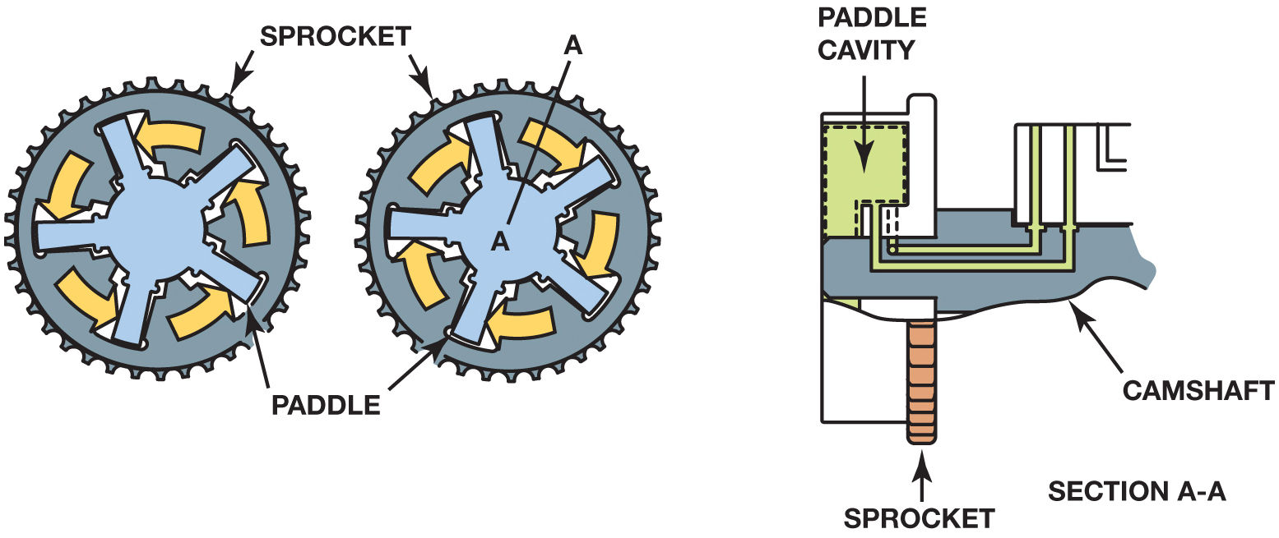
Figure 32.45

Slide 10
Figure 29.3 Retard and Advance
Camshaft Rotation During Advance and Retard

Slide 11
Animation: Vane Phaser (Animation will automatically start)

Slide 12
Figure 29.4 Spline Cam Phaser

Slide 13
Figure 29.5 Control Valve
Spline phaser control valve and how it works internally. Note that PCM uses RPM, crankshaft position (CKP) sensor, and the camshaft position (CMP) sensor to monitor and command the camshaft for maximum power and lowest possible exhaust emissions

Slide 14
Figure 29.6 Vane Phaser
Vane phaser is used to move the camshaft using changes of oil pressure from the oil control valve.

Slide 15
Figure 29.7 Screens
The Screen(s) Protect the Solenoid Valve from Dirt and Debris that can Cause the Valve to Stick
Notes:
TECH TIP: Check the Screen on the Control Valve If There Are Problems: If a NOx emission failure at a state inspection occurs or a diagnostic trouble code is set related to the
cam timing, remove the control valve and check for a clogged oil screen. A lack of regular oil changes can cause the screen to become clogged, thereby preventing proper operation. A rough idle is a
common complaint because the spring may not be able to return the camshaft to the idle position after a long highway trip. ● SEE FIGURE 29–7.

Slide 16
Figure 29.8 Magnetically Controlled
Magnetically Controlled Vane Phaser
Notes:
The following occurs when the pulse width is changed:
■ 0% pulse width. The oil is directed to the advance chamber of the exhaust camshaft actuator and retard chamber of the intake camshaft activator.
■ 50% pulse width. The PCM is holding the cam in the calculated position based on engine RPM and load. At 50% pulse width, the oil flow through the phaser drops to zero.
● SEE FIGURE 29–9.
■ 100% pulse width. The oil is directed to the retard chamber of the exhaust camshaft actuator and the advance chamber of the intake camshaft actuator.

Slide 17
Figure 29.9 50% Duty Cycle
When PCM commands 50% duty cycle, the oil flow through the phaser drops to zero.

Slide 18
Frequently Asked Question: What Happens When the Engine Stops?
? Frequently Asked Question
What Happens When the Engine Stops? When the engine stops, the oil pressure drops to zero and a spring-loaded locking pin is used to keep the camshaft locked to prevent noise at engine start. When the engine starts, oil pressure releases the locking pin.

Slide 19
Diagnostic Steps
STEP 1 Verify customer concern.
STEP 2 Perform a thorough visual inspection
STEP 3 Check for stored DTCs
STEP 4 Use a scan tool and check for duty cycle
STEP 5 Check solenoid for proper resistance.
STEP 6 Check for proper engine oil pressure.
Notes:
DIAGNOSTIC STEPS
The diagnostic procedure as specified by most vehicle manufacturers usually includes the following steps:
STEP 1 Verify the customer concern. This will usually be a “check engine light” (malfunction indicator light or MIL), as the engine performance effects would be minor under most operating conditions.
STEP 2 Perform a thorough visual inspection including checking the oil for proper level and condition.
STEP 3 Check for stored diagnostic trouble codes (DTCs). Typical VVT-related DTCs include the following:
P0011—Intake cam position is over advanced bank 1 P0012—Intake cam position is over retarded bank 1 P0013—Exhaust camshaft position actuator P0014—Exhaust camshaft too far advanced P0021—Intake cam position is over advanced bank 2 P0022—Intake cam position is over retarded bank 2
STEP 4 Use a scan tool and check for duty cycle on the cam phase solenoid while operating the vehicle at a steady road speed. The commanded pulse width should be 50%. If the pulse width is not 50%, the PCM is trying to move the phaser to its commanded position and the phaser has not reacted properly. A PWM signal of higher or lower than 50% usually indicates a stuck phaser assembly.
STEP 5 Check the solenoid for proper resistance. If a scan tool with bidirectional control is available, connect an am- meter and measure the current as the solenoid is being commanded on by the scan tool.
STEP 6 Check for proper engine oil pressure. Low oil pressure or restricted flow to the cam phaser can be the cause of
many DTCs.

Slide 20
Figure 29.10 Case Study
The exhaust camshaft actuator solenoid taken from a Chevrolet 2.4-liter four-cylinder showing the filter screen clogged with metal shavings.
Notes:
CASE STUDY: The Case of the Chevrolet Equinox
The owner of a Chevrolet Equinox complained that the engine was making noise and the “check engine” light on the dash was on. The service technician used a scan tool and retrieved two diagnostic trouble codes:
P0014—Exhaust cam position sensor system performance
P0013—Camshaft position actuator circuit open
The service technician removed the exhaust cam actuator solenoid and found that the filter screen was covered with metal shavings. Figure 29-10.
The technician recommended replacing the engine due to the amount of metal shavings and a new camshaft actuator solenoid. The customer
approved the repair, and this solved both the engine noise and eliminated the check engine light after the installation of the replacement engine, and after that the DTCs were cleared.
Summary:
Complaint—The owner complained of a noisy engine and the “check engine” light on the dash was on.
Cause—Major engine wear caused the noise and the wear metal caused the exhaust camshaft actuator solenoid filter screen to become clogged, setting a diagnostic trouble code and lighting the check engine light.
Correction—The engine was replaced and the trouble code cleared.

Slide 21
Variable Lift and Cylinder Deactivation Systems
Variable Lift
This system uses two different camshafts for low and high R P M.
Engine oil controlled
Cylinder Deactivation
Some engines are designed to operate on four of eight cylinders, or three of six cylinders, during low load conditions to improve fuel economy.
The system uses two-stage hydraulic valve lifters.
Notes:
Variable camshafts such as the system used by Honda/Acura are called variable valve timing and lift electronic control (VTEC). This system uses two different camshafts for low and high RPM. When the engine is operating at idle and speeds below about 4000 RPM, the valves are opened by cam- shafts that are optimized by maximum torque and fuel economy. When engine speed reaches a predetermined speed, depending on the exact make and model, the computer turns on a solenoid, which opens a spool valve. When the spool valve opens, the engine oil pressure pushes against pins that lock the three intake rocker arms together. With the rocker arms lashed, the valves must follow the profile of the high RPM cam lobe in the center. This process of switching from the low-speed camshaft profile to the high-speed profile takes about 100 milliseconds (0.1 sec).See Figures 29-11 and 29-12.

Slide 22
Figure 29.11 Honda VTEC
A Plastic Mockup of a Honda VTEC System That Uses Two Different Camshaft Profiles—one for Low-Speed Engine Operation and the Other for High Speed

Slide 23
Figure 29.12 Honda VTEC
Engine Oil Pressure is Used to Switch Cam Lobes on a VTEC System

Slide 24
Figure 29.13 Oil Pressure
Oil pressure applied to the locking pin causes the inside of the lifter to freely move inside the outer shell of the lifter, thereby keeping the valve closed.
Notes:
CASE STUDY The Case of the Wrong Oil
A Dodge Durango was in the shop for routine service, including a tire rotation and an oil change.
Shortly after, the customer returned and stated that the “check engine” light was on. A scan tool was used to retrieve any diagnostic trouble codes. A P0521, “oil pressure not reaching specified value at 1250 RPM” was set. A check of service information showed that this code could be set if the incorrect viscosity engine oil was used. The shop had used SAE 10W-30, but the 5.7-liter Hemi V-8 with multiple displacement system (MDS) required SAE 5W-20 oil. The correct oil was installed and the DTC cleared.
A thorough test-drive confirmed that the fault had been corrected and the shop learned that the proper viscosity oil is important to use in all vehicles.
Summary:
Complaint—The check engine light was on after an oil change.
Cause—Incorrect viscosity oil was used.
Correction—The oil was replaced with the specified viscosity and the DTC was cleared.

Slide 25
Figure 29.14 Fuel Management
Active Fuel Management Includes Many Different Components and Changes to the Oiling System, Which Makes Routine Oil Changes Even More Important on Engines Equipped with This System

Slide 26
Question 1: ?
How does variable valve timing help improve engine operation and reduce emissions?

Slide 27
Answer 1
By changing the timing of the opening and closing of the intake and exhaust valves, the level of N O x emissions can be lowered.

Slide 28
Engine Repair Videos and Animations
Videos Link: (A1) Engine Repair Videos
Animations Link: (A1) Engine Repair Animations

Slide 29
Copyright
This work is protected by United States copyright laws and is provided solely for the use of instructors in teaching their courses and assessing student learning. Dissemination or sale of any part of this work (including on the World Wide Web) will destroy the integrity of the work and is not permitted. The work and materials from it should never be made available to students except by instructors using the accompanying text in their classes. All recipients of this work are expected to abide by these restrictions and to honor the intended pedagogical purposes and the needs of other instructors who rely on these materials.

