Slide 1
Automotive Technology: Principles, Diagnosis, and Service
Seventh Edition
Chapter 28
Camshafts and Valve Trains
Copyright © 2023 Pearson Education, Inc. All Rights Reserved
Notes:
INSTRUCTOR NOTE: This presentation includes text explanation notes, you can use to teach the course. When in SLIDE SHOW mode, you RIGHT CLICK and select SHOW PRESENTER VIEW, to use the notes.

Slide 2
Learning Objectives (1 of 2)
28.1 Discuss intake and exhaust valves.
28.2 Describe camshaft design.
28.3 Discuss camshaft drives.
28.4 Discuss camshaft movement.
28.5 Discuss rocker arms.
28.6 Discuss pushrods.
28.7 Discuss tappets.

Slide 3
Learning Objectives (2 of 2)
28.8 Explain overhead camshaft valve trains.
28.9 Explain valve train lubrication.
28.10 Explain valve train problem diagnosis.
28.11 Explain camshaft specifications.
28.12 Explain how to remove a camshaft.
28.13 Explain how to measure a camshaft.

Slide 4
Camshaft
Purpose and Function
The major function of a camshaft is to open the valves.
Operation: Camshaft is driven by
Timing Gears
Timing Chain
Timing Belt
Camshaft Location
In Block
In Cylinder Head

Slide 5
Figure 28.1 Camshaft
This High-Performance Camshaft Has a Lobe that Opens the Valve Quickly and Keeps It Open for a Long Time

Slide 6
Figure 28.2 Camshaft Drive
The Camshaft Drives the Distributor and the Oil Pump Through a Shaft from the End of the Distributor

Slide 7
Figure 28.3 Camshaft Bearings
The Camshaft Rides on Bearings Inside the Engine Block Above the Crankshaft on a Typical Cam-in-Block Engine

Slide 8
Camshaft Design (1 of 2)
Construction
Cast Iron
Composite Steel
Components
Lobes
Bearing Journals
Accessory Drive Gears

Slide 9
Camshaft Design (2 of 2)
Camshaft Bearing Journals
Design depends on camshaft location
Hardness
Camshafts are hardened through liquid Nitriding and gas nitriding.
Camshaft Lubrication
Main galley transferring lubricant to the camshaft journal.
Eccentric lobe for high-pressure fuel pump on GDI engines

Slide 10
Figure 28.4 Camshaft Parts

Slide 11
Figure 28.5 Composite Camshaft
Composite Camshaft is Lightweight and yet Flexible, Because the Hollow Tube can Absorb Twisting Forces and the Lobes are Hard Enough to Withstand the Forces Involved in Opening Valves

Slide 12
Figure 28.6 Worn Camshaft
Worn Camshaft with Two Lobes Worn to the Point of Being Almost Round

Slide 13
Figure 28.7 GDI
The Camshaft Powers the High-Pressure Fuel Pump on Engines Equipped with Gasoline Direct Injection

Slide 14
Question 1: ?
How is the camshaft driven by the crankshaft?

Slide 15
Answer 1
Timing gear, timing chain and timing belt.

Slide 16
Camshaft Drives (1 of 2)
Crankshaft drives the camshaft with
Timing gear
Timing chain
Timing belt
Timing Chain
Roller chain
Flat-link or Morse type
Tensioner
On the unloaded side of chain

Slide 17
Camshaft Drives (2 of 2)
Timing Belts
Rubber or fabric reinforced with Kevlar or fiberglass.
Replaced approximately ever 60,000 miles (100,000 Km)
Freewheeling Engine
No damage occurs when a timing belt fails.
Interference Engine
The valves will strike the top of the pistons when the timing belt fails.

Slide 18
Figure 28.8 Chain Tensioner
A Timing Chain Hydraulic Tensioner

Slide 19
Figure 28.9 Silent Chain
Replacement silent chain and sprockets. The original camshaft sprocket was aluminum with nylon teeth to help control noise. This replacement set is not noticeably louder than the original and should give the owner many thousands of miles of useful service.

Slide 20
Figure 28.10 Chain Replacement
Industry Standard for When a to Replace a Timing Chain and Gears is When a 1/2 Inch (13 Mm) or More of Slack Is Measured in the Chain

Slide 21
Animation: Replace Timing Chain (Animation will automatically start)

Slide 22
Figure 28.11 SOHC
A typical overhead camshaft timing chain on an overhead camshaft (OHC) engine. Because the engine rotates clockwise as viewed from the front, this creates a tension side and a slack side for the timing chain. The tensioner is used on the slack side of the chain.

Slide 23
Figure 28.12 DOHC
Typical Overhead Camshaft Engine Showing the Location of the Tensioner, Water Pump, and Chain Guide as Well as the Timing Marks

Slide 24
Figure 28.13 DOHC One Chain
This Dual Overhead Camshaft (DOHC) Engine Uses One Chain from the Crankshaft to the Intake Cam and a Secondary Chain to Rotate the Exhaust Camshaft

Slide 25
Figure 28.14 Timing Belt Failure
Timing Belt Failed When Teeth Were Sheared Off. This Belt Failed at 88,000 Miles Because the Owner Failed to Replace it at Recommended Interval of 60,000 Miles

Slide 26
Figure 28.15 Timing Belt Broke
Timing Belt Broke Because an Oil Leak from One of the Camshaft Seals Caused Oil to Get into and Weaken the Belt

Slide 27
Animation: Timing and Balance Shaft Belts (Animation will automatically start)

Slide 28
Animation: Timing Belt, Remove & Replace (Animation will automatically start)

Slide 29
Figure 28.16 Interference Fit
Many Engines are of the Interference Design. If the Timing Belt (Or Chain) Breaks, the Piston and the Valve Will Collide

Slide 30
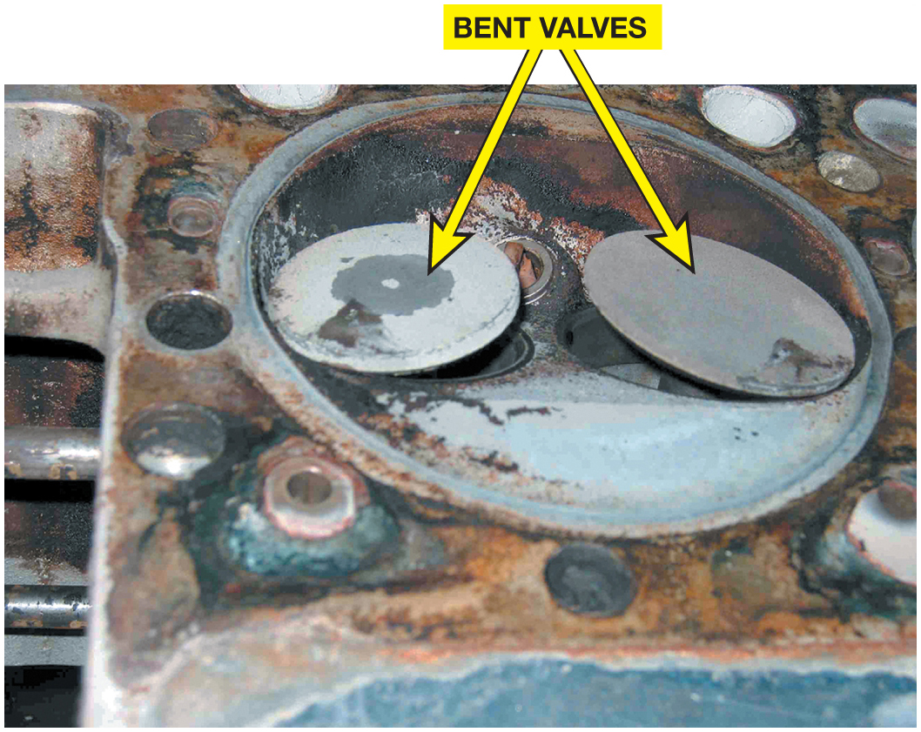
Figure 32.17 A

Slide 31
Figure 28.17 Failed Mercedes
Head from a Mercedes Showing Bent Valves When the Timing Chain Stretched and Skipped over the Crankshaft Sprocket

Slide 32
Figure 28.18 Case Study Timing Belt
A timing belt was replaced which corrected the crankshaft/camshaft correlation error diagnostic trouble code
Notes:
CASE STUDY The Case of the Ford Fiesta 1.6L
The owner of a Ford Fiesta complained of a check engine light, yet the engine seemed to run fine. The service technician retrieved a P0017 (cam and crank correlation error) diagnostic trouble code (DTC). The technician removed the timing belt cover and determined that the timing belt had jumped one tooth, likely due to a stretched belt or a worn tensioner. Because this engine is an interference-type engine where the valves hit the piston if the timing belt breaks when the engine is running, the technician recommended replacing the timing
belt using a kit available from many suppliers that include the following:
• timing belt
• timing belt tensioner
• water pump
The customer approved the repair and the new timing belt corrected the crank/cam correlation error code.
Summary:
Complaint—Check engine light on.
Cause—A diagnostic trouble code (DTC) P0017 cam and crank correlation error was retrieved which was caused by the timing belt that had jumped one tooth.
Correction—Replace timing belt along with the timing belt tensioner and the water pump. The DTC was cleared and road tested to confirm the
check engine light nor any diagnostic trouble codes were set. ● SEE FIGURE 28–18.

Slide 33
Question 2: ?
What is meant by an “interference” engine?

Slide 34
Answer 2
If the timing is incorrect, the valves will strike the top of the pistons.

Slide 35
Camshaft Movement
Cam Chucking
Movement of the camshaft lengthwise in the engine during operation.
Controlled with the use of thrust plates.
Flat Bottom Lifters
Rotate because contact point with lobe is slightly off center
Camshaft Lobe Lift
Lift different for intake and exhaust valves.

Slide 36
Figure 28.19 Bottom Flat Lifter
The Slight Angle and the Curve on the Bottom of a Flat Bottom Lifter Cause the Lifter and the Pushrod to Rotate During Normal Operation

Slide 37
Frequently Asked Question: Why Do Flat-Bottom Lifters Rotate?
? Frequently Asked Question
Why Do Flat-Bottom Lifters Rotate? Valve trains that use flat-bottom lifters use a spherical (curved) lifter face that slides against the cam lobe. This produces a surface on the lifter face that is slightly convex, by about 0.002 inch. The lifter also contacts the lobe at a point that is slightly off center. This produces a small turning force on the lifter to cause some lifter rotation for even wear. In operation, there is a wide line of contact between the lifter and the high point of the cam lobe. ● SEE FIGURE 28–19. These are the highest loads that are produced in an engine. This surface is the most critical lubrication point in an engine.

Slide 38
Figure 28.20 Lobe Lift
The Lobe Lift is the Amount the Cam Lobe Lifts the Lifter. The Blue Circle Is Called the Base Circle

Slide 39
Figure 28.21 Camshaft Ramps
Ramps on the Cam Lobe Allow the Valves to be Opened and Closed Quickly, yet Under Control, to Avoid Damaging Valve Train Components
Notes:
TECH TIP: Best to Warn the Customer
A technician replaced a timing chain and gears on a high mileage Chevrolet V-8. The repair was
accomplished correctly, yet after starting, the engine burned an excessive amount of oil. Before the timing chain replacement, oil consumption was minimal. The replacement timing chain restored proper operation of the engine by restoring the proper cam and valve timing, which increased engine vacuum. Increased vacuum can draw oil from the crankcase past worn piston rings and through worn valve guides during the intake stroke. Similar increased oil consumption problems occur if a valve job is performed on a
high-mileage engine with worn piston rings and/or cylinders.
To satisfy the owner of the vehicle, the technician had to disassemble and refinish the cylinders and replace the piston rings. Therefore, all technicians should warn customers that increased oil usage might result from almost any engine repair to a high-mileage engine.

Slide 40
Rocker Arms
A rocker arm reverses the upward movement of the pushrod to produce a downward movement on the tip of the valve.
Construction
Cast
Forged
Stamped Steel
Mounting Systems
Shaft-Mounted
Stud-Mounted
Pedestal-Mounted

Slide 41
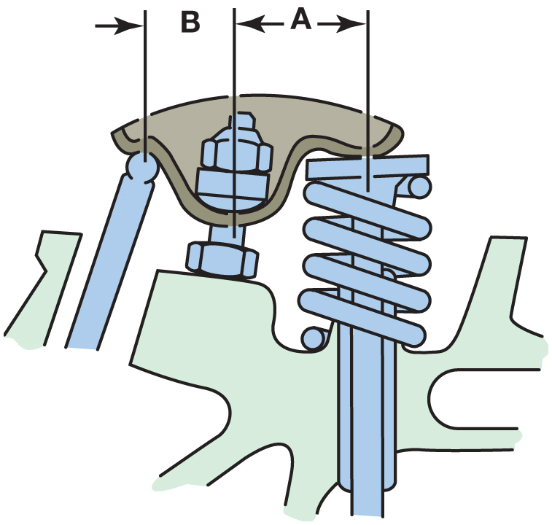
Figure 32.21

Slide 42
Figure 28.22 Rocker Arm Ratio
A 1.5:1 Ratio Rocker Arm Means that Dimension a is 1.5 Times the Length of Dimension B

Slide 43
Animation: Rocker Arm Ratio (Animation will automatically start)

Slide 44
Figure 28.23 High Performance
A High-Performance Aluminium Roller Rocker Arm. Both the Pivot and the Tip that Contacts the Stem of the Valve are Equipped with Rollers to Help Reduce Friction for More Power and Better Fuel Economy

Slide 45
Figure 28.24 Rocker Shafts
Some Engines Today Use Rocker Shafts to Support Rocker Arms, Such as the V-6 Engine with a Single Overhead Camshaft Located in the Center of the Cylinder Head

Slide 46
Frequently Asked Question: Are the Valves Adjustable?
? Frequently Asked Question
Are the Valves Adjustable? If the stud has the same diameter for its whole length, the rockers are adjustable and the nut is the “interference” type (lock-type nut). If the stud has a shoulder of a different diameter, the rockers are nonadjustable and the nut does not have interference threads.
Notes:
TECH TIP: Rocker Arm Shafts Can Cause Sticking Valves
As oil oxidizes, it forms a varnish. Varnish buildup is particularly common on hot upper portions
of the engine, such as rocker arm shafts. The varnish restricts clean oil from getting into and
lubricating the rocker arms. The cam lobe can easily force the valves open, but the valve springs
often do not exert enough force to fully close the valves. The result is an engine miss, which may
be intermittent. Worn valve guides and/or weak valve springs can also cause occasional rough
idle, uneven running, or an engine misfire.

Slide 47
Figure 28.25 Stud-Mounted Rocker
Typical Stud-Mounted Rocker Arm

Slide 48
Figure 28.26 Pushrod Guide Plates
Pushrod Guide Plates are Bolted to the Head and Help Stabilize the Valve Train, Especially at High Engine Speeds

Slide 49
Figure 28.27 Pedestal-Type Rocker
A Pedestal-Type Rocker Arm Design that Uses One Bolt for Each Rocker Arm and is Nonadjustable. If Valve Lash Needs to be Adjusted, Different Length Pushrod(s) must be Used

Slide 50
Push Rods
Pushrods transfer the lifting motion of the valve train from the cam lobe and lifters to the rocker arms.
Types of Pushrods
Hollow pushrods
Solid pushrods
Hollow pushrods are difficult to clean. It is recommended they be replaced when servicing.

Slide 51
Figure 28.28 OHV Engines
Overhead Valve Engines are also Known as Pushrod Engines Because of the Long Pushrod that Extends from the Lifter to the Rocker Arm

Slide 52
Figure 28.29 Bent Pushrods
When the Timing Chain Broke, the Valves Stopped Moving up and Down, but the Pistons Kept Moving and Hit the Valves, Causing the Pushrods to Bend

Slide 53
Figure 28.30 Hardened Pushrod
Hardened Pushrods should be Used in Any Engine that Uses Pushrod Guides (Plates). To Determine If the Pushrod is Hardened, Simply Try to Scratch the Side of the Pushrod with a Pocketknife
Notes:
TECH TIP: The Rotating Pushrod Test
To quickly and easily test whether the camshaft is okay, observe if the pushrods are rotating when
the engine is running. This test works on any overhead valve pushrod engine that uses flat-bottom
lifters. Due to the slight angle on the cam lobe and lifter offset, the lifter (and pushrod) should
rotate whenever the engine is running. To check, simply remove the rocker arm cover and observe the
pushrods when the engine is running. If one or more pushrods are not rotating, this camshaft and/or
the lifter for that particular valve is worn and needs to be replaced.

Slide 54
Lifters or Tappets
Valve lifters or tappets follow the contour or shape of the camshaft lobe.
Valve Lash
Valve train clearance
Mechanical or automatic hydraulic adjustment
Solid Lifters
Require a mechanical adjustment
Hydraulic Lifters
Automatically takes up the valve adjustment

Slide 55
Figure 28.31 Flat-Bottom Lifters
Older Engines Used Flat-Bottom Lifters, Whereas All Engines Since the 1990s Use Roller Lifters

Slide 56
Animation: Camshaft and Flat Tappet (Animation will automatically start)

Slide 57
Animation: Camshaft and Roller Lifter (Animation will automatically start)

Slide 58
Figure 28.32 Roller Lifters
All Roller Lifters Must Use Some Method to Keep the Lifter Straight and Not Rotating

Slide 59
Figure 28.33 Cutaway Lifter
Cutaway of a Flat-Bottom Solid Lifter. Because this type of Lifter Contains a Retaining Ring and Oil Holes, it is Sometimes Confused with a Hydraulic Lifter that also Contains Additional Parts

Slide 60
Figure 28.34 Roller Lifter Cutaway
Exploded View of a Hydraulic Roller Lifter

Slide 61
Overhead Camshaft Valve Trains
Overhead camshaft engines use several different types of valve opening designs.
Open valves with a bucket
Cam follower
Rocker arm through a hydraulic lifter
Hydraulic lash adjuster
The lifters in an O H V engine are lubricated through oil passages drilled through the block.

Slide 62
Figure 28.35 Worn Cam Lobe
The extremely worn cam lobe caused by the valve lifter rotating sideways
Notes:
CASE STUDY The Case of the Worn Hemi Camshaft
A customer complained that the engine of their Ram truck (5.7-liter Hemi V8) was making a “ticking” sound and the “check engine” light was on. A P0300 (random misfire) diagnostic trouble code (DTC) was retrieved and the ticking sound was confirmed by the service technician. Because the ticking sound
usually is associated with the valve train problem, the valve covers were removed for a visual inspection.
It was apparent that one pushrod was not moving with the engine running. Apparently, the valve lifter anti-rotation retainer broke allowing the lifter to turn sideways, which then caused excessive wear to the
camshaft lobe. ^{● SEE FIGURE 28–35.}
The customer approved of the repair of a replacement camshaft and lifters which corrected the misfire and the engine noise concerns.
Summary:
Complaint—The owner of a Ram truck complained of a ticking sound from the engine and a check engine light on in the dash.
Cause—A valve lifter had broken free of the retainer plate which allowed the roller lifter to turn sideways wearing the camshaft lobe This wear caused the engine noise and a random misfire.
Correction—The camshaft and lifters were replaced and the diagnostic trouble code was cleared. These actions corrected the customer concern.

Slide 63
Figure 28.36 Bucket Type Lifters
Hydraulic lifters may be built into bucket type lifters on some overhead camshaft engines
Notes:
CASE STUDY The Noisy Camshaft
The owner of an overhead cam 4-cylinder engine complained of a noisy engine. After taking the vehicle to several technicians and getting high estimates to replace the camshaft and followers, the owner tried to find a less expensive solution. Finally, another technician replaced the serpentine drive belt on the front of the engine and “cured” the “camshaft” noise for a fraction of the previous estimates. Many engines have been disassembled and/ or overhauled because of a noise that was later determined to be from one of the following:
Loose or defective accessory drive belt(s)
Loose torque converter-to-flex plate (drive plate) bolts (nuts)
Defective mechanical fuel pump (if equipped)
Summary:
Complaint—Vehicle owner complained about an noisy engine.
Cause—A defective accessory drive belt was found to be the cause of the noise.
Correction—The accessory drive belt was replaced, which eliminated the noisy engine complaint.

Slide 64
Figure 28.37 Hydraulic Lifters OHC
The Use of Cam Followers Allows the Use of Hydraulic Lifters with an Overhead Camshaft Design

Slide 65
Figure 28.38 HLA
Hydraulic Lash Adjusters (HLA) Are Built into the Rocker Arm on Some OHC Engines. Sometimes HLAS May Not Bleed down Properly If the Wrong Viscosity (SAE Rating) Oil Is Used

Slide 66
Valve Train Problem Diagnosis
Noise heard due to component wear.
Wear may be a result of
Oil level
Oil condition
Oil pressure
Incorrect oil filter
Incorrect oil

Slide 67
Figure 28.39 Misfire Cause
The Cause of a Misfire Diagnostic Trouble Code was Discovered to be a Pushrod That Had Worn through the Rocker Arm on a General Motors 3.1 Liter V-6 Engine

Slide 68
Camshaft Specifications
Duration
The number of degrees of crankshaft (not camshaft) rotation for which a valve is lifted off the seat.
Valve Overlap
The number of degrees of crankshaft rotation during which both intake and exhaust valves are open.
Lobe Centers
The separation between the centerlines of the intake and exhaust lobes

Slide 69
Figure 28.40 Shaft-Mounted Rockers
Shaft-Mounted Rocker Arms are Held in Position by an Assortment of Springs, Spacers, and Washers, Which Should Be Removed so that the Entire Shaft can be Inspected for Wear

Slide 70
Figure 28.41 Valve Timing
Graphic Representation of a Typical Camshaft Showing the Relationship Between the Intake and Exhaust Valves. The Shaded Area Represents the Overlap Period of 100 Degrees

Slide 71
Figure 28.42 Lobe Separation Angle
As the Lobe Center Angle Decreases, the Overlap Increases, with No Other Changes in the Lobe Profile Lift and Duration

Slide 72
Figure 28.43 Camshaft Timing
Typical Cam Timing Diagram

Slide 73
Figure 28.44 Cam Lobe Height
Dial indicator being used to measure cam lobe height.

Slide 74
Engine Repair Videos and Animations
Videos Link: (A1) Engine Repair Videos
Animations Link: (A1) Engine Repair Animations

Slide 75
Copyright
This work is protected by United States copyright laws and is provided solely for the use of instructors in teaching their courses and assessing student learning. Dissemination or sale of any part of this work (including on the World Wide Web) will destroy the integrity of the work and is not permitted. The work and materials from it should never be made available to students except by instructors using the accompanying text in their classes. All recipients of this work are expected to abide by these restrictions and to honor the intended pedagogical purposes and the needs of other instructors who rely on these materials.

