Slide 1
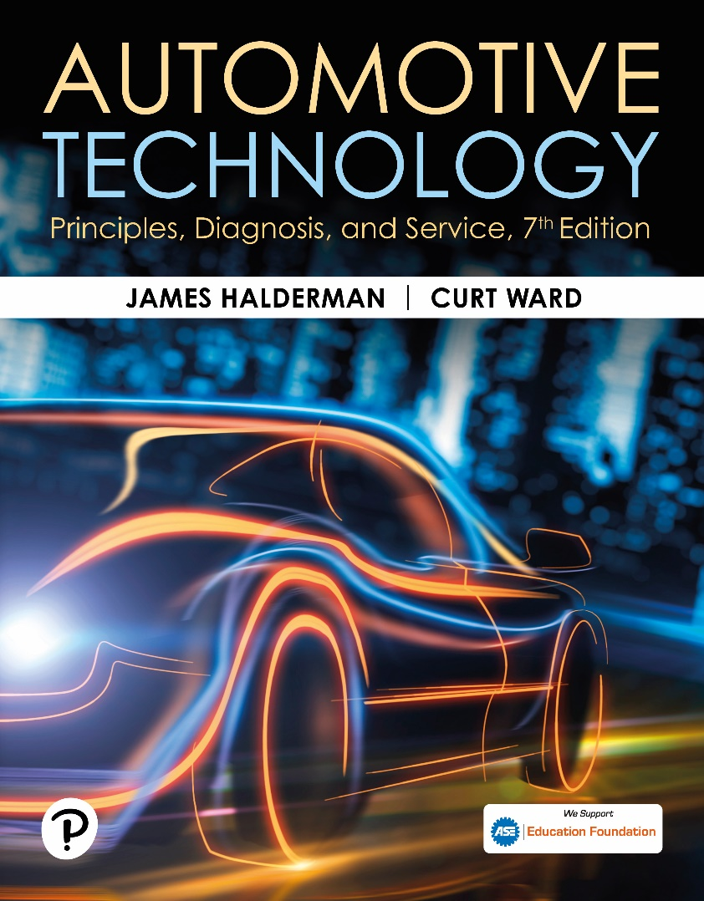
Automotive Technology: Principles, Diagnosis, and Service
Seventh Edition
Chapter 26
Engine Cleaning and Crack Detection
Copyright © 2023 Pearson Education, Inc. All Rights Reserved
Notes:
INSTRUCTOR NOTE: This presentation includes text explanation notes, you can use to teach the course. When in SLIDE SHOW mode, you RIGHT CLICK and select SHOW PRESENTER VIEW, to use the notes.

Slide 2
Learning Objectives
26.1 Explain the mechanical cleaning procedure of engines.
26.2 Discuss chemical cleaners.
26.3 Describe spray and steam washing.
26.4 Describe thermal cleaning.
26.5 Describe tank and vapor cleaning.
26.6 Describe ultrasonic and vibratory cleaning.
26.7 Explain crack detection.
26.8 Explain crack repair.

Slide 3
Mechanical Cleaning
Scraping
Scraper most frequently used is a putty knife, or a plastic card.
Abrasive Pads or Discs
White: Finest grit size
Yellow: Course Grit
Green: Cast-iron Only
Media Blasting
Media blasting with baking soda is the cleaning method of choice for most shops.
Notes:
TECH TIP: The Ice Scraper Trick: Using a steel scraper can damage aluminum heads or block deck surfaces. To prevent damage, try using a file to sharpen a plastic ice scraper and then use this to scrape gaskets from aluminum engine parts. This method works very well.

Slide 4
Figure 26.1 Bristle Pad
An Air-Powered Grinder Attached to a Bristle Pad Being Used to Clean the Gasket Surface of a Cylinder Head

Slide 5
Figure 26.2 Scotch Brite™ Pad
Abrasive Disc Commonly Called by Its Trade Name, Scotch Brite™ Pad

Slide 6
Figure 26.3 Baking Soda Used
Using Baking Soda Is the Recommended Way to Clean Engine Parts Because Any Soda That Is Left on or in the Part Is Dissolved in Oil or Water, Unlike Either Sand or Glass Beads, Which Can Be Engine Damaging

Slide 7
Figure 26.4 Sealed Cabinet
Small Engine Parts Can Be Blasted Clean in a Sealed Cabinet

Slide 8
Question 1: ?
What is the purpose of mechanical cleaning?

Slide 9
Answer 1
The purpose of mechanical cleaning is to remove heavy deposits.

Slide 10
Chemical Cleaners
pH
Indicates the amount of chemical activity in the soap.
Solvent-Based Cleaning
A deposit is said to be soluble when it can be dissolved with a chemical or solvent.
Water-Base (aqueous) Chemical Cleaning
Used because of environmental concerns.
Most aqueous-type chemicals are silicate–based and are mixed with water.

Slide 11
Spray and Steam Washing
Spray Washing
A spray washer directs streams of liquid through numerous high-pressure nozzles to dislodge dirt and grime on an engine surface.
Steam Cleaning
Steam vapor is mixed with high-pressure water and sprayed on the parts.

Slide 12
Figure 26.5 Pressure Jet
A Pressure Jet Washer Is Similar to a Large Industrial-Sized Dishwasher. Each Part Is Then Rinsed with Water to Remove Chemicals or Debris That May Remain There While It Is Still in the Tank

Slide 13
Thermal Cleaning
Temperatures Involved:
600°F (315°C) to 800°F (425°C)
Advantages:
Cleans inside as well as outside
Waste generated nonhazardous
Microbial Cleaning:
Microbes (living organisms [single-celled bacteria]) that literally “eat” hydrocarbons (grease and oils) off of parts being cleaned.
Pyrolytic Oven:
High-temperature oven cleans engine parts by decomposing dirt, grease, and gaskets.

Slide 14
Figure 26.6 Microbial Cleaner
Microbial Cleaning Tank Uses Microbes to Clean Grease and Oil from Parts

Slide 15
Figure 26.7 Pyrolytic Oven
Pyrolytic (High-Temperature) Oven Cleans by Baking Engine Parts. After Parts Have Been Cleaned, They Are Placed into an Airless Blaster. This Unit Uses a Paddle to Scoop Stainless Steel Shot from a Reservoir and Forces It Against the Engine Part

Slide 16
Tank and Vapor Cleaning
Cold Tank Cleaning
Cold soak tank used to remove grease and carbon.
Hot Tank Cleaning
Hot soak tank used for cleaning heavy organic deposits and rust from iron and steel parts.
Vapor Cleaning
Parts to be cleaned are suspended in hot vapors above a perchloroethylene solution.

Slide 17
Ultrasonic and Vibratory Cleaning
Ultrasonic Cleaning
Disassembled parts placed in a tank of cleaning solution that is then vibrated at ultrasonic speeds to loosen all soil from parts.
Vibratory Cleaning
Vibrating bin with small odd-shaped ceramic or steel pieces, called media, with a cleaning solution of mineral spirits or water-based detergents are used to clean the small parts.

Slide 18
Figure 26.8 Ultrasonic Cleaner
An Ultrasonic Cleaner Is Used to Clean Fuel Injectors

Slide 19
Crack Detection
Visual Inspection
After cleaning, parts are reexamined for cracks.
Magnetic Crack Detection
Uses magnetic field that is commonly referred to by the brand name Magnafluxing.
Fluorescent-Penetrant Detection
Dark red penetrating chemical is sprayed on the component and tested with a black light.
Pressure Testing
Head or block is pressurized and then lowered into water, where air bubbles indicate a leak.

Slide 20
Figure 26.9 Crack Inspection
The Top Deck Surface of a Block Is Being Tested Using Magnetic Crack Inspection Equipment

Slide 21
Figure 26.10 Powder In Cracks
If the Lines of Force Are Interrupted by a Break (Crack) in the Casting, Then Two Magnetic Fields Are Created and the Powder Will Lodge in the Crack

Slide 22
Animation: Magnetic Crack Detection (Animation will automatically start)

Slide 23
Figure 26.11 Crack at Plug
This Crack in a Vintage Ford 289, V-8 Block Was Likely Caused by the Technician Using Excessive Force Trying to Remove the Plug from the Block

Slide 24
Figure 26.12 Air Forced In
To Make Sure That the Mark Observed in the Cylinder Wall Was a Crack, Compressed Air Was Forced into the Water Jacket While Soapy Water Was Sprayed on the Cylinder Wall. Bubbles Confirmed That the Mark Was Indeed a Crack.

Slide 25
Figure 26.13 Head Under Water
Cylinder Head Is Under Water and Being Pressure Tested Using Compressed Air. Note That the Air Bubbles Indicate a Crack

Slide 26
Question 2: ?
When id the dye-penetrant testing method most commonly used?

Slide 27
Answer 2
On parts constructed of aluminum or other nonmagnetic material.

Slide 28
Crack Repair (1 of 2)
Crack Concerns
Cracks in engine block can cause coolant to flow into the oil or oil into the coolant.
Stop Drilling
Hole can be drilled at each end of crack to keep it from extending further.
Crack-Welding Cast Iron
Highly skilled welding technique that is typically only successful when the entire cast-part is heated red-hot.

Slide 29
Crack Repair (2 of 2)
Crack-Welding Aluminum
Cracks in aluminum can be welded using a Heli-arc® or similar welder that is specially designed to weld aluminum.
Crack Plugging
In process of crack plugging, a crack closed using interlocking tapered plugs. This process can be used on cast-iron or aluminum components.

Slide 30
Figure 26.14 Crack Fix
(a) Before welding, crack ground out using a carbide grinder. (b) technician practicing using the special cast-iron welding torch before welding the cracked cylinder head. (c) This is the finished welded crack before final machining. (d) Note the finished cylinder head after the crack has been repaired using welding.

Slide 31
Figure 26.15 Reaming Hole
Reaming a Hole for a Tapered Plug

Slide 32
Figure 26.16 Tapping Hole
Tapping a Tapered Hole for a Plug

Slide 33
Figure 26.17 Plug Installed
Screwing a Tapered Plug in the Hole

Slide 34
Figure 26.18 Cutting Plug
Cutting the Plug With a Hacksaw

Slide 35
Figure 26.19 Interlocking Plugs

Slide 36
Figure 26.20 Installed Plugs
(a) A hole is drilled and tapped for the plugs. (b) The plugs are installed. (c) After final machining, the cylinder head can be returned to useful service.

Slide 37
Question 3: ?
What is the purpose of stop drilling?

Slide 38
Answer 3
To prevent the crack from extending any further.

Slide 39
Engine Repair Videos and Animations
Videos Link: (A1) Engine Repair Videos
Animations Link: (A1) Engine Repair Animations

Slide 40
Copyright
This work is protected by United States copyright laws and is provided solely for the use of instructors in teaching their courses and assessing student learning. Dissemination or sale of any part of this work (including on the World Wide Web) will destroy the integrity of the work and is not permitted. The work and materials from it should never be made available to students except by instructors using the accompanying text in their classes. All recipients of this work are expected to abide by these restrictions and to honor the intended pedagogical purposes and the needs of other instructors who rely on these materials.

