Slide 1
Automotive Technology: Principles, Diagnosis, and Service
Seventh Edition
Chapter 25
Engine Removal and Disassembly
Copyright © 2023 Pearson Education, Inc. All Rights Reserved
Notes:
INSTRUCTOR NOTE: This presentation includes text explanation notes, you can use to teach the course. When in SLIDE SHOW mode, you RIGHT CLICK and select SHOW PRESENTER VIEW, to use the notes.

Slide 2
Learning Objectives
25.1 Discuss the different engine repair options.
25.2 Explain the engine removal procedure.
25.3 Explain the engine disassembly procedure.
25.4 Explain disassembly of the short block.
25.5 Explain rotating engine assemblies removal.
25.6 Explain cylinder head disassembly.

Slide 3
Engine Repair Options
Component Replacement
Valve Job
Minor Overhaul
Major Overhaul
Short Block
Long Block
Crate Engine
Remanufactured Engine

Slide 4
Figure 25.1 Worn Timing Sprocket
A Worn Timing Sprocket That Resulted in a Retarded Valve Timing and Reduced Engine Performance

Slide 5
Figure 25.2 Crate Motor
A Crate Engine from Chrysler to Be Used in a Restored Muscle Car. Using a Complete New Engine Costs More than Rebuilding an Existing Engine, but It Has a Warranty and Uses All New Parts

Slide 6
Engine Removal (1 of 2)
Remove the hood and store safely.
Clean the engine area.
Disconnect the negative battery cable.
Remove the air cleaner and accessories.
Drain the coolant and remove the radiator.
Recover the air conditioning refrigerant.
Remove the power steering pump and drain the oil.
Disconnect the wiring, fuel lines, and vacuum hoses.
Notes:
TECH TIP: A Picture Is Worth a Thousand Words: Take pictures with a cell phone camera, digital camera, or a video camcorder of the engine being
serviced. These pictures will be worth their weight in gold when it comes time to reassemble or reinstall the engine. It is very difficult for anyone to remember the exact location of every bracket, wire, and hose. Referring back to the photos of the engine before work was started will help you restore the vehicle to like-new condition.
TECH TIP: Tag and Bag: All components and fasteners should be marked for future reference. Large components should be marked or a tag installed that identifies the part.
Smaller parts and fasteners should be placed in plastic bags and labeled as to what they are used for, such as the water pump bolts.

Slide 7
Figure 25.3 Engine Removal Top
An Engine Must Be Tipped as It Is Pulled from the Chassis

Slide 8
Figure 25.4 FWD Engine
When Removing Just the Engine from a Front-Wheel-Drive Vehicle, the Transaxle Must Be Supported. Shown Here Is a Typical Fixture That Can Be Used to Hold the Engine, If the Transaxle Is Removed, or to Hold the Transaxle, If the Engine Is Removed

Slide 9
Figure 25.5 Entire Front Cradle
Entire Cradle, Which Included the Engine, Transaxle, and Steering Gear, Was Removed and Placed onto a Stand. the Rear Cylinder Head Has Been Removed to Check for the Root Cause of a Coolant Leak

Slide 10
Animation: Remove an Engine RWD (Animation will automatically start)

Slide 11
Question 1: ?
Why is the use of a new replacement engine beneficial?

Slide 12
Answer 1
New parts are used and the engine comes with a warranty.

Slide 13
Engine Disassembly
Mount engine on stand
Cam-In-Block Example
Remove rocker covers, rocker arms, and push rods.
Remove the intake manifold.
Remove the lifters.
Remove the cylinder heads.
Overhead Camshaft Example
Remove timing cover, timing belt or chain, and camshaft prior to removing cylinder head.
Notes:
TECH TIP: Disassembly Is the Reverse Order of Assembly
Cylinder heads often warp upward in the center. Loosening the center head bolts first will tend to
increase the warpage, especially if the head is being removed to replace a head gasket because of
overheating. Always follow the torque table backward, starting with the highest-number bolt and
working toward the lowest number. In other words, always loosen fasteners starting at the end or
outside of the component and work toward
the inside or center of the component.

Slide 14
Figure 25.6 Grade 5 or 6 Bolts
Always Use Graded Bolts—either Grade 5 or 8 Bolts—whenever Mounting an Engine to a Stand

Slide 15
Figure 25.7 Parts in Order
Keeping the Pushrods and the Lifters Sorted by Cylinder, Including the Spark Plugs, Is a Wise Way to Proceed When Disassembling the Cylinder Heads
Notes:
TECH TIP: Mark It to Be Safe
Whenever you disassemble anything, it is always wise to mark the location of parts, bolts, hoses,
and other items that could be incorrectly assembled. Remember, the first part removed will be the
last part that is assembled. If you think you will remember where everything goes—forget it! It
just does not happen in the real world.
One popular trick is to use correction fluid to mark the location of parts before they are removed.
Most of these products are alcohol or water-based, dry quickly, and usually contain a brush in the
cap for easy use.

Slide 16
Figure 25.8 Major Engine Damage
Sometimes, After the Cylinder Head Has Been Removed, the Engine Condition Is Discovered to Be so Major That the Entire Engine May Need to Be Replaced, Rather than Overhauled

Slide 17
Disassembly of the Short Block
Remove oil pan
Mark connecting rods and caps
Remove cylinder ridge
Remove pistons

Slide 18
Figure 25.9 Rod Cap Markings
These Connecting Rods Were Numbered from the Factory. If They Are Not, Then They Should Be Marked

Slide 19
Figure 25.10 Cylinder Wear
Most of the Cylinder Wear Is on the Top Inch Just Below the Cylinder Ridge. This Wear Is Due to the Heat and Combustion Pressures That Occur When the Piston Is near the Top of the Cylinder
Notes:
TECH TIP: Measure the Cylinder Bore before Further Disassembly: As soon as the cylinder head has been removed from the engine, take a measurement of the cylinder bore. This is done for the following reasons:
To verify that the engine size is the same as specified by the vehicle identification number (VIN).
To measure the bore and compare it to factory specifications, to help the technician determine if the cylinder(s) is too worn to use or cannot be restored

Slide 20
Figure 25.11 Ridge Reamer
This Ridge Is Being Removed with One Type of Ridge Reamer Before the Piston Assemblies Are Removed from the Engine

Slide 21
Rotating Engine Assemblies Removal
Remove the harmonic balancer
Remove the camshaft
Remove the crankshaft and main bearings

Slide 22
Figure 25.12 Removing Balancer
Puller Being Used to Pull the Vibration Damper from the Crankshaft

Slide 23
Figure 25.13 Broken Timing Gear
When the Timing Chain Cover Was Removed, the Broken Timing Gear Explained Why This G M 4.3 Liter V-6 Engine Stopped Running

Slide 24
Figure 25.14 Main Cap Markings
Most Engines, Such as This Chevrolet V-8 with Four-Bolt Main Bearing Caps, Have Arrows Marked on the Bearing Caps That Should Point to the Front of the Engine

Slide 25
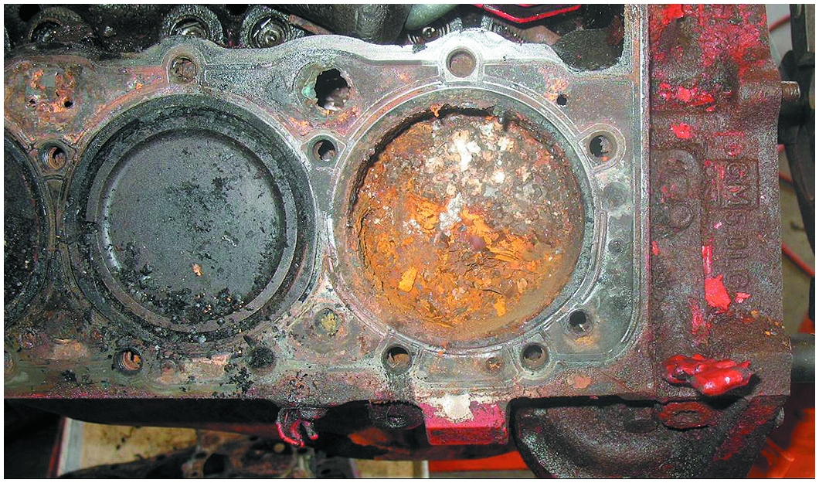
Figure 28.15

Slide 26
Figure 25.15 Rust In Cylinders
This small block Chevrolet V-8 had water standing in the cylinders, causing a lot of rust, which was discovered as soon as the head was removed

Slide 27
Figure 25.16 Removing Gallery Plugs
Torch Is Used to Heat Gallery Plugs. Paraffin Wax Is Then Applied and Allowed to Flow Around the Threads. This Procedure Results in Easier Removal of the Plugs and Other Threaded Fasteners That Cannot Otherwise Be Loosened
Notes:
TECH TIP: The Wax Trick
Before the engine block can be thoroughly cleaned, all oil gallery plugs must be removed. A popular trick of the trade for plug removal involves heating the plug (not the surrounding metal) with an oxyacetylene torch. The heat tends to expand the plug and make it tighter in the block. Do not overheat.
As the plug is cooling, touch the plug with paraffin wax (beeswax or candle wax may be used). ● SEE FIGURE 25–16.
The wax will be drawn down around the threads of the plug by capillary attraction as the plug cools and contracts. After being allowed to cool, the plug is easily removed.

Slide 28
Cylinder Head Disassembly
Tap the valve spring retainer to break the taper.
Compress the spring to expose the keepers.
Remove the keepers and un-compress the spring.
Remove the spring and the valve.
Remove valve seals and spring seats.
Keep all components in order for reassembly.
Overhead cam engines require cam removal first.

Slide 29
Figure 25.17 Valve Spring Tool
A Valve Spring Compressor Is Used to Compress the Valve Spring Before Removing the Keepers (Locks)

Slide 30
Question 2: ?
Why are valve spring retainers tapped with a hammer?

Slide 31
Answer 2
The blow breaks the taper of the keeper and makes them easier to remove.

Slide 32
Engine Removal (2 of 2)

Slide 33
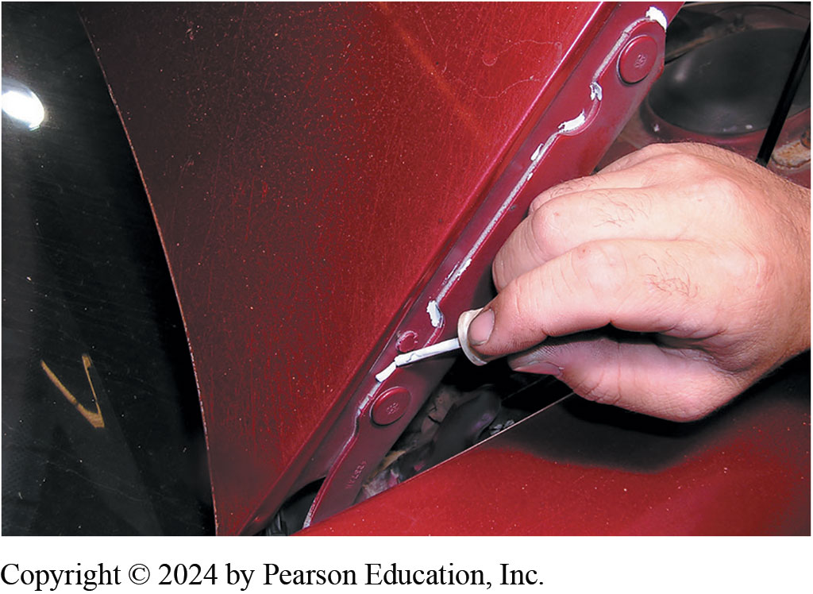
Mark and Remove Hood
Notes:
1. Before Beginning Work on Removing the Engine, Mark and Remove the Hood and Place It in a Safe Location

Slide 34
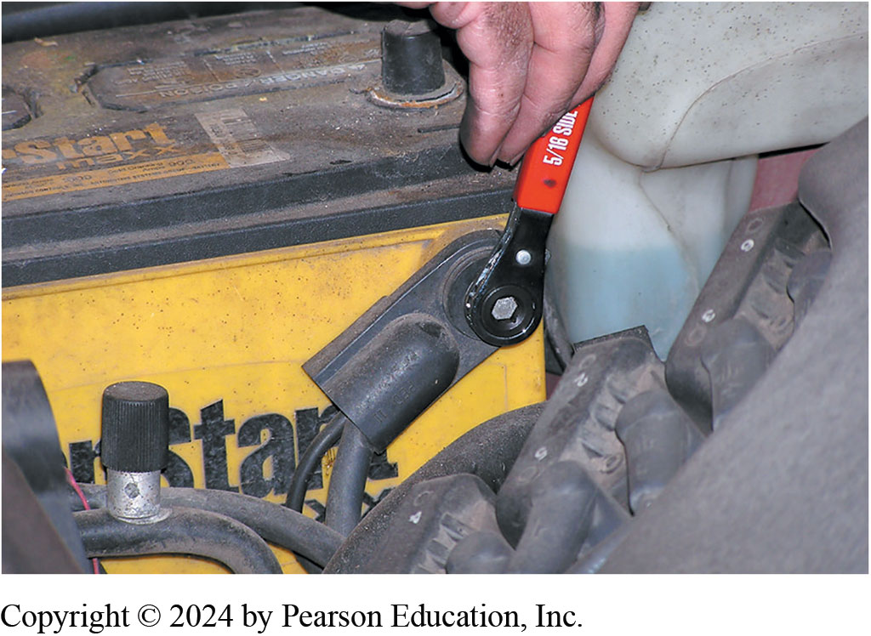
Remove Negative Battery Cable
Notes:
2. For Safety, Remove the Negative Battery Cable to Avoid Any Possible Electrical Problems from Occurring

Slide 35
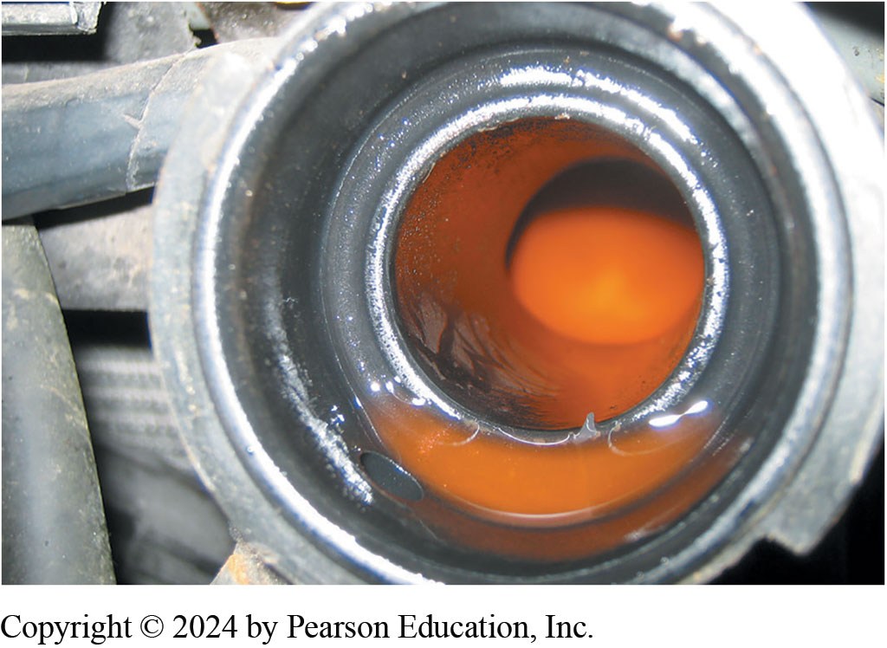
Drain Coolant, Dispose of Properly
Notes:
3. Drain the Coolant and Dispose of Properly

Slide 36
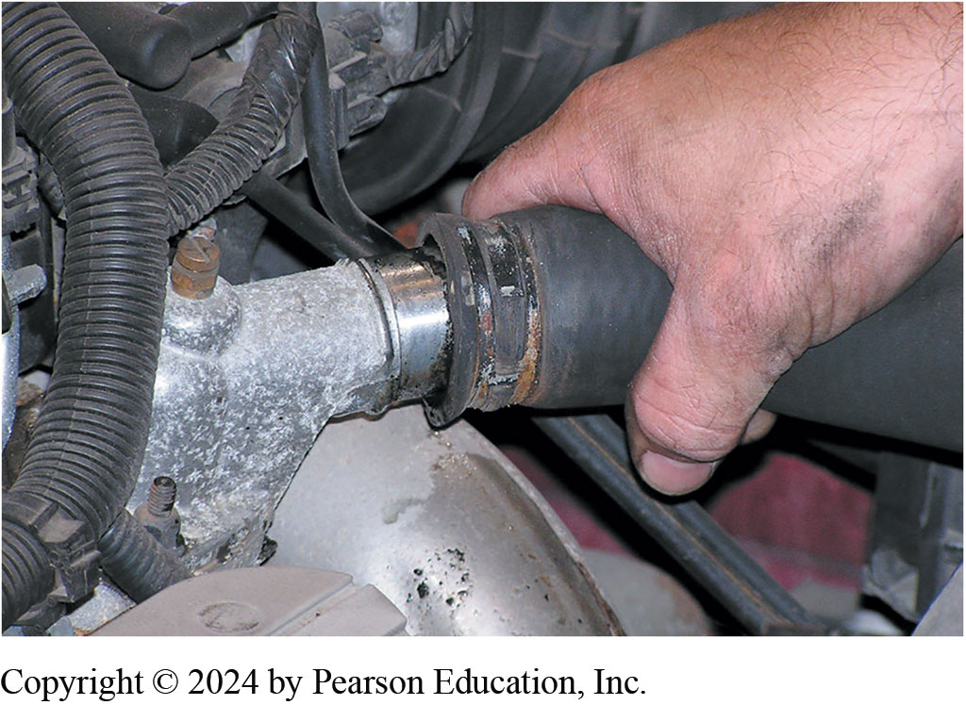
Disconnect Cooling System
Notes:
4. Disconnect All Cooling System and Heater Hoses and Remove the Radiator

Slide 37
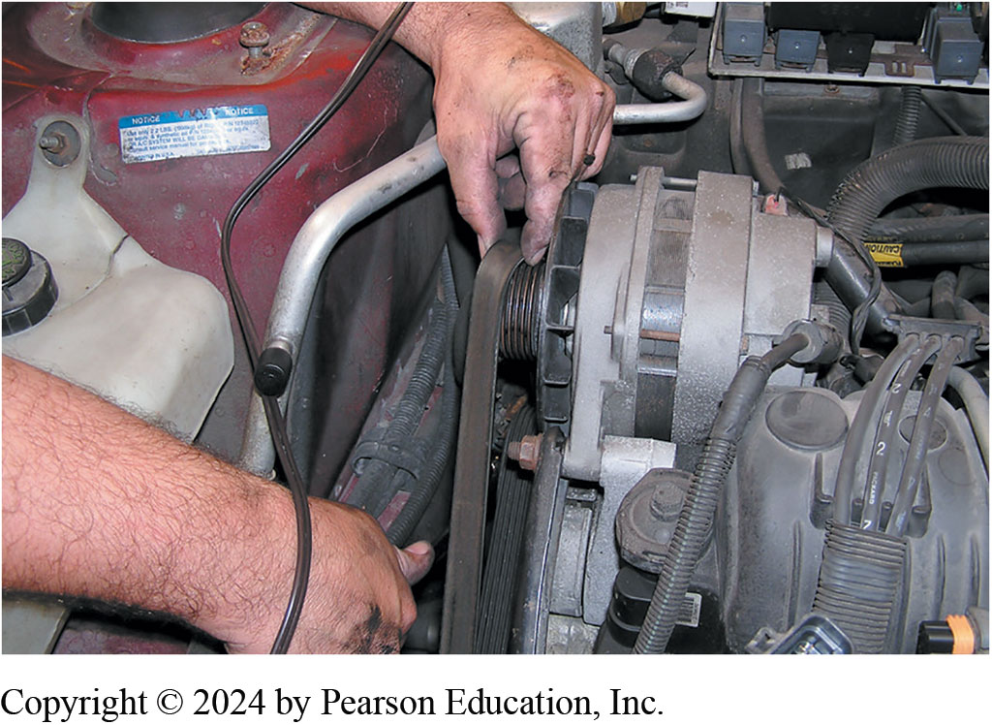
Remove Accessories
Notes:
5. Remove the Accessory Drive Belt(s) and Set the Alternator, Power Steering Pump, and Air-Conditioning Compressor Aside

Slide 38
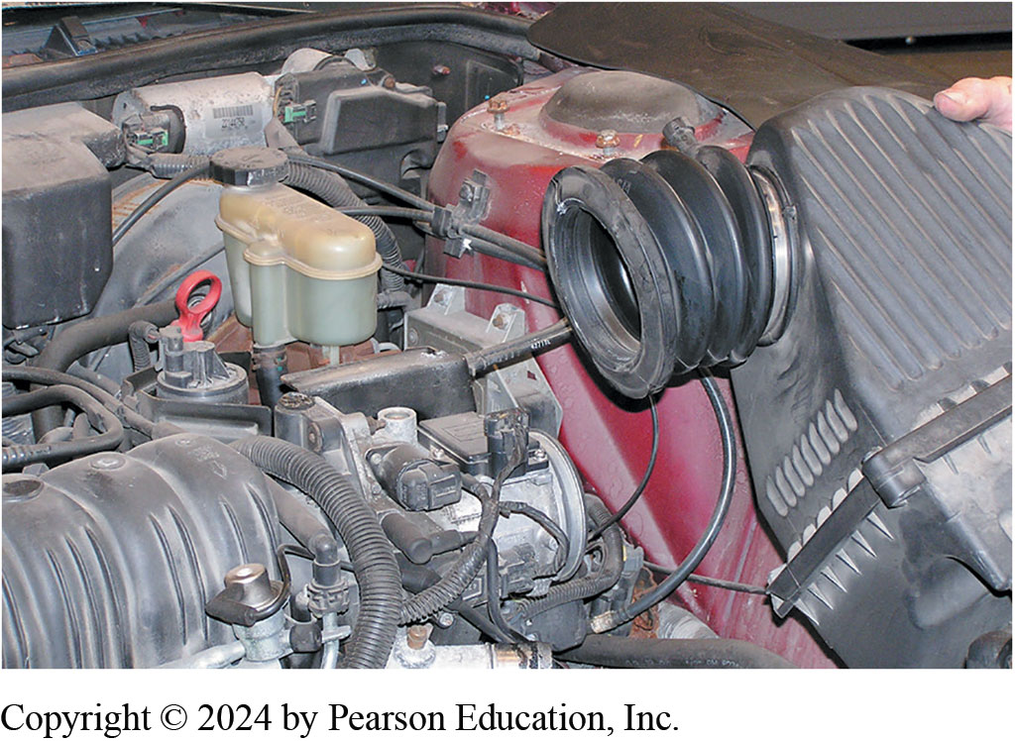
Remove the Air Intake System
Notes:
6. Remove the Air Intake System, Including the Air Filter Housing, as Needed

Slide 39
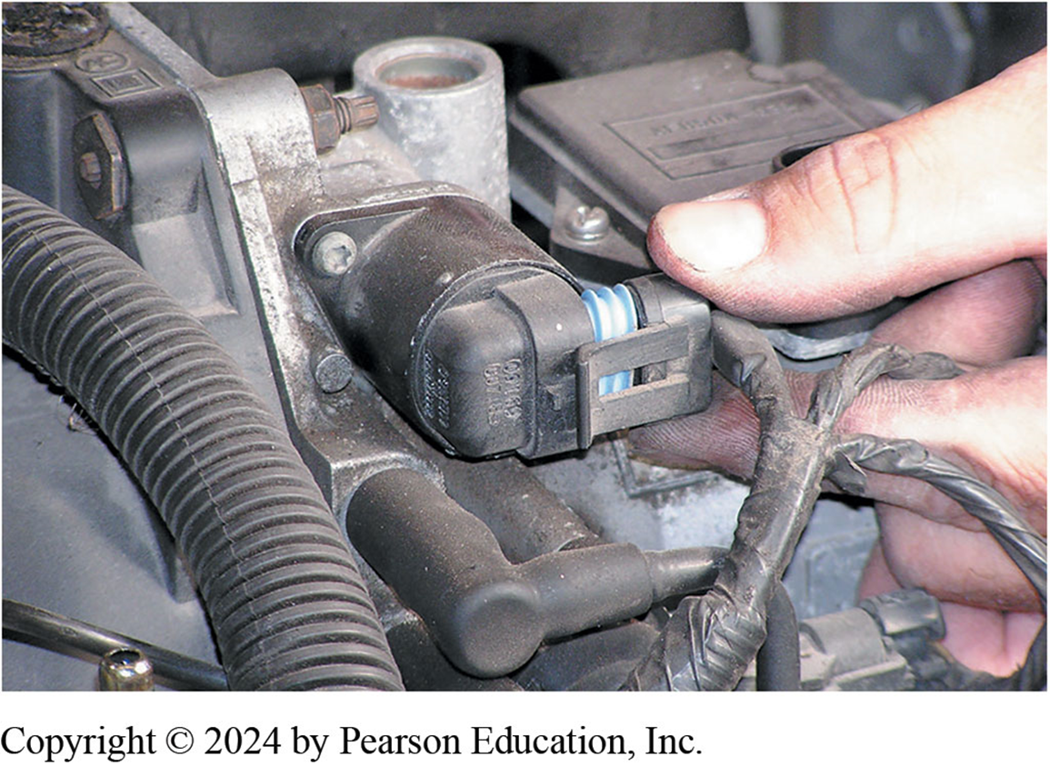
Remove Sensor Connectors
Notes:
7. Remove the Electrical Connector from All Sensors and Label

Slide 40
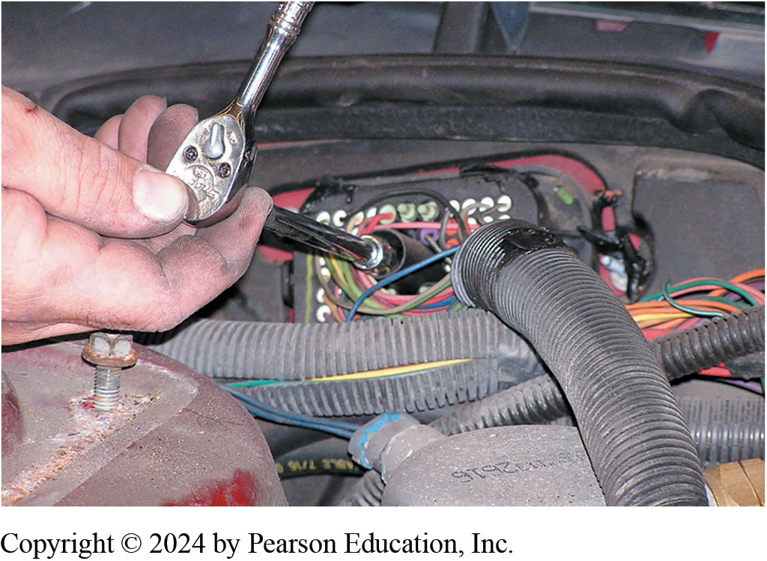
Disconnect Harness at Bulkhead
Notes:
8. Disconnect the Engine Wiring Harness Connector at the Bulkhead

Slide 41
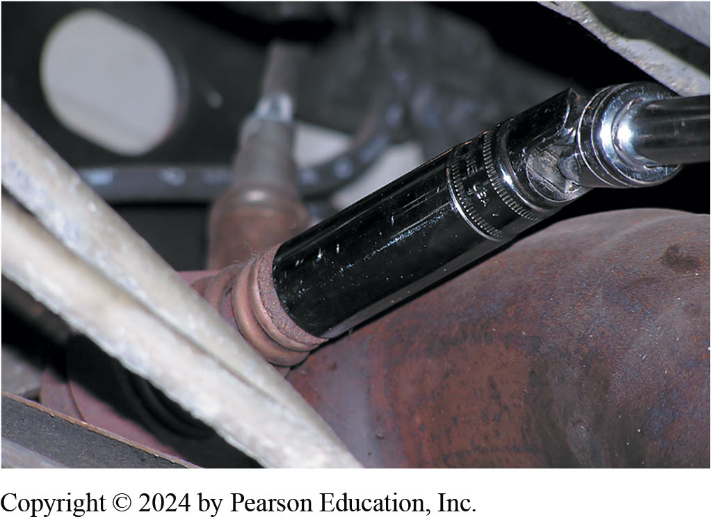
Disconnect Exhaust System
Notes:
9. Safely Hoist the Vehicle and Disconnect the Exhaust System from the Exhaust Manifolds

Slide 42
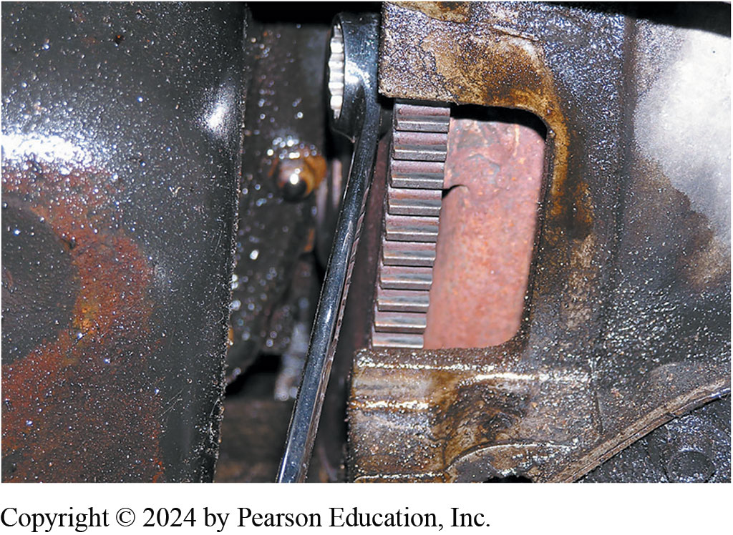
Mark & Remove Flex Plate Fasteners
Notes:
10. Mark and Then Remove the Fasteners Connecting the Flex Plate to the Torque Converter

Slide 43
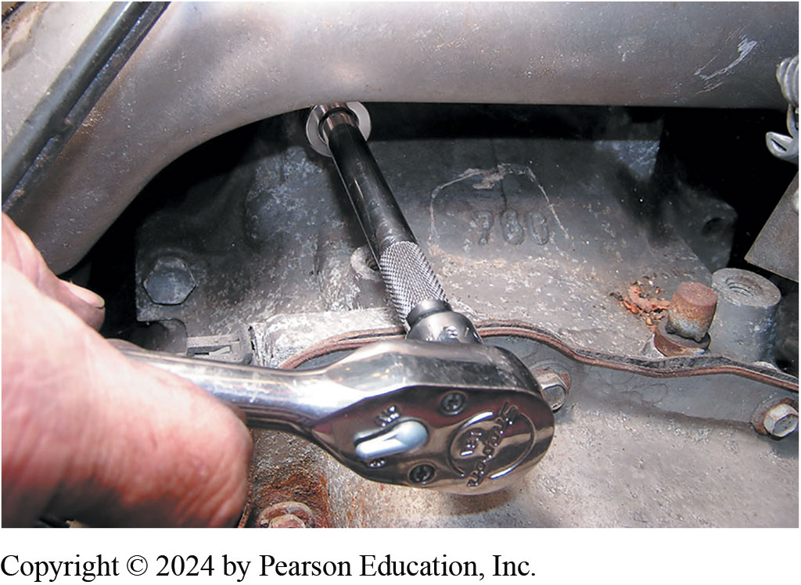
Remove Engine/Trans Mount Bolts
Notes:
11. Lower the Vehicle and Remove the Engine Mount Bolts and Transaxle Bell Housing Fasteners

Slide 44
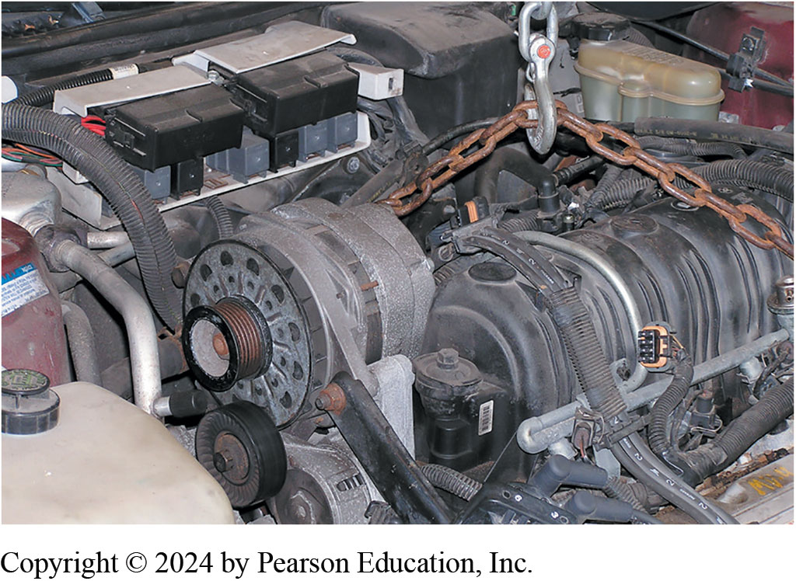
Secure Lifting Chain Remove Engine
Notes:
12. Secure the Lifting Chain to the Engine Hooks and Carefully Remove the Engine from the Vehicle

Slide 45
Engine Repair Videos and Animations
Videos Link: (A1) Engine Repair Videos
Animations Link: (A1) Engine Repair Animations

Slide 46
Copyright
This work is protected by United States copyright laws and is provided solely for the use of instructors in teaching their courses and assessing student learning. Dissemination or sale of any part of this work (including on the World Wide Web) will destroy the integrity of the work and is not permitted. The work and materials from it should never be made available to students except by instructors using the accompanying text in their classes. All recipients of this work are expected to abide by these restrictions and to honor the intended pedagogical purposes and the needs of other instructors who rely on these materials.

