Slide 1
Automotive Technology: Principles, Diagnosis, and Service
Seventh Edition
Chapter 24
In-Vehicle Engine Service
Copyright © 2023 Pearson Education, Inc. All Rights Reserved
Notes:
INSTRUCTOR NOTE: This presentation includes text explanation notes, you can use to teach the course. When in SLIDE SHOW mode, you RIGHT CLICK and select SHOW PRESENTER VIEW, to use the notes.

Slide 2
Learning Objectives
25.1 Explain thermostat replacement in engines.
25.2 Explain water pump replacement in engines.
25.3 Discuss intake manifold gasket inspection.
25.4 Discuss intake manifold gasket replacement.
25.5 Describe the steps involved in timing belt replacement.
25.6 Discuss hybrid engine precautions.
25.7 Discuss gasoline direct-injection engine concerns.

Slide 3
Thermostat Replacement
Failure Patterns
Stuck open
Stuck closed
Stuck partially open
Skewed (does not operate in correct range)
Thermostat Replacement
Allow system to cool, then drain.
Replace thermostat per manufacturer’s instructions.
Refill system and check for proper operation.

Slide 4
Figure 24.1 Thermostat Jiggle Valve
If the thermostat has a jiggle valve, it should be placed toward the top to allow air to escape

Slide 5
Question 1: ?
What are the four pattern failures of a thermostat?

Slide 6
Answer 1
Stuck open, stuck closed, stuck partially open, and skewed.

Slide 7
Water Pump Replacement
Need for replacement:
Coolant leaking from the weep hole.
Bearing noisy or loose.
Lack of proper coolant flow.
Replacement guidelines:
Allow the system to cool, then drain.
Remove and replace water pump per the manufacturer’s specifications.
Refill system and verify proper operation.

Slide 8
Figure 24.2 Removing Gasket
Use caution if using a steel scraper to remove a gasket from aluminum parts. It is best to use a wood or plastic scraper

Slide 9
Intake Manifold Gasket Inspection
To diagnose a possible leaking intake manifold gasket, perform the following tests.
Visual inspection
Coolant leak
Air (vacuum) leak

Slide 10
Figure 24.3 Failed Intake Gasket
An intake manifold gasket that failed and allowed coolant to be drawn into the cylinder(s)

Slide 11
Intake Manifold Gasket Replacement
Allow the cooling system to cool, then drain.
Remove intake manifold making sure not to warp any components that will be reused.
Clean all surfaces.
Replace defective components per the manufacturer’s specifications.
Refill the cooling system and verify proper operation.

Slide 12
Figure 24.4 Lower Intake Manifold
The lower intake manifold attaches to the cylinder heads

Slide 13
Figure 24.5 Upper Intake Manifold
The upper intake manifold, often called a plenum, attaches to the lower intake manifold

Slide 14
Figure 24.6 Pressure Relief Valve
Some plastic intake manifolds are equipped with a pressure relief valve that would open in the event of a backfire condition to prevent the higher internal pressures from causing damage to the manifold

Slide 15
Timing Belt Replacement
Timing belts are required to be replaced if any of the following occur.
Manufacturer’s recommended timing belt replacement interval.
Timing belt contaminated with coolant or engine oil.
Timing belt has failed (missing belt teeth or broken).
Before replacing the timing belt make sure all needed special tools are available.

Slide 16
Figure 24.7 Timing Belt
A single overhead camshaft engine with a timing belt that also rotates the water pump

Slide 17
Animation: Timing Belt, Remove and Replace (Animation will automatically start)

Slide 18
Question 2: ?
Why must timing belts be replaced?

Slide 19
Answer 2
Replacement interval, fluid contamination, or physical damage.

Slide 20
Engine Mount Replacement
Engine mounts are designed to perform the following functions:
Support the weight and torque of the powertrain.
Isolate noise and vibrations.
Inspection:
Obvious damage or fluid leaks.
Loose or damaged fasteners.
Replacement:
Follow the manufacturer’s procedures when replacing.

Slide 21
Animation: Remove & Replace Engine Mounts (Animation will automatically start)

Slide 22
Figure 24.8 HEV Ready Light
A Toyota/Lexus hybrid electric vehicle has a ready light. If the ready light is on, the engine can start at anytime without warning.

Slide 23
Hybrid Engine Precautions
Make sure the ignition is off and the key is out of the vehicle.
Check that the “Ready” light is off.
Do not touch any of the circuits with “orange” conduit.
Always use high-voltage lineman’s gloves when depowering the high-voltage system.

Slide 24
Animation: Hybrid Vehicle Safety (Animation will automatically start)

Slide 25
Figure 24.9 SAW Viscosity
Always use the viscosity of oil as specified on the oil fill cap

Slide 26
Animation: Engine Oil Selection (Animation will automatically start)

Slide 27
Question 3: ?
Why is it important that the READY light be out on the dash before working under the hood of a hybrid electric vehicle?

Slide 28
Answer 3
Any time the “Ready” light is illuminated, the vehicle may start.

Slide 29
Valve Adjustment Step-By-Step

Slide 30
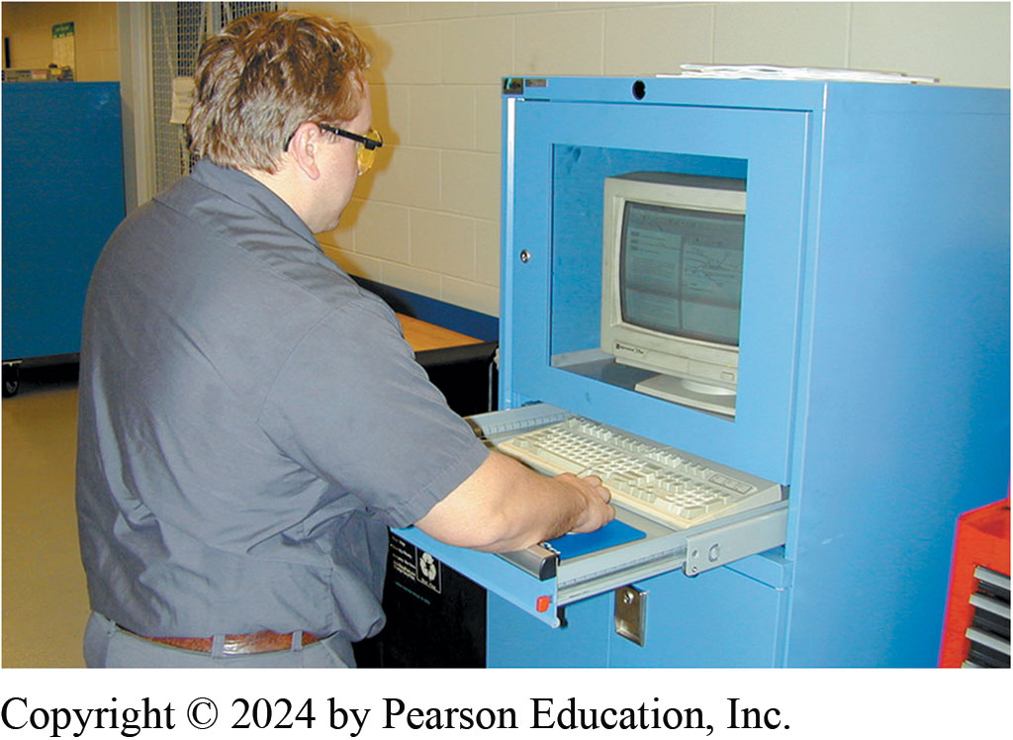
Check Specifications
Notes:
1. Before starting the process of adjusting the valves, look up the specifications and exact procedures

Slide 31
Tools Necessary
Notes:
2. The tools necessary to adjust the valves on an engine with adjustable rocker arms include basic hand tools, feeler gauge, and a torque wrench

Slide 32
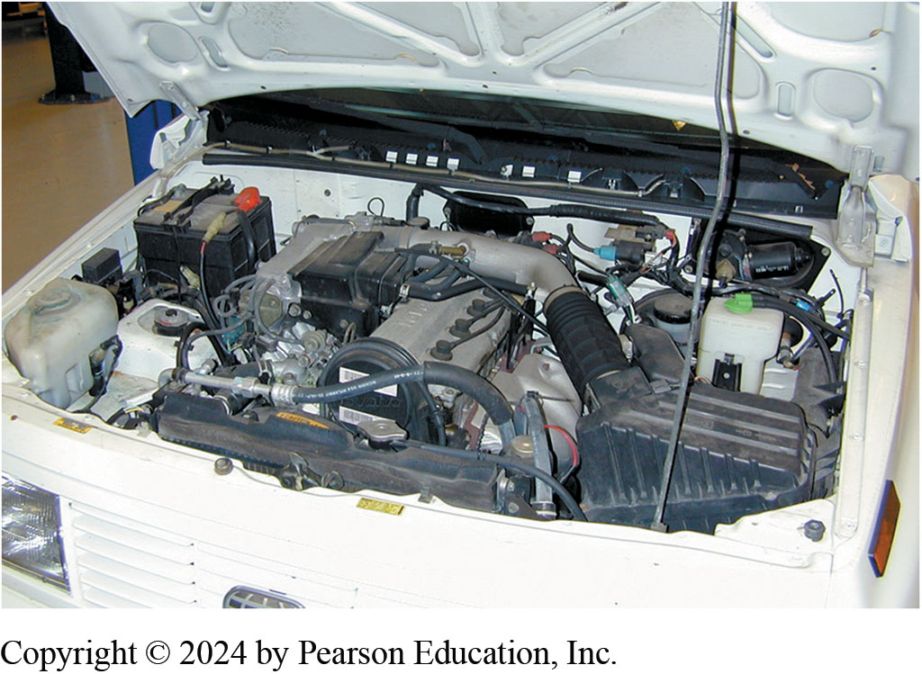
4-Cylinder Engine Valves
Notes:
3. An overall view of the 4-cylinder engine that is due for a scheduled valve adjustment, according to the vehicle manufacturer’s recommendations

Slide 33
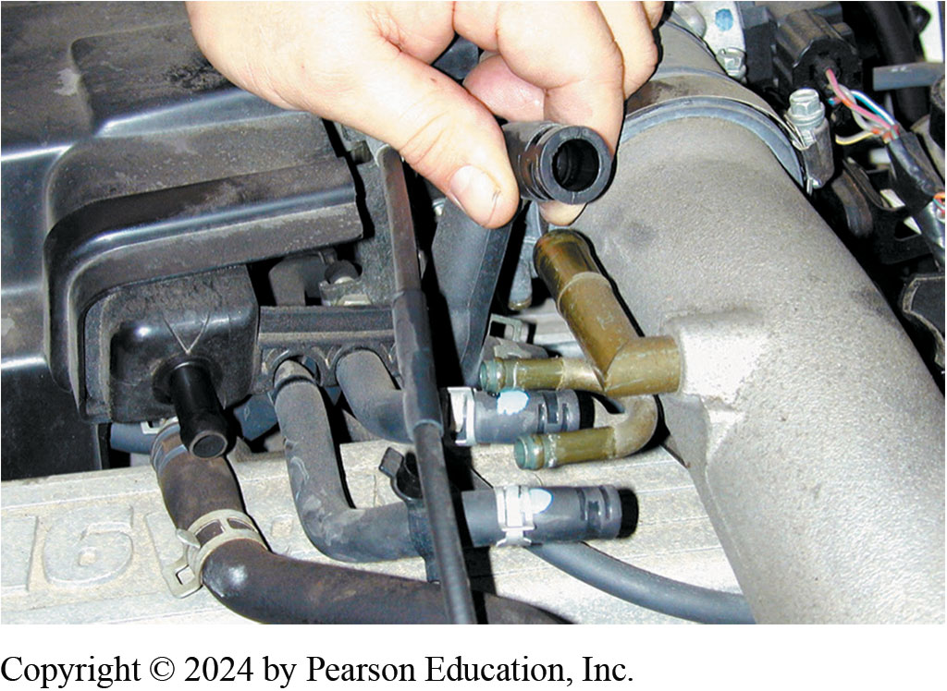
Disconnecting and Label Parts
Notes:
4. Start the valve adjustment procedure by first disconnecting and labeling, if necessary, all vacuum lines that need to be removed to gain access to the valve cover

Slide 34
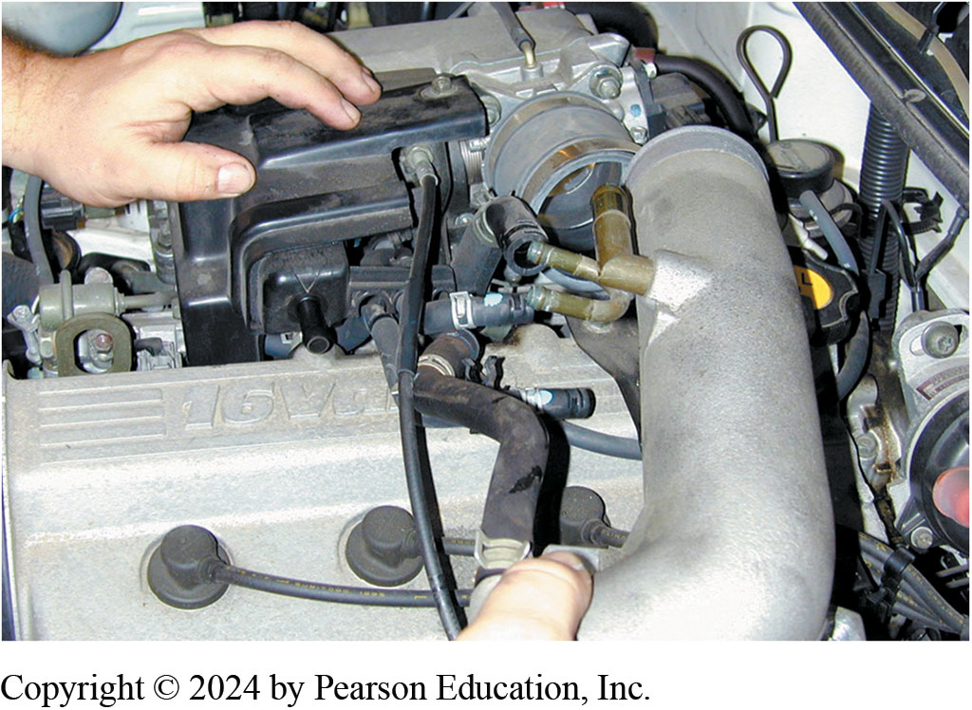
Removing Air Intake Tube
Notes:
5. The air intake tube is being removed from the throttle body

Slide 35
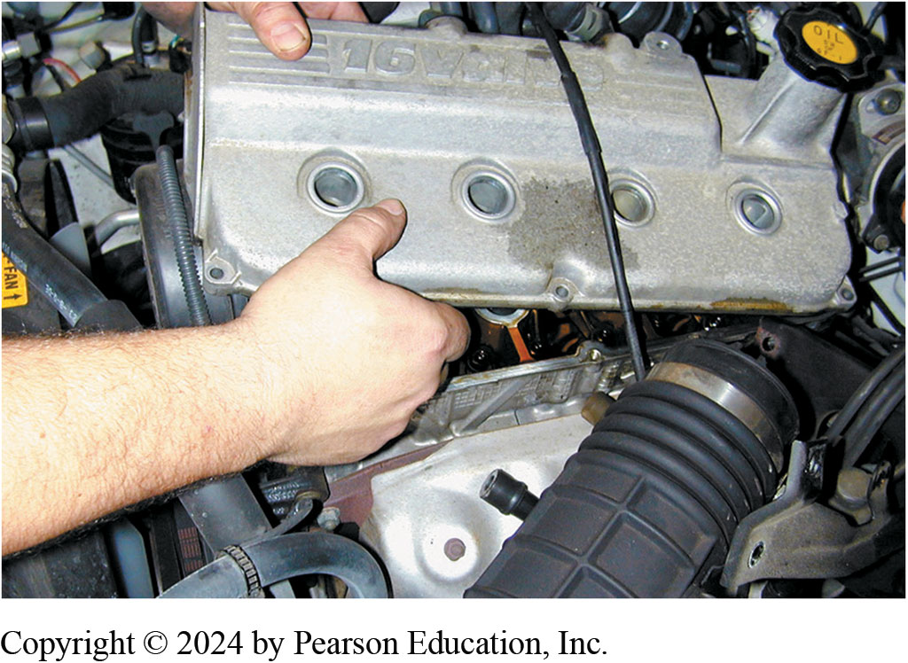
Remove Valve Cover
Notes:
6. With all vacuum lines and the intake tube removed, the valve cover can be removed after removing all retaining bolts

Slide 36
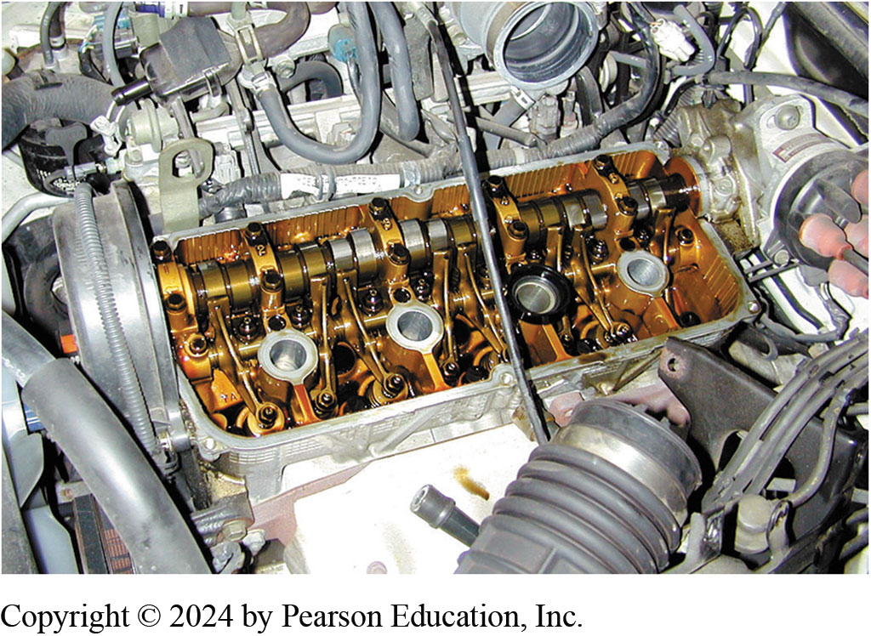
Clean Engine
Notes:
7. Notice how clean the engine appears. This is a testament of proper maintenance and regular oil changes by the owner

Slide 37
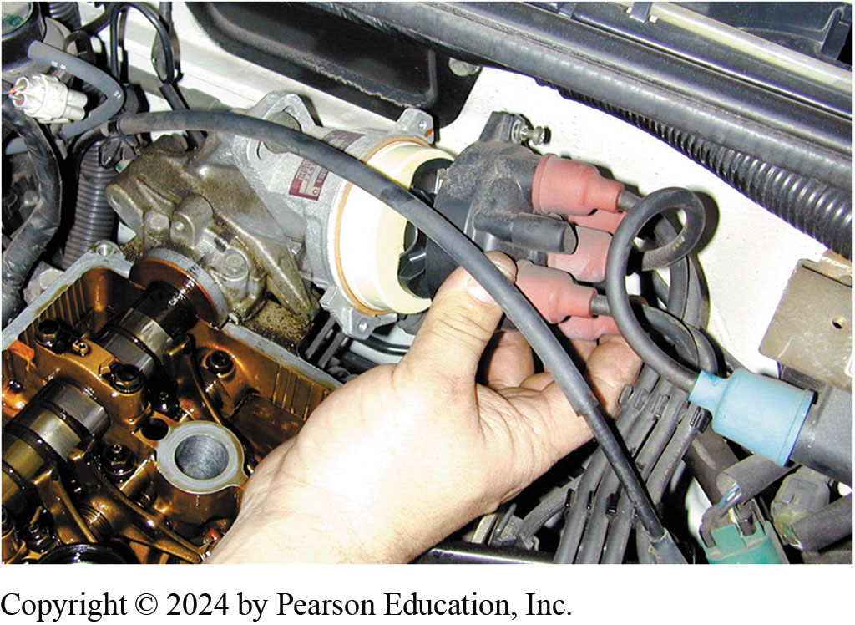
Rotor Position Guide
Notes:
8. To help locate how far the engine is being rotated, the technician is removing the distributor cap to be able to observe the position of the rotor

Slide 38
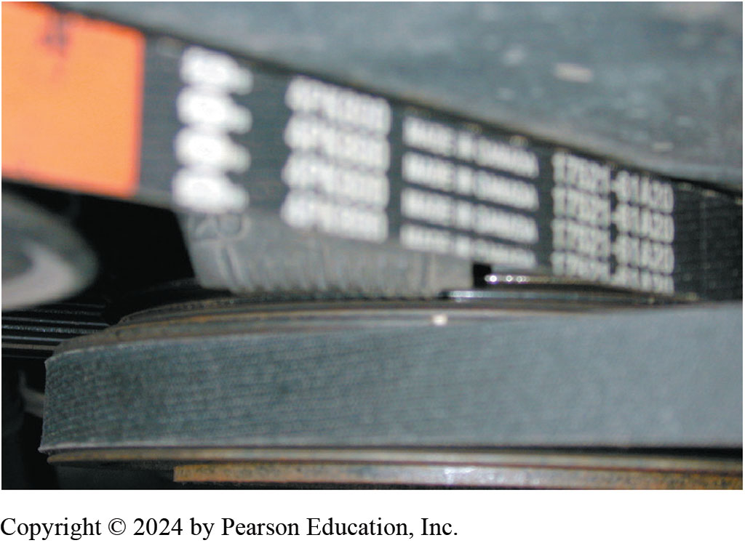
Setting Timing Marks
Notes:
9. The engine is rotated until the timing marks on the front of the crankshaft line up with zero degrees—top dead center (T D C)—with both valves closed on #1 cylinder

Slide 39
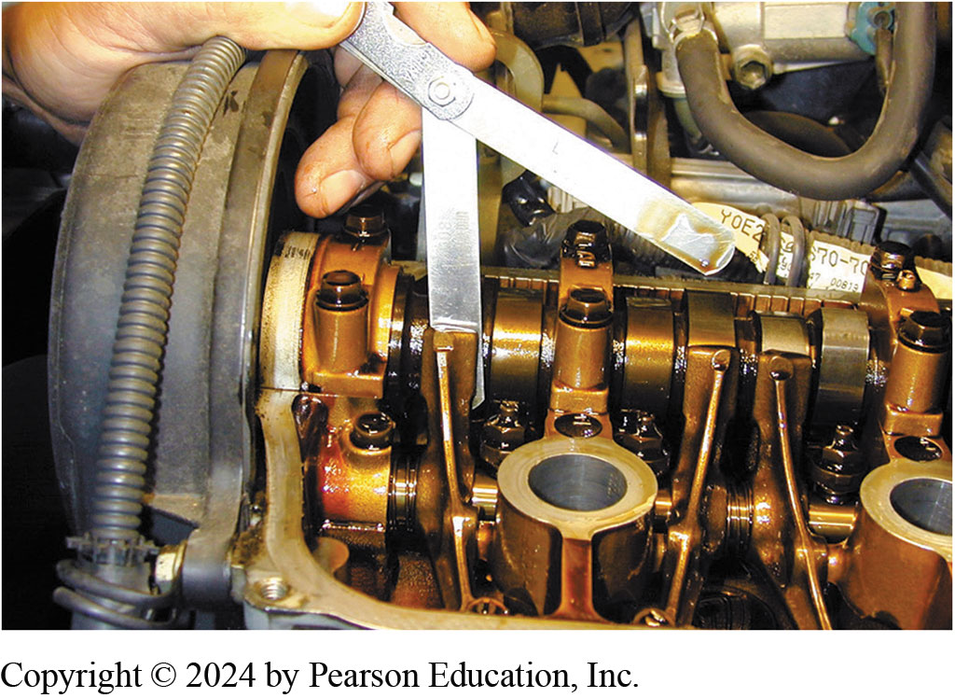
Inserting Feeler Gauge
Notes:
10. With the rocker arms contacting the base circle of the cam, insert a feeler gauge of the specified thickness between the camshaft and the rocker arm. There should be a slight drag on the feeler gauge

Slide 40
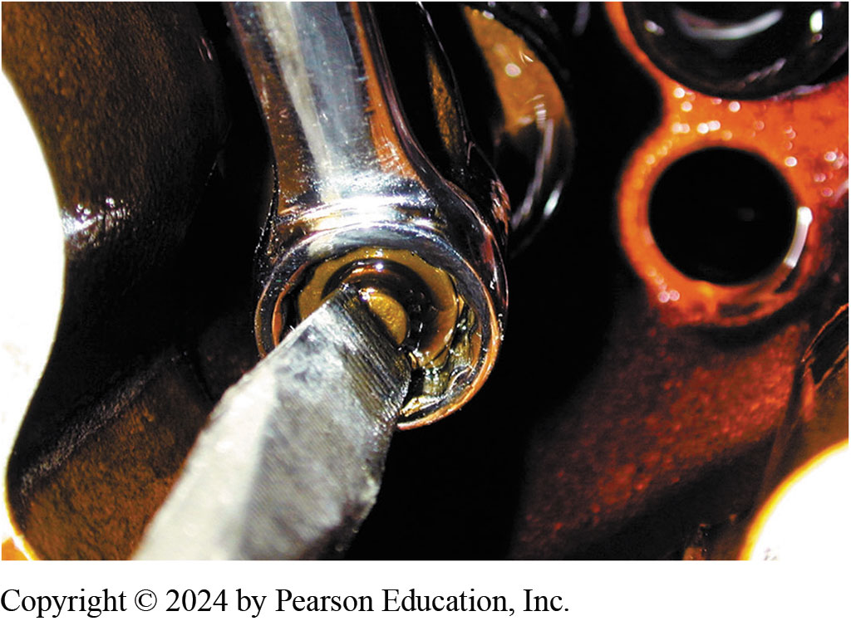
Turn Valve Adjusting Screw
Notes:
11. If the valve clearance (lash) is not correct, loosen the retaining nut and turn the valve adjusting screw with a screwdriver to achieve the proper clearance

Slide 41
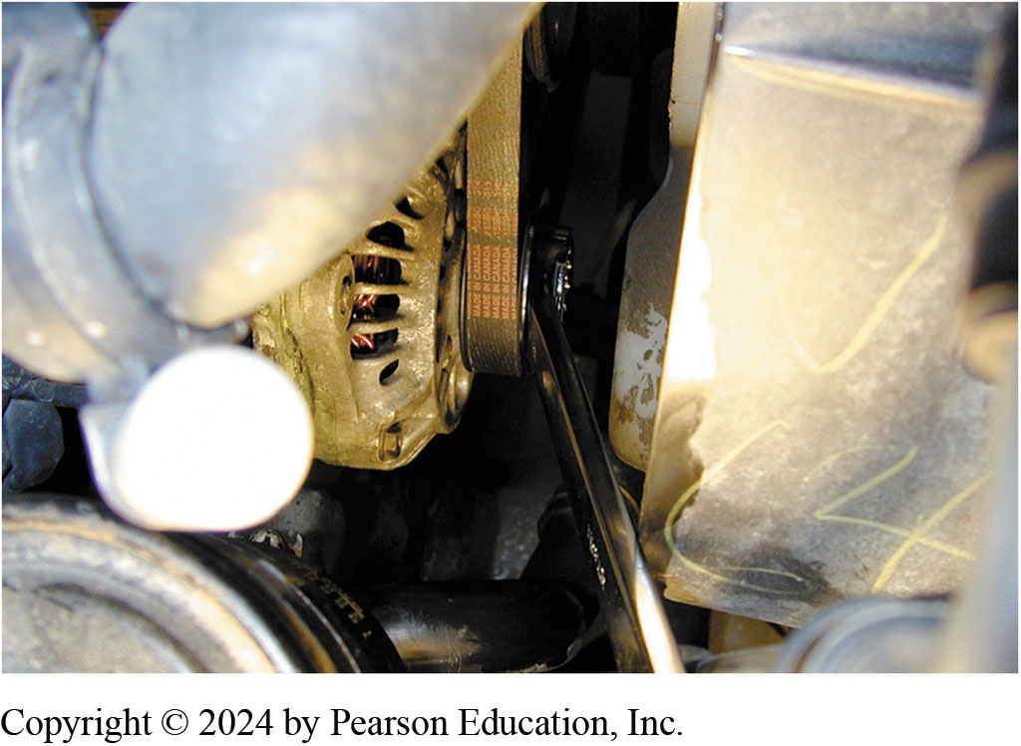
Rotate One Full Turn
Notes:
12. After adjusting the valves that are closed, rotate the engine one full rotation until the engine timing marks again align

Slide 42
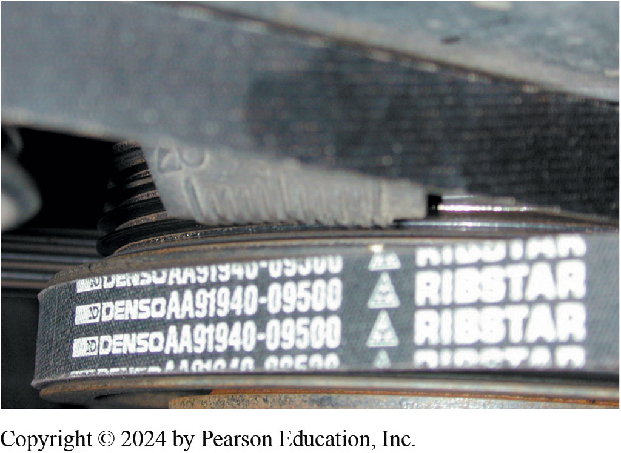
Timing Marks Aligned Again
Notes:
13. The engine is rotated until the timing marks again align, indicating that the companion cylinder will now be in position for valve clearance measurement

Slide 43
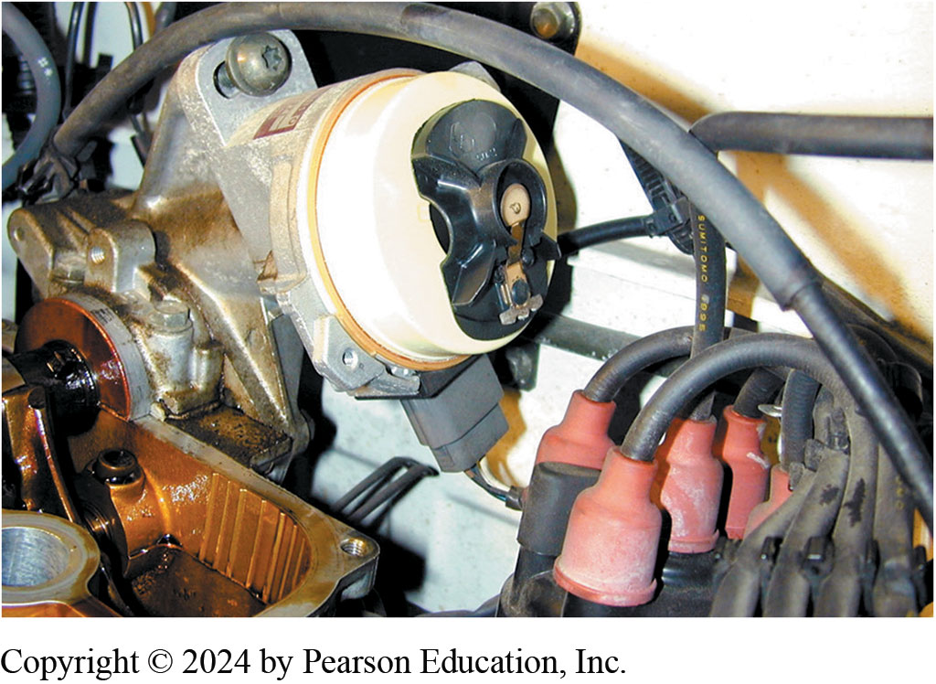
Rotor Position Used Some Engines
Notes:
14. On some engines, it is necessary to watch the direction the rotor is pointing to help determine how far to rotate the engine

Slide 44
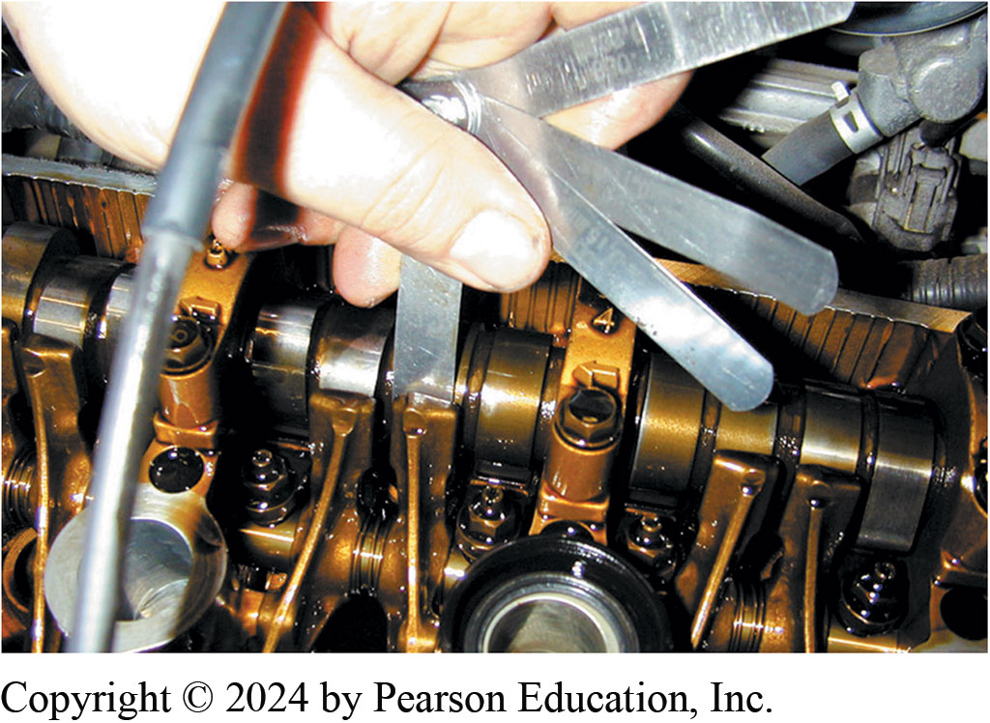
Larger & Smaller Feeler Gauges Used
Notes:
15. The technician is using a feeler gauge that is one thousandth of an inch thinner and another one thousandth of an inch thicker than the specified clearance as a double-check that the clearance is correct

Slide 45
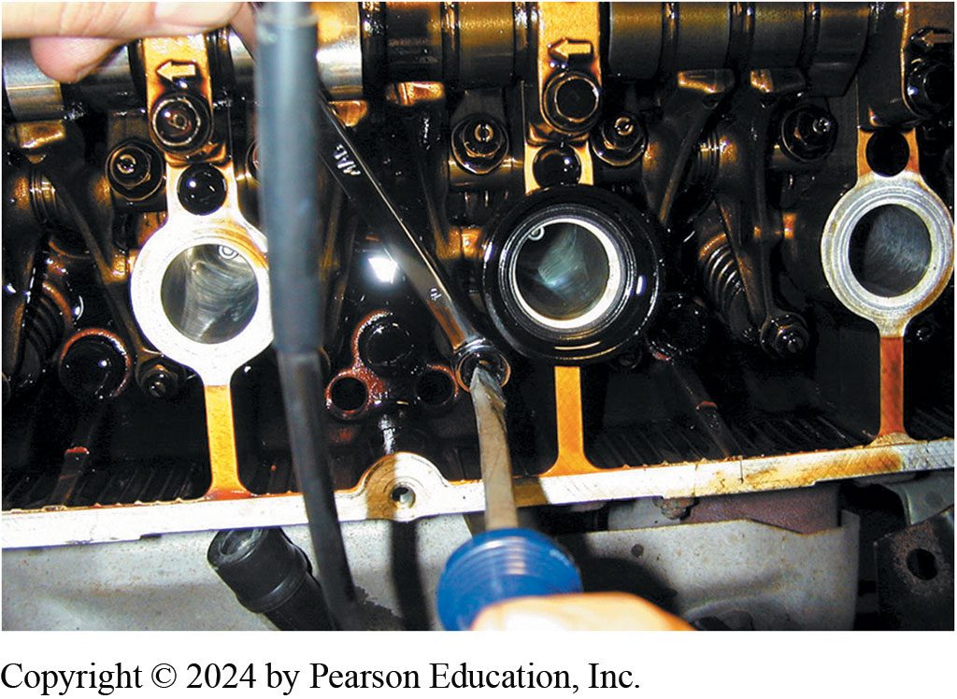
Adjusting Valves Takes 2 Hands
Notes:
16. Adjusting a valve takes both hands—one to hold the wrench to loosen and tighten the lock nut and one to turn the adjusting screw

Slide 46
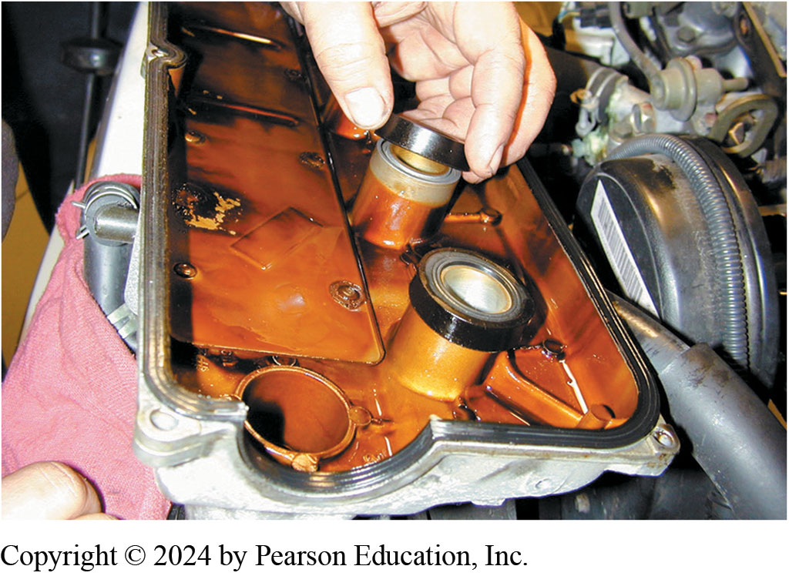
Replacing Gaskets and Seals
Notes:
17. After all valves have been properly measured and adjusted as necessary, start the reassembly process by replacing all gaskets and seals as specified by the vehicle manufacturer

Slide 47
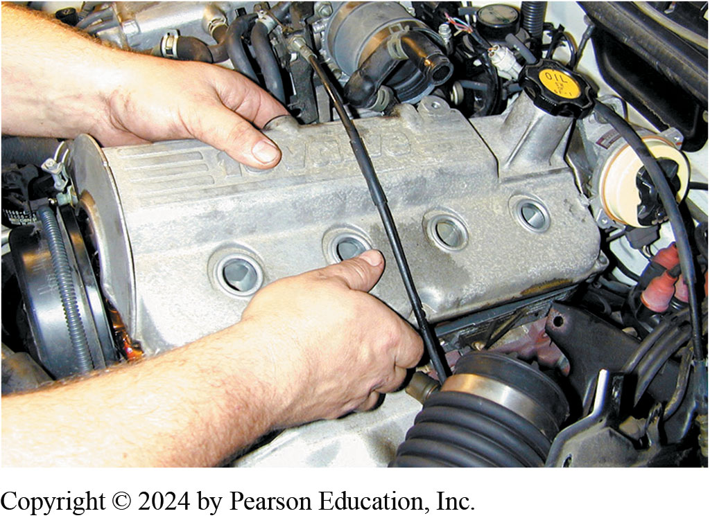
Reinstall Valve Cover
Notes:
18. Reinstall the valve cover, being careful to not pinch a wire or vacuum hose between the cover and the cylinder head

Slide 48
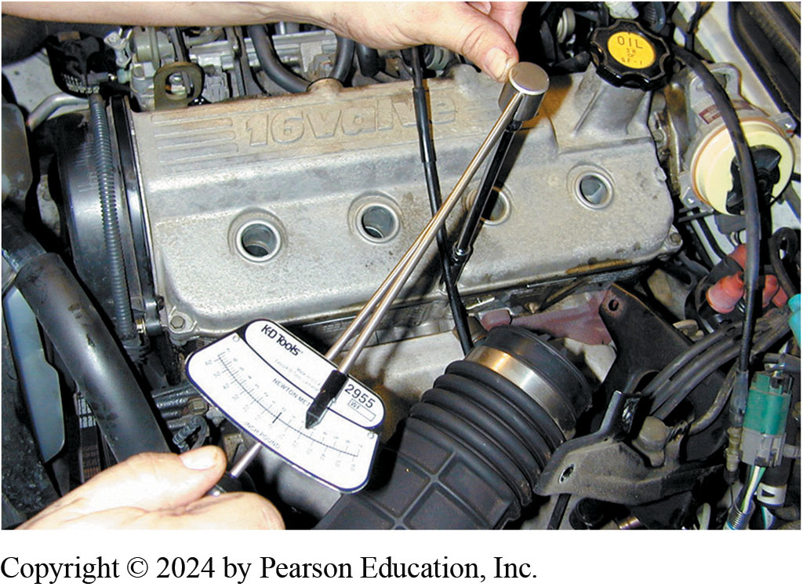
Tighten to Specs
Notes:
19. Use a torque wrench and torque the valve cover retaining bolts to factory specifications

Slide 49
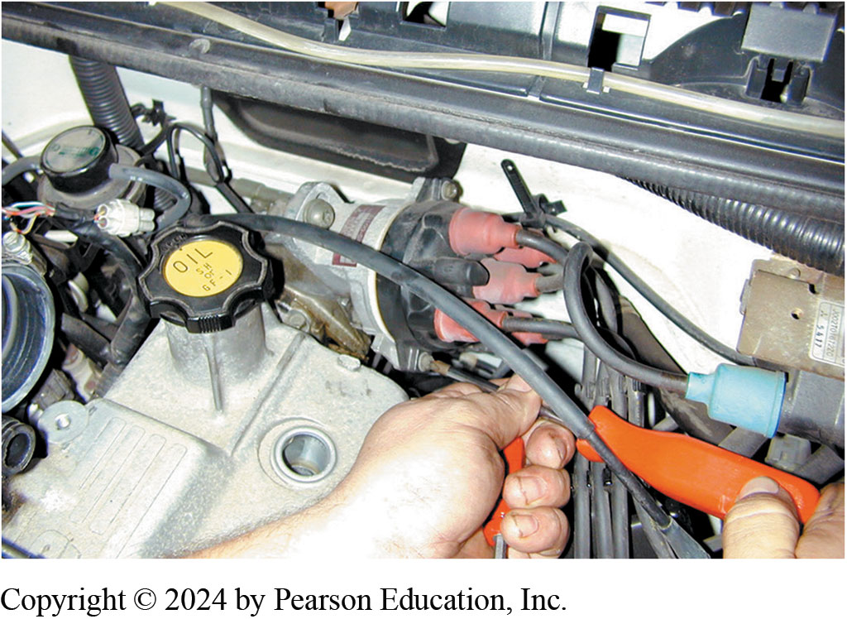
Reinstall Distributor Cap
Notes:
20. Reinstall the distributor cap

Slide 50
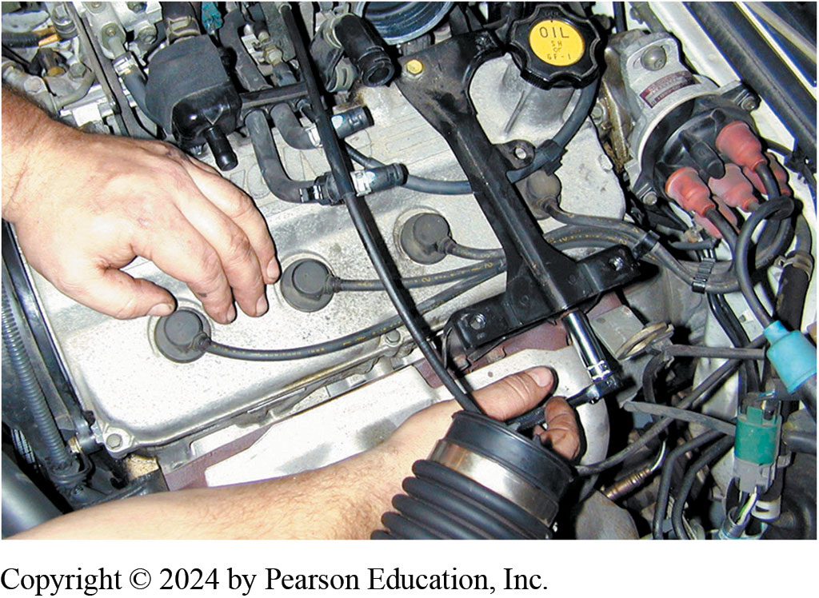
Reinstall Wires and Brackets
Notes:
21. Reinstall the spark plug wires and all brackets that were removed to gain access to the valve cover

Slide 51
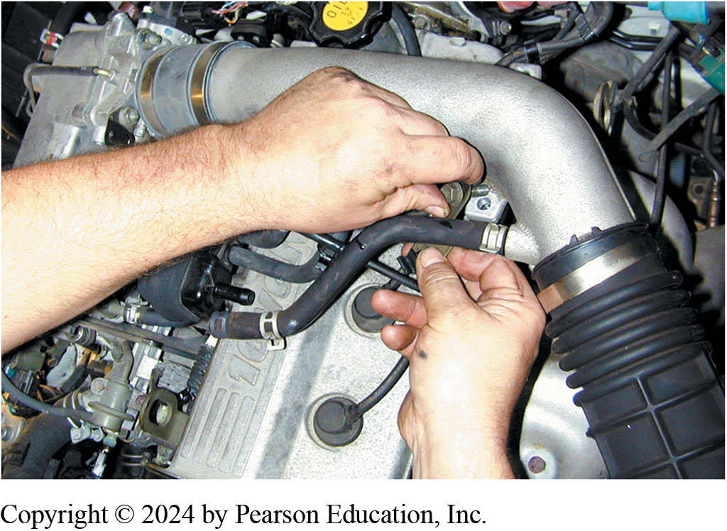
Reconnect Vacuum Lines and Tubes
Notes:
22. Reconnect all vacuum and air hoses and tubes. Replace any vacuum hoses that are brittle or swollen with new ones

Slide 52
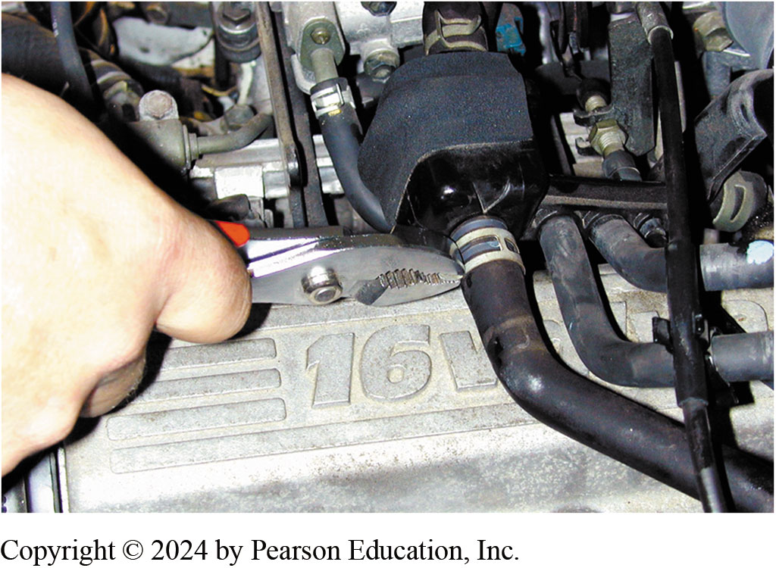
Reinstall Clips, Start Engine
Notes:
23. Be sure that the clips are properly installed. Start the engine and check for proper operation

Slide 53
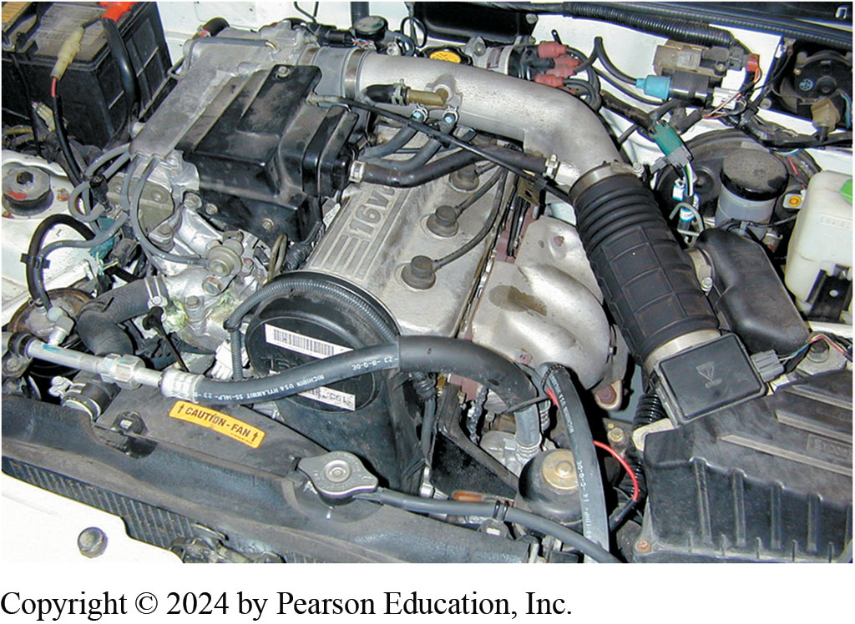
Check for Leaks
Notes:
24. Double-check for any oil or vacuum leaks after starting the engine

Slide 54
Engine Repair Videos and Animations
Videos Link: (A1) Engine Repair Videos
Animations Link: (A1) Engine Repair Animations

Slide 55
Copyright
This work is protected by United States copyright laws and is provided solely for the use of instructors in teaching their courses and assessing student learning. Dissemination or sale of any part of this work (including on the World Wide Web) will destroy the integrity of the work and is not permitted. The work and materials from it should never be made available to students except by instructors using the accompanying text in their classes. All recipients of this work are expected to abide by these restrictions and to honor the intended pedagogical purposes and the needs of other instructors who rely on these materials.

