Slide 1
Automotive Technology: Principles, Diagnosis, and Service
Seventh Edition
Chapter 22
Turbocharging and Supercharging
Copyright © 2023 Pearson Education, Inc. All Rights Reserved
Notes:
INSTRUCTOR NOTE: This presentation includes text explanation notes, you can use to teach the course. When in SLIDE SHOW mode, you RIGHT CLICK and select SHOW PRESENTER VIEW, to use the notes.

Slide 2
Learning Objectives
22.1 Discuss airflow requirements and volumetric efficiency of engines.
22.2 Explain forced induction principles.
22.3 Discuss superchargers.
22.4 Discuss turbochargers.
22.5 Discuss turbocharger failures.
22.6 Explain boost control.

Slide 3
Introduction
Air Flow Requirements
Calculate engine airflow requirements using three factors.
Engine displacement
Engine revolutions per minute (R P M)
Volumetric efficiency
Volumetric Efficiency
A measure of how well an engine breathes.
A new engine is about 85% efficient.
Turbochargers or superchargers can increase volumetric efficiency to over 100%.

Slide 4
Figure 22.1 Supercharger
A supercharger on a Ford V-8

Slide 5
Figure 22.2 Eco-Boost Engine
A turbocharged Ford three-cylinder 1.0 liter Eco Boost engine

Slide 6
Question 1: ?
What is volumetric efficiency?

Slide 7
Answer 1
A measure of how well an engine breathes.

Slide 8
Forced Induction Principles (1 of 2)
Charge density is a term used to define the amount of the air-fuel charge introduced into the cylinders.
When air is pumped into the cylinder, the combustion chamber receives an increase of air pressure known as boost.
Boost can be measured in:
Pounds per square inch (P S I)
Atmospheres (A T M) (1 atmosphere is 14.7 P S I)
Bars (1 bar is 14.7 P S I)

Slide 9
Forced Induction Principles (2 of 2)
Forced induction systems use an air pump to pack a denser air-fuel charge into the cylinders.
The weight of the air-fuel charge is higher.
Power is increased because it is directly related to the weight of an air-fuel charge consumed within a given time period.
Atmospheric pressure drops as altitude increases, but boost pressure remains the same.
Boost increases the amount of air drawn into the cylinder during the intake stroke.

Slide 10
Figure 22.3 Air Density
The more air and fuel that can be packed in a cylinder, the greater the density of the air-fuel charge

Slide 11
Figure 22.4 Atmosphere
Atmospheric pressure decreases with increases in altitude

Slide 12
Chart 22.1 Compression Ratio
The effective compression ratio compared to the boost pressure
Notes:
.

Slide 13
Superchargers
A supercharger is an engine-driven air pump that supplies more than the normal amount of air into the intake manifold, and boosts engine torque and power.
The roots type of supercharger is positive displacement design, because all of the air that enters is forced through the unit.
A centrifugal supercharger is not a positive displacement pump and all of the air that enters is not forced through the unit.
A bypass valve allows intake air to flow directly into the intake manifold.

Slide 14
Figure 22.5 Superchargers
A roots-type supercharger uses two lobes to force the air around the outside of the housing and into the intake manifold

Slide 15
Figure 22.6 Bypass Valve
The bypass actuator opens the bypass valve to control boost pressure

Slide 16
Animation: Supercharger Bypass (Animation will automatically start)

Slide 17
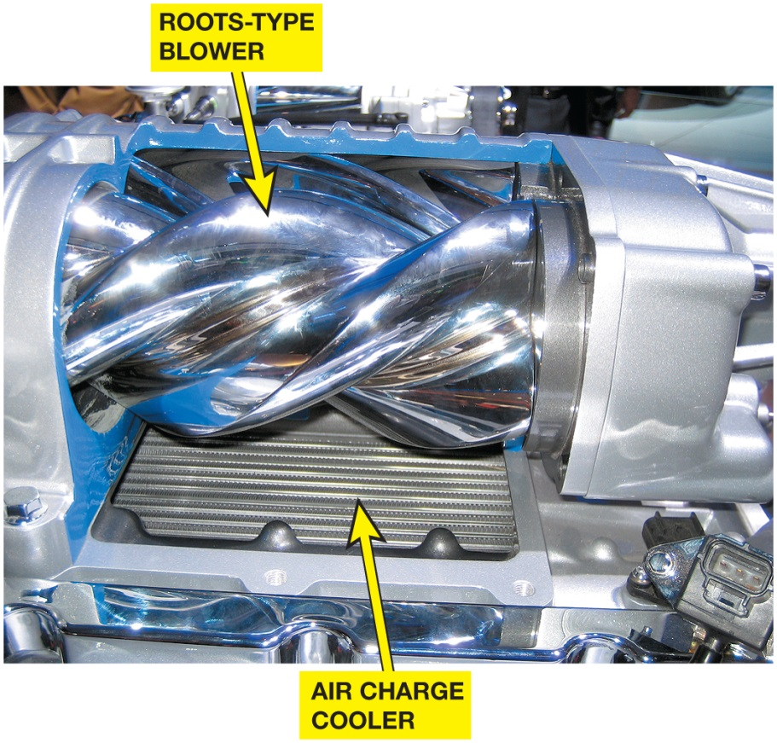
Figure 25.7 A

Slide 18
Figure 22.7 Cutaway
Ford supercharger cutaway display showing the roots-type blower and air charge cooler (intercooler). The air charge cooler is used to reduce the temperature of the compressed air before it enters the engine
Notes:
.
TECH TIP: Faster Moves More Air
One of the high-performance measures that can be used to increase horsepower on a supercharged engine is to install a smaller diameter pulley.
The smaller the pulley diameter, the faster the supercharger will rotate and the higher the potential boost pressure will be. The change will require a shorter belt, and the extra boost could cause serious engine damage.

Slide 19
Turbochargers
A turbocharger uses the heat of the exhaust to power a turbine wheel and, therefore, does not directly reduce engine power.
The turbine wheel turns an impeller (compressor) wheel which is connected by a shaft in the center housing.
The delay between acceleration and turbo boost is called turbo lag.

Slide 20
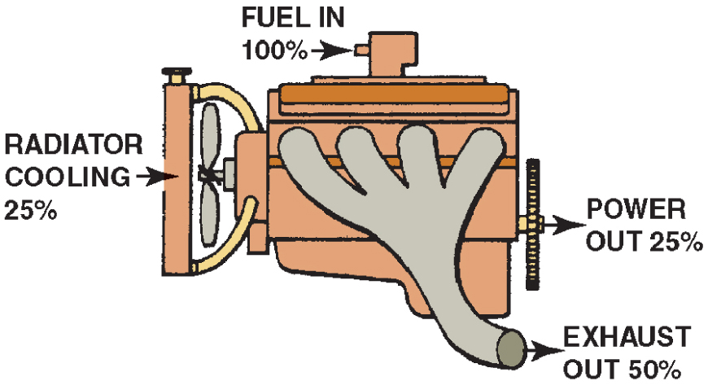
Figure 25.8

Slide 21
Figure 22.8 Turbocharger
A turbocharger uses some of the heat energy that would normally be wasted

Slide 22
Figure 22.9 Turbo Operation
A turbine wheel is turned by the expanding exhaust gases

Slide 23
Animation: Turbocharger (Animation will automatically start)

Slide 24
Figure 22.10 CHRA
The exhaust drives the turbine wheel on the left, which is connected to the impeller wheel on the right through a shaft. The bushings that support the shaft are lubricated with engine oil under pressure

Slide 25
Figure 22.11 Oil Feed
Engine oil is fed to the center of the turbocharger to lubricate the bushings and returns to the oil pan through a return line

Slide 26
Turbocharger Failures
Creates a noticeable drop in power.
Bearing failure is the most common cause.
Excessive oil consumption due to wear.
Most failures are preventable by performing regular maintenance.

Slide 27
Question 2: ?
What is a common cause of turbocharger failures?

Slide 28
Answer 2
Bearing failures.

Slide 29
Figure 22.12 Intercooler
The unit on top of this Subaru that looks like a radiator is the intercooler, which cools the air after it has been compressed by the turbocharger

Slide 30
Boost Control
Wastegate: It is a bypass valve at the exhaust inlet to the turbine, which allows all or part of the exhaust gas to enter the turbine.
Relief Valves: It vents pressurized air from the connecting pipe between the outlet of the turbocharger and the throttle
Two types of relief valves:
Compressor bypass valve (C B V)
Blow-off valve (B O V)

Slide 31
Figure 22.13 Wastegate
A wastegate is used on many turbocharged engines to control maximum boost pressure. The wastegate is controlled by a computer-controlled valve
Notes:
TECH TIP: Boost Is the Result of Restriction
The boost pressure of a turbocharger (or
supercharger) is commonly measured in pounds per
square inch. If a cylinder head is restricted because of
small valves and ports, the turbocharger will quickly
provide boost. Boost results when the air being forced
into the cylinder heads cannot flow into the cylinders
fast enough and “piles up” in the intake manifold,
increasing boost pressure. If an engine had large
valves and ports, the turbocharger could provide a
much greater amount of air into the engine at the
same boost pressure as an identical engine with
smaller valves and ports. Therefore, by increasing the
size of the valves, a turbocharged or supercharged
engine will be capable of producing much greater
power.

Slide 32
Animation: Turbocharger Wastegate (Animation will automatically start)

Slide 33
Figure 22.14 Blow-off Valve
A blow-off valve is used in some turbocharged systems to relieve boost pressure during deceleration

Slide 34
Animation: Turbocharger Blow-off Valve (Animation will automatically start)

Slide 35
Question 3: ?
What is the purpose of an intercooler?

Slide 36
Answer 3
Reduce the temperature of the air entering the engine.

Slide 37
Engine Repair Videos and Animations
Videos Link: (A1) Engine Repair Videos
Animations Link: (A1) Engine Repair Animations

Slide 38
Copyright
This work is protected by United States copyright laws and is provided solely for the use of instructors in teaching their courses and assessing student learning. Dissemination or sale of any part of this work (including on the World Wide Web) will destroy the integrity of the work and is not permitted. The work and materials from it should never be made available to students except by instructors using the accompanying text in their classes. All recipients of this work are expected to abide by these restrictions and to honor the intended pedagogical purposes and the needs of other instructors who rely on these materials.

