Slide 1
Automotive Technology: Principles, Diagnosis, and Service
Seventh Edition
Chapter 19
Engine Oil
Copyright © 2023 Pearson Education, Inc. All Rights Reserved
Notes:
INSTRUCTOR NOTE: This presentation includes text explanation notes, you can use to teach the course. When in SLIDE SHOW mode, you RIGHT CLICK and select SHOW PRESENTER VIEW, to use the notes.

Slide 2
Learning Objectives (1 of 2)
19.1 Explain the purpose and function of engine oil.
19.2 Explain the purpose of engine oil additives.
19.3 Discuss the properties of engine oil.
19.4 Discuss SAE rating.
19.5 Discuss API rating.
19.6 Discuss ILSAC oil rating.
19.7 Discuss the European oil rating system.

Slide 3
Learning Objectives (2 of 2)
19.8 Discuss synthetic oil.
19.9 Discuss high mileage oils.
19.10 Discuss vehicle-specific specifications.
19.11 Discuss brand compatibility of oil.
19.12 Discuss the purpose and function of oil filters.
19.13 Describe the oil change procedure.

Slide 4
Purpose and Function of Engine Oil
Lubricate moving parts.
Help cool engine parts.
Seal piston rings.
Neutralize acids formed by the combustion process.
Reduce friction in the engine.
Reduce rust and corrosion.
Act as a hydraulic fluid for lifters and tensioners.

Slide 5
Engine Oil Additives
Viscosity Index (V I) Improvers
Pour Point Depressant
Antioxidants
Oxidants
Total Base Number (T B N)
Rust and Corrosion Inhibitors
Anti-wear additive
Extreme Pressure Additive

Slide 6
Figure 19.1 Viscosity Index
Viscosity Index (VI) Improver is a Polymer and Feels like Finely Ground Foam Rubber. When Dissolved in the Oil, it Expands When Hot to Keep the Oil from Thinning

Slide 7
Properties of Engine Oil
As oil gets cooler, it gets thicker.
As oil gets hotter, it get thinner.
The viscosity index is the change of viscosity between hot and cold extremes.
The lowest temperature an oil will pour is the pour point.
Oils must be miscible, meaning they have the ability to mix with other oils.

Slide 8
S A E Rating
Society of Automotive Engineers (S A E)
S A E grade number determines the viscosity range.
Oil tested only at 212°F (100°C) have no letter in the grade (example S A E 30).
Oils tested at 0°F (-18°C) and 212°F (100°C) are considered multi-grade oils and have the letter “W” in the grade (Example S A E 0W-20).

Slide 9
Figure 19.2 SAE Rating
SAE Viscosity Rating Required is Often Printed on the Engine Oil Filler Cap. Most Hybrid Electric Vehicles Specify Either S A E 0W-20 or S A E 5W-20 Engine Oil

Slide 10
A P I Rating
American Petroleum Institute (A P I)
Worked with manufacturers to develop engine oil performance classifications.
Oils are tested and rated in production automotive engines.
Gasoline engine ratings begin with the letter “S”.
Diesel engine ratings begin with the letter “C”.

Slide 11
Figure 19.3 API Doughnut
API Doughnut for a SAE 5W-30, S M Engine Oil. When Compared to a Reference Oil, the “Energy Conserving” Designation Indicates a 1.1% Better Fuel Economy for SAE 10W-30 Oils and 0.5% Better Fuel Economy for S A E 5W-30 Oils
Notes:
CASE STUDY The Case of the Wrong Oil Viscosity
A Dodge Durango 5.7 liter Hemi with a multiple displacement system (MDS) had the oil changed at a
shop. SAE 10W-30 was used as this was the
standard bulk oil in the shop. After the oil change, the vehicle was returned to the customer.
Within a few minutes, however, the “check engine” light came on. The technician checked for
diagnostic trouble codes (DTCs) and found a P0521 DTC stored. The technician checked service
information and discovered that the code could be set if the incorrect viscosity engine oil had
been used. The description of the P0521 read:
“Oil pressure not reaching specified at 1250 RPM.”
The technician changed the oil and used the specified SAE 5W-20, then cleared the DTC. A test drive
confirmed that the change to the correct viscosity oil solved the problem.
Summary:
Complaint—Customer stated that the “check engine” came on after an oil change.
Cause—The incorrect viscosity of oil was used.
Correction—The specified viscosity oil (SAE 5W-20) was used and the code cleared.

Slide 12
Animation: Engine Oil Selection (Animation will automatically start)

Slide 13
Question 1: ?
What property of oil does the S A E ratings reflect?

Slide 14
Answer 1
It indicates the viscosity range into which the oil fits.

Slide 15
I L S A C Oil Rating
International Lubricant Standardization and Approval Committee (I L S A C).
Developed an oil rating that consolidates the S A E viscosity rating and the A P I quality rating.
If an engine oil meets the standards, a “starburst” symbol is displayed on the front of the oil container.
Rating begin with the letters “G F” (Example G F-6).

Slide 16
Figure 19.4 ILAC Symbol
The International Lubricant Standardization and Approval Committee (ILAC) Starburst Symbol. If this Symbol is on the Front of the Container of Oil, then it is Acceptable for Use in Almost Any Gasoline Engine
Notes:
TECH TIP: Three Oil Change Facts
Three facts that are important to know when changing oil are
1. Recommended SAE viscosity (thickness) for the temperature range that is anticipated before the next oil change (such as SAE 5W-30)
2. Quality rating as recommended by the engine or vehicle manufacturer, such as API SM, and other specified rating, such as the ILSAC and vehicle manufacturer’s specifications
3. l change interval (time or mileage) (usually every 5,000 miles or every six months)

Slide 17
European Oil Rating System
The Association des Constructeurs Européens d’Automobiles (A C E A)
Gasoline oil ratings: A C E A-A
Diesel oil ratings: A C E A-B
Combined gasoline and diesel rating: A C E A-C
The A,B, or C rating is followed by a number that represents the specific rating (example: A C E A-A4)

Slide 18
Figure 19.5 ACEA Ratings
ACEA Ratings are Included on the Back of the Oil Container if it Meets any of the Standards

Slide 19
Synthetic Oil
The term synthetic means that it is a manufactured product and not refined from a naturally occurring substance.
The American Petroleum Institute classifies oil into groups.
Group I V: Synthetic oils made from mineral oil and monomolecular oil called polyalpholefin (P O A); includes Mobil 1.

Slide 20
Figure 19.6 Mobil 1
Mobil 1 Synthetic Engine Oil is Used by Several Vehicle Manufacturers in New Engines

Slide 21
Figure 19.7 Synthetic Oil
Both Oils Have Been Cooled to -20°F (-29°C). Notice that the Synthetic Oil on the Left Flows More Freely than the Mineral Oil on the Right, Even Though Both are SAE 5W-30

Slide 22
Figure 19.8 True Synthetic Oil
True Synthetic is Made of a Stable Molecule that Does Not Vary Compared to Mineral Oils. However, Regardless of the Molecules, Always Use Oil That Meets the Manufacturer’s Specifications
Notes:
■TECH TIP: Synthetic Good and Bad News: In a true synthetic, such as base oils classified by API as a group IV or V, the molecules are all the same, and it does not have any sulfur that is present in crude oil and refined out. That is great, but API group III is also called a synthetic, and because its cost is lower than the other two synthetics, makes selecting an oil more difficult. However, according to lubrication engineers, service technicians and vehicle owners should not be concerned what molecules are in the oil, but instead should use oil that meets the vehicle specifications. For example, if an oil has a zero (0) as the first number, such as SAE 0W-20, the oil HAS to be a synthetic to be able to meet that specification. The synthetic could be a group III, IV, or V, but more likely a combination of all three. Check service information for the exact oil to use for the vehicle being serviced. ● FIGURE 19–8.

Slide 23
Question 2: ?
What is meant by the term synthetic oil?

Slide 24
Answer 2
The term synthetic means that it is a manufactured product and not refined from a naturally occurring substance.

Slide 25
High Mileage Oils
A “high mileage oil” is sold for use in vehicles that have over 75,000 miles and are, therefore, nearing the eight-year, 80,000-mile catalytic converter warranty period.
Esters are added to swell oil seals (main and valve-stem seals).
The oil usually does not have the energy rating of conventional oils.
Notes:
TECH TIP Dirty Engine Oil Can Cause Oil Burning
Service technicians have known for a long time that some of their customers never change the engine oil. Often these customers believe that because their
engine uses oil and they add a new quart every week, they are doing the same thing as changing the oil. But dirty, oxidized engine oil could cause piston rings to stick and not seal the cylinder.
Therefore, when the oil and filter are changed, the clean oil may free the piston rings, especially if the vehicle is driven on a long trip during which the oil is allowed to
reach the normal operating temperature. An engine that is mechanically sound, but burning oil, may be “fixed” by simply changing the oil and filter.

Slide 26
Vehicle-Specific Specifications
Many manufacturers specify engine that meets their own test standards.
Examples:
General Motors: Dexos 1 and Dexos 2
Ford: W S S-M2C931-A and W SS-M2C934-A
Chrysler: M S-6395 and M S- 10725
Volkswagen: 502.00 and 505.00

Slide 27
Figure 19.9 European Manufacturers
European Vehicle Manufacturers Usually Specify Engine Oil with a Broad Viscosity Range, Such as SAE 5W-40, and Their Own Unique Standards, Such as the Mercedes Specification 229.51

Slide 28
Oil Brand Compatibility
According to S A E standard J-357, all engine oils must be miscible (compatible) with all other brands of engine oil.
Any brand of engine oil can be used as long as it meets the viscosity and A P I standards recommended by the vehicle manufacturer.
Most experts agree that the oil changes are the most important regularly scheduled maintenance for an engine.

Slide 29
Frequently Asked Question: Can Newer Engine Oils Be Used in Engines That Use Flat-Bottom Lifters?
? Frequently Asked Question
Can Newer Engine Oils Be Used in Engines That Use Flat-Bottom Lifters? No. Newer oil standards are designed to reduce phosphates in the engine oil that may leak past piston rings and end up in the exhaust system. These additives found in oil can damage catalytic converter. The levels of phosphate and zinc, have been reduced because they can cause damage to the catalytic converter. If the oil contains zinc, the efficiency of the catalytic converter is reduced. Use of ZDDP was intended to reduce sliding friction. Many camshaft manufacturers are recommending the use of an additive. Older oils had up to 0.15% ZDDP and now SM-rated oils list the zinc at just 0.08%. In 2001, the zinc was reduced to 1000 PPM; and in 2005, reduced again to the current 800 PPM, API ratings do not specify the zinc content, just oil performance If driving a vehicle with flat-bottom lifters, use engine oil specifically designed for older engines, such as Shell Rotella T, or use an additive, such as GM’s engine oil supplement (EOS), part number 1052367 or a zinc additive. Figure 19–10.
Notes:
Can Newer Engine Oils Be Used in Engines That Use Flat-Bottom Lifters? No. Newer oil standards are designed to reduce phosphates in the engine oil that may leak past
piston rings and end up in the exhaust system. These additives found in oil can damage the catalytic converter. The levels of phosphate and zinc, commonly referred to as zinc dialkyl dithiophosphate (ZDDP) or ZDP), have been reduced because they can cause damage to the catalytic converter. Even though engines consume very little oil, if the oil contains zinc, the efficiency of the catalytic converter is reduced. The use of ZDDP was intended to reduce sliding friction in an engine. Sliding friction is usually found in engines that use flat-bottom lifters. Most, if not all, engines produced over the past 15 years have used roller lifters or cam followers, so using the new oil without ZDDP is not a concern. Even diesel oils have reduced amounts of the zinc, so many camshaft manufacturers are recommending the use of an additive. Older oils had up to 0.15% ZDDP and now SM-rated oils list the zinc at just 0.08%, or 800 parts per million. Engine oil had about 1200 PPM zinc prior to 2001., In 2001, the zinc was reduced to 1000 PPM; and in 2005, reduced again to the current 800 PPM, API ratings do not specify the zinc content, just oil performance If driving a vehicle with flat-bottom lifters, use engine oil specifically designed for older engines, such as Shell Rotella T, or use an additive, such as GM’s engine oil supplement (EOS), part number 1052367 or a zinc additive. Check with camshaft manufacturers for their recommended oil or additive to use. Figure 19–10.

Slide 30
Figure 19.10 Zinc Additive
Using a Zinc Additive is Important When Using S M-Rated Oil in an Engine Equipped with a Flat-Bottom Lifter, Especially During the Break-in Period

Slide 31
Oil Filters
Large particles are trapped in the filter material.
The antidrainback valve prevents oil from draining out of the filter when the vehicle is shut off.
The bypass valve will allow the oil to bypass the filter if it becomes clogged.
Used filters should be drained/crushed before disposing according to state and local regulations.

Slide 32
Figure 19.11 Antidrainback Valve
Rubber Diaphragm Acts as an Antidrainback Valve to Keep the Oil in the Filter When the Engine is Stopped and the Oil Pressure Drops to Zero

Slide 33
Figure 19.12 Filter Cutaway
A Cutaway of a Typical Spin-On Oil Filter

Slide 34
Animation: Oil Filter (Animation will automatically start)

Slide 35
Figure 19.13 Filter Crusher
A Typical Filter Crusher. The Hydraulic Ram Forces out Most of the Oil from the Filter. The Oil is Trapped Underneath the Crusher and is Recycled

Slide 36
Oil Change
All vehicle and engine manufacturers recommend a maximum oil change interval.
The maximum oil change interval is shortened when the vehicle is operated in severe use conditions.
Oil life monitors alert the driver when service is required.
Mileage based reminder systems
Algorithm based reminder systems
Notes:
Tech TIP: The Pick Trick
Removing an oil filter that is installed upside down can be a real mess. When this design filter is
loosened, oil flows out from around the sealing gasket. To prevent this from happening, use a pick
to poke a hole in the top of the filter.
This small hole allows air to get into the filter, thereby allowing the oil to drain back into the
engine rather than remain in the filter. After punching a hole in the filter, be sure to wait
several minutes to allow time for the trapped oil to drain down into the engine
before loosening the filter.

Slide 37
Animation: Change Engine Oil (Animation will automatically start)

Slide 38
Frequently Asked Question: Why Change Oil If the Oil Filter Can Trap All the Dirt?
? Frequently Asked Question
Why Change Oil If the Oil Filter Can Trap All the Dirt? Many believe that oil filters will remove all dirt from the oil through filtering material. Most oil filters will filter particles that are about 10 to 20 microns in size. A micron is one- millionth of a meter or 0.000039 inch. Most dirt and carbon particles that turn engine oil black are less than a micron in size. In other words, it takes about 3 million of these carbon particles to cover a pin head. To help visualize the smallness of a micron, consider that a typical human hair is 60 microns in diameter. In fact, anything smaller than 40 microns is not visible to the human eye. The dispersants added to engine oil prevent dirt from adhering together to form sludge. It is the same dispersant additive that prevents dirt from being filtered or removed by other means. If an oil filter could filter particles down to 1 micron, it would be so restrictive that the engine would not receive sufficient oil through the filter for lubrication.
Notes:
Why Change Oil If the Oil Filter Can Trap All the Dirt? Many persons believe that oil filters will remove all dirt from the oil being circulated through the filtering
material. Most oil filters will filter particles that are about 10 to 20 microns in size. A micron is one millionth of a meter or 0.000039 inch. Most dirt and carbon particles that turn engine oil black are less than a micron in size. In other words, it takes about 3 million of these carbon particles to cover a pin head. To help visualize the smallness of a micron, consider that a typical human hair is 60 microns in diameter. In fact, anything smaller than 40 microns is not visible to the human eye. The dispersants added to engine oil prevent dirt from adhering together to form sludge. It is the same dispersant additive that prevents dirt from being filtered or removed by other means. If an oil filter could filter particles down to 1 micron, it would be so restrictive that the engine would not receive sufficient oil through the filter for lubrication. Oil recycling
companies use special chemicals to break down the dispersants, which permit the dirt in the oil to combine into larger units that can be filtered or processed out of the oil.

Slide 39
Figure 19.14 Oil Change Minder
Many Vehicle Manufacturers can Display the Percentage of Oil Life Remaining, Whereas Others Simply Turn on a Warning Lamp When it has been Determined that an Oil Change is Required

Slide 40
Figure 19.15 Cartridge Type
If Replacing a Cartridge-Type Oil Filter, Be Sure to Use the Proper Size Wrench on the Filter Cap and Tighten to Factory Specifications
Notes:
TECH TIP Follow the Seasons
Vehicle owners often forget when they last changed the oil. This is particularly true of the person
who owns or is responsible for several vehicles. A helpful method for remembering when the oil
should be changed is to change it at the start of each season of the year.
• Fall (September 21)
• Winter (December 21)
• Spring (March 21)
• Summer (June 21)
Remembering that the oil needs to be changed on these dates helps owners budget for the expense and
the time needed.

Slide 41
Question 3: ?
What are the two types of oil change reminder systems?

Slide 42
Answer 3
Mileage based and algorithm based systems.

Slide 43
Oil Change Photo Sequence

Slide 44
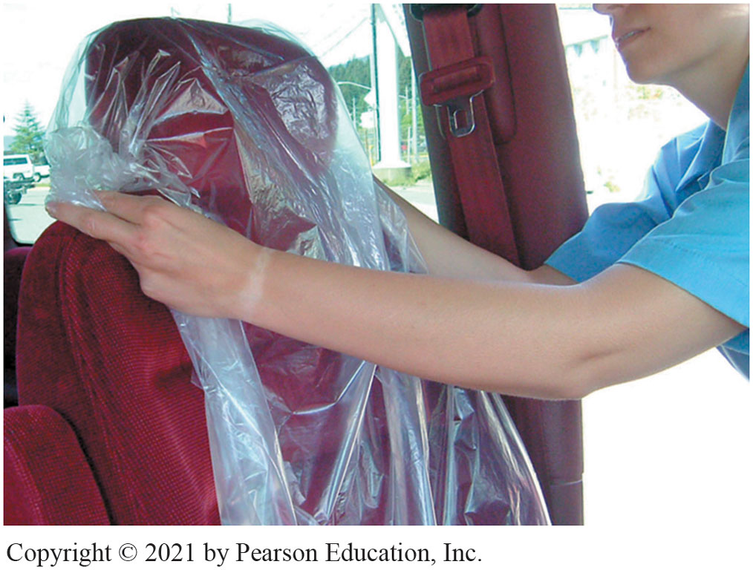
1. Install a Seat Cover
Notes:
1. Before entering the customer’s car for the first time, be sure to install a seat cover as well as a steering wheel cover to protect the vehicle’s interior.

Slide 45
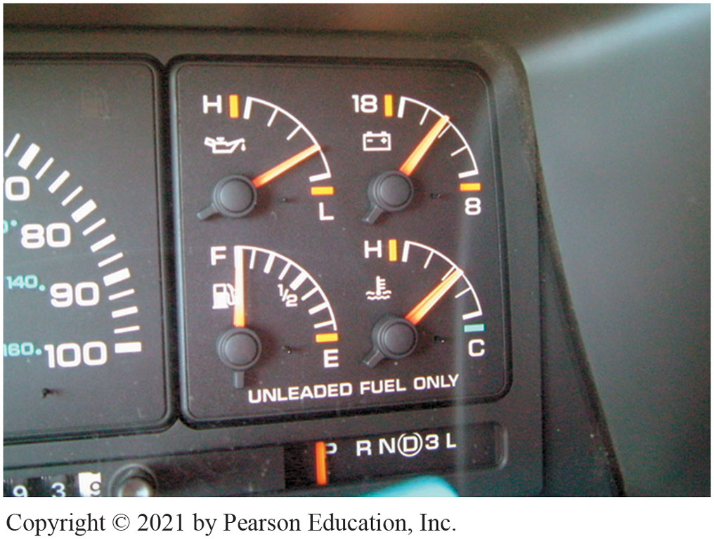
2. Run to Operating Temperature
Notes:
2. Run the Engine Close to Operating Temperature to Help Used Oil Drain

Slide 46
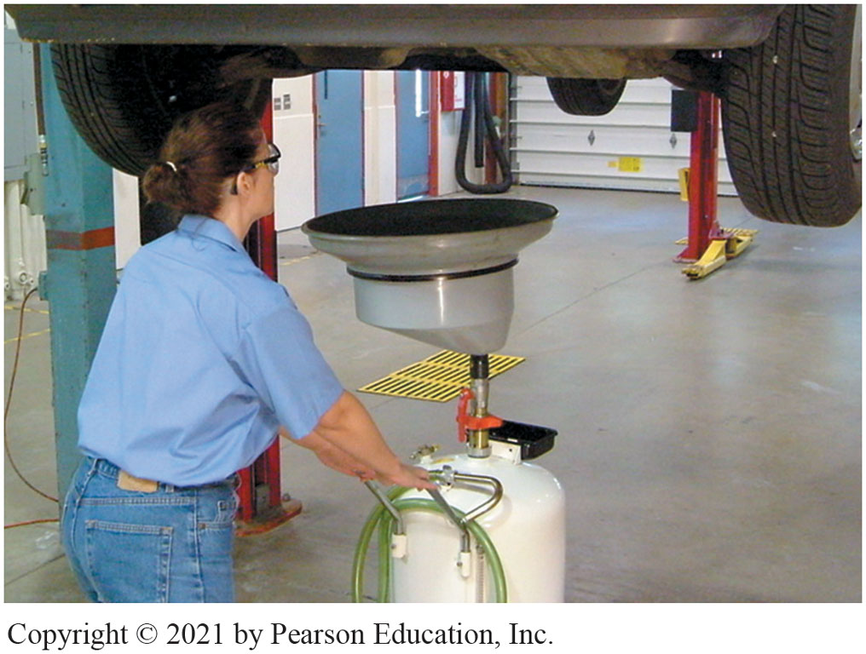
3. Oil drain under oil drain plug
Notes:
3. Raise vehicle, place oil drain container under oil drain plug. Wear gloves

Slide 47
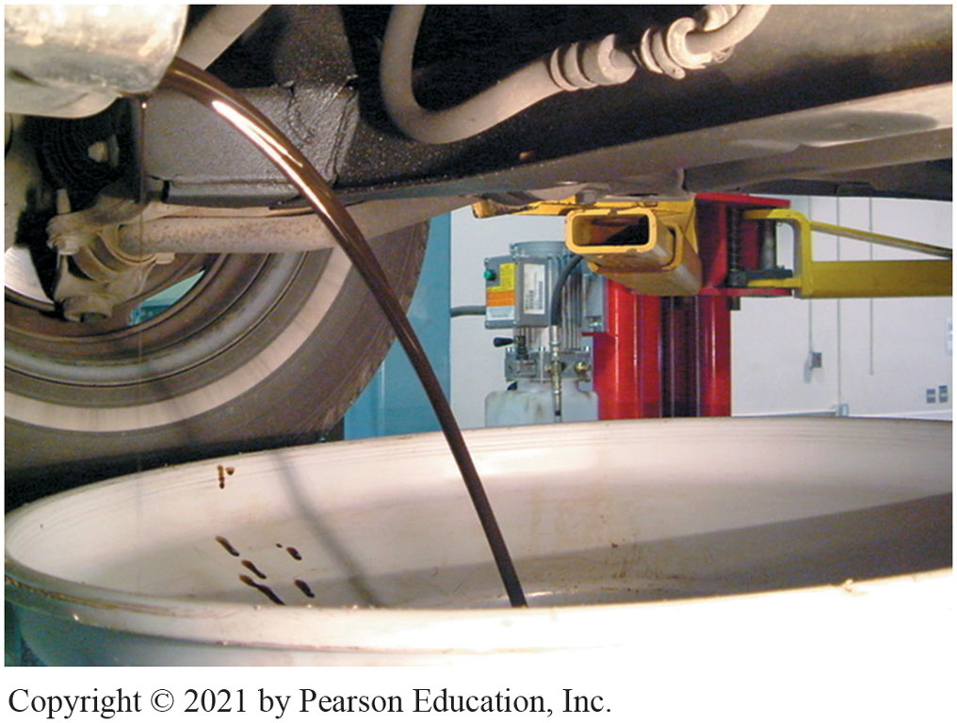
4. Remove plug allow hot oil to drain
Notes:
4. Remove plug allow hot oil to drain. Use caution as hot oil can cause painful burns!

Slide 48
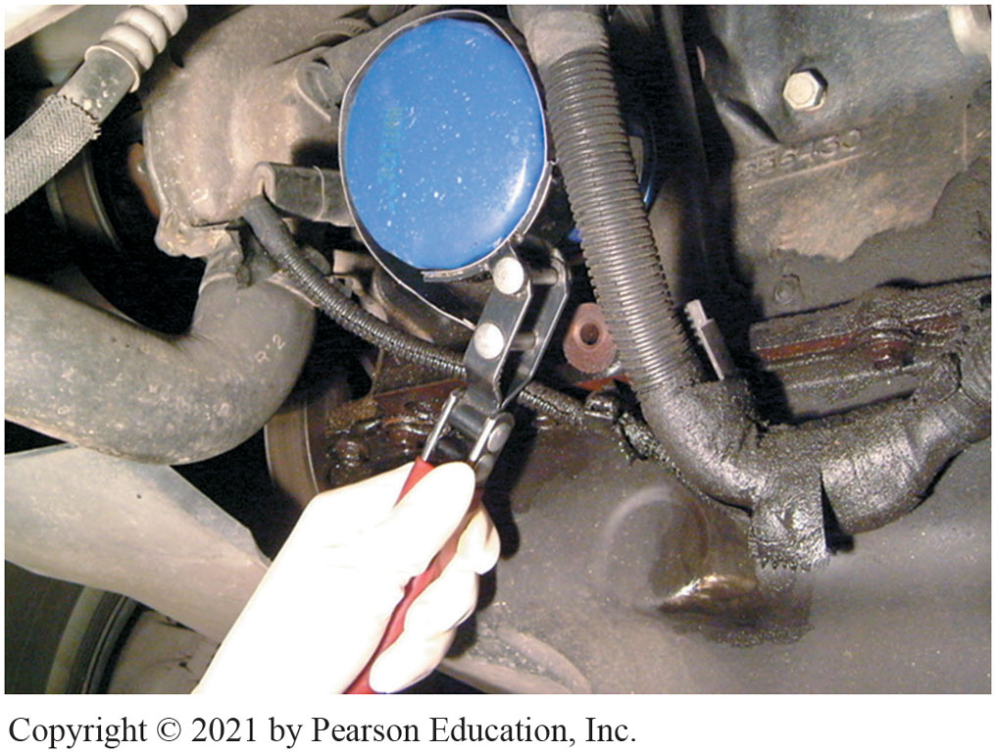
5. Remove oil filter with filter wrench.
Notes:
5. While oil drains, remove oil filter using a filter wrench.

Slide 49
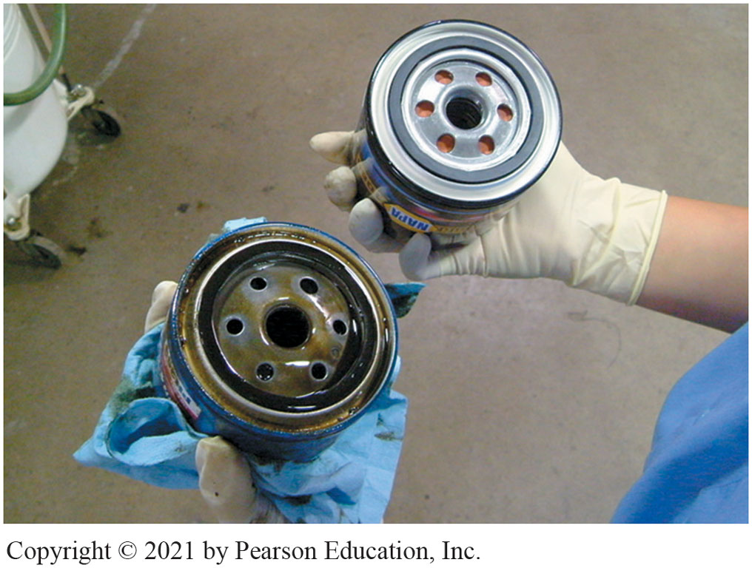
6. Compare New Filter with Old One
Notes:
6. Compare the New Oil Filter with the Old One to be Sure that it is the Correct Replacement

Slide 50
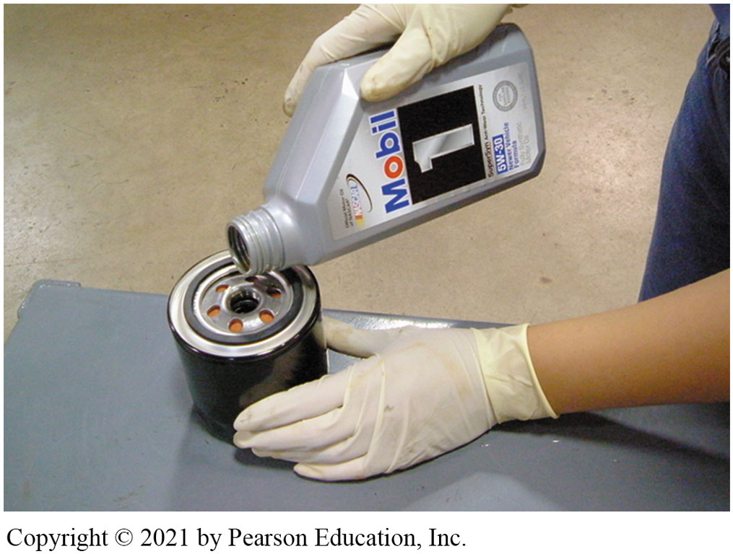
7. Adds Oil to the Oil Filter
Notes:
7. The wise service technician adds oil to the oil filter whenever possible. This provides faster filling of the filter during start-up and a reduced amount of time that the engine does not have oil pressure.

Slide 51
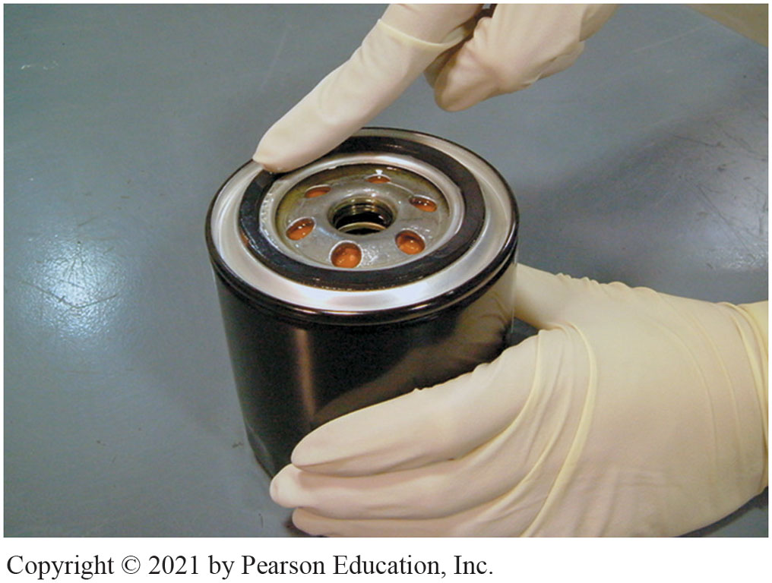
8. Apply Clean Engine Oil to Gasket
Notes:
8. Apply a thin Layer of Clean Engine Oil to the Gasket of the New Filter. This Oil Film will Allow the Rubber Gasket to Slide and Compress as the Oil Filter Is Being Tightened

Slide 52
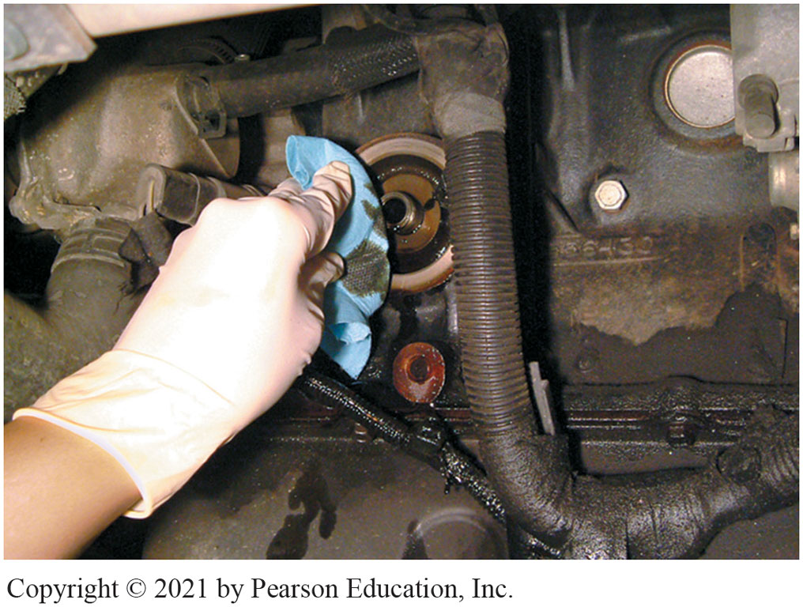
9. Clean filter gasket seat area
Notes:
9. Clean the Area Where the Oil Filter Gasket Seats to Be Sure that No Part of the Gasket Remains That Could Cause an Oil Leak

Slide 53
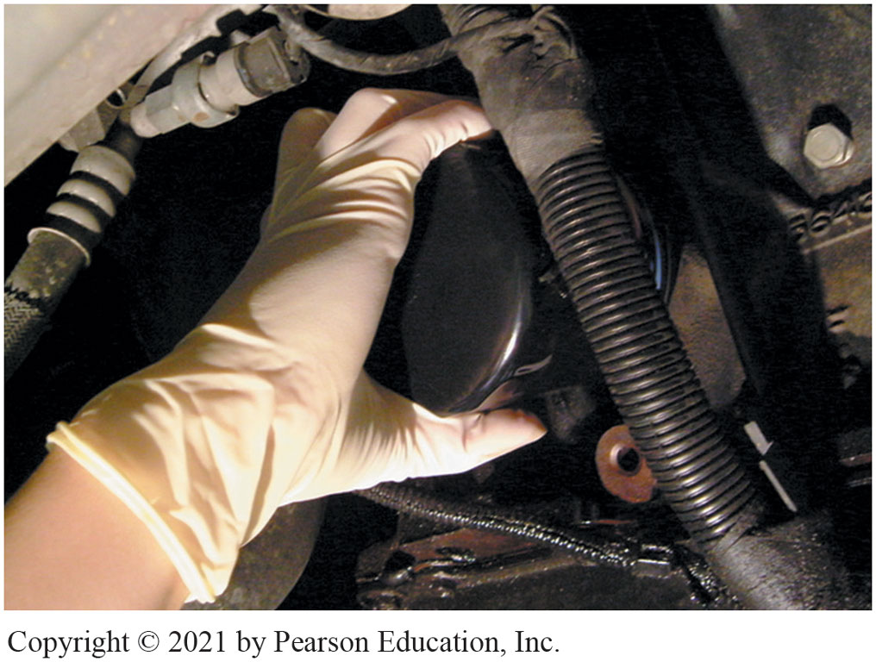
10. Install new oil filter and tighten
Notes:
10. Install the New Oil Filter and Tighten it by Hand. Do Not Use an Oil Filter Wrench to Tighten the Filter! Most Filters Should Be Tightened 3/4 of a Turn After the Gasket Contacts the Engine

Slide 54
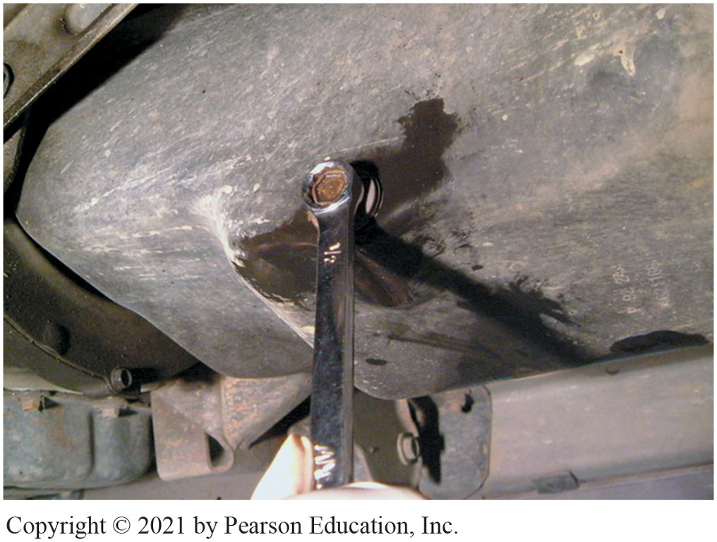
11. Install drain plug do NOT overtighten!
Notes:
11. Carefully Inspect the Oil Drain Plug and Gasket. Replace the Gasket as Needed. Install the Drain Plug and Tighten Firmly, but Do Not Overtighten

Slide 55
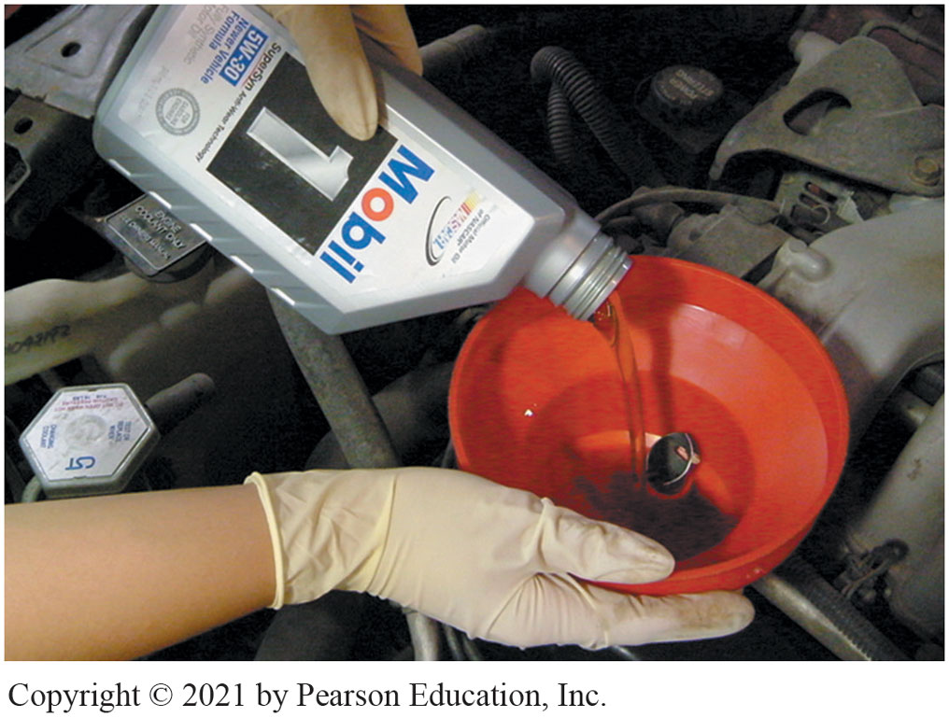
12. Add Specified Amount of Oil
Notes:
12. Use a Funnel to Add the Specified Amount of Oil to the Engine at the Oil Fill Opening. When Finished, Replace the Oil Fill Cap

Slide 56
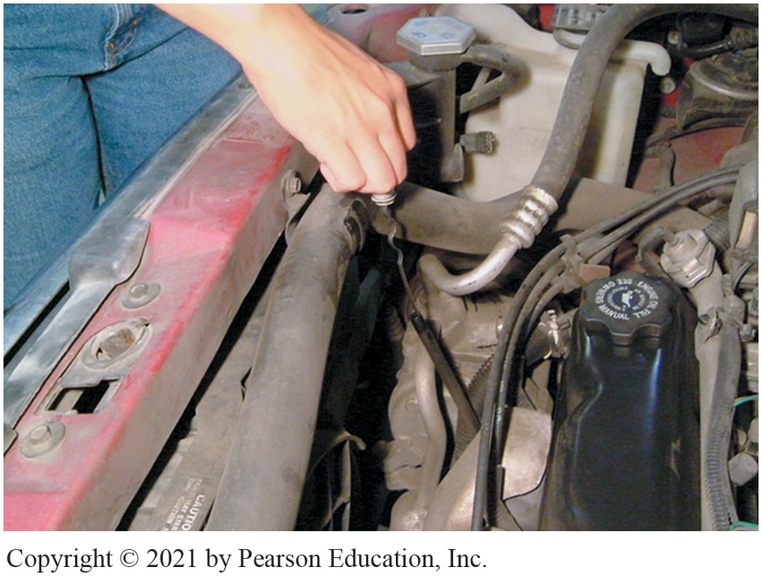
13. Remove dipstick twice read oil level
Notes:
13. Remove the Oil-Level Dipstick and Wipe it Clean with a Shop Cloth. Reinstall the Oil-Level Dipstick. Remove the Dipstick a Second Time and Read the Oil Level

Slide 57
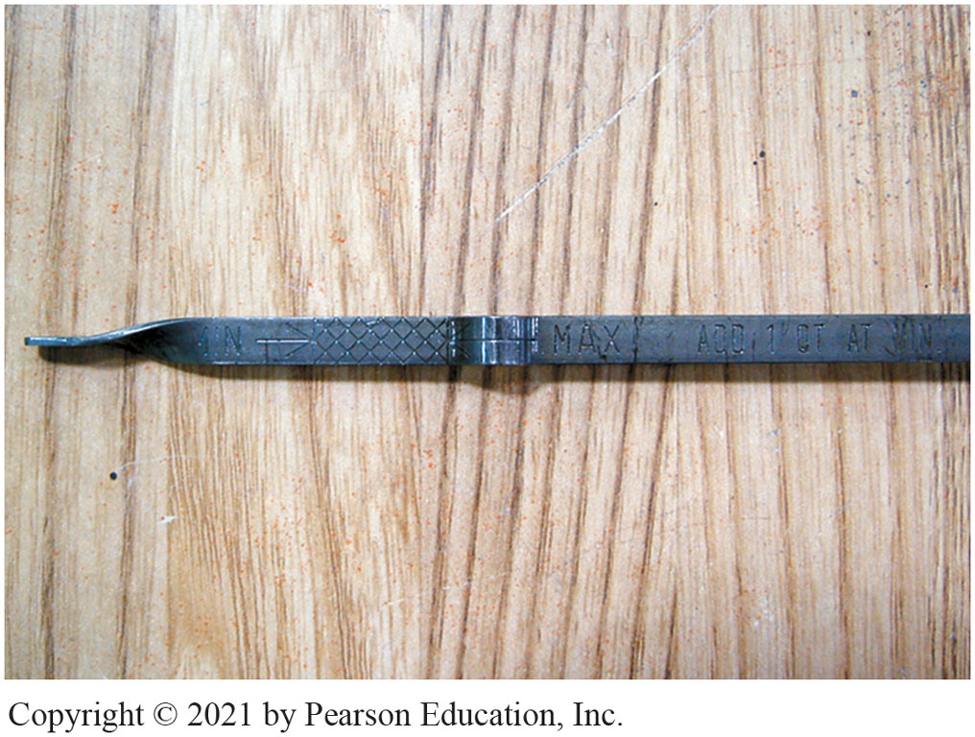
14. Between MIN and MAX Lines
Notes:
14. The Oil Level should be Between the MIN and the MAX Lines. In this Case, the Oil Level should be Somewhere in the Cross-Hatched Area of the Dipstick

Slide 58
Engine Repair Videos and Animations
Videos Link: (A1) Engine Repair Videos
Animations Link: (A1) Engine Repair Animations

Slide 59
Copyright
This work is protected by United States copyright laws and is provided solely for the use of instructors in teaching their courses and assessing student learning. Dissemination or sale of any part of this work (including on the World Wide Web) will destroy the integrity of the work and is not permitted. The work and materials from it should never be made available to students except by instructors using the accompanying text in their classes. All recipients of this work are expected to abide by these restrictions and to honor the intended pedagogical purposes and the needs of other instructors who rely on these materials.

