Slide 1
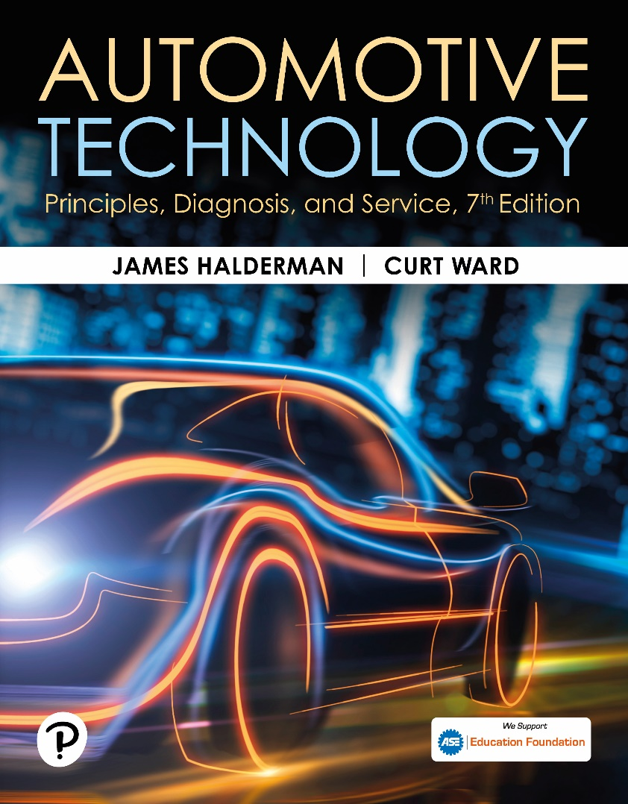
Automotive Technology: Principles, Diagnosis, and Service
Seventh Edition
Chapter 17
Antifreeze and Coolant
Copyright © 2023 Pearson Education, Inc. All Rights Reserved
Notes:
INSTRUCTOR NOTE: This presentation includes text explanation notes, you can use to teach the course. When in SLIDE SHOW mode, you RIGHT CLICK and select SHOW PRESENTER VIEW, to use the notes.

Slide 2
Learning Objectives
17.1 Discuss coolant fundamentals.
17.2 Compare the different types of coolant.
17.3 Discuss water as coolant.
17.4 Discuss coolant freezing/boiling temperatures.
17.5 Discuss coolant testing.
17.6 Discuss coolant replacement issues.

Slide 3
Coolant Fundamentals
Purpose of Coolant: Transfer heat, protect against corrosion, and protect against freezing.
Freezing/Boiling Temperatures: Normal mixture is 50% coolant and 50% water.
Coolant Composition:
47% Ethylene glycol
50% Water
3% Additives

Slide 4
Figure 17.1 Coolant Freezing Point
Graph Showing the Relationship of the Freezing Point of the Coolant to the Percentage of Antifreeze Used in the Coolant

Slide 5
Figure 17.2 Coolant Boiling Point
Graph Showing How the Boiling Point of the Coolant Increases as the Percentage of Antifreeze in the Coolant Increases

Slide 6
Types of Coolant
Inorganic Acid Technology: Contains silicates, phosphates, and borates
Organic Acid Technology: Does not contain silicates or phosphates.
Hybrid Organic Acid Technology: Uses carboxylates that are not abrasive to the water pump.
Phosphate Hybrid Organic Acid Technology: Used in Mazda based Fords, similar to Mazda F L-22.
Universal Coolant: Usually a hybrid organic acid technology.

Slide 7
Figure 17.3 OAT DEXCOOL
Havoline was the First Company to Make and Market OAT Coolant. General Motors Uses the Term DEXCOOL

Slide 8
Frequently Asked Question: What Is a “G” Coolant?
? Frequently Asked Question
What Is a “G” Coolant? The “G” coolants come from the trade name Glysantin of BASF in Europe and Valvoline (Zerex) in the United States. The following is a summary of the types listed by G number. • G05: different from DEX-COOL in certain amounts of additives
G30 and G34: nonsilicate and phosphate free
G11: blue VW used before 1997
G12: pink/red VW 1997+ (purple VW 2003+)
HOAT formulation
Phosphate free
G48: low silicate and phosphate free • Blue
Nitrates, amines, phosphate (NAP) free

Slide 9
Figure 17.4 PHOAT
Coolant Used in Fords that Use Mazda Engines and in Mazda Vehicles. It Requires the Use of a PHOAT Coolant, Which is Dark Green

Slide 10
Frequently Asked Question: What Is “Pet Friendly” Antifreeze?
? Frequently Asked Question
What Is “Pet Friendly” Antifreeze? Ethylene glycol antifreeze used by all manufacturers is attractive to pets because it has a sweet taste. Ethylene glycol is fatal to any animal if swallowed, so any spill should be cleaned up quickly. There are 2 types of coolant that are safer for use around pets than the conventional type. Propylene glycol (PG). This type of antifreeze is less attractive to pets and animals because it is not as sweet, but it is still harmful if swallowed. This coolant, including the Sierra brand, should not be mixed with any other ethylene glycol–based coolant. CAUTION: Some vehicle manufacturers do not recommend the use of propylene glycol coolant. Check recommendation in owner manual or service information before using it in a vehicle. Embittered coolant. This coolant has a small amount of a substance that makes it taste bitter and therefore not appealing to animals. The embittering agent used in ethylene glycol (EG) antifreeze is usually denatonium benzoate, added at the rate of 30 PPM. SEE FIGURE 17–5.

Slide 11
Figure 17.5 Embittered Coolant
Not all Embittered Coolant is Labelled Embittered
Notes:
CASE STUDY: If 50% Is Good, 100% Must Be Better
A vehicle owner said that the cooling system of their vehicle would never freeze or rust. They said
that they used 100% antifreeze (ethylene glycol) instead of a 50/50 mixture with water.
However, after the temperature dropped to
−20°F (−29°C), the radiator froze and cracked. (Pure antifreeze freezes at about 0°F [−18°C].)
After thawing, the radiator had to be replaced. The owner was lucky that the engine block did not
also crack.
For best freeze protection with good heat transfer, use a 50/50 mixture of antifreeze and water. As
the percentage of antifreeze increases, the boiling temperature increases, and freezing protection
increases (up to 70% antifreeze), but the heat transfer performance of the mixture decreases.
Summary:
Complaint—The coolant froze and cracked the radiator.
Cause—Vehicle owner used 100% antifreeze instead of the recommended 50/50 mixture of antifreeze and water.
Correction—The radiator was replaced and the proper mixture of antifreeze/water was used as the coolant.

Slide 12
Frequently Asked Question: What Makes Some Water Bad for Coolant?
? Frequently Asked Question
What Makes Some Water Bad for Coolant? City water is treated with chloride, which, if the levels are high enough, can cause corrosion problems when used in coolants. Well water may contain iron or other minerals that can affect the coolant and may increase the corrosion or cause electrolysis. Due to the fact that the water quality is often unknown and could affect the engine, many vehicle manufacturers are specifying the use of premixed coolant. In premix coolant, the water is usually demineralized and meets the standards for use in coolant.

Slide 13
Frequently Asked Question: Why Is Most Coolant 50/50 with Water?
? Frequently Asked Question
Why Is Most Coolant 50/50 with Water? According to the freezing point, it appears that the lowest freezing point of coolant is achieved when 70% antifreeze is used with 30% water. While the freezing temperature is lower, the high concentrate of antifreeze reduces the heat transferability of the coolant. Therefore, most vehicle manufacturers specify a 50/50 mixture of antifreeze and water to achieve the best balance between freeze protection and heat conductivity.
Notes:
TECH TIP Ignore the Wind Chill Factor
The wind chill factor is a temperature that combines the actual temperature and the wind speed to
determine the overall heat loss effect on open skin. Because it is the heat loss factor for open
skin, the wind chill temperature is not to be considered when determining antifreeze protection
levels. Although moving air makes it feel colder, the actual temperature is not changed by the wind, and
the engine coolant will not be affected by the wind chill. If you are not convinced, try placing a
thermometer in a room and wait until a stable reading is obtained. Now turn on a fan and have the
air blow across the thermometer. The temperature will not change.

Slide 14
Question 1: ?
What types of coolant are used in vehicles?

Slide 15
Answer 1
Inorganic acid technology, organic acid technology, hybrid organic acid technology, phosphate hybrid organic acid technology.

Slide 16
Water
Efficient heat exchange fluid.
It is inexpensive.
Water quality can affect coolant protection.
Many coolants sold as premix solutions to avoid water quality concerns.

Slide 17
Coolant Freezing/Boiling Temperatures
Freezing Point:
Pure water 32° F (0° C)
Pure Coolant 0° F (-18° C)
50/50 Mixture -34° F (-37° C)
70% antifreeze/ 30% water -84° F (-64° C)
Boiling Point:
Pure Water 212° F (100° C)
50/50 Mixture 218° F (103° C)
70/30 Mixture 225°F (107° C)
Pressure Cap will raise boiling point

Slide 18
Coolant Testing
Hydrometer: Measures the density of the coolant.
Refractometer: Tests coolant on a prism surface.
P H: The measure of acidity or alkalinity of the coolant.
Galvanic Activity: The flow of electrical current as a result of two different metals in a liquid.
Electrolysis: Current flow in coolant caused by an external voltage source.

Slide 19
Figure 17.6 Hydrometer
Checking the Freezing Temperature of the Coolant Using a Hydrometer

Slide 20
Animation: Coolant Test, Simple Hydrometer (Animation will automatically start)

Slide 21
Figure 17.7 Refractometer
Using a Refractometer is an Accurate Method to Check the Freezing Point of Coolant.

Slide 22
Animation: Coolant Refractometer (Animation will automatically start)

Slide 23
Figure 17.8 pH Meter
A Meter that Measures the Actual pH of the Coolant can be Used for All Coolants, Unlike Many Test Strips that Cannot be Used to Test the pH of Red or Orange Coolants

Slide 24
Figure 17.9 Galvanic Activity
Galvanic Activity is Created by Two Dissimilar Metals in Contact with a Liquid, in this Case Coolant

Slide 25
Figure 17.10 Litmus Test
A Test Strip can be Used to Determine the pH and Percentage of Glycol of the Coolant. The Percentage of Glycol Determines the Freezing and Boiling Temperatures, as Shown on the Bottle that Contains the Test Strips

Slide 26
Animation: Coolant Test, Test Strips (Animation will automatically start)

Slide 27
Question 2: ?
What is the difference between galvanic activity and electrolysis?

Slide 28
Answer 2
Electrolysis requires an external voltage source.

Slide 29
Coolant Replacement Issues
Service Intervals:
O A T and H O A T coolants every 5 years or 150,000 miles.
Asian vehicles every 3 year or 36,000 miles.
Conventional coolant every 2 years or 24,000 miles.
Passivation: Chemical reaction between coolant and metal.
Recycling Coolant: Removes metals and dirt, then replenishes the depleted acids.

Slide 30
Engine Repair Videos and Animations
Videos Link: (A1) Engine Repair Videos
Animations Link: (A1) Engine Repair Animations

Slide 31
Copyright
This work is protected by United States copyright laws and is provided solely for the use of instructors in teaching their courses and assessing student learning. Dissemination or sale of any part of this work (including on the World Wide Web) will destroy the integrity of the work and is not permitted. The work and materials from it should never be made available to students except by instructors using the accompanying text in their classes. All recipients of this work are expected to abide by these restrictions and to honor the intended pedagogical purposes and the needs of other instructors who rely on these materials.

