Slide 1

Automotive Technology: Principles, Diagnosis, and Service
Seventh Edition
Chapter 136
Exhaust Systems
Copyright © 2023 Pearson Education, Inc. All Rights Reserved
Notes:
INSTRUCTOR NOTE: This presentation includes text explanation notes, you can use to teach the course. When in SLIDE SHOW mode, you RIGHT CLICK and select SHOW PRESENTER VIEW, to use the notes.

Slide 2
Learning Objectives (1 of 2)
136.1 Discuss the purpose and function of an automotive exhaust system.
136.2 Discuss the components of an automotive exhaust system.
136.3 Describe exhaust system mounting hardware.
136.4 Describe how to inspect the exhaust system.
136.5 Discuss exhaust system repairs.
136.6 Explain exhaust emission control systems.
136.7 Discuss the exhaust system fabrication process.

Slide 3
Learning Objectives (2 of 2)
136.8 Discuss MIG welding.
136.9 Discuss oxy-acetylene welding.
136.10 Discuss flame types.

Slide 4
Exhaust System
Job of Exhaust
Rid ICE of spent gases
ICE draws in fresh air charge and uses exhaust system to remove what has been spent.
Cylinders will not fill with air charge if combustion gas pressure builds up in exhaust system.
Backpressure is the resistance to exhaust gas flow in the system, which is often due to restrictions
Do not remove exhaust gases efficiently with backpressure.
Notes:
The job of the automotive exhaust systems is to rid the internal combustion engine (ICE) of spent gases (the gases are left over from the burning of the hydrocarbon fuel, with oxygen, and nitrogen). The ICE draws in the fresh air charge that is needed for combustion and uses the exhaust system to remove what has been spent. Exhaust gases must be removed with as little resistance as possible. The cylinders will not fill with the proper air charge if combustion gas pressure builds up in the exhaust system. Backpressure is the resistance to exhaust gas flow in the system, which is often due to restrictions, such as exhaust pipe blockage, mufflers, catalytic converters, or resonators. Exhaust systems that do not remove exhaust gases efficiently may have unwanted backpressure.

Slide 5
Exhaust System Components (1 of 3)
Exhaust Manifold
Bolts directly to the cylinder head and mates with the cylinder head exhaust ports. Figure 136– 1
Exhaust manifold must be cool before being removed.
Carefully examine exhaust manifold for cracks or other damage. ● See figure 136–2.
Catalytic converter converts harmful exhaust emissions into non-harmful compounds.
Catalytic converter substrate or brick melt or break into pieces if over-fuels due to misfire or defective O2 sensor
Outlet temperature around 10% hotter than inlet temperature.
Notes:
Exhaust Manifold The exhaust manifold bolts directly to the cylinder head and mates with the cylinder head exhaust ports. Inline engines are equipped with a single exhaust manifold, while “V” design engines have one exhaust manifold for each cylinder head. ● SEE FIGURE 136– 1
Exhaust Manifold Removal The exhaust manifold must be cool before being removed. Penetrating spray is often needed on the mounting fasteners to get the nuts or manifold bolts off of the cylinder head. Some vehicles have secondary air injection (SAI) tubes and a check valve that may have to be removed. Often there will be tubing for the exhaust gas recirculation (EGR) that also needs to be removed.
Exhaust Manifold Inspection Carefully examine the exhaust manifold for cracks or other damage. ● SEE FIGURE 136–2. Depending on the design of the manifold, some areas get hotter than others. Thoroughly clean off all dirt and old gasket material from the mating surface of the exhaust manifold. Check the cylinder head mating surface of the exhaust manifold using a straight edge and a feeler gauge and compare to the manufacturer specifications. If the mating surface of the exhaust manifold is warped or damaged, it may be necessary to resurface it or replace the exhaust manifold. Sometimes a gasket is available for these applications, which may take up for the warpage or dam- age. Also inspect the manifold studs for any corrosion or damage. Replace or repair the studs as needed.
Catalytic Converter The catalytic converter converts harmful exhaust emissions into non-harmful compounds. The converter structure contains small amounts of rhodium, palladium, and platinum. When the converter is heated by the exhaust gasses, the three elements act as catalysts and convert the exhaust gases of hydrocarbon (HC), carbon monoxide (CO), and oxides of nitrogen (NOx) into harmless emissions such as water (H₂O), car- bon dioxide (CO₂), and nitrogen (N₂). The catalytic converter can be clogged if an overly rich air fuel mixture overheats the converter and melts the substrate brick. The catalytic converter substrate or brick can melt or break into pieces if the engine over-fuels due to a misfire or defective oxygen sensor or air-fuel ratio (AFR) sensor.
The catalytic converter monitor of OBD II uses an upstream and downstream oxygen sensor to test catalyst efficiency. When the engine burns a lean air–fuel mixture, higher amounts of oxygen flow through the exhaust into the converter. The catalyst materials absorb this oxygen for the oxidation process, thereby removing it from the exhaust stream. If a converter cannot absorb enough oxygen, oxidation does not occur. The oxygen content after the converter is monitored by the downstream oxygen sensor. ● SEE FIGURE 136–3.
Some methods of testing the catalytic converter include the following:
Determine whether a catalytic converter is working. The outlet temperature should be around 10% hotter than the inlet temperature. When the catalytic converter is not working, the inlet temperature is hotter than the outlet temperature.
The tap test involves tapping on the catalytic converter with a rubber mallet. If the substrate inside the converter is broken, the converter will rattle.
When the catalytic converter is being tested for contamination and operation, use a scan tool that can access mode 6 and look at the test results for each of the catalyst monitors. When using mode 6, research must be done for the specific codes that the manufacturer uses to identify each catalyst monitor, as well as the coding for the actual results. A digital storage oscilloscope (DSO) can be used to compare the upstream and downstream oxygen sensor patterns to determine whether the catalyst is working

Slide 6
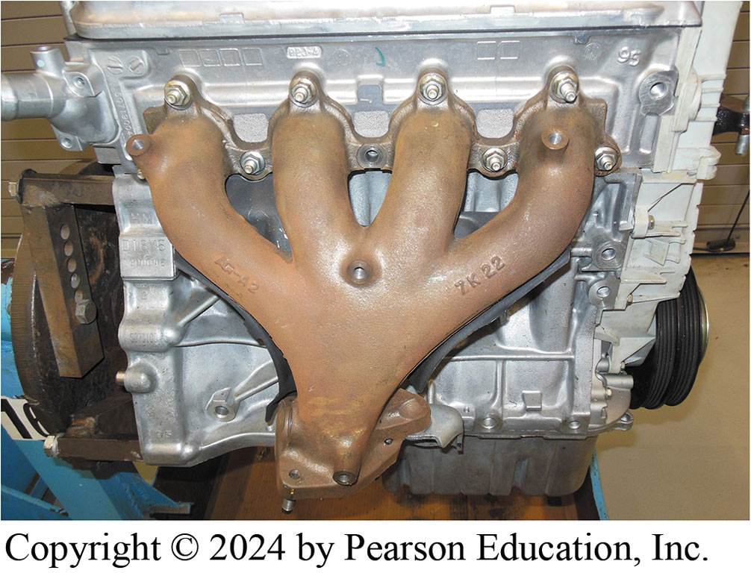
Figure 136.1 Exhaust Manifold
An exhaust manifold on a four-cylinder engine.

Slide 7
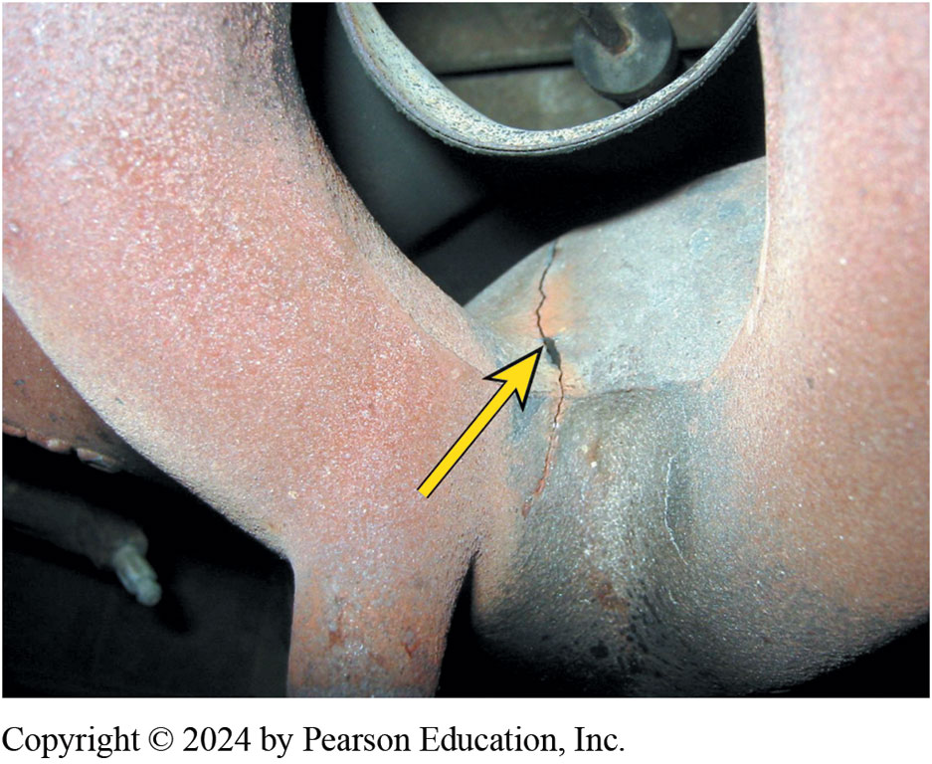
Figure 136.2 Cracked Manifold
A cracked exhaust manifold is often hard to see because the manifold is covered by a heat shield.

Slide 8
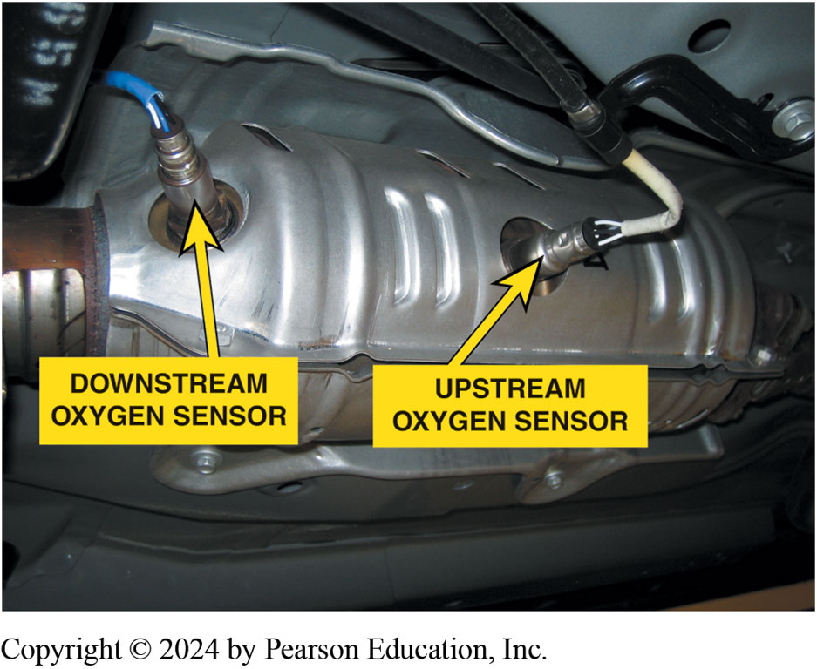
Figure 136.3 Oxygen Sensors
Upstream and downstream oxygen sensors are used to monitor the operation of the catalytic converter.

Slide 9
Frequently Asked Question: How Long Must a Shop Keep a Removed Catalytic Converter?
? Frequently Asked Question
How Long Must a Shop Keep a Removed Catalytic Converter? An aftermarket installer can only keep a catalytic converter after it has been removed from a vehicle for 15 days. In 1986, the EPA issued new guidelines for the construction, efficiency, and installation of aftermarket catalytic converters. EPA guidelines state that replacement converters may be installed only in the following situations: 1. Vehicles manufactured prior to 1996 must have more than 50,000 miles, and a legitimate need for replacement must be established and documented. 2. In cases of OBD II-equipped vehicles (1996 and later), the OEMs 8-year/80,000-mile warranty must have expired, and a legitimate need for replacement must be established and documented. 3. The vehicle is missing a converter. 4. A state or local inspection program has determined that the existing converter needs replacement. 5. Please note that federal law prohibits removal of a properly functioning original equipment catalytic converter.

Slide 10
Exhaust System Components (2 of 3)
Muffler
Quiet sound of engine combustion.
Baffles deflect exhaust inside muffler.
Pressure pulses create sound waves that travel down exhaust pipe and into muffler.
Straight-through mufflers are less restrictive
Used for performance-based engines
Do not reduce sound level as well as reverse-flow mufflers
Some mufflers use a small hole in lower rear part to drain accumulated water.
Notes:
Muffler The muffler is used in the exhaust stream to help quiet the sound of engine combustion. The muffler is a can or container with an inlet and an outlet pipe attached. Inside the muffler is a series of baffles designed to deflect the exhaust inside the muffler. The baffling or deflecting of the exhaust gases inside the muffler quiets the sound of combustion before the gases move out of the tailpipe.
In an exhaust system, pressure pulses create sound waves that travel down the exhaust pipe and into the muffler. The sound waves enter a reverse-flow muffler (most common type) through the center tube, bounce off the back of the muffler, and are reflected through a hole into the muffler main body. Then, they pass through more holes into another chamber and turn and exit the muffler out- let. Mufflers are designed so that the size of their chamber, tubes, and baffles allow the sound waves to cancel each other out, reducing engine noise. There are also straight-through mufflers that use perforations inside the muffler to break up the pulsations and glass insulation inside the muffler to absorb some of the pressure pulses. Straight-through mufflers are less restrictive and are used for performance-based engines. They do not reduce sound level as well as reverse-flow mufflers and may not be legal in your state.
NOTE: Some mufflers use a small hole in the lower rear part to drain accumulated water. About a gallon of water is produced in the form of steam for each gallon of gasoline burned. The water vapor often condenses on the cooler surfaces of the exhaust system unless the vehicle has been driven long enough to fully warm the muffler above the boiling point of water.

Slide 11
Exhaust System Components (3 of 3)
Universal Muffler may require cutting existing pipes, pipe adapters, and new clamps and hangers.
Using OEM exact fit replacement muffler eliminates need for pipe adapters.
Resonator helps to quiet sound of combustion
Before the exhaust gases reach muffler
Tailpipe is last pipe in the exhaust system
Carries exhaust fumes out from under the vehicle
Notes:
Universal Muffler A universal muffler may require cutting existing pipes, pipe adapters, and new clamps and hangers. Using an OEM exact fit replacement muffler eliminates the need for pipe adapters. A pipe adapter is used to connect nonstandard exhaust components to existing OEM components like the one used to connect the catalytic converter to the existing exhaust systems or connect one size pipe to another.
Resonator The resonator is similar to a muffler and is usually connected in the exhaust stream before the muffler. The resonator helps to quiet the sound of combustion before the exhaust gases reach the muffler.
TAILPIPE The tailpipe is the last pipe in the exhaust system; it carries the exhaust fumes out from under the vehicle and into Atmosphere.

Slide 12
Exhaust System Mounting Hardware
Mounting Hardware attach exhaust system to vehicle
Clamps U-bolts that come in different sizes that correspond to pipe diameter that secure slip joint connections
Hangers O-ring or fabric devices that attach to brackets mounted on underside of vehicle to support exhaust
Heat Shields Heat shields are used to protect the under- body of the vehicle from excessive heat
SEE FIGURE 136–4.
Notes:
Purpose Mounting hardware is used to attach the exhaust system to the vehicle using brackets hangers and clamps.
Clamps Clamps are U-bolts that come in different sizes that correspond to the pipe diameter that secure the slip joint connections that are attached to some exhaust system components. Clamps may also be used to attach hangers in some applications. Ensure the inside pipe is fully inserted in the slip joint connection and the clamp is positioned around both pipes, but not too close to the edge of the outer pipe. Position the clamp so that the ends of the U-bolt will not contact other components or snag objects that may pass under the vehicle. Tighten the clamp only enough to secure the connection. Overtightening may distort the pipes, causing an exhaust leak.
Hangers Hangers are O-ring or fabric devices that attach to brackets mounted on the underside of the vehicle to support the exhaust system. Some are welded to the exhaust system. Hangers can also be made of reinforced fabric that are bolted or clamp to the exhaust system. Hangers must be flexible enough to allow the exhaust system to expand as it gets hot and move with the torque of the engine. The hangers also isolate the vehicle from vibrations in the exhaust system. When installing exhaust system components, make sure to take the necessary steps to properly position them. Hangers should be used to support the exhaust system and not pull or force the exhaust system into position. Hangers that are used this way will be under constant stress and most likely break.
Heat Shields Heat shields are used to protect the under- body of the vehicle from excessive heat created by the exhaust system. Heat shields are usually riveted or screwed into the bot- tom of the vehicle floor pan above the exhaust system. ● SEE FIGURE 136–4.

Slide 13
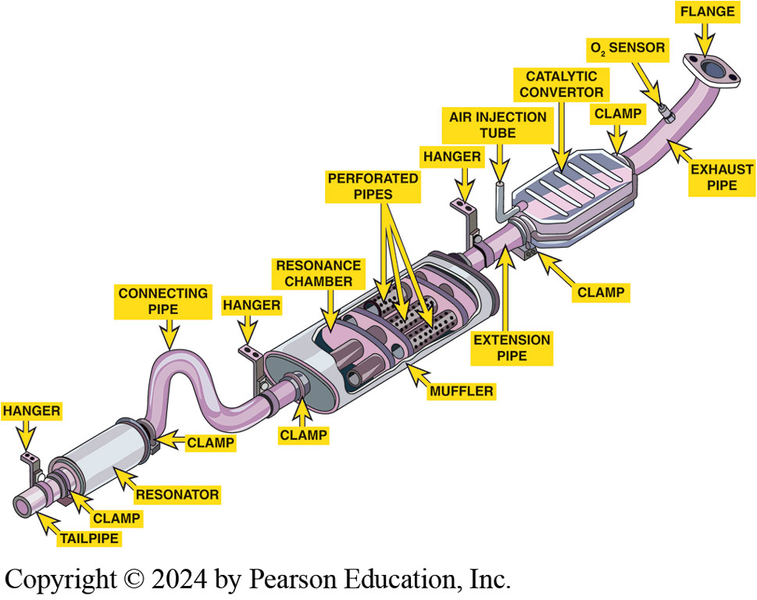
Figure 136.4 Exhaust System
An exhaust system has many individual parts Each has its own purpose and function, and all must be working as designed.

Slide 14
Exhaust System Inspection (1 of 3)
Visual Inspection Exhaust
inspect exhaust system damage, holes, cracks, separated components, bulging muffler seams
Wiggle exhaust system look for movement
Tap on exhaust system components with a mallet.
Rattling noises can be caused by loose heat shields, loose clamps, pipe interfering with another exhaust component.
When tapping on muffler or catalytic converter, listen for the sound of loose rust particles.
First step in diagnosing a noise or exhaust leak under the vehicle is to discuss the noise with the owner
Notes:
TECH TIP: A Rubber Mallet Is a Technician’s Friend and Helper
Some vehicles use double wall tubing for exhaust pipes. The inside tube can collapse or rust inside the outer tube and cause a restriction, even when the outer tube looks good. Tap on the exhaust pipes with a rubber mallet and listen for rattling or rust breaking loose, which would indicate a problem inside the pipe. A restricted exhaust system can cause low power, poor fuel economy, and, if
it is completely clogged, the engine may not run at all.
Visual Inspection Exhaust system inspection starts by raising and safely supporting the vehicle. Visually inspect the exhaust system for physical damage, holes, cracks, separated components, bulging muffler seams, and broken or missing clamps and hangers. A catalytic converter that appears bluish or brownish indicates that it has been overheated. Wiggle the exhaust system at various points to look for excessive movement caused by broken or cracked connections or broken or missing hangers. Tap on the exhaust system components with a mallet. An exhaust component in good condition will make a solid metallic sound, while a component that is worn out will have a dull sound. Rattling noises can be caused by loose heat shields, loose clamps, or an exhaust pipe interfering with another exhaust component. When tapping on the muffler or catalytic converter, listen for the sound of loose rust particles.
Diagnosing Noise The first step in diagnosing a noise or exhaust leak under the vehicle is to discuss the noise with the vehicle owner because the owner or driver is the best resource to find out the nature of the noise. Exhaust system components can fail due to physical or chemical damage. The exhaust system is subject to damage and wear from dirt, stones, water, and other road hazards. It can also rot out from the inside from moisture or internal corrosion from poor combustion. Many vehicles are driven short distances, so the exhaust system never gets warm enough to evaporate the moisture. Whether caused by physical or chemical damage, the result is cracks, holes, or other damage to the exhaust system that can cause excessive noise and can allow harmful exhaust gases to enter the passenger compartment. Exhaust system damage can result in a restriction. A block- age can be caused by physical damage, such as a dented exhaust pipe, or clogged muffler, resonator, or catalytic converter. A be caused by a collapsed inner exhaust pipe.

Slide 15
Exhaust System Inspection (2 of 3)
Exhaust Leaks:
Black streaks/soot on component can be leakage
Tapping sound like valve train noise can be an exhaust leak at exhaust manifold Use steps on page 1736
Electronic Leak Detector Testing
Test for known gas such as at tailpipe
Go down exhaust system to look for leaks.
Soapy Water Testing For Exhaust Leaks
Spray bottle and mix water and dish washing detergent to make a soapy water solution.
Spray joints and pipe looking for soapy bubbles
Notes:
Exhaust Leaks: Black streaks or soot on the outside of a component can be signs of leakage. If the source of exhaust leakage is not seen, start the vehicle and listen care- fully for exhaust leaks at all joints and seals. Never overlook any welded connections because they can crack and leak as well. A small exhaust leak will make a hissing or popping noise. A significant exhaust leak can show up as a diagnostic trouble code (DTC) set for a poor-performing turbocharger or catalyst. A tapping sound that may sound like valve train noise can be an exhaust leak at the exhaust manifold connection to the cylinder head. To check for leaks, perform the following steps:
STEP 1 Use a rag to block off the exhaust flow from the tailpipe. If the exhaust system is not leaking, pressure will build and force the rag out of the pipe. If there are leaks in the exhaust, hissing will be heard from the exhaust system through the leaks. It may be necessary to have an assistant perform this test (block off the tailpipe with a rag) while the technician listens for exhaust leaks.
STEP 2 Use a technician’s stethoscope to help pinpoint small leaks while this test is being performed.
STEP 3 Use a smoke machine with an exhaust pipe adapter to fill the exhaust system with smoke. With the engine off, any signs of smoke will be pinpointed.
Electronic Leak Detector Testing Obtain an electronic exhaust gas leak detector, which can be purchased at a reason- able cost. The first step is to test for a known gas such as at the tailpipe to verify the tester is capable of measuring gas. Raise the vehicle on a lift or safety stands using a floor jack and go down the exhaust system from the turbocharger to the tailpipe and look for leaks. If any leaks are found, take the necessary steps to repair the exhaust system.
Soapy Water Testing For Exhaust Leaks Obtain an empty spray bottle and mix water and a small amount of dish washing detergent to make a soapy water solution. Raise the safety stands using a floor jack and check the exhaust system starting at the turbocharger. Spray the joints and pipe looking for soapy bubbles. If any leaks are located, take the necessary steps to repair the exhaust system

Slide 16
Exhaust System Inspection (3 of 3)
Excessive Exhaust System Backpressure
Cause poor engine breathing from restricted system.
Whistling sound may indicate exhaust restriction
Testing Backpressure 2 methods:
Vacuum Measurement at Intake Manifold Figure 136-5
At idle, vacuum 17 to 22 inches of mercury (in. Hg).
Raise engine speed to 2,000 to 2,500 RPM
Vacuum will drop gradually if there is a restriction
Pressure gauge into an exhaust opening:
Notes:
EXHAUST SYSTEM BACKPRESSURE Excessive exhaust system backpressure can cause poor engine breathing due to a clogged or restricted exhaust system. A low power complaint with a whistling sound may indicate an exhaust system restriction. High exhaust backpressure can cause several destructive engine operating conditions, including the following:
High exhaust valve temperatures can be caused by an inadequate flow of fresh intake air over the exhaust valve, especially during the valve overlap period. High exhaust valve temperatures can cause a valve to burn, resulting in an engine misfire.
Overheating of cooling systems can be caused by transfer of heat energy from slow-moving exhaust gases lingering near the exhaust ports into the cylinder head.
Excessive crankcase pressure can result from exhaust gas pressure retained in the cylinder that will leak past piston rings and enter the crankcase.
Increased engine blow-by gases can cause the combustion gases to leak past the piston rings into the crankcase.
High exhaust emissions due to poor combustion quality can be caused by high exhaust backpressure.
Low turbocharger boost pressure caused by high exhaust backpressure. Turbine speed is dependent on the pressure drop between the turbine inlet and outlet, and high exhaust pressure reduces the pressure differential across the turbine. This causes turbocharger speed and boost pressure to fall.
Testing Backpressure
Two methods can be used to check for exhaust system backpressure:
Vacuum Measurement at Intake Manifold A vacuum gauge measures engine vacuum with the engine running and installs to a port on the intake manifold. To measure engine backpressure, install a vacuum gauge into an intake manifold port. At idle, the vacuum will be from 17 to 22 inches of mercury (in. Hg). Raise the engine speed by opening the throttle by hand or with a scan tool to about 2,000 to 2,500 RPM. When the engine is kept at a constant speed, the manifold vacuum on the gauge will drop gradually if there is a restriction. ● SEE FIGURE 136–5.
Exhaust Manifold Pressure Measurement Back pressure can be measured directly by installing a pressure gauge into an exhaust opening. A manometer is the best gauge to use for this test. The upstream oxygen or air fuel ratio sensor is a convenient place to install the pressure gauge. Using a modified or discarded oxygen sensor is an easy way to connect the gauge. The maximum backpressure should be less than 1.5 PSI (10 kPa) at idle and less than 2.5 PSI (17 kPa) at 2,500 RPM. FIGURE 136–5 A vacuum gauge can be used to determine whether an engine has an exhaust restriction.

Slide 17
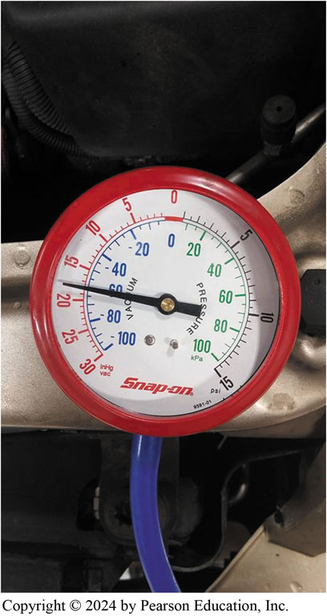
Figure 136.5 Vacuum Gauge
A vacuum gauge can be used to determine whether an engine has an exhaust restriction.

Slide 18
Exhaust System Repair
Rust & Corrosion keep in mind the following:
Nuts rust solid to clamps, and exhaust manifold studs
Threaded fasteners can be soaked with penetrating oil or heated for removal.
Always use six-point sockets, not 12 point
Support the exhaust system
Remove the nuts from the exhaust manifold studs
Remove the exhaust components
Inspect the exhaust manifold studs for corrosion
Be careful not to damage the parts not being replaced
Notes:
TECH TIP: Use a MIG Welder
A time-saving option is to use the stud welding attachment that is available on some MIG welders. With this tool, a
new stud can be welded to the exhaust manifold without removing the manifold from the vehicle.
RUST AND CORROSION Always wait until the exhaust system is cool to the touch before beginning exhaust system repairs to help avoid possible personal injury. The greatest hindrance found during exhaust repair is rust and corrosion. To help address rust and correction problems, keep in mind the following:
Nuts rust solid to clamps, and exhaust manifold studs and other components rust together at their connection points.
Threaded fasteners that must be reused can be soaked with penetrating oil or heated for removal.
Always use six-point sockets to remove exhaust fasteners, as a 12-point socket will round off the corners of a corroded fastener.
Support the exhaust system with a tall jack (safety) stand and remove the necessary clamps, fasteners, and hangers from the component being replaced.
Remove the nuts from the exhaust manifold studs, and pull the pipe flange away from the studs.
Remove the exhaust pipe from the catalytic converter and remove the exhaust pipe from the vehicle.
Inspect the exhaust manifold studs for corrosion. It is a good idea to replace the studs.
Many exhaust system components use a slip joint connection. These connections use an inner pipe that fits inside an outer pipe that fits inside the muffler. When separating these connections, be careful not to damage the parts that are not being replaced.

Slide 19
Powertrain Mounts
Powertrain Mounts
Broken powertrain mounts can cause stress on the exhaust system to wear and even cause components to break.
Hangers designed to allow normal system movement with torque of engine.
Broken mount allows powertrain to move more than intended, the exhaust system can be damaged.
With weight removed from mount
Look for signs of cracking or splitting in rubber section. Figure 136–6.
Notes:
Powertrain Mounts
Broken powertrain mounts can cause stress on the exhaust system to wear and even cause components to break. Exhaust system hangers are designed to allow normal system movement with the torque of the engine. If a bro- ken mount allows the powertrain to move more than intended, the exhaust system can be damaged. On a rear-wheel-drive (RWD) vehicle, to inspect the mounts, carefully raise the engine just high enough to remove weight from the mount. This will place a slight tension on the mount to see if it is broken. Repeat this process at the transmission to relieve pressure on the rear mount reattached to the cross member. On a front-wheel-drive (FWD) vehicle, perform the same procedure by raising the powertrain at support points along the subframe. With the weight removed from the mount, look for signs of cracking or splitting in the rubber section. Figure 136–6.

Slide 20
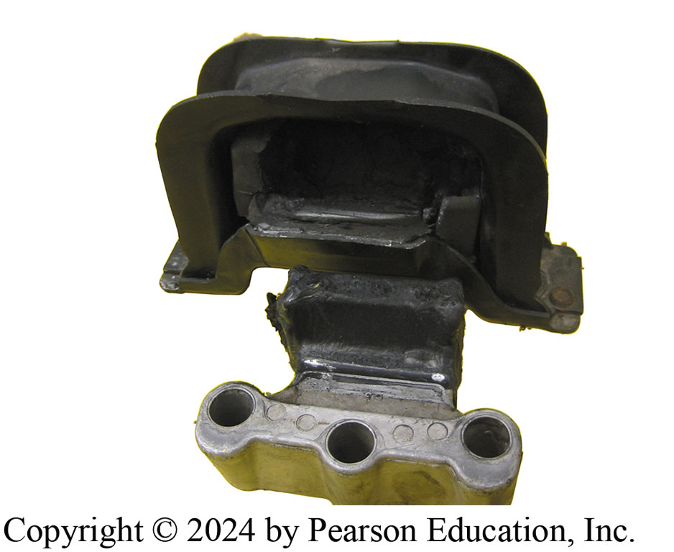
Figure 136.6 Powertrain Mounts
All powertrain mounts should be carefully inspected for damage. This mount has separated from the support frame and needs to be replaced.

Slide 21
Emission Control System
Vehicle Emissions Control Information (VECI) label
located under hood
VECI label includes following information:
Engine identification
Emissions standards that the vehicle meets
Spark plug type and gap
Valve lash, if adjustable
Major emission control systems on the vehicle
Emission calibration codes
Notes:
Exhaust Emission Control
The vehicle identification number (VIN) is a 17-character code that identifies vehicle. In 1981, NHTSA standardized the format. It required all on-road vehicles sold to contain a 17-character VIN. ● SEE CHART 136–1.
VEHICLE EMISSIONS CONTROL INFORMATION (VECI) The Vehicle Emissions Control Information (VECI) label is located under the hood of the vehicle. The VECI label (sticker) can be located on the bottom side of hood, the radiator fan shroud, the radiator core support, or the strut towers. The VECI label usually includes the following information:
• Engine identification
• Emissions standards that the vehicle meets
• Spark plug type and gap
• Valve lash, if adjustable
• Major emission control systems on the vehicle
• Emission calibration codes
VEHICLE EMISSION SYSTEMS The exhaust system specialist needs to have a working knowledge of emission control systems that are used on today’s vehicles. This information can be found in other chapters. ● SEE CHART 136–2. Page 1738

Slide 22
Chart 136.1 VIN by each character.
POSITION | DEFINITION
1 | Country of Origin
2 | Manufacturer
3 | Vehicle Brand/Type
4 | GVWR/Brake System/Body Style
5/ 6 | Line Chassis/Series
7 | Restraint System
8 | Engine
9 | Check Digit
10 | Model year
11 | Plant Location
12–17 | Plant Sequence Number
Notes:
TECH TIP: Always Comply with Exhaust System Repair Regulations
Any and all exhaust system repairs must comply with federal state and local laws including following:
Comply with the standards for the proper operation of the EGR, oxygen sensors, and turbocharger system, if equipped.
Verify that the catalytic converter requirements are met for the type and location, as well as proper record keeping if a converter is replaced.
Ensure that the exhaust system is routed correctly, and that the exhaust exits the vehicle according to regulations and is leak free.

Slide 23
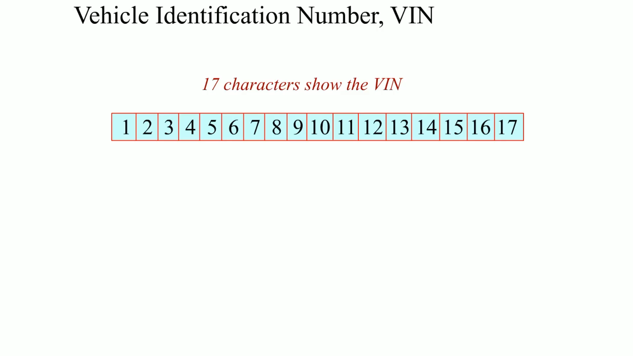
Animation: Vehicle Identification, VIN (Animation will automatically start)

Slide 24
Exhaust System Fabrication
Pipe Bending
There are three methods of bending exhaust pipes:
Program Cards are provided by pipe-bending equipment manufacturer and contain all the information necessary to duplicate the exhaust pipes, Steps found on page 1739
Pattern Bending To use a pattern bending to bend pipe, Use the 6 steps on page 1740:
Custom Bending: Since there is no program card or old pipe to use, inspect area where the pipe is supposed to fit and try to visualize pipe routing in relation to components under he vehicle.
Notes:
PIPE BENDING There are three methods of bending exhaust pipes:
Program Cards are provided by the pipe-bending equipment manufacturer and contain all the information necessary to duplicate the exhaust pipes found on most vehicles. The number of the program card is found by looking up the make, model, year, and engine in the card catalog. There are separate cards for each pipe in the exhaust system. The program card lists the length and diameter of the pipe, the distance between the center of the bends, and the rotation and depth of the bends in degrees. There may also be remarks that describe bending instructions for peculiar applications. Using this information, the technician can make a pipe identical to the one originally installed by the vehicle manufacturer. 8 steps found on page 1739
Pattern Bending To use a pattern bending to bend pipe, Use the 6 steps on page 1740:
Custom Bending: Since there is no program card or old pipe to use, inspect the area where the pipe is supposed to fit and try to visualize the pipe routing in relation to the components under the vehicle. Look for things like heat shields on the underside of the vehicle and old hangers that can indicate how the pipe was routed. Hold a length of stiff wire (welding rod works well) up to the exhaust system component to which the new pipe will be attached. Bend the wire to match the projected routing of the new pipe, making sure to allow enough clearance around other components. To make the new pipe, use the wire in the same manner as the old pipe described under pattern bending. Once the new pipe is made, perform a test fit under the vehicle to make sure the routing is as projected and that there will be no interference with other components.

Slide 25
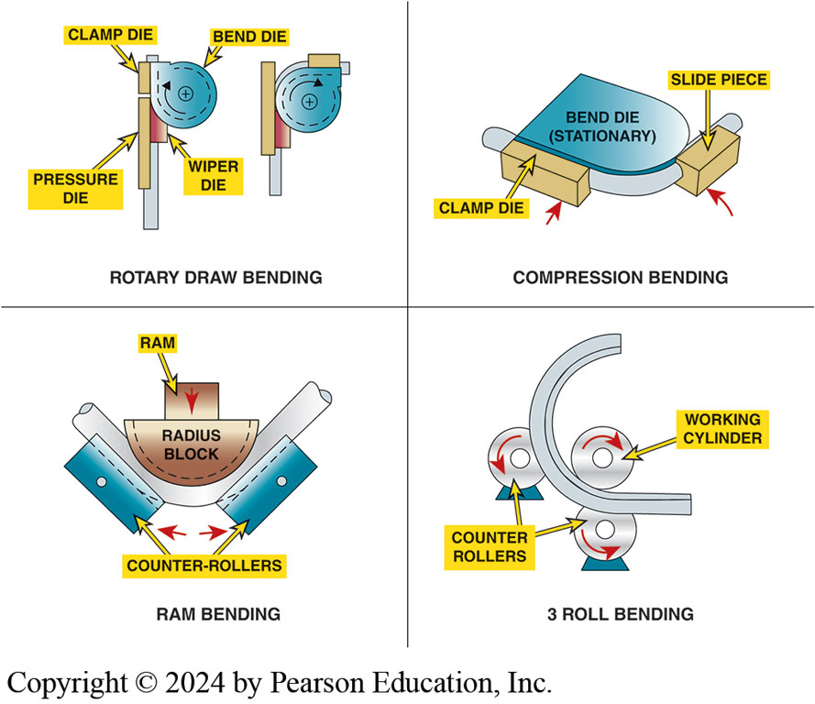
Figure 136.7 Exhaust Pipe Forming
Exhaust pipe forming and bending can include rotary draw bending, compression bending, ram bending, or three roll bending.
Notes:
SAFETY TIP: Safety Precaution When Operating a Pipe
Bender
When bending exhaust pipe, always follow the instructions from the bending tool manufacturer and the following:
Always wear eye protection, gloves, and protective shoes or boots.
Do not wear loose-fitting clothing that could be snagged by the machine or a pipe.
Make sure the area around the machine inside the length of the pipe being bent is clear.
The pipe will move as it is bent, so make sure that the pipe will not contact anything during the bending procedure.
Do not operate the machine without the safety guards in place, and keep hands clear of the bending dies when the machine is in motion.
Use caution when handling the ends of pipes that
have just been cut, as they can be sharp.

Slide 26
MIG Welding
Terminology
Metal Inert Gas (MIG) uses a continuous solid wire electrode heated and fed into weld pool from a welding gun. The 2 base materials are melted together forming a joint shielded by a gas
Operation Arc is struck between end of a wire electrode and workpiece, melting both of them to form a puddle of molten steel, called weld pool.
Wire provides both heat source due to arc at wire tip and filler metal. See figure 136–8.
Notes:
MIG Welding
Terminology Metal inert gas (MIG) welding is an arc welding process that uses a continuous solid wire electrode heated and fed into the weld pool from a welding gun. The two base materials are melted together forming a joint. The gun uses a shielding gas around the electrode to protect the weld pool from oxidation. The MIG welder is currently used for welding panels and structural components together. MIG welding can repair high-strength steel without harming or weakening it.
Operation An arc is struck between the end of a wire electrode and the workpiece, melting both of them to form a puddle of molten steel, called the weld pool. The wire provides both the heat source due to the arc at the wire tip and filler metal. The wire is fed through a copper contact tube (contact tip) that conducts welding current into the wire. The weld pool is protected from the surrounding atmosphere by a shielding gas fed through a nozzle surrounding the wire. Shielding gas selection depends on the material being welded and the application and is usually CO₂ or argon or a combination. The wire is fed from a reel by a motor drive, and the welder moves the welding torch along the joint line. The process offers high productivity, as the wire is continuously fed. ● SEE FIGURE 136–8.

Slide 27
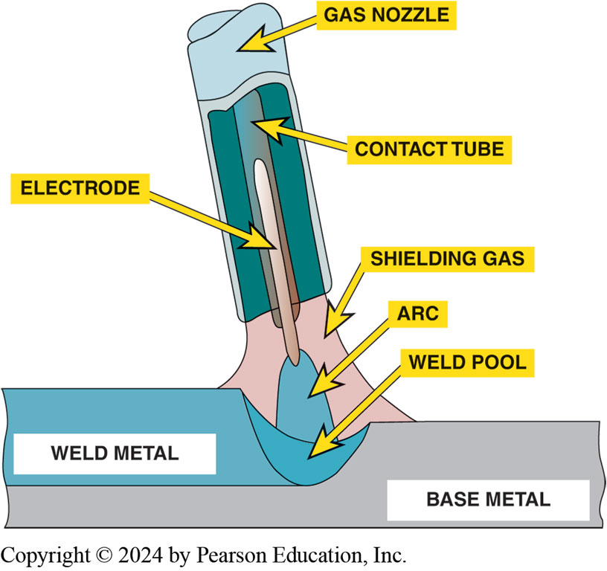
Figure 136.8 Weld Pool
When using a MIG welder, create a weld pool and move the pool to create an even weld.

Slide 28
Oxy-Acetylene Welding
Oxy-acetylene welding is used for welding, cutting, and heating to normalize metal, to shrink metal, to forge or shape metal, and to solder.
Oxygen cylinder
Acetylene cylinder
Hand truck to hold the cylinders
Acetylene and oxygen regulators
Hoses
Welding torch (cutting attachment)
Friction lighter
Notes:
OXYGEN CYLINDER The oxygen cylinder is made from high-grade steel and is a seamless design and painted blue. They range in size from less than 20 cubic feet to greater than 300 cubic feet and contain compressed oxygen at pressures as high as 2,200 PSI (15,200 kPa). Cylinders have valves and are fitted with a screw on a steel cap that protects the cylinder valve. The safety cap MUST always be used during any cylinder movement or replacement. SEE FIGURE 136–9.
Open the cylinder valve and then close it before installing the regulator to clear the valve of any dirt. With the regulator installed, always crack the cylinder valve open first, then open it fully. This lessens the chance of recompression that is caused by high cylinder pressure entering the regulator, heating it up and damaging the regulator
ACETYLENE CYLINDER Acetylene cylinders are under pressure and are painted black or red. They are made of steel, have cylinder valves, and range in size from 10 to 400 cubic feet. The cylinders contain a porous filler material that is wetted with ace- tone and that allows the acetylene to safely be contained in the cylinder at 250 PSI (1,724 kPa). Always use an acetylene cylinder in the upright position so liquid acetylene is not drawn out of the tank. Only open the cylinder valve 1 to 1 1 turns, leaving the valve wrench on the valve if it has to be shut off quickly. Acetylene should never be used at a pressure that exceeds 15 PSI (103kPa) as it becomes highly unstable, which could cause it to decompose and explode.
REGULATORS The pressure in a full acetylene cylinder is about 250 to 2,200 PSI (1724 to 15,170 kPa) in a full oxygen cylinder. Regulators are used to adjust the high oxygen and acetylene pressures to lower working pressures for torch use. The regulator maintains a steady working pressure as the cylinder pressure drops. Regulators admit the high cylinder pressure through a valve, which is operated by a flexible diaphragm. When turning the regulator adjusting knob in or out, it causes a spring to operate the diaphragm to open or close the valve. When turning the adjusting knob in, the flow and pressure are increased. When turning it out, the flow and pressure are decreased.
Oxygen and acetylene regulators connect differently to their cylinders so they cannot be mixed up. Oxygen cylinder regulators have right-hand threads and acetylene cylinders use left- hand threads. There is a groove around fuel connections that indicates a left-handed thread. Finally, all acetylene regulator gauges have the gauge scales marked in red starting at 15 PSI (103 kPa). This is to act as a reminder not to use acetylene at pressures over that marked in red.
Before opening the supply cylinder, check the adjusting screw to see if it is released and then open the cylinder valve. To adjust the working pressure, the valves on the torch body should be opened slightly as the adjusting screw is turned to adjust the regulator pressure that is required for the job. When a regulator is not being used overnight or is idle for a long period, the pressure should always be relieved on the delivery pressure valve seat.
HOSES The cylinder regulators and torch are connected using double-line rubber hoses. Double-line hose is known as type VD. The oxygen line is green, and the acetylene or fuel line is red. Hoses are available in four sizes, 3/16-, 1/ 4-, 3 / 8- and 1/ 2-inch
I.D. The different grades of double-line hose used for acetylene are as follows:
Non-oil resisting rubber cover
RM (carries both a non-oil and flame and an oil-resisting cover for use with all fuel gases and acetylene)
Grades R and RM should be marked for acetylene only. Grade T should be marked fuel or acetylene gas. All hoses are marked to their service level (light, standard, or heavy). The date of manufacture is also marked at a maximum working pressure (200 PSI) along with nominal I.D size and if it meets RMA/CGA IP-90 (Rubber Manufactures Association, Compressed Gas Association) specifications for rubber welding hose. The hose fittings are marked as right- or left-handed threads. Single line hose come in 3 grades: L, light duty, S, standard duty, and H, heavy duty. Hoses are limited pressure of 200 PSI.
CHECK VALVES Acetylene and oxygen must mix to be combustible. This must only take place at the torch mixer or the torch tip. Due to improper operation, sometimes acetylene and oxygen can feed back into the hoses and cause combustion in the hoses or regulators. Check valves are installed between the hoses and the torch to prevent this back flow. Check valves must be used with all oxy-acetylene torches.
TORCH The torch consists of a handle, oxygen, and acetylene gas valves and a mixing chamber. Welding tips or a cutting attachment can be used with the handle to weld, heat, or cut metal. Oxygen and acetylene gas flow through tubes inside the handle that blend in the mixing chamber or tip. It is at the tip where the mixed gases are ignited. Oxygen and acetylene enter the torch.

Slide 29
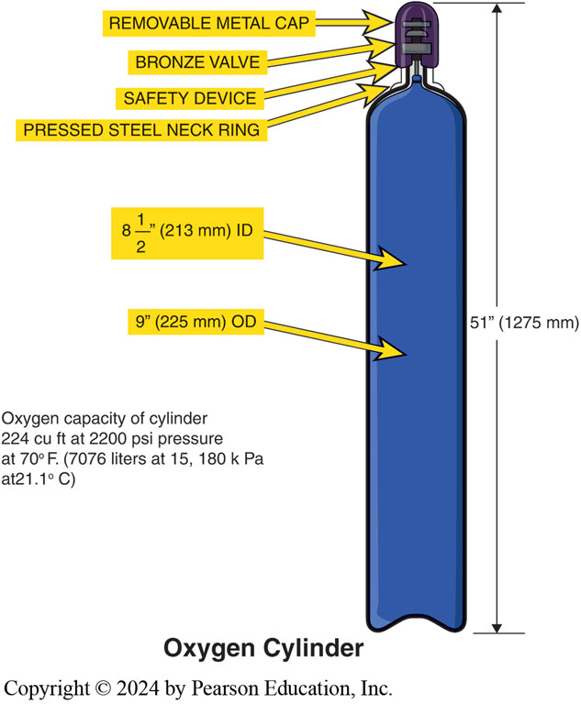
Figure 136.9 Oxygen Tank
A cross-sectional view of an oxygen tank.

Slide 30
Flame Types
Neutral flame is used for welding and burns about one part oxygen to one part acetylene. Burns at 5900°F (3260°C).
Oxidizing flame is used for brazing and is obtained by opening the oxygen valve slightly more than the neutral flame. Flame temperature is about 6300°F (3482°C). ● See figure 136–10.
High acetylene or carburizing flame is the one most commonly used by automotive technicians to heat parts or to solder. Temperature is about 5700°F (3154°C).
Notes:
NEUTRAL FLAME The neutral flame is generally used for welding and burns about one part oxygen to one part acetylene. Adjust the torch until the inner cone is blunt and the feathery edges have disappeared. A typical neutral flame burns at 5900°F (3260°C).
OXIDIZING OR EXCESS OXYGEN FLAME The oxidizing flame is used for brazing and is obtained by opening the oxygen valve slightly more than the neutral flame. The inner cone gets shorter and pointed and it becomes somewhat purple in color. Flame temperature is about 6300°F (3482°C). ● SEE FIGURE 136–10.
CARBURIZING FLAME The high acetylene or carburizing flame is the one most commonly used by automotive technicians to heat parts or to solder. More acetylene is burned than oxygen, so the inner cone has a feather. The inner cone is also white. The envelope around the carburizing flame has the same look as the regular temperature is about 5700°F (3154°C).

Slide 31
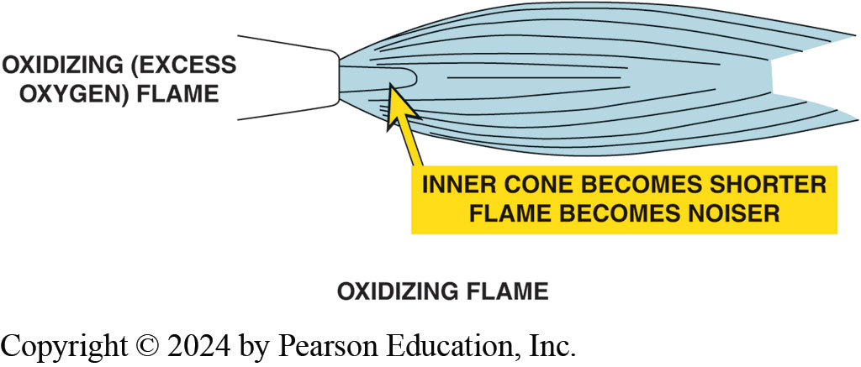
Figure 136.10 Oxidizing Flame
An oxidizing flame is hotter than a neutral flame and is identified by the short inner flame cone.

Slide 32
Frequently Asked Question: What Is a Flashback?
? Frequently Asked Question
What Is a flashback? A flashback is a rapid high-pressure flame in hose, which can occur if there are not any check valves or check valves fail to operate due to improper installation. Once a flashback starts, check valves cannot stop it. The flashback arrestor connects the same as the check valves in the hose at the torch or regulator and contains a trap that is spring loaded that cuts off the gas flow in the event of a flashback. Both check valves and flashback arrestors should be included on every oxy-acetylene setup.

Slide 33
Frequently Asked Question: What Causes a Backfire?
? Frequently Asked Question
What Causes a Backfire? A backfire can take place with improper torch operation. The flame will go out with a loud snap or pop. The torch valves should be turned off and connections and valves checked for leaks. If everything is normal, relight the torch. Backfires are caused by the following: The tip is touching the work. The tip is overheated or dirty. Gas pressure is too low. The torch head or tip are loose. The seal between the torch body and mixing chamber is leaking.

Slide 34
Setup and Lighting a Torch

Slide 35
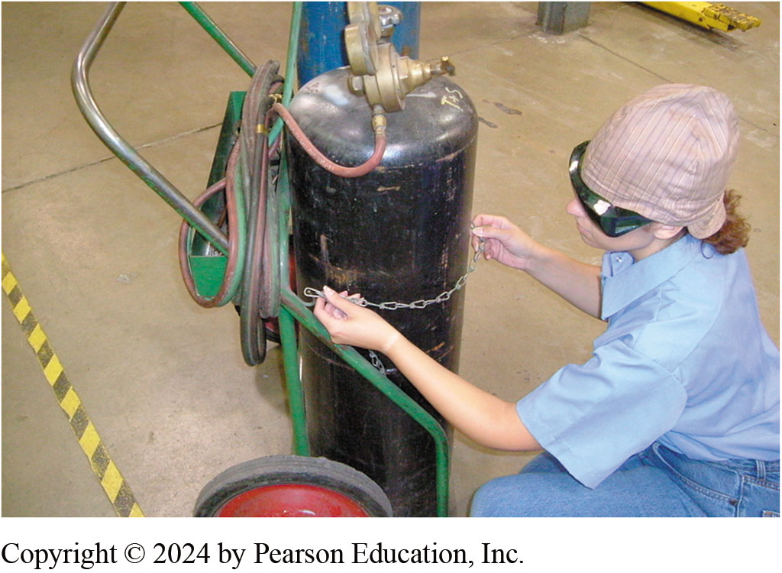
1. Inspect Cart
1. Inspect the cart and make sure the tanks are chained 1 properly before moving it to the work location.

Slide 36
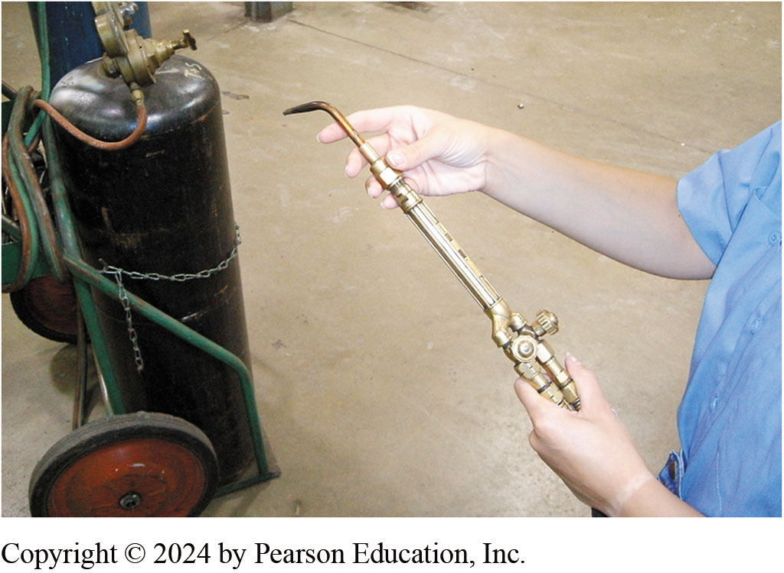
2. Attaching Appropriate Work Tip
2. Start by attaching the appropriate work tip to the torch handle. The fitting should only be tightened hand tight. Make sure the valves on the torch handle are closed at this time

Slide 37
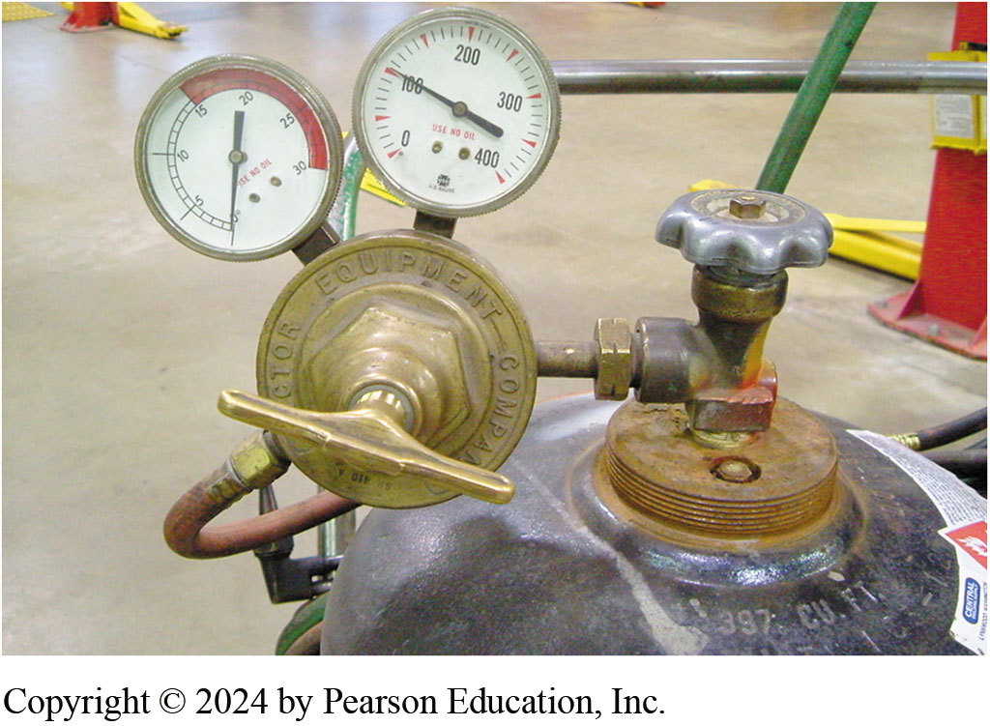
3. Tank Gauges
3. Each tank has a regulator assembly with two gauges. The high-pressure gauge shows tank pressure, and the low-pressure gauge indicates working pressure.

Slide 38
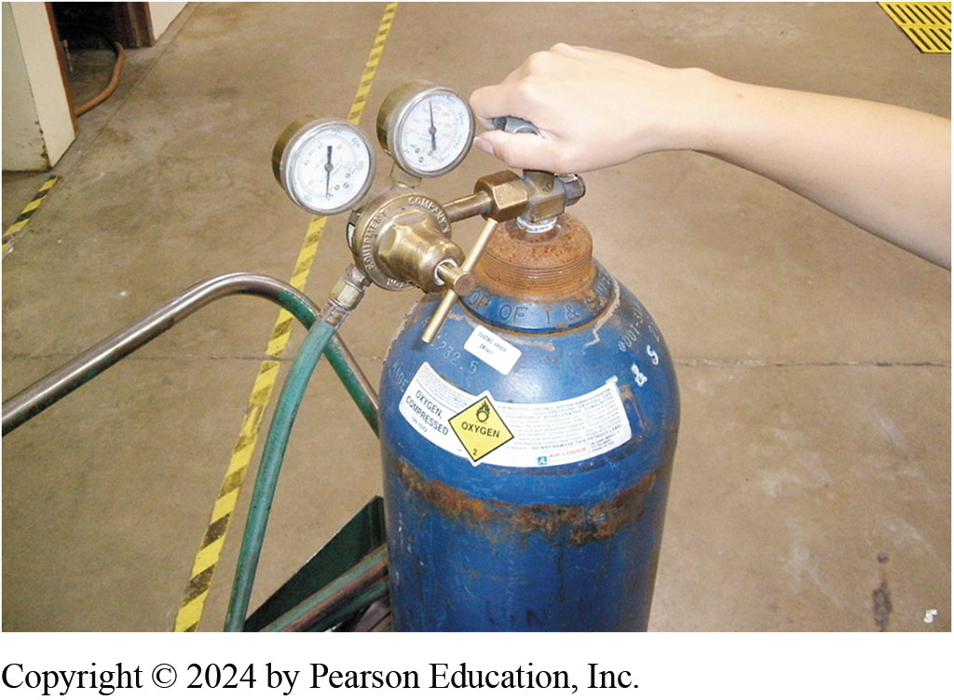
4. Oxygen Tank Valve Fully Open
4. Open the oxygen tank valve fully open, and open the acetylene tank valve ½ turn.

Slide 39
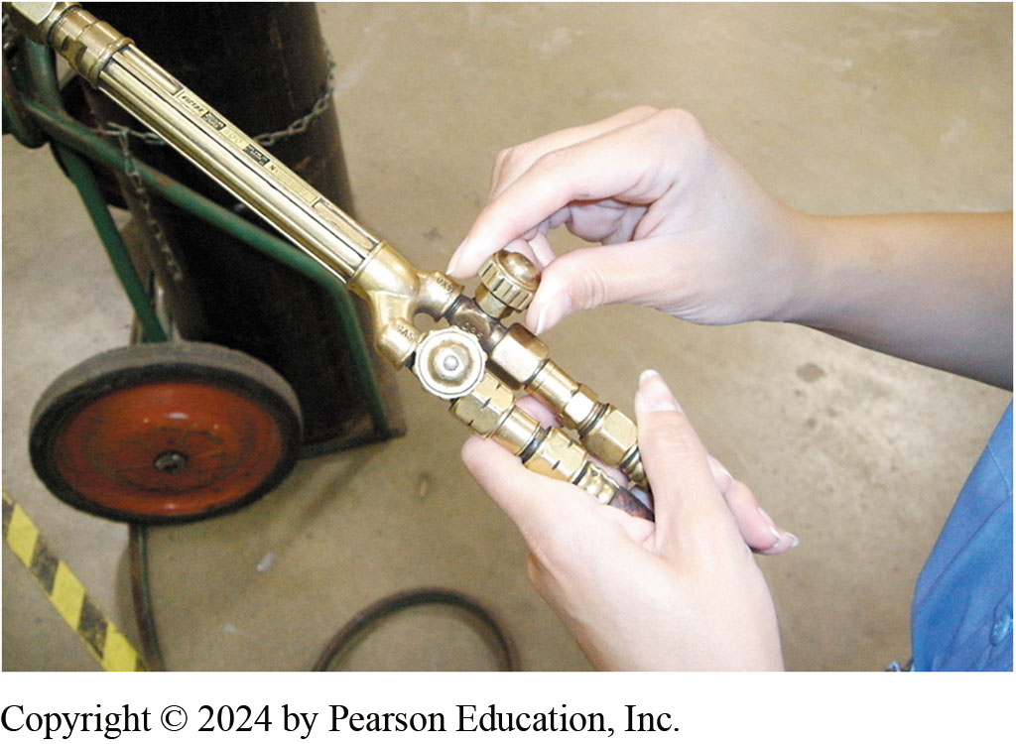
5. Open Torch Oxygen Valve ¼ Turn
5. Open the oxygen valve on the torch handle ¼ turn in preparation for adjusting oxygen gas pressure.

Slide 40
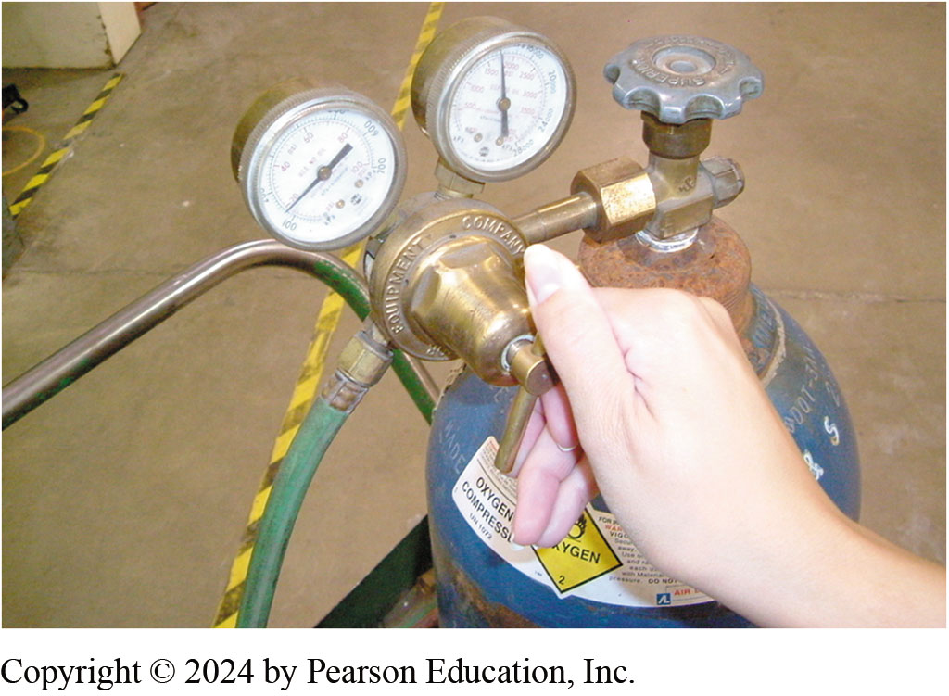
6. Adjust Oxygen Pressure to 20 PSI
6. Turn the oxygen regulator valve clockwise and adjust oxygen gas pressure to 20 PSI. Close the oxygen valve on the torch handle.

Slide 41
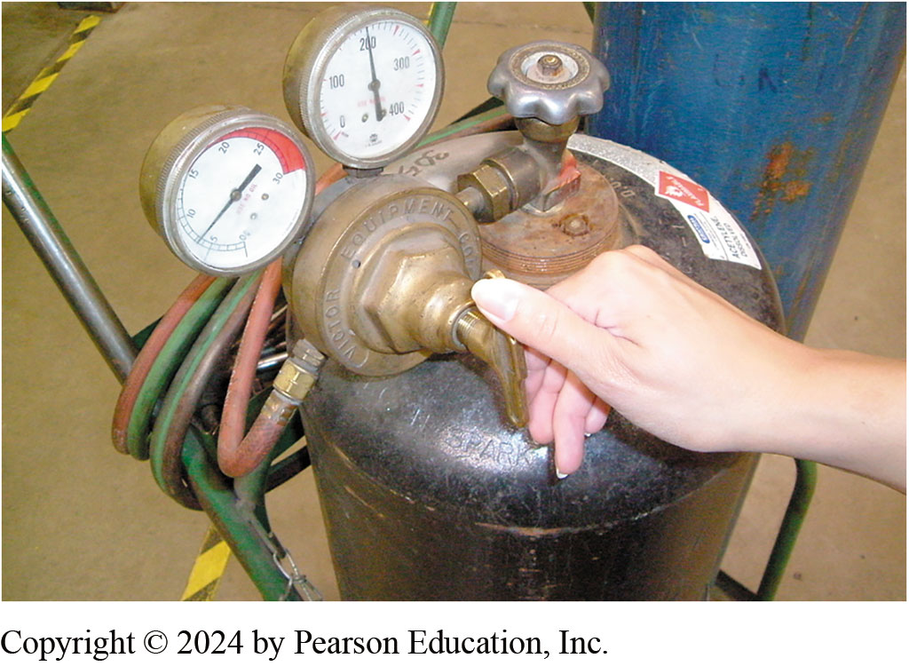
7. Adjust Acetylene Pressure to 7 PSI
7. Open the acetylene valve on the torch handle ¼ turn and adjust acetylene gas pressure to 7 PSI. Close the acetylene valve on the torch handle

Slide 42
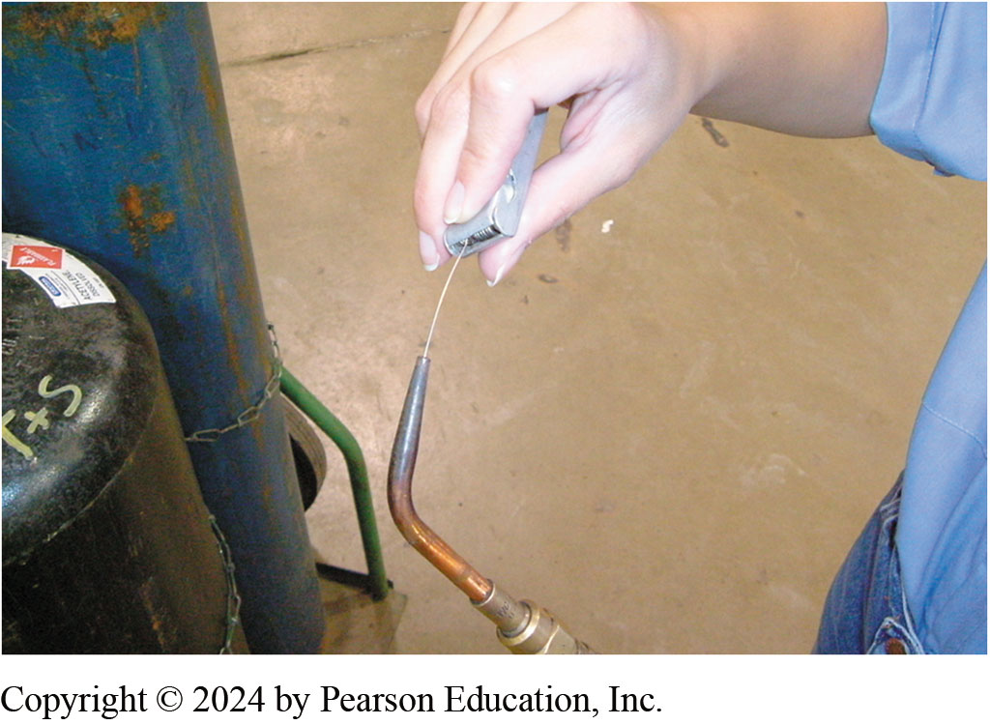
8. Clean Tip Orifice
8. Open the oxygen valve on the torch handle ¼ turn and use an appropriate size tip cleaner to clean the tip orifice. Finish by closing the oxygen valve.

Slide 43
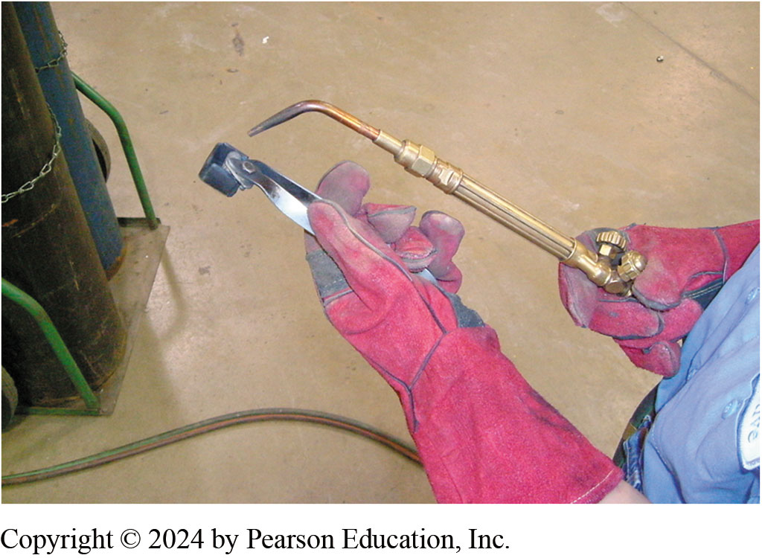
9.Leather Gloves & Ignite Torch
9. Put on leather gloves and open the acetylene valve on the torch handle ¼ turn Use a flint striker to ignite the acetylene gas exiting the torch tip.

Slide 44
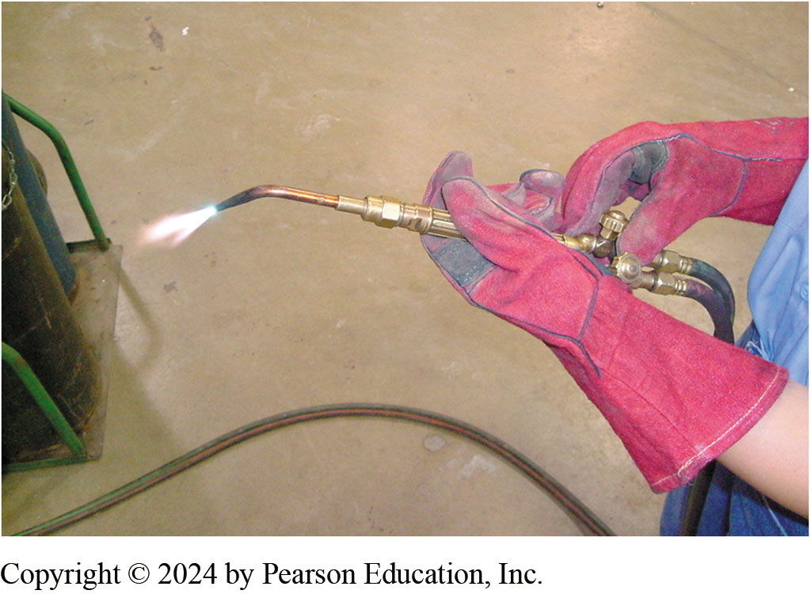
10. Adjust Acetylene Valve
10. Adjust the acetylene valve until the base of the flame just touches the torch tip. Slowly open the oxygen valve on the torch handle and adjust for a neutral flame (blue cone is well-defined)..

Slide 45
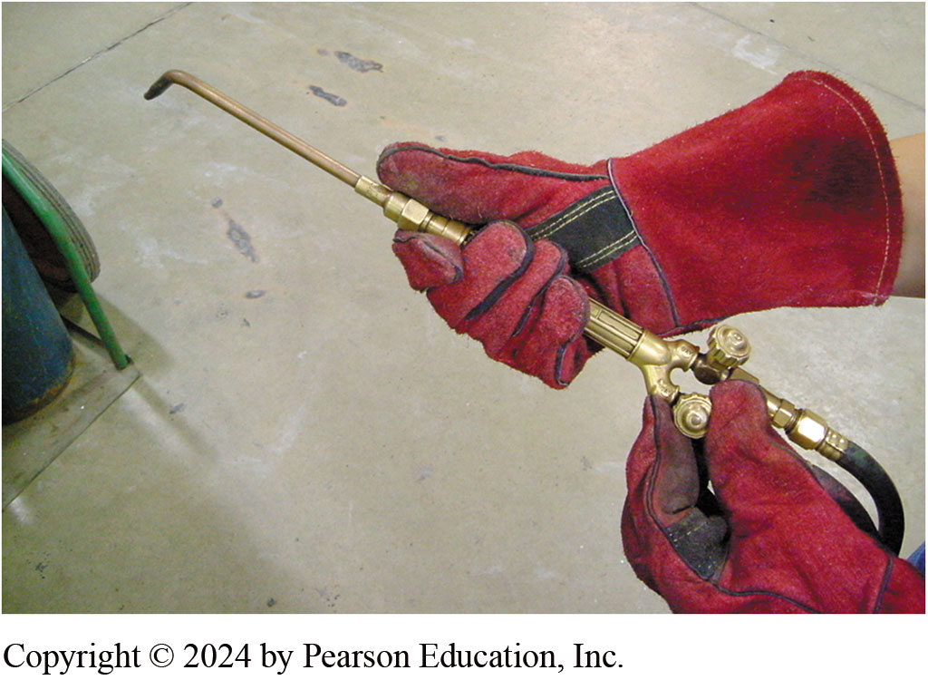
11. Extinguish Flame
11. Once work is complete, extinguish the flame by quickly closing the acetylene valve on the torch handle. Be prepared to hear a loud “pop” when the flame goes out. Close the oxygen valve on the torch handle.

Slide 46
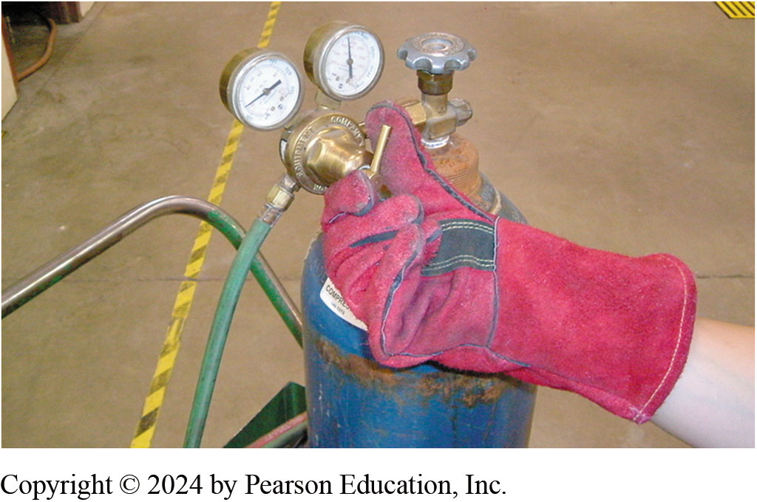
12. Close Valves
Close the valves on both tanks and turn the regulator handles counterclockwise until they no longer contact the internal springs. Open the gas valves briefly on the torch handle to release gas pressure from the hoses. Close the gas valves on the torch handle and put away the torch assembly.

Slide 47
Heating Metal

Slide 48
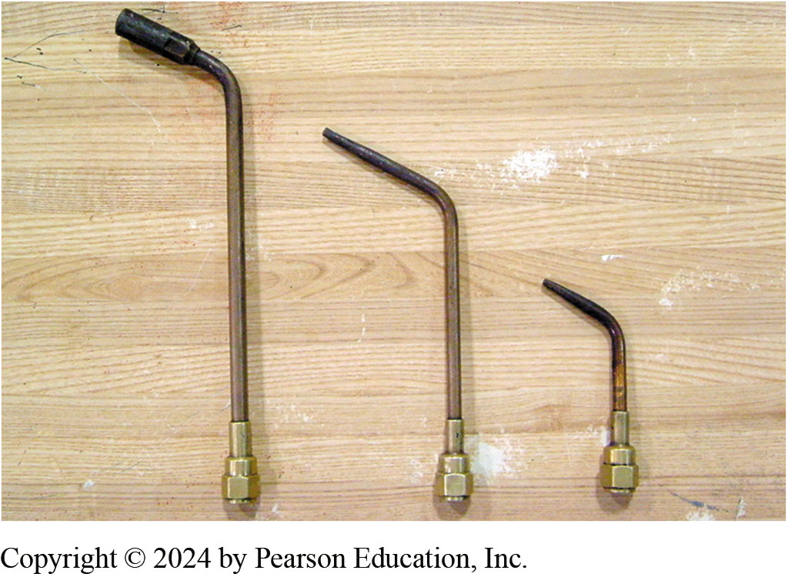
13. Heating Attachments
13. Heating attachments include ordinary heating tips, middle and right and a “rosebud” (left). Ordinary heating tips work fine for most purposes, but occasionally the rosebud is utilized when a great deal of heat is needed.

Slide 49
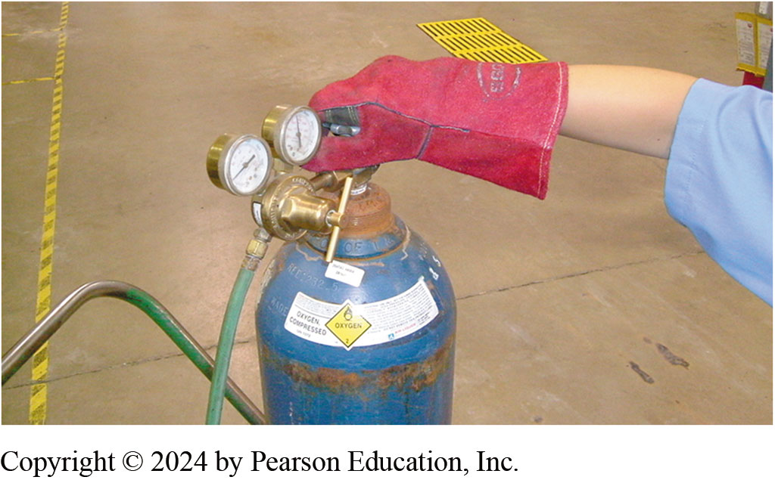
14. Tank Pressures
14. Note that while acetylene tank pressures are relatively low, the oxygen tank can be filled to over 2,000 PSI. This can represent a serious hazard if precautions are not taken. Be absolutely certain that the tanks are chained properly to the cart before attempting to move them!

Slide 50
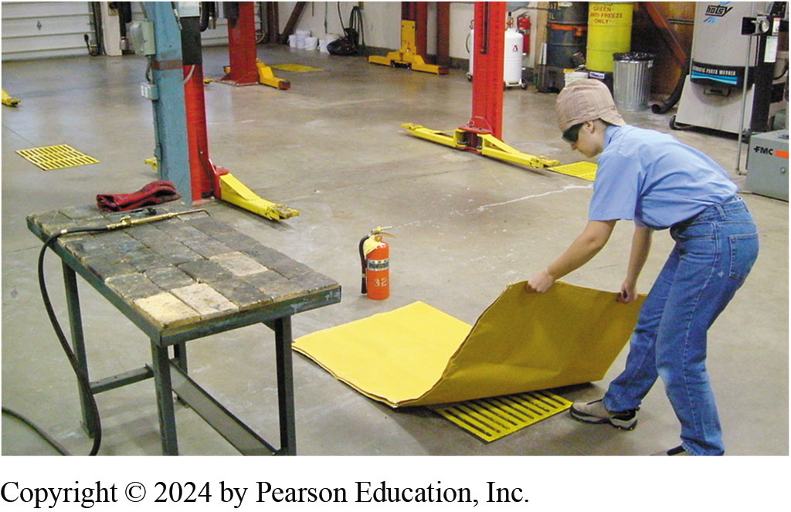
15. Flammables Removed from Area
15. Any time heating or cutting operations are being performed, be sure that any flammables have been removed from the immediate area. A fire blanket may be placed over floor drains or other objects to prevent fires. A fire extinguisher should be on hand in case of an emergency.

Slide 51
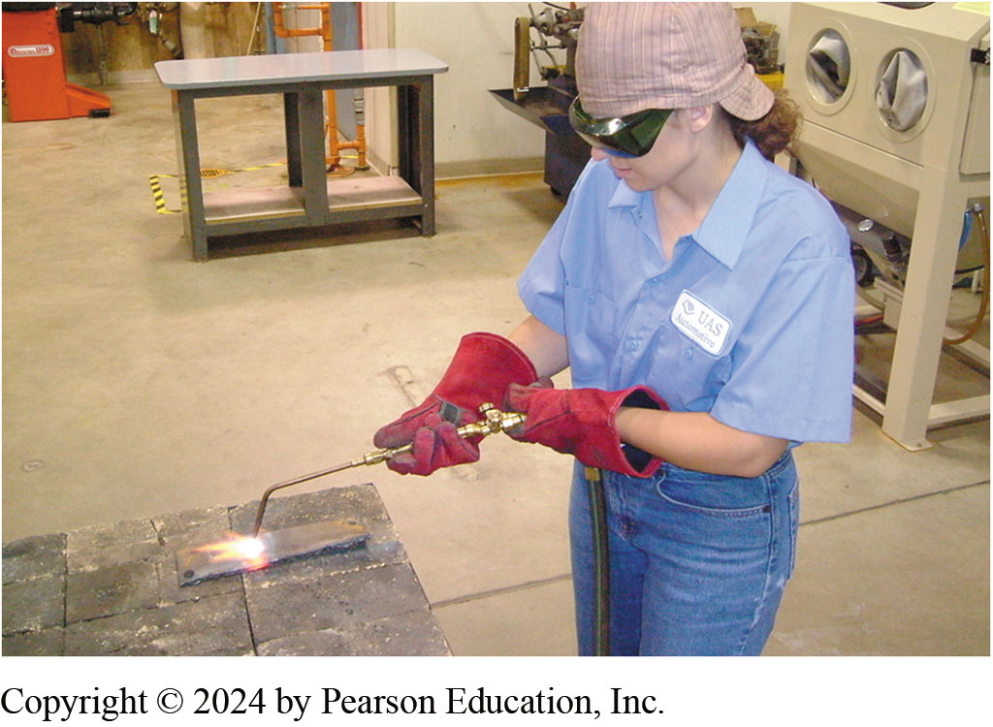
16. Wear PPE
16. Be sure to wear appropriate personal protective equipment during heating and cutting operations.

Slide 52
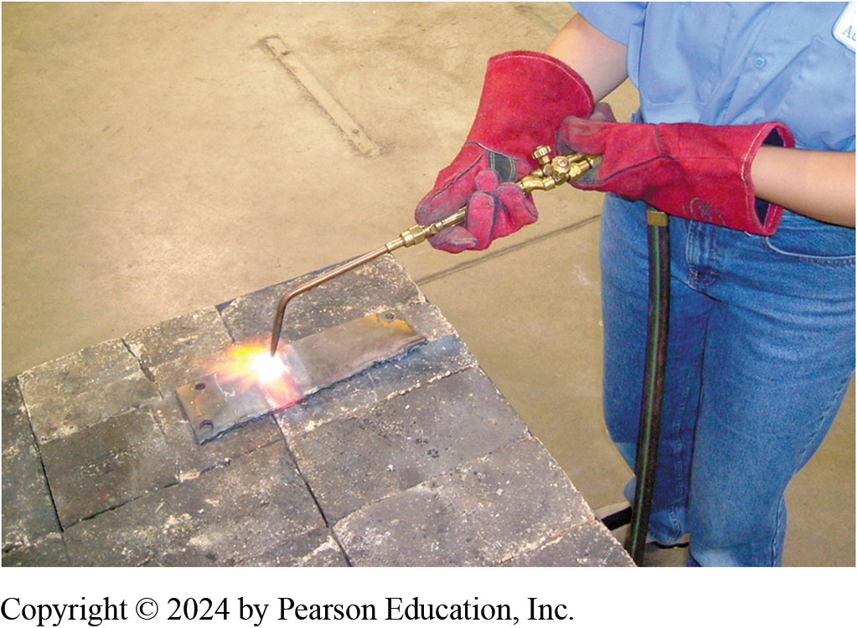
17. Heating Operations over Brick
17. Note that heating operations should be performed over steel or firebrick. Never heat or cut steel close to concrete, as it could cause the concrete to explode.

Slide 53
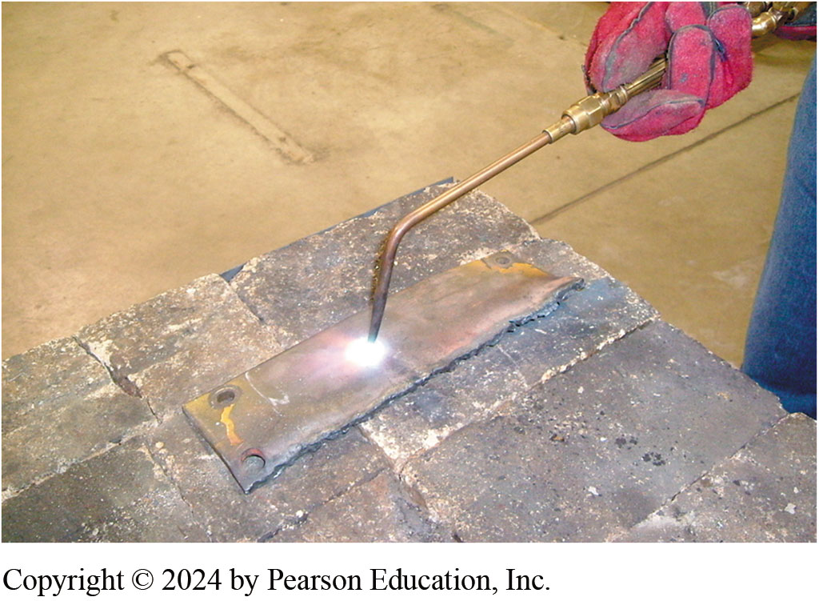
18. Circular Pattern
18. When heating steel, move the torch in a circular pattern to prevent melting of the metal. Don’t hold the torch too close to the work as this will cause a “snapping” or “backfire” that can extinguish the flame.

Slide 54
Cutting Metal

Slide 55
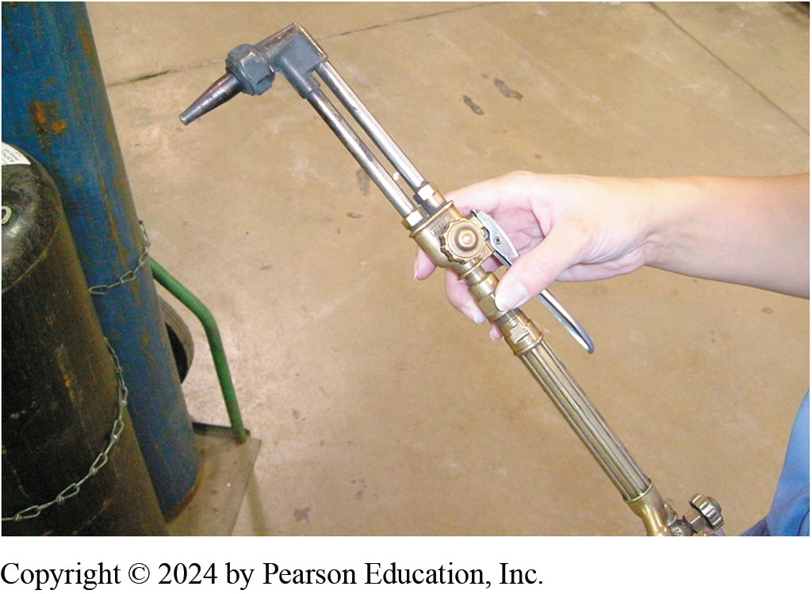
19. Cutting End
19. Affix the cutting attachment to the torch handle. Note that the cutting attachment has a cutting handle and a separate oxygen valve.

Slide 56
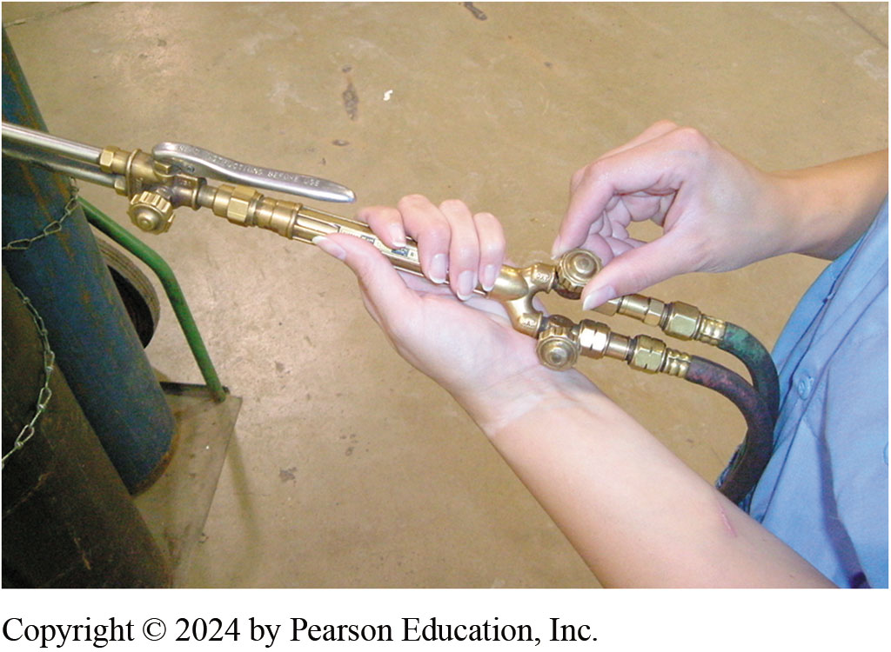
20. Fully Open Oxygen Valve
Fully open the oxygen valve on the torch handle. Oxygen flow will now be controlled with the valve on the cutting attachment.

Slide 57
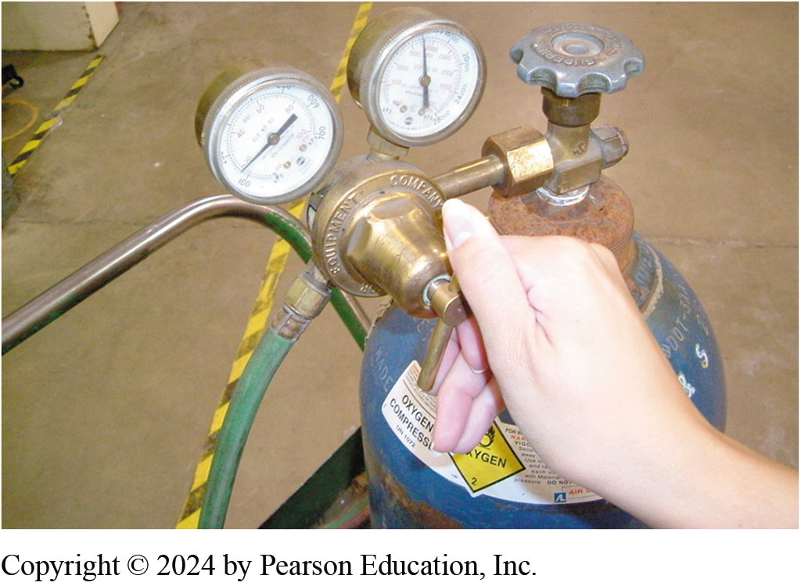
21. Oxygen Pressure 30 PSI
21. Oxygen gas pressure should be adjusted to 30 PSI whenever using the cutting attachment. Acetylene pressure is kept at 7 PSI.

Slide 58
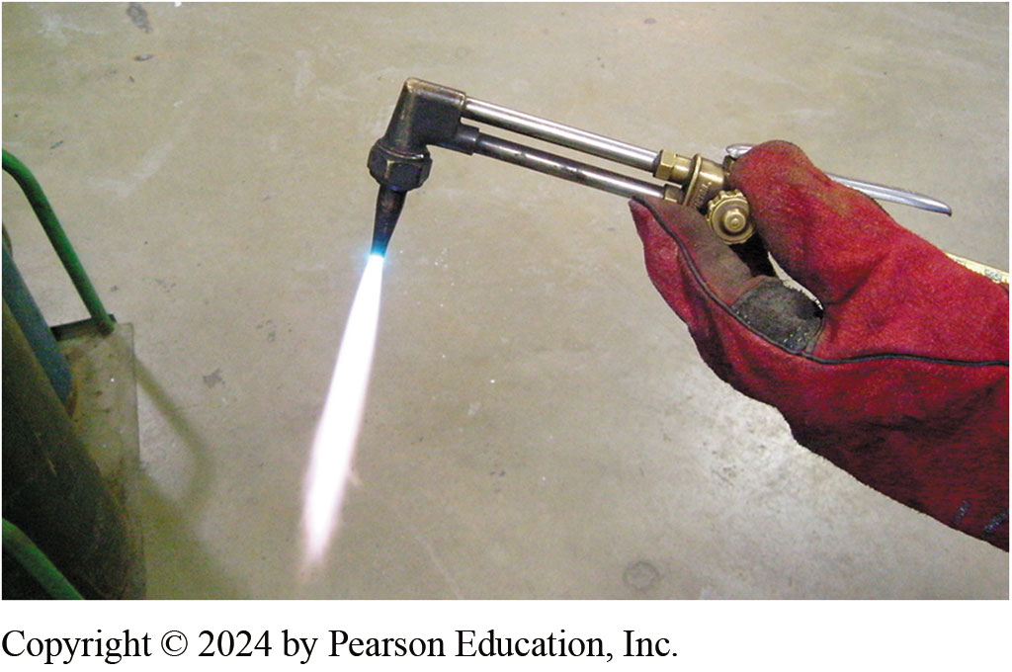
22. Adjust Acetylene
Open the acetylene valve on the torch handle ¼ turn and light the torch. Adjust the flame until its base just touches the cutting tip. Slowly open the oxygen valve on the cutting attachment and adjust the flame until the blue cone is well-defined.

Slide 59
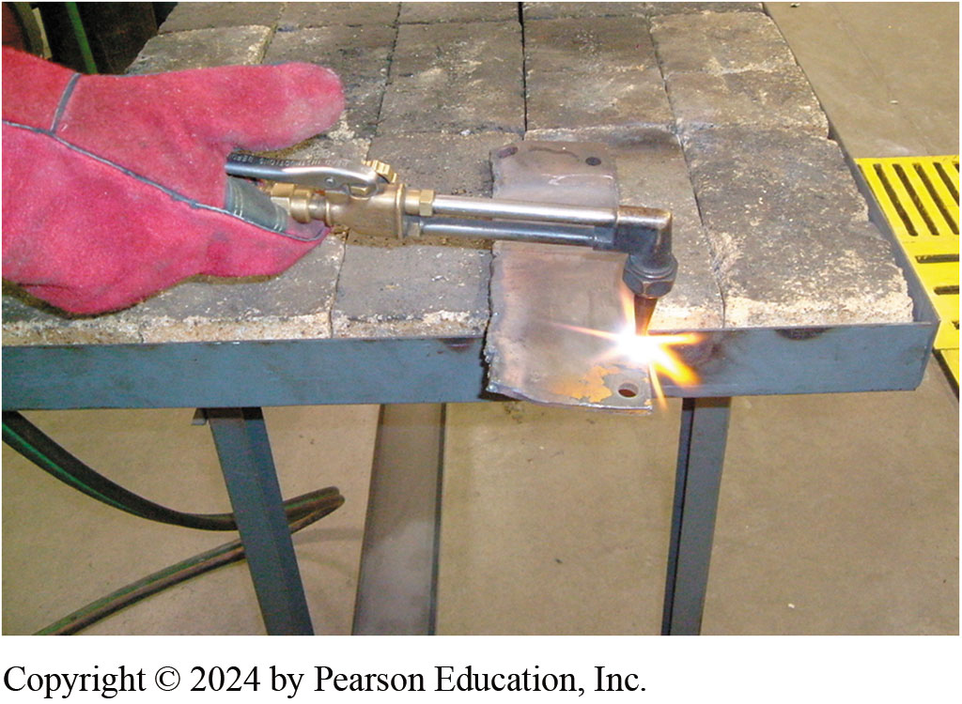
23. Direct Flame Onto Thin Spot
Direct the flame onto a thin spot or sharp edge of the metal to be cut. This will build the heat quicker in order to get the cut started.

Slide 60
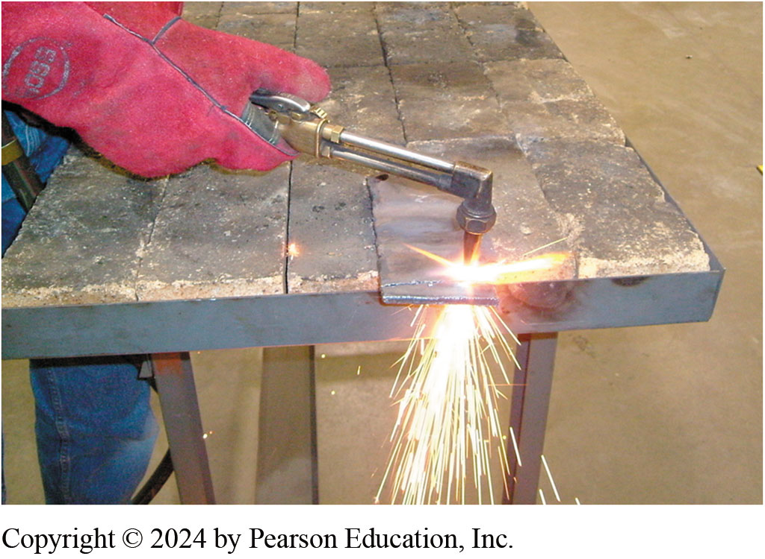
24. Metal Glows Red Depress Handle
When the metal glows red, depress the cutting handle and move the torch to advance the cut. You will need to move the torch faster when cutting thinner pieces of steel. On thicker pieces, point the cutting tip into the direction of the cut.

Slide 61
Question 1?
An engine makes a clicking like sound like a lifter, and all of the hydraulic lifters were recently replaced. Which of these could be the cause?
a. Leaking catalytic converter
b. Cracked exhaust manifold
c. Cracked intake manifold
d. Clogged exhaust pipe

Slide 62
Answer 1
An engine makes a clicking like sound like a lifter, and all of the hydraulic lifters were recently replaced. Which of these could be the cause?
b. Cracked exhaust manifold

Slide 63
Exhaust System Animations

Slide 64
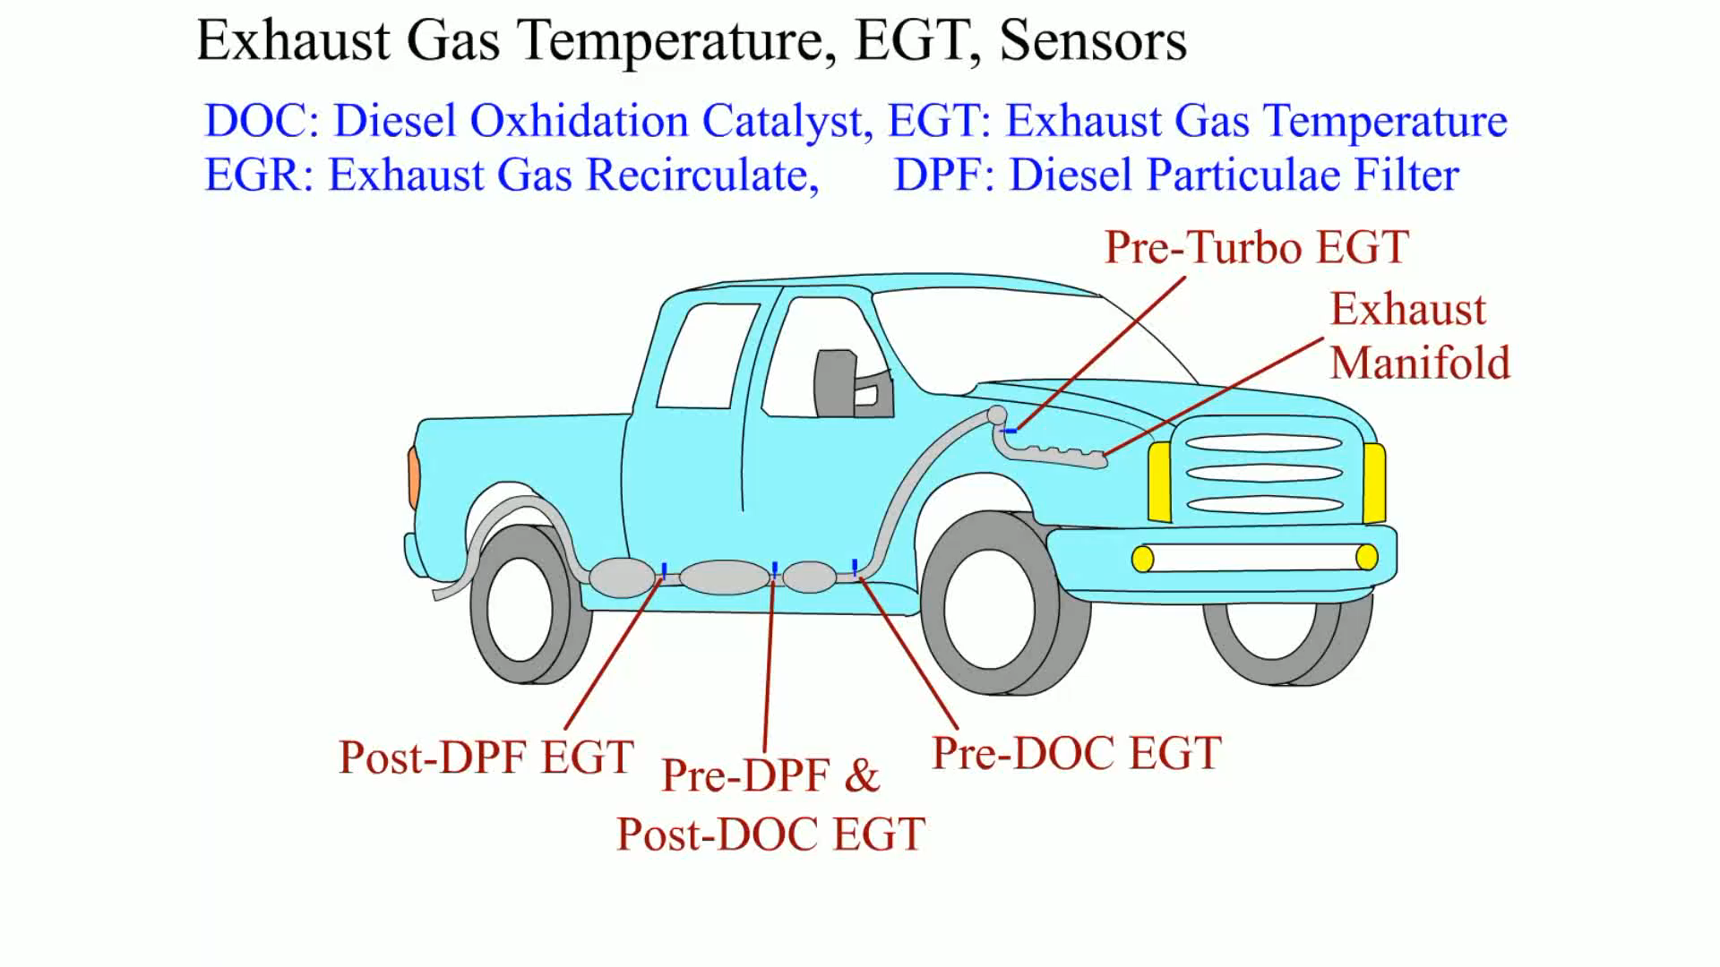
Animation: Exhaust Gas Temperature, EGT, Sensors (Animation will automatically start)

Slide 65
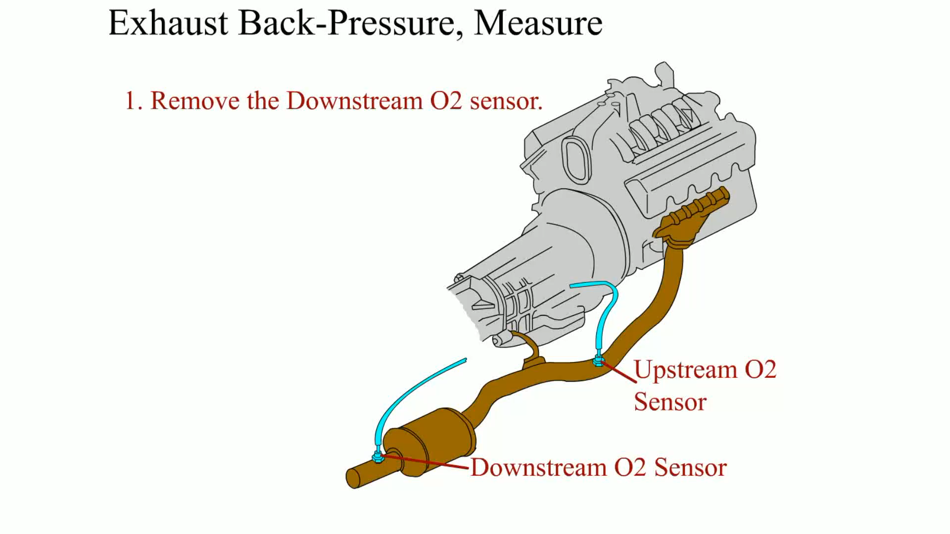
Animation: Exhaust Back-Pressure, Measure (Animation will automatically start)

Slide 66
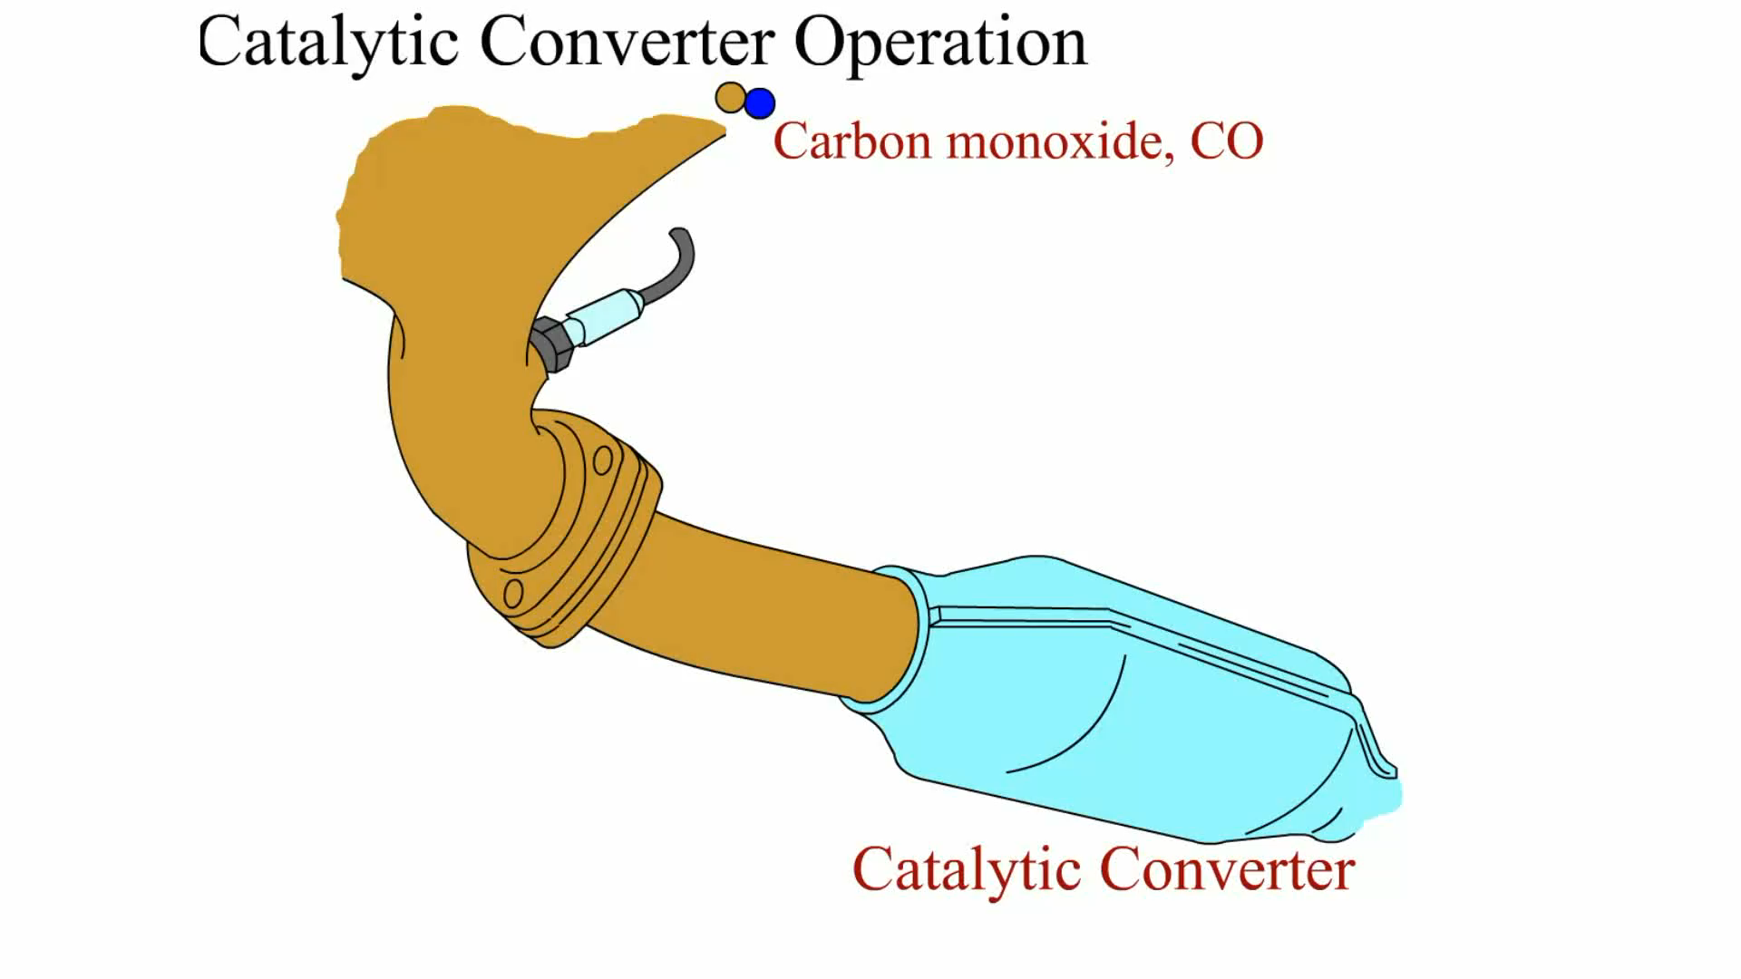
Animation: Catalytic Converter Operation (Animation will automatically start)

Slide 67
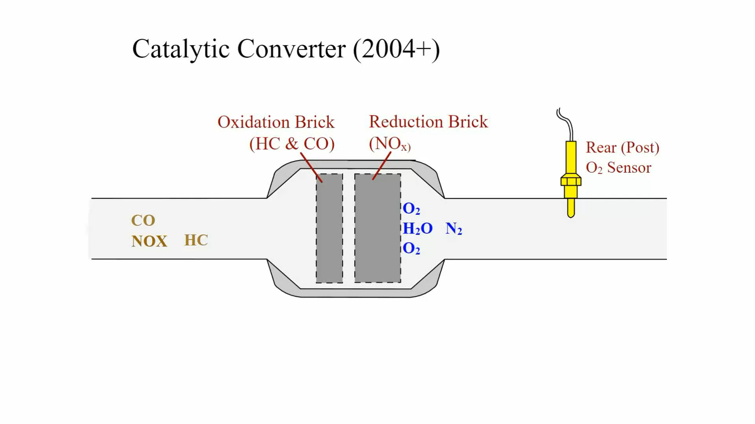
Animation: Catalytic Converter (2004+) (Animation will automatically start)

Slide 68
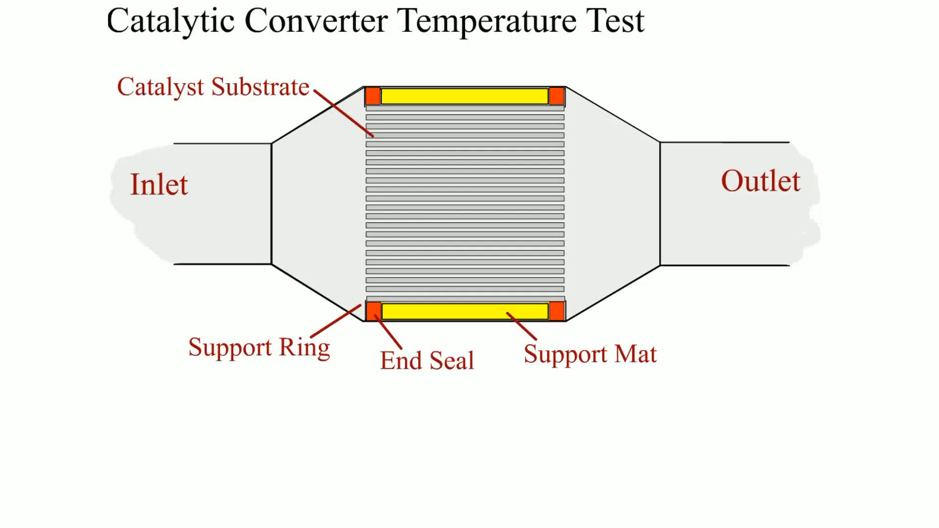
Animation: Catalytic Converter Temperature Test (Animation will automatically start)

Slide 69
Engine Repair Videos and Animations
Videos Link: (A1) Engine Repair Videos
Animations Link: (A1) Engine Repair Animations

Slide 70
Copyright
This work is protected by United States copyright laws and is provided solely for the use of instructors in teaching their courses and assessing student learning. Dissemination or sale of any part of this work (including on the World Wide Web) will destroy the integrity of the work and is not permitted. The work and materials from it should never be made available to students except by instructors using the accompanying text in their classes. All recipients of this work are expected to abide by these restrictions and to honor the intended pedagogical purposes and the needs of other instructors who rely on these materials.

