Slide 1
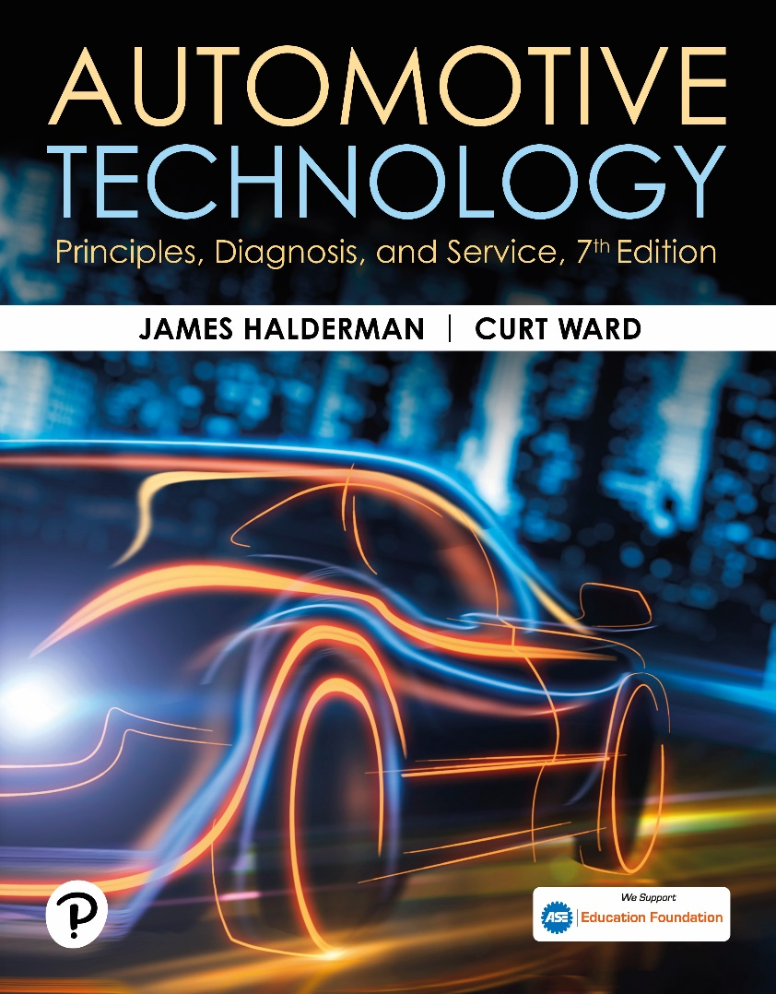
Automotive Technology: Principles, Diagnosis, and Service
Seventh Edition
Chapter 135
Service Consultant (C1)
Copyright © 2023 Pearson Education, Inc. All Rights Reserved
Notes:
INSTRUCTOR NOTE: This presentation includes text explanation notes, you can use to teach the course. When in SLIDE SHOW mode, you RIGHT CLICK and select SHOW PRESENTER VIEW, to use the notes.

Slide 2
Learning Objectives
135.1 Discuss the communication and customer relations skills required of a service consultant.
135.2 Discuss how to project a professional image as a service consultant.
135.3 Describe how to greet customers.
135.4 Discuss how to write work orders.
135.5 Describe how to handle customer complaints.
135.6 Explain effective service sales skills.
135.7 Discuss automotive product knowledge needed for service consultants.

Slide 3
Communication & Customer Relations (1 of 4)
Communication: process of sending/receiving messages
Communication is vital skill for service consultants.
2 basic types of communication: listening and talking
Tips for being a good listener: See Page 1722
Notes:
Communication refers to the process of sending and receiving messages with other people. If the outcome of the communication is not what we intended, the communication was not effective. Communication is a vital skill for service consultants. Two basic types of communication include listening and talking.
Listening To Customers
Listening to customers is more difficult than it may seem. A person speaks at the rate of 150 to 200 words per minute, yet we talk privately to ourselves at the rate of 1,300 words per minute. The problem is that our brain may start talking to us before the other person has finished speaking. Good listening requires that we focus our attention on those speaking to us. The following are tips for being a good listener:
Be attentive; concentrate and focus on the speaker.
Show interest about what other people think and feel.
Show understanding and demonstrate empathy.
Balance input; do not dominate conversations.
Do not finish the sentence for the other speaker or interrupt.
Paraphrase what was said to ensure accurate understanding.
Share positive comments.
Make eye contact when appropriate.
Control body language; try not to show impatience or disapproval.
When service consultants listen to customers it shows they care about and respect their questions and concerns. However, it takes practice and dedication to improve listening skills. Listening is a skill that must continuously be developed, but by focusing on customers and on what they are saying, misunderstandings are less likely.

Slide 4
Communication & Customer Relations (2 of 4)
Talking To Customers
Voice inflection Record yourself.
Ask friends for their honest assistance.
Make a conscious effort to improve.
Keep listening to yourself.
Nonverbal Communication
Eye contact/lack of focus
Gestures
Body movements
Mannerisms
Posture
Notes:
Talking To Customers
Voice inflection refers to the variation in pitch, timing, or loudness of the voice. Problems with voice inflection can be amplified by the telephone. To improve voice inflection, try the following:
■ Record yourself.
■ Ask friends for their honest assistance.
■ Make a conscious effort to improve.
■ Keep listening to yourself. It is easy to slip back into old voice inflection takes practice!
Nonverbal Communication
Nonverbal communication includes such things as:
■ Eye contact/lack of focus
■ Gestures
■ Body movements
■ Mannerisms
■ Posture

Slide 5
Chart 135.1 Suggested Words
WORDS TO USE | WORDS TO AVOID
Please | Can’t
Yes | Never
May I | Don’t tell me no
Consider this | You have to
Do | Don’t
Let’s negotiate | Not our policy
Will | Won’t
Thank you | Not my job
Appreciate | Problem
Can | Sorry
Use customer’s name | Slang (honey, etc.)
Would you like | We’ll try
Opportunity | Haven’t had time
Challenge | I don’t know
Regret | Hang on for a second
A list of suggested words to use compared to a list of words to avoid when talking to customers.

Slide 6
Communication & Customer Relations (3 of 4)
Telephone Communication
Telephone call first point of contact
Creates a first impression in customers
People interact without the visual feedback
Following tips for using the telephone professionally
Listed in notes and Page 1723:
Notes:
Telephone Communication
A telephone call is often the first point of contact a customer has with the shop. A phone call therefore creates a first impression in customers’ minds about the shop, its efficiency, and employees’ communication skills, friendliness, and expertise. However, on a phone call, people interact without the visual feedback that helps us assign meaning to spoken messages. The following are some tips for using the telephone professionally:
1. Answer promptly. An answer after two rings or less conveys efficiency and a willingness to serve. The best way for service consultants to answer a business call is to simply state their name or department and ask, “How may I help you?”
2. Have paper and pens handy to take notes. Use a computer-based customer system for reference. Get the caller’s name and number as soon as possible, and summarize the conversation briefly at the end—especially mentioning any commitments that need to be followed up on. ● SEE FIGURE 135–2.
3. Use proper titles for people when communicating. If in doubt about whether to use a customer’s first name, call the person by the more formal Mr. or Ms. If they prefer that their first name is used, they will say so. It is better to be a little too formal than overly familiar.
4. Express appreciation regularly. Some companies use it as a greeting: “Thank you for calling Jones Buick.” A “Thanks for calling” at the end of a conversation is also a strong customer satisfaction booster. It reassures customers that their calls are not an intrusion.
5. Keep the conversation businesslike. Nothing turns off a customer or caller like forgetting their name. If this happens, simply say, “I’m sorry, I didn’t get your name, sir/ma’am. Would you please repeat it?”
6. Some service consultants find it helpful to list “Words to Use” and “Words to Avoid” on a card so that it is available for easy reference. ● SEE CHART 135–1.
7. Speak clearly and distinctly and avoid using speaker phone.
8. Do not allow “dead air.” When dead air occurs, callers have no idea what is going on and are often annoyed if the silence persists.
9. Take messages cheerfully and accurately. Get customers’ full names and correct spelling. If the name isn’t clear, ask the caller to spell it. Also ensure their correct telephone number is recorded.
10. Smile. Smiling while speaking on the phone creates a friendly tone
11. When the phone rings, the first thing all associates should think is, “There’s an opportunity on the phone—here we go!” It is time to smile, breathe, and project energy and enthusiasm with a heartfelt greeting.
12. Make sure the conversation is finished before hanging up. If the service consultant initiated the call, it is their responsibility to end it. Use conclusion words such as, “Thank you for the help.” If the service consultant received the call, the caller should be finished before hanging up.
13. Don’t let a telephone call interrupt an important live conversation. One concern of many customers is having their discussion with a service consultant interrupted by a phone call. If the service consultant must answer the phone call, ask the caller to hold. If they are not able to hold, call them back promptly.

Slide 7
Frequently Asked Question: What Is the Circle of Communication?
? Frequently Asked Question
What Is the circle of communication? The circle of communication involves two individuals transmitting and receiving messages in an easy-to- understand way. ● Figure 135–1.

Slide 8
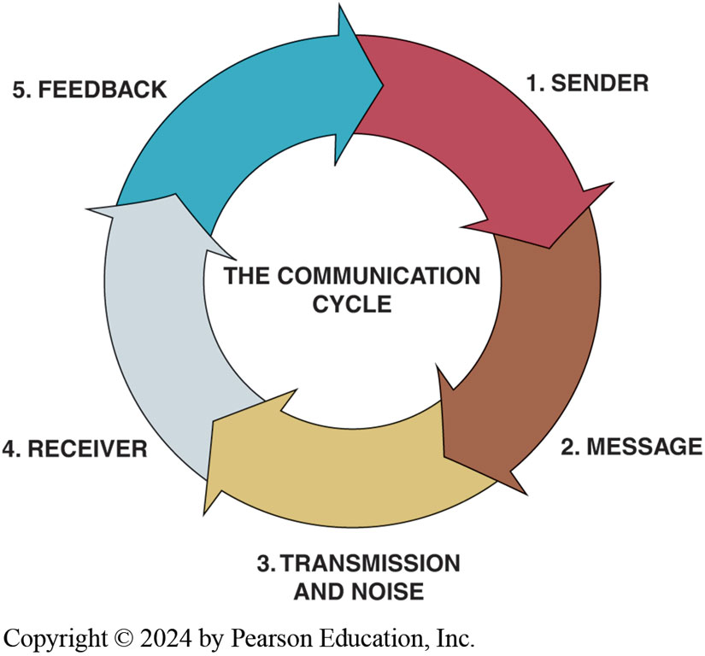
Figure 135.1 Circle of Communication
The circle of communication includes the sender transmitting a message and the receiver understanding it, as well as responding and providing feedback.
Notes:
CASE STUDY: Telling the Customer It Will Be Ready in an Hour
A customer called to check on the status of their vehicle in the shop for a timing belt replacement. The service consultant checked with the technician and found out that the vehicle would be ready in about
15 minutes. However, the service technician told the service consultant to tell the customer that it would be ready in an hour. This way, the customer would be very happy when it was ready sooner rather than later than promised. Plus, the extra time allowed the technician plenty of time for a test drive to confirm that the repair was successfully completed.
Summary:
Complaint—Customer wanted their vehicle back as soon as possible.
Cause—The repair would be completed in less than 30 minutes, but the technician wanted to be sure so told the service consultant to tell the customer it would be ready in an hour.
Correction—The customer was notified that the repair was done before the hour was up, making the customer very happy.

Slide 9
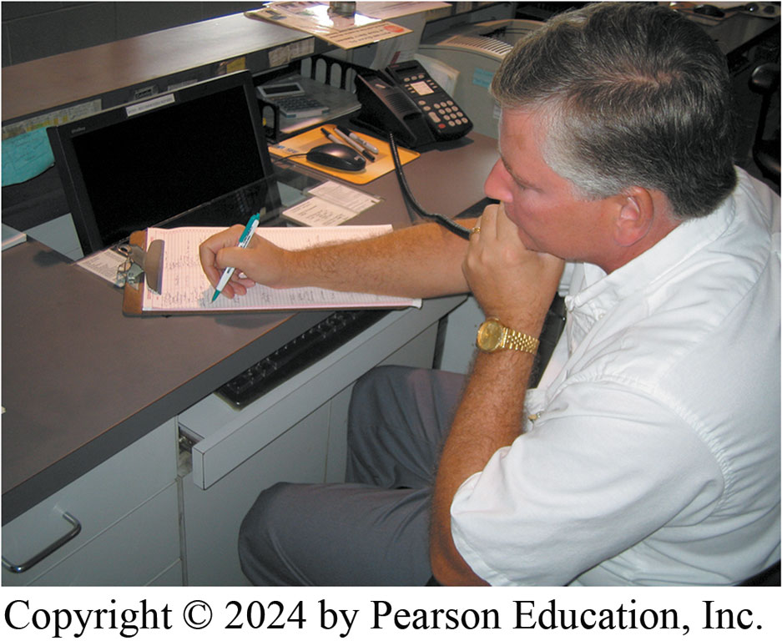
Figure 135.2 Using the Phone
When answering the phone, be sure to have paper and pen or pencil handy.
Notes:
TECH TIP: How to Handle an Upset Customer Here are some tips for handling upset customers:
STEP 1 Try to understand why they are upset. Three common causes of anger or frustration arise
from people feeling that:
• They are not valued or important
• They are helpless
• “It” just is not fair
STEP 2 Try diffusing their anger or frustration with statements or questions such as:
“Help me to understand.” This encourages customers to explain why they are upset. Do not try to
defend or argue with their perceptions—they know what they feel, even if it does not make a lot of
sense.
Express empathy by saying, “I can understand feeling that way.” Do not say “I know exactly what
you mean,” because this may not be true. Instead, convey an idea of what they might be feeling.
Ask, “What would be a good solution from your point of view?” This begins to shift the
conversation away from the venting of emotion toward solution seeking.
Always ask, “Is this a convenient time to talk?” If it really is not a good time, arrange another
time to talk that would be more convenient. Then arrange a callback.

Slide 10
Communication & Customer Relations (4 of 4)
Voicemail, Notes and Page 1724
Email, Notes and Page 1724
TEXT
Ability to communicate most critical aspects
Communication can also be by email or text message.
Ask the customer which method they prefer.
Many prefer the quick and easy text message
Others Prefer talking on the phone
Notes:
Voicemail
Most shops use some form of voicemail system. Service consultants must be comfortable using such systems. When leaving a voicemail, do the following to increase customer responsiveness:
■ Speak clearly and slowly. Service consultants should provide their name, the name of the company, the day and date, and the time.
■ State the reason for the call.
■ Suggest to the customer what the next step should be. Do they need to call back or wait for more information?
■ Leave appropriate contact information and indicate when they can return the call. Provide contact information again, including a phone number.
■ Close with a positive farewell.
■ Remember that when leaving a voicemail, time may be short, so be as brief and to the point as possible.
■ Customers may become frustrated with having to talk to “a machine” when they have a question or problem. When answering complaints about voicemail, do not dismiss the complaint as being unimportant. Ask questions to find out all went wrong.
TEXT
The ability to communicate with customers is one of the most critical aspects of the service
business. Other than direct contact, communication can also be by email or text message. Ask the
customer which method they prefer. Many prefer the quick and easy text message, whereas others
Prefer talking on the phone.
TECH TIP: Email Etiquette Email etiquette includes the following:
Double check grammar, spelling, and punctuation
Avoid long and detailed emails. If an email conversation has exceeded two emails on both sides already, call that person instead.
Writing in a very friendly manner can come across as too casual, whereas a formal approach can seem too impersonal. Try to write as if addressing a close business contact.
Reply to emails from others promptly.

Slide 11
Projecting a Professional Image
Customers notice personal appearance of service consultants
Appearance of the service center.
Appearances give a feeling about care given to vehicle
Service consultants should be clean and neatly dressed.
“whatever it takes” attitude and shows interest
Ask questions, and listen to let customer know
Shop cares about them and their vehicle concerns.
Notes:
Projecting a Professional Image
Customers notice the personal appearance of service consultants and other team members as well as
the appearance of the service center. Appearances often give customers a feeling about the care the
service center will give to their vehicle. To convey a professional image, service consultants
should be clean and neatly dressed.
When a service consultant projects a “whatever it takes” attitude and shows interest in solving the
customer’s needs, the customer will be more at ease and be more receptive to the service consultant’s recommendations and suggestions. Try to keep the conversation on the subject, ask
questions, and listen to let the customer know that the shop cares about them and their vehicle
concerns.
NOTE: When all team members are committed to a set of common goals, they can contribute in positive ways to the success of the team. Customer service has a direct impact on the ability of employers to hire employees, provide wages, and offer promotions. In fact, vehicle manufacturers place great importance on the customer satisfaction index rating at their dealerships.

Slide 12
Greeting Customers
Follow these steps when greeting customers:
Smiling and cheerfully saying “Hello,”
Make eye contact with customers.
Be aware of cultural differences
Introduce yourself and state your position
Mention and repeat each step so the customer
Notes:
Follow these steps when greeting customers:
Recognize the customer’s presence by smiling and cheerfully saying “Hello,” even when the service center is very busy. Smiling helps customers relax and feel more comfortable. Remember, they are in an unfamiliar area, one that they may view as being a negative place to visit. If customers are recognized and made to feel comfortable, they are more likely to be patient and wait until they can be helped.
Make eye contact with customers. In American culture, eye contact conveys sincerity and interest. Avoiding eye contact may suggest a lack of concern or lack of honesty. Customers may perceive that a customer service provider is not interested in what they are saying if they do not periodically make eye contact with them.
NOTE: When dealing with people from other cultures, customer service providers should be aware of cultural differences. In many other cultures, avoiding eye contact is a sign of respect. Be sensitive to others, but use eye contact whenever possible.
Service consultants should introduce themselves and state their position at the shop or dealership. Explain what will be happening and the steps that will occur, so the customer is aware of what to expect. For example, the customer needs to know that an accurate estimate may not be possible until a diagnostic procedure has been performed. Let customers know that the shop will contact them after diagnostic procedures have been performed to inform them of the results plus any other additional information.
Mention and repeat each step so the customer is assured that the shop is doing exactly what it said would be done. Customers do not like surprises, and while the news is often not good news, keeping customers informed is the best way to avoid misunderstandings.

Slide 13
Writing Work Orders (1 of 4)
Primary Job of Service Consultant
Write an effective and accurate work order (also called a repair order)
Most use an electronic repair order system.
Missing information may need to be gathered.
Verify customer information and update
Capture the customer concern exactly way customer states it.
Notes:
The primary job of a service consultant is to write an effective and accurate work order (also called a repair order) with repair/service authorization, warranty repair, and customer follow-up.
Most dealerships and shops use an electronic repair order system. The process may differ from shop to shop. Some considerations include
If this is a new client or a new vehicle, missing information may need to be gathered.
If this is an existing customer (i.e., one that is already in the database), verify the customer information and update it if needed.
It is very important to capture the customer concern exactly the way the customer states it. For example, if the customer states that their vehicle runs rough, shakes, and sputters when they give it gas from a stop, we know there is an engine running problem. So, the service consultant would enter “Engine Diagnostic” and then the exact customer statement. Determine whether it is a predetermined service such as a brake inspection or tire rotation.

Slide 14
Frequently Asked Question: What Is the Purpose of the Pre-Service Inspection?
? Frequently Asked Question
What Is the Purpose of the Pre-Service Inspection? The service consultant, or another designated person, should perform a quick visual inspection of vehicle before service work is performed to check for any preexisting body damage or other faults. Any issues found should be brought to attention of customer and noted on work order. E.G. worn or damaged tires are found, it may be time to recommend that they be replaced. The primary reason for the pre- service inspection is to protect shop from claims of damage that were not caused when the vehicle was under the control of the shop. Many shops have installed cameras to record all views of the vehicle, making a physical inspection unnecessary.

Slide 15
Writing Work Orders (2 of 4)
The work order includes:
Customer details such as name and address
Vehicle make, model, and year
Vehicle identification number (VIN)
Odometer reading
Date
Customer concern information
Cause of the problem(s)
Correction for the problem(s)
Hours of labor
Parts used for the repair
Notes:
TECH TIP: Listen to the Entire Story
It is important to allow the customer to explain the problem or concern even if it involves a long
and drawn-out story. Customers often provide important clues about the problem if the technician or
the service advisor is carefully listening. For example, the customer could say that during the
previous day before the problem started that the “kid next door slammed the driver’s door shut.”
This one clue could be the root cause of a problem that otherwise would be very difficult to locate. Try to avoid talking or adding to what the customer is saying, no matter how difficult that may be.
The work order includes:
Customer details such as name and address
Vehicle make, model, and year
Vehicle identification number (VIN)
Odometer reading
Date
Customer concern information
Cause of the problem(s)
Correction for the problem(s)
Hours of labor
Parts used for the repair
The repair order should always include all of the information pertaining to the customer, vehicle, and cost of repair. The most important part is the VIN. There may be many white Chevrolets, but there is only one vehicle that matches a particular VIN. Repair orders are legal documents that can be used as evidence in the event of a lawsuit. Make sure the information is complete and accurate when filling out a repair order and store it in a safe place on a secure computer network.

Slide 16
Writing Work Orders (3 of 4)
Determine Customer’s Prime Concern
Know customer’s main concern for visit to shop
Confirm What Is Expected
Always start with a diagnosis to confirm the fault.
Document Work Order
Concern is why the customer brought the vehicle in for service.
Verify the concern
Correct operation of the system is understood
Provide a short, concise statement about the cause and correction
Notes:
Determine The Customer’s Prime Concern
The service consultant needs to know the customer’s main concern for their vehicle on this visit to the shop. To help determined this, ask questions such as:
What is your main concern?
Why are you here today?
What can we do to help?
When does the problem occur?
How often does it occur?
What does it sound like?
What does it feel like?
Follow with more focused questions that help zero in on the customer concern. These questions could provide additional information such as what type of road the vehicle was being driven on when the problem occurred or whether the vehicle was towing something when the problem happened. The purpose of these additional questions is to gather as much information as possible for the technician so that the root cause can be found and corrected.
Confirm What Is Expected
When speaking with customers, do not use unnecessary technical jargon. When discussing issues with customers, do the following:
Speak clearly and concisely.
Always start with a diagnosis to confirm the fault.
List the procedures that should be followed according to the online service information to pinpoint the root cause followed by the service procedure.
State that the repair will be confirmed to assure that the original concern has been addressed.
Document Work Order
The complaint or concern is why the customer brought the vehicle in for service. The service consultant enters the technician’s diagnosis on the work order based on the concern. To properly verify the concern:
Make sure the customer’s complaint and the service writer’s repair order description are understood before starting work.
Make sure the correct operation of the system is understood by the customer or the service consultant.
Check the online service information to verify all aspects of normal system operation.
Once the repair is complete, provide a short, concise statement about the cause of the concern and the correction or repair necessary to solve the customer’s original concern or complaint.
SEE FIGURE 135–3.

Slide 17
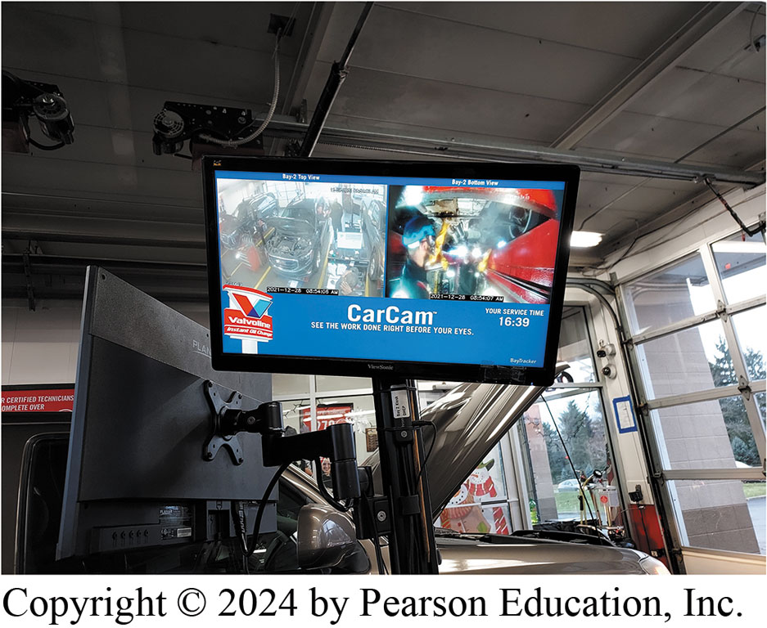
Figure 135.3 Customer Camera
Some shops are equipped with cameras that show the work being done so customers can view their vehicle while service is being performed. Some shops are equipped with glass between the waiting area and the service area for the same reason.

Slide 18
Writing Work Orders (4 of 4)
Three Cs Concern, Cause, and Correction
Concern: The vehicle overheats
Cause: Thermostat faulty, not opening at specified temperature.
Correction: Replaced the thermostat
Vehicle Service History
Scheduled Maintenance Needs
Customer Lounge Area
Alternative Transportation Options
Notes:
The Three Cs
The three “Cs” are Concern, Cause, and Correction. Remember that each of these sections needs to be written up as concisely and completely as possible. For example:
Concern: The vehicle overheats within about 10 minutes of vehicle operation from a cold start, no matter whether it is hot or cold outside. The coolant is full and protected to −30°F. The engine was started and engine temperature was monitored with a temperature gun. The temperature exceeded the specified 195°F thermostat opening and still did not open at 205°F.
Cause: Thermostat faulty, not opening at specified temperature. Removed, no external damage noted.
Correction: Replaced the thermostat with a new thermostat. Using a scanning tool, retested and determined that thermostat starts to open at 205°F, which is within specifications.
Vehicle Service History
Good customer relations require knowing the service history of the vehicle. Having service his- tory information available allows the service consultant to track previous service work and to recommend future maintenance. This helps avoid misunderstandings that can occur, such as the request from a customer for an alignment when the actual problem is a vibration that an alignment may not correct. Therefore, be sure that the customer is aware that the shop will try to fix the concern rather than selling parts or service procedures.
Scheduled Maintenance Needs
After reviewing the vehicle service history, the service consultant can suggest any needed maintenance. Multipoint inspections cover many vehicle systems and should be completed at regular intervals. What is inspected and the inspection results should be documented on the work order or on a separate inspection checklist.
Customer Lounge Area
Show the customer a comfortable location where they can wait for the diagnosis or service. Offer the customer a snack or beverage while they wait. The furnishings and cleanliness of the client reception area should be constantly monitored. Often, these areas become cluttered and are not noticed by those working in the area. Try to look at service areas as customers would if they were seeing the area for the first time.
Alternative Transportation Options
A service consultant may need to offer alternative transportation options to the customer. Car rental sources are often found near repair shops and dealers. Many of these businesses can pick up the customer from the shop. Some shops provide substitute transportation or pay the rental depending on the situation. A free loaner provided under some circumstances involving a warranty repair, liability, or other special consideration. Many shops and dealers provide shuttle service for customers. When shuttling a customer, the following should be adhered to:
Radios should be off or light music/news stations should be on. Always ask clients what they would like to listen to.
The climate-control settings should be set to make clients comfortable; again ask clients what they would prefer.
Ask whether they need to make any special stops while on the way to their destination.

Slide 19
Handling Customer Complaints (1 of 5)
Customer Satisfaction
Satisfaction with automotive service and repair facility.
Difference between expectations and perceptions
Examples of Customer Service
Customer service may involve:
Calling customer by name
On-time delivery of repaired vehicles
Courtesy, Enthusiasm
Demonstrating care for the customer
Excellent follow-up Empathy
Well-explained repairs
Notes:
Customer satisfaction is defined as the customer’s overall feeling of satisfaction with an interaction with an automotive service and repair facility. Customer satisfaction recognizes the difference between customer expectations and customer perceptions. Satisfaction may develop quickly or may be refined over time. Customers have many concerns, and the task of the service consultant is to reduce the stress of vehicle service and to create a pleasant customer experience, while providing current information and helping to solve customers’ vehicle repair concerns.
Examples of Customer Service
Customer service may involve the following:
Calling the customer by name
On-time delivery of repaired vehicles
Courtesy
Enthusiasm
Demonstrating care for the customer
Excellent follow-up
Empathy in handling customer complaints and questions
Well-explained repairs
Suggesting a less expensive option

Slide 20
Handling Customer Complaints (2 of 5)
Customer Needs
Every customer has different needs: 5 basic needs:
Service.
Price
Quality
Action.
Appreciation.
Exceeding Customers’ Expectations
To begin attempting to exceed customers’ expectations
Try following as listed in notes or page 1721
Notes:
Customer Needs
Every customer has different needs. While what the customer wants is frequently hard to identify and may occasionally be unrealistic, all customers have the following five basic needs:
Service. Customers expect the service they think is appropriate for the level of purchase they are making. A small, spontaneous purchase may have a smaller service need than a large purchase that has been carefully planned and researched. Exceeding customers’ expectations, such as under-promising and over-delivering, is beneficial for businesses as it often results in repeat sales and free word-of-mouth advertising.
Service Customers expect the service they think is appropriate for the level of purchase they are making.
Price. People and businesses want to use their financial resources as efficiently as possible. Many products previously considered unique are now considered commodities. This makes the component price even more important to customers.
Quality. Customers want the products they purchase to be durable and functional until they decide to replace them. This requirement of quality mandates that manufacturers and distributors produce products that live up to customers’ expectations of durability. Customers are much less likely to question price if they are doing business with a company that has a reputation for producing high-quality products.
Action. Customers need action when a problem or question arises. Customers like to think that they are an important priority and that when a need or question arises, someone will be ready and waiting to help them.
Appreciation. Customers need to know that the shop appreciates their business. Service consultants can convey this appreciation in many ways. Saying “thank you” to the customer through their words and actions is a good starting point. Additionally, letting them know their business is appreciated conveys a positive message.
Exceeding Customers’ Expectations
To begin attempting to exceed customers’ expectations, try the following:
Become familiar with customers. Get to know who they are and why they do business at the shop. Find out their likes and dislikes.
Ask customers what their expectations are. Find out what they see as the benefit of doing business at the shop.
Tell customers what they can expect. Convey to customers a commitment to them.
Live up to their expectations. Follow through by accomplishing what was promised.
Always deliver a consistent service. Customers like to know that they will have the same positive experience every time they interact with the shop.
One important key to exceeding customers’ expectations is to remember that expectations are always changing

Slide 21
Handling Customer Complaints (3 of 5)
Ethics in Customer Service
Principles that govern conduct of individual or group.
Ethical decisions can be easy or hard to identify
Why Are Some Customers Difficult?
Visibly upset about something
Did not repair their vehicle correctly
Do not have expertise
Quiet and non-communicative
Impatient
Difficulty making decisions
Notes:
Ethics in Customer Service
Most individuals periodically face ethically challenging situations. Ethics are a set of principles that govern the conduct of an individual or group. Sometimes ethical decisions are easy to recognize and are perceived as popular choices of behavior by the people around us. At other times, the spectrum of potential choices falls into gray areas in which the “right” or “wrong” course of action is difficult or nearly visible to identify.
Why Are Some Customers Difficult?
Customers may be perceived as challenging for reasons such as the following:
They are visibly upset about something.
The facility did not repair their vehicle correctly.
They do not have expertise regarding the specific product or situation.
They are quiet and non-communicative.
They are impatient.
They have difficulty making decisions.
Every customer should be the most important person at the moment. They come into our shops with past experiences, perceptions, expectations, frustrations, the stresses of daily life, and the desire for us to show that we value them as customers. Customer service providers also bring their own unique backgrounds to an interaction. The difference between customers and customer service providers is that the customer service provider is responsible for building the bridge of communication.

Slide 22
Handling Customer Complaints (4 of 5)
Avoiding Difficult Customer Interactions
Respect customer’s time. Stay focused on customer
Do not impose bad or negative mood on anyone else
Recognize regular customers with smile learn their names
Avoid destructive remarks
Go extra mile for customers
Notes:
Avoiding Difficult Customer Interactions
The following are some tips for avoiding difficult customer interactions:
Respect the customer’s time. Stay focused on the customer.
Do not impose bad or negative mood on anyone else.
Recognize regular customers with a smile and try to learn their names. It is not too much for regular customers to expect they would be remembered from one interaction to another. Giving someone a look of recognition is a great place to start. Try for one week to call everyone by name, including coworkers. This may increase the morale in the work area. People usually choose to do business with people who they like.
Avoid destructive remarks. Jokes that seem creative and “smart” may seem inappropriate to customers. In the long run, destructive remarks are just that—destructive.
Go the extra mile for customers. It is refreshing to do business with someone who offers to do a little something extra through a project to the end.
Handling Difficult Customers
When confronted with a difficult customer, consider the following:
Listen. Allow customers to express their concerns or to share their side of the story.
Try not to take it personally. Remember that the customer is upset at the situation, not at the service consultant personally.
Ask questions. Seek clarification of the problem. Determine the variables involved.
Show empathy. Attempt to understand what the customer is experiencing.
Solve the problem. Determine the most appropriate solution to the situation. Use creativity and follow company policies while seeking to create a positive outcome for both the customer and the business.
Follow up. Restate what has been decided and how the situation is being resolved. Ask the customer whether they have any further questions.
End on a positive note. Thank the customer for their understanding. Bid them farewell in an enthusiastic manner so that they remember the professional manner used to resolve their problem. Customers are more likely to remember the end of an interaction than the beginning.

Slide 23
Frequently Asked Question: What Is a Customer Satisfaction Survey?
? Frequently Asked Question
What Is a Customer Satisfaction Survey? A customer satisfaction survey is a study of customers’ perceived satisfaction with a product or service. A completed survey provides answers for a list of questions that the company has concerning its products or services. A survey can also help determine inactive leads. The general purpose of customer satisfaction surveys is to assess how satisfied customers are with different aspects of the product/ service. Identifying unhappy customers is as important as identifying extremely happy ones (i.e., potential advocates).

Slide 24
Handling Customer Complaints (5 of 5)
Handling Difficult Customers
When confronted with difficult customer, consider:
Listen
Try not to take it personally
Ask questions
Show empathy
Solve the problem
Follow up
End on a positive note
Notes:
Handling Difficult Customers
When confronted with a difficult customer, consider the following:
Listen. Allow customers to express their concerns or to share their side of the story.
Try not to take it personally. Remember that the customer is upset at the situation, not at the service consultant personally.
Ask questions. Seek clarification of the problem. Determine the variables involved.
Show empathy. Attempt to understand what the customer is experiencing.
Solve the problem. Determine the most appropriate solution to the situation. Use creativity and follow company policies while seeking to create a positive outcome for both the customer and the business.
Follow up. Restate what has been decided and how the situation is being resolved. Ask the customer whether they have any further questions.
End on a positive note. Thank the customer for their understanding. Bid them farewell in an enthusiastic manner so that they remember the professional manner used to resolve their problem. Customers are more likely to remember the end of an interaction than the beginning.

Slide 25
Frequently Asked Question: What Should Service Consultants Do When They Are Wrong?
? Frequently Asked Question
What Should Service Consultants Do When They Are Wrong? Customer service providers are only human and may make mistakes. When you believe that you have made a mistake, you should try the following: Examine behavior and words. Try to look at situation from customer’s point of view. Observe the customer’s reaction. Is the customer visibly upset? Does the customer seem surprised or hurt by the service consultant’s actions? Admit the mistake. Regardless of whether it was an error in information or judgment, it is always best to acknowledge it. Apologize for actions or error. Express regret about problem to customer, but do not make excuses for why it occurred. Find a solution and implement it. The most effective way to undo the improper treatment of a customer is to create an effective solution and to put it into effect as quickly as possible
Notes:
.

Slide 26
Sales Skills (1 of 2)
Sales Skills Issues
Estimates: suggested service cost to the customer
Service Pricing: A service pricing menu provides a quick reference
Shop Management Software: allows shop owners and service consultants to evaluate work, prepare estimates, sell and buy vehicle parts,
Sublet Procedures: repair (part of a repair) performed by another person or company outside the shop.
Notes:
Estimates
The service consultant is the first person to discuss concerns customers have about their vehicle and is ultimately responsible for writing up the repair order and providing the initial estimate of repair. An estimate is the suggested service cost to the customer, which is determined by the service consultant. It is the estimate of what the expected service costs will be.
Service Pricing
A service pricing menu provides a quick reference for service consultants to identify and accurately quote the cost for the most common repairs that the shop performs. It is a valuable tool to help service personnel quickly and accurately provide estimates for common light, medium, and heavy repairs. Preventive maintenance is one of the easiest items to sell to every customer because it is based on the manufacturer’s scheduled vehicle maintenance.
NOTE: The service consultant should sell only what is needed. Be sure that the repairs and services recommended are based on sound practices.
Cost of Repair and Approval
All work must be documented on the work order. It is important to have the customer’s approval before working on the vehicle. This approval must be in writing or verbal approval if the telephone call is documented with the telephone number and time when the call was made. The customer could refuse to pay for unapproved repairs. In some areas, customers legally do not have to pay if they did not sign the repair order first. These are very important steps, and if done correctly, they help build customer loyalty and avoid possible misunderstandings when the work has been completed.
Shop Management Software
Shop management soft- ware allows shop owners and service consultants to evaluate work, prepare estimates, sell and buy vehicle parts, and control the whole operation using one integrated computer system. Garage software is convenient for all businesses as it offers multiple functionalities. It includes service assessment and vehicle tracking and generates point-of-sale invoices.
Sublet Procedures
A sublet repair is a repair (or a part of a repair) performed by another person or company outside the shop. For example, an engine needing repair that also has a defective or leaking radiator would be repaired by the original repair facility, but the radiator may be sent to a specialty radiator repair shop. The radiator repair cost is entered on the work order as a sublet repair. Radio repair, radiator repair, and glass replace.

Slide 27
Sales Skills (2 of 2)
Sales Skills Issues Continued
Establish Completion Expectations Use the appointment
Manage After-Hours Vehicles: drop off box
Monitor Repair/Service Progress: repair order log
Document Services Performed/Declined: An inspection form is a useful guide
Trust: service is completed, the results should be reviewed
Thank You Note Place a business card in the customer’s car with a written thank you on the back.
Notes:
TECH TIP: Separate “Needed” from “Suggested”
The service consultant should always separate items into Service that is required because the part or system no longer meets factory specifications. Service that is suggested because those items are close to the end of their service life or are in need of replacement based on the extensive and informed experience of the technician.
Establish Completion Expectations
The appointment is the best time to discuss when the customer will get their vehicle back. The appointment is the earliest point in the repair process where the customer expectations can be addressed. Appointments provide customer preferential treatment, effective shop management, qualified technician availability, bay space availability, proper equipment available, permits pre-ordering of parts, determine client’s initial concerns, and allows more time for new customers. The appointment log is created by the service consultant to record all the vehicles that are scheduled to come in on a particular day. There are now computer-generated logging and scheduling systems.
Manage After-Hours Vehicles
A drop off box with a write-up envelope can manage after-hours vehicle drop offs. The customer fills out a form and places the keys and form in an envelope and drops it in the opening of a locked box. Extending the business hours is another way to accommodate customers who work late.
Monitor Repair/Service Progress
A repair order log (or daily work control log) is used to track the repair and completion process or the lead time for each repair order. It provides an overview of all the vehicles that are in the shop on a given day.
Document Services Performed/Declined
An inspection form is a useful guide when conducting a vehicle inspection. By following the checklist, all the components can be tested in a systematic way to ensure that they are operational or serviceable. It also becomes a record for the shop to bring a customer’s attention to needed service, or if a customer declines repairs, shows that the shop made the customer aware of them.
Trust
Once the service is completed, the results should be reviewed with the customer to confirm that the repairs have successfully resolved the customer’s concerns and that the vehicle has been returned to the condition in which it was received. It is important to accurately communicate with customer so they have a decent understanding of the service that was completed and so that any remaining questions are answered. This conversation should be based on trust and the relationship built with the customer during their experience with the shop. The service consultant must make sure the vehicle service was completed in a timely manner to maintain satisfied customers. Having a conversation with the customer also gives the customer an opportunity to add something to the project that they may have forgotten. The added items may include those that were suggested at the time the work order was written. Once the original job has been completed, the customer may wish to have the additional work done when the vehicle is already at the shop.
Thank You Note
Place a business card in the customer’s car with a written thank you on the back. This little item seems as if it would not be important to customers, but it helps personalize the vehicle repair. Instead of a faceless service technician, the business card and/or note makes the transaction a personal one build customer loyalty.

Slide 28
Product Knowledge (1 of 2)
Need basic knowledge of vehicle systems & components.
CHART 135–2 lists the subject areas
Services/Maintenance Intervals
Maintenance reminder reset procedures
Specified oil and other lubricant specifications
Component location
Tire rotation methods
Periodic vehicle inspection services
Maintenance item part numbers
Warranty, Service Contracts, Bulletins, Campaigns/Recall
Notes:
The service consultant should have a basic knowledge of vehicle systems and components. There is too much to cover within this chapter, but this text has other chapters that contain that information. ● CHART 135–2 lists the subject areas and the related chapters to study.
Services/Maintenance Intervals
Online service information provides a systematic procedure and identifies special tools, safety precautions, and specifications relevant to the maintenance task. Maintenance and lubrication information includes topics such as:
Maintenance reminder reset procedures
Specified oil and other lubricant specifications
Chassis lubrication points
Component location
Tire rotation methods
Periodic vehicle inspection services (items to check and time/mileage intervals)
Maintenance item part numbers, such as oil and air filter numbers, and specifications, such as oil capacity and tire pressures
Warranty, Service Contracts, Bulletins, Campaigns/Recalls
Service consultants need to be familiar with the warranty of a vehicle that has one to be able to answer any questions customers may have. All new vehicles are provided with a warranty document when the vehicle is delivered.
NOTE: No vehicle manufacturer provides warranty cover- age for tires. Tires are only covered for defects by the tire manufacturer. Some shops or dealers sell a service contact through an insurance company and documents are also issued by the seller. These contracts like Car Shield generally require preapproval of repairs.
Service campaigns and recalls are usually conducted by OEMs when a safety issue is discovered with a particular vehicle. Recalls are costly because they may require the repair of an entire model or production run of vehicles. This could involve many thousands of vehicles. Depending on the nature of the problem, recalls can be mandatory and enforced by law, or OEMs may choose to voluntarily recall these vehicles.
The service consultant should use the online service information to check for technical service bulletins for any concerns that enter the shop. Also check for recall campaigns or use the NHTSA website at https://www.nhtsa.gov/recalls by inputting the VIN. The recall notice is sent to the customer and the OEM dealer. The service information indicates what campaigns are covered for that vehicle by VIN, but not the specific vehicle notice.

Slide 29
Chart 135.2 ATE7 Correlation chart
Engine Systems (Includes Computer Controls, Mechanical, Cooling, Fuel, Ignition, Exhaust, Emissions Control, and Starting/Charging) | Chapters 15, 17, 21, 47, 49, 51, 80–82
Drive Train Systems (Includes Computer Controls, Manual Transmission/Transaxles, Automatic Transmission/Transaxles, and Drive Train Components) | Chapters 121–126, 128
Chassis Systems (Includes Computer Controls, Frames, Brakes, ABS, Traction Control, Suspension, Steering, Wheels, Tires, and TPMS) | Chapters 93, 105, 107–109, 111
Body Systems (Includes Computer Controls, Body Components, Glass, Heating and Air Conditioning, Electrical, Restraint and Accessories) | Chapters 46, 56, 57, 60
Correlation chart for where vehicle system knowledge is found in this text.

Slide 30
Product Knowledge (2 of 2)
Vehicle Identification
Service work requires that the vehicle, including the engine and accessories, be properly identified.
The most common identification is the VIN:
First number or letter designates country of origin
Model of vehicle is commonly fourth
Eighth character is often engine code.
Tenth character represents model year (MY) on all vehicles.
A vehicle safety certification label SEE FIGURE 135–4
Notes:
Vehicle Identification
Service work requires that the vehicle, including the engine and accessories, be properly identified. The most common identification is the make, model, and year of the vehicle. The VIN provides most of the information needed for identification. Since 1981, all vehicle manufacturers have used a VIN that is 17 characters long. Although every vehicle manufacturer assigns various letters or numbers within these 17 characters, there are some constants, including
First number or letter designates the country of origin
Model of the vehicle is commonly the fourth and/or character
Eighth character is often the engine code.
Tenth character represents the model year (MY) on all vehicles.
A vehicle safety certification label is attached to the left side pillar post on the rearward-facing section of the left front door. This label shows the month and year of manufacture, the VIN, as well as the gross vehicle weight rating (GVWR), which is the maximum weight of a vehicle as specified by the OEM. The gross axle weight rating (GAWR) is the maximum weight that an axle can support and is usually followed by “FR” for front axle and “RR” for rear axle. ● SEE FIGURE 135–4.

Slide 31
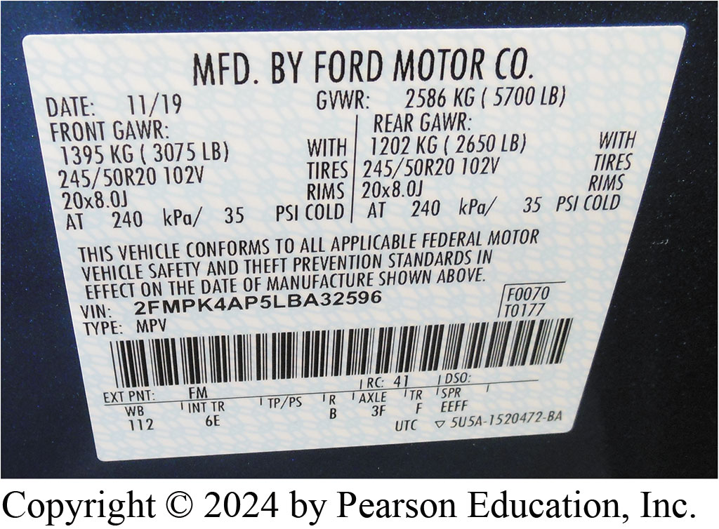
Figure 135.4 VSCL
A typical vehicle safety certification label showing the front and rear gross axle weight rating (GAWR).

Slide 32
Question 1?
A work order is also called a(n) ______________.
a. invoice
b. repair order
c. technical service bulletin
d. None of the above

Slide 33
Answer 1
A work order is also called a(n) ______________.
b. repair order

Slide 34
Automotive Fundamentals Videos and Animations
Videos Link: (A0) Automotive Fundamentals Videos
Animations Link: (A0) Automotive Fundamentals Animations

Slide 35
Copyright
This work is protected by United States copyright laws and is provided solely for the use of instructors in teaching their courses and assessing student learning. Dissemination or sale of any part of this work (including on the World Wide Web) will destroy the integrity of the work and is not permitted. The work and materials from it should never be made available to students except by instructors using the accompanying text in their classes. All recipients of this work are expected to abide by these restrictions and to honor the intended pedagogical purposes and the needs of other instructors who rely on these materials.

