Slide 1
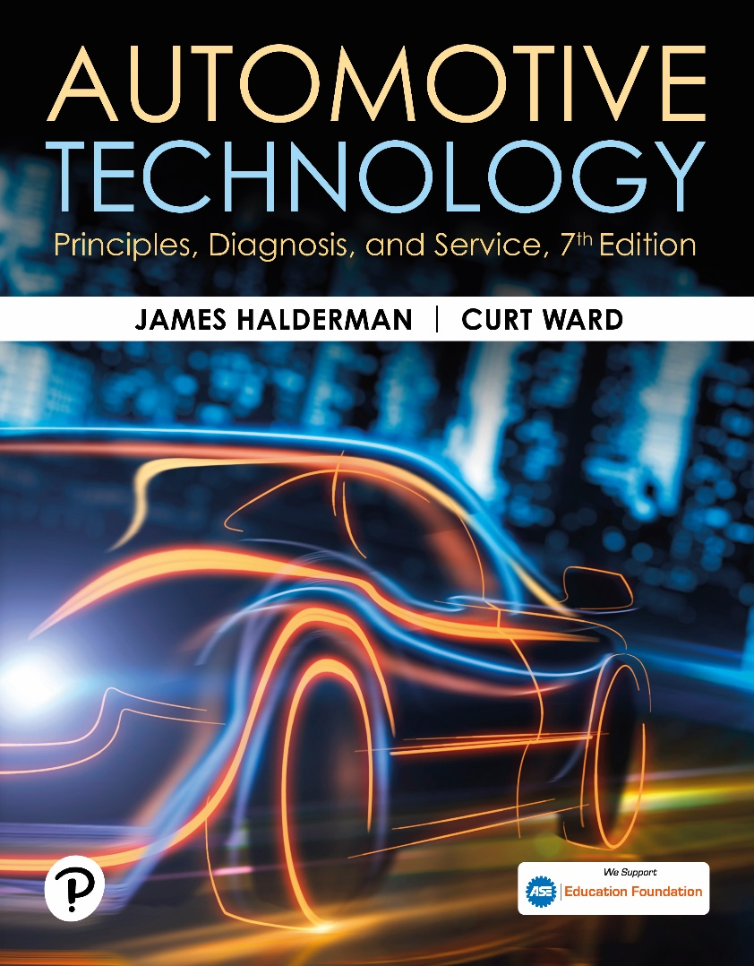
Automotive Technology: Principles, Diagnosis, and Service
Seventh Edition
Chapter 134
Parts Specialist (P2)
Copyright © 2023 Pearson Education, Inc. All Rights Reserved
Notes:
INSTRUCTOR NOTE: This presentation includes text explanation notes, you can use to teach the course. When in SLIDE SHOW mode, you RIGHT CLICK and select SHOW PRESENTER VIEW, to use the notes.

Slide 2
Learning Objectives (1 of 2)
134.1 Discuss the terminology of a typical automotive parts business.
134.2 Discuss the general operations of a typical automotive parts business.
134.3 Describe the customer relations and sales skills needed by a parts specialist.
134.4 Explain how to identify a vehicle, including the VIN, body style, and paint codes.
134.5 Demonstrate basic knowledge of the systems common to every vehicle.

Slide 3
Learning Objectives (2 of 2)
134.6 Describe catalog and information system skills that a parts specialist must have.
134.7 Explain inventory management, including physical inventory, stock rotation, and parts returns.
134.8 Describe merchandising strategies

Slide 4
Definitions & Terminology (1 of 2)
Parts Specialist
OEM Parts
Jobber Parts
OSHA
Safety Data Sheets (SDS)
Notes:
Parts Specialist
Automotive parts specialists must learn the skills needed to work competently in a retail or jobber
parts store. Automobile parts specialists must possess knowledge about a wide range of vehicle
component systems for all makes and models. They must also have customer relations, sales,
merchandising, vehicle identification, cataloging, and inventory management skills.
OEM PARTS
Original equipment manufacturer (OEM) parts are manufactured by the same company that produced the original part used in assembly of the vehicle. Vehicle dealer parts departments carry OEM parts as well as some parts and supplies manufactured by other companies.
JOBBER PARTS Jobber parts (or aftermarket parts ) are not made by the original manufacturer of the vehicle. The aftermarket
industry makes up about 80% of the parts used in vehicle repair. A jobber store purchases manufacturer goods at wholesale
prices, usually through a warehouse distributor and then sells products to consumers at retail prices.
OSHA The U.S. Congress passed the Occupational Safety and Health Administration (OSHA) act into public law in 1970. Workers must be familiar with OSHA standards regarding health and safety in the workplace.
A Safety Data Sheet (SDS) is provided by manufacturers for all chemicals used in industry. The SDS
includes warnings and precautionary information about hazardous materials. OSHA requires that
SDSs “shall be maintained and kept in a readily accessible area.” Any SDSs received with shipments
or received separately should be placed in a local SDS binder or file. ● Figure 134–1.

Slide 5
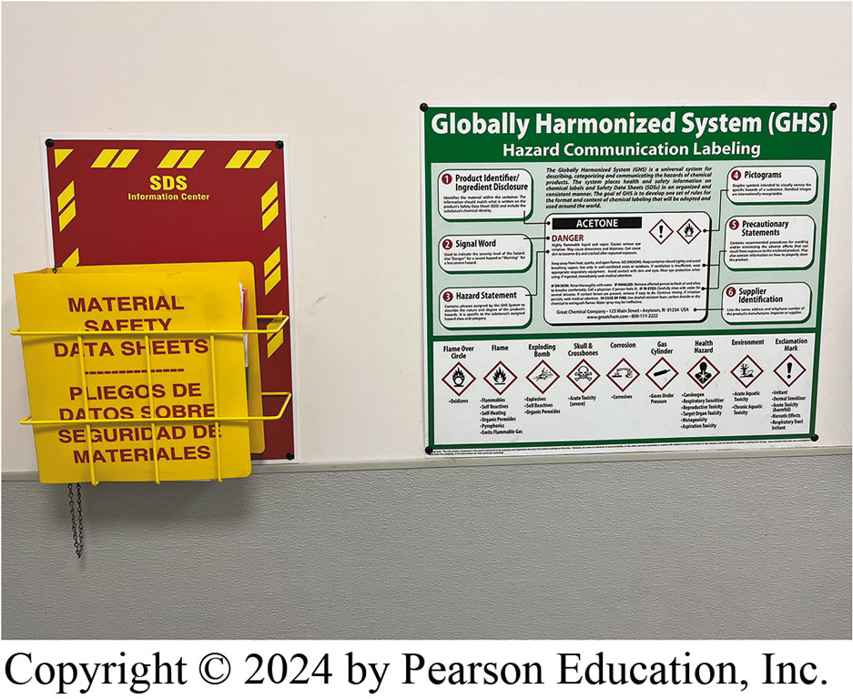
Figure 134.1 SDS
The SDS and Globally Harmonized System (GHS) information are displayed in a parts store. The GHS includes health, physical, and environmental hazards as well as SDSs.

Slide 6
Definitions & Terminology (2 of 2)
Parts Industry Terminology
Invoice lists all parts by name and is used to track inventory and purchases for billing purposes.
Purchase order (PO) is used to enable a store or business to purchase parts.
Stock order is used to order more parts from the supplier on a routine basis.
Backorder is for parts ordered from a supplier but not shipped due to them being out of stock.
Notes:
PARTS INDUSTRY TERMINOLOGY The parts industry has many terms relating to ordering, stocking,
selling, or returning parts:
■ The invoice lists all parts by name and is used to track inventory and purchases for billing
purposes.
■ A purchase order (PO) is used to enable a store or business to purchase parts. It describes the
component and the quantity being purchased along with billing information.
■ A stock order is used to order more parts from the supplier on a routine basis.
■ A backorder is for parts ordered from a supplier but not shipped due to them being out of stock.

Slide 7
General Parts Operations (1 of 3)
Special Orders and Stocking Fees
Unit Conversions And Measuring
Working knowledge of units of measurement, measuring, and converting
Alpha, Numeric, Alphanumeric Sequences
Cash, Checks, Credit/Debit/Gift Cards Cash
E-commerce buying or selling products or services over the Internet.
Notes:
Businesses often offer discounts and special sales to promote customer interest. Parts specialists might be expected
to calculate such discount. A discount is often expressed in percentages such as “20% off.”
Special Orders And Stocking Fees A special order is placed whenever a customer purchases a part
that the business does not normally keep in stock. A customer who places a special order may be
asked to pay shipping or handling charges, which may be based on the purchase price. If a customer
returns a part, a stocking fee may be charged based on the original purchase price. For example, if
a customer returns a $50 component and is charged a 5% restocking fee, 5% of $50 is $2.50 and
Subtracting $2.50 from $50 equals $47.50.
Unit Conversions And Measuring Parts specialists should have a working knowledge of units of
measurement, measuring, and converting from conventional to metric units. For example, engine
displacement can be specified in either cubic inches or liters. Converting liters to cubic inches
or cubic inches to liters is performed by dividing the volume value of cubic inches by 61 (liters =
cubic inches/61).
A ruler, dial caliper, or micrometer might be needed to verify the size and fit of a replacement
part, so parts specialists should know how to use and read these tools.
ALPHA, NUMERIC, AND ALPHANUMERIC SEQUENCES An
alphanumeric listing is a series of numbers and letters starting from the left digit and working
across to the right. If the part numbers are the same but there are slightly different versions
of the part, then the order sequence might continue with an A, B, C suffix.
CASH, CHECKS, AND CREDIT/DEBIT/GIFT CARDS Cash sales are more profitable than credit card sales because there method. Follow these steps when accepting payment using a personal check:
1. Get a driver’s license number and write it on the check.
2. Compare the license photo ID to the customer’s appearance.
3. Use a check verification process.
4. Apply store endorsement to the check before placing it in the cash drawer.
5. Post the check number.
Credit cards and debit card concerns include the following:
■ Make sure the credit/debit card belongs to the customer.
■ Check the information on the credit/debit card against the customer’s photo ID.
E-Commerce refers to the process of buying or selling products or services over the Internet. E-commerce sales
involve the following:
1. The online order is received.
2. The order is processed using the store’s back-office system.
3. The customer is notified that the order has been received.
4. A request for fulfillment is sent to the warehouse.
5. The order is picked from stock at the warehouse.
6. The order is packed at the warehouse.
7. The order is shipped from the warehouse.
8. A shipping notification is sent to the customer.
9. The customer receives the order.

Slide 8
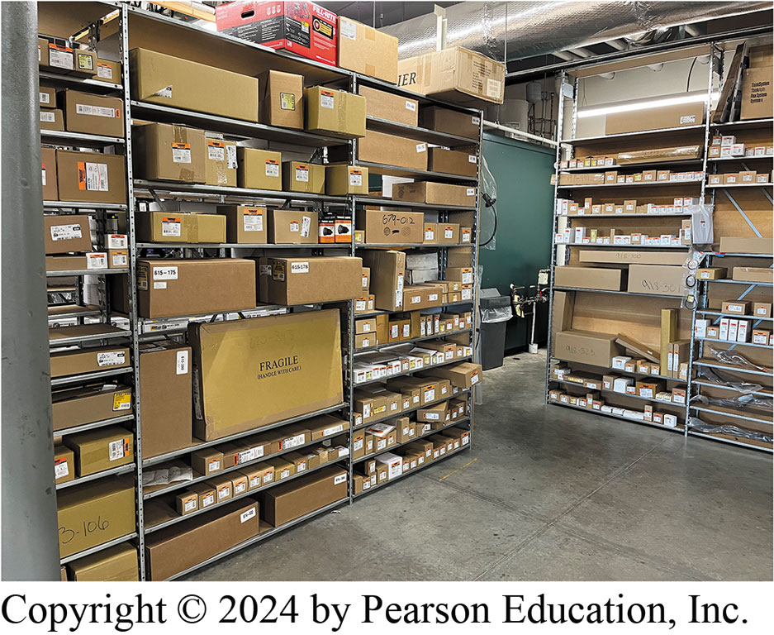
Figure 134.2 Clear Of Clutter
Even areas customers do not see should be clear of clutter to provide a path for employees to walk.

Slide 9
General Parts Operations (2 of 3)
Refunds Credit Invoicing
Familiar with the store’s charge policy
know the steps necessary to complete transactions
Procedure for refunds .
Housekeeping Skills
Keeping all areas of the business clean and orderly
Lost sales can result from a disorderly and sloppy appearance.
Good housekeeping leads to a safe, clean, and productive environment.
Keep all lights in working order.
Notes:
REFUNDS AND CREDIT INVOICING Parts specialists need to be familiar with the store’s charge policy
to provide the best customer service. If a sale needs to be voided or credited, parts specialists should know the steps necessary to complete this action. The procedure for refunds should be specific to the business and to the specific processor.
HOUSEKEEPING SKILLS Housekeeping relates to keeping all areas of the business clean and orderly;
everyone in a parts store must have housekeeping skills. Lost sales can result from a disorderly and sloppy appearance.
Countertops, shelves, and displays should all be neat and clean. Good housekeeping leads to a safe,
clean, and productive environment. The following are some general housekeeping guidelines:
■ Keep aisles and walkways clear of tools, equipment, and other items. ● SEE FIGURE 134–2.
■ Make sure that garbage containers are conveniently located and emptied regularly.
■ Keep all lights in working order.

Slide 10
Frequently Asked Question: How Is Margin Determined?
? Frequently Asked Question
How Is Margin Determined? All businesses must earn money from every sale in order to pay their employees, rent on the building, as well as insurance and other expenses. It is typical in the automotive parts business for each level in the parts distribution chain to earn a 35% (or higher) margin on the parts handled. For example, take a part that costs the manufacturer $5 to produce: First level The manufacturer needs to make money and sells the part to a warehouse distributor for $10 (50% margin). Second level The warehouse distributor sells the part to a parts store and adds its markup, usually 35%. To determine what the parts store pays, divide $10 by 0.65. This equals $15.38. Third level The parts store wants to make a 35% margin, so the cost that it paid ($15.38) is divided by 0.65 = $23.66, which is a 35% margin. This $23.66 is the price that retail customers pay for the part
Notes:
.

Slide 11
General Parts Operations (3 of 3)
Address Customer Concerns
Always sell the right parts to customers
If a customer comes in for a starter while carrying a pair of jumper cables
Mention battery or wiring could be the problem
Proper Safety Practices
Maintain safe environment to avoid personal injury
Damage to the merchandise or customers.
Potential Security Risks Expensive items should be displayed behind the counter in locked cases
Notes:
Address Customer Concerns Parts specialists should always sell the right parts to customers. This may involve educating
the customer about the parts being bought and the importance of related items or tasks to be performed in combination with the parts installation. If a customer comes in for a starter while carrying a pair of jumper cables, the wise parts specialist will ask: “What is the problem that makes you think you need a starter motor?” The specialist may also mention that the battery or wiring could be the problem. ● SEE FIGURE 134–3.
Proper Safety Practices All parts specialists must maintain a safe environment to avoid personal
injury or damage to the merchandise or customers. Safety includes the following:
■ Learning about all safety precautions.
■ Applying this safety precaution knowledge while working by developing safe working habits.
■ Receiving training on how to lift heavy objects. Some heavy components should be moved with
handling equipment like a forklift.
Following safety practices results in protecting employees and customers from harm.
Potential Security Risks Expensive items should be displayed behind the counter in locked cases.
Parts specialists should give thought as to what is displayed near entrances and exits to avoid
theft. It is best to use a video surveillance system
areas around entrances clear.

Slide 12
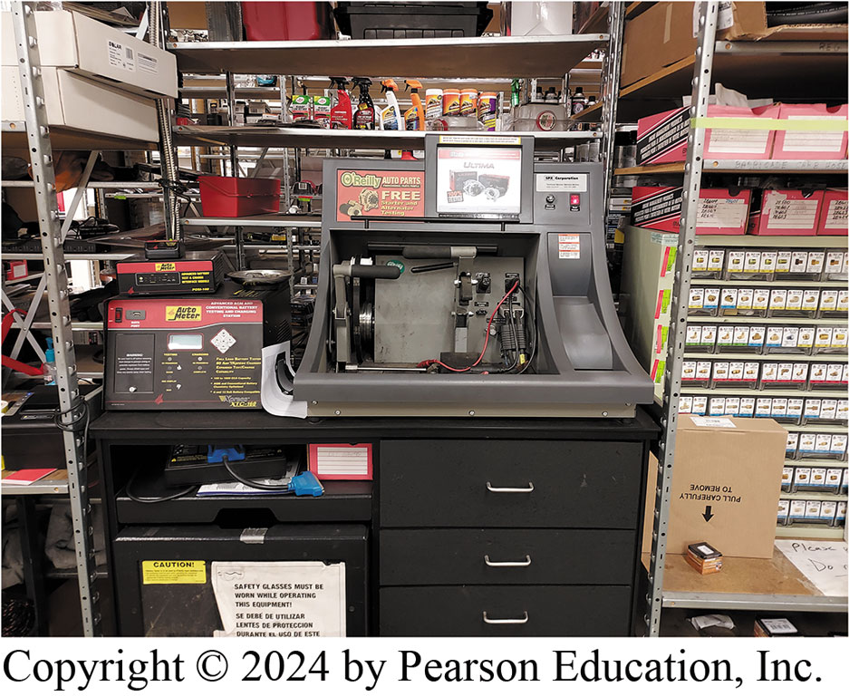
Figure 134.3 Starter/Alternator Test
Most parts stores offer starter and alternator testing as part of their customer service policy.

Slide 13
Customer Relations (1 of 3)
Customer Satisfaction
Overall feeling of satisfaction with an interaction
Satisfaction may develop quickly or may be refined over time.
Appearance
All aspects of the parts specialist’s appearance, including clothing, personal hygiene, and outward demeanor, create a first impression with customers.
Acknowledging & Greeting Customers
Welcome and acknowledge them in a friendly manner. Good morning/afternoon”
Notes:
Customer Satisfaction Customer satisfaction is defined as the customer’s overall feeling of satisfaction with an interaction
with the store. Customer satisfaction recognizes the difference between customer expectations and customer perceptions.
Satisfaction may develop quickly or may be refined over time.
Appearance All aspects of the parts specialist’s appearance, including clothing, personal hygiene, and outward demeanor,
create a first impression with customers. First impressions affect the level of trust achieved. It is harder to convey a message effectively
if the customer is distracted by some aspect of the parts specialist’s appearance. Thus the parts specialist should always have a professional appearance.
Acknowledging & Greeting Customers From the moment customers walk through the door until they leave, employees should welcome and acknowledge them in a friendly manner. Parts specialists should not hold personal conversations with one another when a customer is at the counter. The first step toward making customers feel noticed is to make eye contact with them and say “Good morning/afternoon” and “I’ll be with you in a few minutes.” Customers should be waited on in the same order in which they came into the store.

Slide 14
Customer Relations (2 of 3)
Handling Difficult Customers
Do the following:
Listen. allow customer to explain the problem
Do not get angry.
Ask questions. Seek clarification of problem and determine variables
Show empathy.
Determine most appropriate solution
Follow-Up Restate what has been decided and how the situation is being resolved.
Notes:
Handling Difficult Customers
When confronted with a difficult customer, consider doing the following:
■ Listen. It is important to allow the customer to explain the problem or concern even if it involves a long and drawn-out story.
■ Do not get angry. Remember that the customer is upset at the situation, not at the parts specialist.
■ Ask questions. Seek clarification of the problem and determine the variables involved.
■ Show empathy. Attempt to understand what the customer is experiencing.
■ Determine the most appropriate solution to the problem. Use creativity and follow company policies to create a positive outcome for both the customer and the business.
■ Follow up. Restate what has been decided and how the situation is being resolved. Ask the customer whether they have any further questions.

Slide 15
Customer Relations (3 of 3)
Answering Telephone
Answer calls promptly
Have paper and pens handy to take notes
“How may I help you?”
Use proper titles for people when communicating
“Thank you” is most powerful phrase
Keep conversation businesslike
Speak clearly and distinctly
Do not allow “dead air.”
Take messages cheerfully and accurately.
Try to picture customers on the phone, Smile
Notes:
Answering the Telephone
The telephone is a powerful tool for sales, information gathering, and relationship building. A telephone call is often the first point of contact a customer has with the store. Creating a good first impression helps establish positive feelings about the store. Some useful telephone tips include the following:
1. Answer calls promptly and be prepared to handle them. Answer at the second ring if possible. When the telephone rings longer, callers get the feeling that no one is available and that their call is an intrusion.
2. Have paper and pens handy to take notes. Use a computer-based customer system for reference. Get the caller’s name and number as soon as possible, and summarize the conversation briefly at the end—especially mentioning any commitments that need to be followed up on.
3. The best way to answer a business call is for the parts specialist to simply state their name or department and ask, “How may I help you?”
4. Use proper titles for people when communicating. If in doubt about whether to use a customer’s first name, call the person by the more formal Mr. or Ms. If they prefer that their first name be used, they will say so. It is better to be a little too formal than overly familiar.
5. “Thank you” is the most powerful phrase in human relations. Express appreciation regularly. Some companies use it as a greeting: “Thank you for calling Jones Buick.” A “Thanks for calling” at the end of a conversation is also a strong customer satisfaction booster.
6. Keep the conversation businesslike. Nothing turns off a customer or caller like forgetting their name. If this happens, simply say, “I’m sorry, I didn’t get your name, sir/ma’am. Would you please repeat it?”
7. Speak clearly and distinctly. Avoid using speaker phone.
8. Do not allow “dead air.” When dead air occurs, callers have no idea what is going on and are often annoyed if the silence persists.
9. Take messages cheerfully and accurately. Get customers’ full names and correct spelling by asking callers to spell their names. Also ensure their correct telephone number is recorded.
10. Try to picture customers on the phone. Physically smiling somehow travels through the telephone line via voice tones.

Slide 16
Frequently Asked Question: What Is a Customer Satisfaction Survey?
? Frequently Asked Question
What Is a Customer Satisfaction Survey? A customer satisfaction survey is a study of customers’ perceived satisfaction with a product or service. A completed survey provides answers for a list of questions that a company has concerning its products or services. Identifying unhappy customers is as important as identifying extremely happy ones (i.e., potential advocates). Parts stores can use a number of survey websites to help determine their level of customer satisfaction.

Slide 17
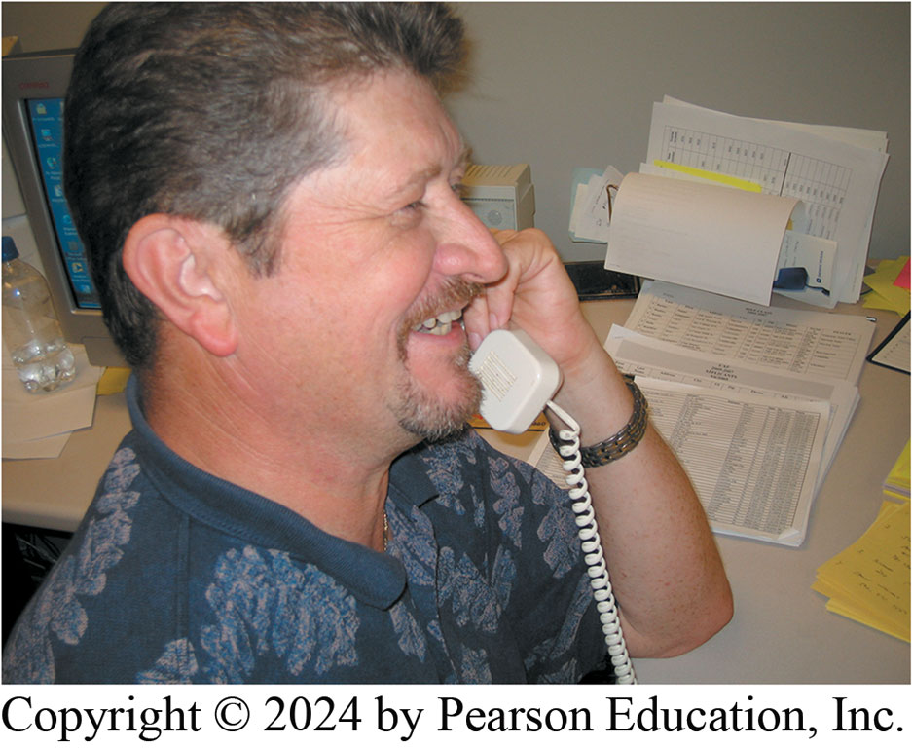
Figure 134.4 Phone Etiquette
Smiling while talking on the telephone conveys a positive attitude to customers.
Notes:
TECH TIP: How to Handle Customers When Times Are Busy Sometimes the phone will ring while the parts
specialist is waiting on a customer. When no one else is available to answer the phone, the parts
specialist should ask the customer to stand by and then answer the phone, requesting the caller to
hold. The parts specialist should never pick up the phone and press the hold button without talking
to the caller. If it appears that the call will take some time, the parts specialist should try to
explain to the caller that they are with another customer at the moment. Return the call as soon as
possible or tell the caller to call back in a few minutes.

Slide 18
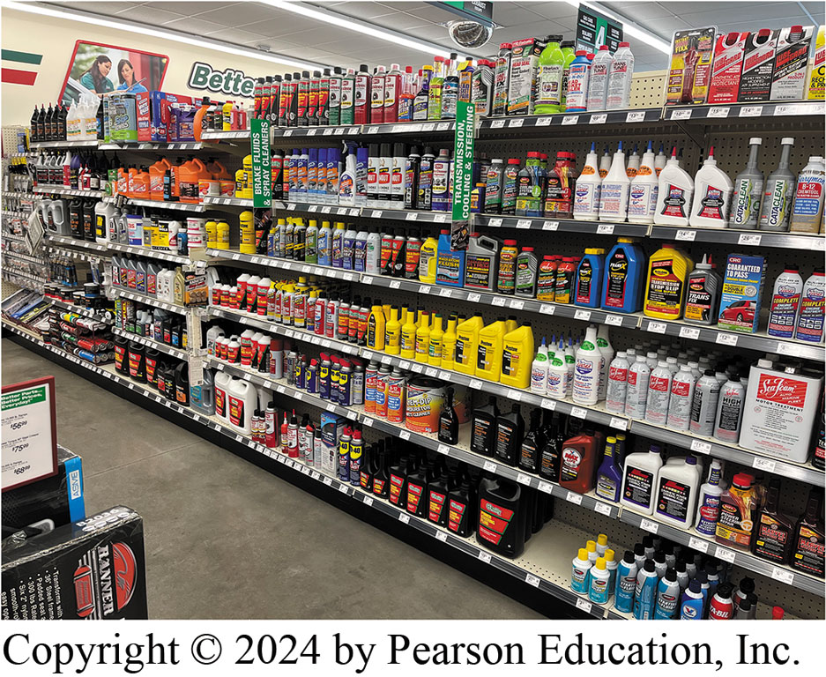
Figure 134.5 Products Arrangement
Products that are related are often arranged together so customers see related items while shopping.
Notes:
If a customer comes into the store to purchase a product, the parts specialist should suggest
buying related items. Selling related parts when a customer buys a particular part can boost sales.
For example, when selling brake pads, suggest Brake Clean to prevent brake dust from going
airborne, brake pad silencing gel or spray, and caliper slide lube. ● Figure 134–5.

Slide 19
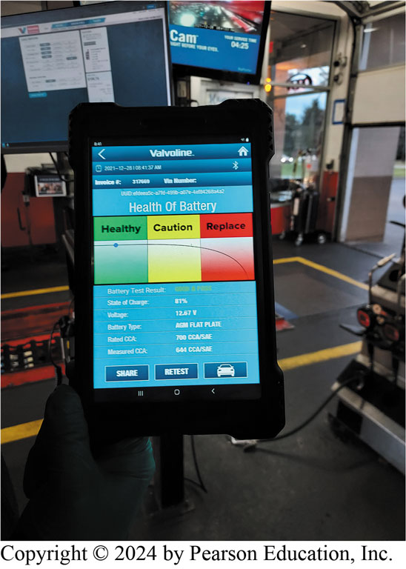
Figure 134.6 Battery Testing
Many parts stores are able to test batteries for their retail customers.

Slide 20
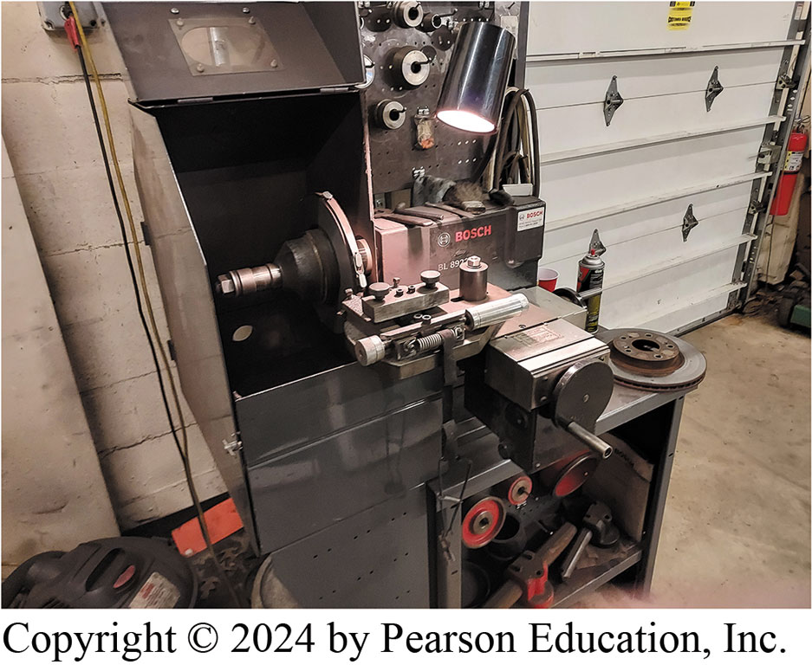
Figure 134.7 Drum/Rotor Machining
Many parts stores are also equipped to handle brake drum and rotor machining.
Notes:
Store Services
Parts specialists should always promote sales and store services. For example, if a customer
asks for brake pads, let the customer know that the store has a machine shop service that can
machine the rotors. If a customer is purchasing tires, suggest mounting, balancing, and wheel
alignment service. If the store does not do this, recommend a reputable shop that can. ● SEE FIGURES 134–6 AND 134–7.

Slide 21
Frequently Asked Question: What Is a Loss Leader?
? Frequently Asked Question
What Is a Loss Leader? A loss leader is a product that is sold for less than the usual or expected price in an effort to entice customers to visit the parts store to purchase the item. Once customers are in the store, they often purchase other items or services that are not highly discounted. It is these purchases of the higher-priced items that make selling a loss leader at a discount worth it to the store.

Slide 22
Frequently Asked Question: What Is Meant by “Upselling”?
? Frequently Asked Question
What Is Meant by “Upselling”? Upselling refers to the attempt to increase sales above and beyond what the customer first wanted. For example, parts specialists could suggest that brake cleaner would also be helpful when they sell brake pads to a retail customer. Other examples of upselling include Recommending a funnel and gloves to a customer purchasing engine oil and an oil filter. Recommending a new accessory drive belt to a customer purchasing an alternator. Recommending a new battery or battery cable to a customer purchasing a new starter. Recommending microfiber cloths to a customer purchasing wax or polish. Additional sales help the store be more profitable by increasing the total revenue of the store.

Slide 23
Product Application Information VIN
To get correct part, parts specialists
Must obtain right vehicle information:
Year
Make
Model
Engine
Drive Line
Wheel or tire size, wheelbase, presence or absence of air conditioning
17-character VIN may be needed
Notes:
Proper selling techniques help customers leave the store with the part they need. To get the
correct part, parts specialists must obtain the right vehicle information, including the following:
■ year
■ make
■ model
■ engine
■ drive line
Sometimes, additional information such as the wheel or tire size, wheelbase, presence or absence of
air conditioning, or the 17-character vehicle identification number (VIN) may be needed from
customers when researching their parts needs. Having the right information will ensure the customer
is sold the correct parts. ● SEE FIGURE 134–8.
Parts specialists should also know how to find the following additional information about the vehicle:
■ Vehicle build date
■ Vehicle-specific options
■ Body style and chassis type
■ Paint color codes

Slide 24
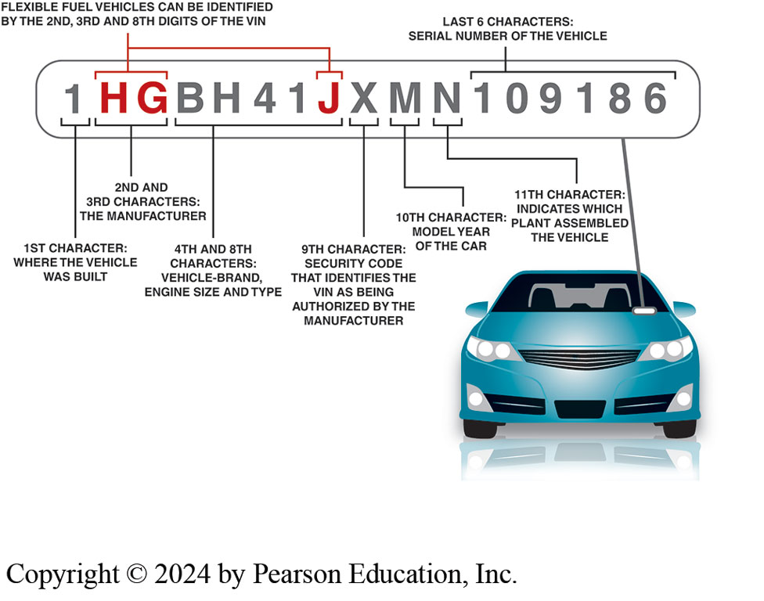
Figure 134.8 VIN
Explanation of the VIN code located on the dash visible through the windshield and also on the driver’s side door pillar.

Slide 25
Vehicle Systems Knowledge
Parts specialists need basic knowledge of vehicle systems
and components. Review the chapters in ● CHART 134–1
for more information.

Slide 26
Chart 134.1 ATE7 Chapters
Engine Mechanical Parts | Chapter 15
Cooling Systems | Chapters 17–18
Fuel Systems | Chapters 74–76
Ignition Systems | Chapters 68–69
Exhaust Systems | Chapters 21 and 136
Emission Control Systems | Chapters 80–82
Manual Transmissions | Chapters 121–122
Automatic Transmissions | Chapters 128–133
Drive Train Components | Chapters 123–126
Brakes | Chapters 93–107
Suspension, Steering, Wheels, and Tires | Chapters 108–118
Heating and Air- Conditioning Systems | Chapters 60–66
Electrical Systems | Chapters 36 and 41–42
Battery, Charging, and Starting Systems | Chapters 47–52
Miscellaneous | Chapters 8–9 and 14
Chapters containing information regarding vehicle systems information and parts identification.

Slide 27
Catalog/Information Skills
Cataloging Systems digital and/or online systems
Using Proper Resource To Identify Parts
Interpreting Additional Information:
Consulting Additional Reference Material:
New item & Product information bulletins
Correction bulletins
Parts specification guides
Illustrated part guides
Cross-reference lists/supersession lists
Identifying Terminology & Abbreviations
Notes:
Cataloging Systems Parts specialists must be familiar with digital and/or online cataloging systems. Subscription-based electronic information retrieval systems serve both the OEM and the aftermarket. Program jobbers like NAPA, CARQUEST, AutoZone, and Advance Auto contract for the use of electronic parts systems to make information retrieval faster, easier, and up-to-date.
Using The Proper Resource To Identify Parts To obtain the correct replacement part, often the owner or parts specialist must supply additional, specific information. For example, when parts are ordered for a differential assembly, the exact axle specification must be determined. OEMs use differentials from more than one axle manufacturer. Each OEM has its own arts, service procedures, and specifications.
Interpreting Additional Information: Parts specialists must refer to an online catalog to reference additional information, determine
parts exceptions, or find alternative parts. A footnote is used to provide additional information for multiple applications. The footnotes themselves are important and should be referenced systematically in order to define parts. Parts bulletins inform the parts store personnel about technical changes to a part.
Consulting Additional Reference Material Besides parts catalogs, other reference materials provide information to parts specialists. These include
■ New item bulletins
■ Product information bulletins, which contain specific information about a product, such as a defect or a unique method of installation
■ Correction bulletins, which refer to catalog errors due to keystroke errors or incorrect parts numbers
■ Parts specification guides, which help determine correct parts based on their dimensions, and electrical connections
■ Illustrated part guides, which help parts specialists identify the correct replacement part if the original part number is not known or the old part is not available for inspection
■ Cross-reference lists and supersession lists, which offer replacement part numbers if earlier issued parts are no longer available
Identifying Terminology And Abbreviations SAE releases practices for nomenclature (parts names) in the industry. Parts specialists must be familiar with these and the OEM counterpart names if used. OEMs include aids for using these information-retrieval systems. These include an abbreviation list, which can be helpful since abbreviations can often have more than one meaning. For example:
■ OD can mean overdrive or outside diameter.
■ AC can mean alternating current or air conditioning.

Slide 28
Inventory Management
Lost Sales Reporting
Verifying Incoming & Outgoing Merchandise
Knowing Reasons For Physical Inventory
Identifying and Reporting Inventory Discrepancies
Stock Rotation
Outside Purchases
Core Handling
Product Packaging
Returns and Exchange Parts
Notes:
Lost Sales Reporting The main benefit of a lost sales report is to spot trends in the parts
business. This type of report shows new part numbers that the store does not stock along with older
part numbers that are increasingly in demand. Some part numbers have an instant demand, such as
those found in some newer vehicles. Other parts grow in demand. The store owner or buyer must
investigate not only part numbers that are selling, but also those that they do not stock.
Verifying Incoming And Outgoing Merchandise A shipment order must be carefully picked, packaged, and documented. The packing list or slip is included with each shipment. This slip contains a detailed description of all parts included in the shipment. A separate packing list can be placed in each part of a shipment, but often a single all-inclusive list is packaged with or secured to the first part of a multiple-part shipment.
Knowing Reasons For Physical Inventory Physical inventory should be performed once a year, when all the stock is counted on the shelves and checked to determine what is actually in the store versus what the computer system shows. This helps keep
the computer inventory current and can help provide customers with faster and more accurate parts service. Some parts inventory on one product line per month as part of a continuous process; others do a complete inventory every year. A physical inventory may show
whether parts are missing from the store and whether some part numbers have been incorrectly invoiced.
Identifying And Reporting Inventory Discrepancies: After a physical inventory has been completed, any discrepancies must be recorded and logged into the computer system. The cause of the discrepancy needs to be identified (e.g., wrong stock
numbers, stolen products, transfers to other stores, incorrect part numbers, or quantities of parts picked off the shelf). Parts specialists must attempt to eliminate discrepancies by using an inventory discrepancy form. Such forms should be kept for future reference. When a discrepancy is discovered in the inventory, the records need to be changed.
Stock Rotation Stock rotation means selling older stock ahead of newer stock. This can be done by placing older parts or chemicals in front on shelves where they are visible and where customers can easily select them. This FIFO (first-in-first- out) stock rotation prevents older stock from getting an aged appearance. ● SEE FIGURE 134–9.
Outside Purchases An outside purchase is a non-stocking part that has been ordered from an outside supplier. A part that repeatedly appears on a lost sales report and needs to be special ordered or that appears on outside purchase reports should be considered as a candidate for normal stock.
Core Handling A core charge is a charge that is added when the customer buys a remanufactured component like a starter or alternator. The core charge is refunded to the customer when the old core is returned. To make sure that customers return the core, the store should charge the core charge to the customer upfront when the rebuilt component is purchased.
Product Packaging Parts specialists need to be knowledgeable of how various products are packaged to bill and sell them. The term EACH is for a single item. A CARTON or CASE sold as a unit. The term PAIR is two of something. SET is two or more compatible items. A KIT is a package of parts used to rebuild a component. For example:
■ Brake pads are sold as one unit in one box.
■ Shocks are sold as individual units.
■ Engine oil is shipped by the case but can be sold by the quart.
Returns And Exchange Parts Freight charges may be added to emergency-order parts to cover the cost of special
transportation to the store. Some parts have a restocking fee that is charged to the customer when a product is returned for a
refund. Broken kits may not be acceptable for refund, or if a kit is accepted for refund, it must be checked to ensure the kit is resalable,
with no missing or damaged parts. Exchange parts must be inspected for resalable condition.

Slide 29
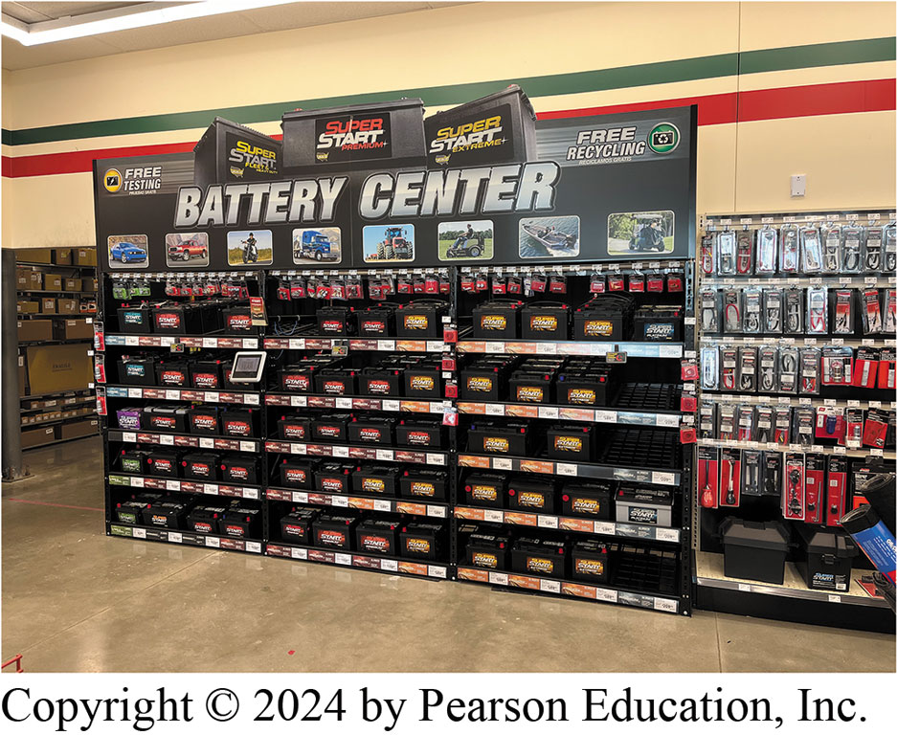
Figure 134.9 Batteries
Batteries are one example of a product that shops need to keep up to date because batteries lose capacity over time. Most batteries have a date sticker, which can help parts specialists determine when batteries have been on the shelf unsold for a period of time.
Notes:
CASE STUDY: The Case of the Overwhelmed Parts Store Manager
The manager of a locally owned and operated automotive parts store felt overwhelmed every day. It
seemed as if there was always more to do. Plus, the store was hard to keep looking clean because
many of the part cores were dirty and often leaked fluids. The parts manager saw an advertisement
for an automotive expo nearby that offered both technical as well as management training sessions.
The parts store manager signed up to attend the management classes. During one management session,
the parts manager learned one important lesson:
“Nothing should be on the floor that does not have to be on the floor.”
Everything should be placed off the floor and on shelves or in cabinets, and only those items that
are heavy, such as a brake lathe, should be on the floor. By keeping almost everything else off the
floor, cleaning is made easier and the store appears neat and clean for a longer period of time.
After returning from the expo, the parts manager spent about a week making a place for everything
and putting everything in its place. Now instead of placing cores on the floor or on the steps
leading to the upper level of shelving, the parts manager purchased plastic bins and placed the
cores in the plastic bins on a shelf. Larger cores, such as rack and pinion assemblies, were kept
on a shelf and off the floor. After about a week, the parts manager finally had a handle on the
store.
By keeping almost everything off the floor, cleaning was a lot easier. Customers even noticed that
the store always looked clean and neat.
Summary:
Complaint—The parts store always seemed to be messy and was hard to keep clean, making the parts manager feel overwhelmed.
Cause—Almost everything, especially cores, were on the floor of the parts store, making it difficult to clean and keep clean.
Correction—The parts store manager learned to keep the store looking clean by keeping almost everything off the floor.

Slide 30
Merchandizing
Point-of-Purchase
Best place for a display is in an open area near front of the store
Price Display Products
Customer is more likely to notice a display with a posted price than notice a specially priced item on shelf in its normal position.
Identifying Seasonal, Impulse, & Related Items
A seasonal item is something that is stocked only at certain times of year
Notes:
Point-of-Purchase The best place for a display is in an open area near the front of the store. An
attractive display will catch customers’ eyes when they enter. A display should be large and
appealing to the customer. This can be accomplished by building the display out of the product
being sold with the intent of the customer picking the item from the display. Many times, the OEM
of a product will send a display kit, which is assembled in the store. Often included with such
kits are shelves, banners, signs, and handouts. Displays are also often built near the cash
register as a point of purchase (POP) display, so that customers
notice the product when they pay. ● SEE FIGURE 134–10.
Price Display Products The practice of display pricing is to feature an item that is specially
priced as a display in an open part of the store or department. Along with the display is a
noticeable sign that calls out the special pricing. The product that is specially priced may remain
in its assigned shelf position, but this additional display lets customers know the part is on
sale. A customer is more likely to notice a display with a posted price than notice a specially
priced item on the shelf in its normal position. This type of display and pricing is also used to
introduce new items. A vendor may also choose to put up a display when certain items are
overstocked. This helps promote the item and possibly leads to increased sales.
Identifying Seasonal, Impulse, And Related Items
A seasonal item is something that is stocked only at certain times of the year or throughout the
entire year but not in large quantities. For example, dry gas is an alcohol-based product used to
remove moisture from fuel lines and tanks on gasoline- fueled vehicles in the winter months.
Batteries fail more often in the winter, so more of them should be kept in stock during the impulse
item is a product that the customer t rather than a need. Some examples include
■ speakers
■ phone adapters and cables
■ chrome accessories
■ interior items like extra cup holders or seat covers

Slide 31
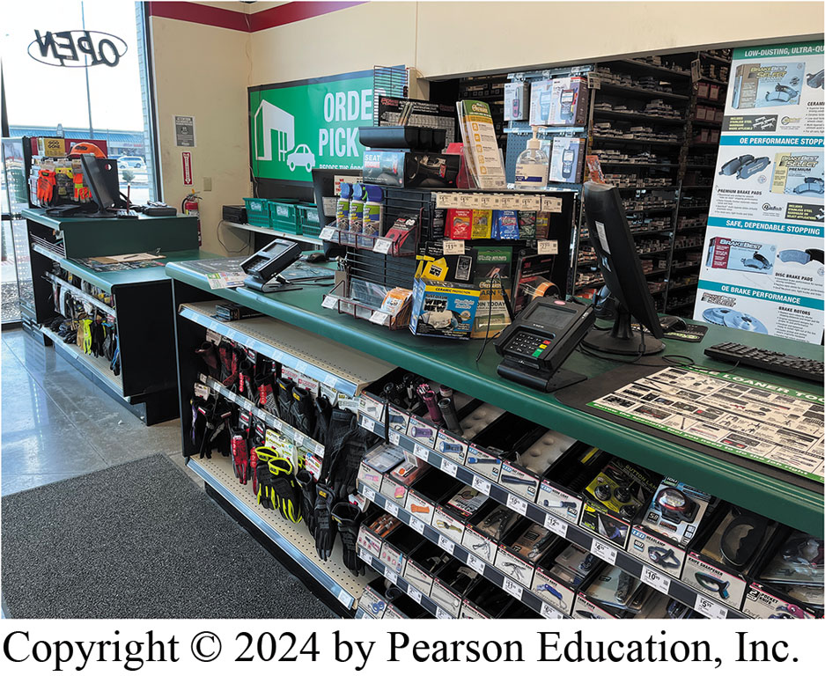
Figure 134.10 Point of Sale
The point of sale is often another place where a potential sale can be made by displaying small and popular items near where customers pay.

Slide 32
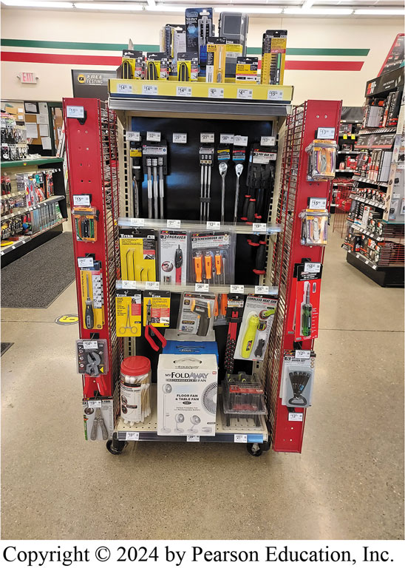
Figure 134.11 End Caps
End caps are a highly visible location where select products are showcased.
Notes:
TECH TIP: End Caps
An end cap is a rack or counter at the end of a store aisle used to display promotional or sale items. Studies repeatedly show that end caps sell better than in-aisle displays of the same product(s). Frequent rotation of products displayed on end caps rather than the regular shelves often makes economic sense because they grab customers’ attention. Figure 134–11.

Slide 33
Frequently Asked Question: What Is included in the Parts Specialist (P2) Test?
? Frequently Asked Question
What Is included in the Parts Specialist (P2) Test? Test Specifications and Task List Automobile Parts Specialist (Test P2) include
CONTENT AREA | NUMBER OF QUESTIONS IN THE TEST
A. General Operations | 10 (13%)
B. Customer Relations and Sales Skills | 11 (15%)
C. Vehicle Systems Knowledge | 40 (53%)
D. Vehicle Identification | 3 (4%)
E. Catalog and Information Systems Skills | 6 (8%)
F. Inventory Management | 3 (4%)
G. Merchandising | 2 (3%)
Total = 75 Questions | 100%

Slide 34
Question 1?
What is the purpose of an end cap?
a. To hide the end of the shelf
b. To showcase merchandise
c. To store unneeded parts
d. Any of the above

Slide 35
Answer 1
What is the purpose of an end cap?
b. To showcase merchandise

Slide 36
Automotive Fundamentals Videos and Animations
Videos Link: (A0) Automotive Fundamentals Videos
Animations Link: (A0) Automotive Fundamentals Animations

Slide 37
Copyright
This work is protected by United States copyright laws and is provided solely for the use of instructors in teaching their courses and assessing student learning. Dissemination or sale of any part of this work (including on the World Wide Web) will destroy the integrity of the work and is not permitted. The work and materials from it should never be made available to students except by instructors using the accompanying text in their classes. All recipients of this work are expected to abide by these restrictions and to honor the intended pedagogical purposes and the needs of other instructors who rely on these materials.

