Slide 1

Automotive Technology: Principles, Diagnosis, and Service
Seventh Edition
Chapter 133
Automatic Transmission/Transaxle Unit Repair
Copyright © 2023 Pearson Education, Inc. All Rights Reserved
Notes:
INSTRUCTOR NOTE: This presentation includes text explanation notes, you can use to teach the course. When in SLIDE SHOW mode, you RIGHT CLICK and select SHOW PRESENTER VIEW, to use the notes.

Slide 2
Learning Objectives (1 of 2)
133.1 Explain how to verify the need for unit repair.
133.2 Discuss the steps involved in removing the automatic transmission/transaxle.
133.3 Discuss the steps involved in disassembling the automatic transmission/transaxle.
133.4 Describe how to reassemble an automatic transmission/transaxle.
133.5 Discuss how to flush the cooler and torque converter.
133.6 Discuss dynamometer testing the automatic transmission/transaxle.

Slide 3
Learning Objectives (2 of 2)
133.7 Describe how to reinstall the automatic transmission/transaxle.
133.8 Describe road testing.

Slide 4
Verify The Need For Unit Repair
Verify the Fault
  Verify that the fault is inside, not outside, the unit.
In-Vehicle Repairs
  Parts and components that may be replaced with the transmission/transaxle still in the vehicle include:
  Pressure switches
  Transmission range switch
  Turbine and output speed sensors
  Valve body replacement
  Select gaskets and seals

Slide 5
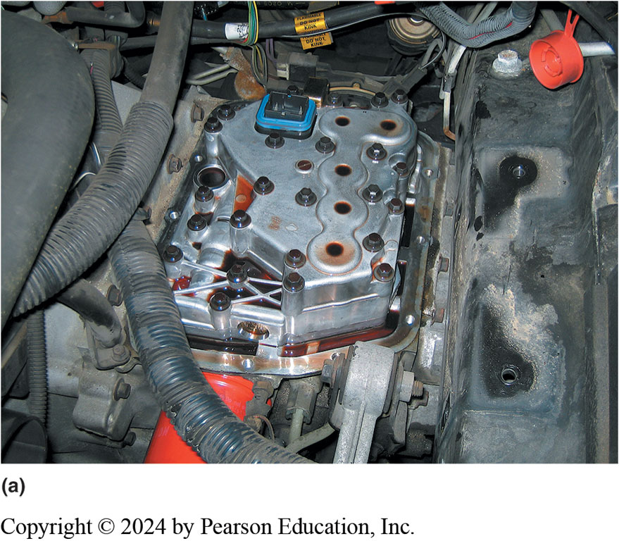
Figure 133.1 Valve Body Fault
(a) This Saturn did not shift correctly and one technician was ready to replace the unit; however, another technician thought that the problem could be due to a fault in the valve body

Slide 6
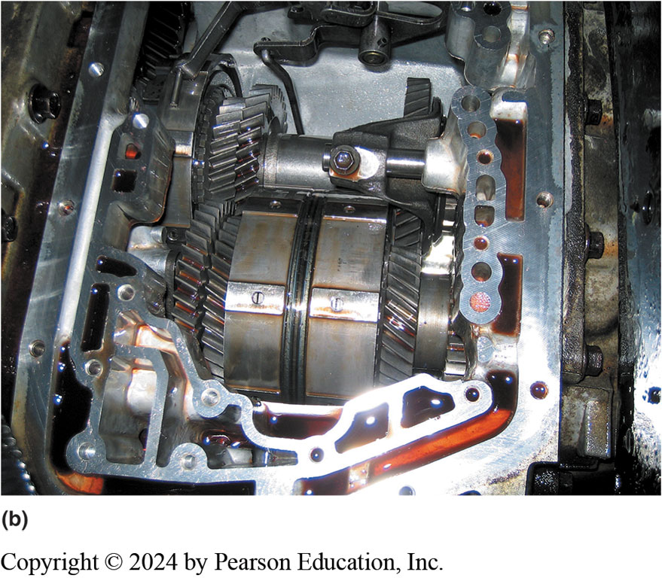
Figure 133.1.b Saturn Gears
(b) Removing the valve body shows the non-planetary gears used in the Saturn automatic transaxle

Slide 7
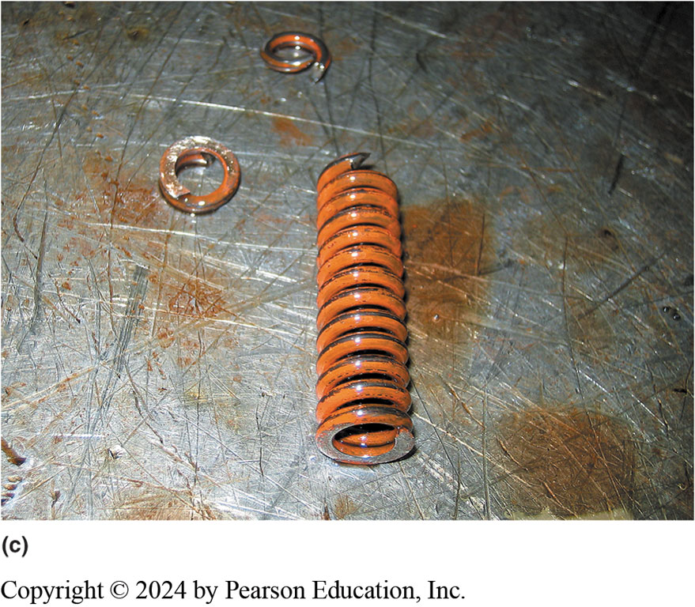
Figure 133.1c Broken Valve Spring
(c) The valve body was disassembled and a broken pressure regulator spring was found to be the cause of the customer concern

Slide 8
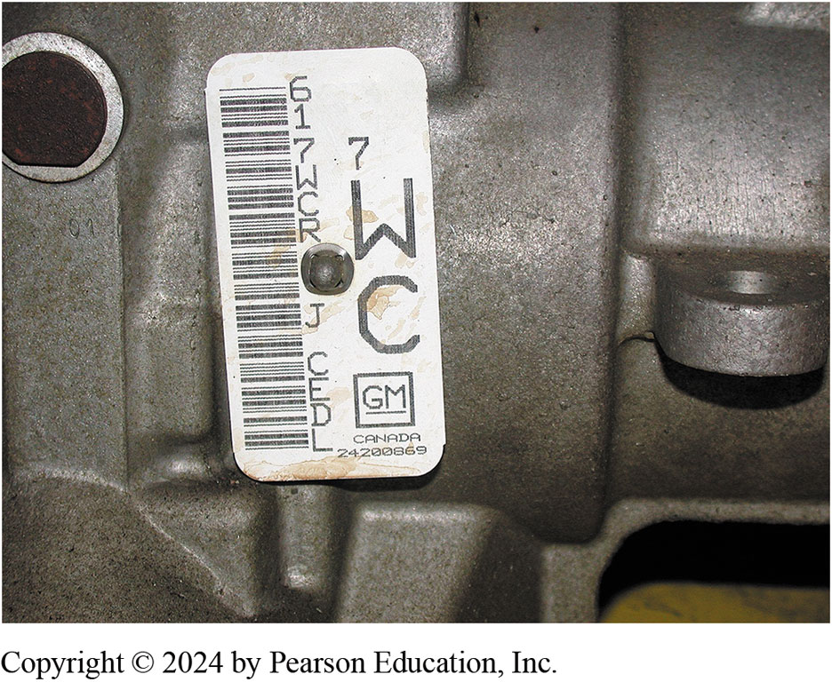
Figure 133.2 ID Tag
A transmission identification number on the side of the unit. The information on this tag is needed when ordering parts, as there are often several versions of the same transmission used in similar vehicles and the differences could affect the parts needed

Slide 9
Removing The Automatic Transmission/Transaxle For Service
Steps Involved
  Disconnect the battery
  Hoist the vehicle and drain the unit.
  Disconnect the drive shaft or drive axle shafts.
  Disconnect all cooler lines, linkage, and electrical connections.
  Disconnect the torque converter from the flex plate.
  Support the engine.
  Remove the transmission fasteners and safely remove the transmission from the vehicle.

Slide 10
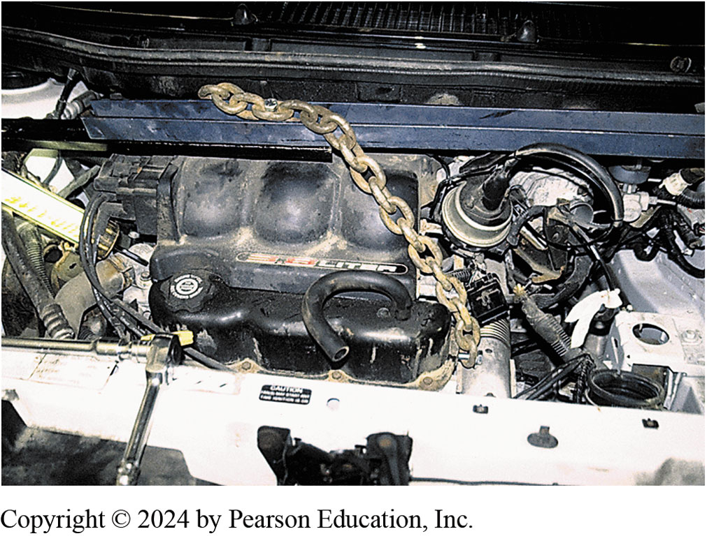
Figure 133.3 Engine Holding Tool
A chain and holding fixture being used on this front-wheel-drive vehicle to support the engine when the transaxle is removed

Slide 11
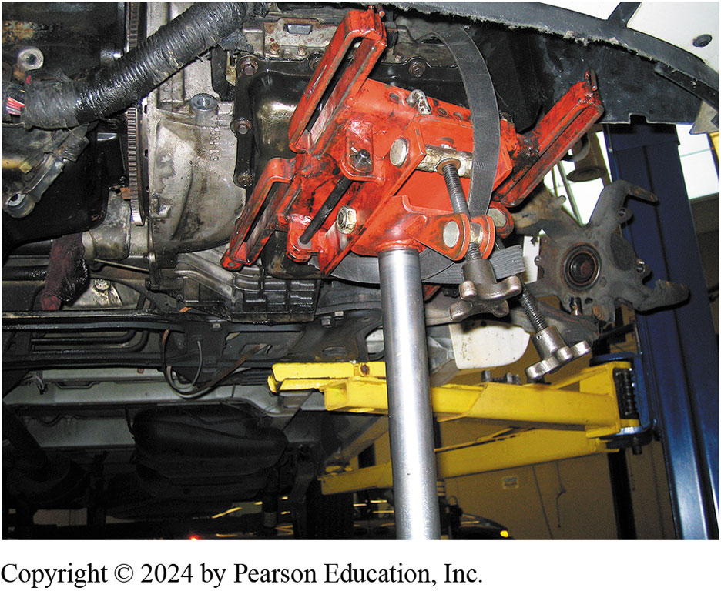
Figure 133.4 Transmission Jack
A transaxle being supported by a transmission jack prior to removal of the unit from underneath the vehicle

Slide 12
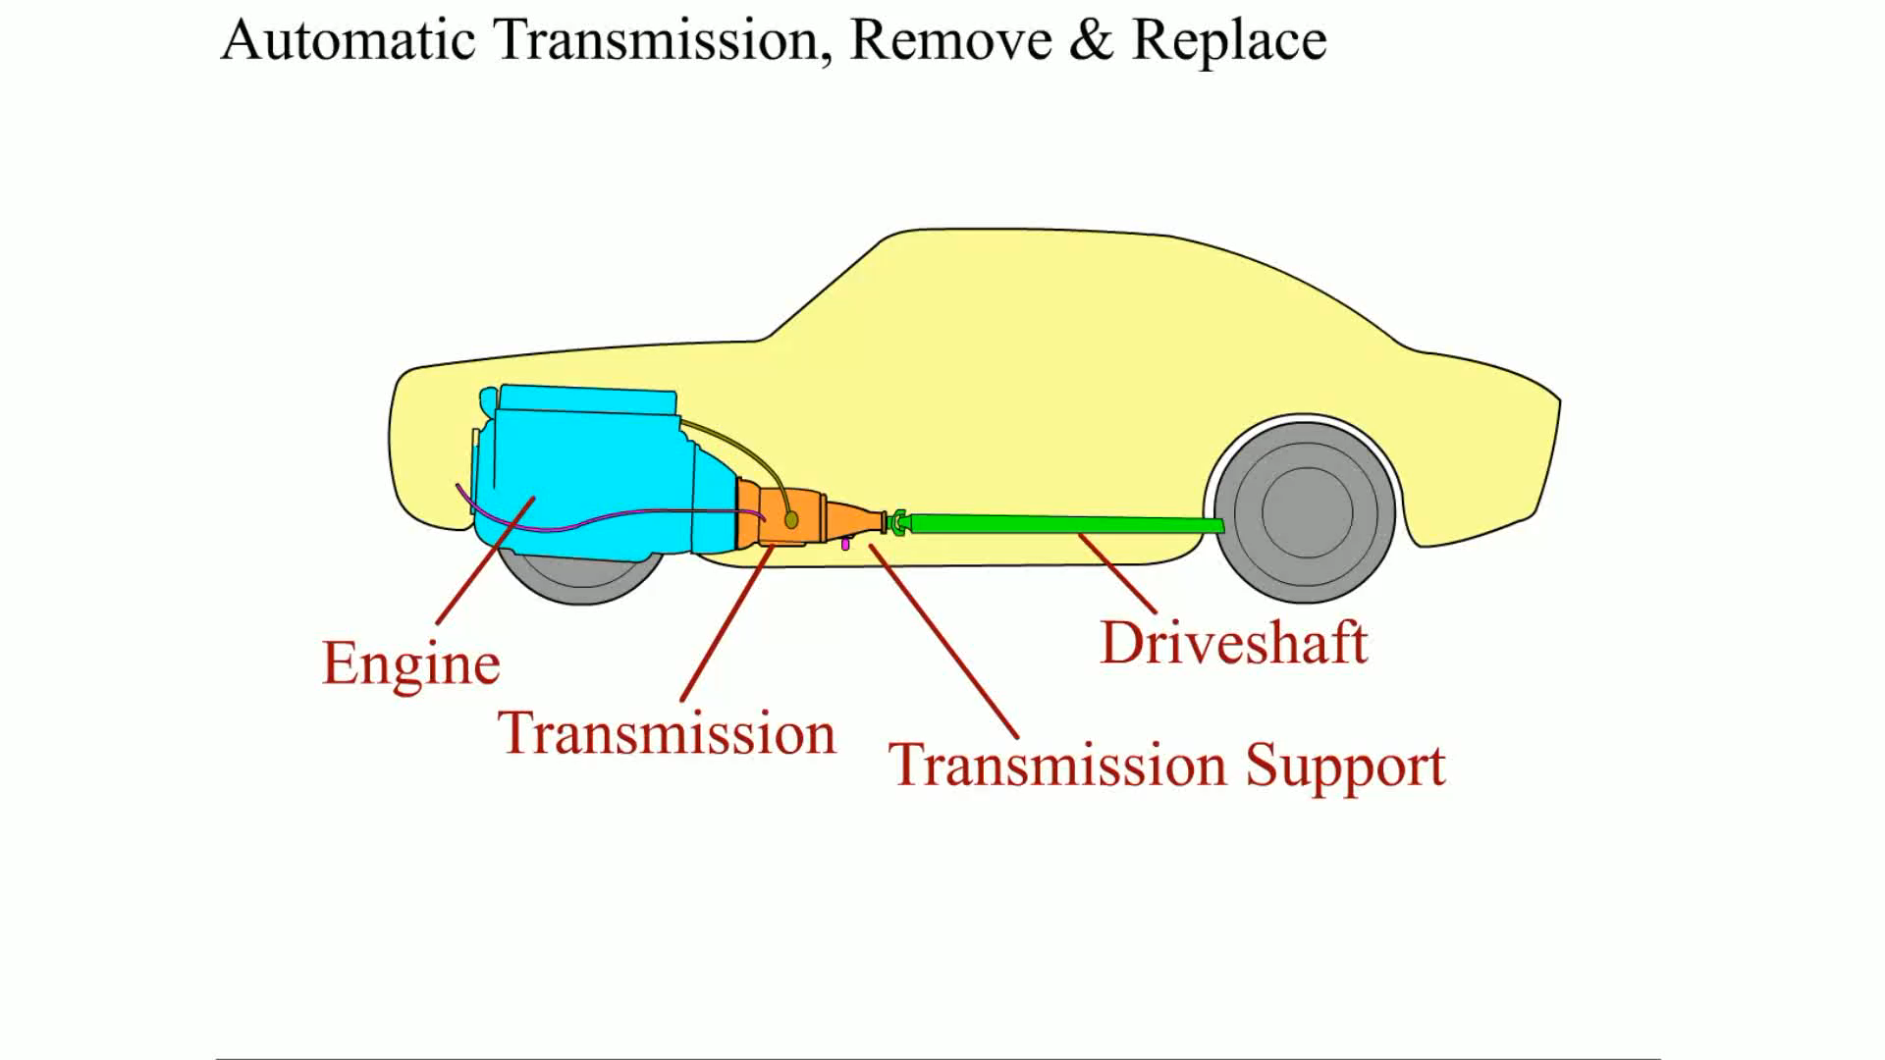
Animation: Automatic Transmission Remove and Replace
(Animation will automatically start)

Slide 13
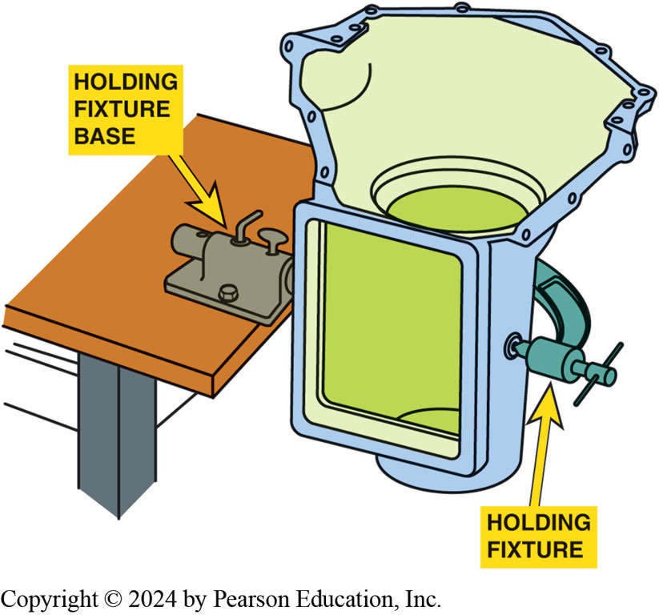
Figure 133.5 Holding Fixture
A holding fixture makes working on a transmission easier

Slide 14
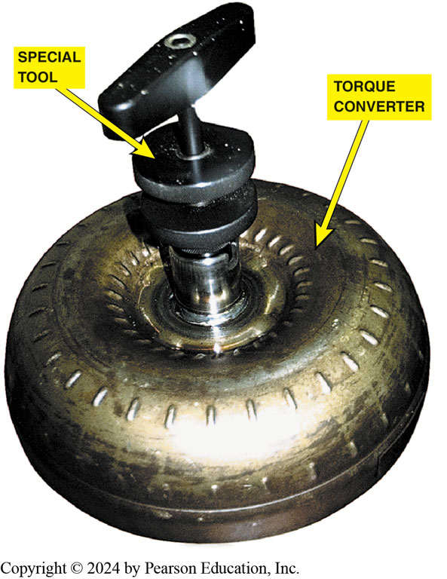
Figure 133.6 Converter Endplay
A special tool being used to check the end play of the stator inside the torque converter
Notes:
TECH TIP: Check the Flex Plate
After removing the transmission or transaxle, carefully inspect the flexplate for the following
faults:
1. Cracks
2. Warpage
3. Stripped starter ring gear teeth

Slide 15
Automatic Transmission/Transaxle Disassembly (1 of 5)
Mount to a Holding Fixture
  For best results, the automatic transmission/transaxle should be attached to a holding fixture that allows the unit to be rotated yet properly supported during disassembly and reassembly.
Torque Converter Checks
  Visually check for wetness that could indicate a leak such as at the welded seam.
  Inspect the hub for seal and wear.
  Check that the one-way clutch of the stator is working.
  Check for end play of the stator.

Slide 16
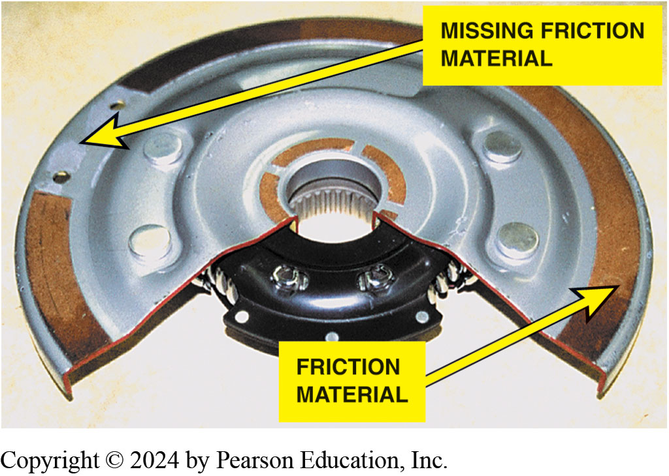
Figure 133.7
Cutaway of the torque converter clutch showing the paper-thin friction material
Notes:
TECH TIP: Replace the Torque Converter
Many automotive transmission/transaxle experts recommend that the torque converter be replaced when the automatic transmission is rebuilt or replaced. This is because the torque converter is
generally considered to be the “garbage pit” of the entire unit in that it often collects wear
particles from the clutches and bands that can cause future problems. According to remanufacturers
of torque converters, the majority of the torque converters being returned as cores have little, if
any, friction material remaining for the torque converter clutch. ● FIGURE 133–7.

Slide 17
Automatic Transmission/Transaxle Disassembly (2 of 5)
Valve Body
  Carefully check the operation of all shift valves by using a plastic tool or compressed air to move the valves in their bores. All valves should be free to move and should return to the home position by spring pressure.
Pump Assembly
  Check the pump for wear by checking service information for the recommended procedure and specifications.

Slide 18
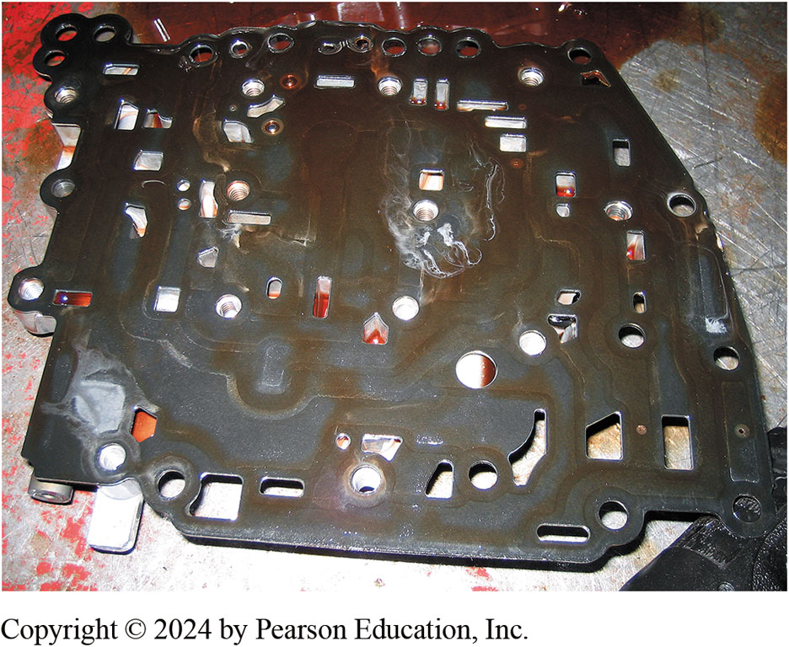
Figure 133.8 Separator Plate
A typical separator plate. Check holes over check balls to make sure that the metal balls have not caused damage to the separator plate during operation

Slide 19
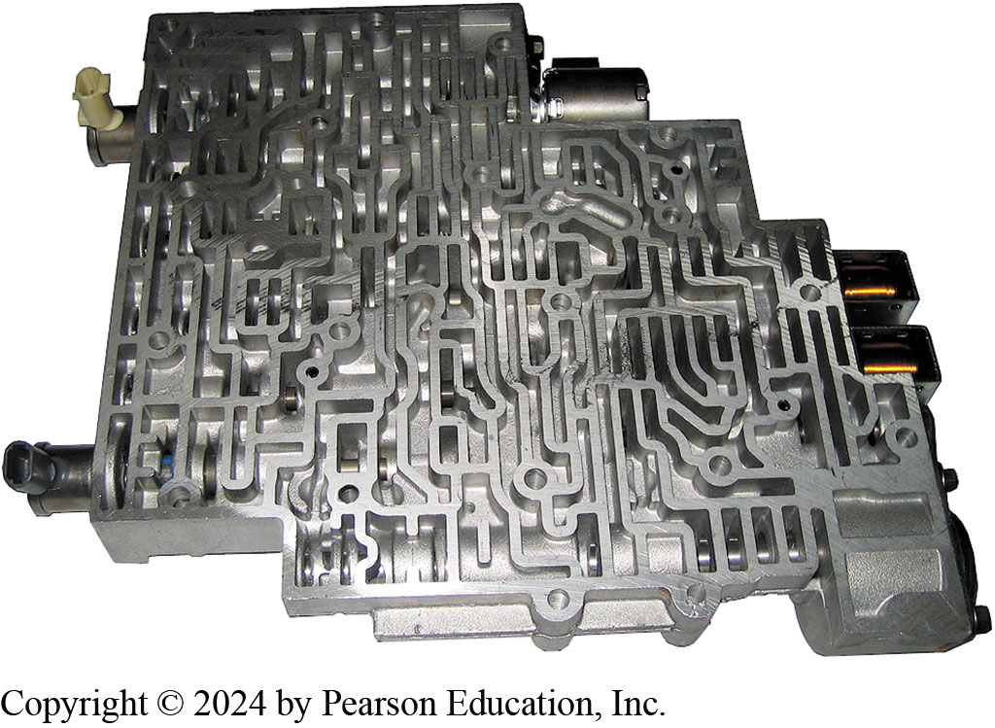
Figure 133.9 Valve Body
Check that all valves are free to move, and look for signs that the valves have caused wear to the valve bore. This causes fluid to leak around the valves, which can also cause shifting problems. If the bore is found to be worn, then the valve body will require repair using specialized tools or replacement
Notes:
TECH TIP: The Valve Body Cardboard Trick
To help remember where each bolt goes in the valve body, draw an outline of the valve body on
cardboard and then stick the bolts through the cardboard in the position where they were removed. Often the lengths of the bolts are different, so this method saves time and helps prevent possible harm to the valve body of the case of the transmission/transaxle when reassembling the unit.

Slide 20
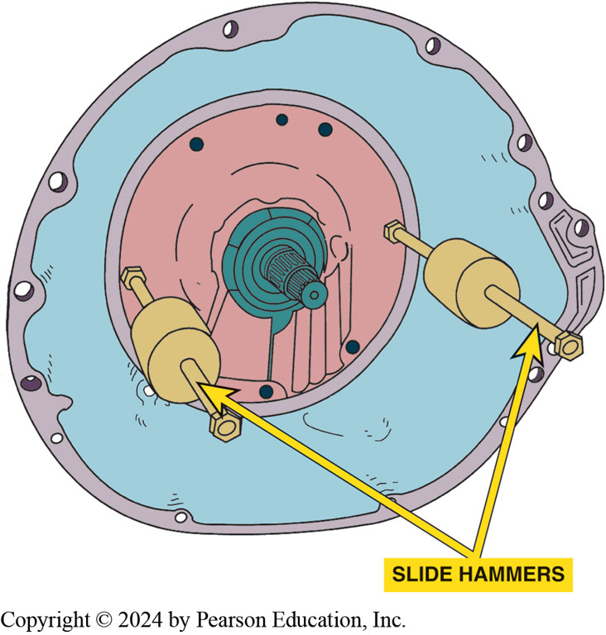
Figure 133.10 Front Pump
Two slide hammers are often used to remove a pump from older automatic transmissions

Slide 21
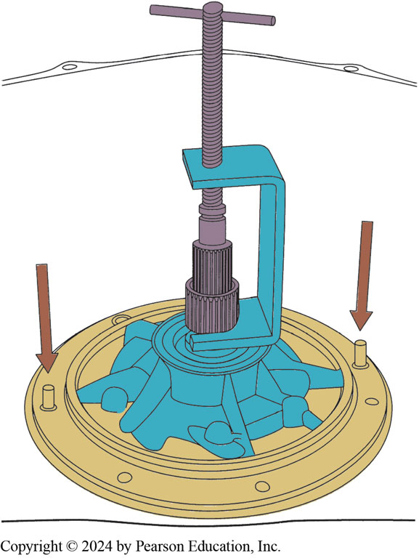
Figure 133.11 Pump Puller
A special puller is usually specified to remove aluminum pumps from automatic transmission/transaxles. Alignment pins (arrows) are used to properly align the gasket and pump on the case during reassembly

Slide 22
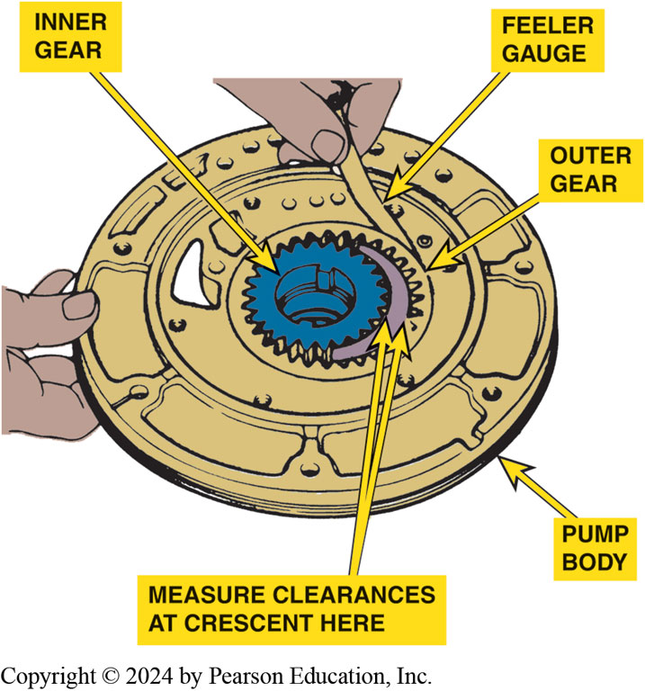
Figure 133.12
Checking a transmission pump assembly for wear using a feeler gauge. Compare the reading to factory specifications

Slide 23
Automatic Transmission/Transaxle Disassembly (3 of 5)
Unit Disassembly
  Before disassembly, measure input shaft end play.
  Some transmissions require the measurement of output shaft end play.
  Always check service information for the specified procedures to follow.
Clutch Packs
  Begin disassembling a clutch pack by removing the snap ring that holds the discs in the housing.

Slide 24
Automatic Transmission/Transaxle Disassembly (4 of 5)
Friction Disc Inspection
  If any friction disc shows signs of one or more of the defects, replace the entire set.
Steel Disc Inspection
  Replace the entire set of steels if you note a rough surface or there is uneven or spotty discoloration on any of the discs.
Clutch Piston Removal and Inspection
  To remove the snap ring holding the clutch piston in place, compress the piston return springs using the proper compressor tool.

Slide 25
Automatic Transmission/Transaxle Disassembly (5 of 5)
Return Spring Inspection
  Coil springs should be straight and provide proper pressure.
Clutch Piston Inspection
  Check the piston for cracks, scoring, seal damage, and ensure any check valve works normally.
Hubs, Drums, Shells, and Planetaries
  Carefully check drums and shells for cracks before reusing.
  Gear sets should be checked for proper pinion gear end play

Slide 26
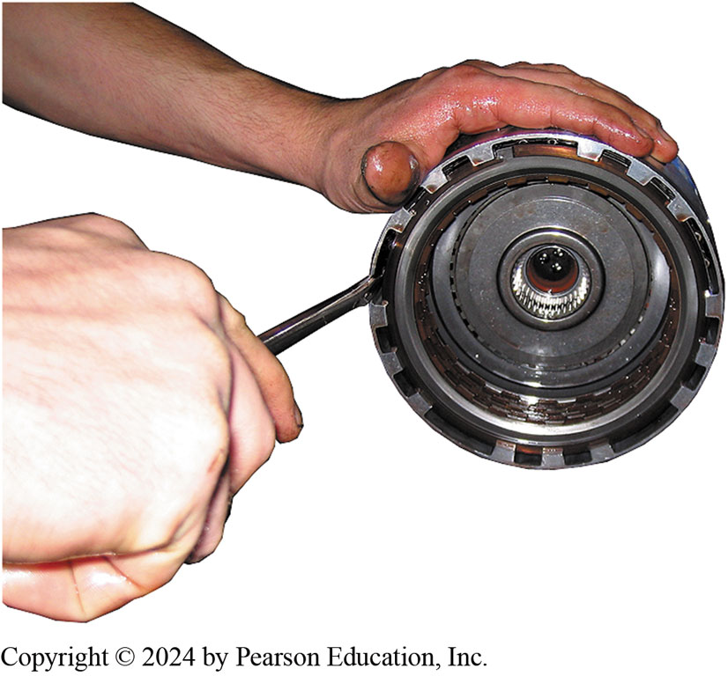
Figure 133.13 Removing Snap Ring
A straight-blade screwdriver can help remove the snap ring that is used to retain the frictions and steels in the clutch pack
Notes:
TECH TIP: A Picture Is Worth a Thousand Words
During disassembly, note items such as direction of snap rings front and back and clock position of
the snap ring openings. Instead of taking numerous detailed notes, use a digital or phone camera
and take pictures as the unit is being disassembled. Then the photos can be reviewed during
reassembly to be sure that everything is installed in the same position as it
was when it was disassembled.

Slide 27
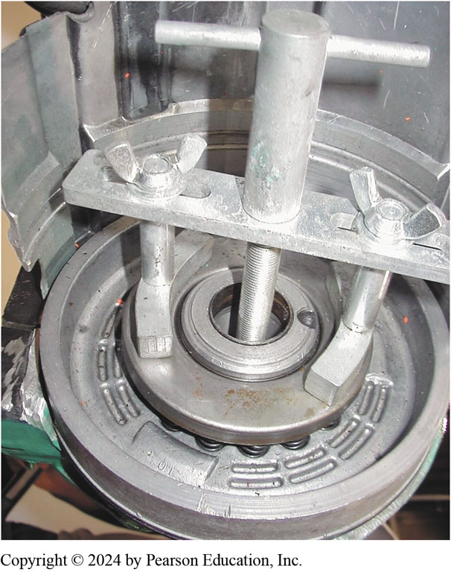
Figure 133.14 Compressor Tool
A compressor tool is usually necessary to compress the springs of the clutch piston to remove the snap ring
Notes:
TECH TIP: Smooth Is In; Rough Is Out
It used to be common practice in the automatic transmission business for the rebuilder to use
sandpaper to “roughen up” the surface of the steel discs to achieve a good clutch apply. This is
not true now. Sanding creates grooves and sharp peaks that decrease the oil film between the paper
on the friction plate and the steel plates. There should be a thin oil film between the paper and the steel to create a holding bond and make it possible for a clutch pack to apply and release thousands of times without wear. Therefore, for consistent shifts and a long-lasting transmission/transaxle, do not sand the steel discs. Steels are often replaced with new steels along with new friction discs during an overhaul.

Slide 28
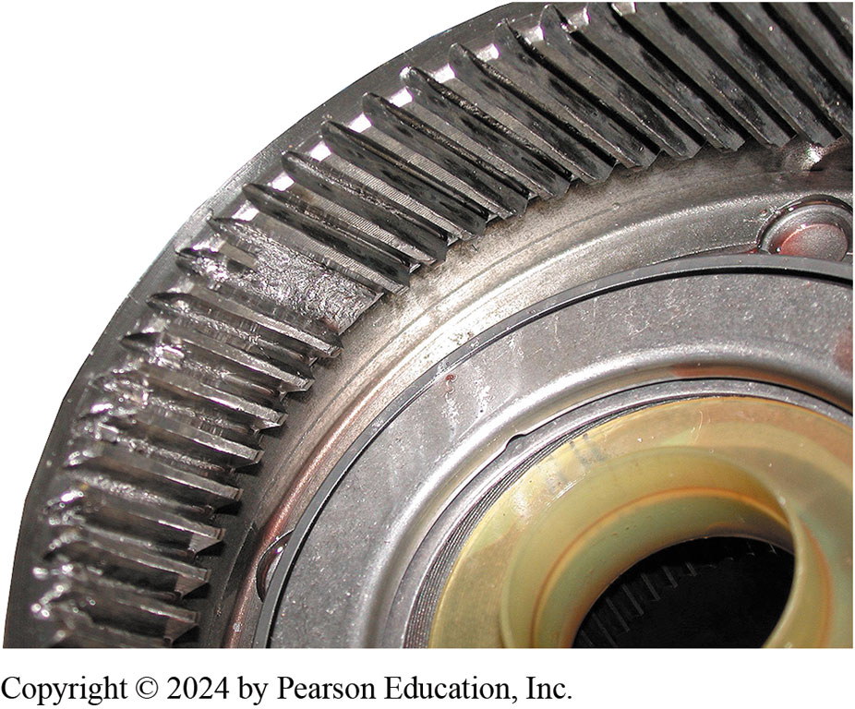
Figure 133.15 Damaged Ring Gear
The ring gear has damaged gear teeth. This entire planetary gear set must be replaced because the damage also affected the gear teeth of the planetary pinion gears and the sun gear

Slide 29
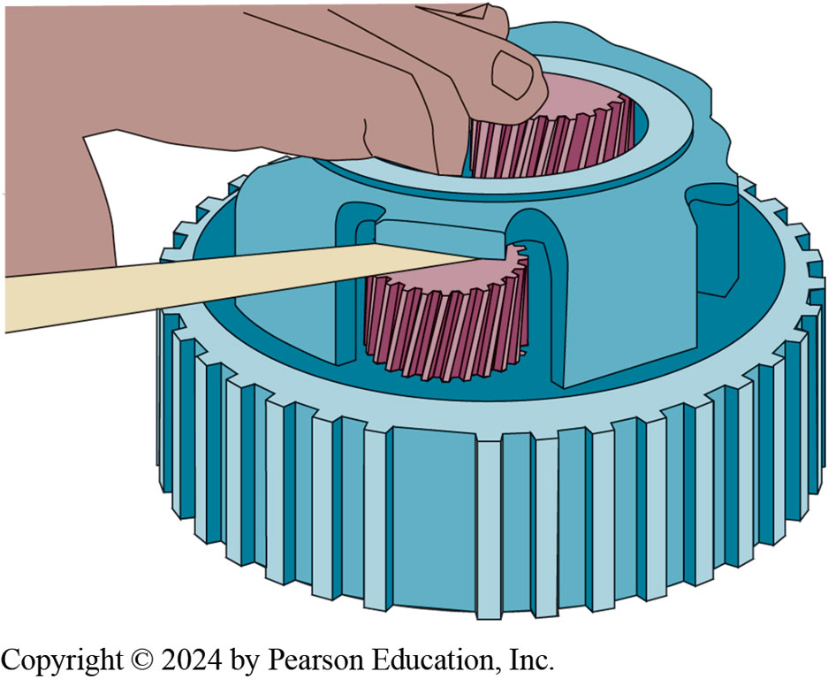
Figure 133.16 Pinion End Play
Pinion gear end play can be checked using a feeler gauge

Slide 30
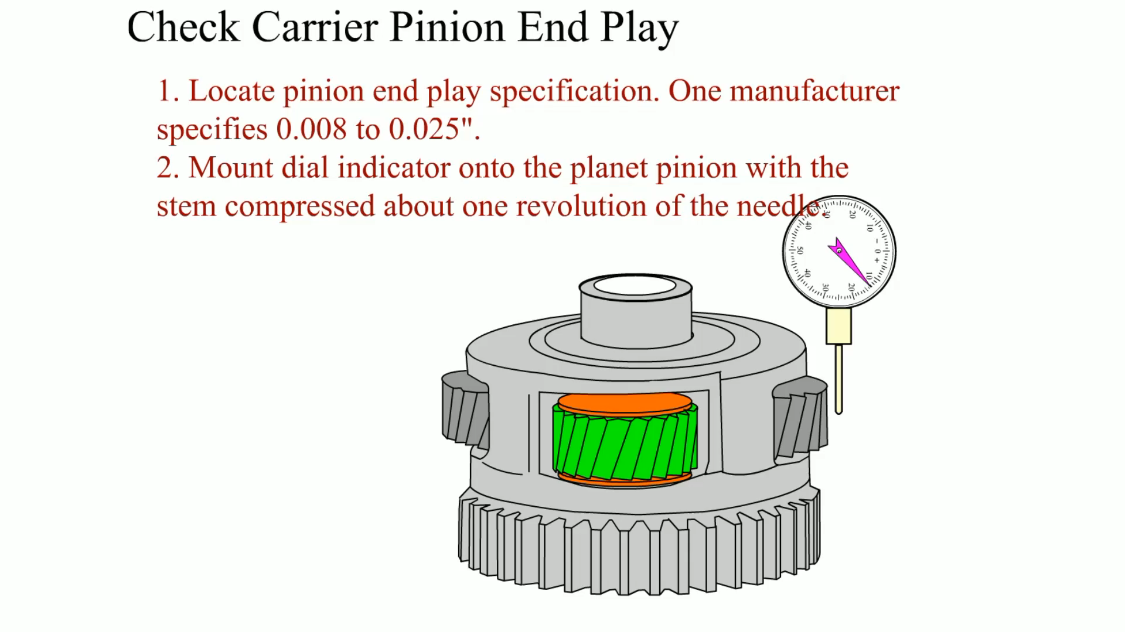
Animation: Check Carrier Pinion End Play
(Animation will automatically start)

Slide 31
Reassembling An Automatic Transmission/Transaxle (1 of 3)
Clutch Assembly
  Before assembling a clutch assembly, soak all friction plates in automatic transmission fluid (A T F).
Air Pressure Checks
  An air pressure check uses air to apply clutches and/or bands to verify that components such as clutch packs perform correctly.
Bushings
  All bushings should be inspected and replaced if necessary.

Slide 32
Reassembling An Automatic Transmission/Transaxle (2 of 3)
One-Way Clutches
  Always double check that all one-way roller clutches are installed correctly.
Special Tools
  Special tools are often specified by the vehicle manufacturer.
Pump Assembly
  Follow the vehicle manufacturer’s recommended procedures.

Slide 33
Reassembling An Automatic Transmission/Transaxle (3 of 3)
End Play Checks
  Perform all end play checks during assembly to ensure that the unit was properly assembled and that the proper internal clearances are achieved.
Valve Body Checks
  The valve body should be checked for leaks and to ensure all valves move freely.

Slide 34
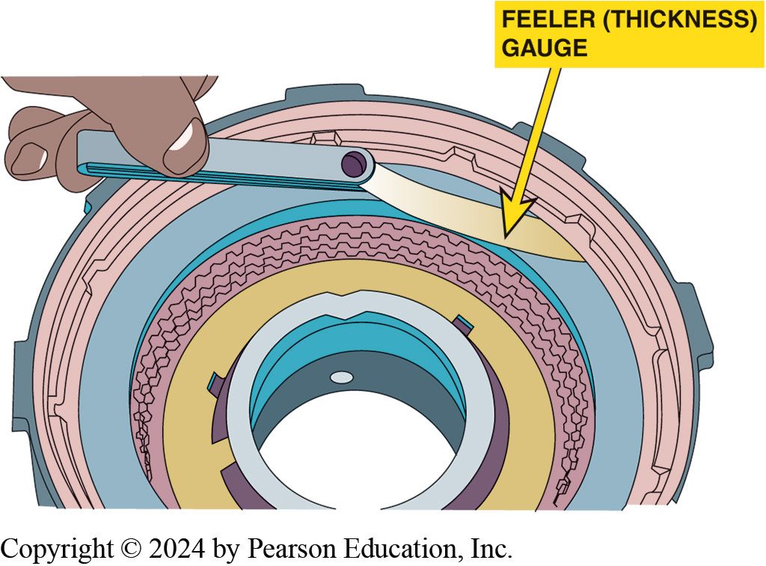
Figure 133.17 Clutch Pack Clearance
All clutch packs should be checked for proper clearance. Here, a feeler (thickness) gauge is used to check the clearance to make sure it is within factory specifications

Slide 35
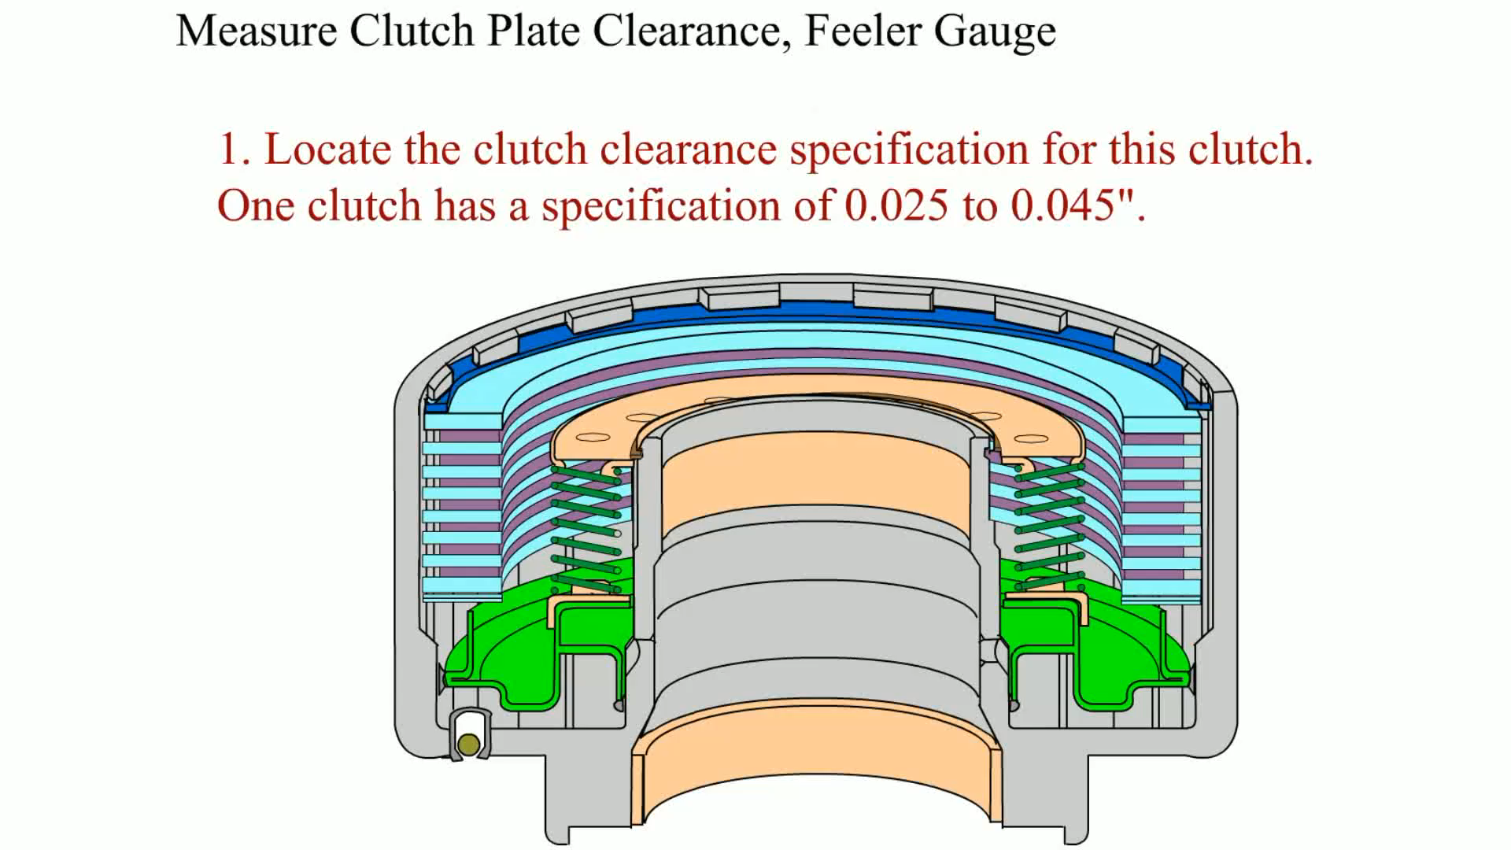
Animation: Measure Clutch Plate Clearance, Feeler Gauge
(Animation will automatically start)

Slide 36
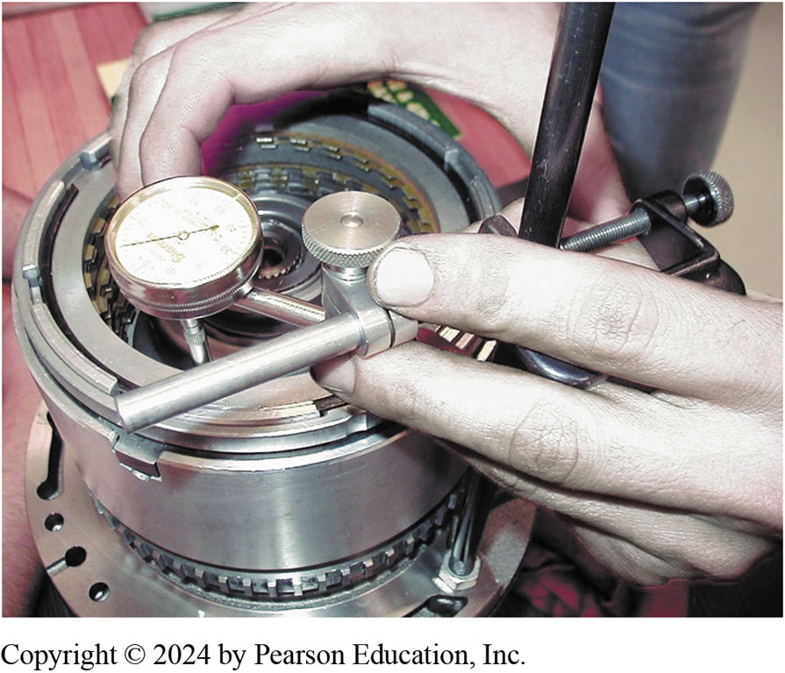
Figure 133.18 Using Dial Indicator
Checking clutch pack clearance using a dial indicator. This method is used when a feeler gauge cannot be inserted to check for proper clearance

Slide 37
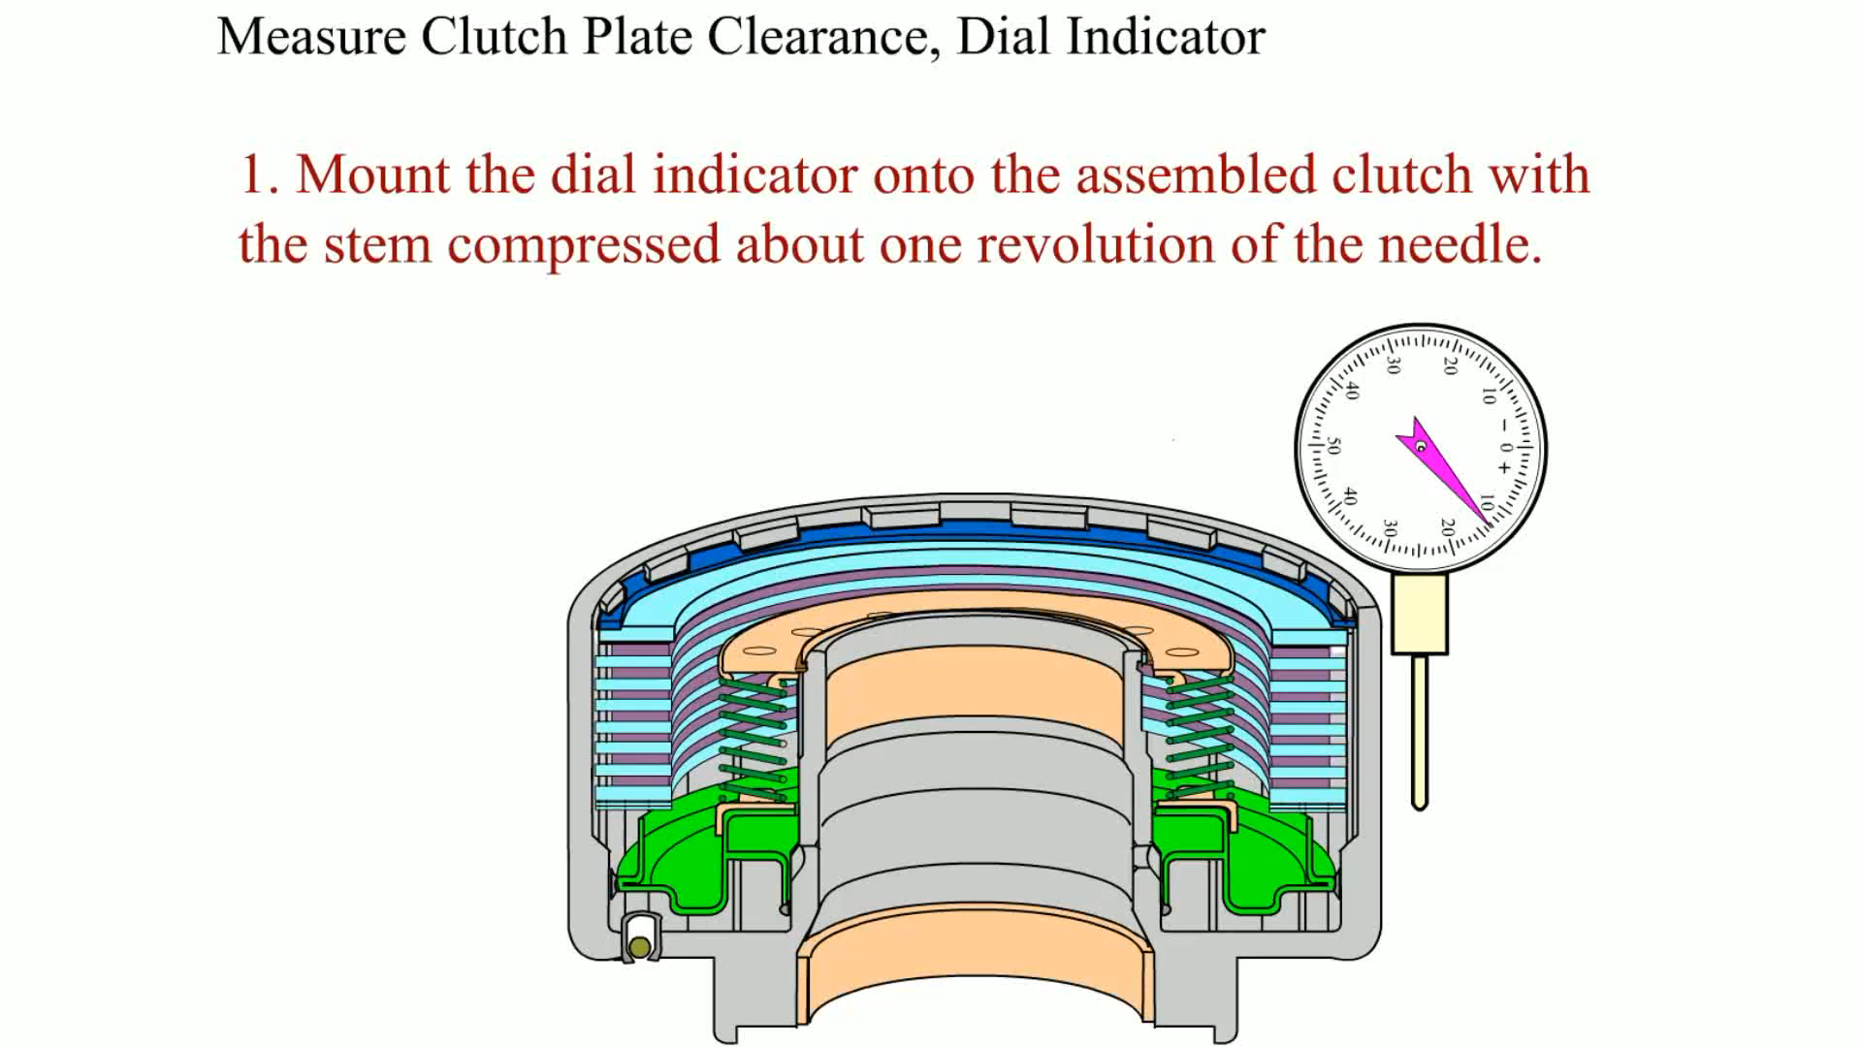
Animation: Measure Clutch Clearance, Dial Indicator
(Animation will automatically start)

Slide 38
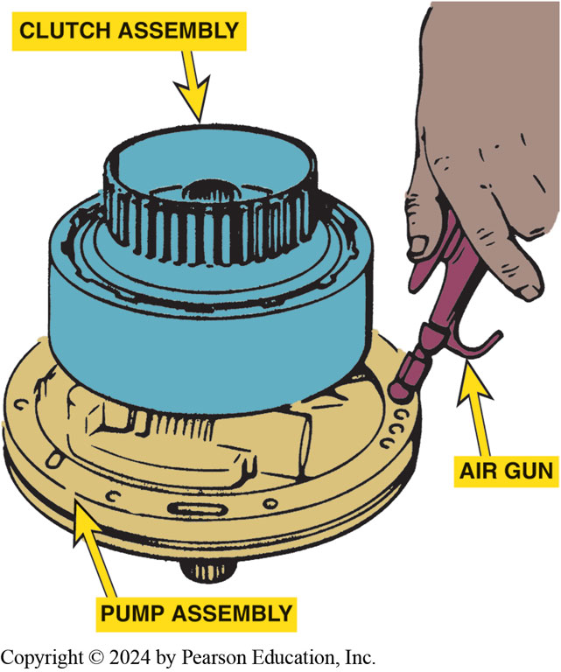
Figure 133.19 Air Testing
Air testing a clutch pack before installing it into an automatic transmission or transaxle

Slide 39
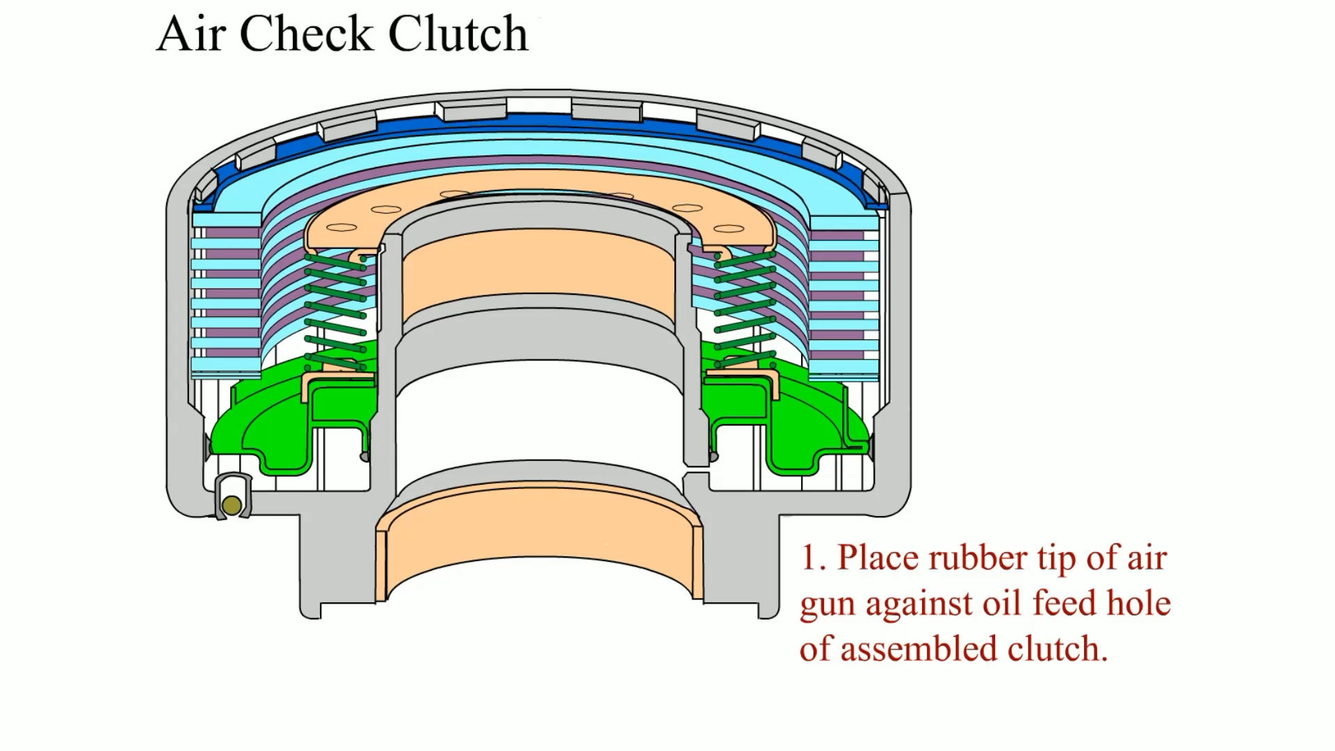
Animation: Air Check Clutch
(Animation will automatically start)

Slide 40
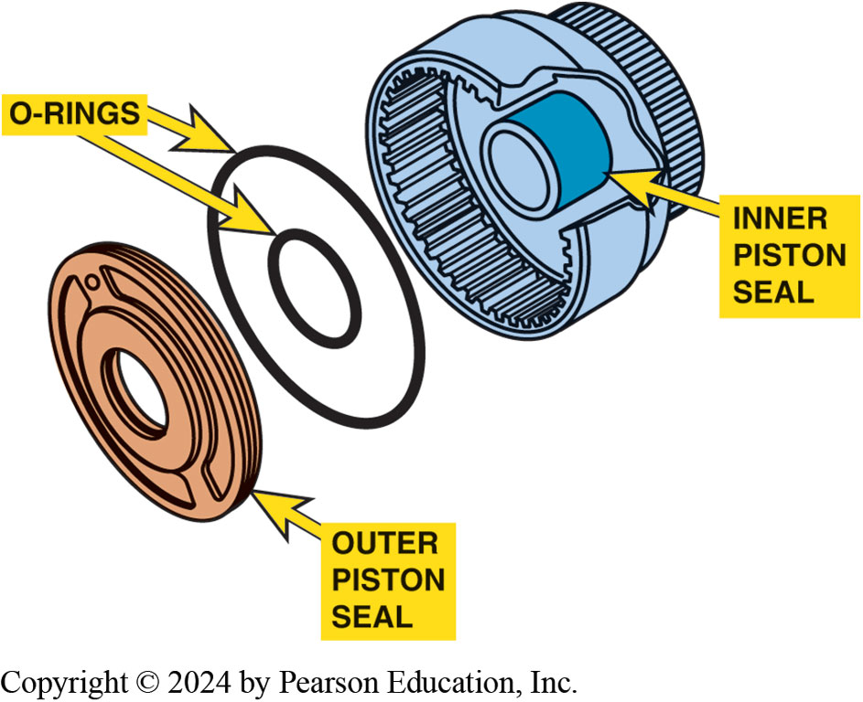
Figure 133.29 Seals
Both the inner and outer seals are checked when air testing a clutch pack assembly

Slide 41
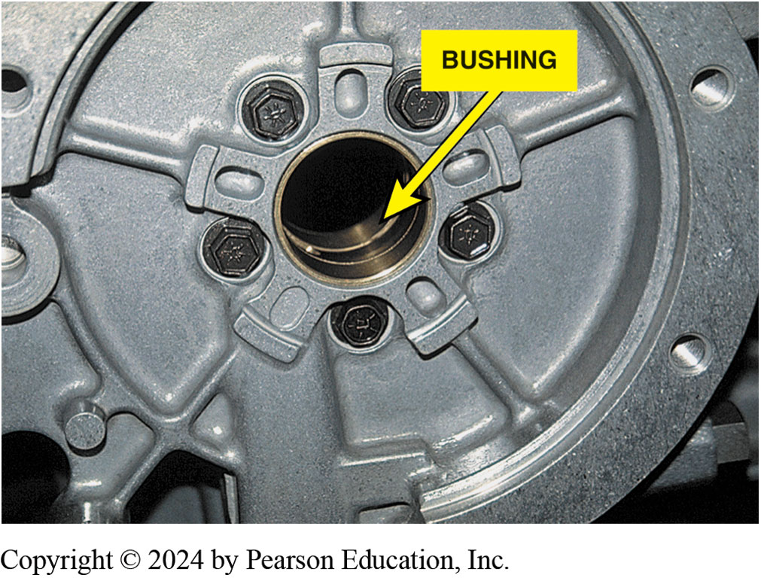
Figure 133.21 Bushing
A typical brass bushing used in an automatic transmission

Slide 42
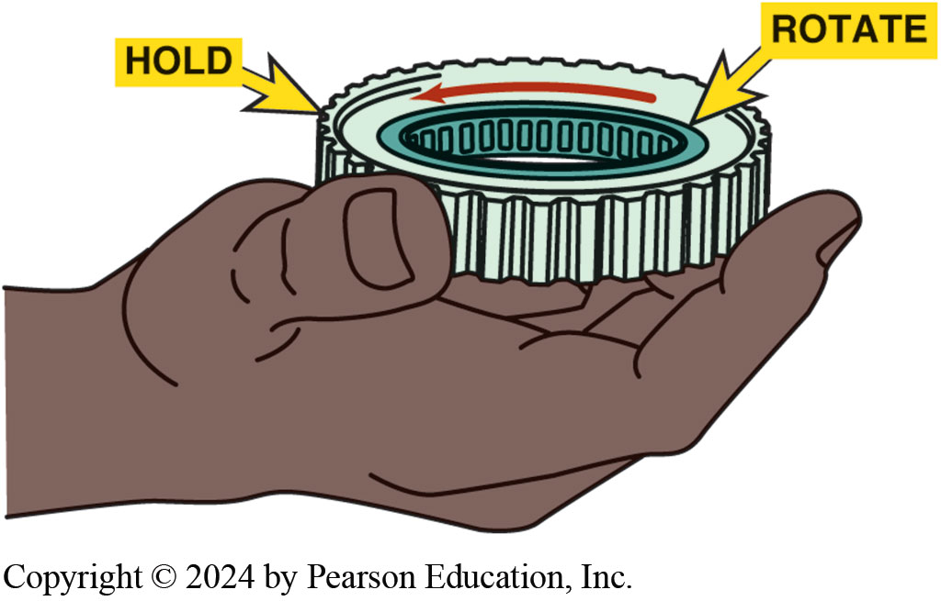
Figure 133.22 One-Way Roller Clutch
Service information states that this one-way roller clutch should be installed as shown. Check by holding the outer race so that the inner race is free to rotate counterclockwise as shown

Slide 43
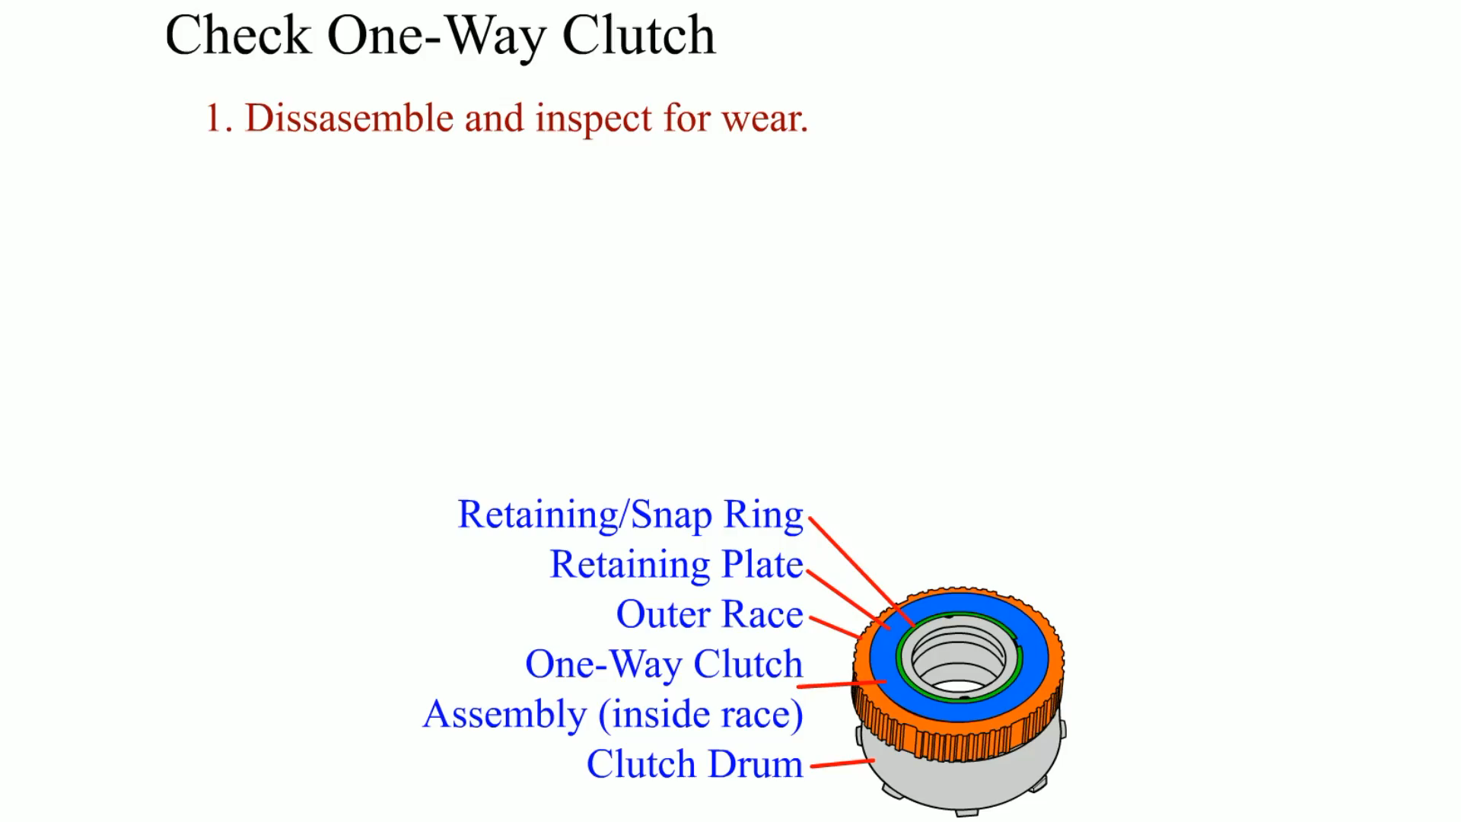
Animation: Check One-Way Clutch
(Animation will automatically start)

Slide 44
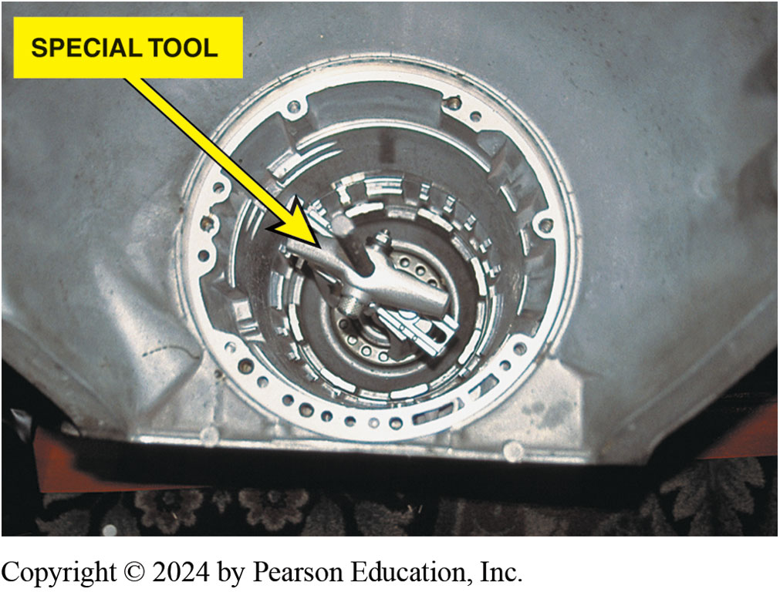
Figure 133.23 Special Clamp Tool
A special clamp makes removal and reinstallation of this clutch pack easier

Slide 45
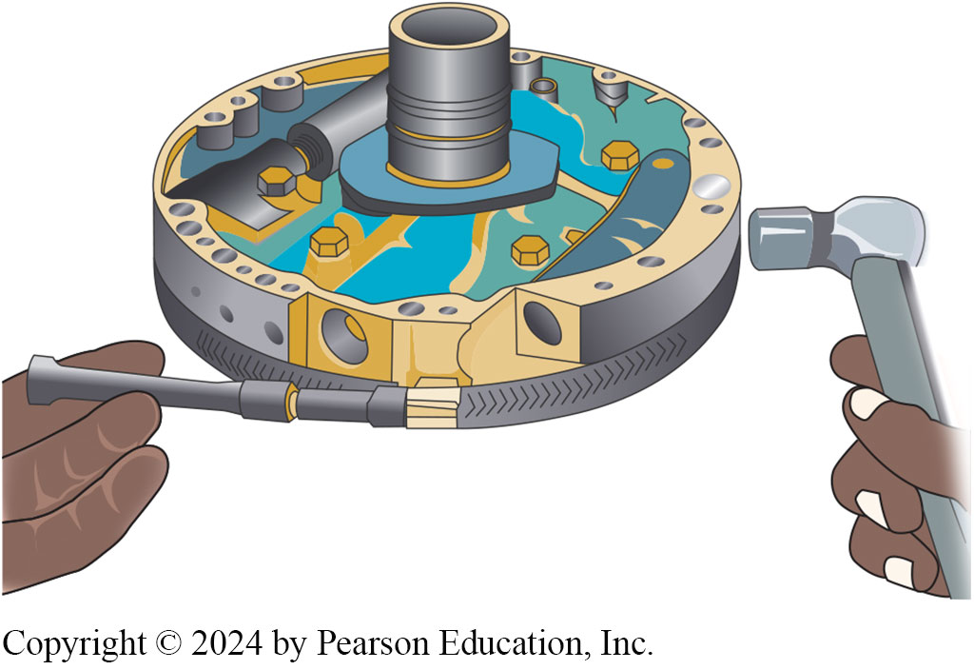
Figure 133.24 Pump Alignment
Using an alignment clamp to assemble both pump halves. To ensure proper alignment, many experts recommend lightly tapping the outer edges of the pump while tightening the clamp

Slide 46
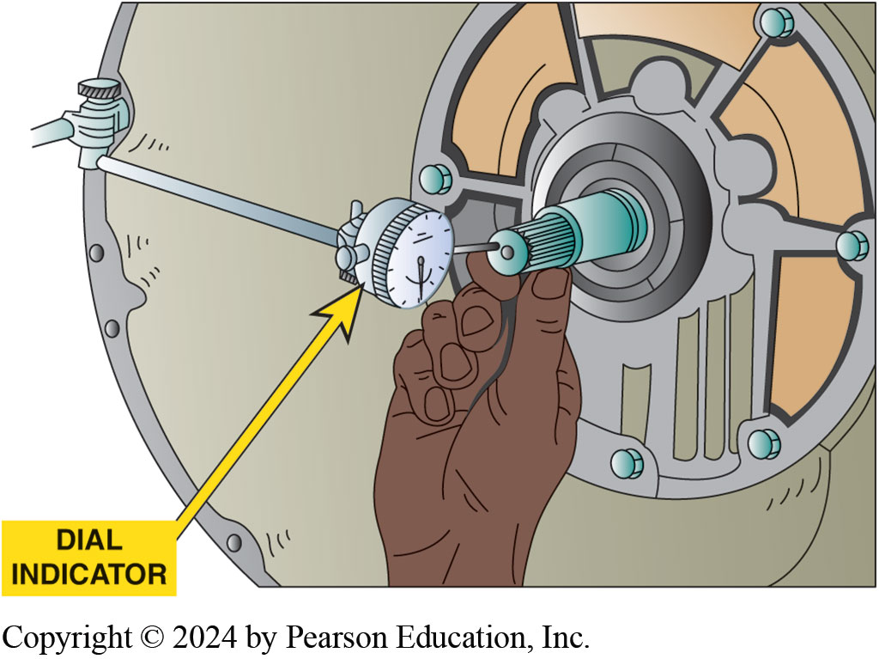
Figure 133.25 End Play
A dial indicator being used to measure the end play of an input shaft. If the end play is not within factory specifications, the unit may not have been assembled correctly

Slide 47
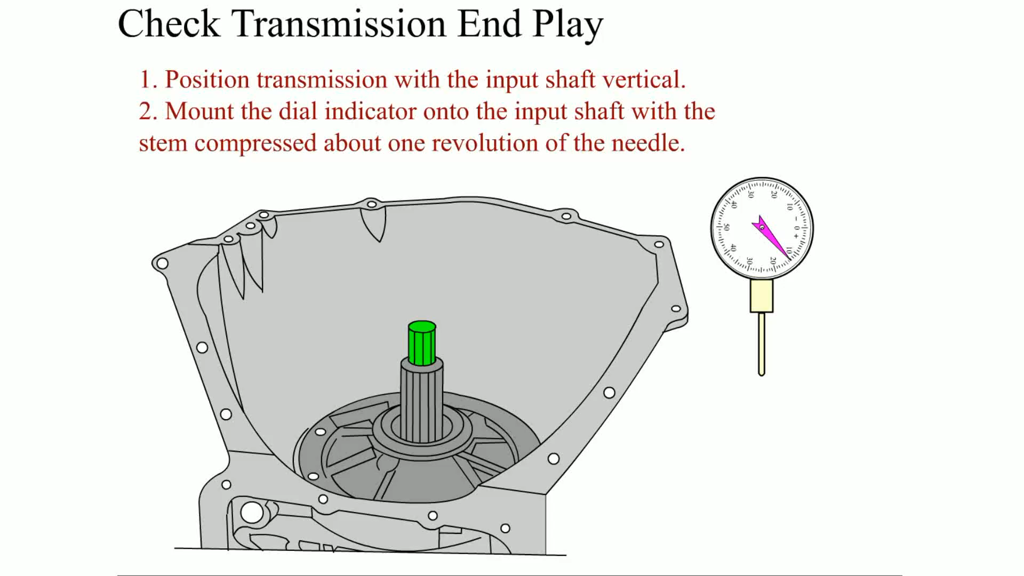
Animation: Check Transmission End Play
(Animation will automatically start)

Slide 48
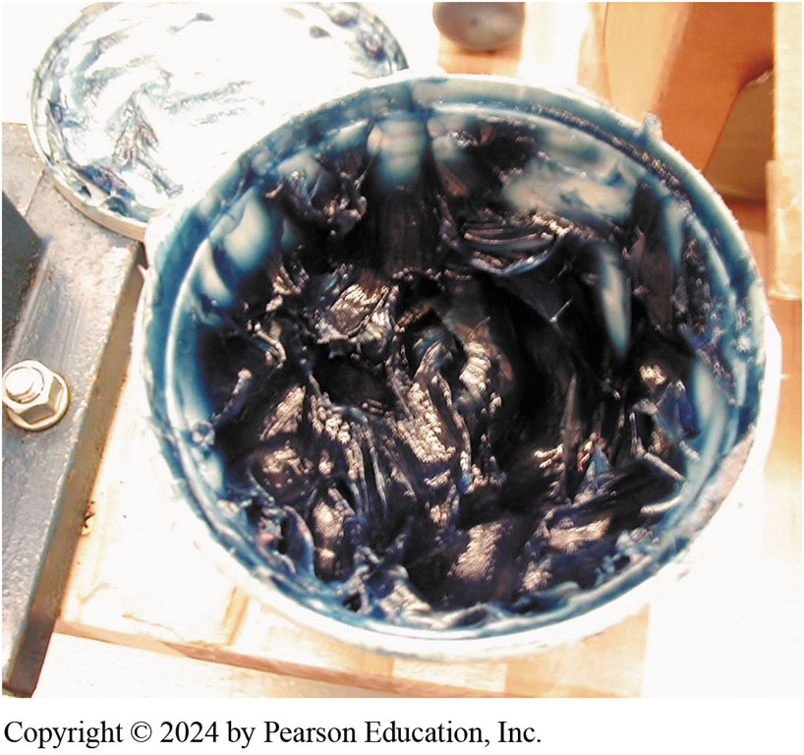
Figure 133.26 Blue Assembly Lube
Notes:
TECH TIP: Avoid Using Red Assembly Lube
Assembly lube is used during the reassembly of automatic transmissions. If red assembly lube is
used on seals, it may look like an automatic transmission fluid leak when the transmission gets hot
and the lube melts. If you use blue, green, brown, or clear assembly lube, then the color will
immediately identify it as assembly lube. ● SEE FIGURE 133–26.
Many transmissions have been disassembled because the service technician thought that the red
liquid dripping from parts of the transmission was automatic transmission fluid when, in fact, it
was only assembly lube that melted and ran when the transmission reached normal operating
temperature.

Slide 49
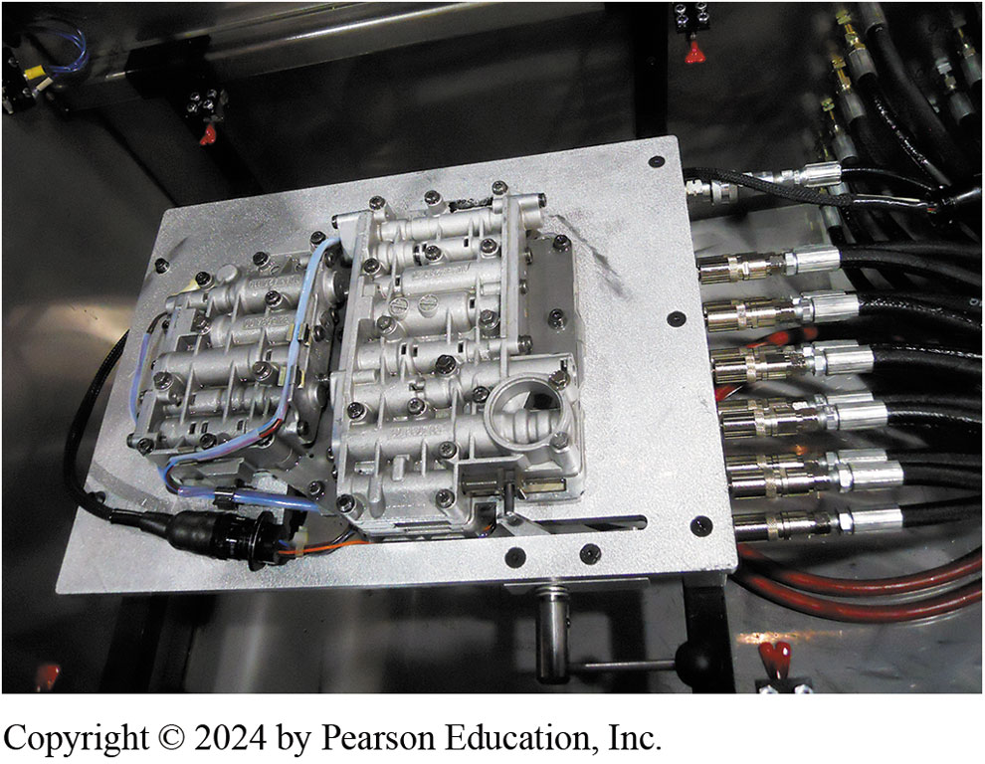
Figure 133.27 Valve Body Tester
A valve body being tested on a valve body tester. While it takes some setup time to adapt each valve body to the proper hoses, this type of machine can find valve body problems before the transmission/transaxle is installed in the vehicle
Notes:
TECH TIP: Change the Bolts and Washers
When reassembling an automatic transmission, always replace the pump bolts and sealing washers to avoid the possibility of a leak. A leak in the area of the pump can cause quite a headache for the
technician because the entire assembly must be removed from the vehicle again to fix it.

Slide 50
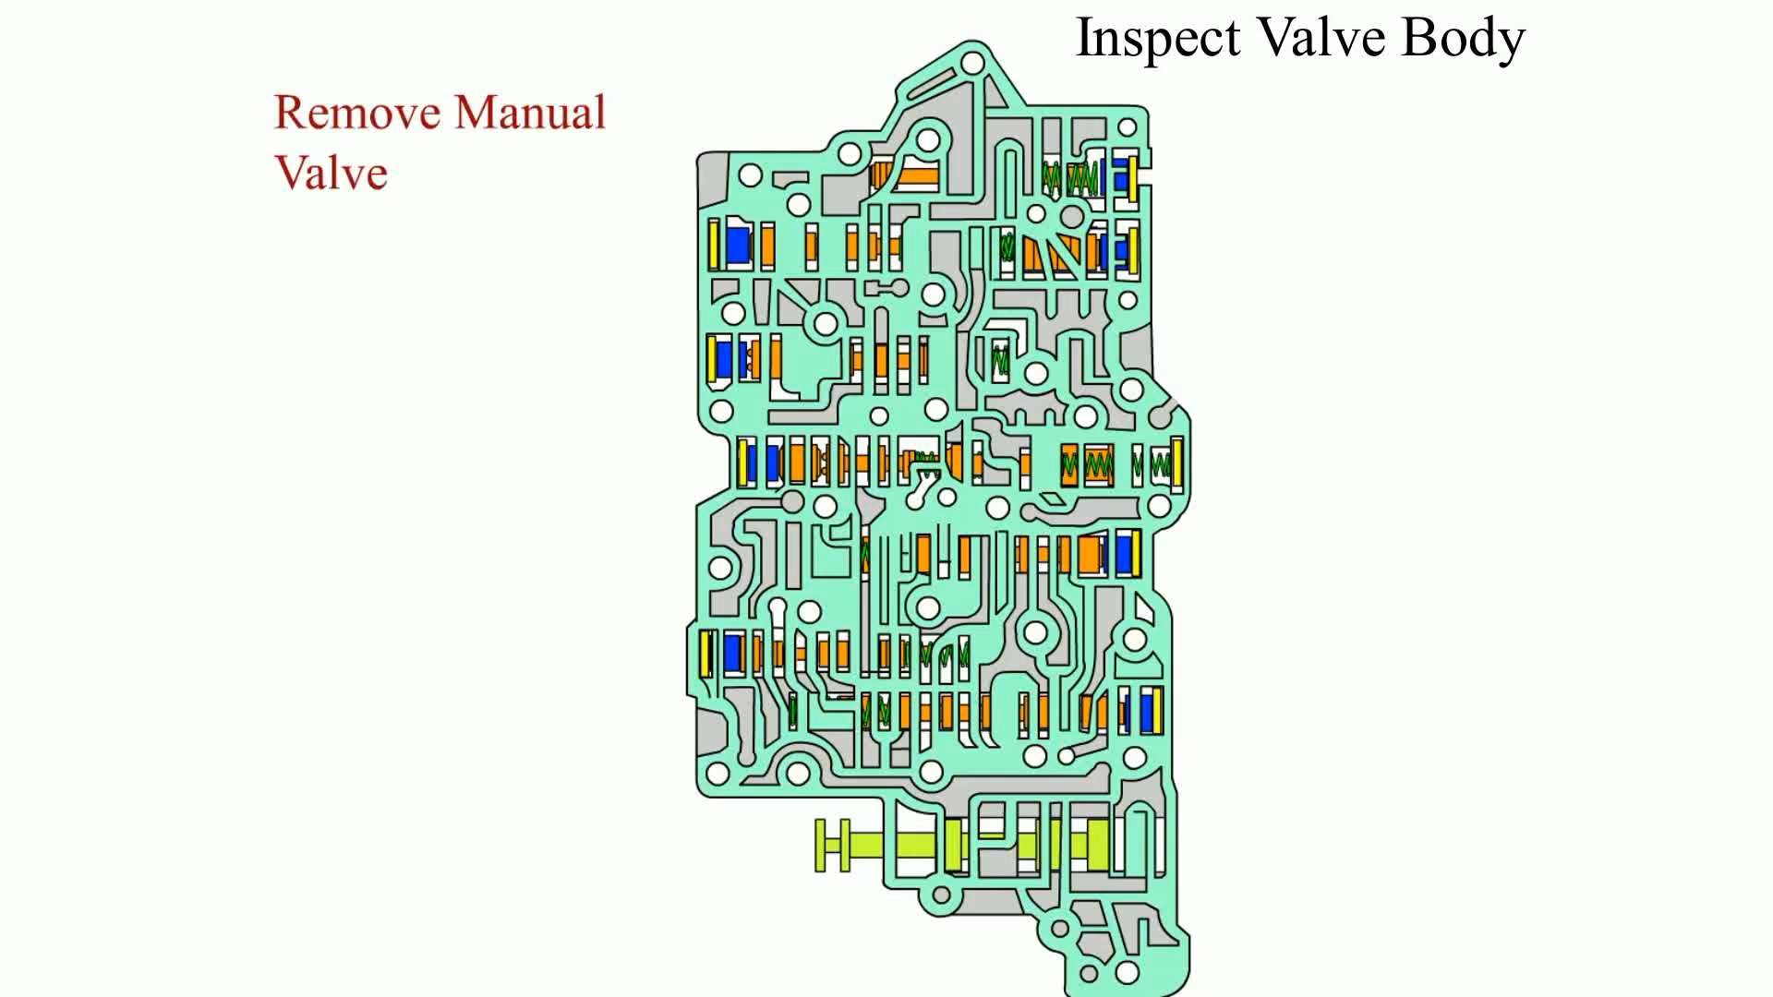
Animation: Inspect Valve Body
(Animation will automatically start)

Slide 51
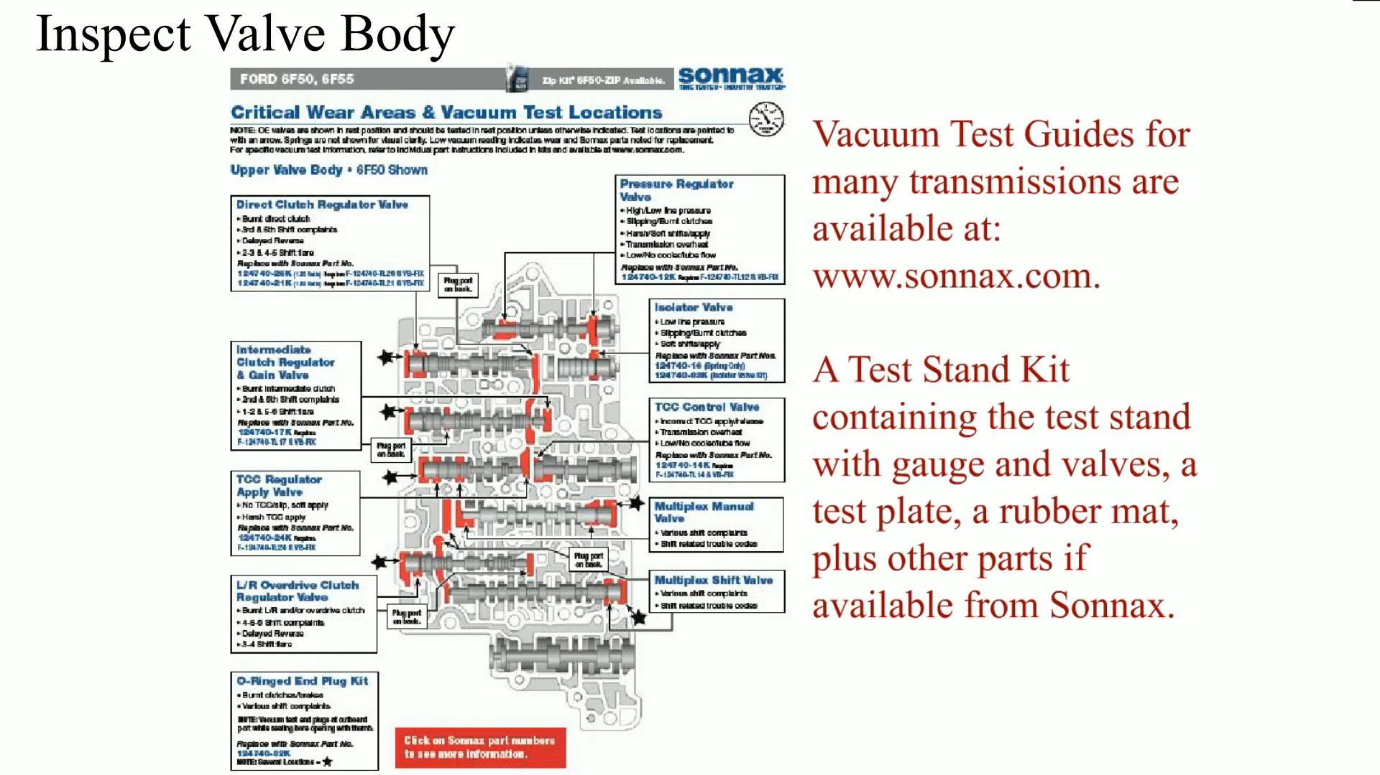
Animation: Inspect Valve Body
(Animation will automatically start)

Slide 52
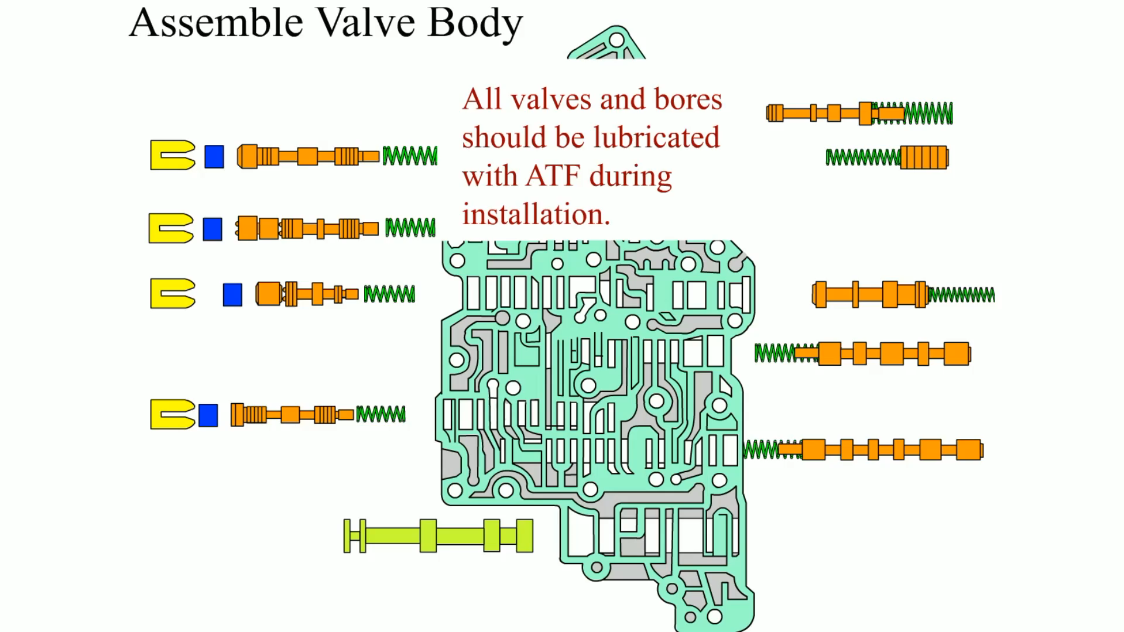
Animation: Assemble Valve Body
(Animation will automatically start)

Slide 53
Flushing Cooler/Torque Converter
Purpose
  Fluid cooler should be checked for proper flow.
  The cooler can be flushed using special machines that pulsate A T F through the cooler.
Notes:
See Chart 133-1 on page 1701 for the location of the cooler-out lines varies by vehicle and transmission/transaxle. Check service information for location of the cooler lines on the vehicle being serviced.

Slide 54
Dynamometer Testing The Automatic Transmission/Transaxle
A rebuilt automatic transmission/transaxle can be tested on a dynamometer powered by:
  An electric motor
  A gasoline engine
Most dynamometers are equipped with pressure gauges to provide a load so the operation of the unit can be checked before being installing in the vehicle.

Slide 55
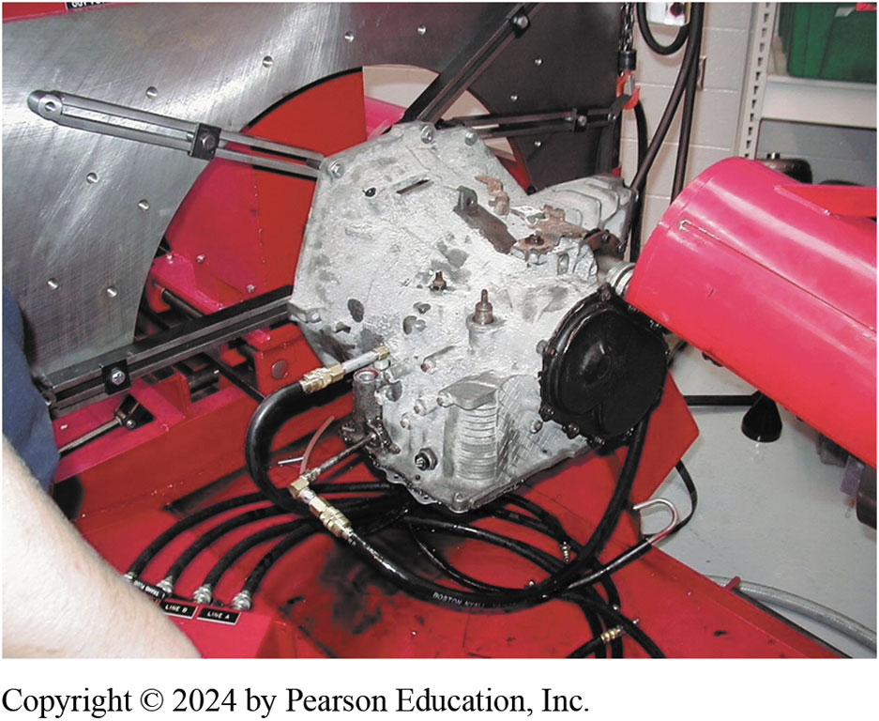
Figure 133.28 Dyno Testing
An electric motor-driven dynamometer being used to check the operation of a 41TE transaxle

Slide 56
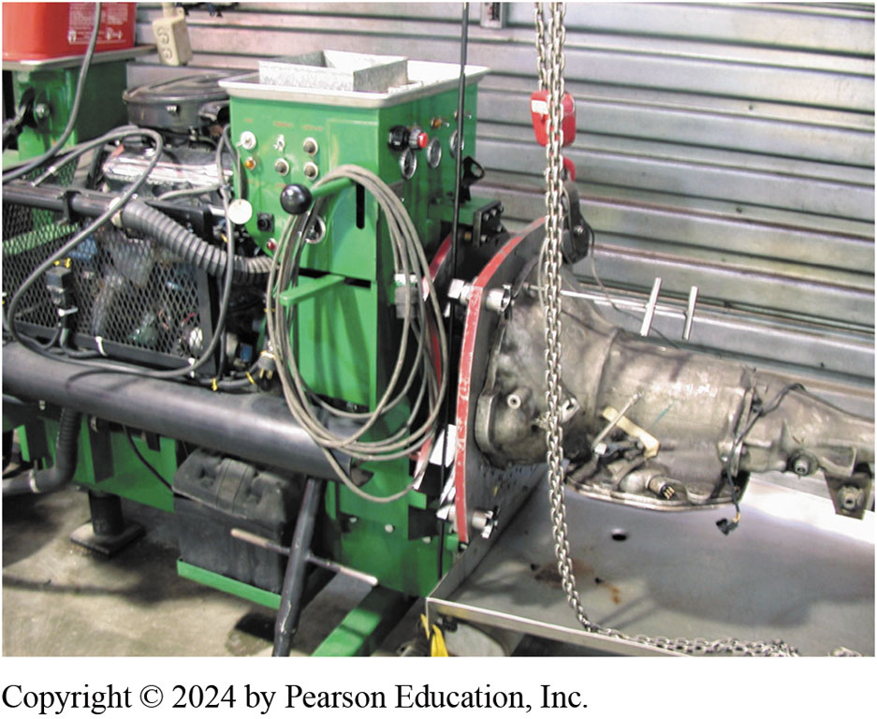
Figure 133.29 Dyno Testing
A gasoline-powered dynamometer being used to test a rear-wheel-drive automatic transmission

Slide 57
Reinstalling The Automatic Transmission/Transaxle
Double Check End Play
  After the unit has been reassembled and all end play checks indicate that the unit is properly assembled, reinstall the automatic transmission/transaxle in the vehicle.
Torque Converter Installation
  Carefully install the torque converter onto the input shaft being sure to fully engage the pump gears, the stator splines and the turbine splines.

Slide 58
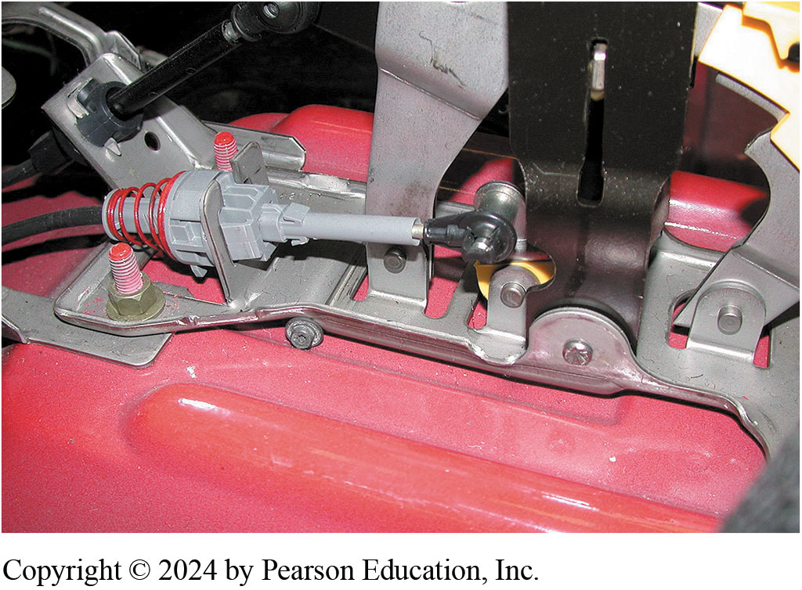
Figure 133.30 Linkage
Check the linkage for proper adjustment so that the shift interlock works correctly and
PR DL is aligned with transmission range switch

Slide 59
Road Test
Fast Learn the P C M/T C M
  This action will get the adaptive settings close to what they should be and will help prevent damage to the unit if this procedure is not done.
Road Test Procedure
  Carefully test drive the vehicle, checking for proper operation and shift points.
  Hoist the vehicle and check for any possible A T F leaks before returning the vehicle to the customer.

Slide 60
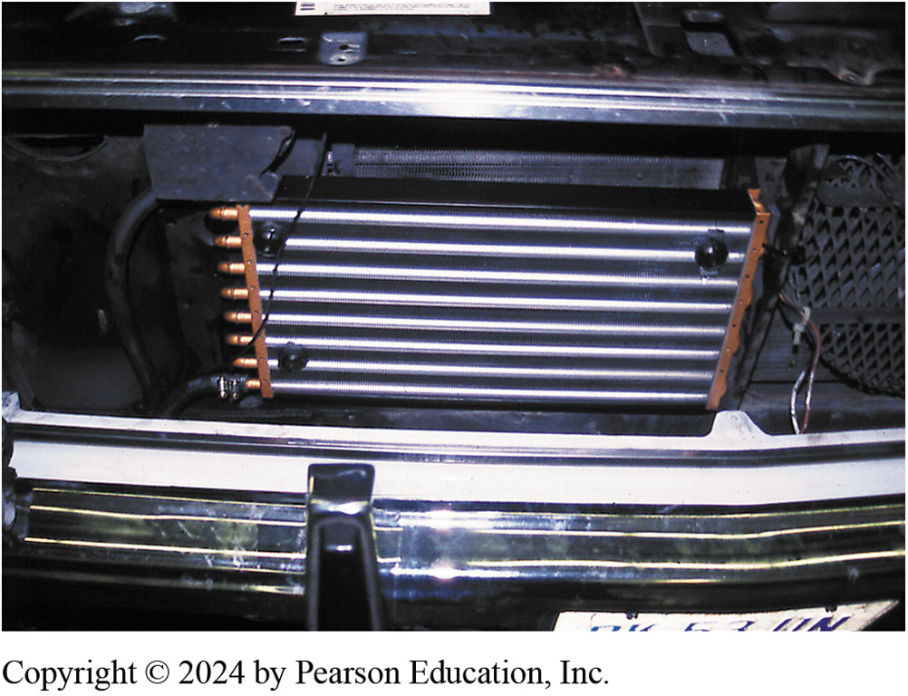
Figure 133.31 Auxiliary Cooler
An auxiliary automatic transmission fluid cooler installed on a Chevrolet pickup truck used to haul a car trailer
Notes:
TECH TIP: Install a Transmission Cooler
An auxiliary transmission fluid cooler is recommended by most experts to help keep the temperature
from becoming excessive, especially when towing or performing other heavy-duty vehicle operation.
SEE FIGURE 133–31. Most experts recommend that the cooler be connected so that the hot fluids travel through the auxiliary cooler and then through the factory cooler and return to the transmission/transaxle. Using this method of plumbing allows the radiator to warm the transmission fluid in cold weather as well as provide additional cooling of the fluid when the fluid temperature is high.
TECH TIP: If the Torque Converter Is Dropped, Replace It
Torque converters include plastic thrust plates, which are very strong under the compressive forces
of normal torque converter operation. However, if a torque converter is dropped, even from a
distance of less than 6 inches (15 cm), the thrust washer can easily break, ruining the torque converter. Even though torque converts look strong and feel heavy, handle them as if they are glass.

Slide 61
TRANSAXLE REMOVAL

Slide 62
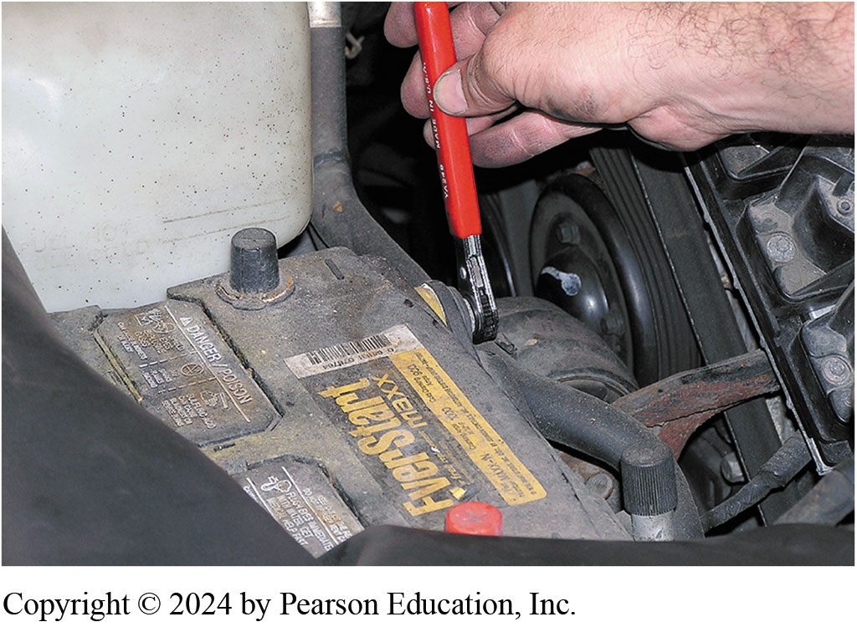
1. Remove Negative Battery Cable
1 For safety purposes, remove the negative battery cable before starting the removal procedure

Slide 63
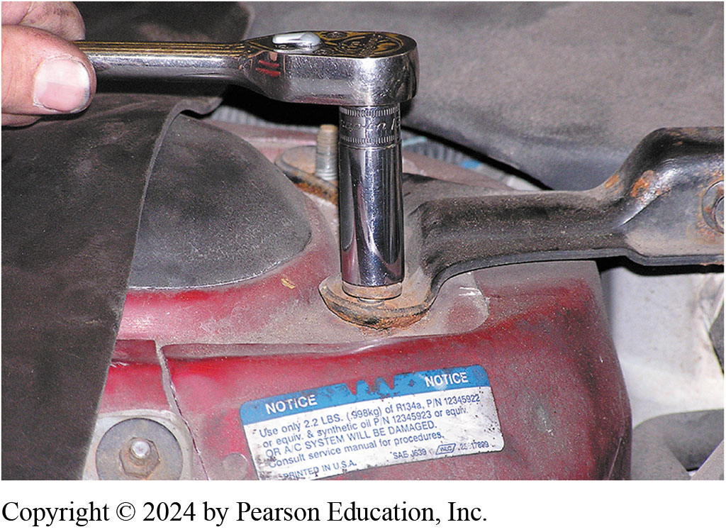
2. Remove Bay Cross Members
2 Remove engine bay cross members that may interfere with access to the transaxle fasteners

Slide 64
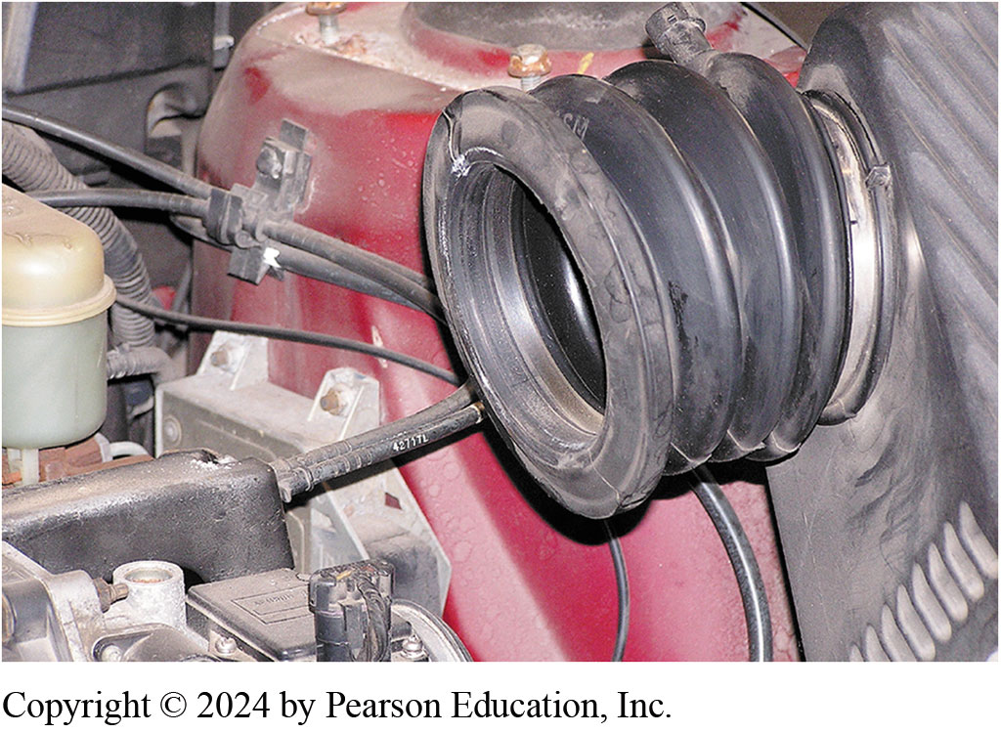
3. Remove Air Intake and Air Filter
3 Remove the air intake and air filter assembly, which is covering the transaxle in this vehicle

Slide 65
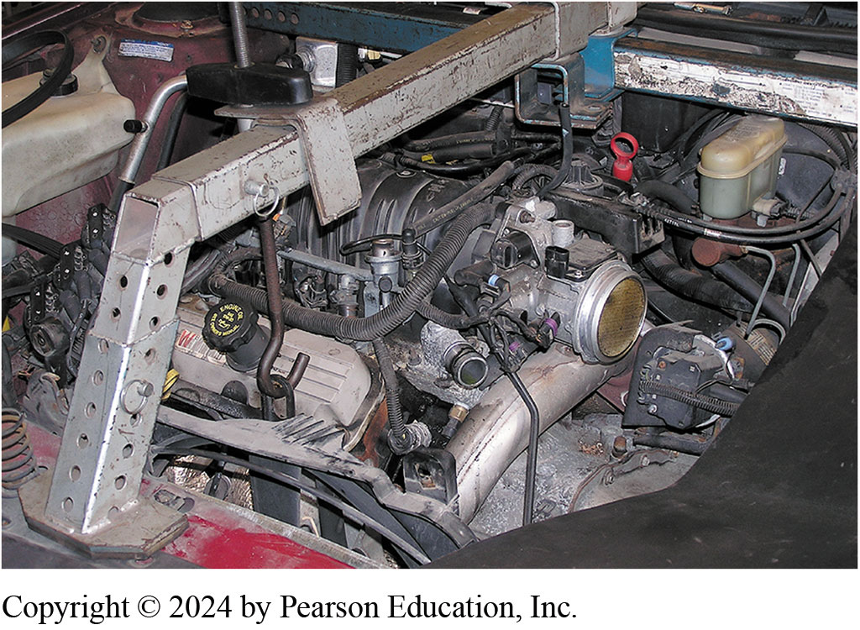
4. Install Support Tool
4 Install a support for the engine

Slide 66
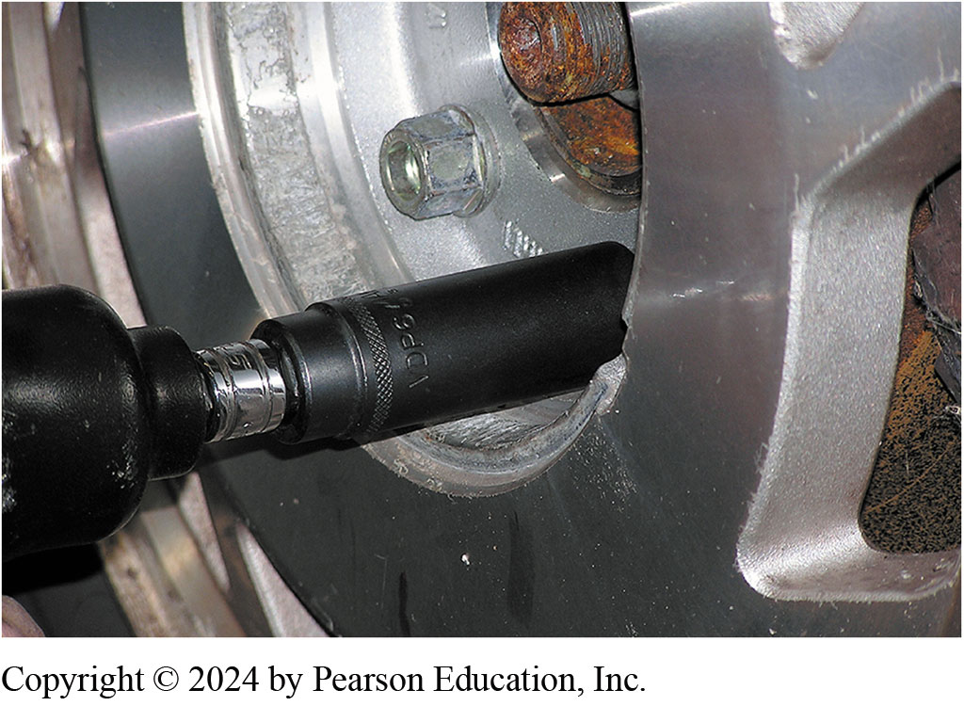
5. Hoist Vehicle Remove Wheels

Slide 67
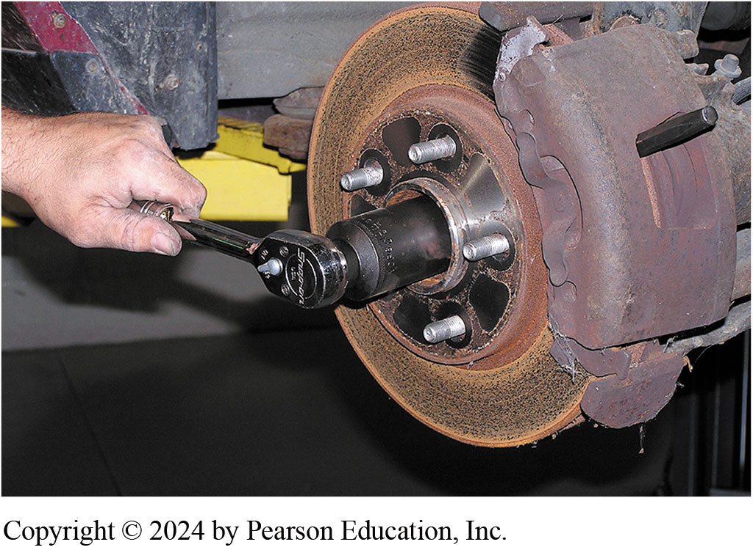
6. Remove Retaining Nut
6 Remove the retaining nut from the drive axle shaft

Slide 68
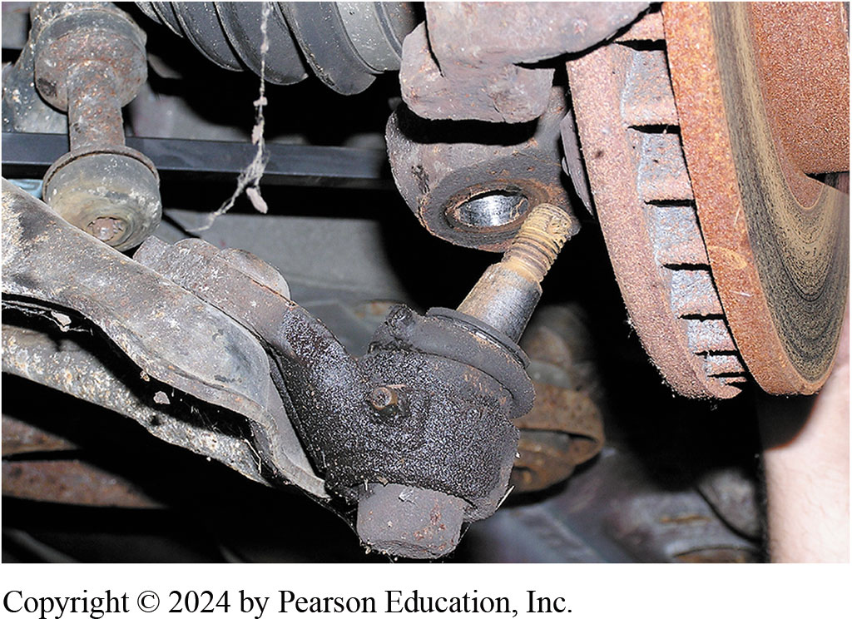
7. Disconnect Lower Ball Joint
7 Disconnect the lower ball joint on the front-wheel-drive vehicle to allow removal of the drive axle shaft

Slide 69

8. Remove Drive Axle
8 Remove the drive axle shaft from the transaxle using a pry bar

Slide 70

9. Disconnect Cooler Lines
9. Disconnect the cooler lines from the transaxle using a line wrench

Slide 71

10. Unbolt Torque Converter
10 Unbolt the torque converter from the flexplate, then remove the transaxle mounts

Slide 72

11. Remove Bell Housing Bolts
11 With the transaxle supported on transmission jack, remove the retaining bolts from the bell housing

Slide 73

12. Remove Transaxle
12 Carefully remove the transaxle from the vehicle

Slide 74
Transaxle Disassembly and Assembly

Slide 75

1. GM 6T70
1 The GM 6T70 forward speed transaxle was a joint venture with Ford and therefore is similar to the 6F50

Slide 76

2. Torque Converter
2 A unique thin torque converter is used to help reduce the overall length of the transaxle

Slide 77

3. Remove Housing
3 After removing the torque converter, the housing is being removed

Slide 78

4. Final Drive Assembly
4 The final drive assembly is exposed after the housing has been removed

Slide 79

5. Remove Final Drive
5 The final drive is easily lifted out after the housing has been removed

Slide 80

6. Tapered Roller Bearing
6 Note the tapered roller bearing used in the final drive assembly component

Slide 81

7. Rotate Transaxle
7 The transaxle is rotated and the plastic side cover is removed

Slide 82

8. Integrated Solenoid Assembly
8 Under the side cover is the valve body and integrated solenoid assembly

Slide 83

9. Valve Body Assembly
9 Under the plastic electrical solenoid assembly is the valve body assembly

Slide 84

10. Removing Valve Body
10 Removing valve body assembly

Slide 85

11. End Cover
11 Turning the assembly around, showing the end cover

Slide 86

12. Removing End Cover
12 Removing the end cover shows the clutch packs and planetary gear set

Slide 87

13. Removing Clutches
13 Removing the first of five clutch packs (two driving and three holding)

Slide 88

14. Selective Clutch Plates
14 A typical clutch pack in a 6T70 showing the selective thickness steel used to determine clutch pack clearance

Slide 89

15. Lower Clutches
15 A view down into the case where multiple clutch packs are found

Slide 90

16. Output Planetary Gear Set
16 The output planetary gear set with four pinions used on 6T70 units. The 6T75 version uses a five pinion carrier and a reinforced case

Slide 91

17. Reassembly of Clutches
17 Reassembly of clutches. Check service information for specified clutch pack clearance

Slide 92

18. Final Drive Tapered Bearings
18 Notice that the final drive is equipped with tapered roller bearings and this means that the preload must be adjusted

Slide 93

19. Special Tools
19 A special set of spacers and blocks used to determine the preload needed. A feeler gauge is then used to measure the clearance

Slide 94

20. Shim Selection
20 Following the procedure in service information, the designated thickness of shim is selected, which is placed under the bearing race in the bearing packet

Slide 95

21. Selective Shim Under Cone
21 The selective shim and race before the race is driven into position

Slide 96

22. Driving Race
22 Driving the race into position using the specified driver

Slide 97

23. Reassemble Valve Body
23 Reassembly of the valve body being sure that all fasteners are tightened to factory specifications

Slide 98

24. Solenoid Assembly
24 The solenoid assembly is replaced as an assembly only if defective and all the fasteners need to be torqued to factory specifications

Slide 99
Question 1?
Air pressure checking is used to test ____________.
  a. clutch packs
  b. transmission filters
  c. TCC solenoids
  d. shift valves

Slide 100
Answer 1
Air pressure checking is used to test ____________.
  a. clutch packs

Slide 101
Automatic Transmissions and Transaxles Videos and Animations
Videos Link: (A2) Automatic Transmissions and Transaxles Videos
Animations Link: (A2) Automatic Transmissions and Transaxles Animations

Slide 102
Copyright
This work is protected by United States copyright laws and is provided solely for the use of instructors in teaching their courses and assessing student learning. Dissemination or sale of any part of this work (including on the World Wide Web) will destroy the integrity of the work and is not permitted. The work and materials from it should never be made available to students except by instructors using the accompanying text in their classes. All recipients of this work are expected to abide by these restrictions and to honor the intended pedagogical purposes and the needs of other instructors who rely on these materials.

