Slide 1
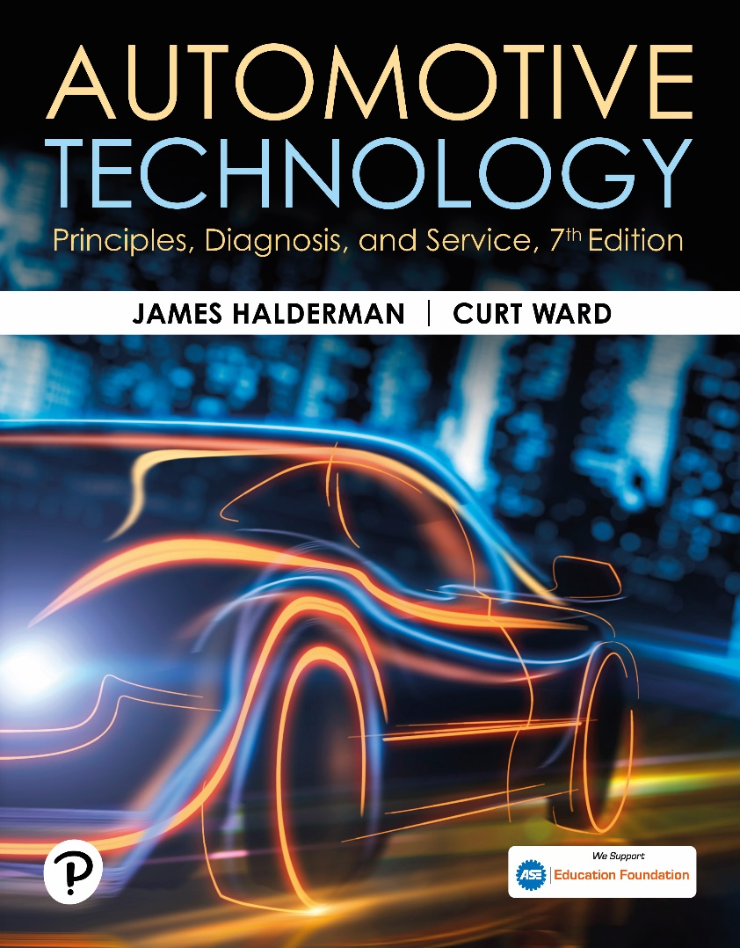
Automotive Technology: Principles, Diagnosis, and Service
Seventh Edition
Chapter 132
Automatic Transmission/Transaxle Diagnosis and In-Vehicle Service
Copyright © 2023 Pearson Education, Inc. All Rights Reserved
Notes:
INSTRUCTOR NOTE: This presentation includes text explanation notes, you can use to teach the course. When in SLIDE SHOW mode, you RIGHT CLICK and select SHOW PRESENTER VIEW, to use the notes.

Slide 2
Learning Objectives
132.1 Explain the process of diagnosing transmission problems.
132.2 Describe how to diagnose transmission fluid leaks.
132.3 Discuss the procedures for performing in-vehicle service.

Slide 3
Verify Customer Concern (1 of 2)
First step is to verify the customer concern
Ask following questions
  What exactly seems to be the concern?
  When did the problem first appear?

Slide 4
The Diagnostic Process (1 of 2)
STEP 1 Verify the customer concern.
STEP 2 Check fluid level and condition.
STEP 3 Check for diagnostic trouble codes (DTCs).
STEP 4 Check for technical service bulletins (TSBs).
STEP 5 Check scan tool data including checking the adaptive values.

Slide 5
The Diagnostic Process (2 of 2)
STEP 6 Visual inspections,
STEP 7 Locate root cause of problem.
STEP 8 Replace all components that do not meet factory specifications.
STEP 9 Perform an adaptive relearn
  Drive vehicle to verify that repairs corrected customer concern.

Slide 6
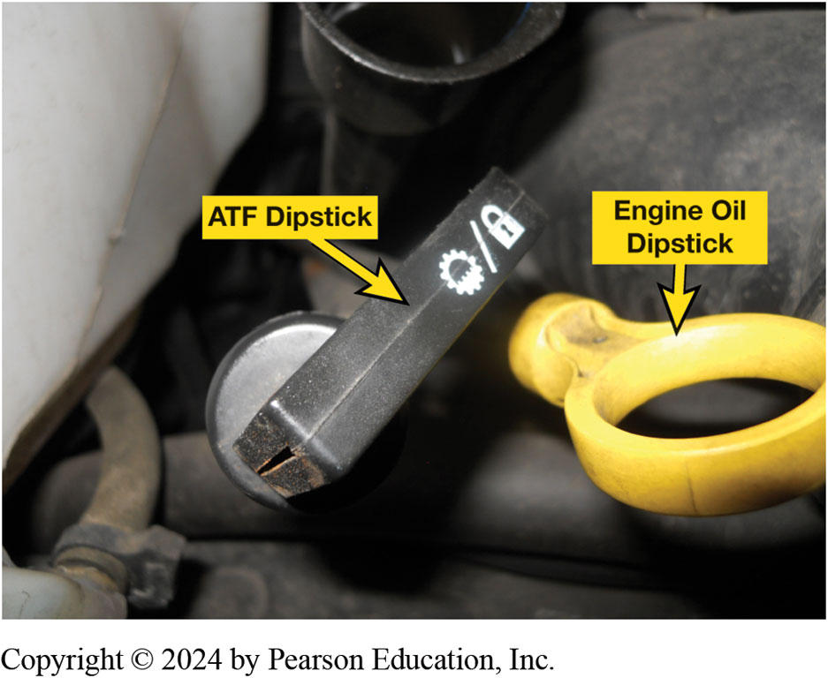
Figure 132.1 Dipstick
A automatic transmission dipstick (fluid level indicator). Many use a clip to keep it from being forced upward due to pressure changes inside the automatic transmission. A firm seal also helps keep water from getting into the fluid, which can cause severe damage to the clutches and bands.
Notes:
To check transmission fluid with a dipstick, check the procedure stamped on the
dipstick. The usual procedure includes the following steps:
STEP 1 Park the vehicle on a level surface, apply the parking brake securely, and place the gear
selector in park or neutral as recommended by the manufacturer. Start the engine and let the
temperature of the transmission come up to operating temperature.
STEP 2 Apply the service brakes firmly and move the gear selector to each of the operating
ranges. Leave the selector in each position long enough for each gear to become completely engaged.
STEP 3 Return the selector lever to park or neutral, depending on the transmission. Leave the
engine running at idle speed.
STEP 4 Clean any dirt from the dipstick cap and remove the dipstick.
STEP 5 Wipe the dipstick clean and return it to the filler pipe, making sure that it is fully seated.
STEP 6 Pull the dipstick out again and read the fluid level. ● SEE FIGURE 132–2.
Carefully grip the end of the dipstick between two fingers to get an indication of the fluid temperature.
a. If it feels cold, use the COLD marks.
b. If it feels warm, the correct fluid level will be between the HOT and COLD marks.
c. If it is too hot to hold onto, use the HOT marks.
STEP 7 Replace the dipstick completely into the filler tube.

Slide 7

Figure 132.2 Dipstick Level
The “add” mark on most automatic transmission dipsticks indicates the level is down 0.5 quart (0.5 L). Always follow the instructions stamped or printed on the dipstick.

Slide 8
Fluid Level & Condition (1 of 2)
Overfilled or Underfilled
  An underfill is below the low, cold level on dipstick
  Sometimes marked "Do not drive.”
  Overfilling can cause slippage and mushy operation
  Because of air in foamy fluid.
  An overfill condition can bring the fluid level up
  To the point where it contacts the spinning gear sets.
Notes:
The driver of a vehicle should periodically check the fluid level in an automatic transmission. A good time to check this is at every engine oil change. If the level is low, fluid of the correct type should be added. It usually takes 1 pint (0.5 L) to move the fluid level from low to the full mark on the dipstick. Most transmission dipsticks are marked for both cold and hot fluid temperatures. ● See Figure 132–2. The most obvious markings are for the hot level, which is the normal operating temperature, about 150°F to 170°F (66°C to 77°C). Room temperature of about 65°F to 85°F (18°C to 29°C) is considered cold for transmission fluid. If the fluid at the end of the dipstick
is too hot to hold, then the fluid is hot. When the fluid is cold, use the cold markings on the dipstick. Some transaxles use a thermostatic valve to raise the fluid level in the upper valve body pan as the transaxle warms up. These units have a lower hot level and a higher
cold level. The exact procedure for checking the fluid level can be found in the vehicle owner’s manual, or occasionally it is printed on the dipstick

Slide 9
Fluid Level & Condition (2 of 2)
Checking Fluid Level with Dipstick
Checking Fluid Level without Dipstick
Fluid condition should always be checked
When checking fluid level
  A transmission technician will normally smell fluid
  Check color for unusual characteristics
Notes:
TECH TIP: Using the Wrong ATF Could Cause Shifting Problems
If the incorrect automatic transmission fluid has been used, such as during a previous repair, the
following problems could occur:
• Hard shifts
• Slipping
• Shudder (feels like a vibration similar to driving over a rippled road surface)
If any of these conditions are present, check with the customer to find out if the transmission had
been recently serviced or if the customer added new fluid or some additive. Often, some of the
above concerns can
be solved by replacing fluid with the specified fluid.

Slide 10
Checking Fluid Level Without A Dipstick
Some units do not use dipsticks.
Fluid level is checked by following service information.
Bring transmission to operating temperature
Remove the fluid level plug.
Fluid will trickle or weep out of plug if level is correct.
  If it runs out, the level is high.
  If there is no fluid, the level is low.
Notes:
CHECKING FLUID LEVEL WITHOUT A DIPSTICK
Some manufacturers require a special procedure or tool in
order to check the fluid level of their sealed transmissions, so it is wise to review their
fluid-checking procedures. A general procedure follows.
To check transmission fluid level on a vehicle without a dipstick, perform the following steps:
STEP 1 Check service information for the correct checking procedure.
STEP 2 Check the transmission temperature using a scan tool. This is very important and the
vehicle will usually need to be driven for several miles before the specified fluid temperature is
achieved. ●Figure 132–3.
STEP 3 Locate and carefully remove the fluid level plug. Note that the level plug can be small,
like a pressure check plug, or large, like a conventional plug. The plug can be located in the
transmission case or on the bottom or side of the pan.
STEP 4 If fluid drips or seeps from the hole, the level is correct. Add additional fluid of the
correct type until the level is correct. If necessary, add additional fluid by pumping it into the
fill port located at the side of the case or up through the fluid level checking plug opening.

Slide 11
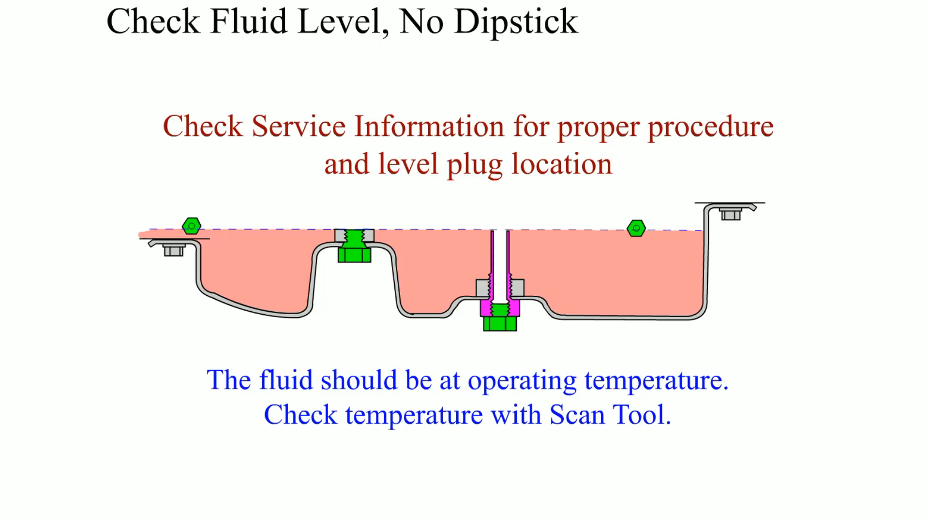
Animation: Check Fluid Level, No Dipstick
(Animation will automatically start)

Slide 12
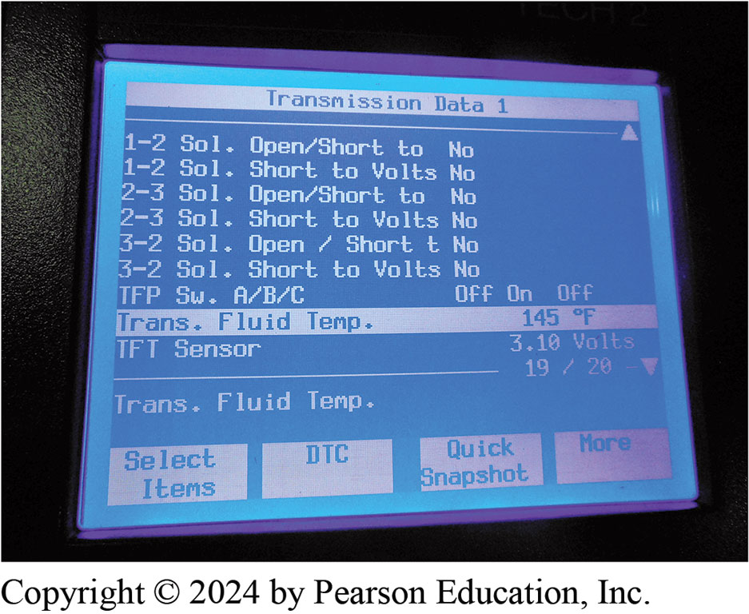
Figure 132.3 Transmission Data
Temperature of automatic transmission fluid is displayed on a factory or factory-level scan tool. It may require that vehicle be driven under a load for the fluid to reach the specified temperature and can often not be achieved by simply allowing engine to idle

Slide 13
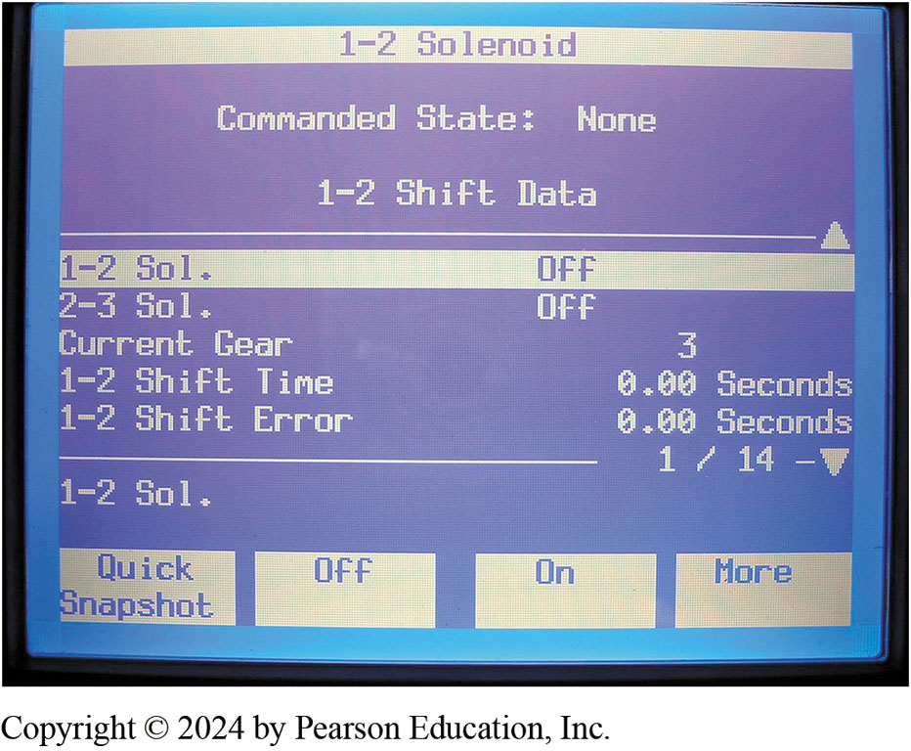
Figure 132.4 Commanding Shifts
Most factory or factory-level scan tools are capable of bidirectional control of the automatic transmission or transaxle.
Notes:
Many automatic transmission test tools or scan tools can be used to actually cause the automatic transmission/transaxle to shift electrically. The tester is connected to the electrical connector at the automatic transmission/transaxle after disconnecting the factory connector. To perform this simple test, perform the following steps:
STEP 1 Safely hoist the vehicle.
STEP 2 Start the engine.
STEP 3 Place the gear selector in the drive position and use the tester or scan tool to command
the various shift solenoids to actuate.
Results: If the shift occurs when commanded, the hydraulic sys- tem is functioning. If the tester
commands a shift to occur and a shift does not occur, the service technician knows that the problem
is either in the solenoid itself or the hydraulic system that actuates the clutch or band to
accomplish the shift. ● Figure 132–4.

Slide 14
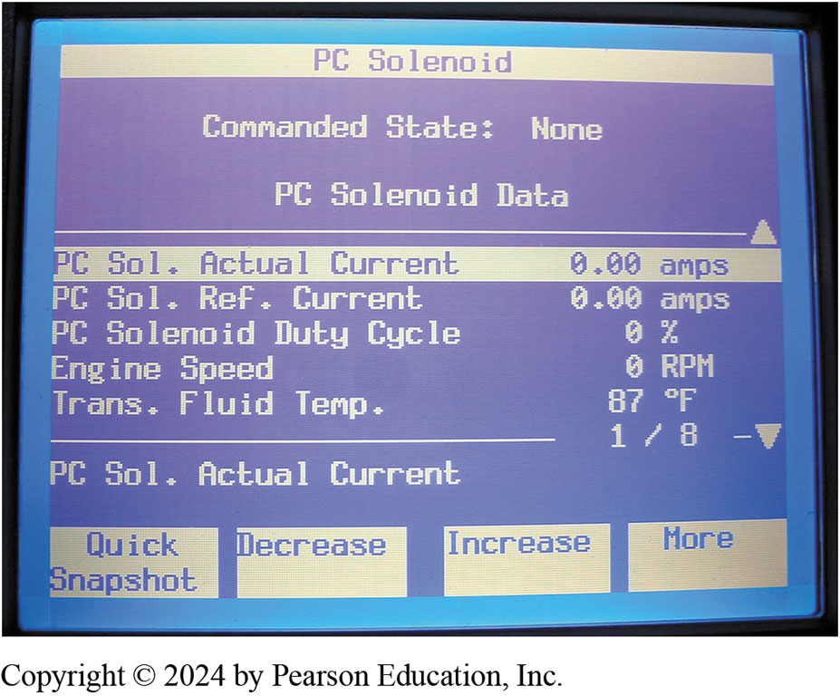
Figure 132.5 Solenoid Scan Data
Tech 2 scan tool is able to display shift solenoid current. Use this information and check service information for the specified current to help diagnose shift solenoid-related faults.

Slide 15
Retrieve Diagnostic Trouble Codes
When problem has been detected
  PCM will generate a diagnostic trouble code (DTC).
  May also place transmission in limp-home mode
  Depending on what sort of problem has been detected.
Notes:
If there are any diagnostic trouble codes (DTCs) stored in the memory of the vehicle computer,
then a problem has been detected that should be corrected before further testing. ● SEE CHART 132–1 for transmission-related diagnostic trouble codes. A weak or missing engine cylinder can cause the vehicle to lack power, jerk, and hesitate. These symptoms are often blamed on an incorrectly shifting or slipping automatic transmission/ transaxle. If a P0300 diagnostic code (random engine misfire code) is set, repair the cause of the misfire before trying to diagnose the transmission.

Slide 16
Chart 132.1 DTCs
TRANSMISSION-RELATED DTCS
P0703 Brake switch input circuit |  | P0740 Torque converter clutch system problem
P0705 Transmission range sensor circuit problem (PRNDL input) |  | P0741 Torque converter clutch system performance or stuck off
P0706 Transmission range sensor circuit range or performance |  | P0742 Torque converter clutch system stuck on
P0707 Transmission range sensor circuit low input |  | P0743 Torque converter clutch system electrical
P0708 Transmission range sensor circuit high input |  | P0745 Pressure control solenoid problem
P0710 Transmission fluid temperature sensor problem |  | P0746 Pressure control solenoid performance or stuck off
P0711 Transmission fluid temperature sensor range |  | P0747 Pressure control solenoid stuck on
P0712 Transmission fluid temperature sensor low input |  | P0748 Pressure control solenoid electrical
P0713 Transmission fluid temperature sensor high input |  | P0750 Shift solenoid A problem
P0715 Input or turbine speed sensor circuit problem |  | P0751 Shift solenoid A performance or stuck off
P0716 Input or turbine speed sensor circuit range or performance |  | P0752 Shift solenoid A stuck on
P0717 Input or turbine speed sensor circuit no signal |  | P0753 Shift solenoid A electrical
P0720 Output speed sensor circuit problem |  | P0755 Shift solenoid B problem
P0721 Output speed sensor circuit range or performance |  | P0756 Shift solenoid B performance or stuck off
P0722 Output speed sensor circuit no signal |  | P0757 Shift solenoid B stuck on
P0725 Engine speed input circuit problem |  | P0758 Shift solenoid B electrical
P0726 Engine speed input circuit range or performance |  | P0760 Shift solenoid C problem
P0727 Engine speed input circuit no signal |  | P0761 Shift solenoid C performance or stuck off
P0728 Gear 6 incorrect ratio |  | P0762 Shift solenoid C stuck on
P0730 Incorrect gear ratio |  | P0763 Shift solenoid C electrical
P0731 Gear 1 incorrect ratio |  | P0765 Shift solenoid D problem
P0732 Gear 2 incorrect ratio |  | P0766 Shift solenoid D performance or stuck off
P0733 Gear 3 incorrect ratio |  | P0767 Shift solenoid D stuck on
P0734 Gear 4 incorrect ratio |  | P0768 Shift solenoid D electrical
P0735 Gear 5 incorrect ratio |  | P0770 Shift solenoid E problem
P0736 Reverse incorrect ratio |  | P0771 Shift solenoid E performance or stuck off
 |  | P0772 Shift solenoid E stuck on
 |  | P0773 Shift solenoid E electrical
Notes:
Chart 15–3
Transmission/transaxle-related diagnostic trouble codes (DTCs). For transmission-related diagnostic trouble codes for vehicles older than 1996, check service information on how to retrieve and read the codes.

Slide 17
Check For TSB
Check for corrections or repair procedures in technical service bulletins (TSBs) that match the symptoms.
Bulletins often include information on solving problems that involve a stored diagnostic trouble code.

Slide 18

Figure 132.6 Check for TSB
Checking service information for how to perform diagnosis on an automatic transmission fault is a wise step.
Notes:
As many as 30% of the vehicles can be repaired following the information, suggestions, or instructions concerning replacement parts found in a TSB. Before an accurate search of a TSB can be performed, the technician must know the following information about the vehicle under service:
■ Make, model, and year of the vehicle
■ Engine size and VIN
■ Transmission type
■ Federal, high-altitude, or California emissions
■ Build date (sometimes)
TECH TIP: You’d Ask a Friend, Wouldn’t You?
If you were stuck on a difficult transmission problem, you would probably ask a technician friend
for ideas. Think of the service information as a friend with some inside information. It is written
by the people who know how the system works in detail.
Such advice is available in service information. If the technician follows the recommended steps,
chances are excellent of finding the problem—just like getting the advice of an experienced
technician. ● Figure 132–6

Slide 19
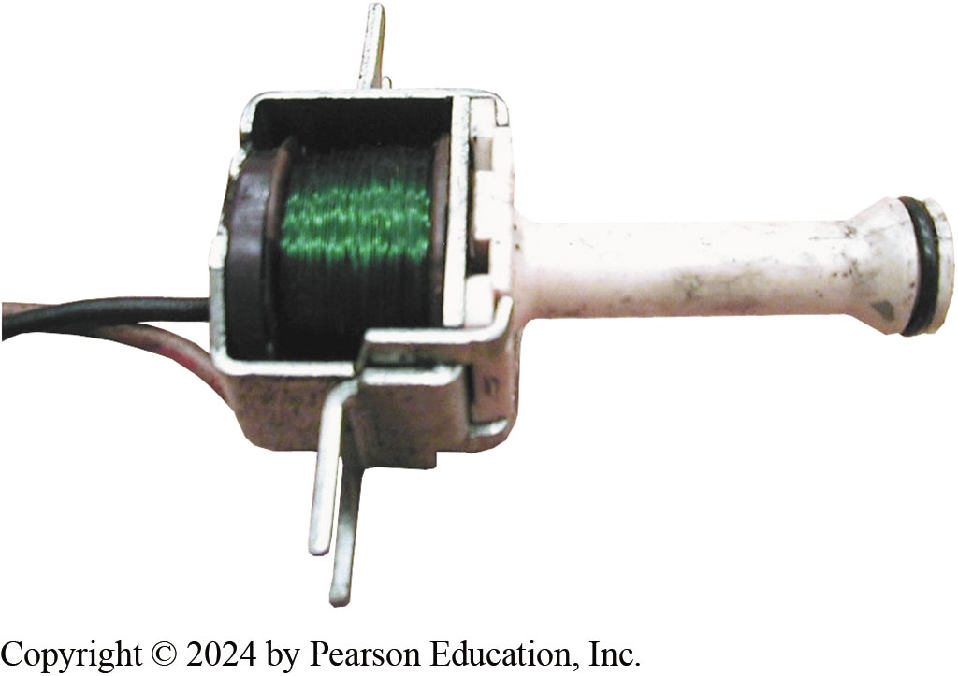
Figure 132.7 TCC Solenoid
A torque converter clutch (TCC) solenoid. This TCC can be replaced on a GM vehicle without having to remove the transmission/transaxle from the vehicle.
Notes:
CASE STUDY: The Stalling Impala
The owner of a Chevrolet Impala complained that the vehicle would occasionally stall when slowing
to a stop. The problem only occurred after at least 20 miles and occurred more frequently in warm weather. The owner also indicated even though this vehicle was equipped with an automatic transmission it felt like the clutch not being depressed on a manual transmission. Thankfully, the service technician was aware of this common problem and installed a new torque converter clutch solenoid.
When the original solenoid got hot, it became stuck in the applied position. Even though the
voltage was removed from the solenoid when the brakes were applied, the solenoid and the torque
converter clutch (TCC) remained applied. ● SEE FIGURE 132–7.
Summary:
Complaint—The owner of the vehicle complained that the engine would stall when slowing to a stop,
but only after the car was driven for 20 miles or further.
Cause—A defective torque converter clutch (TCC) solenoid.
Correction—Replacing the TCC solenoid cured the

Slide 20
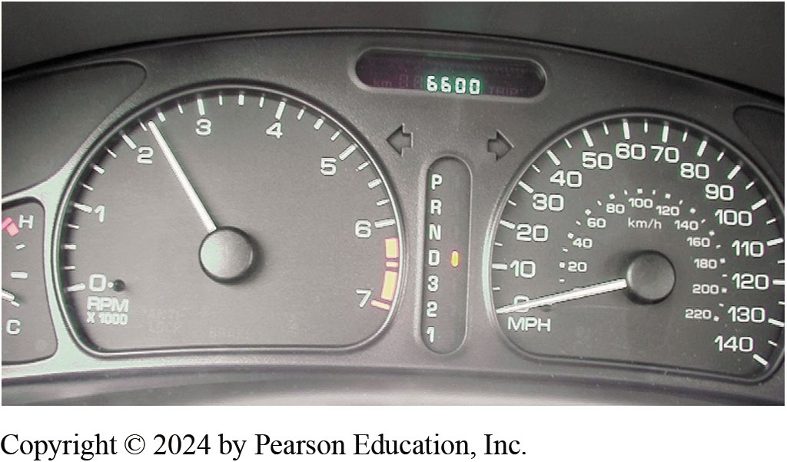
Figure 132.8 Stall Testing
This 4-cylinder GM vehicle has a stall speed of about 2350 RPM. Notice that the gear selector is in drive and the speedometer is reading zero.
Notes:
Stall Testing
A stall test is often performed to verify the proper operation of the torque converter.
CAUTION: Some vehicle manufacturers do not recommend performing a stall test because it can be
dangerous if the brakes were to fail during the test and it places stress on the engine. Always
follow the manufacturer’s recommended service procedures.
Performing a stall test includes the following steps:
STEP 1 Drive the vehicle until normal operating temperature is achieved.
STEP 2 Check the stall speed specifications for the vehicle being serviced and connect a tachometer
to the engine.
STEP 3 With your left foot firmly applied to the brake pedal, move the shift selector in the drive
position and depress the accelerator pedal to the floor. Observe the maximum engine speed. This
engine speed is the stall speed. ● SEE FIGURE 132–8.
STEP 4 Release the accelerator as soon as possible to avoid the possibility of overheating the
automatic transmission fluid. Repeat the test with the gear selector in reverse.
NOTE: Checking the stall speed in reverse is just a double check. This is done because the line
pressure is higher in re- verse and, as a result, the higher pressure will hold clutches better and
keep them from slipping. A slipping forward clutch could cause the engine speed to be higher than
normal and would affect the recorded stall speed.
STEP 5 Compare results with the specifications:
■ If the engine speed is higher than specifications, then a holding clutch or band is slipping.
■ If the engine speed is lower than specifications, then the torque converter is defective (one-way
clutch or stator is slipping) or the engine is not producing normal power output.
Both conditions can result in reduced vehicle performance and slow acceleration.
NOTE: There are many other possible causes of poor performance or sluggish acceleration besides a fault with the automatic transmission/transaxle. The stall test is just one test that can be
performed to help narrow the problem to the root cause.

Slide 21
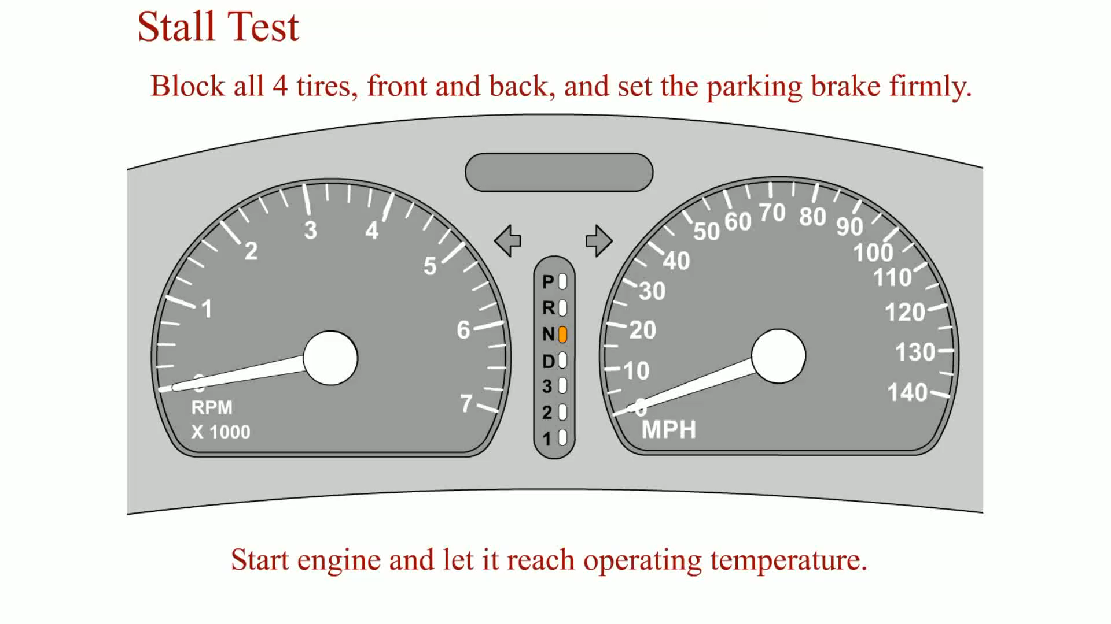
Animation: Stall Test
(Animation will automatically start)

Slide 22
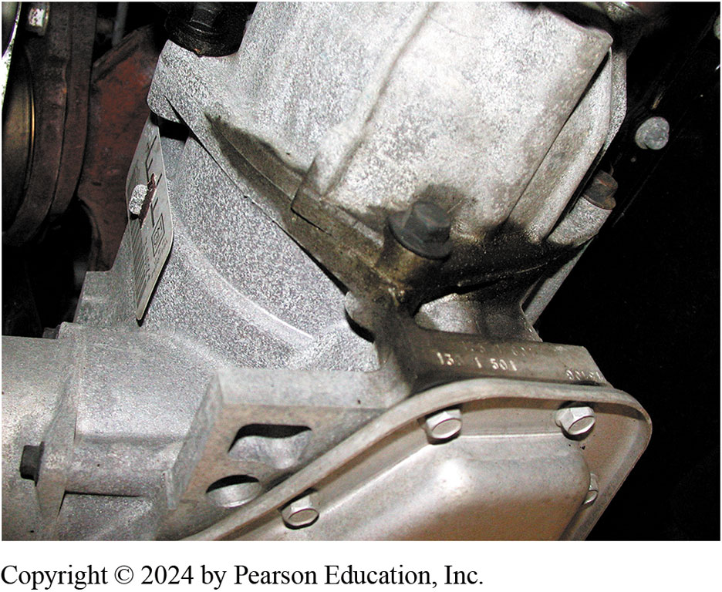
Figure 132.9 Leak Diagnosis
Sometimes the location of a transmission fluid leak is easy to see, but with others it can be difficult to find the exact location. Look closely at places where O-rings or gaskets are used, as these are the most common areas where fluid leaks occur.
Notes:
A leak from an automatic transmission/transaxle, the first step is to perform a thorough visual inspection. Start by checking the fluid level:
■ If too high, then the fluid loss could be caused by it being overfilled and forced out of the
vent opening located at the top of the unit.
■ If too low, a fluid leak is the most likely cause and should be corrected as soon as possible to
prevent damage, wear, or harm to the transmission/transaxle parts due to low fluid level.
Perform a visual inspection using the following steps:
STEP 1 Use a trouble light and start the visual inspection under the hood and look for signs of
fluid leakage on the top of the unit. Because fluids flow downward due to gravity, the fluid will
be most likely seen from underneath the vehicle; however, the source could be at or the near the
top.
STEP 2 Hoist the vehicle safely and look for the highest and most forward place where fluid is
seen. Due to gravity and the forward movement of the vehicle, leaking fluid will travel downward
and toward the rear. ● Figure 132–9.

Slide 23
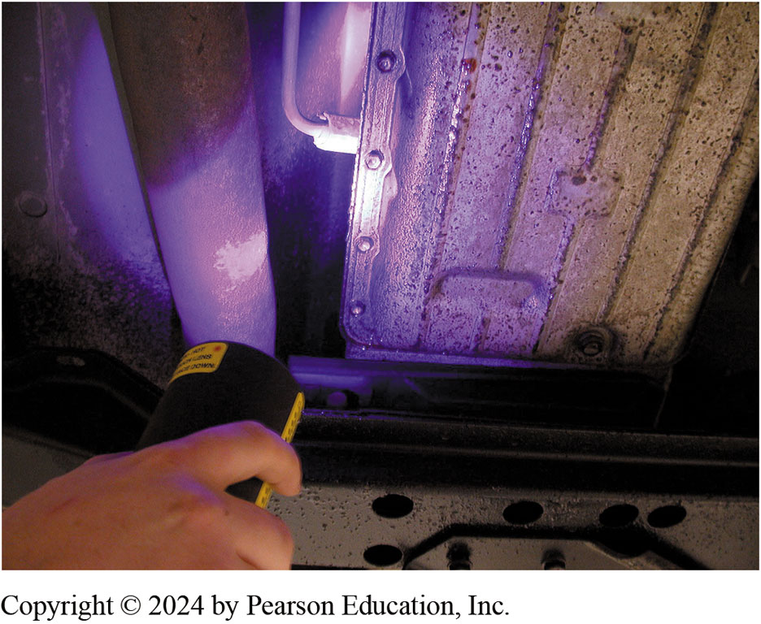
Figure 132.10 Dye Checking
A black light being used to locate the source of an automatic transmission fluid leak.
Notes:
Often the exact location of a fluid leak is difficult to locate. Using a dye designed for ATF and a black light is an effective method to locate ATF leaks. To check for leaks using a dye, perform the following steps:
STEP 1 Add a small bottle of dye that is designed for use in ATF into the dipstick tube using a
transmission funnel.
CAUTION: Do not use dye designed for use in coolant or air-conditioning systems or severe harm can occur to the automatic transmission/transaxle.
STEP 2 Drive the vehicle until the fluid has reached normal operating temperature.
STEP 3 Safely hoist the vehicle.
STEP 4 Using a black light, look for the highest and most forward place where a greenish stain
appears. This is the source of the leak. ● SEE FIGURE 132–10.

Slide 24
TCC Diagnosis
Drive vehicle and watch tachometer or scan tool
  Observe engine RPM:
STEP 1 Drive until normal operating temperature.
STEP 2 Drive about 50 MPH (80 km/h).
STEP 3 apply brake pedal with your left foot to open electrical circuit for the torque converter clutch
  TCC disengage RPM should increase 150 to 250 RPM
  Drop back when the brake pedal is released.
RPM change is evidence that the TCC is working.
Notes:
The torque converter clutch is usually applied above 30 MPH (48 km/h) when the automatic
transmission/transaxle is in second, third, or overdrive gear, depending on the vehicle speed and
the throttle position. It is often difficult to distinguish between a normal shift and the
application of the torque converter clutch. The torque converter clutch (TCC) may not even be
applying due to a fault in the computer sensors, wiring, or the TCC solenoid.
To test for proper operation of the torque converter clutch, simply drive the vehicle and watch either the tachometer on the dash or connect a scan tool to observe the engine RPM:
STEP 1 Drive the vehicle until the engine has reached normal operating temperature.
STEP 2 Drive the vehicle on a flat, level road away from any traffic about 50 MPH (80 km/h).
STEP 3 While maintaining constant speed with your right foot on the accelerator, gently apply the
brake pedal with your left foot to open the electrical circuit for the torque converter clutch
through the brake switch. The TCC will disengage and the RPM should increase about 150 to 250 RPM and then drop back when the brake pedal is released. This RPM change is evidence that the TCC is, in fact, working. If the torque converter clutch is not operating, consult the factory information
for the exact procedures to follow.
TECH TIP: Look at the Command and the Engine Speed
Using a scan tool is very helpful when diagnosing automatic transmission problems. However, the display often shows when the shift has been commanded and may not show if the shift or the TCC engagement actually occurred. To help ensure that the shifts have in fact occurred, also watch the engine speed. Many factory or enhanced scan tools can also display the engagement speed. A slow engagement is usually caused by worn clutches. Check service information for the exact parameters and range of proper operation for the vehicle being diagnosed.
TECH TIP: Vibration—Engine or Transmission?
A vibration is often difficult to diagnose. One method is to separate (unbolt) the torque converter
from the engine drive flex plate. Push the torque converter as far toward the transmission/transaxle as possible, then start the engine. If the vibration is gone, the problem is due to a fault in the torque converter, pump assembly, or other component that is constantly rotating with the engine running. If the vibration is still present, then the cause is due to an engine or accessory problem.

Slide 25
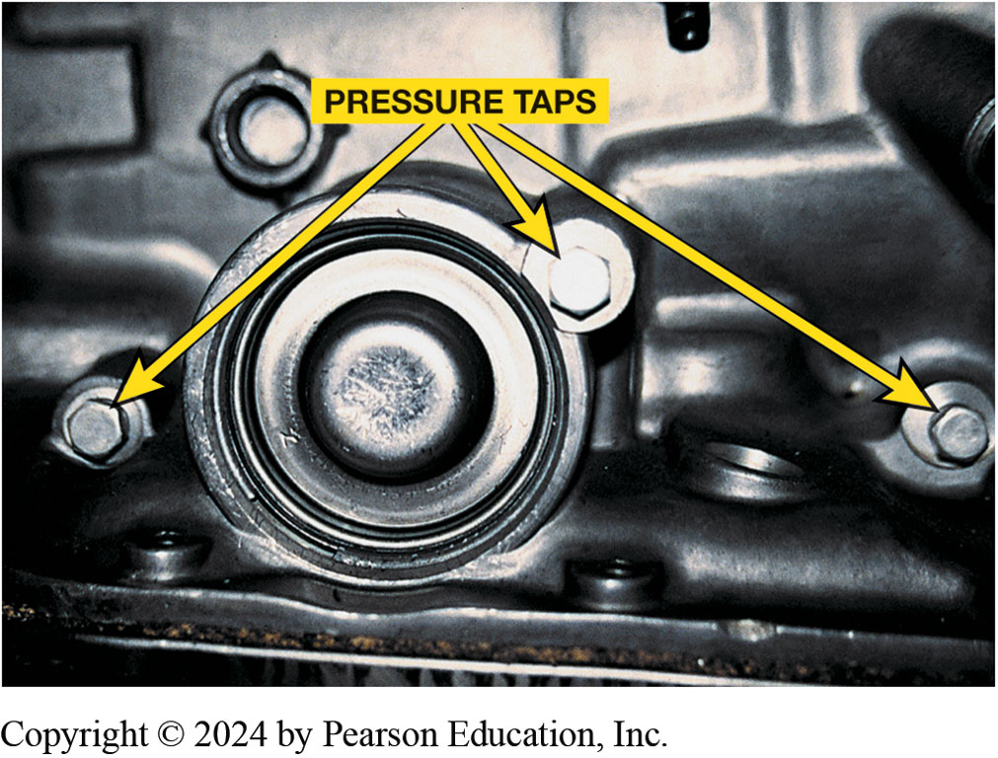
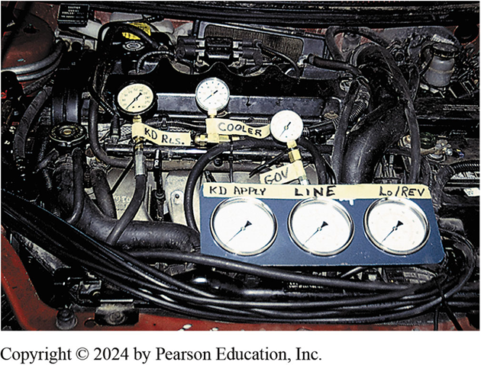
Pressure Testing
Figure 132–11 locations (taps) for connecting pressure gauge to measure pressure of various hydraulic circuits are usually found on side of automatic transmission/transaxle. Check service information for exact locations for vehicle being tested.
Figure 132–12 Six pressure gauges are installed on this vehicle to show students how pressures vary and how gauges can be used to find faults or possible problem areas before unit is removed and disassembled
Notes:
Pressure testing involves connecting a pressure gauge to pressure taps located on the outside of the
automatic transmission/transaxle. ● SEE FIGURE 132–11.
CASE STUDY: The Customized Van Story
The owner of a customized General Motors van equipped with an electronically controlled automatic
transmission (4L80-E) complained that the automatic transmission downshifted into second gear and
stayed in second gear whenever the headlights were turned on. The transmission shifted okay when the headlights were turned off. After hours of troubleshooting, including the replacement of the
vehicle computer (which did not help), the technician discovered that 4 volts DC were on the one
wire leading from the vehicle speed (VS) sensor to the vehicle computer whenever the headlights
were turned on. Obviously, there was a short to voltage between a light wire and the sensor wire.
Instead of totally disassembling the van, the technician decided to replace the wire with a new
one, and the problem was solved. The 4 volts DC apparently shut down the computer. With both solenoids A and B off, the transmission was in second gear. This is the default gear or the limp-in-mode gear for this transmission. After replacing the wire, the automatic transmission returned to normal operation:
Summary:
Complaint—The customer stated that whenever the headlights we on, the transmission would not shift.
The transmission worked fine if the headlights were turned off.
Cause—A wiring fault caused a four-volt DC current to be applied to the vehicle speed sensor wiring.
Correction—A new wire was run and this corrected the default gear from being used when the headlights were on.

Slide 26
Range Charts
All vehicle manufacturers publish range charts
Indicate which holding device used
  For each gear selection.
Knowing which component is being used for each gear
Helps determine cause of a failure or problem.
See chart 132–3 on page 1687
Notes:
RANGE CHARTS All vehicle manufacturers publish range charts that indicate which holding device is used for each gear selection. Knowing which component is being used for each gear
helps the service technician determine the cause of a failure or problem. SEE CHART 132–3.

Slide 27
Chart 132.4 Pressures
GEAR SELECTION | IDLE (PSI) | WIDE OPEN THROTTLE (WOT) (PSI)
Park (P) | 54–60 | 54–60
Reverse (R) | 100–105 | 250–300
Neutral (N) | 54–60 | 54–60
Drive (D) | 54–87 | 240–250
Low (L) | 84–87 | 240–250
A pressure chart for the Ford 6F50N/GM 6T70 transaxle.

Slide 28
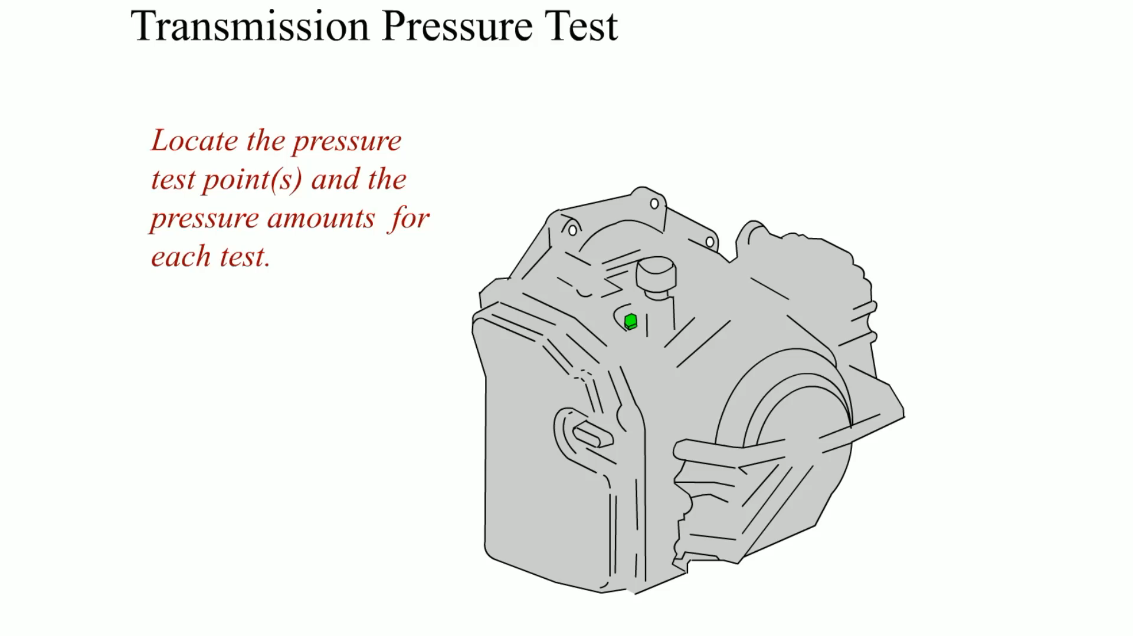
Animation: Transmission Pressure Test
(Animation will automatically start)

Slide 29
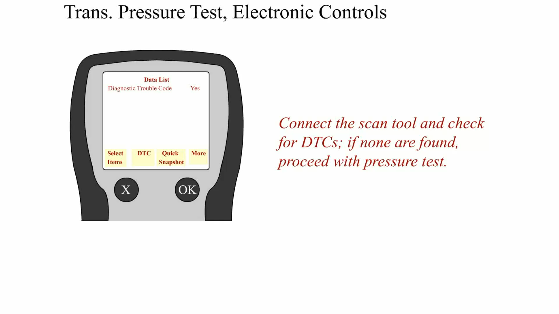
Animation: Transmission Pressure Test, Electronic Controls
(Animation will automatically start)

Slide 30
In-Vehicle Service Items
Automatic transmissions/transaxles
Can operate properly for many miles.
Several surveys of transmission shops have shown
Over 80% of transmission failures result of neglecting
Change fluid.
Notes:
Tech Tip: Test Drive Before and After Every Service
The wise technician test drives any vehicle being serviced, especially one where a routine automatic transmission service is being requested. Sometimes, a vehicle owner will ask that a service be performed hoping that it will fix an issue that has been noticed. To help avoid misunderstandings and to insure good customer relations, test drive the vehicle and let the customer know if any transmission-related issues are discovered before performing a routine transmission service. Then, of course, test drive vehicle after the service has been performed to verify that everything is normal and operating properly.

Slide 31
Fluid Changes
Severe Driving Conditions Described As:
  Frequent trailer pulling.
  Heavy city traffic, in areas where temperature exceeds 90°F (32°C).
  Very hilly or mountainous conditions.
  Commercial use such as taxi or delivery service.
  Police or ambulance usage.

Slide 32
Fluid Changing, Dropping Pan (1 of 4)
STEP 1 Safely hoist vehicle.
STEP 2 Select best direction for fluid to spill from the pan.
STEP 3 When pan lowers to an angle of about 30° to 45°, support it by hand,
  Remove remaining two bolts and finish draining pan.

Slide 33
Fluid Changing, Dropping Pan (2 of 4)
STEP 4 Remove filter, attached to valve body
  Watch for any small parts that may come loose
  Set aside old filter for comparison with new filter.
STEP 5 Inspect pan, filter, and pan magnet
  For debris and varnish buildup
STEP 6 Install new filter using new gasket or O-ring,
  Tighten the mounting bolts to the correct torque

Slide 34
Fluid Changing, Dropping Pan (3 of 4)
STEP 7 Clean oil pan check
  Straighten if needed any bends at pan bolt holes.
STEP 8 Install new gasket on pan
  Install pan on transmission.
STEP 9 bolts should be tightened in a back-and-forth
  Across-the-pan sequence to specified torque.
Notes:
Case Study: The Case of the Bent Pan: A Nissan minivan van (147,000 mi) would go into neutral under varying conditions. During a test drive, it operated normally in all gears until accelerating from a stop but then it went to neutral and after a short period of time, back into gear. The fluid appeared and smelled normal. The transmission electrical connections were checked, and these were clean and tight. The pan was checked—it was bent upward, apparently blocking flow to the filter. The pan was removed, bent back to the proper shape, and was reinstalled. This repair fixed the problem.
Summary:
Complaint—Customer complained that the trans- axle would go into neutral when accelerating.
Cause—The pan was bent upward apparently blocking fluid flow to the filter.
Correction—The pan was straightened which corrected the customer concern.

Slide 35
Fluid Changing, Dropping Pan (4 of 4)
STEP 10 Lower vehicle, and add proper amount of fluid.
STEP 11 Dispose of old transmission fluid according to
  Federal, State, and local laws and regulations.
Notes:
NOTE: This procedure only changes the fluid in the pan, which is about one-quarter to one-third (1/4 to 1/3) of the total fluid capacity still in the transmission. The remaining fluid stays in torque converter, clutches and band servos, accumulators, cooler, and fluid passages.

Slide 36
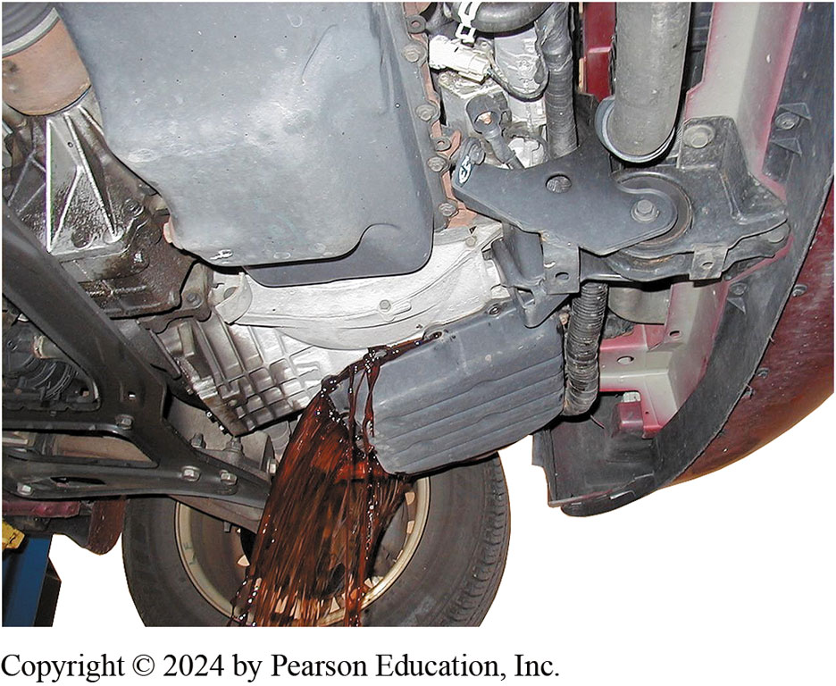
Figure 132.13 Draining Fluid
Draining the fluid from an automatic transaxle by allowing the fluid to flow into a container after most of the retaining bolts have been removed.

Slide 37
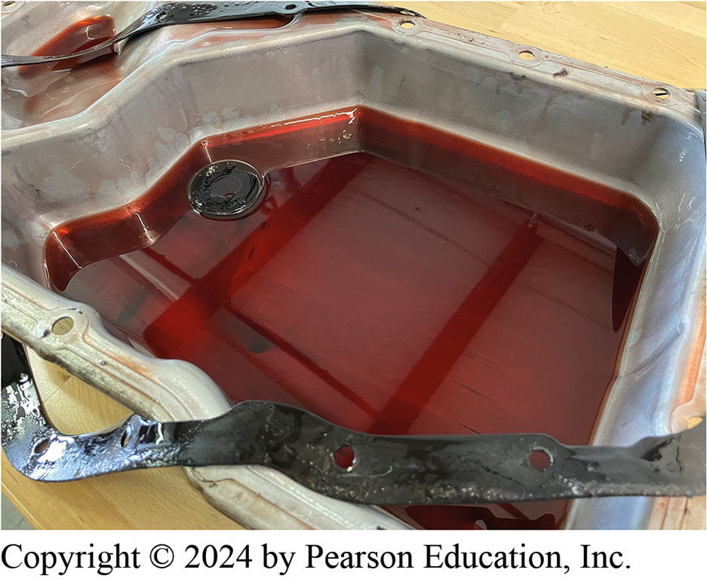
Figure 132.14 Normal Wear Material
This is a normal amount of wear material in the bottom of an automatic transmission pan.

Slide 38
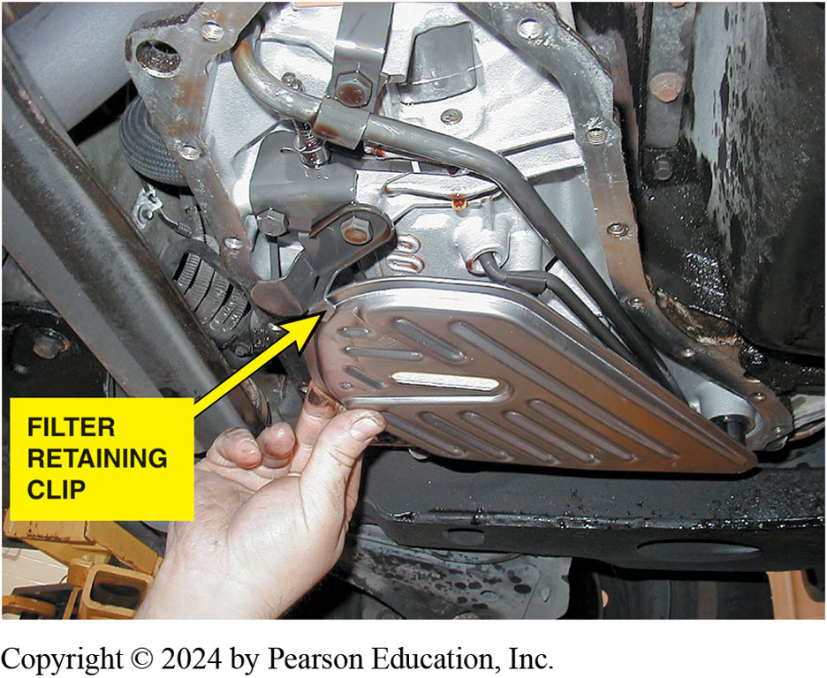
Figure 132.15 Secure Filter
Always check that the filter is secured by a clip or other fastener to keep it from dropping out of its position.
Notes:
Check service information for the exact procedure to follow. Most are retained by a clip or a bolt. ● 132–15.

Slide 39
Fluid Exchange and Flush Units
Fluid flushing typically uses chemical to
  Dissolve varnish and other deposits.
Fluid exchange usually means taking out old fluid
Replacing it with new fluid of the correct type.
Typical procedure
Notes:
Case Study: TSB to the Rescue: A Dodge Durango came in to shop with a customer complaint of delayed engagement into reverse after sitting for a while. A check of a TSB (21-016-05) described filters with defective check valves. Replacement of filter cured problem.
Summary:
Complaint—Customer complained of a delayed engagement into reverse after the vehicle sat for a while.
Cause—The original filter had a defective check valve.
Correction—A replacement filter fixed the concern.

Slide 40
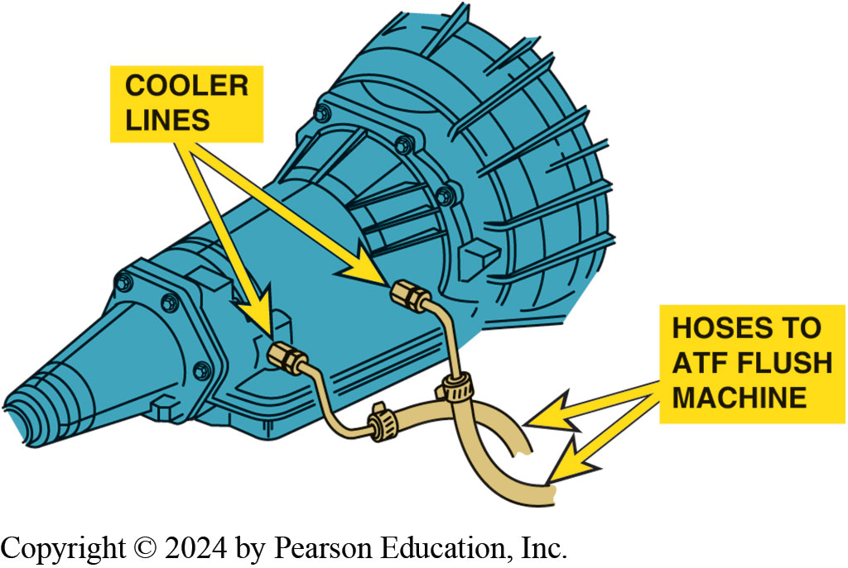
Figure 132.16 Fluid Exchange
A fluid exchange machine uses the engine and the transmission pump to force the fluid into the machine where the old fluid is used to push against a diaphragm, which then forces new fluid back through the transmission. A sight glass is used to show the technician the fluid, so the process can be stopped when only clean, new fluid is seen flowing through the cooler line.

Slide 41
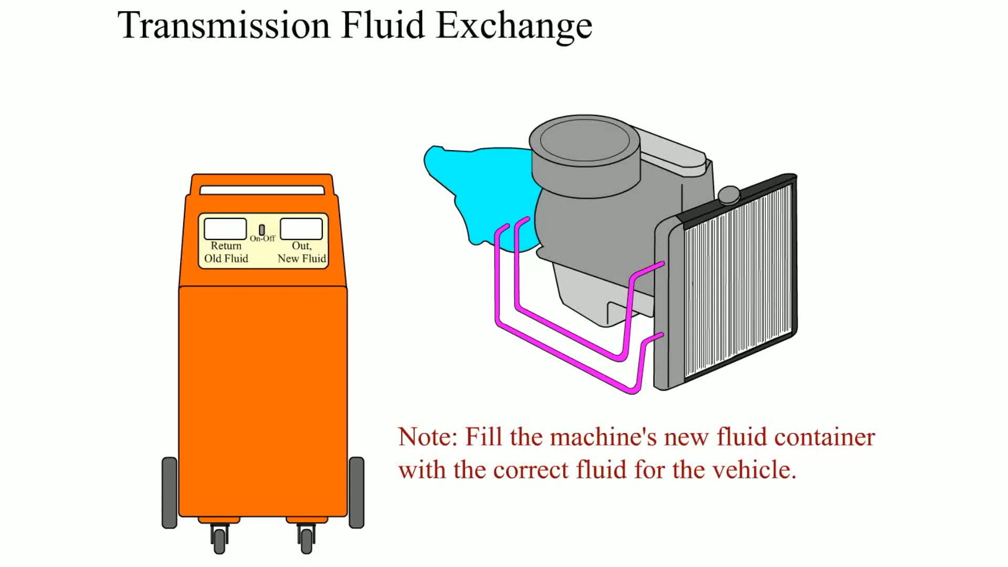
Animation: Transmission Fluid Exchange
(Animation will automatically start)

Slide 42
Frequently Asked Question: What Is Wrong When My Automatic Transmission Does Not Upshift?
? Frequently Asked Question
What Is Wrong When My Automatic Transmission Does Not Upshift? The following examples can cause the automatic transmission/transaxle to fail to upshift: A defective governor (if so equipped) will often not allow any automatic transmission/transaxle to shift out of first gear or stuck in high gear. A defective vacuum modulator (if so equipped) or misadjusted throttle valve will often delay the shift until a very high speed is achieved. A fault in the PCM, TCM, or a speed sensor on electronically controlled automatic transmissions/transaxles will occur when one gear, usually second or third, is selected and the unit will not shift out of that gear.

Slide 43
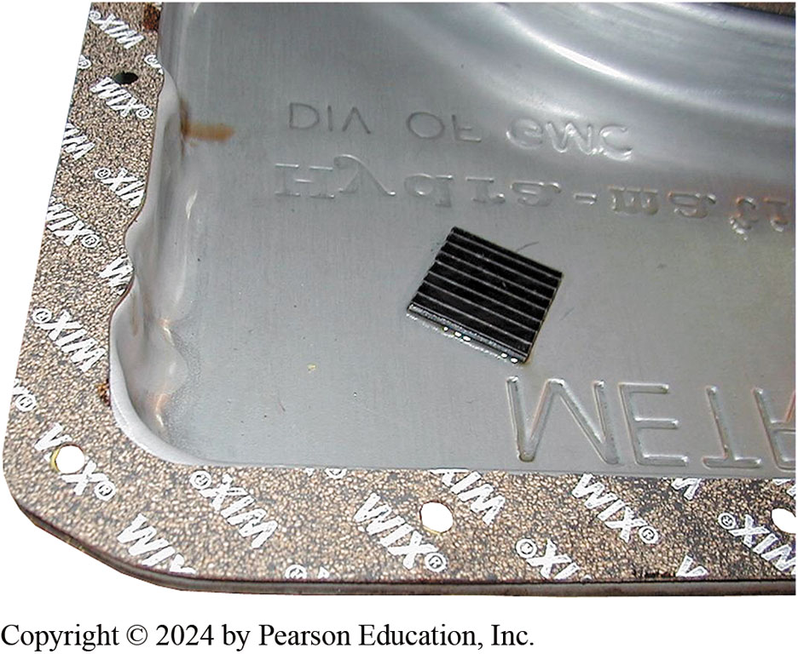
Figure 132.17 Pan Gasket
In this case, the cork-rubber gasket is glued to the pan and is ready to be installed. The retaining bolts need to be tightened in sequence, but be aware that over-tightening will cause a leak. Also, some manufacturers recommend using only an RTV sealer, but never use an RTV sealer and a gasket together.

Slide 44
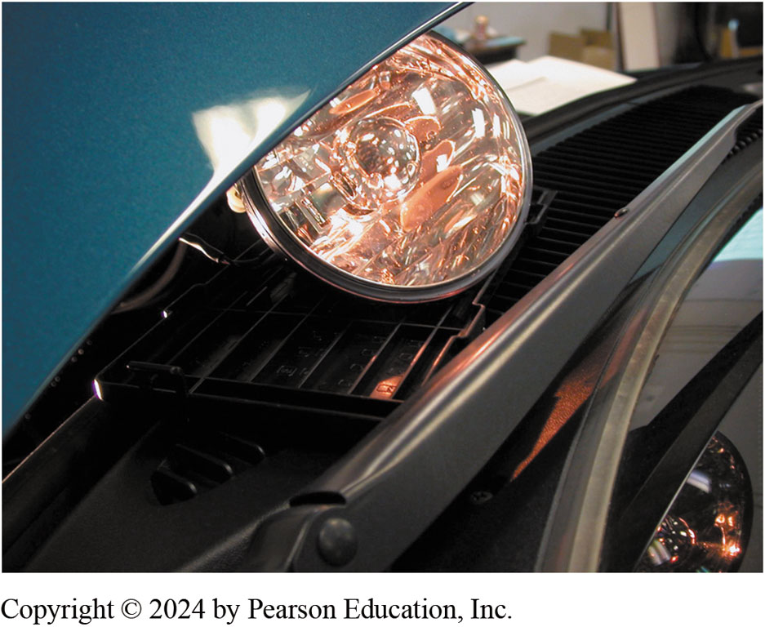
Figure 132.18 Dim Headlight
A dim headlight indicates excessive resistance between the battery and the electrical connector to the automatic transmission/transaxle.
Notes:
TECH TIP: Use Old Headlights to Check Wiring
The proper operation of any electronically controlled automatic transmission/transaxle depends on
having electrical power available to operate the solenoids. Before removing the unit from the vehicle, use a headlight to check if there is enough current being sent to the unit. Unplug the electrical connection that supplies 12 volts, usually from the ignition switch. Use a headlight and attach wires to the ground and the bright filament terminals. Attach one test lead from a headlight to the terminal that supplies 12 volts to the unit. Attach the other lead from the headlight to a good clean chassis or transmission ground such as the case.
Turn ignition key on, engine off (KOEO), and observe the headlight.
• If the headlight is dim, there is a voltage drop be- tween the source (battery) and the
transmission feed. Check the wires directly leaving the ignition switch or transmission control
relay. If the headlight is still dim, replace the ignition switch or transmission feed relay. ● SEE FIGURE 132–18.
• If the headlight is off, then there is an open circuit between the battery and the
transmission/transaxle. Follow electrical troubleshooting procedures to find and repair the open
circuit.
• If the headlight is bright, there is enough voltage and current being supplied to the
transmission/transaxle to correctly operate all of the solenoids. ● SEE FIGURE 132–19.

Slide 45

Figure 132.19 Bright Headlight
A bright headlight indicates that there should be sufficient current flow available at the automatic transmission/transaxle to operate all the solenoids correctly.

Slide 46
Manual Linkage Checks (1 of 2)
Manual linkage adjustable on most automatic
  Ensures manual valve is positioned correctly
  Relative to gear selector
Linkage position should be checked periodically.
  Misadjusted linkage can cause manual valve to
  Leak oil pressure into wrong passage

Slide 47
Manual Linkage Checks (2 of 2)
Manual Linkage Adjustment
  Manual linkage should be adjusted
  If starter engagements
  Occur in wrong position
  Or transmission detents do not align correctly relative
  To gear range pointer
  Shift Lock Mechanism
  Locks shifter in park position when ignition key is removed

Slide 48
Question 1?
Severe service includes ____________.
  a. extensive highway driving
  b. commercial use, such as police or taxi use
  c. a combination of city and highway driving
  d. driving in temperatures below freezing

Slide 49
Answer 1
Severe service includes ____________.
  b. commercial use, such as police or taxi use

Slide 50
Automatic Transmissions and Transaxles Videos and Animations
Videos Link: (A2) Automatic Transmissions and Transaxles Videos
Animations Link: (A2) Automatic Transmissions and Transaxles Animations

Slide 51
Copyright
This work is protected by United States copyright laws and is provided solely for the use of instructors in teaching their courses and assessing student learning. Dissemination or sale of any part of this work (including on the World Wide Web) will destroy the integrity of the work and is not permitted. The work and materials from it should never be made available to students except by instructors using the accompanying text in their classes. All recipients of this work are expected to abide by these restrictions and to honor the intended pedagogical purposes and the needs of other instructors who rely on these materials.

