Slide 1
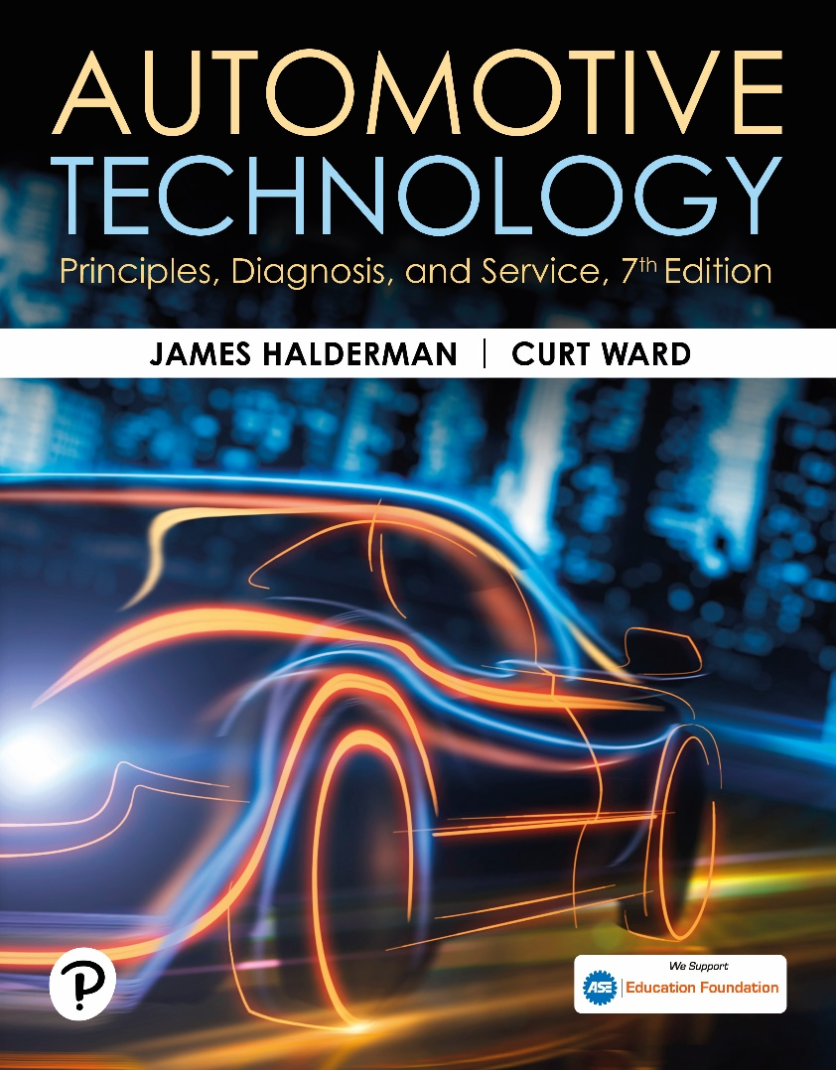
Automotive Technology: Principles, Diagnosis, and Service
Seventh Edition
Chapter 131
EV and HEV Transmissions
Copyright © 2023 Pearson Education, Inc. All Rights Reserved
Notes:
INSTRUCTOR NOTE: This presentation includes text explanation notes, you can use to teach the course. When in SLIDE SHOW mode, you RIGHT CLICK and select SHOW PRESENTER VIEW, to use the notes.

Slide 2
Learning Objectives (1 of 2)
131.1 Describe the powertrain configuration.
131.2 Explain the principles involved with vehicle transmissions/transaxles.
131.3 Describe the function of a hybrid electric vehicle (HEV)transmission.
131.4 Discuss the transmission in GM parallel hybrid trucks (PHTs).
131.5 Discuss the GM two-mode hybrid transmission.
131.6 Discuss the Ford/Lincoln 10R80 MHT.

Slide 3
Learning Objectives (2 of 2)
131.7 Discuss the Toyota/Lexus power-split system.
131.8 Discuss the diagnosis of an HEV transmission.
131.9 Describe the transmissions used in electric vehicles (EVs).

Slide 4
Transmissions and Transaxles (1 of 2)
Purpose and Function
All vehicles, regardless of the power source, require the use of a transmission to achieve reasonable acceleration and efficiency.
The transmission is responsible for providing the following:
Torque applied to the drive wheel to accelerate the vehicle from a stop.
Power at higher speeds that allows the powertrain to operate efficiently.

Slide 5
Transmissions and Transaxles (2 of 2)
Powertrain Configuration
In rear-wheel-drive (R W D) applications, it is most common to use a transmission along with a driveshaft and differential.
In a front-wheel-drive (F W D) vehicle, a transaxle assembly is used with half-shafts to transmit torque to the drive wheels.
In a four-wheel-drive (4W D) or all-wheel-drive (A W D) vehicle, a transfer case or rear electric motor is used to distribute power to all four wheels.

Slide 6
Vehicle Configurations
VEHICLE | FWD RWD AWD | CONFIGURATION
Toyota Prius 2001–2009 | FWD | ECVT 2 Motors/1 Planetary
Chevrolet Volt 2011–2015 | FWD | ECVT 2 Motors/1 Planetary/Clutches
Toyota Prius 2010–2015 | FWD | ECVT 2 motors/2 Planetary
Toyota Prius 2016–2021 | FWD/ AWD | ECVT 2 Motors/2 Planetary/One-way clutch
General Motors 2 Mode 2009 | RWD/ AWD | ECVT 2 Motors/ 3 Planetary/Clutches
Honda Accord Hybrid 2015 | FWD | ECVT 2 Motors/ 2 Clutches
Nissan Leaf 2011 | FWD | Electric Motor with gear reduction unit
Chevrolet Bolt 2017–2022 | FWD | Electric Motor with gear reduction unit
Notes:
Example Vehicle Transmission Configurations

Slide 7
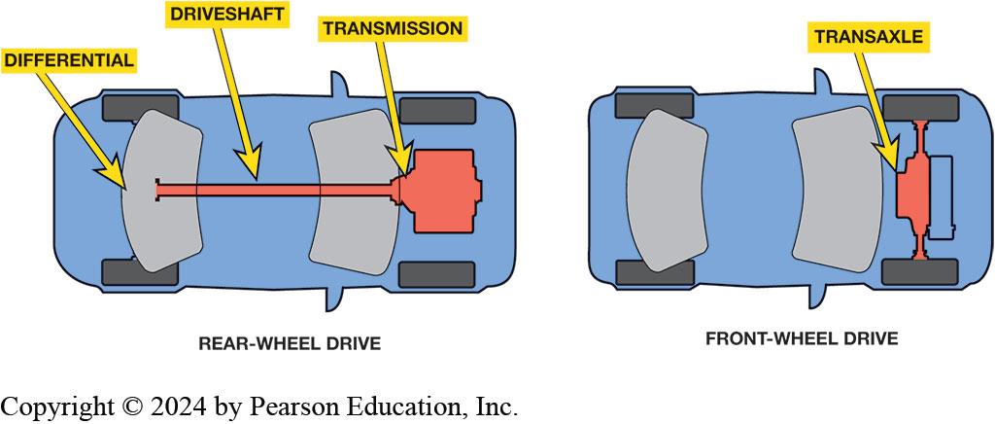
Figure 131.1 Drivelines
Rear-wheel-drive (R W D) vehicles use transmissions to send torque to the rear differential and final drive. Front- wheel-drive (F W D) vehicles use a transaxle, which incorporates the differential and final drive into the transaxle case.

Slide 8
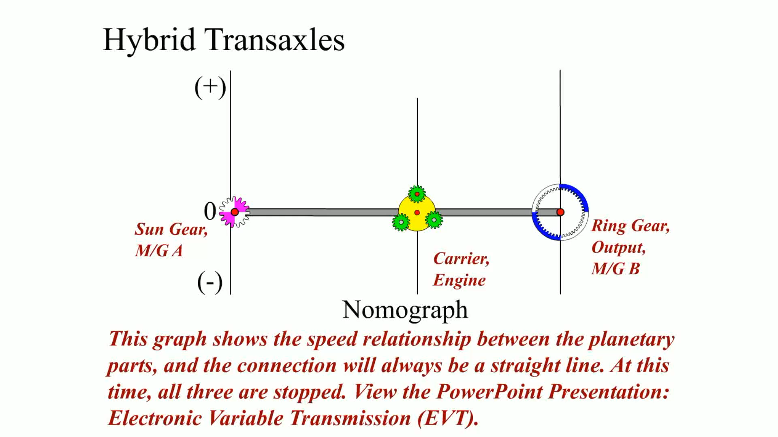
Animation: Hybrid Transaxle (Animation will automatically start)

Slide 9
Principles Involved (1 of 2)
Torque Delivery
Torque is a twisting force.
Torque is applied to the drive wheels to make the vehicle accelerate.
An I C E is most efficient when it is operating near its torque peak.
With more transmission ratios, it is easier to match the vehicle road speed with the most efficient engine R P M.

Slide 10
Principles Involved (2 of 2)
Multiple Speed Transmissions/Transaxles
Years ago, it was common for vehicles with automatic transmissions to have only 2, 3, or 4 gear ratios.
Currently, 5-, 6-, 7-, 8- and 10-speed automatic transmissions are becoming common.

Slide 11
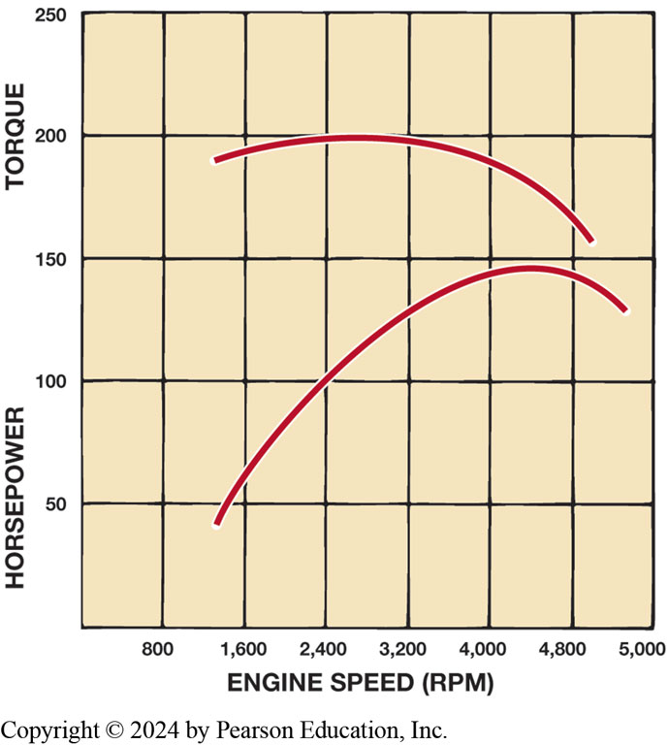
Graph showing engine torque vs horsepower output for typical internal combustion engine. ICEs produce maximum torque at a high RPM, whereas electric motors produce maximum torque at low RPM.
Figure 131.2 Torque vs. HP
Notes:
To move a vehicle, torque must be applied to the drive wheels. Torque is twisting force. Torque is applied to the drive wheels to make the vehicle accelerate. The vehicle transmission is responsible for increasing engine torque in the lower speed ranges when acceleration is required, and then reducing engine speed for the best fuel economy when the vehicle is cruising. ICEs are
very different from electric motors in that they only produce torque in a relatively narrow RPM range. ● Figure 12–2. An ICE is most efficient when it is operating near its torque peak. This is the RPM when the engine is breathing most efficiently, and is typically where the engine can
deliver

Slide 12
Principles Involved
To move vehicle, torque must be applied to drive wheels.
ICEs produce maximum torque at high RPM
Electric motors produce maximum torque at low RPM
Keep ICE in Most Efficient Range
increase RPM range where engine produces torque
(“flattening” torque curve)
Increasing number of gear ratios
Easier to match vehicle road speed with
Most efficient engine RPM.
Notes:
Torque is applied to the drive wheels to make the vehicle accelerate. The vehicle transmission is responsible for increasing engine torque in the lower speed ranges when acceleration is required, and then reducing engine speed for the best fuel economy when the vehicle is cruising. ICEs are very different from electric motors in that they only produce torque in a relatively narrow RPM range. ● See Figure 12–2. An ICE is most efficient when it is operating near its torque peak. This is the RPM when the engine is breathing most efficiently, and is typically where the engine can deliver the best fuel economy. However, it is difficult to keep the engine in this range during all phases of vehicle operation. Automotive engineers overcome this difficulty in two ways:
1. By increasing the RPM range where the engine produces torque (“flattening” the torque curve)
2. By increasing the number of gear ratios in the transmission With more transmission ratios, it is easier to match the vehicle road speed with the most efficient engine RPM. Therefore, any torque increase is generated at the expense of speed. In other words,
when torque is increased in a transmission, output speed is decreased. Figure 12–3.

Slide 13
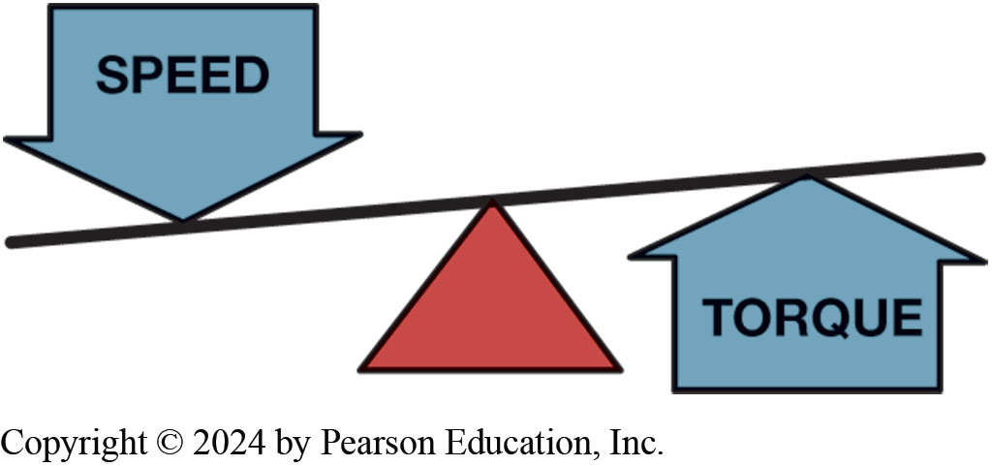
Figure 131.3 Speed & Torque
When output speed decreases in a transmission, output torque will increase.

Slide 14
H E V Transmissions (1 of 2)
Classifications
A mild hybrid with stop-start system typically contains a transmission with a single electric motor.
A full hybrid generally contains a transmission with two electric motors.
Electric Auxiliary Pump
In order to adapt a conventional automatic transmission to a hybrid powertrain, an electric auxiliary pump is used.

Slide 15
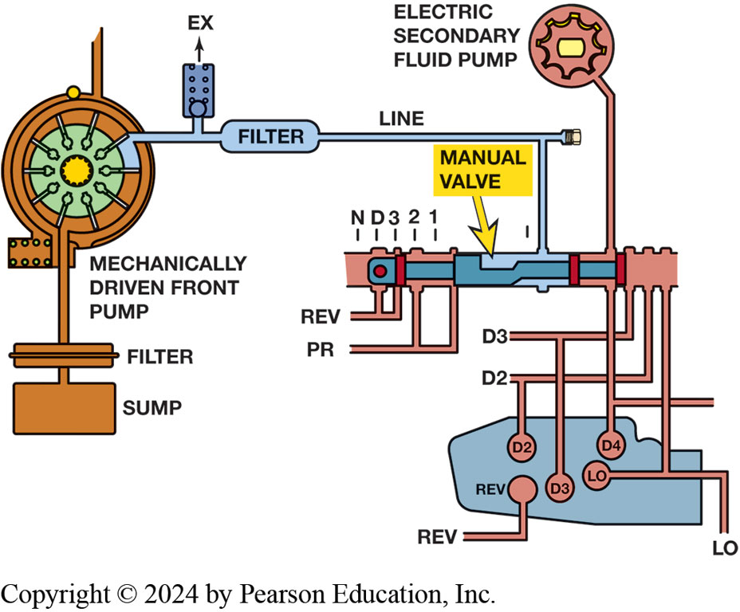
Figure 131.4 Hydraulic Circuit
Hydraulic circuit diagram for G M transmission includes mechanical pump and an electric secondary fluid pump.
Notes:
Long Description:
A mechanically driven front pump extends from the GM transmission, which is connected with the filter followed by the sump. On the other side, the transmission is connected to Ex, further connected to the filter line controlled by the manual valve. One end of the value contains lines such as 1, 2, 3, D, N, REV, and PR. The other end contains the electric secondary fluid pump such as D2 and D3, followed by D4, LO, REV, D2, and D3.

Slide 16
H E V Transmissions (2 of 2)
Hydraulic Impulse Storage Accumulator
A hydraulic impulse storage accumulator is used to provide fluid pressure as the I C E restarts after the idle-stop mode.
Eliminates the need for an electric auxiliary pump.

Slide 17
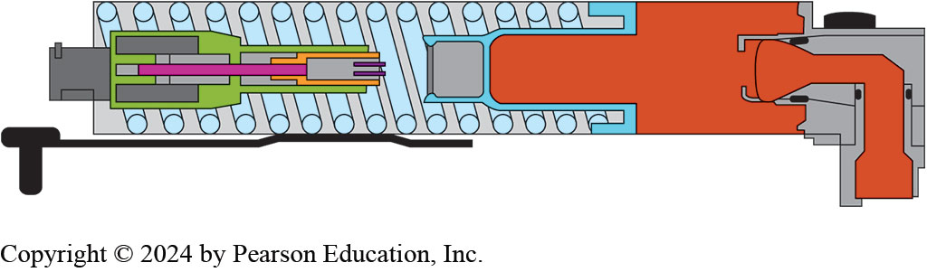
Figure 131.5 Accumulator
When the solenoid is energized, the accumulator releases the fluid creating the initial pressure needed at restart.
Notes:
The automatic idle stop feature shuts down a vehicle’s engine when it detects the ride has stopped in order to help maximize fuel economy in traffic and city driving patterns. Once the driver releases the brake pedal, turns the steering wheel, or steps on the gas, the engine will restart and the vehicle will seamlessly begin to move again.
Hydraulic Impulse Storage Accumulator
Provide fluid pressure as
ICE restarts after idle-stop mode
Provides initial hydraulic pressure
Ensures there is no delay in acceleration

Slide 18
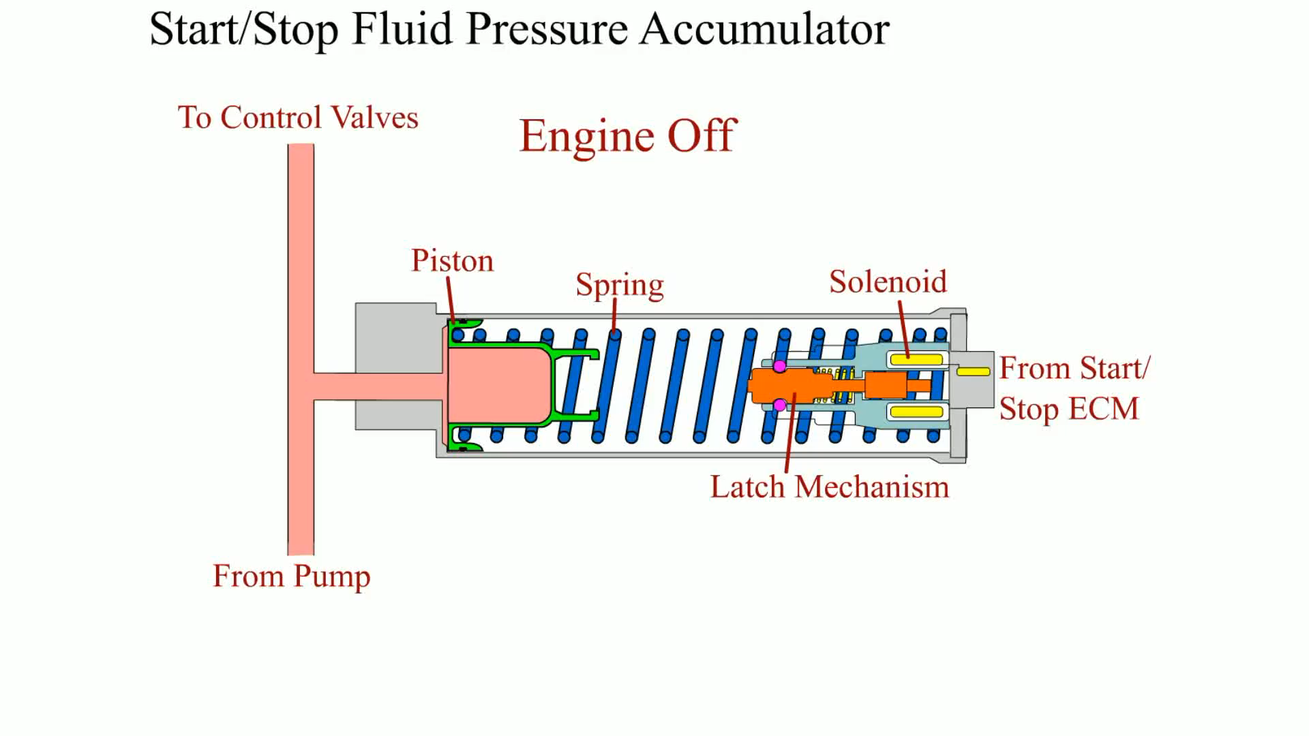
Animation: Start/Stop Fluid Accumulator (Animation will automatically start)

Slide 19
G M Parallel Hybrid Truck (1 of 2)
Description
The transmission in the 2004–2008 Chevrolet Silverado/G M C Sierra parallel hybrid truck (P H T) is based on the 4L60E automatic transmission.
Operation
Whenever the engine goes into idle-stop, the electric fluid pump is turned on to maintain oil pressure.
Service
This transmission requires Dexron VI ATF

Slide 20
GM Parallel Hybrid Truck (2 of 2)
Transmission gear selector lever can be placed in 7 positions, as follows:
P—Park
R—Reverse
N—Neutral
D—Drive
3—Manual third
Notes:
The transmission in the 2004–2008 Chevrolet Silverado/GMC Sierra parallel hybrid truck (PHT) is based on the 4L60E electronically controlled automatic transmission design with minor modification to adjust for its new role in a hybrid powertrain. It has four forward speeds and one reverse, with the fourth speed being an overdrive. It is designed primarily for medium- and large- displacement engines and is used extensively in GM pickups and SUVs. The specific model used in the hybrid pickup is known as the M33.

Slide 21
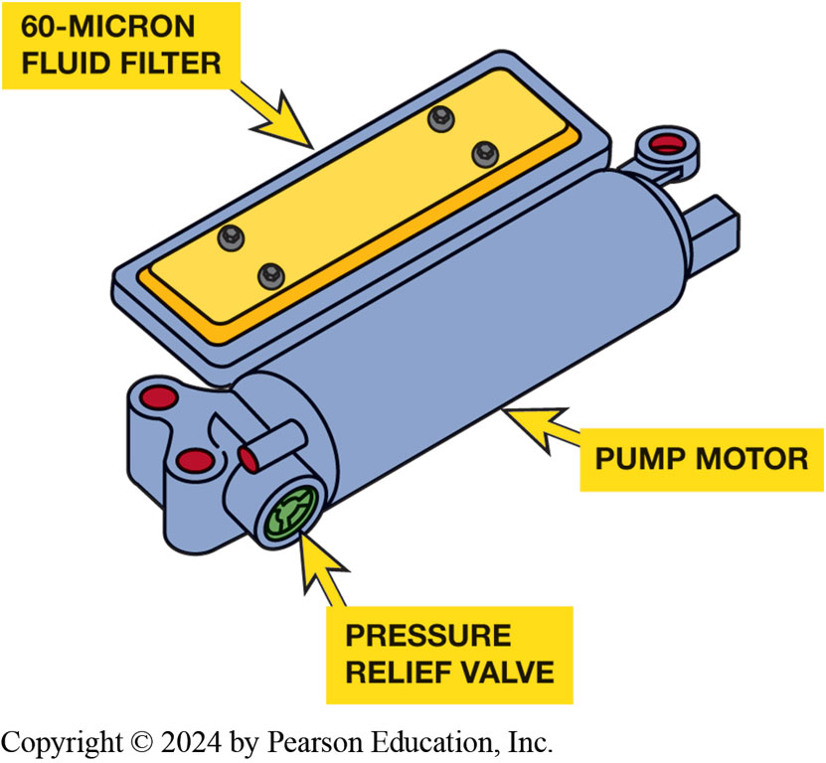
Figure 131.6 Secondary Fluid Pump
Electric secondary fluid pump from a transmission in a G M hybrid pickup.

Slide 22
G M Two-Mode Hybrid Transmission (1 of 3)
Description
The two-mode hybrid transmission used in 2009–2013 General Motors hybrid trucks is labeled a 2M L70.
This unit features two 60-kW motors in the hybrid drivetrain, a 300-volt battery pack, and a V8 engine.

Slide 23
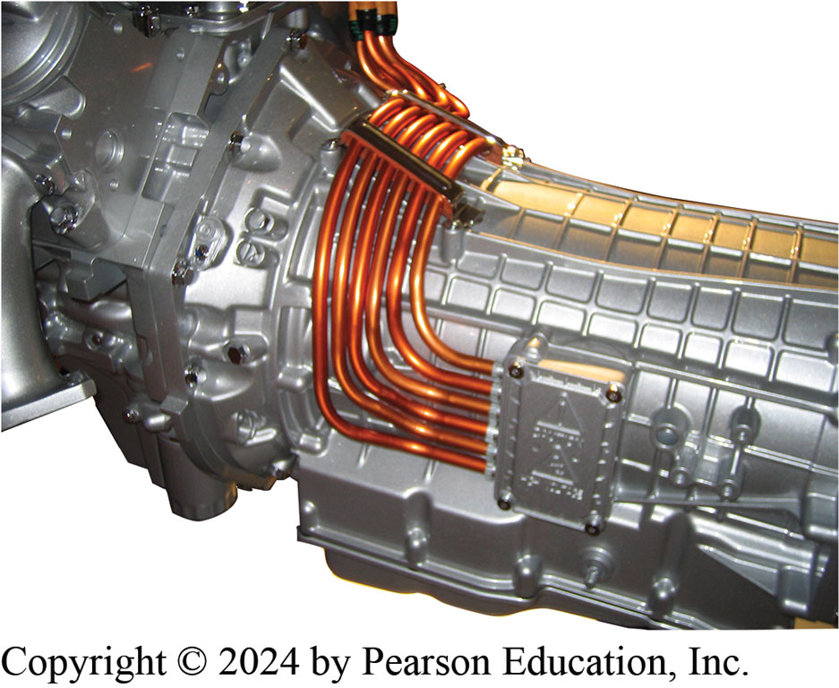
Figure 131.7 Two-Mode Trans
The two-mode transmission has orange high-voltage cables entering the unit to carry electric energy from the high-voltage battery pack to propel the vehicle and also charge the battery during deceleration.

Slide 24
G M Two-Mode Hybrid Transmission (2 of 3)
Components
The two-mode unit is effectively an electronically variable transmission (E V T).
It includes 3 simple planetary gear sets with 4 multiplate clutches.
It has 4 fixed gear ratios with 2 E V ratios for smooth, more efficient operation.

Slide 25
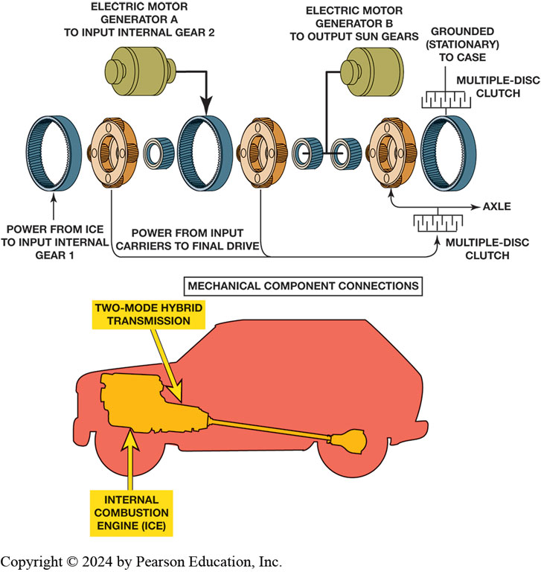
Figure 131.8 Two-Mode Trans
Using two planetary gear sets, the I C E can be maintained in the most efficient speed of about 2000 R P M under most operating conditions.
Notes:
Part 1: The mechanical components of the two planetary gear sets are connected one by one as follows: Power from ICE to input internal gear 1. Power from input carriers to final drive connected with the multiple-disc clutch and axle. The electric motor generator A to input internal gear 2 is followed by the carrier, further connected with the disc clutch. The electric motor generator B to output sun gears is mounted to the axle. The multiple-disc clutch is grounded (stationary to case). Part 2: Underside view of a vehicle with the parts labeled as follows: Two-mode hybrid transmission, Internal combustion engine (ICE).

Slide 26
G M Two-Mode Hybrid Transmission (3 of 3)
First Mode of Operation
The first mode is for accelerating from standstill to second gear.
Second Mode of Operation
The second mode takes the vehicle from second gear through to overdrive.
Two-Mode Service
Fluid-level check and visual inspection should be all that is required until the first scheduled fluid change.
Always use Dexron VI.

Slide 27
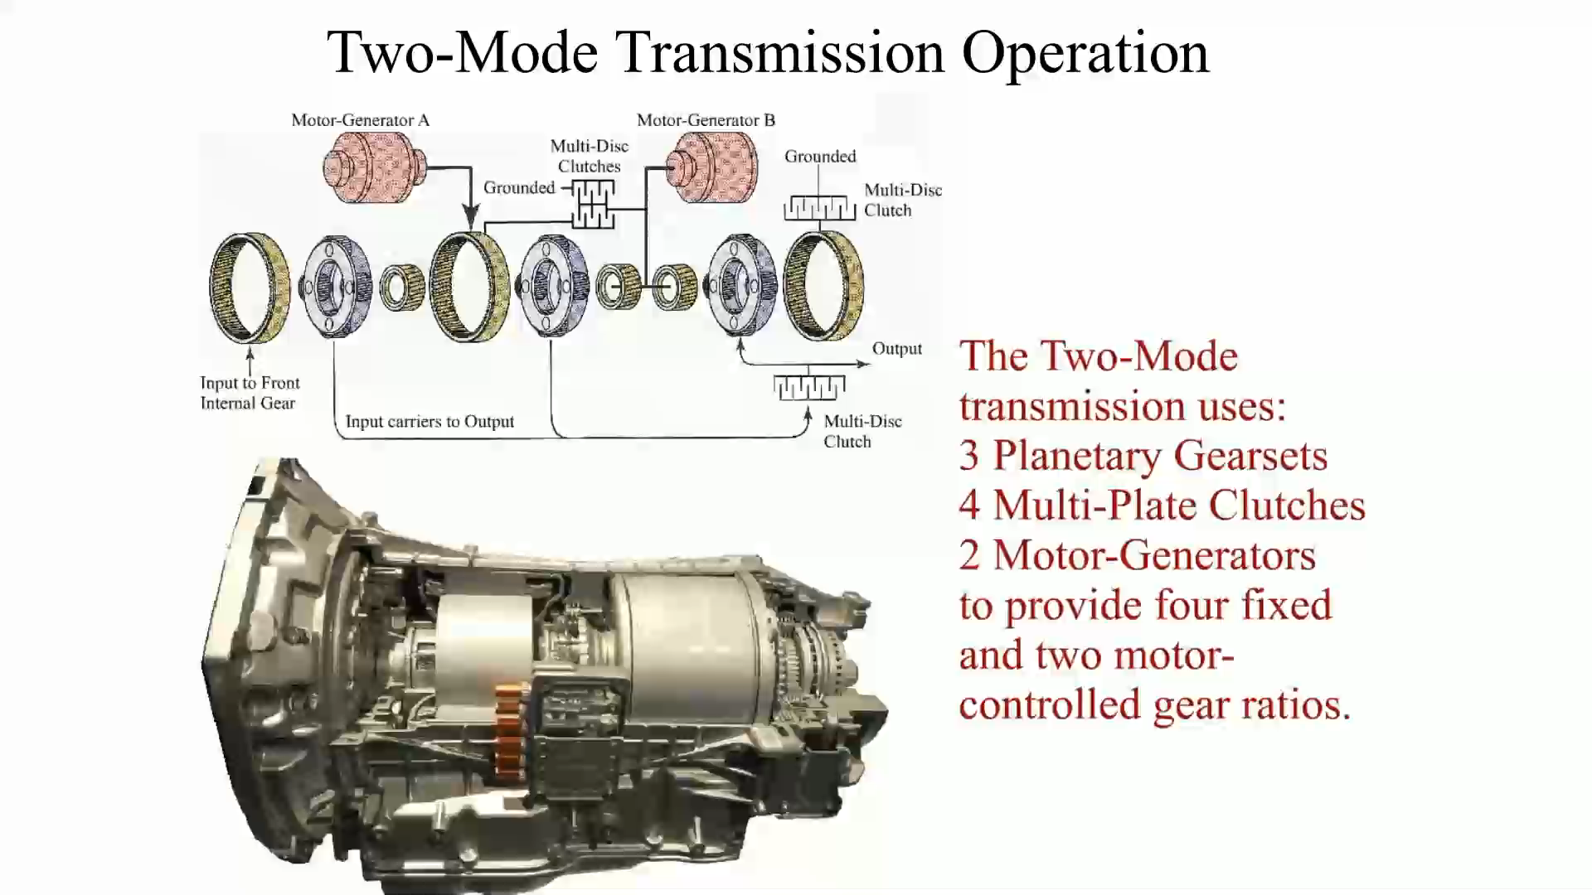
Animation: Two-Mode Transmission Operation (Animation will automatically start)

Slide 28
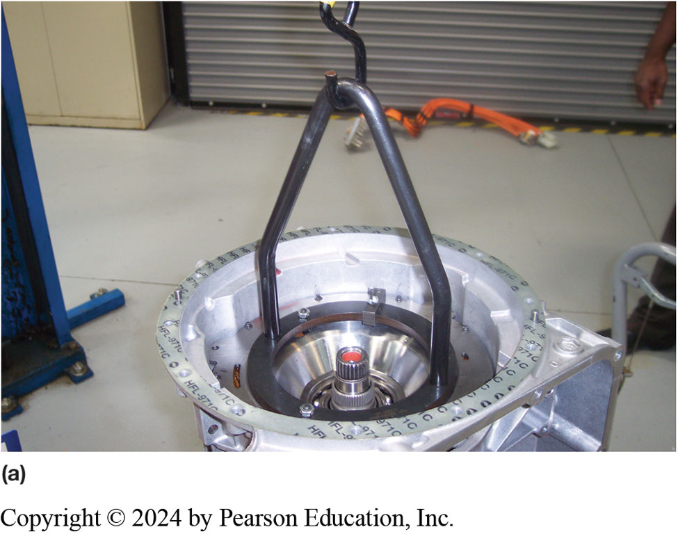
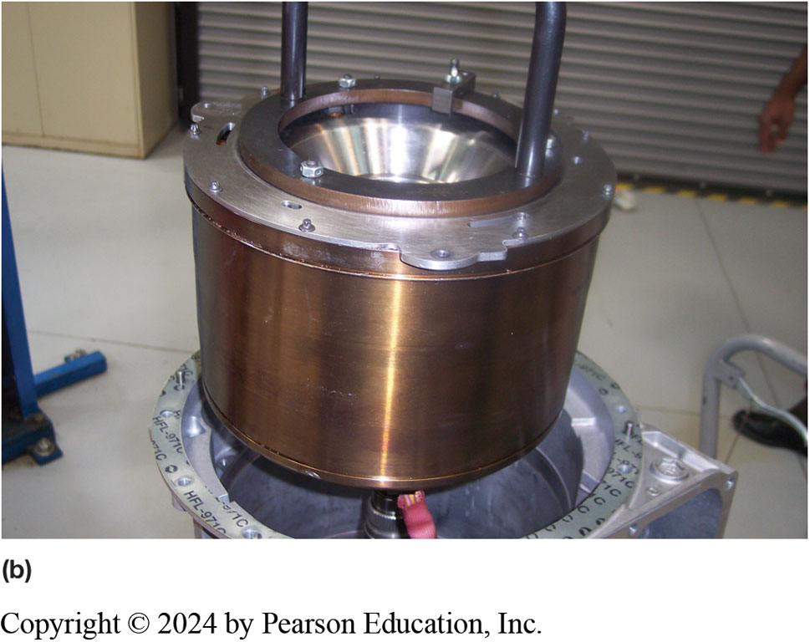
Figure 131.9 GM 2ML70 Service
(a) Disassembly of the 2ML70 transmission requires the use of a special tool and a lift or engine hoist to remove the motor assembly. (b) The motor assembly after being removed from the transmission
Notes:
.

Slide 29
Ford/Lincoln 10R80 MHT
10-speed hybrid transmission 2020 Explorer/Aviator
Plug-in hybrid.
Still uses a torque converter.
Electric motor & disconnect clutch placed between engine & converter.
Electric motor provides low-speed torque and additional power.
6 inches longer non-hybrid model
10R80 shares 90% of components
Notes:
10R80 MHT is a modular 10-speed hybrid transmission that was introduced in the 2020 Explorer
and the 2020 Lincoln Aviator plug-in hybrid. The transmission is unique because unlike most
hybrid transmissions, it still uses a torque converter. The continued use of the torque converter
improves towing and hauling capabilities. An electric motor and disconnect clutch are placed
between the engine and the torque converter. In addition to providing stop–start capabilities, the
electric motor provides low-speed torque and additional power. The MTH transmission is six inches
longer than the non-hybrid model (10R80) and shares 90% of the same components.

Slide 30
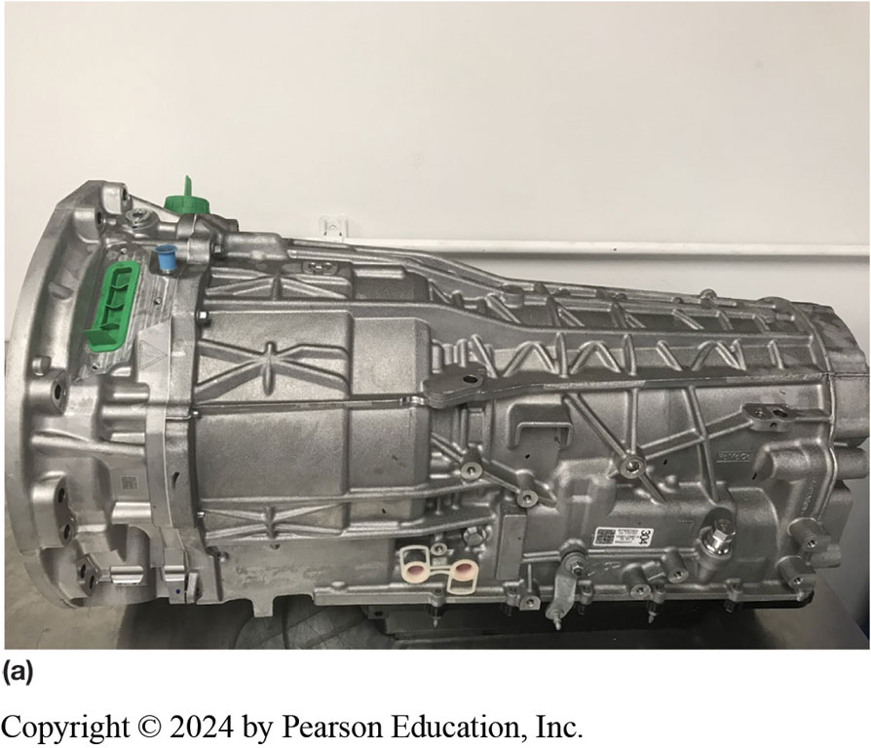
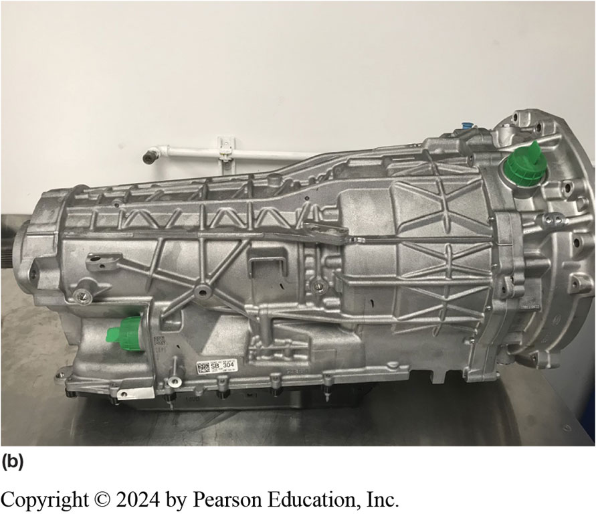
Figure 131.10 Ford 10R80 MHT
(a) The driver side of the transmission contains the high-voltage connections and the shift level assembly. The hybrid portion of the transmission is forward of the gasket. (b) The passenger side of the transmission contains the low-voltage connections

Slide 31
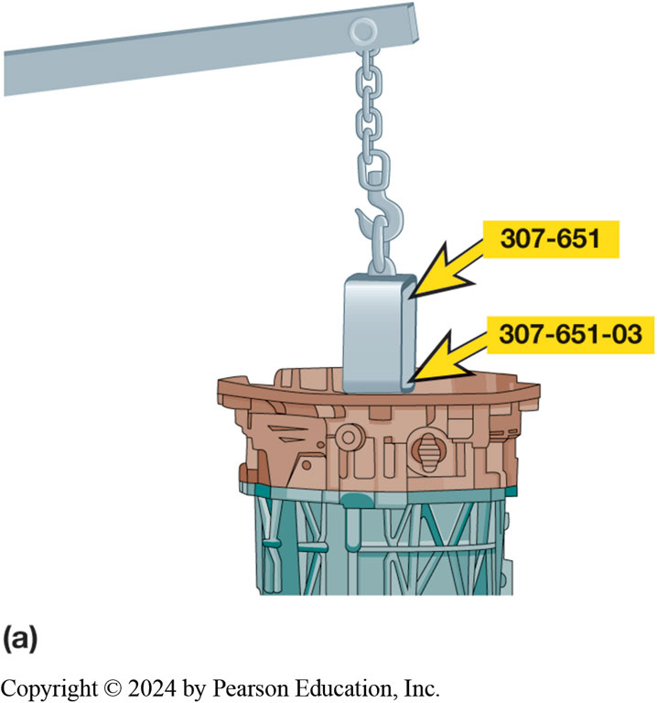
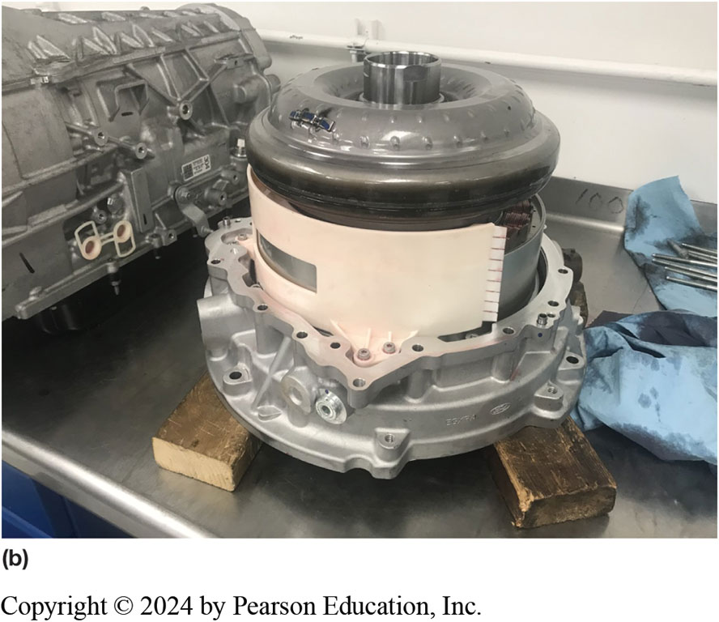
Figure 131.11 Removing Hybrid
(a) An engine hoist and adapter are used to remove the hybrid portion of the transmission. (b) The hybrid portion of the transmission resting on two wooden blocks after being removed from the transmission
Notes:
The components of the hybrid drive unit of the transmission are as follows:
■ Electric motor
■ Resolver (speed sensor)
■ High-voltage connection
■ Low-voltage connection
The hybrid drive unit is removed from the transmission as a unit. An engine hoist and special adapter are recommended when completing this task because of the weight of the unit.
The electric motor is a permanent magnet three-phase motor that generates 33 kW of power. ● See Figure 12–12 A A & B.

Slide 32
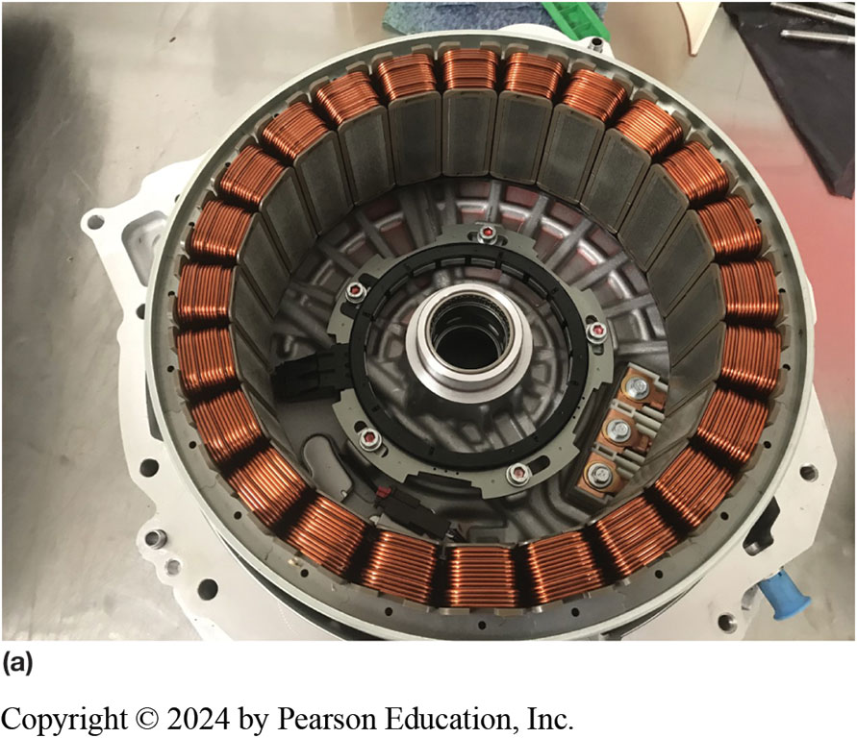
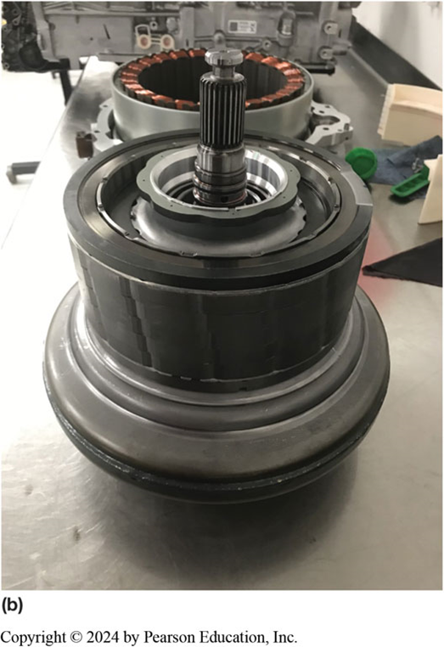
Figure 131.12 Motor Windings
(a) The motor windings attached to the housing after the rotor has been removed. (b) The rotor and torque converter assembly after being separated from the winding.

Slide 33
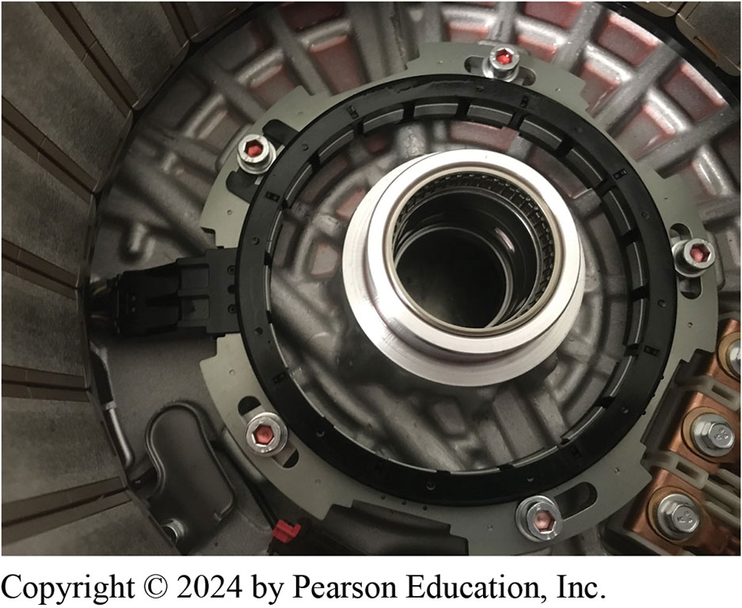
Figure 131.13 Resolver
The resolver is the black and gray electrical sensor bolted to the housing at the bottom of the motor housing.
Notes:
The resolver (speed sensor) provides the PCM with the speed, location, and direction of rotation of the electric motor

Slide 34
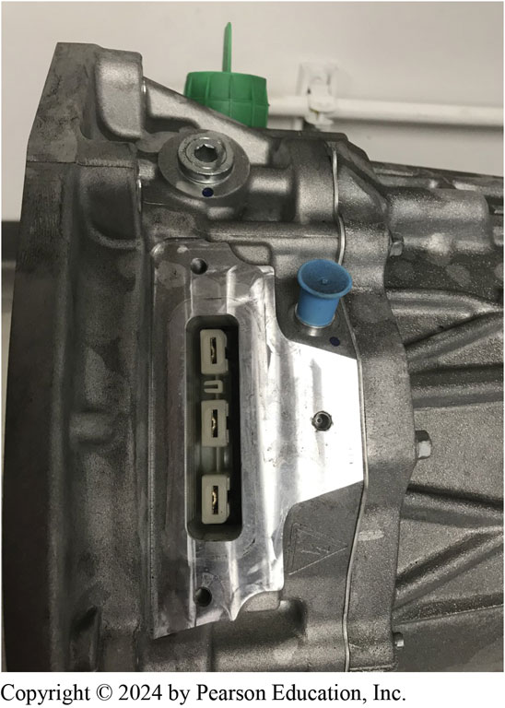
Figure 131.14 3 Connectors
The three large flat connectors allow the electric motor to be connected to the I S C via the high-voltage cables.
Notes:
The high-voltage connector at the transmission allows the electric motor in the hybrid section of the transmission to be connected to the Inverter System Controller (ISC) via the orange- colored high-voltage insulated wiring

Slide 35
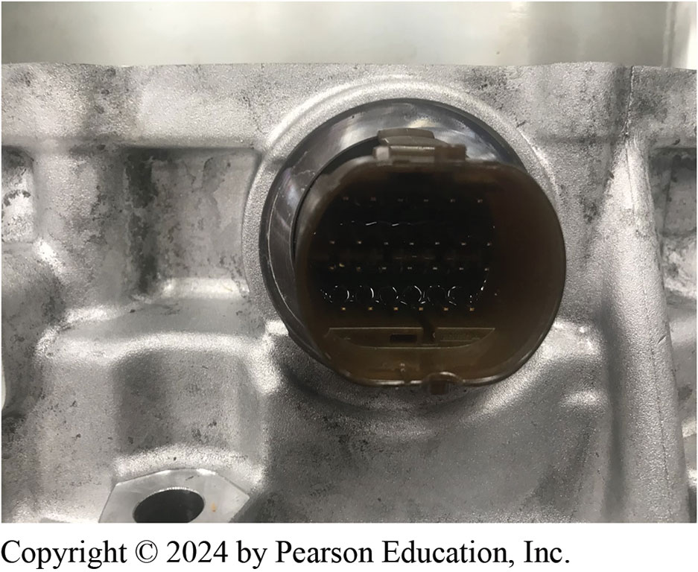
Figure 131.15 Low-Voltage Connector
The low-voltage connector is for transmission control and monitoring
Notes:
The low-voltage connectors at the transmission provide for traditional transmission control and monitoring by the powertrain control module

Slide 36
Toyota/Lexus Power-Split System
Toyota/Lexus Power-Split System
Vehicle stopped
Light acceleration
Normal driving
Full-Throttle Acceleration and High-Speed Cruise
Deceleration and Braking
Reverse
Notes:
Toyota/Lexus Power-split System
he power-split transaxle is a series-parallel hybrid technology. During most phases of vehicle operation, the system is operating as both series and parallel at the same time. While the control system is complex, the basic transaxle is very simple in design as it is built around a single planetary gear set (power-split device) and two electric motor/generators, called MG1 and MG2.
A planetary gear set is composed of three main components:
1. Ring gear
2. Planet carrier
3. Sun gear

Slide 37
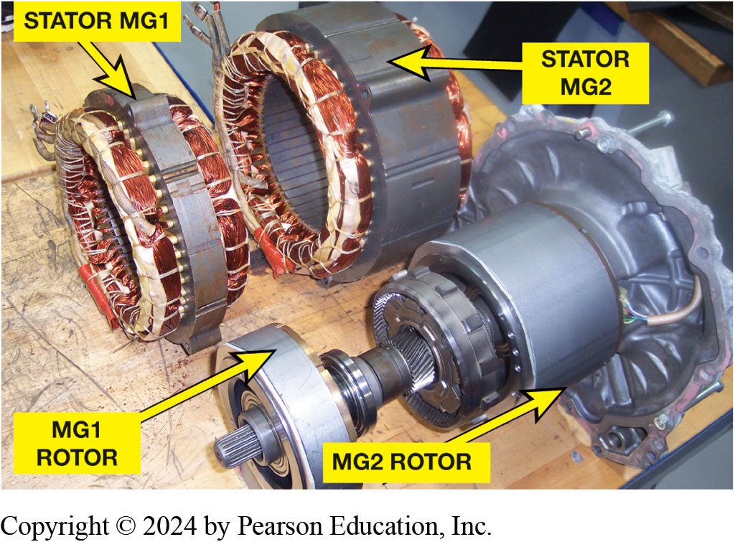
Figure 131.16 Toyota MG1/MG2
Toyota Hybrid System uses 2 electric motor/generators (MG1 and MG2) and an ICE, all connected together by a power-split device, which is a simple planetary gear set.

Slide 38
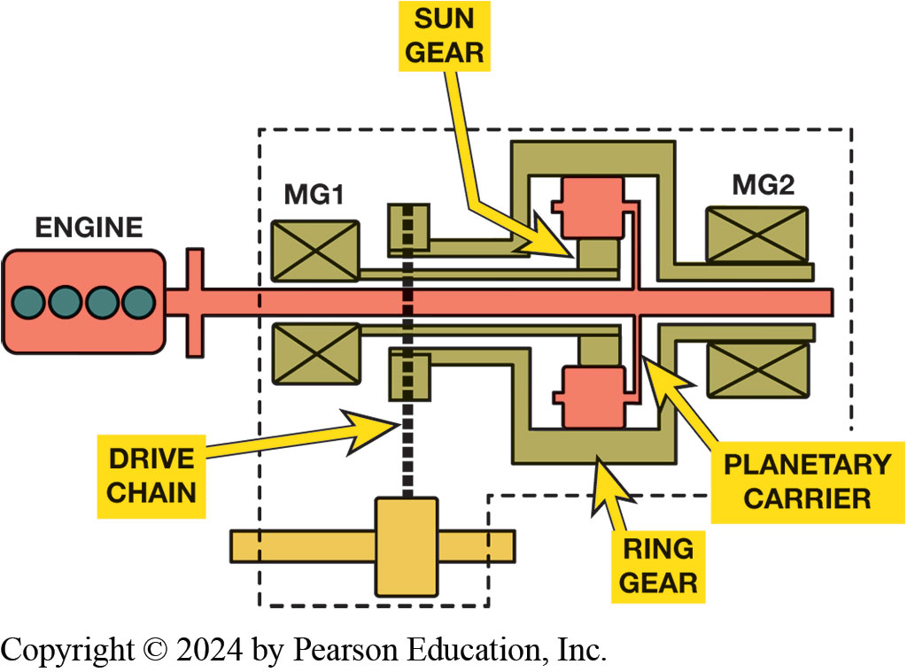
Figure 131.17 Power-Split Device
The power-split device from Toyota Hybrid System. Vehicle will only move when M G2 (and the ring gear) is turning.
Notes:
In the power-split transaxle, a large electric motor/generator (MG2) is directly attached to transaxle final drive and to the planetary ring gear. The ICE is connected to planet carrier, and the small electric motor/generator (MG1) is connected to the sun gear. The planetary ring gear always turns in the same direction as the drive wheels and its speed is directly proportional to vehicle speed. In other words, if the ring gear is not moving, the vehicle is not moving. The power-split device is so named because the ICE (attached to the planet carrier) splits its torque output between the sun gear (MG1) and the ring gear (MG2 and drive wheels).

Slide 39
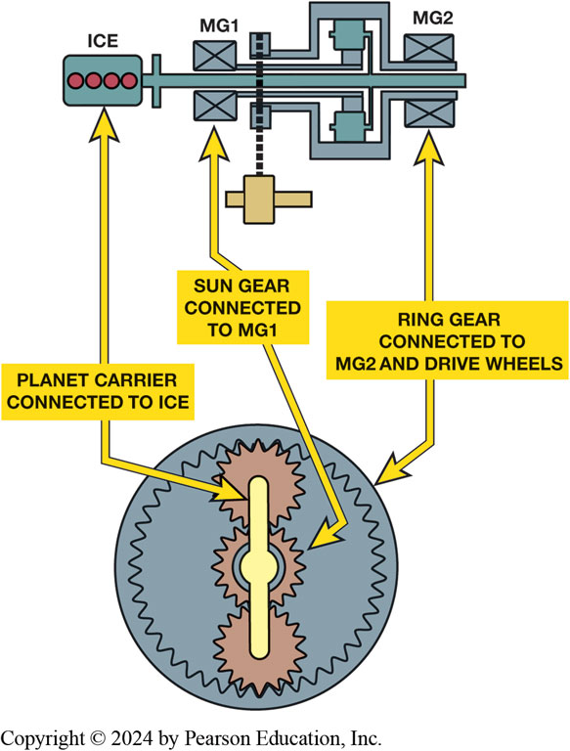
Figure 131.18 Planet Carrier
The planetary gearset used in the Toyota Hybrid System has 2.6 times number of teeth in its ring gear as it has in its sun gear. This means that the ICE (attached to the planet carrier) will send 72% of its torque to the ring gear (drive wheels) and 28% of its torque to the sun gear (MG1).

Slide 40
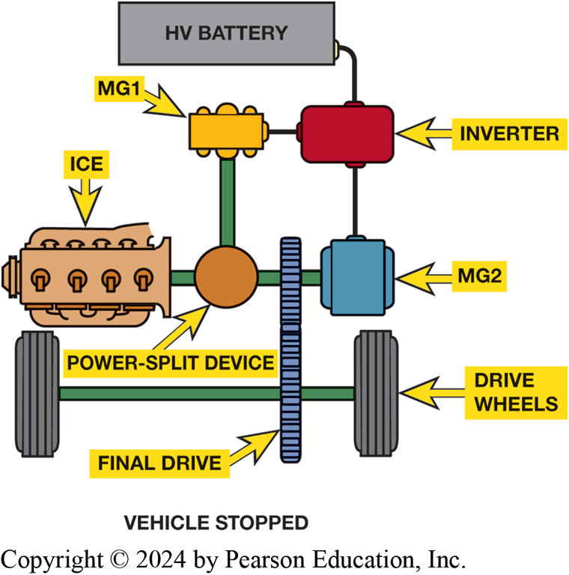
Figure 131.19 Vehicle Stopped
When the vehicle is stopped, the ICE is shut off along with both motor generators
Notes:
Vehicle Stopped. When the vehicle is stopped, nothing is happening within the vehicle drive system. The ICE is shut off, and both electric motor/generators are shut off as well. There are circuits within the vehicle that will use electrical energy from the auxiliary battery, but the drive system itself is effectively inert. The Toyota hybrid system does not use an auxiliary starter, but instead uses the MG1 for starting under all conditions

Slide 41
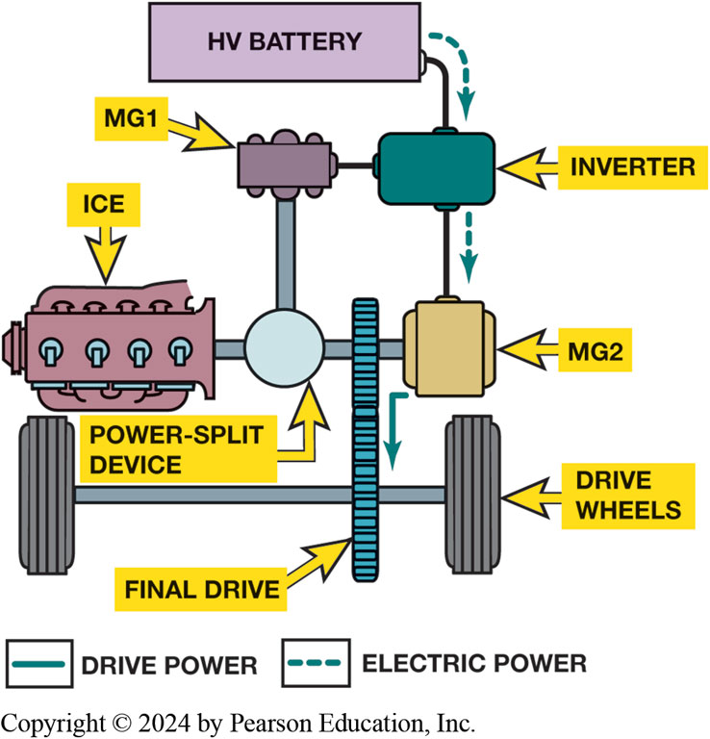
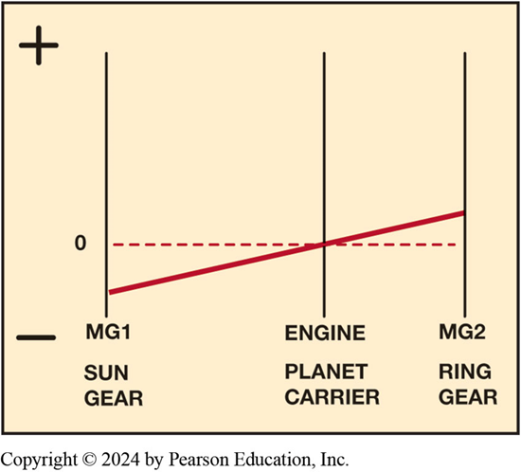
Light Acceleration
Figure 131–21 Under light acceleration, the engine is stopped (0 RPM), MG2 is turning forward (+), and MG1 is turning backward (−).
Figure 131–20 Under light acceleration, power is sent to MG2 to move the vehicle.

Slide 42
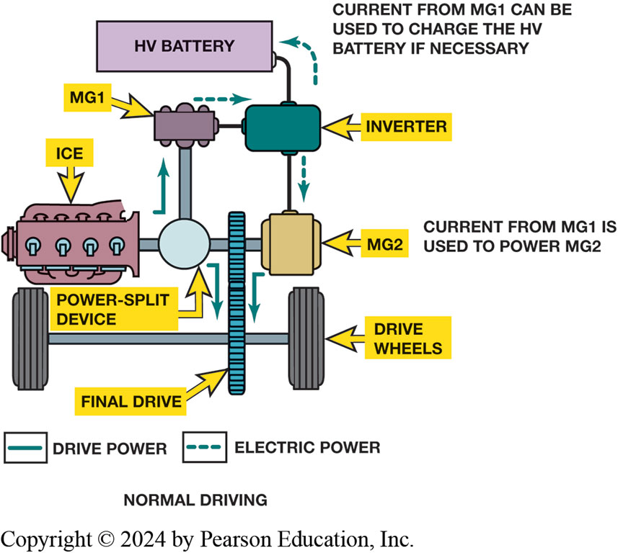
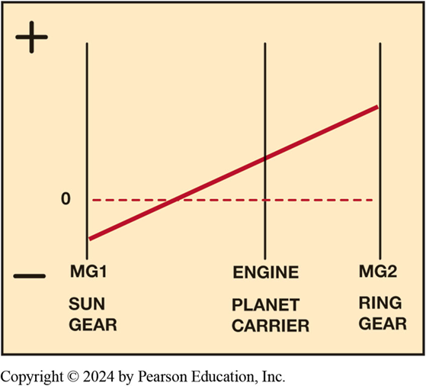
Generator Action
FIGURE 131–23 Normal driving—ICE is now running and some of its torque is used to drive MG1. Electricity generated by MG1 is used to power MG2 or recharge the HV battery.
Figure 131–24 Normal driving—the engine is running, MG2 is turning forward (+), and MG1 is turning backward (−).

Slide 43
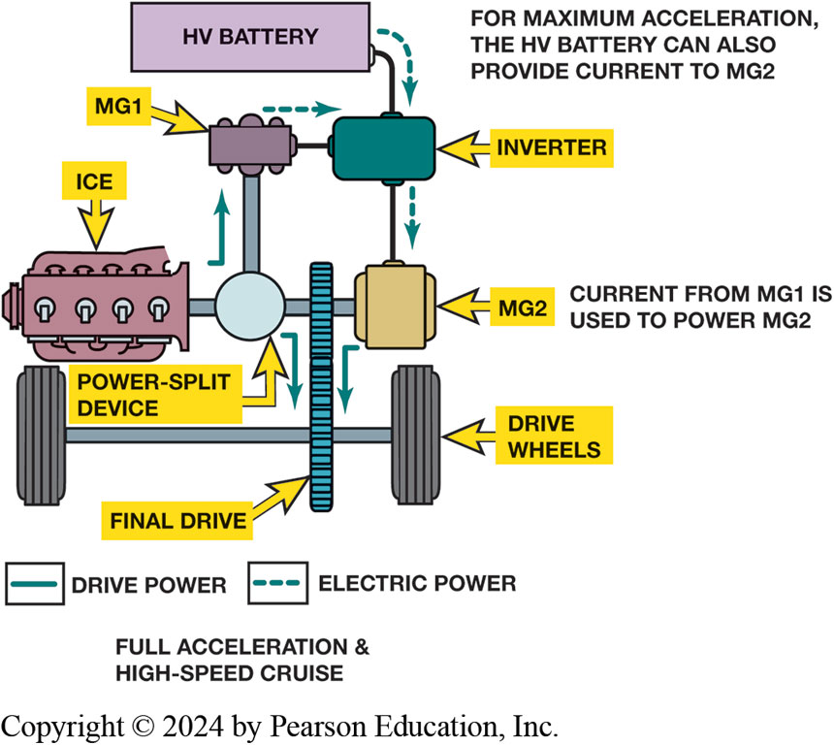
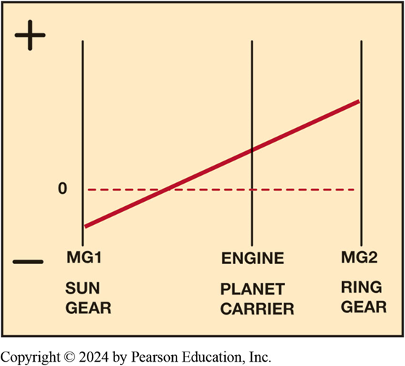
Acceleration
Figure 131–25 Full-throttle acceleration and high-speed cruise—with greater demand for acceleration, power from MG1 combined with power from HV battery to generate higher output from MG2. It is possible to configure MG2 as a generator, send power to MG1 (acts as a motor).
Figure 131–26 Full-throttle acceleration and high-speed cruise—graph shows MG1 acting as a motor using power from MG2. This increases the speed of the ICE, allowing it to produce higher output.

Slide 44
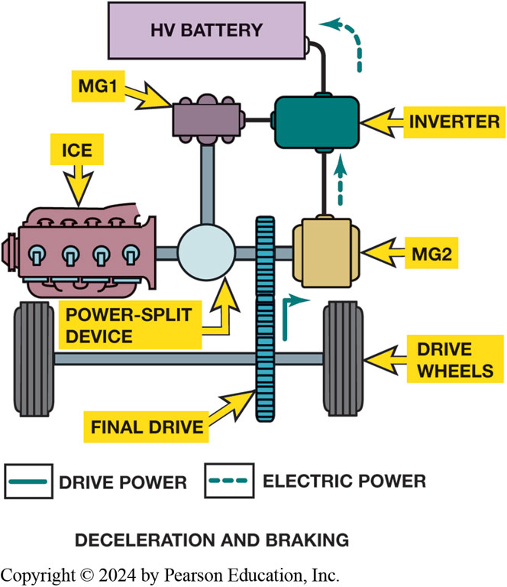
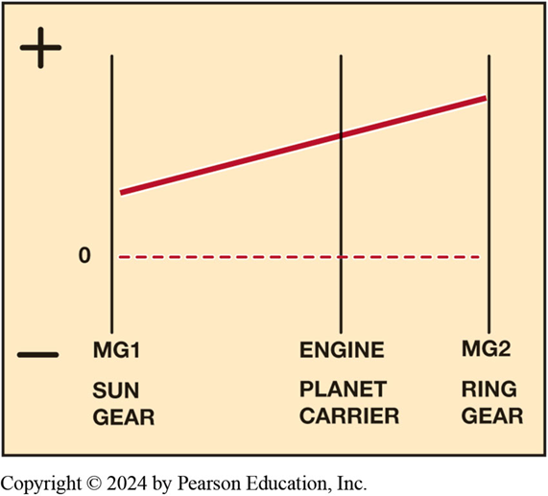
Decel & Reverse
Figure 131–27 Deceleration and braking—MG2 is configured as a generator and recharges HV battery.
Figure 131–28 Reverse—MG2 alone is used to move the car in reverse. This is accomplished by reversing the direction of MG2.

Slide 45
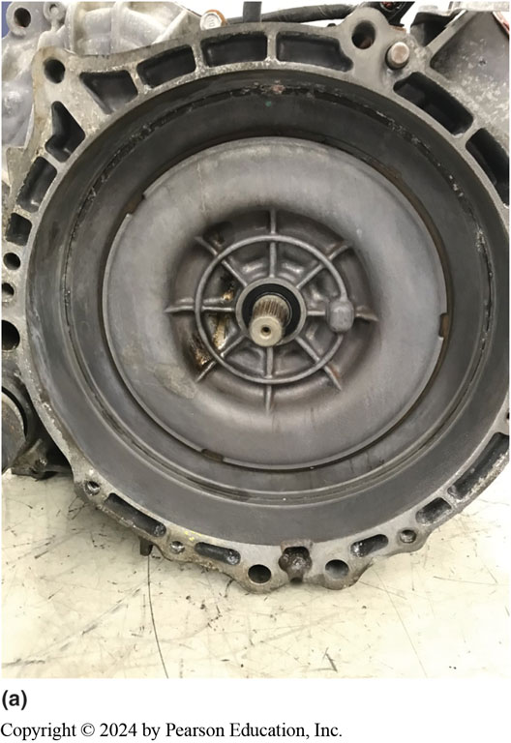
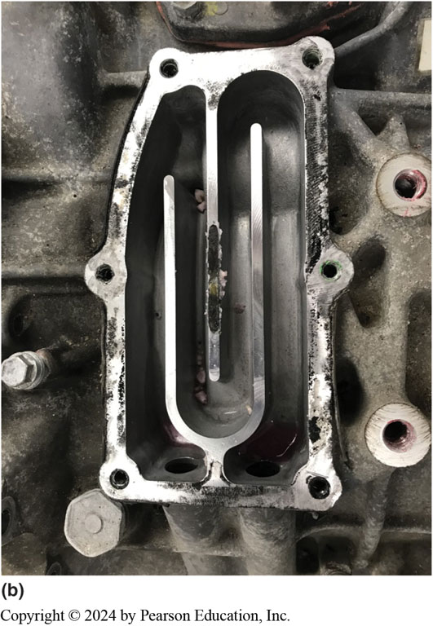
Figure 131.29 Cooling Water Jackets
Notes:
Figure 131-29 (a) Coolant is circulated under the ring in the bellhousing area to remove heat generated by MG1. (b) Coolant is circulated in the passages near the rear of the transmission to remove heat generated by MG2.
Each of these major assemblies has its own water jacket for cooling the motor/generator windings in the housing. There are two water jacket unions installed in each major assembly, and these send coolant to the motors from the separate inverter cooling system.

Slide 46
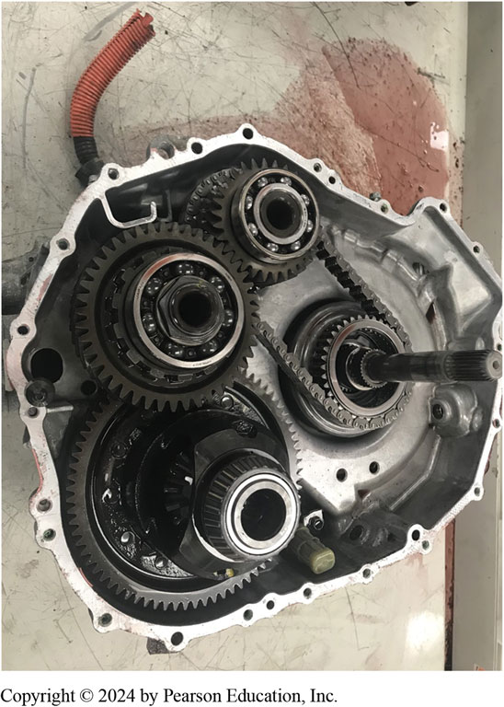
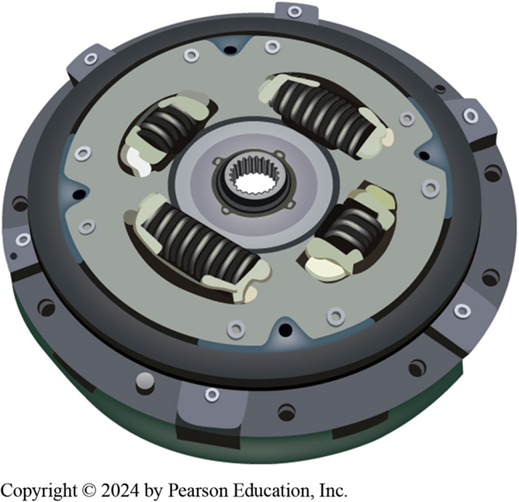
Final Drive & Damper Disc
Figure 131–30 The view of the configuration of the final drive assembly after the front cover has been removed.
Figure 131–31 The flywheel and clutch assembly serve as the dampener between the engine and transmission.

Slide 47
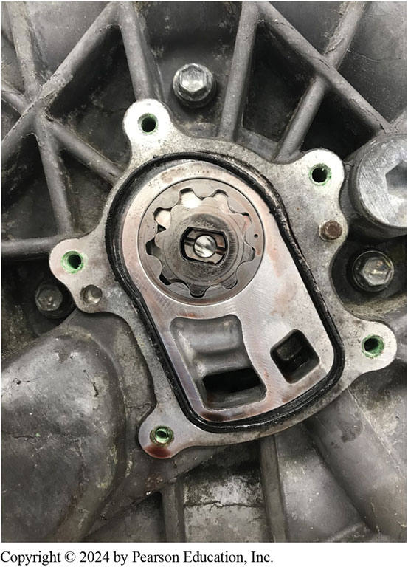
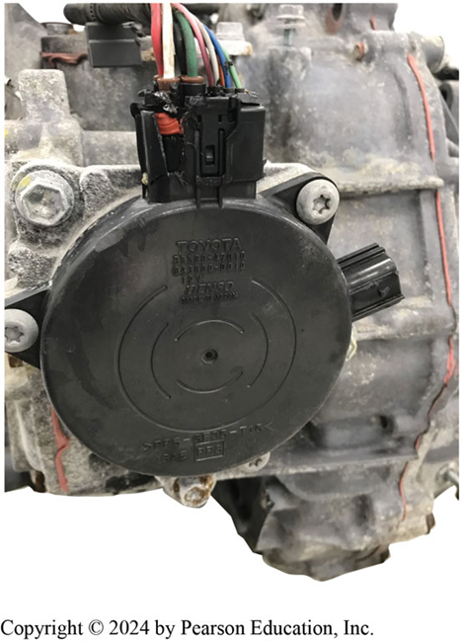
Oil Pump & Parking Lock
Figure 131–32 With the cover removed, transmission oil pump is visible on rear of transmission.
Figure 131–33 electronic actuated park lock mechanism is mounted externally beginning with the 2004 model year.

Slide 48
Hybrid Transmission Diagnosis
8 Step Process
STEP 1 verify the customer complaint.
STEP 2 Check fluid level and condition.
STEP 3 Check DTCs
STEP 4 Check for TSBs
STEP 5 Check scan tool data Figure 12–37.
STEP 6 Perform visual inspections.
STEP 7 Perform bidirectional control
STEP 8 Locate and correct root cause
Notes:
Diagnosing a HEV transmission concerns, perform the following steps:
STEP 1 The first step is to verify the customer complaint.
STEP 2 Check the fluid level and condition.
STEP 3 Check for stored diagnostic trouble codes (DTCs).
STEP 4 Check for any related technical service bulletins (TSBs).
STEP 5 Check scan tool data including checking the adaptive values. ● SEE FIGURE 12–37.
STEP 6 Perform visual inspections, including checking for recent accident damage, previous repairs, or other issues.
STEP 7 Perform bidirectional control of the transmission using a factory or an enhanced aftermarket scan tool to check operation. This helps to establish if the issue is inside or outside of the transmission/ transaxle.
STEP 8 Locate and correct the root cause of the problem.

Slide 49
Electric Vehicle Transmissions (1 of 4)
Acceleration V S Top Speed
Most electric vehicles use single-speed transmission.
E V manufactures usually design their system
For optimum low-end acceleration NOT top speeds.

Slide 50
Electric Vehicle Transmissions (2 of 4)
Ford Mustang Mach-E
BorgWarner producing Integrated Drive Module (I D M)
Being used in Ford Mustang Mach-E.
I D M consists within one compact assembly including:
Electric traction motor
Single-speed gearbox
Thermal-management system (liquid cooling)
Motor and power electronics

Slide 51
Electric Vehicle Transmissions (3 of 4)
Chevrolet Bolt
Chevrolet Bolt drive unit consists of an electric motor
Final drive assembly.
Electric motor is rated at 150 k W
Maximum rotation speed of 8810 R P M.

Slide 52
Electric Vehicle Transmissions (4 of 4)
Nissan Leaf
Three-phase A C electric motor that
produces 80 kilowatts of power.
L E A F incorporates a reducer that
Transfers torque from traction motor to drive wheels.
Two-Speed Gearing
Original Tesla Roadster featured
two-speed transmission
Currently a two-speed unit is used in Porsche Taycan.

Slide 53
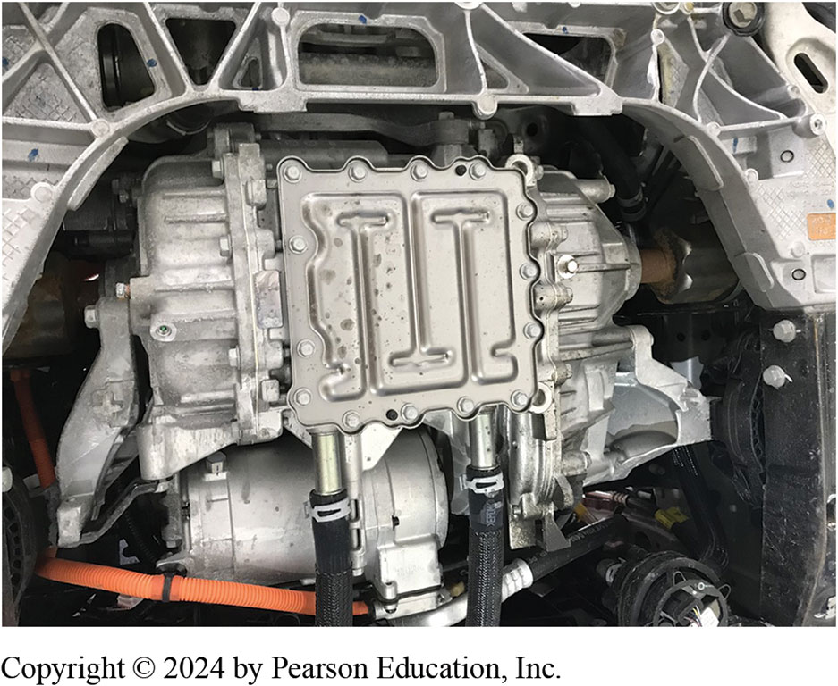
Figure 12.34 Bolt Electric Motor & Final Drive
The electric motor and final drive assembly installed in a Chevrolet Bolt.

Slide 54
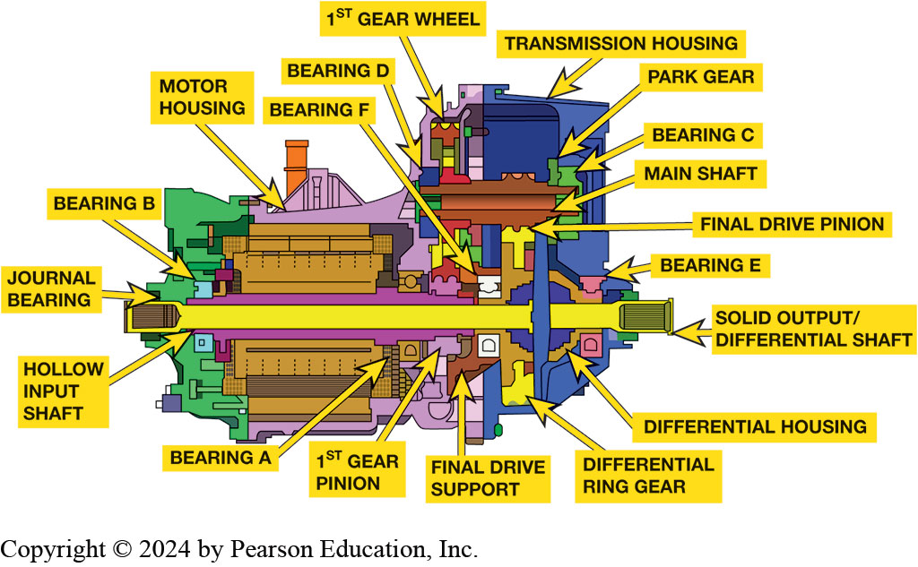
Figure 131.35 Bolt Drive Unit
C A T I A drafting of a Chevrolet Bolt electric motor and final drive assembly.
Notes:
Illustration of a Chevrolet Bolt drive unit with the parts labeled as follows: First gear wheel, bearing D, bearing F, motor housing, bearing B, journal bearing, hollow input shaft, bearing A, first gear pinion, final drive support, differential ring gear, differential housing, transmission housing, park gear, bearing C, main shaft, final drive pinion, bearing E, solid output/differential shaft.
The electric motor is a permanent-magnet synchronous AC motor. It is rated at 150 kW and has a maximum rotation speed of 8,810 RPM (2022 model year specifications). The final drive section of the drive unit consists of the drive gear on the output end of the electric motor, the main shaft, and the ring gear which is mounted on the differential assembly. Figure 131–35.

Slide 55
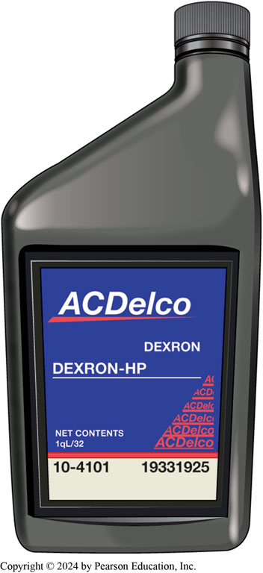
Figure 12.36 Dexron HP
Dexron HP synthetic transmission fluid is specified for Bolt final drive assembly.
Notes:
The final drive assembly provides a gear reduction of 7.05:1 between the electric motor and the drive wheels. The drive unit is internally lubricated and cooled using Dexron HP transmission fluid. The heat is transferred out of the transmission to an external radiator using engine coolant. See Figure 131–36

Slide 56
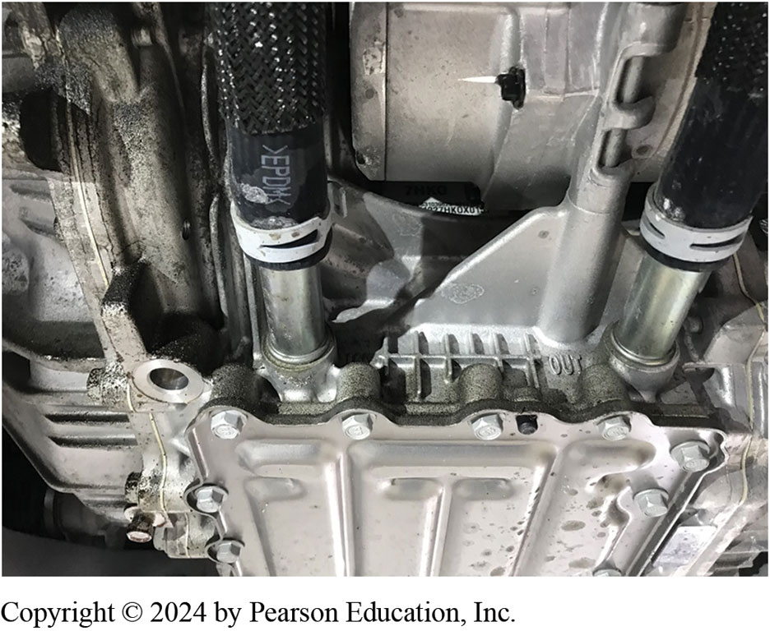
Figure 131.37 Bolt Coolant Lines
Coolant enters through the hose on the left, travels through the passageway absorbing heat, and exits to the radiator through the hose on the right..
Notes:
.

Slide 57
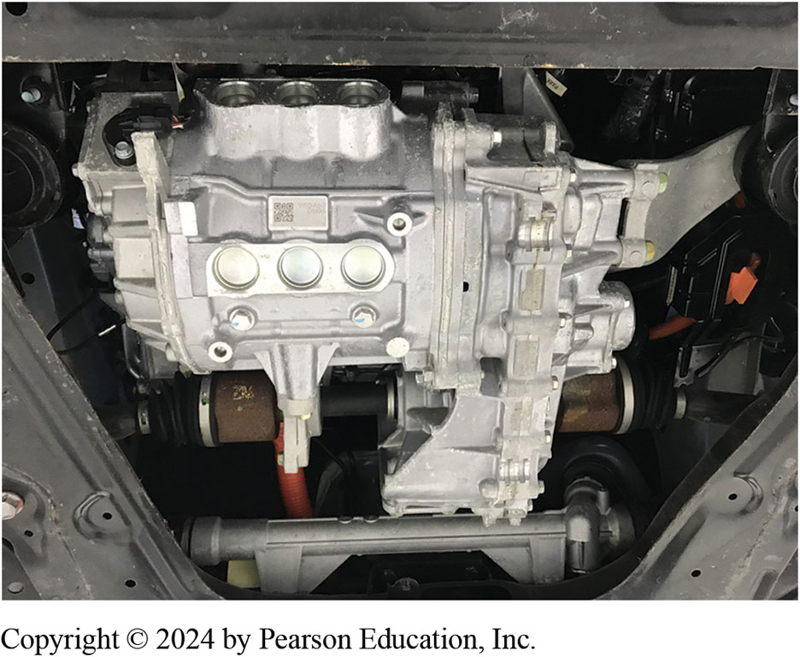
Figure 131.38 Leaf AC Motor
The electric motor assembly and reducer installed in a 2011 Nissan Leaf.
Notes:
At the heart of LEAF’s powertrain is its three-phase AC electric motor. It produces 80 kilowatts of power and can produce maximum torque within 0.1 seconds. This motor has a permanent magnet rotor core with high-density stator winding. It produces 206.5 pound-feet of torque and weighs 129 pounds. ● See Figure 131–38.

Slide 58
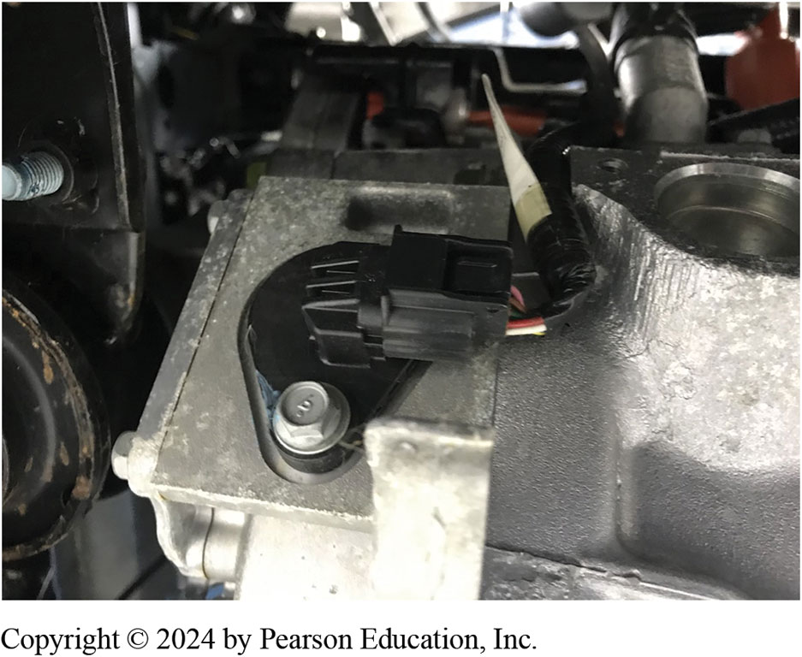
Figure 131.39 External Connection For Resolver
Notes:
A resolver is incorporated to input rotor position and speed to the Vehicle Control Module (VCM). Resolver calibration data to correct for variations in manufacturing is encoded on the traction motor housing. ● See Figure 131–39.

Slide 59
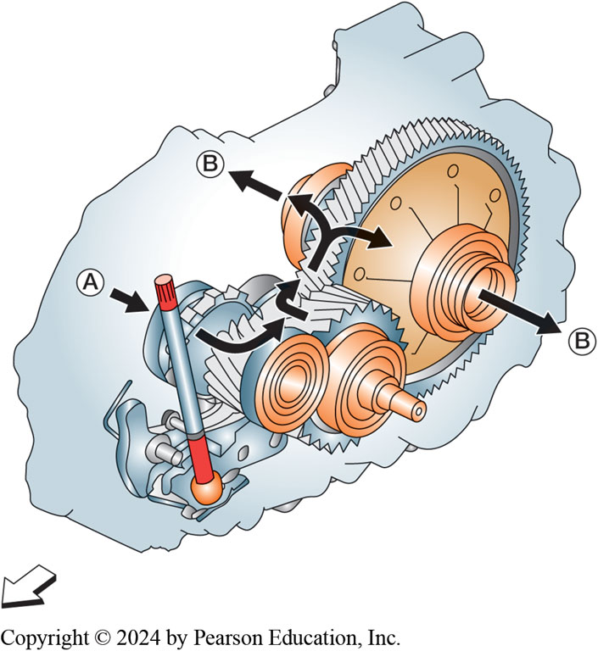
Figure 131.40 Power Thru Reducer
Power flow through the reducer.
Notes:
The reducer is connected to the electric drive motor. The output gear of a speed reducer has more teeth than the input gear. So, while the output gear might rotate more slowly, by reducing the speed of the input, the torque is increased. With an input power source, the torque can be increased, while decreasing the speed.

Slide 60
Frequently Asked Question: What Happens When You Shift to Neutral?
? Frequently Asked Question
What Happens When You Shift to Neutral? When neutral is selected, does it just disconnect the power connections? Or is the motor free to spin? In neutral, there is no power being supplied to the electric traction motor. The motor is never disconnected.

Slide 61
Question 1?
What is the first step when diagnosing a hybrid vehicle transmission?
a. Check the fluid level
b. Verify the customer concern
c. Check for trouble codes
d. Check for Technical Service Bulletins (TSBs)

Slide 62
Answer 1
What is the first step when diagnosing a hybrid vehicle transmission?
b. Verify the customer concern

Slide 63
Hybrid and Fuel Cell Vehicles Videos and Animations
Videos Link: (L3) Light Duty Hybrid Electric Videos
Animations Link: (L3) Light Duty Hybrid Electric Animations

Slide 64
Copyright
This work is protected by United States copyright laws and is provided solely for the use of instructors in teaching their courses and assessing student learning. Dissemination or sale of any part of this work (including on the World Wide Web) will destroy the integrity of the work and is not permitted. The work and materials from it should never be made available to students except by instructors using the accompanying text in their classes. All recipients of this work are expected to abide by these restrictions and to honor the intended pedagogical purposes and the needs of other instructors who rely on these materials.

