Slide 1
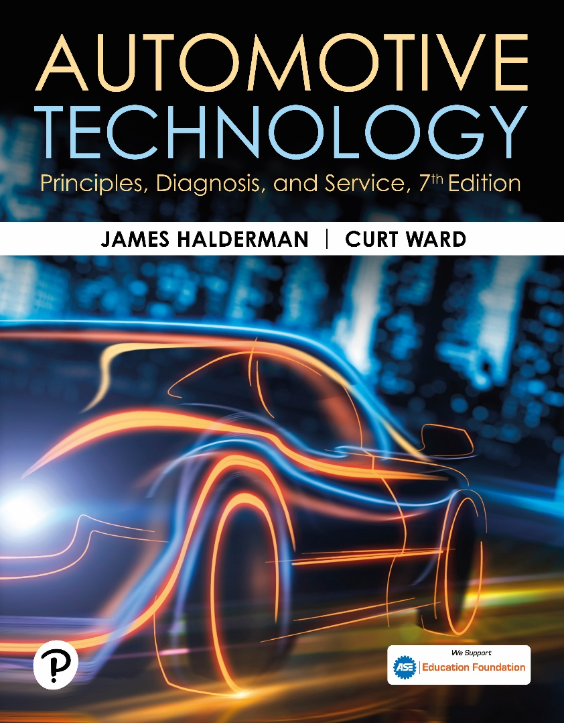
Automotive Technology: Principles, Diagnosis, and Service
Seventh Edition
Chapter 130
Hydraulic Components and Control Systems
Copyright © 2023 Pearson Education, Inc. All Rights Reserved
Notes:
INSTRUCTOR NOTE: This presentation includes text explanation notes, you can use to teach the course. When in SLIDE SHOW mode, you RIGHT CLICK and select SHOW PRESENTER VIEW, to use the notes.

Slide 2
Learning Objectives (1 of 2)
130.1 Discuss the different types of automatic transmission fluid.
130.2 Explain the function of automatic transmission fluid coolers.
130.3 Explain the function of transmission oil pumps.
130.4 Explain the function of apply/holding devices.
130.5 Discuss bands.
130.6 Discuss multi-plate clutches.
130.7 Discuss accumulators.

Slide 3
Learning Objectives (2 of 2)
130.8 Discuss one-way clutches.
130.9 Explain the construction of a valve body.
130.10 Explain electronically controlled transmissions.
130.11 Discuss the typical torque flow in these transmissions.

Slide 4
Automatic Transmission Fluid (1 of 2)
Purpose and Function
  A T F highly refined oil that is specially designed for use in an automatic transmission.
Purposes and functions of A T F are as follows:
  Transfers power in torque converter
  Provides hydraulic pressure in clutches and servos
  Lubricates bearings, bushings, and gears
  Transfers heat to cool transmission parts
  Provides the correct friction for clutch and band application

Slide 5
Automatic Transmission Fluid (2 of 2)
Three basic types of A T F include:
  Non-friction modified.
  Friction modified.
  Highly friction modified.
Typical A T F Applications
  Automatic transmission fluid is formulated to work in specific transmissions. Using the specified fluid is the key to proper operation.

Slide 6
Automatic Transmission Fluid Cooler
Purpose and Function
  Most vehicles use a small section of the engine cooling system radiator to transfer heat from the A T F to the coolant, which cools the A T F.
Parts and Operation
  The A T F is pumped (directed) from the torque converter (greatest source of heat) to the cooler when the torque converter clutch is not applied.
Transmission Fluid Heater
  Some vehicles are equipped with a transmission fluid heater to improve lubrication when the fluid is cold.

Slide 7
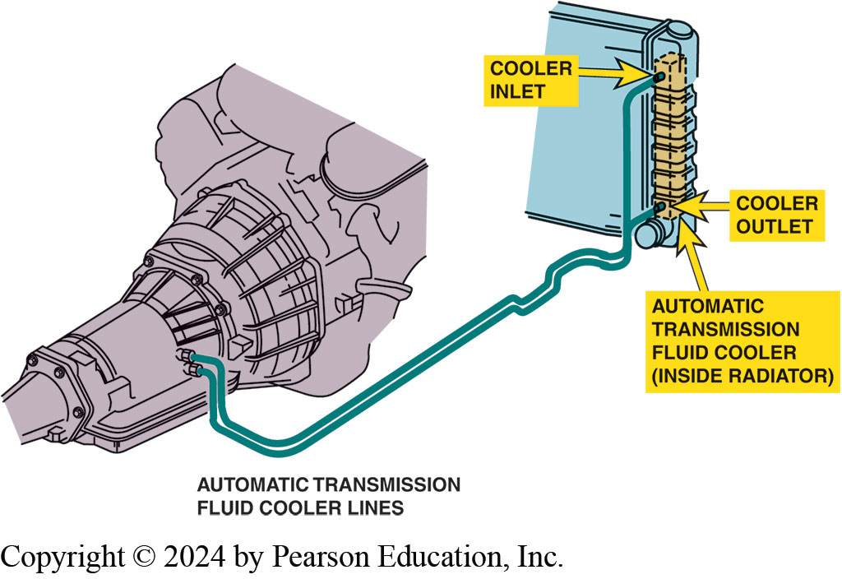
Figure 130.1 Fluid Cooler
Automatic transmission fluid is routed from the torque converter, where most of the heat is generated, to the radiator where it is cooled. The fluid then returns to the transmission/transaxle to lubricate the bearings and bushings

Slide 8
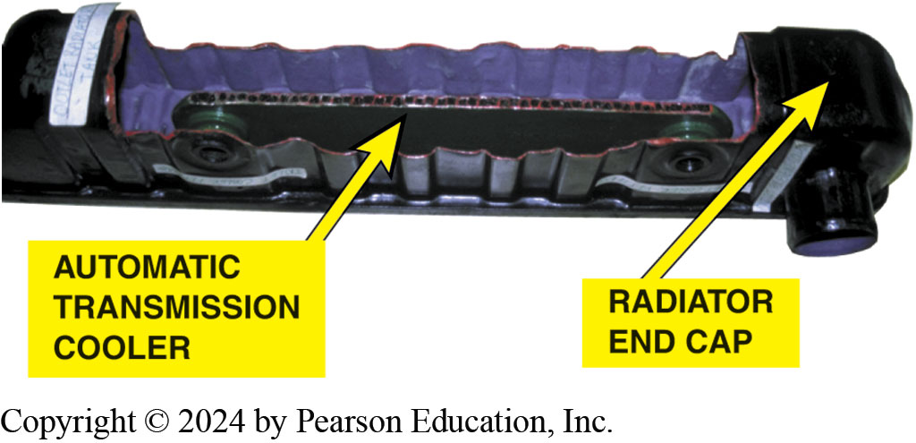
Figure 130.2 Cooler Cutaway
A cutaway of a typical radiator showing the automatic transmission cooler. The heat from the automatic transmission fluid is released to the engine coolant. The engine coolant also warms the fluid as soon as the coolant flows through the radiator

Slide 9
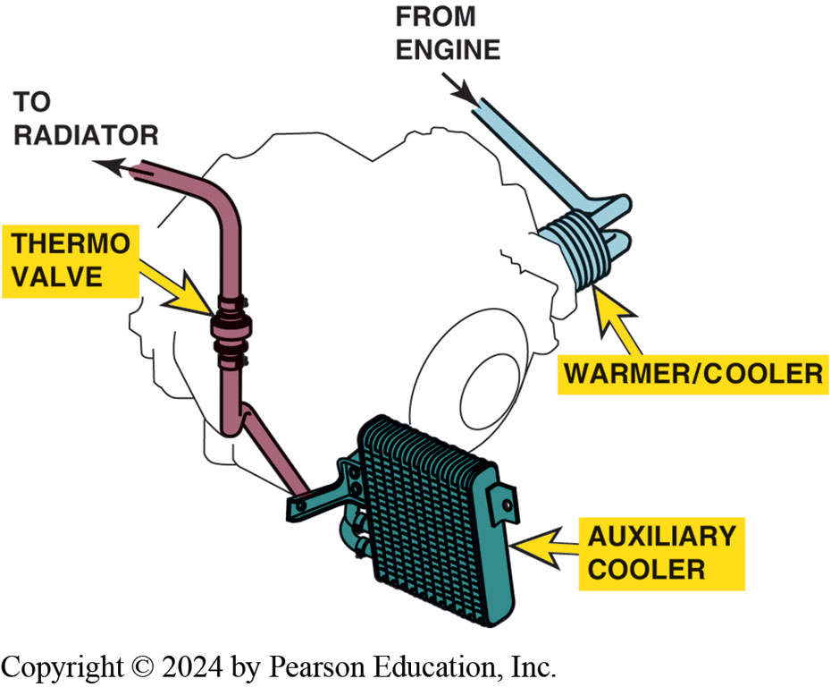
Figure 130.3 ATF Cooler Flow
Engine coolant from the engine block flows through the passages in the cooler/warmer, and then out through the thermo valve to the upper radiator tank. The thermo valve uses a wax element–type valve to control the flow of engine coolant through the case-mounted cooler/warmer

Slide 10
Question 1: ?
What is the purpose of a transmission cooler?

Slide 11
Answer 1
To dissipate heat created primarily in the torque converter.

Slide 12
Transmission Oil Pump (1 of 2)
        Supply fluid flow and to pressurize the system.
  Mount directly behind the torque converter
  Driven by the converter drive hub.
  Pressure regulator valve, or pressure control valve
        Control hydraulic pressure.

Slide 13
Transmission Oil Pump (2 of 2)
Variable Displacement Pump
  Newer units use variable displacement pump
    Reduce the power needed to achieve fluid pressure.
Electronic Pressure Regulation
    Regulate hydraulic system pressure using computer-controlled solenoids.
Typical Pressures
    Normal line pressure = 60 to 120 P S I (414 to 830 kPa)
    Wide open throttle (W O T) = 90 to 150 P S I (620 to 1,034 kPa)

Slide 14
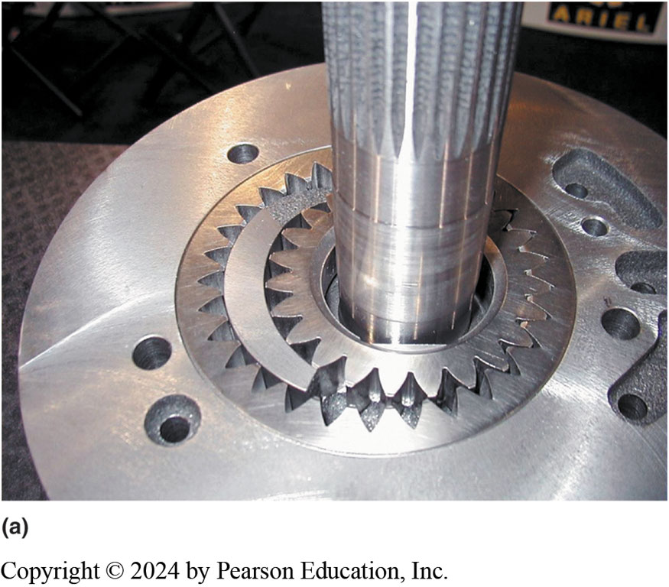
Figure 130.4 (a) Gear-Type Pump

Slide 15
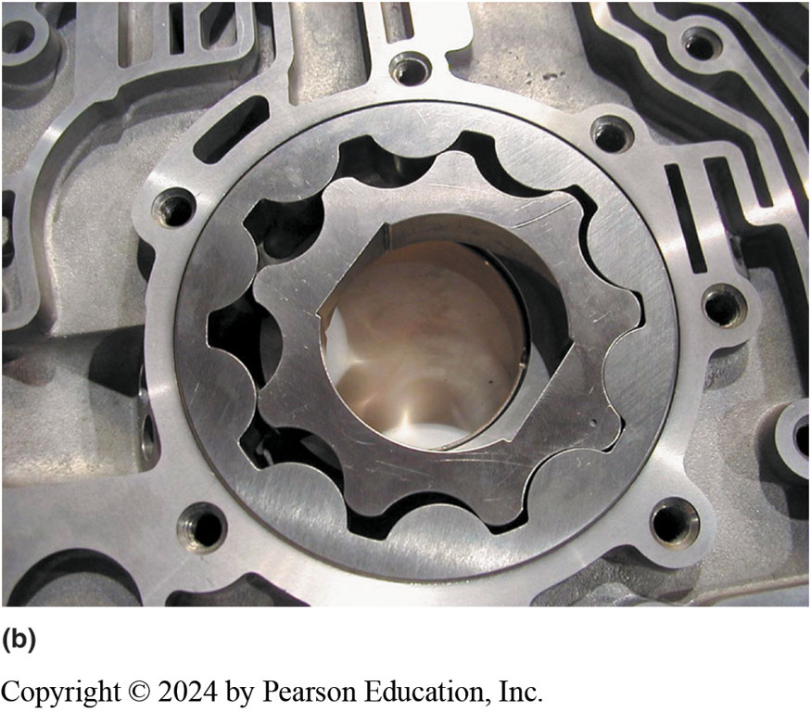
Figure 130.4 (b) Geroter-Type Pump

Slide 16
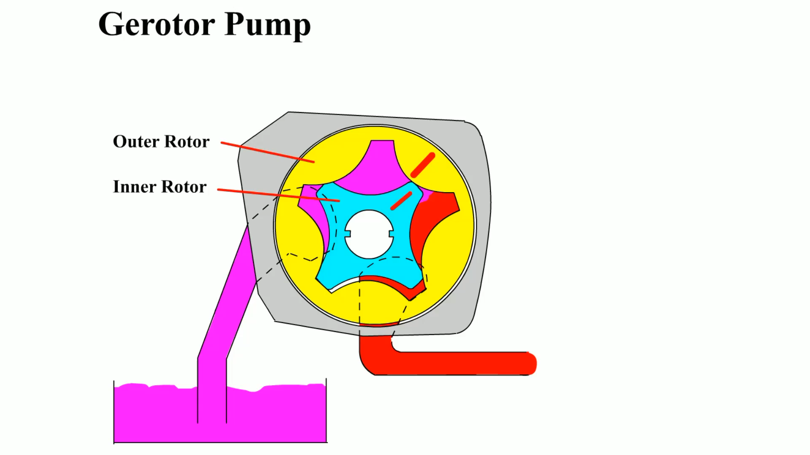
Animation: Gerotor Pump
(Animation will automatically start)

Slide 17
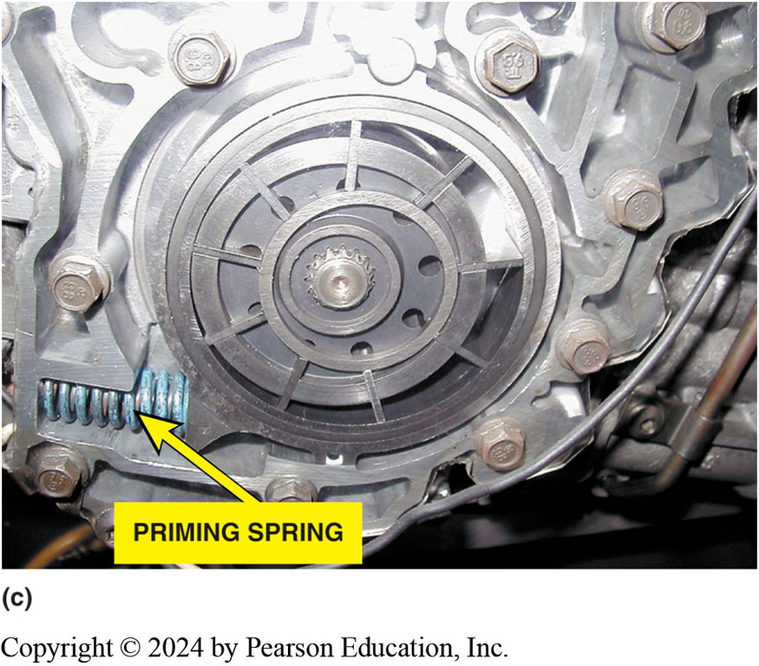
Figure 130.4 (c) Vane-Type Pump

Slide 18
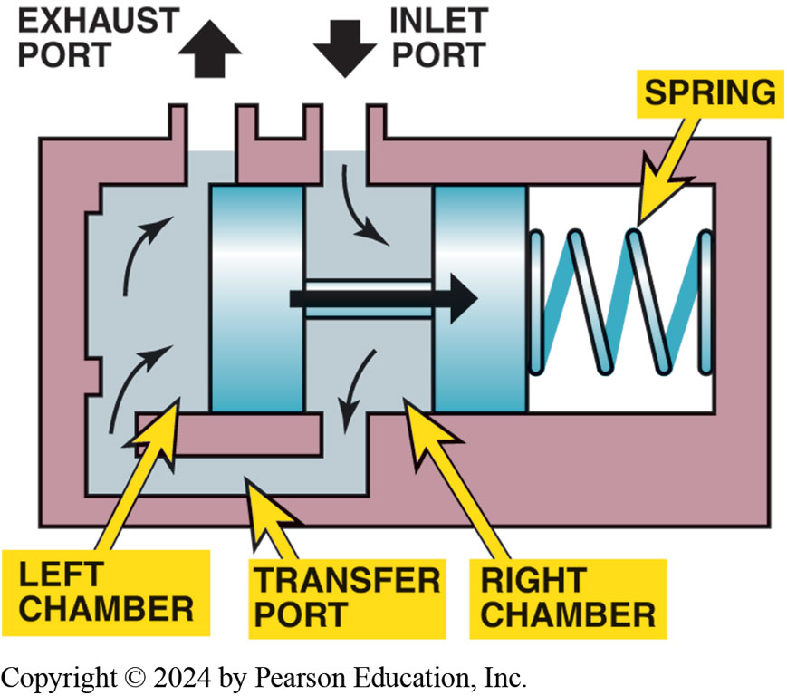
Figure 130.5 Pressure Regulator
Then pressure on the face of the pressure regulator valve overcomes spring force, the valve moves to open the exhaust port.

Slide 19
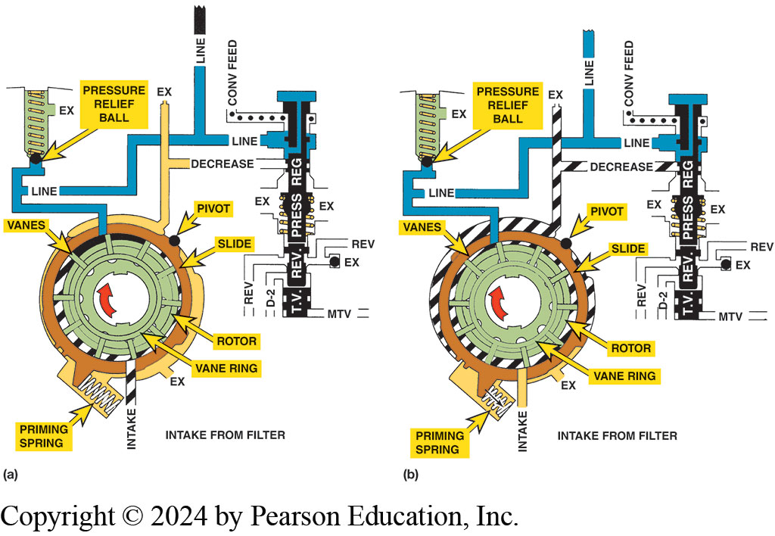
Figure 130.6 Variable Pump
The variable pump is at the maximum output position until the regulator valve moves enough to decrease volume by rotating the slide against the force of the priming spring

Slide 20
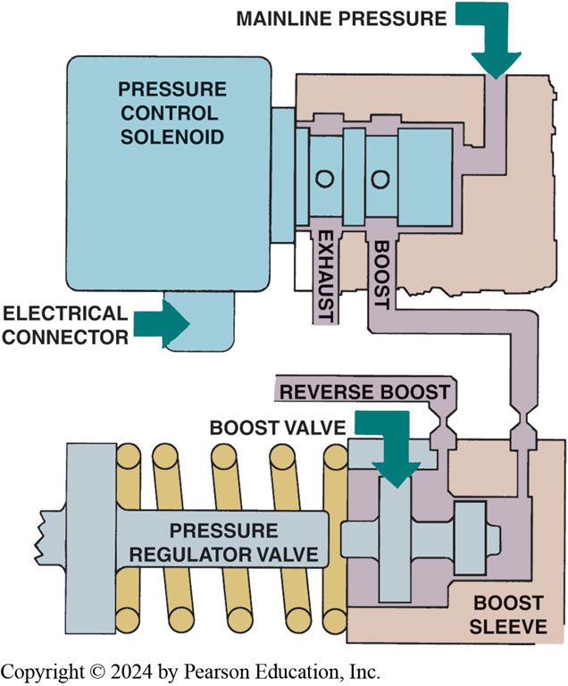
Figure 130.7 Control Solenoid
The pressure control solenoid controls the mainline pressure, which is in turn controlled by the powertrain control module (PCM) or the transmission control module (TCM), by applying pressure to the spring side of the pressure regulator valve

Slide 21
Apply or Holding Devices
Purpose and Function
  Mechanical or hydraulic assemblies that provide the force to hold or drive members of a planetary gear set.
Use following as apply devices.
  Bands
  Multi-plate clutches
  One-way clutches

Slide 22
Bands
Terminology
  Transmission bands are holding (braking) devices.
  Band stops and holds one planetary gear set member.
Hydraulic Servos
  Applied by using a hydraulically operated piston that travels inside a machined cylinder bore.
Servo Linkages
  Servo rods and struts transfer the servo apply force to the transmission band.

Slide 23
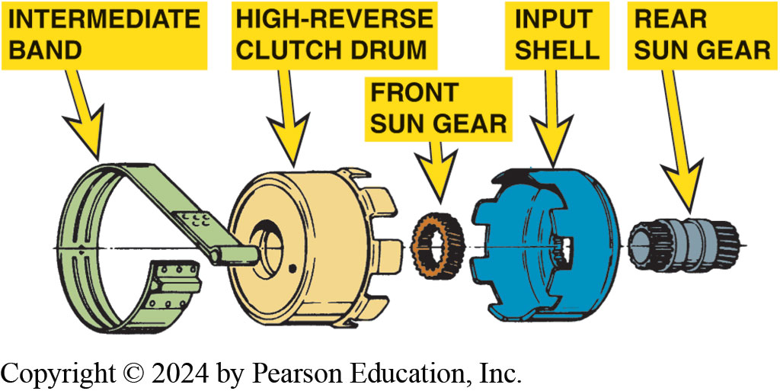
Figure 130.8 Gear Set Members
Gear set members are attached to a drum and are held stationary when the band applies

Slide 24
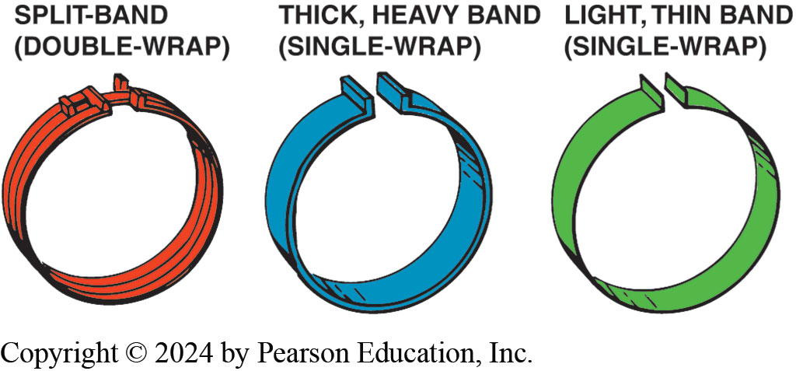
Figure 130.9 Bands
Transmission bands come in several designs and thicknesses

Slide 25
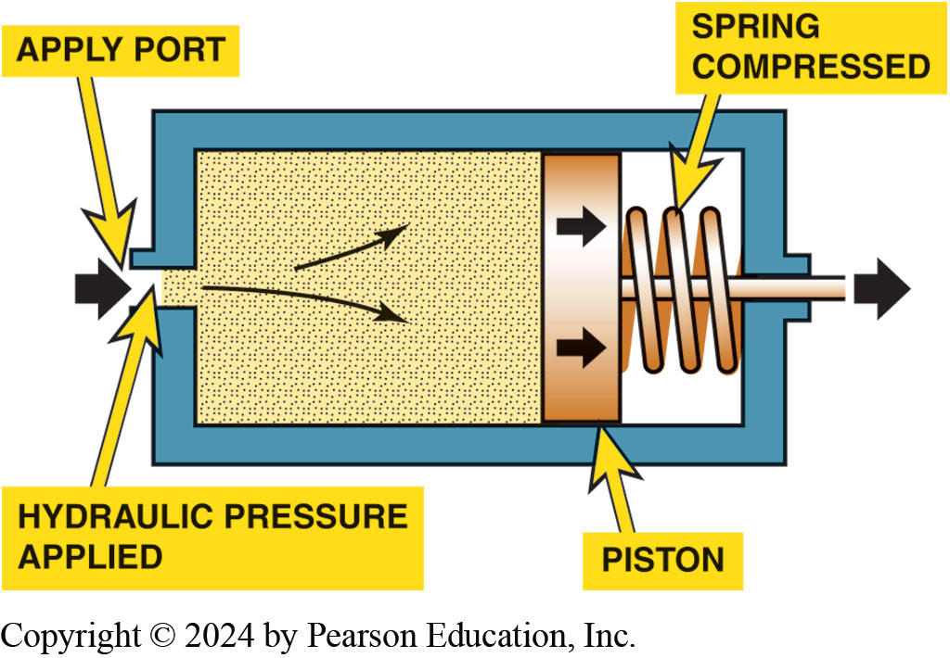
Figure 130.10 Servo
A servo uses hydraulic pressure to move a piston, which applies a band

Slide 26
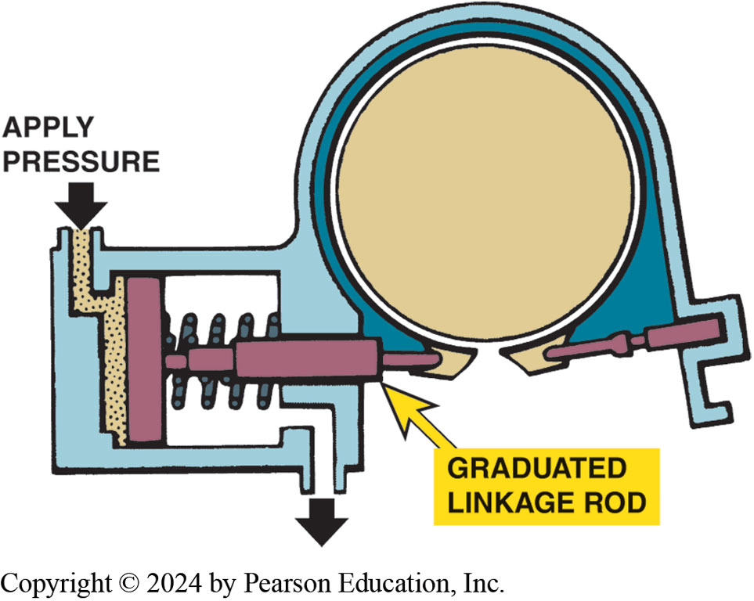
Figure 130.11 Band Linkage
One end of a band is held stationary and the other end is attached to the servo

Slide 27
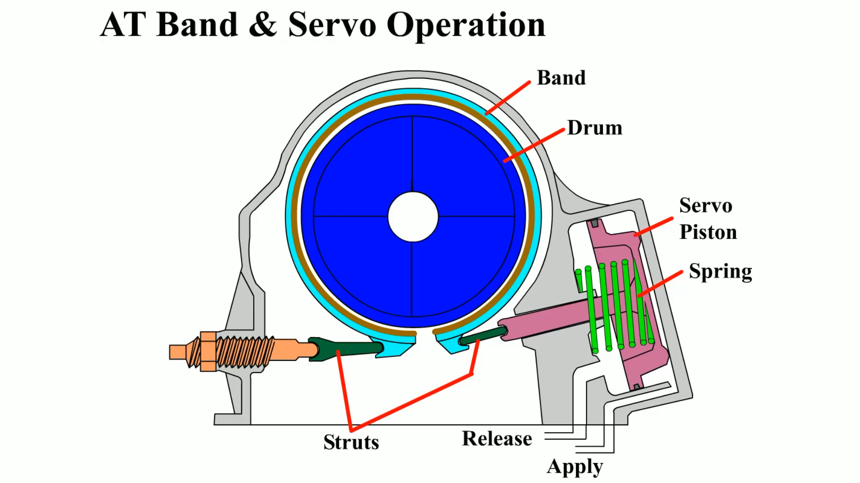
Animation: AT Band & Servo Operation
(Animation will automatically start)

Slide 28
Multiple-Plate Clutches (1 of 2)
Terminology
  Clutches have more friction area so they can develop more force and handle more torque than a band, and they are self-adjusting.
Parts
  Consists of plates, a piston, drum (retainer), snap ring.

Slide 29
Multiple-Plate Clutches (2 of 2)
Clutch Operation
  To apply clutch, pressurized fluid enters drum through an internal passage in the input shaft.
  To release clutch piston return spring returns piston to it’s at rest position.
Two Types of Clutches
  Holding (braking) clutches
  Driving clutches

Slide 30
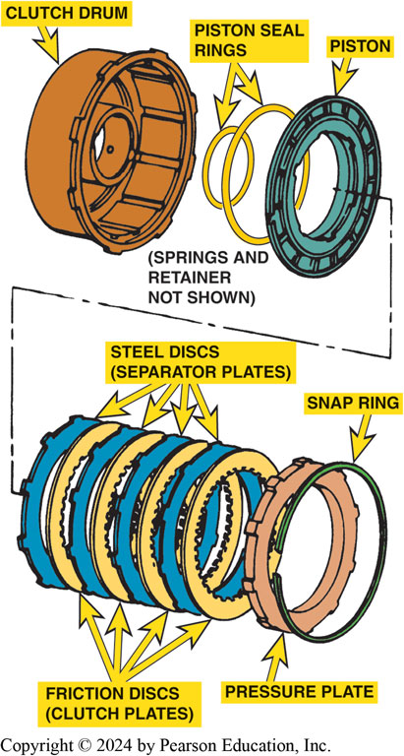
Figure 130.12 Clutch Pack Assembly
An exploded view of a multiple-plate clutch pack assembly

Slide 31
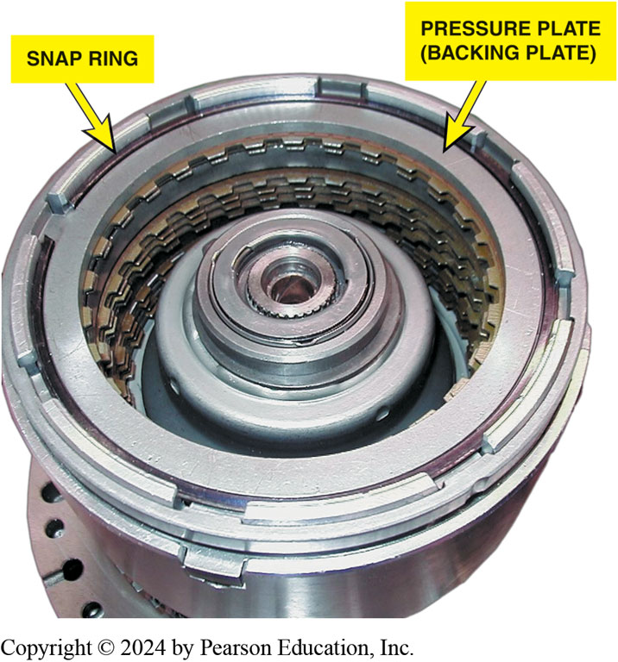
Figure 130.13 Clutch Pack Assembly
A typical clutch pack assembly

Slide 32
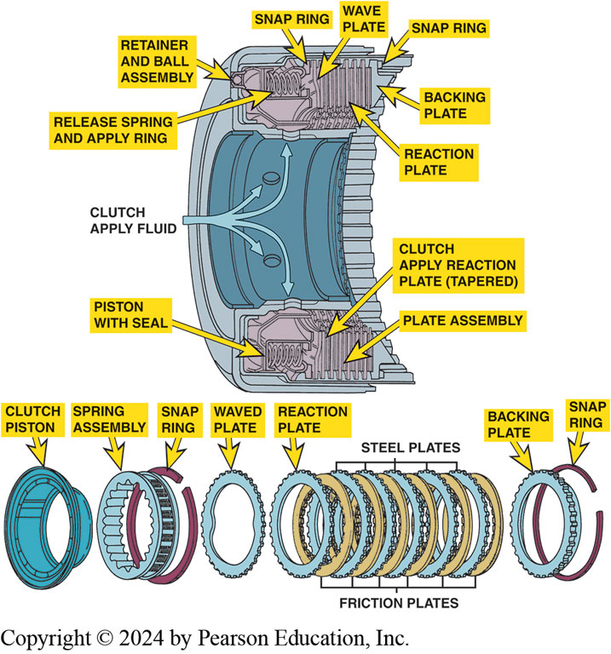
Figure 130.14 Clutch Application
Hydraulic fluid under pressure enters the clutch housing and exerts a force on the clutch piston. The clutch piston forces the steel plates and the friction plates together, creating a shift

Slide 33
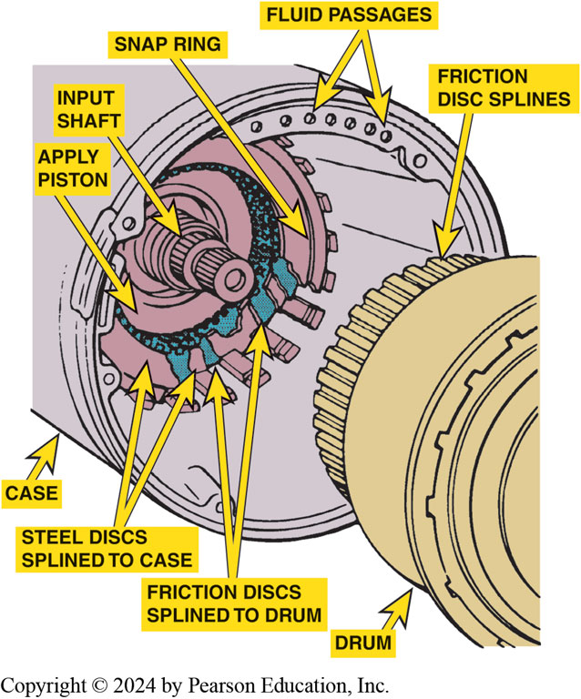
Figure 130.15 Holding Clutch
In a holding clutch, one set of discs engages splines on the transmission case and the other set engages splines on the drum. By applying the clutch, the drum is locked to the case.

Slide 34
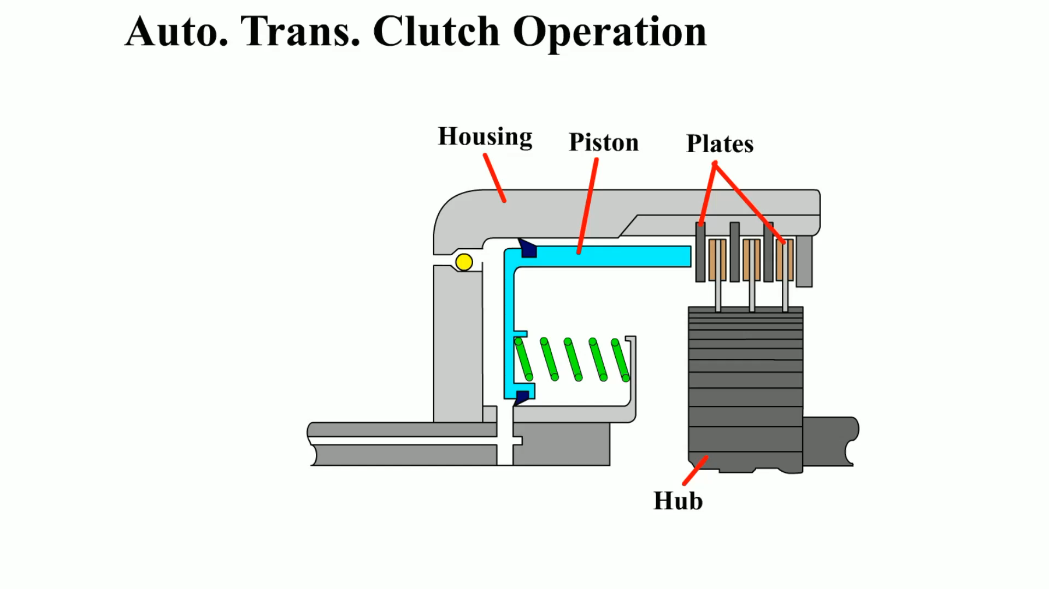
Animation: Automatic Transmission Clutch Operation
(Animation will automatically start)

Slide 35
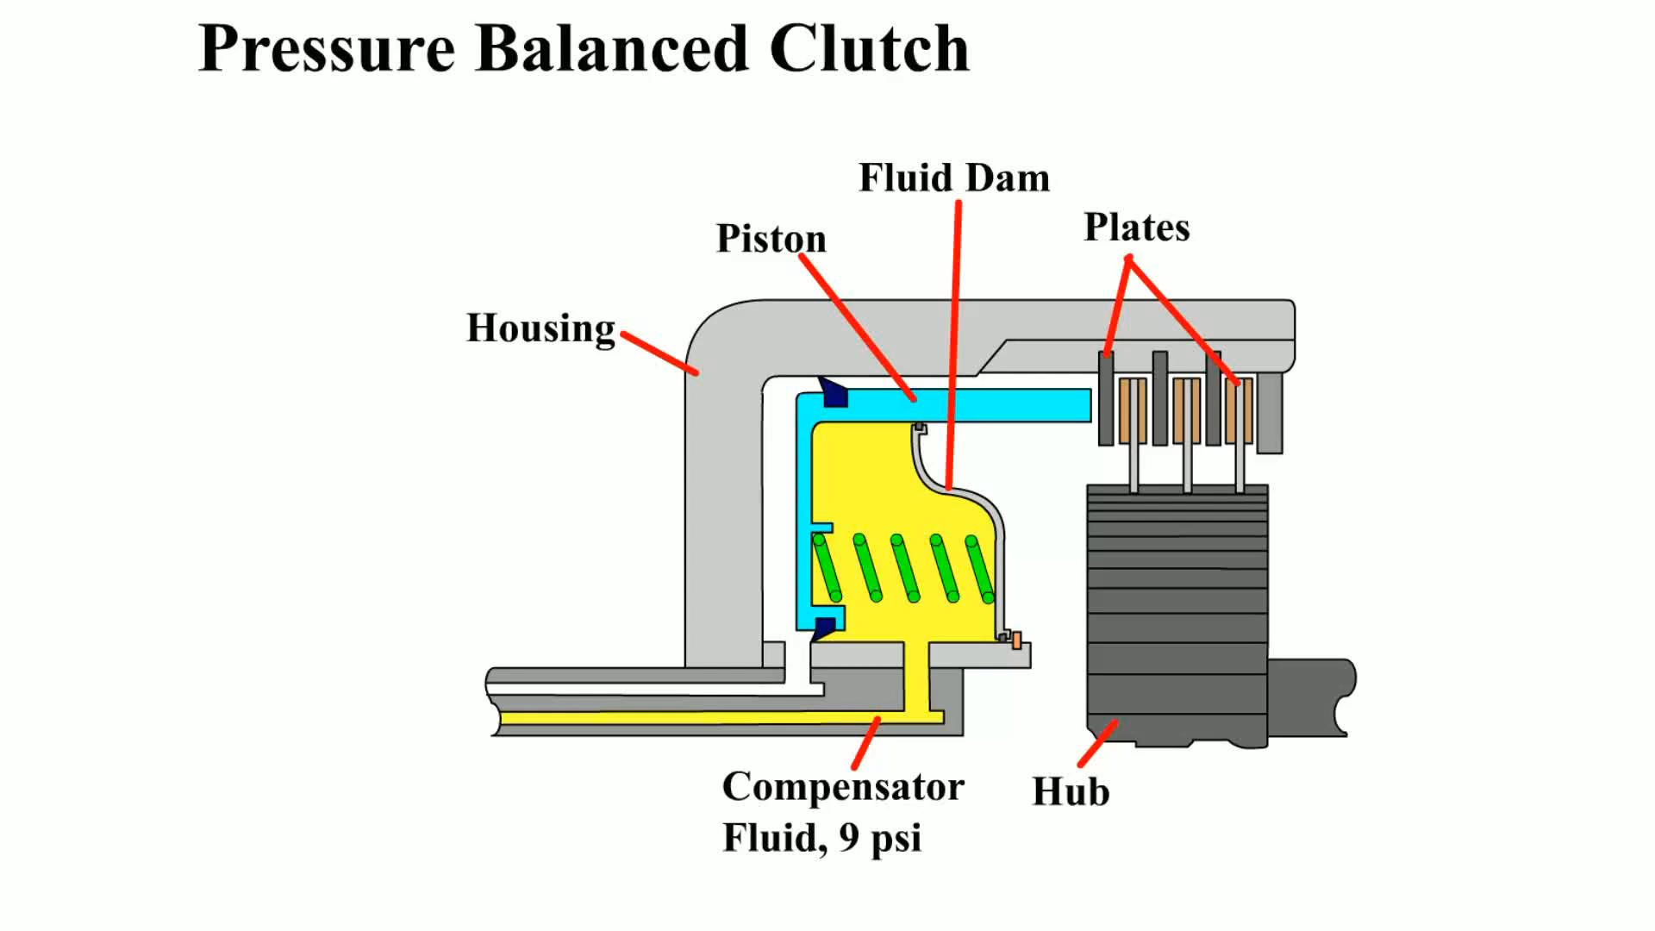
Animation: Pressure Balanced Clutch
(Animation will automatically start)

Slide 36
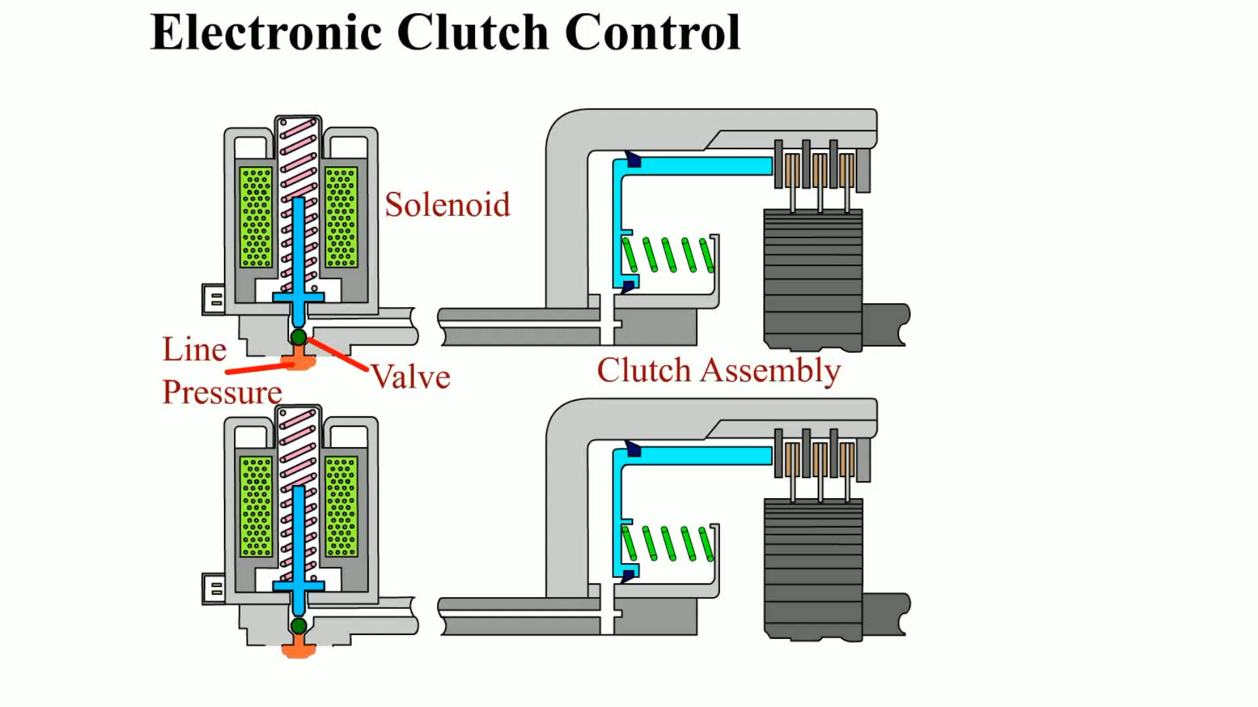
Animation: Electronic Clutch Control
(Animation will automatically start)

Slide 37
Question 2: ?
What is the function of a holding clutch?

Slide 38
Answer 2
To hold a member of a planetary gear set.

Slide 39
Accumulators
Purpose and Function
  Cushions or dampens apply force during a shift.
Operation
  Piston area and spring are designed to absorb fluid during the clutch circuit pressure rise when the clutch piston stops moving.

Slide 40
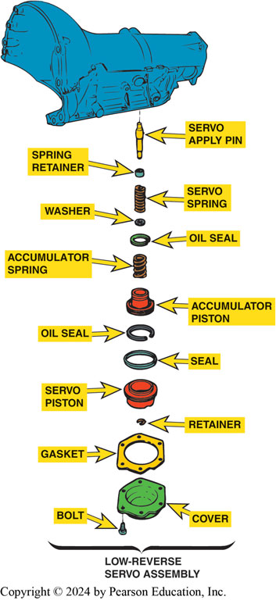
Figure 130.16 Integral Accumulator
An integral accumulator is combined with a servo in a single bore in the transmission housing

Slide 41
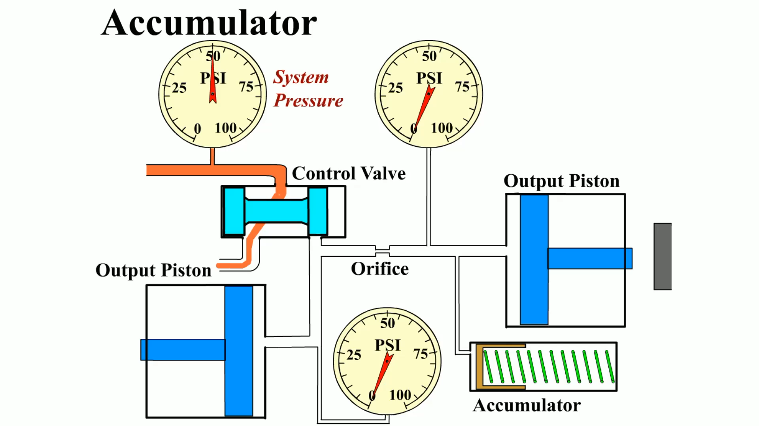
Animation: Accumulator
(Animation will automatically start)

Slide 42
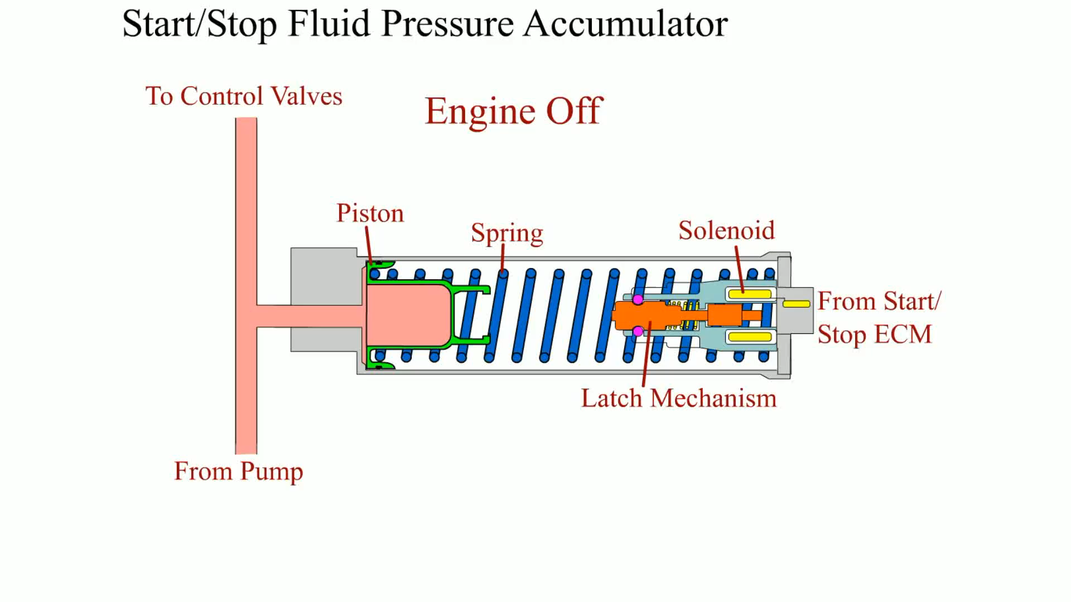
Animation: Start/Stop Fluid Pressure Accumulator
(Animation will automatically start)

Slide 43
One-way Clutches
Terminology
  A one-way clutch is always a holding device.
  One-way clutches are either roller or sprag clutches.
One-Way Roller Clutch
  A one-way roller clutch consists of a hub, rollers, and springs that fit inside a drum.
One-Way Sprag Clutch
  A one-way sprag clutch that consists of a hub and a drum separated by a number of figure-eight shaped metal pieces called sprags.

Slide 44
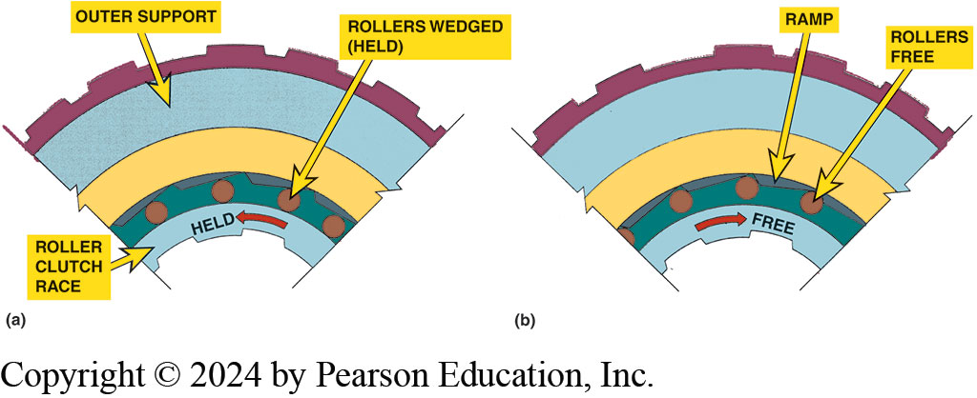
Figure 130.17 One-Way Roller Clutch
(a) Roller one-way clutch in the locked (held) position. Note how the rollers are wedged into the ramp that is machined into the outer support. (b) Roller one-way clutch in released (free) position. When the inner roller clutch race rotates faster than the outer support, the rollers move out of the wedge and are free to rotate, thereby unlocking the one-way clutch.

Slide 45
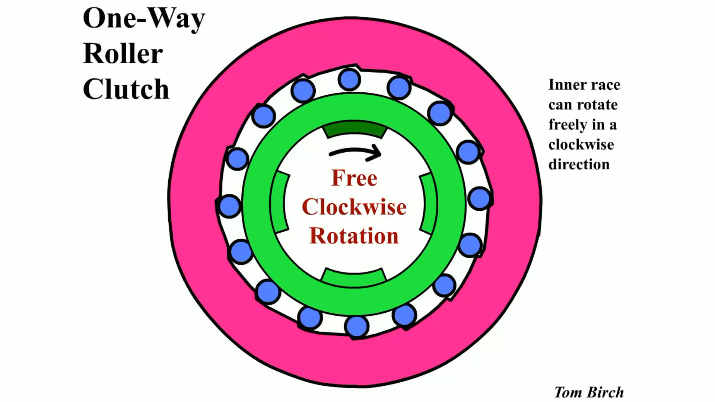
Animation: One-Way Roller Clutch
(Animation will automatically start)

Slide 46
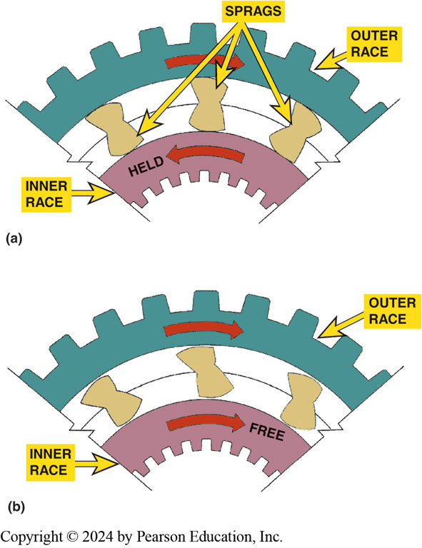
Figure 130.18 Sprag Clutch
(a) The sprag in the holding (locked) position. Note how the long portion of the sprag is wedged between the inner and outer race. (b) The sprag in the released position. The inner race is free to rotate faster than the outer race

Slide 47
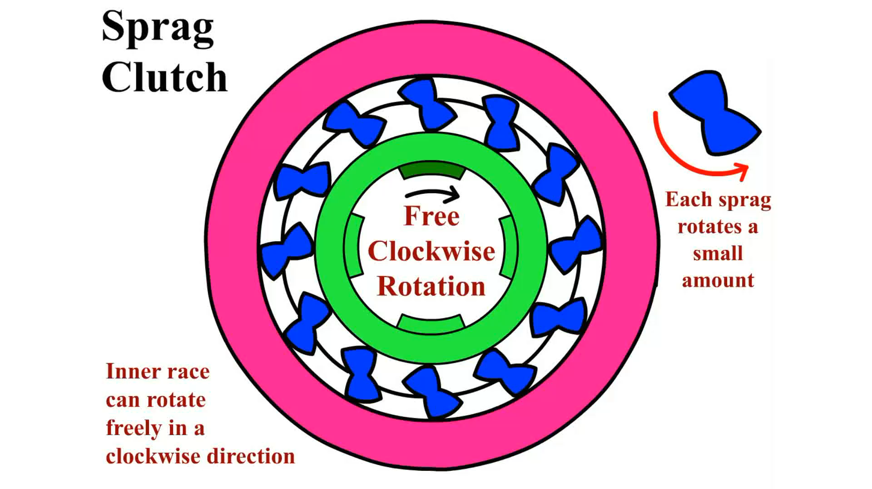
Animation: Sprag Clutch
(Animation will automatically start)

Slide 48
Valve Body (1 of 2)
Purpose and Function
  Valve body is where most of valves in a transmission are located, and is attached to the case with bolts.
Parts
  Valve bodies have many fluid passages for the various transmission hydraulic circuits as well as check balls, a separator plate and mounting locations for solenoids.

Slide 49
Valve Body (2 of 2)
Flow-Directing Valves
  Control the direction and distribution of fluid flow in the hydraulic system.
One-Way Valves
  A one-way valve allows fluid to flow in one direction.
Check Balls and Orifices
  Control rate of fluid flow.
Manual Valve
  The primary flow-directing valve in an automatic transmission.

Slide 50
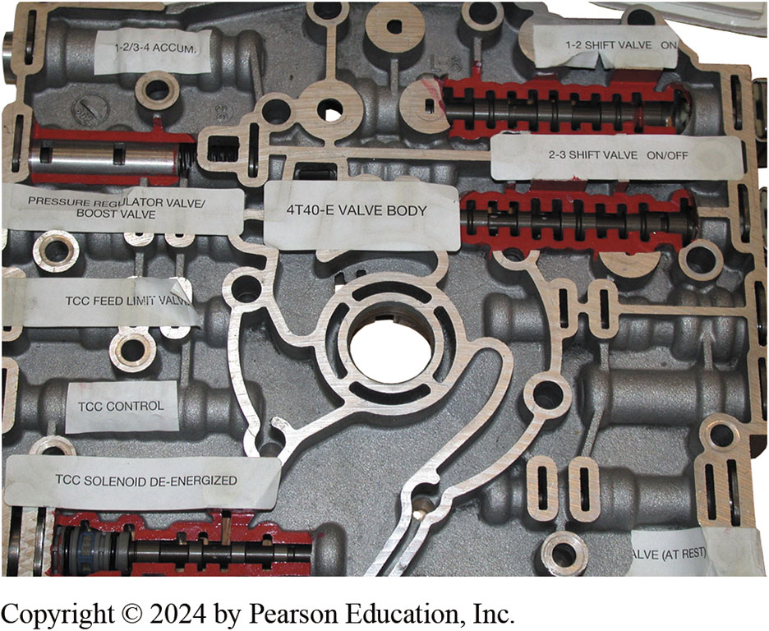
Figure 130.19 Valve Body Cutaway
partially cutaway valve body from a General Motors 4T40-E transaxle

Slide 51
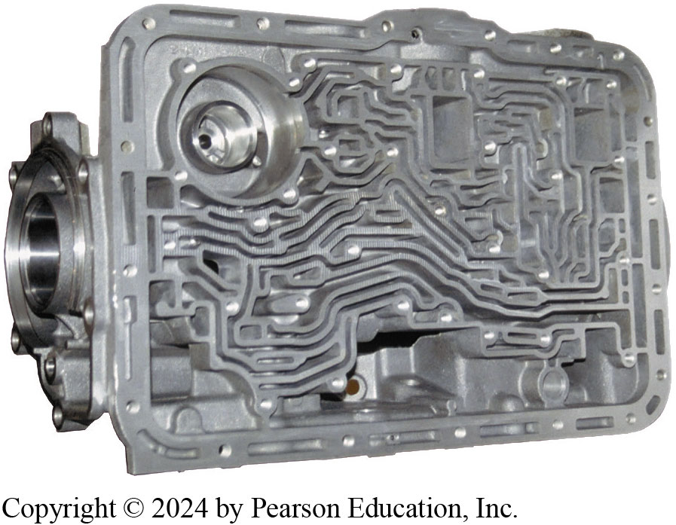
Figure 4.13 Valve Body Passages
A typical upper valve body showing the fluid passages (“worm holes”).

Slide 52
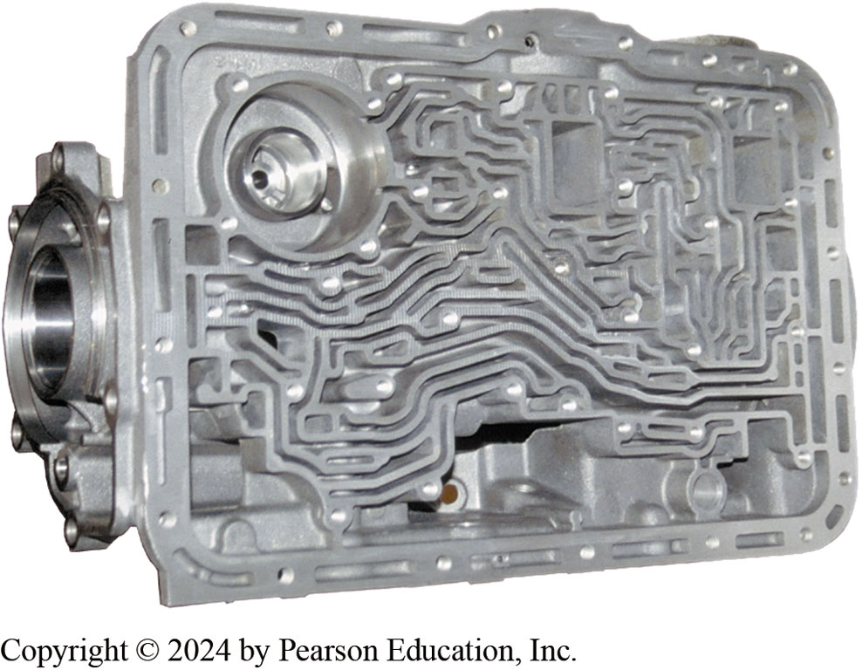
Figure 130.20 Case Worm Holes
A typical upper valve body showing the fluid passages (“worm holes”)

Slide 53
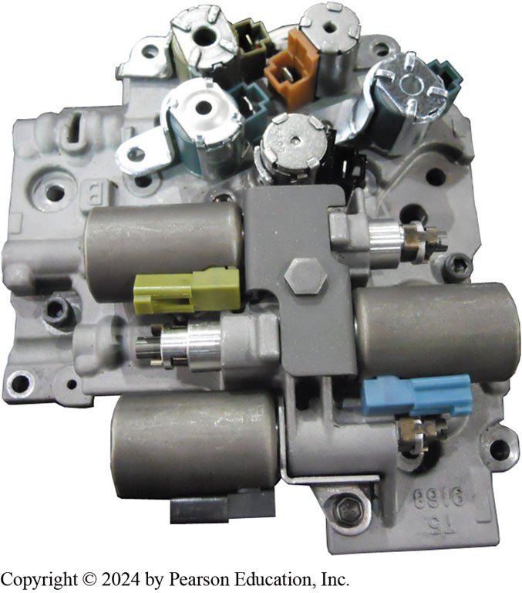
Figure 130.21 Electronic Controls
Electronically controlled automatic transmissions/transaxles use solenoids located in the valve body to control line pressure and to open and close passages in the valve body to control shifts

Slide 54
Controlling Fluid Flow (1 of 2)
Check Balls
  Fluid flow from pressure regulator to manual valve
  Into control circuit called mainline, line, or control pressure
  Flow to and from a transmission hydraulic actuator
  Controlled by one or more valves
    Spool valves sliding in a round bore are used for this purpose

Slide 55
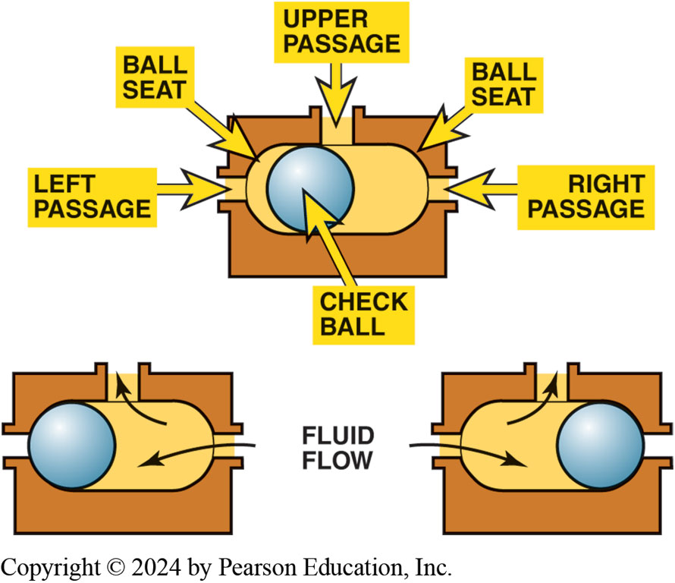
Figure 130.22 Check Balls
Check balls are used in the valve body to allow hydraulic circuits to share a common passage

Slide 56
Manual Valve
Primary flow-directing valve in an automatic transmission
Connects to a shift lever in the transmission
Connects to gear selector lever through linkage.
Driver controls manual valve position
Rooster Comb
  part used to position the manual valve
Notes:
The manual valve is the primary flow-directing valve in an automatic transmission. This valve connects to a shift lever in the transmission, which in turn connects to the gear selector lever through a mechanical linkage. The driver controls
manual valve position through the gear selector and shift linkage. Mechanical linkage physically positions the manual valve in its bore for the particular gear range selected. The part used to position the manual valve is commonly called the “rooster comb” because
of its shape. ● SEE FIGURE 130–23. The manual valve receives mainline pressure from the regulated pump output and distributes it to
the hydraulic circuits uncovered by the valve lands.

Slide 57
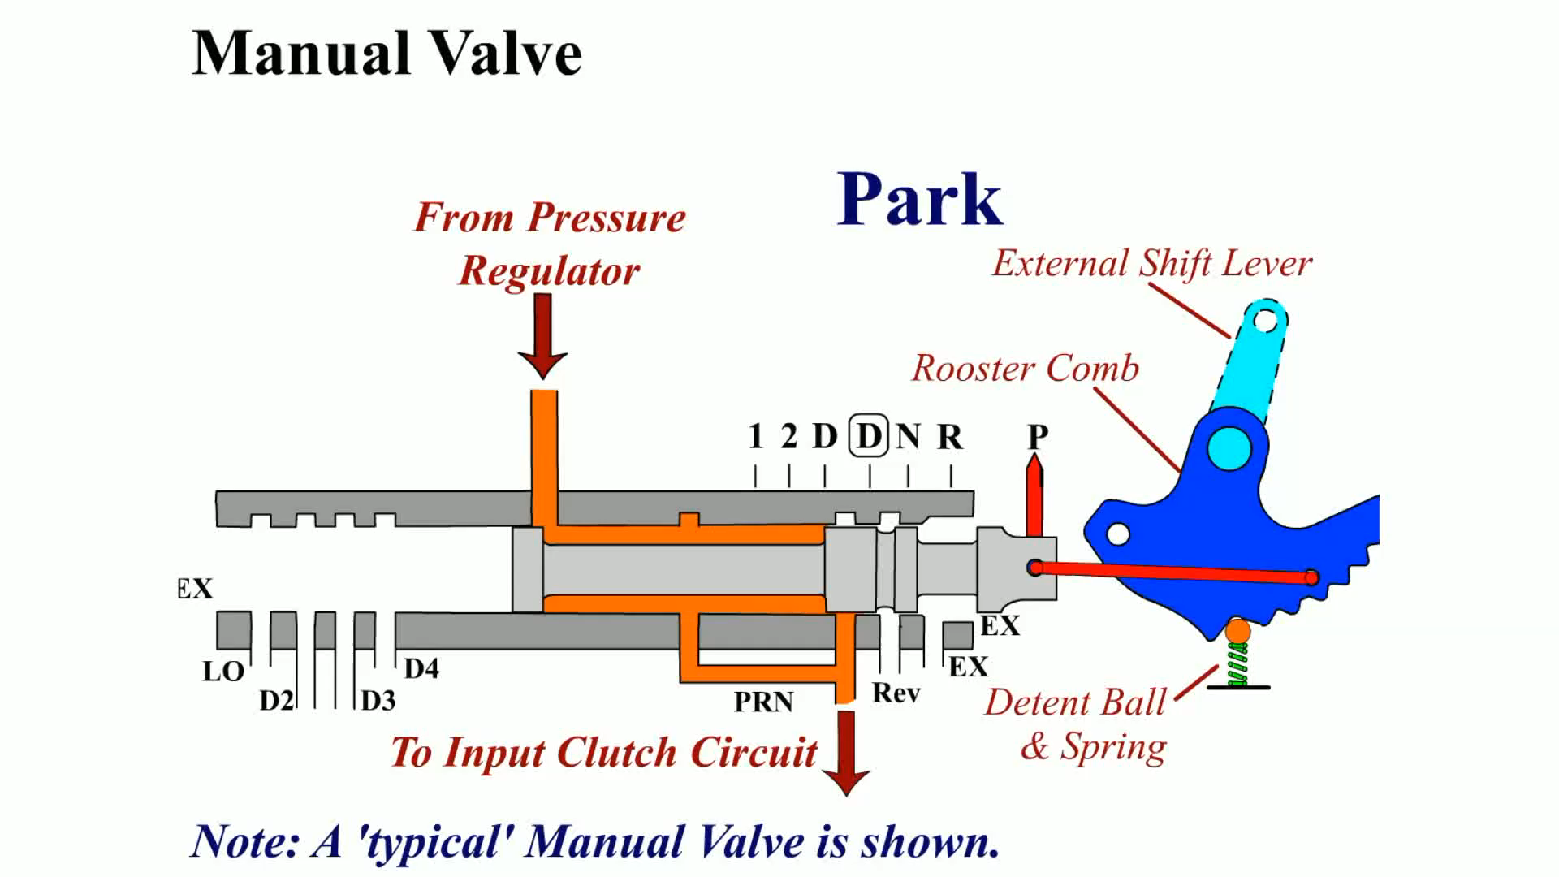
Animation: Manual Valve
(Animation will automatically start)

Slide 58
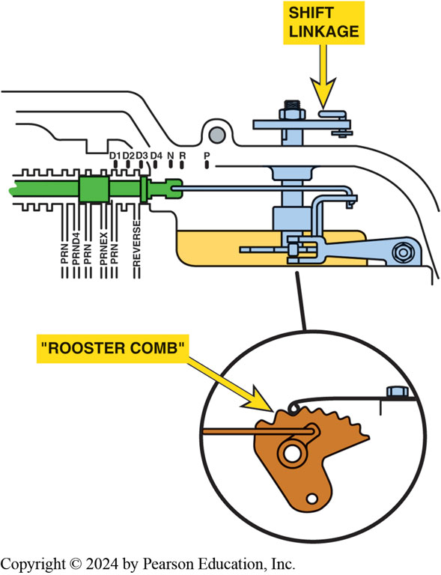
Figure 130.23 Rooster Comb
Rooster comb is detent that helps retain the manual positions in valve body

Slide 59
Frequently Asked Question: What Is a Spool Valve?
? Frequently Asked Question
What Is a Spool Valve? A spool valve is named after a spool of thread. A spool of thread is wooden and a spool valve used in an automatic transmission/transaxle is aluminum or steel. The ridges (larger diameter) of the spool valve fit closely into a smooth bore in the valve body and are used to direct the flow of automatic transmission fluid. The larger diameter sections of the spool valve are called lands. The smaller diameter sections of the valve are called grooves or valleys. The fluid is blocked by the lands and flows through the grooves or valleys. Figure 130–24.

Slide 60
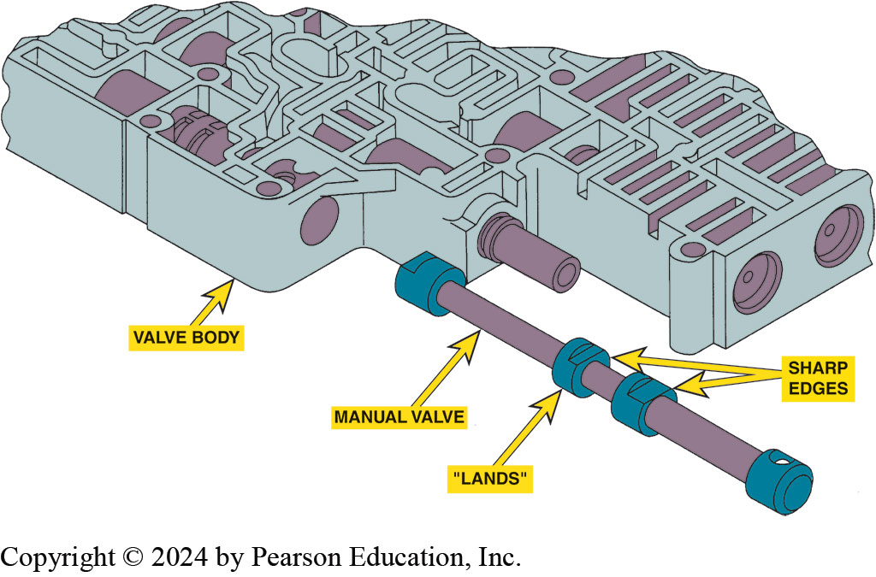
Figure 130.24 Manual Valve
The manual valve is a spool valve that is moved by the shift linkage. All valves in the valve body have sharp edges on the lands. Any dirt in the valve body area can cause shifting problems due to the close tolerances between the valves and the bores in the valve body.
Notes:
TECH TIP: Parking Brake before Parking Pawl
To prevent possible damage to the transmission/
transaxle case or other internal components, most
experts agree that the parking brake should be applied
before placing the gear selector into the park position,
especially when parking on a hill. This procedure keeps
the weight of the vehicle from being exerted entirely
on the parking pawl and makes it easier to move the
gear selector out of the park position.

Slide 61
Electronically Controlled Transmissions (1 of 2)
Background
  P C M or T C M control shifting.
Inputs
  The control module uses information from various sensors to make shift calculations.
Outputs
  The control module uses various actuators to control transmission operation.
Notes:
Electronically controlled transmissions and transaxles have been used by most vehicle manufacturers since
the early 1990s. Compared to hydraulically controlled units, using the powertrain control module (PCM) or the transmission control
module (TCM) to operate and control shifting results in smoother operation. Also, the PCM or TCM can monitor the circuits and set
a diagnostic trouble code if a fault is detected.

Slide 62
Electronically Controlled Transmissions (2 of 2)
Adaptive Learning
  Most late model electronically controlled automatic transmissions/transaxles use the P C M or T C M to monitor the time it takes to complete a shift.
  The control module can control fluid volume and/or pressure as the transmission wears to ensure a proper shift.
Shift Solenoids
  On-Off Solenoids
  Linear Solenoids
Notes:
The following are inputs to the powertrain control module (PCM) and their purposes:
■ Transmission range switch. This sensor is used by the PCM to detect the gear being commanded by
the driver. If reverse or a manual forward gear is selected, then higher line pressure will be
needed and the shifts will be delayed to provide more power being delivered to the drive wheels.
● SEE FIGURE 130–25.
■ Engine speed. The speed of the engine has a direct relation to the amount of power the engine is
developing. The engine speed information is taken from the crankshaft position (CKP) sensor and is
used by the PCM or TCM to control shift points and regulate line pressure.
■ Throttle position (TP) sensor. This sensor is used by the PCM to detect the throttle opening
being commanded by the driver. A higher throttle opening means that higher line pressure will be needed and the shifts
will be delayed to provide more power being delivered to the drive wheels.
■ Manifold absolute pressure (MAP) sensor. This sensor is used by the PCM to detect the amount of
load on the engine. The greater the load, the more fuel that needs to be supplied, and the greater
the amount of power the
engine will create. This signal is used to determine the best shift points and regulate line
pressure.
■ Mass airflow (MAF) sensor. This sensor is used by the PCM to detect the amount of air entering
the engine. The greater the amount of air, the more fuel that needs to be supplied and, therefore,
the greater the amount of power the engine will create. This signal is used to determine the best
shift points and regulate line pressure.
■ Speed sensors. These sensors measure the speed of the input shaft and output shaft or sometimes other shaft speeds in the automatic transmission or transaxle. The output shaft speed sensor is often used to provide vehicle speed information to the PCM and for adaptive learning and self-diagnosis. ● SEE FIGURE 130–26.
■ Transmission fluid temperature (TFT) sensor. This sensor is used by the PCM or TCM to detect the temperature of the automatic transmission fluid. This signal is used to determine the best shift points and regulate line pressure. It will cause the PCM or the TCM to engage the torque converter clutch (TCC) sooner and disable overdrive, to help reduce the fluid temperature if it

Slide 63
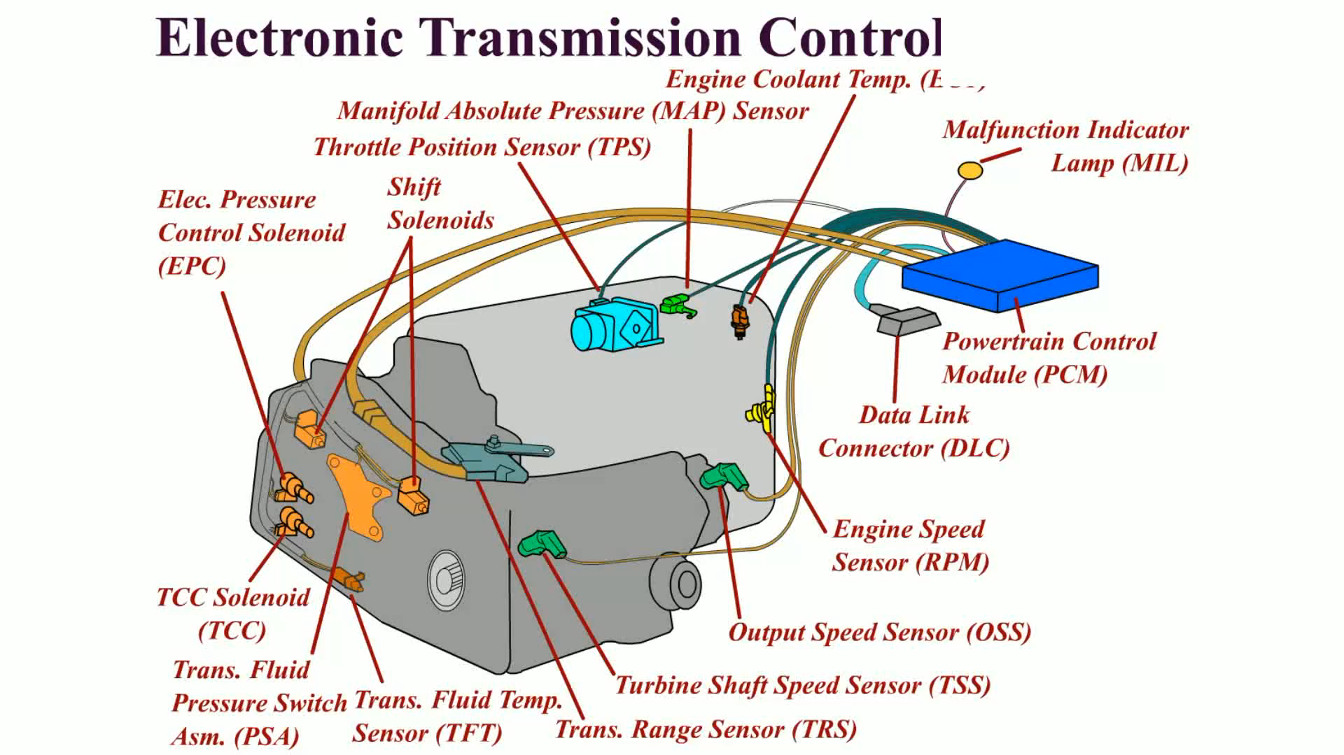
Animation: Electronic Transmission Control
(Animation will automatically start)

Slide 64
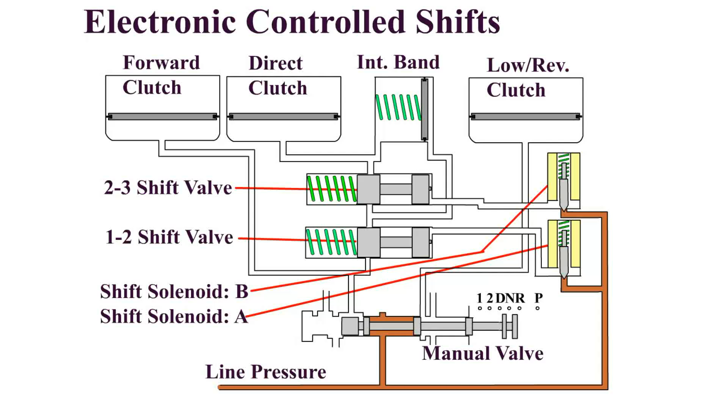
Animation: Electronic Controlled Shifts
(Animation will automatically start)

Slide 65
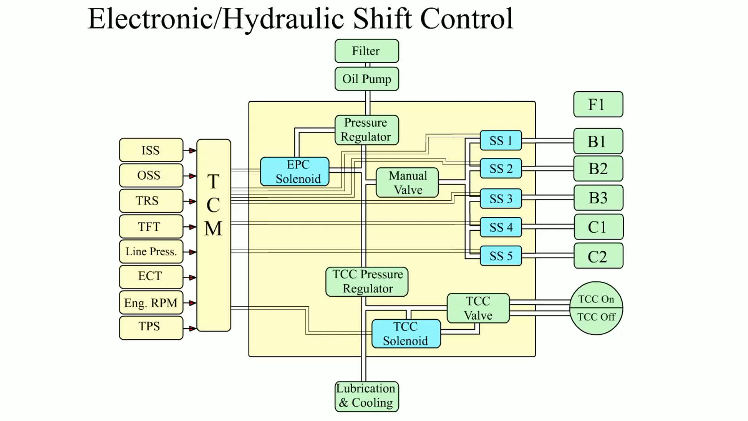
Animation: Electronic/Hydraulic Shift Control
(Animation will automatically start)

Slide 66
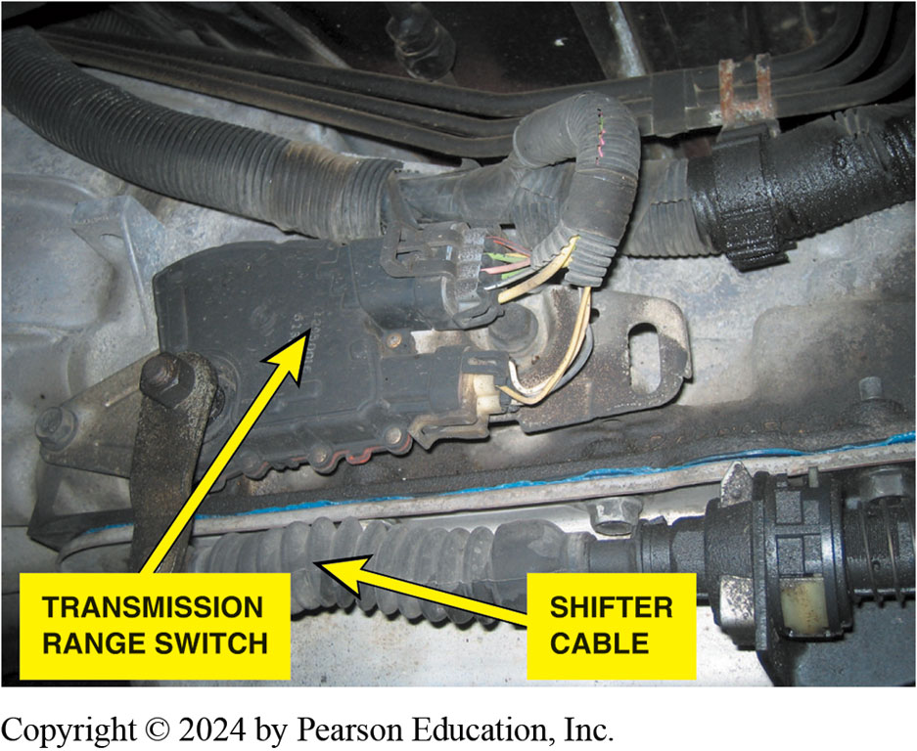
Figure 130.25 Range Switch
A transmission range switch on a rear-wheel drive automatic transmission mounted directly to the side of the case of the unit and accessible from underneath the vehicle.

Slide 67
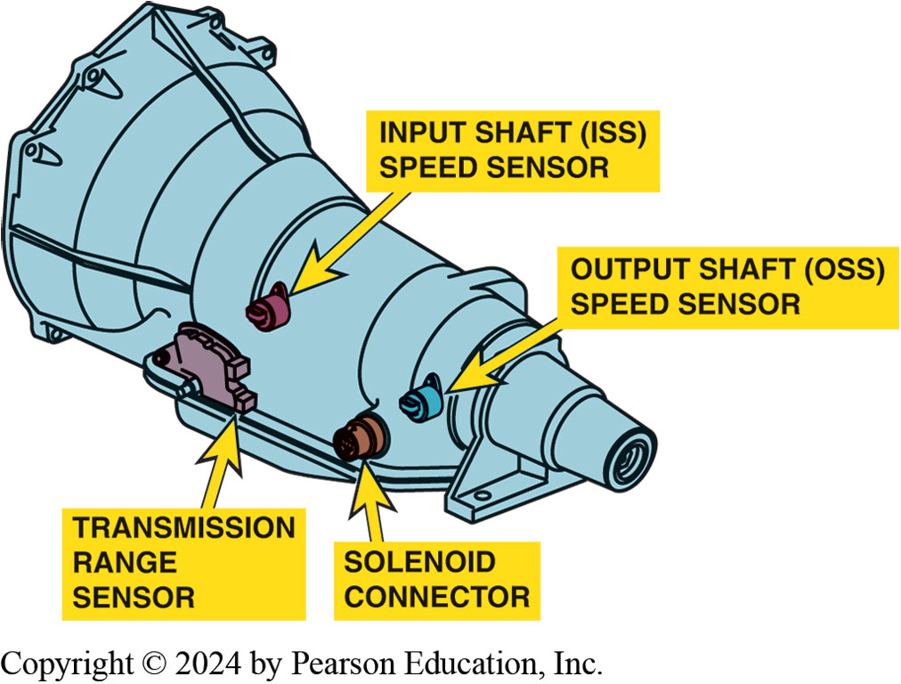
Figure 130.26 Speed Sensors
Speed sensors are used by the powertrain control module (PCM) or the transmission control module (TCM) to control shifts and detect faults such as slippage when the two speeds do not match the predetermined ratio for each gear commanded.

Slide 68
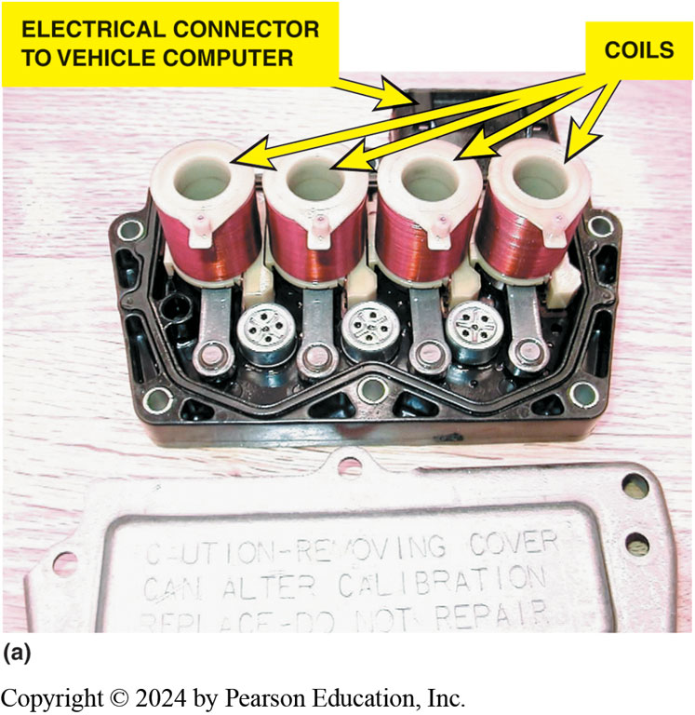
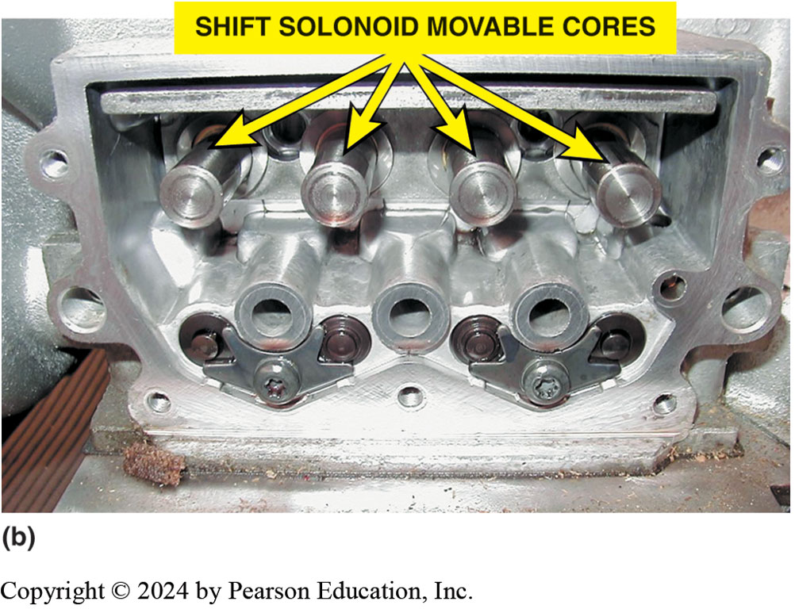
Figure 130.27 Shift Solenoids
(a) An example the shift solenoids installed in a valve body assembly, showing the coils and (b) the solenoid cores.

Slide 69
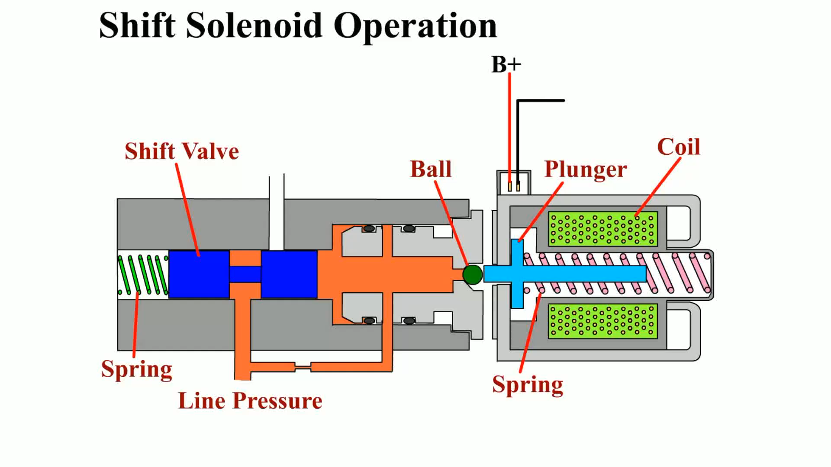
Animation: Shift Solenoid
(Animation will automatically start)

Slide 70
Chart 130.1 Example 1
GENERAL MOTORS 4T60-E (FRONT-WHEEL-DRIVE TRANSAXLE)
GEAR RANGE | SOLENOID A | SOLENOID B
First gear | On | On
Second gear | Off | On
Third gear | Off | Off
Fourth gear | On | Off
In this example, the vehicle would start out and remain in third gear if there was a fault with the computer or wiring.

Slide 71
Chart 130.2 Example 2
GENERAL MOTORS 4L80-E (REAR-WHEEL-DRIVE TRANSMISSION)
GEAR RANGE | SOLENOID A | SOLENOID B
First gear | On | Off
Second gear | Off | Off
Third gear | Off | On
Fourth gear | On | On
In this example, the vehicle would start out and remain in second gear if there was a fault with the computer or wiring.

Slide 72
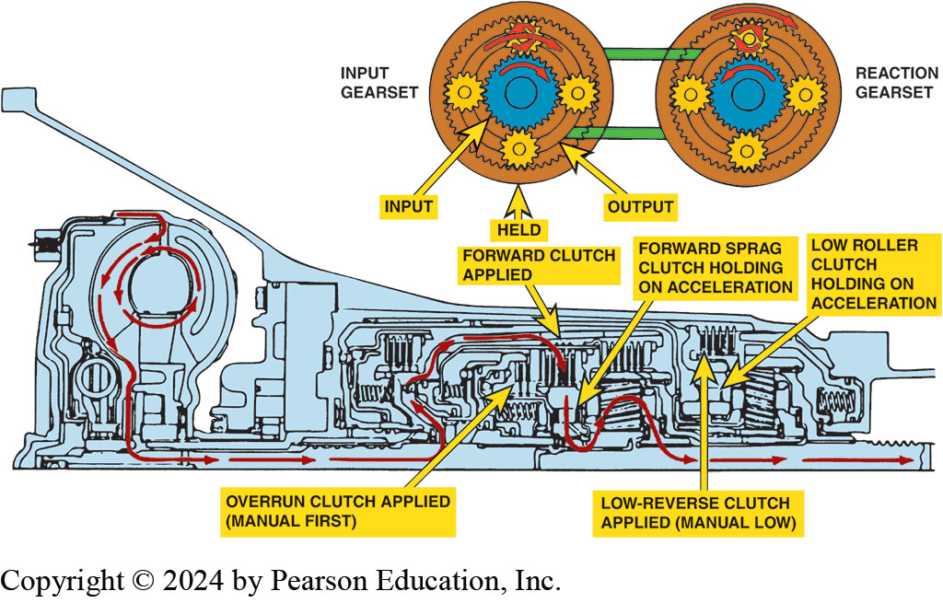
Figure 130.28 OD First Gear
GM 4L60-E torque (power) flow in overdrive first gear.
Notes:
See Chart 130-3 on page 1659: The General Motors 4L60-E electronically controlled rear-wheel-drive transmission clutch, band, and solenoid application chart.

Slide 73
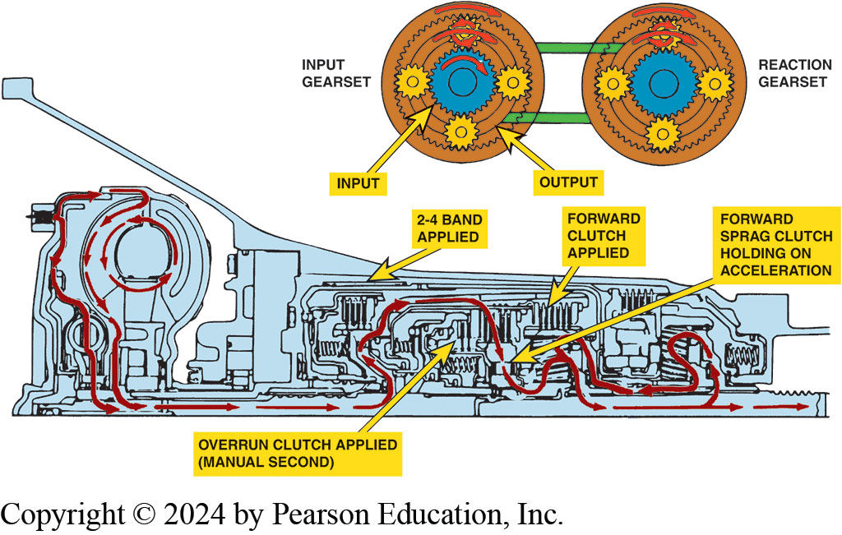
Figure 130.29 OD Second Gear
GM 4L60-E torque (power) flow in overdrive second gear

Slide 74
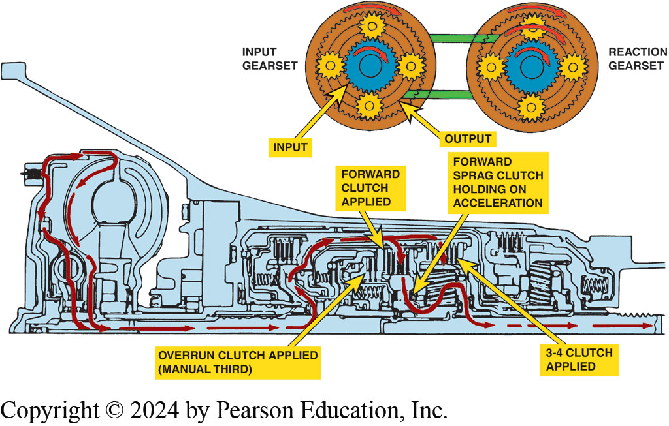
Figure 130.30 OD Third Gear
GM 4L60-E torque (power) flow in overdrive third gear

Slide 75
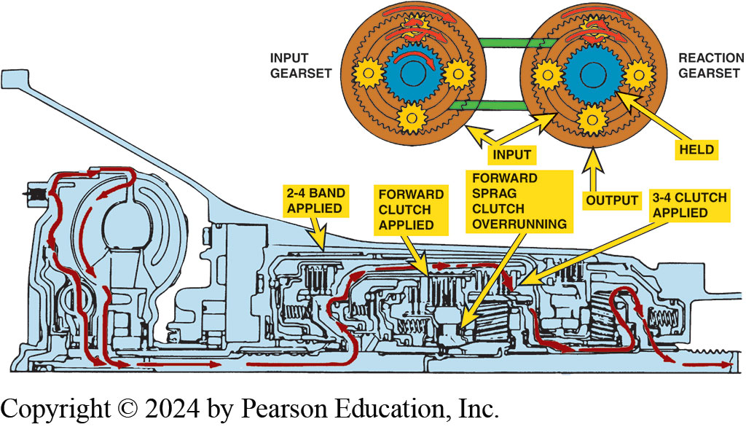
Figure 130.31 OD Fourth Gear
GM 4L60-E torque (power) flow in overdrive fourth gear

Slide 76

Figure 130.32 OD Reverse
GM 4L60-E torque (power) flow in reverse.

Slide 77

Animation: Automatic Shift Element
(Animation will automatically start)

Slide 78

Animation: 1-2 Upshift Minimum Throttle
(Animation will automatically start)

Slide 79

Animation: 2-3 Shift Valve
(Animation will automatically start)

Slide 80

Animation: 2-3 Shift Valve, WOT Upshift
(Animation will automatically start)

Slide 81

Animation: 2-3 Shift Valve, Light Throttle Upshift
(Animation will automatically start)

Slide 82

Animation: 2-3 Shift Valve, Light Throttle Downshift
(Animation will automatically start)

Slide 83

Animation: 2-3 Shift Valve, Full Throttle Downshift
(Animation will automatically start)

Slide 84

Animation: 2-3 Shift Valve, Coast Downshift
(Animation will automatically start)

Slide 85
Automatic Transmissions and Transaxles Videos and Animations
Videos Link: (A2) Automatic Transmissions and Transaxles Videos
Animations Link: (A2) Automatic Transmissions and Transaxles Animations

Slide 86
Copyright
This work is protected by United States copyright laws and is provided solely for the use of instructors in teaching their courses and assessing student learning. Dissemination or sale of any part of this work (including on the World Wide Web) will destroy the integrity of the work and is not permitted. The work and materials from it should never be made available to students except by instructors using the accompanying text in their classes. All recipients of this work are expected to abide by these restrictions and to honor the intended pedagogical purposes and the needs of other instructors who rely on these materials.

