Slide 1
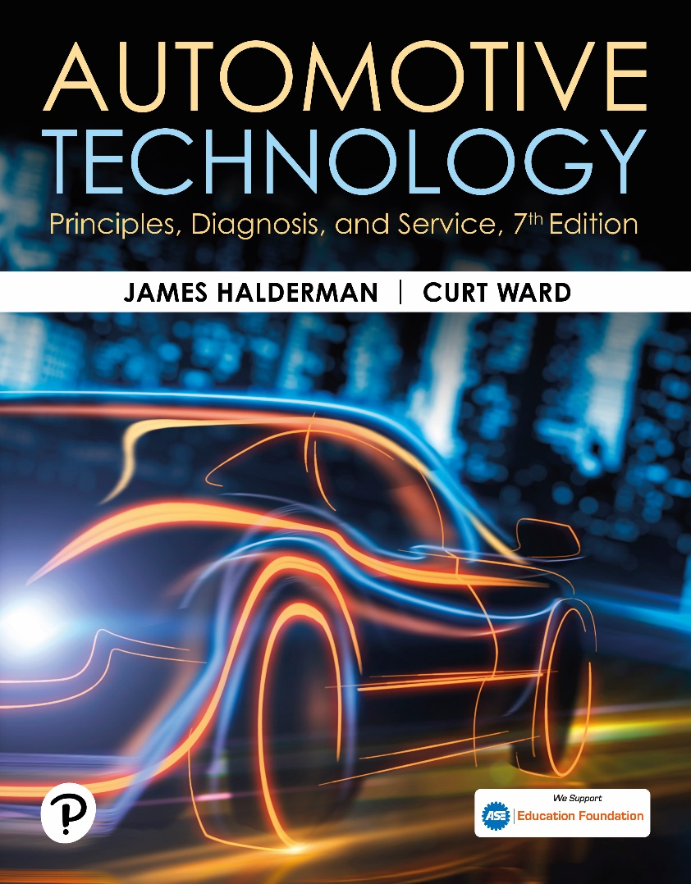
Automotive Technology: Principles, Diagnosis, and Service
Seventh Edition
Chapter 129
Continuously Variable and Dual Clutch Automatic Transmissions
Copyright © 2023 Pearson Education, Inc. All Rights Reserved
Notes:
INSTRUCTOR NOTE: This presentation includes text explanation notes, you can use to teach the course. When in SLIDE SHOW mode, you RIGHT CLICK and select SHOW PRESENTER VIEW, to use the notes.

Slide 2
Learning Objectives (1 of 2)
129.1 Describe the function, advantages, and disadvantages of a continuously variable transmission
129.2 Describe the construction of a continuously variable transmission.
129.3 Discuss the electronic controls of a CVT.
129.4 Discuss the operation of a CVT.
129.5 Explain CVT pressure testing.
129.6 Discuss CVT fluid.
129.7 Discuss CVT-related DTCs.

Slide 3
Learning Objectives (2 of 2)
129.8 Discuss the parts and operation of a dual-clutch automatic transmission.
129.9 Discuss the dual-clutch transaxle.
129.10 Describe the diagnostic and service procedures for a dual clutch transmission/transaxle system.

Slide 4
Continuously Variable Transmission (CVT) (1 of 2)
CVT offers following advantages over planetary-gear transmission.
  Compact, very short
  Lighter weight
  Constant, stepless acceleration
  Engine staying at RPM for maximum power
  Efficient fuel use and emissions
  Cruise with engine staying at RPM for maximum efficiency
  Lower internal power loss
Notes:
CVT offers the following advantages over planetary-gear automatic transmission.
■ Compact, very short
■ Lighter weight
■ Constant, stepless acceleration with engine staying at the RPM for maximum power
■ Efficient fuel use and emissions, cruise with engine staying at the RPM for maximum efficiency
■ Lower internal power loss
Disadvantages of a CVT compared to conventional automatic transmission include the following:
■ High and constant engine speed when accelerating rapidly
■ Requires special fluid that may not be readily available
■ Often not repaired but instead replaced as an assembly if the unit fails

Slide 5
Continuously Variable Transmission (CVT) (2 of 2)
Each pulley has a movable face and a fixed face
CVT improves efficiency by changing ratios
From underdrive/reduction to overdrive in a gradual, continuous manner
Each pulley, also called a sheave, has 2 sides
One is fixed so it cannot move
The other can float sideways to change pulley width
Push belt and pull chain

Slide 6
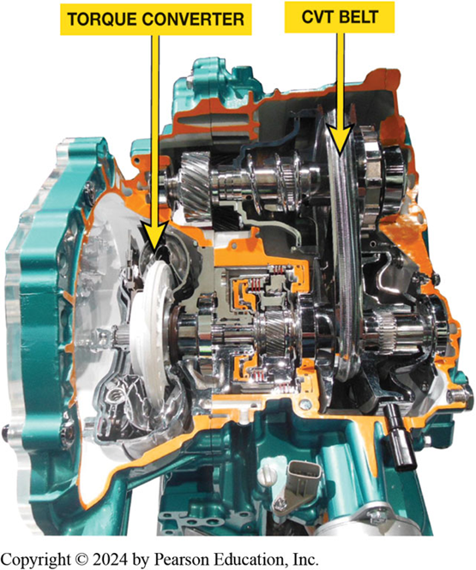
Figure 129.1 CVT Cutaway
A typical CVT transaxle cutaway showing the torque converter and CVT belt.

Slide 7
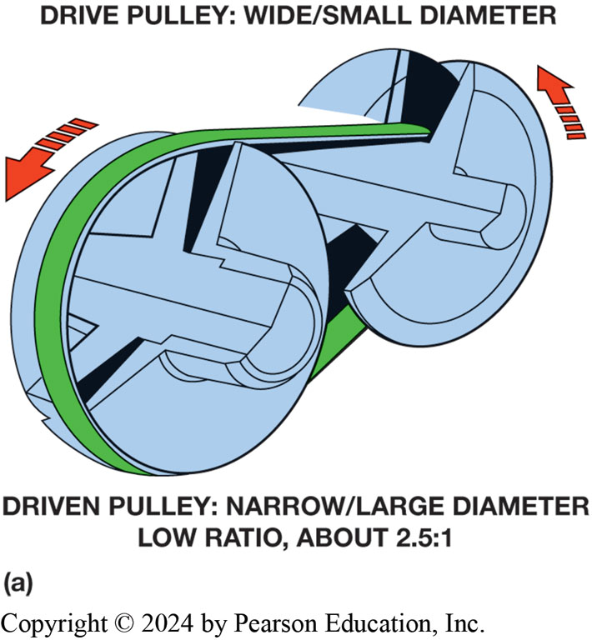
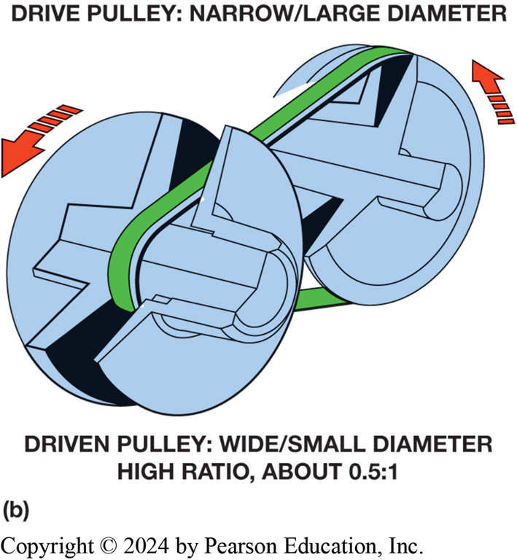
Figure 129.2 CVT Pulleys
Belt and pulley CVT uses variable width pulleys to provide an infinite number of speed ratios

Slide 8
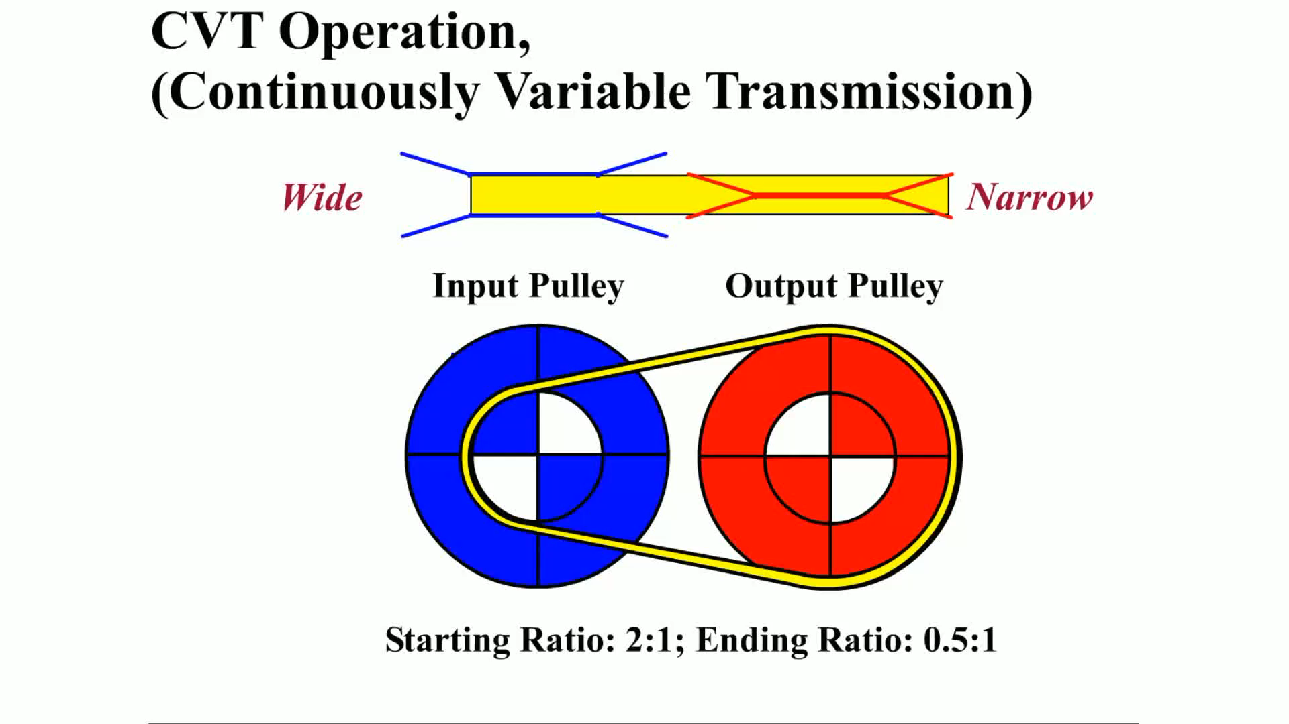
Animation: Assemble Valve Body
(Animation will automatically start)

Slide 9
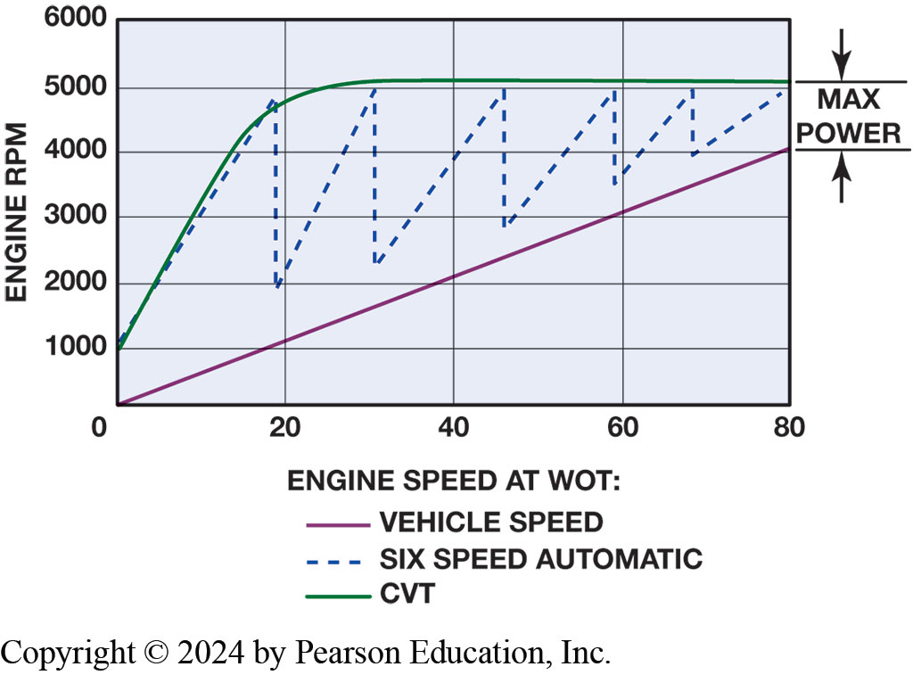
Figure 129.3 Engine Speed Chart
Engine speed and vehicle speed of a CVT transaxle compared to a typical six-speed Conventional automatic transaxle

Slide 10
Frequently Asked Question: What Is It Like to Drive a Vehicle Equipped with CVT?
? Frequently Asked Question
What Is It Like to Drive a Vehicle Equipped with CVT? For most people, driving a vehicle equipped with a CVT is same as driving vehicle equipped with a conventional automatic transmission/transaxle. The vehicle creeps slightly when brake is released and accelerates normally when throttle is opened. Because no shifts occur, first thing driver and passenger notice is that it is very smooth. If vehicle is equipped with a tachometer, driver may notice that engine speed increases when first accelerating and often remains higher until vehicle speed increases. During periods of rapid acceleration, engine speed may be close to its maximum and thereby creates noise and vibration often not experienced in a similar vehicle. Because vehicle speed slowly catches up to engine speed, this effect is often referred to as “rubber band effect” and is most noticeable only during periods of rapid acceleration. However, the fuel economy improvement of a CVT compared to a conventional automatic transmission makes slight difference a reasonable trade-off.

Slide 11
Construction
Variators
  Pulleys used in CVT design can vary their width
  Varying hydraulic pressure applied to them.
  Drive Belt
  Push belt
  Pull chain
  Vehicles That Use a Belt or a Chain
Notes:
Instead of using three or more gears, a CVT uses two variable-width pulleys, sometimes called variators, to change the gear ratio.
The pulleys used in CVT design can vary their width by varying the hydraulic pressure applied to them. Each pulley has a movable face and a fixed face.
The movable face for each pulley is attached to a piston that has hydraulic control pressure applied to it.
Higher application pressure on the movable face causes the pulley to become narrow and this makes the steel belt ride closer to the outside diameter of the pulley. A lower application pressure will allow the pulley to become wider and the belt will ride closer to the pulley axis. If a low hydraulic pressure is applied to the drive pulley and a high hydraulic pressure is applied to the driven pulley, a low speed ratio is achieved.
CVT (continuously variable transmission) has an infinite number of gear ratios between its lowest ratio (about 3.7:1) and highest ratio, which is a 0.27:1 overdrive.
CVT improves efficiency by changing ratios from underdrive/reduction to overdrive in a gradual, continuous manner. The primary/drive pulley is attached to the input shaft. The secondary/driven pulley is on the output shaft and drives the final drive gears. Each pulley, also called a sheave, has two sides:
1. One is fixed so it cannot move.
2. The other can float sideways to change pulley width.

Slide 12
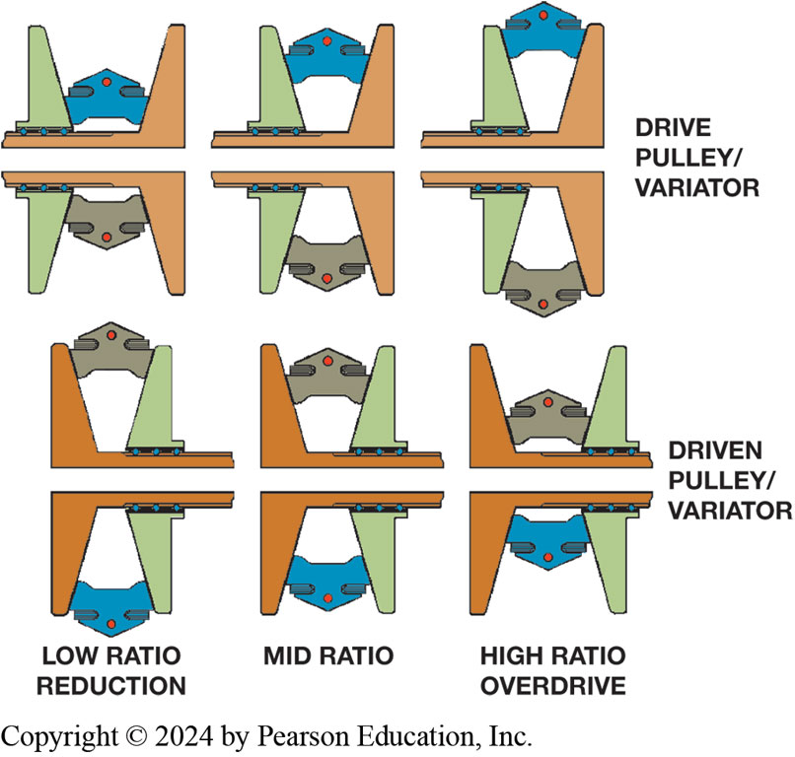
Figure 129.4 Pulley Operation
Drive pulley is wide while driven pulley is narrow for a low ratio vehicle start (left). Ratio changes by making drive pulley narrow and driven pulley wider.
Notes:
When the vehicle is at rest, the primary pulley is wide so the belt sits low on the pulley, and the secondary pulley is narrow so the belt sits high. This produces the lowest under- drive ratio. ● See Figure 129–4.
The secondary pulley is spring loaded to force it to a narrow position. The primary pulley is adjusted to control the gear ratio, and the secondary pulley is adjusted to maintain tension on the belt. The belt must never be loose between the pulleys.
At start, pulley halves/discs on the input (primary) shaft are spread apart, and the pair of pulley halves on the output (secondary) shaft are pushed together. This produces a small pulley driving a large pulley, which produces the lowest drive ratio.
As vehicle moves, the floating side of the primary pulley moves inward, making pulley narrower and forcing belt to move out to a wider diameter. This produces a higher gear ratio.
Both pulleys must maintain enough pressure on drive belt to transfer required torque. Fluid pressure is used to force drive piston/pulley to a narrower position and driven pulley to a wider position. The secondary pulley is spring loaded to force it to a narrow position. The primary pulley is adjusted to control the gear ratio, and the secondary pulley is adjusted to maintain tension on the belt. The belt must never be loose between the pulleys. A reverse gear set, controlled by a multi-plate clutch pack, is used to produce reverse.

Slide 13
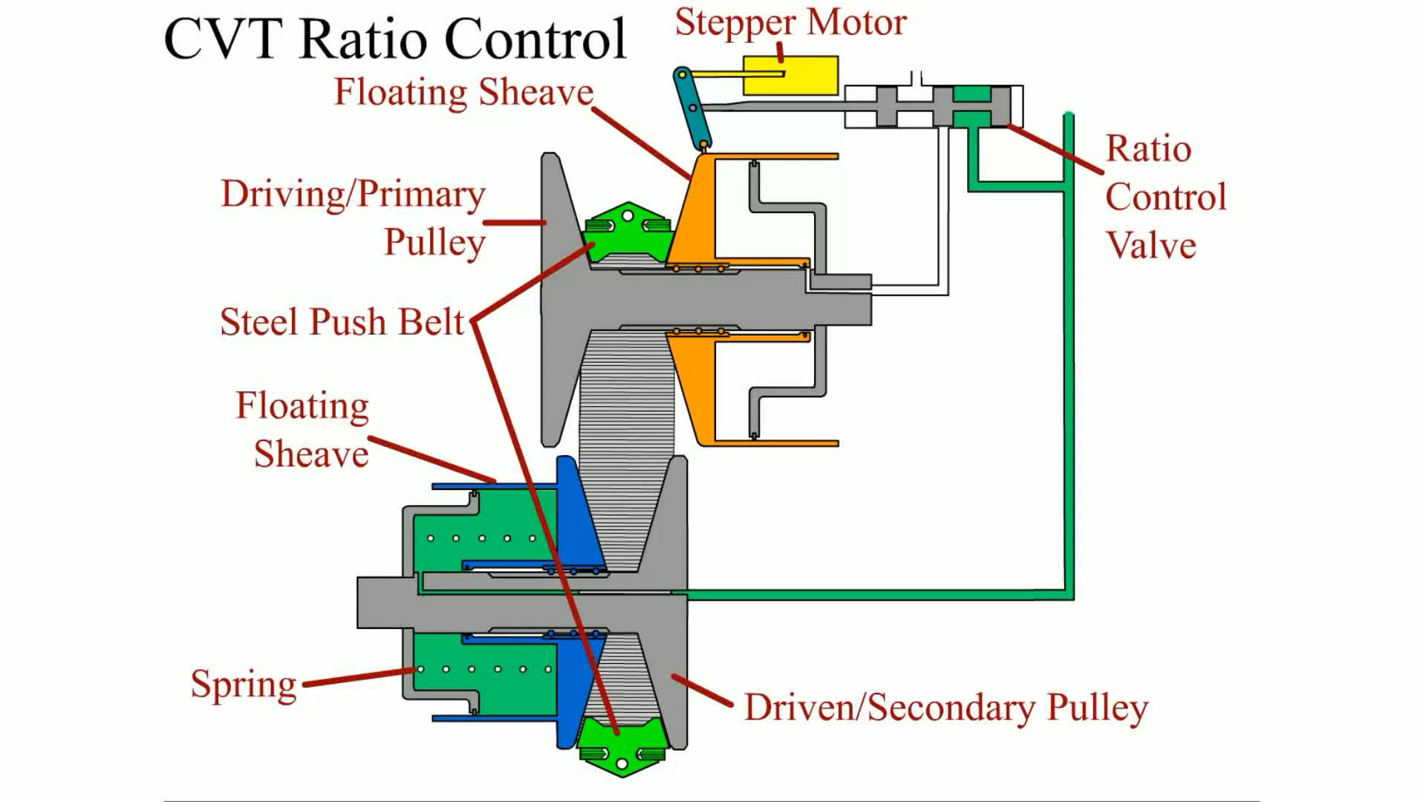
Animation: CVT Ratio Control
(Animation will automatically start)

Slide 14
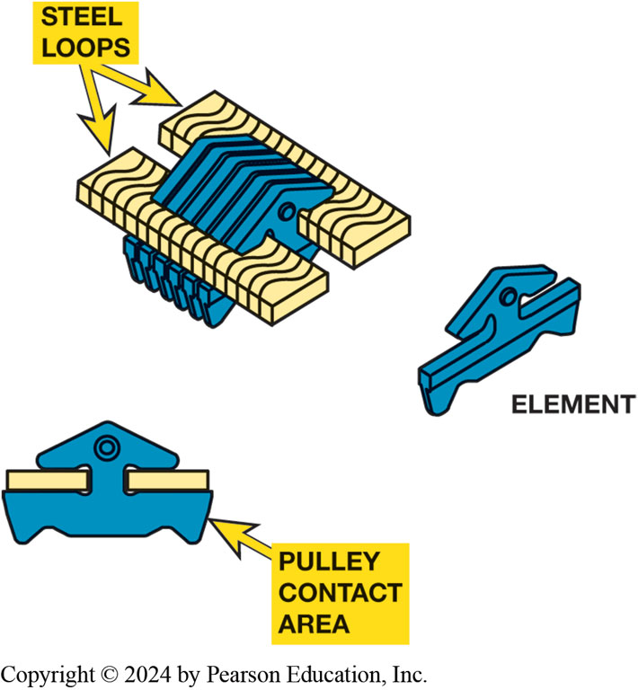
Figure 129.5 Push Type Belt
A Typical push-type CVT belt construction
Notes:
Two different styles of fixed-length steel belts are used.
1. Push belt It is made up of about 400 wedge-shaped segments that are held together by two steel
bands. Each band is made of multiple layers to allow flexibility. The segment sides contact the
pulley sides. A push belt is often called the Van Doorne design. This style of belt is directional,
and is usually marked with an arrow to show belt direction. ● SEE FIGURE 129–5.
2. Pull chain It is made up of links and link pins, much like a silent chain. The ends of the
link pins contact the pulley sides. This style is also called a Luk chain drive. ● Figure 129–6.

Slide 15
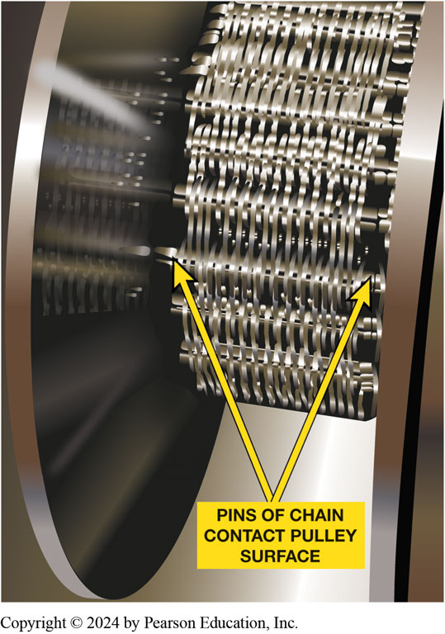
Figure 129.6 Pull Type Chain
The pull chain looks similar to a silent chain

Slide 16
Chart 129.1 CVT Transaxle Types
VEHICLES THAT USE A PUSH-TYPE CVT (BELT-TYPE) | VEHICLES THAT USE A PULL-TYPE CVT (CHAIN-TYPE)
Honda (Accord, Civic, Civic hybrid, Insight hybrid) | Audi (A4, S4, RS4)
Dodge Caliber | Ford (500, Freestar, Freestyle)
Jeep (Compass, Patriot) | Mercury (Montego, Monterey
Mini Cooper | Subaru Lineartronic (Legacy, Forester, Impreza, Outback)
Mitsubishi (Lancer, Outlander)
Nissan (Altima, Cube, Maxima, Murano, Rogue, Sentra, Versa)
Saturn (Aura, Ion, Vue) Subaru Justy
Suzuki SX4
Toyota Corolla
Notes:
Vehicles that use a CVT transaxle, separated by type: either push-type (belt) or pull-type (chain). Check service information for the exact years and types of transmissions used for each model.

Slide 17
CVT Electronic Controls (1 of 3)
Inputs:
  Transmission Range Sensor
  Input Speed Sensor
  Output Speed Sensor
  Primary Pressure Sensor
  Secondary Pressure Sensor
  Transmission Temperature Sensor

Slide 18
CVT Electronic Controls (2 of 3)
Indirect inputs from CAN bus include:
  PCM requests
  Engine output torque
  Brake switch
  ABS status signals
  Charging system voltage
  Engine RPM
  Engine coolant temperature

Slide 19
CVT Electronic Controls (3 of 3)
Accelerator pedal position
Vehicle speed
A/C system requests
Outputs
Radio control motor
Stepper motor
Line pressure solenoid
Secondary pressure solenoid
TCC lockup solenoid

Slide 20
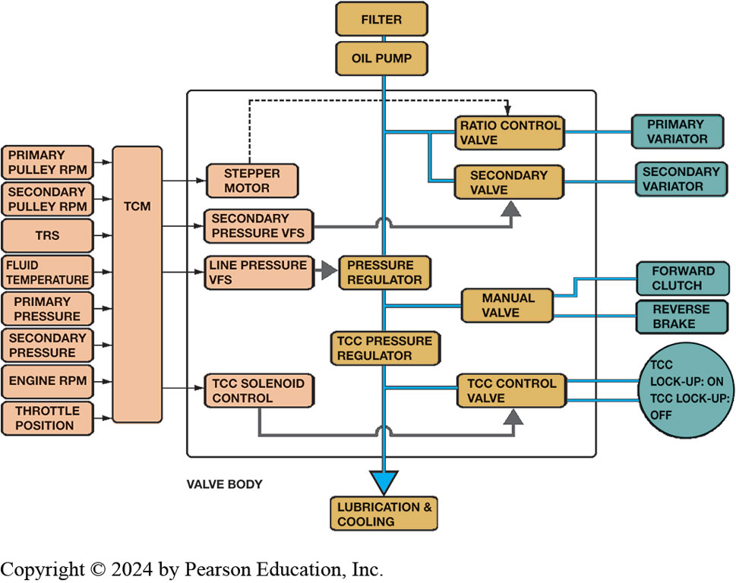
Figure 129.7 Block Diagram
Block diagram showing the relationship between the TCM, electrical actuators, valve body, and hydraulic actuators for a CVT transmission

Slide 21
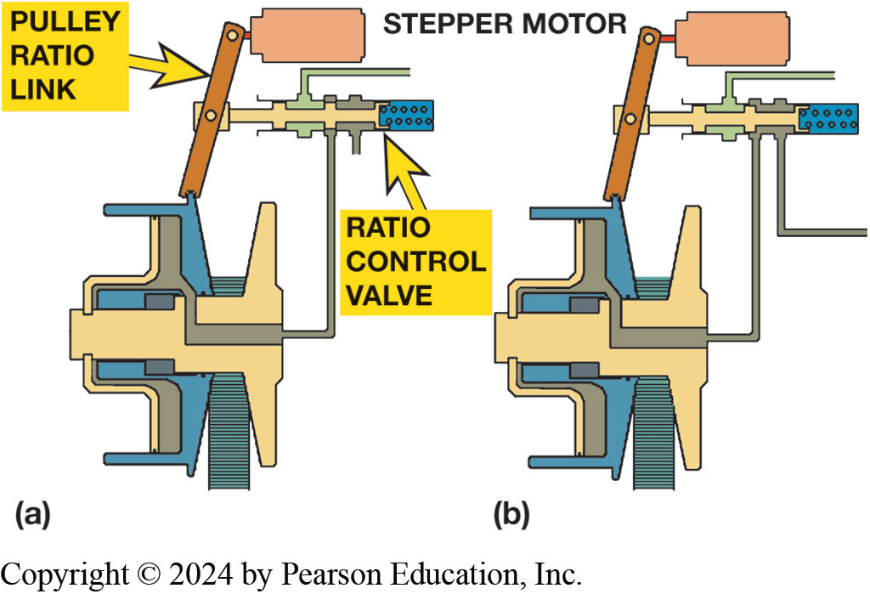
Figure 129.8 Stepper Motor
(a) stepper motor and pulley ratio link with the CVT in low ratio. (b) The stepper motor has extended, moving the ratio link and ratio control valve; this should cause the primary pulley to become narrower to produce a higher ratio.
Notes:
The stepper motor, also called a ratio control motor,
is a linear position motor that changes the position of the upper end of the pulley ratio link. The stepper motor
controls the hydraulic ratio valve through the link, which in turn controls fluid flow to the piston. The lower end of this link moves with the floating side of the primary/drive pulley and the ratio control valve is connected to the center of this link. Movement of the stepper motor or the floating sheave will move the ratio control valve to produce a ratio change. .

Slide 22
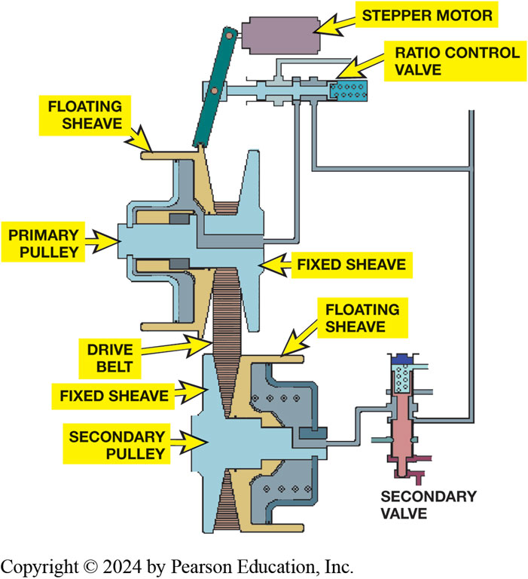
Figure 129.9 Movement
Movement of either stepper motor or primary floating sheave will move the ratio control valve to add or remove fluid from the primary pulley. The secondary valve maintains the necessary pulley pressure on the drive belt
Notes:
The TCM controls the drive ratio to match vehicle needs. It can adjust the ratio during vehicle cruise to produce the maximum fuel economy, lowest emissions, or maximum pulling power. ● Figure 129–9.

Slide 23
CVT Operation
Describe what happens during…
  Starting
  Reverse
  Forward
Notes:
STARTING With no fluid pressure, the secondary pulley spring forces the floating side to a narrow,
high-belt position, which in turn moves the primary pulley to a wide, low-belt position. This
produces an underdrive that is always used as the vehicle starts moving. Continued fluid flow to
the primary piston will change the ratio from an underdrive/reduction through 1:1 to an overdrive.
REVERSE A planetary gear set is needed for reverse-direction operation, and this is a simple
planetary with a carrier that can be held by the reverse clutch. The input shaft drives the
ring/internal gear, and the sun gear drives the shaft to the primary pulley.
FORWARD OPERATION A forward clutch is mounted on the input shaft from the torque converter; it is
mounted inside a clutch drum that also contains the planetary ring gear. When it applies, the
forward clutch drives the planetary sun gear so both the sun and ring gears are driven. This locks
the gear set to produce a 1:1 ratio.

Slide 24
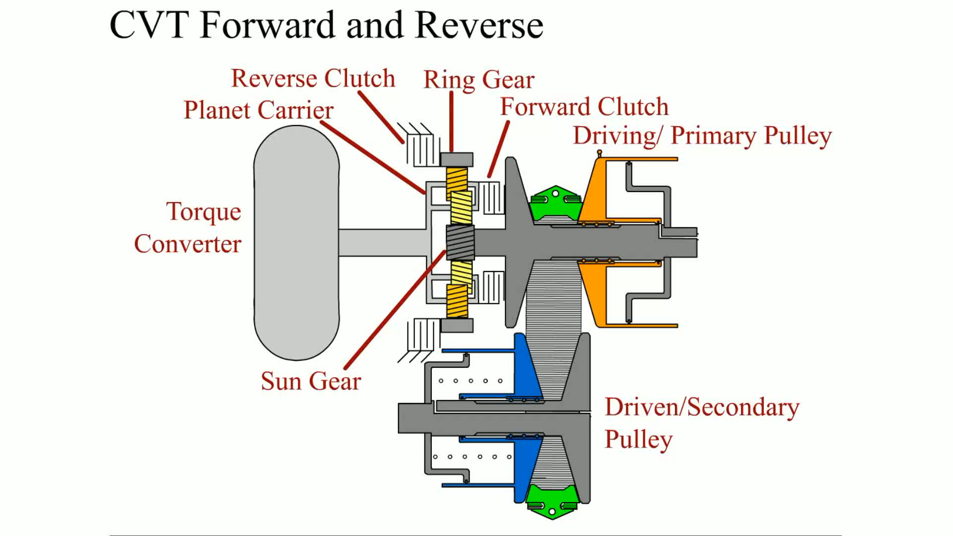
Animation: CVT Forward and Reverse
(Animation will automatically start)

Slide 25
CVT Torque Converter
Most CVT transmissions use
Low-profile elliptical torque converter with a lockup clutch
Since CVTS are infinitely variable
Torque converter not needed once the vehicle is moving.
Notes:
CVT Torque Converter Most CVT transmissions use a low- profile elliptical torque converter with a
lockup clutch. Since CVTs are infinitely variable, the torque converter is not needed once the
vehicle is moving. Therefore, the converter is used to multiply the torque to get the vehicle
moving from a stop, and then becomes a mechanical connection between the engine and the CVT. The
torque converter clutch apply will occur at about 12 MPH (20 km/h) and stay locked until the
vehicle comes to a stop. Some small vehicles with CVTs do not use a torque converter. The forward
and reverse clutches are released for stops and one will to start the vehicle moving.

Slide 26
Pressure Testing CVT
Pressure Testing
  Typical pressures:
  Mainline pressure 70 to 900 PSI (485 to 6,200 kPa)
  Primary pressure 15 to 900 PSI (100 to 6,200 kPa)
  Secondary pressure 15 to 900 PSI (100 to 6,200 kPa)
Notes:
Measuring the CVT oil pressures is
similar to performing pressure testing on conventional auto- matic transmissions/transaxles. Always check service information for the exact procedures to follow and the location of the pressure tap. ● See Figure 13–13.

Slide 27
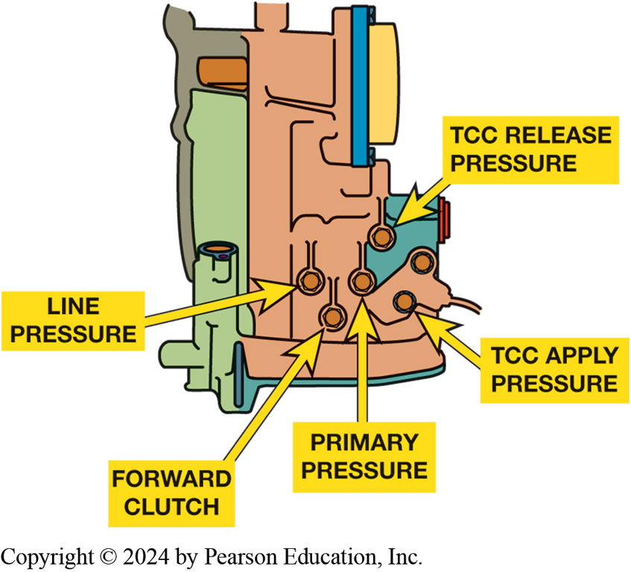
Figure 129.10 CVT Pressure Taps
The pressure tap locations as found on a Dodge Caliber CVT transaxle.
Notes:
Measuring the CVT oil pressures is similar to performing pressure testing on conventional
automatic transmissions/transaxles. Always check service information for the exact procedures to
follow and the location of the pressure tap. Figure 129–10.

Slide 28
CVT Fluid
CVT fluid and noise issues Page 190
Checking CVT fluid level
Replacing CVT Fluid
CVT Fluid Options
Option 1
Option 2

Slide 29
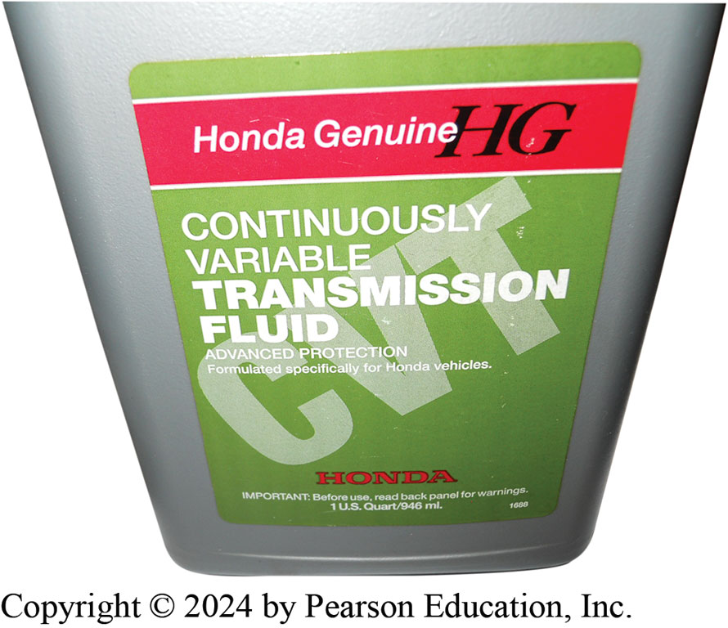
Figure 129.11 CVT Fluid
Using exact fluid recommended by the vehicle manufacturer is the preferred choice when servicing a CVT transaxles

Slide 30
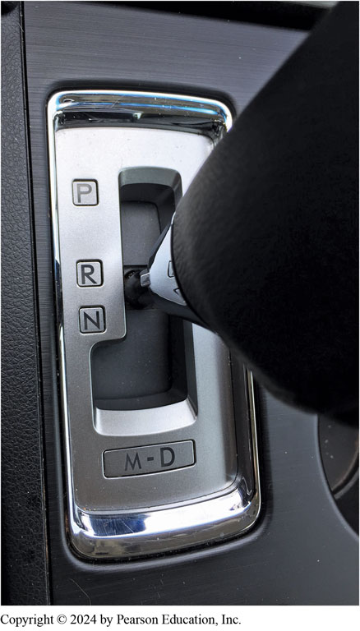
Figure 129.12
“fix” to the customer concern was to perform a relearn procedure using the gear selector following the instructions found in a TSB.
Notes:
Case Study The Case of the Delayed Shift Subaru
The owner of a Subaru Legacy complained that the CVT (TR580) transmission was slow to engage from
park to reverse and from drive to reverse. The technician assigned to the vehicle was able to verify that it required as long as four seconds to shift from drive to reverse or from neutral to reverse. After performing a through visual inspection, including a fluid level check, and not finding any issues, a scan tool was used to see if there were any transmission related diagnostic trouble codes. There were none so the technician checked for any TSBs and found one (#16-97-15) that did address customer complaint. In the TSB, there was a procedure to follow to relearn the TCM, which stated that this should be performed if there is a lag time greater than 1.5 seconds. The technician performed the relearn control procedure that included the following steps:
• Shift into “N” for 5 second, then shift into “R” for 3 seconds, and then shift back into “N” Repeat 10 times.
• Stay in “N” for 5 seconds, then shift into “D” for 3 seconds, and then shift back into “N” Repeat 10 times.
After 10 times, perform the “time lag test” again to confirm if this procedure corrected customer complain.
The technician was pleased that the relearn procedure did result in a delay time of less than a second. The customer was very pleased too because it did not require an expensive repair.
Summary:
Complaint—Customer complained of excessive time into a drive gear.
Cause—The transmission needed to be relearned.
Correction—The relearn procedure as found in a TSB was used to relearn the shifting of the CVT.
● Figure 129-12

Slide 31
CVT-Related DTCs
DIAGNOSTIC TROUBLE CODE (DTC) | DESCRIPTION
P0219 | Engine speed excessive—check for speed sensor or transmission slip codes
P0571 | Brake switch fault detected
P0707; P0708 | TCM detects improper signal from transmission range switch (P0707— signal low; P0708—signal high)
P0711; | Transmission temperature sensor
P0712; | (TSS) fault detected (P0711—circuit
P0713 | performance; P0711—signal low;
 | P0713— signal high)
P0716; P0717 | Transmission input speed sensor (ISS) fault detected (P0716—circuit performance; P0717—no signal)
P0721; P0722 | Transmission output speed sensor (OSS) fault detected (P0721—circuit performance; P0722—no signal)
P0730 | Incorrect gear ratio detected (transmission slip)
P0746 | Line pressure sensor performance issue detected
P0776; P0777 | Secondary pressure sensor (SPS) fault detected (P0776—performance fault; P0777—stuck on)
P0842; P0843 | Primary oil pressure (POP) sensor fault detected (P0842—sensor circuit low; P0843—sensor circuit high)
P0847; P0848 | Secondary oil pressure (SOP) sensor fault detected (P0847—sensor circuit low; P0848—sensor circuit high)
Notes:
Typical continuously variable transmission (CVT) diagnostic trouble codes (DTCs) and code description. Transmission-related
DTCs are usually P07XX or P08XX, where XX represents the specific fault code.

Slide 32
Question 1?
How is a variable ratio achieved in a CVT?
  a. By using multiple gears
  b. By using a steel belt with two variable-width pulleys
  c. By using a start clutch assembly
  d. By using a variable-torque converter

Slide 33
Answer 1
How is a variable ratio achieved in a CVT?
  b. By using a steel belt with two variable-width pulleys

Slide 34
Dual-Clutch Automatic
Transmissions
Dual Clutch Design
  2 clutches engage inner or outer transmission shaft
  Like conventional automatic
    Improve fuel economy.
    Reduce cost of assembly
    Improve speed of gear changes.
    Provide smoother operation.
Notes:
A dual clutch transaxle is essentially two transmissions built into one case. Each portion is driven by one of the clutches, and these
clutches are applied, one at a time, to transfer power. A dual clutch transmission is essentially an automatic transmission that uses manual transmission-style gear layout and synchronizers with two countershafts. The shifts can occur vary rapidly, being controlled by how fast each clutch can be applied and with partially engaging one clutch while slipping the other during shifts.
DESCRIPTION An electronically controlled manual transmission/transaxle uses a manual
transmission or transaxle as the basic framework and then uses hydraulic actuators to make the
shifts all controlled by an electronic control module. While some use a single clutch disc like the
RAM M40MTA, most use a dual clutch design.
PURPOSE AND FUNCTION A dual clutch automatic transmission or transaxle uses a manual-type
transmission and two clutches that engage either the inner or outer transmission shaft. This type
of transmission is designed to achieve ls, compared to a conventional automatic

Slide 35
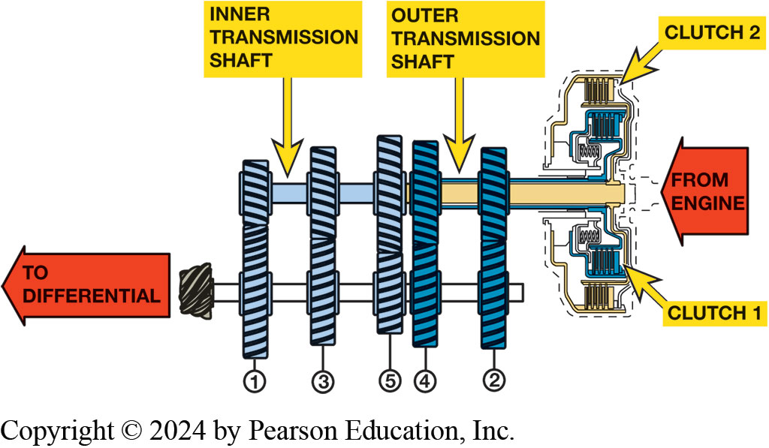
Figure 129.13 Dual-Clutch Automatic
A dual clutch automatic uses best features of an automatic transmission without the power loss of a torque converter.
Notes:
Dual clutch automatic transmission/ transaxle can also be referred to as
■ Direct shift gearbox (DSG). Most commonly used by the VW/Audi Group (VAG) of vehicles.
■ Porsche Doppelkupplung (PDK). The Porsche term used to describe their dual clutch automatic.
■ Automated manual transmission (AMT). Original term no longer commonly used.
■ Twin clutch transmission. Another variation of the term used for a dual clutch automatic transmission.

Slide 36
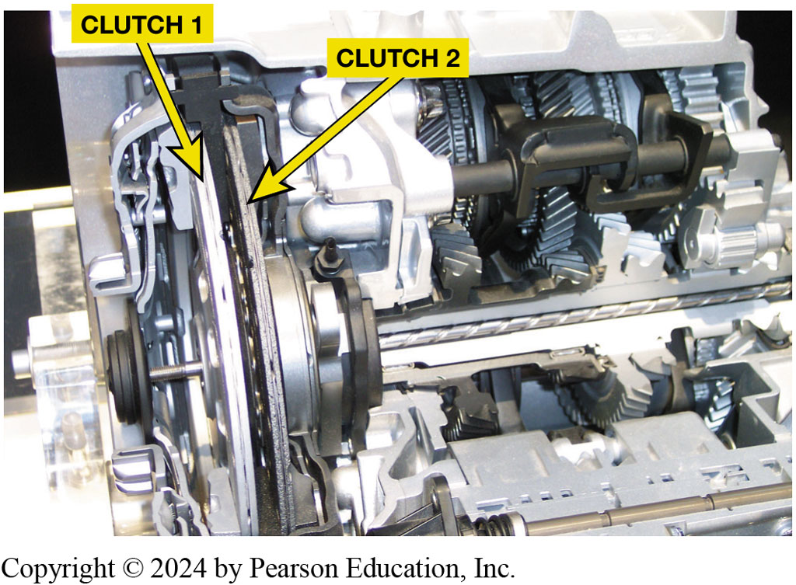
Figure 129.14 Parts & Operation
2 Types Dual Clutch
  Dual Dry Clutches used in low powered vehicles, such as small front-wheel-drive vehicles..
  Dual Wet Clutches used in higher powered vehicles.
Dual clutch automatic transaxles that use 2 dry clutches. Larger clutch drives the odd number gear ratios (1st, 3rd, and 5th ) and smaller clutch drives even numbered gear ratios (2nd, 4th, and 6th).
Notes:
PARTS AND OPERATION
A dual clutch automatic transmission/transaxle uses two clutches that are mounted together. One clutch drives the odd number gears (first, third, fifth, and seventh). The other clutch drives the even number gears (second, fourth, and sixth). ● Figure 129-14. The shifts occur without interrupting the torque from the engine by applying torque to the clutch while at the same time disconnecting the other clutch. These actions result in a rapid shift without the slight delay usually associated with an
automatic transmission.
There are two types of clutches used depending on application.
1. Dual dry clutches are used in low powered vehicles, such as small front-wheel-drive vehicles. ● Figure 129-15.
2. Dual wet clutches are often used in higher powered vehicles.

Slide 37
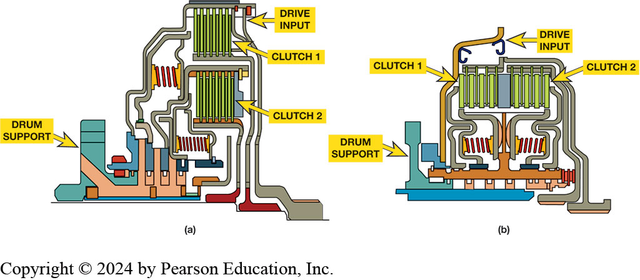
Figure 129.15 Clutches
(a) concentric (nested) clutch design, assembly is shorter in length but taller in height. (b) parallel clutch design is longer but has a smaller diameter drum assembly
Notes:
There are two basic Wet Clutch Designs used in dual clutch auto- matic transmissions.
(a) Concentric clutch (also called a nested-type clutch) is a design where both plates share the same vertical plane and provides a shorter assembly.
(b) Parallel clutch design is used in a side-by-side arrangement.

Slide 38
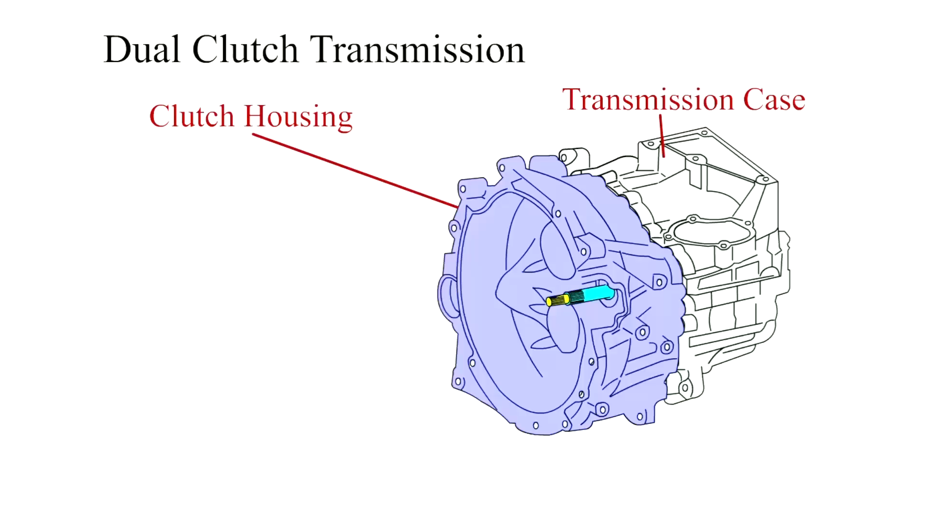
Animation: Dual Clutch Transmission
(Animation will automatically start)

Slide 39
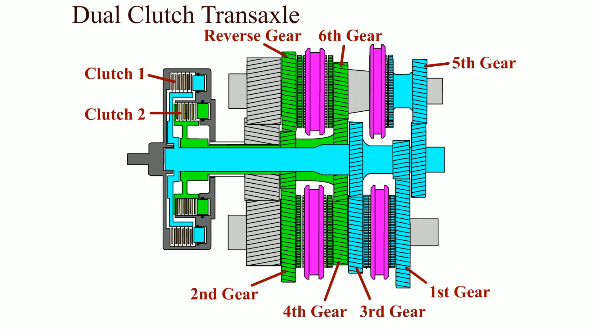
Animation: Dual Clutch Transaxle
(Animation will automatically start)

Slide 40
Frequently Asked Question: How Does Dual Clutch Achieve Better Fuel Economy?
? Frequently Asked Question
How Does a Dual Clutch Type Transmission Achieve Better Fuel Economy? One of advantages of a dual clutch automatic is that it is able to provide improved fuel economy over a conventional torque converter- type automatic. One strategy is to have the unit go into neutral when the vehicle is stopped by disengaging the clutches. This allows the engine to remain running but reduces the load on the engine, which improves fuel economy and reduces vibrations. The clutch is engaged when driver releases the brake.

Slide 41
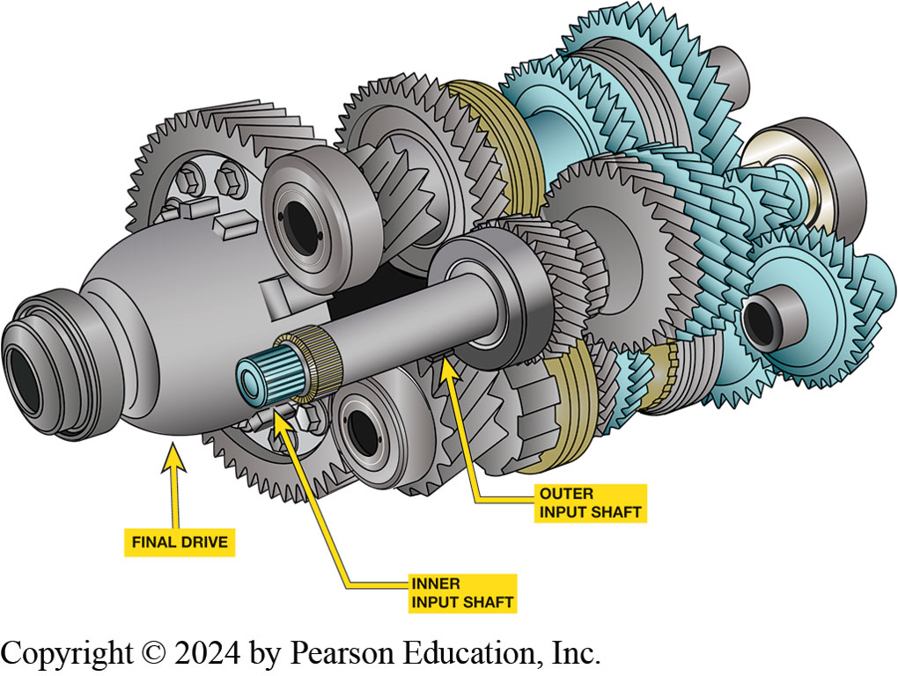
Figure 129.16 Concentric Input Shafts
Notice the two concentric input shafts. Each shaft is splined to a clutch.
Notes:
Gear Arrangements
The 1–3 and 5 synchronizer assemblies are driven by clutch 1 and the 2–4 and 6-reverse synchronizers are driven by clutch 2. Vehicle movement begins with the 1–3 synchronizer shifted to first gear and clutch 1 applied. The 2–4 synchronizer is then shifted into second gear by a hydraulic servo, and the 1–2 upshift will occur when clutch 1 is released and clutch 2 is applied.
The remaining upshifts occur in the same manner, with the synchronizer pre-shifted or shifted early, and the actual shift occurring when the clutches are cycled.
The driver can control the transmission/transaxle using a floor-mounted shift lever or one of a pair of paddles mounted on the steering wheel.
■ Clutches 1 and 2 are applied by hydraulic pressure, similar to automatic transmission clutches.
■ The hydraulic flow to the clutches and servos is controlled electronically by a control module.

Slide 42
Frequently Asked Question: Why Is TCM Using Position of Steering Wheel?
? Frequently Asked Question
Why Is the TCM Using the Position of the Steering Wheel? The steering wheel position (SWP) sensor information is sent to the transmission control module (TCM) over the network to prevent the transmission from upshifting when cornering. This helps the driver by allowing the vehicle to be accelerated when exiting a corner. If the steering wheel position was not part of the shift program, the transmission might likely upshift to a higher gear as the vehicle slows then the transmission may have to downshift again when the vehicle exits the corner.

Slide 43
GETRAG DCT 450 Speed Sensors
Engine Speed Sensor
  Inputs engine speed to TCM from clutch housing sensor
  Speed Sensor Input Shaft Odd Gears.
    Gives TCM information on input shaft RPM
    (after C1 clutch) for odd gears, 1, 3, 5, and R.
  Speed Sensor Input Shaft Even Gears.
    Gives TCM information on input shaft RPM
    (after the C2 clutch) for even gears, 2, 4, and 6
Notes:
SPEED SENSORS Speed sensors include the following:
Engine speed sensor. Inputs the engine speed to the TCM from the sensor located on the clutch drum housing.
Speed sensor input shaft odd gears. Gives the TCM information on input shaft RPM (after the C1 clutch) for odd gears, 1, 3, 5, and R.
Speed sensor input shaft even gears. Gives the TCM information on input shaft RPM (after the C2 clutch) for even gears, 2, 4, and 6.

Slide 44
GETRAG DCT 450 Temperature Sensors
Clutch Fluid Temperature
  Measure temperature of fluid leaving clutches
Transmission Fluid Temperature
  Measure temperature of fluid in transmission
Oil Temperature Sensor
  Located on TCM
  Provides information on transmission oil temperature
Notes:
TEMPERATURE SENSORS The TCM uses temperature information to determine correct system pressure, for controlling the
clutch, for cold starts, and for overheating protection.

Slide 45
GETRAG DCT 450 Pressure & Position Sensors
Pressure Sensors
  Give TCM information on hydraulic pressure of clutches.
  TCM supplies sensors with 5V.
  Register pressure to control clutch pressure
  TCM controls solenoids to provide correct clutch pressure
Position Sensors
  Fork Position Sensors
    Give TCM information on position of 4 gear shift forks
    Handle shifting in transmission includes 1-R; 3-5; 2-4; & 6-N
  Transmissions Range Sensor (TRS)
    Sensor provides the actual P R N D gear selection
Notes:
Pressure sensors give the TCM information on hydraulic pressure of clutches. The TCM sup- plies the sensors with 5V. The sensors register the oil pressure to control clutch pressure so that the TCM can control the solenoids to provide correct clutch pressure for each clutch.
Position sensors include the following:
Fork position sensors—sensors give TCM information on position of 4 gear shift forks that handle shifting 1-R; 3-5; 2-4; and 6-N.
Transmissions Range Sensor (TRS)—This sensor provides the actual PRND gear selection.
The transmission electronic control module uses information from the sensors to determine proper clutch and shift servo operation. Once the TCM determines the required gear range and driving conditions, actuators are turned on or off to control hydraulic pressure, gear selection, clutch control shift lock.

Slide 46
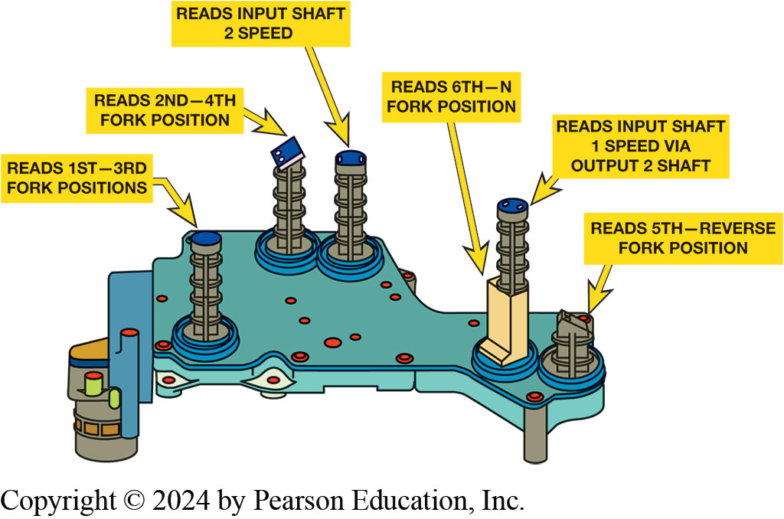
Figure 129.17 Solenoids
Fork position and shaft speed sensors are used as inputs to the TCM.
Notes:
The transmission control module (TCM) operates shift solenoids. These pistons apply force to the shift forks through lever points to help increase the force applied. Both an even and an odd gear can be commanded at the same time in parallel. Position sensors are located inside the case and this information is used by the TCM to determine the actual position of each shift fork. See Figure 14-8

Slide 47
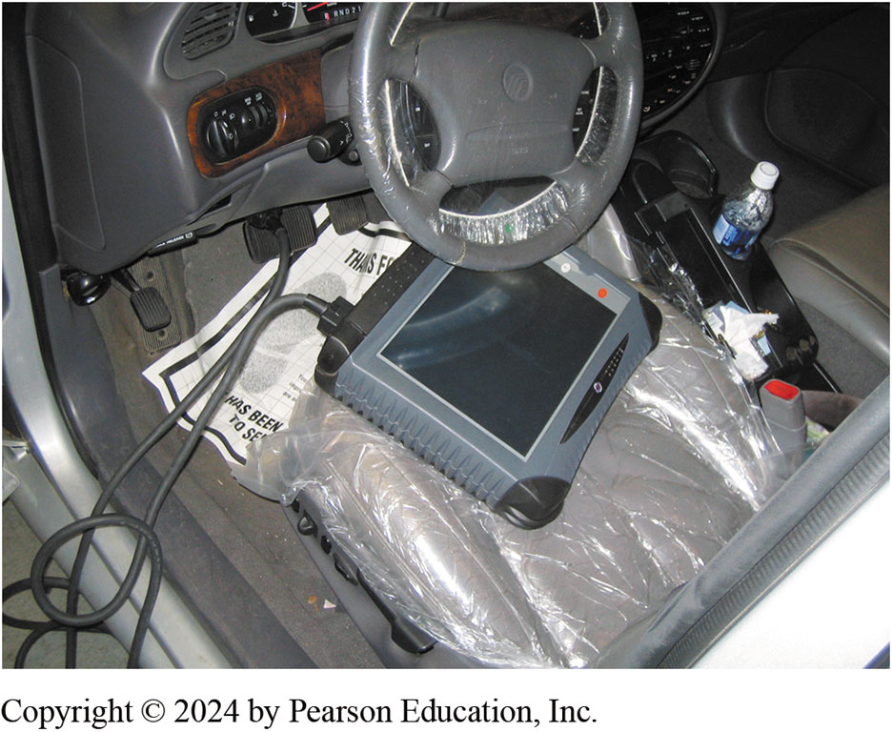
Figure 129.18 Diagnosis & Service
Verify concern
Perform visual inspection:
  Checking fluid level and condition
  Checking drivetrain mounts
Check for procedure
Follow it
Repair & Road Test
The use of a factory or a factory-level aftermarket scan tool is often used to diagnose the dual clutch transmission system.
Notes:
STEP 1 Verify the customer concern (complaint). This step includes trying to duplicate what the customer or driver is concerned about.
STEP 2 Perform a thorough visual inspection, including the following:
Checking level and condition of the fluid
Checking drivetrain mounts for damage or faults
STEP 3 Check service information for the specified procedure to follow. Most vehicles require the use of a factory-brand scan tool.
STEP 4 Follow the troubleshooting procedure as specified to fix the root cause of the problem. This means following the instructions displayed on the scan tool or service information.
STEP 5 Repair the fault.
STEP 6 Road test the vehicle under the same conditions that were performed to verify the fault to ensure that the repair is completed.
Fluid Maintenance
The transmission fluid is usually high-quality synthetic oil, which is unique for this type of transmission. Dual clutch transmission fluid is usually green to help identify it as a unique fluid and to help prevent someone from using conventional automatic transmission fluid. Always use the specified fluid. For example, the Ford dry dual clutch fluid is specifically formulated for use in the DPS6 power shift twin dry clutch transmission. This fluid is manufactured with synthetic base oils and performance additives, providing im- proved shifting at all ambient temperatures. This fluid is used only in transmissions requiring a fluid meeting WSS-M2C200-D2.
Most dual clutch automatic transmissions/transaxles use an external filter that is serviceable and an internal filter that is a non serviceable part unless the unit is totally disassembled. Always follow the vehicle manufacturer’s recommended fluid and filter service intervals.

Slide 48
Chart 129.3 Diagnostic Trouble Code
P0715 | Input shaft 1 (odd number gear axle) speed sensor system (output high range out)
P0716 | Input shaft 1 (odd number gear axle) speed sensor system (poor performance)
P0717 | Input shaft 1 (odd number gear axle) speed sensor system (output low range out)
P0746 | Line pressure solenoid system (drive current range out)
P0753 | Shift select solenoid 1 system (open circuit) P0758 Shift select solenoid 2 system (open circuit)
P0776 | Clutch cooling flow solenoid system (drive current range out)
P0842 | Clutch 1 pressure sensor system (output low range out)
P0960 | Line pressure solenoid system (open circuit)
Chart 129-3 Found on Page 1645 0f the text showing some common DTCs
Notes:
DTCs
As part of any diagnostics, checking for diagnostic trouble codes is one of the first steps. See Chart 129-3

Slide 49
Question 2?
A concentric clutch ______________
  Has a smaller drum diameter
  Type of dry clutch
  Shorter in length
  Taller in height

Slide 50
Answer 2
Shorter in length

Slide 51
Automatic Transmissions and Transaxles Videos and Animations
Videos Link: (A2) Automatic Transmissions and Transaxles Videos
Animations Link: (A2) Automatic Transmissions and Transaxles Animations

Slide 52
Copyright
This work is protected by United States copyright laws and is provided solely for the use of instructors in teaching their courses and assessing student learning. Dissemination or sale of any part of this work (including on the World Wide Web) will destroy the integrity of the work and is not permitted. The work and materials from it should never be made available to students except by instructors using the accompanying text in their classes. All recipients of this work are expected to abide by these restrictions and to honor the intended pedagogical purposes and the needs of other instructors who rely on these materials.

