Slide 1
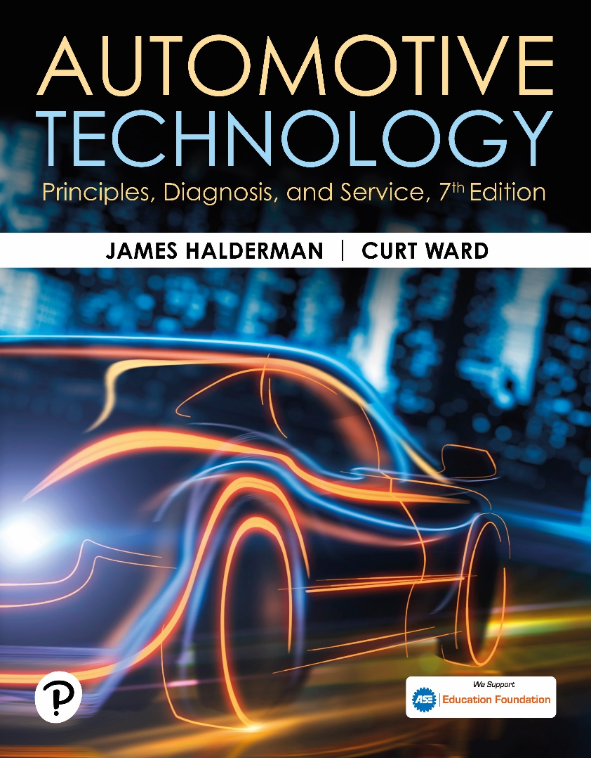
Automotive Technology: Principles, Diagnosis, and Service
Seventh Edition
Chapter 128
Automatic Transmission/Transaxle Principles
Copyright © 2023 Pearson Education, Inc. All Rights Reserved
Notes:
INSTRUCTOR NOTE: This presentation includes text explanation notes, you can use to teach the course. When in SLIDE SHOW mode, you RIGHT CLICK and select SHOW PRESENTER VIEW, to use the notes.

Slide 2
Learning Objectives
128.1 Explain the purpose, function, and operation of torque converters.
128.2 Explain the purpose, function, and operation of lockup torque converters.
128.3 Describe the various shift modes.
128.4 Discuss planetary gear sets.
128.5 Discuss compound planetary gear sets.
128.6 Discuss automatic transaxles.
128.7 Discuss non-planetary gear automatic transaxles.

Slide 3
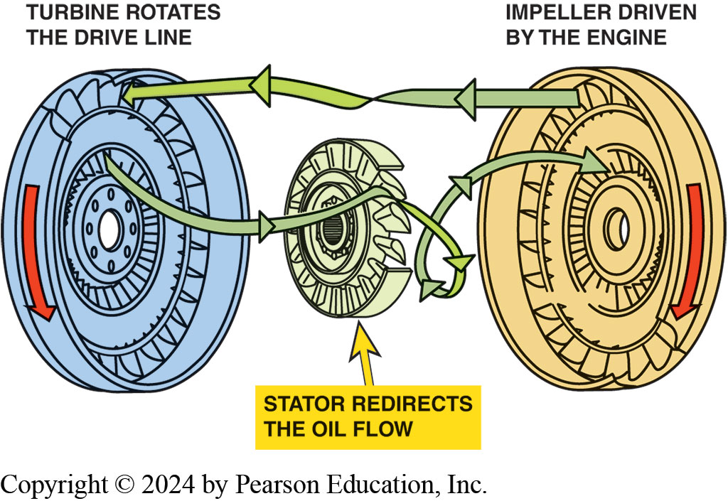
Figure 128.1 Torque Converter
Torque converter is made from 3 parts: The impeller is located at transmission end, attached to housing, and is driven by engine. The turbine is located at the engine side and is driven by the fluid flow from the impeller and drives the input shaft of the transmission. The stator redirects the flow to improve efficiency and multiply torque.

Slide 4
Torque Converter Terminology
3 major parts of torque converter: turbine, impeller, and stator.
  Torque converter contains stator mounted on one-way clutch.
  Stator is reaction member of torque converter
  Impeller is driving member and rotates with engine
  Located on transmission side of converter
  Turbine is located on engine side of converter.
  Impeller vanes pick up fluid in converter housing
  Direct it toward turbine

Slide 5
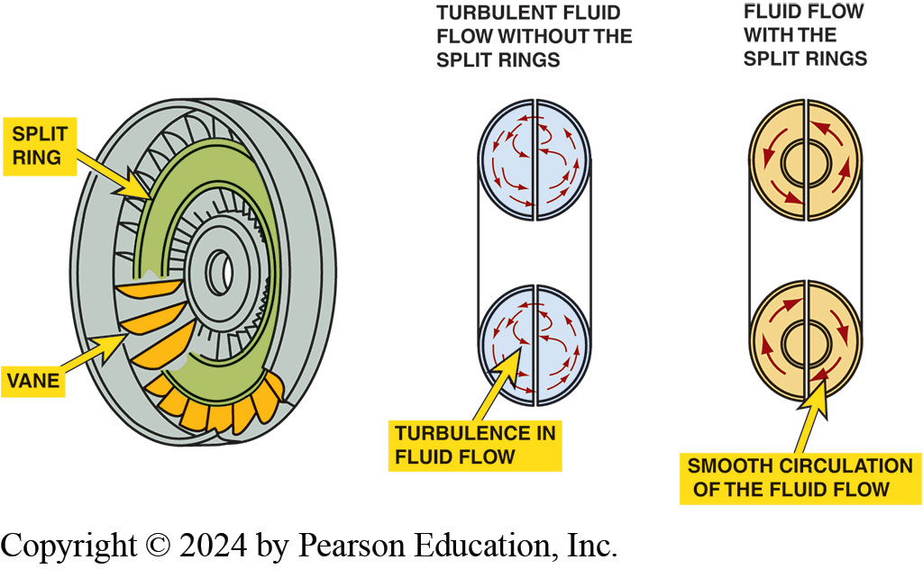
Figure 128.2 Split Rings
Split rings in the impeller and turbine help to direct the flow of fluid and improve the efficiency of the torque converter by reducing turbulence.

Slide 6
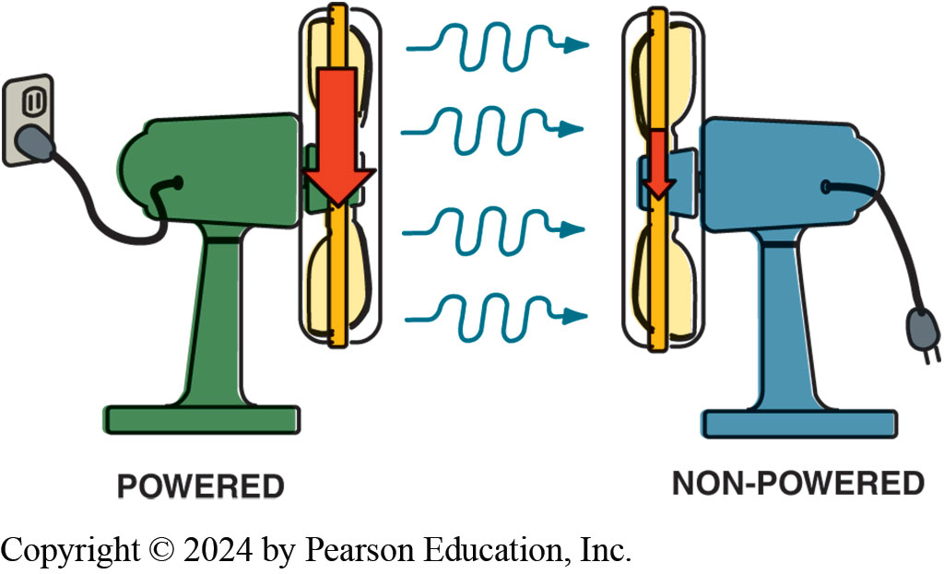
Figure 128.3 Two Fans
Two fans can be used to show how fluid, or air in the case of fans instead of automatic transmission fluid, can be used to transfer energy. If one fan is operating, which represents the impeller, and the blades of a second fan (turbine) will be rotated by the flow of air past the fan that is unplugged, causing the blades to rotate

Slide 7
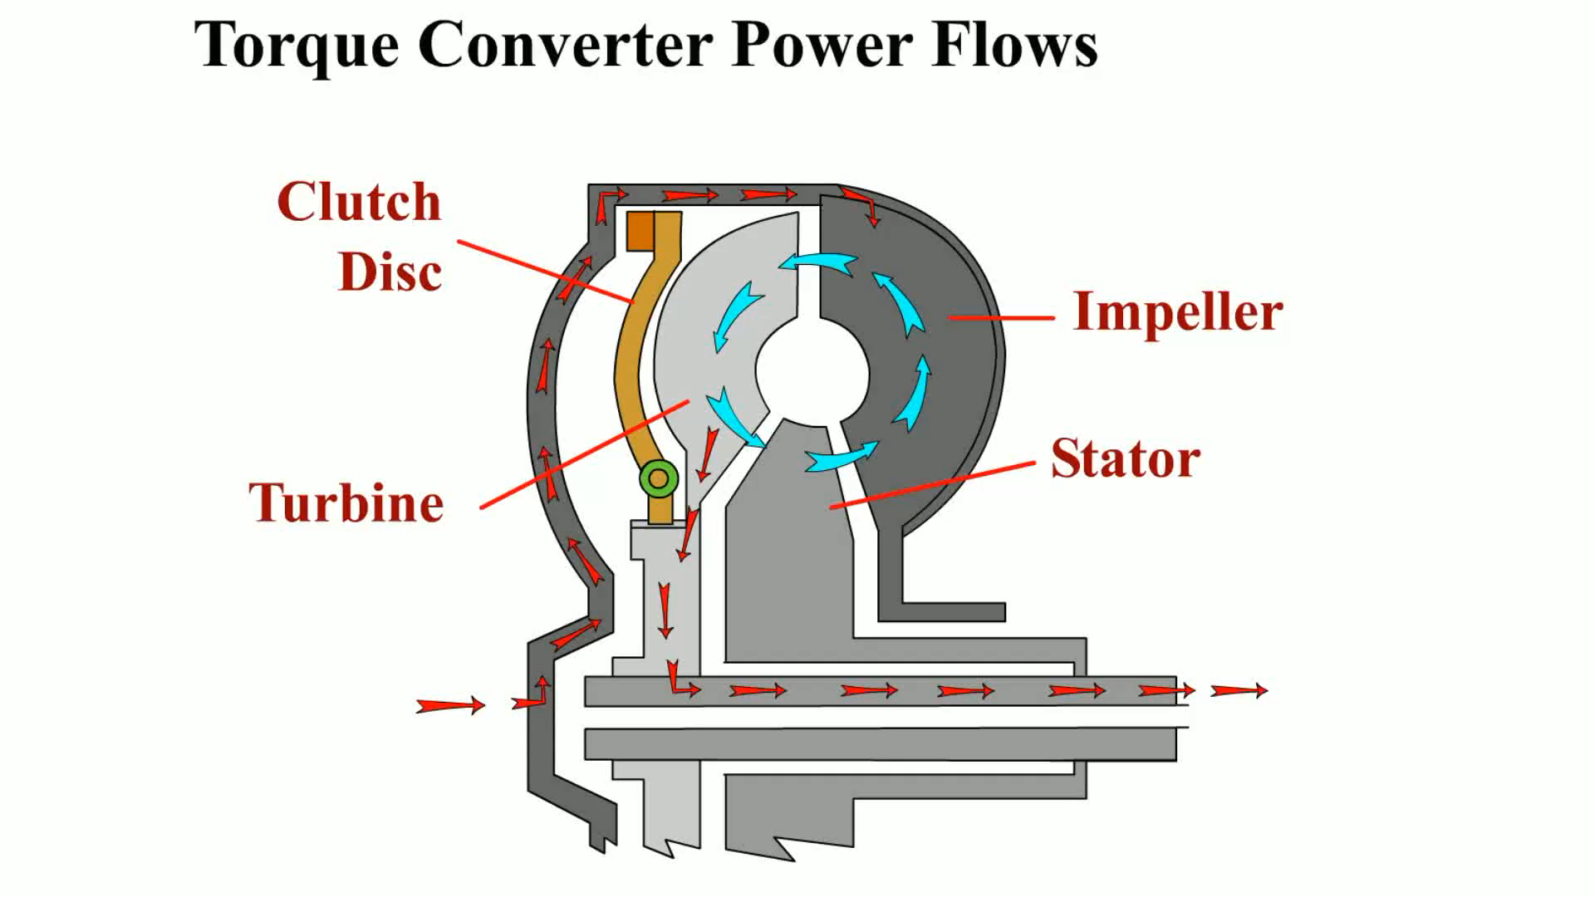
Animation: Torque Converter Power Flows
(Animation will automatically start)

Slide 8
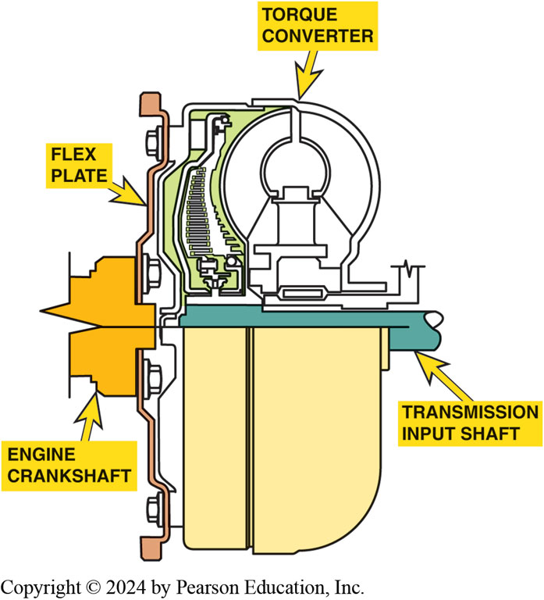
Figure 128.4 Bolts to Flexplate
The torque converter bolts to the flexplate that is attached to the engine crankshaft and rotates at engine speed.

Slide 9
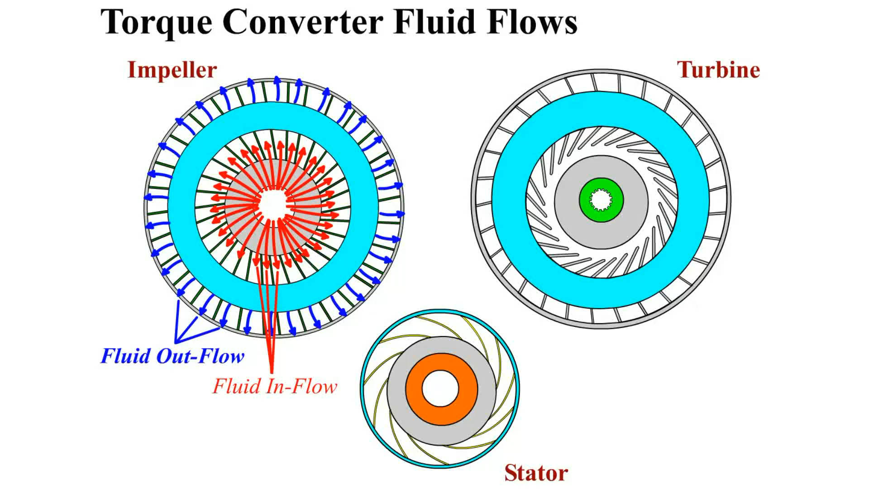
Animation: Torque Converter Fluid Flows
(Animation will automatically start)

Slide 10
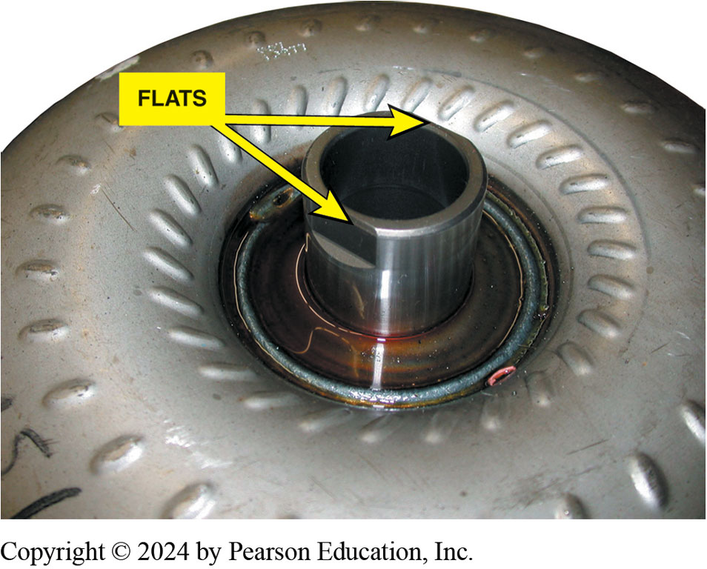
Figure 128.5 Pump Drive
The flat sections that are cut into the hub of the torque converter are used to drive the fluid pump.

Slide 11
Torque Converter Operation
Torque Converter is a Hydrodynamic Unit.
  Transfers power through dynamic motion of fluid.
  Other hydraulic units transfer power through static pressure of fluid.
  Torque multiplication
  Coupling phase

Slide 12
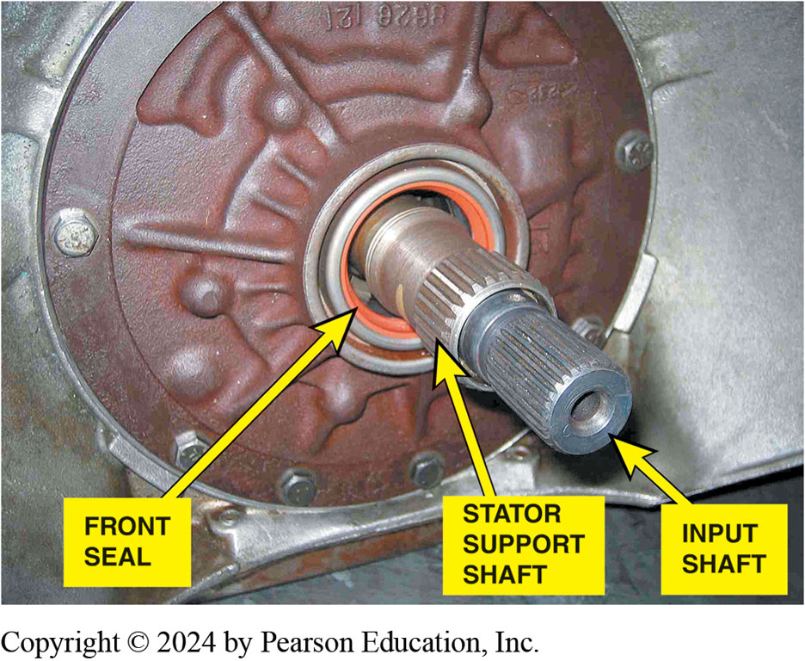
Figure 128.6 External Splines
The internal splines inside the torque converter are connected to the splines on the shaft and the turbine splines to the input shaft.
Notes:
Most rear-wheel-drive trans- missions use an inline method to drive the converter and pro- vide a
direct mechanical connection between the turbine and the transmission input shaft. In a typical
design, splines on the turbine connect it to the transmission input shaft and the stator hub mounts
on a one-way overrunning clutch. The one-way clutch mounts on splines to a stationary extension of
the oil pump called the stator support, or reaction shaft. ● Figure 128–6

Slide 13
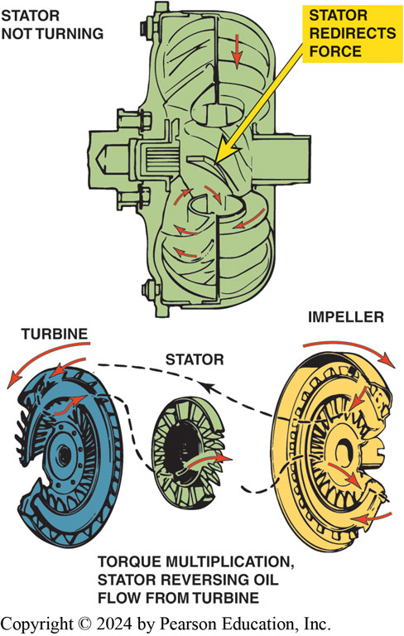
Figure 128.7 Torque Multiplication
Torque multiplication occurs when fluid leaving the turbine strikes the front of the stator vanes and is redirected back to the impeller.
Notes:
Fluid sent to the torque converter from the transmission oil pump is picked up by the rotating vanes of the impeller and transferred to the turbine vanes. The two types of fluid flow inside a torque converter are rotary flow and vortex flow.
Rotary flow is created by the rotation of the torque converter and causes the oil (ATF) to flow around the circumference of the torque converter.
Vortex flow is the flow of the fluid from the impeller to the turbine and back to the impeller.
Torque Multiplication: The stator redirects the fluid flow in the torque converter. It returns the fluid from turbine back to the impeller in a clockwise direction. This action helps recover any energy remaining in the fluid. The curved shape of the stator vanes and a one-way clutch make this possible. Fluid leaving the turbine in a counterclockwise direction tries to turn the stator counterclockwise. This causes the stator one-way clutch to lock up and hold the stator stationary. The smooth, curved shape of the stator vanes redirects the fluid flow in a clockwise direction.

Slide 14
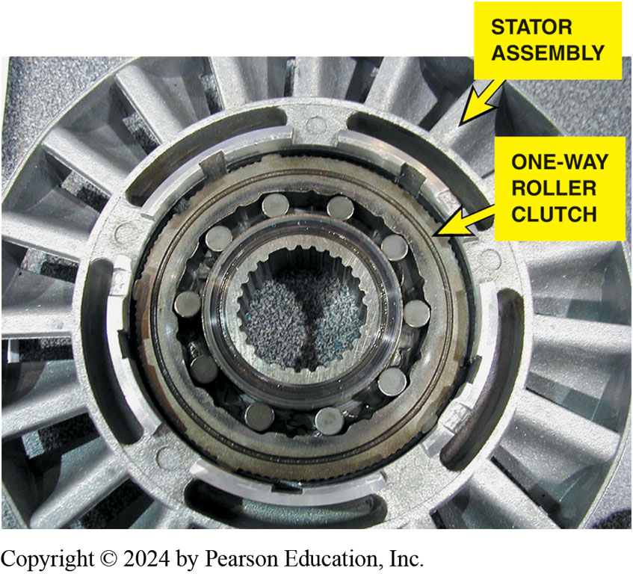
Figure 128.8 Stator One-Way Clutch
A stator contains a one-way roller clutch which locks it from rotating in one direction and allows it to rotate freely in the opposite direction.
Notes:
Torque Multiplication occurs because the stator redirects fluid flow. This occurs only when impeller is rotating faster than turbine. As turbine speed increases, the direction of flow becomes more rotary. The stator clutch overruns and converter becomes more of a coupling, transferring power from the engine to the transmission. An engineering term used for torque converters is the Stall Torque Ratio (STR), which is the torque converter’s ability to multiply torque. Most passenger vehicle torque converters have a STR between 1.68:1 and 2.1:1. For most converters, this means that the torque converter is able to double the torque of the engine at the stall speed of the converter.
Coupling Phase: When the turbine speed reaches 90% to 95% of impeller speed, coupling occurs. The coupling phase occurs when the speeds of the impeller and turbine are nearly equal. Centrifugal force acting on fluid in the spinning turbine is high enough to stop the vortex flow. At this point, there is no torque multiplication. It should be noted that this coupling speed is a relative point between the speeds of the impeller and turbine. Therefore, the coupling phase occurs at various vehicle speeds depending on throttle position and speed. Some slippage occurs during the coupling phase. If power and load demands require, the converter can return to the torque multiplication phase. In a non lock-up converter, the turbine almost never turns at the same speed as the engine and impeller, a condition commonly referred to as converter slippage. The converter’s efficiency steadily improves during torque multiplication and
the coupling phases to about 90% to 95%.
Stall Speed is the fastest RPM that an engine can reach while the turbine is held stationary. Stall is when the turbine is held stationary while the converter housing and impeller are spinning. This is done by shifting the transmission into gear and applying brakes to hold the drive wheels stationary. The importance of stall speed is that an engine must be able to reach an RPM where enough torque is available to accelerate the vehicle, but not running so fast that there is poor fuel economy and excessive noise. Stall occurs to some degree
each time a vehicle starts moving, either forward or backward, and each time a vehicle stops at a stop sign.
Creep When the transmission selector is moved from park (P) or neutral (N) into a drive gear, some engine torque is input shaft of the transmission or transaxle. The vehicle will move slightly if the brakes are released. This slight movement of the vehicle when
the engine is at idle speed and the brakes are released, is called creep. Therefore, a slight movement is normal for a vehicle equipped with an automatic transmission. NOTE: Vehicle creep is more noticeable when the engine is cold due to the higher idle speed.

Slide 15
Torque Converter Clutches
Torque converter clutch (TCC) applied to eliminate slippage
  During coupling phase, which improves fuel economy
Converter clutch is a large clutch disc
Called a pressure plate or clutch disc
  It has friction material and a damper assembly
  Attached to it and it is splined to the turbine

Slide 16
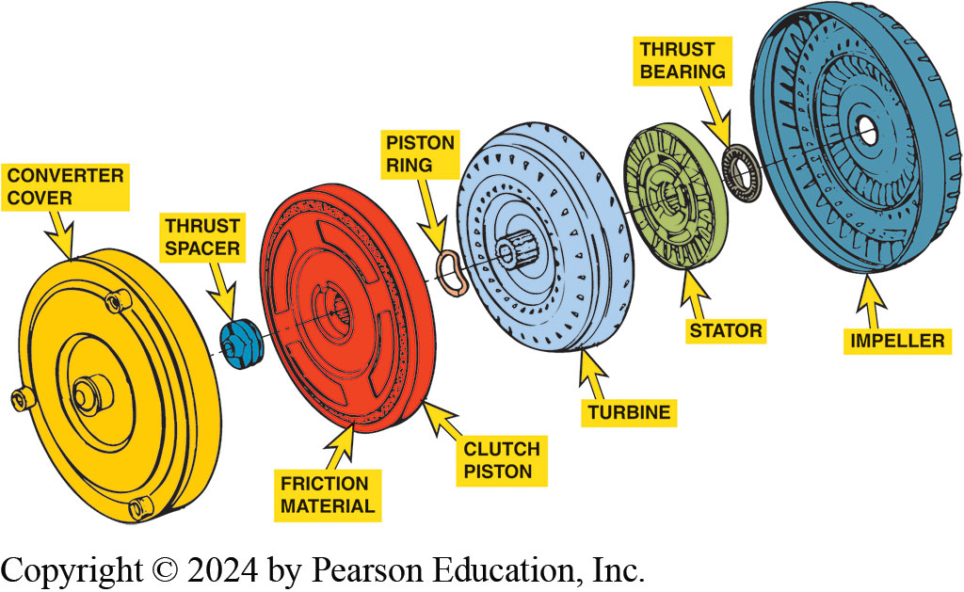
Figure 128.9 Torque Converter Clutch
An expanded view of a typical torque converter assembly showing the torque converter clutch (TCC).

Slide 17
Stall Test
Stall test used to check the stator one-way clutch
Strength of apply devices inside transmission/ transaxle.
Stall test can severely damage transmission if done incorrectly.
Notes:
A stall test is used to check the stator one-way clutch inside the torque converter and the
strength of the apply devices inside the transmission/transaxle. A stall test measures stall
speed of the torque converter in each of the gear positions. It is an important diagnostic test to
determine transmission and torque converter condition.

Slide 18
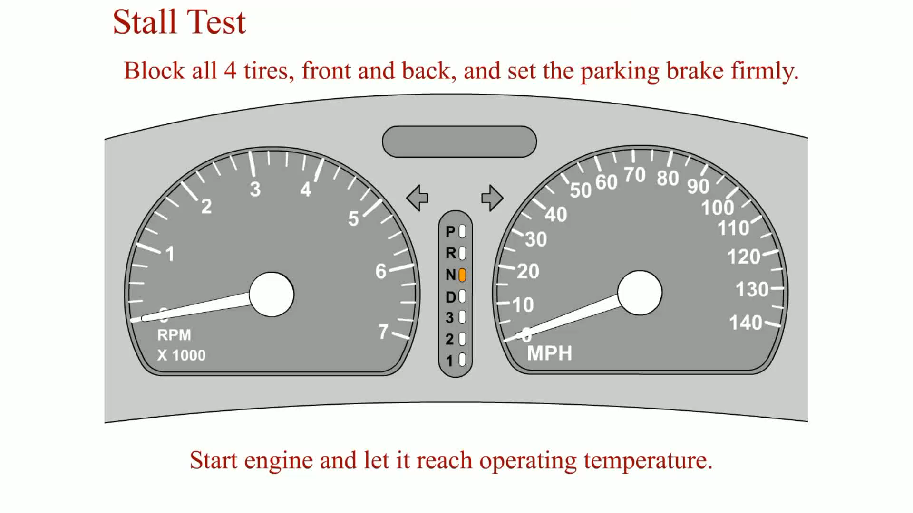
Animation: Stall Test
(Animation will automatically start)

Slide 19
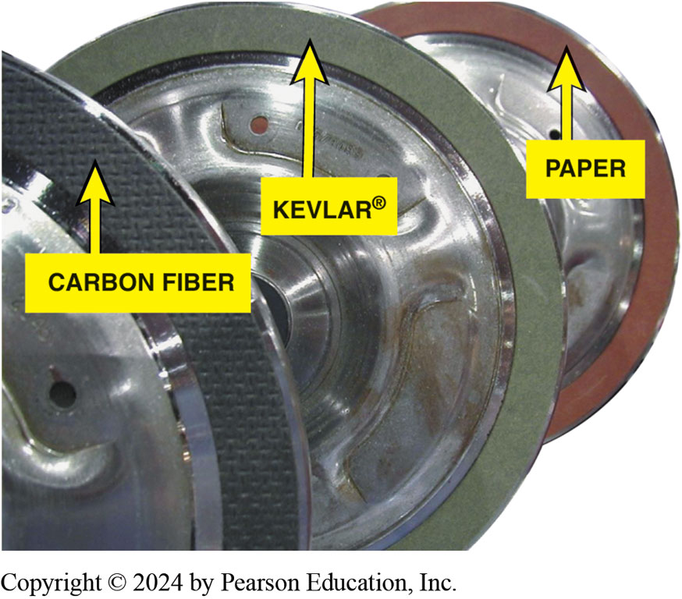
Figure 128.10 Clutch Friction Material
Torque converter clutch friction material is determined by the vehicle manufacturer to provide the needed coefficient of friction needed. For example, many older units use a paper-type friction material because they are fully applied or released, whereas most newer units use a synthetic material such as Kevlar® or carbon fiber because the torque converter clutch is pulsed on and off, therefore requiring a more robust material for long service life.
Notes:
.

Slide 20
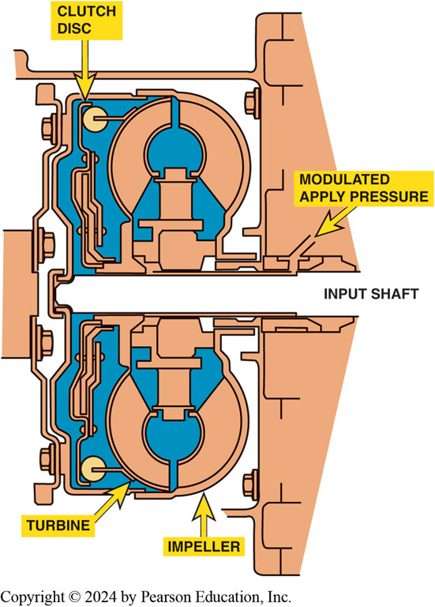
Figure 128.11 Clutch Control
A cross-sectional view of a pulse-width-modulated (PWM) torque converter clutch. The powertrain control module (PCM) pulses the control solenoid, which then controls the fluid flow to apply the torque converter clutch.
Notes:
TECH TIP: Use a Smaller Diameter Torque Converter for Improved Performance
A smaller-than-stock-diameter torque converter will not be capable of absorbing as much torque as a
larger (stock) torque converter. As a result, the stall speed is increased. Because an engine
develops more torque with increased speed (up to a point), the smaller torque converter will allow
the engine to increase to a higher speed and create more torque to the transmission than would be capable with the stock torque converter. This is especially helpful for modified engines because an engine having a camshaft with increased lift and duration usually lacks low RPM torque. By using a smaller torque converter, the stall speed is increased to better match the engine torque.
CAUTION: Using a torque converter with a different stall speed rating is likely to increase exhaust
emissions and decrease fuel economy as well as void the
warranty on the vehicle.

Slide 21
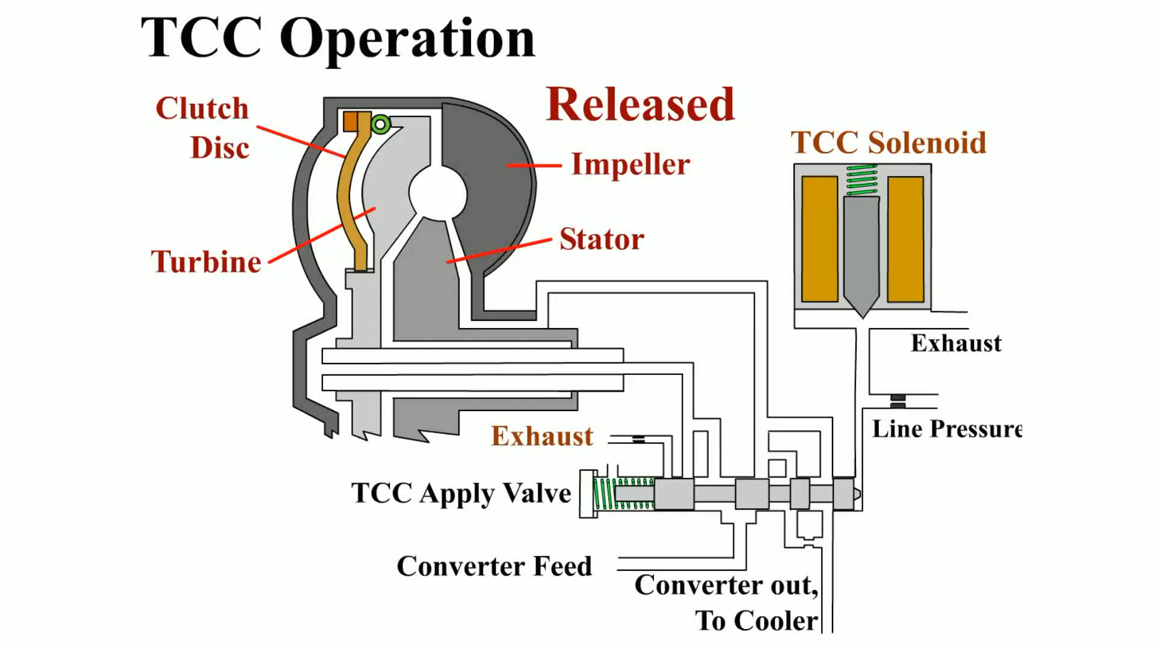
Animation: TCC Operation
(Animation will automatically start)

Slide 22
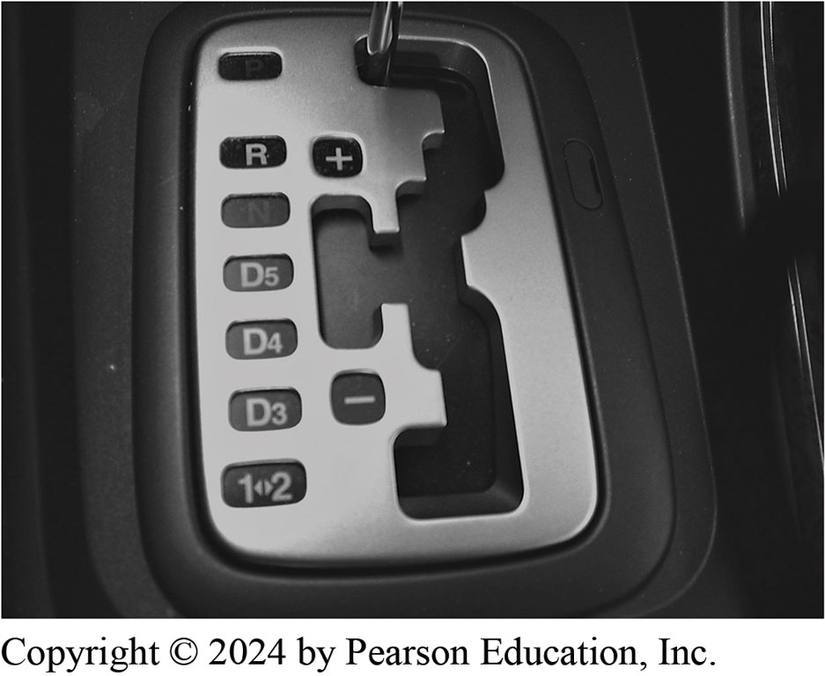
Figure 128.12 Gear Selector
The gear selector is often called the “PRNDL,” pronounced “prindle,” regardless of the actual letters or numbers used.

Slide 23
Shift Modes
Most automatic transmissions and transaxles include the following shift modes:
  Park. output shaft is locked
  Reverse. move vehicle in reverse.
  Neutral. no torque is being transmitted
  Overdrive (OD). normal position for the shift selector
  Drive (D). provide all forward gears
  Third (3) upshift to 3rd gear not upshift to a higher gear
  Second (2). slowing descending long grades. Speed
  First ( Low). slowing vehicle descending long grades
Notes:
Most automatic transmissions and transaxles include the following shift modes: FIGURE
128–12.
Park. In the park position, the output shaft is locked to the case of the transmission/transaxle,
which keeps the vehicle from moving. No power is transmitted through the unit
so the engine can remain running while the vehicle is held stationary. In the park position:
1. The engine can be started by the driver.
2. To move the shifter out of the park position on a late model vehicle, the brake pedal must be
depressed to release the brake transmission shift interlock.
Reverse. The reverse gear selector position is used to move the vehicle in reverse. Reverse
usually uses a lower gear ratio than any of the forward gears.
Neutral. In the neutral position, no torque is being transmitted through the automatic
transmission/transaxle. In this position, the engine can be started by the driver.
Overdrive (OD). The OD is the normal position for the shift selector for most driving conditions.
This position allows the transmission or transaxle to shift through all forward gears as needed for
the best fuel economy and lowest exhaust emissions.
Drive (D). The D position includes the overdrive ratios in most vehicles. If there is an
overdrive shift mode,
however, then D is used to provide all forward gears except overdrive. Use this position when
driving in hilly areas or when towing in the vehicle equipped with an overdrive selection.
Third (3). In third position, the transmission/transaxle will upshift normally to third gear but
will not upshift to a higher gear. When the third (3) position is selected while driving in a
higher gear, the transmission will downshift
into third if the vehicle speed is low enough to prevent the engine from being overrevved. This
gear selection is used for the gentle grades at a moderate vehicle speed.
Second (2). The second position is used for slowing the vehicle while descending long grades. In
this gear selection, the vehicle speed is controlled and the engine speed is increased to provide
engine compression braking. This gear selection is used for the gentle grades at a moderate vehicle
speed.
First (1 or Low). The first (or low) position is used for slowing the vehicle while descending
long grades. In this gear selection, the vehicle speed is controlled and the engine speed is
increased to provide engine compression breaking. This gear selection is used for the steepest
grades at the lowest possible speed.

Slide 24
Planetary Gear Sets
Planetary gear sets are able to provide following:
  Neutral
  One or more gear reductions
  Direct-drive ratio ( 1:1 )
  Reverse
  Overdrive
Exact ratio for reduction and overdrive achieved
Varying number of teeth on sun and ring gears

Slide 25
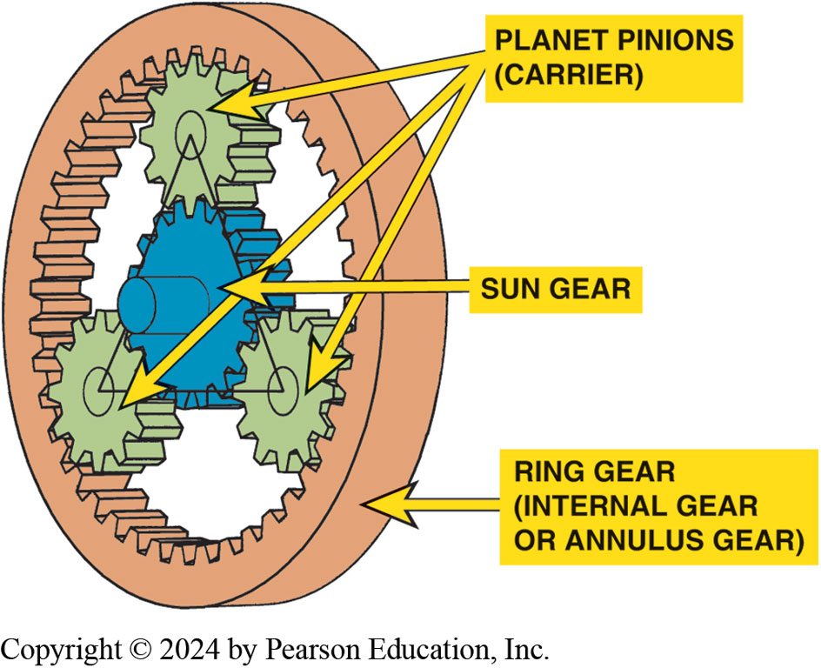
Figure 128.13 Planetary Gearset
A typical planetary gear set showing the terms that are used to describe each member.
Notes:
Simple planetary gear set consists of three primary components:
■ Sun gear
■ Planet carrier (including planet pinion gears)
■ Ring (annulus) gear
As discussed in the last chapter on transfer cases, the sun gear gets its name from its position at
the center of the gear set. The planet carrier holds the pinion gears, also known as planet gears,
which revolve around the sun gear. The planet carrier assembly is commonly referred to simply as
“the carrier.” The outermost member of the gear set is the ring gear, the internal type with teeth inside. The ring gear is sometimes called an annulus or internal gear. The pinion gears are in simultaneous mesh with both the sun gear and the ring gear. ● SEE FIGURE 128–13.

Slide 26
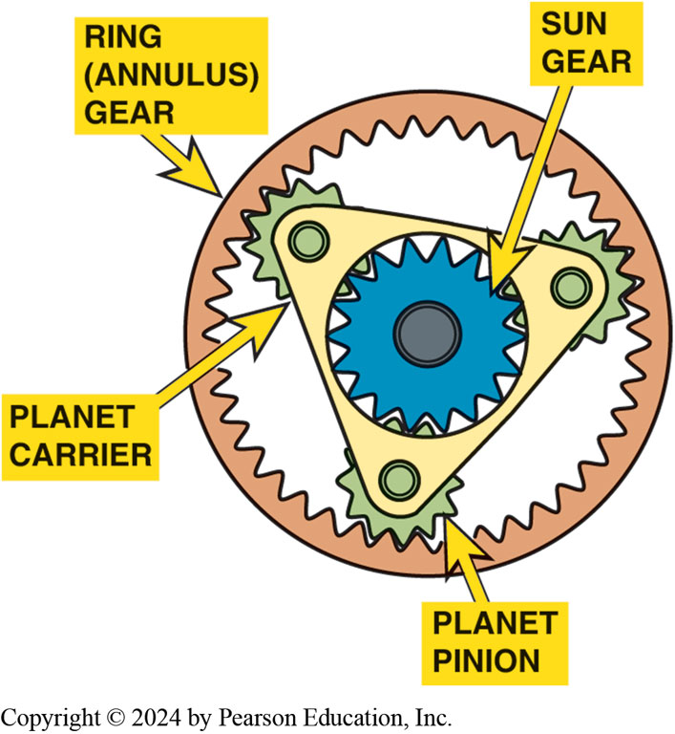
Figure 128.14 Typical Planetary
A typical planetary gear set showing the planet carrier, which supports all of the pinion gears (also called planet pinion gears).
Notes:
In a planetary gear set, the following is done to achieve the various gear ratios and reverse.
■ One of the members is being driven (input).
■ One of the members is being held (reaction member).
■ One of the members is the output.
Therefore, driving one gear will cause all of the other gears to rotate as well. This allows the
gear set to provide different gear ratios, depending upon how torque is distributed through the
assembly. To transmit torque through a planetary gear set, a drive member rotates while a second
member is held, which causes a third member to be driven. ● Figure 128–14.

Slide 27
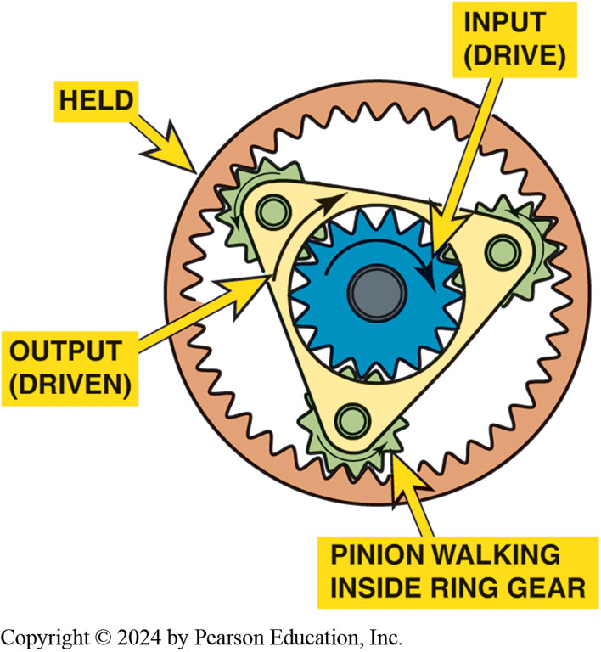
Figure 128.15 Sun Gear Input
Maximum reduction can be achieved by using the sun gear as the input, holding the ring gear and using the planet carrier as the output.
Notes:
Each member of a planetary gear set can play any one of these three roles to transmit torque. The
various combinations of drive, held, and driven members result in the number of gear ratios avail-
able and change the direction of rotation as well for reverse.
NOTE: The held member can also be allowed to move one di- rection or another as it is being held
and does not necessarily need to be held to zero RPM to create a variable gear ratio. This is done
in hybrid electric vehicle transmissions.
Torque flows through a planetary gear set in several steps to get from the drive action of the
first member to the driven action of the last member.
■ The terms “drive” and “driven” simply describe how any two gears work together.
■ When three or more gears are involved, the second gear is a driven gear in relation to the first,
but it becomes a drive gear in relation to the third gear.
■ For this reason, the drive member of a planetary gear set is known as the input member, the held
member is the reaction member, and the driven member is the output member.
Simple Planetary Gear Set Systems A simple planetary gear set system consists of one sun gear, the carrier, and a ring gear. A single planetary gear set can provide all of the necessary gear ratios for a basic automatic transmission. ● SEE 128–15 THROUGH 128–17.

Slide 28
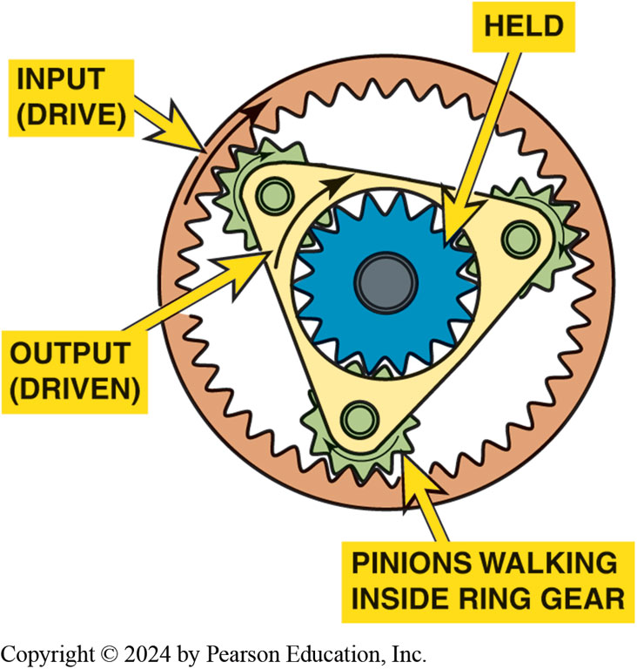
Figure 128.16 Ring Gear Input
Minimum reduction can be achieved by using the ring gear as the input, holding the sun gear and using the planet carrier as the output.
Notes:
.

Slide 29
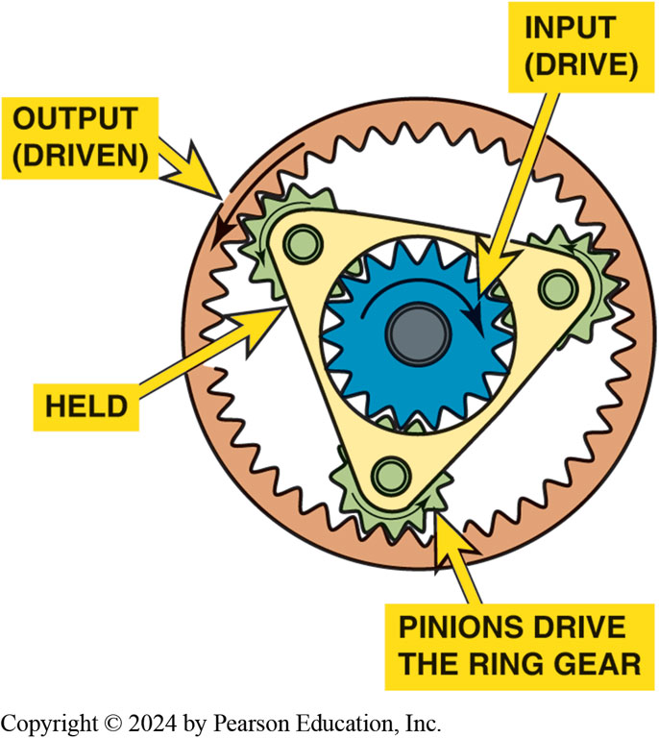
Figure 128.17 Reverse
Reverse can be achieved by using the sun gear as the input, holding the planet carrier and using the ring gear as the output.
Notes:
.

Slide 30
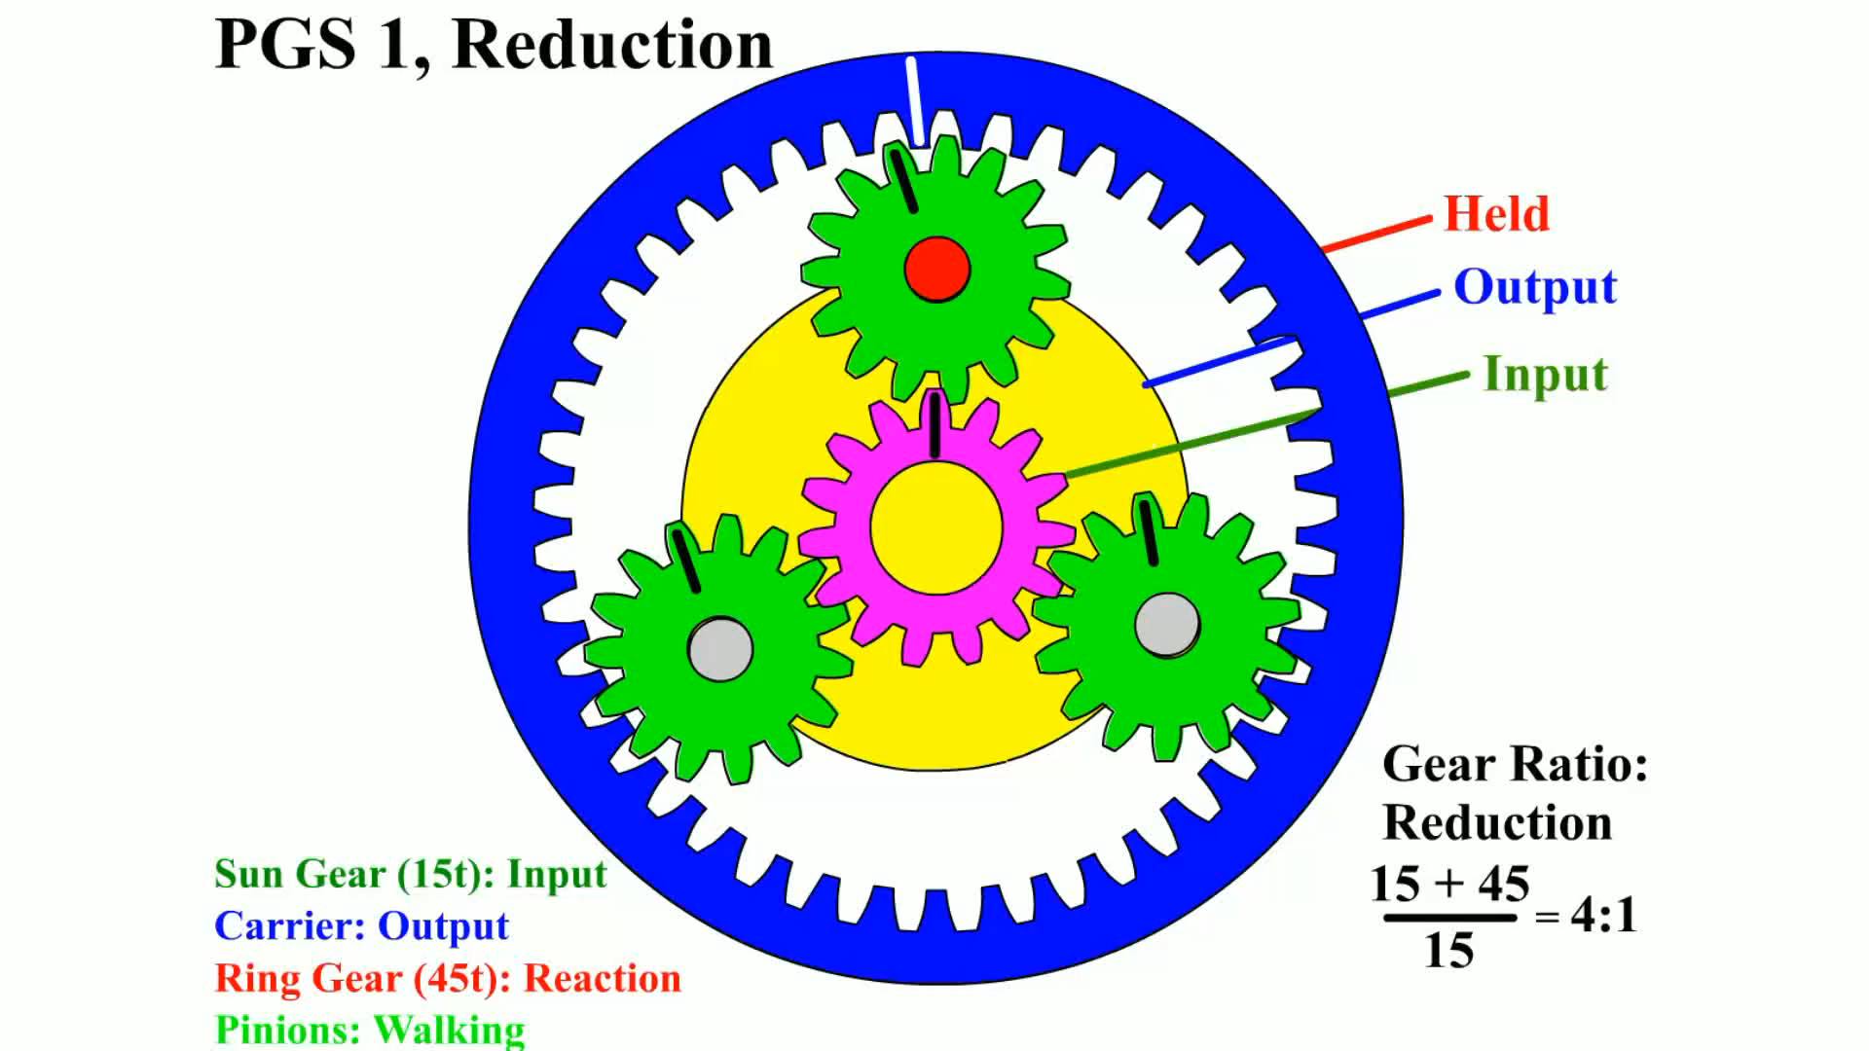
Animation: PG 1, Reduction
(Animation will automatically start)

Slide 31
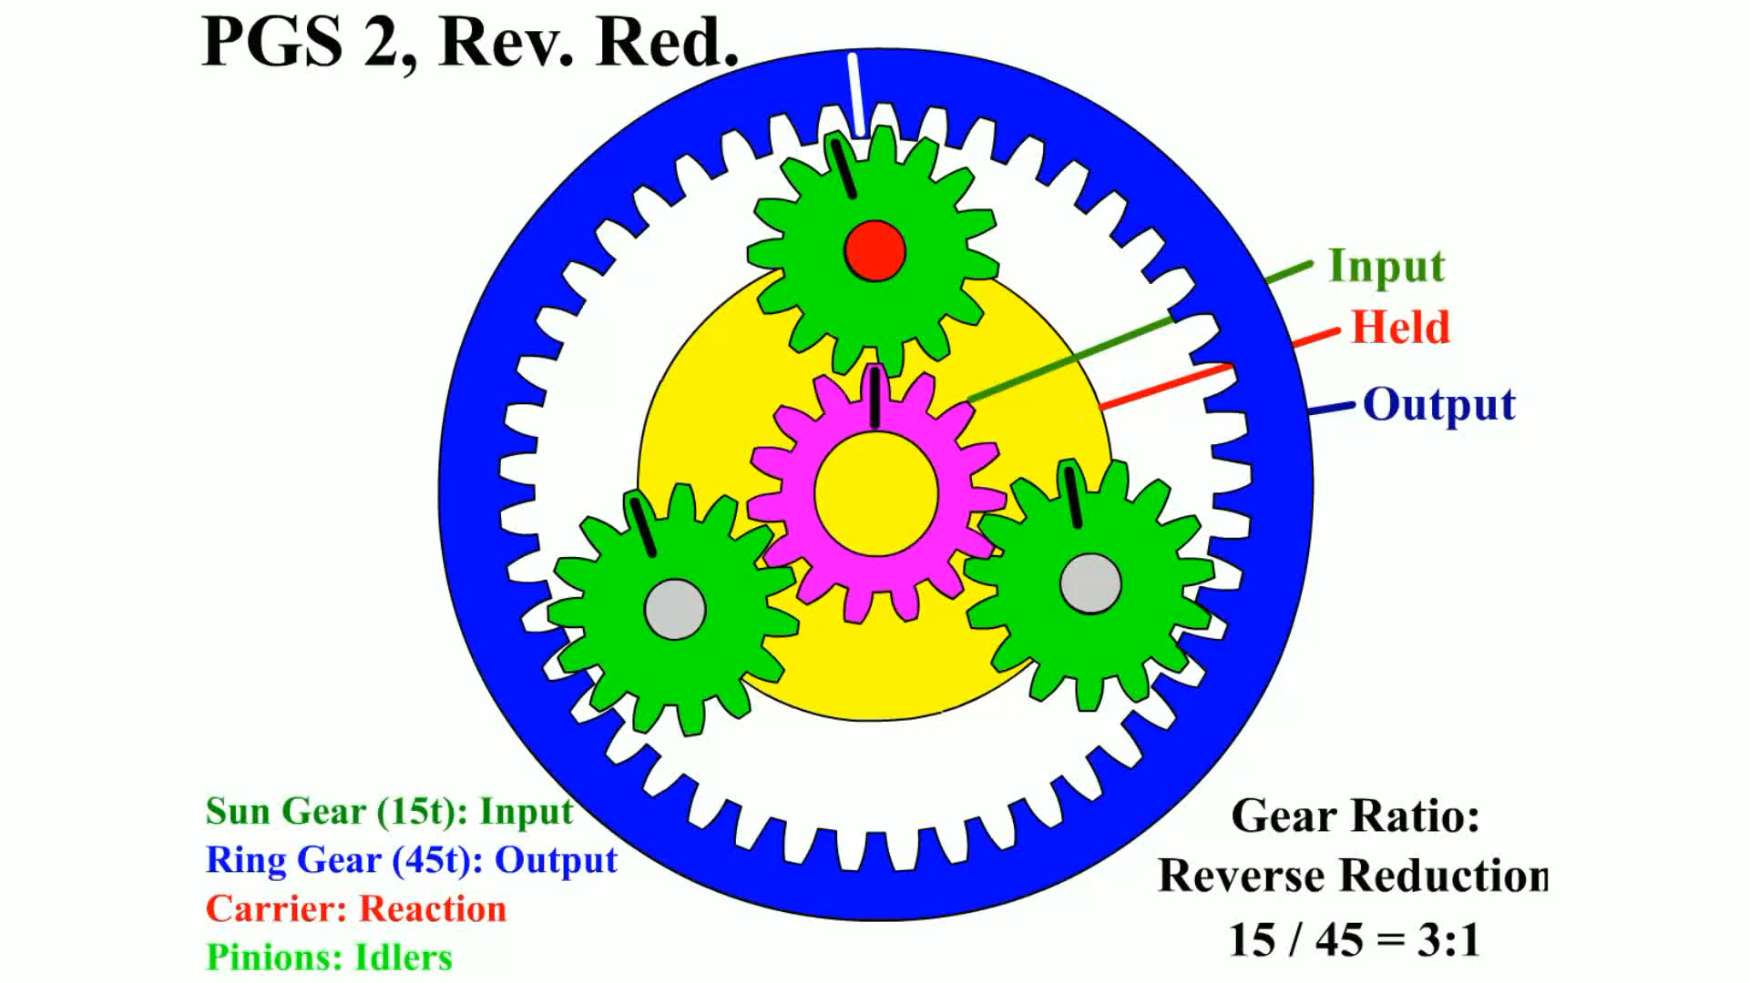
Animation: PGS 2, Rev. Red.
(Animation will automatically start)

Slide 32
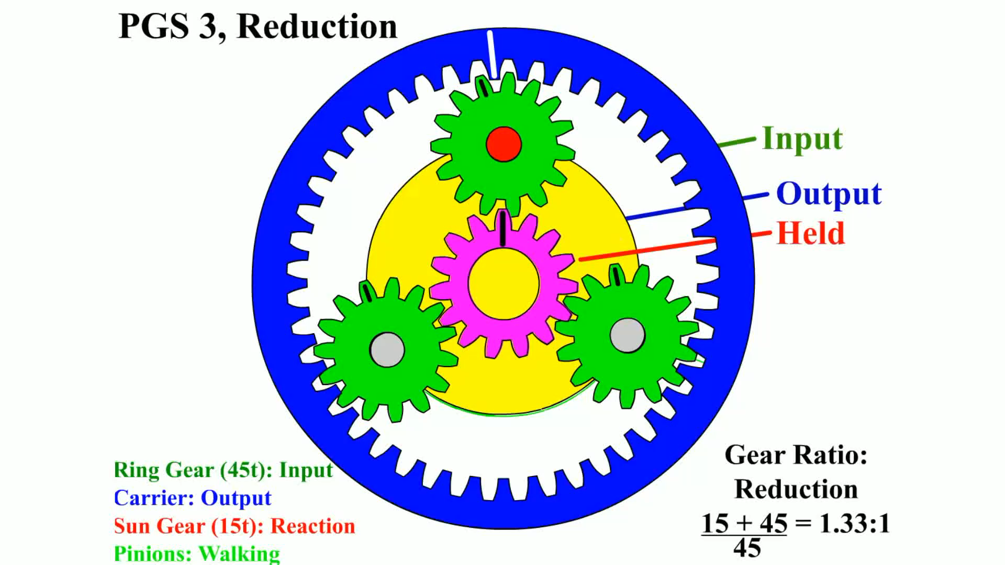
Animation: PGS 3, Reduction
(Animation will automatically start)

Slide 33
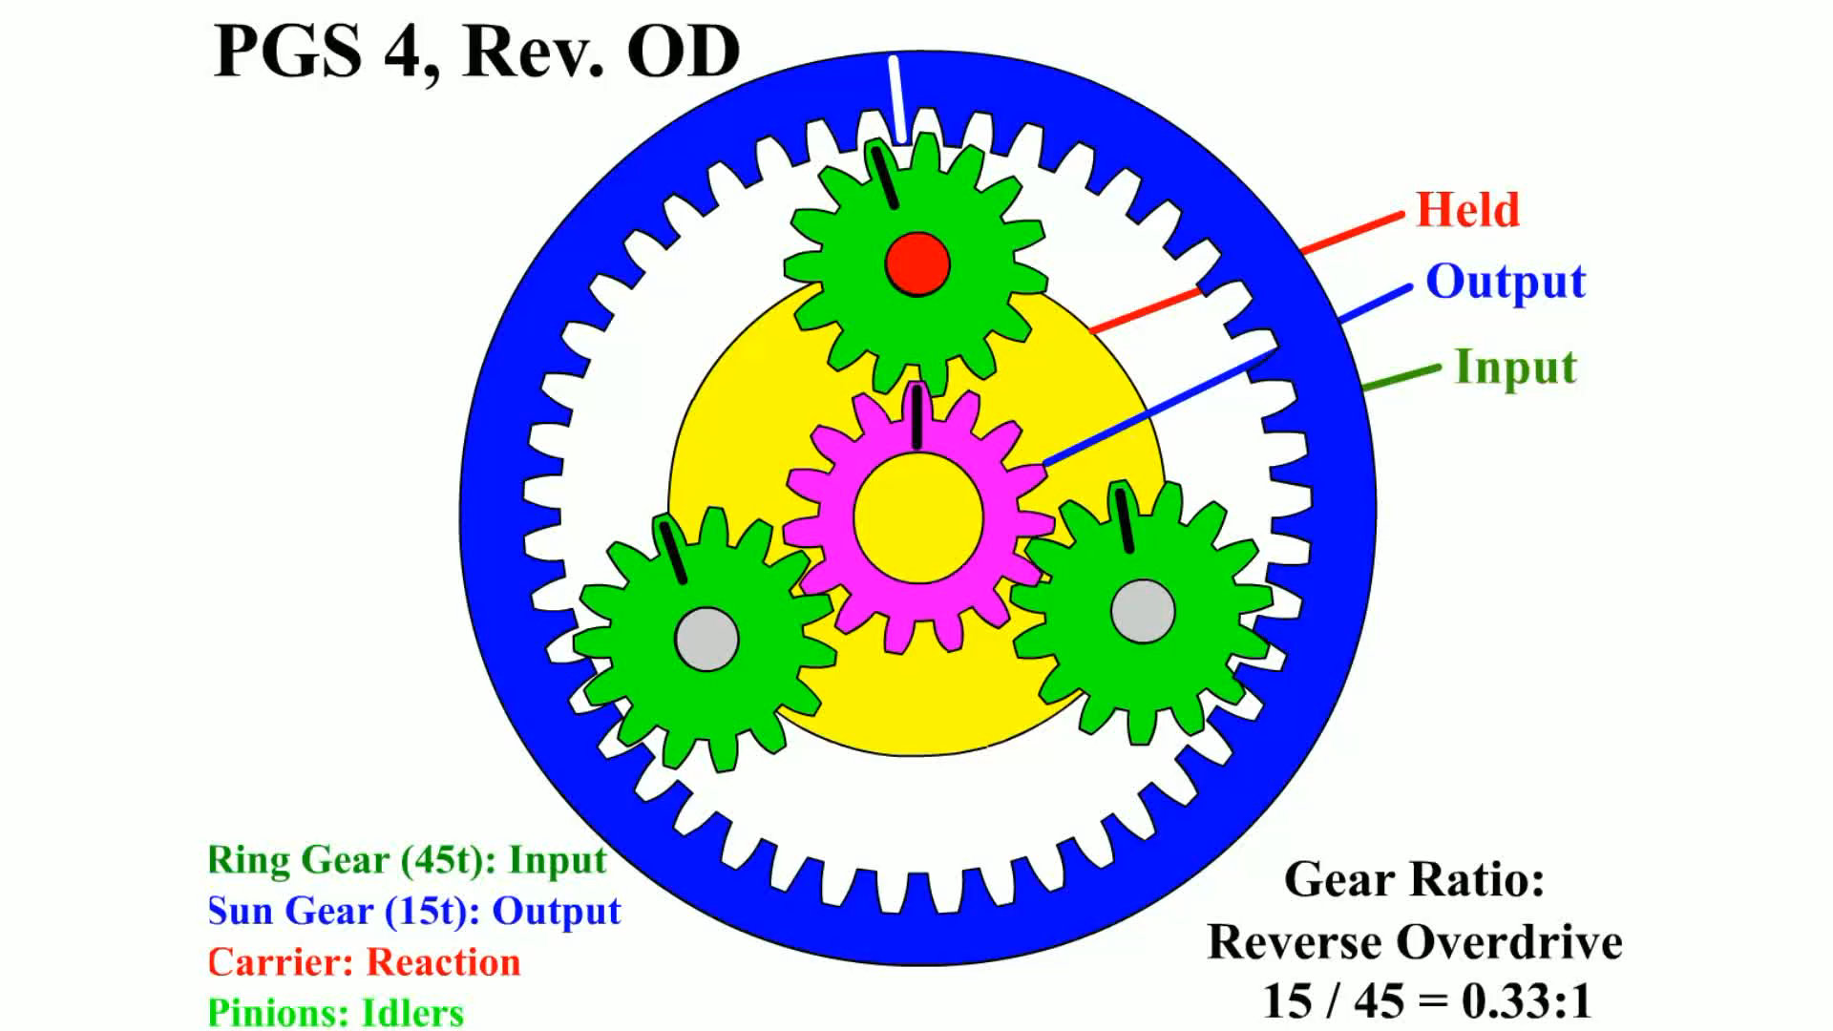
Animation: PGS 4, Rev. OD
(Animation will automatically start)

Slide 34
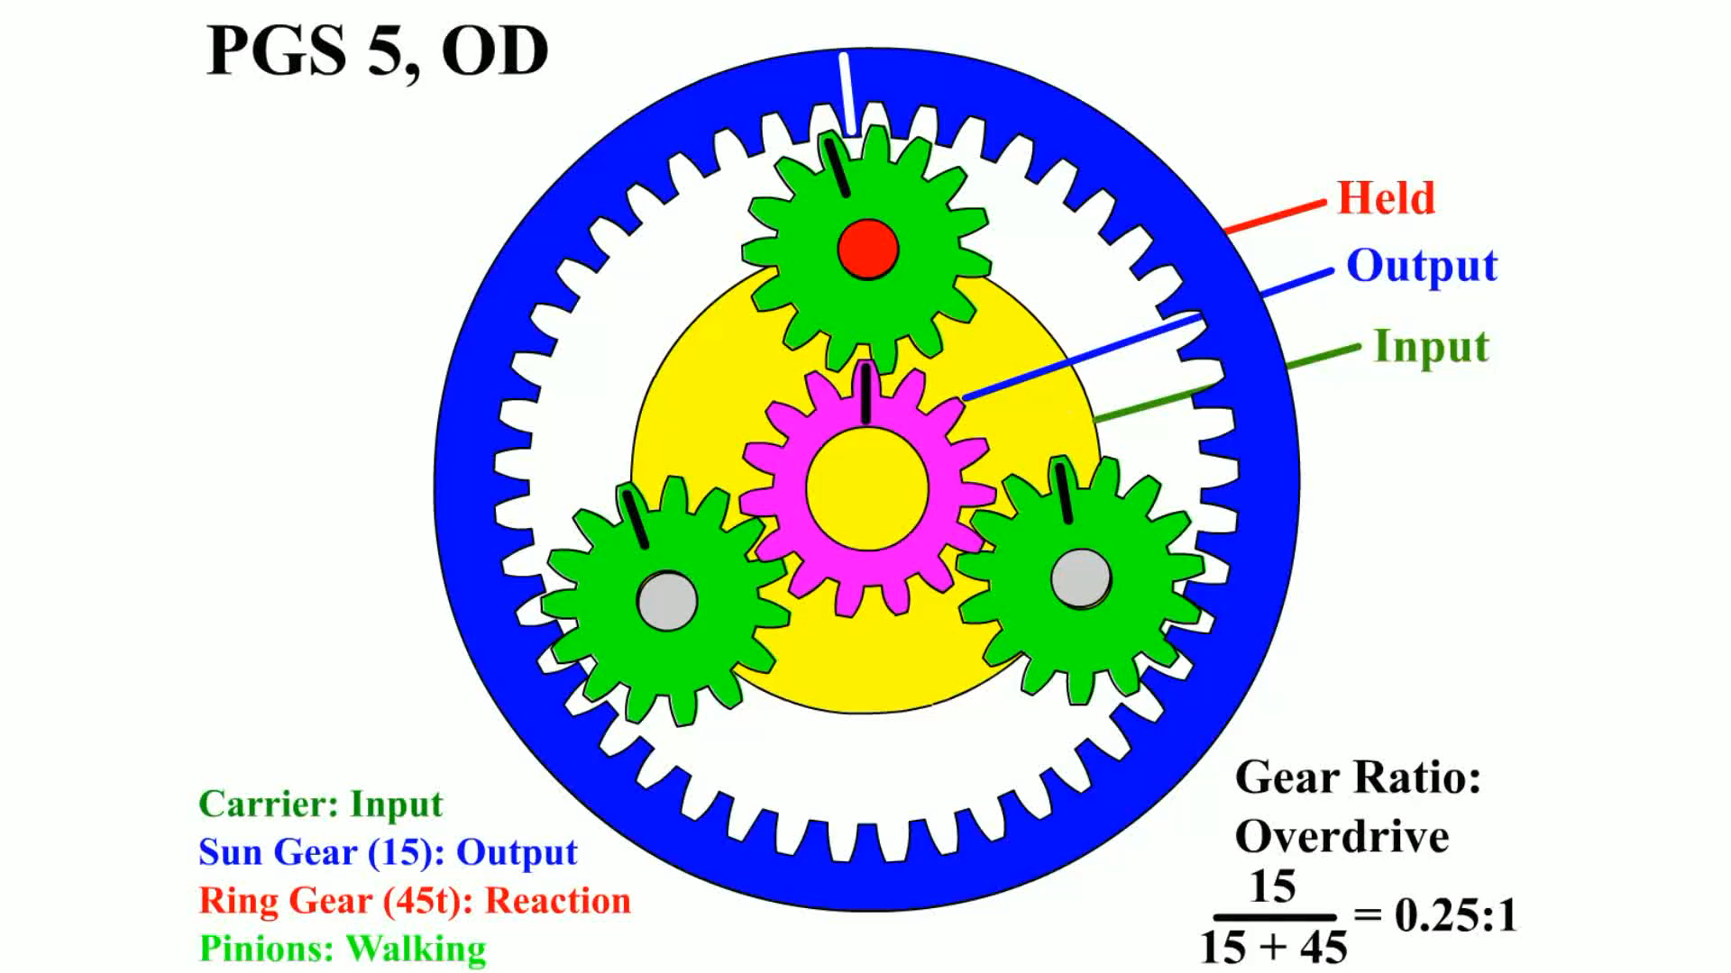
Animation: PGS 5 OD
(Animation will automatically start)

Slide 35
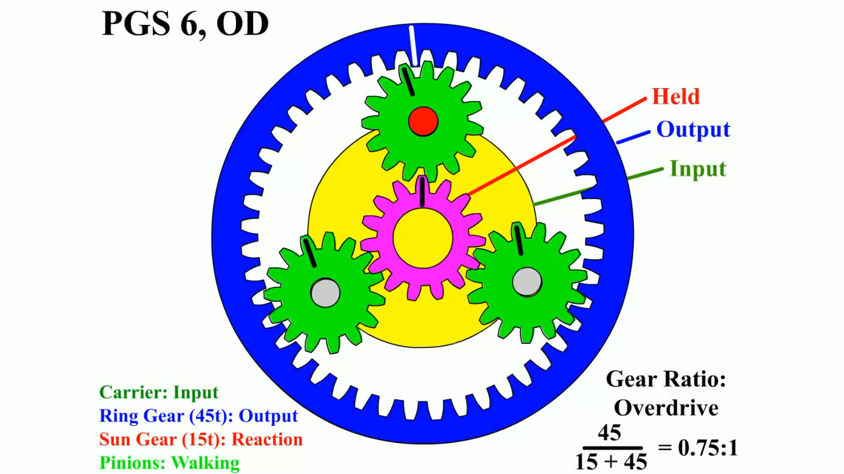
Animation: PGS 6, OD
(Animation will automatically start)

Slide 36
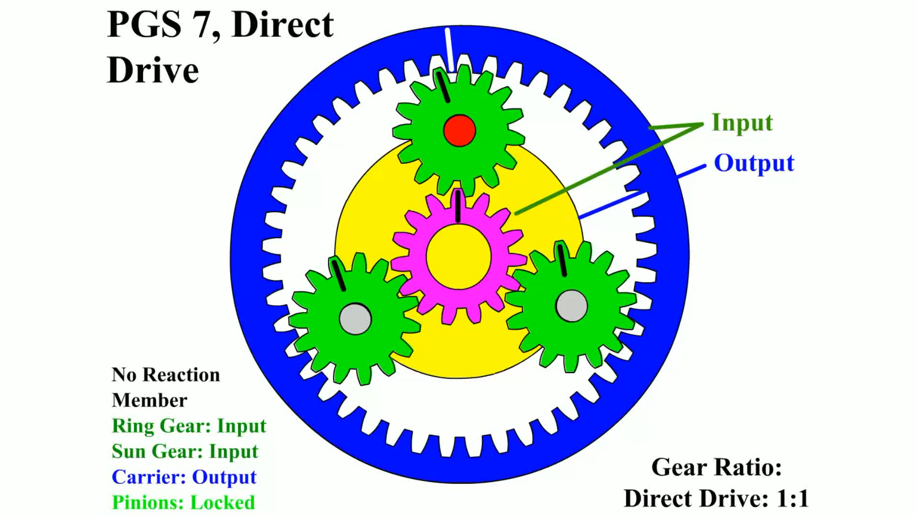
Animation: PGS 7, Direct Drive
(Animation will automatically start)

Slide 37
Chart 128.1 Gearset Positions
SUN GEAR | PLANET CARRIER | RING GEAR | SPEED | TORQUE | DIRECTION
Input (Drive) | Output (Driven) | Held | Maximum reduction | Increase | Same as input
Held | Output (Driven) | Input (Drive) | Minimum reduction | Increase | Same as input
Output (Driven) | Input (Drive) | Held | Maximum Increase | Reduction | Same as input
Held | Input (Drive) | Output (Driven) | Minimum Increase | Reduction | Same as input
Input (Drive) | Held | Output (Driven) | Reduction | Increase | Reverse of input
Output (Driven) | Held | Input (Drive) | Increase | Reduction | Reverse of input
Notes:
See Chart 128-1. Manufacturers usually provide clutch and band application charts for their transmissions, and these charts show which apply devices are used for each gear range. Each apply device drives a particular gear set member or holds it in reaction. Clutch and band charts are very helpful in understanding the power flow through a transmission. They are also very helpful when diagnosing transmission
failures.
If any two members are locked together, then the resulting output is 1:1 ratio in the same direction as the input. If no
Member is held (locked), then there is no output (neutral).

Slide 38
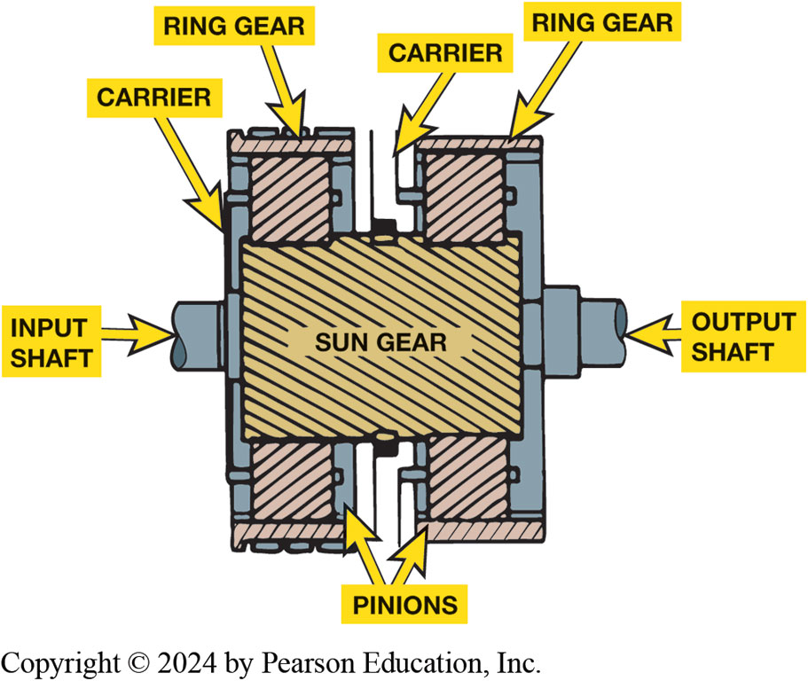
Figure 128.18 Compound Planetary
Simpson planet gear set is composed of two ring gears and two planet carrier assemblies that share one sun gear
Notes:
A compound planetary gear set system is a configuration that contains more than just the three
basic members of a simple planetary system. A compound planetary gear set is one or more simple
planetary gears sets with one or more common gears. Compound planetary gear sets are capable of
providing various combinations of gear reduction, direct drive, neutral, reverse, and overdrive.
SIMPSON GEAR SET One of the most popular compound planetary designs is the Simpson gear set. Named for its inventor, Howard Woodworth Simpson (1892–1963), an American automotive engineer, the Simpson gear set consists of two simple planetary gear sets that share a common sun gear. ● SEE FIGURE 128–18.

Slide 39
Frequently Asked Question: Which Companies Build Automatic Transmissions?
? Frequently Asked Question
Which Companies Build Automatic Transmissions? Many larger automobile manufacturers make their own automatic transmissions, GM, Ford, Chrysler, and Honda. Several companies manufacture automatic transmissions and transaxles that are used in a variety of vehicles. These include: ZF Friedrichshafen AG. German company manufactures manual and automatic transmissions and transaxles for many vehicle manufacturers, including Mercedes, BMW, Volvo, VW, Audi, Jaguar, Chrysler, Bentley, and Maserati. Aisin AW. Japanese company makes automatic transmissions for many vehicle manufacturers, including Ford, Toyota, Nissan, Mazda, Mitsubishi, Subaru, Kia, and VW. JATCO (Japan Automatic Transmission Company). This is a Japanese manufacturer of automatic transmissions and transaxles for many vehicle manufacturers, including Nissan, Mazda, Infiniti, VW, Mitsubishi, and Suzuki.

Slide 40
Frequently Asked Question: What Do All the Letters and Numbers Mean in Transmission Designations?
? Frequently Asked Question
What Do All Letters & Numbers Mean in Transmission Designations? The numbers and letters usually mean the following: Number of forward speeds. may include 4, 5, or 6 (GM 4T60-E 4 speed unit). FWD or RWD. The letter T usually means transverse (FWD transaxle) Chrysler 41-TE; L means longitudinal (RWD transmission) such as the GM 6L80; and the R means RWD Ford 5R55E. E is often used to indicate that the unit is electronically controlled, and M or H is used to designate older mechanically (hydraulically) controlled units. All automatic transmissions built since 1990s are electronically controlled; so, E is often included in the designation of newer designs. The torque rating is designated by a number where the higher the number, higher amount of torque that unit is designed to handle. In a GM 6L80-E. torque rating is 80.
Notes:
What Do All the Letters and Numbers Mean in Transmission Designations?
The numbers and letters usually mean the following:
■ Number of forward speeds. The number of forward speeds may include four, five, or six (such as GM 4T60-E four speed unit).
■ Front-wheel drive or rear-wheel drive. The letter T usually means transverse (front-wheel-drive transaxle) such as the Chrysler 41-TE; the L means longitudinal (rear-wheel-drive transmission) such as the General Motors 6L80; and the R means RWD Ford 5R55E.
■ Electronically controlled. The letter E is often used to indicate that the unit is electronically
controlled, and M or H is used to designate older mechanically (hydraulically) controlled units.
All automatic transmissions built since the early 1990s are electronically controlled; therefore, E
is often included in the designation of newer designs of transmission or transaxles.
■ Torque rating. The torque rating is usually designated by a number where the higher the number, the higher the amount of torque that the unit is designed to handle. In a GM 6L80-E. the torque rating is 80.Always check service information for the exact transmission designation for the vehicle being
Studied or serviced.

Slide 41
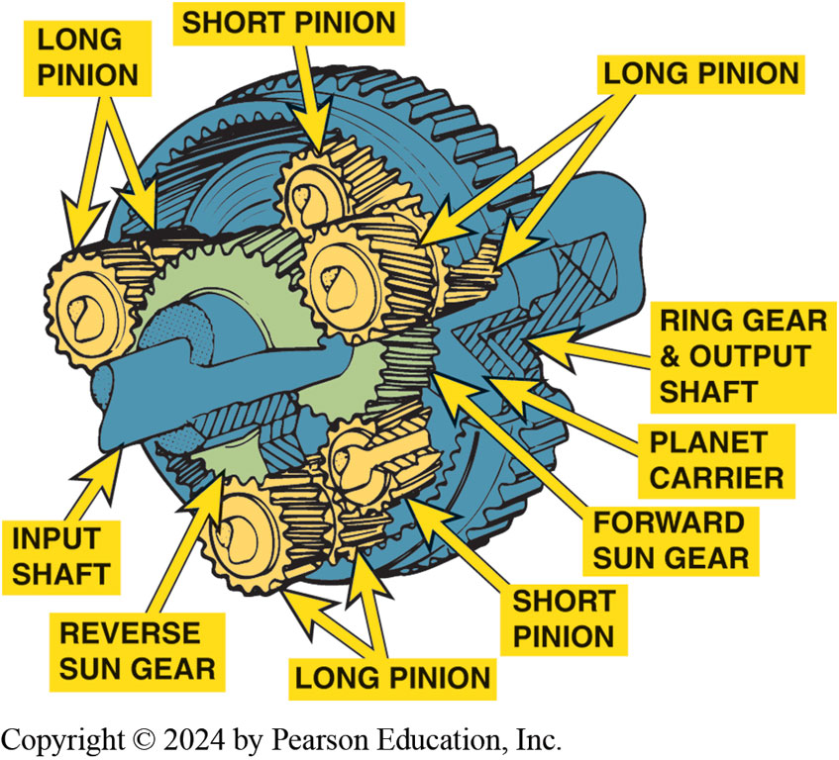
Figure 128.19 Ravigneaux Gearset
A Ravigneaux gear set is composed of two sun gears, one planet carrier that supports 2 sets of pinion gears, and a single ring gear
Notes:
Ravigneaux Gear Set. Combines one carrier that has two sets of planet gears with two sun gears, and one ring gear. Figure 128–19.
Lepelletier Gear Set. A Ravigneaux gear set and a simple planetary gear set can be combined to get six, seven, and eight speeds and is known as the (pronounced “la-plet-e-ay”).

Slide 42
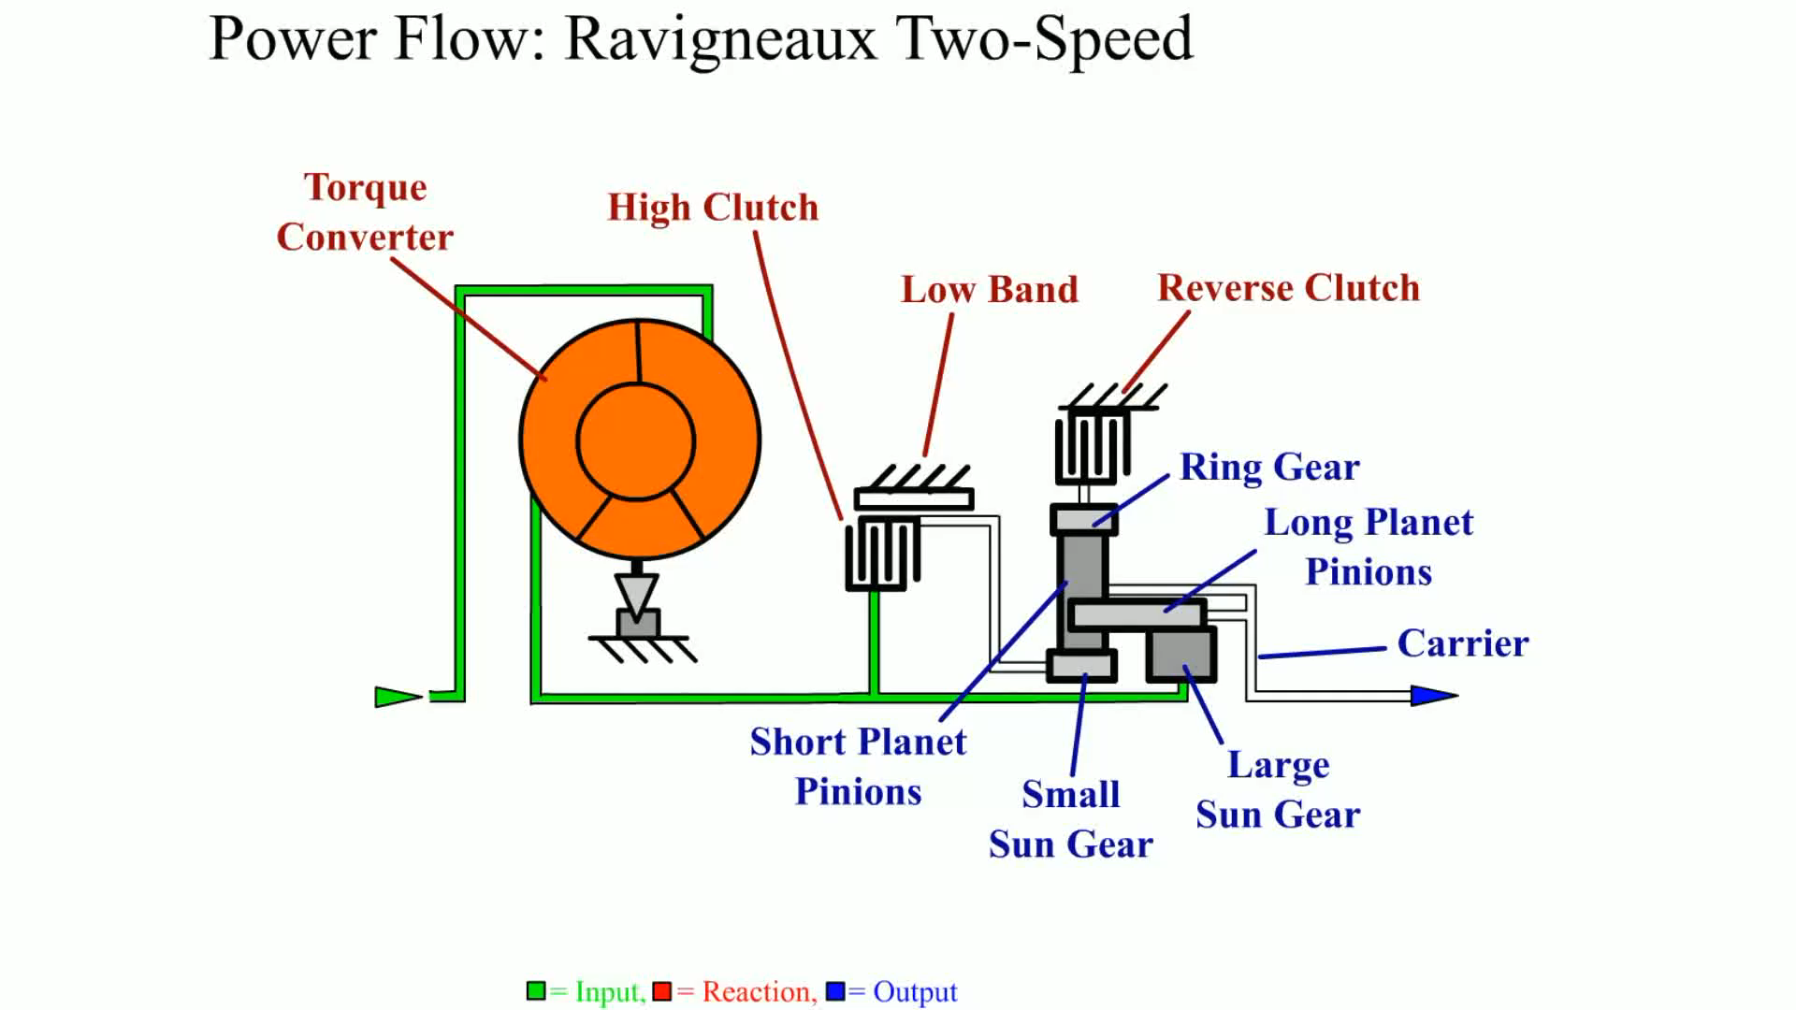
Animation: Power Flow Ravigneaux Two-Speed
(Animation will automatically start)

Slide 43
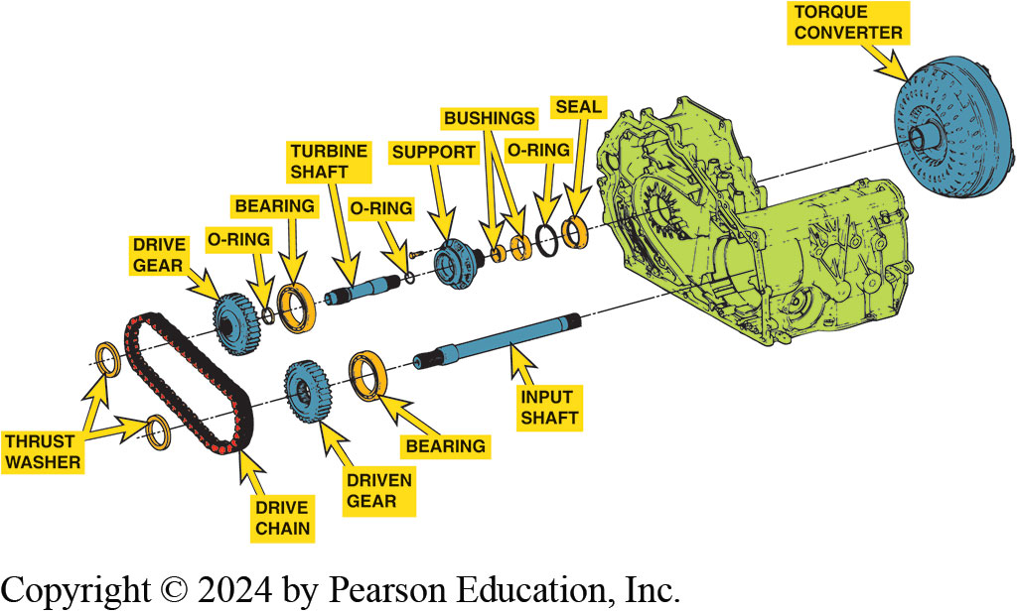
Figure 128.20 Transaxle
On one style of transaxle, the turbine shaft drives the input shaft through a drive chain assembly.
Notes:
Automatic transaxles include a differential assembly as well as the planetary gear sets of an automatic transmission. The engine torque also needs to be transferred by the use of a chain or gears to provide a shorter overall length so it can be used with an engine mounted transversely in the engine compartment. Some use gears and others use a chain to transfer engine torque to either the
planetary gear sets or to the differential (final drive) assembly. ● SEE FIGURES 128–20 AND
128–21.
A transaxle can be used in the following applications:
■ Front engine, front-wheel drive
■ Rear engine, rear-wheel drive
■ Front engine, all-wheel drive
■ Mid engine, rear-wheel drive

Slide 44
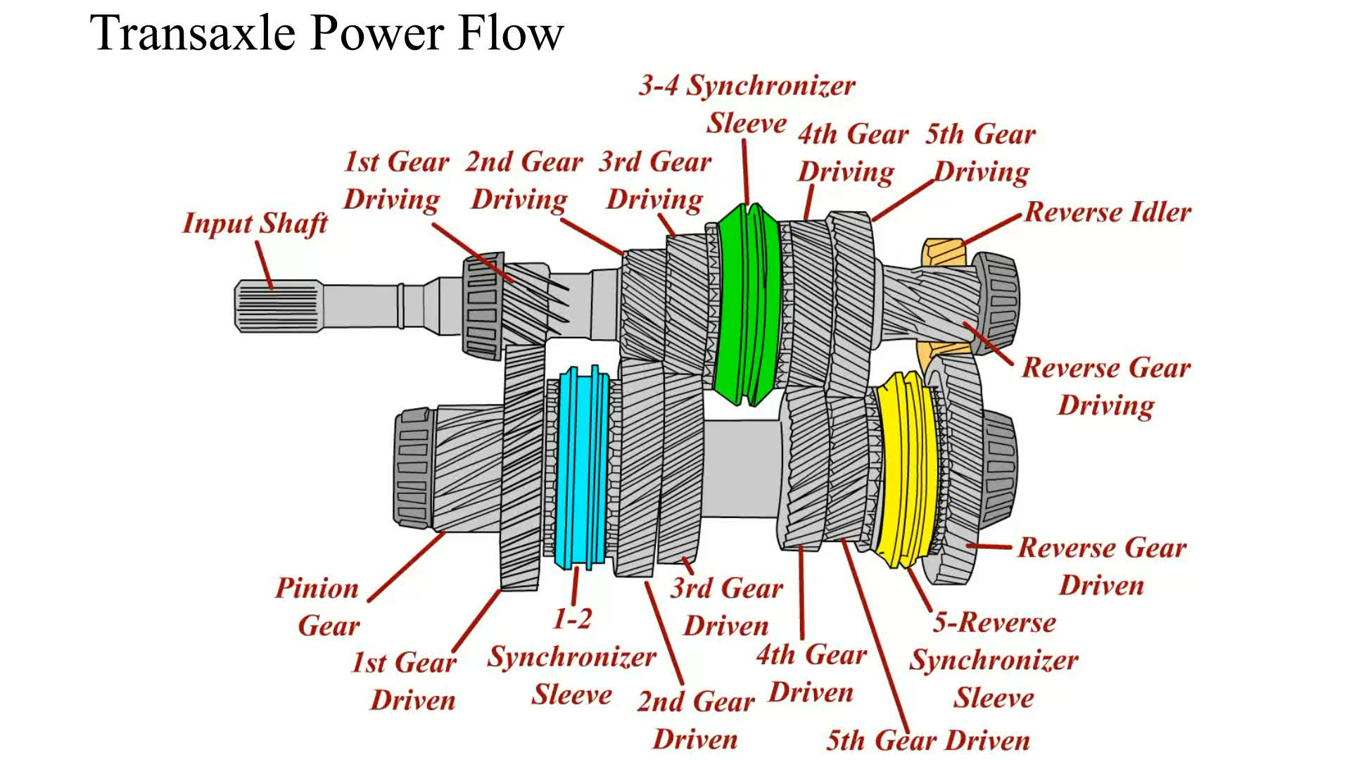
Animation: Transaxle Power Flow
(Animation will automatically start)

Slide 45
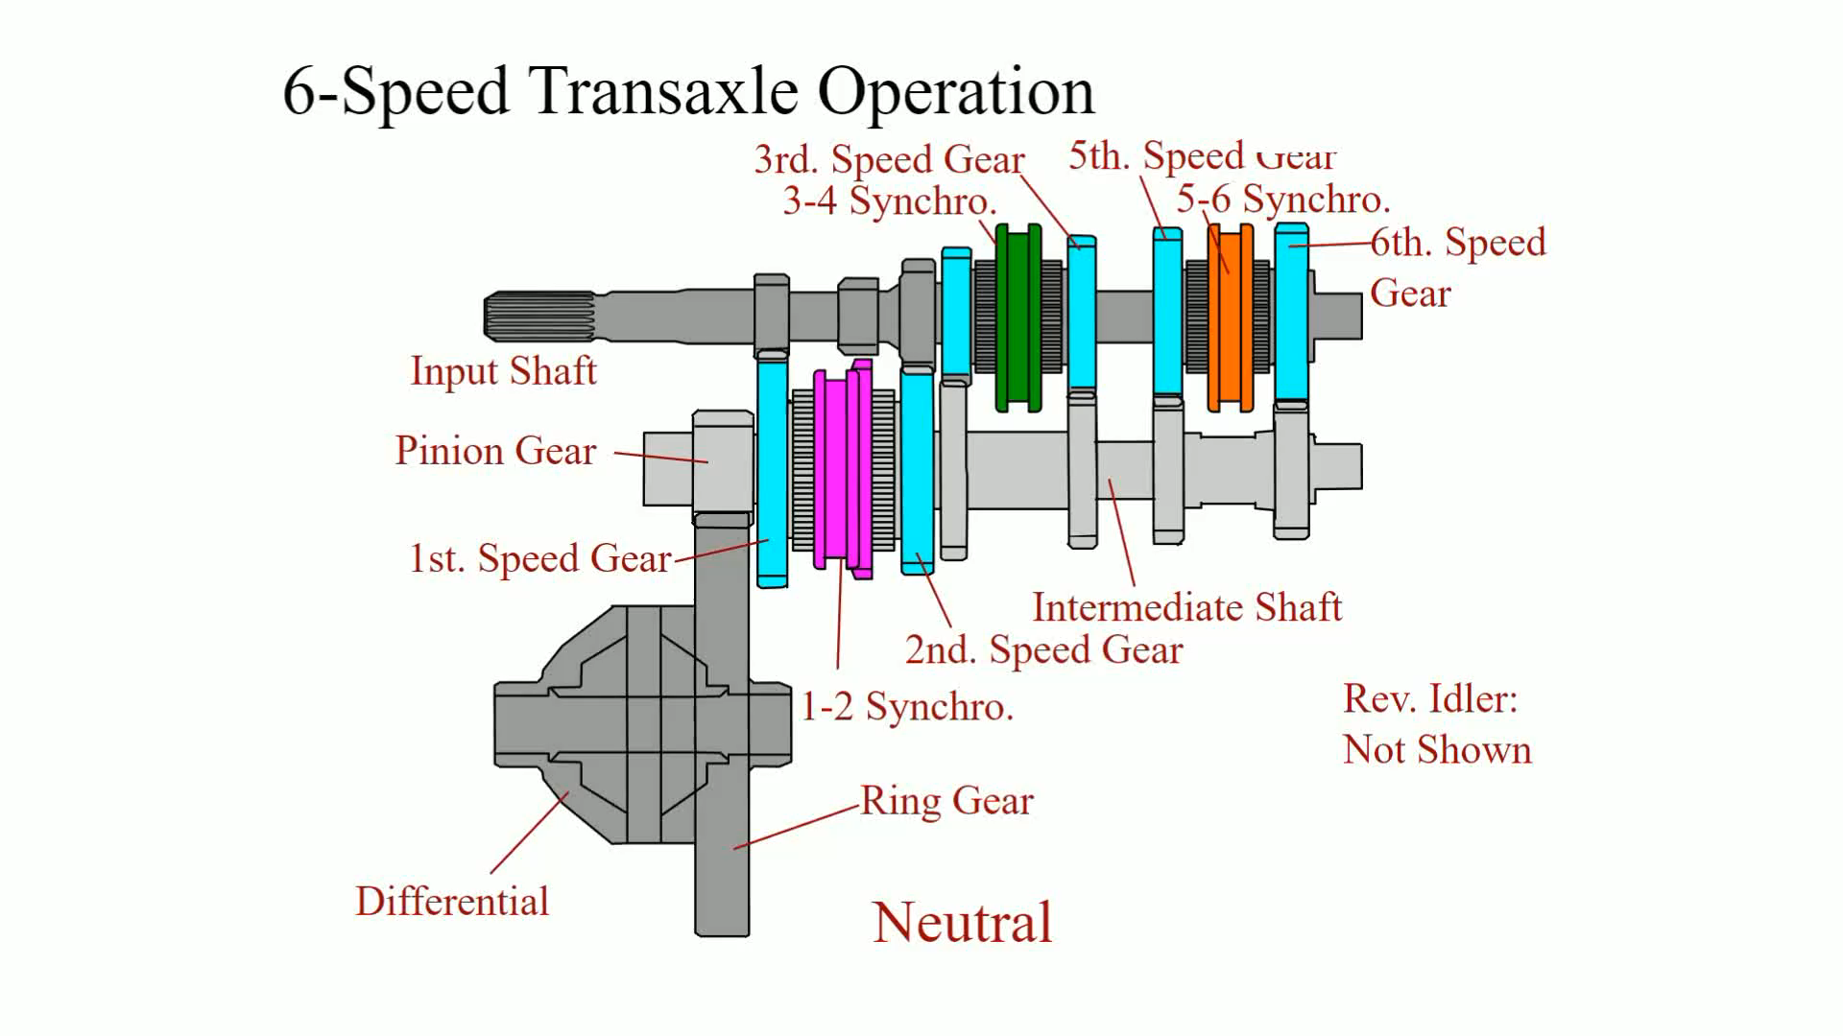
Animation: 6-Speed Transaxle Operation
(Animation will automatically start)

Slide 46
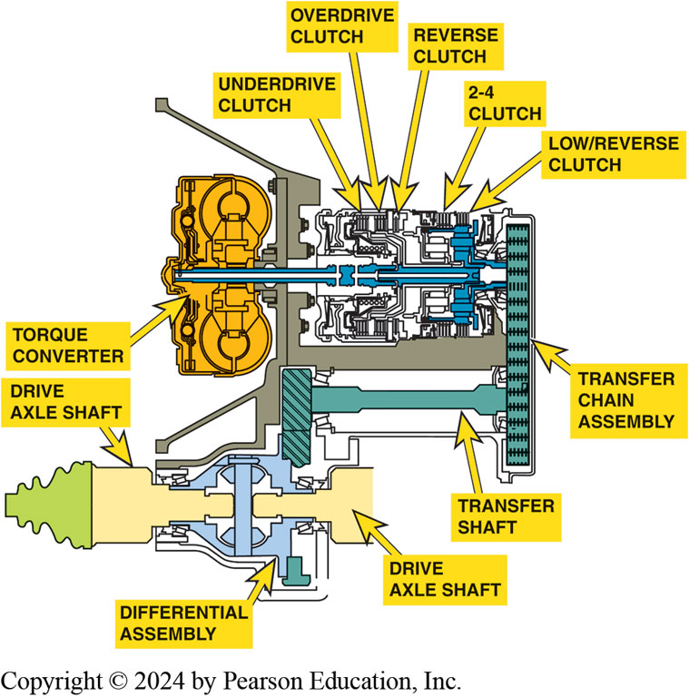
Figure 128.21 Transfer Chain
Another type of transaxle uses a chain to transfer engine torque from the output of the gear sets to the differential assembly (final drive).

Slide 47
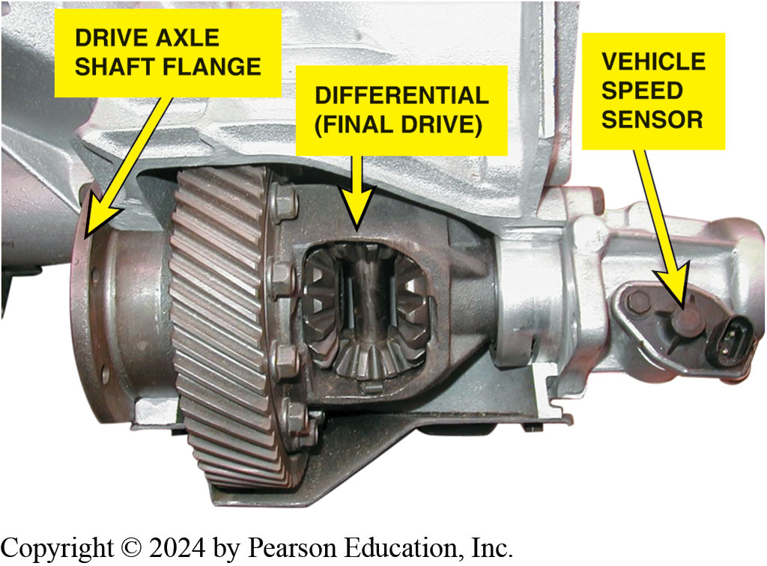
Figure 128.22 Final Drive Units
Cutaway showing the final drive assembly of a transaxle.
Notes:
Final Drive Units A transaxle includes a differential assembly, often called a final drive
assembly as part of the transaxle. This final drive assembly connects the output from the gear sets
to the drive axle shafts. The final drive assembly includes the side gears and pinions gears as
well as the housing.● SEE FIGURE 128–22.

Slide 48
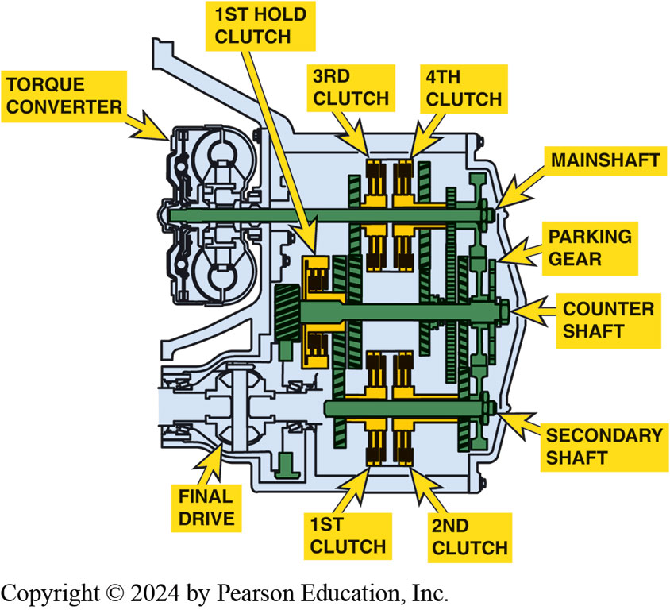
Figure 128.23 Non-Planetary
A Honda non planetary gear set-type automatic transmission that uses helical cut gears instead of planetary gears. Hydraulically applied clutches as commanded by the PCM with fluid flow controlled by shift solenoids to make the shifts.
Notes:
Honda and Saturn vehicles use an automatic transmission with no planetary gear sets. This type is
similar to and uses many of the same parts as their manual transaxles. This design uses hydraulic
clutches instead of synchronizers to make the shift between gears. By using the same parts as
manual transaxles, this automatic transaxle has the following advantages:
1. It allows both manual and automatic transmissions to be manufactured in the same plant,
therefore reducing cost.
2. By using many of the same parts for both manual and auto- matic transaxles, manufacturers see a
cost reduction.
3. Honda automatic transaxles are diagnosed, and if an internal fault is detected, the entire
assembly is replaced with a remanufactured unit. Honda dealership technicians do not repair
automatic transaxles. ● Figure 128–23.

Slide 49
Question 1?
Which component in the torque converter multiplies engine torque?
  a. Stator
  b. Impeller
  c. Turbine
  d. Converter clutch

Slide 50
Answer 1
Which component in the torque converter multiplies engine torque?
  a. Stator

Slide 51
Automatic Transmissions and Transaxles Videos and Animations
Videos Link: (A2) Automatic Transmissions and Transaxles Videos
Animations Link: (A2) Automatic Transmissions and Transaxles Animations

Slide 52
Copyright
This work is protected by United States copyright laws and is provided solely for the use of instructors in teaching their courses and assessing student learning. Dissemination or sale of any part of this work (including on the World Wide Web) will destroy the integrity of the work and is not permitted. The work and materials from it should never be made available to students except by instructors using the accompanying text in their classes. All recipients of this work are expected to abide by these restrictions and to honor the intended pedagogical purposes and the needs of other instructors who rely on these materials.

