Slide 1
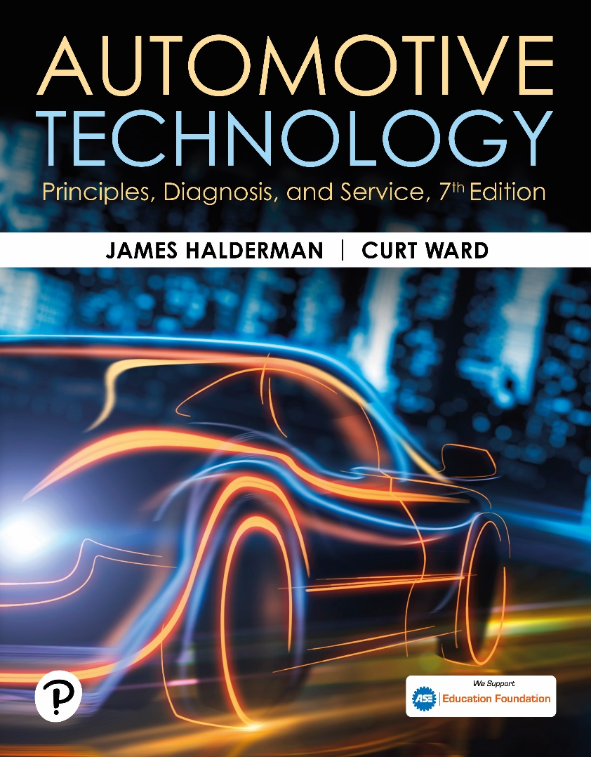
Automotive Technology: Principles, Diagnosis, and Service
Seventh Edition
Chapter 127
Vibration and Noise Diagnosis and Correction
Copyright © 2023 Pearson Education, Inc. All Rights Reserved
Notes:
INSTRUCTOR NOTE: This presentation includes text explanation notes, you can use to teach the course. When in SLIDE SHOW mode, you RIGHT CLICK and select SHOW PRESENTER VIEW, to use the notes.

Slide 2
Learning Objectives
127.1 Discuss vibration and noise concerns in vehicles.
127.1 List the procedures for a test-drive when diagnosing vibration/noise problems.
127.1 Explain the vibration speed ranges.
127.1 Explain how to determine the frequency of a vibration.
127.1 Explain ways to diagnose drive-line vibrations and noise.
127.1 Discuss how to find and correct noises.

Slide 3
Causes of Vibration and Noise
Vehicles are designed and built to prevent most vibrations
Dampen out any vibrations that cannot be eliminated.
If a new vehicle has a vibration or noise problem
Most likely cause is an assembly or parts problem.

Slide 4
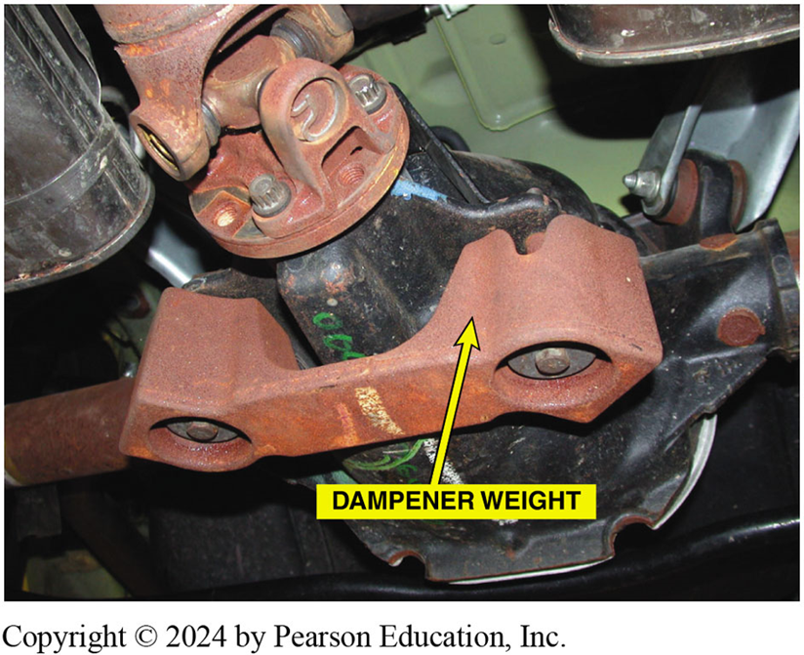
Figure 127.1 Dampener Weight
Many vehicles, especially those equipped with four-cylinder engines, use a dampener weight attached to the exhaust system or drive axle as shown to dampen out certain frequency vibrations.

Slide 5
Test-Drive
First thing when given vibration or noise problem
  Try to duplicate condition.
Observations that may help locate problem?
  Gather information about vibration
Vibration felt in steering wheel, dash, or hood
  Most likely defective/ out-of-balance front wheels or tires.
Vibration felt in seat of pants or all over vehicle
  Defective or out-of-balance rear wheels or tires
  RWD driveshaft and related components
Notes:
Case Study: The Vibrating Ford Transmit Connect
The owner of a Ford Transit Connect complained of a severe vibration at idle. The technician
checked for any stored diagnostic trouble codes (DTCs) and any related technical service bulletins
(TSBs) and found a TSB that the lower engine mount could be the cause. The transmission
(powertrain) mount was found to be cracked so this was also replaced. The vibration was still
present. Thinking that the engine mounts could be an issue the technician found them to be clean
without any leaks or cracks. Checking with other technicians on www.iatn.net resulted in several
responses that suggested that the upper mount, being fluid (gel) filled has been found to be the
cause or a vibration even if it is not leaking. Taking the advice of other technicians who have solved a vibration by replacing the
upper mount, the technician did replace it and this corrected the vibration concern. Apparently the failed engine mounts caused the engine to vibrate because they were not in the original position where they were designed to dampen engine noise and vibrations.
Summary:
Complaint—The owner complained of a vibration in the engine when at idle speed only.
Cause—Defective engine mounts including the upper liquid filled mount was found to the root cause.
Correction—All three engine (powertrain) mounts were replaced based on a TSB and a visual inspection, plus advice from other service technicians.

Slide 6
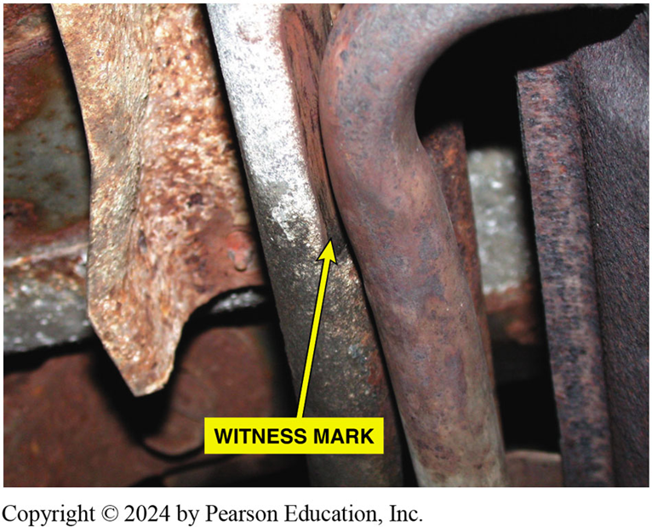
Figure 127.2 Witness Marks
Exhaust was found to be rubbing on the frame rail during a visual inspection. Rubber exhaust system hangers are used to isolate noise and vibration from the exhaust system from entering the interior. These rubber supports can fail causing the exhaust system to be out of proper location. It was found by looking for evidence of witness marks.

Slide 7
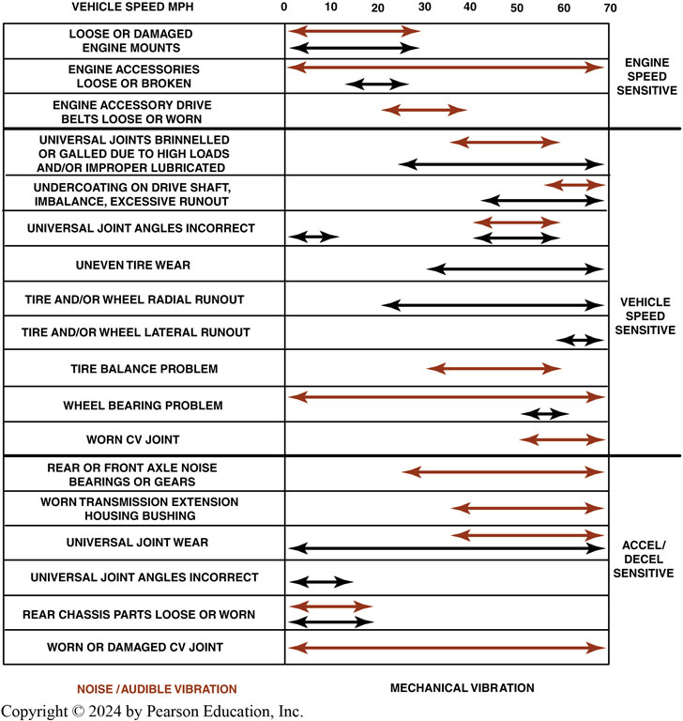
Figure 127.3 Speed Chart
Notes:
Figure 127–3 A chart showing the typical vehicle and engine speeds at which various components will create a noise or vibration and under what conditions.

Slide 8
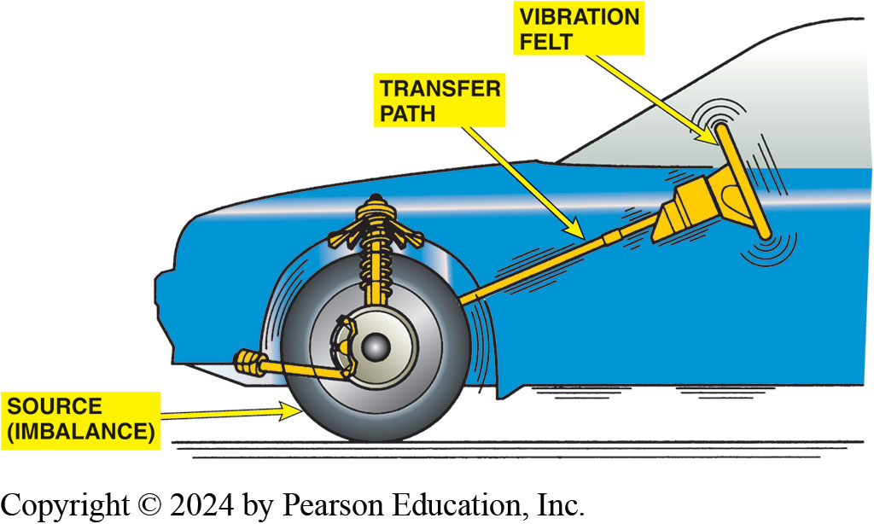
Figure 127.4 Transfer Path
Vibration created at one point is easily transferred to the passenger compartment. MacPherson strut suspensions are more sensitive to tire imbalance than SLA-type suspensions.
Notes:
Tech Tip: The Duct Tape Trick
A clicking noise heard at low speeds from the wheels is a common noise complaint. This noise is
usually most noticeable while driving with the windows lowered. This type of noise is caused by
loose disc brake pads or noisy wheel covers. To confirm exactly what is causing the noise, simply
remove the wheel covers and drive the vehicle. If the clicking noise is still present, check the
brakes and wheels for faults. If the noise is gone with the wheel covers removed, use duct tape
over the inner edge of the wheel covers before installing them onto the wheels. The duct tape will
cushion and dampen the wheel cover and help reduce the noise. The sharp prongs of the wheel cover
used to grip the wheel will pierce through the duct tape and still help retain the wheel covers.

Slide 9
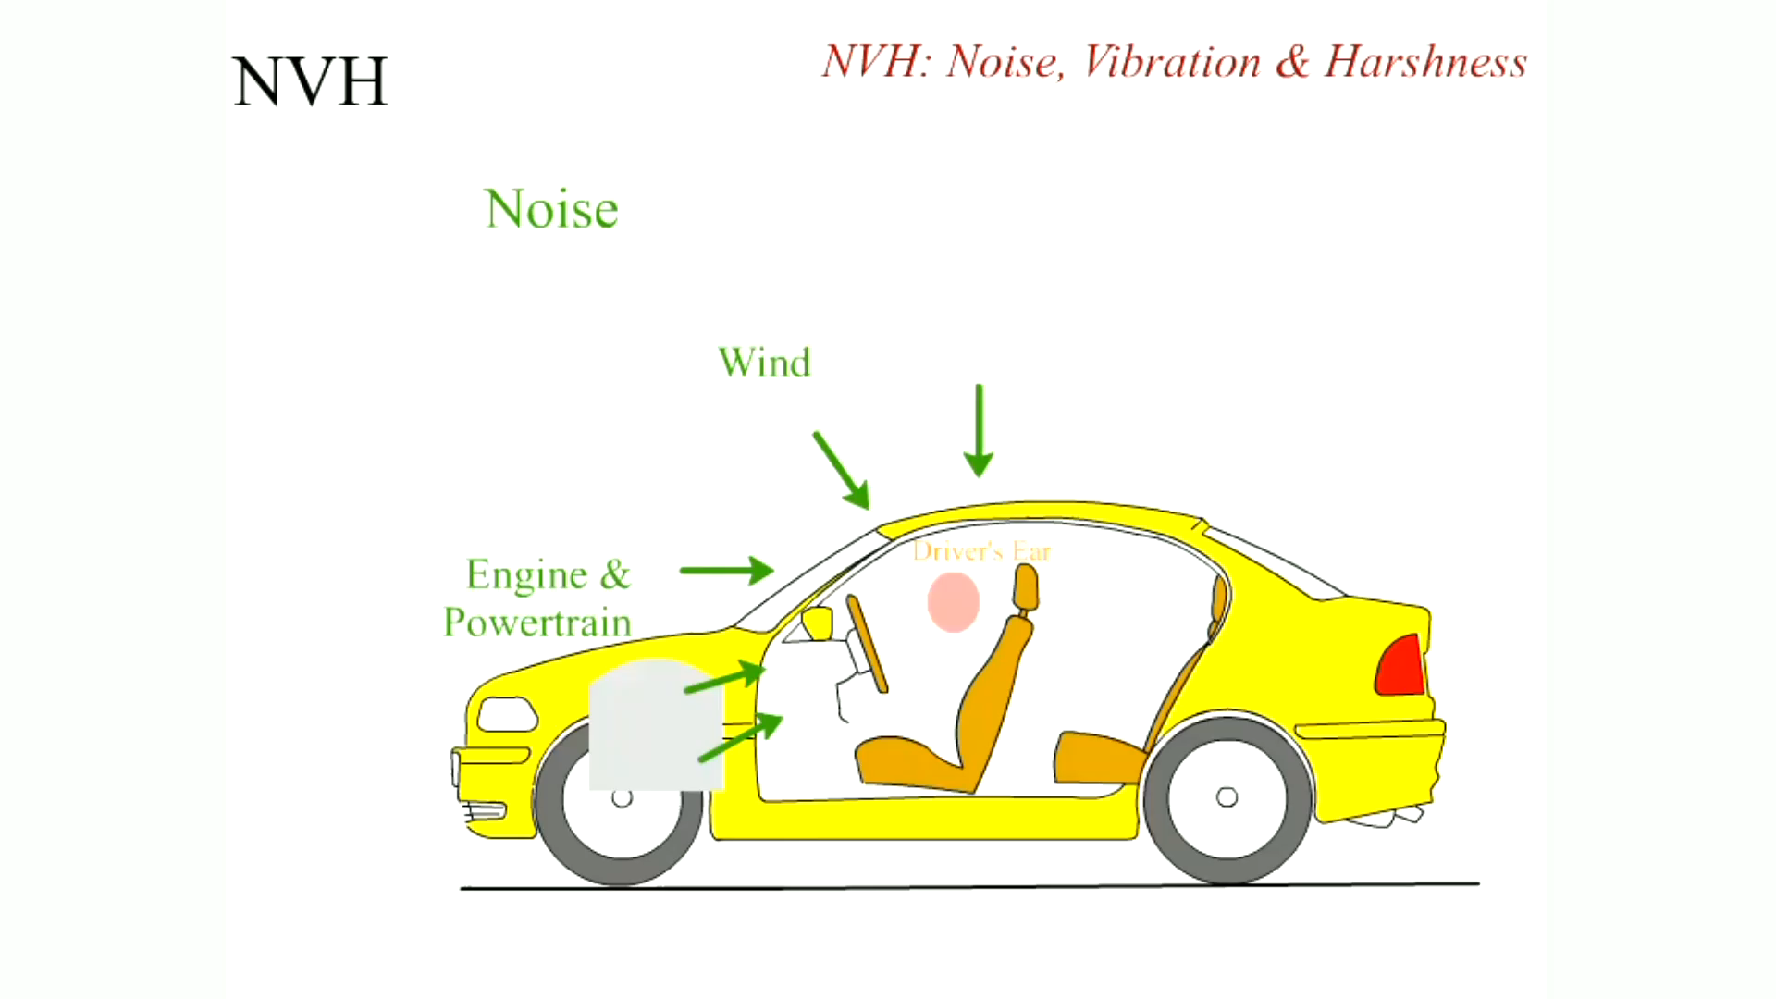
Animation: NVH
(Animation will automatically start)

Slide 10
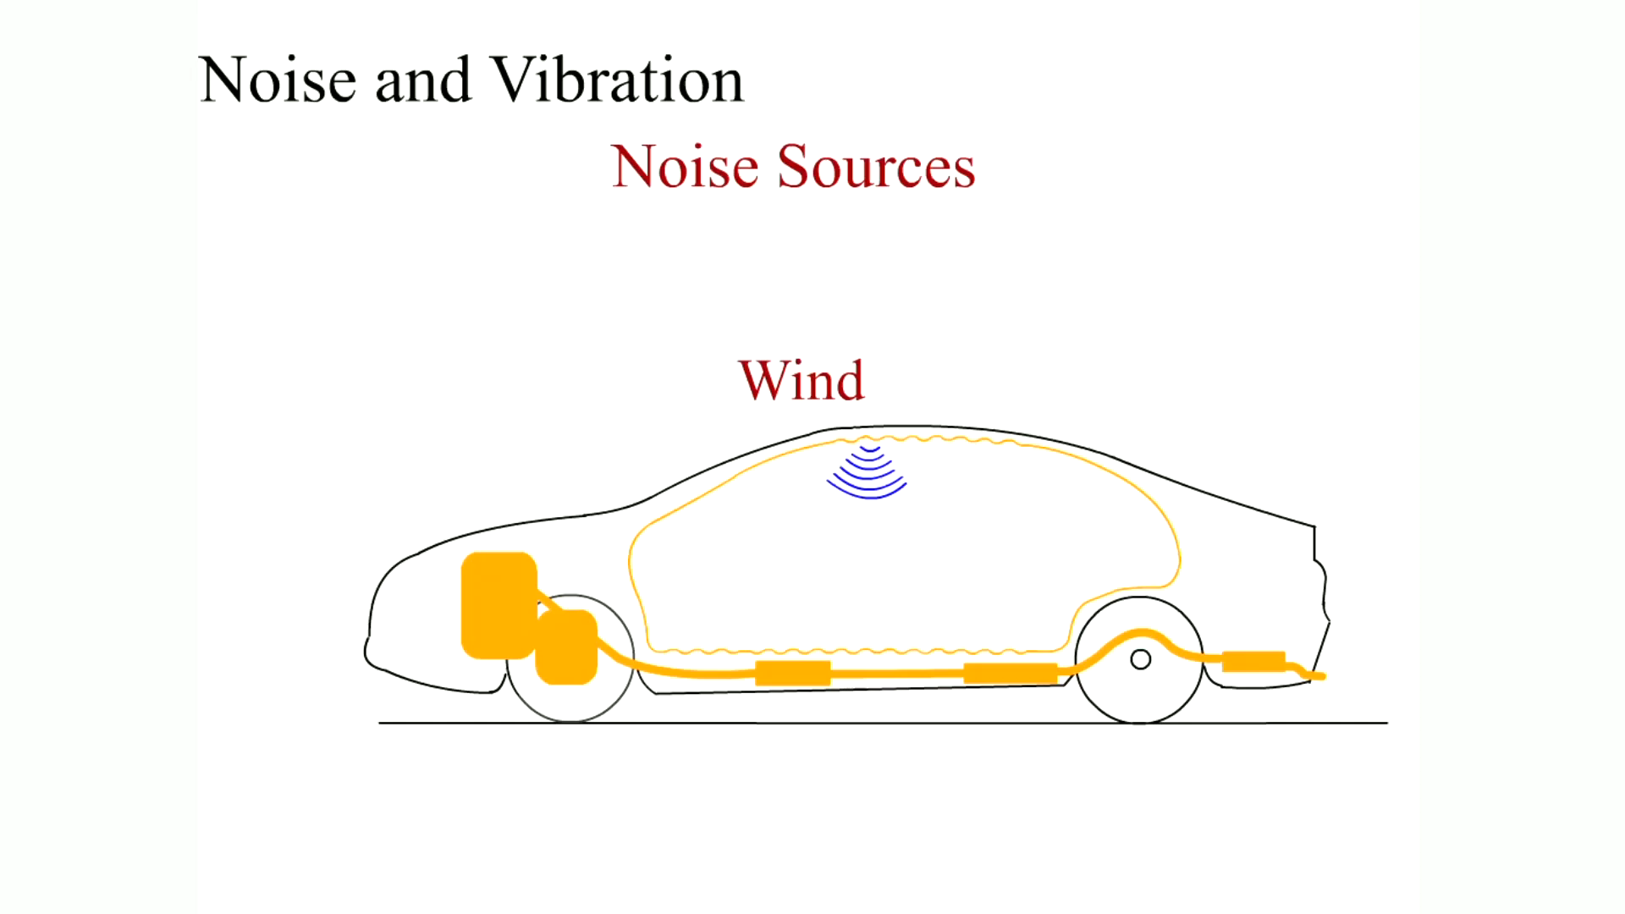
Animation: Noise and Vibration
(Animation will automatically start)

Slide 11
Neutral Run-Up Test
Neutral run-up test is used to determine
Source of vibration is engine-related.
With transmission in neutral or park
Slowly increase engine RPM and with a tachometer
Observe RPM at which vibration occurs.
Notes:
The neutral run-up test is used to determine if the source of the vibration is engine-related. With the transmission in Neutral or Park, slowly increase the engine RPM and with a tachometer, observe the RPM at which the vibration occurs. Do Not Exceed the Manufacturer’s Recommended Maximum Engine RPM. If the fault is found in the engine itself, further engine testing is needed to find the root cause.

Slide 12
Vibration During Braking
Vibration during braking indicates out-of-round brake drums
  Warped disc brake rotors, or other braking system problems.
Note: Wheels should never be installed using an air impact wrench.

Slide 13
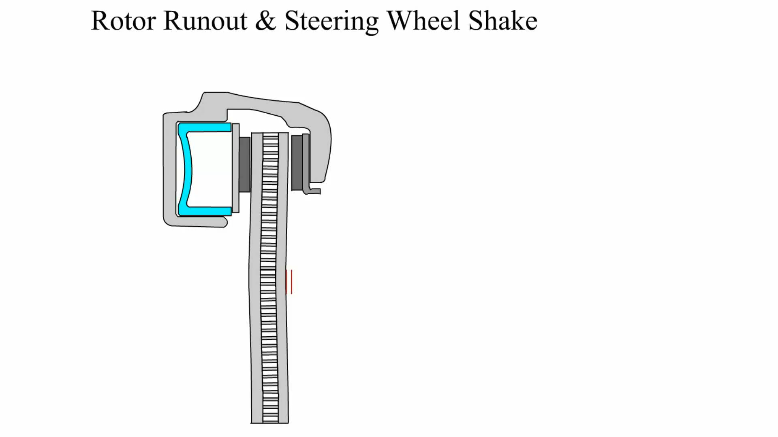
Animation: Rotor Runout & Steering Wheel Shake
(Animation will automatically start)

Slide 14
Vibration Speed Ranges
Number of times a complete motion cycle takes place
During period of 1 second called FREQUENCY and measured in hertz (Hz).
Vibration order number of vibrations created in 1 revolution of component.
Tire/Wheel vibrations
  Name steps used to determine rolling circumference?
  Low (5-20 Hz), Medium (20-50 Hz), and High (50-100 Hz)
Notes:
Vibration Order is the number of vibrations created in one revolution of a component. A single high spot on a tire, for example, will cause one bump per revolution, which is a first-order vibration. If the tire rotates10 times per second, there are 10 disturbances per second, which is also called a first-order vibration of 10 Hz. If there are two bumps on a tire, a second-order vibration is created that would generate a vibration of 20 Hz if the tire were rotating 10 times per second.
Low Frequency (5–20 HZ). This frequency range of vibration is very disturbing to many drivers because this type of vibration
can be seen and felt in the steering wheel, seats, mirrors, and other components. Terms used to describe this type of vibration include nibble, shake, oscillation, shimmy, and shudder. Tires and wheels are the most common source of vibration in the low-frequency range. To determine the exact frequency for the vehicle being checked, the following formula and procedure can be used.
Tire rolling frequency is calculated as follows:
Hz = mph x 1.47/ tire circumference in ft
This formula works for all vehicles regardless of tire size. The circumference (distance around the tread) can be
measured by using a tape measure around the tire. The rolling circumference of the tire is usually shorter due to the contact patch. To determine the rolling circumference see page 276
Medium Frequency (20−50 Hz). This frequency range of vibrations may also be described as a shake, oscillation, or
shimmy. These higher frequencies may also be called roughness or buzz. Components become blurred and impossible to
focus on above a vibration of 30 Hz.
Engine-Related Vibrations: High Frequency (50−100 Hz). Vibrations in this range may also be heard as a moan or hum. The vibration is high enough that it may be felt as a numbing sensation that can put the driver’s hands or feet to sleep. Engine-related vibrations vary with engine speed, regardless of road speed. Frequency of the vibration from an engine is determined from the engine
speed in revolutions per minute (RPM).
Frequency in Hz = engine RPM/60
For example, if a vibration occurs at 3,000 engine RPM, then the frequency is 50 Hz.
Hz = 3,000 RPM/60 = 50 Hz

Slide 15
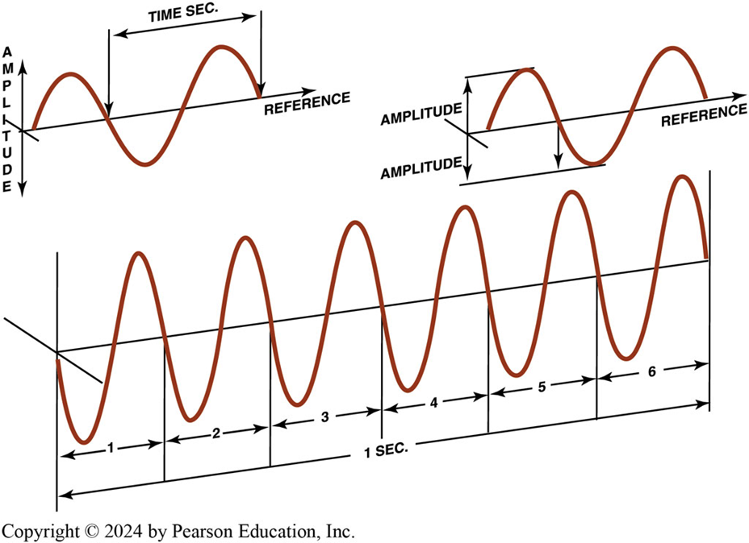
Figure 127.5 Frequency
Hertz means cycles per second. If six cycles occur in one second, then the frequency is 6 Hz. The amplitude refers to the total movement of the vibrating component.
Notes:
Vibration describes an oscillating motion around a reference position. The number of times a complete motion cycle takes place during a period of one second is called frequency and is measured in hertz (Hz) (named for Heinrich R. Hertz, a nineteenth-century German physicist)..
The unit of measure for frequency was originally cycles per second (CPS). This was changed to hertz in the 1960s. To help understand frequency, think of the buzzing sound made by some fluorescent light fixtures. That 60 Hz hum is the same frequency as the alternating current. A 400 Hz sound is high pitched. In fact, most people can only hear sounds between 20 and 15,000 Hz. Generally, low-frequency oscillations between 1 and 80 Hz are the most disturbing to vehicle occupants.
Case Study Pickup Truck Frame Noise
The owner of a Chevrolet pickup truck complained of a loud squeaking noise, especially when turning left. Several technicians attempted to solve the problem and replaced shock absorbers, ball joints, and control arm bushings without solving the problem. The problem was finally discovered to be the starter motor hitting the frame. A measurement of new vehicles indicated that the clearance between the starter motor and the frame was about 1/8 inch (0.125 in.) (0.3 cm)! The sagging of the engine mount and the weight transfer of the engine during cornering caused starter motor to rub up against the frame. The noise was transmitted through the frame throughout the vehicle and made the source of the noise difficult to find.
Summary:
Complaint—Owner complained of a loud squeaking noise.
Cause—The starter was found to be hitting the frame due to a collapsed engine mount.
Correction—Both engine mounts were replaced, which proved to be the root cause.

Slide 16
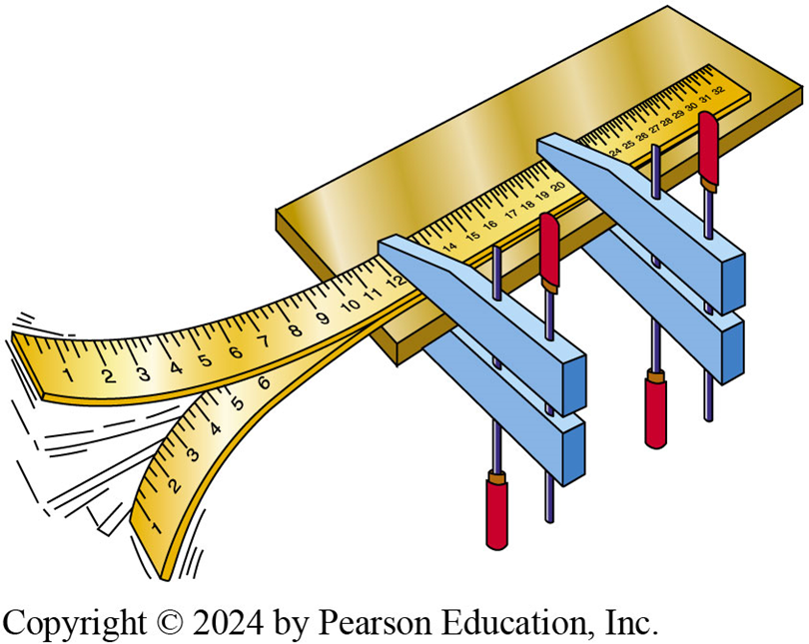
Figure 127.6 Cycle
Every time the end of a clamped yardstick moves up and down, it is one cycle. The number of cycles divided by the time equals the frequency. If the yardstick moves up and down 10 times (10 cycles) in two seconds, the frequency is 5 Hertz (10 ÷ 2 = 5)
Notes:
Case Study: The Vibrating Van
After the engine was replaced in a rear-wheel- drive van, a vibration that felt like an engine miss
was noticed by the driver. Because the vibration was not noticed before the engine was replaced, the problem was thought to be engine-related. Many tests failed to find anything wrong with engine. Even the ignition distributor was replaced, along with the electronic ignition module, on the suspicion that an ignition misfire was the cause. After hours of troubleshooting, a collapsed transmission mount was discovered. After replacing the transmission mount, the “engine miss” and the vibration were eliminated. The collapsed mount caused
the driveshaft U-joint angles to be unequal, which caused the vibration.
Summary:
Complaint—Owner complained of a vibration during acceleration only that was believed to be an ignition misfire.
Cause—The transmission mount was found to have collapsed which affected the driveshaft angles.
Correction—The transmission mount was replaced which restored the proper driveshaft angles.

Slide 17
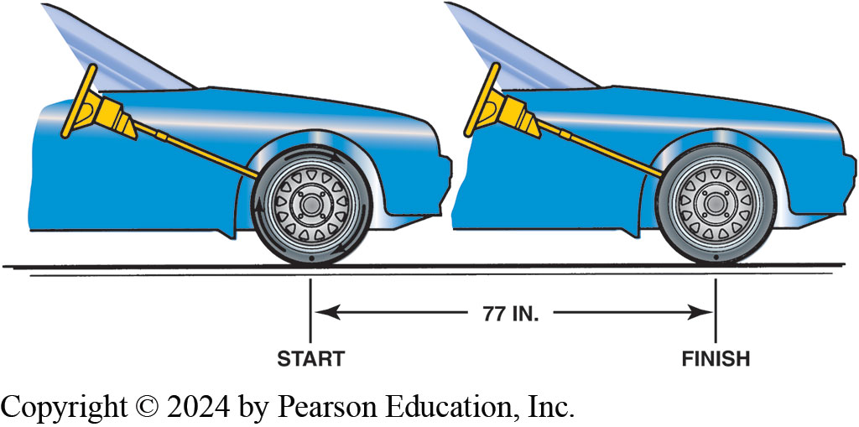
Figure 127.7 Rolling Circumference
Determining rolling circumference of a tire.

Slide 18
Vibration Frequency
Measure frequency with a reed tachometer.
Correcting low-frequency vibrations: Page 277
  What low-frequency vibration problems may be included?
Correcting medium-frequency vibrations: Page 278
  What medium-frequency vibration problems may be included?
Correcting high-frequency vibrations: Page 279
  What high-frequency vibration problems may be included?

Slide 19
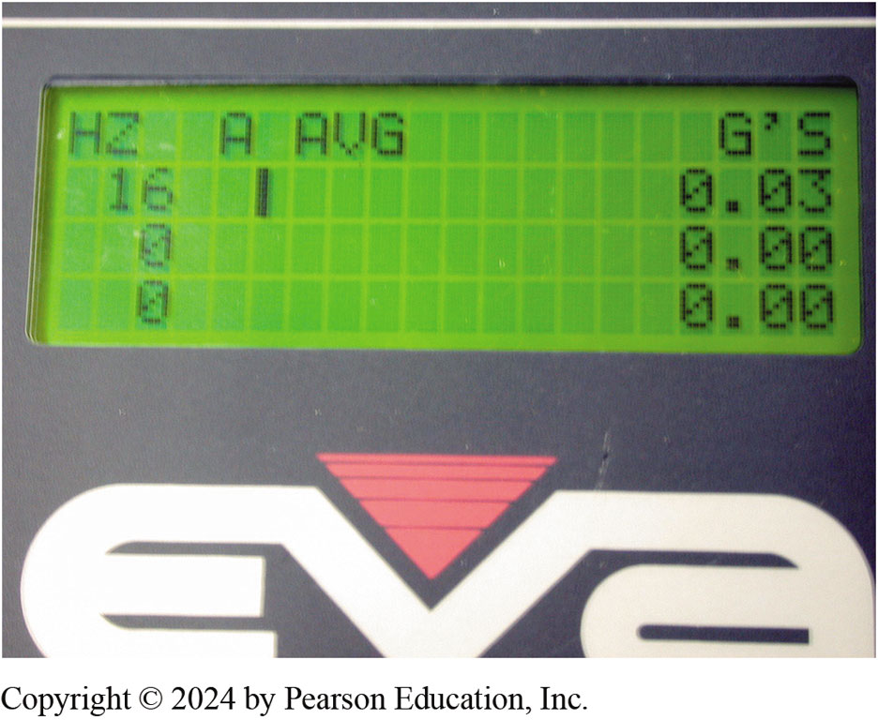
Figure 127.8 EVA
An Electronic Vibration Analyzer
Notes:
Measuring Frequency Knowing the frequency of the vibration greatly improves the speed of tracking down the
source of the vibration. Vibration can be measured using a reed tachometer or an electronic vibration analyzer (EVA).
Correcting Low-frequency Vibrations
A low-frequency vibration (5−20 Hz) is usually due to tire/wheel problems, including the following:
1. Tire and/or wheel imbalance.
2. Tire and/or wheel radial or lateral runout.
3. Radial force variation within the tire itself.
4. If front-wheel drive, a bent or damaged drive axle joint or shaft.
5. Warped rotors.
Tires that are out of round or defective will be most noticeable at low speeds, will get better as speed increases, vibrate again at highway speeds.
Tech Tip: Recommend Rotate and Balance
Most vehicle manufacturers recommend that the tires be rotated on a regular basis, usually every 7,500–10,000 miles (12,000–16,000 km). Often this mileage interval corresponds to an oil change according to the oil life monitor. Checking and balancing the tires while they are already off the vehicle and in the hands of technician makes it a quick and easy additional service to provide customers. Because the tires have been operating in one position in the vehicle for many miles, it is not uncommon for them to wear in a certain way that may cause the tire/wheel assembly to be slightly out of balance. Balancing and rotating the tires at the same time often results in a smoother ride that many customers notice. While the tires may only require 0.25−0.75 oz. (7−20 g), the balancing helps to increase the life of the tires and increases customer satisfaction by providing a smoother ride.

Slide 20
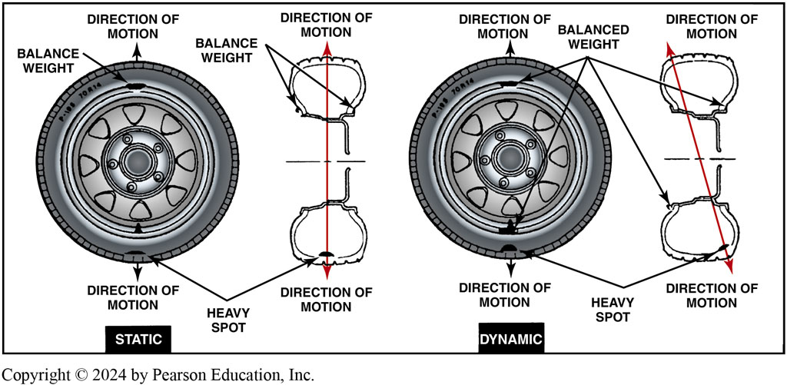
Figure 127.9 Balanced Wheels/Tires
Properly balancing all wheels and tires solves most low-frequency vibrations.

Slide 21
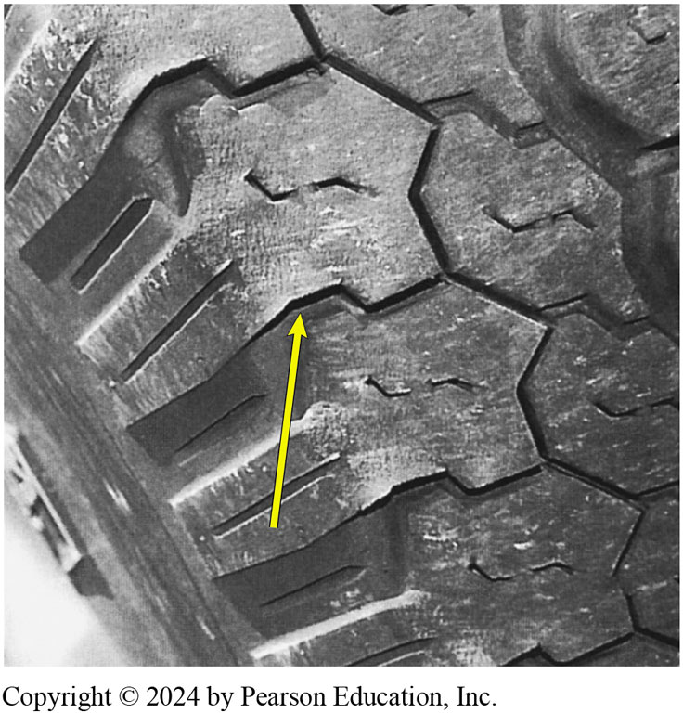
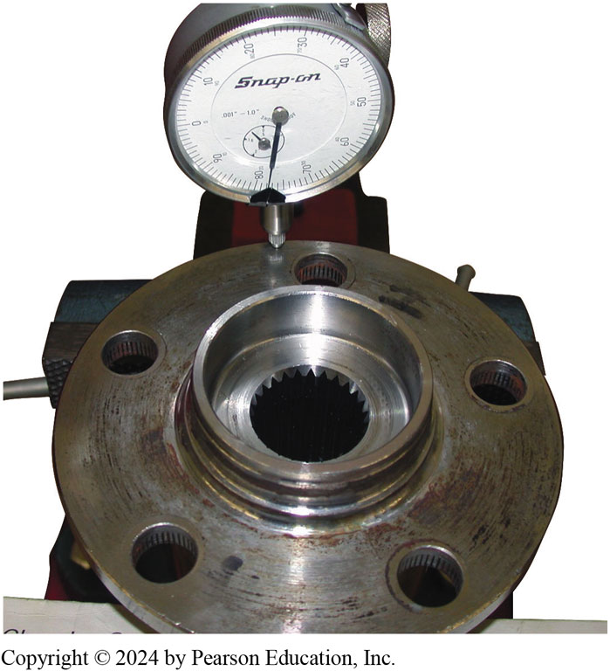
Vibration Causes
Figure 127-10 out-of-balance tire showing scallops or bald spots around the tire. Even if corrected, this cupped tire would create a vibration.
Figure 127-11 Another cause of a vibration that is often blamed on wheels or tires is a bent bearing hub. Use a dial indicator to check the flange for runout.
Notes:
Tech Tip Squeaks and Rattles: Many squeaks and rattles commonly heard on any vehicle can be corrected by tightening all bolts and nuts you can see. Raise the hood and tighten all fender bolts. Tighten all radiator support and bumper brackets. Open the doors and tighten all hinge and body bolts. An even more thorough job can be done by hoisting the vehicle and tightening all under- vehicle
fasteners, including inner fender bolts, exhaust hangers, shock mounts, and heat shields. It is amazing how much this quiets the vehicle, especially on older models. It also makes the vehicle feel more solid with far less flex in body, especially when traveling over railroad crossings or rough roads.
NOTE: If a vibration is felt during heavy acceleration at low speeds, a common cause is incorrect universal joint angles. This often happens when the rear of the vehicle is heavily loaded or sagging due to weak springs. If the angles of the U-joints are not correct (excessive or unequal from one end of the driveshaft to the other), a vibration will also be present at higher speeds and is usually torque-sensitive.

Slide 22
Correcting Driveline Angles
Incorrect Driveline Angles Usually Caused By:
  Worn, damaged, or improperly installed U-joints.
  Worn, collapsed, or defective engine or transmission mount(s).
  Incorrect vehicle ride height.
    (As weight added to rear of RWD vehicle, front of differential rises and changes working angle of rear U-joint.)
  Bent or distorted driveshaft.

Slide 23
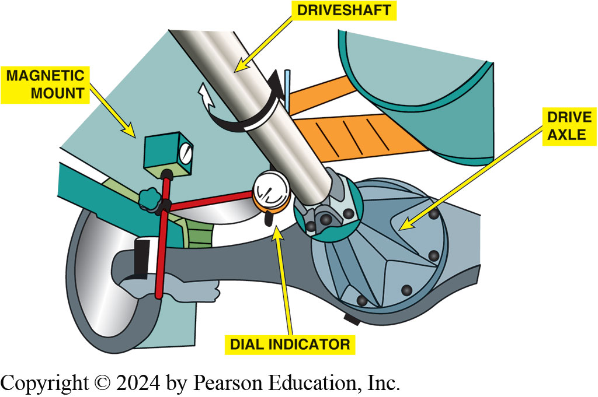
Figure 127.12 Driveshaft Runout
Checking a driveshaft for runout using a magnetic mounted dial indicator.
Notes:
Check to see that the driveshaft is not bent by performing a driveshaft runout test using a dial
indicator. Runout should be measured at three places along the length of the drive- shaft. The maximum allowable runout is 0.030 inch (0.8 mm). If runout exceeds 0.030 inch, remove driveshaft from the rear end and re-index driveshaft onto the companion flange at 180 degrees from its original location. Remeasure the driveshaft runout. If the runout is still greater than 0.030 inch, the driveshaft is bent and needs replacement or the companion flange needs replacement.

Slide 24
Checking Driveshaft Runout
Check to see that driveshaft is not bent
Performing a driveshaft runout test using a dial indicator.
Runout should be measured at 3places along length of driveshaft.

Slide 25
Companion Flange Runout
companion flange is splined to rear axle pinion shaft
Provides mounting for rear U-joint of driveshaft.
What things should be checked on companion flange
  while diagnosing a vibration?
Notes:
The companion flange is splined to the rear axle pinion shaft and provides the mounting for the
rear U-joint of the drive- shaft. Two items should be checked on the companion flange while
diagnosing a vibration:
The companion flange should have a maximum run- out of 0.006 inch (0.15 mm) while being rotated. If the flange was pounded off with a hammer during a previous repair, the deformed flange could cause a vibration.
Check the companion flange for a missing balance weight. Many flanges have a balance weight that is spot-welded onto the flange. If the weight is missing, a driveline vibration can result.

Slide 26
Measuring Driveshaft U-Joint Phasing
Measuring Driveshaft U-joint Phasing
  Checking to see if front and rear U-joints are directly
    in line or parallel with each other
  Place an inclinometer on front U-joint bearing cup
  Rotate driveshaft until horizontal
  Move inclinometer to rear U-joint.
  Angles should match

Slide 27
Balancing Driveshaft
Driveshaft Balance Done With Strobe Balancer
  Mark driveshaft with 4 equally spaced marks around its circumference
  Attach strobe balancer sensor to bottom of differential housing
  Start engine put into gear to allow drive wheels to rotate
  Check using strobe light close to driveshaft for balance
  Apply hose clamps so that screw portion of clamp(s)
  Opposite number seen with strobe light
Notes:
The procedure for testing driveshaft balance using a strobe balancer includes the following:
NOTE: Driveshaft balance is more important than front drive axle shaft balance because a driveshaft Rotates much faster. A typical driveshaft rotates about three times faster than the drive wheels due to the gear reduction in the differential. Drive axle shafts rotate at the same speed as the drive wheels.

Slide 28
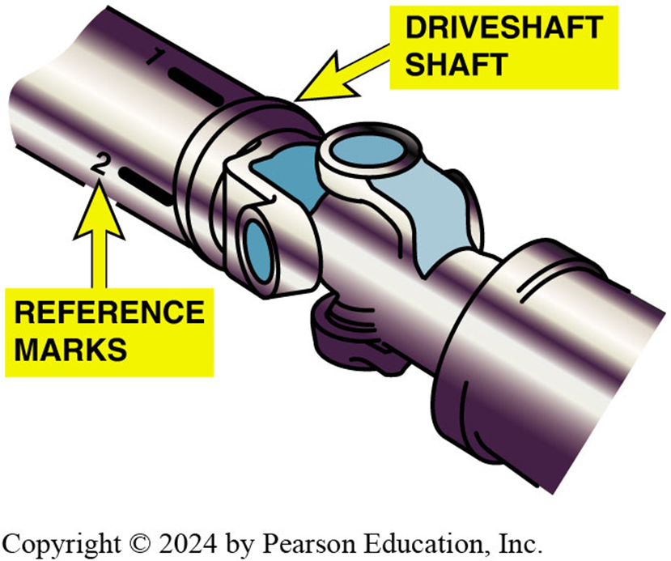
Figure 127.13 Driveshaft Balance
When checking the balance of a driveshaft, make reference marks around the shaft so that the location of the unbalance may be viewed when using a strobe light
Notes:
Step 1 Raise the vehicle and mark the driveshaft with four equally spaced marks around its circumference. Label each mark with a 1, 2, 3, and 4. Figure 7–13.

Slide 29
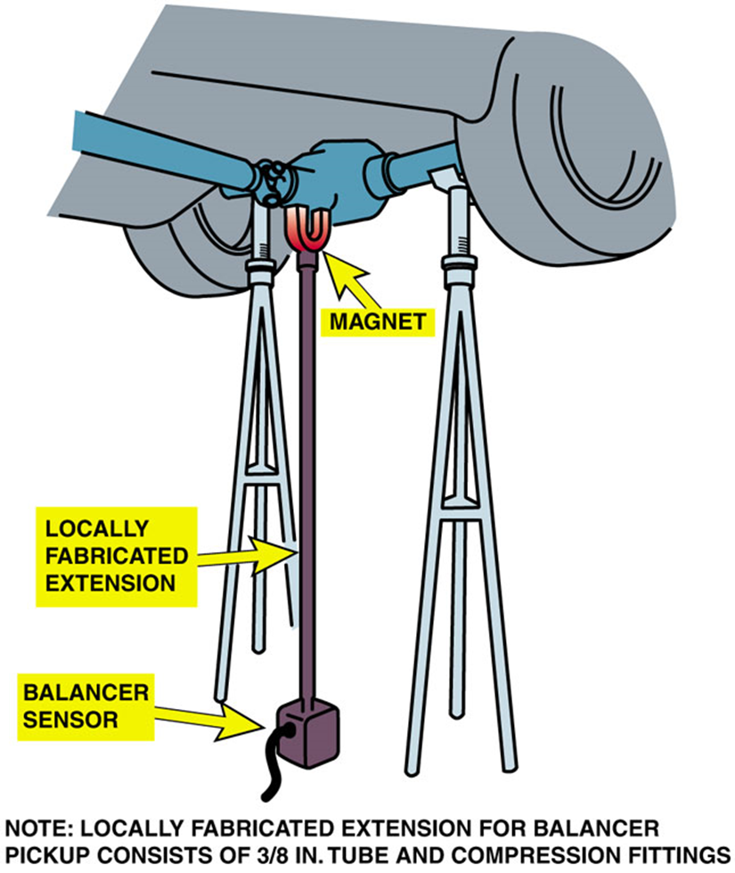
Figure 127.14 Strobe Balancer
Using a strobe balancer to check for driveline vibration requires that an extension be used on the magnetic sensor. Tall safety stands are used to support the rear axle to keep the driveshaft angles the same as when the vehicle is on the road.
Notes:
Apply hose clamps so that the screw portion of the clamp(s) is opposite the number seen with the strobe light. The screw portion of the hose clamp is the corrective weight. Remember, the strobe light sensor was mounted to the bottom of differential housing. The strobe light flashes when the heavy part of the driveshaft is facing downward. If the heavy part of the driveshaft is down, then corrective weight must be added to the opposite side of the driveshaft.

Slide 30
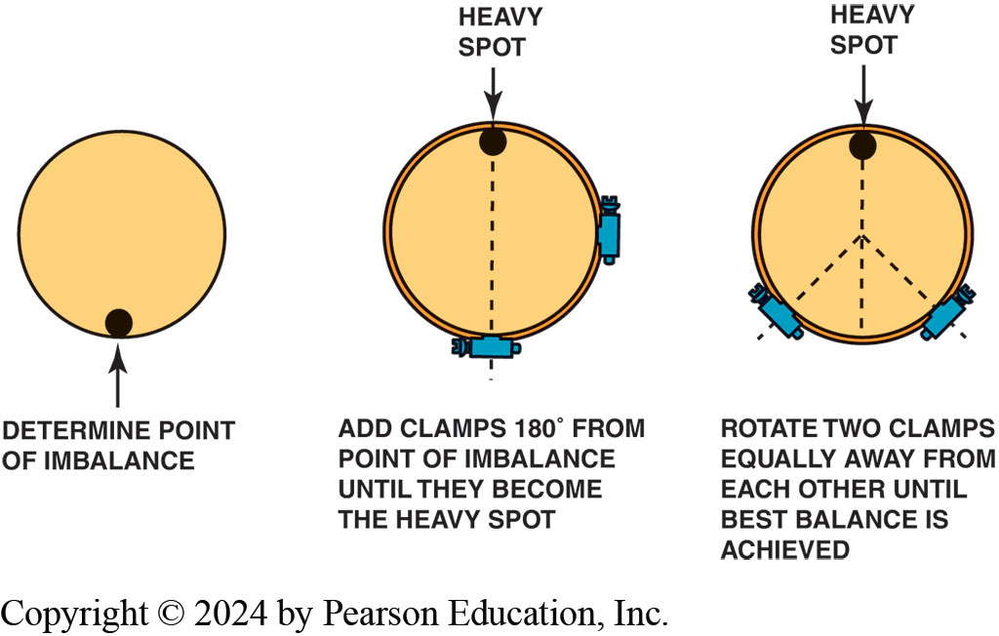
Figure 127.15
Typical procedure to balance a driveshaft using hose clamps

Slide 31
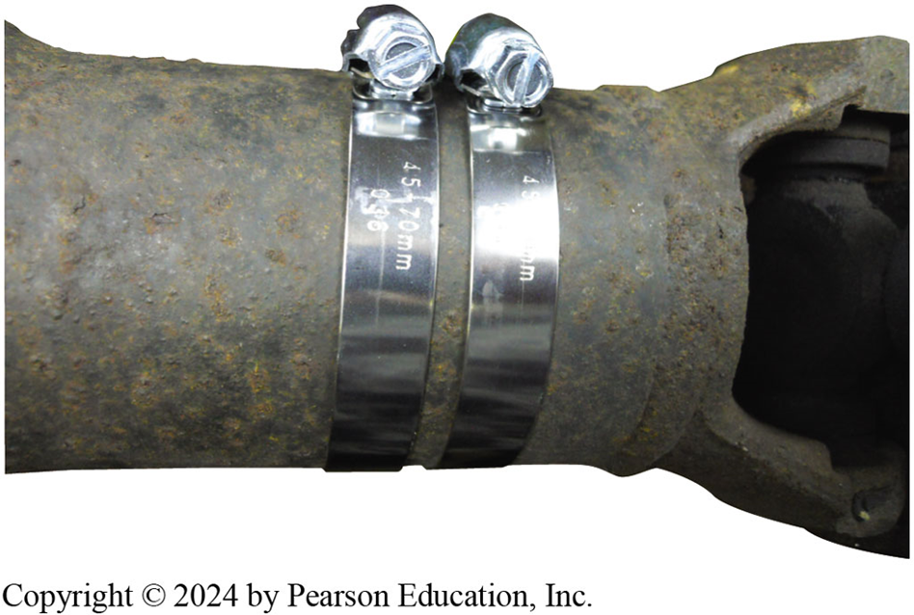
Figure 127.16 Hose Clamps
Two clamps were required to balance this front driveshaft of a four-wheel-drive vehicle. Be careful when using hose clamps that the ends of the clamps do not interfere with the body or other parts of the vehicle

Slide 32
Noise Diagnosis (1 of 4)
Tire Noise
Engine/Exhaust Noise
Wheel Bearing Noise
Differential Side Bearing Noise
Differential Pinion Bearing Noise
U-joint Noise
Clutch Noise

Slide 33
Noise Diagnosis (2 of 4)
Noises usually become louder and easier to find
As time and mileage increase.
An occasional noise usually becomes a constant noise.

Slide 34

Figure 127.17 Tire Wear
Tire wear caused by improper alignment or driving habits, such as high-speed cornering, can create tire noise. Notice the feather edged outer tread blocks.

Slide 35
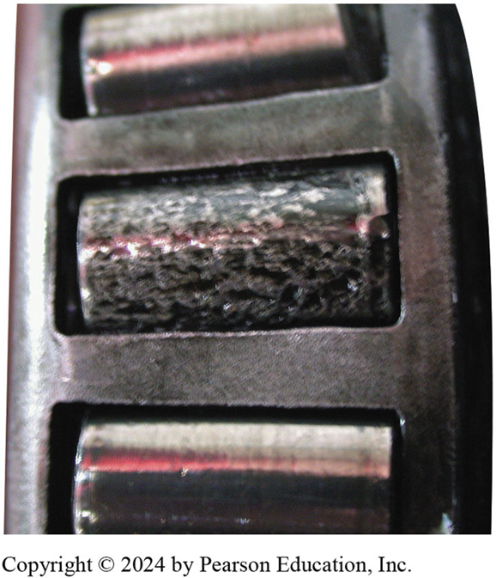
Figure 17.18 Wheel Bearing
This bearing was found on a vehicle that had been stored over the winter. This corroded bearing produced a lot of noise and had to be replaced.

Slide 36
Noise Correction
Check all power steering high-pressure lines.
Carefully check, tighten, lubricate the flexible couplings in exhaust system.
Lubricate all rubber bushings with rubber lube
Replace any engine or transmission mounts that are collapsed.
Replace and/or tighten all engine drive belts
Check that all accessory mounting brackets are tight.
Notes:
Case Study: Everything Is OK until I Hit a Bump
The owner of an eight-year-old vehicle asked that the vibration in the steering wheel be repaired.
It seemed that the vehicle drove fine until the front wheels hit a bump in the road—then the steering wheel shimmied for a few seconds.
This problem is typical of a vehicle with excessive steering linkage freeplay. When driving straight, centrifugal (rolling) force on the tires tends to force the front wheels outward (toe-out). When one or both wheels hit a bump, the play in the linkage becomes apparent, causing steering wheel to shimmy until the rolling force again equalizes the steering. The technician performed a test-drive and a careful steering system inspection and discovered freeplay in both inner tie rod end sockets of the rack-and-pinion unit. The steering unit also had some power steering leakage at the tie rod bellows. A replacement remanufactured power-rack-and-pinion steering unit was recommended to the customer. The customer approved replacement rack and authorized the required realignment. A careful test-drive confirmed that the problem was corrected.
Summary:
Complaint—Owner complained of vibration but only after hitting a bump in the road.
Cause—The rack-and-pinion steering had excessive looseness in both the inner and outer tie rods.
Correction—The steering gear assembly was replaced and the problem was corrected.

Slide 37
Noise Diagnosis (3 of 4)
NOISE DIAGNOSTIC PROCEDURE
Tire noise Change tire pressure; if no change, then the problem is not tires but bearings, or other components.
Drive on various road surfaces—smooth asphalt reduces tire noise.
Rotate the tires front to rear, if possible.
Various tread designs can cause added noise (● SEE FIGURE 17–17).
Engine/Exhaust Noise
Operate the engine at various speeds and loads.
Drive faster than speed where noise occurs, place transmission in Neutral, and “coast” down through speed of maximum noise.
Determine if the engine speed or vehicle speed is the cause of the noise.

Slide 38
Noise Diagnosis (4 of 4)
NOISE | DIAGNOSTIC PROCEDURE
Wheel bearing noise ( SEE FIGURE 17–18) | Drive the vehicle slowly on a smooth road. Make left and right turns with the vehicle. Wheel bearing noise changes as weight is transferred side to side. If noise occurs when turning to the right, then the left bearing is the cause. if noise occurs when turning to the left, then the right bearing is the cause. Hoist the vehicle and rotate the wheel by hand to verify the roughness.
Differential side bearing noise | Drive the vehicle slowly on a smooth road. Differential bearing noise is a low-pitch noise that does not change when turning. The noise varies with vehicle speed.
Differential pinion | A whine noise increases with the vehicle speed.
bearing noise | Drive on a smooth road and accelerate, coast, and hold a steady speed (float). A defective front pinion bearing may be louder on acceleration. A defective rear pinion bearing may be louder on deceleration. Pinion bearing noise usually peaks in a narrow speed range.
U-joint noise | Drive slowly on a smooth road surface. Drive in reverse and forward. U-joints usually make a “chirp, chirp, chirp” noise in reverse because of lack of lubrication and brinelling from driving forward. Driving in reverse changes the force on the needle bearings in the U-joint, and noise is created.
Clutch noise | Transmission input bearing: Start the engine with the transmission in Neutral and the parking brake set. The clutch should be engaged (foot off the clutch pedal). If the bearing noise is heard, the transmission input bearing is the source. Release (throw-out) bearing: Start the engine with the transmission in Neutral and the parking brake set. Lightly depress the clutch pedal just enough to take up freeplay (usually 1 in. or less). If the noise is now heard, the source is the release (throw-out) bearing as the clutch fingers make contact with the bearing. Pilot bearing: Start the engine with the transmission in Neutral and the parking brake set. Push the clutch pedal fully to the floor (disengage the clutch). If the bearing noise is heard with the clutch disengaged, it is caused by the pilot bearing.

Slide 39
Frequently Asked Question: What Is “Chassis Ears”?
? Frequently Asked Question
What Is “Chassis Ears”? Chassis ears is a brand name for a tool that uses microphones that can be attached to parts under the vehicle and transmit noise to a receiver. The receiver can be tuned so that a technician can listen to one microphone at a time while someone else is driving. This tool makes finding the source of a noise easier. Figure 127-19

Slide 40
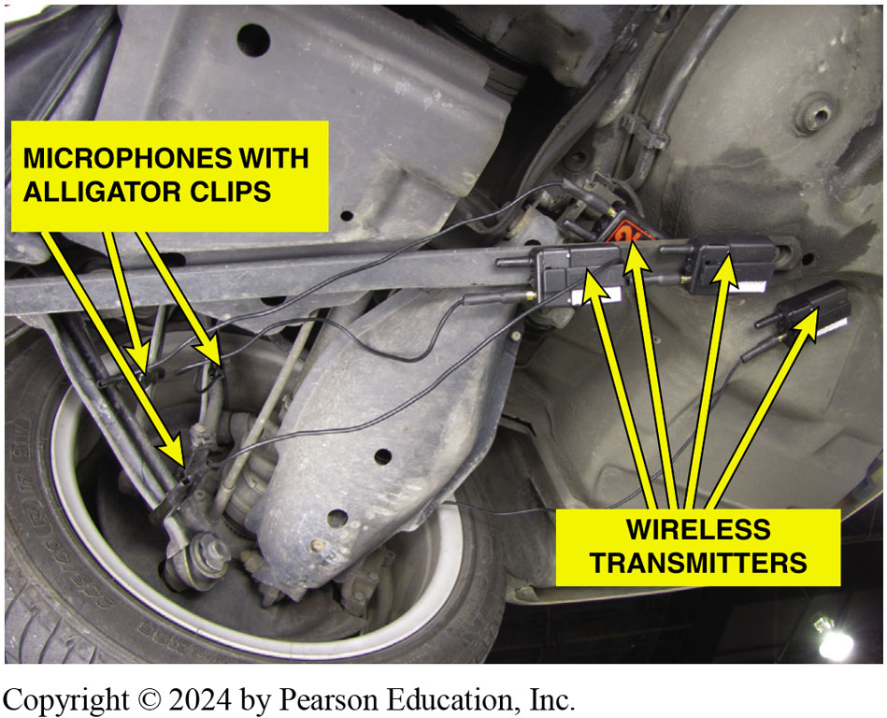
Figure 127.19 Chassis Ears
Notes:
Figure 127–19 Chassis ear microphones attached to various suspension components using the integral clamps. The sound is transmitted wirelessly to the receiver inside the vehicle where an assistant technician can listen for
noises while the vehicle is being driven.

Slide 41
Question 1?
A vibration or noise can be caused by all of the following, Except:
  a. exhaust system
  b. wheels and tires
  c. incorrect drive angles
  d. exhaust smoke

Slide 42
Answer 1
A vibration or noise can be caused by all of the following, Except: .
  d. exhaust smoke

Slide 43
Automatic Transmissions and Transaxles Videos and Animations
Videos Link: (A2) Automatic Transmissions and Transaxles Videos
Animations Link: (A2) Automatic Transmissions and Transaxles Animations

Slide 44
Copyright
This work is protected by United States copyright laws and is provided solely for the use of instructors in teaching their courses and assessing student learning. Dissemination or sale of any part of this work (including on the World Wide Web) will destroy the integrity of the work and is not permitted. The work and materials from it should never be made available to students except by instructors using the accompanying text in their classes. All recipients of this work are expected to abide by these restrictions and to honor the intended pedagogical purposes and the needs of other instructors who rely on these materials.

