Slide 1
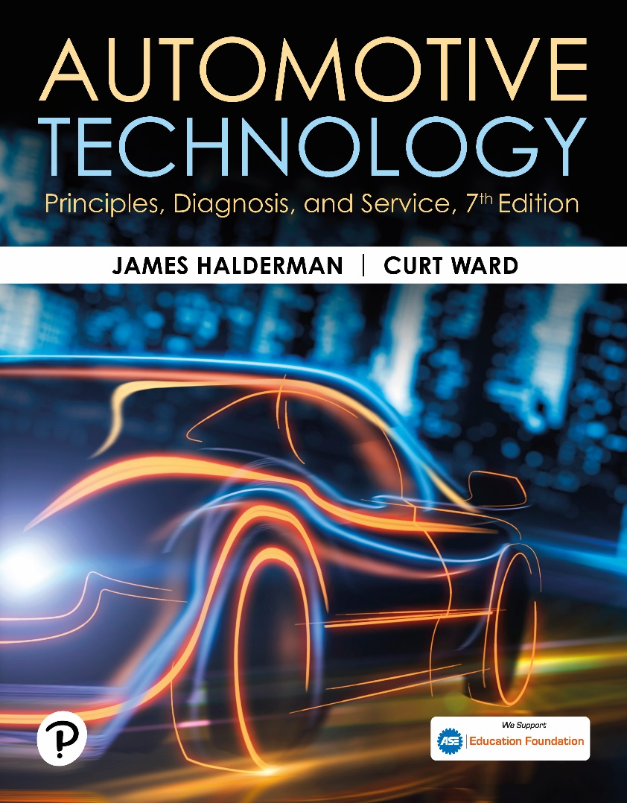
Automotive Technology: Principles, Diagnosis, and Service
Seventh Edition
Chapter 126
Four-Wheel-Drive and All-Wheel Drive
Copyright © 2023 Pearson Education, Inc. All Rights Reserved
Notes:
INSTRUCTOR NOTE: This presentation includes text explanation notes, you can use to teach the course. When in SLIDE SHOW mode, you RIGHT CLICK and select SHOW PRESENTER VIEW, to use the notes.

Slide 2
Learning Objectives (1 of 2)
126.1 Explain the operation of four-wheel-drive systems.
126.2 Explain the operation of all-wheel-drive systems.
126.3 Discuss front and rear differential axle ratios.
126.4 Describe the components of a transfer case.
126.5 Discuss the purpose and function of an interaxle differential.
126.6 Describe the different types of four-wheel-drive axles and drive axle ratios.

Slide 3
Learning Objectives (2 of 2)
126.7 Describe the procedure to diagnose and service transfer cases.
126.8 Describe the procedure to diagnose and service locking hubs.

Slide 4
Four-Wheel Drive Systems (1 of 3)
Two-wheel-drive vehicles
  Use engine torque to turn front or rear wheels.
  Differential allows drive wheels to travel different distances and speeds
Four-wheel-drive vehicle
  Requires 2 differentials
  One for front wheels and one for rear wheels.
Notes:
Two-wheel-drive vehicles use engine torque to turn either the front or the rear wheels. A differential is required to allow the drive wheels to travel different distances and speeds while cornering or driving over bumps or dips in the road. A four-wheel-drive vehicle, therefore, requires two differentials—one for the front wheels and one for the rear wheels.
NOTE: The term 4 × 4 means a four-wheeled vehicle that has engine torque applied to all four wheels
(four-wheel drive). A 4 × 2 means a four-wheeled vehicle that has engine torque applied to only
two wheels (two-wheel drive). The front and the rear wheels of a four-wheel-drive vehicle also travel different distances and speeds whenever cornering or running over dips or rises in the road. Therefore, a four- wheel-drive vehicle also needs a center differential to allow the front wheels to travel different distances than the rear wheels.

Slide 5
Four-Wheel Drive Systems (2 of 3)
Transfer Case
  Engine torque from the transmission
  Applied directly to rear differential through transfer case
  Permits driver to select different modes of operation.
    4H four-wheel drive No gear reduction
    4L four-wheel drive with gear reduction
    2H two-wheel drive (rear wheels only)
Notes:
TRANSFER CASE Engine torque from the transmission is applied directly to the rear differential through the transfer case. ● SEE FIGURE 126– 1 The transfer case permits the driver to select different modes and ranges of operation. These positions and their meanings include
4H four-wheel drive with no gear reduction in the transfer case.
4L four-wheel drive with gear reduction. Use of this position is usually restricted to low speeds on slippery surfaces.
2H two-wheel drive (rear wheels only) in high range, meaning no gear reduction in the transfer case.
To prevent driveling binding and stress when in four-wheel- drive, there must be a way to allow for
differences in front-to-rear driveline speed variation. Three methods to do this are:
Manual Locking Hubs
In normal 4H driving on hard sur- faces, the front hubs must be in the unlocked position. The front
hubs are locked whenever driving on loose road surfaces to absorb and allow for tire slippage due
to the different tire speeds front to back. ● Figure 126–2.

Slide 6
Four-Wheel Drive Systems (3 of 3)
3 methods to operate in 4WD:
  Manual Locking Hubs
    Front hubs unlocked position in 2WD
    Front hubs locked in 4WD
  Autolocking Hubs
    Clutch into hub assembly
    Free wheel or lock with speed difference
  Full-Time 4WD
    Center differential to allow front/rear wheels to travel at different speeds
    Front Axle uses a locking mechanism
Notes:
Three methods to operate in 4WD:
Manual Locking Hubs
In normal 4H driving on hard sur- faces, the front hubs must be in the unlocked position. The front
hubs are locked whenever driving on loose road surfaces to absorb and allow for tire slippage due
to the different tire speeds front to back. ● Figure 126–2.
Autolocking Hubs
Another method of locking the hubs on a part-time four-wheel-drive system is with a clutch
arrangement built into the hub assembly. Whenever driving on smooth, hard road surfaces, the hubs
“free wheel” and allow the front wheels to rotate at different speeds from the rear wheels. When
the speed difference between the wheels and the front drive axle is great, the hubs will
automatically lock and allow engine torque to be applied to the front wheels.
Method 3—full—time Four-wheel Drive
This method uses a center differential to allow front and rear wheels to travel at different speeds
under all operating conditions, as shown in ● FIGURE 126–5. Although this drive train design is the easiest to operate both on and off the road, the center differential can cause the vehicle to get stuck in
mud or snow even though it is a four-wheel- drive vehicle. All open-style differentials allow for speed differences and torque is applied equally, so if one wheel is on ice or mud, the other wheel receives the same low torque. This is why many vehicles spin just one wheel when stuck on ice or snow. But if one rear wheel starts to spin, the vehicle may not move forward at all! There are two methods used to lock the center differential to prevent this from happening.
Viscous coupling is commonly used on many four-wheel- drive vehicles to provide an “automatic” lockup of the center differential. A viscous coupling is a type of fluid clutch. When the speed difference between the front and rear wheels is high enough, the silicone fluid inside the coupling stiffens to reduce the speed difference between the front and rear drive shafts. ● SEE FIGURES 126–6 AND 126–7.
An electronically controlled clutch assembly is actuated by the vehicle’s computer based on inputs from the ABS wheel speed sensors. If a wheel starts to spin, the computer can pulse the clutch on and off as necessary to amount of wheel slippage.

Slide 7
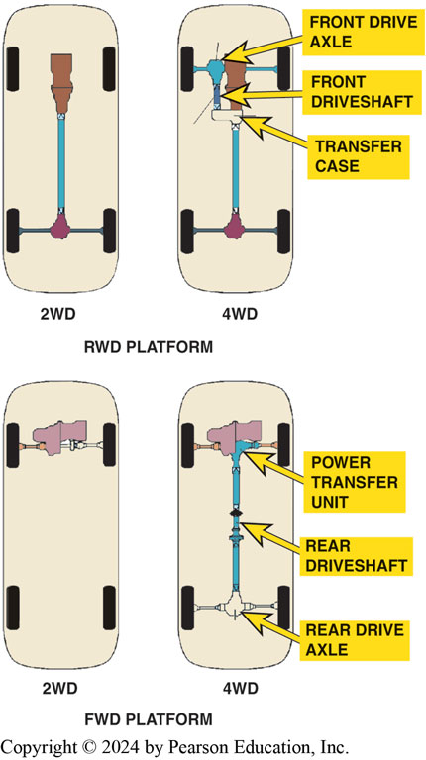
Figure 126.1 Drive Configurations
4WD vehicles can be achieved by using an existing RWD arrangement and adding a transfer case, or FWD arrangement with the addition of rear axle output shaft and center differential assembly
Notes:
4WD can be based on any drivetrain configuration including:
Front engine–RWD—
Most truck-based four-wheel systems use this arrangement.
Front engine–FWD—
Many passenger vehicles and SUV use this arrangement.
Mid-engine–RWD—
Some sport cars use this arrangement such as some Porsches.
Rear engine–RWD—
Some sport cars use this arrangement such as some Porsches

Slide 8
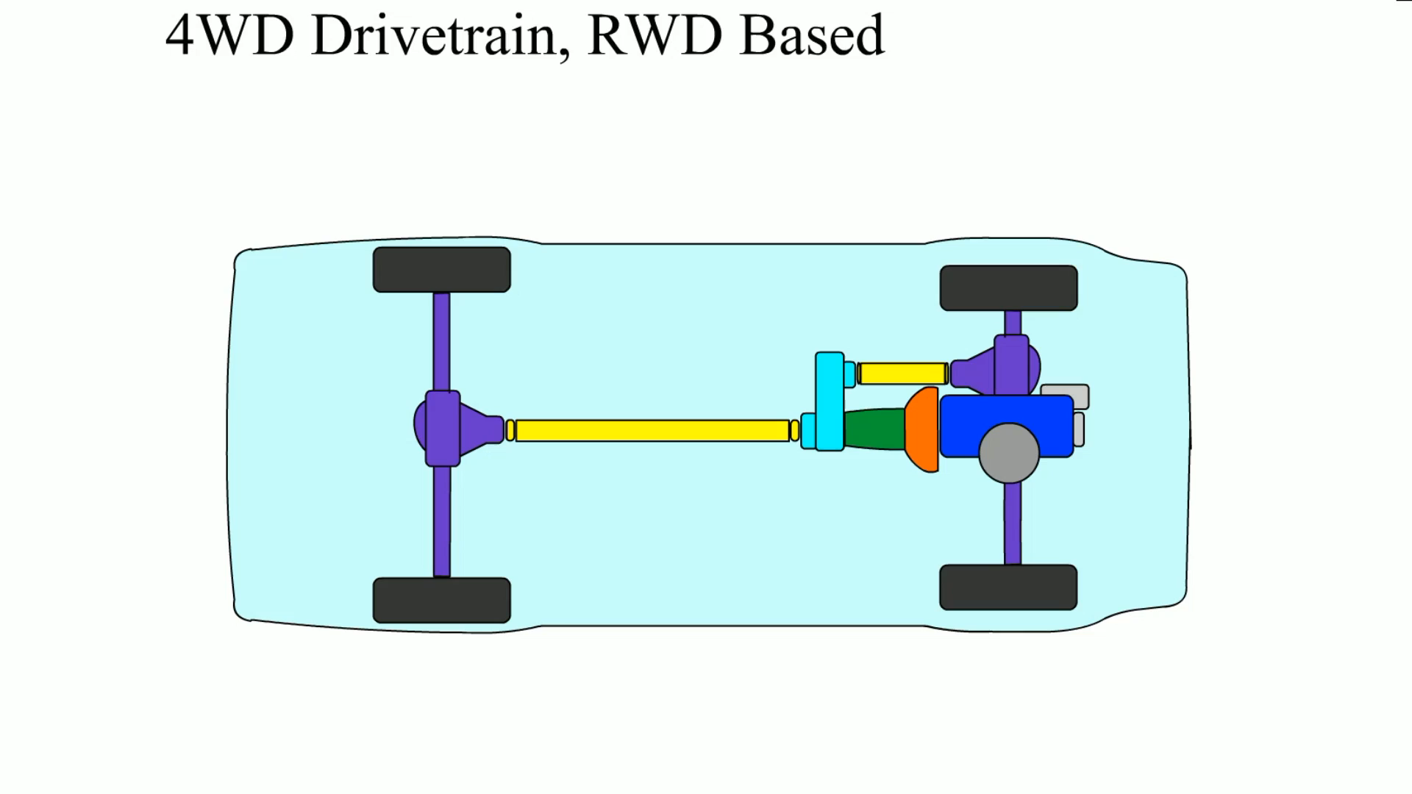
Animation: 4 WD Drivetrain, RWD Based
(Animation will automatically start)

Slide 9
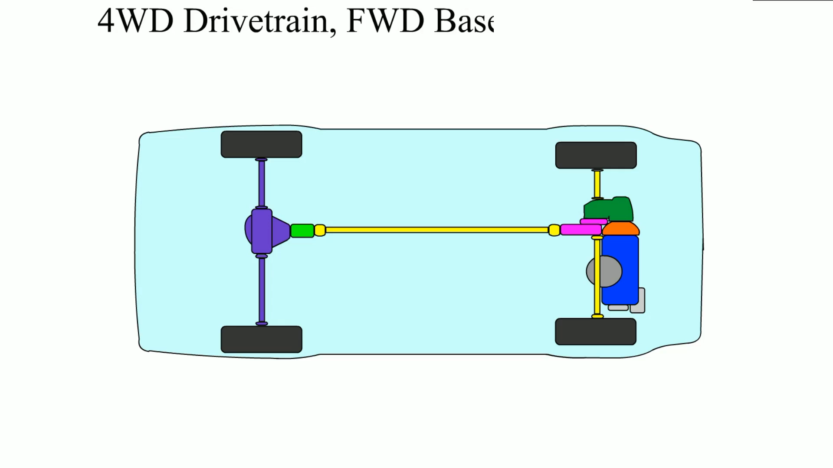
Animation: 4 WD Drivetrain, FWD Based
(Animation will automatically start)
4 WD Drivetrain, FWD Based

Slide 10
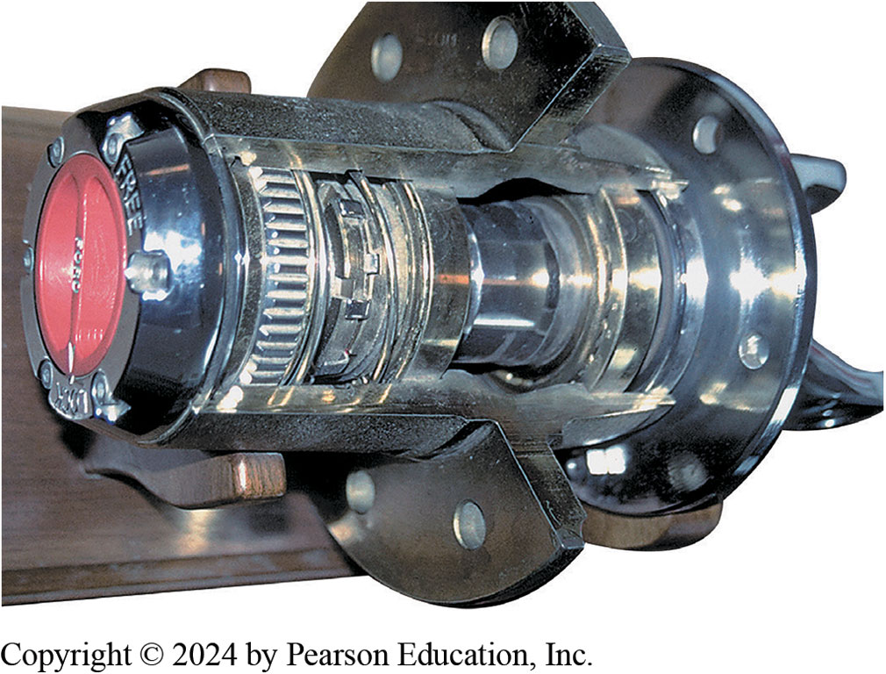
Figure 126.2 Locking Hub
Locking Hub
Connect Power
To Front Wheels
Normally unlocked
Locked in 4WD
Cutaway of a manually operated locking hub
Notes:
Power is then applied to the front wheels through the drive axles to the locking hubs. In normal 4H driving on hard surfaces, the
front hubs must be in the unlocked position. The front hubs are locked whenever driving on loose road surfaces to absorb and allow for tire slippage due to the different tire speeds front to back. This type of four-wheel-drive system is called part-time four- wheel drive because it can be driven in four-wheel drive only on slippery surfaces. ● SEE FIGURE 15–5.
CAUTION: Failure to unlock the front wheel hubs while driving on a hard road surface can cause serious drive- line vibrations and damage to driveshafts, U-joints, and bearings, as well as to the transfer case, transmission, and even the engine.

Slide 11
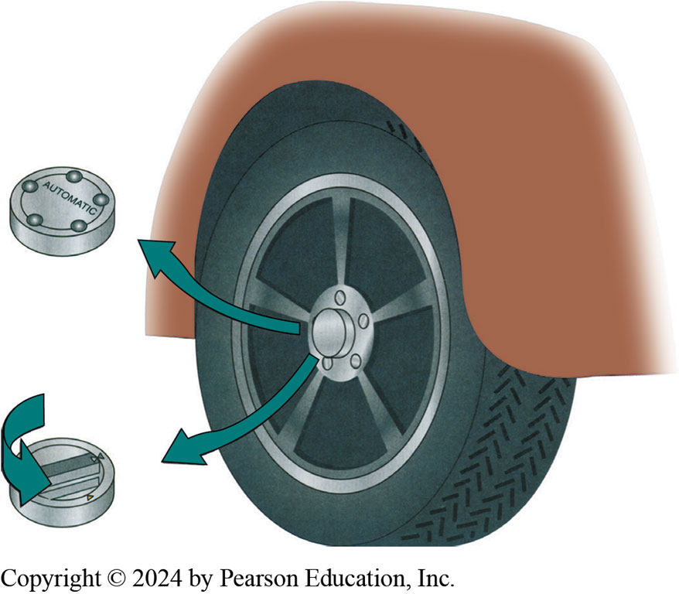
Figure 126.3 Locking Hub
Manual locking hubs require that the hubs be rotated to the locked position by hand to allow torque to be applied to the front wheels
Notes:
AUTO LOCKING HUBS Another method of locking the hubs on a part-time four-wheel-drive system is with a clutch arrangement built into the hub assembly. Whenever driving on smooth, hard road surfaces, the hubs “free wheel” and allow the front wheels to rotate at different speeds from the rear wheels. When the speed difference between the wheels and the front drive axle is great, the
hubs will automatically lock and allow engine torque to be applied to the front wheels. Automatic-locking hubs are unlocked by disengaging four-wheel drive at the transfer case and driving for several feet.
Tech Tip: Keep It in Four-Wheel Drive if Driving in Snow or Mud
The disadvantage with automatic locking hubs is that this design requires the vehicle to move some distance (usually a whole wheel turn, often going backwards) after engaging 4WD, in order for the hubs to engage or disengage. However, if the vehicle gets completely stuck before 4WD has been engaged, this means that vehicle cannot be placed into four-wheel drive.

Slide 12
Frequently Asked Question: What Is the Difference between Four-Wheel Drive (4WD) and All-Wheel Drive (AWD)?
? Frequently Asked Question
What Is the Difference between Four-Wheel Drive (4WD) and All-Wheel Drive (AWD)? The major difference between four-wheel drive and all-wheel drive is that four-wheel-drive units contain a transfer case with a low range. Most all-wheel-drive vehicles do not have low range and are in high four- wheel drive all the time. Both use a center (interaxle) differential and both usually use a viscous coupling or an electronically controlled clutch to control (lock) the center differential.

Slide 13
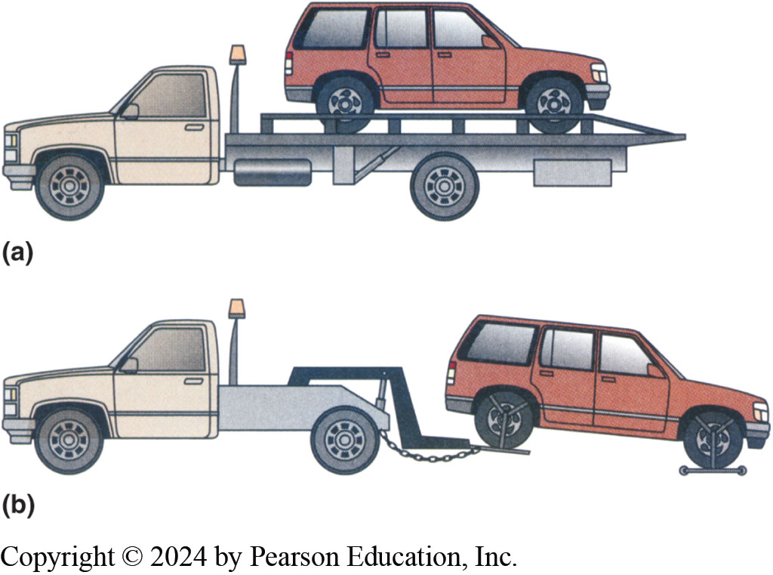
Figure 126.4 Towing
If a four-wheel-drive vehicle must be towed, it should be either on (a) a flatbed truck or (b) a dolly.
Notes:
TECH TIP: How to Tow a Four-Wheel-Drive Vehicle without Doing Harm
If any of the drive wheels are on the ground, the wheels are turning the axles. Depending on the
exact type of four-wheel-drive vehicle being towed, this rotation of the wheels can cause severe
wear; therefore, most experts suggest the following options:
Placing the vehicle on a flatbed or trailer. This keeps all four wheels off the ground and is the safest method for transporting a four-wheel-drive (or all- wheel-drive) vehicle without doing any harm.
Hoisting the front wheels off the ground and placing the rear wheels on a dolly. This procedure also keeps all wheels off the ground and therefore prevents any damage being done to the powertrain as a result of towing. ● SEE FIGURE 126–4.
Always check with vehicle-specific information for exact towing procedures.

Slide 14
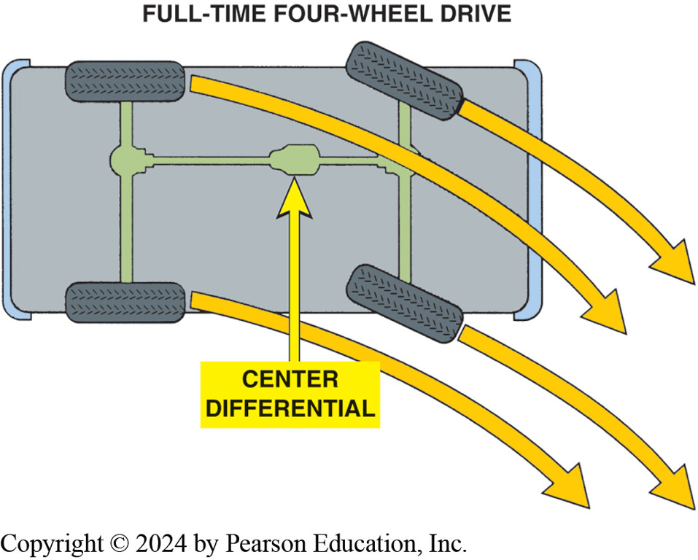
Figure 126.5 Turning a Corner
When turning a corner, each wheel takes a slightly different path and rotates at a slightly different speed. Unlike a part-time four-wheel-drive system, which when engaged locks the front and rear axles together, a full-time system uses a center differential that allows for any speed differences between the front and rear axles. It can therefore be activated on any surface—slippery or dry.

Slide 15
Full-Time Four-wheel Drive
Uses a center (interaxle) differential
Allows for both front and rear axles to rotate at different speeds.
Can be safely driven in 4WD on dry pavement
Under all driving conditions.
Notes:
Full-time 4WD is also called all-wheel drive (AWD) or anytime 4WD. AWD vehicles include a transfer case that has center
differential, which allows the front and rear driveshafts to be driven at different speeds to prevent drivetrain binding. AWD transfer cases that deliver power to both driveshafts all of the time are called mechanically active. Some AWD vehicles are passenger car based, using AWD to enhance driving on wet or icy roads, such as the Subaru.

Slide 16
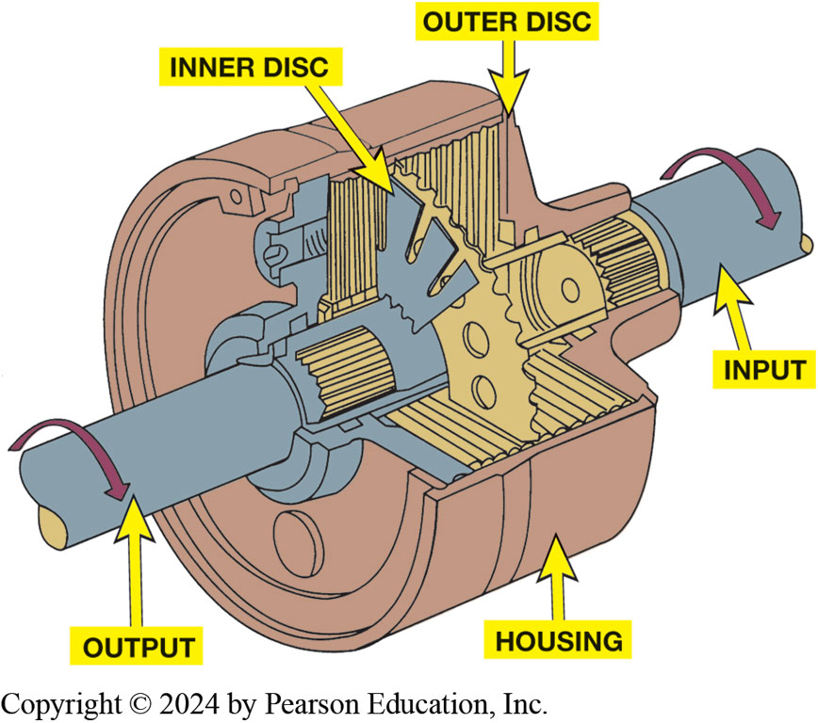
Figure 126.6 Viscous Clutch
A viscous coupling is a sealed unit containing many steel discs. One-half of them are splined to the input shaft, with every other disc splined to the output shaft. Surrounding these discs is a thick (viscous) silicone fluid that expands when hot and effectively locks the discs together.
Notes:
A viscous coupling is a series of steel plates housed in a sealed steel drum. The viscous coupling is not active during equal traction conditions. It actively transfers torque during light to moderate cornering, but there is a certain amount of slippage under these conditions to prevent driveline windup. If there is a significant loss of traction, speed differences between the front and rear axles
increase, and this increase in plate speed heats the silicone fluid in the viscous coupling, causing it to thicken to the point that it transfers more torque to the axle that is losing traction. During a severe loss of traction, the viscous fluid thickens enough to lock the
plates together, dividing engine torque equally 50/50 between the front and rear axles.

Slide 17
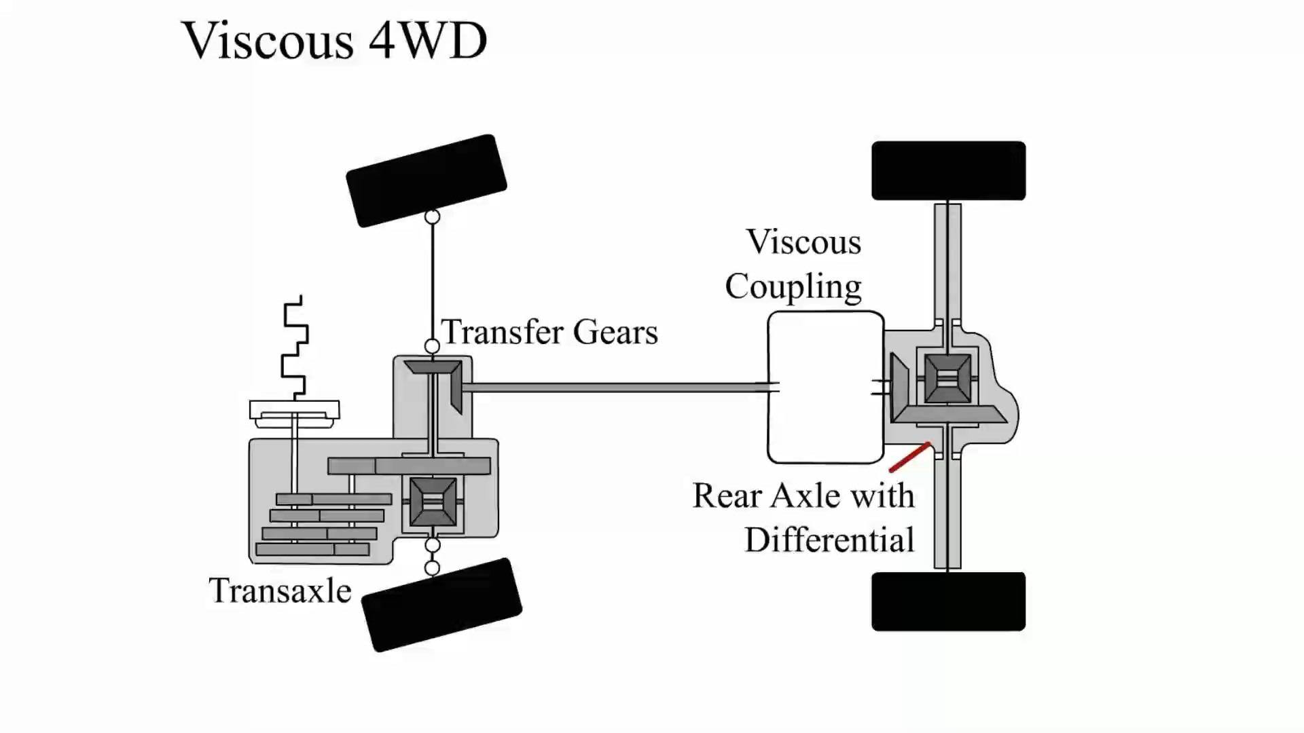
Animation: Viscous 4 WD
(Animation will automatically start)

Slide 18
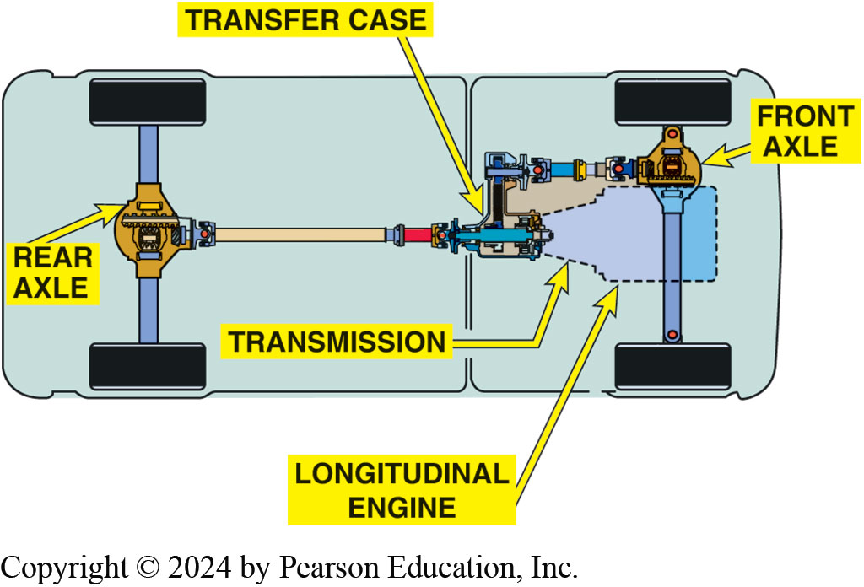
Figure 126.7 Typical 4WD Vehicle
A typical four-wheel-drive vehicle that uses a longitudinal engine and a transfer case to send engine torque to both the front and rear wheel. Even a 4WD vehicle can get stuck.

Slide 19
All-Wheel Drive (AWD)
Uses transfer case with center differential
  Only one speed (high).
  Low-range gear reduction is not used.
Viscous coupling used in center differential
Combined with a limited-slip differential in the rear, and sometimes also in front
Notes:
All-Wheel Drive (AWD)
Some cars and light trucks are equipped with an all-wheel-drive system that uses a transfer case
with a center differential and only one speed (high). Low-range gear reduction is not used. A
viscous coupling is usually incorporated into the center differential to provide superior
all-weather traction. Combined with a limited-slip differential in the rear, and sometimes also in
the front, an all-wheel-drive system can provide ideal road traction under all driving conditions
without any action by the driver.
● 126–8.

Slide 20
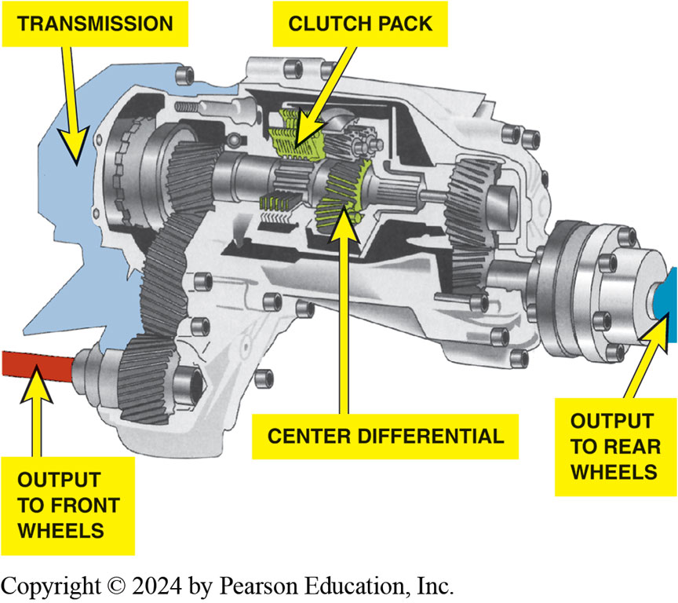
Figure 126.8 Center Differential
The center differential is heart of a all-wheel-drive system. All-wheel-drive systems do not use a low range, and therefore the vehicle may not be able to go off-road like a vehicle equipped with a four-wheel drive with a low range.

Slide 21
Frequently Asked Question: What Is Brake-Actuated Traction Control?
? Frequently Asked Question
What Is Brake-Actuated Traction Control? The engine torque of a full-time four-wheel-drive vehicle (with the center differential unlocked) is split into four nearly equal parts. One quarter of the torque is applied to each wheel. If a brake is applied to a spinning wheel, the torque to that wheel is increased, which will increase the torque to all of the other wheels. The increased torque applied to the wheels that have contact with a surface that has some traction will enable the vehicle to proceed. This is the principle involved in brake-controlled traction control such as is used on the Mercedes M4 sport utility vehicle (SUV).

Slide 22
Transfer Cases (1 of 2)
Control power flow to both front and rear axles.
Gear ranges engaged in a number of ways, such as:
  Manual lever (older vehicles)
  Electrical motor (most commonly used)
  Vacuum actuators
    Connect and disconnect front-drive axle when 2WD selected
Mode Shift
Range Shift
Notes:
The purpose and function of the transfer case is to direct engine torque to the front and rear axle
assemblies. ● SEE FIGURE 126–9. A four-wheel-drive transfer case is basically an auxiliary 2-speed
trans- mission. It uses the transmission output as an input to a secondary gear train or planetary
gear set, which provides a low and high range. The transfer of torque to the front axle output
shaft can be accomplished either by a gear-to-gear transfer or a gear and chain transfer. The
gear ranges can be engaged a number of ways, such as a manual lever, electrical, or vacuum
actuators. A transfer case has one input shaft (connected to the output of the transmission) and
two output shafts (● SEE FIGURE 126–10). The two output shafts are connected to the driveshafts and transfer torque to the front and rear differen- tials. Most transfer cases also provide for two
types of shifts:
Mode shift. Either two-wheel drive or four-wheel drive may be selected. Many transfer cases also
have a neutral position. The mode shift is achieved by the use of a floor- mounted lever to engage
and disengage a clutch inside the transfer case. This shift is usually performed when the vehicle
is stopped. However, new designs allow the mode shift to be performed under most driving
conditions. NOTE: The mode shift is not available on all-wheel-drive vehicles.
Range shift. A low range may be selected to deliver high torque at low speeds to the drive wheels. Low range usually provides a 2:1 to 3:1 gear reduction. High range (usually 1:1) simply transfers engine torque at the same speed as the output shaft of the transmission.

Slide 23
Transfer Cases (2 of 2)
Two-wheel drive operation
Four-wheel drive operation
Oil pump
Manual Shift On-the-Fly Systems
Most transfer cases today use an electric motor to make the mode and range changes and use a dial or push button for each position.

Slide 24
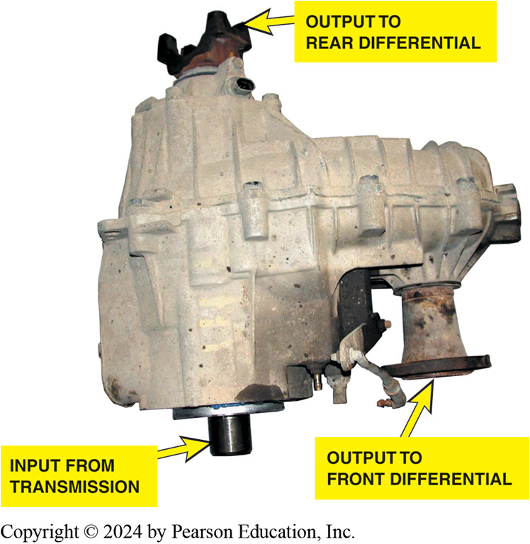
Figure 126.9 Typical Transfer Case
A typical transfer case is attached to the output of the transmission and directs engine torque to the rear or to the front and rear differentials.

Slide 25
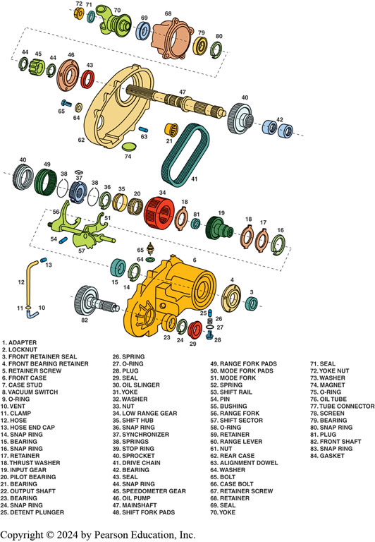
Figure 126.10 Exploded View
An exploded view of a New Venture 241 transfer case.

Slide 26
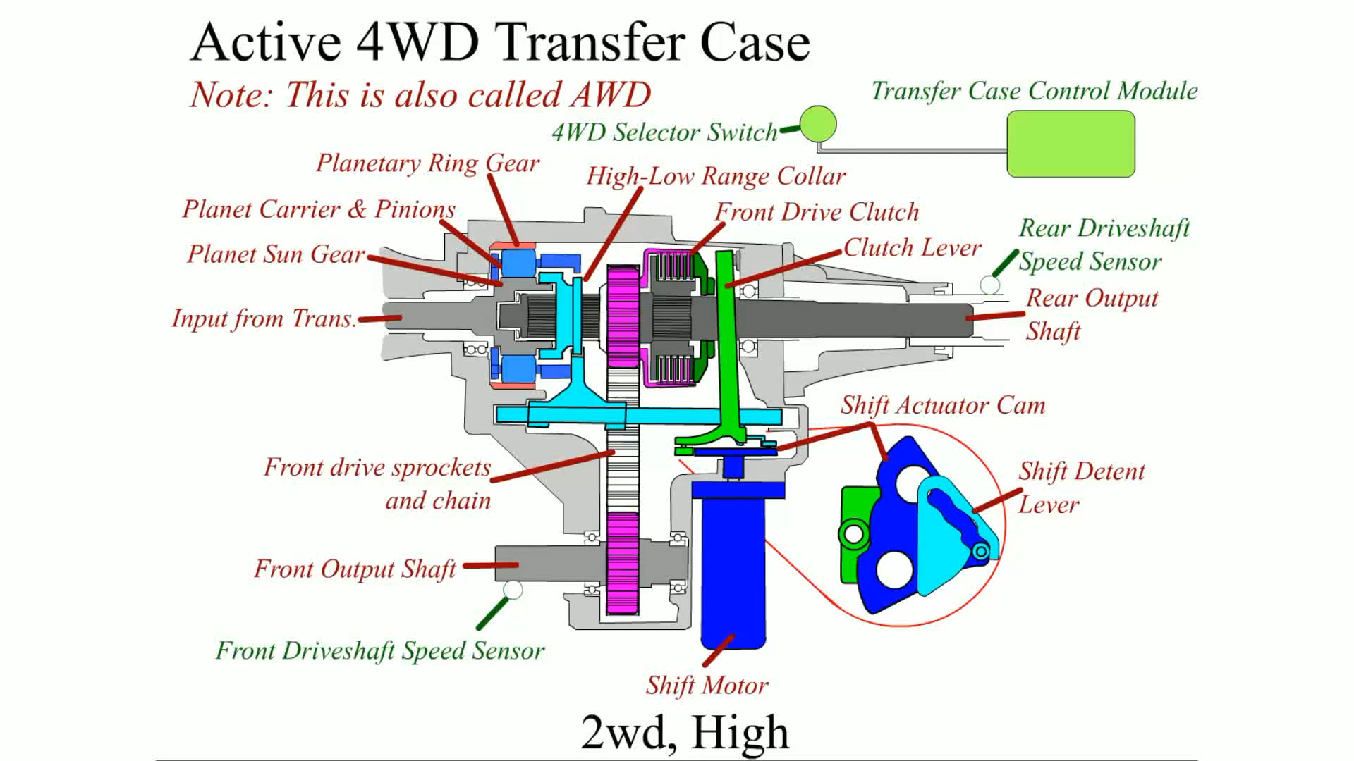
Animation: Active 4WD Transfer Case
(Animation will automatically start)

Slide 27
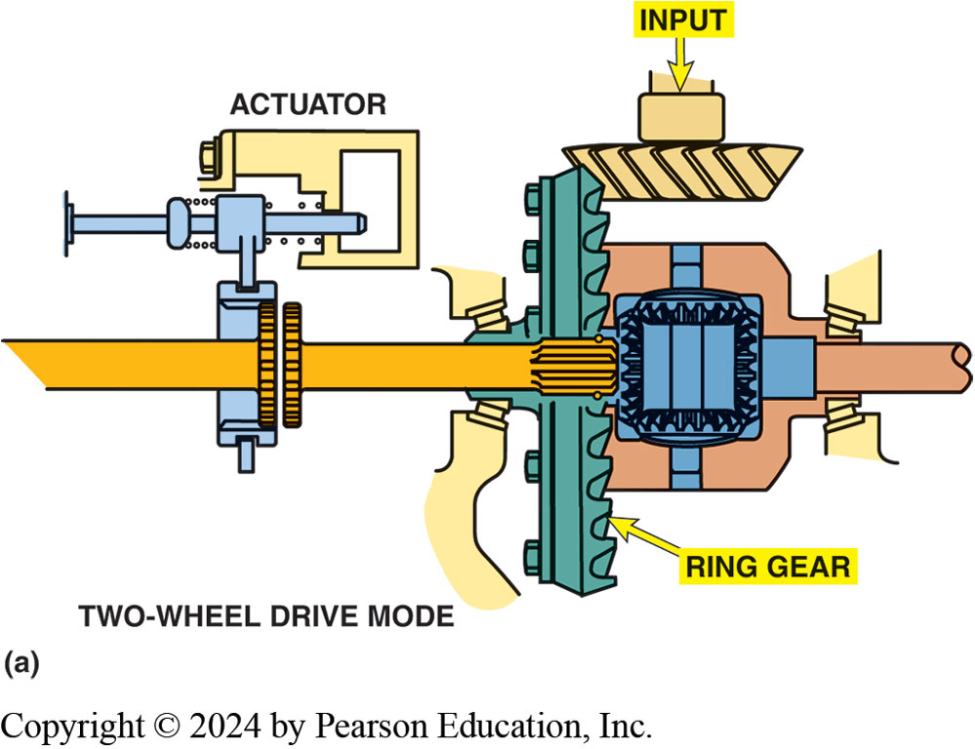
Figure 121.11a Front Axle Connect
(a) When one axle shaft is disconnected, both front wheels can rotate independently, reducing excessive tire wear.
Notes:
Gear-to-Gear Transfer Cases Gear-to-gear transfer cases are simple in design. Three gear shafts are in mesh within the transfer case. One gear shaft is attached to the transmission output shaft. The second shaft acts as an idler, and the third shaft is the output to the front axle.
Gear-to-gear transfer cases, in most cases, have two speeds. The first, 4-wheel-drive low, is a
gear reduction that is usually around two to one (2:1). The second gear in the transfer case is a
direct drive. The gears are engaged by sliding collars or synchronizers to lock the gears to the
shaft. Neutral is accomplished when neither gear collar is locking a gear in place.
TWO-WHEEL-DRIVE OPERATION When the transfer case controls are in two-wheel drive, the front
differential assembly is disconnected from the transfer case. This disconnection is usually accomplished by disconnecting one of the drive axles, as shown in FIGURES 126–11 AND 126–12. The disconnect mechanism inthe front axle and a synchronizer assembly in the transfer case
combine to remove torque for the front wheels.
FOUR-WHEEL-DRIVE OPERATION To achieve four-wheel drive, two things must occur:
A synchronizer assembly connects the torque from the engine to the front driveshaft in the transfer case.
The drive axles must be connected to allow the torque from the front differential to be applied to the drive wheels.

Slide 28
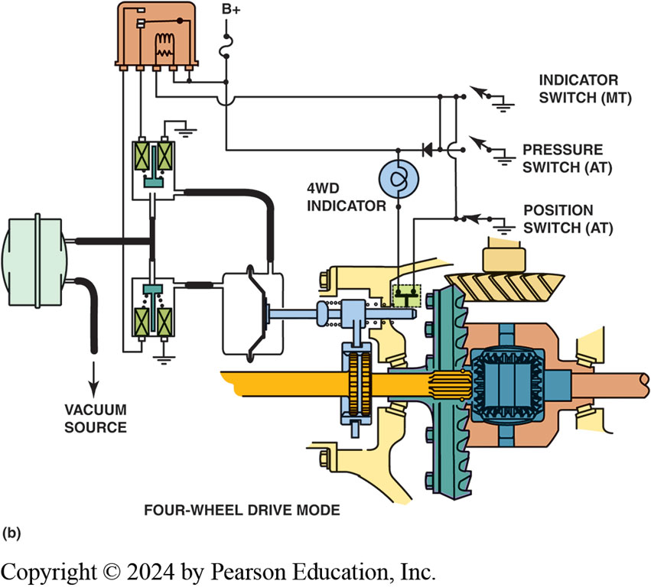
Figure 121.11b Front Axle Connect
(b) 4WD mode, vacuum applied to front part and opposite side is vented to atmospheric pressure retracting shift motor stem. Shift fork & collar move into engagement with both axle shaft gears. Engine torque from front differential can now be applied to both front axles.

Slide 29
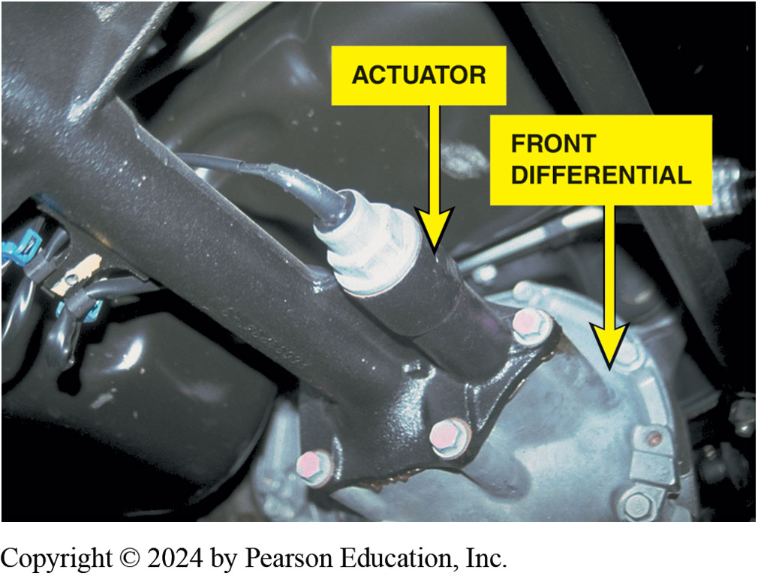
Figure 126.12 Electric Axle Actuator
GM sport utility vehicle front axle showing the electric axle disconnect actuator

Slide 30
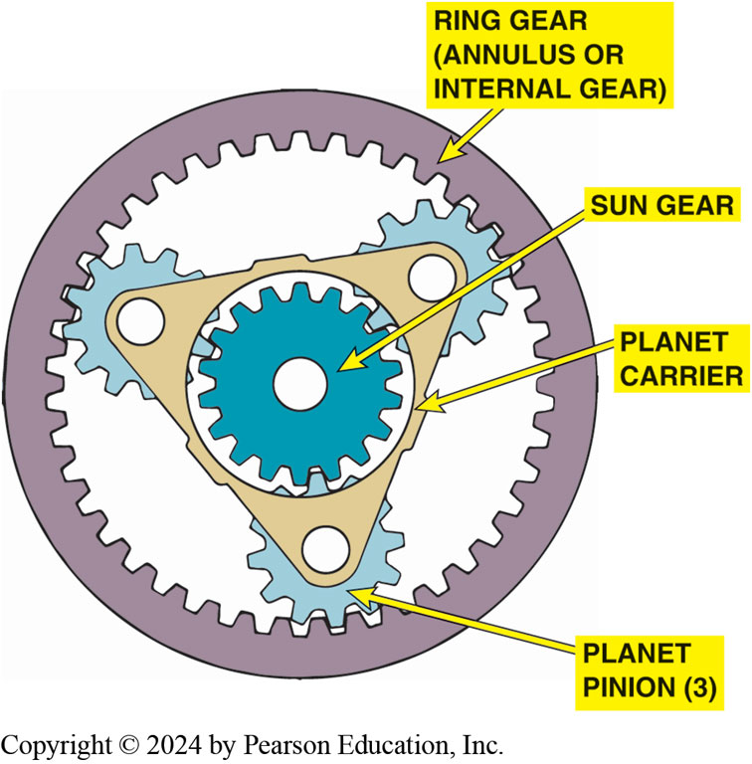
Figure 126.13 Planetary Gearset
A typical planetary gear set used in a transfer case.
Notes:
Many transfer cases use a planetary gear set for gear reduction in low range. A planetary gear set
includes the following three elements:
1. Sun gear. This gear is in the center like the position of the sun is in our solar system.
2. Planet pinions. The planet pinion gears rotate around the sun gear, like the planets around the
sun, and are attached by a planet carrier.
3. Ring gear. The outer ring gear has teeth on the inside that mesh with the teeth of the planet
pinion gears. The ring gear is also called the annulus gear or internal gear because the gear teeth
are on the inside (rather than the outside) portion of the gear.
The gear teeth of a planetary gear set remain in constant mesh. When gear reduction is needed, the
sun gear is often the drive gear and the planet carrier is often the driven gear. The gear ratio
reduction depends on the number of teeth on the various gears used in a planetary gear set. ● SEE FIGURES 126–13 AND 126–14. To achieve direct 1:1 output from the transfer case, any two of the three elements can be locked together and the entire
assembly will rotate as a unit.

Slide 31
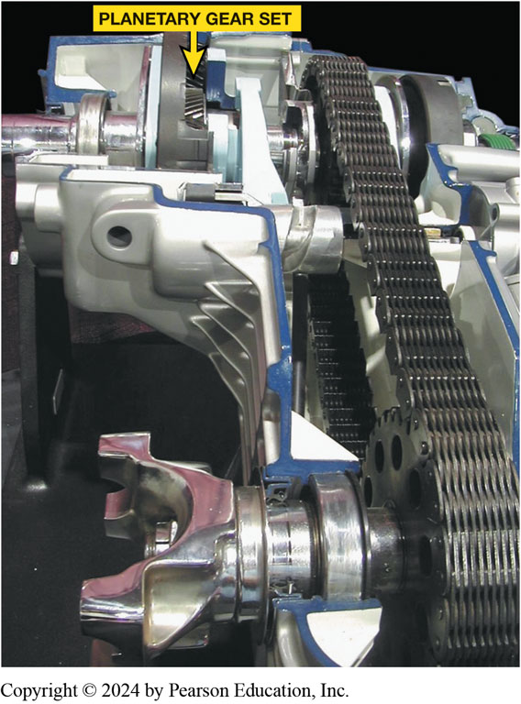
Figure 126.14 Planetary Transfer
Cutaway of a planetary gear set transfer case. Planetary gear differentials are designed to split the torque unequally between the front and rear drive axles.
Notes:
Planetary gear differential. A planetary gear set is often incorporated in transfer cases to act as a differential. The torque split can be varied by using a planetary gear set as a center differential by changing the number of teeth on the various elements and how they are interconnected can result in various torque splits front to rear.

Slide 32
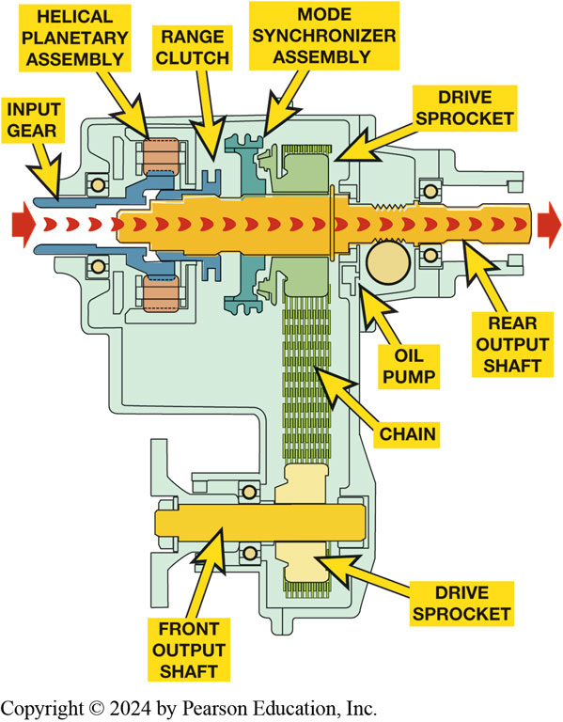
Figure 126.15 2WD Operation
Notes:
Figure 126-15 Two-wheel-drive/high-range torque flow in a NV231 transfer case. The sliding range
clutch is shifted to the forward position by the range lever and fork, which connects the input
gear to the output shaft and rear axle. The mode synchronizer sleeve is moved out of engagement
from the drive sprocket to remove torque from the front axle. When the transfer case controls are in two-wheel drive, the front differential assembly is disconnected from the transfer case. This disconnection is usually accomplished by disconnecting one of the drive axles. The disconnect mechanism in the front axle and a synchronizer assembly in the transfer case combine to remove torque for the front wheels. 126–15.

Slide 33
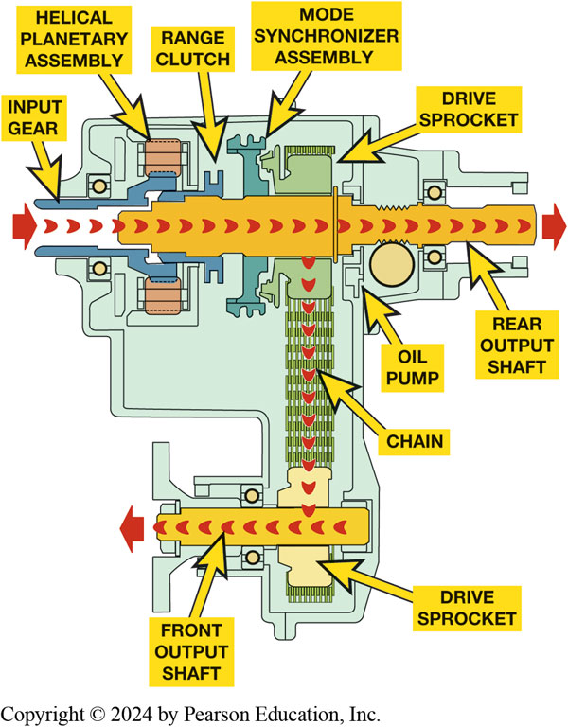
Figure 126.16 4WD Operation
Notes:
Figure 126–16 Four-wheel-drive/high-range torque flow in a NV231 transfer case. The range clutch position remains the same as in two-wheel drive/high-range, but the synchronizer sleeve is moved rearward and engages the drive sprocket clutch teeth. This action connects the drive sprocket to the rear output shaft, thereby applying equal torque to both front and rear output shafts.
4WD Operation: To achieve four-wheel drive, two things must occur.
synchronizer assembly connects the torque from the engine to the front driveshaft in the transfer case.
drive axles must be connected to allow the torque from the front differential.
Full-time 4WD or all-wheel drive (AWD) transfer cases maintain constant power to both the front and rear axles and include a center (interaxle) differential, between the front and rear output shafts.
A chain drive transfer case uses the following parts:
An input shaft, which is connected to the output shaft of the transmission.
In a planetary gear set transfer case, the input shaft is d to the sun gear.
The output shaft to the rear wheels is connected directly to the output shaft through the range clutch if it is in four-wheel drive high range. In low range, the torque flows though the planetary gear set and exits through the ring gear.
In two-wheel drive, engine torque is sent directly to the output shaft and on to the rear drive axle assembly.
In four-wheel drive mode, engine torque is sent through a drive sprocket and a wide chain to the driven sprocket and front output shaft.

Slide 34
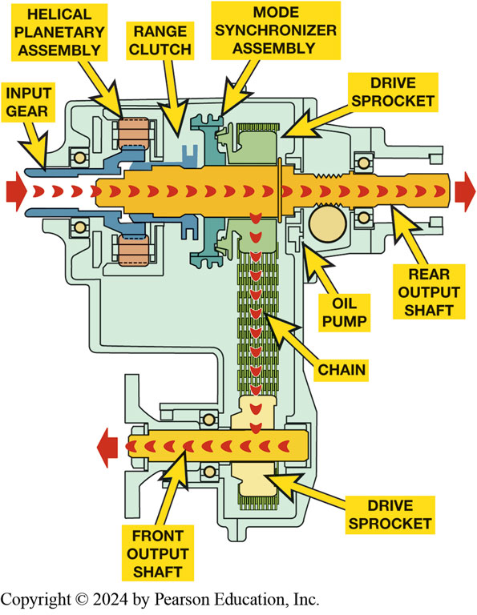
Figure 126.17 Transfer Case Encoder
Purpose and Function
  Transfer case motor/ encoder assembly is electric motor
  Used to shift transfer case from 2WH to 4WH
    Can also make a range change between 4WH & 4WL
Motor/Encoder Assembly
Torque Split
Notes:
Figure 126–18 Four-wheel-drive/low-range torque flow in a NV231 transfer case. The mode synchronizer assembly remains engaged and the range clutch is moved to rearward position. The annulus (ring) gear is fixed to the case and the input (sun) gear drives pinion gears, which walk around the stationary annulus gear and drive the planetary carrier and output shaft at a speed lower than the input gear.
Transfer Case Motor/ Encoder Assembly is electric motor used to shift transfer case from two-wheel high (2WH) to four-wheel high (4WH) and can also make a range change between four-wheel high (4WH) and four-wheel low (4WL). These are used on vehicles that feature:
Electronic Shift-on-the-Fly (ESOF) transfer cases. In an electronic transfer case the operation of
the range clutch and mode synchronizer assembly is controlled by the motor/ encoder assembly. ● SEE
Figure 15–18.
Motor/Encoder Assembly Part of the motor assembly is an encoder, which is a position sensor that
sends the actual position of the transfer case shift shaft to the transfer case control module
(TCCM). The TCCM uses the data from the input and output speed sensor to determine when to shift
the transfer case to four-wheel drive. If the rear wheels start to slip, the TCCM commands the
motor/encoder assemble to make the mode shift. The TCCM also sends a signal to the front axle
motor or actuator to engage the front axle when the transfer case is engaging four-wheel high mode.
● SEE FIGURE 15–19.
Torque Split:

Slide 35
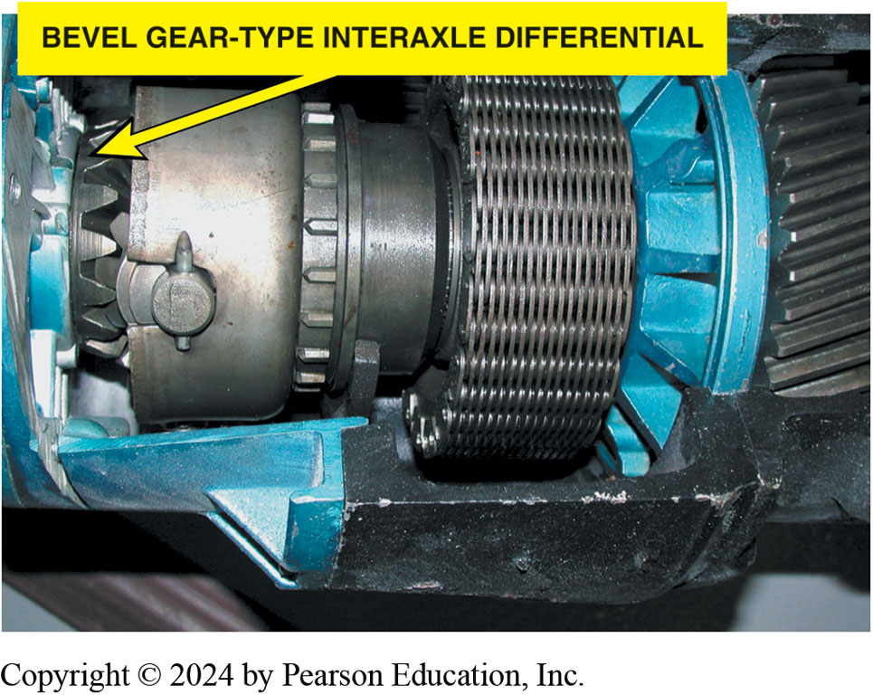
Figure 126.18 Interaxle Differential
A bevel gear-type interaxle differential.
Notes:
All-the-time four-wheel-drive, all-wheel-drive, and full-time four- wheel-drive systems use an
interaxle differential (center differential) to prevent driveline harshness and vibration, com-
monly referred to as driveline windup. An interaxle differential can be found in various
configurations including
■ Standard bevel gear differential
■ Planetary gear differential
■ Viscous coupling
Although they are different in appearance, interaxle differ- entials serve the same purpose, to
maintain smooth operation while making turns in a four-wheel-drive/all-wheel-drive vehicle. The
bevel gear differential uses two bevel gears or spider gears attached to the output shaft of the
transmission. Two to four differential pinion gears are attached to a carrier, which is attached
to the transfer gears. In other words, it operates in the same fashion as the differential in a
rear axle; power is transferred to the tire with the least traction. When there is unequal traction
between the front and rear axles, the axle with the most traction is allowed to slip enough to
prevent damage to driveline components. ● Figure 126–18.

Slide 36
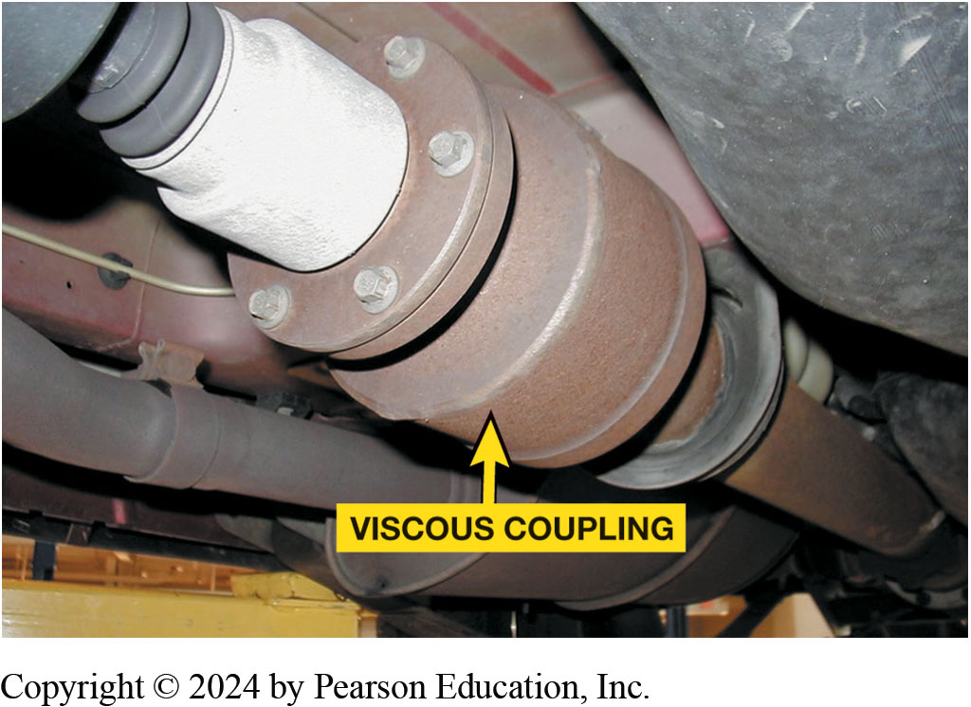
Figure 126.19 Viscous Coupler
A viscous coupling. Note that the unit is attached to the output shaft between the transfer case (or transaxle) and the rear differential. A typical viscous coupling in a sealed unit is serviced as a complete assembly.

Slide 37
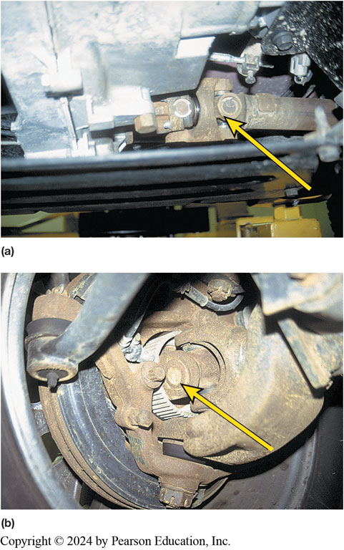
Figure 126.20 Front Drive
(a) A double Cardan U-joint used on the output driveshaft from the transfer case to the front differential assembly. (b) A Cardan-type U-joint at the front drive wheels on a Jeep Wrangler.
Notes:
Four-wheel-drive vehicles use a variety of driveshafts and U-joint designs:
■ Standard Cardan-type U-joints. ● SEE FIGURE 126–20. It can cause the front wheels to skip, hop, and shake if engine torque is applied while on dry pavement and turning a corner at the same time. This is normal for this type of U-joint used on the front wheels of a 4WD vehicle.
■ Constant velocity (CV) joints. The use of CV joints at the front wheels allows engine torque to
be applied without changes in wheel speed, as can often occur if standard U-joints are used. ● SEE FIGURE 126–21.
NOTE: Constant velocity (CV) joints are commonly used on vehicles that have the differential
assembly attached to the frame of the vehicle. This design reduces the amount of weight that has to
move up and down during suspension movement and helps provide a smooth ride.

Slide 38
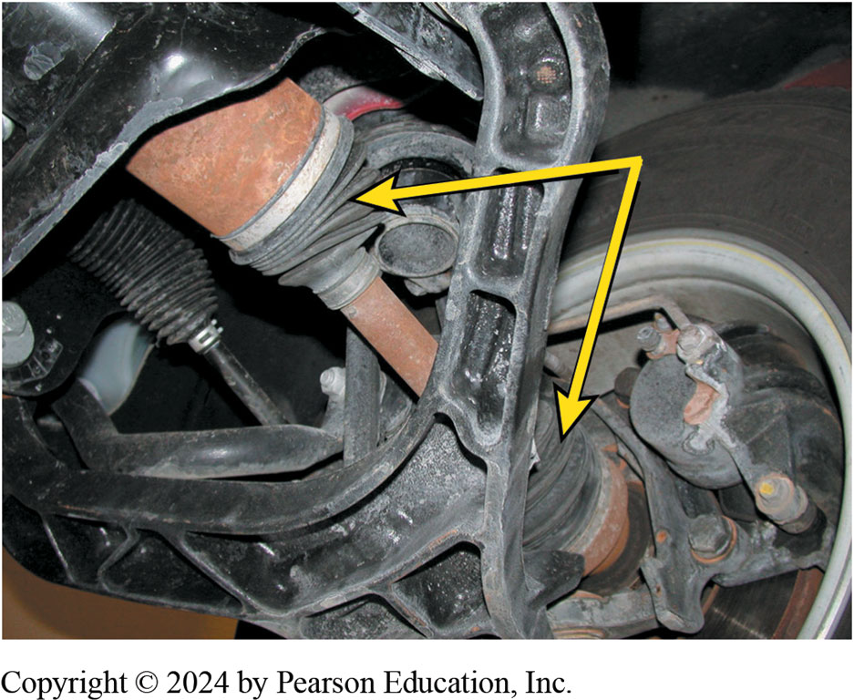
Figure 126.21 Front Drive
Constant velocity (CV) joints are used on the front axles of many four-wheel-drive vehicles like this Chevrolet Blazer.

Slide 39
Question 1?
All of these can occur if a part-time four-wheel-drive vehicle is driven on hard pavement in four-wheel drive, EXCEPT:
  Vehicle will shake and shutter as engine torque is applied to the drive wheels
  Vehicle will slip and hop over the pavement
  Vehicle will experience driveline vibrations and damage to driveshafts,
  Vehicle engine will stall

Slide 40
Answer 1
All of these can occur if a part-time four-wheel-drive vehicle is driven on hard pavement in four-wheel drive, EXCEPT:
D. Vehicle engine will stall

Slide 41
Transfer Case Service and Problem Diagnosis
4WD transfer cases built for heavy-duty use
Preventative maintenance may need to be done:
  Draining and refilling the transfer case.
  Most use ATF
  Some require SAE 80W-90 GL-4 gear lube.
  Fluid leaks should be corrected
Drive Chain. can stretch
Bearings. may cause noise
Shifting. shift linkage bent or binding, wrong lubricant
Notes:
Four-wheel-drive transfer cases and related components are usually built strong enough for
heavy-duty use. However, there is some preventative maintenance that may need to be done:
Draining and refilling the transfer case. Most transfer cases require automatic transmission fluid (ATF), yet some (especially older) units require SAE 80W-90 GL-4 gear lube. Any fluid leaks should be corrected as soon as possible to avoid damage from low lubricant level. ● SEE FIGURE 126–22.
Drive Chain. The chain in chain-drive transfer cases can stretch and start hitting the inside of the transfer case. ● SEE FIGURE 126–23. This occurs most frequently in vehicles that use four-wheel drive under heavy loads for extended periods of time. The noise the chain makes is very loud, and the chain should be replaced as soon as possible to avoid excessive damage to the case.
Bearings. Transfer case bearings may cause noise whenever the input shaft is rotating even if the transfer case is in neutral. Consult the factory service information for details on transfer case bearing noise diagnosis procedures.
Shifting. Shifting problems can be caused by several items: shift linkage bent or binding, worn shift fork or synchronizer assembly (● SEE FIGURE 126–24), incorrect transfer case lubricant.

Slide 42
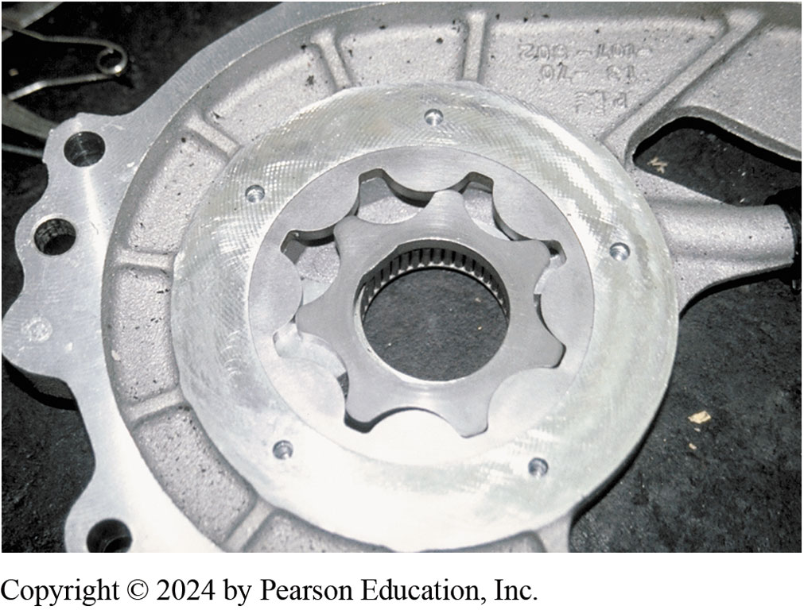
Figure 126.22 Internal Oil Pump
Most transfer cases use an internal oil pump to force the lubricant throughout the unit. Using the correct lubricant is critical to the proper operation of the transfer case.

Slide 43
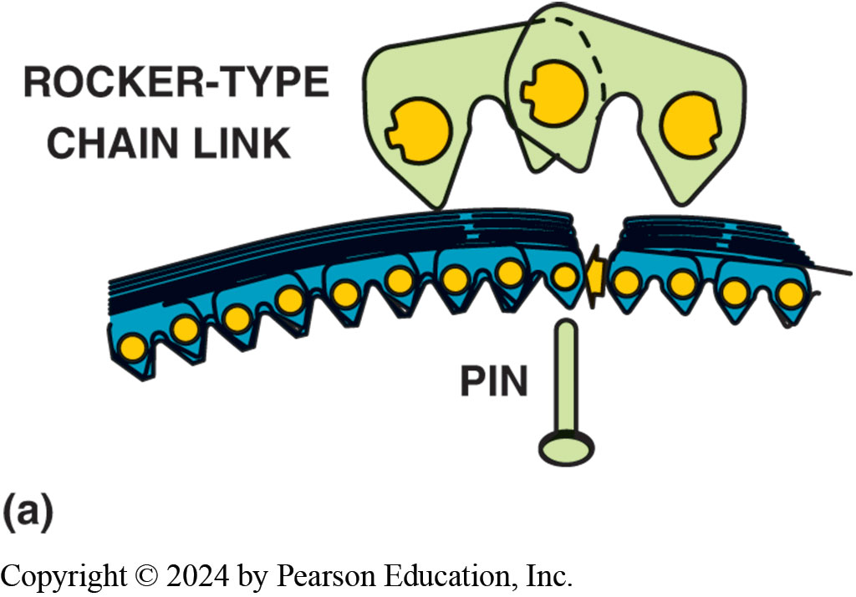
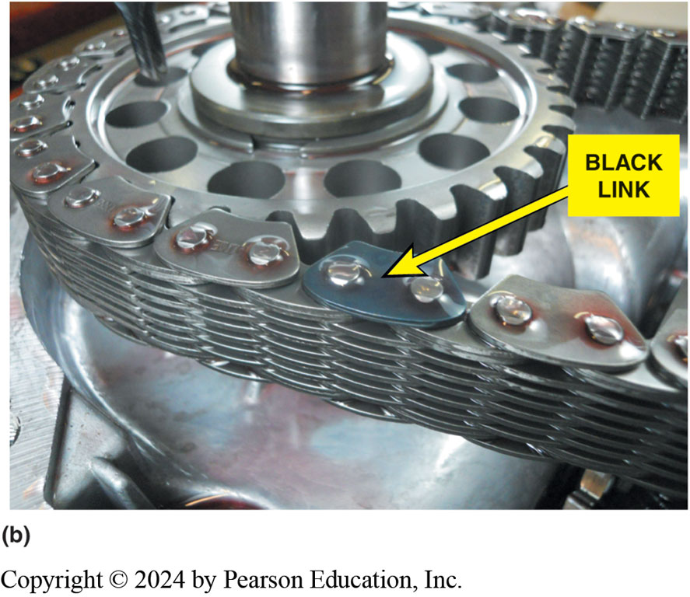
Figure 126.23 Drive Chain
(a) A pin and rocker-type chain, which is also called a rocker joint-type chain, is used in transfer cases because of low noise and high efficiency, which improves fuel economy.(b) A rocker pin-type chain used in a transfer case. The black link faces upward and is used as an indicator to the service technician to help insure that the chain is replaced in the same side up when it is reassembled.
Notes:
What Is a Rocker Pin Chain? The type of chain used in transfer cases is usually assembled from pin links and chain links and is called “rocker pin” type chain. The chain links are what contact the teeth of the sprocket and not the pins as with a roller-type chain.

Slide 44
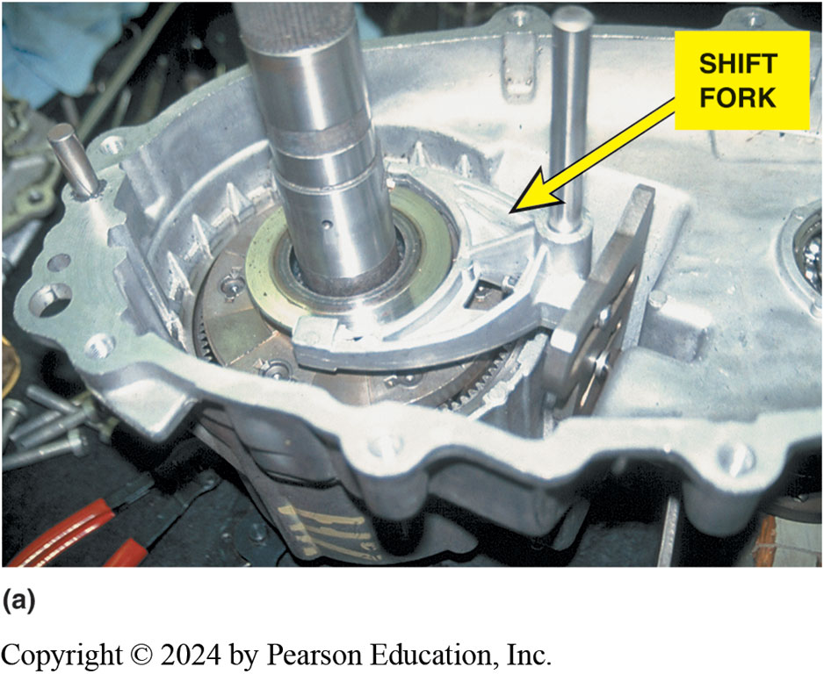
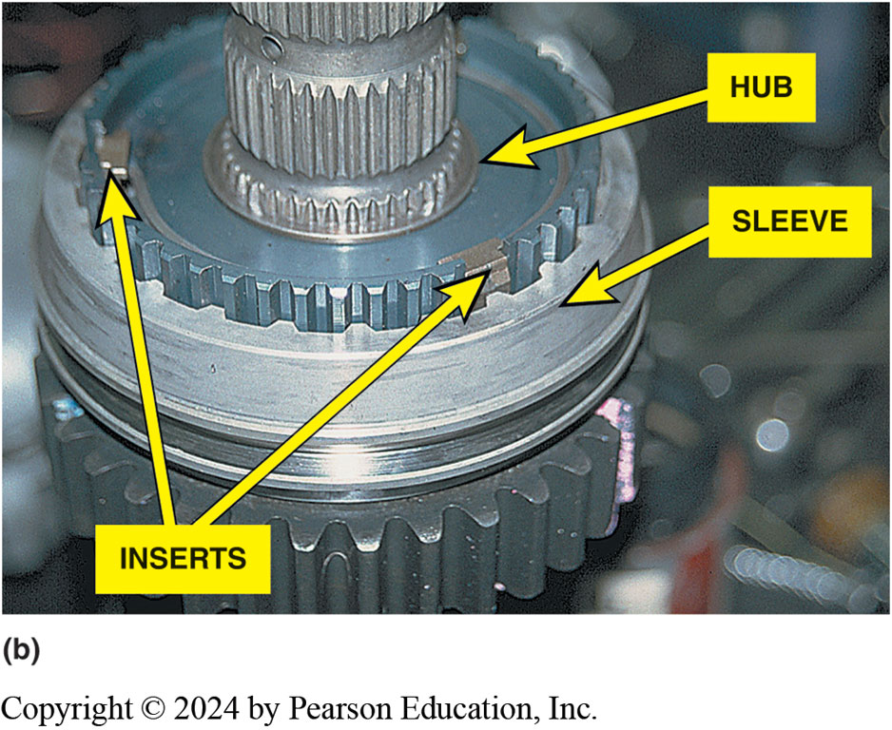
Figure 126.24
The transfer case shift forks attach to the synchronizer sleeve. (b) The sleeve, hub, and inserts are similar in design except larger than those used in a manual transmission/transaxle.

Slide 45
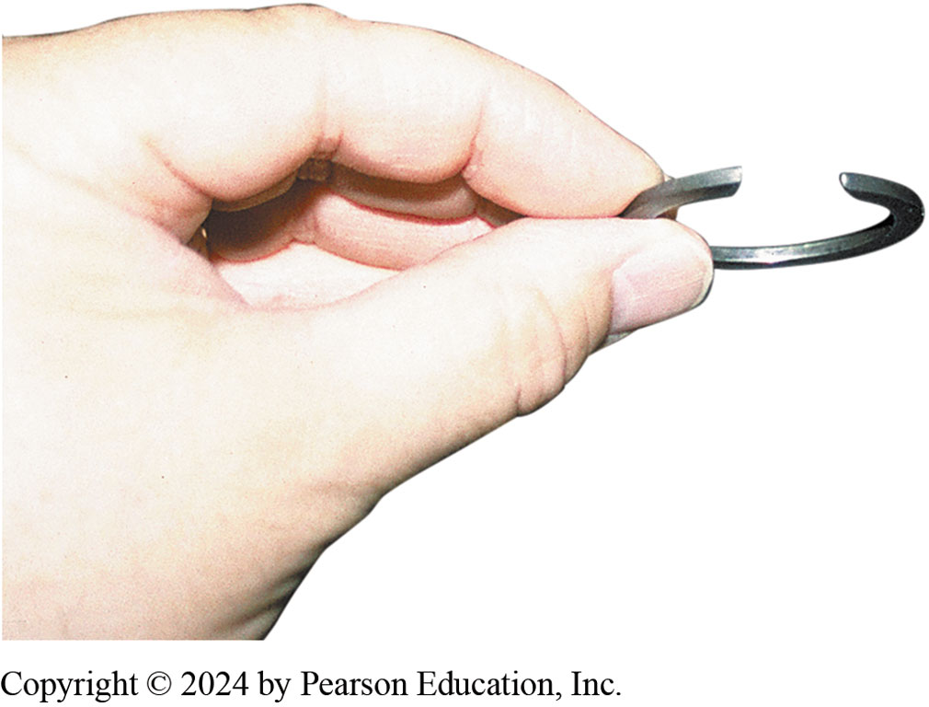
Figure 126.25 Snap Ring
When reassembling a transfer case (or another automotive component) that includes a snap ring, always be sure that the upper opening is tapered from the top to allow snap-ring pliers room to get a grip on the open end.
Notes:
TECH TIP Please Install Snap Rings Correctly
Many snap rings are tapered at their opening, as shown in ● FIGURE 126–25. This allows the snap
ring pliers to grasp the points of the snap ring so that it can be expanded and easily removed. If
the points are facing down, it is very difficult for snap-ring pliers to grasp the end of the snap
ring. Therefore, to make it easier to disassemble a transfer case later, always
install snap rings as they were designed to be installed.

Slide 46
Diagnosing & Servicing
Locking Hubs
Cleaned periodically, driven under water or dusty conditions.
Most recommend hubs be cleaned and lightly coated with grease when front wheel bearings are serviced
Start front hub inspection removing the cover plate
Problems with locking hubs can be corrected
  By cleaning and lubricating
Service kits are often available for the hubs
Notes:
Locking front hubs should be cleaned periodically, especially if the vehicle has been driven under
water or in dusty conditions. Most vehicle manufacturers recommend that the hubs be cleaned and
lightly coated with grease at the same time the front wheel bearings are serviced. Check the
service information for the exact procedure for the vehicle being serviced. ● SEE FIGURE 126–26.
Start the inspection of the front hubs by removing the cover plate. Many problems associated with
locking hubs can be corrected by cleaning and lubricating the components. If noise is heard from the hubs, carefully inspect the inner components on both sides of the vehicle. A damaged part can cause noise in the hub on the other side. Service kits are often available for the hubs. These kits contain the
gaskets, seals, and retaining rings necessary for installing the hubs correctly after wheel bearing
or front brake work has been completed.
NOTE: Check the amount of axle end play. Excessive end play caused by defective bearings can cause the drive axle to move enough to damage the hubs.
TRANSFER CASE SERVICE Transfer cases usually require occasional lubricant change during normal service life. However, driver abuse often causes parts to break, requiring the overhaul
of the entire assembly. Always follow the vehicle manufacturer’s recommended servicing procedure.

Slide 47
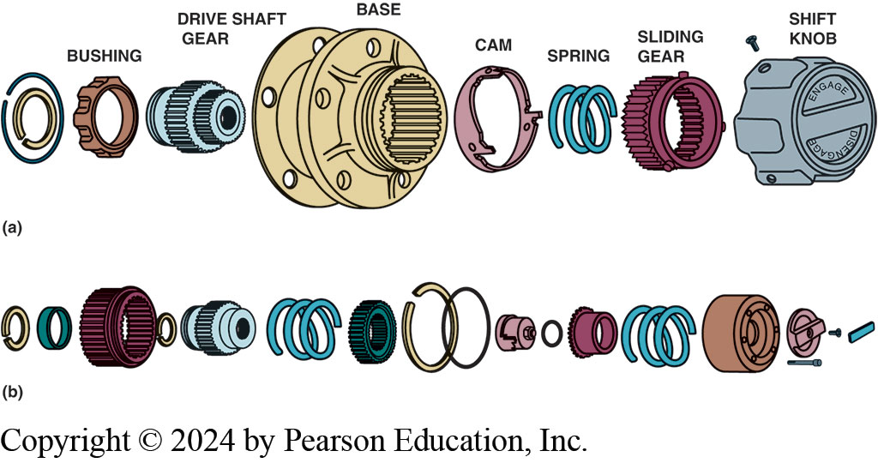
Figure 126.26 Auto Locking Hubs
(a) An exploded view of a Dualmatic® manual locking hub. (b) A Warn® manual locking hub.
Notes:
CASE STUDY: The Differential Lubricant Story
A 4WD vehicle was serviced and both differentials were drained and refilled as recommended by the manufacturer. The owner returned shortly after picking up the vehicle and complained that the vehicle drove as if the parking brake was still applied. The vehicle lacked power and would decelerate rapidly whenever the accelerator pedal was released. Careful inspection of the parking brake revealed that everything was functioning correctly. Because all that was done was the differential fluid service, the fluid level was checked and again, the level was correct and not overfull. Then the technician checked
the container of gear lubricant that was used and discovered that the parts store had accidentally
sent SAE 80W-140 instead of the requested, and more commonly used, SAE 80W-90. Both lubricants were listed GL-5, meaning that they were acceptable for differentials. The container of lubricant
had been installed in the portable lubricating dispenser when it was delivered, and therefore the
label on the container was not visible to the technician. The correct lower viscosity lubricant was
installed in the differential and normal vehicle performance was restored. The technician and the parts store learned to double-check the product before shipping or using it.
Summary:
Complaint—The customer complained of poor performance after the differential fluid was replaced.
Cause—The incorrect fluid was used.
Correction—the correct viscosity fluid was used, which restored proper vehicle performance.

Slide 48
NV-242 Transfer Case Service Photo Sequence

Slide 49
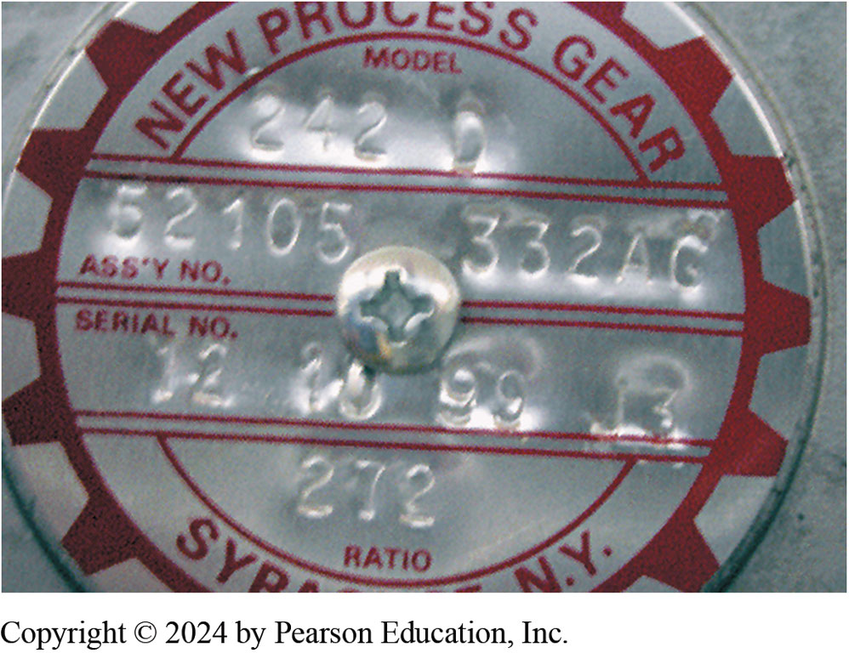
1. Identification Plate
1. The identification plate on the housing indicates the transfer case is a New Venture (New Process) model #242 and has a low-range gear ratio of 2.72.1.

Slide 50
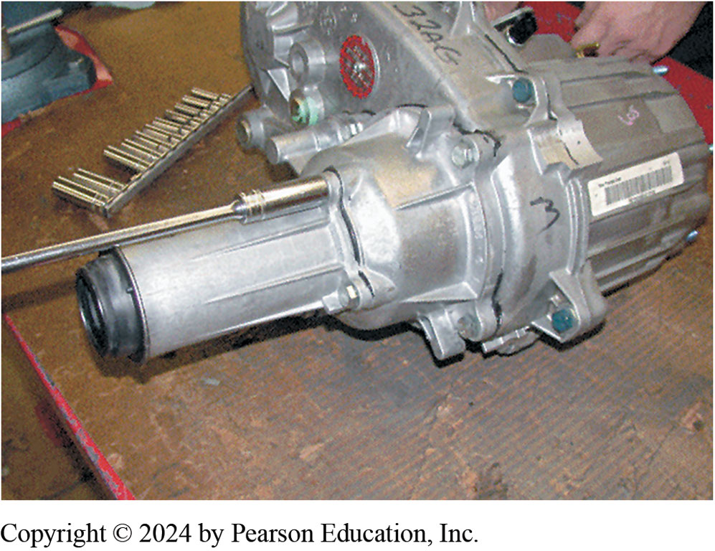
2. Rear Output Shaft Removed
2. Rear output shaft housing being removed.

Slide 51
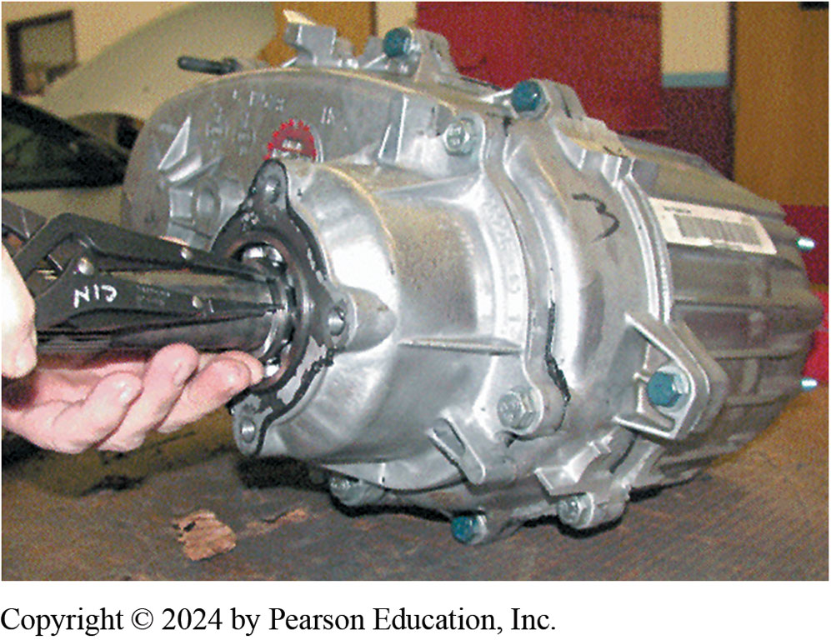
3. Bearing Retainer Removed
3. Before the case can be separated, the bearing retaining snap ring must be removed using snap-ring pliers.

Slide 52
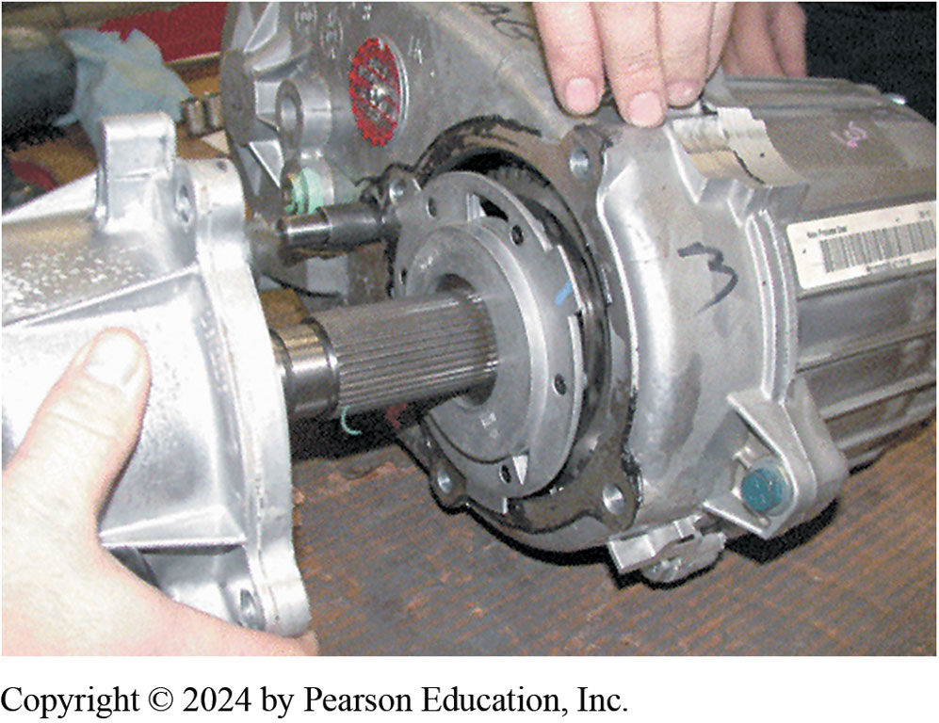
4. Lubricating Oil Pump Visible
4. lubricating oil pump is visible after the cover and bearing assembly have been removed.

Slide 53
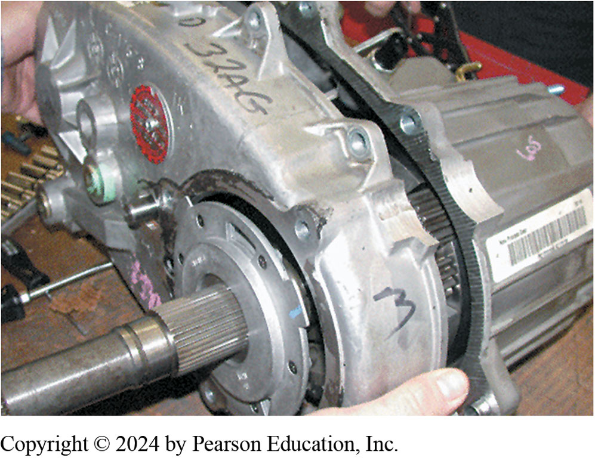
5. Case Halves Being Separated
5. The two case halves are being separated.

Slide 54
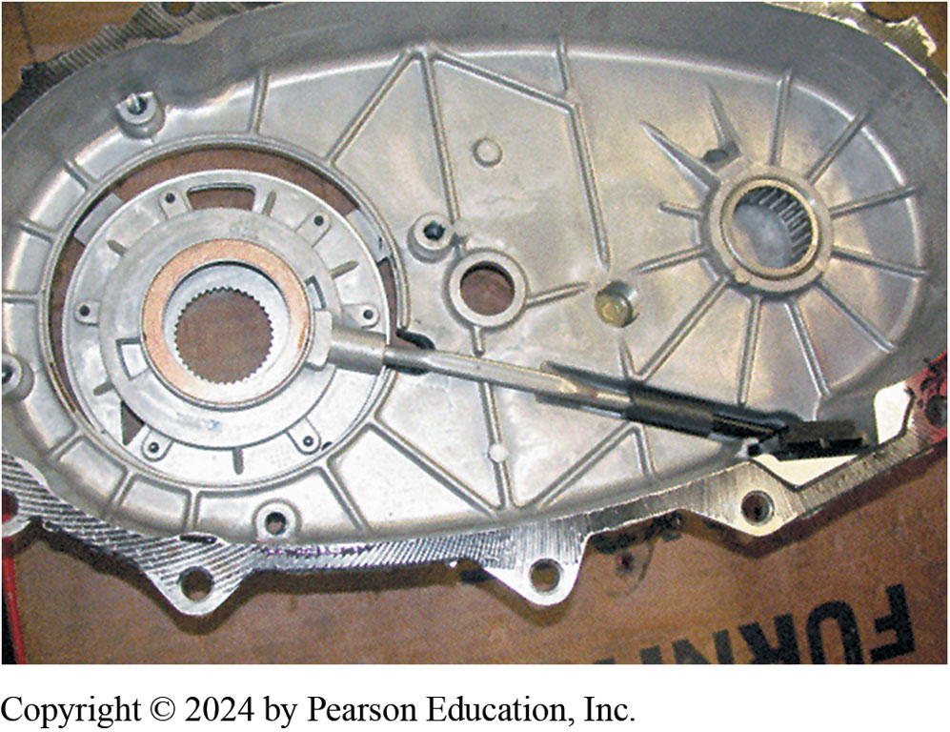
6. Oil Pump
6. The oil pump assembly, pickup screen, and tube are visible on the backside of the case cover.

Slide 55
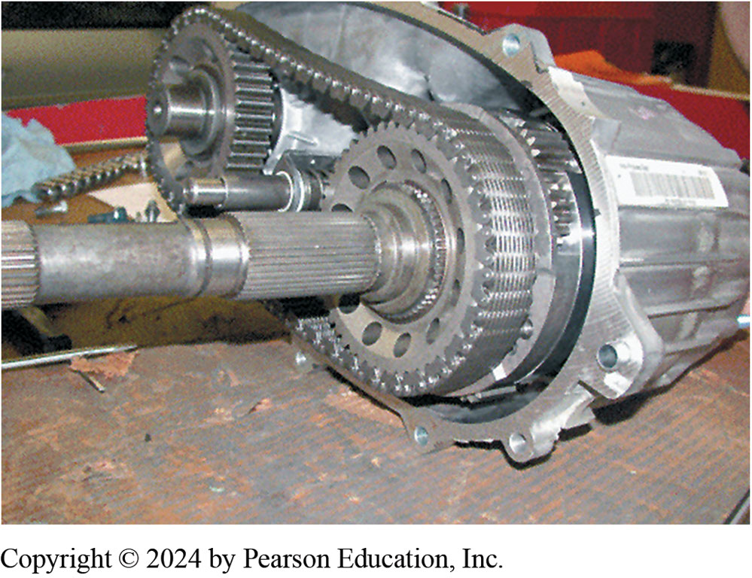
7. Rear Output Shaft
7. The rear output shaft and sprocket are visible on the right. The front output shaft and sprocket are visible on the left connected by the drive chain.

Slide 56
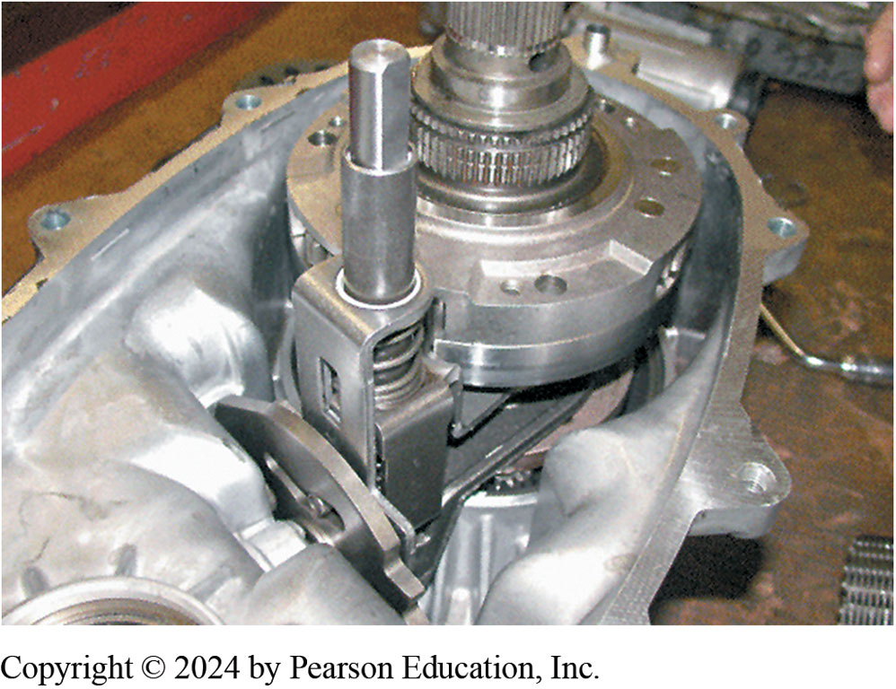
8. Shift Levers & Center Differential
8. View of the shift levers and the center differential after the chain has been removed.

Slide 57
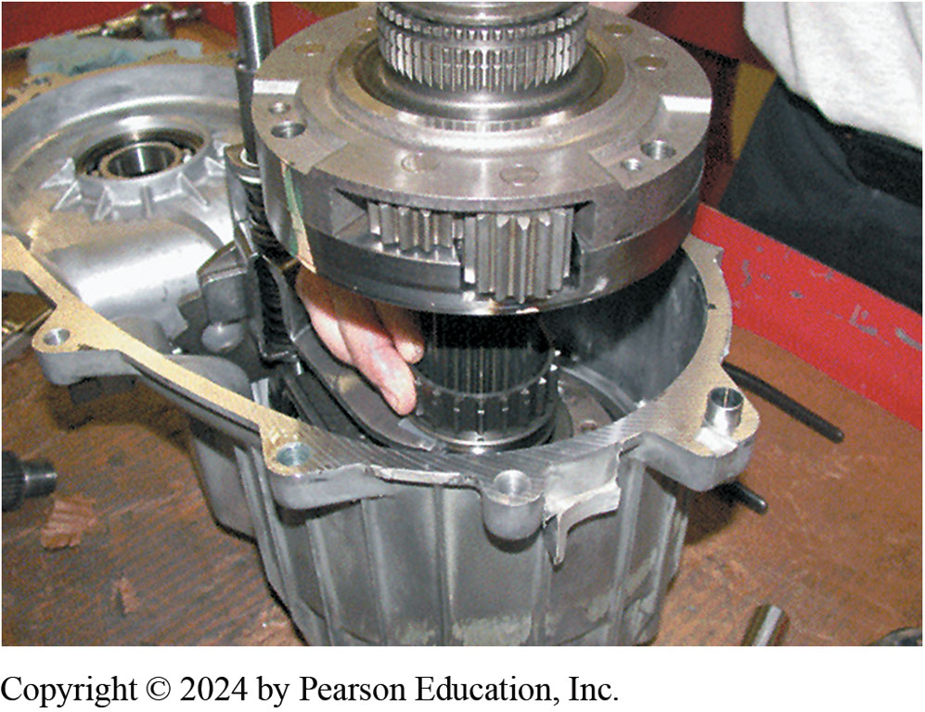
9. Differential Being Removed.

Slide 58
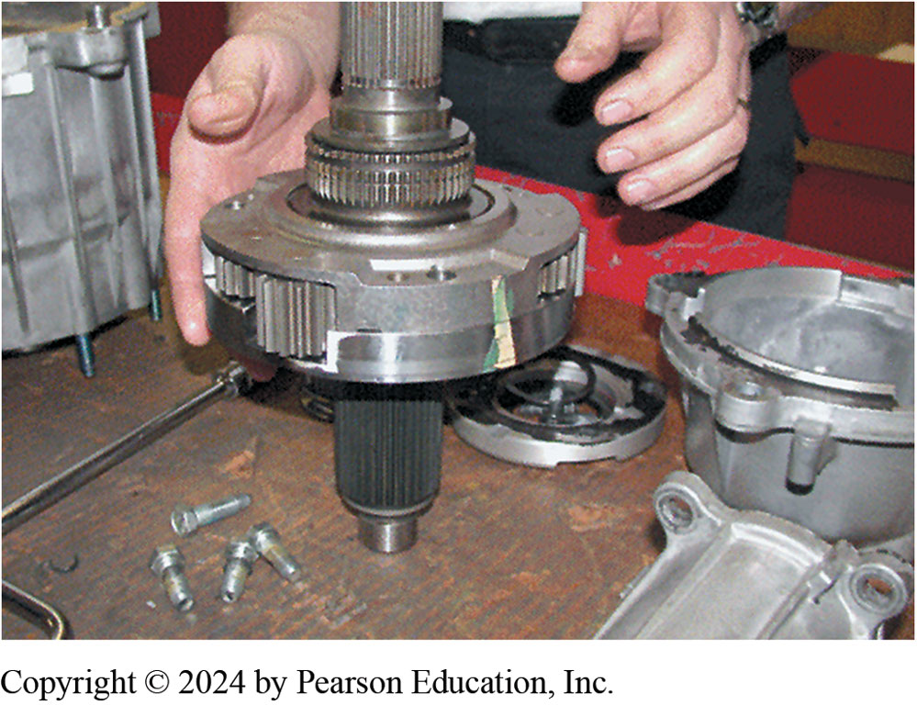
10. Center Differential
10. Center differential assembly after removal from the transfer case.

Slide 59
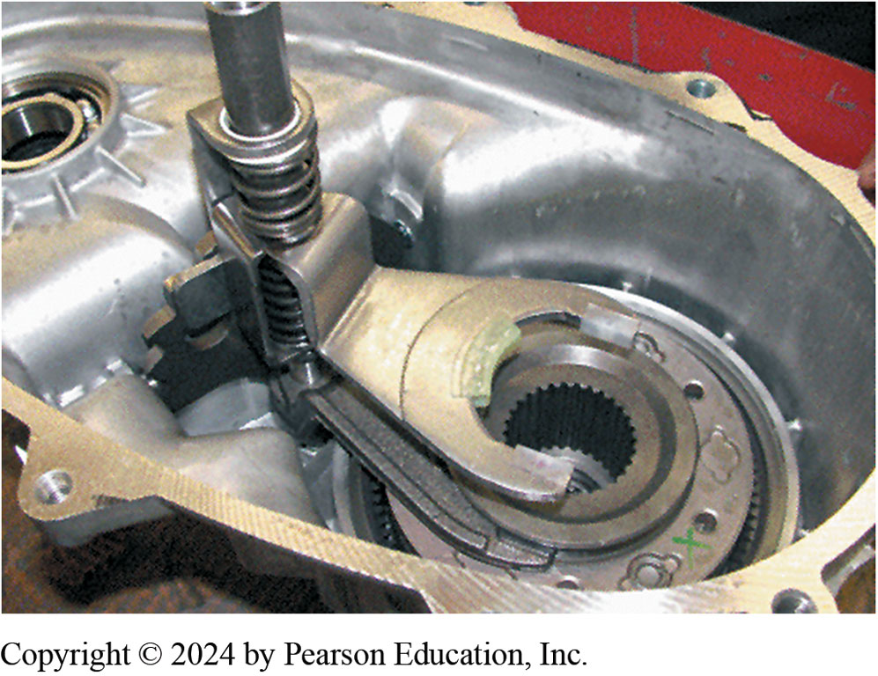
11. Mode Shift Fork (Upper Fork)
11. Mode shift fork (upper fork) is used to change 2-wheel drive & 4-wheel drive. Fork is attached to range hub, which changes 4-wheel drive high to 4-wheel drive low.

Slide 60
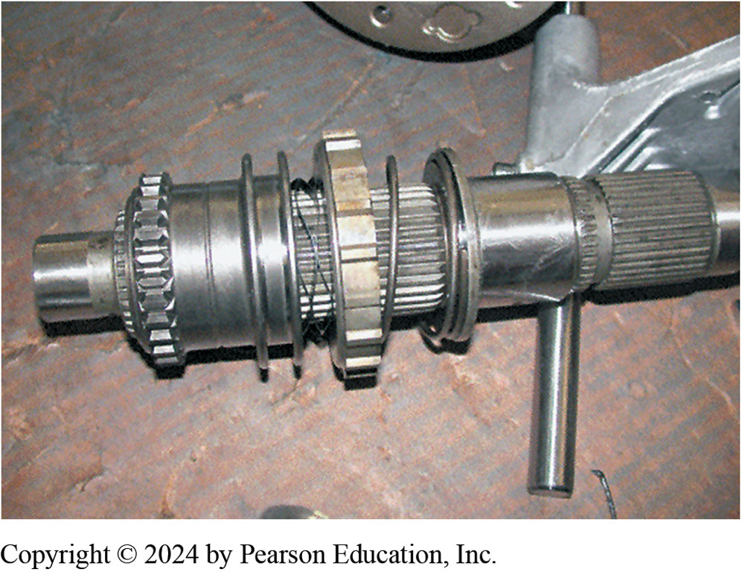
12. Main Shaft
12. Main shaft showing the range hub (left), which changes the transfer case between four-wheel high and four-wheel low.

Slide 61
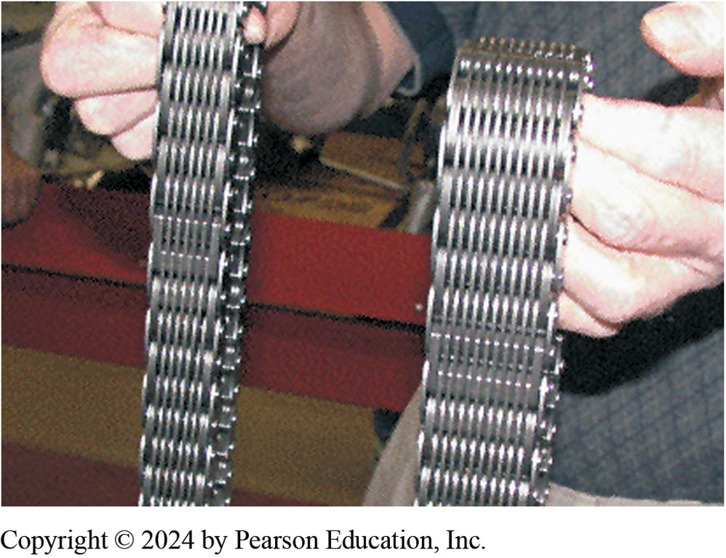
13. NV-242 (Right) Larger
13. The chain used on the NV-242 (right) is larger than the chain used in the smaller version NV-231 (left).

Slide 62
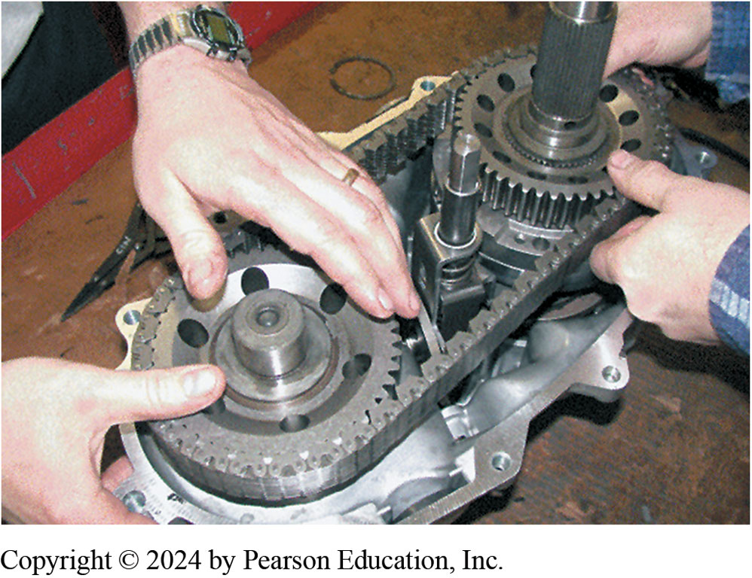
14. Reinstalling Chain Components
14. Reinstalling components and the drive chain.

Slide 63
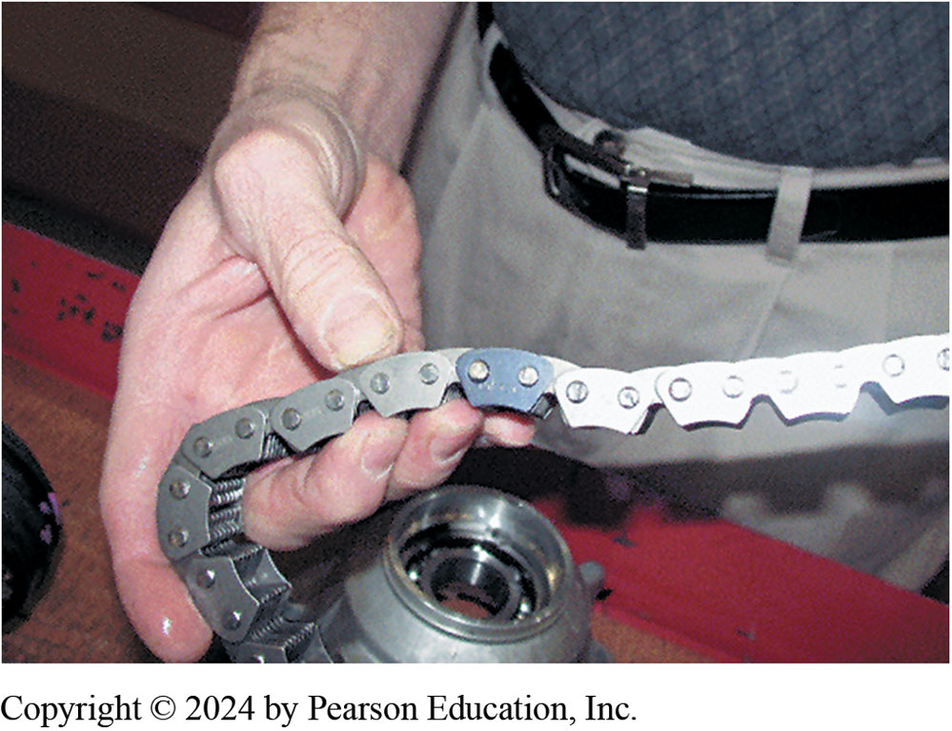
15. Black (Dark) Link(s) Up
15. The drive chain should be installed with the black (dark) link(s) up.

Slide 64
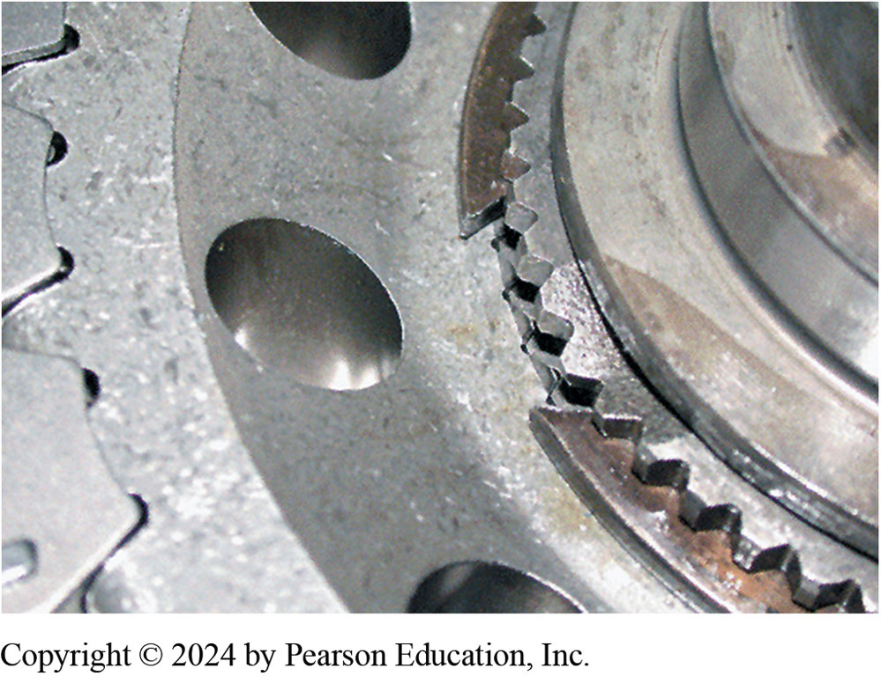
16. Install All Snap Rings
16. Install all snap rings so that the sharpest tips face up so snap-ring pliers can grab onto the tips for easier removal.

Slide 65

17. Assembling Case Halves

Slide 66

18. Sealed with RTV
18. The parting surface should be sealed with RTV silicone. Do not use too much or the oil pump screen can become clogged.

Slide 67

19. Output Shaft Housing Installed
19. After attaching the oil pump and tube, the output shaft housing is installed.

Slide 68

20. Speed Sensor Drive
20. The output shaft speed sensor drive gear is correctly installed in this photo. The slip yoke of the drive shaft slips onto the splines and inside nylon gear.

Slide 69

21. Electric Motor Shift
21. The electronically-shifted version of the case is identical except that shifting is achieve an electric motor, shown here installed in a vehicle.

Slide 70
Automatic Transmissions and Transaxles Videos and Animations
Videos Link: (A2) Automatic Transmissions and Transaxles Videos
Animations Link: (A2) Automatic Transmissions and Transaxles Animations

Slide 71
Copyright
This work is protected by United States copyright laws and is provided solely for the use of instructors in teaching their courses and assessing student learning. Dissemination or sale of any part of this work (including on the World Wide Web) will destroy the integrity of the work and is not permitted. The work and materials from it should never be made available to students except by instructors using the accompanying text in their classes. All recipients of this work are expected to abide by these restrictions and to honor the intended pedagogical purposes and the needs of other instructors who rely on these materials.

