Slide 1
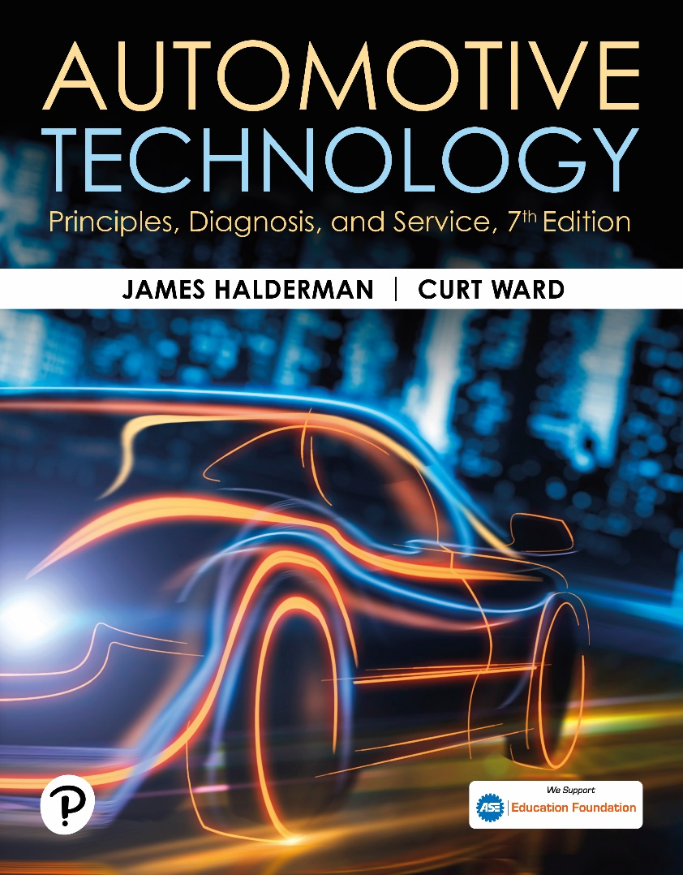
Automotive Technology: Principles, Diagnosis, and Service
Seventh Edition
Chapter 125
Drive Axles and Differentials
Copyright © 2023 Pearson Education, Inc. All Rights Reserved
Notes:
INSTRUCTOR NOTE: This presentation includes text explanation notes, you can use to teach the course. When in SLIDE SHOW mode, you RIGHT CLICK and select SHOW PRESENTER VIEW, to use the notes.

Slide 2
Learning Objectives (1 of 3)
125.1 Describe the purpose and function of a drive axle.
125.2 Describe the parts of a drive axle.
125.3 Describe drive axle gear ratios.
125.4 Discuss open differentials.
125.5 Discuss limited slip differentials.
125.6 Describe the components of a drive axle.
125.7 Describe rear axle bearings.

Slide 3
Learning Objectives (2 of 3)
125.8 Explain how to identify drive axles.
125.9 Explain how to determine the axle ratio.
125.10 Discuss rear-end noise diagnosis.
125.11 Discuss drive axle inspection.
125.12 Discuss drive axle disassembly.
125.13 Explain how to replace the pinion shaft bearing.
125.14 Explain how to set the drive pinion depth.

Slide 4
Learning Objectives (3 of 3)
125.15 Discuss how to set the preload for pinion gears.
125.16 Discuss drive axle reassembly.
125.17 Discuss drive axle lubricants.

Slide 5
Drive Axles (1 of 2)
The major parts of a drive axle include:
  The ring and pinion gears
  Differential
  Axle shafts
Notes:
All rear-wheel-drive (RWD) vehicles use a drive axle assembly to transfer power from the
driveshaft to the drive wheels. Because it is powered, it is sometimes called a live axle. Front-
wheel-drive (FWD) vehicles use a dead axle or non-powered rear axle. The major parts of a drive
axle include the following:
■ The ring and pinion gears
■ Differential
■ Axle shafts
Many 4WD and AWD vehicles use a similar axle at front, the major difference being steerable drive wheels.

Slide 6
Drive Axles (2 of 2)
Purpose and function
  Changing the direction of engine torque
  Allowing the drive wheels to rotate at different speeds
  Support the weight of the vehicle
  Drive the wheels through axles

Slide 7
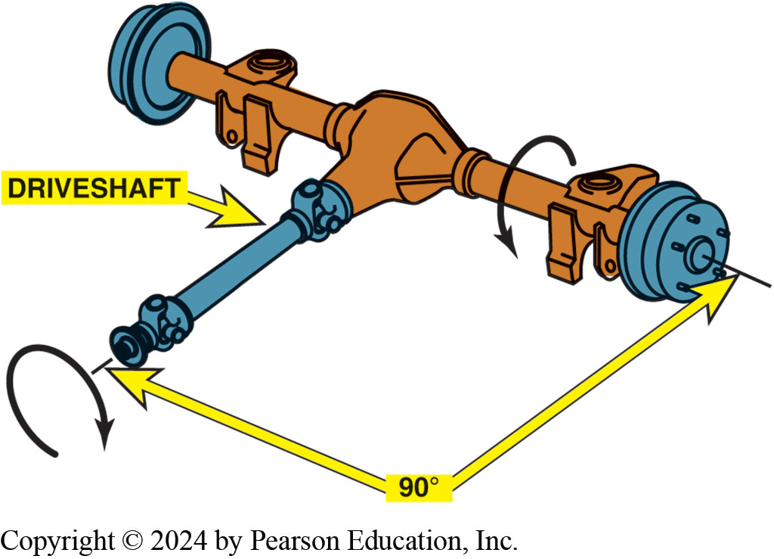
Figure 125.1 Differential Assembly
Differential assembly changes the direction of engine torque and increases the torque to the drive wheels

Slide 8
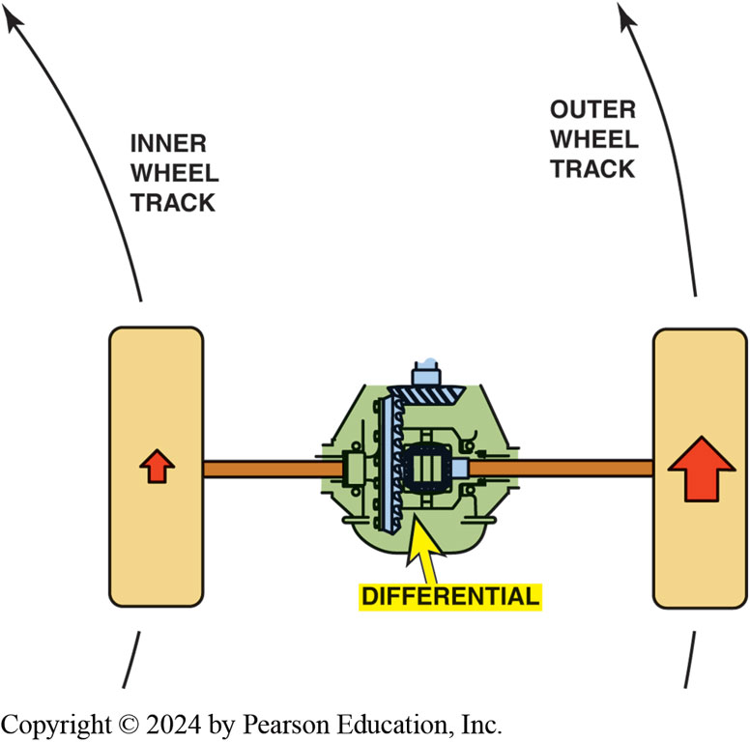
Figure 125.2 Travel Distance
Difference between the travel distance of the drive wheels is controlled by the differential

Slide 9
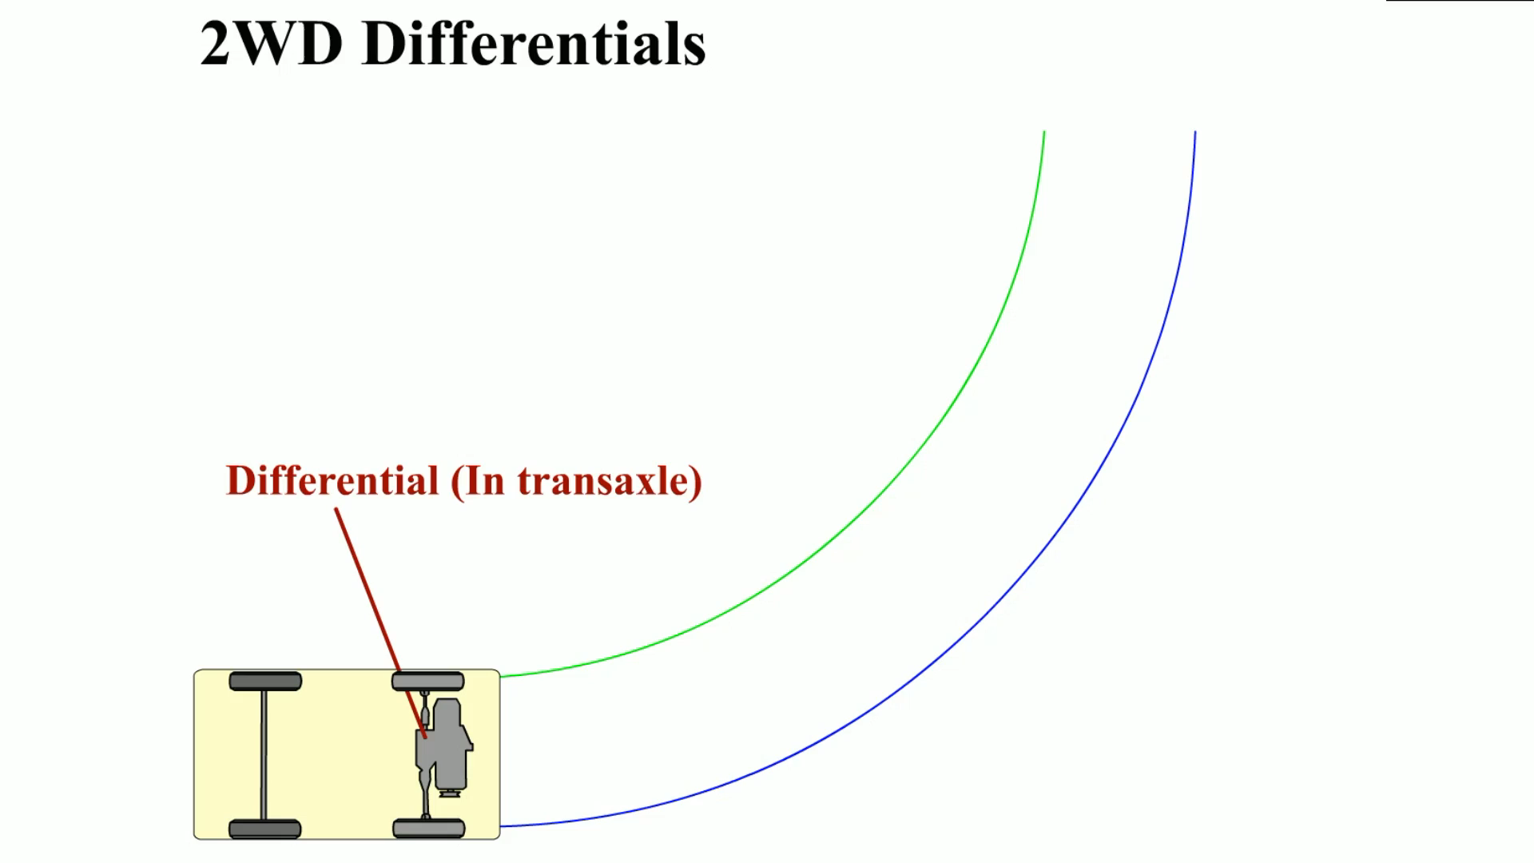
Animation: 2 WD Differentials
(Animation will automatically start)

Slide 10
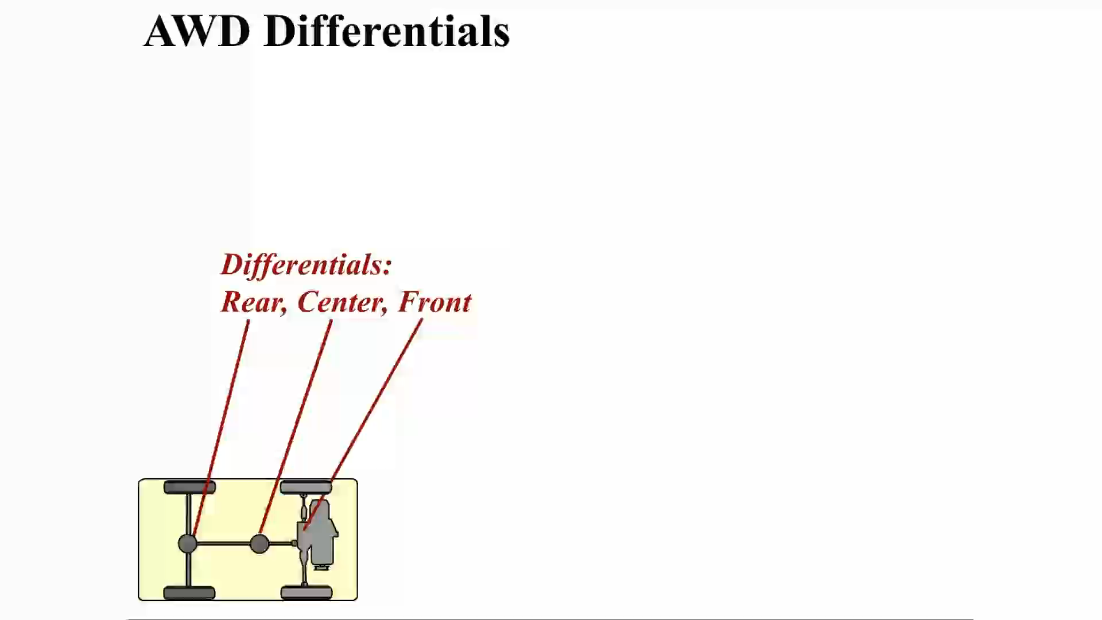
Animation: AWD Differentials
(Animation will automatically start)

Slide 11
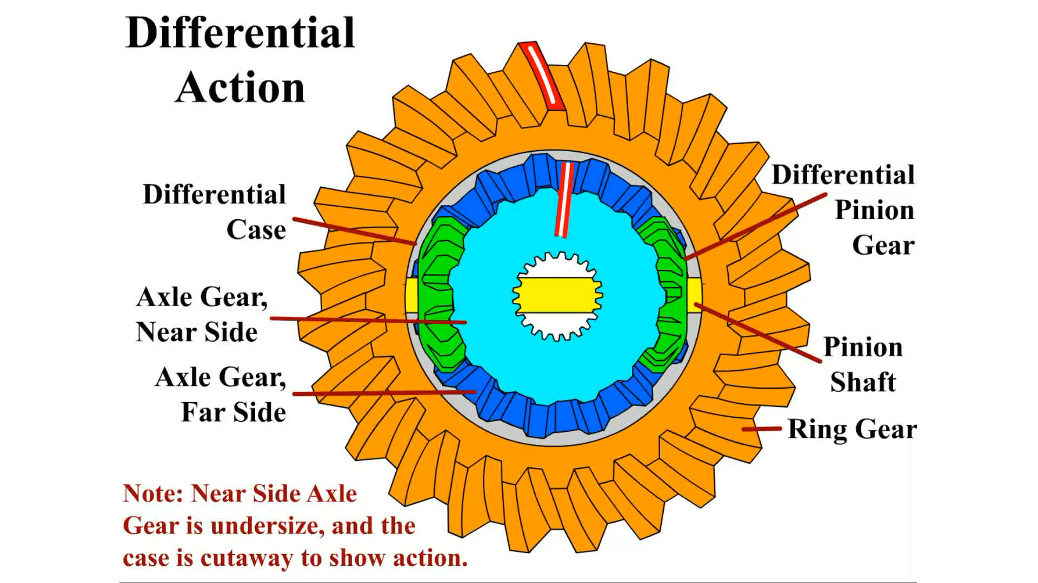
Animation: Differential Action
(Animation will automatically start)

Slide 12
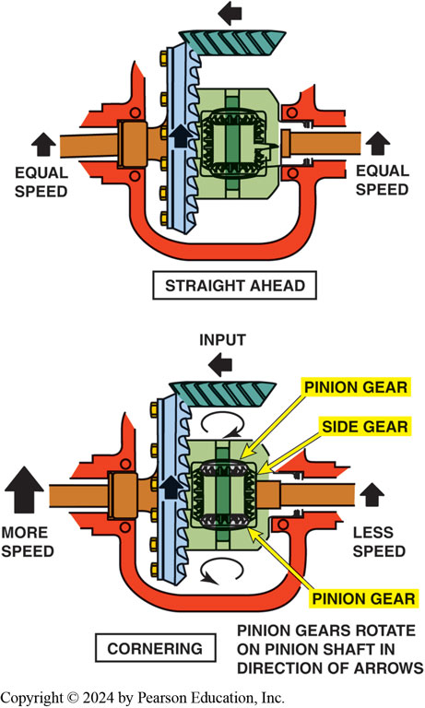
Figure 125.3 Retainer Plate Axle
When the vehicle turns a corner, the inner wheel slows and the outer wheel increases in speed to compensate. This difference in rotational speed causes the pinion gears to “walk” around the slower side gear.
Notes:
A differential is a mechanical addition and subtraction assembly. By splitting the engine torque to the drive wheels when the vehicle is turning a corner, the torque forces cause the side gear and pinion gears to subtract torque from one side and add torque to the opposite side. ● Figure 125–3.

Slide 13
Parts of a Drive Axle (1 of 2)
Drive axle called a rear end or diff In a turn
Outside wheel must travel a greater distance than the inside wheel.
Driveshaft applies torque to the drive pinion
Meshes below center line of a ring gear
Called a hypoid gear set
Notes:
A drive axle is also called a rear end or abbreviated simply as a diff. Whenever any vehicle makes
a turn, the outside wheel must travel a greater distance than the inside wheel. The driveshaft
applies torque to the drive pinion gear that meshes below the center line of a ring gear as shown
in ● FIGURE 125–4. This type of gear set is called a hypoid gear set and requires gear lubrication
specifically designed for this type of service. The ring gear is attached to a
differential case that also contains small beveled spider gears or pinion gears. A pinion shaft
passes through the two pinion gears in the case. In mesh with the pinion gears are two side gears
that are splined to the inner ends of the axles. ● Figure 125–5.

Slide 14
Parts of a Drive Axle (2 of 2)
Ring gear is attached to differential case
Contains small beveled spider gears or pinion gears.
pinion shaft passes through 2 pinion gears in the case
In mesh with the pinion gears are two side gears
Splined to the inner ends of the axles.
Notes:
A drive axle is also called a rear end or abbreviated simply as a diff. Whenever any vehicle makes
a turn, the outside wheel must travel a greater distance than the inside wheel. The driveshaft
applies torque to the drive pinion gear that meshes below the center line of a ring gear as shown
in ● FIGURE 125–4. This type of gear set is called a hypoid gear set and requires gear lubrication
specifically designed for this type of service. The ring gear is attached to a differential case that also contains small beveled spider gears or pinion gears. A pinion shaft
passes through the two pinion gears in the case. In mesh with the pinion gears are two side gears
that are splined to the inner ends of the axles. ● Figure 125–5.

Slide 15
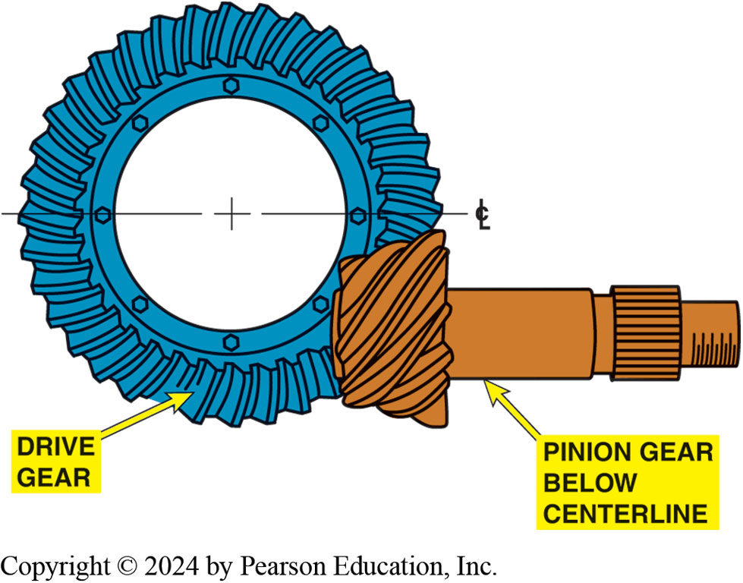
Figure 125.4 Hypoid Gear Set
A hypoid gear set uses a drive pinion that meshes with the ring gear below the center line of the ring gear.

Slide 16
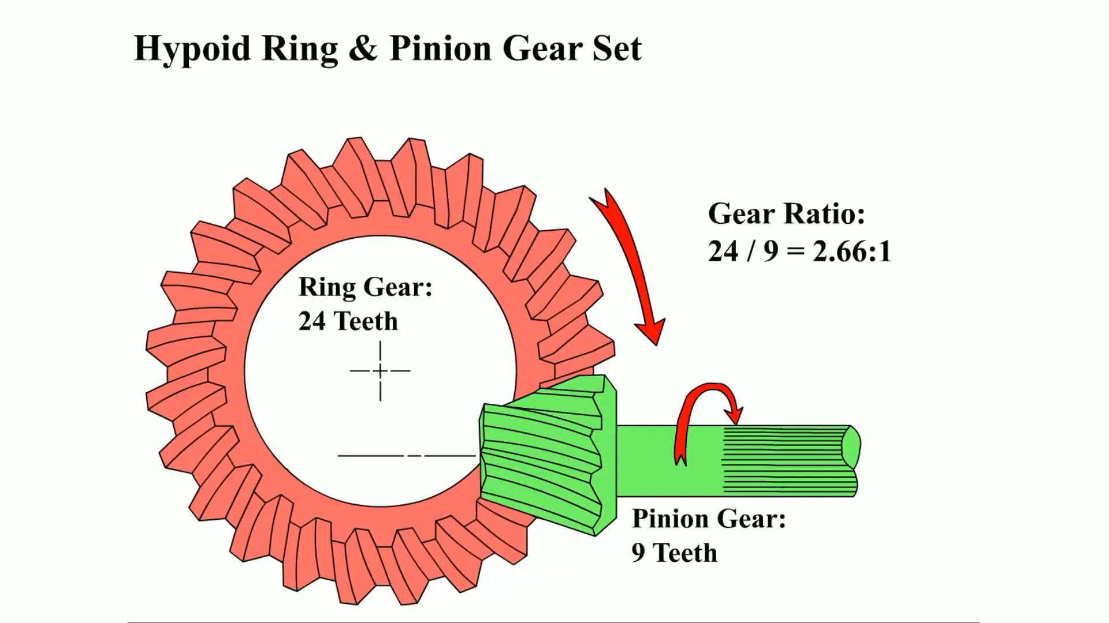
Animation: Hypoid Ring & Pinion Gear Set
(Animation will automatically start)

Slide 17
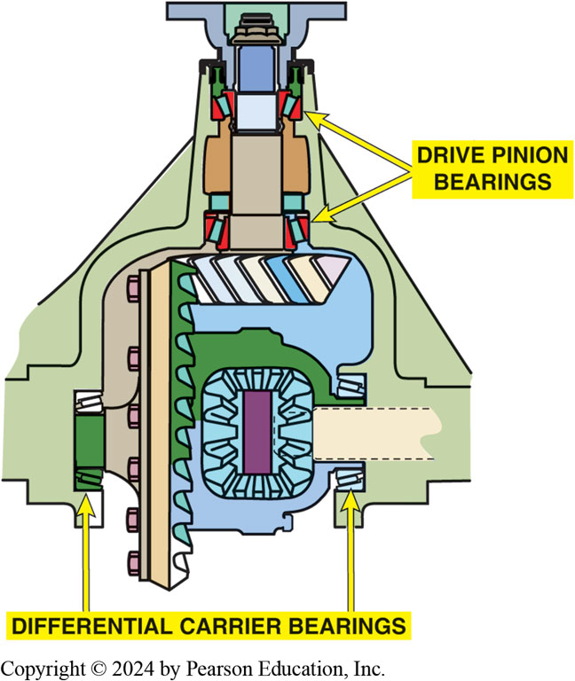
Figure 125.5 Tapered Roller Bearings
A pair of tapered roller bearings called carrier bearings is used to locate the drive pinion gear and the differential case and ring gear. Another pair of bearings locates the drive pinion gear.

Slide 18
Ring and Pinion Gears (1 of 3)
Ring and pinion gears are the final drive reduction gears.
Ring and pinion gear set is a hypoid type.
After gears have been cut, hardened, and ground to shape,…
  Ring and pinion are run against each other in a machine with abrasive compound on their teeth.
Final gear ratio

Slide 19
Ring and Pinion Gears (2 of 3)
How are hypoid gear sets manufactured?
Hypoid gear tooth terms
  Pitch line
  Face
  Flank
  Drive side
  Backlash
  Coast side
  Float

Slide 20
Ring and Pinion Gears (3 of 3)
Hunting, non-hunting, and partially non-hunting gear sets
Reverse-cut ring and pinion gears
ABS reluctor wheel
Gear and pinion mounting
Notes:
R SET TYPES
The final drive gear ratio determines how many times a drive pinion tooth will make con- tact with a particular ring gear tooth during one revolution. This affects final drive gear set manufacture and service.
Final drive gear sets may be divided into three types, depending on the final drive gear ratio.
Hunting gear sets are gear sets with final drive ratios expressible in a fraction that cannot be reduced to any lower terms. An example of a hunting gear set is one that has 41 teeth on the ring gear and 11 teeth on the drive pinion. This combination creates a 3.73:1 axle ratio. This type of gear set requires no timing marks or alignment during assembly. As the pinion gear drives the ring gear, each pinion tooth will hunt for, or seek, contact with every ring gear tooth.
Non-hunting gear sets are gear sets with final drive ratios expressible as a whole number. An example of a non-hunting gearset is a differential that uses 39 teeth on the ring gear and 13 teeth on the pinion gear, which gives a 3.00:1 gear ratio. Non-hunting gear sets require timing marks. As the pinion gear drives the ring gear, each pin- ion tooth contacts only a few ring gear teeth during each revolution.
Partially nonhunting gear sets are gear sets with final drive ratios expressible as a reducible fraction not equaling a whole number. An example of a partial nonhunting gearset
is an axle ratio of 3.50:1.

Slide 21
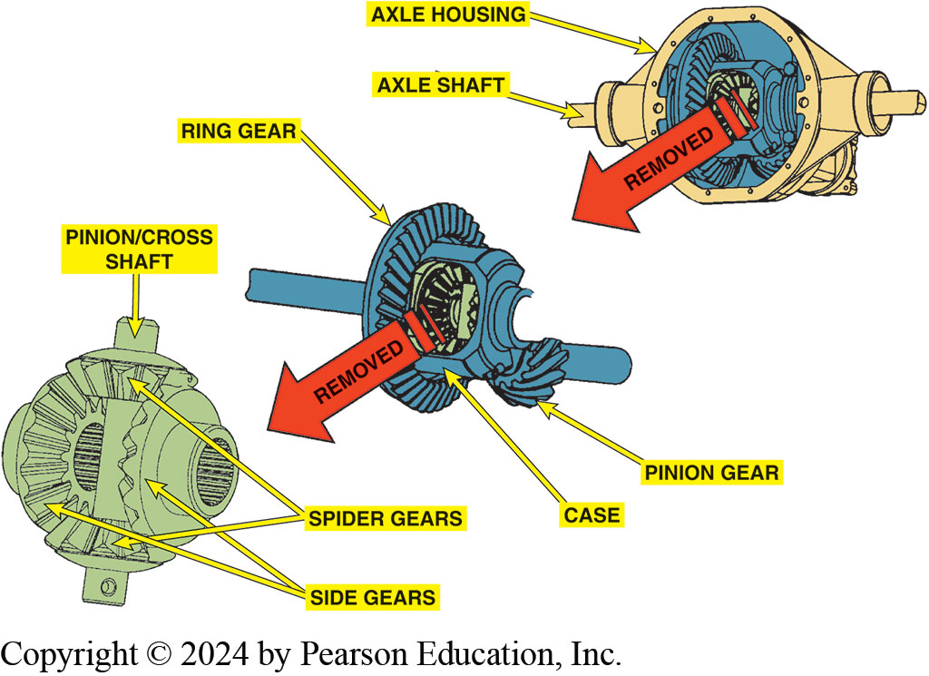
Figure 125.6 Ring Gear/Drive Pinion
The relationship among the ring gear and drive pinion as well as the side and spider gears.

Slide 22
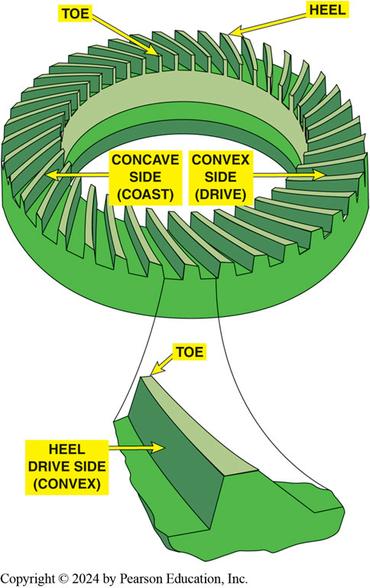
Figure 125.7 Convex/Concave
Drive side is convex side of ring gear except for some front axles used in 4WD vehicles, & often use concave side on drive side.
Notes:
CASE STUDY: Change the Axle Ratio
To increase vehicle performance, replace a high ratio (lower number) rear axle ratio with a lower ratio (higher number) rear axle. For example,
Stock rear end = 3.23:1 (drive pinion has 13 teeth and the ring gear has 42 teeth)
Replacement rear end = 3.73:1 (drive pinion has 11 teeth and the ring gear has 41 teeth)
The high-performance axle ratio (3.73:1) allows the engine to rotate faster than the stock 3.23:1 ratio. Because most engines produce greater torque with increasing RPM (up to a point), this allows more torque to be applied to the drive wheels. Not only is the engine producing more torque, but the higher-number gear ratio also multiplies the available torque times
3.73 instead of the original 3.23. However, there are several disadvantages associated with changing the rear end ratio:
Decreased fuel economy
Incorrect speedometer and odometer readings that can affect the shifting of the automatic transmission unless changes are made to the computer or vehicle speed sensors
Increased engine noise due to the higher engine speed
Increased engine wear, again due to the increased engine speed
If you can live with these disadvantages, a change in the rear end ratio generates a real performance
in.

Slide 23
Open Differentials
Differential…
  Splits torque equally to the drive wheels
  Allows engine torque to be applied to both drive axles
Parts must include a differential, which includes
  two or more differential pinion gears and two side or axle gears.
Types
  Open, limited slip, and locked

Slide 24
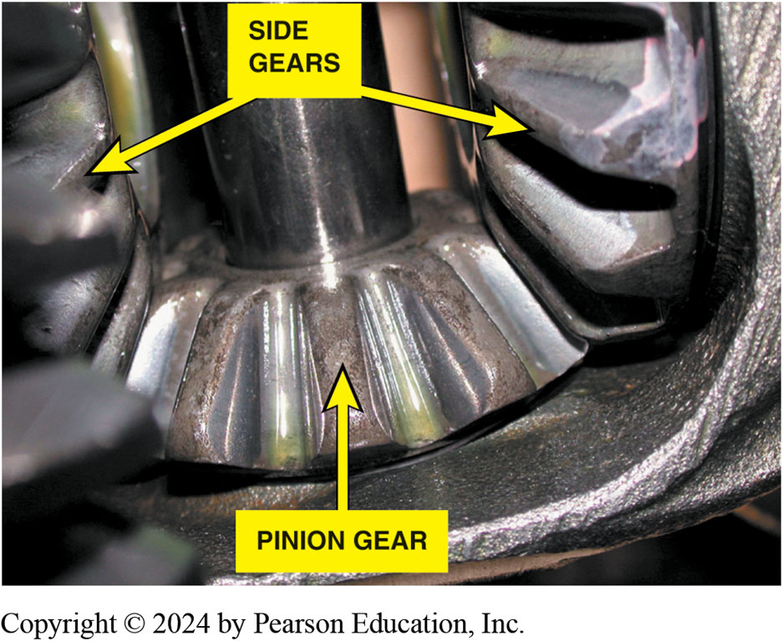
Figure 125.8 Side Gears & Pinion
Close-up view of side gears and spider (pinion) gear. Note ridges on the gear teeth. These ridges are manufactured into the gear teeth to help retain lubricant so that no metal-to-metal contact occurs
Notes:
Note the ridges on the gear teeth. These ridges are manufactured into the gear teeth to help retain lubricant so that no metal-to-metal contact occurs

Slide 25
Limited Slip Differentials (1 of 3)
Open Differential Has A Torque Bias Ratio (TBR) of 1:1.
Limited Slip Types
  Preloaded clutches
  Self-applying clutches
  Viscous couplings
  Eaton locker differential
  Hydraulic applied clutches
  Cone type

Slide 26
Limited Slip Differentials (2 of 3)
What is a Torsen differential?
Electric locking differentials
  When the axle shaft or side gear is connected to the differential case, the differential becomes locked.
Electronic torque management
Independent rear suspension drive axles

Slide 27
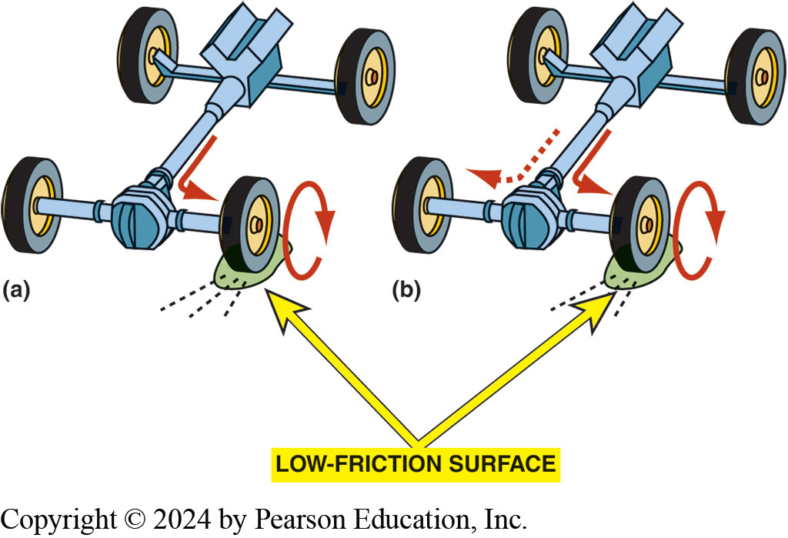
Figure 125.9 Limited-Slip Differential
(a) A two-wheel-drive vehicle equipped with an open differential. (b) A two-wheel-drive vehicle equipped with a limited-slip differential.

Slide 28
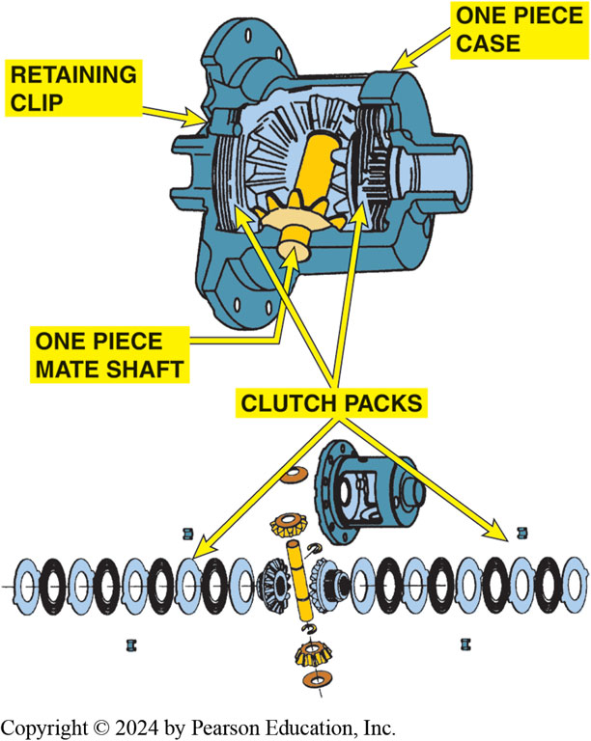
Figure 125.10 Trac-Loc Limited-Slip
Trac-loc limited-slip differential. This type of limited-slip differential uses the preload force from a spring and the torque generated by the side gears as the two axles rotate at different rates to apply the clutches and limit the amount of difference in the speed of two axles.

Slide 29
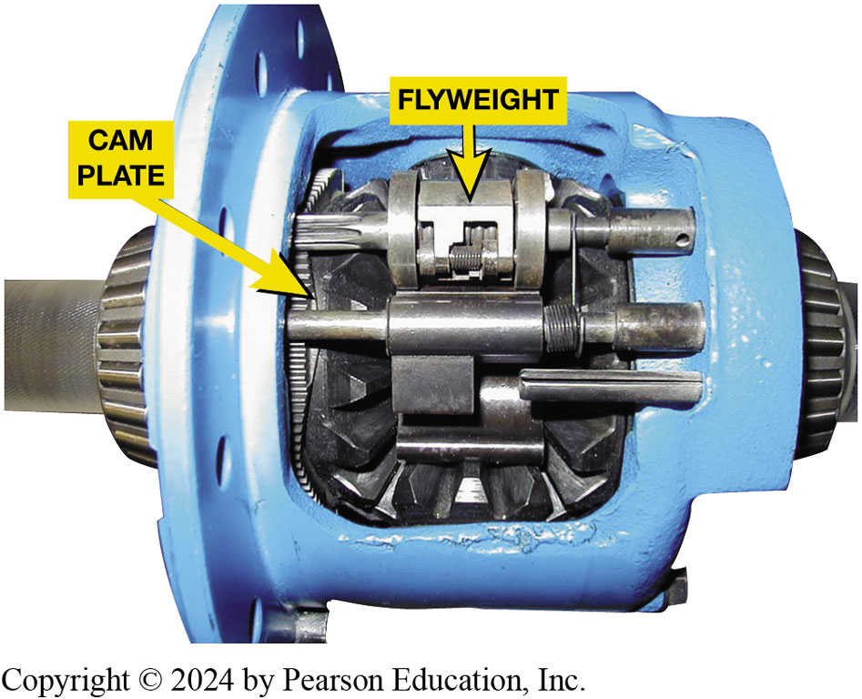
Figure 125.11 Eaton Locker
A locker-type differential operates as a limited slip differential until there is a wheel-to-wheel speed difference of 100 RPM or more. At that point, governor weights move outward and cause the mechanism to lock the clutch pack.
Notes:
Viscous coupling differentials use a stack of intermeshed clutch plates that run in a bath of silicone fluid and are not spring loaded. The thickness of the fluid causes a drag that tries to keep the two sets of plates at the same speed. Slippage between the plates heats the fluid causing it to expand. A unique feature of silicone fluid is that the drag increases as the slip speed of the plates increases. Single-wheel spinning tends to lock up the differential. The plates and silicone fluid must be isolated within a chamber inside the differential case and must be kept separate from the gear oil in the axle.
Eaton “locker” differential used in some pickups and light trucks includes a governor,
latching mechanism, and differential cam gear. Normally, this unit will operate as a limited slip
differential, but if a wheel-to-wheel speed difference of 100 RPM or more occurs, the unit will
lock up. Lockup occurs because the spinning cam in the case turns the governor weights fast enough to fly outward. This, in turn, causes the latching operation, which causes the cam gear to rotate relative to the cam side gear, and locks up the clutch pack. ●Figure 125–11.

Slide 30
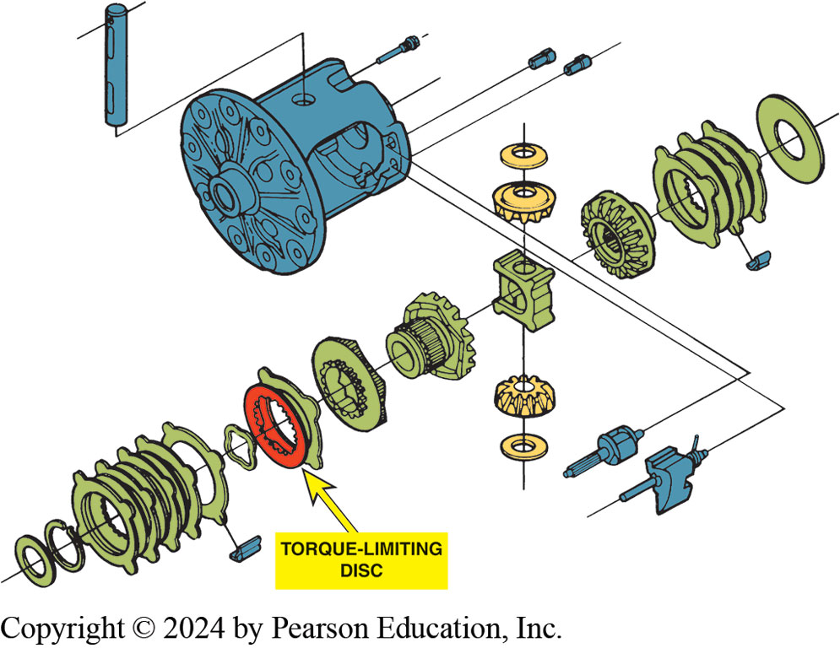
Figure 125.12 Torque Limiting Disc
Eaton design differential uses torque-limiting disc to prevent possibility of breaking an axle in event of a high-torque demand. When disc tangs shear, differential continues as open rather than limited slip differential.
Notes:
Case Study: I Used to Have a Limited Slip Differential
An owner of a Chevrolet S-10 pickup truck equipped with a V-6 and five-speed manual transmission complained that he used to be able to spin both rear tires on dry pavement, but lately only one tire spins. Many GM pickup trucks are equipped with an Eaton locking differential that uses a torque limiting disc. The teeth of this disc are designed to shear to prevent the possibility of breaking an axle. The service procedure to correct the customer’s concern is to replace the left-hand clutch plates. Usually, the shearing of the torque-linking teeth is associated with a loud bang in the rear axle. The differential will continue to operate normally as
a standard (open) differential. ● SEE FIGURE 125–12.
Summary:
Complaint—Driver complained that only one rear wheel would spin when accelerating.
Cause—A torque-limiting disc was sheared.
Correction—The left side clutch plates were replaced and the proper operation of the drive axle was restored to normal operation.

Slide 31
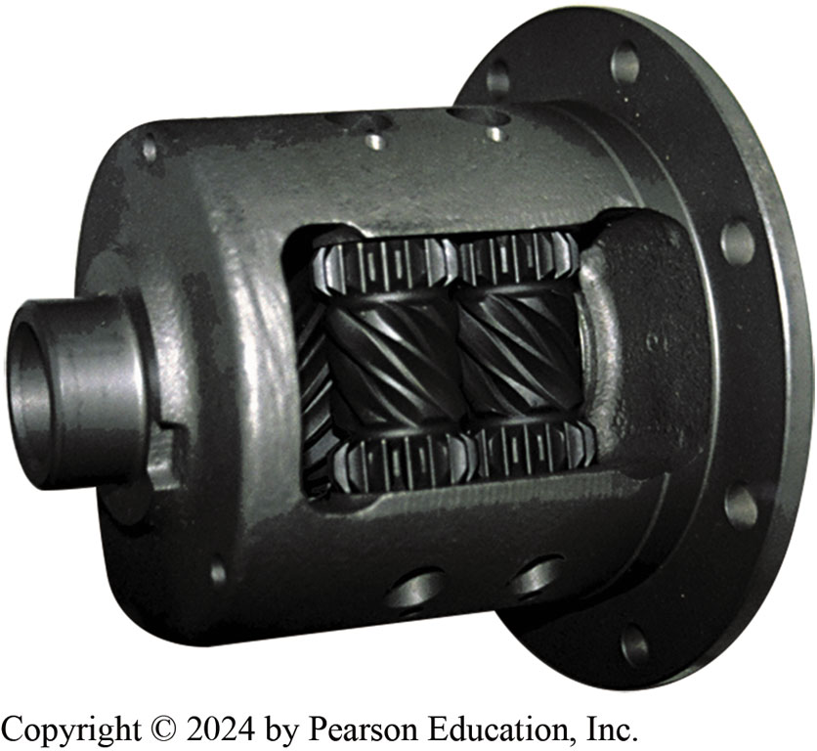
Figure 125.13 Torsen® Differential
Torque sensing differential is used in the front drive axle in front-wheel-drive vehicles & in Rear in rear-wheel-drive or all-wheel-drive vehicle
Notes:
TORSEN® DIFFERENTIAL The Torsen® differential is a pure mechanical worm gear differential. The name is derived from torque sensing. Two helical gears, called “side gears,” are connected to the axle shafts. Three pairs of worm gears are mounted in the differential case, and these are called “element gears.” Each element gear has the worm gear in the center and a spur gear at each end. The spur gears mesh with the spur gears of the mating element gear. If one of the element gears rotates in the case, its mate must rotate in the opposite direction. Note that all three pairs of element gears must rotate at the same time. Gleason, the company that developed Torsen® differentials, calls the element and side gears Invex gearing. ● SEE FIGURE 125–30.

Slide 32
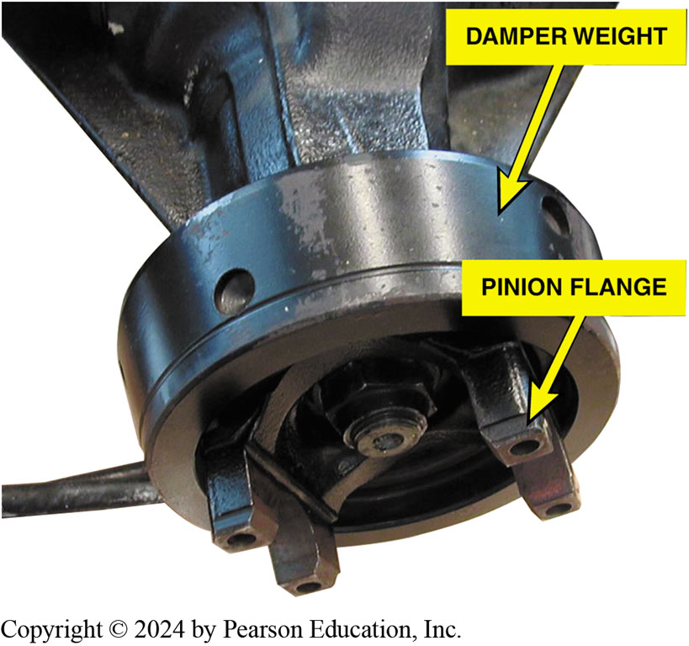
Figure 125.14 Damper
This pinion flange is equipped with a damper weight to help dampen driveline vibrations.
Notes:
The drive pinion gear of the drive axle is driven by a flange often called a companion flange. The
heavy bulk of the companion flange helps dampen vibrations and absorb shocks in the driveline. ● SEE FIGURE 125–14.

Slide 33
Drive Axle Components
Final drive pinion shaft supported by bearings
Using one of two methods
  1st 2 opposed taper roller bearings collapsible spacer separating 2 inner races to support an overhung pinion
  2nd 2 opposed taper roller bearings to support a straddle-mounted pinion
  Distance between them is smaller with a third smaller bearing attaches to a stem like machined pilot
Straddle-mounted pinions are usually mounted in a pinion housing that can be removed from the carrier.
Notes:
The final drive pinion shaft may be supported by bearings using one of two methods.
1. The first method, and most common, uses two opposed taper roller bearings, with a
collapsible (compressible) spacer separating the two inner races to support an overhung pinion.
● SEE FIGURE 125–15. The term “overhung” means all of the bearings supporting the pinion shaft lie on one side of the pinion gear. The bearings are preloaded, a state that minimizes wobble and endwise movement while the drive pinion shaft rotates.
2. The second method uses two opposed taper roller bearings to support a straddle-mounted pinion, but the distance between them is smaller than in the overhung design. Most noticeably, a third smaller bearing attaches to a stem like machined pilot protruding from the gear-end of the drive pin- ion shaft. This third bearing, usually a straight roller type, fits into a bore in the carrier. Unlike the overhung design, bearings supporting a straddle-mounted pinion lie on both sides of the pinion gear. Like the overhung design, a straddle-mounted pinion shaft usually has a compressible preloaded spacer positioned between the two larger differential case bearings. Straddle-mounted pinions are usually mounted in a pinion housing that can be removed from the carrier.

Slide 34
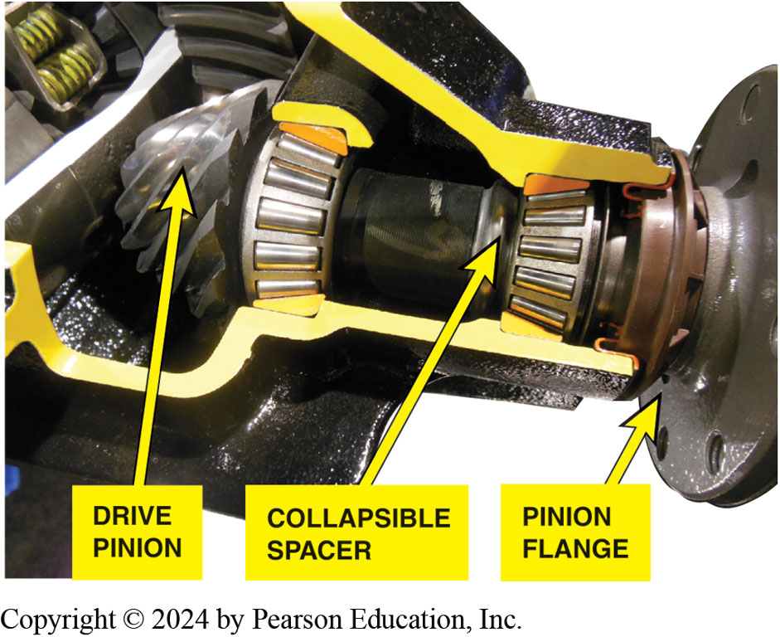
Figure 125.15 Collapsible Spacer
A collapsible spacer-type drive pinion shaft.
Notes:
The pinion shaft mounting method also determines how deeply the pinion gear meshes into the ring gear. This is called pinion depth and helps adjust the precise gear tooth relationship between the ring and pinion gears. You can vary the pinion depth adjustment by changing the thickness of a shim (spacer). This shim is located between the rear preloaded bearing and the pinion gear, or between the removable pinion housing and the carrier.

Slide 35
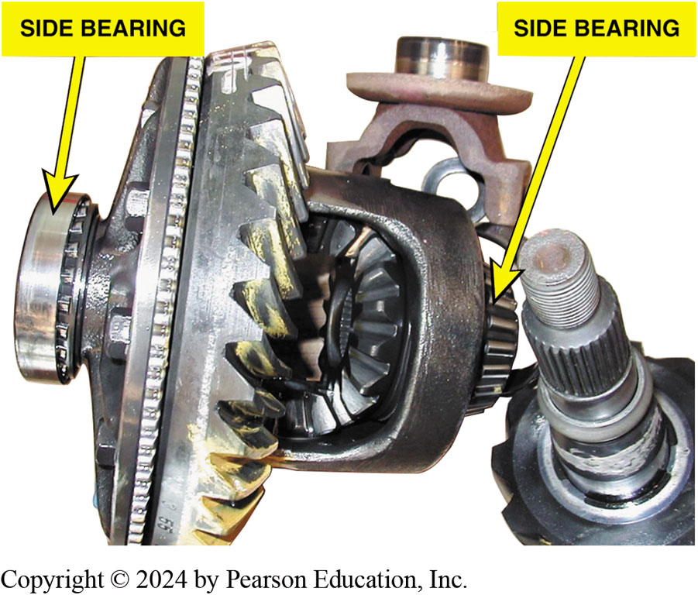
Figure 125.16 Side Bearings
Side bearings are press fit on the differential case.
Notes:
Side Bearings; The differential case is supported by two side bearings pressed onto its sides. ● SEE FIGURE 125–16. These are usually tapered roller bearings and are preloaded to ensure case rotation without axial or radial movement. Side bearing preload is adjusted either by threaded adjusting nuts as shown in ● FIGURE 125–17 or by placement of adjusting shims (spacers) on either side of the case between the bearing outer races and the inside of the carrier. The method used to adjust side bearing preload is also used to adjust ring the gear teeth to allow adequate lubrication of the tooth surfaces and still allow full tooth contact for good transfer of torque from one gear to the other. Too much clearance between the gears will allow one to travel too far before contacting the other when the powertrain goes from drive to coast and back again. Excess clearance can result in final drive noise and gear tooth damage.

Slide 36
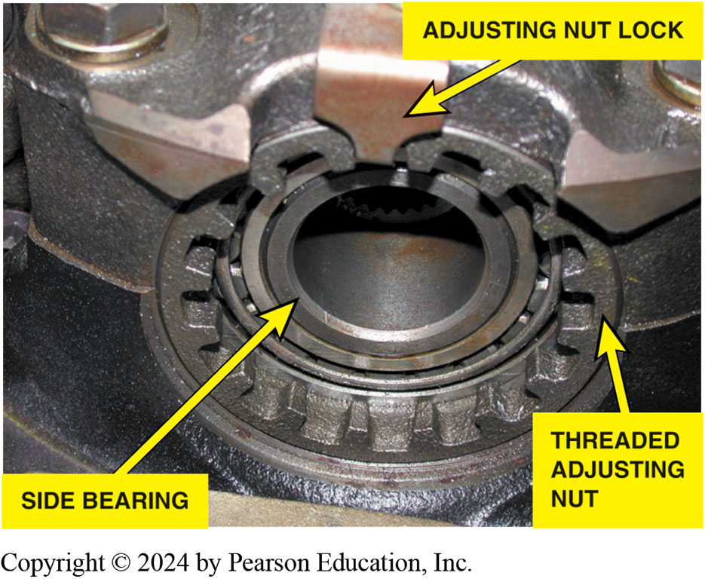
Figure 125.17 Threaded Adjusters
Some side bearings use threaded adjusters to adjust preload.

Slide 37
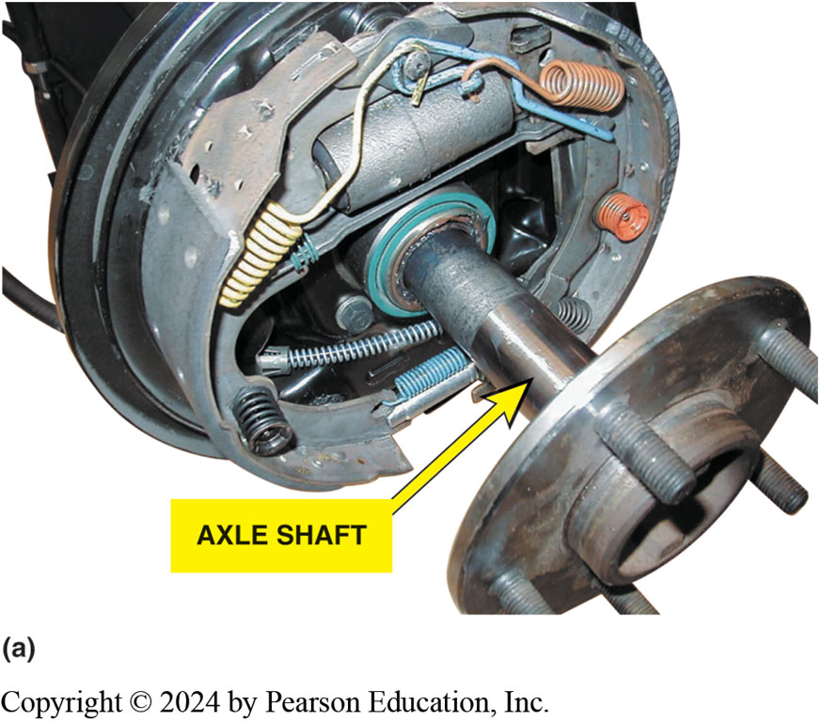
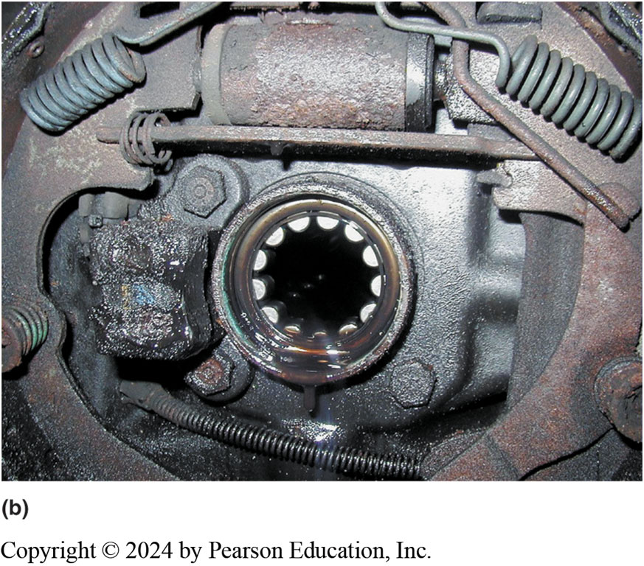
Figure 125.18 Axle Bearings

Slide 38
Rear Axle Bearings (1 of 2)
Ball bearings used
  Bearing is placed on the axle and retained by a pressed-on collar.
  Stamped steel plate bolts to the axle housing
  Bearing is pre-lubricated
  Oil seal is located on the inboard side
  Bearing is Hypoid lubricanted
  There is no axle shaft end play (thrust) adjustment.
Notes:
Ball Bearings/Rear Axles If ball bearings are used, the bearing itself absorbs the radial forces. The bearing is placed on the axle and retained by a pressed-on collar. A stamped steel plate bolts to the axle housing and keeps the axle in place. The bearing is pre-lubricated when it is
manufactured. An oil seal is located on the inboard side of the bearing retainer collar, and keeps
the hypoid lubricant from reaching the bearing or the brake assembly. In this design, there is no
axle shaft end play (thrust) adjustment.

Slide 39
Rear Axle Bearings (2 of 2)
Straight Roller Bearings/Rear Axles
Axle surface serves as inner race
Outer race is pressed into housing
Grease seal is pressed in afterward.
Bearing is Hypoid lubricanted
Design uses a C-washer
Notes:
Straight Roller Bearings/Rear Axles If a straight roller bearing is used, the axle surface serves as the inner race. ● SEE FIGURE 125–18. The outer race is pressed into the housing, and a grease seal is pressed in afterward. The bearing is Hypoid lubricant. This design uses a C-washer

Slide 40
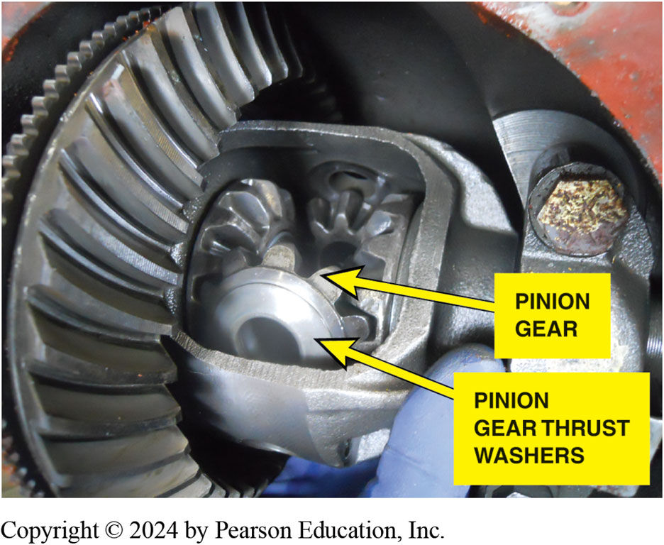
Figure 125.19 Pinion Thrust Washers
The pinion gear thrust washers can be destroyed by spinning one wheel for an extended period of time.
Notes:
TECH TIP: Don’t Spin Those Wheels!
While driving on ice or snow-covered roads, it is common to see drivers moving slowly up a hill by
simply spinning one drive wheel. However, when one wheel is spinning and the other wheel is stationary (or close to stationary), the pinion gears are spinning twice as fast as the drive wheel. This spinning of the drive wheel has been known to completely wear down the pinion
gear thrust washers in less than one minute! ● SEE FIGURE 125–19. The same wear can occur if different- size tires are used on the same drive axle. Therefore, to prevent expensive repairs, avoid unnecessary tire spinning and check that both tires on the same axle are the same size, brand name, and condition.

Slide 41
Drive Axle Identification
Differential assembly identification includes:
  Visual identification—manufacturer and size only
  Axle assembly number—stamped in the axle tube
    identifies gear ratio and other information
  Limited-slip identification tag
  Differential cover shape—and number of bolts used to retain the cover
Notes:
Before any service work is performed on a drive axle assembly, the exact axle specification must be determined. Vehicle manufacturers often use axles from more than one axle manufacturer, and each manufacturer has its own individual ratios, parts, service procedures, and specifications.
Differential assembly identification includes
Visual identification—usually identifies the manufacturer and size only
Axle assembly number—usually stamped in the axle tube of the differential assembly and identifies the gear ratio and other information
Limited-slip identification tag—often the only external identification whether or not the axle
assembly is an open design or limited-slip design
Differential cover shape—and number of bolts used to retain the cover

Slide 42
Determining the Axle Ratio
Hoist vehicle safely.
Mark rear tires at 12 o’clock position.
Mark driveshaft with masking tape.
Hold one drive tire to keep it from moving and slowly rotate other drive tire exactly 10 times counting driveshaft revolutions.
Multiply driveshaft revolutions by 2, then move the decimal point one place to the left.
Notes:
DETERMINING THE AXLE RATIO
To determine the axle ratio of a differential without having to remove the axle housing cover,
simply follow these steps:
STEP 1 Hoist the vehicle safely.
STEP 2 Mark the rear tires with masking tape at 12 o’clock position.
STEP 3 Mark the driveshaft with masking tape.
STEP 4 Have an assistant hold one drive tire to keep it from moving and slowly rotate the other
drive tire exactly 10 times while the assistant counts the driveshaft revolutions.
STEP 5 Multiply the driveshaft revolutions by 2 (except for a limited-slip differential), and then
move the decimal point one place to the left. For example, if 10 turns of the tire result in 18.5
turns of the driveshaft, that multiplied by 2 equals 37.0; then, moving the decimal point to the
left one place equals a 3.70:1 gear ratio.

Slide 43
Drive Axle Diagnosis (1 of 2)
Road Test
Noise Diagnosis
  Gear noise
  Bearing noise
  Clunk
  Chuckle
  Chatter on corners
Notes:
Most drive axle problems are related to noise, vibration, leaks, and failure to transmit power.
The road test should include the following driving conditions:
■ Drive. Light-to-moderate throttle acceleration
■ Cruise. Enough throttle to maintain a constant speed
■ Float. Just enough throttle to keep engine load off the drivetrain as the vehicle slows
■ Coast. Closed throttle deceleration
■ Coast while in neutral. Isolates transmission noises
Gear noise. Howling or whining and is often torque sensitive but can be continuous.
Bearing noise. Can be a high-pitched, whistle like sound but is usually a rough growl or rumble. Bearings will often make a “wow-wow” type of sound at the speed frequency of the spinning shaft.
Clunk. Heavy metallic slapping noise during reversal of power flow or engagement of power from neutral. This fault is caused by excessive slack or excessive clearances in the drivetrain and can be felt in the drive axle.
Chuckle. A rattling noise, similar to a playing card against spinning bicycle spokes, during deceleration below 40 MPH (64 km/h). This fault is often caused by excessive clearance in the differential.
Chatter on corners. A vibration or noise as the vehicle turns a corner, especially after prolonged straight driving.
This noise is often called chatter, commonly caused by a stick/slip condition at the clutch plates of a limited slip differential. After changing the lubricant in a limited slip differential to cure a chatter problem, drive the vehicle through 10 to 12 figure-8 turns. This procedure will force the new lubricant between the clutch plates.

Slide 44
Drive Axle Diagnosis (2 of 2)
Major internal drive axle problems usually require
Assembly be removed from vehicle.
Drive axle disassembly and reassembly procedures
Vary between makes and models.
Notes:
One of the major reasons why differentials are serviced is to correct a noise problem. Knowing
when and under what conditions the noise is noticeable is a big help in identifying which bearing
or component is the likely cause. Typical noise and its sources
include
■ Grinding or growling noise while turning—usual cause is a defective axle bearing.
■ Whine noise during cruise—drive pinion bearings are the likely causes of this type of noise.

Slide 45
Drive Axle Inspection
Carefully inspect drive axle for obvious damage or wear.
Check backlash.
  Clearance between drive pinion and ring gear; excessive backlash could indicate excessive wear.
Also use a dial indicator to check ring gear runout
If visual measurement tests indicate a problem or a noise analysis indicates a bearing problem
  Axle assembly should be disassembled for further analysis and service.
Notes:
DRIVE AXLE INSPECTION
Carefully inspect the drive axle for obvious damage or wear.
● SEE FIGURE 125–20. Check the backlash. The backlash is the amount of clearance between the drive pinion and the ring gear; excessive backlash could indicate excessive wear. Use a dial indicator as shown in ● FIGURE 125–21 to check and compare the results with specifications.
Also use a dial indicator to check ring gear runout (● SEE FIGURE 125–22). If any of the visual
measurement tests indicate a problem or a noise analysis indicates a bearing problem, the axle assembly should be disassembled for further analysis and service.

Slide 46
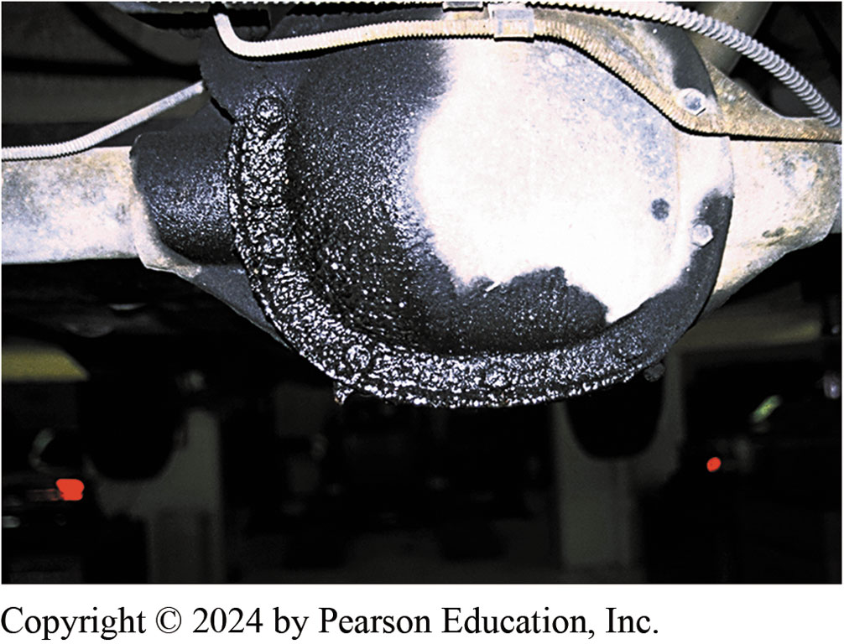
Figure 125.20 Leaking Differential
This differential has obviously been leaking. If the differential lubricant is low, wear may have occurred that would require further inspection.

Slide 47
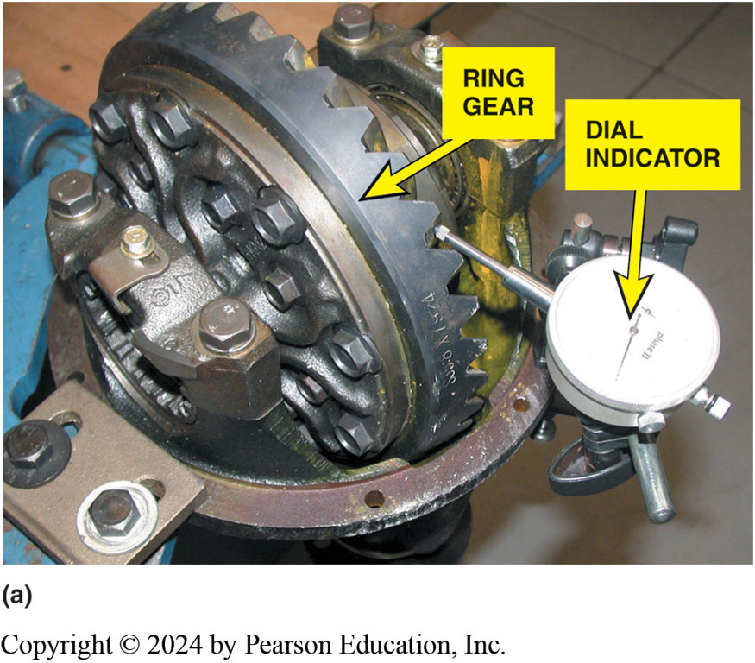
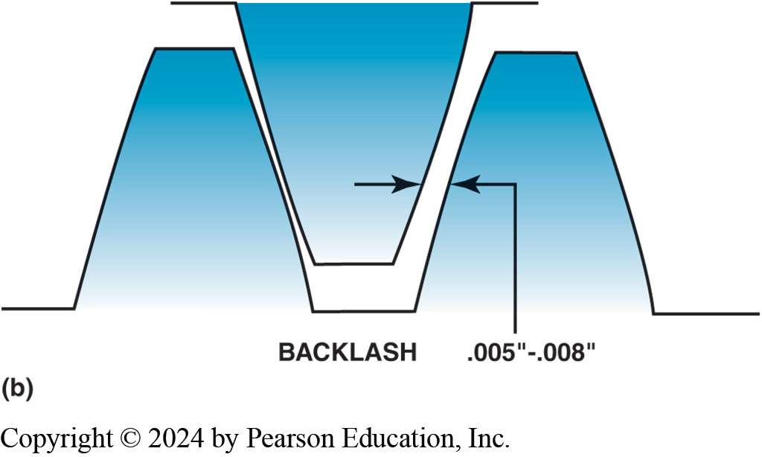
Figure 125.21 Backlash
(a) Backlash is determined by mounting a dial indicator to the differential housing and placing the button of the gauge against a tooth of the ring gear. Moving the ring gear back and forth will indicate on the dial indicator the amount of backlash. (b) Backlash is the clearance between the drive pinion and the ring gear teeth.
Notes:
TECH TIP: A Quick-and-Easy Backlash Test
Excessive clearance (lash) between the drive pinion and the ring gear can cause driveline clash
noise during a gear selector change. To check if the cause is due to the differential, simply hoist
the vehicle and, while one wheel and the driveshaft are being held stationary, use your hand to move the opposite wheel. The maximum amount the tire should move is 1 inch (2.5 cm) measured at the tread of the tire. If backlash is greater than this, then further inspection of the differential assembly is required. Beside excessive clearance between the drive pinion and the ring gear, the wear may also be between the pinion and the side gears.

Slide 48
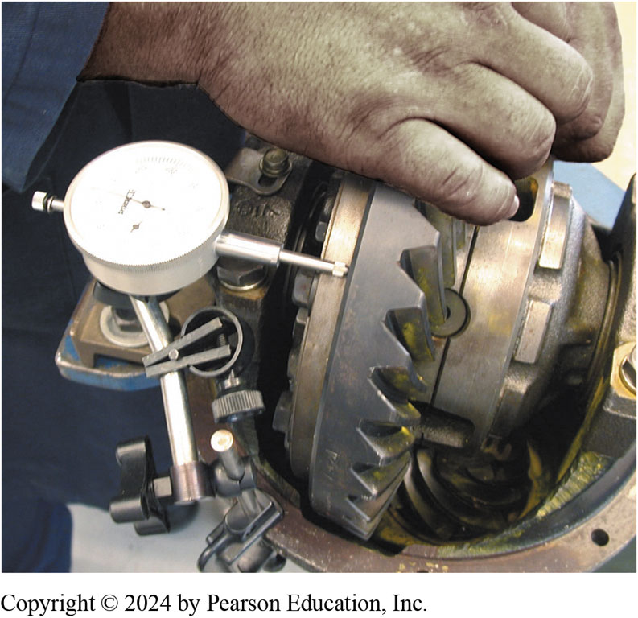
Figure 125.22 Ring Gear Runout
Ring gear runout should be less than 0.002 inch (0.05 mm) as measured by a dial indicator.

Slide 49
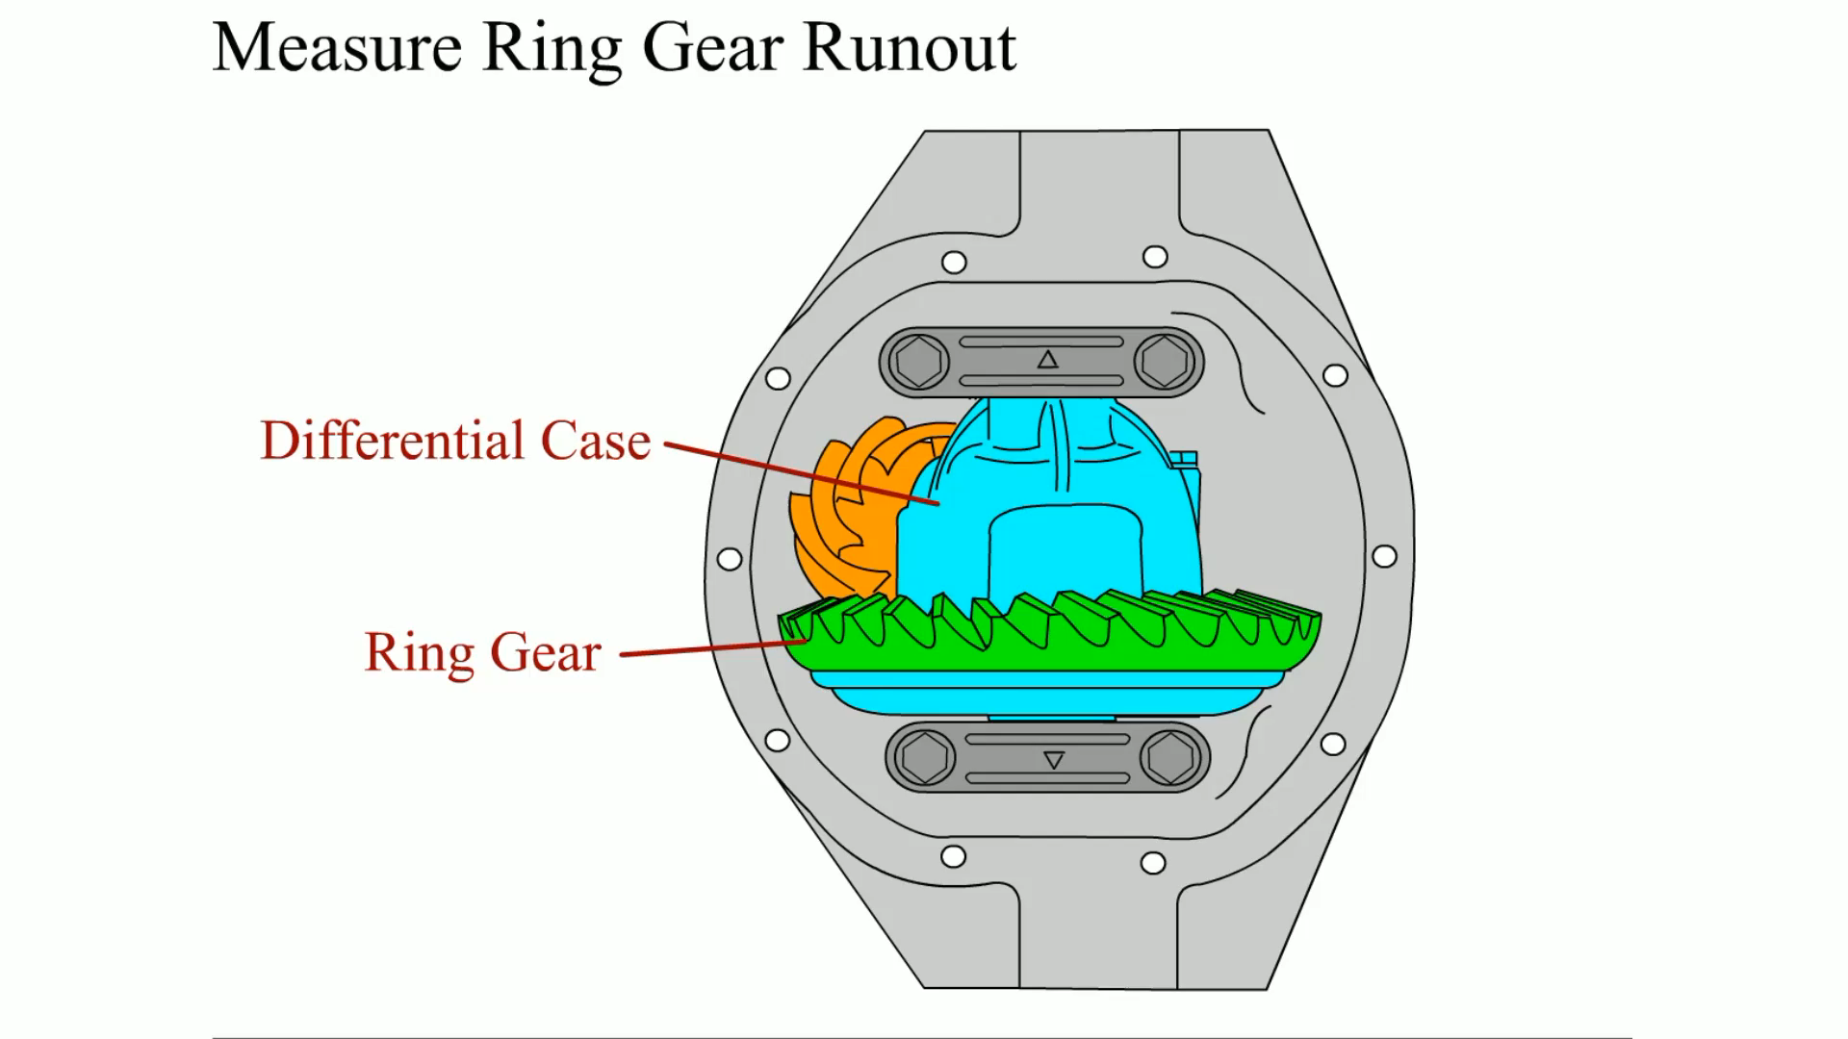
Animation: Measure Ring Gear Runout
(Animation will automatically start)

Slide 50
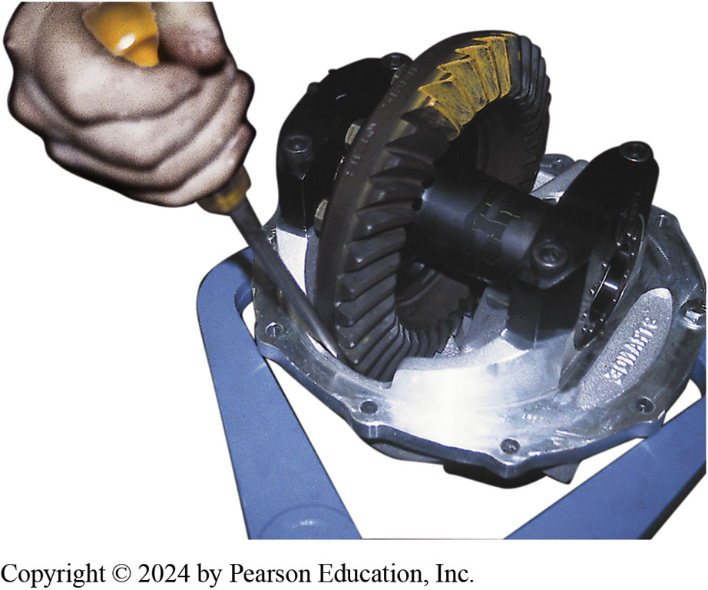
Figure 125.23 Tooth Pattern
Force has to be applied to the ring gear to achieve a proper contact pattern.
Notes:
A tooth contact pattern test is an excellent method for checking proper drive pinion depth as well as proper backlash between the drive pinion and the ring gear. Any faults in these areas will be reflected in the pattern. The pattern test involves the following steps:
STEP 1 Clean the gear teeth of the ring gear and the drive pinion.
STEP 2 Using a small brush, apply a light coating of iron oxide compound.
STEP 3 Use a small pry bar to apply a load to the ring gear to achieve a more accurate contact pattern. ^{● SEE} FIGURE 125–23.
STEP 4 Rotate the drive pinion until the ring gear turns one revo- lution (about three revolutions of the drive pinion gear).
STEP 5 Repeat rotating the drive pinion in the opposite direc- tion. This will create a contact pattern on both the drive side and the coast side of the ring gear.

Slide 51
Question 1?
Inside the drive axle of a rear-wheel-drive vehicle, the ring gear is attached to the ______________.
  a. drive shaft
  b. pinion gear
  c. differential case
  d. spider gears

Slide 52
Answer 1
c. differential case

Slide 53
Drive Axle Disassembly (1 of 2)
Start disassembly by removing the axle housing cover
Old lubricant is drained into a disposal container
Complete disassembly steps:
After the cover has been removed, remove pinion shaft lock bolt.
Remove pinion shaft.
Remove 2 spider gears and 2 axle side gears.
Push axles in and remove C-clips
Notes:
Start the disassembly by removing the axle housing cover. Be sure that the old rear-end lubricant is drained into a disposal container according to local, state, provincial, and federal laws and regulations. After the cover has been removed, complete the disassembly by following these steps:
STEP 1 After the cover has been removed, remove pinion shaft
lock bolt.
STEP 2 Remove pinion shaft.
STEP 3 Remove two spider gears and two axle side gears.
STEP 4 Push axles in and remove C-clips.
STEP 5 Remove axles.
STEP 6 Mark and remove case caps.
STEP 7 Using a case spreader or two pry bars, pry up and remove carrier case keeping the shims separate. ● SEE FIGURE 125–25.
STEP 8 Remove pinion shaft nut and washer. Discard the nut.
STEP 9 Mark and remove companion flange with suitable puller.
STEP 10 Remove front pinion seal and front pinion bearing.
STEP 11 Using suitable punch, drive pinion gear rearward until it
is free of housing.
STEP 12 Remove crush collar (never re-use). ● SEE FIGURE 125–26.

Slide 54
Drive Axle Disassembly (2 of 2)
Remove axles.
Mark and remove case caps.
Using a case spreader or 2 pry bars, pry up and remove carrier case keeping shims separate.
Remove pinion shaft nut and washer. Discard nut.
Mark and remove companion flange with suitable puller.
Remove front pinion seal and front pinion bearing.
Using suitable punch, drive pinion gear rearward
Remove crush collar (never re-use).

Slide 55
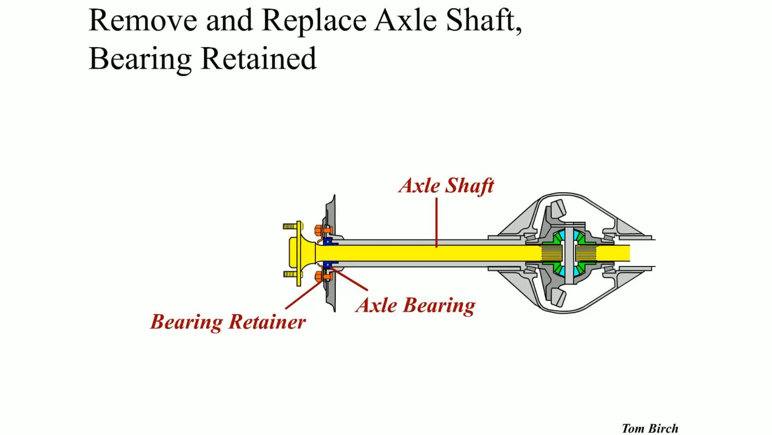
Animation: Remove and Replace Axle Shaft; Bearing Retained
(Animation will automatically start)

Slide 56
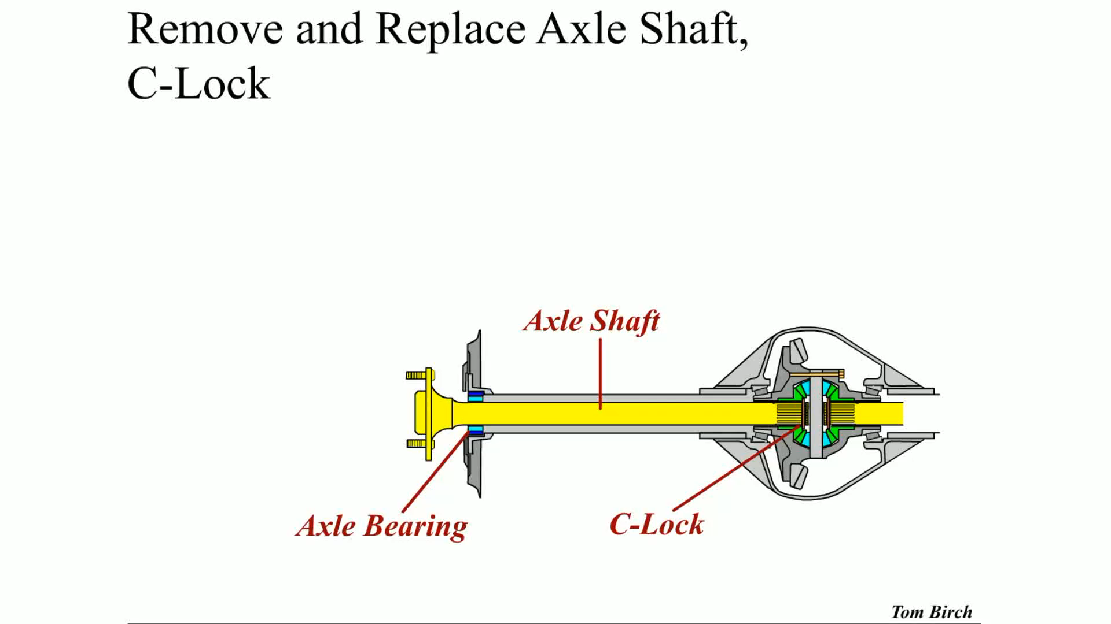
Animation: Remove and Replace Axle Shaft C-Lock
(Animation will automatically start)

Slide 57
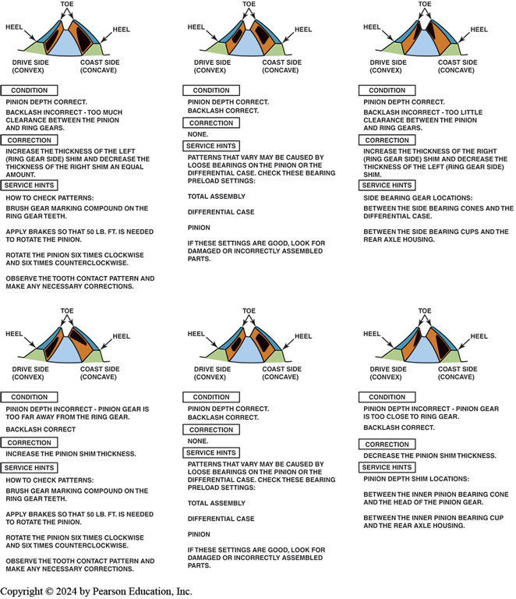
Figure 125.24 Tooth Contact Pattern

Slide 58
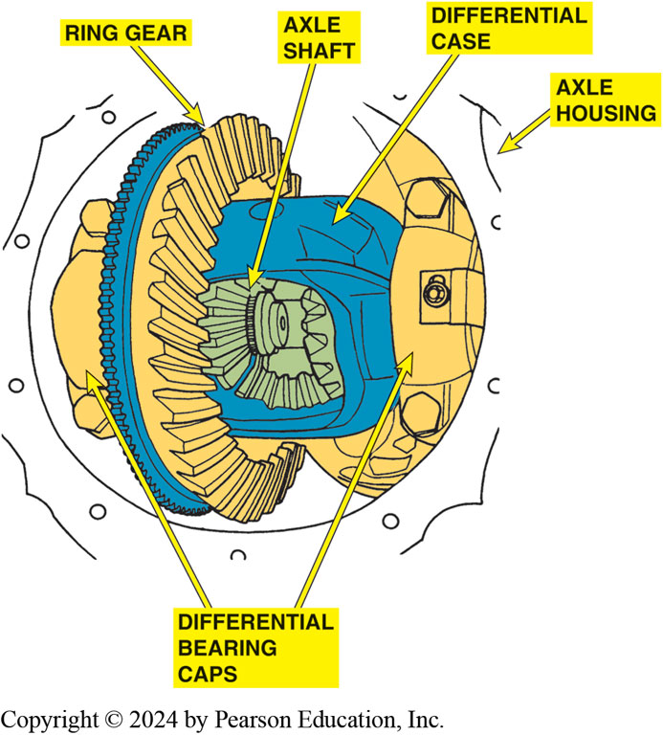
Figure 125.25 Mark Bearing Caps
Mark the differential bearing caps before removing them to make sure that they are replaced in the same location.

Slide 59
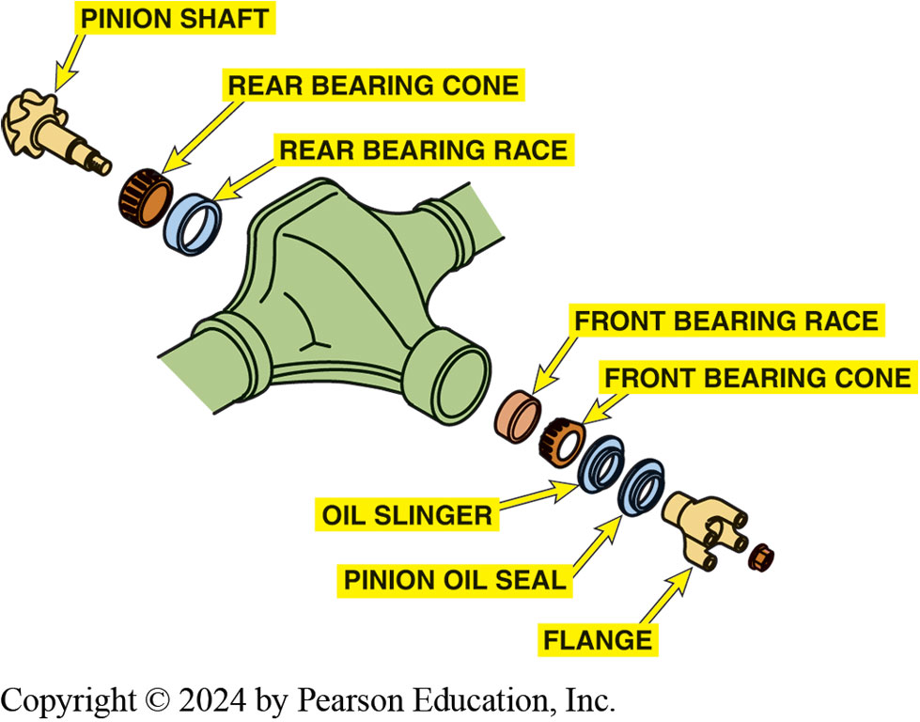
Figure 125.26 Axle Parts
Pinion gear and associated parts. The pinion end yoke is also called the pinion flange.

Slide 60
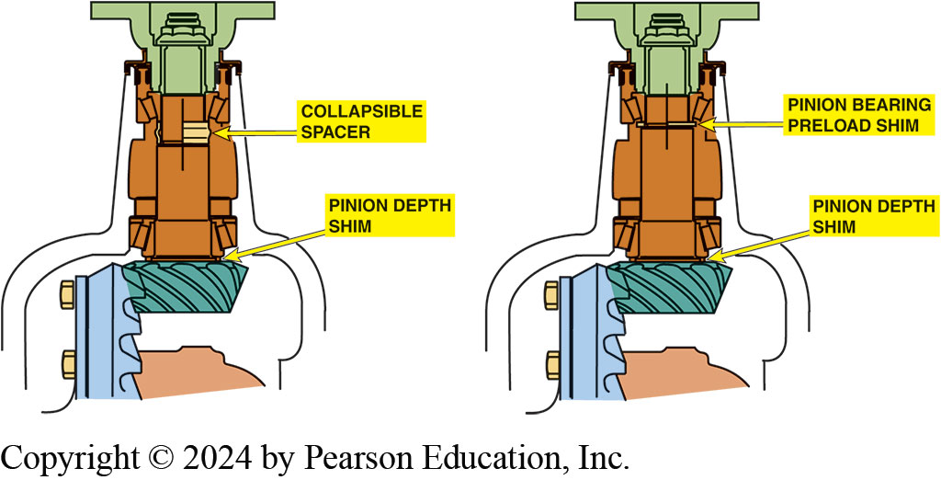
Figure 125.27 Bearing Replacement
The pinion on the left uses a collapsible spacer, and the pinion on the right uses shims to provide the necessary preload to the pinion shaft bearings.
Notes:
Pinion Shaft Bearing Replacement
The pinion shaft usually has two tapered roller bearings; the small diameter of each bearing faces the other. This arrangement allows the two bearings to absorb thrust load in both directions. When tapered roller bearings are used in a differential, it is very important that they have the proper pre- load. If a tapered roller bearing is too loose (too little preload), then the bearing cannot properly support and position the pinion shaft. If the preload is too great, excessive heat will quickly destroy the bearing as it expands with heat during normal operation of the rear axle assembly. Two methods
are used to ensure proper drive pinion gear preload (^{● SEE} FIGURE 125–27):
Preload shims
Collapsible spacer

Slide 61
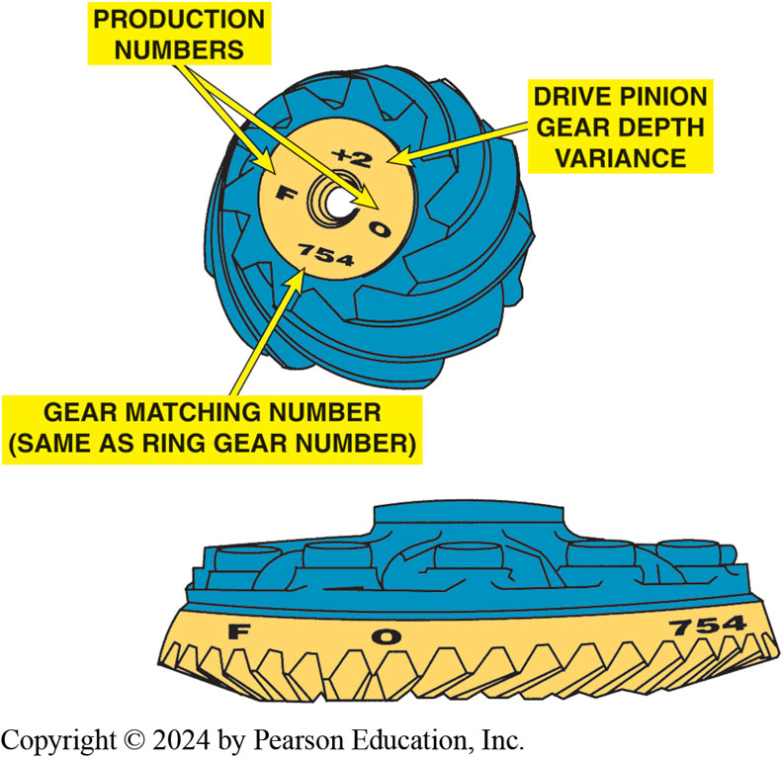
Figure 125.28 Ring Gear Markings
The ring and pinion gears are a matched set and are marked for correct pinion depth variance.

Slide 62
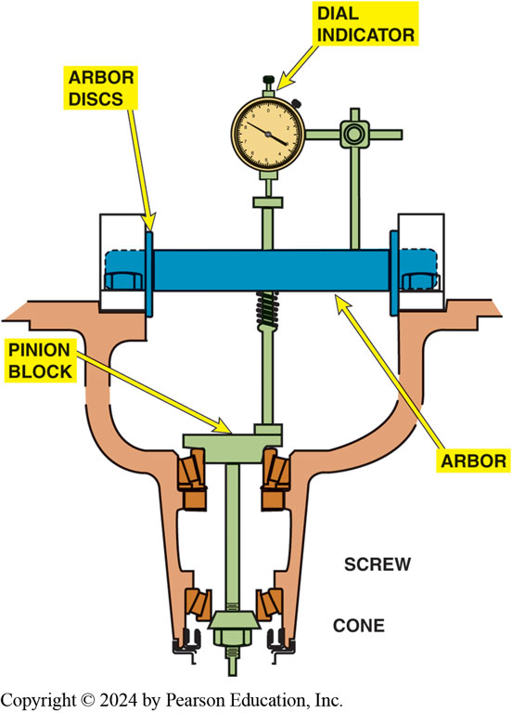
Figure 125.29 Drive Pinion Depth
Special tool kit used for determining correct pinion shaft shim thickness.
Notes:
Drive Pinion Depth
The drive pinion gear and ring gear are manufactured as a matched set and must be installed as a set. Due to variances in the production of these gears, it is often necessary to vary the thickness of a shim (thin metal spacer) between the rear pinion bearing and the pinion gear to provide correct contact tooth pattern when the gears are assembled. Correct drive pinion depth
measurement can be determined in several different ways:
■ Wear pattern analysis. This method is useful as a first step and a last step to verify correct
setup (discussed earlier in the chapter). It is time consuming to use this method to determine the
thickness of the drive pinion shim because the rear pinion bearing must be pressed off and then
back on for each shim change.
■ Plus (+) and minus (−) markings on the drive pinion. The end of the pinion gear is usually marked as to the variance needed to create the proper ring gear-to-drive pinion pattern:
A plus (+) sign means the gear is too long and removing a shim(s) is required when assembling the drive pinion into the axle housing.
A minus (−) sign means that the gear is too short and a shim(s) will be needed when assembling the drive pinion into the axle housing.
■ A gauging set and depth micrometer. This is a common method used to determine the correct shim thickness necessary to provide the proper gear pattern. ● SEE FIGURE 125–29.

Slide 63
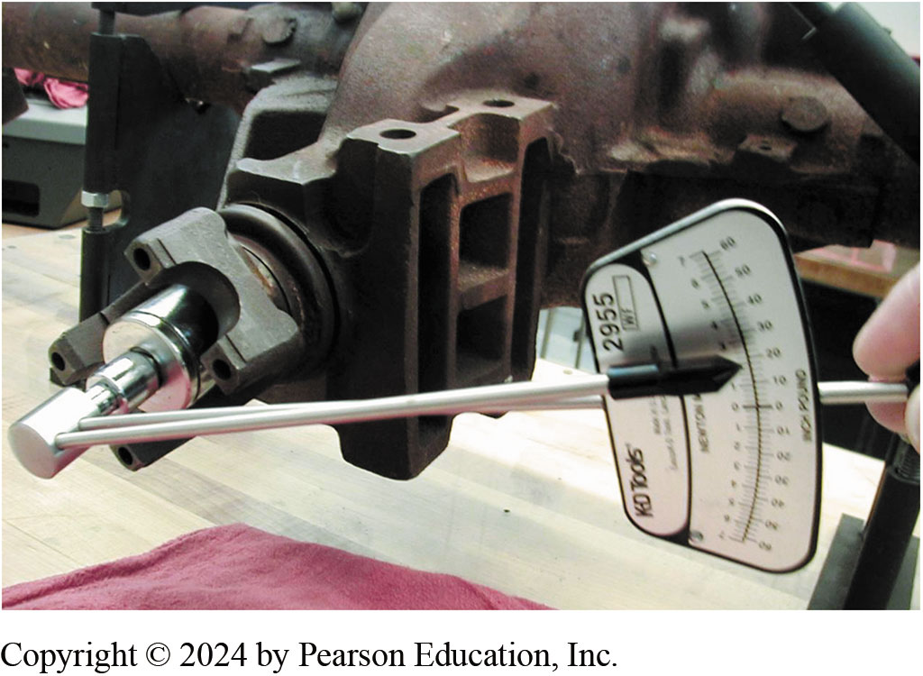
Figure 125.30 Pinion Gear Preload
Using an inch-pound torque wrench to check the rotating torque of the drive pinion. This procedure is very important if the axle uses a collapsible spacer. The drive pinion nut should be gradually tightened and the rotating torque checked to prevent over-tightening the nut. If the rotating torque is higher than specifications, the collapsible spacer will require replacement and the installation procedure must be repeated.
Notes:
Pinion Gear Preload
After the proper drive pinion depth has been determined, the correct size shim is installed and the rear drive pinion bearing is pressed onto the drive pinion. The outer races of the pinion bearing
should be replaced in the axle housing and the pinion shaft placed in the housing. It is then necessary to apply the specified preload to the pinion bearings. A new drive pinion nut should
be used and tightened to specifications. After the nut has been tightened, torque needed to rotate the drive pinion should be measured using a beam-type torque wrench. The drive pinion nut
is then tightened farther until the turning torque is within specifications. ● SEE FIGURE 125–30.

Slide 64
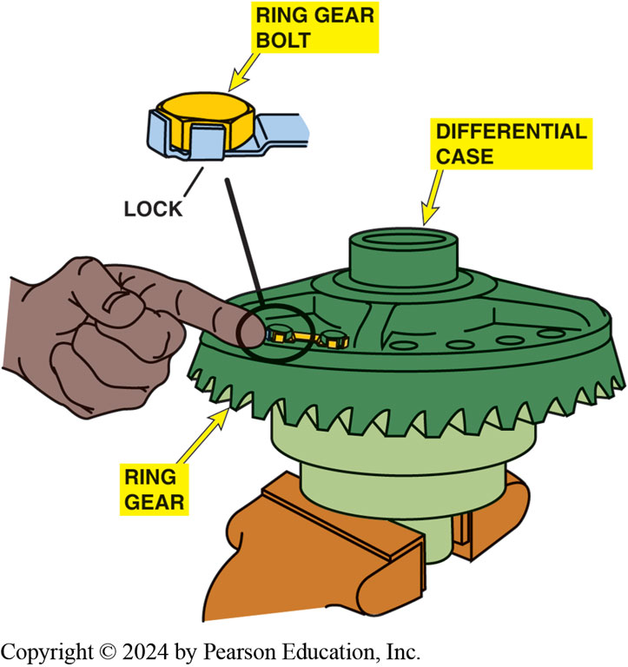
Figure 125.31 Replace Bolts
If the ring gear has been removed from the differential case or if a new ring gear is being installed, always replace the ring gear bolts.
Notes:
Checking & Correcting Backlash
If the ring gear and pinion are being replaced, the bolts that hold the ring gear to the differential case must be replaced. ● SEE FIGURE 125–31. The differential case with the ring gear is then
placed into the differential housing. Backlash is the clearance between the drive pinion gear and the ring gear. A dial indicator is used to measure backlash, as shown in ● FIGURE 125–32.
The backlash should be checked at three or four points around the ring gear and the lash should not vary over 0.002 inch (0.05 mm). Backlash normally is between 0.005 and 0.008 inch
(0.10 and 0.20 mm) for most axle assemblies. Always check the specifications for the differential being serviced. ● SEE FIGURE 125–33.
Backlash is corrected by moving the ring gear either closer or farther away from the drive pinion gear. The correction is made by either of two methods depending on the manufacturer and
the type of differential:
■ Transferring shims from one side of the axle housing to the other
■ Turning threaded adjusters located in the differential housing bores, as shown in ● FIGURE 125–34.SCREW

Slide 65
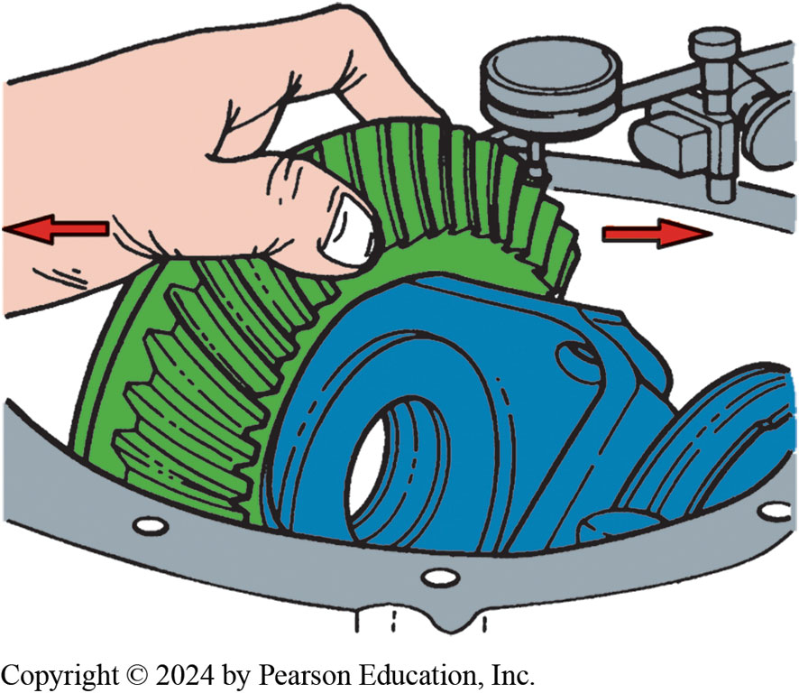
Figure 125.32 Backlash
Backlash should be between 0.005 and 0.008 inch on most differentials. If the backlash is too great, add shim thickness to the ring gear side and subtract shim thickness from the opposite side.
Notes:
TECH TIP: “Click-Click” Is Okay-“Clunk-Clunk” Is Not
An experienced service technician was observed checking the backlash on a differential. The technician was simply turning the drive pinion by grasping the pinion flange and using wrist action to quickly rotate it first in one direction and then the other. The technician explained that if it made a “click-click” sound, the backlash was usually between 0.005 and 0.008 inch, which is usually within specifications for most differentials. If, however, the sound made was more like a “clunk-clunk,” then the backlash was greater than 0.010 inch and had to be corrected. To summarize what the sounds mean when the drive pinion is moved back and forth:
No sound when moved back and forth—too little or no backlash; backlash must be adjusted.
A “click-click” sound—backlash is usually within specifications; double-check with a dial indicator and compare against specifications for the axle being serviced. A “clunk-clunk” sound—usually too much backlash; correction is required to restore proper backlash.

Slide 66
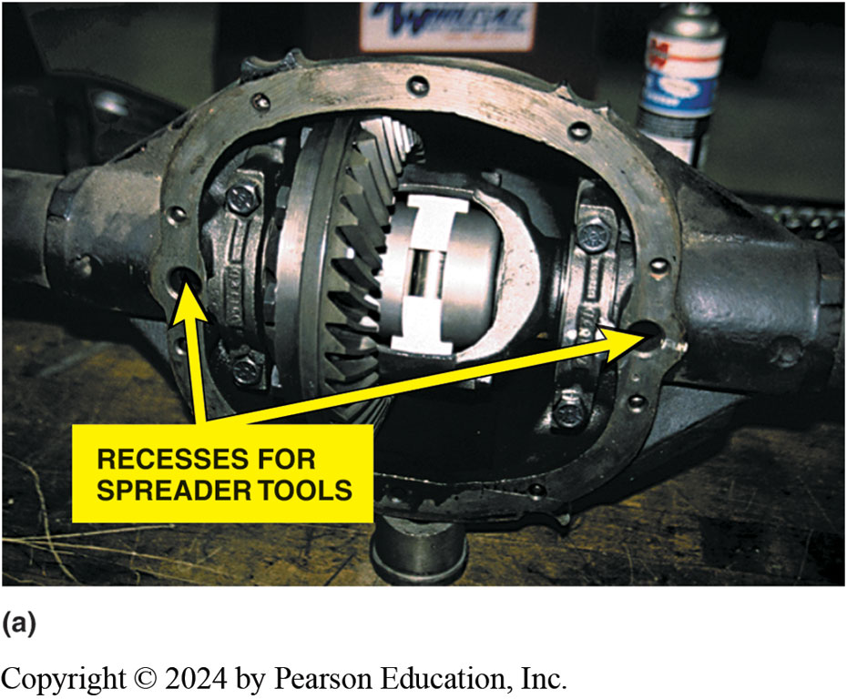
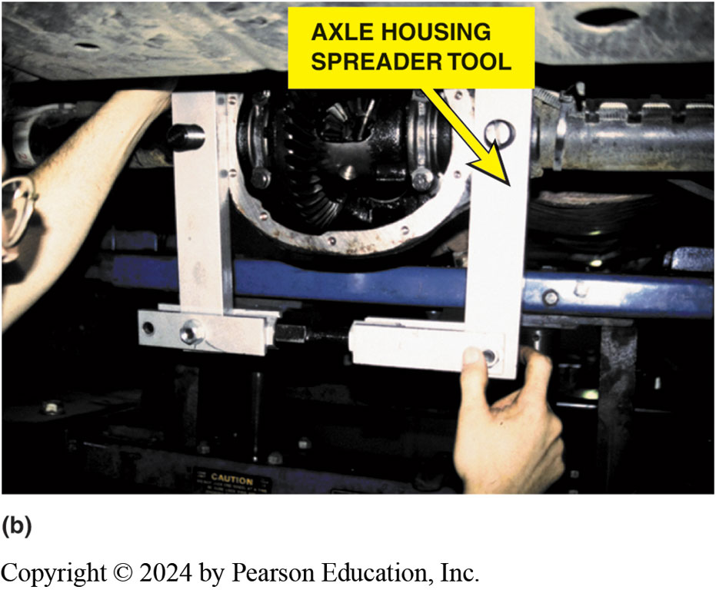
Figure 125.33 Spreader
(a) Some vehicle manufacturers recommend using a housing spreader tool that fits into the round openings on both sides. (b) The spreader tool being installed. The housing is spread a specified amount and the differential is then installed into the housing.

Slide 67
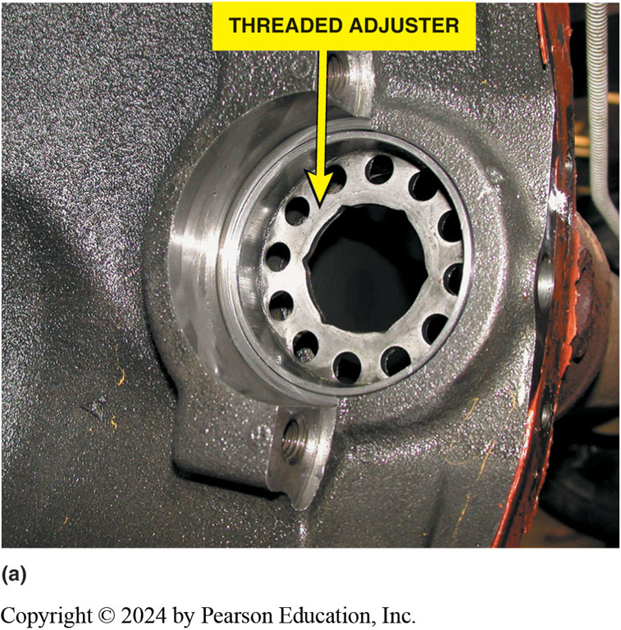
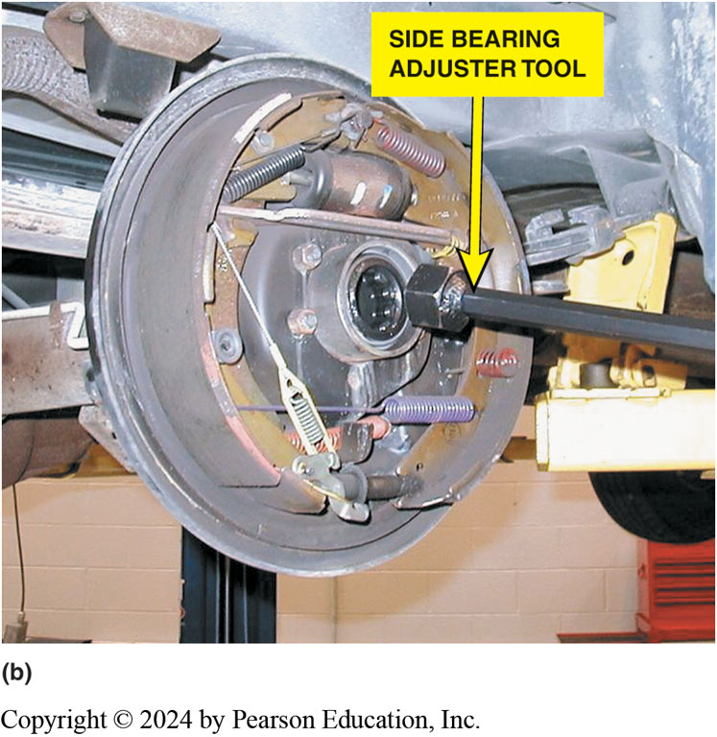
Figure 125.34 Preload Adjuster
(a) Note the hex shape of the threaded adjuster used to adjust side bearing preload and ring gear backlash on a Dodge Dakota truck. (b) A long-handled adjuster tool is needed to turn the side bearing adjuster on this truck.

Slide 68
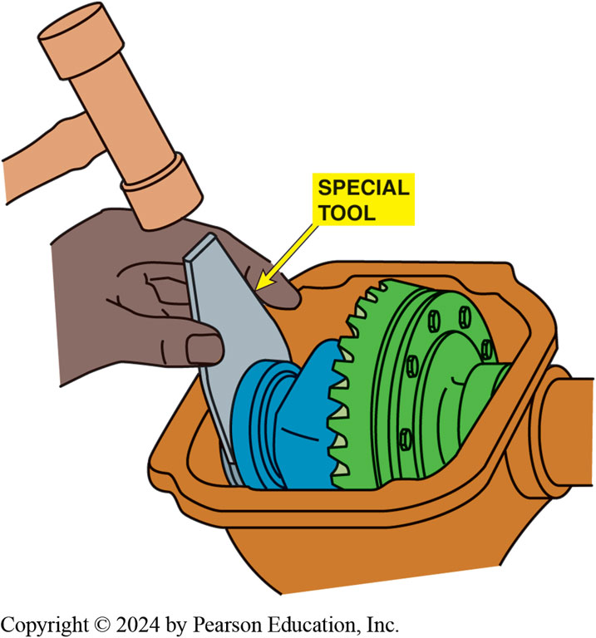
Figure 125.35 Shim Installer
On many axles, it is necessary to use a special tool to install steel spacers (shims) to achieve the specified backlash and side bearing preload.

Slide 69
Frequently Asked Question: What Is a Spool Rear End?
? Frequently Asked Question
What Is a Spool Rear End? A spool is a solid piece of metal that takes the place of the side gears and pinion gears in a differential assembly (● SEE FIGURE 125–36). A spool used in drag racing is not suitable for street driving because the spool does not allow for any differences in the speeds of the drive wheel during cornering. Obviously, drag vehicles do not turn corners while racing and the spool rear end is one of the reasons they bounce when turning around at the end of the strip to return to the pits.

Slide 70
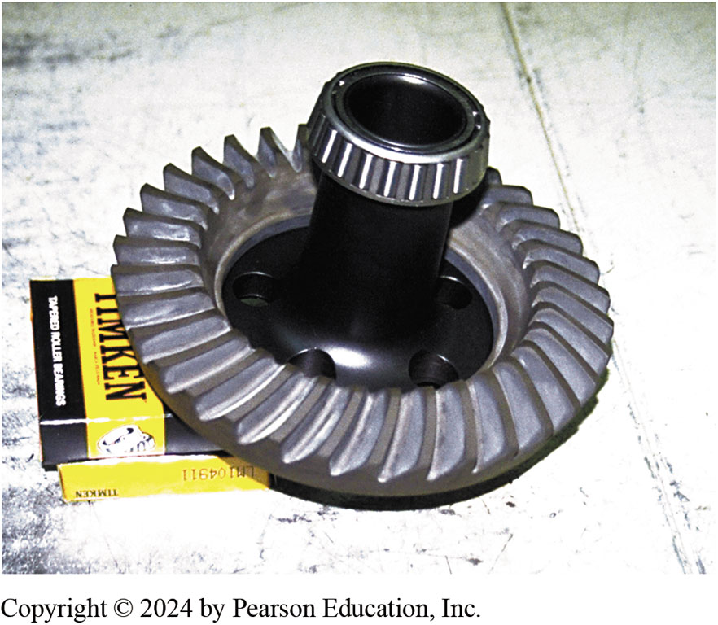
Figure 125.36 Spool
A spool used in a rear end for drag racing only.

Slide 71
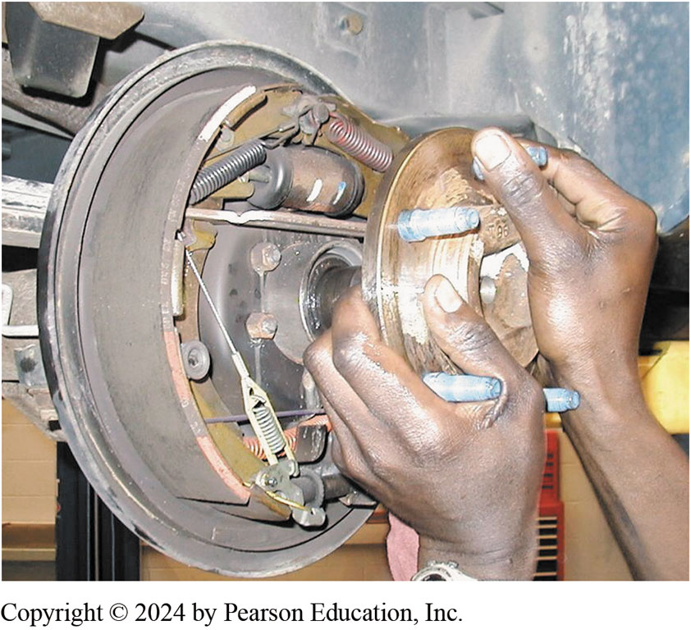
Figure 125.37 Be Careful of Seal
Install the axle shaft, being careful to not damage the seal.

Slide 72
Frequently Asked Question: What Do I Do about Drive Pinion Bearing Preload When I Replace Just the Pinion Seal?
? Frequently Asked Question
What Do I Do about Drive Pinion Bearing Preload When I Replace Just the Pinion Seal? To replace a pinion seal, drive pinion nut and pinion flange must be removed. Do not use an air impact wrench on drive pinion nut. The pinion bearings can be damaged by impact of the wrench. Before nut is removed, make a mark on pinion nut and on axle housing. After the new pinion seal is installed, tighten pinion nut to same position it was in before disassembly and then rotate the nut 1/16 inch (1.5 mm) farther. This extra rotation makes sure that collapsible space (crush sleeve) is still able to maintain proper preload on pinion bearing. Another method is to measure rotating torque of the drive pinion using an inch-pound beam- type torque wrench after removing both rear wheels and brake drums. After installing replacement pinion shaft seal, tighten drive pinion nut until the rotating torque is 3 to 5 in-lb more than the reading obtained before the pinion nut was removed.
Notes:
What Do I Do about Drive Pinion Bearing Preload When I Replace Just the Pinion Seal?
To replace a pinion seal, the drive pinion nut and pinion flange must be removed.
CAUTION: Do not use an air impact wrench on the drive pinion nut. The pinion bearings can be damaged by the impact of the wrench. Before the nut is removed, make a mark on the pinion nut and on the axle housing. After the new pinion seal is installed, tighten the pinion nut to the same position it was in before disassembly and then rotate the nut 1/16 inch (1.5 mm) farther. This extra rotation makes sure that the collapsible space (crush sleeve) is still able to maintain the proper preload on the pinion bearing. Another method is to measure the rotating torque of the drive pinion using an inch-pound beam- type torque wrench after removing both rear wheels and brake drums. After installing the replacement pinion shaft seal, tighten the drive pinion nut until the rotating torque is 3 to 5 in-lb more than the reading obtained before the pinion nut was removed.

Slide 73
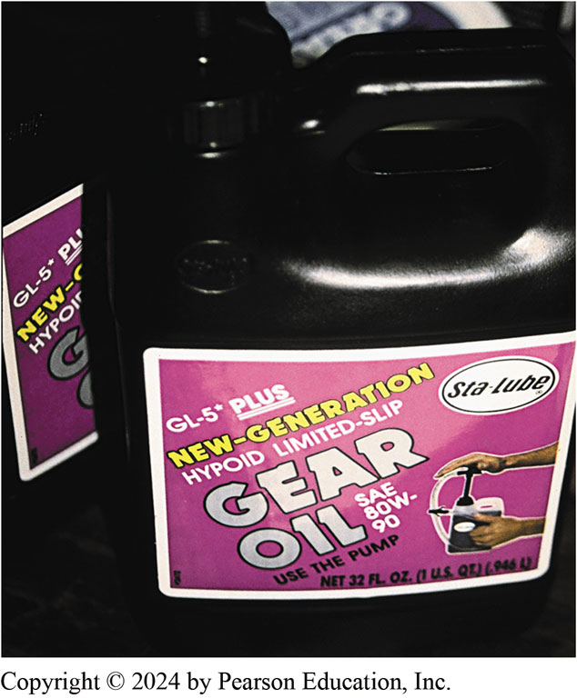
Figure 125.38 GL-5 SAE 80W-90
A container of GL-5 SAE 80W-90 gear lubricant.
Notes:
Drive Axle Lubricant
Because all differentials use hypoid gear sets, a special lubricant is necessary because the gears
both roll and slide between their meshed teeth. Gear lubes (GL) are specified by the American
Petroleum Institute (API):
GL-1 Straight mineral oil
GL-2 Worm gear lubricant
GL-3 Mild EP lubricant (will not protect hypoid gears)
GL-4 Mild EP lubricant suitable for manual transmissions/ transaxles
GL-5 EP lubricant okay for hypoid gears (meets military Mil-L2150B requirements)
● SEE FIGURE 125–38.
NOTE: EP additives contain sulfurized esters and organic sulfur phosphorous compounds. These ingredients give the lubricant a very strong pungent smell. To avoid possible skin irritation, always wear protective gloves or wash your hands thoroughly with soap and water if exposed to Differential lubricant.

Slide 74

Figure 125.39 Housing Cover
The beginning automotive student did not realize that the axle housing cover could fit the wrong way. The only problem was that the ring gear scraped against the cover.
Notes:
CASE STUDY: I Didn’t Know It Would Fit the Wrong Way!
An automotive student changed the differential lubricant by removing the housing cover. The cover was reinstalled and then filled with the correct lubricant. However, when the student drove the vehicle it made a grinding sound that was not there before the differential service. When the cover was removed, it was discovered that the cover had been installed with the raised area on the right side of the housing instead of on the left side and the ring gear had rubbed a groove in the cover, as shown in ● FIGURE 125–39. Installing the cover correctly stopped the grinding sound.
Summary:
Complaint—Vehicle made a grinding noise after a differential fluid service procedure was performed.
Cause—The drive axle hosing cover was installed incorrectly.
Correction—The cover was removed and installed correctly.

Slide 75
Question 2?
Backlash and carrier side bearing preload adjustments are made by .
  A. Adding A Shim Behind The Pinion Shaft Bearing
  B. Threaded Adjusters Or By Changing The Shims
  C. Tightening Or Loosening Retainer Bolts
  D. Using A Case Spreader

Slide 76
Answer 2
Backlash and carrier side bearing preload adjustments are made by .
  B. Threaded Adjusters Or By Changing The Shims

Slide 77
Manual Drive Train and Axles Videos and Animations
Videos Link: (A3) Manual Drive Train Axles Videos
Animations Link: (A3) Manual Drive Train Axles Animations

Slide 78
Copyright
This work is protected by United States copyright laws and is provided solely for the use of instructors in teaching their courses and assessing student learning. Dissemination or sale of any part of this work (including on the World Wide Web) will destroy the integrity of the work and is not permitted. The work and materials from it should never be made available to students except by instructors using the accompanying text in their classes. All recipients of this work are expected to abide by these restrictions and to honor the intended pedagogical purposes and the needs of other instructors who rely on these materials.

