Slide 1
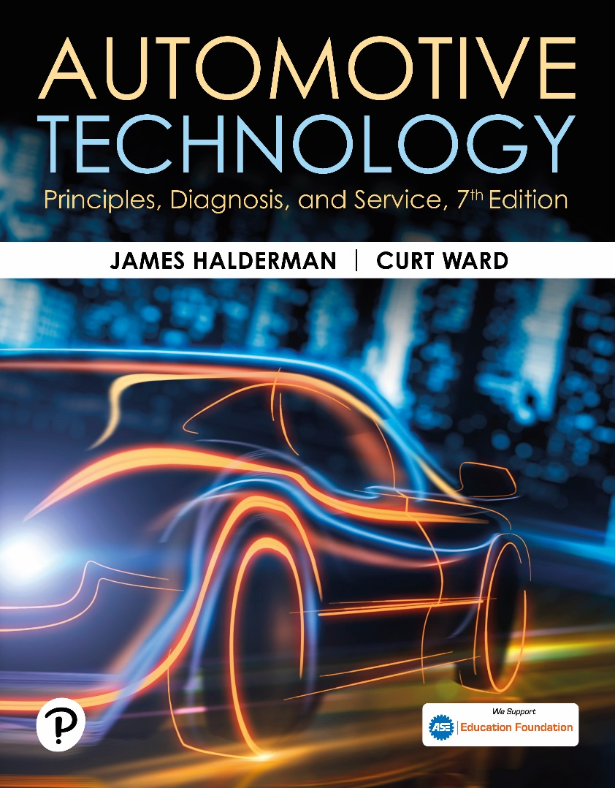
Automotive Technology: Principles, Diagnosis, and Service
Seventh Edition
Chapter 124
Drive Shafts and Half Shaft Service
Copyright © 2023 Pearson Education, Inc. All Rights Reserved
Notes:
INSTRUCTOR NOTE: This presentation includes text explanation notes, you can use to teach the course. When in SLIDE SHOW mode, you RIGHT CLICK and select SHOW PRESENTER VIEW, to use the notes.

Slide 2
Learning Objectives
124.1 Explain how to diagnose a U-joint.
124.2 Explain how to inspect a driveshaft and U-joint.
124.3 List the steps necessary to replace a U-joint.
124.4 Explain how to measure U-joint working angles.
124.5 Discuss CV joint diagnosis and replacement shaft assemblies.
124.6 Describe the service procedures for replacing CV joints..

Slide 3
U-Joint Diagnosis
What is some background on driveshaft of a rear-wheel-drive vehicle?
Symptoms of Defective U-Joints
  1. Vibration or harshness at highway speed
  2. Clicking sound vehicle moving either forward or in reverse
  3. Clunking sound whenever changing gears
    Such as moving from drive to reverse
Notes:
The driveshaft of a typical RWD vehicle rotates about three times faster than wheels. This is due to the gear reduction that occurs in the drive axle. The drive axle not only provides gear reduction but also allows for a difference in the speed of the rear wheels that
is necessary whenever turning a corner. The driveshaft rotates at the same speed as the engine if the transmission ratio is 1 to 1 (1:1).
The engine speed, in revolutions per minute (RPM), is transmitted through the transmission at the same speed. In lower gears, the engine speed is many times faster than the output of the transmission. Most transmissions today, both manual and automatic, have an overdrive gear. This means that at highway speeds, the driveshaft is rotating faster than the engine.

Slide 4
Driveshaft and U-Joint Inspection
U-joints should be inspected every time
Vehicle chassis lubricated, or four times a year.
  Driveshaft must be removed to do this.
  Check driveshaft for movement of u-joints
  Movement means u-joint must be replaced.
Notes:
CAUTION: A dented or creased driveshaft can collapse, especially when the vehicle is under load.
This collapse of the driveshaft can cause severe damage to the vehicle and may cause an accident.
Case Study: The Squeaking Pickup Truck
The owner of a pickup truck complained that a squeaking noise occurred while driving in reverse. The “eeee eeee eeee” sound increased in frequency as the truck increased in speed, yet the noise did not occur when driving forward. Because there was no apparent looseness in the U-joints, the service technician at first thought that the problem was inside either transmission or the rear end. When the driveshaft was removed to further investigate the problem, it became obvious where the noise was coming from. The U-joint needle bearing had worn the cross-shaft bearing surface of the U-joint. ● SEE FIGURE 10–1, Next Slide. The noise occurred only in
reverse because the wear had occurred in the forward direction, and therefore only when the torque was applied in the opposite direction did the needle bearing become bound up and start to make noise. A replacement U-joint solved the squeaking noise in reverse.
Summary:
◼ Complaint—Customer complained of squeaking sound but only while driving in reverse.
◼ Cause—A worn U-joint was found to be the cause.
◼ Correction—The worn U-joint was replaced and the noise issue was corrected.

Slide 5
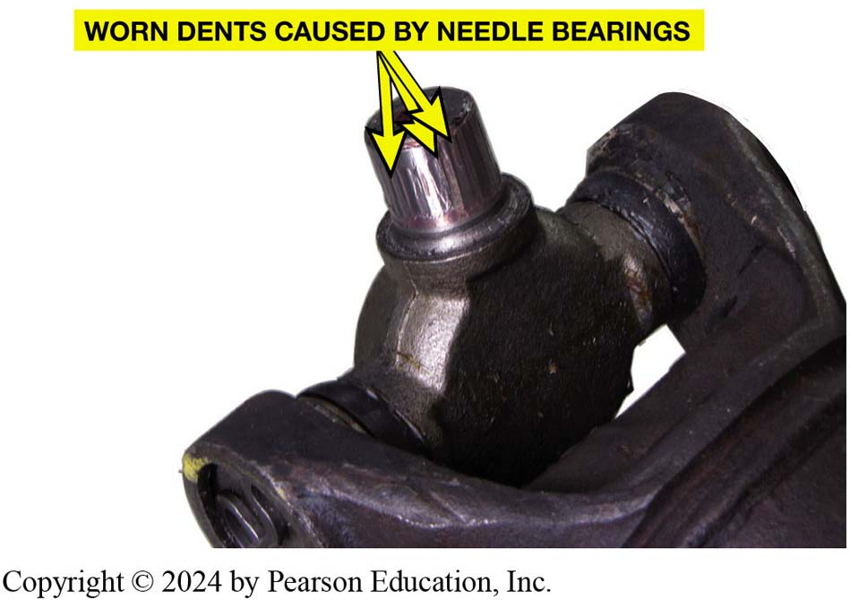
Figure 124-1 Brinelling Grooves
Notice how the needle bearings have worn grooves, called Brinelling, into the bearing surface of U-joint.

Slide 6
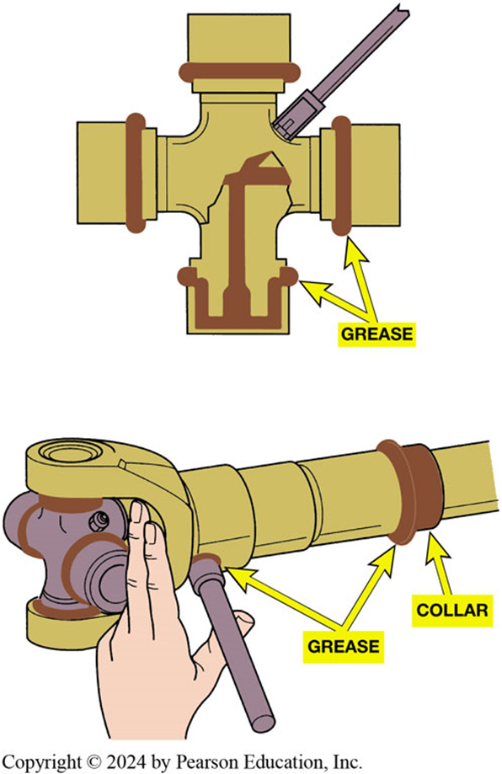
Figure 124-2 Grease Fitting
All U-joints and spline collars equipped with a grease fitting should be greased four times a year as part of a regular lubrication service.
Notes:
U-joints are permanently lubricated and have no provision for greasing. If there is a grease fitting,
the U-joint should be lubricated by applying grease with a grease gun. ● See Figures 10–2 And 10–3.

Slide 7
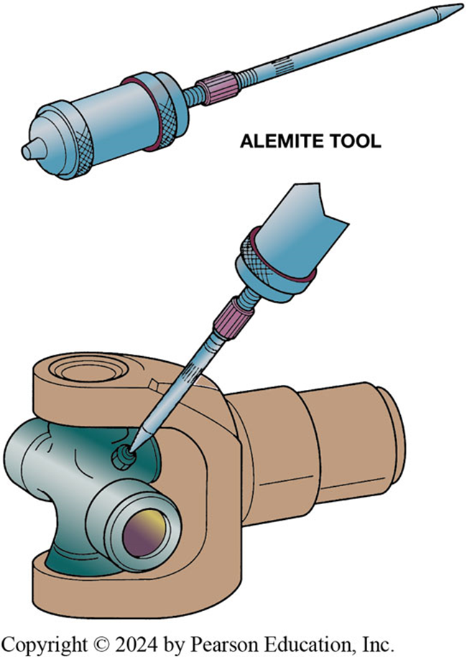
Figure 124-3 Alemite Tool
Many U-joints require a special grease gun tool to reach the grease fittings

Slide 8
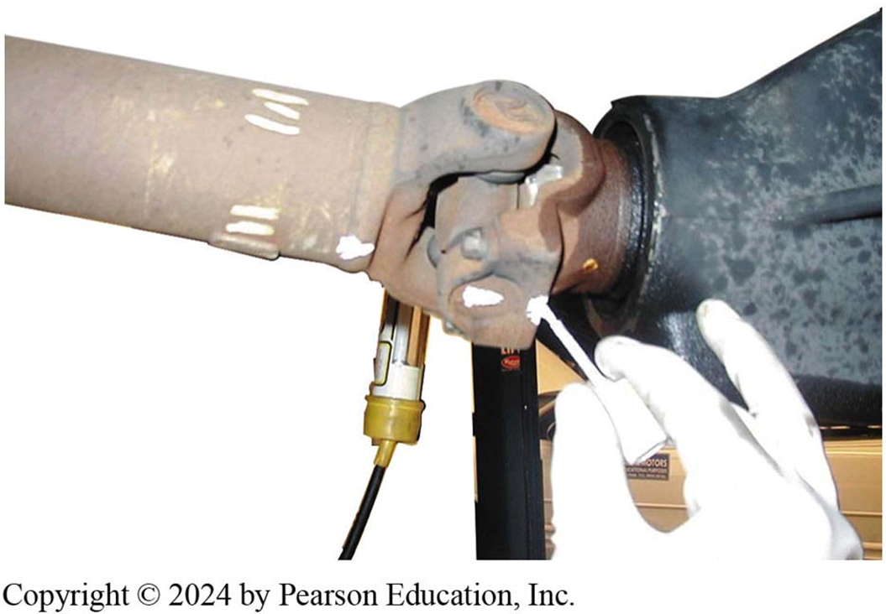
Figure 124-4 Marking Location
Always mark the original location of U-joints before disassembly

Slide 9
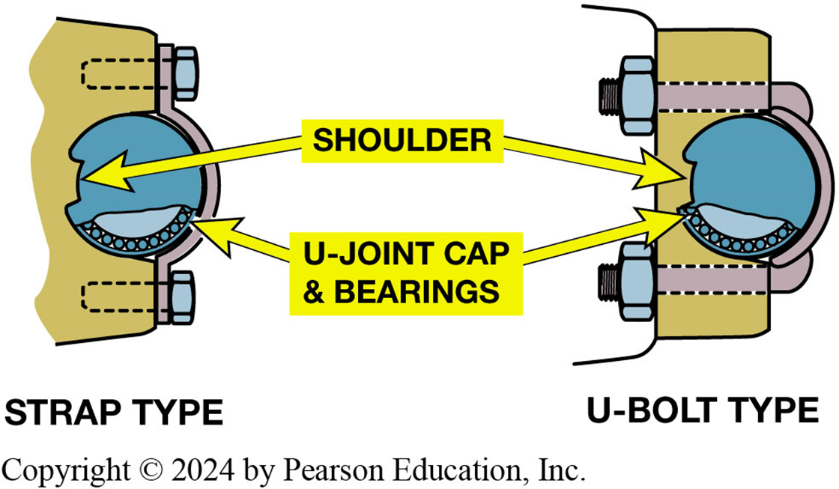
Figure 124-5 Retaining Caps
Two types of retaining methods that are commonly used at the rear U-joint at the differential.

Slide 10
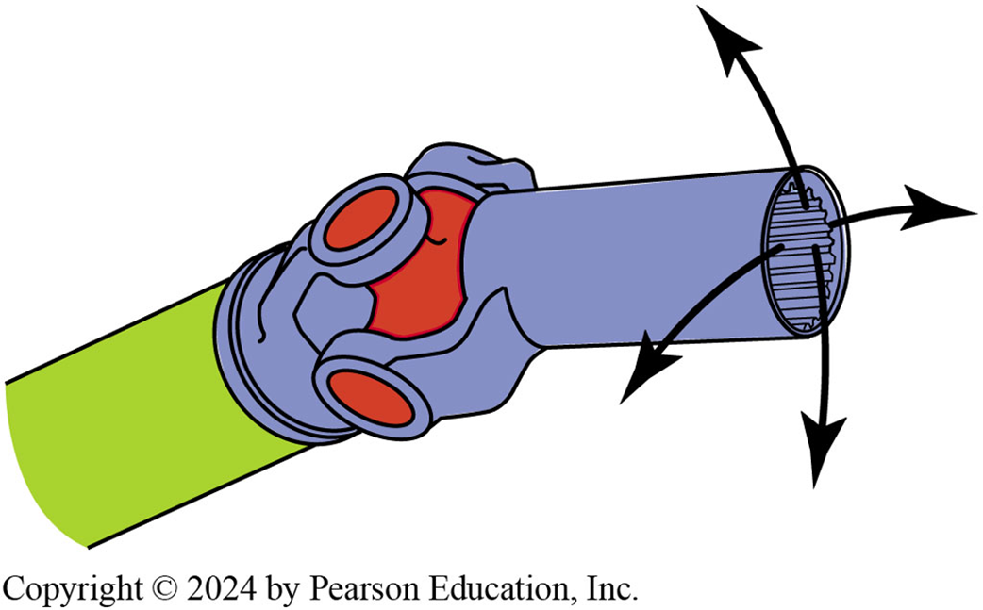
Figure 124-6 Checking U-Joint
The best way to check any U-joint is to remove driveshaft from vehicle and move each joint in all directions.

Slide 11
U-Joint Replacement
Remove retainers; use press or a vise to separate U-joint from yoke.
Replacement U-joints use spring clips instead of injected plastic.
  Should be forged and use up to 32 needle bearings.
After removing any dirt or burrs from the yoke, press in a new U-joint.
Notes:
All movement in a U-joint should occur between the trunnions and the needle bearings in the end caps. The end caps
are press-fit to the yokes, which are welded to the driveshaft. Three types of retainers are used to keep the bearing caps on
the U-joints: the outside snap ring (● SEE FIGURE 10–7), the inside retaining ring, and injected synthetic (usually nylon).
● SEE FIGURE 10–8. After removing the retainers, use a press or a vise to separate the U-joint from the yoke. ● SEE FIGURE 10–9.
U-joints that use synthetic retainers must be separated using a press and a special tool to press onto both sides of the joint in order to shear the plastic retainer, as shown in ● FIGURE 10–11.

Slide 12
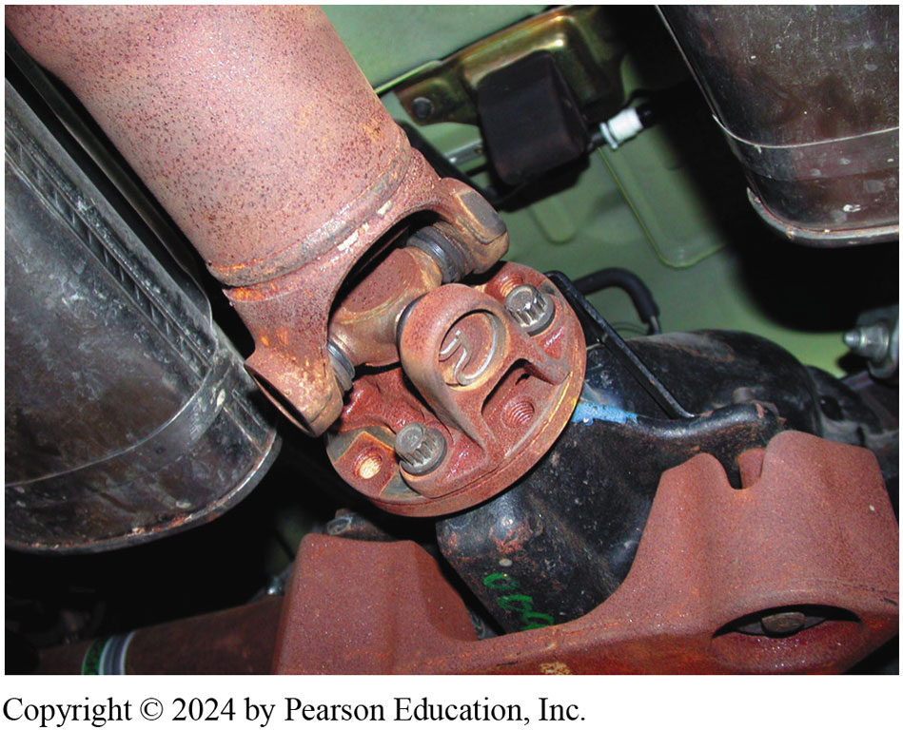
Typical U-joint that uses an outside snap ring.
Figure 124-7 Outside Snap Ring

Slide 13
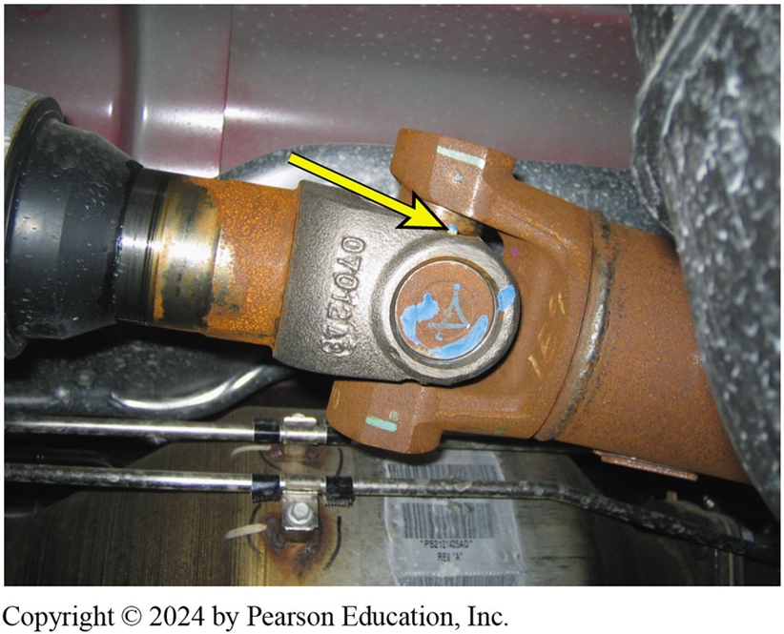
Figure 10-8 Nylon Sealed
A U-joint that is held together by nylon and usually requires that heat be applied to remove from the yoke

Slide 14
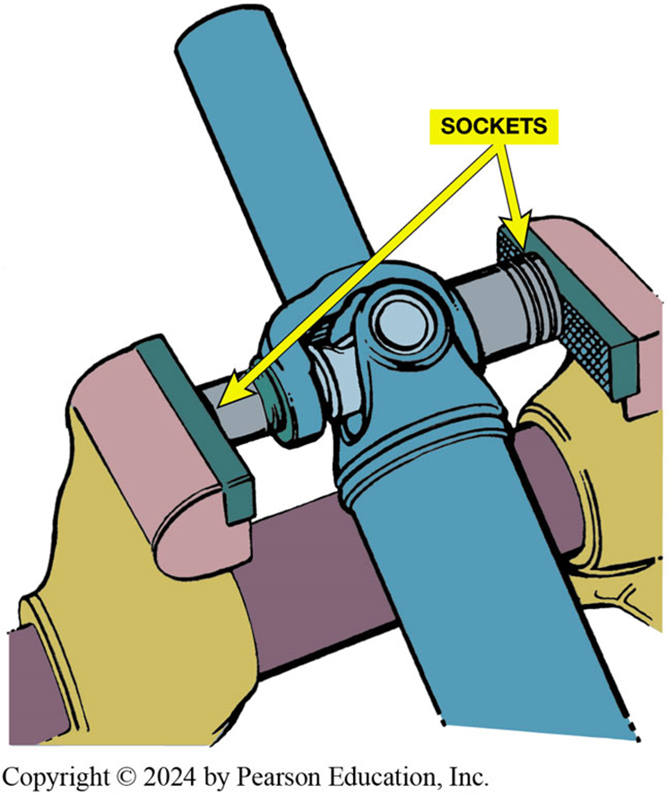
Figure 124-9 Use a vise and two sockets to replace a U-joint.

Slide 15
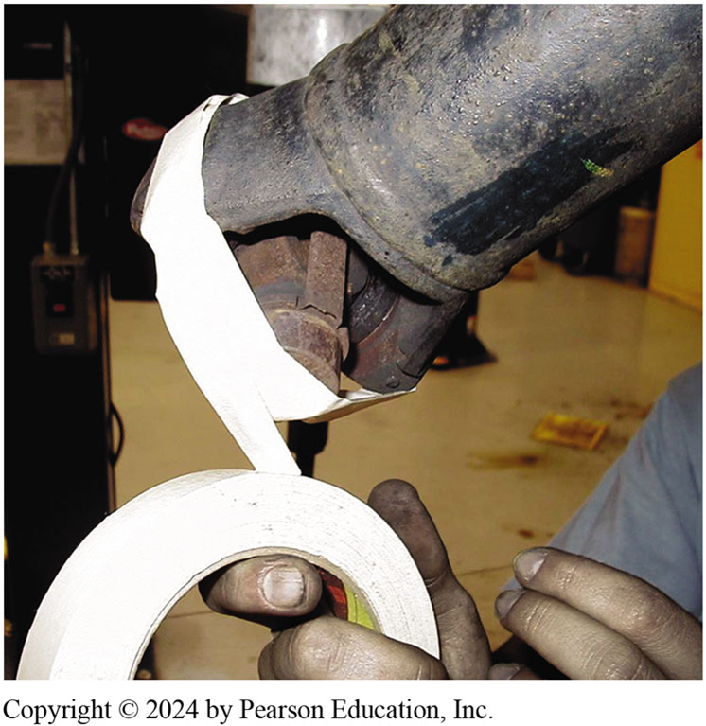
Figure 124-10 Taping U-joint to prevent caps from coming off

Slide 16
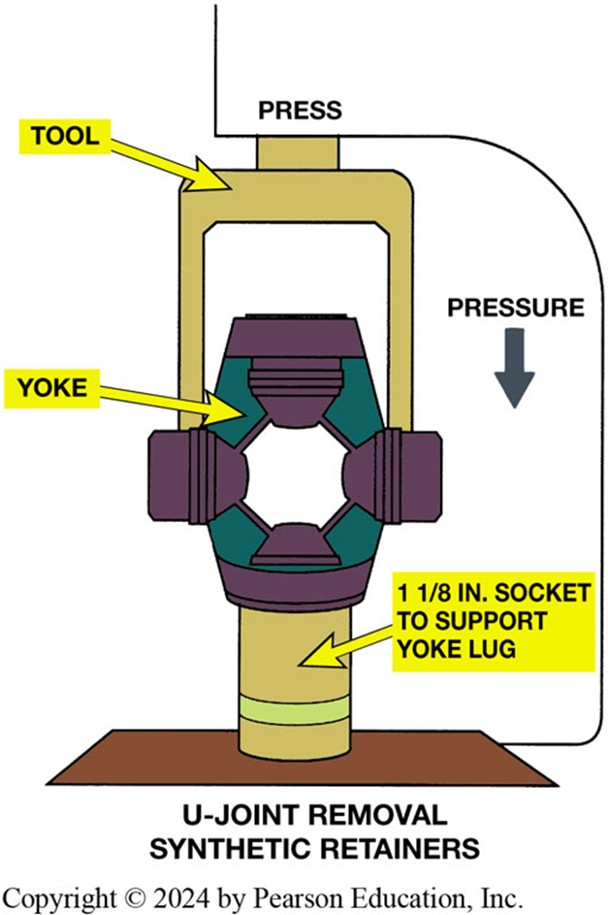
Figure 124-11 Special Tool
Special tool being used to press apart U-joint that is retained by injected plastic. Heat from a
propane torch may be used to soften plastic to avoid exerting too much force on U-joint.

Slide 17
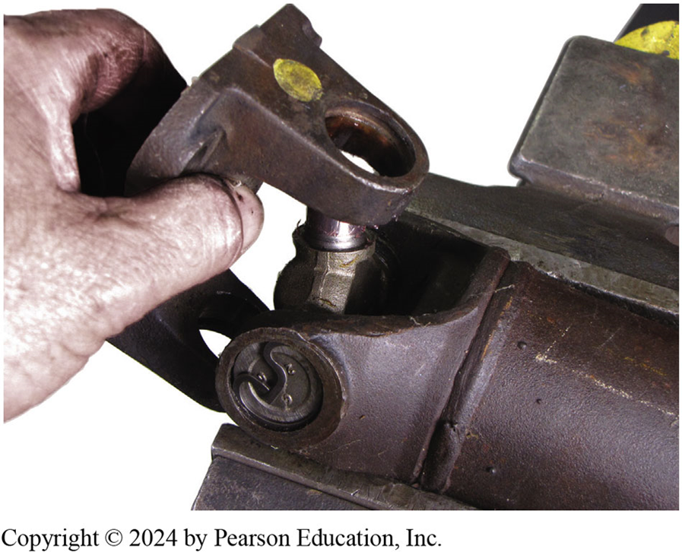
Figure 124-12 Removing worn cross from yoke.

Slide 18
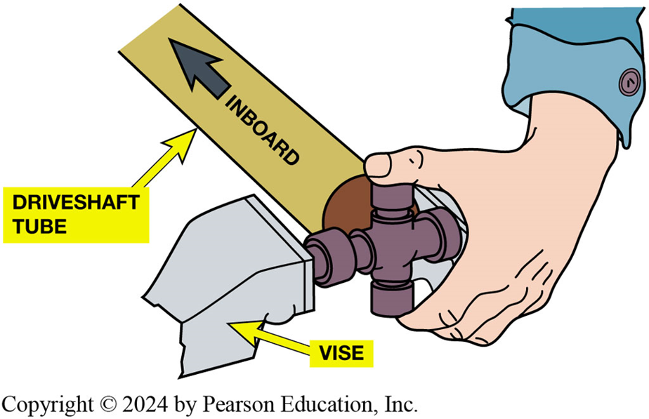
Figure 124-13 Installing U-Joint
When installing a new U joint, position the grease fitting on the inboard side (toward the driveshaft tube) and in alignment with the grease fitting of the U-joint at the other end.

Slide 19
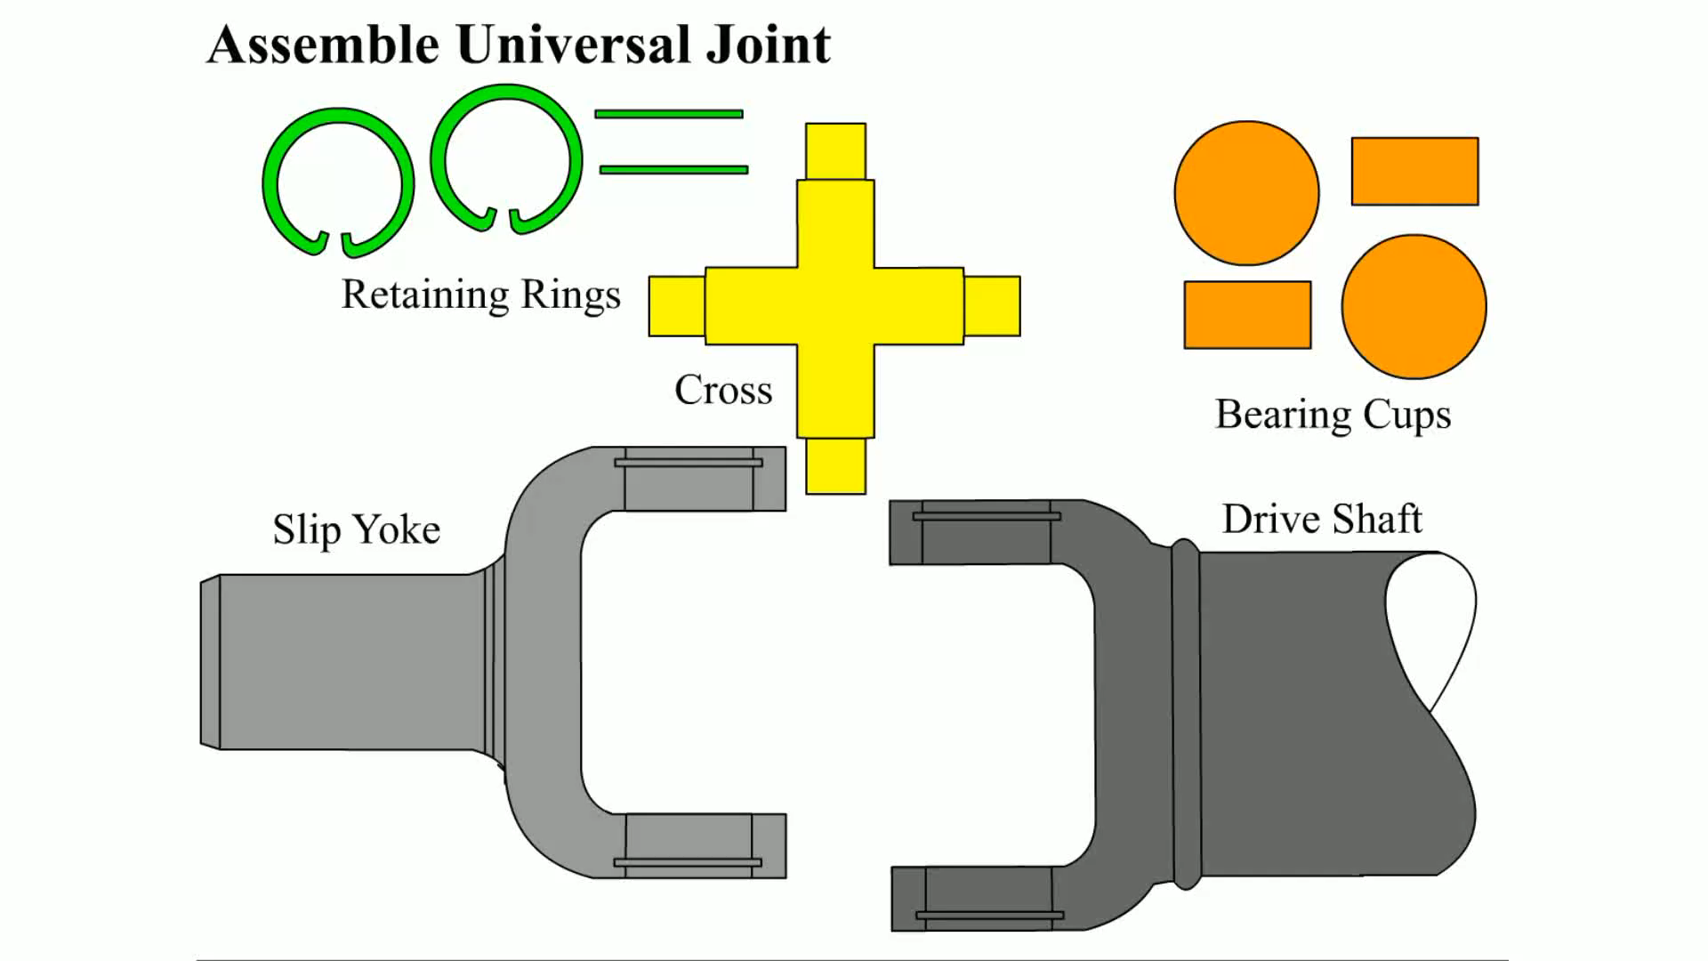
Animation: Assemble Universal Joint
(Animation will automatically start)

Slide 20
U-Joint Working Angles
Place an inclinometer on rear U-joint bearing cap.
Level bubble and read angle.
Rotate driveshaft 90 degrees, read angle of rear yoke.
Subtract smaller reading from larger reading
To obtain working angle of joint.
Notes:
To measure U-joint and driveshaft angles, the vehicle must be hoisted using an axle contact or drive-on-type lift so as to maintain the same driveshaft angles as the vehicle has while being driven. The working angles of the two U-joints on a driveshaft should be within 1/2 degree of each other in order to cancel out speed changes. ● SEE FIGURE 10–14.

Slide 21
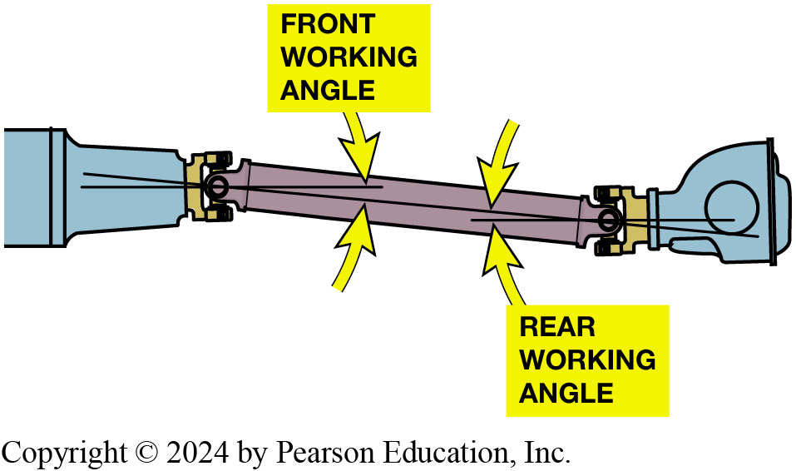
Figure 124-14 Working Angles
Working Angle
  At Least ½ Degree
  Not Exceed 3 Degrees
Working angle of most U-joints should be at least ½ ° (to permit needle bearing to rotate in U-joints) and should not exceed 3 °or a vibration can occur in driveshaft, especially at higher speeds. The difference between front and rear working angles should be within ½ ° of each other.

Slide 22
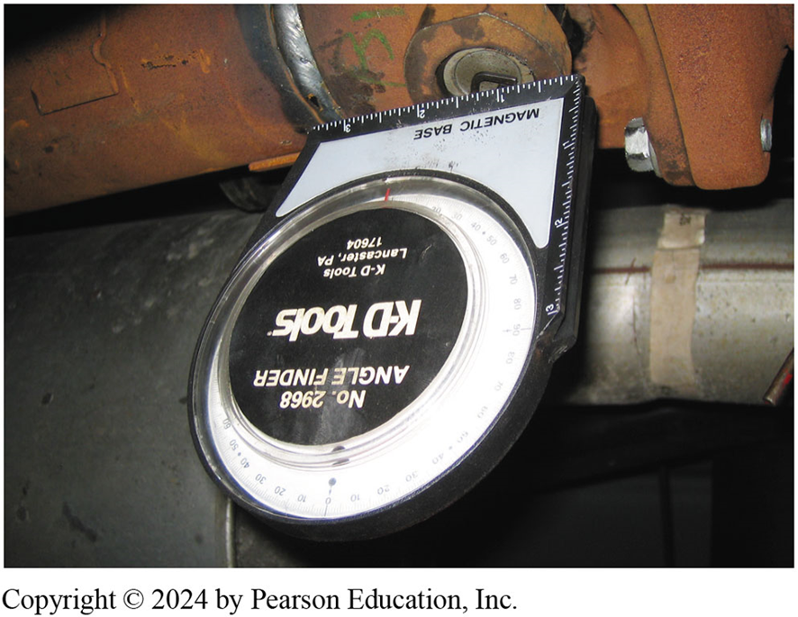
Figure 124-15 Inclinometer
Inclinometer with a magnetic base is being used to measure the angle of the driveshaft at the rear U-joint.

Slide 23
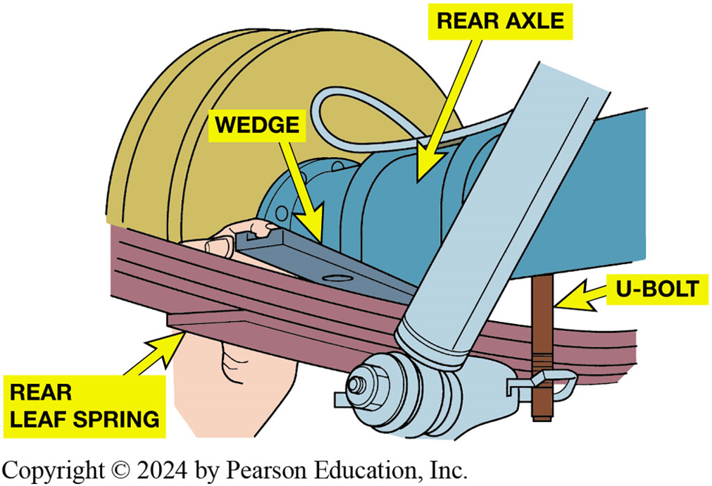
Figure 124-16 Tapered Wedge
Placing a tapered metal wedge between the rear leaf spring and rear axle pedestal to correct rear U-joint working angles.
Notes:
CAUTION: Use caution whenever using wedges between the differential and the rear leaf spring to restore correct U-joint working angle. Even though wedges are made to raise the front of the differential, the tilt often prevents rear-end lubricant from reaching pinion bearing, resulting in pinion bearing noise and eventual failure.

Slide 24
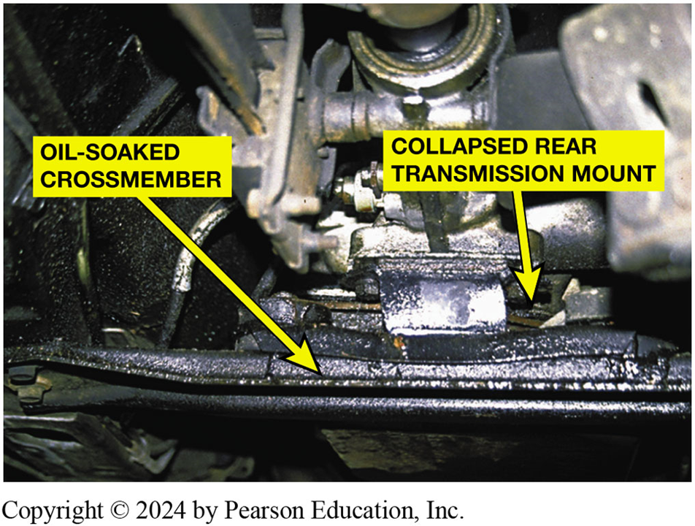
Figure 10-17 Mount Collapse
A transmission oil pan gasket leak allowed automatic trans-mission fluid to saturate the rear transmission mount rubber, causing it to collapse.
Notes:
TECH TIP: Quick and Easy Backlash Test
Whenever a driveline clunk is being diagnosed, one possible cause is excessive backlash (clearance) between the ring gear teeth and differential pinion teeth in the differential. Another common cause of excessive differential backlash is too much clearance between differential carrier pinion teeth and side gear teeth. A quick test to check backlash involves three easy steps:
STEP 1 Hoist the vehicle on a frame contact lift, allowing the drive wheels to be rotated.
STEP 2 Have an assistant hold one drive wheel and the driveshaft to keep them from turning.
STEP 3 Move the other drive wheel, observing how far the tire can rotate. This is the amount of backlash in the differential; it should be less than 1 inch (25 mm), of movement measured at the tire.
If the tire can move more than 1 inch (25 mm), then the differential should be inspected for wear and parts should be replaced as necessary. If the tire moves less than 1 inch (25 mm), then the backlash between the ring gear and pinion is probably not the
cause of the noise.

Slide 25
CV Joint Diagnosis
Noise while driving could signal that a CV joint is worn or has failed.
  Try driving the vehicle in reverse while turning and accelerating.
Notes:
When a CV joint wears or fails, the most common symptom is noise while driving. An outer fixed CV joint will most likely be heard when turning sharply and accelerating at the same time. This noise is usually a clicking sound. While inner joint failure is less common, a defective inner CV joint often creates a loud clunk while accelerating from rest. To help verify a defective joint, drive the vehicle in reverse while turning and accelerating. This almost always will reveal a defective outer joint.

Slide 26
Replacement Shaft Assemblies
FWD vehicles were widely used in Europe and Japan
Long before they became popular in North America.
Standard repair procedure in those countries
Replace entire drive assembly if there is CV joint failure.

Slide 27
CV Joint Service
Hub nut must be removed whenever servicing a CV joint or shaft assembly
on a front-wheel-drive vehicle.
What are steps to follow after the hub nut is loosened?

Slide 28
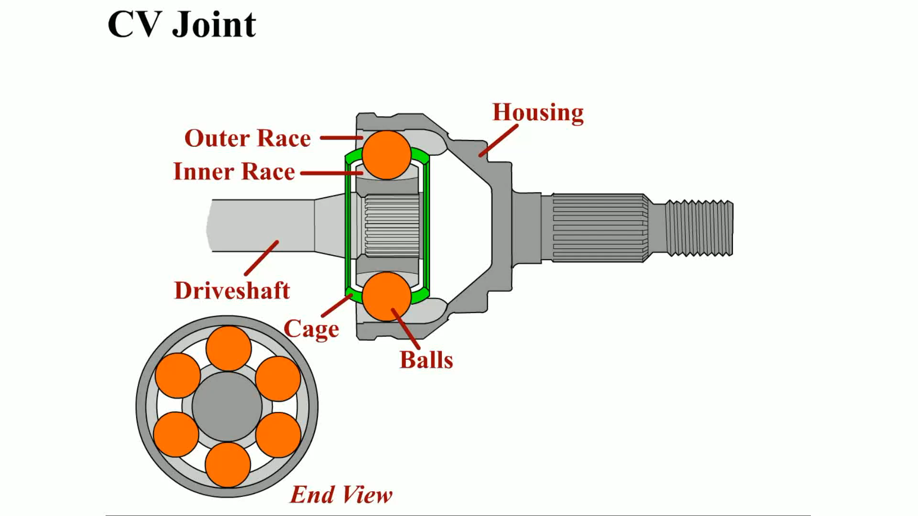
Animation: CV Joint
(Animation will automatically start)

Slide 29
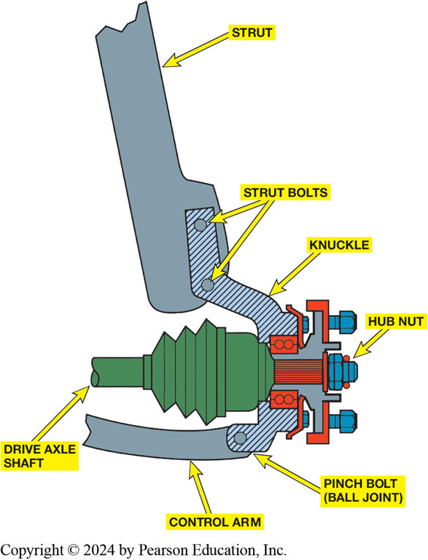
Figure 124-18 Hub Nut
The hub nut must be removed before the hub bearing assembly or drive axle shaft can be removed from the vehicle.

Slide 30
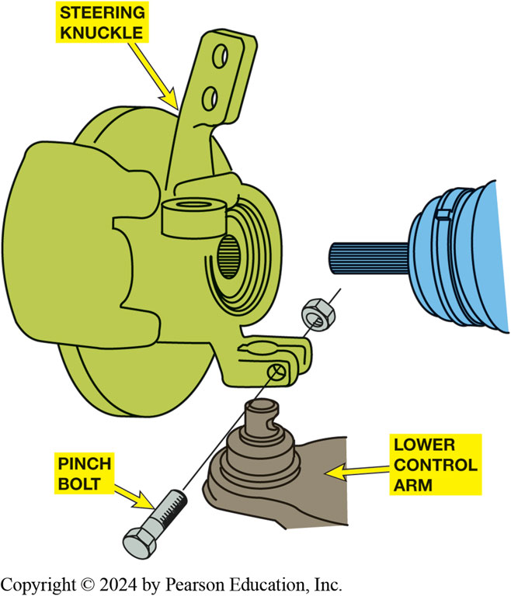
Figure 124-19 Pinch Bolt
Many knuckles are attached to ball
joint on lower control arm by a pinch bolt.

Slide 31
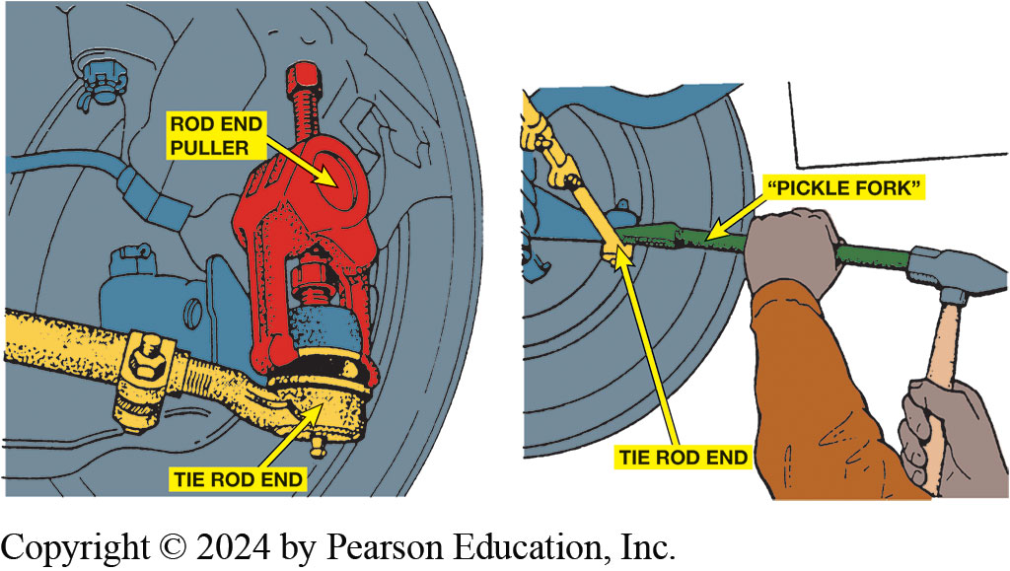
Figure 124-20 Separating Tie Rod
preferred method for separating tie rod end from steering knuckle is to use a puller such as one shown. A “pickle-fork”-type tool should be used only if tie rod is going to be replaced. A pickle-fork-type tool can damage or tear rubber grease boot. Striking tie rod end with a hammer while holding another hammer behind joint to shock and break taper from steering knuckle can also be used.

Slide 32
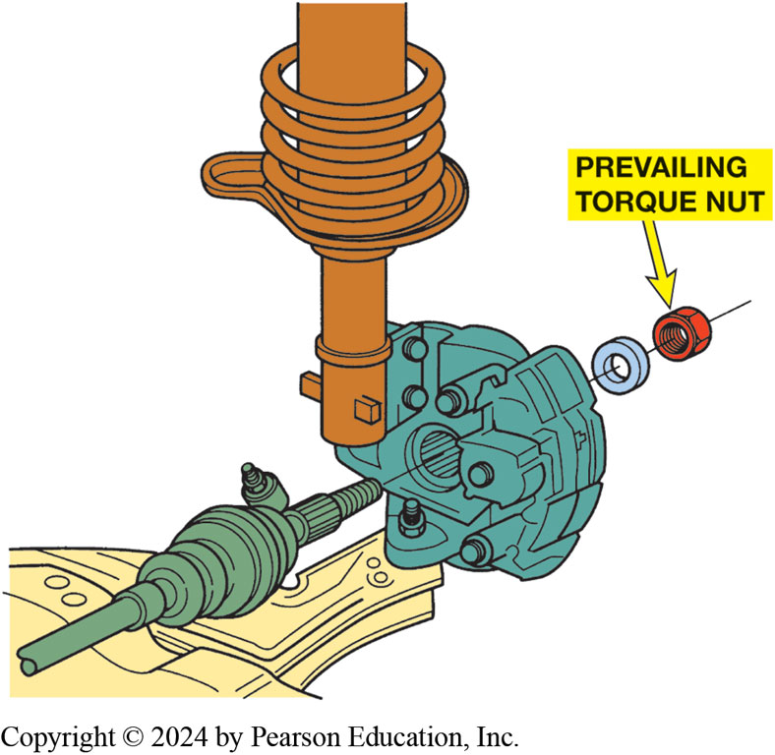
Figure 124-21 Torque Prevailing Nut
Many drive axles are retained by prevailing torque nut that must not be reused. Prevailing torque nuts are slightly deformed or contain a plastic insert that holds nut tight (retains torque) to shaft without loosening

Slide 33
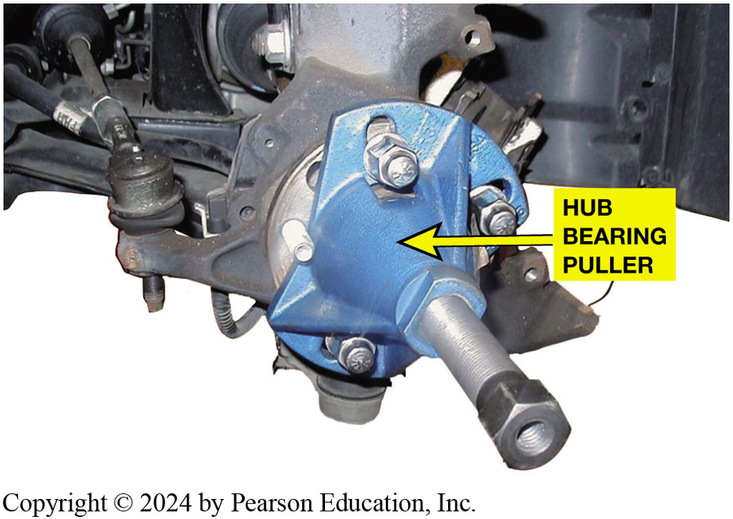
Figure 124-22 Hub Bearing Puller
A special GM tool is used to separate drive axle shaft from wheel hub bearing.

Slide 34
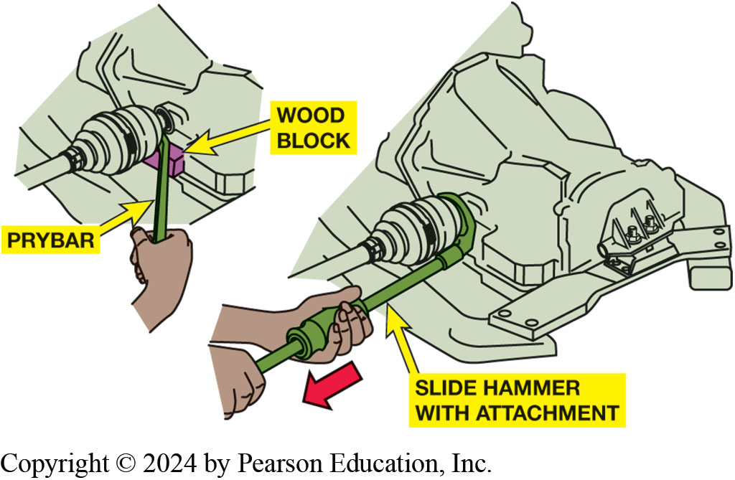
Figure 124-23 Pulling From Transaxle
Most inner CV joints can be separated from the transaxle with a prybar.

Slide 35
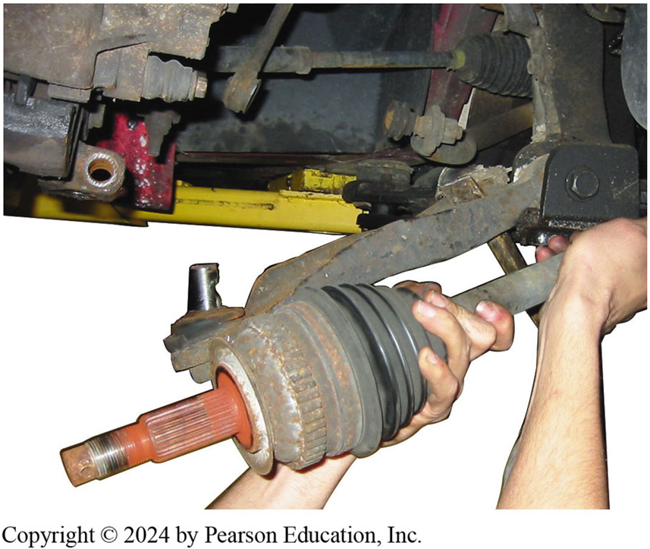
Figure 124-24 Removing Drive Shaft
When removing a drive axle shaft assembly, use care to avoid pulling the plunge joint apart.

Slide 36
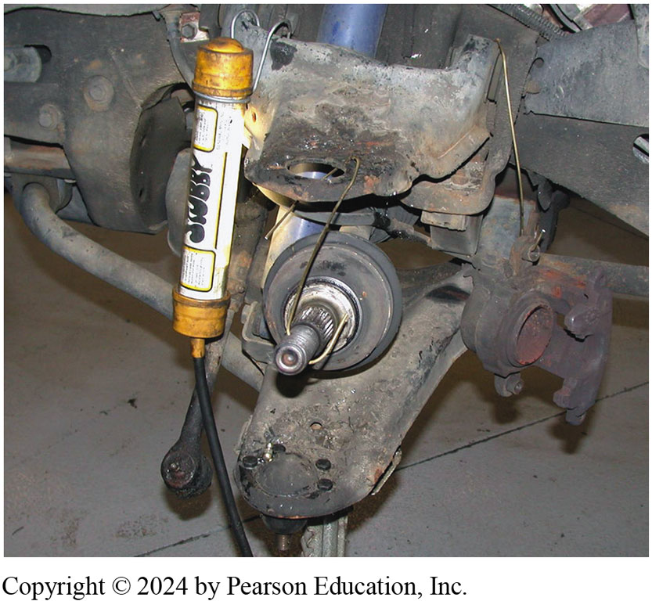
Figure 124-25 Supporting Shaft
If other service work requires that just one end of drive axle shaft be disconnected from the vehicle, be sure that the free end is supported to prevent damage to protective boots or allowing the joint to separate.

Slide 37
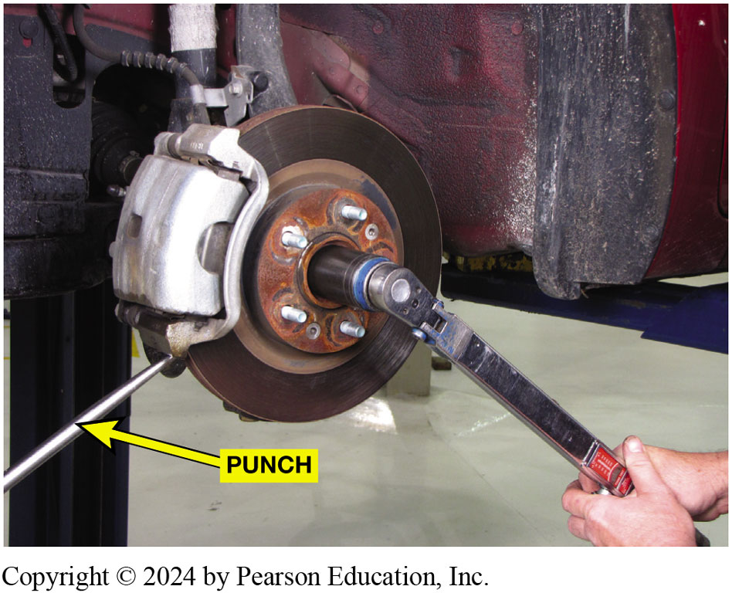
Figure 124-26 Spindle Nut Torqued
A punch being used to keep the rotor from rotating while torquing the axle shaft spindle nut.
Notes:
TECH TIP: Spline Bind Cure
Driveline “clunk” often occurs in rear-wheel-drive vehicles when shifting between drive and reverse or when accelerating from a stop. Often the cause of this noise is excessive clearance in the differential. Another cause is called spline bind, where the changing rear pinion angle creates a binding in the spline when the rear springs change in height. For example, when a pickup truck stops, the weight transfers toward the front and unloads the rear springs. The front of the differential noses downward and forward as the rear springs unload. When the driver accelerates forward, the rear of the truck squats downward, causing the driveshaft to be pulled rearward when the front of the differential rotates upward. This upward movement on the spline often causes the spline to bind and make a loud clunk when the bind is finally released.
The method recommended by vehicle manufacturers to eliminate this noise is to follow these steps:
Remove the driveshaft. Clean the splines on both the driveshaft yoke and the transmission output shaft. Remove any burrs on the splines with a small metal file (remove all filings). Apply a high-temperature grease to the spline teeth of the yoke. Apply grease to each spline, but do not fill the splines. Synthetic chassis grease is preferred because of its high temperature resistance. Reinstall the driveshaft.

Slide 38
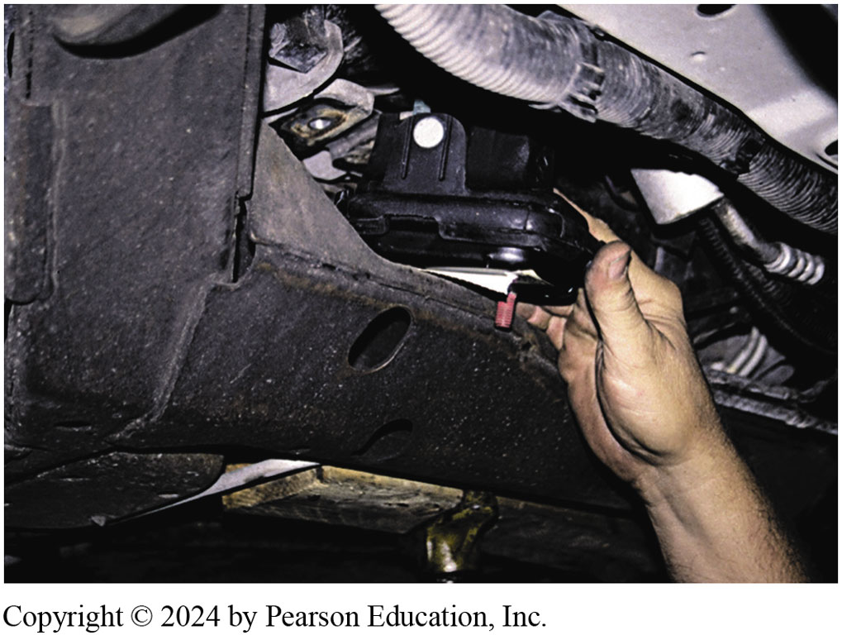
Figure 124-27 Engine Mount
The engine had to be raised higher to get the new (non-collapsed) engine mount installed.
Notes:
Case Study: The Vibrating Buick
The owner of a FWD Buick complained that it vibrated during acceleration only. The vehicle would also pull toward one side
during acceleration. An inspection discovered a worn (cracked) engine mount. After replacing the mount, the CV joint angles were restored and both the vibration and the pulling to one side during acceleration were solved. ● Figure 10–33.
Summary:
◼ Complaint—Owner complained about a vibration and a pull to one side during acceleration.
◼ Cause—defective engine mount caused CV joint angles to be unequal causing vibration and pulling during acceleration.
◼ Correction—The engine mount was replaced and the customer concern was solved.

Slide 39
Question 1?
A defective outer CV joint will usually make a __________.
  a. rumbling noise
  b. growling noise
  c. clicking noise
  d. clunking noise

Slide 40
Answer 1
A defective outer CV joint will usually make a __________.
  c. clicking noise

Slide 41
Drive Axle Shaft Replacement Photo Sequence

Slide 42
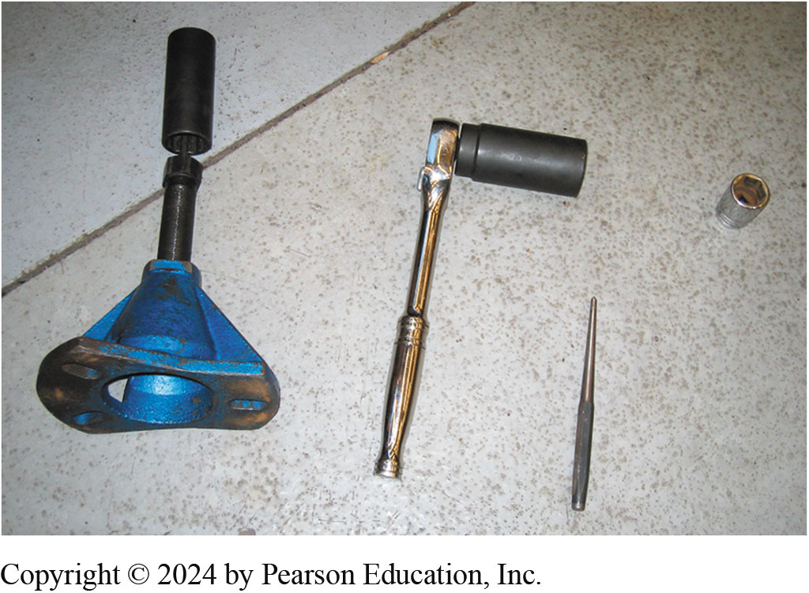
1. Tools Needed
1. Tools needed to replace a drive axle shaft on a General Motors vehicle include a drift, sockets, plus a prybar bearing/axle shaft special tool.

Slide 43
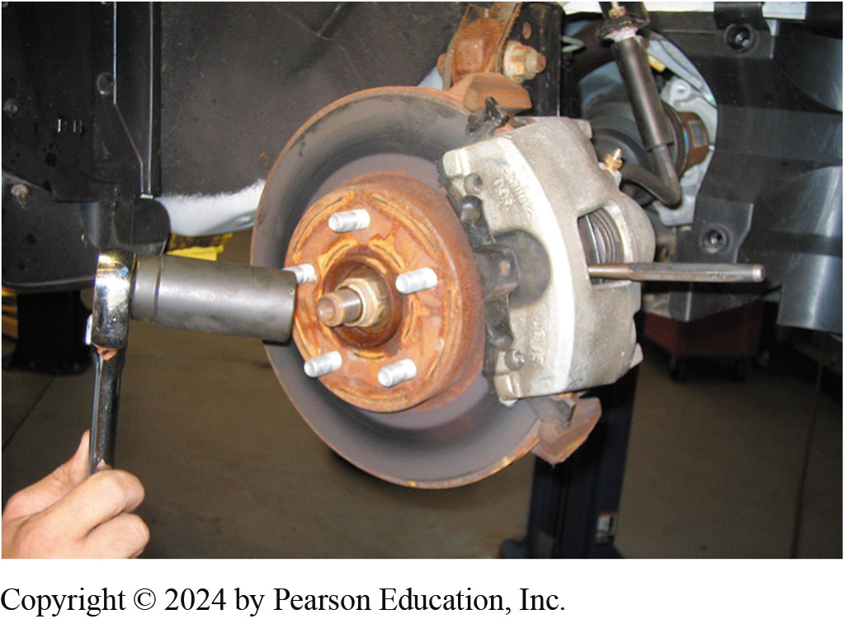
2. Drive Axle Shaft Retaining Nut
2. Drive axle shaft retaining nut can be loosened with the tire on the ground, or use a drift inserted into rotor cooling fins before removing the nut.

Slide 44
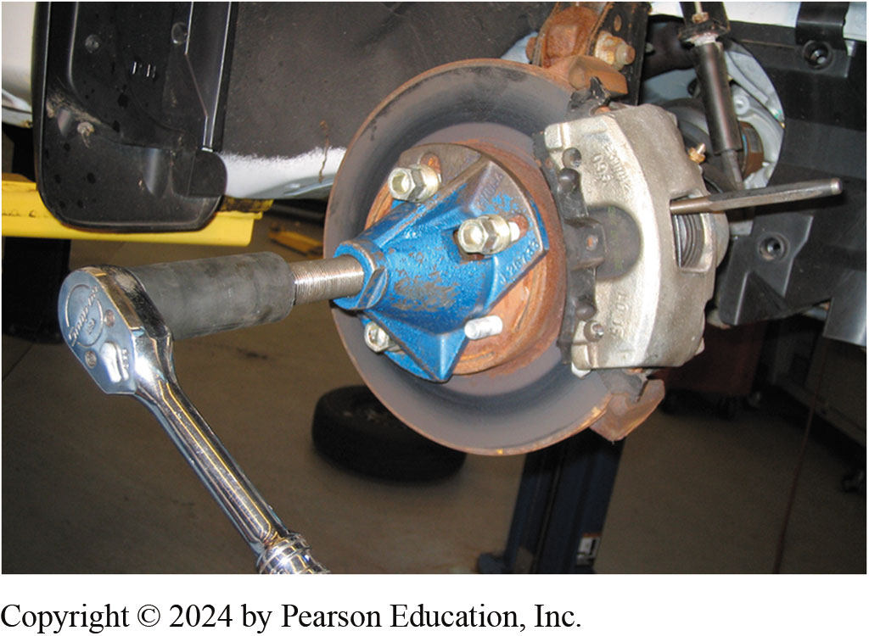
3. Using a Special Tool
3. Using a special tool to push the drive axle splines from the bearing assembly

Slide 45
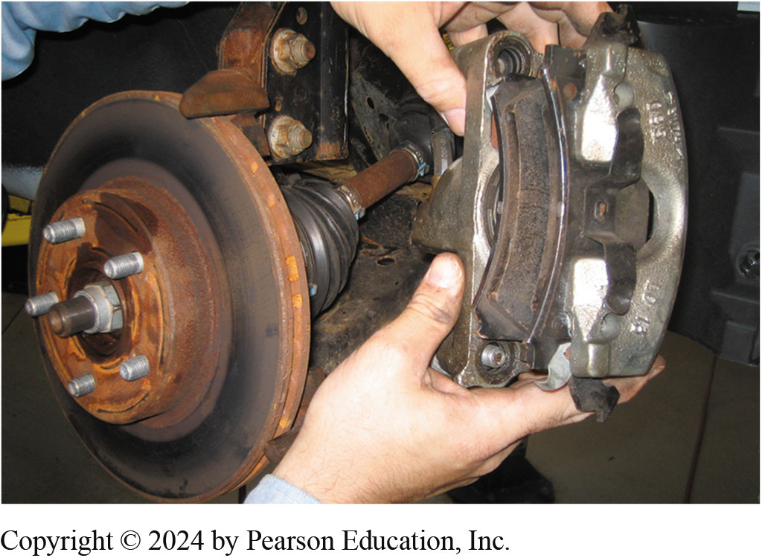
4. Remove Disc Brake Caliper
4. Remove the disc brake caliper and support it out of the way. Then, remove the disc brake rotor.

Slide 46
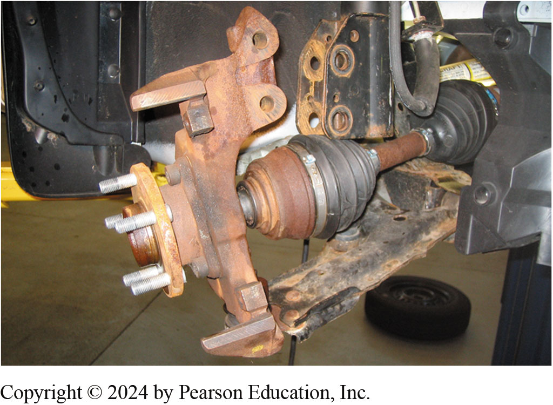
5. Lower Ball Joint Removed
5. Lower ball joint could have been removed instead of disconnecting the strut from the knuckle so that the
alignment could be retained.

Slide 47
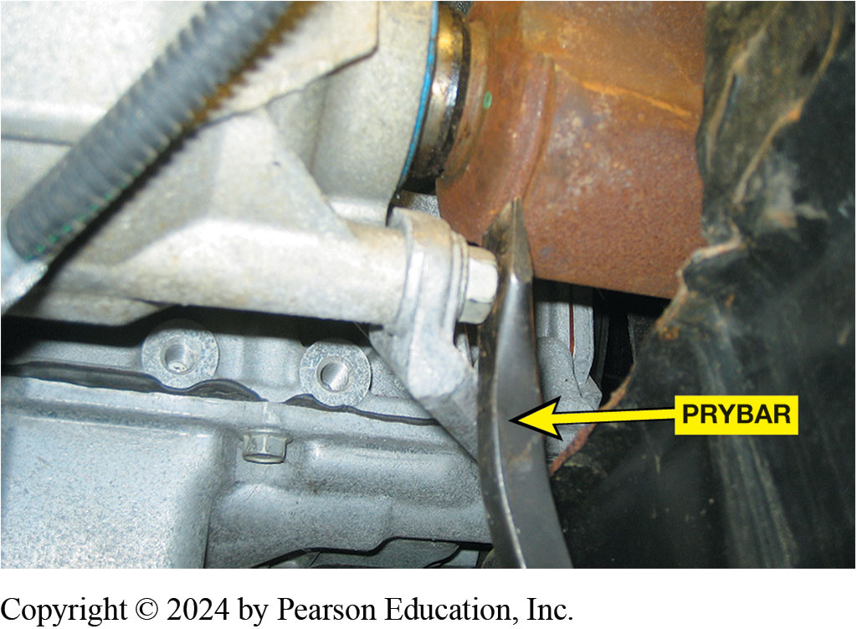
6. Separate Inner Drive Axle
6. A prybar is used to separate the inner drive axle shaft joint from the transaxle.

Slide 48
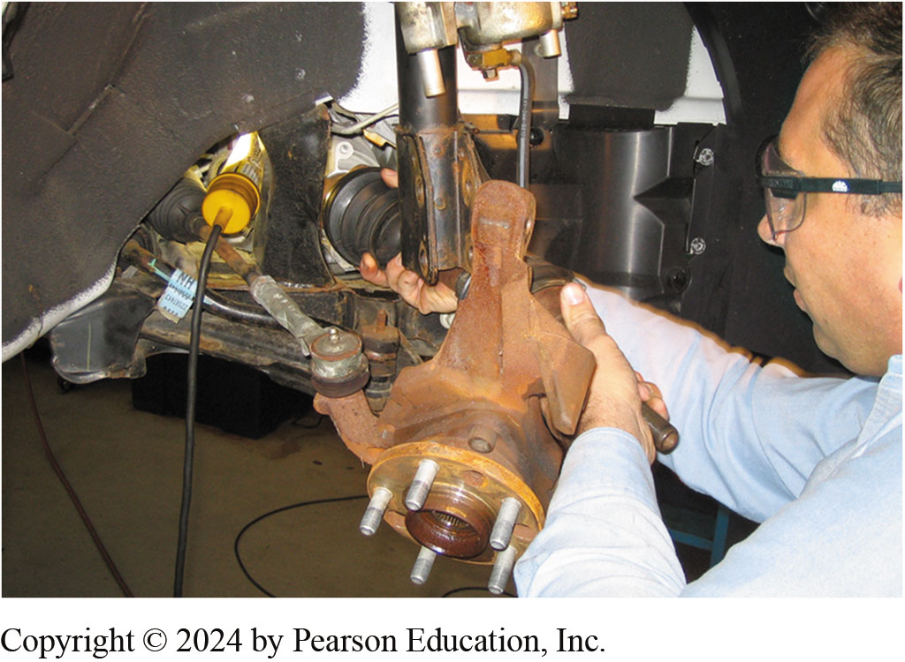
7. Remove Drive Axle Shaft
7. After the inner joint splines have been released from the transaxle, carefully remove the drive axle shaft assembly from the vehicle.

Slide 49
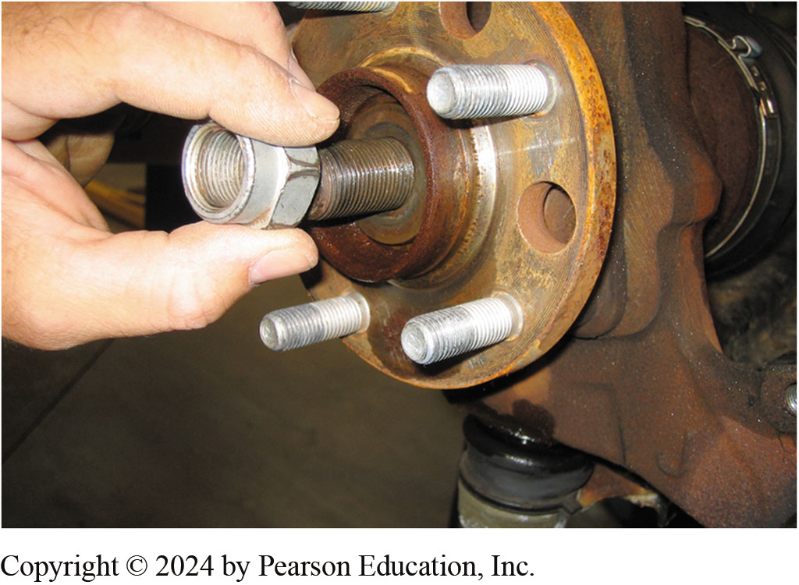
8. Reverse Order & Install Nut
8. To install, reverse disassembly procedure, be sure to install washer under retainer-nut, and always use new prevailing torque nut.

Slide 50
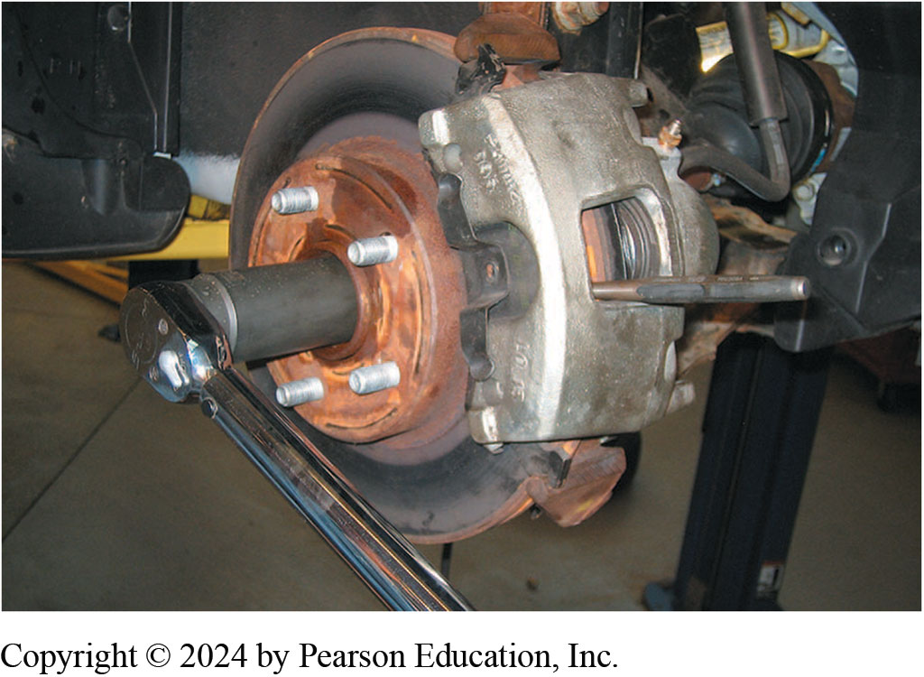
9. Reinstall Disc Brake Rotor
9. Reinstall the disc brake rotor and caliper and then torque the drive axle shaft retaining nut to factory specifications.

Slide 51
Manual Drive Train and Axles Videos and Animations
Videos Link: (A3) Manual Drive Train Axles Videos
Animations Link: (A3) Manual Drive Train Axles Animations

Slide 52
Copyright
This work is protected by United States copyright laws and is provided solely for the use of instructors in teaching their courses and assessing student learning. Dissemination or sale of any part of this work (including on the World Wide Web) will destroy the integrity of the work and is not permitted. The work and materials from it should never be made available to students except by instructors using the accompanying text in their classes. All recipients of this work are expected to abide by these restrictions and to honor the intended pedagogical purposes and the needs of other instructors who rely on these materials.

