Slide 1
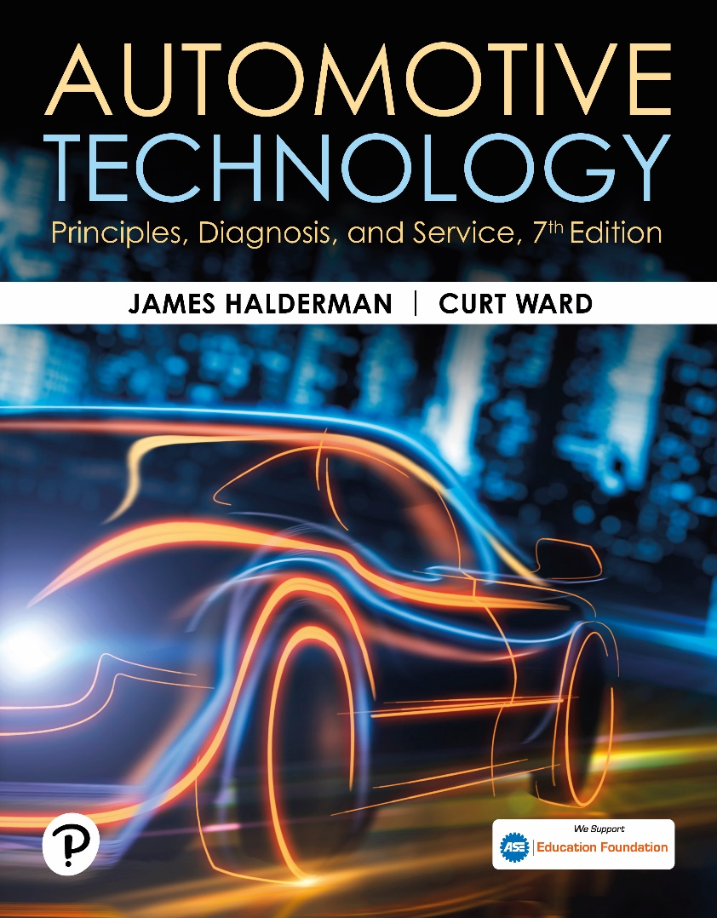
Automotive Technology: Principles, Diagnosis, and Service
Seventh Edition
Chapter 123
Drive Axle Shafts and Half Shafts
Copyright © 2023 Pearson Education, Inc. All Rights Reserved
Notes:
INSTRUCTOR NOTE: This presentation includes text explanation notes, you can use to teach the course. When in SLIDE SHOW mode, you RIGHT CLICK and select SHOW PRESENTER VIEW, to use the notes.

Slide 2
Learning Objectives
123.1 Describe driveshaft design and balance.
123.2 Describe the function and operation of U-joints.
123.3 Discuss double-Cardan joints.
123.4 Discuss the two types of CV joints and how they work.

Slide 3
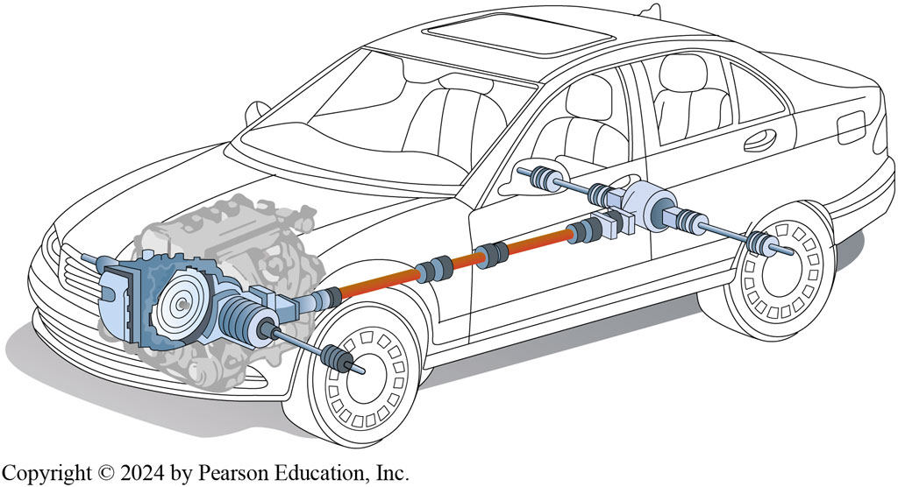
Figure 123.1 AWD Vehicle
A vehicle equipped with all-wheel drive using a transaxle uses many different driveshafts. From transaxle to front wheels, 2 “half shafts” are used. In this example, the multi-piece driveshaft is used to transmit engine torque to drive axle at rear of vehicle. From drive axle, 2 more half-shafts (drive axle shafts) are used to transmit torque to rear wheels.
Notes:
A driveshaft transmits engine torque from the transmission or transaxle (if front-wheel drive) to
the rear axle assembly or drive wheels. ● SEE FIGURES 9–1 AND 9–2.
Driveshaft is the term used by the Society of Automotive Engineers (SAE) to describe the shaft between the transmission and the rear axle assembly on a rear-wheel-drive vehicle. General Motors and some other manufacturers use the term propeller shaft or prop shaft to describe this same part. The SAE term will be used throughout this textbook. A typical driveshaft is a hollow steel tube. A splined end yoke is welded onto one end that slips over the splines of the output shaft of the transmission. ● SEE FIGURE 9–3. An end yoke is welded onto the other end of the driveshaft. Some driveshafts use a center support bearing.

Slide 4
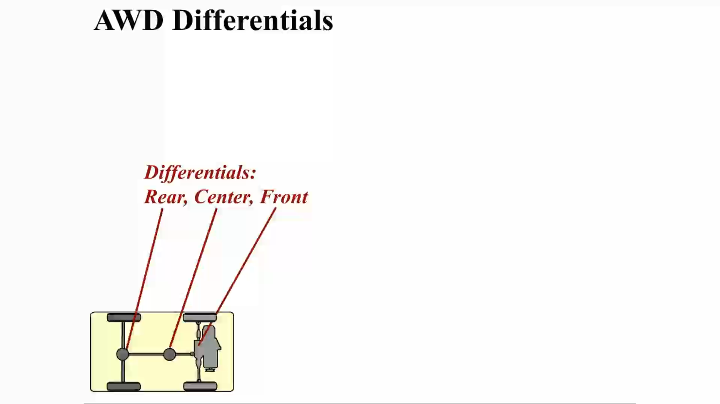
Animation: AWD Differentials
(Animation will automatically start)

Slide 5
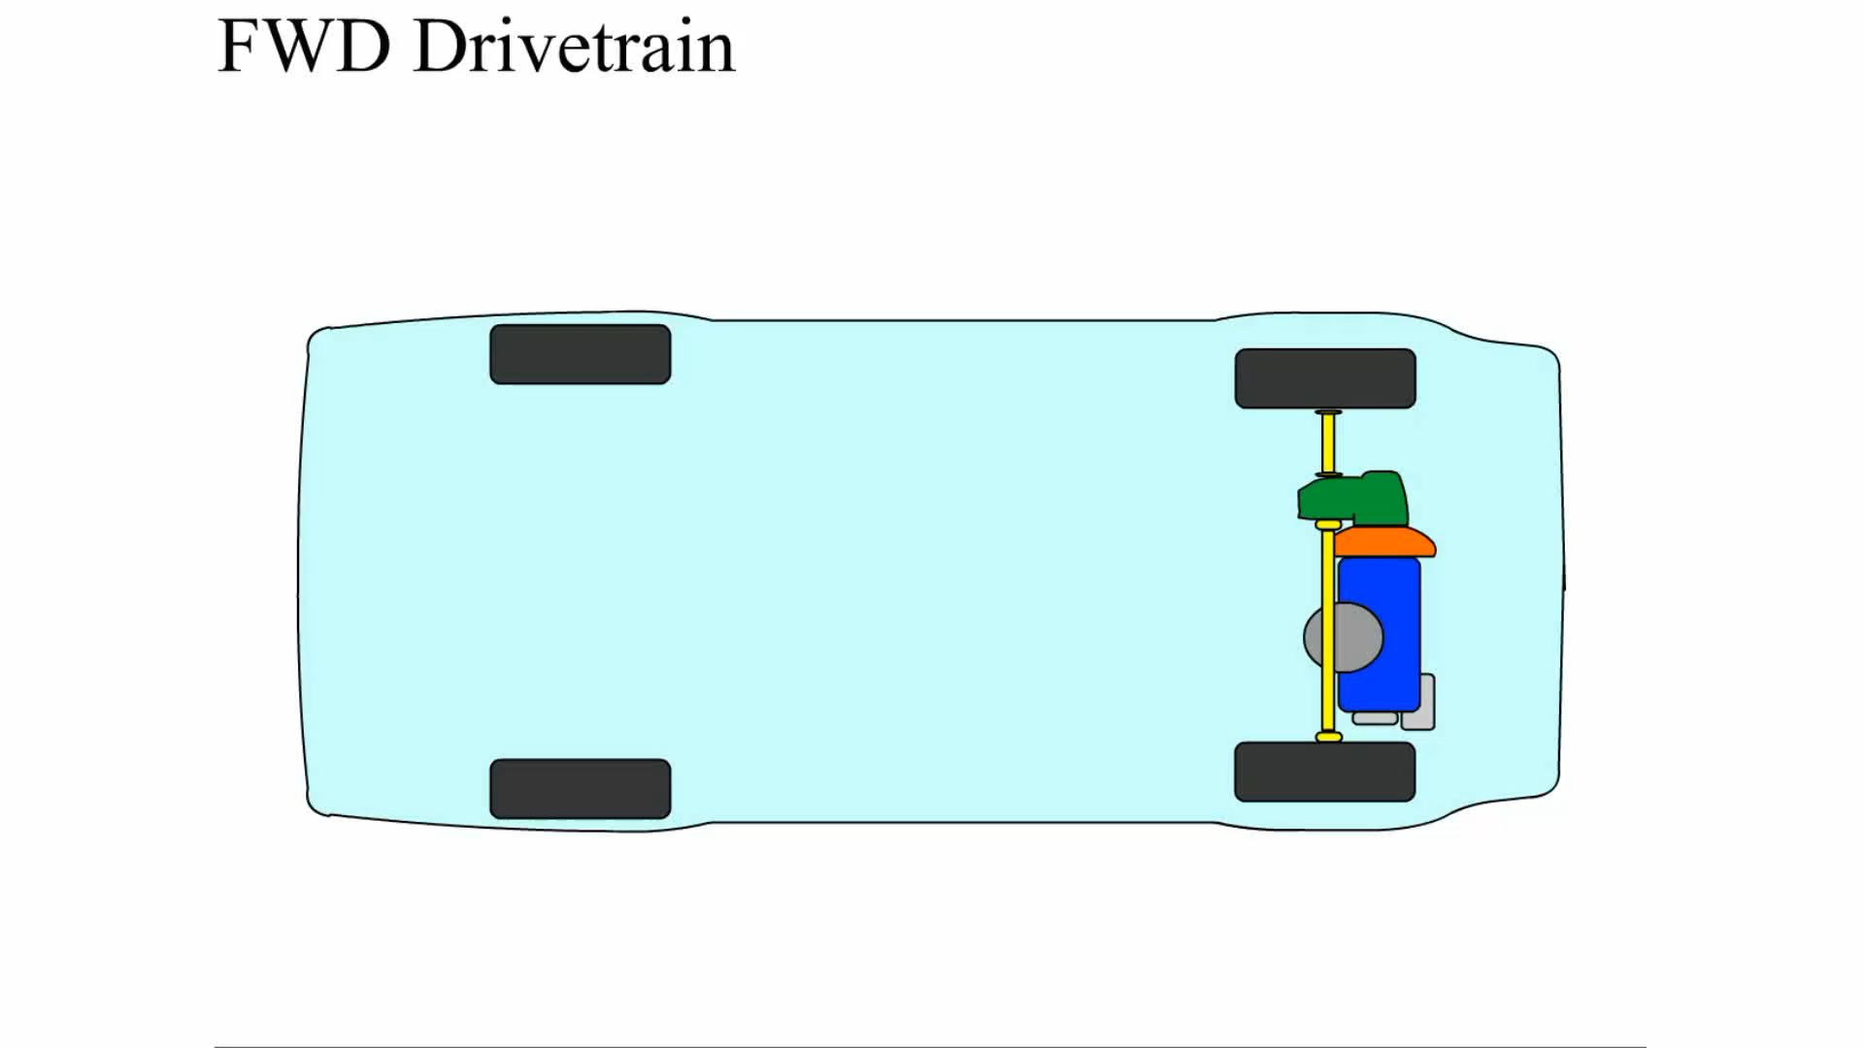
Animation: FWD Drivetrain
(Animation will automatically start)

Slide 6
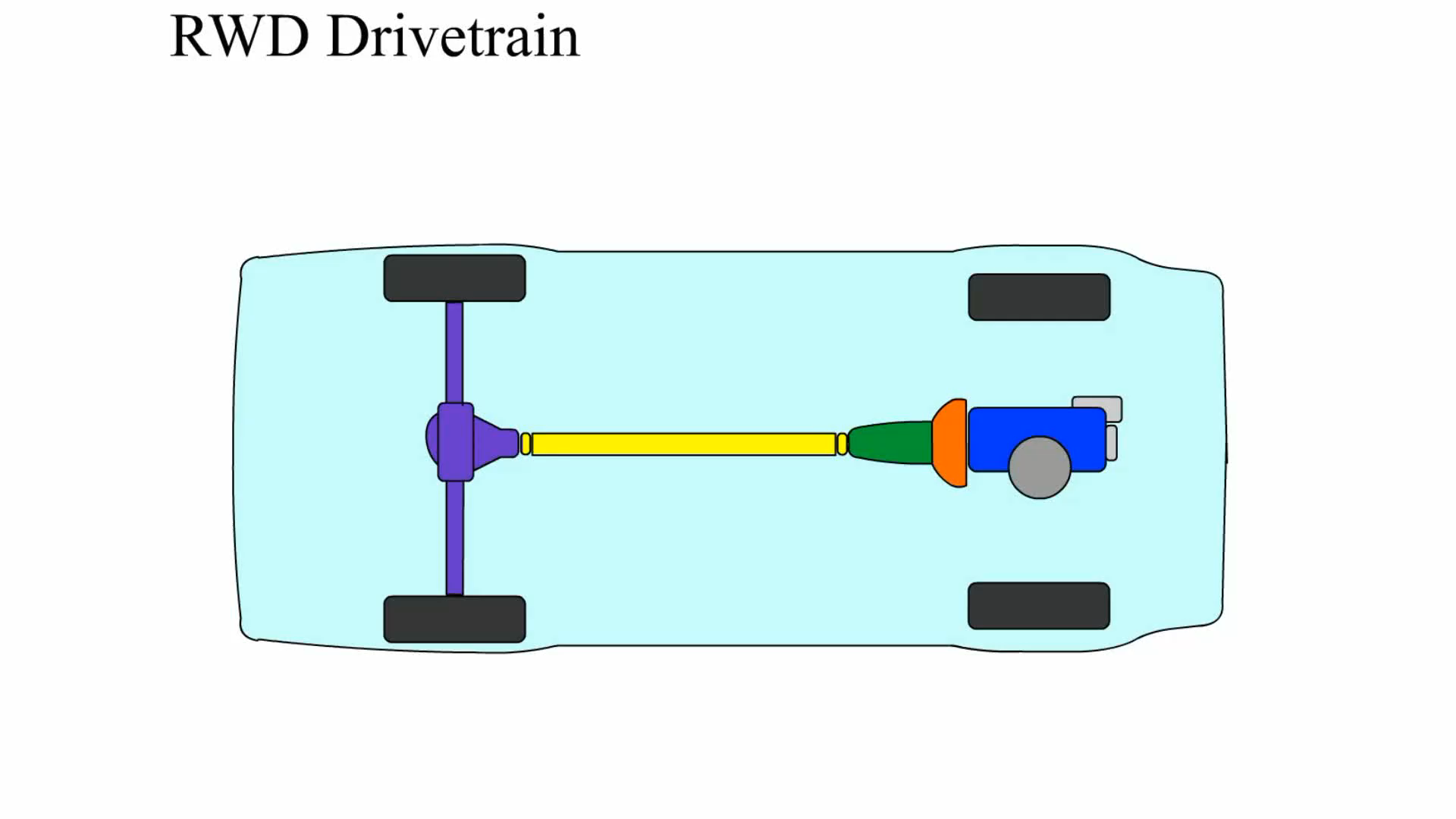
Animation: RWD Drivetrain
(Animation will automatically start)

Slide 7
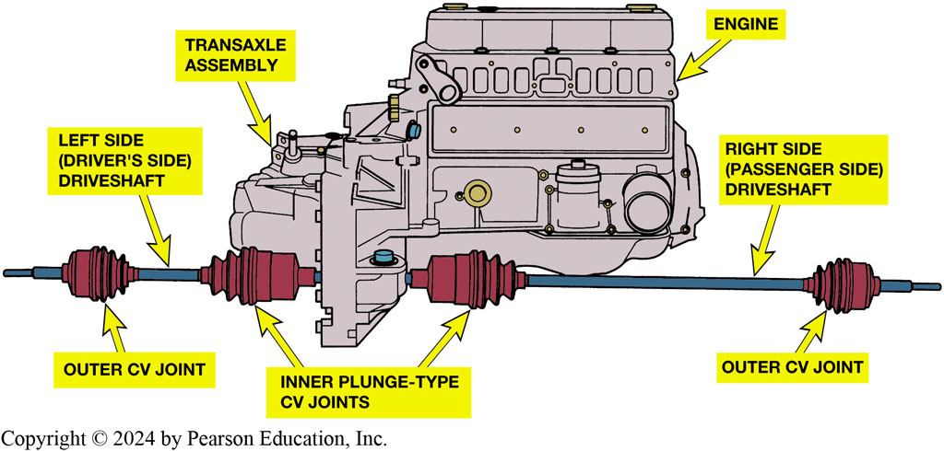
Figure 123.2 FWD Vehicle Setup
In a rear-wheel-drive vehicle, driveshaft transmits engine torque from transmission to the rear axle assembly and drive wheels. In a front-wheel-drive vehicle driveshafts (also called axle shafts) transmit torque from transaxle to each of the front drive wheels.

Slide 8
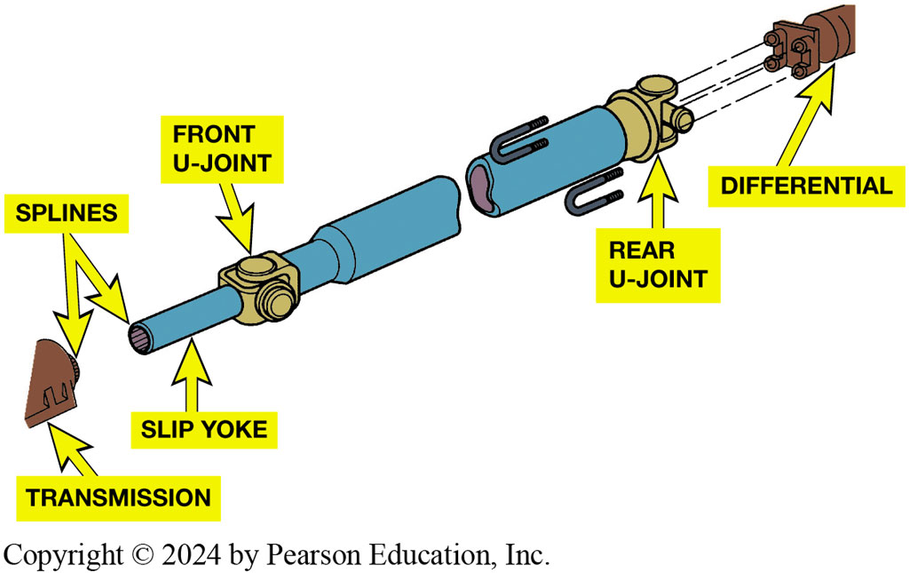
Figure 123.3 Driveshaft
What is purpose and function of driveshafts?
Driveshaft Design
  One- or two-piece driveshaft
  Aluminum driveshafts
Typical driveshaft (also called a propeller shaft). Driveshaft transfers engine power from transmission to differential.
Notes:
Page 121 answers the question What is purpose and function of driveshafts?
Most driveshafts are constructed of hollow steel tubing. The forces are transmitted through surface of the driveshaft tubing. The surface is therefore in tension, and cracks can develop on outside surface of the driveshaft due to metal fatigue. Driveshaft tubing can bend and, if dented, can collapse. A dented driveshaft should be replaced and no attempt should be made to repair the dent.
● See Figure 9–4.
Most rear-wheel-drive cars and light trucks use a one- or two-piece driveshaft. A steel tube driveshaft has a maximum length of about 65 inches (165 cm). Beyond this critical length, a center support bearing must be used, as shown in FIGURE 9–5. A center support bearing is also called a steady bearing or hanger bearing. Some vehicle manufacturers use aluminum driveshafts; these can be as long as 90 inches (230 cm) with no problem. Many extended-cab pickup trucks and certain vans use aluminum driveshafts to eliminate the need (and expense) of a center support bearing. Composite-material driveshafts are also used in some vehicles. These carbon-fiber-plastic driveshafts are very strong yet lightweight, and can be made in extended lengths without the need for a center support bearing.

Slide 9
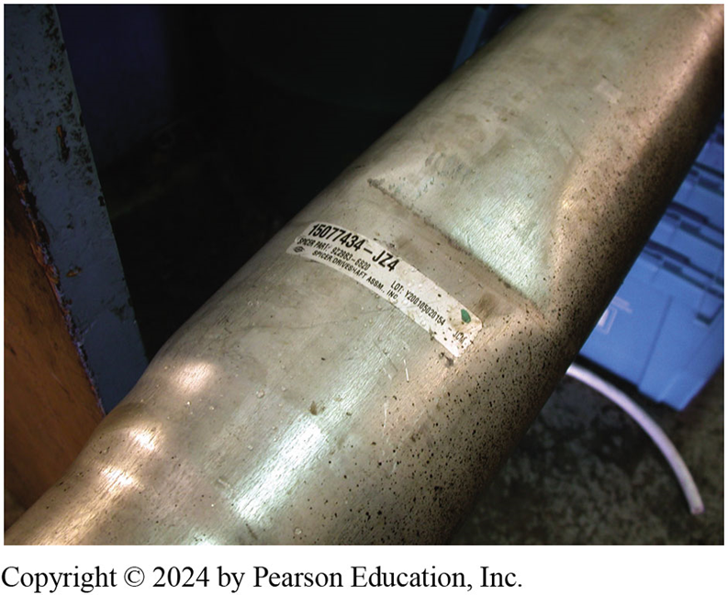
Figure 123.4 Dented Driveshaft
This driveshaft was found to be dented during a visual inspection and has to be replaced.

Slide 10
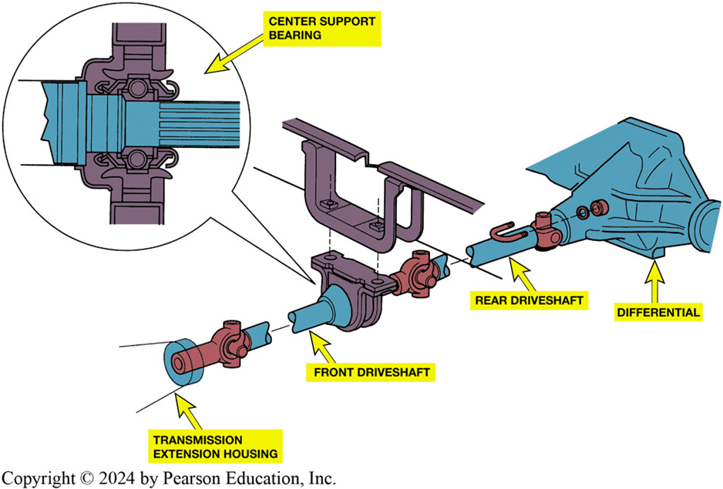
Figure 123.5 Center Support Bearing
A center support bearing is used on many vehicles with long two-part driveshafts.

Slide 11
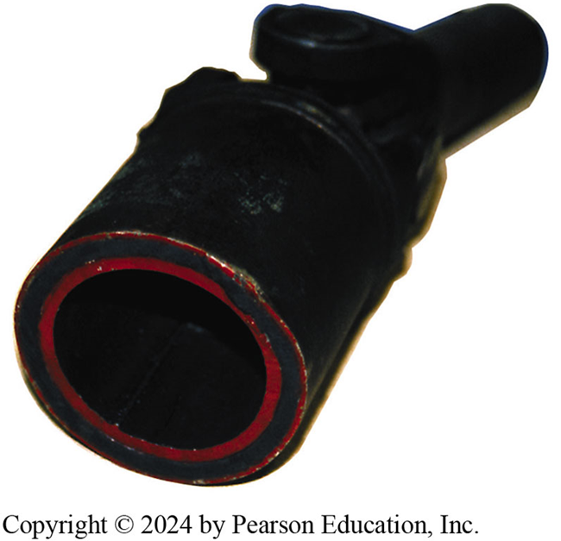
Figure 123.6 Inner & Outer Housing
Some driveshafts use rubber between an inner and outer housing to absorb vibrations and shocks to the driveline.

Slide 12
Driveshaft Balance
Any driveshaft whose rotational speed is greater than 1000 RPM
Must be balanced.
Driveshaft balance should be within 0.5% of driveshaft weight.
Notes:
All driveshafts are balanced. Generally, any driveshaft whose rotational speed is greater than 1000 RPM must be balanced.
Driveshaft balance should be within 0.5% of the driveshaft weight. (This is one of the biggest reasons why aluminum or
composite driveshafts can be longer because of their light weight.)

Slide 13
U-Joint Design and Operation
U-joints allow wheels and the rear axle to move up and down
Remain flexible, and still transfer torque to drive wheels.
Working angle of 1/2 to 3 degrees
  If angles differ by more than a ½ °
  between front and rear joint
  Vibration is usually produced that is torque sensitive.

Slide 14
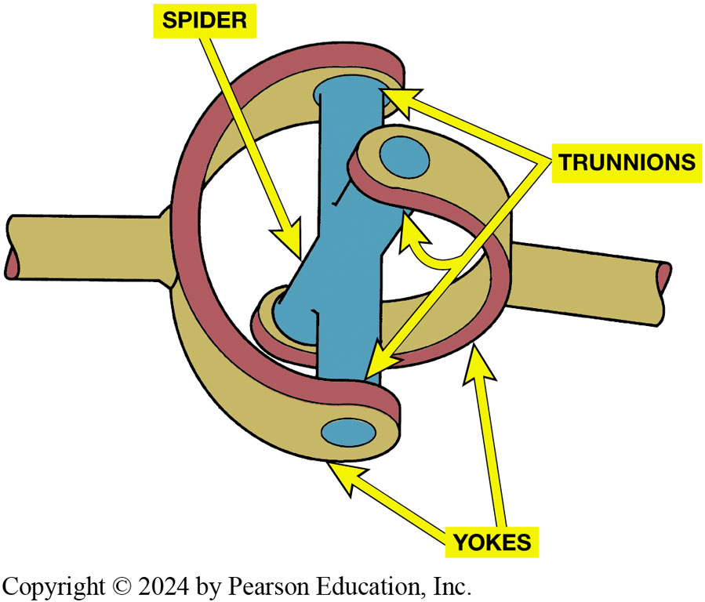
Figure 123.7 U-Joint Components
A simple universal joint (U-joint).

Slide 15
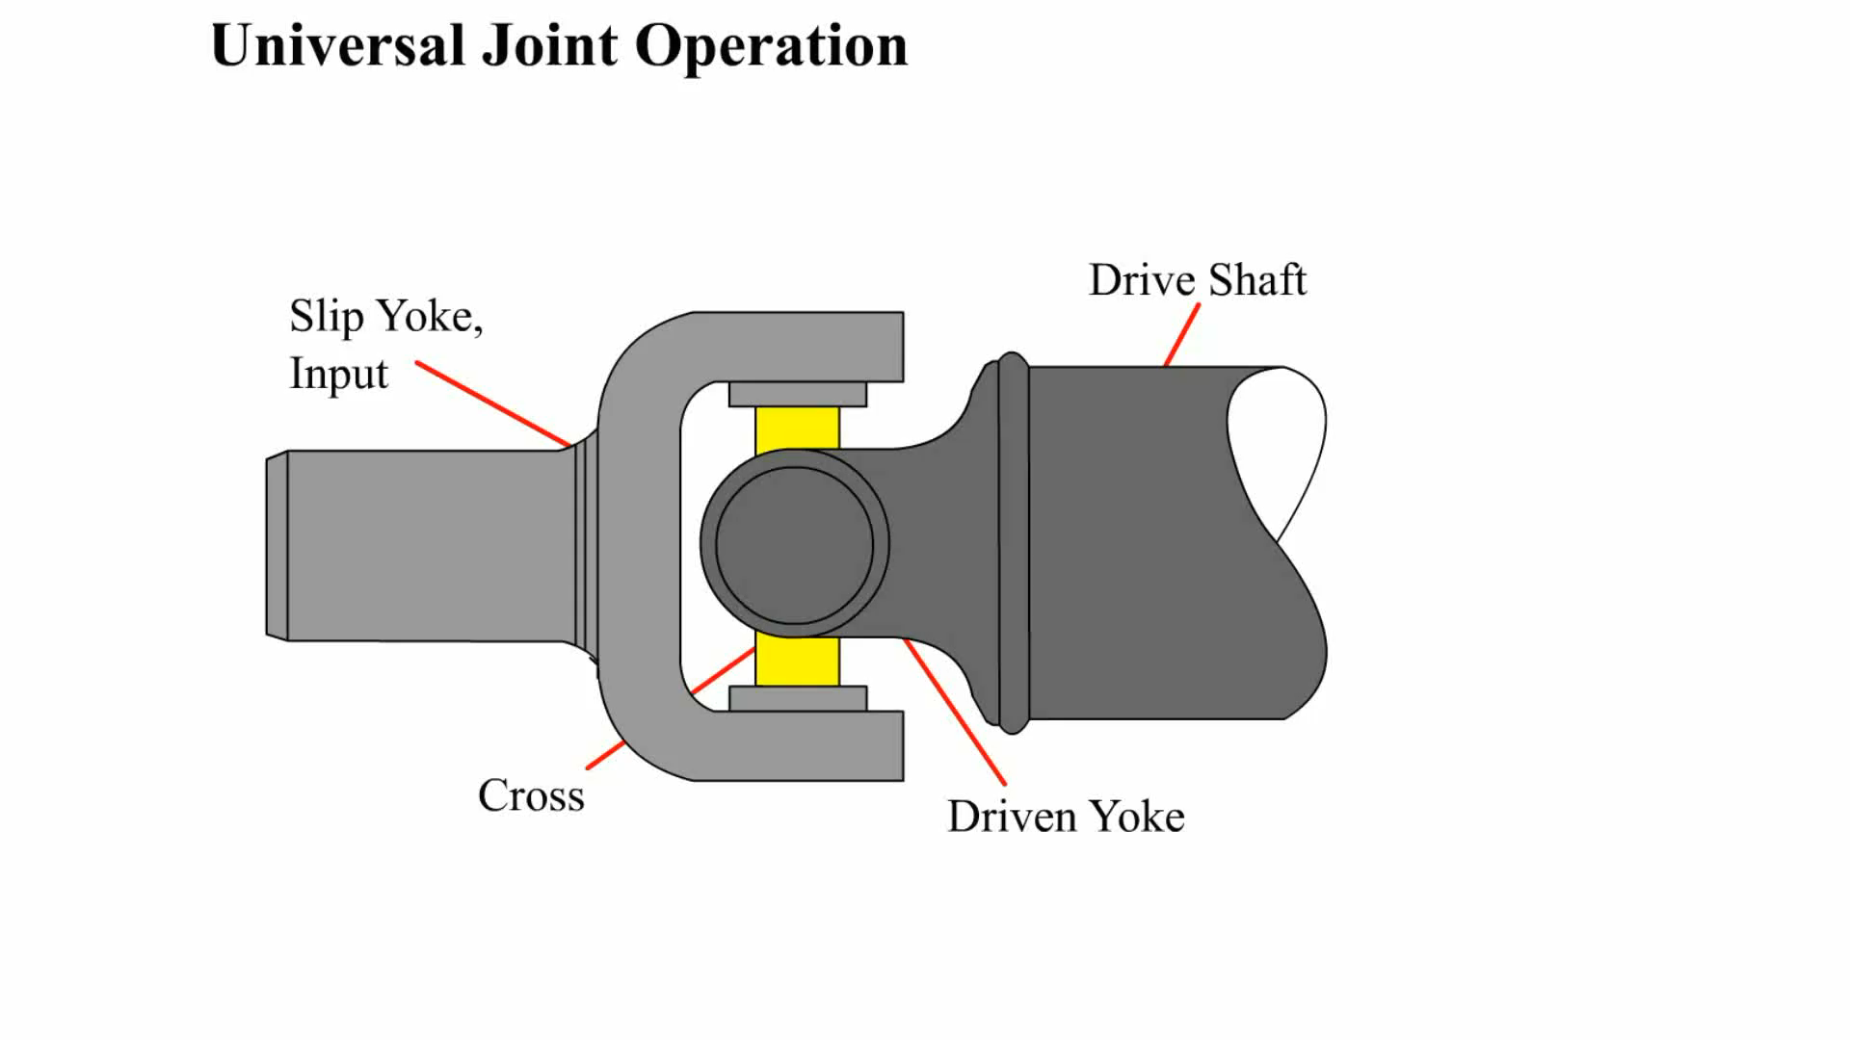
Animation: Universal Joint Operation
(Animation will automatically start)

Slide 16
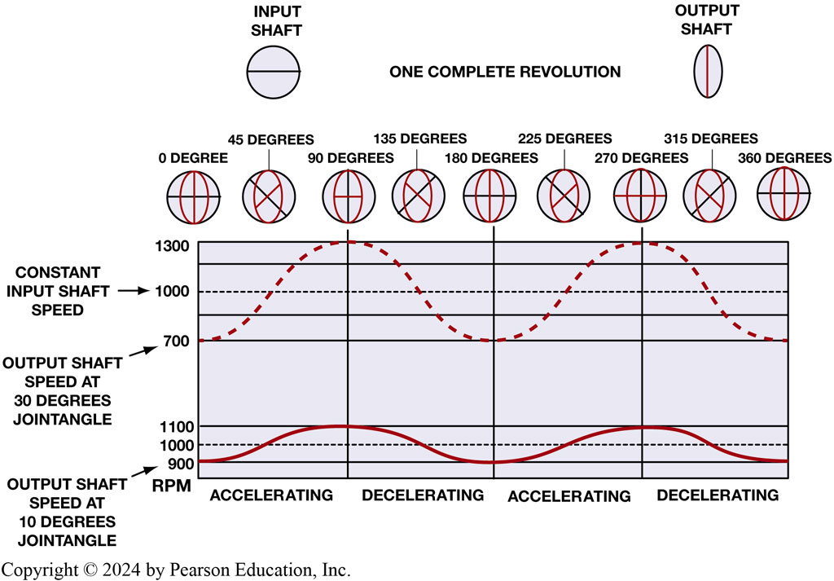
Figure 123.8 U-Joint Speed & Angle
Notes:
Figure 123-8 How the speed difference on the output of a typical U-joint varies with the speed and the angle of the U-joint. At the bottom of the chart, the input speed is a constant 1000 RPM, while the output speed varies from 900 to 1100 RPM when the angle difference in the joint is only 10 degrees. At the top of the chart, the input speed is a constant 1000 RPM, yet the output speed varies from 700 to 1200 RPM when the angle difference in the joint is changed to 30 degrees.

Slide 17
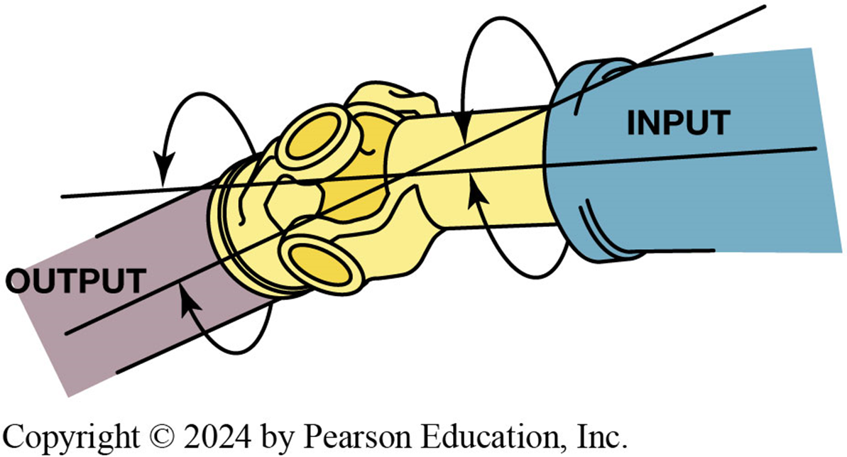
Figure 123.9 Joint Angle
Joint angle is difference between angles of joint.

Slide 18
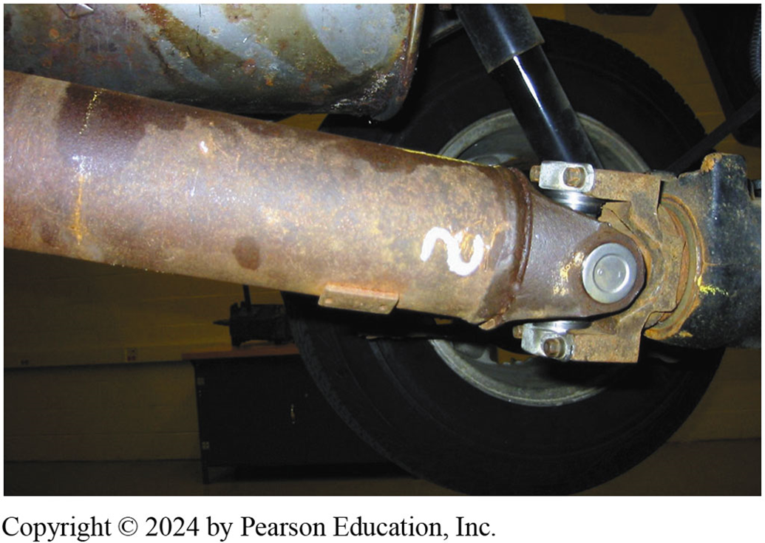
Figure 123.10 Cardan U-Joint
The angle of this rear Cardan U-joint is noticeable.

Slide 19
Double-Cardan Joints
Regular U-joints are usually designed to work up to 12 degrees of angularity.
If two Cardan-style U-joints are joined together, the angle at which this double-Cardan joint can function is about 18 to 20 degrees.

Slide 20
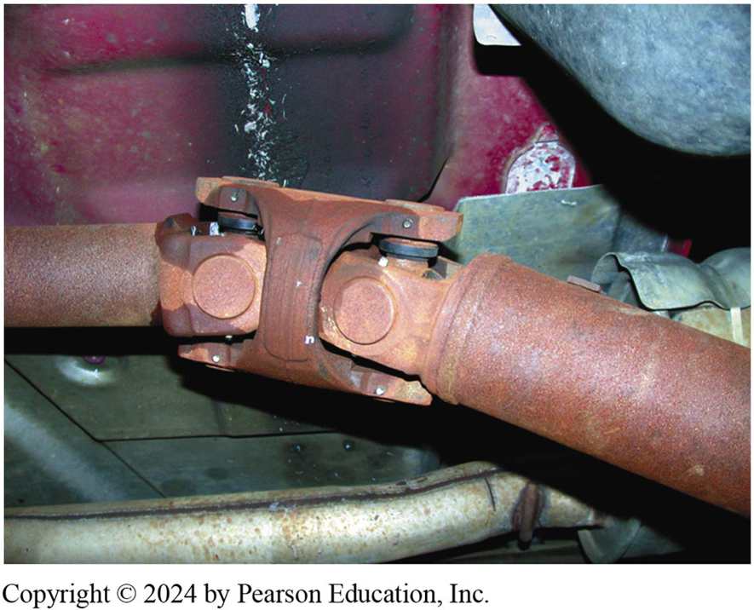
Figure 123.11 Double-Cardan U-joint

Slide 21
Constant Velocity Joints (1 of 2)
Designed to rotate without changing speed
Regular U-joints are usually designed to work up to 12 degrees of angularity
Double-Cardan U-joints were first used on large rear-wheel drive vehicles to help reduce drive line-induced vibrations

Slide 22
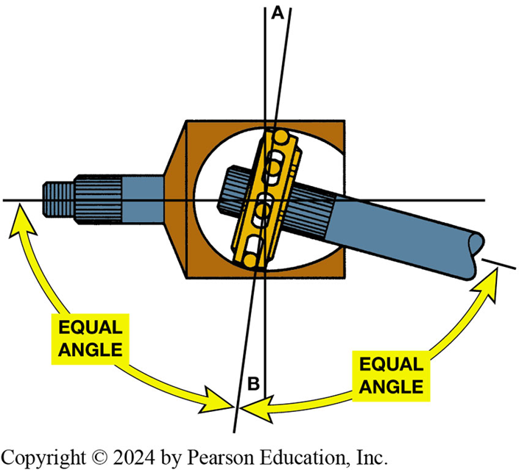
Figure 123.12 CV Joint
A constant velocity (CV) joint can operate at high angles without a change in velocity (speed) because the joint design results in equal angles between input and output.

Slide 23
Constant Velocity Joints (2 of 2)
Outer CV Joints
  Rzeppa Joints: commonly used joint as outer joints
  Transfers torque through six round balls that are held in position midway between the two shafts
Inner CV Joints
  Attach output of transaxle to drive axle shaft

Slide 24
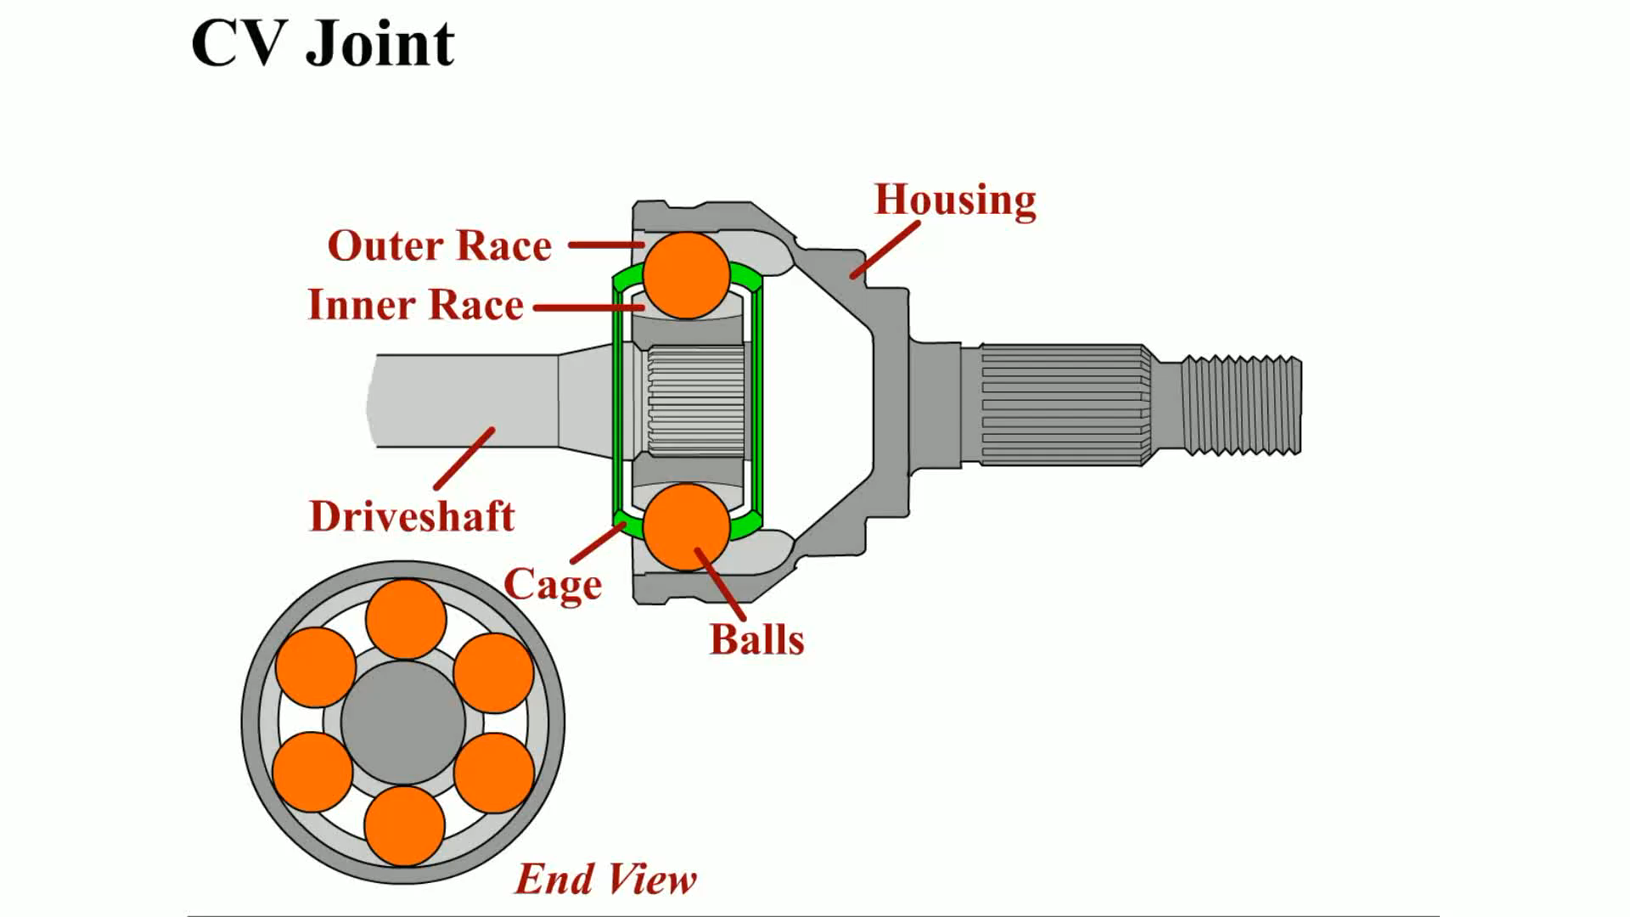
Animation: CV Joint
(Animation will automatically start)

Slide 25
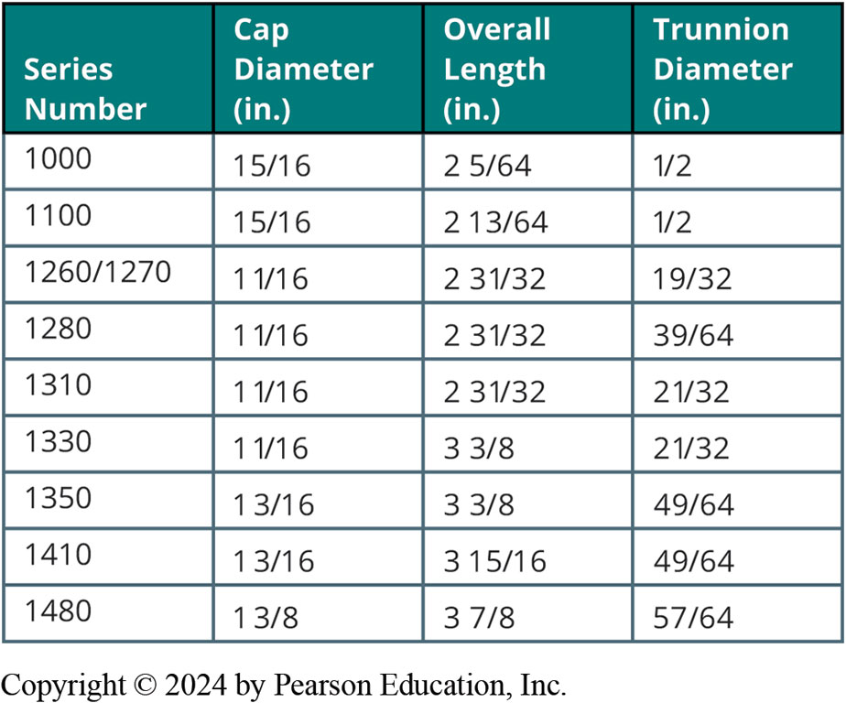
Frequently Asked Question: What Is a 1350-Series U-Joint?
? Frequently Asked Question
What Is a 1350-Series U-Joint? Most universal joints are available in sizes to best match the torque that they transmit. The larger the U-joint, the higher the amount of torque. Most U-joints are sized and rated by series numbers. See the accompanying chart for series numbers and sizes.

Slide 26
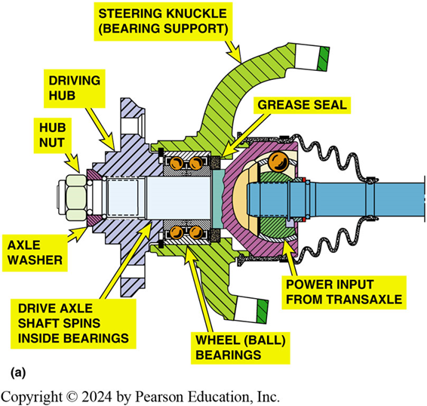
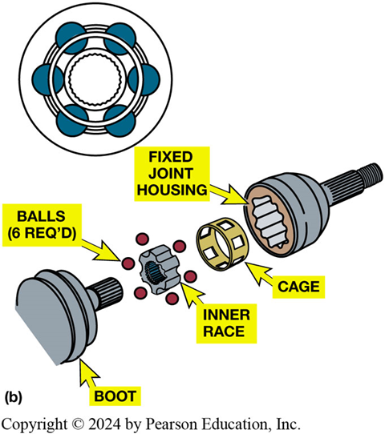
Figure 123.13 Rzeppa Fixed Joint
(a) cutaway view of outer CV joint with double-row ball bearing assembly that shows relations of parts involved. (b) Rzeppa fixed joint. This type of CV joint is used at wheel side of drive axle shaft. This joint can operate at high angles to compensate for suspension travel and steering angle changes.

Slide 27
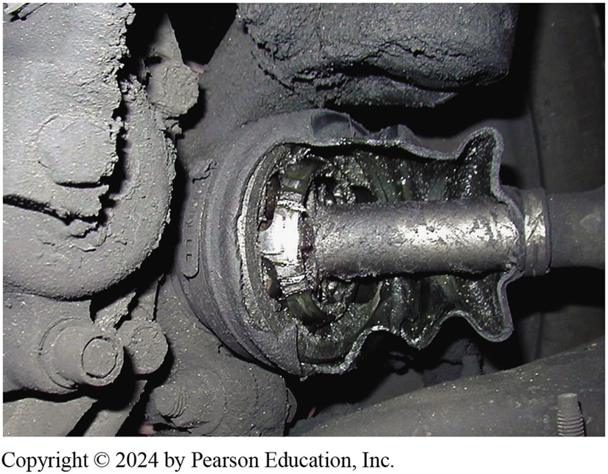
Figure 123.14 Torn Joint Boot
Protective CV joint boot has been torn away on this vehicle and all of grease has been thrown outward onto brake and suspension parts. The driver of this vehicle noticed a “clicking” noise, especially when turning.

Slide 28
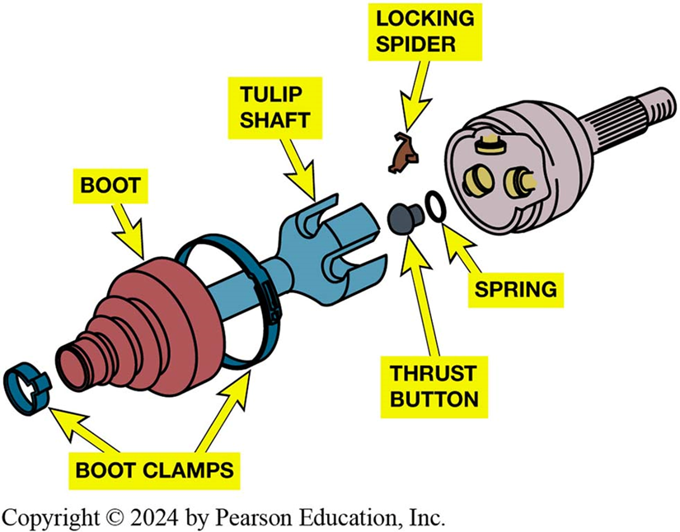
Figure 123.15 Tripod Fixed Joint
A tripod fixed joint. This type of joint is found on some Japanese vehicles. If the joint wears out, it is to be replaced with an entire drive axle shaft assembly.

Slide 29
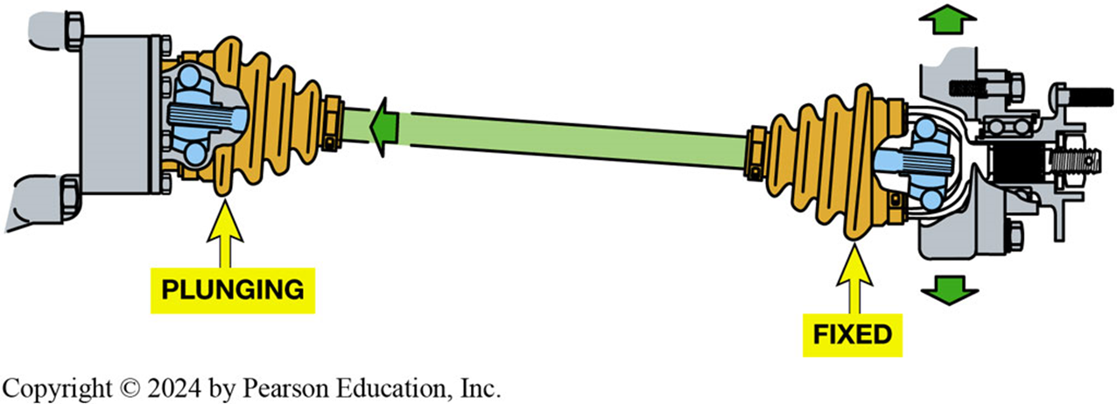
Figure 123.16 Fixed Outer Joint
Fixed outer joint is required to move in all directions because wheels must turn for steering as well as move up and down during suspension movement. The inner joint has to be able to not only move up and down but also plunge in and out as the suspension moves up and down.

Slide 30
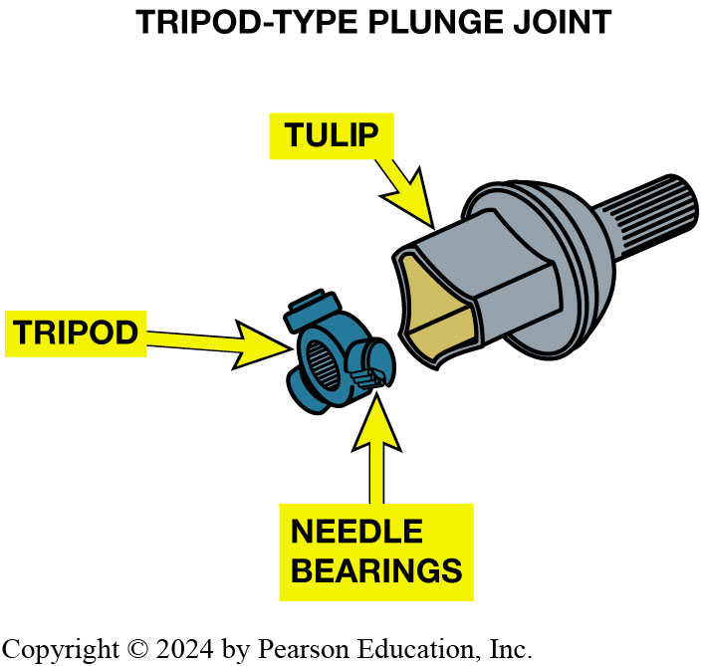
Figure 123.17 Tripod Joint
A tripod joint is also called a tripot, tripode, or tulip design.

Slide 31
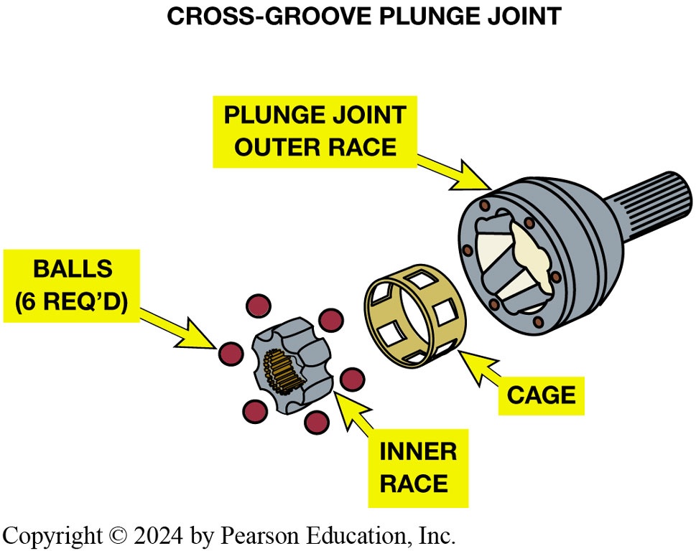
Figure 123.18 Cross-Groove Joint
A cross-groove plunge joint is used on many German front-wheel-drive vehicles and as both inner and outer joints on the rear of vehicles that use an independent-type rear suspension.

Slide 32
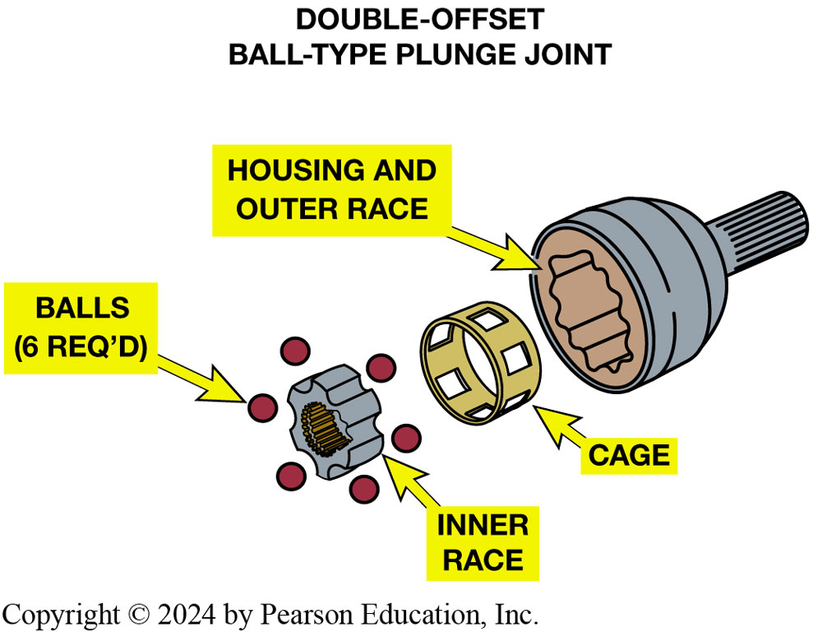
Figure 123.19 Double-Offset Ball Type
Double-offset ball-type plunge joint.

Slide 33
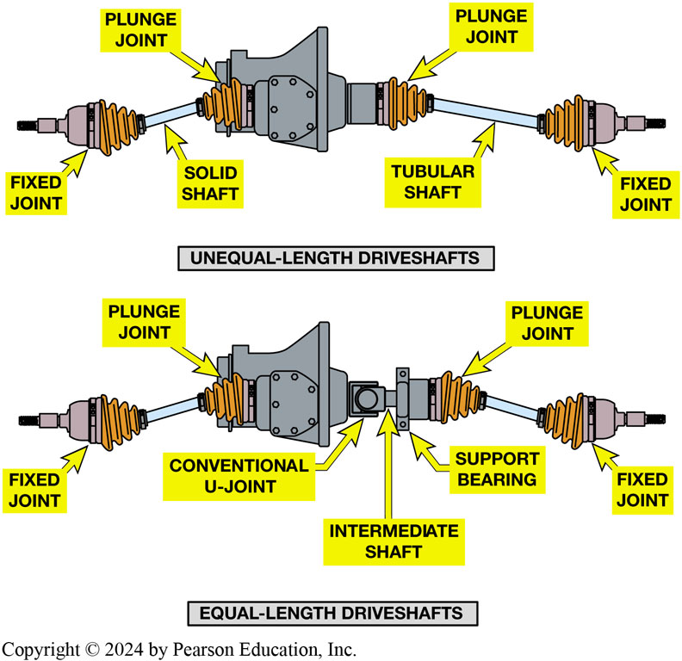
Figure 123.20 Torque Steer
Unequal-length driveshafts result in unequal drive axle shaft angles to front drive wheels. This unequal angle side to side often results in a steering of vehicle during acceleration called torque steer. By using an intermediate shaft, both drive axles are same angle and torque steer effect is reduced.
Notes:
Unequal-length drive axle shafts (also called half shafts) result in unequal drive axle shaft
angles to the front drive wheels. ● SEE FIGURE 9–17. This unequal angle often results in a pull on
the steering wheel during acceleration. This pulling to one side during acceleration due to unequal engine torque
being applied to the front drive wheels is called torque steer. To help reduce the effect of torque
steer, some vehicles are manufactured with an intermediate shaft that results in equal drive axle shaft angles. Both designs use fixed
outer CV joints with plunge-type inner joints.
Typical types of inner CV joints that are designed to move axially, or plunge, include the following:
1. Tripod. ● SEE FIGURE 9–19.
2. Cross groove. ● SEE FIGURE 9–20.
3. Double offset. ● SEE FIGURE 9–21.
CV joints are also used in rear-wheel-drive vehicles and in many four-wheel-drive vehicles.

Slide 34
Frequently Asked Question: What Is That Weight for on the Drive Axle Shaft?
? Frequently Asked Question
What Is That Weight for on the Drive Axle Shaft? Some drive axle shafts are equipped with what looks like a balance weight. Figure 9–18. It is actually a dampener weight used to dampen out certain drive line vibrations. The weight is not used on all vehicles and may or may not appear on the same vehicle depending on engine, transmission, and other options. The service technician should always try to replace a defective or worn drive axle shaft with the exact replacement. When replacing an entire drive axle shaft, the technician should always follow the manufacturer’s instructions regarding either transferring or not transferring the weight to the new shaft.

Slide 35
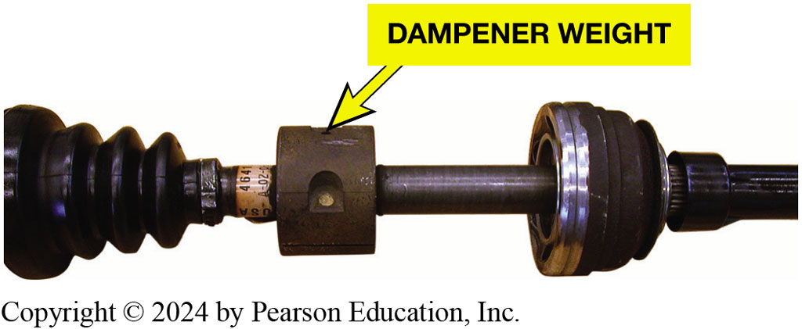
Figure 123.21 Dampener Weight
A typical drive axle shaft with dampener weight.
Notes:
Figure mentioned in Frequently Asked Question

Slide 36
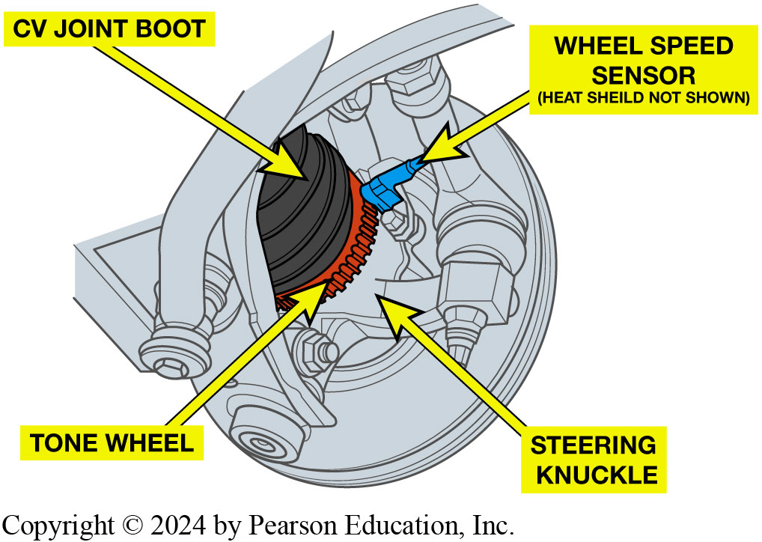
Figure 123.22 Wheel Speed Sensor
Many outer CV joints include tone wheel for wheel speed sensor used by the anti-lock and stability control systems.

Slide 37
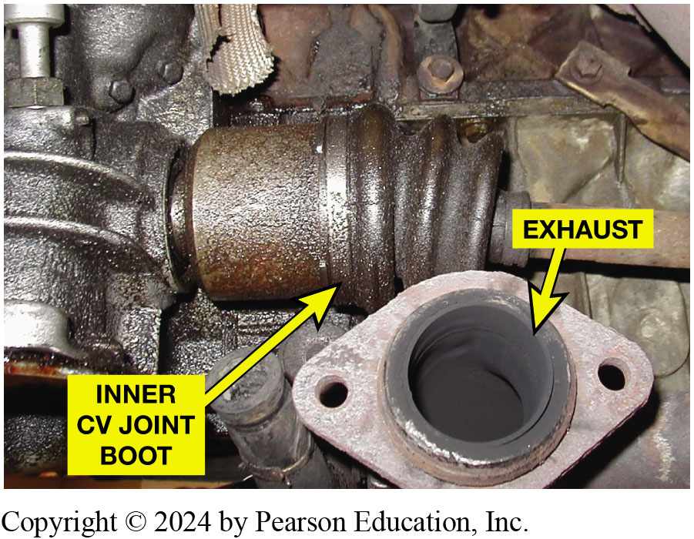
Figure 123.23 Tech Tip
Tech Tip:
  CV Joint Boots Are in Hot Place
Many CV joints are close to exhaust system where they are exposed to higher than normal temperatures.
Notes:
Tech Tip: CV Joint Boots Are in a Hot Place
While the outer CV boots move when the front wheels are steered, the inner boots are also subjected to possible damage because they are often near the exhaust system where the high temperatures can damage the boot material. Then, if there is an engine oil leak, the engine oil could harm the CV boot too. Try to fix all leaks to help prevent premature CV boot failure. ● Figure 123–23.

Slide 38
Question 1?
The proper grease to use with a CV joint is .
  A. Black chassis grease
  B. Dark blue EP grease
  C. Red moly grease
  D. Grease supplied with boot kit

Slide 39
Answer 1
The proper grease to use with a CV joint is .
  d. grease supplied with boot kit

Slide 40
Manual Drive Train and Axles Videos and Animations
Videos Link: (A3) Manual Drive Train Axles Videos
Animations Link: (A3) Manual Drive Train Axles Animations

Slide 41
Copyright
This work is protected by United States copyright laws and is provided solely for the use of instructors in teaching their courses and assessing student learning. Dissemination or sale of any part of this work (including on the World Wide Web) will destroy the integrity of the work and is not permitted. The work and materials from it should never be made available to students except by instructors using the accompanying text in their classes. All recipients of this work are expected to abide by these restrictions and to honor the intended pedagogical purposes and the needs of other instructors who rely on these materials.

