Slide 1
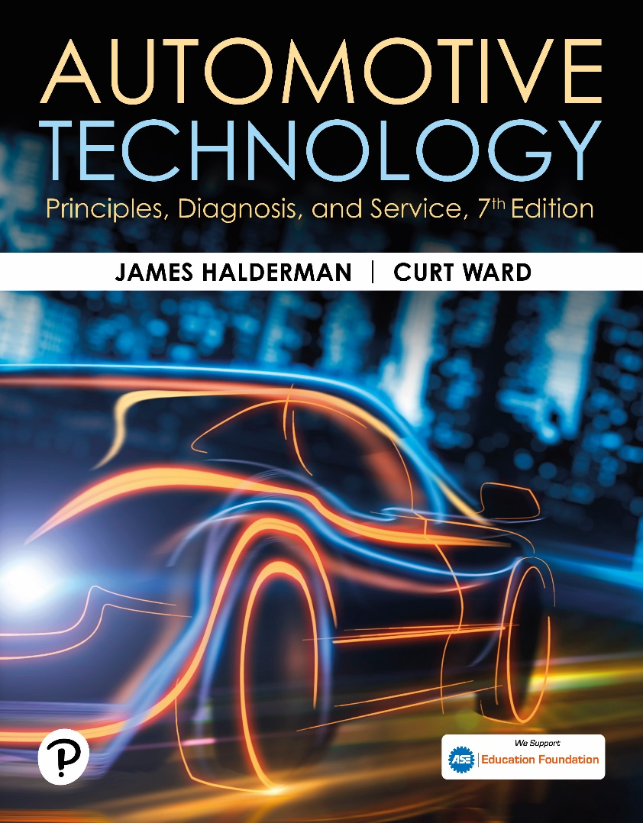
Automotive Technology: Principles, Diagnosis, and Service
Seventh Edition
Chapter 122
Manual Transmissions/Transaxles
Copyright © 2023 Pearson Education, Inc. All Rights Reserved
Notes:
INSTRUCTOR NOTE: This presentation includes text explanation notes, you can use to teach the course. When in SLIDE SHOW mode, you RIGHT CLICK and select SHOW PRESENTER VIEW, to use the notes.

Slide 2
Learning Objectives (1 of 2)
122.1 Discuss the need for a transmission.
122.2 Explain the different types of gears.
122.3 Discuss gear ratios.
122.4 Describe the relationship between torque, speed, and power.
122.5 Describe the construction of a transmission/transaxle.
122.6 Describe speed gears.
.

Slide 3
Learning Objectives (2 of 2)
121.7 Explain the construction and operation of a synchronizer.
121.8 Describe the torque flow through a five-speed manual transmission.
121.9 Describe the procedure to diagnose, remove, disassemble, assemble, and install a manual transmission/transaxle.
121.10 Discuss manual transmission/transaxle lubricants.

Slide 4
Need for a Transmission
Provide neutral, forward gear speeds or ranges, and reverse.
It must be able to provide a gear ratio that is low enough
Multiplied by final drive ratio
Increase engine’s torque sufficiently to accelerate vehicle at desired rate.
Notes:
A vehicle requires a lot of torque to start off and to climb hills, yet it
does not require as much torque to move on level ground. The source
of the torque is the engine. Torque is a twisting or turning force that is
exerted on the input shaft of a transmission/transaxle. An engine produces
increasing torque as its speed increases up to a certain point
where the torque output starts to decrease. Therefore, to get a vehicle
moving or to accelerate up a hill, it is desirable to use a transmission
that allows the engine speed to be increased even though the vehicle
speed may be low. Using gears allows the engine speed to increase at
low vehicle speeds yet still permits the engine speed to drop at higher
speeds to save fuel and reduce exhaust emissions.
For example,
■ First gear: Vehicle speed is low, engine speed is high.
■ Second gear: Vehicle speed increases, engine speed
decreases as shift is made.
The purpose of the transmission is to provide neutral, forward gear speeds or ranges, and reverse. It must be able to provide a gear ratio that is low enough, when multiplied by the final drive ratio, to increase the engine’s torque sufficiently to accelerate the vehicle at the desired rate. The highest gear ratio should allow the vehicle to cruise at an engine speed that is low enough to conserve fuel and decrease noise. There also needs to be intermediate ratios that are spaced so that the engine will not overrev before a shift or lug after a shift. Reverse must be roughly the same ratio as first since the vehicle will be starting from a stop in both cases.

Slide 5
Gear Types
Spur Gear
  Gear blank with straight-cut teeth around its entire circumference
  Permits 1.5 to 2.5 gear teeth to mesh at a time
  Gear teeth are in full contact increases their strength
  Spur gear operation are noisy
Helical Gear
  teeth cut at an angle to axis of gear
  More teeth, 2.5 to 3.5, to mesh at a time
  Angle allows teeth to mesh gradually,
  Quieter than spur gears.
Notes:
The simplest type of gear is the spur gear . ● SEE FIGURE 122– 1 . A spur gear consists of a gear blank with straight-cut teeth around its entire circumference. All gear teeth lie parallel to the centerline, or axis , of the gear. The teeth are shaped so they can mesh without slippage with a second spur gear’s teeth positioned along
a parallel axis. Spur gear design permits 1.5 to 2.5 gear teeth to mesh at a time. The gear teeth make contact with each other over their full width at the same instant. The fact that the gear teeth are in full contact increases the strength of the gear, but also causes spur gear operation to be noisy. Due to their strength, most heavy-duty
truck transmissions use spur gears.

Slide 6
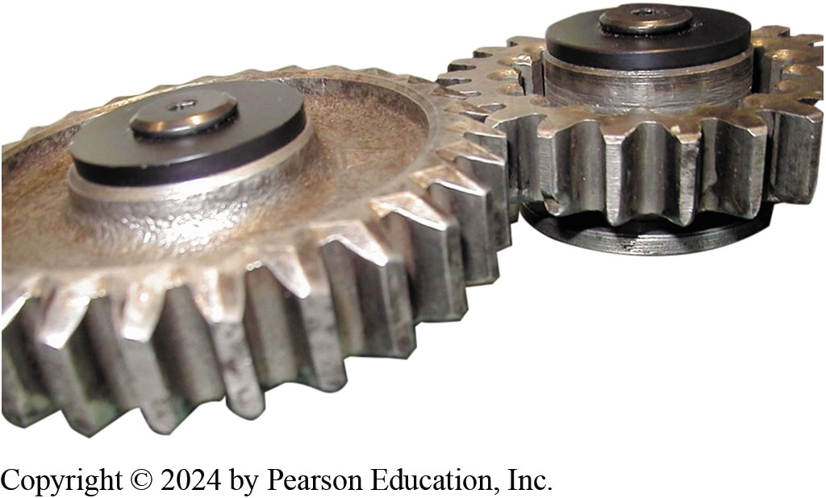
Figure 122.1 Spur Gear
Spur gears have straight-cut teeth.

Slide 7
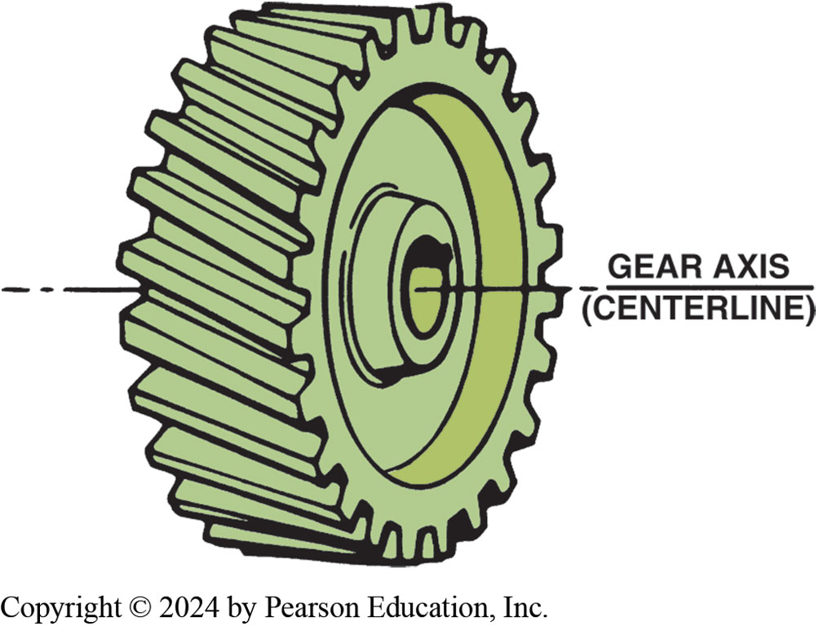
Figure 122.2 Helical Gear
The teeth of a helical gear are cut at an angle to the gear axis.
Notes:
A helical gear, although similar to a spur gear, has its teeth cut at an angle to the axis of the gear. ● SEE FIGURE 122–2. This enables more teeth, 2.5 to 3.5, to mesh at a time than the spur gear. Additionally, the angle allows the teeth to mesh gradually,
rather than all at once. As a result, helical gears run quieter than spur gears. Helical gears, however, have two disadvantages. Each gear pushes against its shaft parallel to its axis. Special bearings are needed to protect the gearbox from this type of axial, or thrust, loading. Furthermore, because of the increased contact area, helical gears create more friction than spur gears. ● SEE FIGURE 122–3. Spur and helical gears have gear teeth on their outside circumference and, for this reason, are called external gears. This type of gear is the most commonly used in manual transmissions
and transaxles.

Slide 8
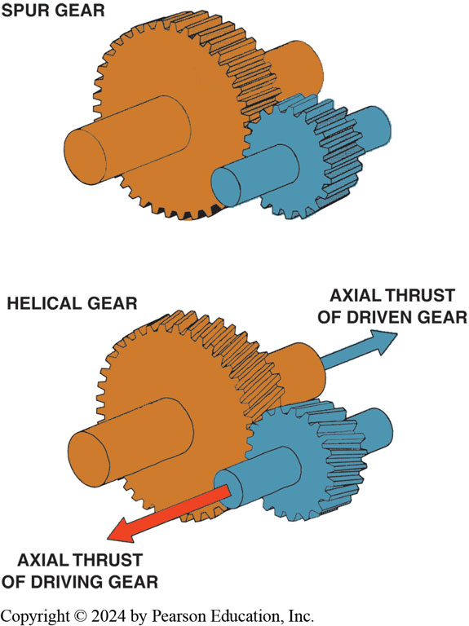
Figure 122.3 Spur vs Helical
A spur gear has straight-cut teeth. This design is very strong and is used where strength is important. Spur gears are noisy during operation. Helical-cut gears, on the other hand, operate quietly but create a force in line with the axis of gears due to the angle of the gear teeth.

Slide 9
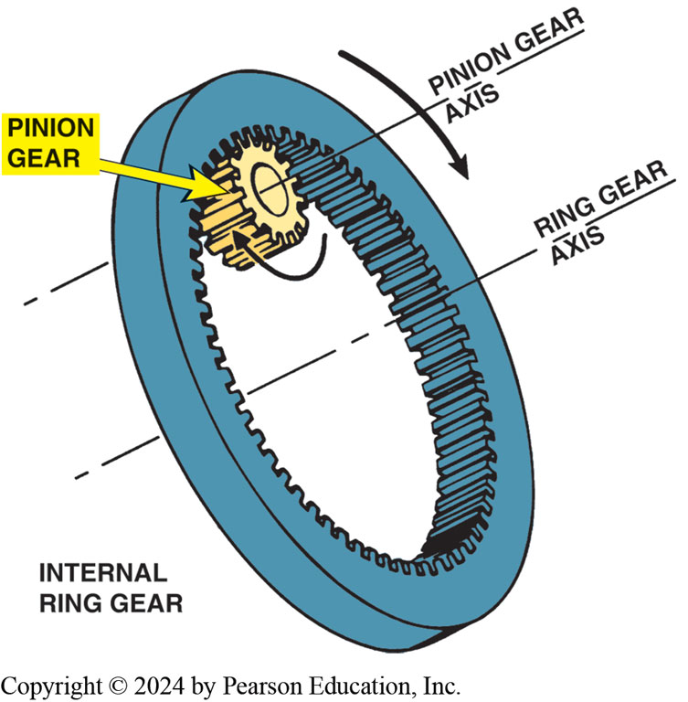
Figure 122.4 Internal Gear
A pinion gear meshed with an internal ring gear rotates in the same direction around a parallel axis of rotation.
Notes:
Gears having teeth along the inside circumference are called internal ring gears. ● SEE FIGURE 122–4. The teeth of an internal ring gear may be spur or helical teeth. An internal ring gear may mesh with a smaller external gear designed to rotate as it travels around the inside of the internal ring gear. This type of external gear is called a pinion gear because of its smaller diameter. When an external gear meshes with an internal ring gear, both gears rotate in the same direction,

Slide 10
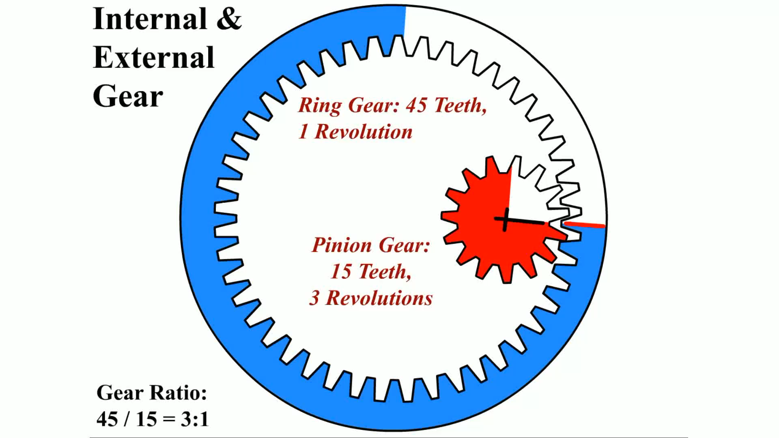
Animation: Internal Gear
(Animation will automatically start)
Internal Gear

Slide 11
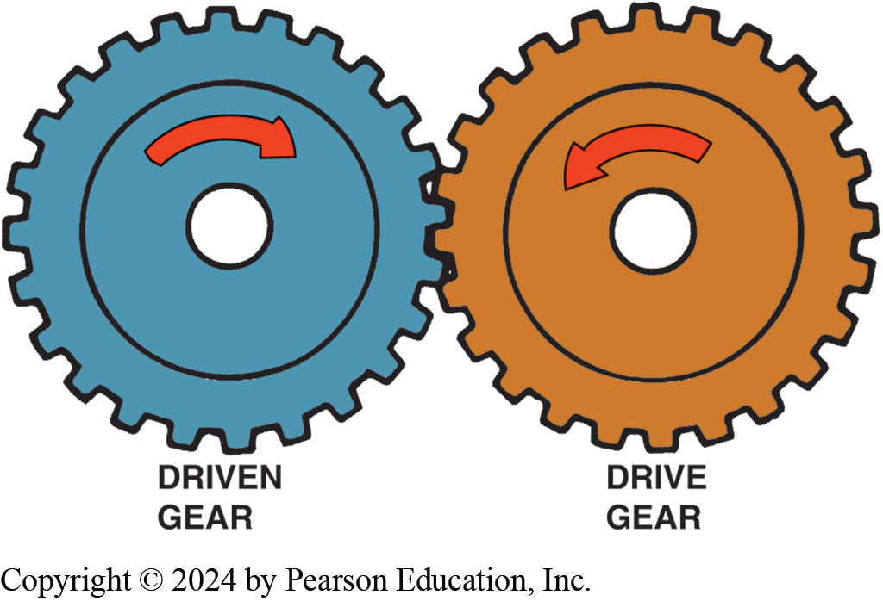
Figure 122.5 Two External Gears
When two external gears mesh, they rotate in opposite directions.
Notes:
When an external gear meshes with another external gear, the gears rotate in opposite directions as shown in ● SEE FIGURE 122–5.

Slide 12
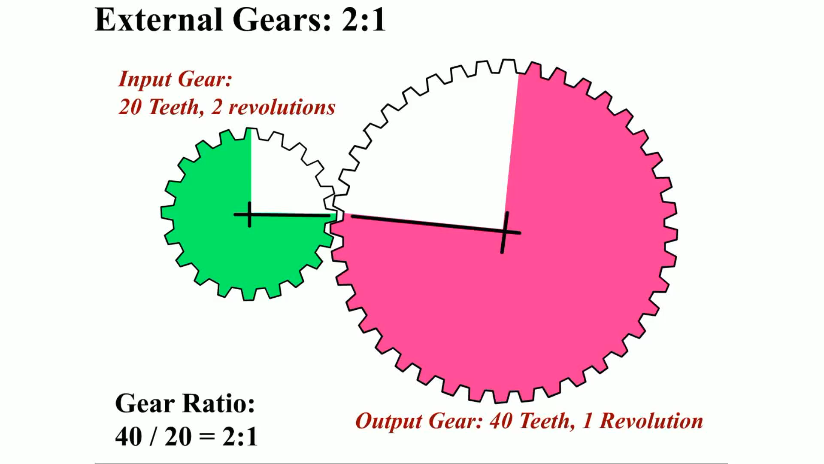
Animation: External Gears: 2:1
(Animation will automatically start)

Slide 13
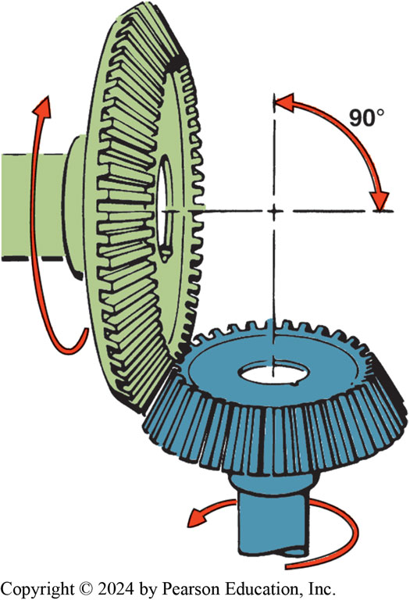
Figure 122.6 Bevel Gears
Bevel gears are often used to change the direction of rotation and are typically used in differentials..
Notes:
BEVEL GEARS The teeth of a bevel gear are cut at an angle to the outside gear surface. Simple bevel gears have straight cut teeth similar to those on a spur gear. ● SEE FIGURE 122–6.

Slide 14
Gear Ratio
Number of rotations drive gear must make
To rotate driven gear through one revolution.
Divide number of teeth on driven gear
By number of teeth on drive gear.
Gear ratios, expressed relative to number 1
Fall into 3 categories:
  Direct drive
  Gear reduction
  Overdrive
Notes:
When one gear turns another, the speed that the two gears turn in relation to each other is the gear ratio. Gear ratio is expressed as the number of rotations the drive gear must make in order to rotate the driven gear through one revolution. To obtain a gear ratio, simply divide the number of teeth on the driven gear by the number of teeth on the drive gear. Gear ratios, which are expressed relative to the number one,
fall into three categories:
■ Direct drive
■ Gear reduction
■ Overdrive
A gear ratio is determined by dividing the number of teeth on the driven gear (output) by the number of teeth on the driving gear (input). ● SEE FIGURE 122–7. The gear ratio represents the number of turns of the input gear to one turn of the output gear. A transmission/transaxle usually uses two pairs of gears to achieve each gear ratio, and
there may be four, five, or six forward gears plus reverse. When two pairs of gears are used to create a gear, simply multiply the two ratios together to get the gear ratio.
A low first-gear (high numerical) ratio creates a high amount of torque applied to the drive wheels to get the vehicle moving. To summarize what is occurring if the engine speed is constant:
First gear:
■ Output shaft speed is a lot lower than engine speed.
■ Output torque is a lot higher than the engine is producing.
Fifth gear:
■ Output shaft speed is faster than the engine speed.
■ Output torque is lower than the engine is producing.

Slide 15
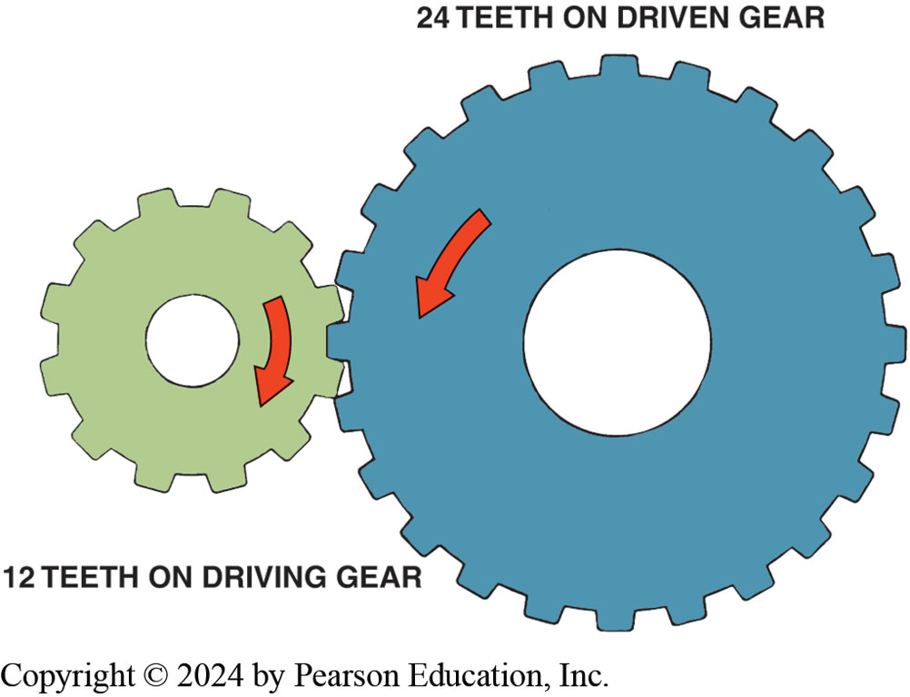
Figure 122.7 2:1 Gear Ratio
Gear ratio is determined by dividing the number of teeth of the driven (output) gear (24 teeth) by the number of teeth on the driving (input) gear (12 teeth). The ratio illustrated is 2:1.
Notes:
DIRECT DRIVE If two meshed gears are the same size and have the same number of teeth, they will turn at the same speed. Since the drive gear turns once for each revolution of the driven gear, the gear ratio is 1:1; this is called a direct drive. When a
Transmission is in direct drive, the engine and transmission turn at the same speed.

Slide 16
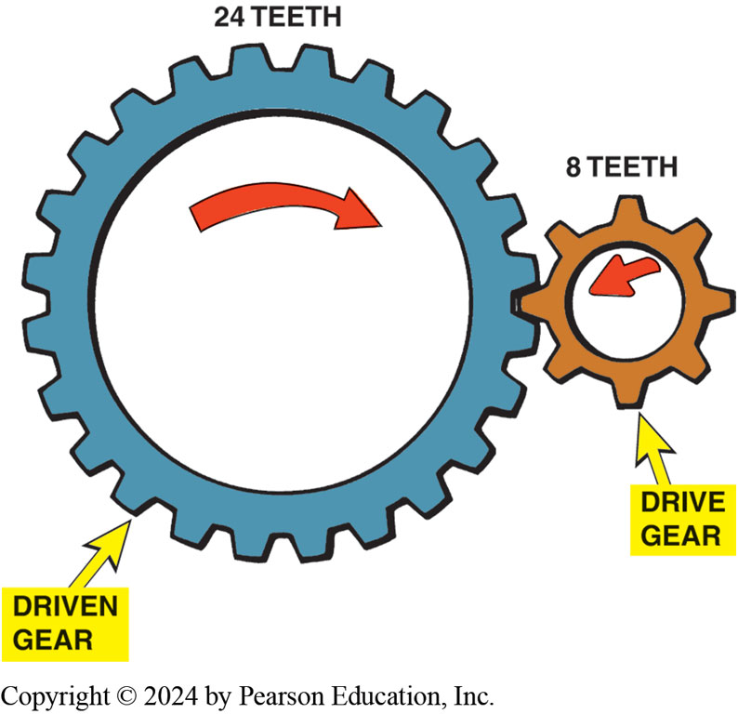
Figure 122.8 3:1 Gear Ratio
This gear combination provides a gear reduction of 3:1.
Notes:
GEAR REDUCTION If one gear drives a second gear that has three times the number of teeth, the smaller drive gear must travel three complete revolutions in order to drive the larger gear through one rotation. ● SEE FIGURE 122–8. Divide the number of
teeth on the driven gear by the number of teeth on the drive gear and you get a 3:1 gear ratio (pronounced three to one). This type of gear arrangement, where driven gear speed is slower than drive gear speed, provides gear reduction. Gear reduction may also be called underdrive as drive speed is less than, or under, driven speed. Both terms mean the same thing and use is a matter of preference. Gear reduction is used for the lower gears in a transmission. First gear in a transmission is called “low” gear because output speed, not gear ratio, is low. Low gears have numerically high
gear ratios. That is, a 3:1 gear ratio is a lower gear than those with a 2:1 or 1:1 gear ratio. These three ratios taken in order represent a typical upshift pattern from low gear (3:1), to second gear (2:1), to third gear (1:1)

Slide 17
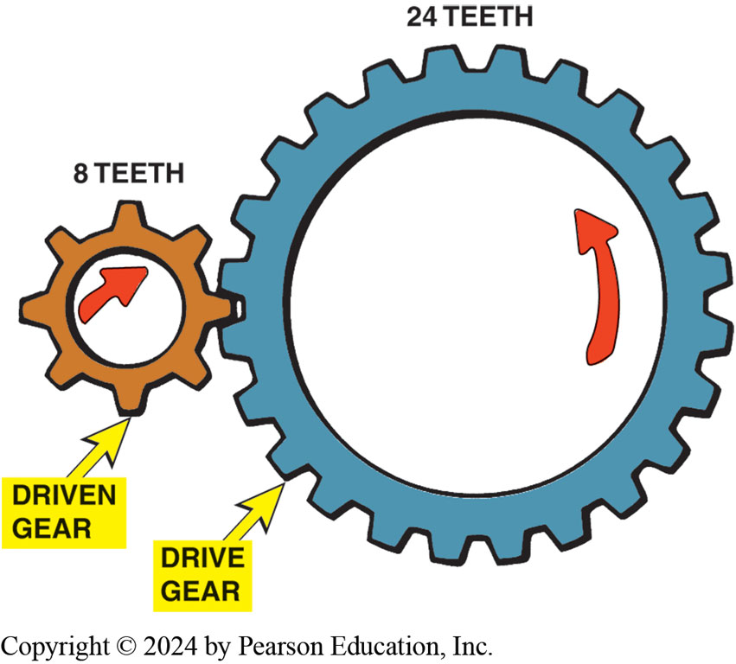
Figure 122.9 Overdrive
This gear combination provides an overdrive ratio of 0.33:1.
Notes:
Overdrive is the opposite of a gear reduction condition and occurs when a driven gear turns faster than its drive gear. For the gears shown in ● FIGURE 122–9, the driven gear turns three times for each turn of the drive gear. The driven gear is said to overdrive the drive gear. For this example, the gear ratio is 0.33:1. Overdrive ratios of 0.65:1 and 0.70:1 are typical of those used in automotive applications.
NOTE: Ratios always end in one with a colon in between. Therefore, the first number is less than one if it is an overdrive ratio and greater than one if it is a gear reduction ratio.

Slide 18
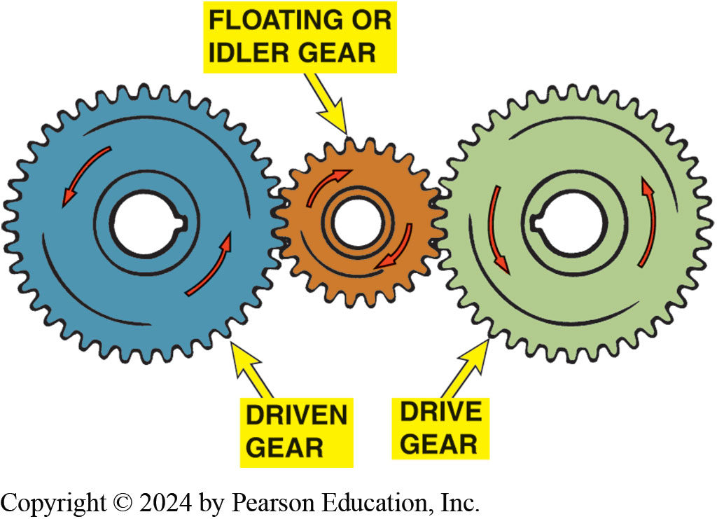
Figure 122.10 Idler Gears
Idler gears affect the direction of rotation in a gear train, but not the final drive ratio.
Notes:
IDLER GEARS A gear that operates between the drive and driven gears is called a floating gear, or idler gear. ● SEE FIGURE 122–10. Idler gears do not affect the speed relationship between the drive and driven gears, although they do affect the
direction of rotation. Reverse gear on a manual transmission often uses an idler gear to change the direction of rotation. When a drive and driven gear mesh directly, they rotate in opposite directions. When an idler gear is installed between the drive and driven gears, both drive and driven gears rotate in the same direction.

Slide 19
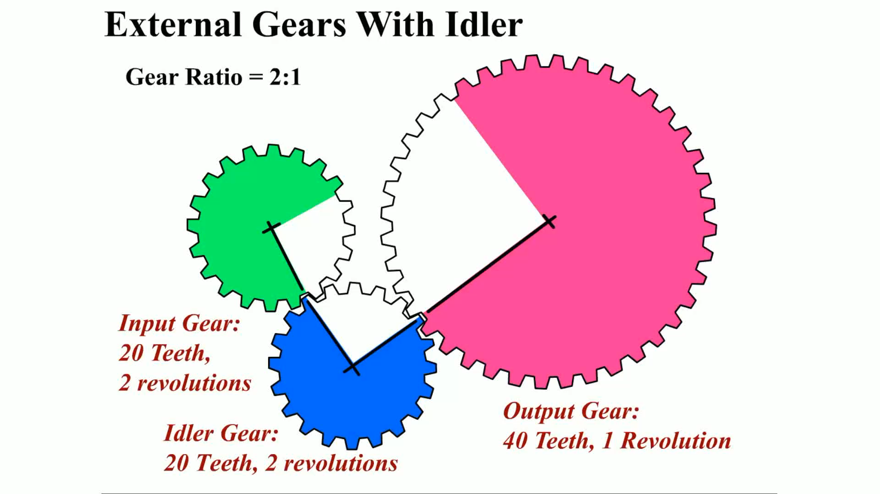
Animation: External Gears with Idler: 2:1
(Animation will automatically start)

Slide 20
Frequently Asked Question: What Is Meant by a 77 mm Transmission?
? Frequently Asked Question
What Is Meant by a 77 mm Transmission? The size (77 mm or about 3 inches) is the distance between the center of the input shaft and the center of the countershaft. The greater this distance, the larger the transmission and the more torque it is capable of handling due to the larger gears. ● SEE FIGURE 122–14.

Slide 21
Torque, Speed, And Power
Torque is a twisting force form of work
  Gears apply torque much like a wrench does
  Each tooth of a gear is actually a lever
  Gear with 2-foot radius, applying a force of 10 pounds
  To one gear tooth exerts 20 lb-ft of torque
Torque & speed have an inverse relationship
  One goes up, the other goes down.
  Torque decreases as output speed increases
  Torque increases as output speed decreases
Notes:
Torque, Speed, And Power
Torque is a twisting force commonly expressed in pound-feet (lb-ft) or Newton-meters (N-m). Gears apply torque much like a wrench does; each tooth of a gear is actually a lever. On a gear with a 2-foot radius, applying a force of 10 pounds to one gear
tooth exerts 20 lb-ft of torque on the center of the shaft to which the gear attaches. ● SEE FIGURE 122–11.
TORQUE AND SPEED RELATIONSHIP Torque and speed have an inverse relationship: as one goes up, the other goes down. With a constant input speed, transmission torque decreases as output speed increases. The opposite also applies assuming a
constant input speed, transmission torque increases as output speed decreases.

Slide 22
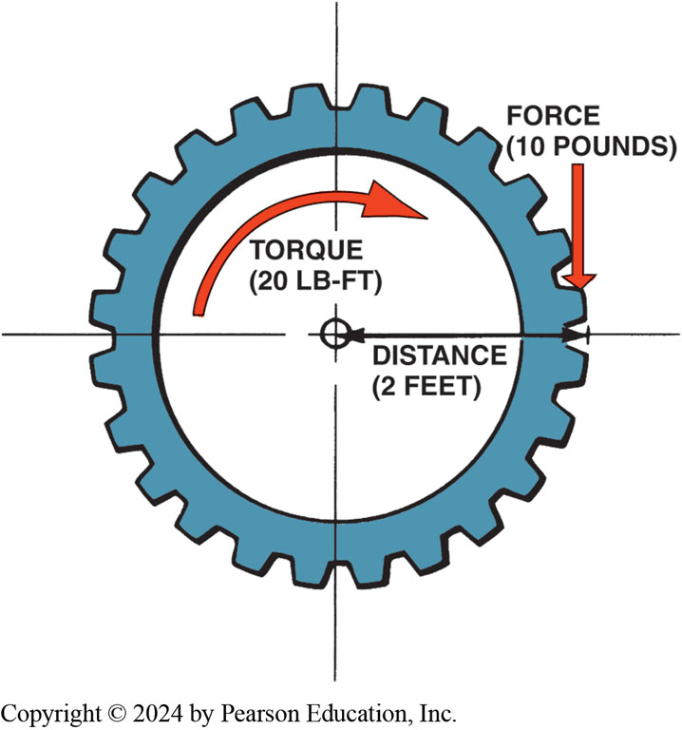
Figure 122.11 Torque Multiplication
Gears apply torque in the same way a wrench applies torque—the force applied multiplied by the distance from the center of the gear equals the torque.
Notes:
TORQUE MULTIPLICATION Levers can be used to increase or multiply torque. For example, a wheel that is too heavy for a person to turn by muscle power alone turns easily when that same person uses a lever and fulcrum to multiply the applied force.
● SEE FIGURE 122–12. The force, or torque, increases at one end, but the lever must be moved a greater distance at the opposite end to obtain the increase in force. Either distance or speed must always be given up in order to increase, or multiply, torque.

Slide 23
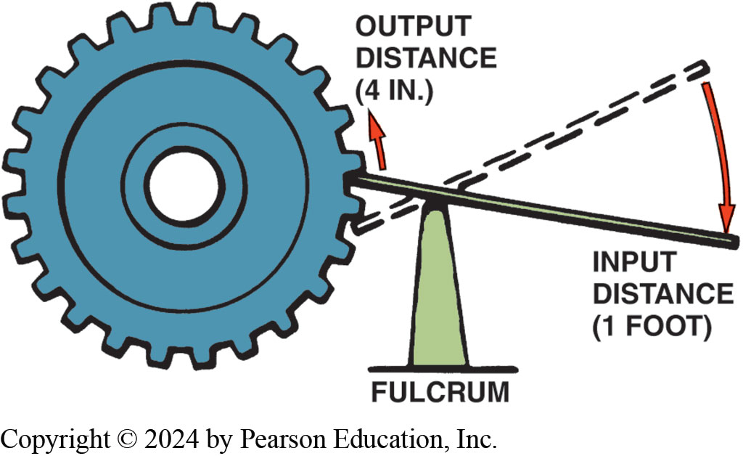
Figure 122.12 Lever Concept
A lever can be used to multiply torque, but it does so at the expense of distance or speed.
Notes:
When two gears of the same diameter are meshed, the driven gear will turn at the same speed as the drive gear. Since there is no difference in speed, there is no difference in torque between the two gears. If the drive gear is one-third the diameter of the driven gear, it must rotate three times for each rotation of the larger gear. This
means that the larger gear will turn three times slower than the smaller gear. At the same time, the larger gear will exert three times the torque of the smaller gear. When speed decreases, torque increases. Torque multiplication and gear ratios are directly related. When a gear system is in reduction, there is more torque available at the driven gear, but less speed. When the gear system is in overdrive, there is less torque available at the driven gear, but greater speed.

Slide 24
Construction
Power Paths
Parts: Cluster gear, input shaft, output shaft, reverse idler shaft
Shifting gears: constant mesh gears; speed gear
Gear ratios
Torque capacity
Notes:
A transmission is usually constructed of cast aluminum machined to accept the internal parts and strong enough to be a structural member of the drive train. The front of the transmission attaches to a separate bell housing or includes the bell housing as part of
the casting of the transmission itself. At the front of the transmission (toward the engine) is the front bearing retainer (sometimes called the quill) that supports the clutch throwout (release) bearing and usually houses the front grease seal. The rear of the transmission usually includes a separate casting called the extension housing. The center housing is usually referred to as the transmission case. ● SEE FIGURE 122–13. The input shaft is splined to the clutch disc and is also referred to as the main gear, clutch gear, or main drive pinion assembly. The main shaft, also called the output shaft, is splined at the end and transmits engine torque to the drive shaft (propeller shaft) through a yoke and universal shaft.
All manual transmissions/transaxles use a countershaft (also called a lay shaft or cluster shaft) to provide the other set of gears necessary to achieve the changes in gear ratios. The gears on the countershaft are called cluster gears or counter gears.

Slide 25
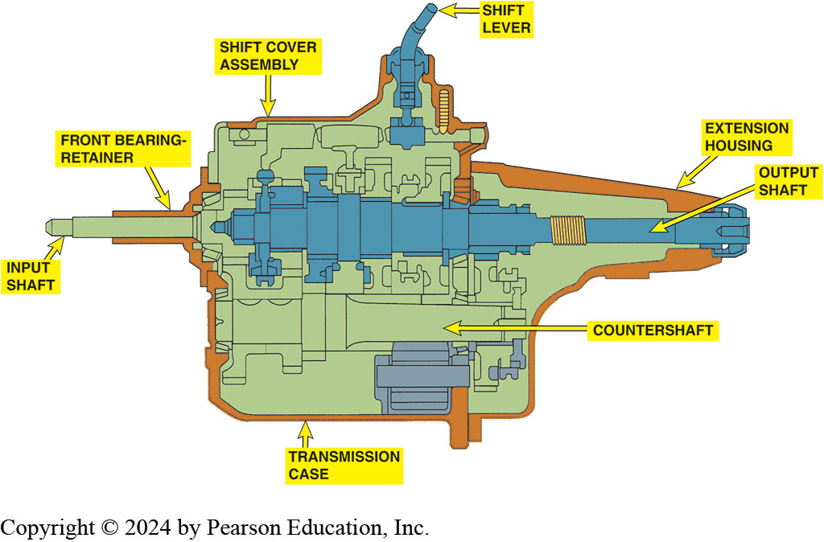
Figure 122.13 RWD Transmission
Cross section of a five-speed manual transmission showing the main parts.
Notes:
The main shaft is piloted into rear of input shaft gear with a bearing. It is also supported at rear of transmission case by another large bearing, and by universal joint slip yoke, which in turn is supported by a bushing at rear of the extension housing. The input shaft gear
is supported by a bearing at front of the transmission case and the pilot bearing at end of crankshaft. Most transmissions support cluster gear directly by a bearing set

Slide 26
Frequently Asked Question: What Is the Difference between a Transmission and a Transaxle
? Frequently Asked Question
What Is the Difference between a Transmission and a Transaxle? A transmission is used on rear-wheel-drive vehicles, whereas a transaxle is usually used on FWD vehicles. A vehicle equipped with a transmission uses a separate differential to split the torque equally to the drive wheels. A transaxle includes a differential assembly. In a transaxle, the differential, sometimes called the final drive unit, is incorporated in the construction of the transmission.

Slide 27
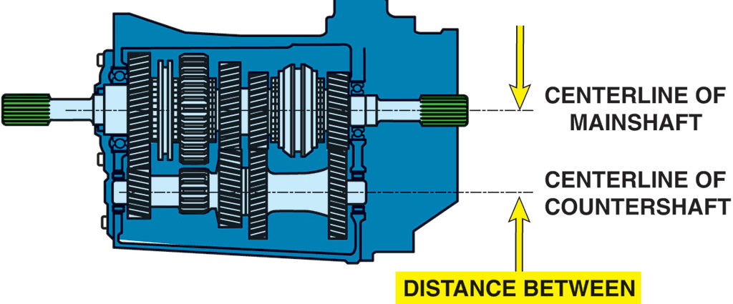
Figure 122.14 Torque Capacity
Torque capacity of a transmission is determined by the size of gear and bearings used. The greater the distance, usually measured in millimeters such as 77 mm, between the main shaft and the countershaft, the greater the torque capacity.

Slide 28
Speed Gears
All gears on countershaft are permanently attached to shaft.
When countershaft rotates, all gears on countershaft rotate.
Notes:
All gears on countershaft are permanently attached to shaft. When countershaft rotates, all gears on countershaft rotate. The input shaft gear is also part of input shaft. However, gears on main shaft are free to move on the shaft and are connected to the main shaft through the synchronizer hub when a shift is made. The gears that rotate on the main shaft are called speed gears and are free to rotate on a film of oil or on bearings.

Slide 29
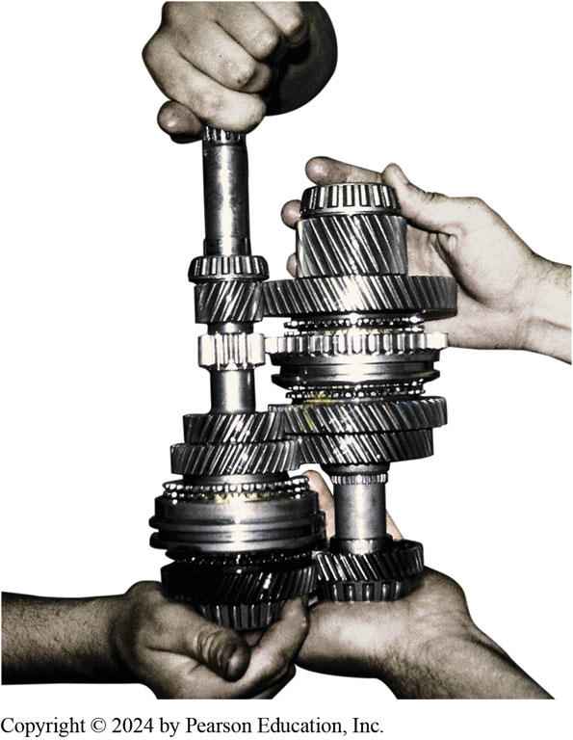
Figure 122.15 Speed Gears
Notice that the countershaft and the main
shaft both use gears of increasing size that mesh together.
Notes:
All gears on the countershaft are permanently attached to the
shaft. When the countershaft rotates, all gears on the countershaft
rotate. The input shaft gear is also part of the input shaft. However,
the gears on the main shaft are free to move on the shaft and are
connected to the main shaft through the synchronizer hub when
a shift is made. The gears that rotate on the main shaft are called
speed gears and are free to rotate on a film of oil or on bearings.
HINT: When assembling the main shaft and the countershaft,
just remember that each shaft should look like a fir
tree (tapered downward from the top). When installed in
the transmission, these two “fir trees” are meshed together
with the small gear end of one shaft meshing with the large
gear end of the other shaft. ● SEE FIGURE 122–15.

Slide 30
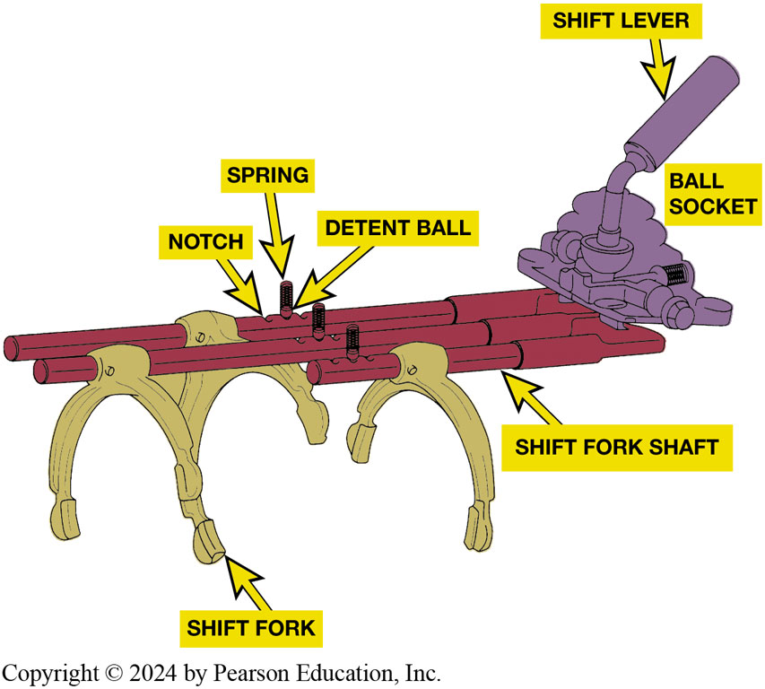
Figure 122.16 Shift Mechanism
To shift into gear, driver disengages clutch & moves shift linkage.
As sleeve moves, detent keys help guide stop ring toward speed gear.
Stop ring acts as a brake to slow down gear
Speed matches speed of synchronizer assembly.
Interlocks: typical shift mechanism showing shift detents designed to give the driver a solid feel when shifting. The shifter also prevents shifting into reverse except from the neutral position

Slide 31
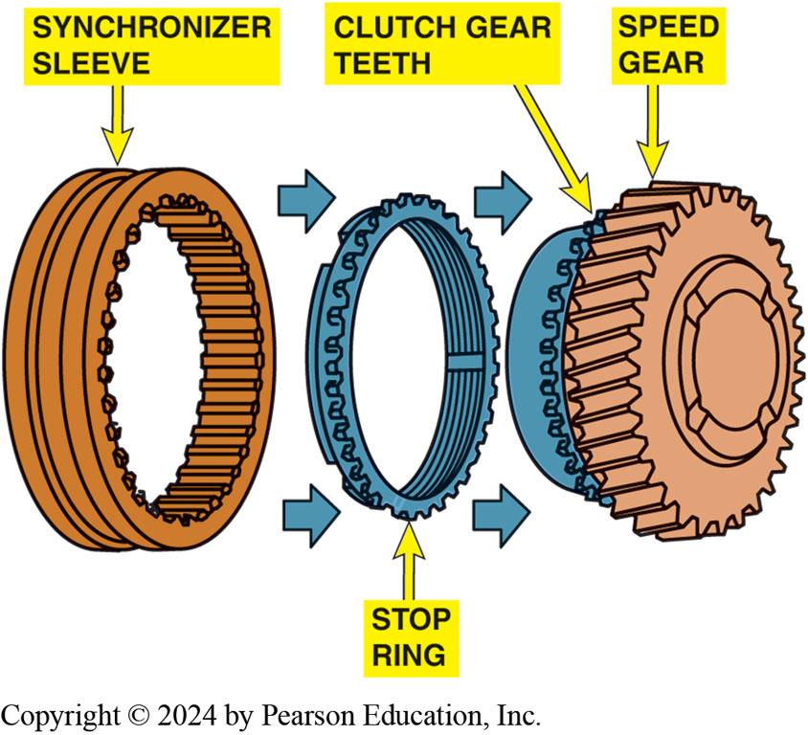
Figure 122.17 Synchronizer
Shifter fork fits into groove of synchronizer sleeve. When shift is made, sleeve is moved toward speed gear. Sleeve presses stop ring (synchronizer ring) against cone area of speed gear. The friction between stop ring and speed gear causes speed of two to become equal, permitting sleeve to engage gear clutch teeth of speed gear. When this engagement occurs, shift is complete.
Notes:
Although there are number of design variations, all are similar and include the following:
Hub
Sliding sleeve
Blocker ring, also called stop ring or synchronizer ring
Keys
Springs
In addition, tapered cone & coupling teeth machined on speed gear are part of synchronizer assembly. FIGURE 5–6.
In a typical synchronizer
Splines attach center hub of synchronizer to output shaft, so hub and output shaft rotate together. There are also splines machined on outer circumference of hub.
An outer sliding sleeve rides on the external hub splines with enough clearance so that it slides freely.
Splines on sleeve also match small coupling teeth of stop ring and speed gear. Coupling teeth are also called engagement or clutch teeth. The sleeve is splined to the hub, so it rotates with the output shaft.
Blocker ring sits between speed gear and sleeve. The coupling teeth on the stop ring match those on both the sleeve and the speed gear. The stop ring also has a tapered cone to match the cone machined on the speed gear.
Small, spring-loaded detent keys, also called synchronizer keys or struts, ride in slots on outer sleeve. The stop ring has slots to match these keys. This allows stop ring to rotate slightly, relative to the sleeve, before the keys hit the sides of their slots and stop the stop ring. As the sleeve moves, the synchronizer keys move with it, which pushes to the tapered cone of the speed gear.

Slide 32
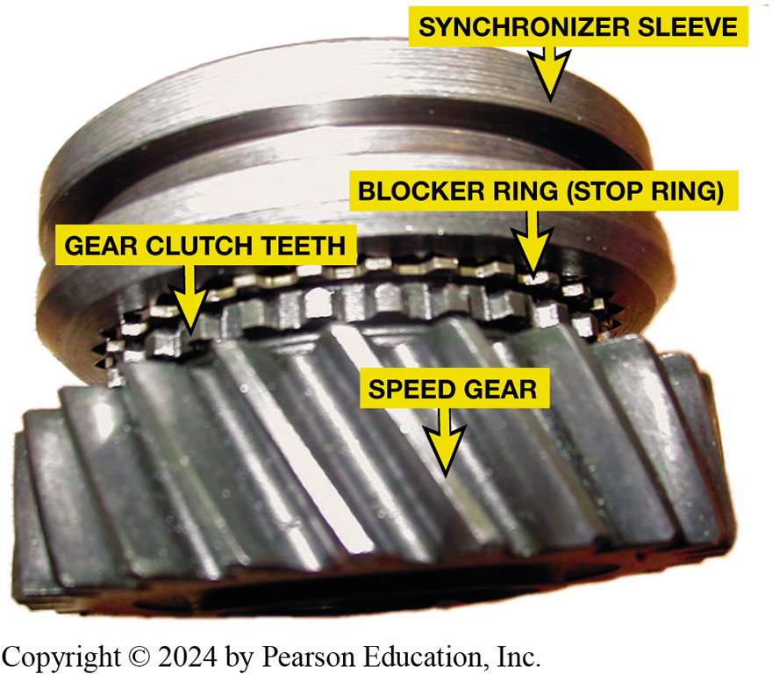
Figure 122.18 Synchronizer Assembly.
As sleeve moves, detent keys help guide stop ring toward speed gear.
Cone slides onto tapered cone of speed gear.
Causes ring cone to slide onto tapered cone of speed gear
As shift made, stop ring acts as brake to slow down gear
Speed matches speed of synchronizer assembly.
Notes:
To shift into gear, driver disengages the clutch and moves shift linkage. The shift linkage, which is described later in this chapter, pushes the sleeve toward one of the speed gears. As sleeve moves, detent keys help guide stop ring toward speed gear. This causes the ring cone to slide onto the tapered cone of the speed gear. Speed gear is turning because it is in constant mesh with a countershaft gear. However, the gear may not be turning at the same speed as the synchronizer assembly even though both are on the same shaft. When the clutch is disengaged, the engine is no longer driving the transmission, so there is no torque applied to the input shaft, and the counter- shaft, or cluster gear, simply freewheels. As shift is made, stop ring acts as a brake to slow down the gear so that its
Speed matches the speed of the synchronizer assembly. That is, it synchronizes the shift. This matched speed allows the internal hub splines to easily engage the coupling teeth on the stop ring and speed gear. When the clutch disengages, the crankshaft drives the input shaft, which drives countershaft, which in turn drives the output shaft through the selected gear.

Slide 33
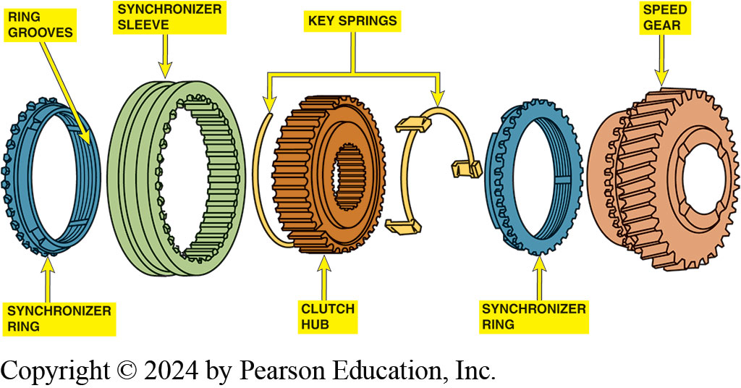
Figure 122.19 Synchronizer Operation
Synchronizer keys are attached to clutch hub and push against the synchronizer ring when the sleeve is being moved during a shift. Notice grooves on the synchronizer ring. These grooves prevent lubricating oil from becoming trapped between ring and cone surface of speed gear. The grooves also help ring release from cone surface when a shift is made out of a gear.
Notes:
The synchronizer goes through three stages during a shift:
Shift is selected, synchronizer sleeve moves toward speed gear. If speeds of sliding sleeve (main shaft) and the speed gear (counter shaft) are not identical, the speed difference will cause tapered cone to “misalign” teeth of sleeve, stop ring, and speed gear. This “blocks” shift. Now, tapered teeth of sliding sleeve push against teeth of stop ring, which in turn pushes stop ring tapered surface up against tapered surface of speed gear. This causes the speed gear to either speed up or slow down based on difference between the main shaft speed (hub) and the counter gear speed (speed gear). When speeds are equal, the thrust is released on the tapered surface, which now allows “alignment” of the sliding sleeve teeth, stop ring teeth, and speed gear teeth, which allows the shift to be completed. Figure 5–8.
Sleeve overcomes force of detent key springs as shift linkage continues to move it toward gear. This allows stop ring to relax and move slightly so that sleeve splines begin to engage coupling teeth on the stop ring. At this point, the coupling teeth on the stop ring and speed gear may not line up with each other. However, friction continues to build between the ring and the cone, so the gear continues to slow down.

Slide 34
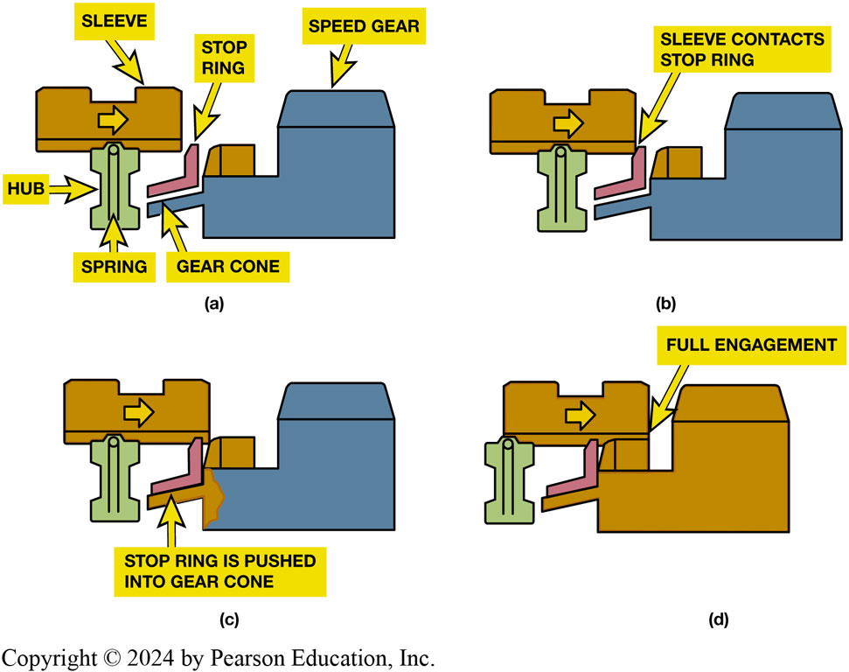
Figure 122.20 Synchronizer Stage 3
A shift sequence starts when shift fork is moved by driver. (a) Applying a force on sleeve that moves it toward speed gear. (b) sleeve and inserts contact stop ring (blocking ring). (c) synchronizer ring (stop ring) engages cone on speed gear, causing both assemblies to reach the same speed. (d) The shift is completed when the internal teeth of sleeve mesh with gear clutch teeth of speed gear.
Notes:
Stage 3 Operation
Once sleeve, stop ring, and gear are all turning at same speed, it takes just a small movement between stop ring and gear to align the coupling teeth and allow sleeve to slip completely over both sets. The speed gear is now locked to the output shaft through the synchronizer stop ring and sleeve. ● Figure 5–9.
Synchronizer stop rings are a simple type of clutch, called a cone clutch for the shape of the mating surfaces. Some manufacturers refer to the synchronizer action as “clutching.” Synchronizer sleeves and hubs are gear-quality steel. Stop
rings are a softer metal—usually brass, copper, or a sintered metal—to absorb the friction of synchronizer operation. The tapered cone is relieved; that is, grooves are machined into its contact surface. These grooves serve two purposes:
They channel excess lubricant out from between the two pieces for better contact.
Retain a small amount of lubricant. This decreases wear when the cone clutch must slip slightly during coupling tooth alignment.

Slide 35
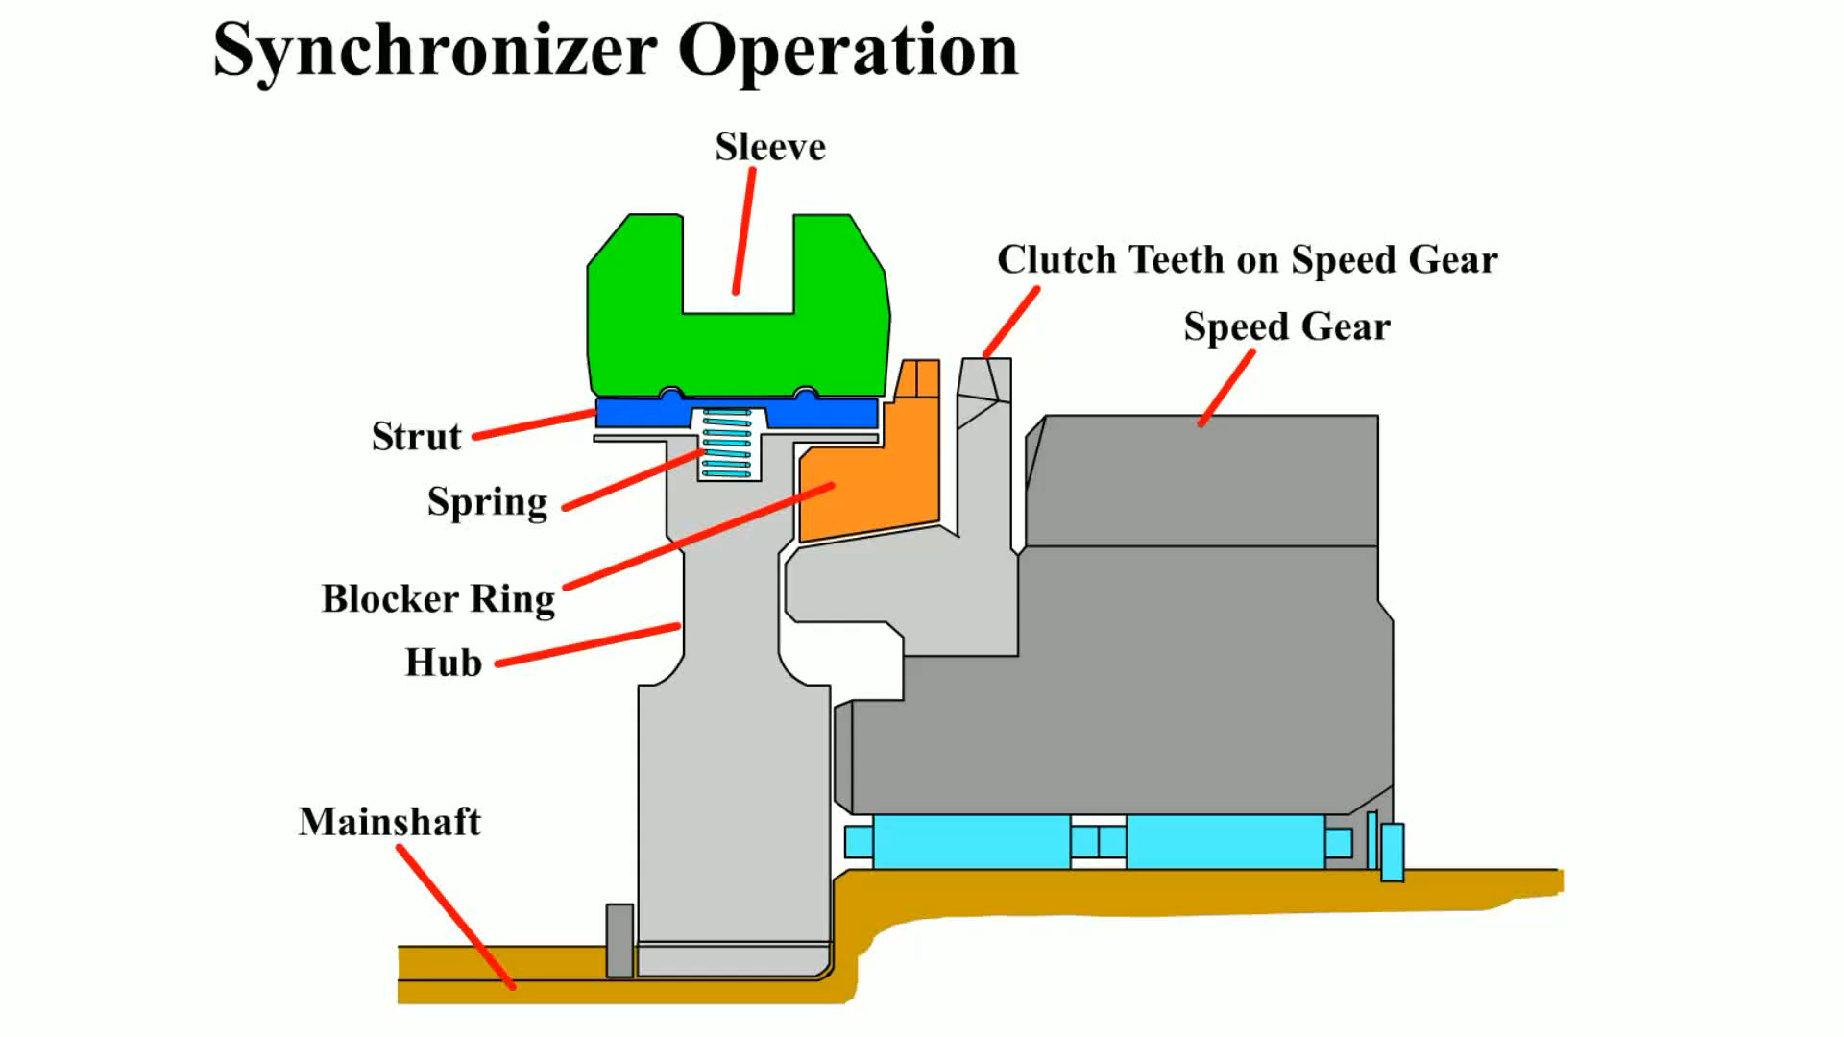
Animation: Synchronizer Operation
(Animation will automatically start)

Slide 36
Frequently Asked Question: What Do the Keys Do?
? Frequently Asked Question
What Do the Keys Do? The keys are there to limit the amount of rotation of the ring from 1/2 tooth misaligned in the forward direction, to 1/2 tooth misaligned in the “coast” direction so that both upshifts and downshifts can be made. The detent key springs are designed to “push up” on the keys that have a “bump” on them that aligns with a notch in the inside center of the sliding sleeve. This upward pressure tends to keep the sliding sleeve in the neutral position and prevents unwanted movement toward another unwanted gear.

Slide 37
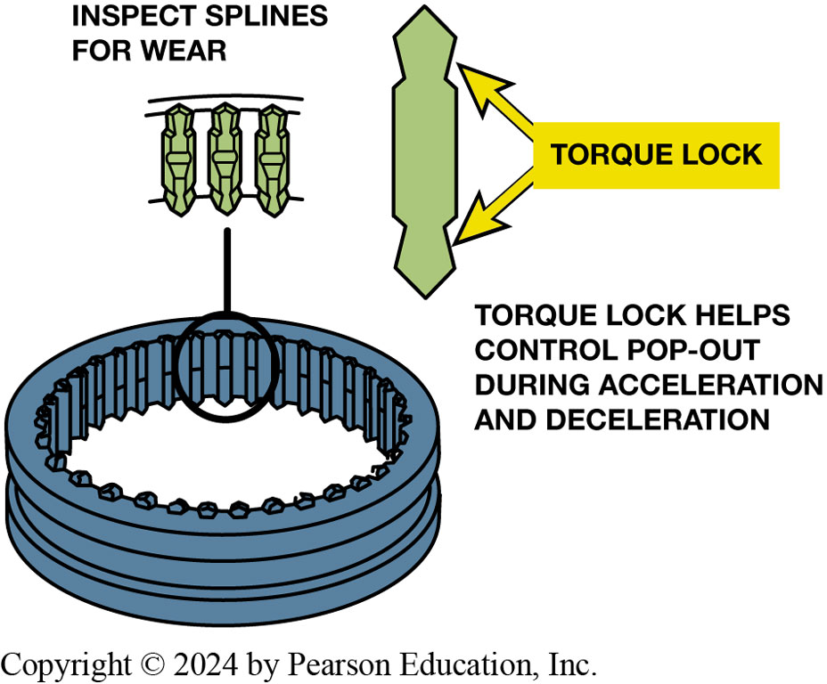
Figure 122.21 Torque Locks/Taper
Back Taper
  Angle cut opposite to chamfer
  Spline or tooth narrows
  Just behind chamfered end
Shape of splines helps prevent transmission/transaxle from jumping out of gear during acceleration and deceleration.
Notes:
The internal splines on the synchronizer sleeve and coupling gear teeth on stop rings and speed gears have a special shape that works to hold the gear engaged once the driver releases the shift lever. The ends of the gear teeth are chamfered, giving them a triangular shape. These pointed ends allow easier sleeve-to-gear alignment as the angles tend to center the splines between the teeth. Once aligned, a back taper machined behind the chamfered end of the teeth and splines tends to keep the sleeve in place until the linkage pushes the sleeve away for another shift. Back taper is an angle cut opposite to the chamfer so that spline or tooth narrows just behind the chamfered end. ● Figure 5–10.
The back taper creates resistance to motion to keep the splines from sliding off the coupling teeth. This is

Slide 38
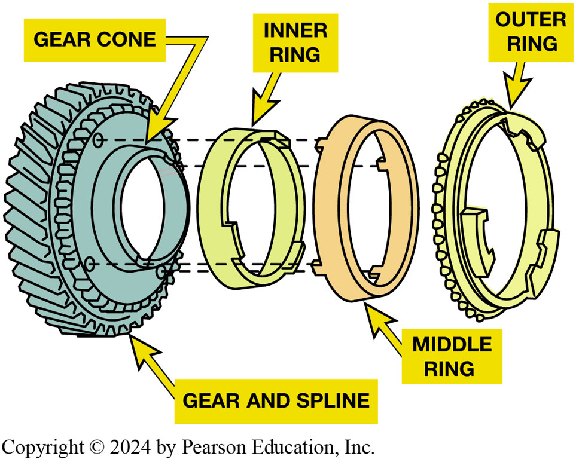
Figure 122.22 Triple-Cone Synchro
Double Cone Synchronizer
  Multiple cones
  More surface area
  Better synchronization
  Longer service life
Exploded view of a triple-cone synchronizer. The inner and outer rings rotate with the synchronizer sleeve while the middle ring rotates with the speed gear.
Notes:
A manual transmission with paper stop rings must use automatic transmission fluid (ATF). Other lubricants damage paper ring surface.
Some synchronizers use a double cone, with an outer cone and an inner cone along with the blocker ring. The multiple cones provide more surface area for better synchronization and longer service life. See Figure 5–11.

Slide 39
5-Speed Trans Torque Flow (1 of 3)
Neutral: all synchronizer sleeves centered on their hubs.
First Gear:
  Shift linkage slides 1–2 synchronizer sleeve rearward
  Toward first speed gear.
Second Gear:
  shift linkage slides 1–2 synchronizer sleeve forward
  Away from first speed gear and toward second speed gear.
Notes:
5-SPEED RWD TRANSMISSION
A five-speed transmission has 6 gear sets that provide 5 forward speeds and 1 reverse speed. Either a sliding gear or constant-mesh gears may be used for reverse.
All forward gears are constant-mesh type.
Borg–Warner T5 manual transmission serves as an example of a contemporary 5-speed design.
In addition to reverse, the T5 provides three gear reduction ratios (first, second, and third), direct drive (fourth), and overdriven ratio (fifth).
A sliding idler gear is used to change output shaft direction and provide reverse.

Slide 40
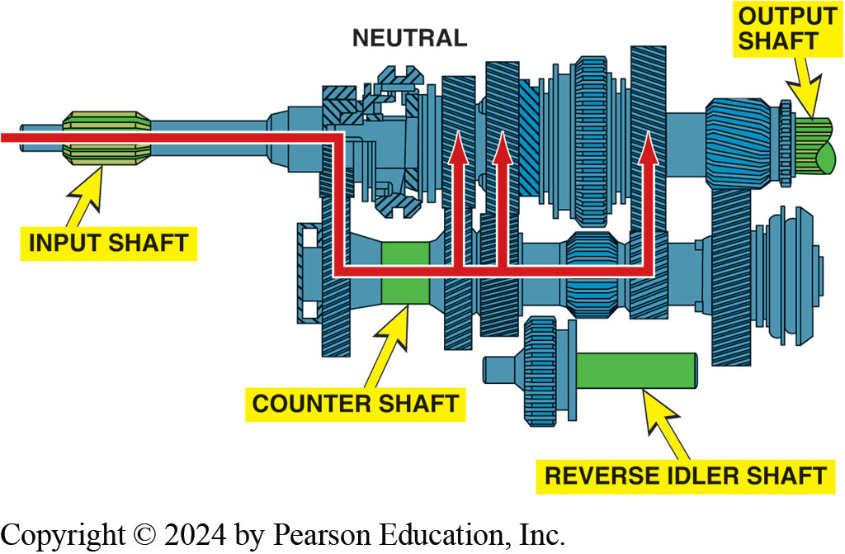
Figure 122.23 Neutral
In neutral, input shaft and countershaft are rotating if clutch is engaged (clutch pedal up), but no torque is being transmitted through transmission.

Slide 41
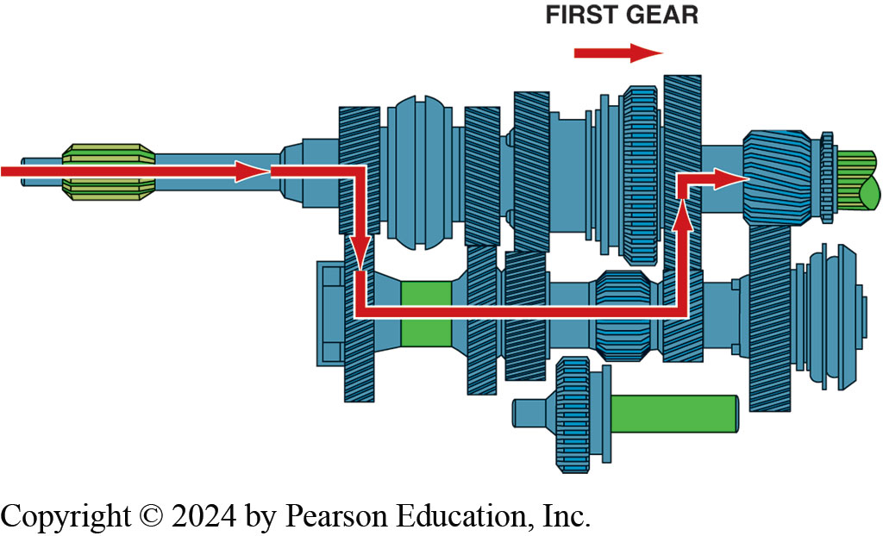
Figure 122.24 First Gear
In first gear, 1–2 synchronizer sleeve is moved rear-ward, locking first speed gear to output shaft. Torque is transmitted from input shaft to countershaft and then to output shaft

Slide 42
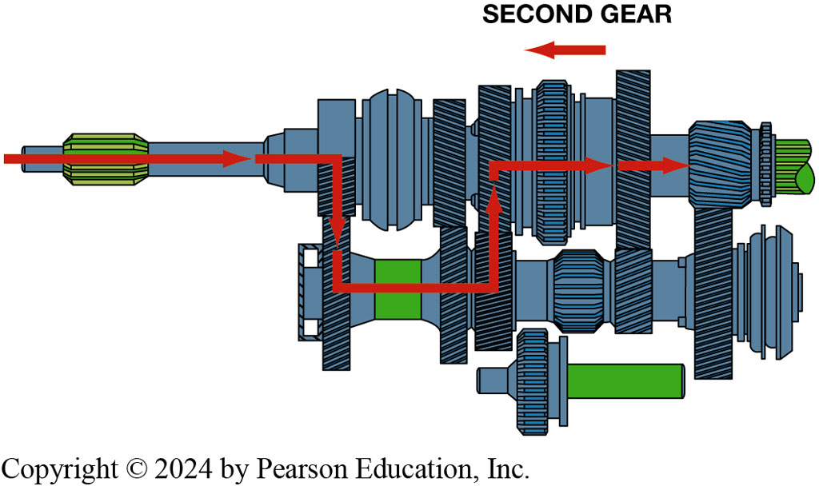
Figure 122.25 Second Gear
In second gear, 1–2 synchronizer sleeve is moved forward, which locks second speed gear to the output shaft.

Slide 43
5-Speed Trans Torque Flow (2 of 3)
Third Gear:
  Shift linkage centers 1–2 synchronizer sleeve
  Moves 3–4 synchronizer sleeve back toward the third speed gear.
Fourth Gear:
  Shift linkage moves 3–4 synchronizer sleeve forward
  Away from third speed gear and toward input shaft drive gear.

Slide 44
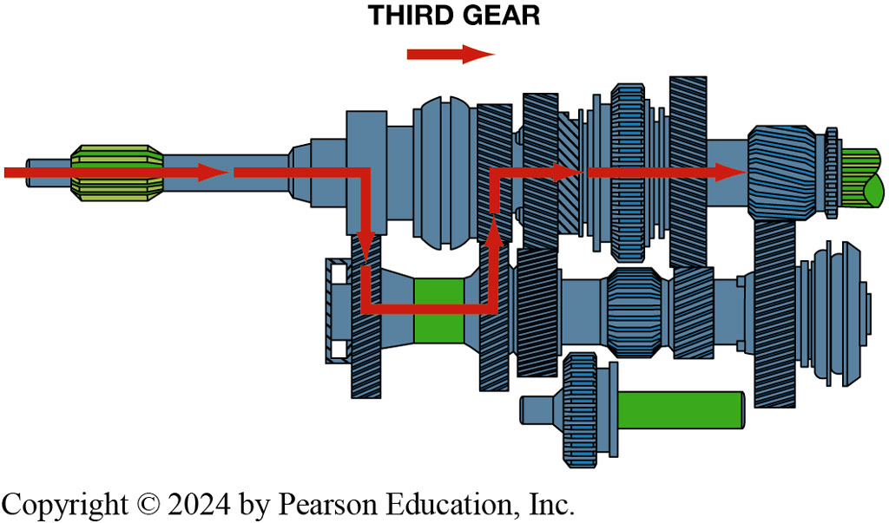
Figure 122.26 Third Gear
To achieve third gear, shaft linkage first centers 1–2 synchronizer sleeve and then moves 3–4 synchronizer sleeve rearward, locking third speed gear to output shaft.

Slide 45
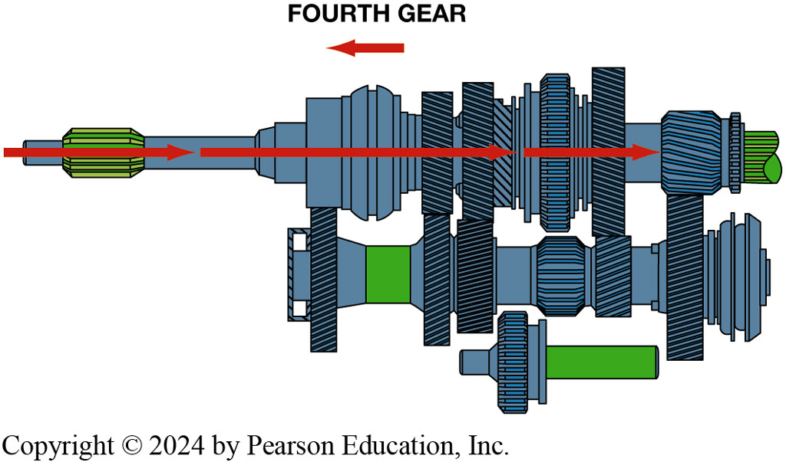
Figure 122.27 Fourth Gear
In fourth gear, 3–4 synchronizer sleeve is moved forward, which locks the 4th speed gear to output shaft. This is direct drive

Slide 46
5-Speed Trans Torque Flow (3 of 3)
Fifth Gear:
  Shift linkage centers 3–4 synchronizer sleeve
  Moves fifth synchronizer sleeve toward fifth speed gear.
Reverse:
  Sliding gear and constant-mesh gear.

Slide 47
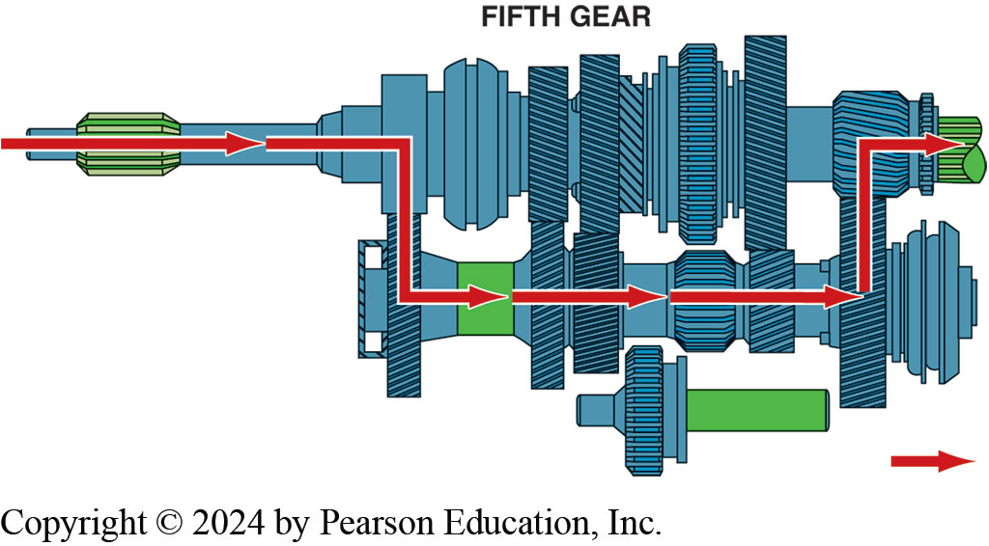
Figure 122.28 Fifth Gear
To achieve fifth gear, shift linkage first centers the 3–4 synchronizer sleeve and then moves fifth synchronizer sleeve toward fifth speed gear, locking it to output shaft.

Slide 48
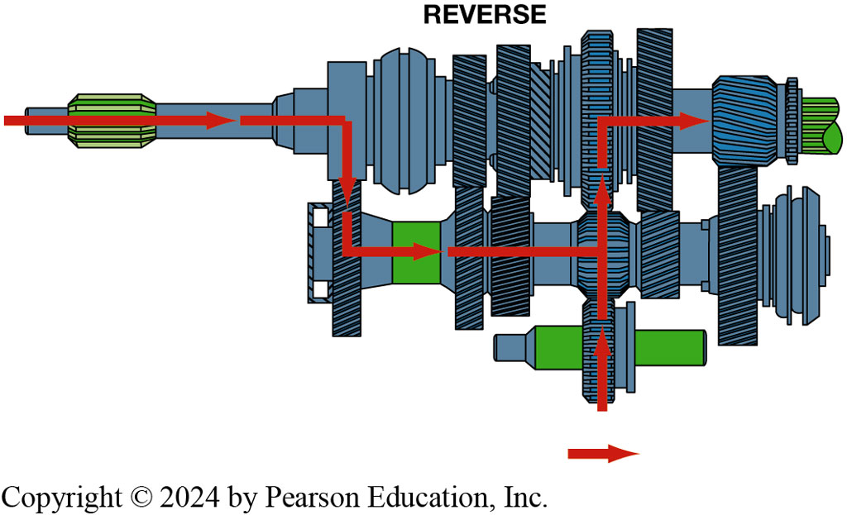
Figure 122.29 Reverse
Torque flows through transmission in reverse gear. Note that idler gear drives 1–2 synchronizer sleeve gear, which is splined to output shaft.
Notes:
There are two common reverse gear designs used on transmissions:
1. Sliding gear.
2. Constant-mesh gear.
With a sliding reverse gear design, such as on the Borg–Warner T5, the shift linkage slides the
reverse idler gear on its shaft until it engages the reverse gears on the countershaft and output
shaft gear. Both gears are fixed to their respective shafts. This design uses spur gears for
reverse, not helical gears, because the gear teeth must move into and out of mesh. On some
gearboxes, the sliding gear splines to the output shaft. The linkage moves the gear along the
output shaft splines to engage the reverse idler gear. An unusual feature of the Borg–Warner T5 is
that it does not have a separate reverse output shaft gear. Figure 5–18.

Slide 49
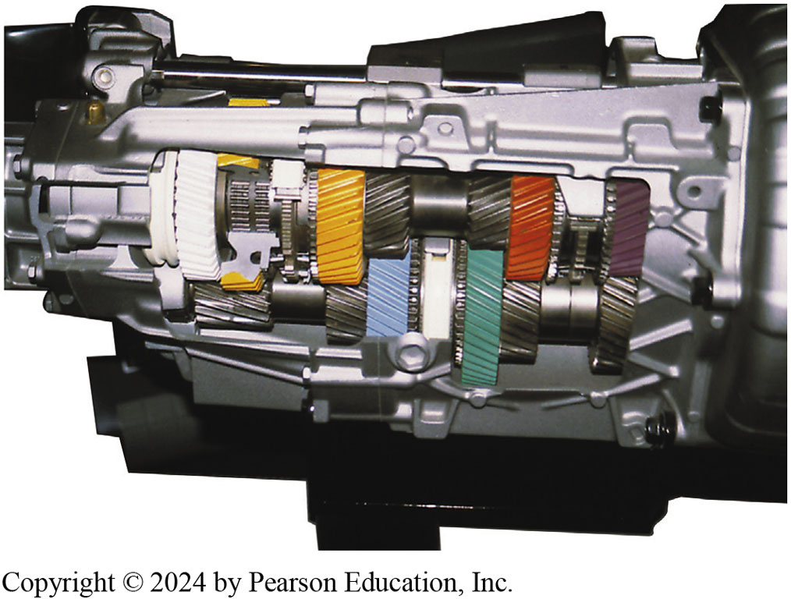
Figure 122.30 Six Speed Trans
Cutaway of a T56 six-speed transmission showing all of its internal parts.
Notes:
A six-speed transmission requires one more gear on the cluster, an additional speed gear, and
one-half of a synchronizer assembly. This increases the weight, length, and cost of the unit. The
additional gear is usually another overdrive ratio. Some six-speeds have low and high gear ratios
similar to those of a five-speed, with the ratios closer together. See Figure 5–19.

Slide 50
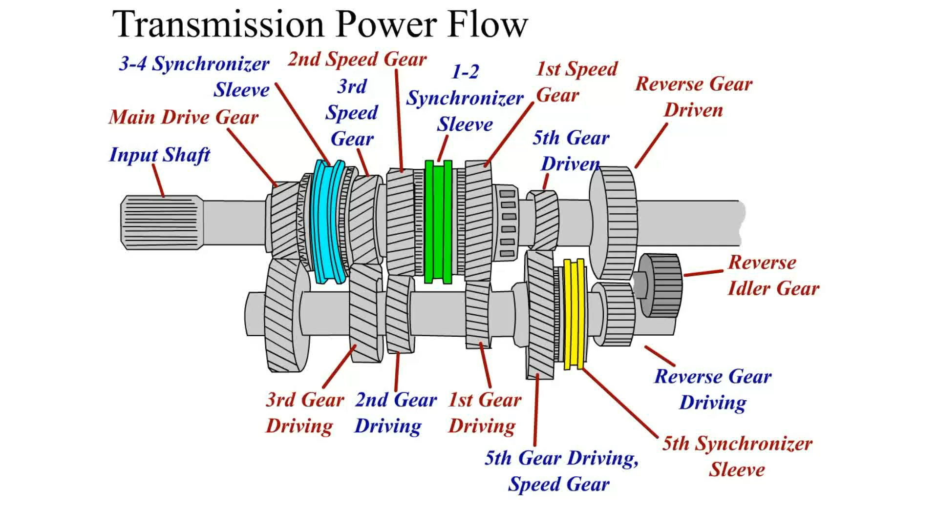
Animation: Transmission Power Flow
(Animation will automatically start)

Slide 51
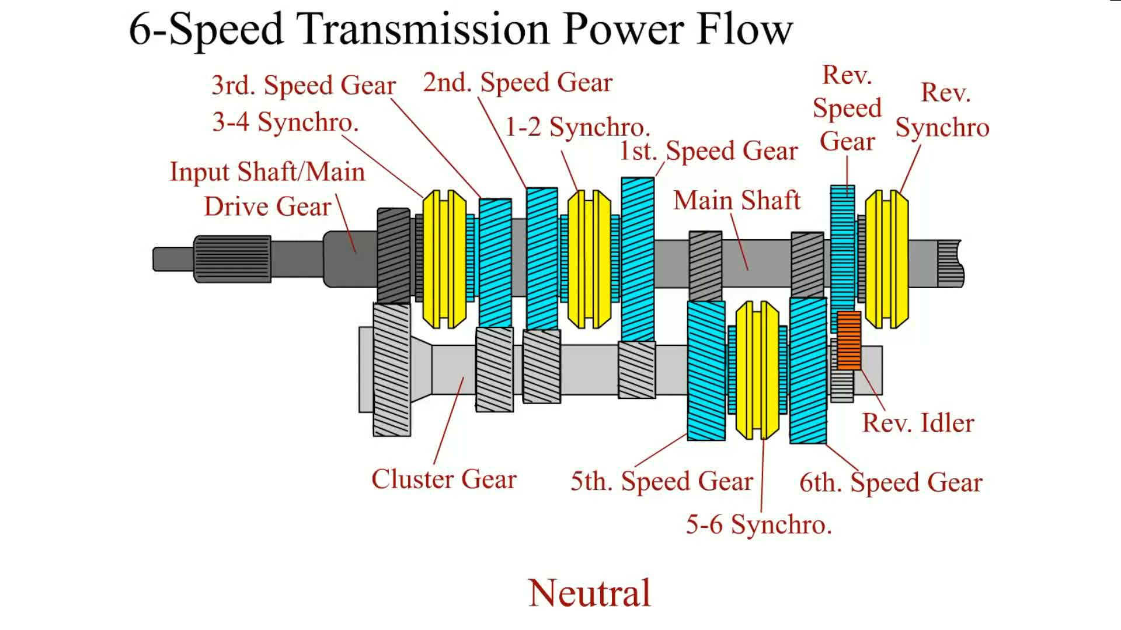
Animation: 6-Speed Transmission Power Flow
(Animation will automatically start)

Slide 52
Manual Transmission/
Transaxle Construction & Service
Manually shifted transaxle
  input shaft, an output shaft, and a differential
  input shaft is attached to the clutch
  Most transaxles use speed gears and synchronizers on both input and output shafts
  Differential assembly, called a final drive assembly,
  Attaches to the output shaft
  Splits the torque to both front drive axles
Notes:
A manually shifted transaxle includes an input shaft, an output shaft, and a differential
assembly all in one case. The input shaft is attached to the clutch, which transfers engine torque from the engine flywheel to the input shaft when the clutch is engaged. Most transaxles use speed gears and synchronizers on both the input and output
shafts, as shown in ● SEE FIGURE 122–31. The differential assembly, also called a final drive assembly, attaches to the output shaft and splits the torque to both front drive axles. ● SEE FIGURE 122–32.

Slide 53
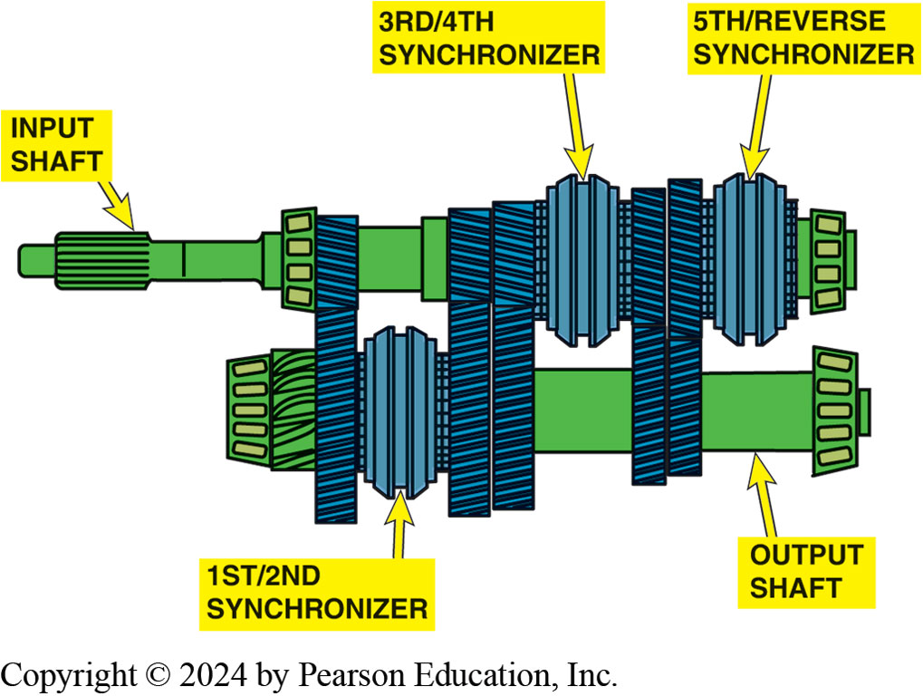
Figure 122.31 Transaxle Construction
Input shaft
Sometimes called clutch shaft.
Main shaft
  Sometimes called countershaft or intermediate shaft.
Includes drive pinion gear
Notice that this 5-speed transaxle from a Dodge/Plymouth Neon uses synchronizers on both input and output shafts.
Notes:
PARTS INVOLVED Most transaxles are made with four parallel shafts:
1. Input shaft—The input shaft is sometimes called the clutch shaft because it is splined to the
clutch disc. The driving gears are positioned on the input shaft, and there is one for each forward
speed.
2. Main shaft—The main shaft, also called a countershaft or an intermediate shaft, also includes a
gear for each forward speed and these are the driven gears. The main shaft also includes the drive
pinion gear. The drive pinion gear is the transmission output and the input for the final drive.
3. Final drive ring gear—The final drive ring gear is mounted on the differential case. The
differential divides the power flow between the two CV joints coupled to the drive shafts and on to
the wheels. The differential pinion gears and side (axle) gears in the differential allow for
speed differences when the vehicle turns a corner. This gear arrangement also splits the power from
a single source to two sources with, typically, 50/50 torque distribution.
4. Reverse idler shaft—All of the gears in a transaxle, with the exception of the reverse idler,
are in constant mesh, and each of the gear pairs on the input shaft and main shaft represents the
power paths for a particular gear ratio. ● SEE FIGURE 6–2.

Slide 54
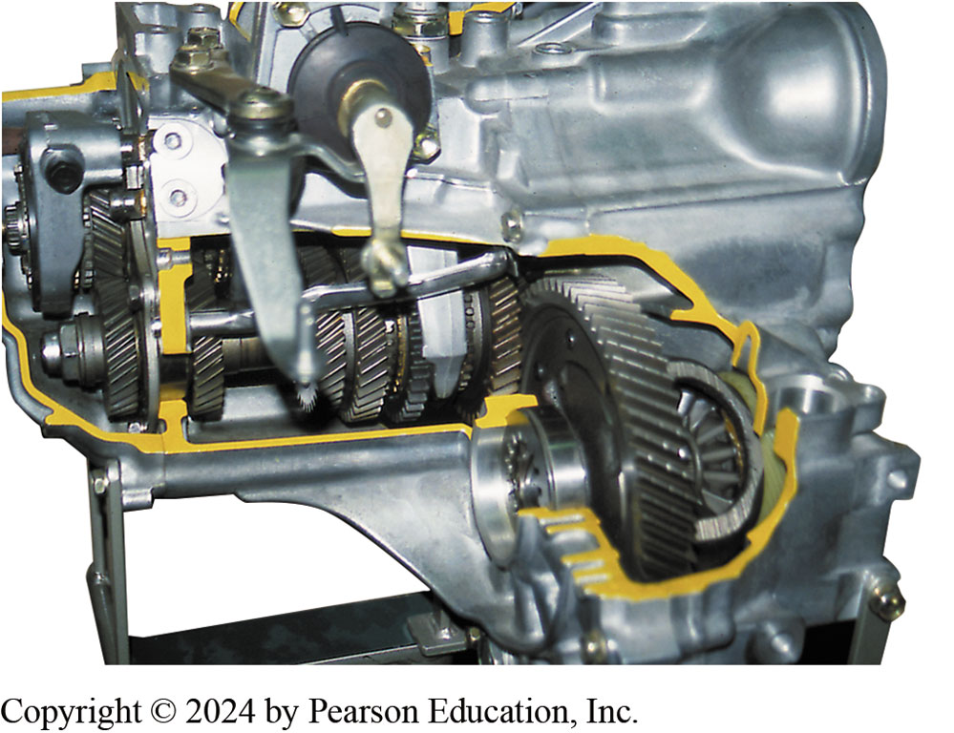
Figure 122.32 Transaxle
Most engines rotate in CW direction (viewing rotation from right, or passenger, side
Input shaft rotates CW, main shaft rotates CCW in forward gears, & differential rotates CW to drive wheels in CW direction
Cutaway of a typical manual transaxle showing all of its internal parts including the final drive assembly.
Notes:
HARD-TO-SHIFT DIAGNOSIS Several items that could be worn or defective can cause a manual transmission/transaxle to be difficult to shift, including
■ Clutch not fully disengaging. If the clutch linkage is not properly adjusted or if there is a leak in the hydraulic clutch linkage, the clutch may not be fully disengaged. A shift is very difficult, if not impossible, if engine torque is being transferred through the transmission/transaxle as a shift is being attempted.
■ Worn synchronizer. If the synchronizer rings are worn, the rings will be unable to properly match the speed gear speed, making the shift difficult and/or creating gear clash (noise) when shifting.
■ Worn, cracked, or loose shift forks. If there is any problem with the shift forks, the synchronizer cannot be properly moved during a shift attempt, making shifting difficult, if not impossible. If only one fork is worn or defective, usually
engaging two gears instead of one is likely.
■ Excessive input- or main-shaft end play. Excessive end play in the input or main shaft will cause the gears to move away from the synchronizer assembly, resulting in grinding during shifts or shifts that are difficult or impossible to
complete.
■ Improper lubrication. Many of today’s manual transmissions use synchronizer rings (blocking rings) that are lined with compounds, paper, or other friction material.
All of these transmissions/transaxles must be filled with the proper fluid formulated for proper shifting.
NOTE: A worn synchronizer sleeve and/or blocking ring can
cause the transmission/transaxle to pop out of gear while
accelerating or decelerating.

Slide 55
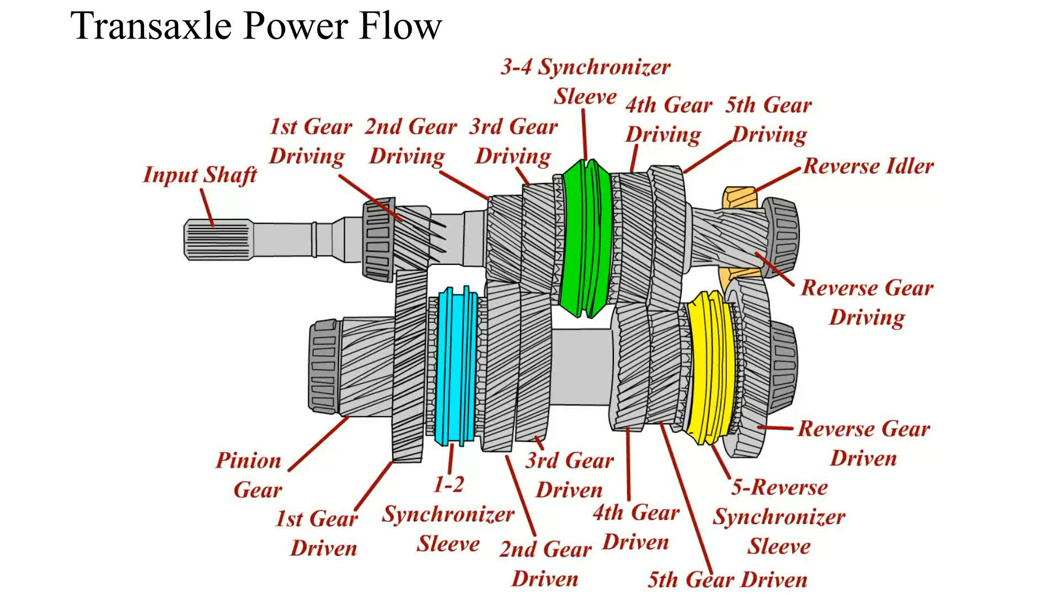
Animation: Transaxle Power Flow
(Animation will automatically start)

Slide 56
Transaxle/Transmission Removal (1 of 3)
Transaxle Removal
  Disconnect negative (–) battery cable.
  Disconnect shift cables or rods, clutch linkage, backup light switch, wires. speedometer cable speed sensor connections, hose, etc.
  Installation of an engine support tool.
  Remove upper clutch housing bolts
  Install guide pin into 1 or 2 of bolt holes
Notes:
See Pages 98-99 for transaxle removal and installation

Slide 57
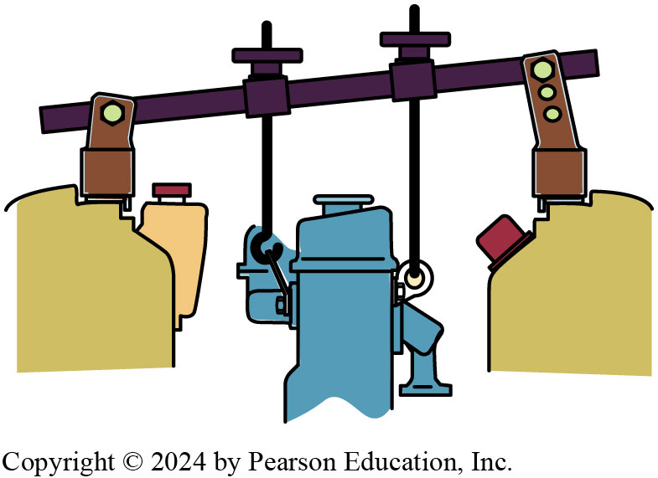
Figure 122.33 FWD Engine Support
Tools Needed
  Transmission jack
  Tall safety stand to support vehicle or engine
  Engine support fixture must be used to support and move unit in and out
Most front-wheel-drive (FWD) vehicles require the use of a fixture to support the engine before removing the transaxle.

Slide 58
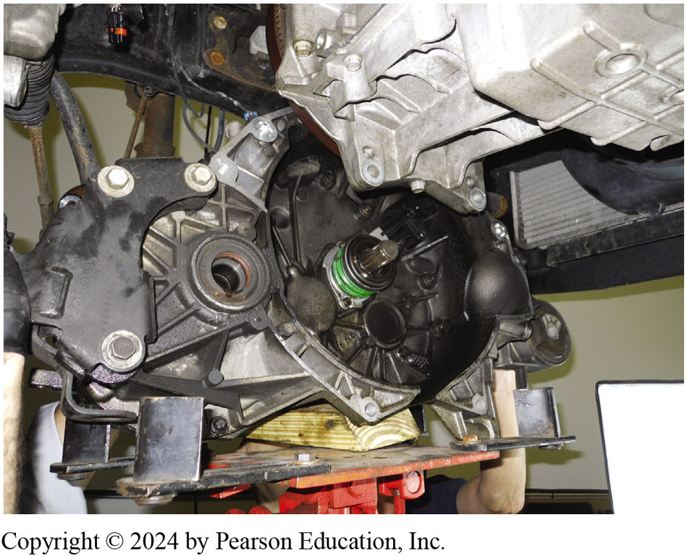
Figure 122.34 Transaxle Removal
Position A Transmission Jack
  Support transaxle,
  Remove any mounts or supports,
  Carefully lower it from vehicle.
A transaxle being removed from underneath a vehicle and being supported by a transmission jack.

Slide 59
Transaxle/Transmission Removal (2 of 3)
Raise, securely support vehicle on hoist or jack stands
Drain transaxle oil and install second guide pin.
How does transaxle get installed?
Transmission Removal/Replacement
  Disconnect negative (–) battery cable.
  Raise and securely support vehicle.
  Drain fluid.
Notes:
See pages 98-99 of the text for the answer

Slide 60
Transaxle/Transmission Removal (3 of 3)
Remove:
  Backup light wires, speedo cable or speed sensor
  Hose or cable brackets attached to the vehicle, and the shift linkage.
Remove transmission bolts.
Remove transmission-to-clutch housing or transmission-to-engine bolts.
Lower unit out of vehicle
Notes:
See Pages 99-100 for transmission removal and installation

Slide 61
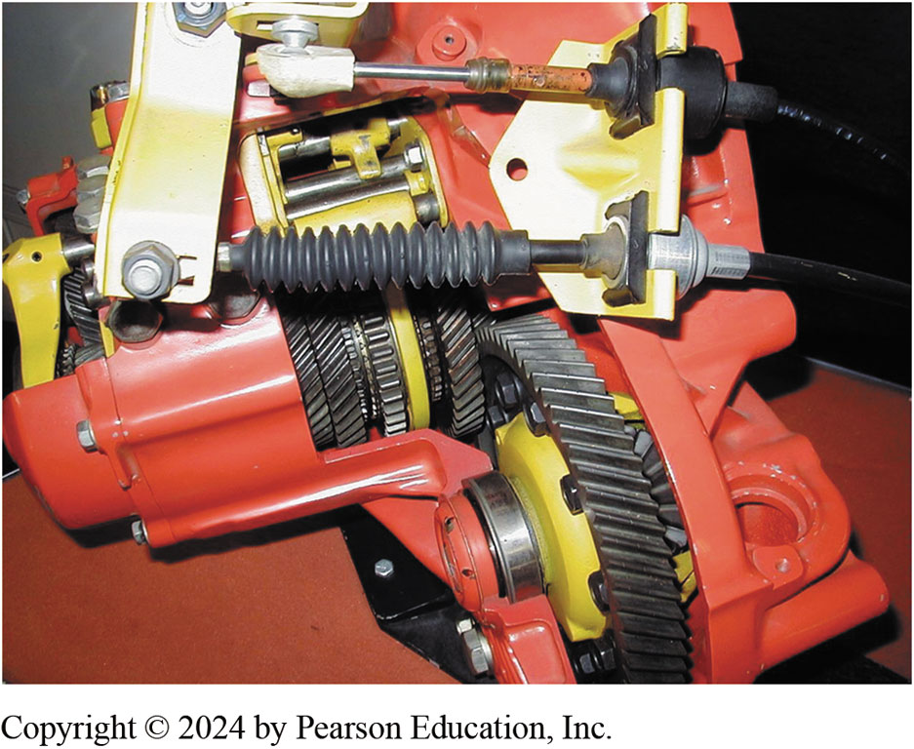
Figure 122.35 Shift Linkage
Typical cable-operated shift linkage used on a front-wheel-drive transaxle.

Slide 62
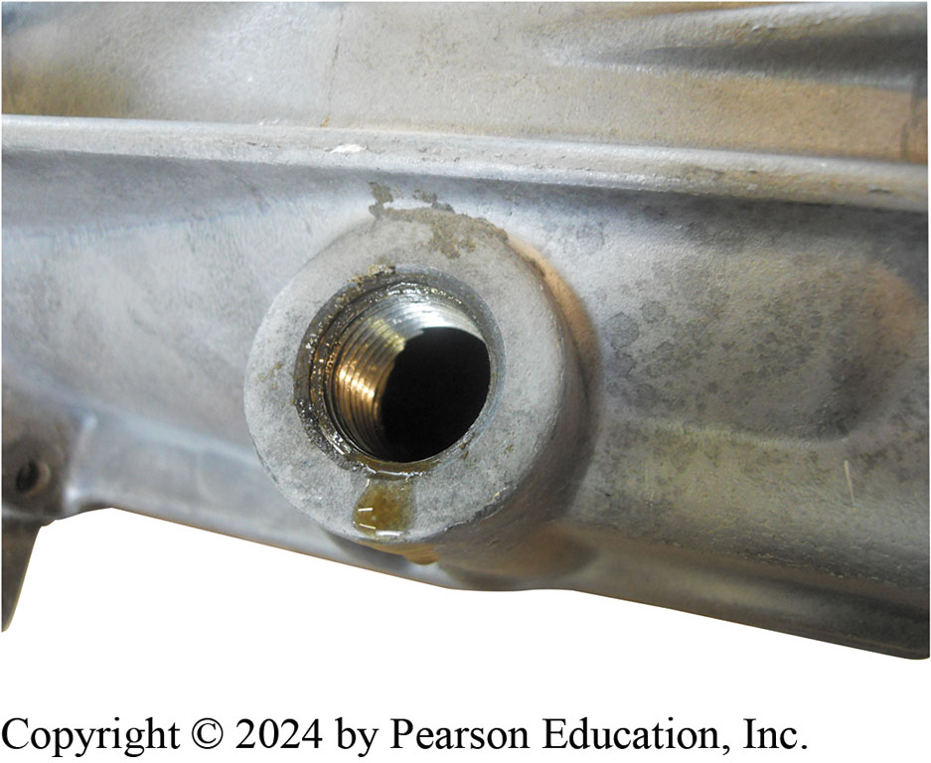
Figure 122.36 Drain Fluid
Drain the fluid into a suitable container and dispose of the old fluid according to local, state, and federal regulations.

Slide 63
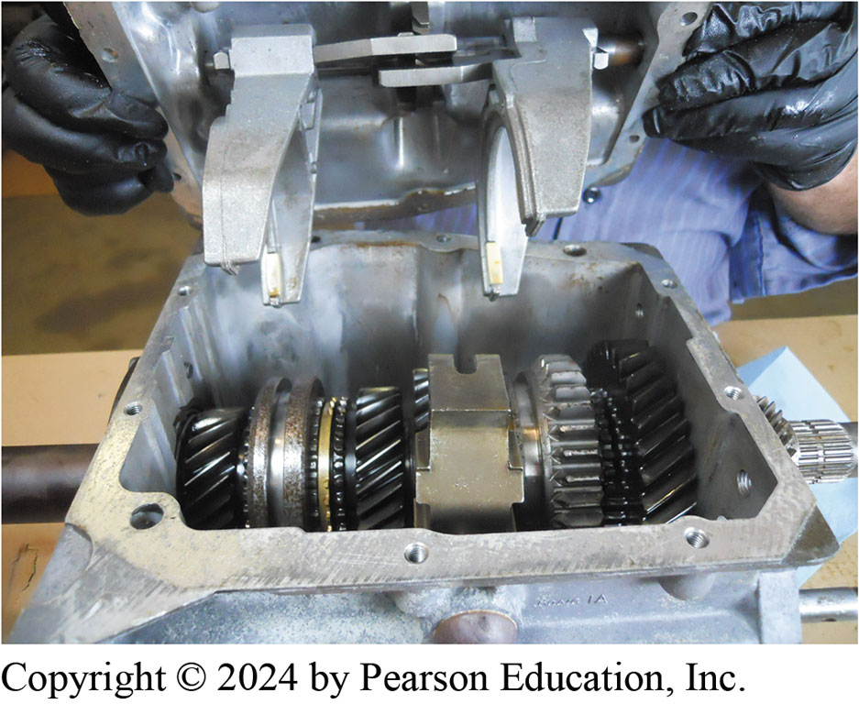
Figure 122.37 Shifter Cover Off
A Borg-Warner T5 five-speed transmission shown with the shifter cover removed.

Slide 64
Transaxle/Transmission Overhaul (1 of 3)
Typical Procedure
  Disassembly of unit
  Clean and identify unit
  Gear and bearing inspection
  Reconditioning of subassemblies
  Checking gear end float
  Unit is reassembled
  What wear items should be checked? Page 99
Notes:
The exact procedure for carrying out each of these steps will vary depending on the make and model. It is highly recommended that the procedure specified in service information be followed along with the clearances and torque specifications.
The following wear items are normally checked during disassembly:
■ The internal shift linkages for rough operation and wear
■ Clearance between all shift forks and sleeves
■ All shafts for excessive end play and rough operation
■ All floating gears for excess end float or rough rotation
■ All blocker rings for free motion and excessive or insufficient clearance or damaged lining
■ broken teeth

Slide 65
Transaxle/Transmission Overhaul (2 of 3)
What is included in a typical transmission/transaxle kit?
  See Page 100 of the text & next slide
Transaxle Disassembly
  Install holding fixture
  Remove drain plug and check fluid
  On some transaxles, differential bearing retainer, extension housing, and differential are removed first.
  On some transaxles, disassembly begins with removal of left side case cover, fifth-gear synchronizer assembly, and fifth counter gear.

Slide 66
Transaxle/Transmission Overhaul (3 of 3)
Service Information Specifies Disassembly Begin With
  Removal of backup light switch, reverse idler shaft retaining bolt, detent plunger retaining screw, interlock sleeve retaining pin, and fill plug.
  Remove case-to-clutch housing or end-cover-to-case attachment bolts.
  Remove shift mechanism, reverse idler gear, shaft
  Remove input and main shaft
  Remove ring gear and differential assembly

Slide 67
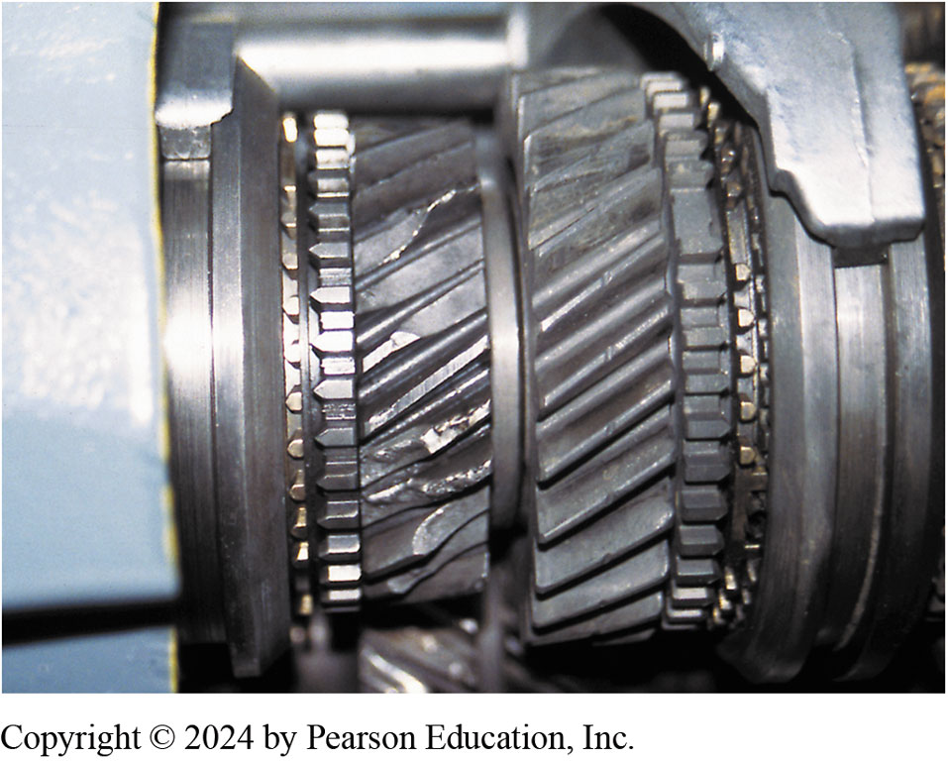
Figure 122.38 Damaged Gears
The cost to replace these gears may exceed the cost of a replacement transmission.
Notes:
Tech Tip Manual Transmission Service Tips
A wise technician once told a beginning technician to remember these items when working with transmissions:
• Always use a brass or plastic hammer when pounding on a steel or aluminum component.
If using a steel hammer, always use a brass or aluminum punch or place wood between the steel components and the hammer.
Many parts can be installed in either direction but usually only one way is correct.
If you are exerting a lot of force, you are probably doing something wrong.
Many drive train parts are pulled or pressed off and pressed or driven on.

Slide 68
Transmission Disassembly
Bearing Inspection
  Normally done by sight, feel, and sound
  Brinelling; Contamination; Electric arcing; Fretting; Misalignment; Peeling; Seizing; Spalling
Bearing Removal & Installation
  Inner races of bearing are often pressed onto shaft
  Pressing force should be transmitted to inner race.
  Main shaft disassembly
Notes:
Bearing Inspection
Immediately after cleaning an antifriction (ball, roller, or needle) bearing, it should be dipped in a clean, lightweight lubricant and covered to keep it clean and dust free. Inspection of a bearing is normally done by sight, feel, and sound. Visual inspection of a worn bearing can reveal a broken cage or pitted races. ● Figure 8–18.
Bearing damage occurs in many forms. The terms commonly used to describe bearing damage are as follows:
■ Brinelling: a series of indentations pressed or worn into a race
■ Contamination: scratches, pitting, or scoring in a scattered pattern on the ball or roller surfaces
■ Electric arcing: a series of small burn marks or grooves across the raceways
■ Fretting: small particles that decay and break off the bearing races
■ Seizing: caused when balls or rollers fail to roll and this causes damage to cage and end of rollers with evidence of excessive heat
■ Spalling: an advanced stage of decay with flaking away from the bearing race

Slide 69
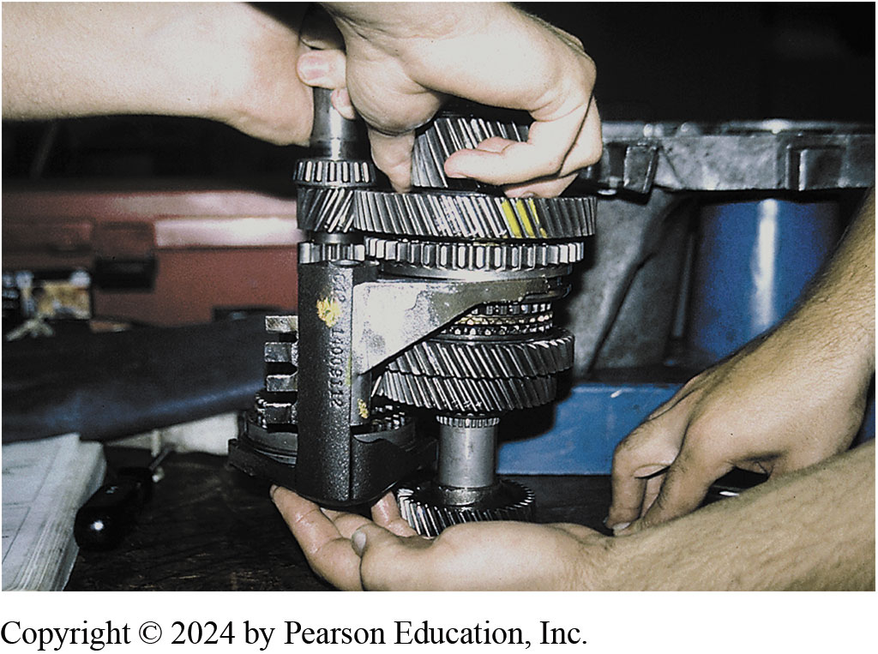
Figure 122.39 Two People Needed
It often requires two people to assemble a transaxle because the shaft with the shifter forks needs to be placed into the case as an assembly, as on this unit.

Slide 70
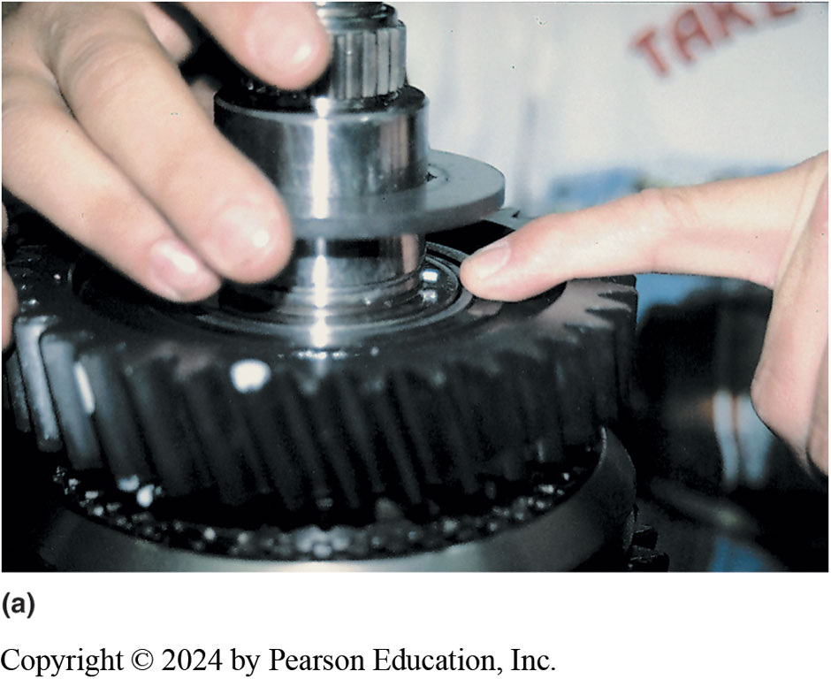
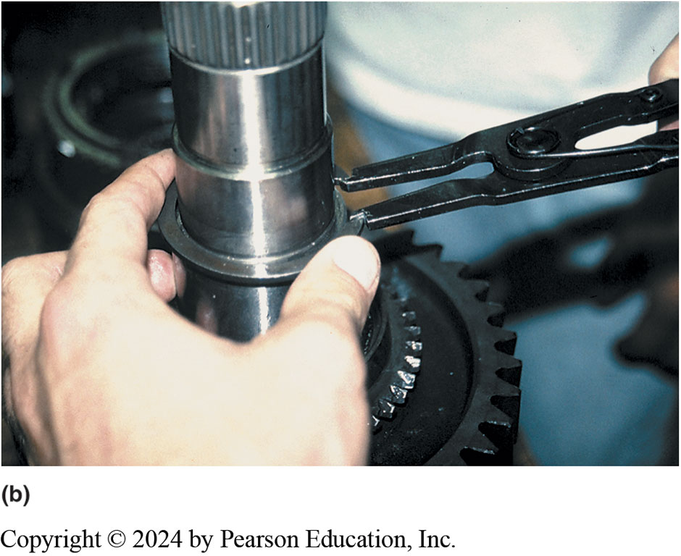
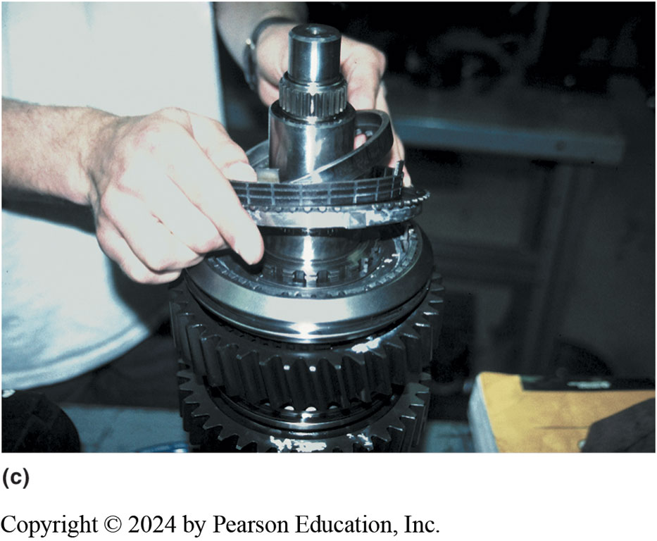
Figure 122.40 Snap Rings
During the disassembly of any manual transmission/transaxle, carefully check for the location of the snap rings. Often they are hidden. Consult service manual or unit repair manual for information and procedures for the unit being serviced. (b) Using snap-ring pliers to remove a snap ring. Many snap rings have an “up” side. Be sure to reinstall any snap rings in the correct direction. (c) After the snap ring is removed, some components can be simply lifted off main shaft, while other gears may require the use of a press.

Slide 71

Figure 122.41a Bearing Installation
Pressing Force
  Transmitted
  Only To Inner Race
(a) When a ball bearing is pressed off a shaft, the bearing should be supported by the inner race (if possible) so the force is not exerted on the outer race by the balls.
Notes:
Bearing Installation
The inner races of bearing are often pressed onto the shaft and the pressing force should be transmitted only to the inner race. Figure 122-41
Tech Tip: Heat or Cool for Best Results
When installing a tight-fitting bearing over a shaft, heat the bearing in an oven or hot oil. A temperature of 300° to 400°F (150° to 200°C)
will expand the bearing about 0.001 inch per inch of bearing diameter. If the external part cannot be heated, sometimes the internal part can be cooled to make it smaller. Parts can be chilled by placing them in a freezer or immersing them in a container with dry ice and acetone. Either of these methods can change a press fit into a slip fit.

Slide 72

Figure 122.41b Main Shaft Assembly
(b) Use caution when pressing parts onto the main shaft. Always follow the specified assembly procedures as found in service information.
.
Notes:
CASE STUDY: The Worn Shift Fork Mystery
A vehicle equipped with a manual transmission had
to be repaired several times for worn shift forks. Even
though the vehicle warranty paid for the repair, both
the customer and the service department personnel
were concerned about the repeated failures. All
technical service bulletins (TSBs) were checked to
see if there was an updated, improved shift fork. No
luck. Even the manufacturer’s technical assistance
personnel were unable to determine why the shift
forks were wearing out. After the third repair, the
service technician rode with the customer to see if
the cause could be determined. As the driver got
into the driver’s seat, she placed the handle of her
purse over the shifter on the floor and allowed the
purse to hang from the shifter. The technician asked
the owner if she always placed her purse on the
shifter and when she said yes, the technician knew
immediately the cause of the worn shift forks. The
purse exerted a force on the shifter all the time. This
force pushed the shift forks against the synchronizer
sleeve. Because the sleeve rotates all the time the
vehicle is in motion, the shift forks were quickly worn.
The service technician should have determined the
root cause of the problem after the first repair. The
customer agreed to find another location for her
purse so that the transmission problem would not
reoccur.
Summary:
Complaint—Driver complained of repeated transmission failures.
Cause—The root cause was found to be that the driver was hanging their purse over the floor shifter causing wear to occur to the shift forks.
Correction—The driver found another location for her purse.

Slide 73

Figure 122.42 End Play
End Play
  Free, lengthwise movement of shaft
  Measured using dial indicator
    or feeler gauge.
Dial indicator is set up to measure input shaft endplay as it is lifted and dropped using the prybar.

Slide 74
Preventive Maintenance
Normal Maintenance Operation Includes:
  Periodic check of the lubricant level
  Linkage/shifter adjustment
  Mount inspection or replacement as needed
  Visual inspection for leaks and other abnormal conditions
  Lubricant check
Notes:
In-vehicle service, also called on-vehicle service, in most cases is a normal maintenance operation
and includes the following:
Periodic check of the lubricant level
Linkage/shifter adjustment
Mount inspection or replacement as needed
Visual inspection for leaks and other abnormal conditions When a problem such as hard shifting occurs, the shift linkage is also be checked and readjusted, if necessary.
If possible, service and repair operations are done with the transaxle/transmission in the vehicle. Transmission removal and replacement (R&R) takes about 2.5 hours and trans- axle removal and replacement may take up to 5 hours. This varies greatly depending on the vehicle and the experience of the technician, but in any case, transmission/transaxle removal and replacement is time consuming.

Slide 75

Figure 122.43 Synchromesh Fluid
Some manual transmissions/transaxles require synchromesh transmission fluid.
Notes:
After the installation of the transmission/transaxle, the unit should be filled with the correct lubricant. The various lubricants, their general use, and their American Petroleum Institute (API) rating include
GL-1 Straight mineral oil
GL-2 Worm-type gear lubricant
GL-3 Mild-type EP lubricant (will not protect hypoid gears)
FIGURE 122–43 Some manual transmissions/transaxles
require synchromesh transmission fluid.
GL-4 EP-type lubricant (okay for manual transmissions/
transaxles)
GL-5 EP-type okay for hypoid gears and for Mil-L2150B (military)
Manual transmissions/transaxles require one of the following
lubricants:
■ SAE 80W-90 (GL-4) gear lube.
■ STF
(synchromesh transmission fluid), but with friction
characteristics designed for manual transmissions. ● SEE
FIGURE 122–43.
■ ATF (automatic transmission fluid).
■ Engine oil (usually SAE 5W-30).
CAUTION: Failure to use the specified manual transmission/
transaxle lubricant could cause hard shifting and possible
severe transmission damage.

Slide 76
Question 1 ?
2. The type of gears used in a transmission include ___________.
  a. spur gear
  b. helical gear
  c. external gears
  d. All of the above

Slide 77
Answer 1
2. The type of gears used in a transmission include ___________.
  a. spur gear
  b. helical gear
  c. external gears
  d. All of the above X

Slide 78
NV-1500 Transmission Service Photo Sequence

Slide 79

1. NV-1500
1. NV-1500 five-speed manual transmission is used in 2-wheel drive applications only.

Slide 80

2. Shifter Removed
2. The shifter assembly has been removed. Note roll pin in center of the shift lever socket.

Slide 81

3. Remove Snap Ring
3. Snap-ring pliers are being used to remove the snap ring retaining the input shaft bearing.

Slide 82

4. Case Separation
4. The upside down case is being separated showing the countershaft (top) and shift forks.

Slide 83

5. Remove Shift Roll Pin
5. Before further disassembly can be accomplished, the shift lever socket roll pin must be driven out using a punch and a hammer.

Slide 84

6. Shift Shaft Forks Removed
6. The shift shaft and forks can now be removed.

Slide 85

7. Reverse Idle Gear Removed.
7. The reverse idle gear is unbolted from the case and removed.

Slide 86

8. Output Shaft Assembly
8. The output shaft assembly fifth gear (far left) and the synchronizer assemblies.

Slide 87

9. Bearing Being Removed
9. The bearing is being removed using a bearing splitter and a hydraulic press.

Slide 88

10. Speed Gear
10. A speed gear (bottom) along with the double row needle bearing used between the shaft and speed gear. Hub (center) is splined & rotates with output shaft.

Slide 89

11. Synchronizer Reassembled
11. Synchronizer assembly being reassembled. It often takes several hands to hold hub (center) and sleeve (outer ring).

Slide 90

12. Reassemble Output Shaft
12. A hydraulic press is used to reassemble output shaft and bearing

Slide 91

13. Assembled Output Shaft
13. The assembled output shaft is held against the counter shaft to double check that all of the gears have been correctly assembled.

Slide 92

14. Output Shaft/Counter Shaft
14. The assembled output shaft and counter shaft are being reinstalled in the transmission case.

Slide 93

15. Case Halves Bolted Together
15. The case halves are bolted together.

Slide 94

16. Assembly Shift Lever
16. The last step is to assembly the shift lever and check for proper operation in all gear positions.

Slide 95
NV-350 Transaxle Service Photo Sequence

Slide 96

1. Place Transaxle On Work Surface
1. After transaxle has been removed from the vehicle and fluid drained, place transaxle on a work surface.

Slide 97

2. Bell Housing Case Half
2. Bell housing case half containing the large output shaft front bearing (center) and the input shaft front bearing (smaller bearing on left).

Slide 98

3. Differential Lifted Out
3. The differential assembly is simply lifted out of half of the case.

Slide 99

4. Input/Output Shafts Press Fit
4. The input and output shafts are a press fit into the bearings and are also retained with a snap ring, which must be removed.

Slide 100

5. Input/Output Shafts Pressed Out
5. Using a special tool, the input and output shafts are pressed out of the housing using a hydraulic press.

Slide 101

6. Input Shaft Disassembled
6. The input shaft can be disassembled using a bearing splitter and a press, or 2 screwdrivers to pry gears off shaft.

Slide 102

7. Brass Synchronizer Rings
7. This transaxle uses both brass and powdered metal synchronizer rings with a fiber (paper) inner cone surface.

Slide 103

8. Synchronizer Ring Gaps
8. Synchronizer ring gaps are being measured using a feeler (thickness) gauge. The factory specifications are usually 0.040 to 0.069 inches.

Slide 104

9. Clutch Inspected For Wear
9. The gear clutch teeth should be inspected for wear.

Slide 105

10. Assembled Synchronizer
10. An assembled synchronizer assembly containing a sleeve, keys, springs, and detent.

Slide 106

11. Input Shaft/Output Shaft
11. The input shaft (left) and the output shaft (right) are checked for proper assembly before being installed into the case.

Slide 107

12. Differential Bearing Preload
12. The differential bearing preload is determined by measuring for zero end play; then adding the thickness shim under the bearing cup.

Slide 108

13. Bearing Cup Being Installed
13. The bearing cup is being installed using an installation tool and a hammer.

Slide 109

14. Shift Forks/Shift Arms Aligned
14. All of the shift forks and shift arms must be aligned properly before installing the components into the case.

Slide 110

15. All Components Installed
15. All components, including differential (right), output shaft (center), & input shaft (left), plus shift linkage are installed and checked for proper positioning.

Slide 111

16. Case Halves Reinstalled
16. Case halves being reinstalled. The bearings (top) must be pressed back onto the input and output shafts using a press.

Slide 112

17. Bell Housing Reattached
17. The bell housing case being reattached.

Slide 113

18. Assembly Completed
18. The completed assembly. Notice the bearing cover (top) has already been installed

Slide 114
Additional Transmission and Transaxle Animations

Slide 115

Animation: 5-Speed Transmission, 1st Gear
(Animation will automatically start)

Slide 116

Animation: Transmission 2nd Gear
(Animation will automatically start)

Slide 117

Animation: Transmission 3rd Gear
(Animation will automatically start)

Slide 118

Animation: 5 Speed Transmission, 4th Gear
(Animation will automatically start)

Slide 119

Animation: 5 Speed Transmission: 5th Gear
(Animation will automatically start)

Slide 120

Animation: Transaxle: 1st Gear
(Animation will automatically start)

Slide 121

Animation: Transaxle, 2nd Gear
(Animation will automatically start)

Slide 122

Animation: Transaxle, 3rd Gear
(Animation will automatically start)

Slide 123

Animation: Transaxle, 4th Gear
(Animation will automatically start)

Slide 124

Animation: Transaxle, 5th Gear
(Animation will automatically start)

Slide 125
Manual Drive Train and Axles Videos and Animations
Videos Link: (A3) Manual Drive Train Axles Videos
Animations Link: (A3) Manual Drive Train Axles Animations

Slide 126
Copyright
This work is protected by United States copyright laws and is provided solely for the use of instructors in teaching their courses and assessing student learning. Dissemination or sale of any part of this work (including on the World Wide Web) will destroy the integrity of the work and is not permitted. The work and materials from it should never be made available to students except by instructors using the accompanying text in their classes. All recipients of this work are expected to abide by these restrictions and to honor the intended pedagogical purposes and the needs of other instructors who rely on these materials.

