Slide 1

Automotive Technology: Principles, Diagnosis, and Service
Seventh Edition
Chapter 121
Clutches
Copyright © 2023 Pearson Education, Inc. All Rights Reserved
Notes:
INSTRUCTOR NOTE: This presentation includes text explanation notes, you can use to teach the course. When in SLIDE SHOW mode, you RIGHT CLICK and select SHOW PRESENTER VIEW, to use the notes.

Slide 2
Learning Objectives (1 of 1)
121.1 Explain the purpose and function of a clutch.
121.2 Discuss clutch discs.
121.3 Discuss pressure plates.
121.4 Discuss flywheels.
121.5 Discuss dual-mass flywheels.
121.6 Discuss pilot bearings.
121.7 Describe clutch pedal linkages including hydraulic clutch systems..

Slide 3
Learning Objectives (1 of 2)
121.8 Discuss release (throwout) bearings.
121.9 Discuss clutch pedal switches.
121.10 Explain the diagnosis of common clutch problems, recommend the proper repair procedures, and explain how to remove and replace a clutch assembly.

Slide 4
Clutch Purpose & Function
Clutch located between engine & transmission/transaxle.
  Disconnect engine power from transmission/transaxle
  Permit engine to remain running vehicle is stopped in gear
  Permit transmission/transaxle to be shifted.
  Dampen and absorb engine power impulses & drive train vibration
  Provide a smooth engagement and disengagement of torque
Notes:
Clutch assembly is located between the engine & transmission/transaxle.
To disconnect engine power from the transmission/transaxle to permit the engine to remain running when vehicle is stopped with the transmission in gear and to permit the transmission/transaxle to be shifted.
Connect and transmit engine torque to the transmission/transaxle
Dampen and absorb engine power impulses and drive train vibration
Provide a smooth engagement and disengagement of torque between the engine and the transmission/transaxle.

Slide 5
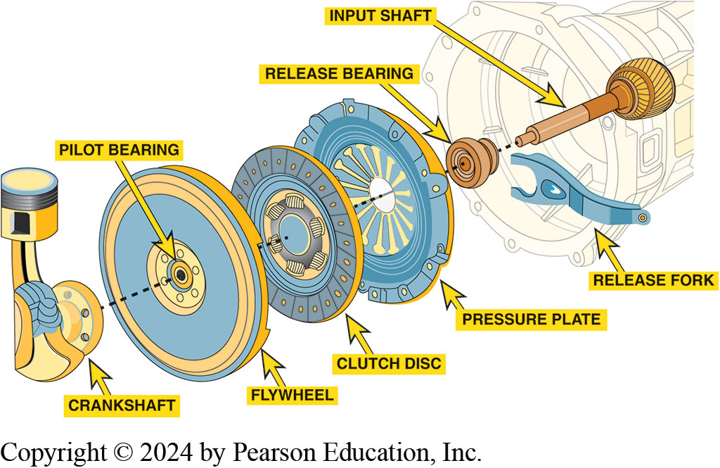
Figure 121.1 Clutch Assembly
Clutch disc splined to input shaft of transmission/transaxle
Depress clutch pedal, release bearing, forced against diaphragm spring
Release Clutch
Typical automotive clutch assembly showing all related parts
Notes:
A clutch assembly consists of a clutch disc that is splined to the input shaft of the transmission/transaxle. When the driver depresses the clutch pedal, a release bearing, also called a throwout bearing, is forced against the diaphragm spring , part of the clutch cover assembly. This lifts the pressure plate releasing the clutch disc. The clutch cover assembly is bolted to and rotates with the flywheel. ● Figure 121–1
Purpose & Function
Disconnect engine power from the transmission/transaxle to permit engine to remain running when vehicle is stopped with transmission in gear and to permit the transmission/transaxle to be shifted.
Connect and transmit engine torque to the transmission/transaxle
Dampen and absorb engine power impulses and drive train vibration
Provide a smooth engagement and disengagement of torque between the engine and the transmission/transaxle.

Slide 6
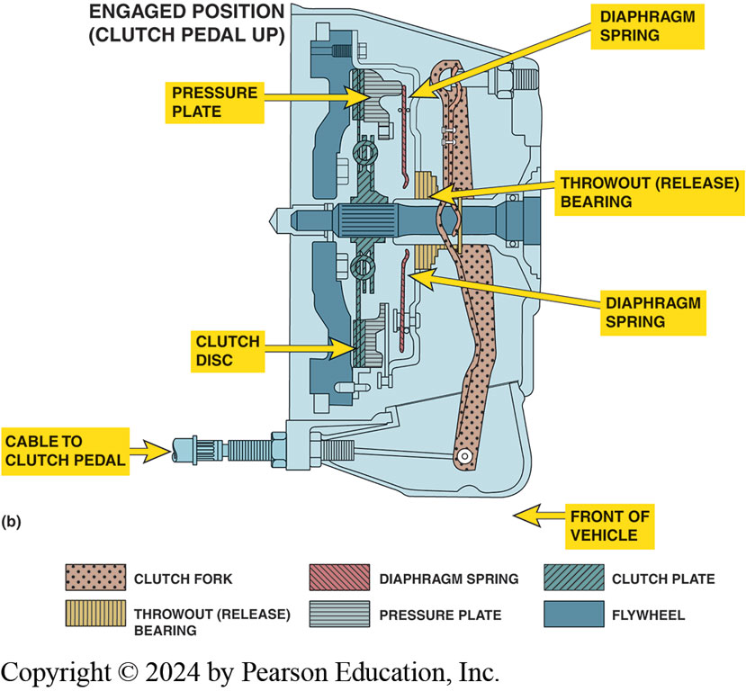
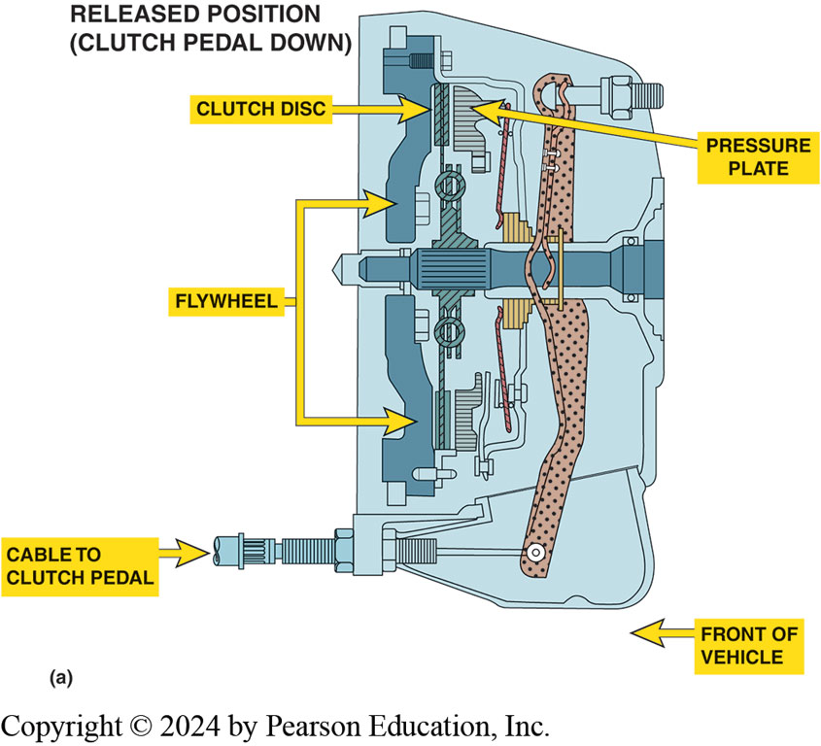
Figure 121.2 Clutch Operation
(a) When the clutch is in released position (clutch pedal depressed), clutch fork is applying a force to throwout (release) bearing, which pushes on diaphragm spring, releasing pressure on the friction disc. (b) When clutch is in the engaged position (clutch pedal up), the diaphragm spring exerts force on the clutch disc, holding it between the flywheel and the pressure plate.
Notes:
When force is exerted on the center of the diaphragm spring by the release bearing, the applied force is released from the clutch disc that had been squeezed between the engine flywheel and the pressure plate.
With the pressure removed from the clutch disc, engine can be operated without transferring torque to transmission/transaxle. Using a clutch also permits transmission/transaxle to be shifted easily because a shift cannot be made easily if the transmission/transaxle is transferring engine torque.
When the driver releases force on the clutch pedal, pedal return spring and the diaphragm spring combine to return the clutch pedal to its at-rest position (clutch engaged position).
When the clutch pedal moves up, the pressure on the release bearing is released and the force against the pressure plate diaphragm spring is released allowing the spring force of the pressure plate to clamp the Clutch disc tightly between the flywheel and pressure plate. ● Figure 3–2.

Slide 7
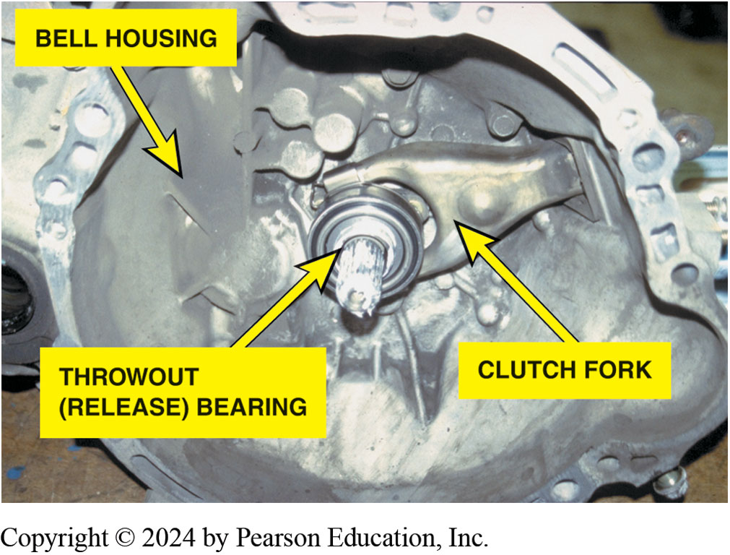
Figure 121.3 Transaxle Removed
The transmission has just been removed. Note that this type of transmission incorporates the bell housing, which was removed at the same time as the transmission. The clutch fork and throwout (release) bearing also came off
together. All that remained attached to the engine was the flywheel, clutch disc, and pressure plat

Slide 8
Clutch Discs
Clutch discs transfer engine torque
From flywheel to input shaft of transmission/transaxle.
Connects flywheel and pressure plate when clutch is engaged…
Pressure plate spring exerts spring pressure
Against disc and forces it against flywheel.
How do you assemble the hub and dampener?
Notes:
Clutch Facing Material
The clutch friction material must be able to withstand the heat generated by the friction during engagement and disengagement. Older clutch friction discs used a mixture of either molded or woven asbestos with various filler and binder materials. Asbestos is nearly ideal friction material for brake lining and clutch facing because it has a very good coefficient of friction, excellent heat characteristics, and low cost. However, the possibility of technicians getting cancer from inhaling asbestos fibers has greatly reduced its use. Asbestos was replaced with fiberglass, aramid nonmetallic compounds and/or metallic materials to obtain the desired friction and wear characteristics. Some of the materials used include:
Powdered iron
Copper
Graphite
Ceramics

Slide 9
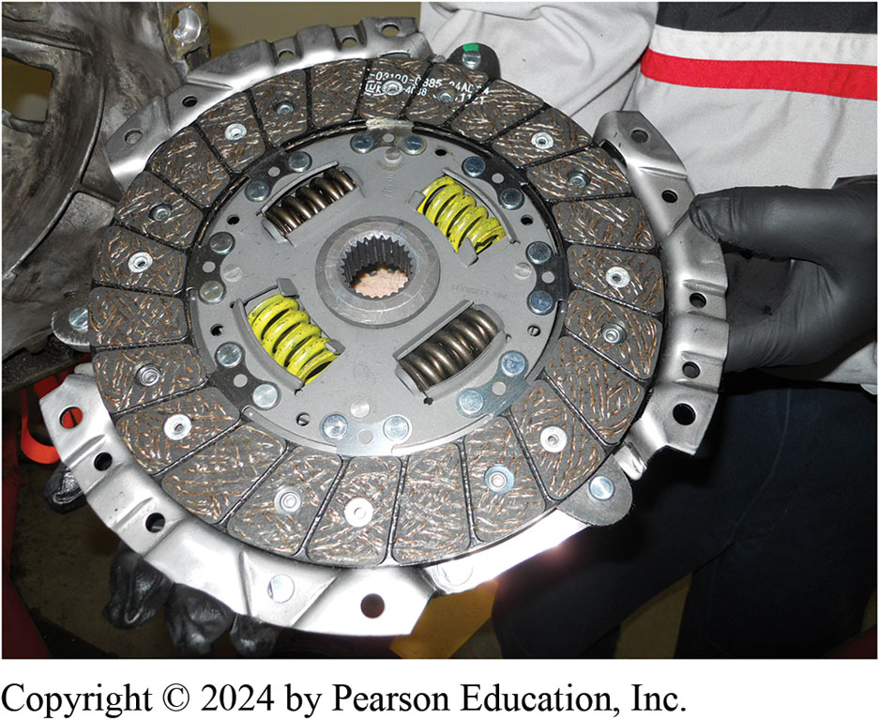
Figure 121.4 Clutch Disc
Overheating Effects
  Torque Lowered
  Slippage
  Binding failure
Surface Grooves
  Wipe Dust
  Keep cool
  Prevent sticking
A replacement clutch is designed to meet the same friction specifications of the original so the new clutch will operate like new.
Notes:
The wear rate and coefficient of friction of nonmetallic facings is greatly affected by temperature, Figure 121-4.
If facing is overheated, its capacity to transmit torque is lowered, and this will probably cause slippage and more heat.
As temperature increases, binders holding facing material together will lose their strength, greatly increasing the clutch disc wear rate.
Surface Grooves
Most nonmetallic facings have a series of radial grooves cut across their surface.
Wipe dust and dirt from the surfaces of the flywheel and pressure plate
Allow airflow to help cool the friction surfaces
Prevent a vacuum that might cause the friction surfaces to stick together during disengagement. Sticking during disengagement will cause clutch drag.
■ Some metallic discs have a series of radial slots cut
across the facing which allows the disc to expand
without warping when it gets hot.

Slide 10
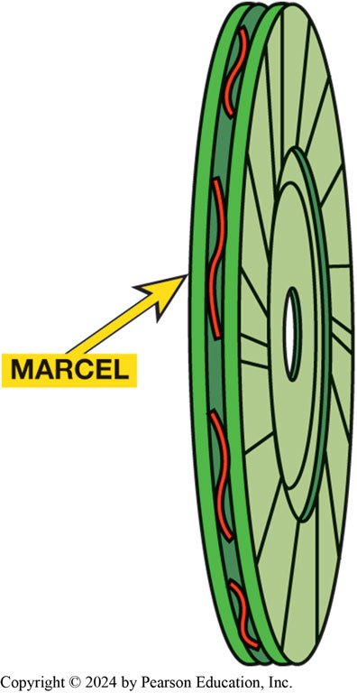
Figure 121.5 Marcel Springs
Marcel Spring
  Space between friction surfaces
  Wavy cushion spring
  Absorb initial shock of rapid engagement
  Prove Smooth Engagement
A marcel is a wavy spring that is placed between the two friction surfaces to cushion the clutch engagement.

Slide 11
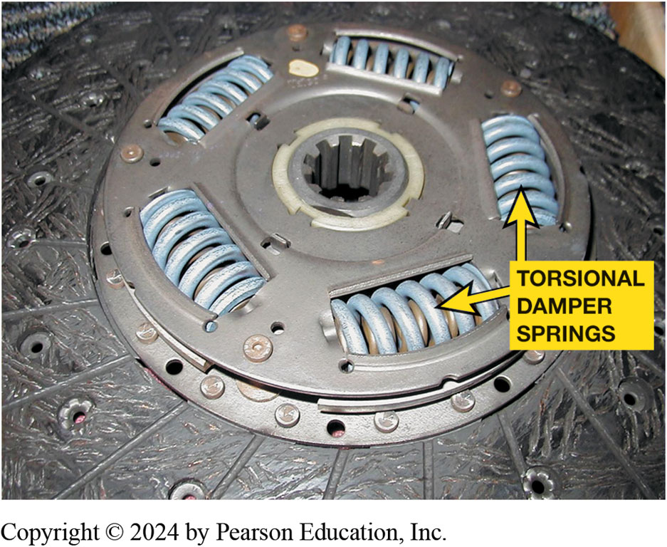
Figure 121.6 Hub & Torsional Damper
Torsional Damper Springs
  Reduce vibrations
  Reduce gear rattle
  Reduce noise
A typical stock clutch friction disc that uses coil spring torsional dampers.
Notes:
Hub & Dampener Assembly
The clutch hub has internal splines (from 10 to 26 teeth) that slide on the external
splines of the transmission input/clutch shaft. Each time clutch is engaged, the disc must slide forward slightly to contact the flywheel, and it must slide back to prevent drag on the flywheel when the clutch is disengaged. Around the center hub of the clutch disc are torsional dampers that are coil springs or rubber plugs that help dampen engine firing pulses from being transmitted into and
through the transmission/transaxle. ● Figure 121–6.
An engine produces uneven power impulses that cause torsional vibration. The torsional damper reduces the torsional vibrations that result from the uneven engine power impulses from the rest of the drivetrain.
As an engine goes through its power cycle, crankshaft will speed up and slow down during each revolution.
If these slight speed fluctuations are not removed by the damper, they could cause “gear rattle,” vibration, noise, and increased wear.
The damper assembly is composed of the hub with 4-8 openings, with one or more springs for each extension, a spring washer, and a friction washer. These parts are fitted between the web of the disc and a metal retainer and are held together by a series of rivets called stop pins, which also keep the hub from revolving too far, usually about 0.037 inch (9.5 mm). The damper springs are positioned by a
series of windows in the web and retainer. The torque must pass through the damper springs on its way from the engine to the transmission, and any power impulses that tend to speed up the clutch hub will compress the springs. The springs will re-extend when there is a torque lag.

Slide 12
Pressure Plates
Exerts force on clutch disc
Torque transmitted from engine to transmission/ transaxle.
Strong clamping force provided by pressure plate spring(s).
What are different styles of pressure plates?
What are advantages of a diaphragm-type clutch?
What is a: pressure plate ring?
  Cover (hat)?
  Release lever?
  Double disc clutch?
Notes:
COMPONENT PARTS The pressure plate assembly is a combination of:
Cover (also called a hat),
Pressure springs or diaphragm spring,
Release levers (also called fingers) on coil spring types, and
Cast iron pressure ring (driving plate) that contacts the friction disc.
PRESSURE PLATE STYLES
A coil spring pressure plate uses coil springs and 3 or 4 release levers. A coil-spring-style pressure plate is also
called the lever style because it uses levers to compress oil springs. This type of pressure plate is often called a
“three-finger” pressure plate. ● SEE FIGURE 121–7.
Two styles of coil-spring style are the following:
Borg and Beck: uses a round closed cover with 3 wide stamped-steel release levers and up to 12 springs with six evenly spaced mounting holes.
Long: uses a triangle-shaped cover with three narrow, forged-steel release levers, which extend through the cover and often have weights on them. This style also use 9 springs and has mounting bolt holes in three groups of two.

Slide 13
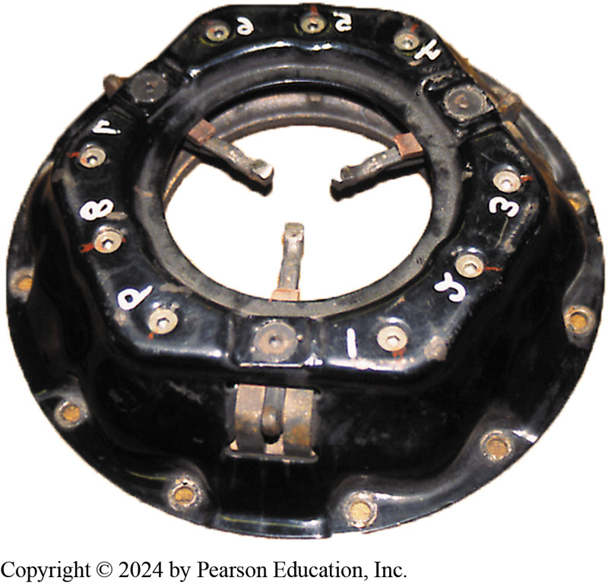
Figure 121.7 Coil-Type Pressure Plate
A coil spring (lever style) clutch pressure plate.

Slide 14
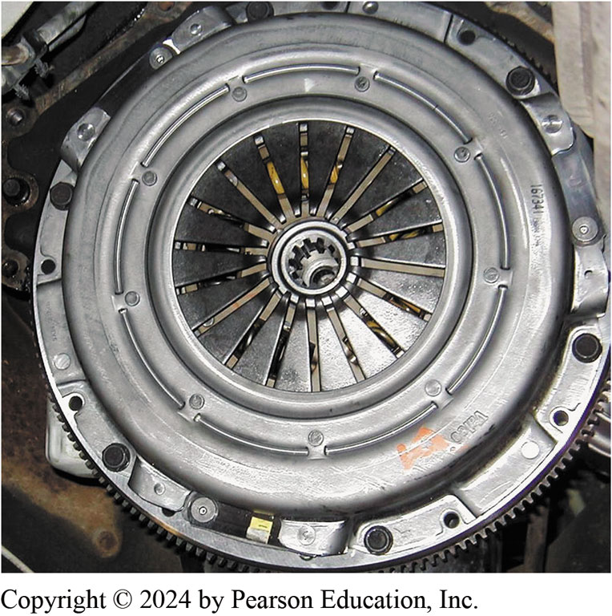
Figure 121.8 Diaphragm Spring Style
Diaphragm Pressure Plate
  Most Common
  Belleville Spring
Advantages
  Smaller lighter
  Reduced pedal pressure
Typical diaphragm-style pressure plate that uses a Belleville spring.
Notes:
A diaphragm spring style is the most commonly used pressure plate design. It uses one large, round, spring, called
a Belleville spring, to apply an even force on the clutch disc. The relatively low height of the diaphragm design is highly
favored for transverse engine vehicles where engine and transaxle lengths are critical. ● SEE FIGURE 3–8.
Advantages:
Smaller assemblies, weigh less, and have fewer parts than coil spring assemblies. The one-piece diaphragm spring does the job of all the release levers and coil springs in a coil spring clutch.
Push harder on the clutch pedal to disengage a coil spring clutch than to disengage a comparable diaphragm spring design. The pedal effort for a coil spring clutch increases the farther down the pedal is pushed.
Decreased pedal effort for a diaphragm spring clutch decreases during the second half of pedal travel. As the friction disc wears, coil springs expand and lose some of their clamping force. In contrast, the design of the diaphragm spring tends to increase its clamping force as the friction disc wears to half its original thickness. Then, as the friction disc continues to wear, the clamping force of the spring gradually returns to its original level. This happens without any obvious change in clutch pedal effort.

Slide 15
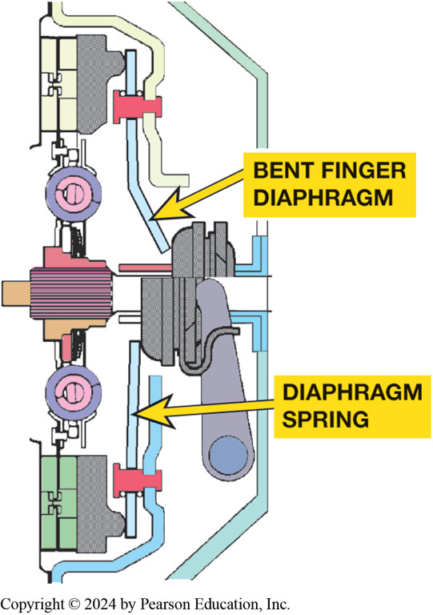
Figure 121.9 Bent-Finger Diaphragm
A bent finger diaphragm clutch. The shape of the fingers keeps the fingers and release bearing from going past center during clutch release.

Slide 16
Flywheels
Characteristics
  Smooth out or dampens engine power pulses.
  Absorbs some of heat created by clutch operation.
  Provides connection point for starter motor to rotate engine.
  Provides friction surface for clutch friction disc.
  What is inertia?
  What are stepped flywheels?
Notes:
Stepped Flywheel
Some manufacturers use a stepped flywheel. These are combined with a pressure plate that has either a flat or almost flat cover. Stepped flywheels have more of the mass at the outer edge, which increases the rotational inertia. ● SEE FIGURE 3–13.
Inertia
Newtons First Law of Motion: An object in motion, tends to stay in motion and an object at rest tends to say at rest.

Slide 17
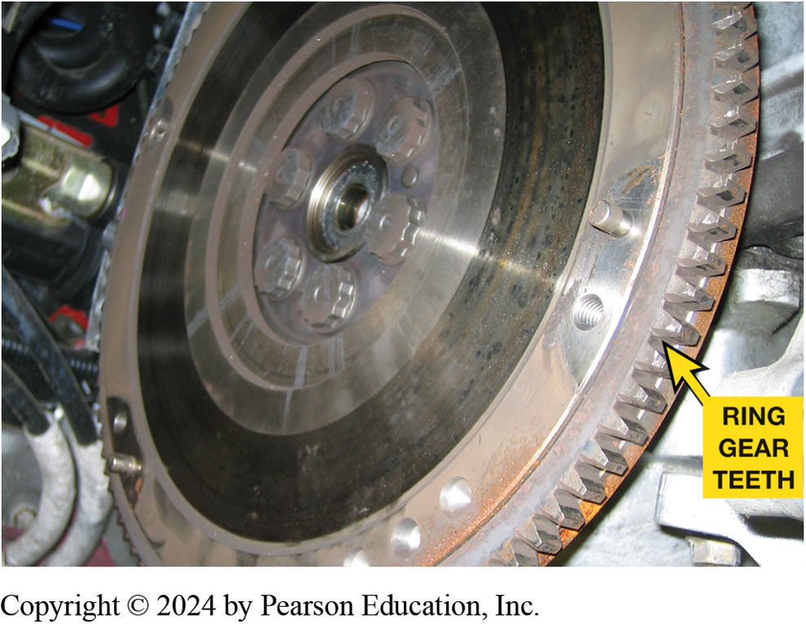
Figure 121.10 Ring Gear
Ring gear, which is attached to outer rim of flywheel, provides teeth needed to mesh with the starter pinion gear

Slide 18
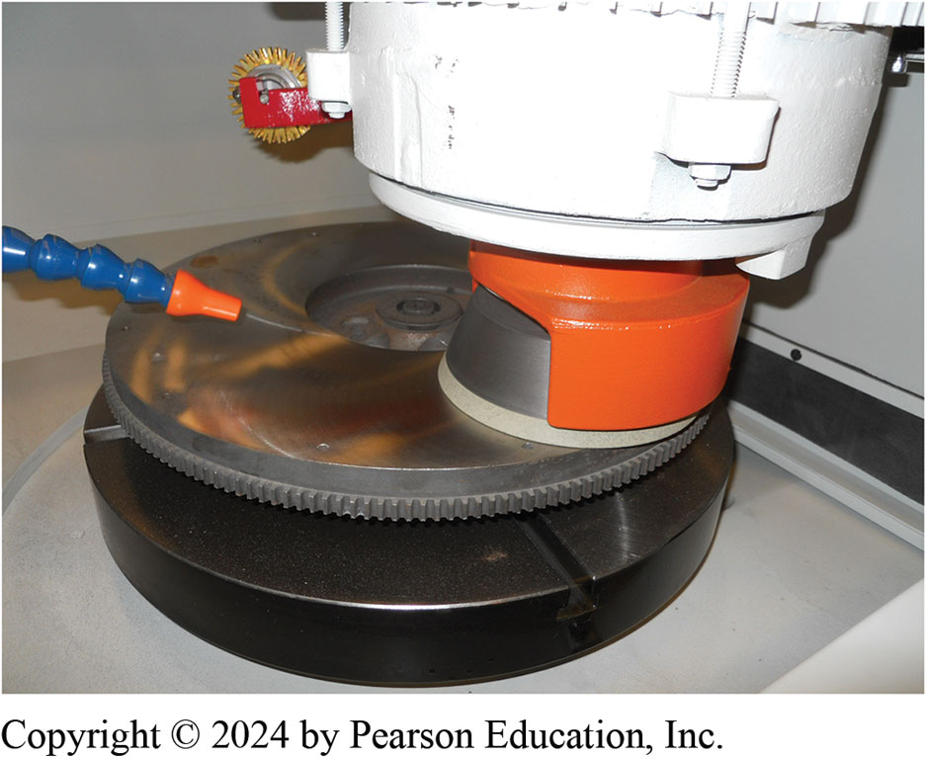
Figure 121.11 Flywheel Resurface
A flywheel being machined (ground) to provide the correct surface finish for the replacement clutch disc.
Notes:
Construction
The flywheel is constructed of cast iron and attaches to the end of the engine crankshaft. The carbon content of the cast iron (about 3%) provides a suitable surface for the clutch disc. The carbon, in the form of graphite, acts as a lubricant to help provide a smooth engagement of the clutch. The face on the transmission side of the flywheel has a smooth, machined area that creates the application surface for the clutch friction disc. This surface must be properly finished to allow adequate slippage as the clutch engages and disengages, and to prevent slippage when the clutch is engaged. Being made from cast iron makes resurfacing easy. ● figure 121–11

Slide 19
Dual-Mass Flywheel
Starter ring gear mounts on the primary flywheel.
Power from starter motor does not have to flow through damper assembly
To reach engine crankshaft.
Pilot bearing is also attached to primary flywheel.
Clutch friction surface is usually on secondary flywheel.
Notes:
Some vehicles, especially high-performance vehicles and vehicles equipped with diesel engines, use a dual-mass flywheel. The purpose of a dual-mass flywheel is to dampen engine vibrations and keep them from being transmitted to the passenger compartment through the transmission and shift linkage.
NOTE: If the dual-mass flywheel fails, the symptom is the same as a slipping clutch. The torque-limiting friction material connecting the primary and secondary flywheels can fail. This failure requires the replacement of the flywheel assembly.

Slide 20
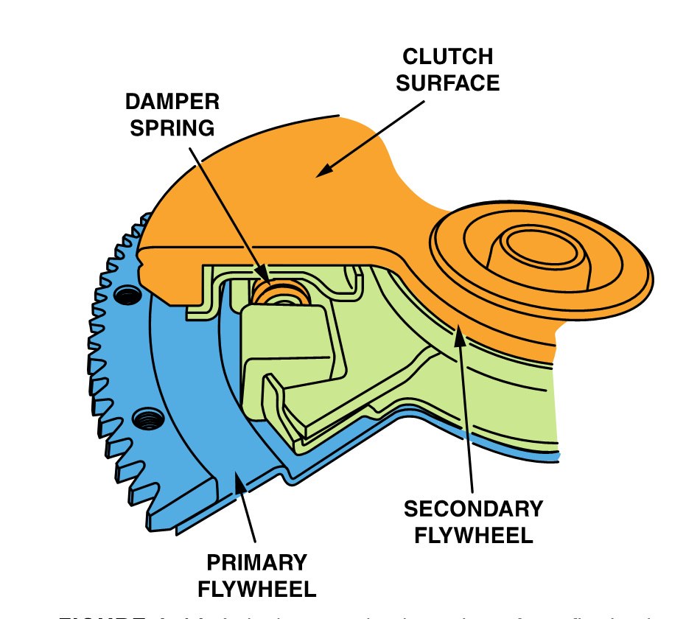
Figure 121.12 Dual-Mass Flywheel
A dual-mass wheel consists of two flywheels connected between with a spring to help absorb engine pulsations

Slide 21
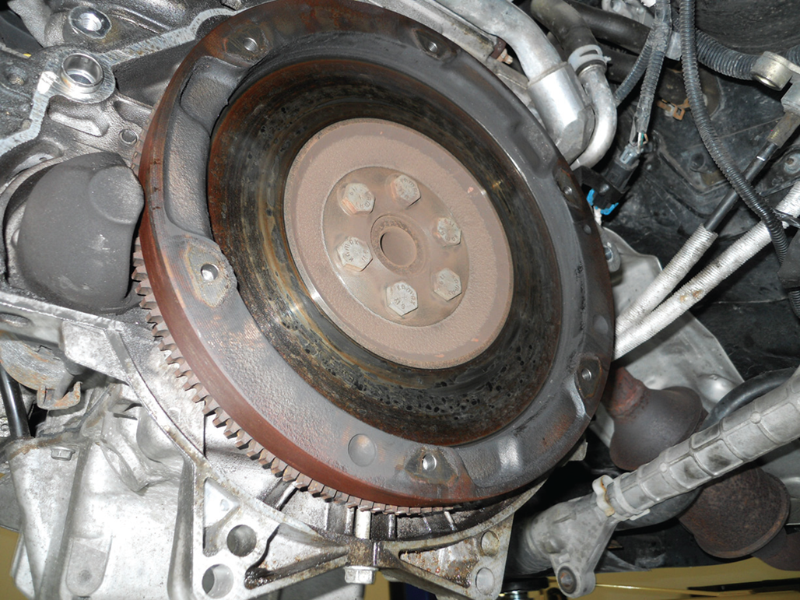
Figure 3.13 Stepped Flywheel
A stepped flywheel has more mass on the outer edge which helps smooth out impulses from a 4-cylinder engine especially at idle speed

Slide 22
Pilot Bearings
Engine end of a transmission input (clutch) shaft
Supported by pilot bearing pressed into end of crankshaft.
Need for pilot bearing
Construction: How can pilot bearings be constructed?
How do pilot bearings operate?
Notes:
Purpose & Function
The engine end of a transmission input (clutch) shaft is supported by a pilot bearing that is
Pressed into the end of the crankshaft.
Pilot Bearing
The transmission input shaft goes all the way from the transmission, through the clutch assembly, to the engine. Transmission bearings support the transmission end of the shaft. The pilot bearing or bushing supports it at the engine end. FWD vehicle has a transaxle with an input shaft supported by a pair of bearings and a short input shaft which may not reach all the way to the flywheel. This design does not need a pilot bushing or bearing to support the engine end of the input shaft.
Construction
Pilot bearings can be constructed using:
Sintered Bronze Oilite Bushing
Needle Bearing
Ball Bearing.

Slide 23
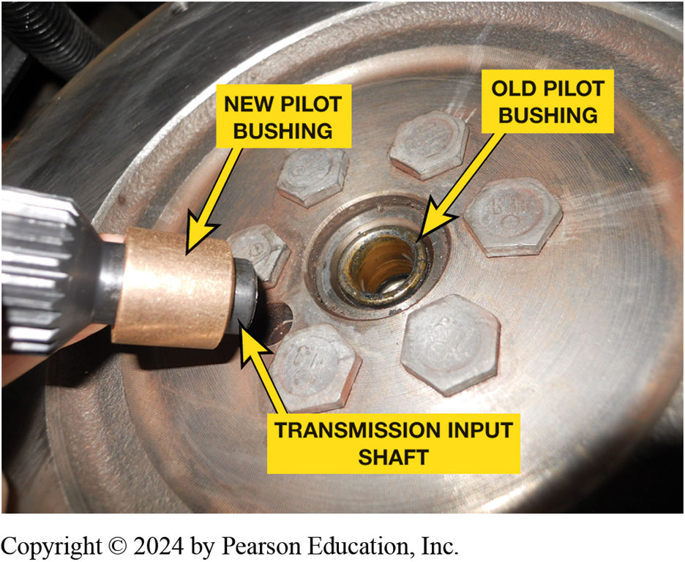
Figure 121.13 Pilot Bearing Installation
A pilot bearing or bushing, such as one being used on the rear-wheel-drive pickup truck, is pressed into the end of the engine crankshaft and supports the input shaft of the transmission.

Slide 24
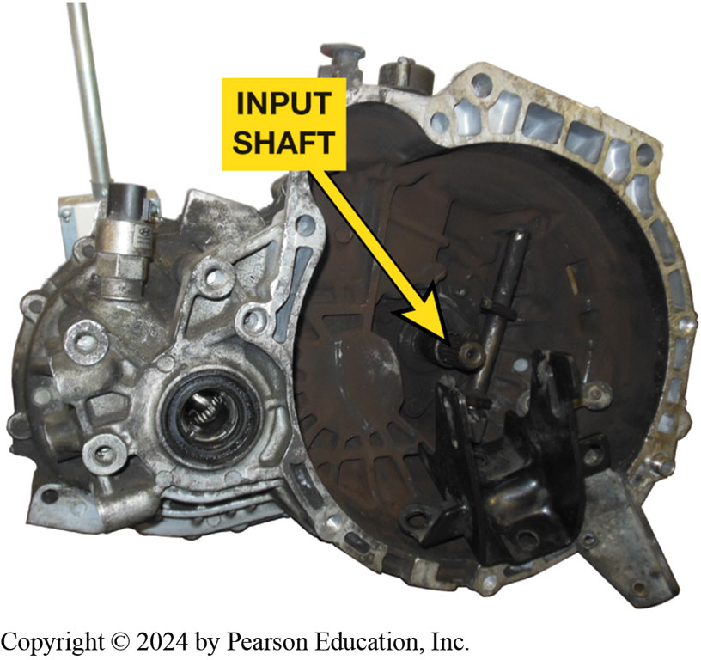
Figure 121-14 Manual Transaxle
A manual transaxle assembly showing the short input shaft

Slide 25
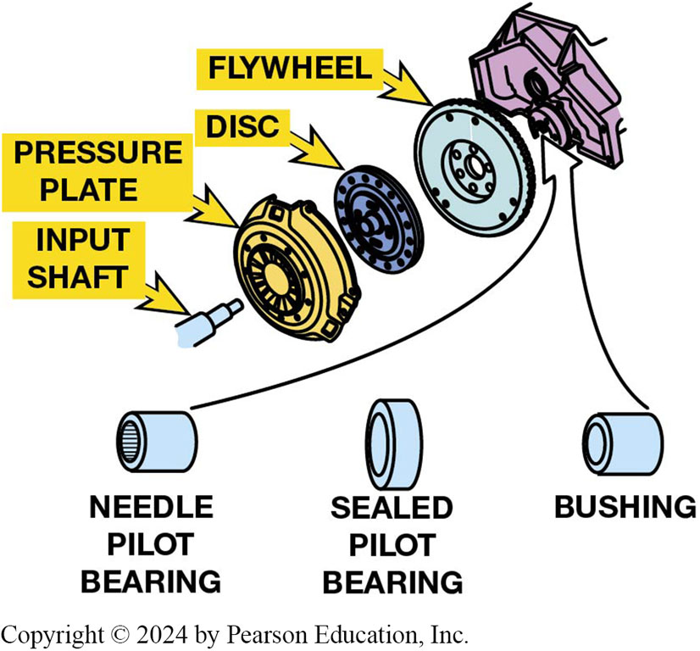
Figure 121.15 Pilot Bearing
Pilot bearings (bushings) are made in several different designs depending on the application.

Slide 26
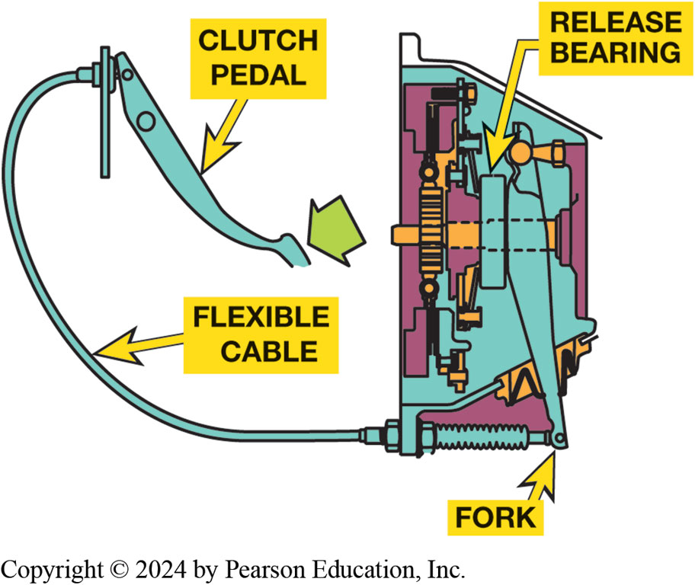
Figure 121.16 Clutch Cable Type
A typical cable operated clutch mechanism uses two springs. One at the pedal assembly is used to return the clutch pedal after it is depressed and the other is located at the fork to return the throwout bearing fork to thee clutch applied (pedal up) position.
Notes:
Clutch Linkage
3 methods of transferring the force of driver’s foot to the release (throwout) bearing; they are the following:
Levers and rods. Mechanical linkage uses a series of levers and rods, to move the release fork against the throwout bearing. This method was commonly used in older vehicles. If a change in direction is needed, bell cranks, commonly called an equalizer bar (also known as a Z-bar) are mounted on pivot shafts to reverse the direction of the force.
Cable operation. A cable is used similar to a brake cable used on a bicycle. Cable linkage consists of a steel cable attached to the clutch pedal. The clutch cable is routed to the engine/bell housing, where it can pull on the clutch fork/lever. Much of the cable is enclosed in a housing or conduit so that it can be routed around corners or obstacles. Although simple and inexpensive, cables have a drawback in that they develop internal friction through time, which makes them harder to operate. ● Figure 121–16.
Hydraulic. A small clutch cylinder is located on the bulkhead and operated by the clutch pedal and an actuator cylinder located near the release (throwout) bearing is a very common method of connecting the clutch pedal to the release fork on vehicles equipped with a manual transmission. ● SEE FIGURE 121–20.

Slide 27
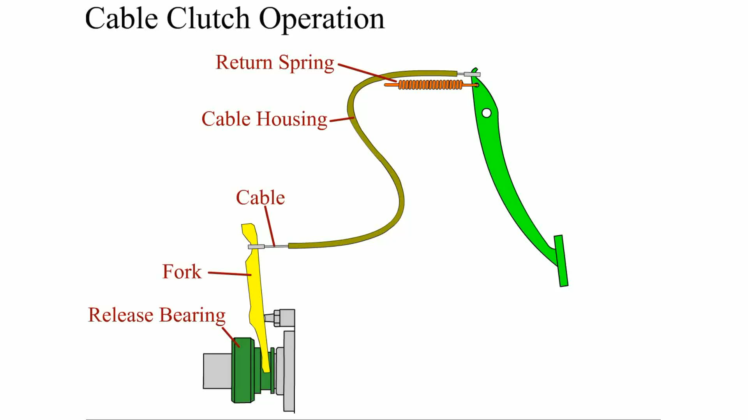
Animation: Cable Clutch Operation
(Animation will automatically start)

Slide 28
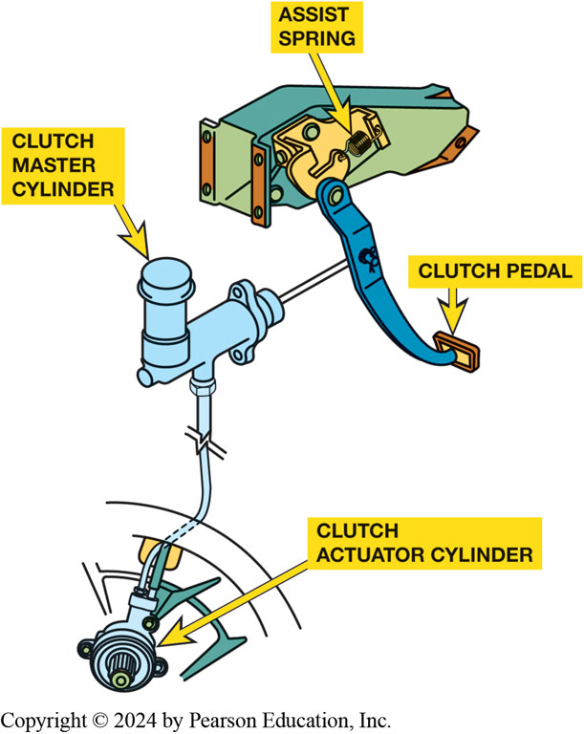
Figure 121.17 Hydraulic Clutch
Hydraulic fluid is used to transmit force and motion from the clutch pedal to the clutch actuator cylinder.
Notes:
Hydraulic Clutch Operation
A hydraulic system transmits force using a fluid and is the most commonly used clutch operating system. Liquids cannot be compressed, and if a force is put on liquid at one end of a passage, liquid at the other end of the passage will exert the same force. In a hydraulic clutch system, the input piston is located in the clutch cylinder and is connected to the clutch pedal. The output piston is located in the actuator cylinder, and operates the release bearing directly or through a clutch fork/lever. The clutch cylinder and actuator cylinder pistons are connected by metal, reinforced rubber, or plastic tubing.
When the clutch pedal is depressed, the clutch cylinder piston forces fluid through the tubing to actuator cylinder, where the pressure forces the actuator cylinder piston to move the clutch fork/lever.
When the clutch pedal is up, the pressure plate forces the actuator cylinder piston to return fluid to master cylinder.
When the clutch pedal is up, a compensating port in the clutch cylinder is opened up between the cylinder bore and the fluid reservoir.
Port allows for fluid expansion or contraction due to temperature changes, for any air to leave the fluid, and in many cases, for self-adjustment for disc wear.
Because air can be compressed, any air trapped in a hydraulic system will cause mushy, spongy pedal, or incomplete operation. DOT 3 brake fluid is generally used in clutch hydraulic systems.
Many systems use an actuator cylinder that is concentric to the bearing retainer and has the release bearing connected directly to it. Some vehicles use an actuator cylinder that is mounted on the exterior of the bell housing. SEE FIGURE 121–17.

Slide 29
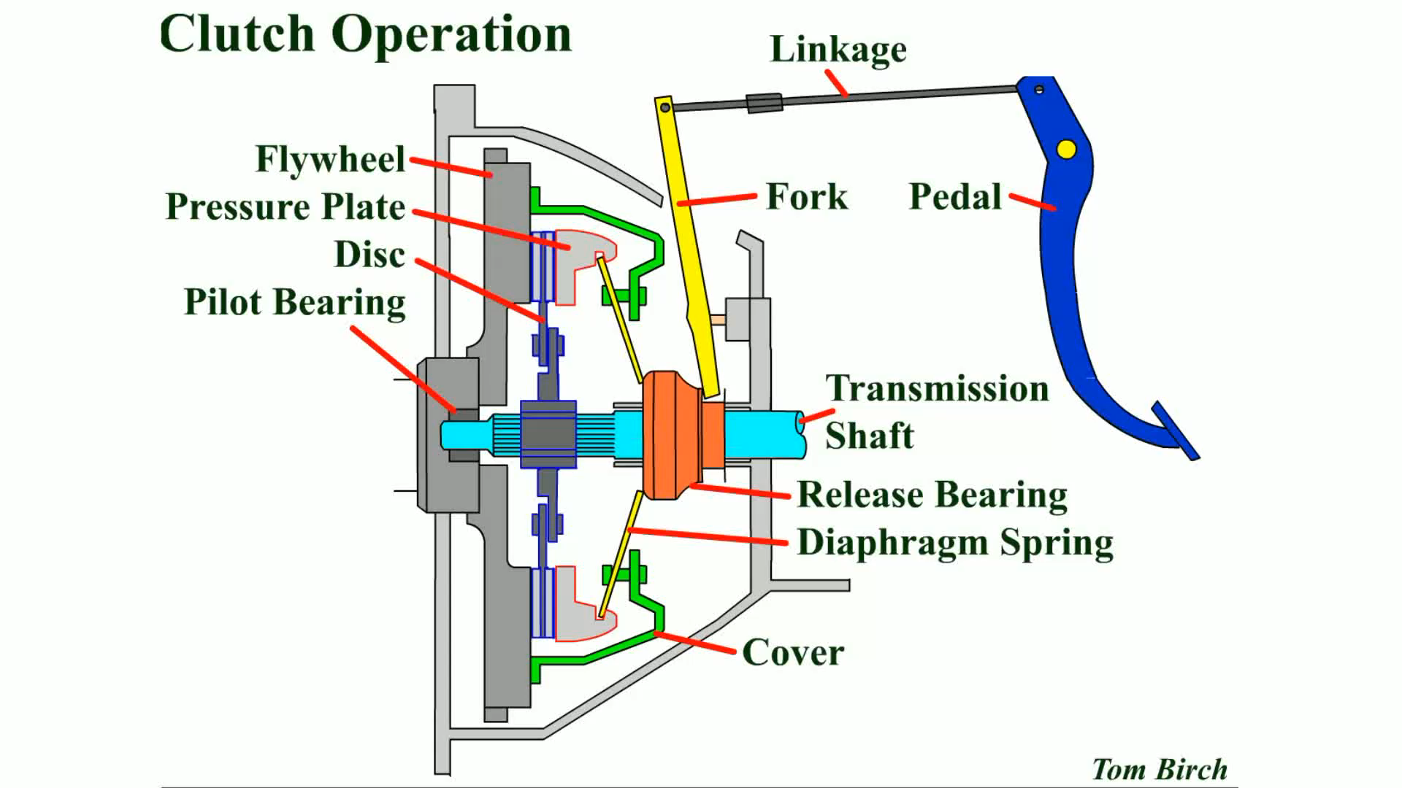
Animation: Clutch Operation
(Animation will automatically start)

Slide 30
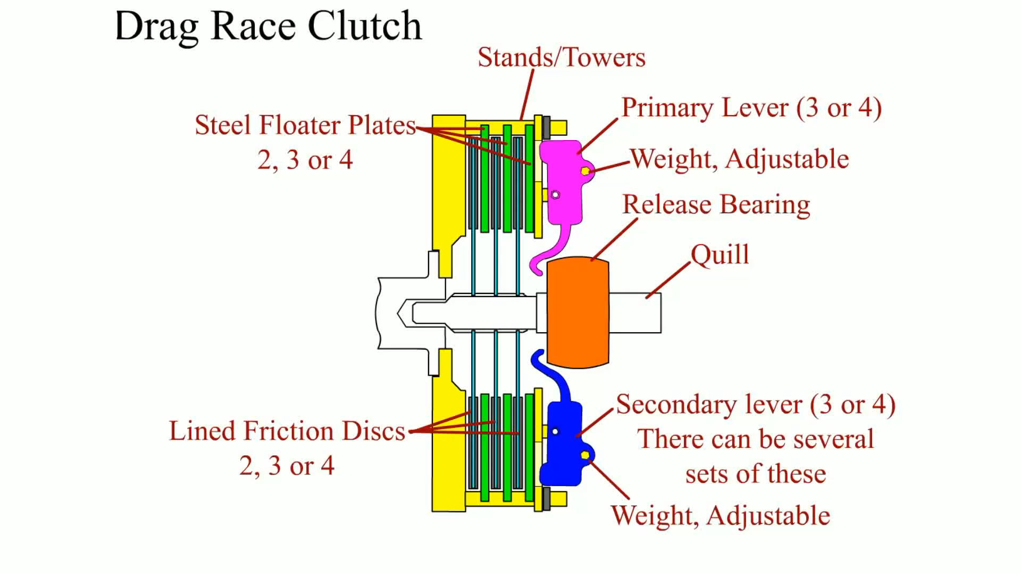
Animation: Drag Race Clutch
(Animation will automatically start)

Slide 31
Release (Throwout) Bearings
Release Bearing Operation :
  Presses against diaphragm spring fingers or coil spring levers
  Takes spring force off pressure plate
  No longer clamps friction disc against flywheel
  Constant-running:
  Release bearing outer race constantly turns at crankshaft speed
    What are the types of release bearings?
    See Figure 3-22

Slide 32
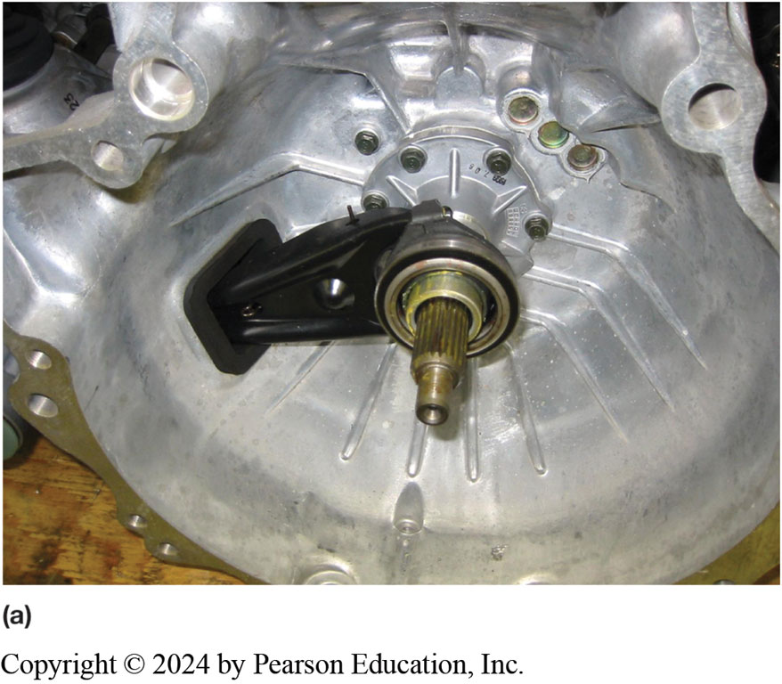
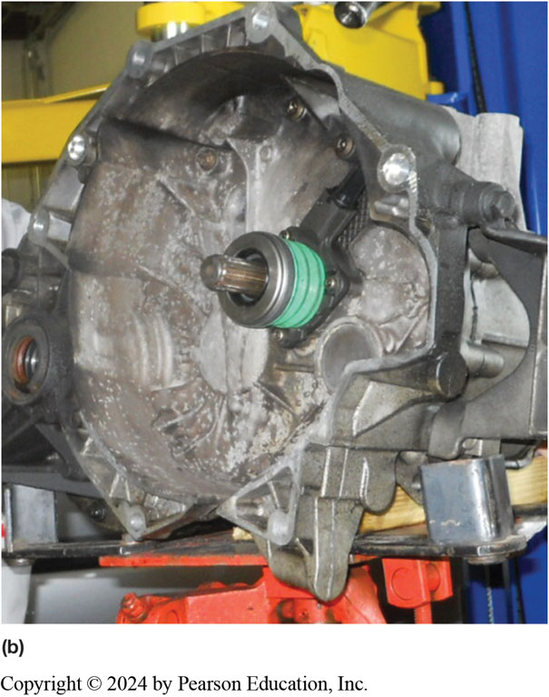
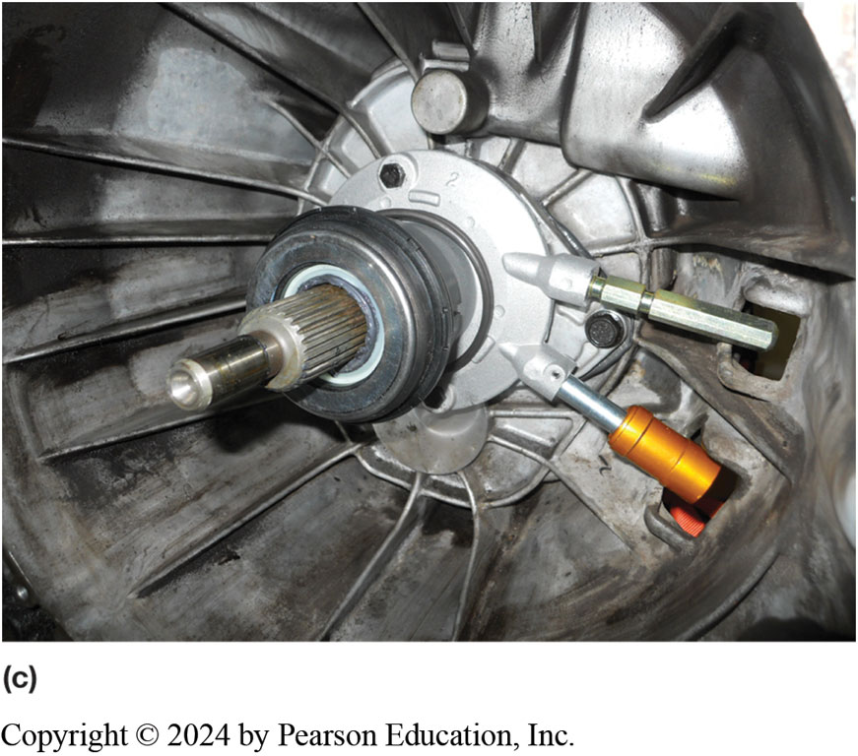
Figure 121.18 Release Bearing Types
(a) release (throwout) bearing on a transmission that uses a clutch fork and a mechanical or cable-operated linkage. (b) style of release bearing that includes actuator cylinder, sometimes called a concentric actuator cylinder. (c) combination release bearing and actuator cylinder showing 2 hydraulic lines. The lower line is from the master clutch cylinder and upper line is used to bleed air from hydraulic system.
Notes:
The release bearing sleeve slides on the outer surface of this tube, which is also commonly called (slang):
Quill
Quill Shaft
Candlestick

Slide 33
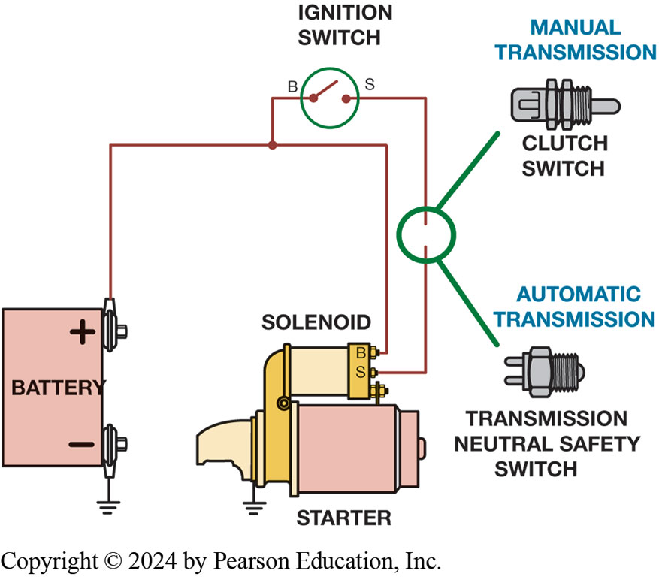
Figure 121.19 Clutch Pedal Switch
Clutch Pedal Switch…
  Signals starter circuit that clutch is released which prevents starter operation unless clutch pedal is depressed
To prevent engine from cranking, an electrical switch is usually installed to open circuit between ignition switch and starter solenoid. When clutch pedal is depressed, switch closes completes circuit to the starter.

Slide 34
Question 1
Which part does not rotate when the engine is running and the clutch pedal is depressed?
  a. Pilot bearing (bushing)
  b. Pressure plate
  c. Input shaft
  d. Flywheel

Slide 35
Answer 1
Which part does not rotate when the engine is running and the clutch pedal is depressed?
  c. Input shaft

Slide 36
Clutch Problem Diagnosis (1 of 3)
Fault in Clutch, Linkage, Hydraulic System:
  Transmission difficult (impossible) to shift into reverse
  Transmission difficult (impossible) to shift between forward gears
Fluid leaks
  Repairs could include:
    Tightening loose line fitting
    Replacing O-ring, fluid line or hose
    Replacing clutch master cylinder or slave cylinder

Slide 37
Clutch Problem Diagnosis (2 of 3)
Check Slave Cylinder Travel.
Clutch Slippage
  Check/adjust clutch pedal free travel.
  Warm up engine to temperature
  Block wheels, and apply parking brake completely.
  Shift transmission into high gear
  Let out clutch pedal smoothly.
  Engine should stall immediately.
    Delay indicates slow engagement and slipping.

Slide 38
Clutch Problem Diagnosis (3 of 3)
Clutch Spin-Down Test
  Check/adjust clutch pedal free travel.
  Warm up engine to operating temperature.
  Push in clutch pedal, wait 9 seconds
  Shift transmission into reverse.
Notes:
Gear clash or grinding indicates a dragging clutch that has not released completely. If a clutch fails the spin-down check, it likely needs to be replaced.
TECH TIP:
Take Precautions Whenever working on a clutch assembly, most OEMS recommend the use of PPE to protect against possible hazards. The items needed include the following:
1. Safety glasses
2. Protective gloves
Because clutch disc material may contain asbestos, precautions should include avoid causing any clutch friction material from becoming airborne by wetting the area. Check service information for specific precautions recommended by OEM

Slide 39
Clutch Replacement
Carefully move transmission toward rear
After the transmission has cleared the clutch
Can be lowered and inspected before
Being reinstalled after clutch assembly replaced.
Mark pressure plate and flywheel if they are to be reused

Slide 40
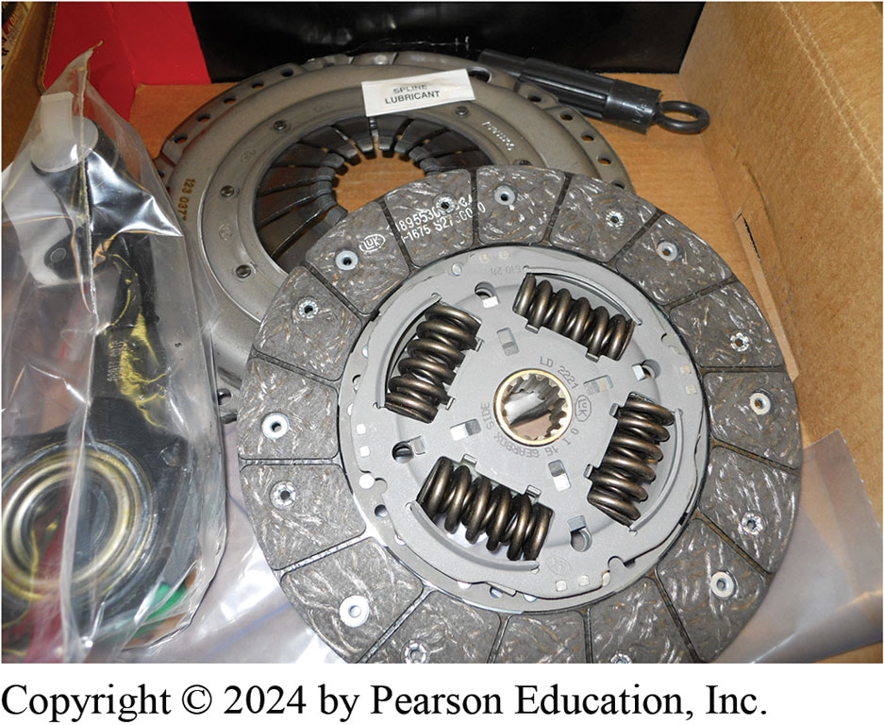
Figure 121.20 Clutch Replacement
Hoist Vehicle Safely
  Remove driveshaft.
  Disconnect linkage, speedometer, & reverse switch
  Support transmission
  Remove rear cross member
  Remove bell housing bolts
Typical clutch kit, which includes clutch disc, pressure plate, and release (throwout) bearing as well as grease for spline and a clutch disc alignment tool

Slide 41
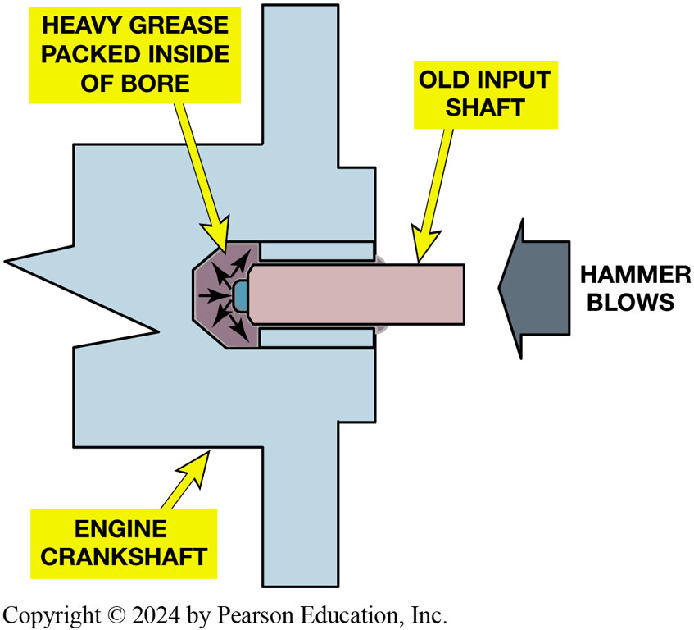
Figure 121.21 Clutch Replacement
Remove clutch pressure plate retaining bolts, & remove clutch assembly including release bearing, pressure plate, and clutch disc.
Pilot Bearing
An old input shaft obtained from a disassembled transmission can be used to force old pilot bushing out.
Notes:
Warning The clutch driven disc may contain asbestos, which is known to be a cancer-causing agent. Never clean clutch surfaces with compressed air. Avoid inhaling any dust from any clutch surface. When cleaning the clutch surfaces, use a commercially available brake cleaning fluid.

Slide 42
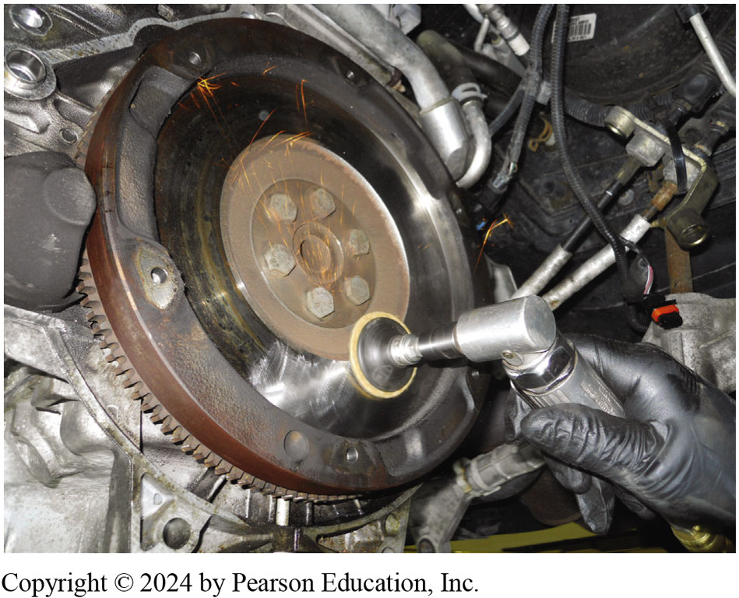
Figure 121.22 Abrasive Disc
Using an abrasive disc to remove the glaze and to restore the proper surface finish to a flywheel.
Notes:
REFACING
Blanchard grinding moves a spinning grinding stone around the flywheel surface. This is the recommended method of resurfacing because it leaves a truly flat surface with a circular, non directional pattern. A non directional finish promotes rapid disc facing-to-fly- wheel break-in.
If the friction surface is flat and smooth but highly polished or glazed, some technicians will sand the friction sur- face using a disc sander with 80- to 120-grit paper. When doing this, the sander is kept in motion while attempting

Slide 43
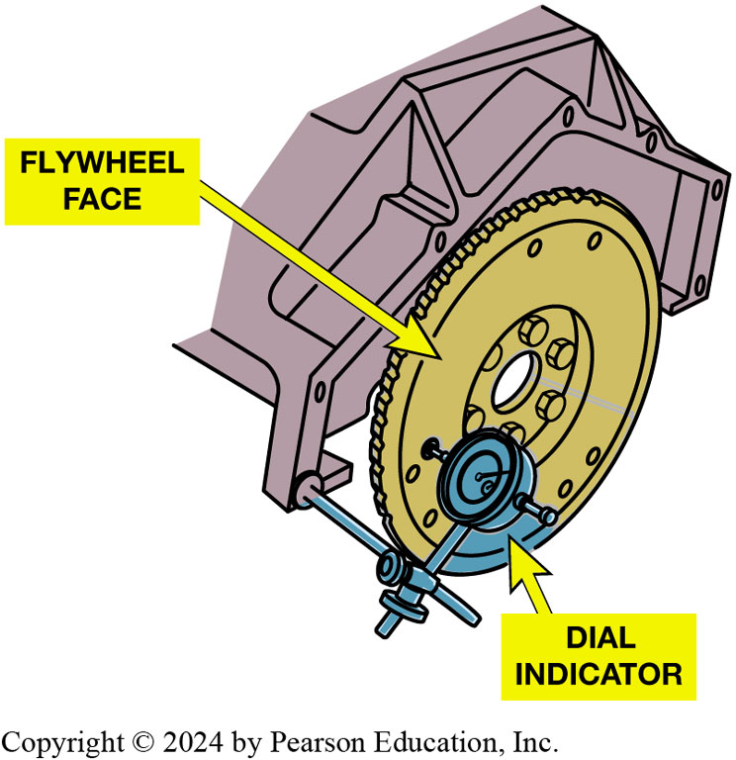
Figure 121.23 Axial Runout
Face or axial runout
  Positioning dial indicator
  Indicating stylus
  Outer edge of flywheel
Dial indicator set up to measure flywheel face or axial runout.
Notes:
Axial Face Runout
Many flywheels are forged steel, which tends to warp (potato chip shape) or dish if overheated.
This is checked by placing a straightedge across the flywheel in several locations. Over 0.0005 inch (0.013 mm) of warpage per inch of diameter is considered excessive. This means that a 12-inch-diameter flywheel can have 0.006 inch (12 × 0.0005) of warpage error.
If there is a vibration concern or an odd wear pattern at the hub of the disc or pressure plate release levers, the fly- wheel should be checked for excessive runout. Face or axial runout is checked by positioning a dial indicator with the indicating stylus at the outer edge of the flywheel face. ● Figure 4–7.
Process
STEP 1 Mount the dial indicator so the measuring stem is parallel to the crankshaft and pointing directly to- ward the flywheel contacting the disc friction area, and adjust the indicator to read zero.
STEP 2 Rotate the flywheel while watching the dial indicator. Maintain an even pressure, either inward or outward, to maintain zero crankshaft end play. The variation in reading is the amount of axial runout.
STEP 3 Set up the dial indicator to measure lengthwise fly- wheel/crankshaft motion, and push and pull on the flywheel and crankshaft in a direction that is parallel to the crankshaft. The dial indicator is measuring crankshaft end play. Normal crankshaft end play should be about 0.002 to 0.010 inch (0.05 to 0.25 mm). Movement greater than specified indicates worn engine crankshaft thrust bearings.
To measure flywheel radial runout, perform the following steps:
STEP 1 Mount the dial indicator so it is at the edge of the flywheel, pointing directly toward the center of the flywheel.
STEP 2 Adjust the dial indicator to read zero.
Case Study: Stepped-Type Flywheel
The clutch in a VW (107,000 mi) has been replaced and the flywheel was resurfaced at the same time. But now there is noticeable clutch chatter. The technician was told that during the flywheel resurfacing, only the clutch mating surface was machined. The technician feels that the step height could be incorrect, but could not find the specification.
After contacting international Automotive Technician Network (iATN), a fellow technician provided the step-height specification. A check of the flywheel showed that its step was at the limit, but the clutch surface also had 0.003 inch of runout. Machining the flywheel fixed this problem.
Summary:
Complaint—The technician discovered a clutch chatter after the clutch had been replaced.
Cause—Measuring the flywheel showed excessive runout.
Correction—The flywheel was machined which corrected the clutch chatter concern.

Slide 44
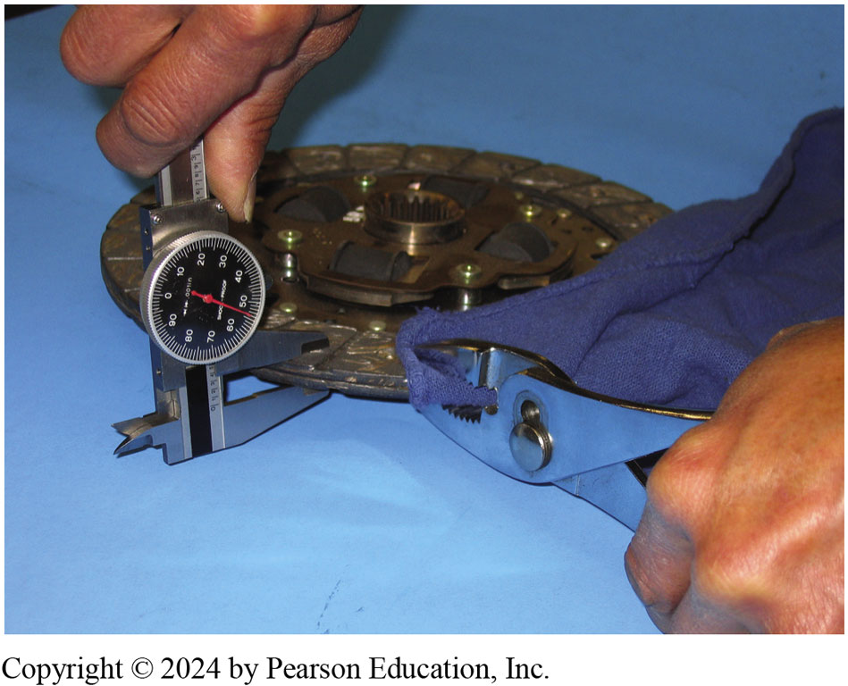
Figure 121.24 Using Caliper
Thickness of clutch disc facing can be measured using a dial caliper.
Notes:
The thickness of the facing can be checked by two different methods.
Method 1. The first method is to place cardboard or a shop cloth over the facing to keep it clean and squeeze the facings together to compress the marcel spring. If specifications are not available, the minimum thickness of the compressed disc should be 0.280 inch (7.1 mm). ● SEE FIGURE 121–24.
Method 2. The most popular method is to measure the height of the facing surface above the rivets which is also called rivet head depth. With a new disc, rivet head depth will be about 0.050 inch (1.2 mm). A disc with less than 0.015 to 0.020 inch (0.38 to 0.5 mm) should be replaced. SEE FIGURE 4–9.

Slide 45
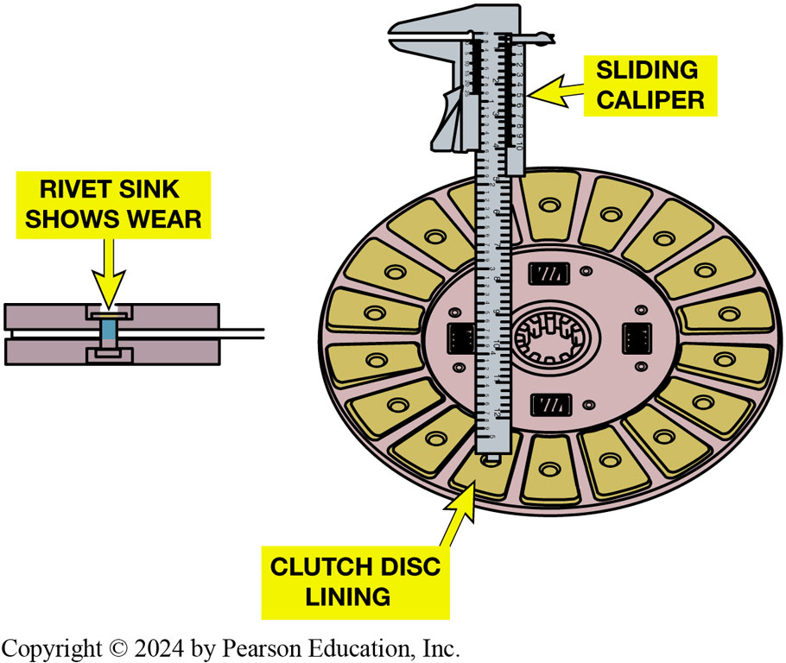
Figure 121.25 Measuring Disc
The thickness of the clutch disc facing can be measured using a dial caliper.
Notes:
The thickness of the facing can be checked by two different methods.
Method 1. The first method is to place cardboard or a shop cloth over the facing to keep it clean and squeeze the facings together to compress the marcel spring. If specifications are not available, the minimum thickness of the compressed disc should be 0.280 inch (7.1 mm). ● Figure 4–8.
Method 2. The most popular method is to measure the height of the facing surface above the rivets which is also called rivet head depth. With a new disc, rivet head depth will be about 0.050 inch (1.2 mm). A disc with less than 0.015 to 0.020 inch (0.38 to 0.5 mm) should be replaced. Figure 4–9.

Slide 46
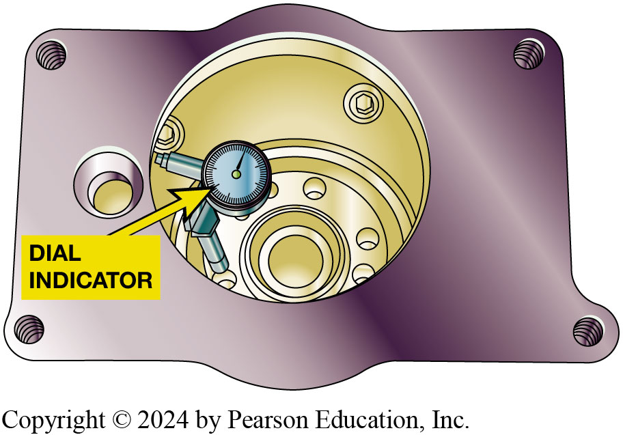
Figure 121.26 Clutch Housing Runout
Dial indicator has a lever added to check clutch housing bore runout. Excessive runout can be caused by damaged or missing dowels in engine block. If dowels are okay, excessive runout can be corrected by installing eccentric dowels.
Notes:
RUNOUT
To check clutch housing bore runout, perform the following steps:
STEP 1 Reposition the dial indicator so the measuring stem is inside the bore and pointing outward.
STEP 2 Adjust the dial indicator to read zero.
STEP 3 Rotate the crankshaft while watching the indicator reading.
STEP 4 Any variation in reading is the amount of bore runout. If the runout cannot be corrected, the bell housing is usually replaced, but it is possible to put shims between the
bell housing and the engine block to correct excessive run- out. The limit for bore runout is about 0.010 inch (0.25 mm). Bore runout can be corrected by using eccentric dowel pins to reposition the bell housing. These are available in different sizes. Position the bell housing so it is centered with the crankshaft. SEE FIGURE 4-10.

Slide 47
Hydraulic Clutch Service
Hydraulic Clutch Bleeding
  Bled by gravity bleeding
  Others, a helper may be needed.
  To bleed a clutch hydraulic system using gravity method, perform the following 3 steps:
  Pages 1528 of text
  See Figure 121-27
Notes:
Precautions
Fluid leaks or failure to release completely indicate the need for hydraulic system service. Clutch hydraulic systems have evolved from the early systems that had free travel adjustment and required clearance at the release bearing to newer systems that maintain a slight preload. Older systems used steel and reinforced rubber lines with threaded fittings, whereas the newer systems use plastic tubing sealed by O-rings and held together by locking pins at the connections.
STEP 1 Clean bleeder valve at the actuator cylinder and place a shop cloth under it to catch escaping fluid, FIGURE 4-12.
STEP 2 Open bleeder valve by loosening bleeder screw and observe the flow. If no flow occurs, have a helper depress the clutch pedal in a smooth, slow manner. Air bubbles coming from the bleed valve indicate that the system needed bleeding. After the air bubbles stop and a constant flow of fluid occurs, close the bleed valve. An alternative method is reverse, or back-bleeding. This is done by forcing fluid through the actuator cylinder bleed valve and upward to the reservoir.
STEP 3 Check the fluid level and correct it, if necessary.

Slide 48
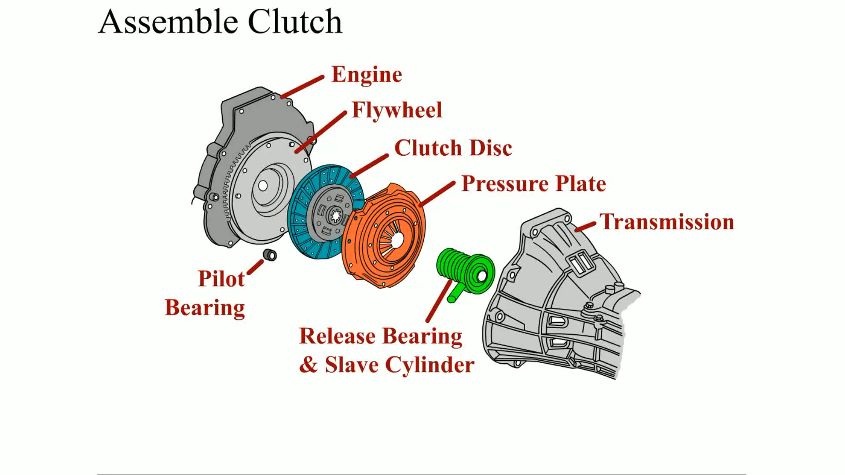
Animation: Assemble Clutch
(Animation will automatically start)

Slide 49
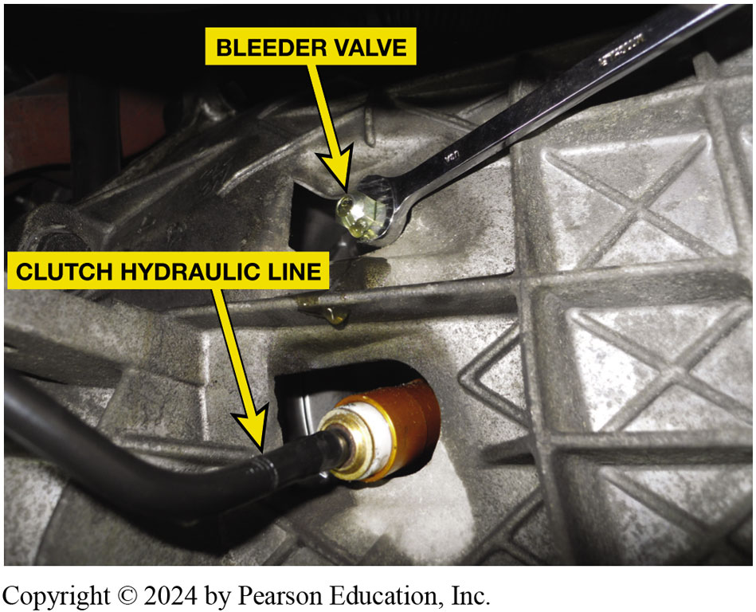
Figure 121.27 Bleeding Hydraulic Clutch
Gravity bleeding a hydraulic clutch. Opening the bleeder valve should allow air to escape and then fluid should flow

Slide 50
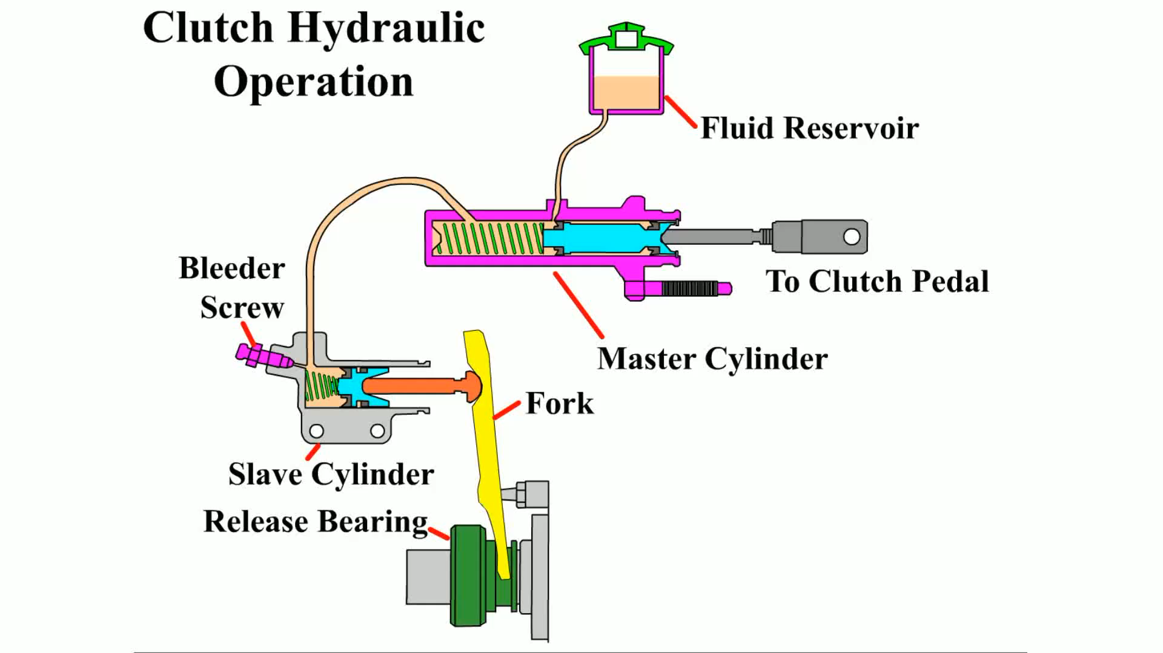
Animation: Clutch Hydraulic Operation
(Animation will automatically start)

Slide 51
Question 2
Clutch chatter can be caused by .
  Grease or oil on the clutch friction material
  Broken engine mount(s)
  Low hydraulic clutch fluid level
  Too little free play in the clutch pedal

Slide 52
Answer 2
A. Grease or oil on the clutch friction material

Slide 53
Manual Drive Train and Axles Videos and Animations
Videos Link: (A3) Manual Drive Train Axles Videos
Animations Link: (A3) Manual Drive Train Axles Animations

Slide 54
Copyright
This work is protected by United States copyright laws and is provided solely for the use of instructors in teaching their courses and assessing student learning. Dissemination or sale of any part of this work (including on the World Wide Web) will destroy the integrity of the work and is not permitted. The work and materials from it should never be made available to students except by instructors using the accompanying text in their classes. All recipients of this work are expected to abide by these restrictions and to honor the intended pedagogical purposes and the needs of other instructors who rely on these materials.

