Slide 1

Automotive Technology: Principles, Diagnosis, and Service
Seventh Edition
Chapter 120
Alignment Diagnosis and Service
Copyright © 2023 Pearson Education, Inc. All Rights Reserved
Notes:
INSTRUCTOR NOTE: This presentation includes text explanation notes, you can use to teach the course. When in SLIDE SHOW mode, you RIGHT CLICK and select SHOW PRESENTER VIEW, to use the notes.

Slide 2
Learning Objectives (1 of 2)
120.1 Explain the purpose of an alignment and discuss the various checks that should be performed before aligning a vehicle.
120.2 Explain the diagnosis of lead/pull.
120.3 Explain the diagnosis of memory steer.
120.4 Explain the diagnosis of torque steer.
120.5 Describe alignment specifications.
120.6 Describe alignment setup procedures.
120.7 Discuss how to measure camber, caster, SAI, toe, and TOOT.

Slide 3
Learning Objectives (2 of 2)
120.8 Explain diagnostic angles.
120.9 List the types of alignments.
120.10 Discuss rear wheel adjustments.
120.11 Describe how to adjust front camber/caster.
120.12 Discuss setting toe.
120.13 Discuss centering the steering wheel.
120.14 Discuss the tolerance adjustment procedure.
120.15 Explain how to reset steering angle sensor (SAS).

Slide 4
Purpose of an Alignment
Proper wheel alignment of all four wheels is important for the safe handling of any vehicle.
Tire life and fuel economy are maximized and vehicle handling is sure and predictable.

Slide 5
Pre-Alignment Correction Techniques
There are four basic steps in the correction of any problem:
  Verify
  Isolate
  Repair the problem
  Recheck

Slide 6
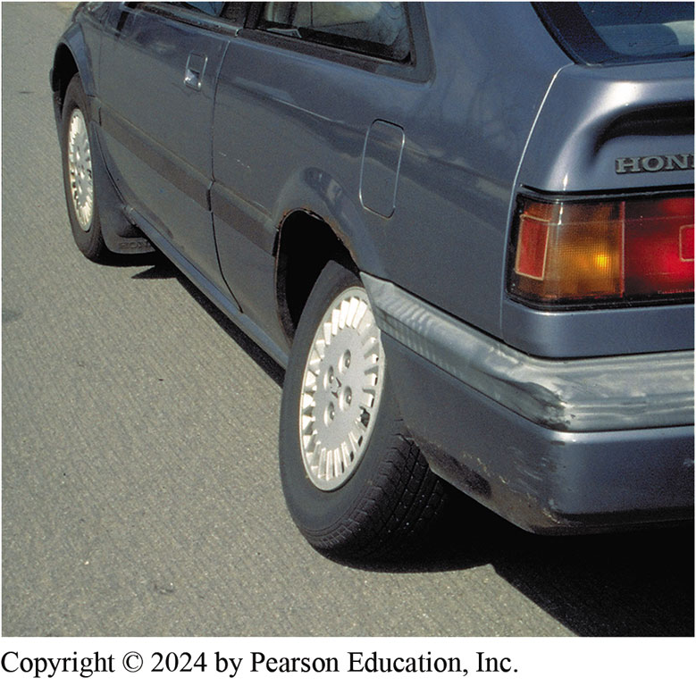
Figure 120.1 Alignment
The owner of this Honda thought that all it needed was an alignment. Obviously, something more serious than an alignment caused this left rear wheel to angle inward at the top

Slide 7
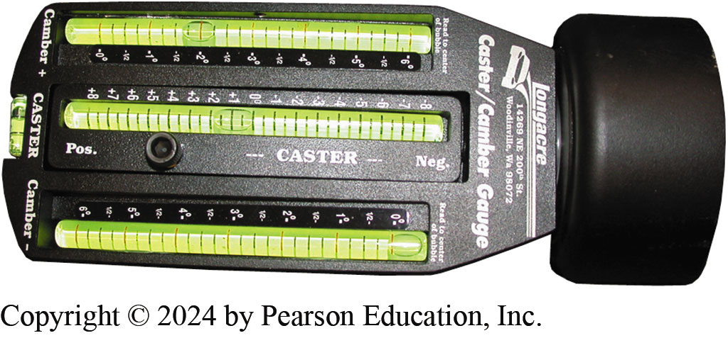
Figure 120.2 Bubble Type Gauge
Magnetic bubble-type camber/caster gauge. To help it keep its strong magnetism, it is best to keep it stored stuck to a metal plate or metal tool box
Notes:
TECH TIP: Align and Replace at the Same Time
Magnetic bubble-type camber/caster gauges can be mounted directly on the hub or on an adapter attached to the wheel or spindle nut on front- wheel-drive vehicles. ^{● SEE FIGURE 120–2.}
Any time a suspension component is replaced, the wheel alignment should be checked and corrected as necessary. An easy way to avoid having to make many adjustments is to use a magnetic alignment head on the front wheels to check camber with
the vehicle hoisted in the air before replacing front
components, such as new MacPherson struts. Then, before tightening all of the fasteners, check the front camber readings again to make sure they match the original setting. This is best done when the vehicle is still off the ground. For example, a typical front-wheel- drive vehicle with a MacPherson strut suspension may have a camber reading of +1/4 degree on the ground and +2 degrees while on the hoist with the wheels off the ground. After replacing the struts, simply return the camber reading to +2 degrees and it should return to the same +1/4 degree when lowered to the ground. Though checking and adjusting camber before and after suspension service work does not guarantee a proper alignment, it does permit the vehicle to be moved around with the alignment fairly accurate until a final alignment can be performed.

Slide 8
Pre-Alignment Checks
Before checking or adjusting the front-end alignment, the following items should be checked and corrected, if necessary, as part of the pre-alignment checks:
  Tire inflation, size and tread depth
  Wear bearing adjustment
  Looseness or damage in front end components
  Vehicle ride height
  Looseness or damage in steering components
  Brake drag

Slide 9
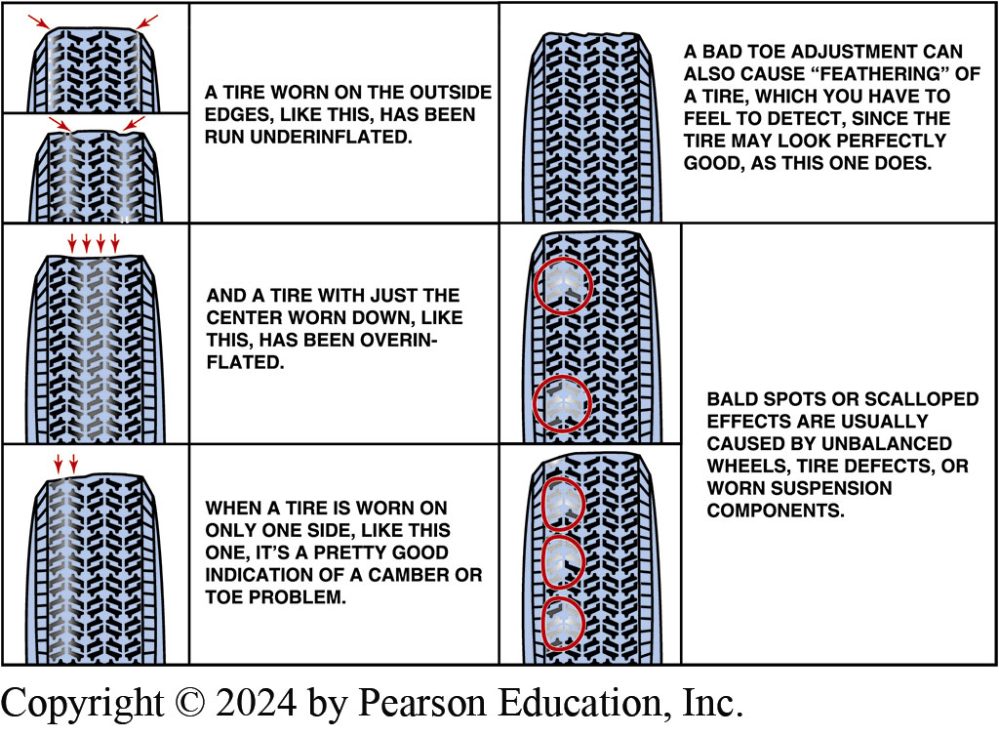
Figure 120.3 Tire Wear Chart
Typical tire wear chart as found in a service manual. Abnormal tire wear usually indicates a fault in a steering or suspension component that should be corrected or replaced before an alignment is performed

Slide 10
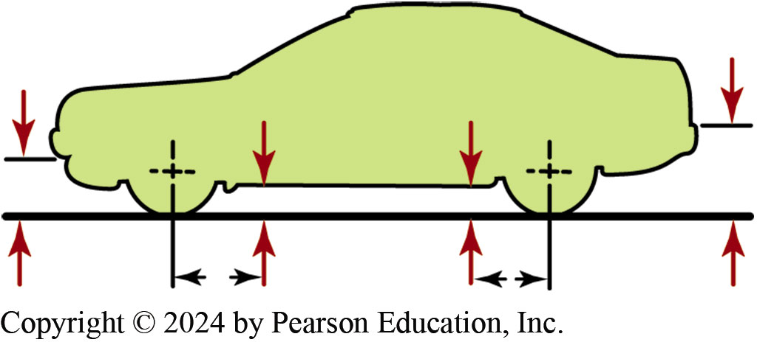
Figure 120.4 Measuring Points
Measuring points for ride (trim) height vary by manufacturer

Slide 11
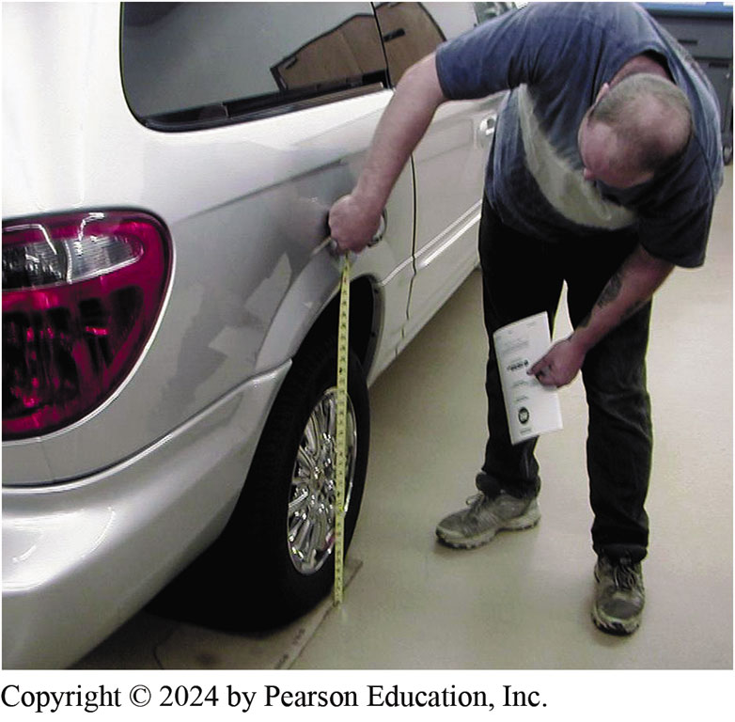
Figure 120.5 Ride Height
Measuring to be sure the left and right sides of the vehicle are of equal height. If this measurement is not equal side to side by as little as 1/8 inch (3 mm), it can affect the handling of the vehicle.

Slide 12
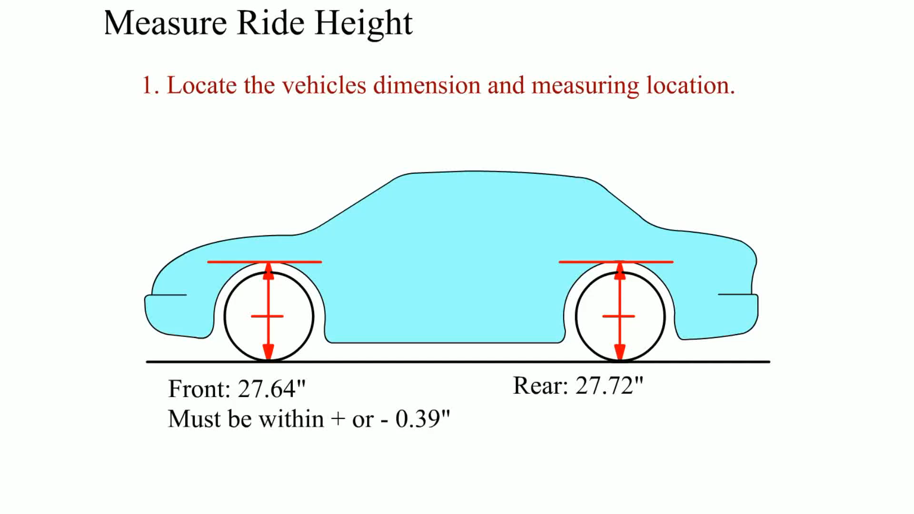
Animation: Measure Ride Height
(Animation will automatically start)

Slide 13
Question 1: ?
What is the purpose of a pre-alignment check?

Slide 14
Answer 1
To find and correct any problems prior to the alignment.

Slide 15
Lead/Pull
Diagnosis
Before aligning vehicle, verify customer complaint first, then perform a careful inspection.
  Inspect all tires for proper inflation.
  Road test the vehicle on a straight, level road.
  If lead/pull problem is sometimes toward left and other times toward the right, check for a memory steer condition.
  If lead/pull problem occurs during acceleration and deceleration, check for a torque steer condition.

Slide 16
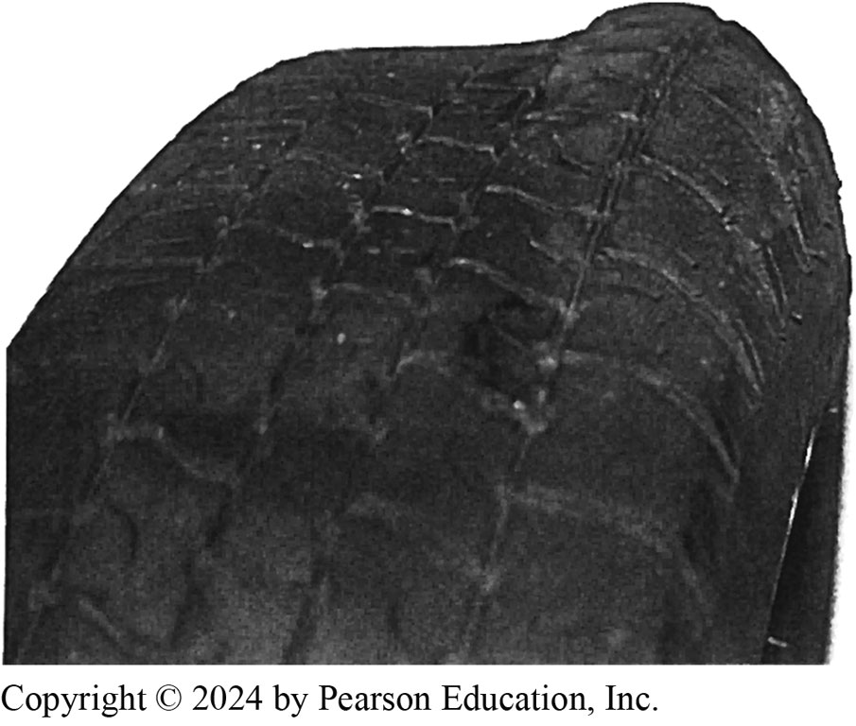
Figure 120.6 Tire Bulge
The bulge in this tire was not noticed until it was removed from the vehicle as part of a routine brake inspection. After replacing this tire, the vehicle stopped pulling and vibrating

Slide 17
Memory Steer
Diagnosis
  Memory steer is a term used to describe the lead or pull of a vehicle caused by faults in the steering or suspension system.
Correction
  A binding suspension or steering component is the most likely cause of memory steer.

Slide 18
Torque Steer
Diagnosis
  Torque steer occurs in FWD vehicles when engine torque causes a front wheel to change its angle from straight ahead.
Correction
  Confirm it is not a normal condition.
  Defective motor mount may cause powertrain to not be level.
  Confirm alignment angles.

Slide 19
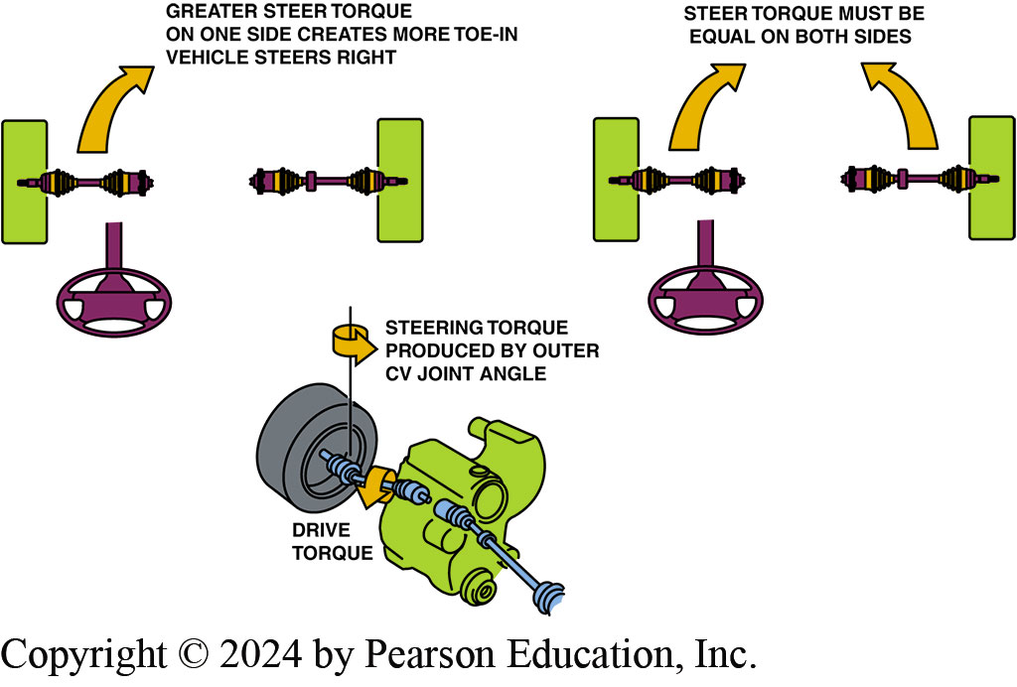
Figure 120.7 Outer CV Joint Angles
Equal outer CV joint angles produce equal steer torque (toe-in). If one side receives more engine torque, that side creates more toe-in and the result is a pull toward one side, especially during acceleration

Slide 20
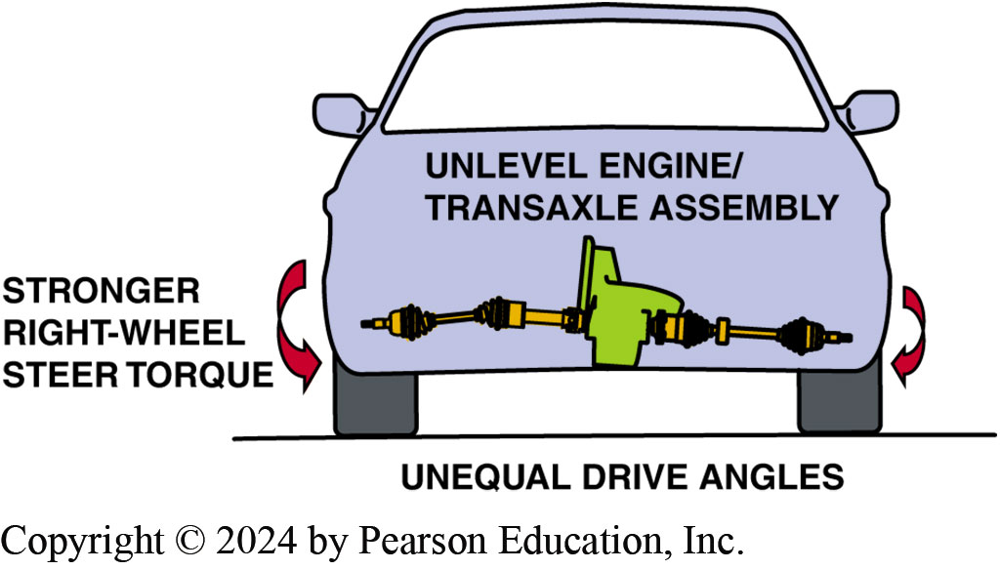
Figure 120.8 Broken Motor Mounts
Broken or defective engine or transaxle mounts can cause the powertrain to sag, causing unequal drive axle shaft CV joint angles
Notes:
CASE STUDY: The Five-Wheel Alignment
The steering wheel should always be straight when driving on a straight, level road. If the steering wheel is not straight, the customer will often think that the wheel alignment is not correct. One such customer complained that the vehicle pulled to the right while driving on a straight road. The service manager test- drove the vehicle and everything was perfect, except that the steering wheel was not perfectly straight, even though the toe setting was correct. Whenever driving on a straight road, the customer would “straighten the steering wheel” and, of course, the vehicle went to one side. After adjusting toe with the steering wheel straight, the customer and the service manager were both satisfied. The technician learned that regardless of how accurate the alignment, the steering wheel must be straight; it is the “fifth wheel” that the customer notices most. Therefore, a five-wheel alignment rule includes a check of the steering wheel.
NOTE: Many vehicle manufactures now include the maximum allowable steering wheel angle variation from straight. This specification is commonly ±3 degrees (plus or minus 3 degrees) or less.
Summary:
Complaint—Owner complained that the vehicle pulled to one side after an alignment.
Cause—The steering wheel was not perfectly straight and when the driver straightened the wheel, it went to one side.
Correction—The technician straightened the steering using the tie rod end ends while maintaining the specified toe setting.

Slide 21
Alignment Specifications (1 of 2)
Before attempting any alignment, consider the following:
  Determine the correct specifications for the exact vehicle being checked.
  Ensure the vehicle is properly loaded.
Reading Alignment Specifications
  Maximum/Minimum/Preferred Method
  Plus or Minus Method
Notes:
TECH TIP: Keep the Doors Closed, but the Window Down
An experienced alignment technician became upset when a beginning technician opened the driver’s door to lock the steering wheel in a straight-ahead position on the vehicle being aligned. The weight of the open door caused the vehicle to sag. This disturbed the level position of the vehicle and changed all the alignment angles.
The beginning technician learned an important lesson that day: Keep the window down on the driver’s door so that the steering wheel and brakes can be locked without disturbing the vehicle weight balance by opening a door. The brake pedal must be locked with a pedal depressor to prevent the wheels from rolling as the wheels are turned during a caster sweep. The steering must be locked in the straight-ahead
position when adjusting toe.

Slide 22
Alignment Specifications (2 of 2)
Degrees, Minutes, and Fractions

Slide 23
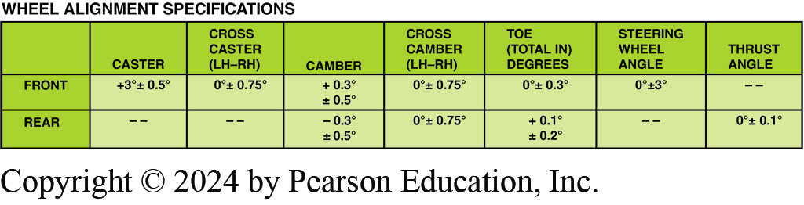
Figure 120.9 Specifications
This alignment chart indicates the preferred setting with a plus or minus tolerance

Slide 24
Alignment Setup Procedures
Typical alignment procedures include the following:
  Drive onto alignment rack straight and center ramps under vehicle.
  Chock the wheels.
  Attach and calibrate the wheel sensors to each wheel.
  Unlock all rack or turn plates.
  Lower the vehicle and jounce the suspension.
  Follow the procedures for the alignment equipment.

Slide 25
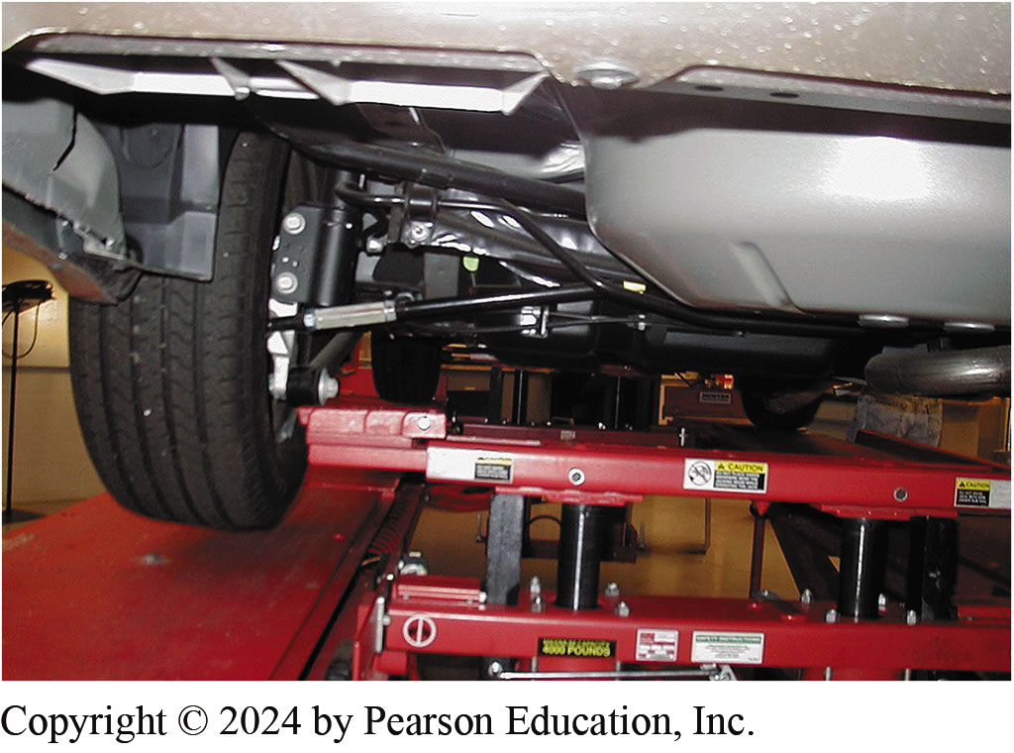
Figure 120.10 Alignment Rack Jacks
Using the alignment rack hydraulic jacks, raise the tires off the rack so that they can be rotated as part of the compensating process

Slide 26
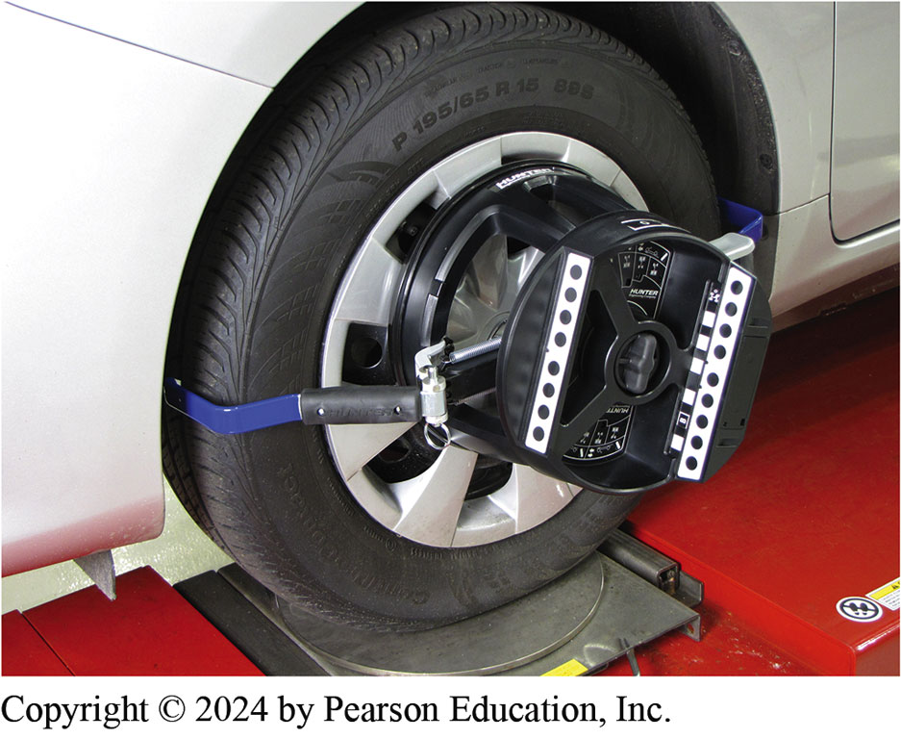
Figure 120.11 Wheel Sensor
An optical-type wheel sensor. Compensation is achieved by simply rolling the vehicle backward and forward

Slide 27
Measuring Camber, Caster, S A I, Toe, and TOOT (1 of 2)
Camber
  Camber measured with wheels in straight ahead position on a level platform.
Caster
  Caster measured by moving front wheels through an arc inward, then outward, from straight ahead.
S A I
  Steering axis inclination (S A I) is also measured by performing a caster sweep of the front wheels.

Slide 28
Measuring Camber, Caster, S A I, Toe, and T O O T (2 of 2)
T O E
  Toe determined by measuring angle of both front and both rear wheels from straight-ahead (0 degree) position.
T O O T
  Toe-out on turns (T O O T) is diagnostic angle and is normally not measured as part of a regular alignment, but it is recommended to be performed as part of a total alignment check.

Slide 29
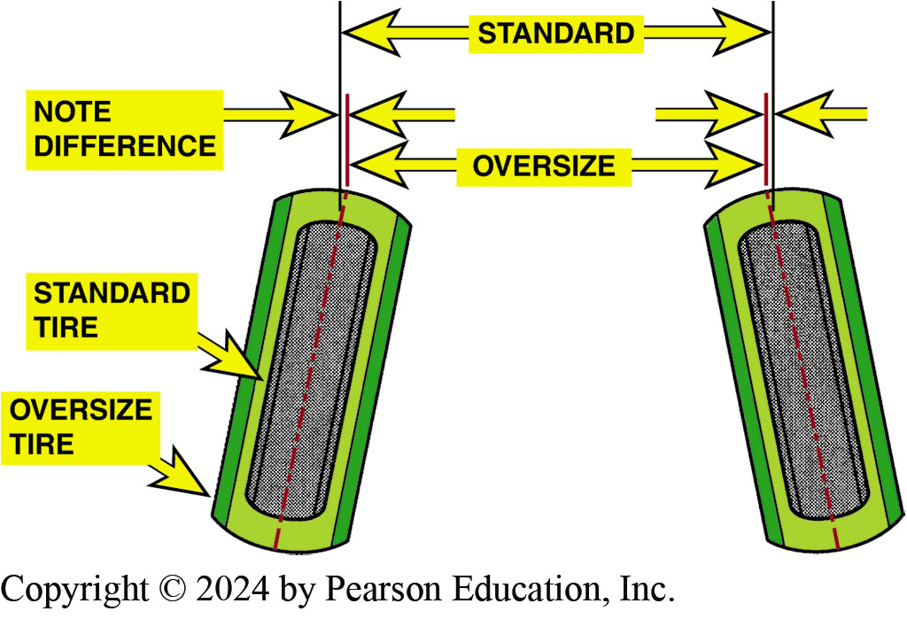
Figure 120.12 Toe
If toe for an oversize tire is set by distance, the toe angle will be too small. Toe angle is the same regardless of tire size

Slide 30
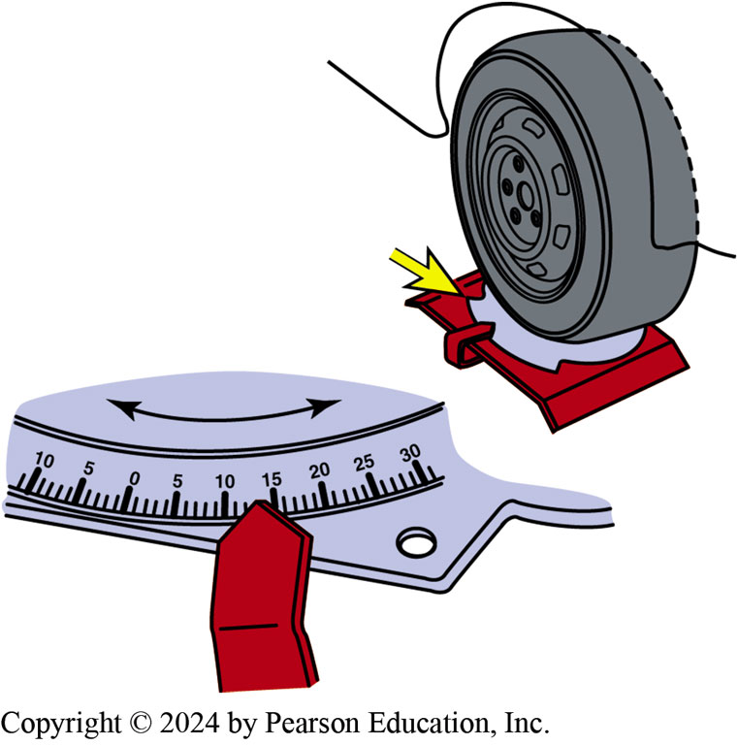
Figure 120.13 Protractor Scale
The protractor scale on the front turn plates allows the technician to test the turning radius by turning one wheel to an angle specified by the manufacturer and observing the angle of the other front wheel.

Slide 31
Specifications Versus Alignment Readings
Secure both alignment specifications from manufacturer and the alignment readings and compare the two.
Before starting an alignment, check the S A I, included angle, setback, and toe-out on turns to make sure that there is no hidden damage such as a bent spindle or strut that was not found during the pre-alignment inspection.

Slide 32
Checking For Bent Struts, Spindles, Or Control Arms
Before attempting to correct an alignment, check all the angles and use the appropriate diagnostic chart to check for hidden damage that a visual inspection may miss.
Understand the terms used in the charts:
At spec Over spec Under spec | The alignment angle is within specifications. The alignment angle is greater or higher than specified by the manufacturer. The alignment angle is less than or lower than specified by the manufacturer.

Slide 33
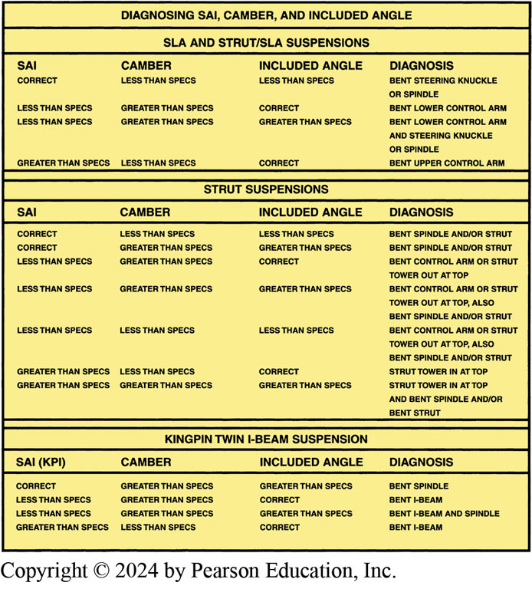
Figure 120.14 Diagnosis Chart
By checking the SAI, camber, and included angle, a damaged suspension component can be determined by using this chart

Slide 34
Checking Frame Alignment of Front-wheel-drive Vehicles
Many front-wheel-drive vehicles mount the drive train (engine and transaxle) and lower suspension arms to a subframe or cradle.
If the frame is shifted either left or right, this can cause differences in S A I, included angle, setback, and camber.

Slide 35
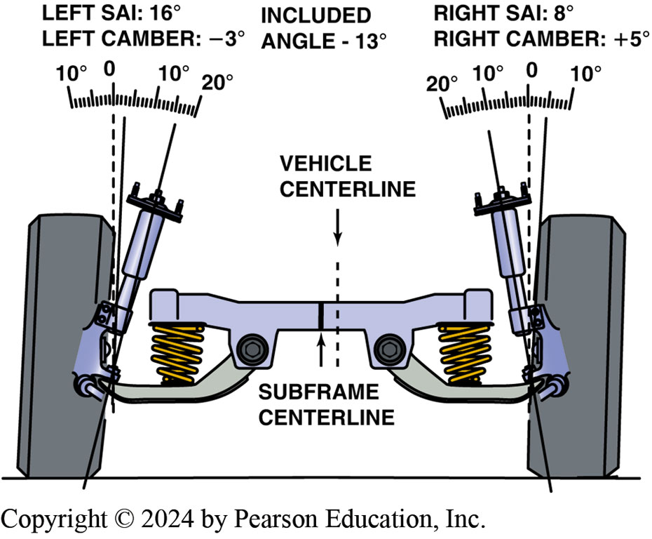
Figure 120.15 Example
In this example, both SAI and camber are far from being equal side to side. However, both sides have the same included angle, indicating that the frame may be out of alignment

Slide 36
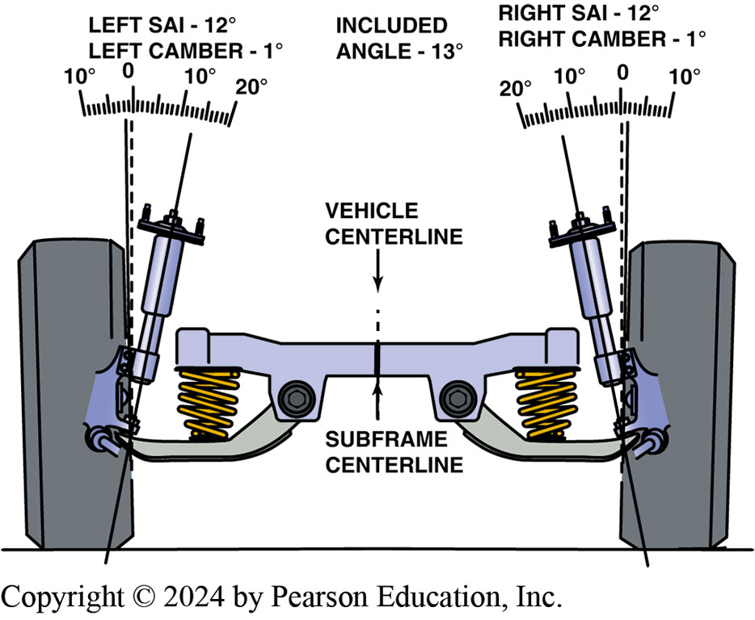
Figure 120.16 2nd Example
Same vehicle as shown in Figure 120.15, except now frame (cradle) has been shifted over and correctly positioned. Notice how both the SAI and camber become equal without any other adjustments necessary

Slide 37
Types of Alignments (1 of 3)
Geometric Centerline
  Used until the 1980s. Now considered obsolete.
Thrust Line
  A thrust line alignment uses the thrust angle of the rear wheels and sets the front wheels parallel to the thrust line.
Four-Wheel Alignment
  A four-wheel alignment is the most accurate alignment method and is necessary to ensure maximum tire wear and vehicle handling.

Slide 38
Types of Alignments (2 of 3)
Sample Alignment Specifications and Readings
Example 1: Wheel Alignment
Alignment Specifications
 | Left | Right
Camber = | +1/2° ± 1/2° | +1/2° ± 1/2°
Caster = | +1° ± 1/2° | +1° ± 1/2°
Toe (total) = | 1/8 in. ± 1/16 in.
Actual Reading
 | Left | Right
Camber = | +1/4° | 0°
Caster = | +1° | +1 1/4°
Toe (total) = | 1/8 in.

Slide 39
Types of Alignments (3 of 3)
Example 2: Four-Wheel Alignment
Alignment Specifications
 | Left | Right
Front camber = | +1/4° ± 1/2° | 0° ± 1/2°
Front caster = | +3° ± 1/2° | +1/2° ± 1/2°
Front toe (total) = | 3/16 in. ± 1/16 in.
Rear camber = | 0° ± 1/4° | 0° ± 1/4°
Rear toe = | 0 in. ± 1/16 in.
Actual Reading
 | Left | Right
Front camber = | −1/2° | 0°
Front caster = | +2 3/4° | +2°
Front toe = | −1/8 in. (toe-out)
Rear camber = | 0° | +1/4°
Rear toe = | 1 1/2° (toe-in)

Slide 40
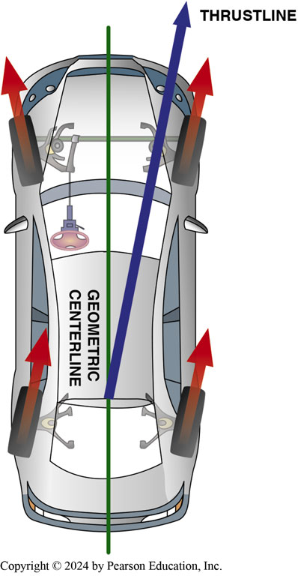
Figure 120.17 Geometric-Centerline
Geometric-centerline-type alignment sets the front toe readings based on the geometric centerline of the vehicle and does not consider the thrust line of the rear wheel toe angles

Slide 41
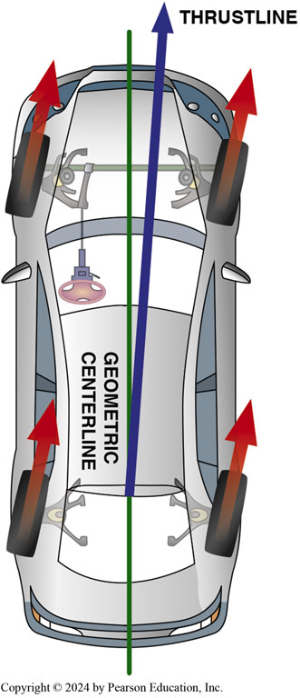
Figure 120.18 Thrust Line Alignment
Thrust line alignment sets the front toe parallel with the rear-wheel toe

Slide 42
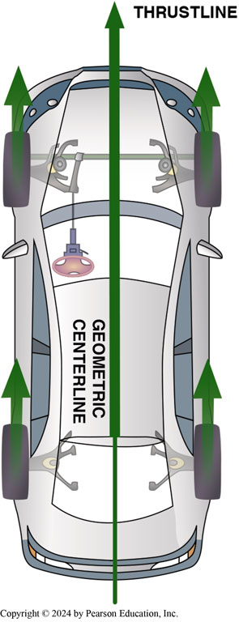
Figure 120.19 Four-Wheel Alignment
Four-wheel alignment corrects for any rear wheel toe to make the thrust line and the geometric centerline of the vehicle both the same

Slide 43
Question 2: ?
What are the three types of alignment?

Slide 44
Answer 2
Geometric centerline, Thrust line, and four-wheel alignment.

Slide 45
Adjusting Rear Camber
Adjusting rear camber is 1st step in 4-wheel alignment process.
Rear camber is rarely made adjustable, but can be corrected by using aftermarket alignment kits or shims.
When using aftermarket plastic or metal alignment shims to correct angles, follow the manufacturers procedures.

Slide 46
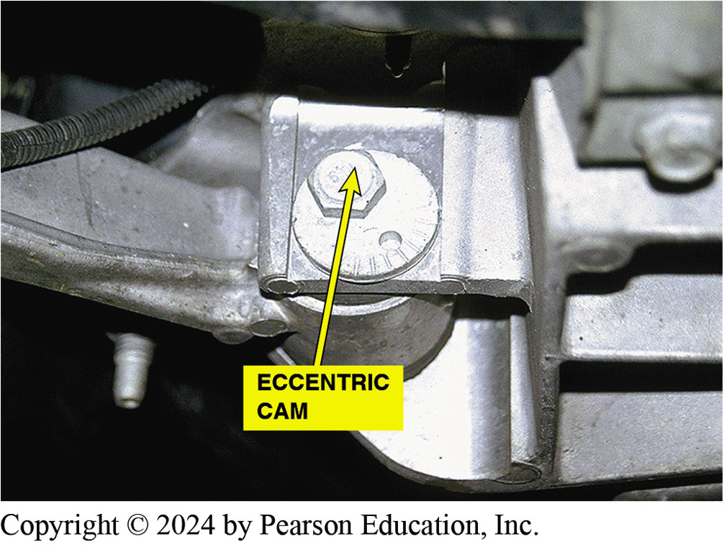
Figure 120.20 Rear Camber
The rear camber is adjustable on this vehicle by rotating the eccentric cam and watching the alignment machine display

Slide 47
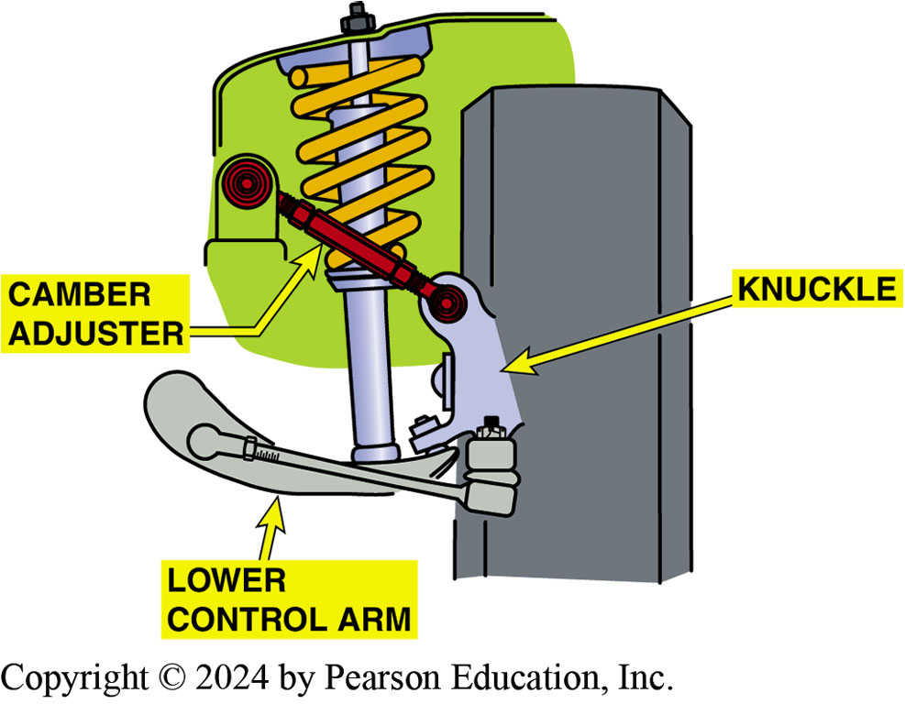
Figure 120.21 Threaded Fastener
Some vehicles use a threaded fastener similar to a tie rod to adjust camber on the rear suspension

Slide 48
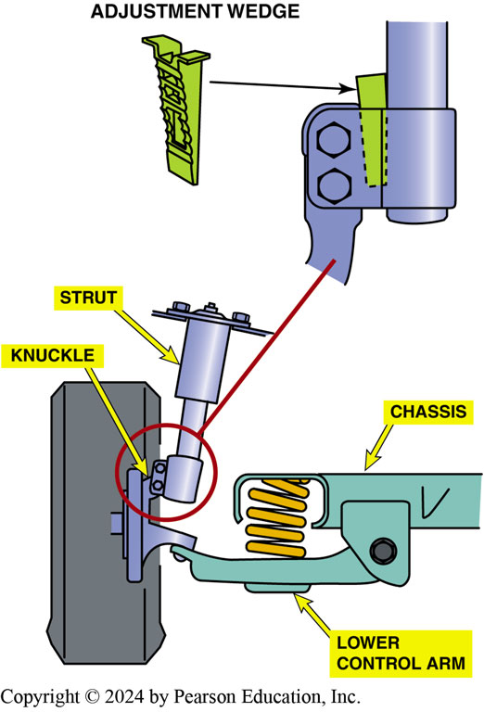
Figure 120.22 Aftermarket Parts
Aftermarket alignment parts or kits are available to change the rear camber

Slide 49
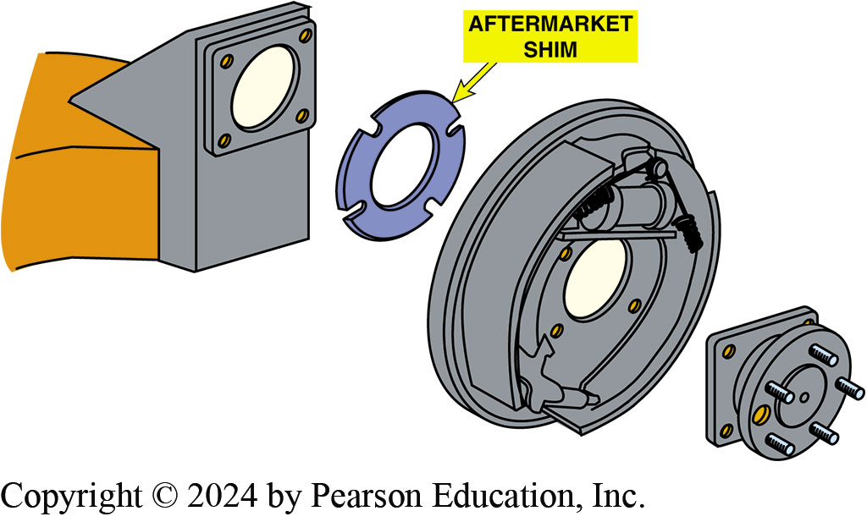
Figure 120.23 Aftermarket Shim Kit
Full-contact plastic or metal shims can be placed between the axle housing and the brake backing plate to change rear camber, toe, or both

Slide 50
Adjusting Rear T O E
Many vehicle manufacturers provide adjustment for rear toe on vehicles that use an independent rear suspension.
Rear toe is often adjusted using an adjustable tie rod end or an eccentric cam on the lower control arm.
Most solid rear axles do not have a method to adjust rear toe except for aftermarket shims or kits.

Slide 51
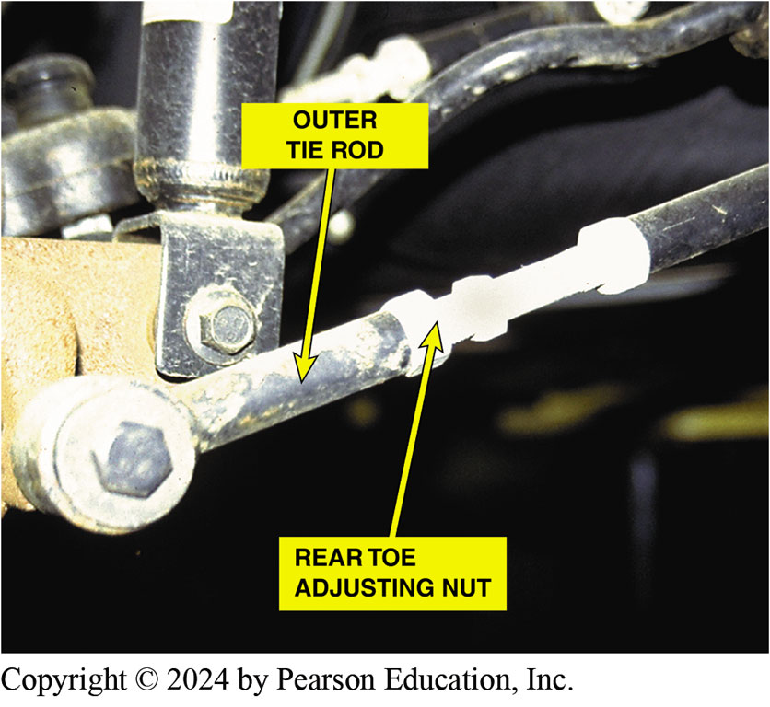
Figure 120.24 Rear Toe Adjustment
The rear toe was easily set on this vehicle. The adjusting nuts were easy to get to and turn. Adjusting rear toe is not this easy on every vehicle

Slide 52
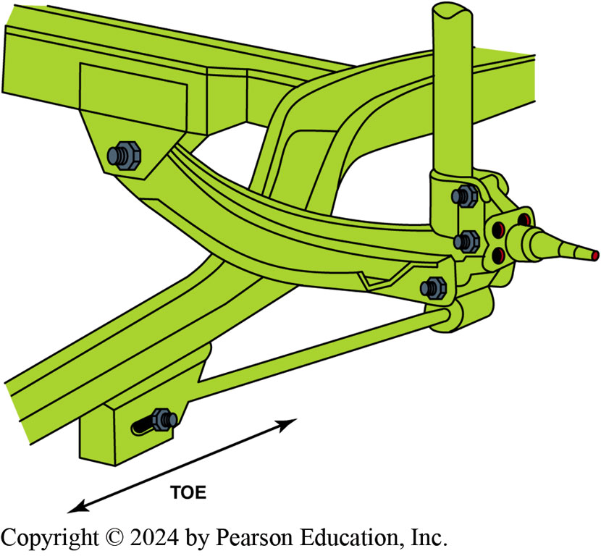
Figure 120.25 Rear Toe Adjustment
By moving various rear suspension members, the rear toe can be changed

Slide 53
Front Camber/Caster Adjustment Methods
Many vehicles are constructed with only limited camber/caster factory adjustment.
Adjustment methods include:
  Shims
  Slots
  Cams
  Nuts

Slide 54
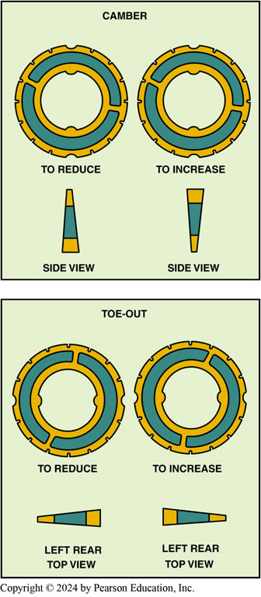
Figure 120.26 Plastic Shims
The use of these plastic or metal shims requires that the rear wheel as well as the hub assembly and/or backing plate be removed. Proper torque during reassembly is critical to avoid damage to the shims.

Slide 55
Guidelines For Adjusting Front Camber/S A I and Included Angle
If the camber is adjusted at the base of the MacPherson strut, camber and included angle are changed and S A I remains the same.
If camber is adjusted by moving the upper strut mounting location, included angle remains the same, but S A I and camber change.
Alignment Angle | Recommended Maximum Variation
SAI | Within 1/2° (0.5°) side to side
Included angle | Within 1/2° (0.5°) side to side
Cross camber | Within 1/2° (0.5°) side to side
Cross caster | Within 1/2° (0.5°) side to side

Slide 56
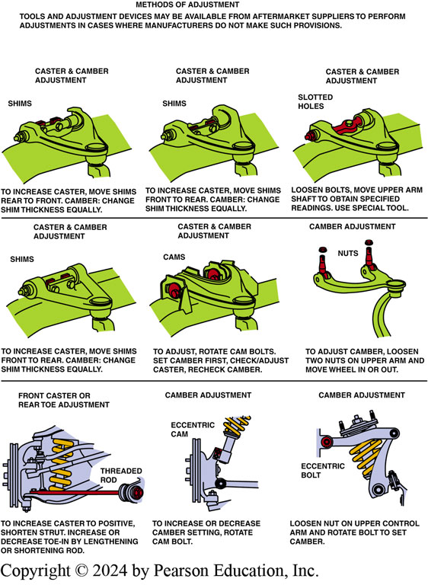
Figure 120.27 Adjustments
An example of the many methods that are commonly used to adjust front caster and camber.

Slide 57
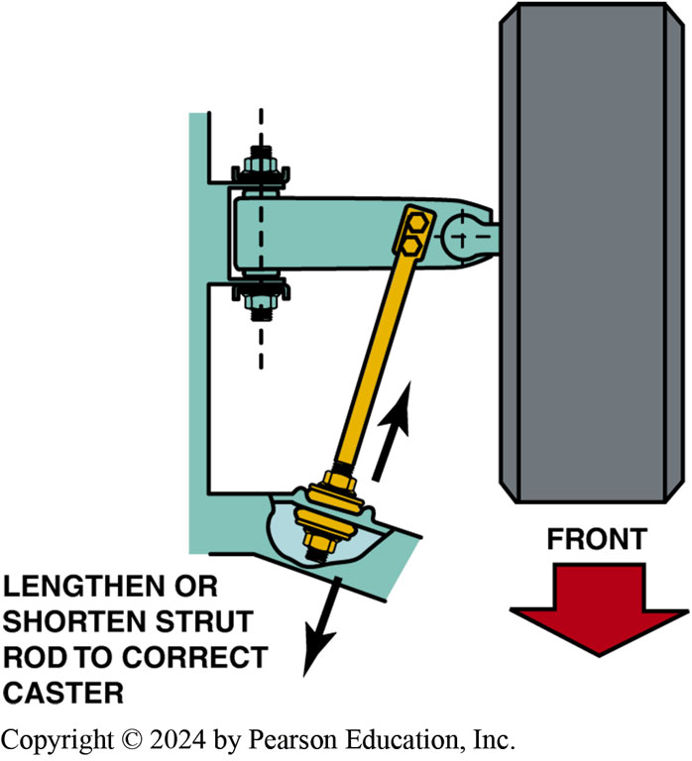
Figure 120.28 Strut Rod Bushing
If there is a nut on both sides of the strut rod bushing, then the length of the rod can be adjusted to change caster

Slide 58
Adjusting Front Camber/Caster
Most manufacturers recommend adjusting caster, then camber, before adjusting the toe.
As the caster is changed, the camber and toe also change.
If the camber is then adjusted, the caster is unaffected.

Slide 59
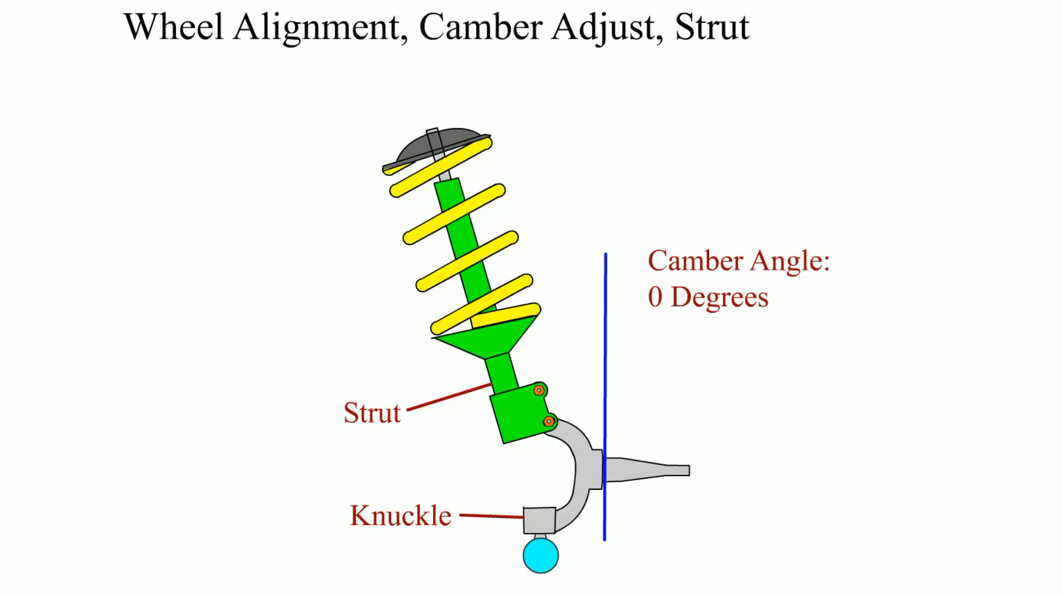
Animation: Wheel Alignment, Camber Adjust, Strut
(Animation will automatically start)

Slide 60
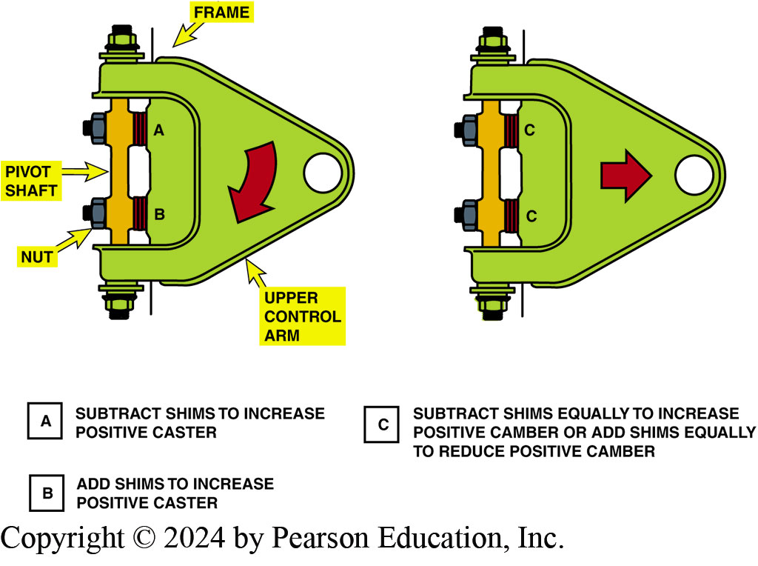
Figure 120.29 Shims
Placing shims between the frame and the upper control arm pivot shaft is a popular method of alignment for many SLA suspensions. Both camber and caster can be easily changed by adding or removing shims

Slide 61
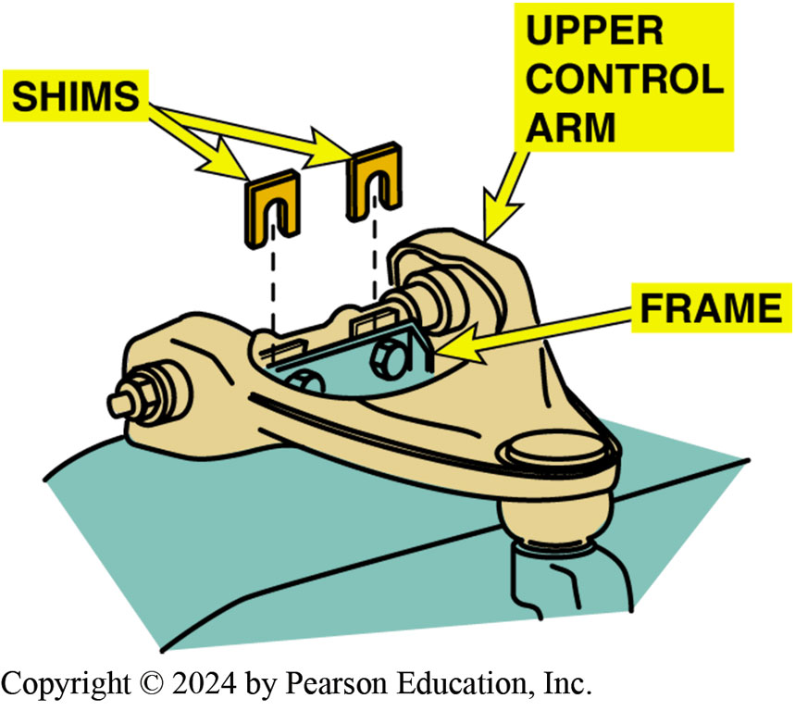
Figure 120.30 Shims
The general rule of thumb is that a 1/8 inch shim added or removed from both shim locations changes the camber angle about 1/2 degree. Adding or removing a 1/8 inch shim from one shim location changes the caster by about 1/4 degree.

Slide 62
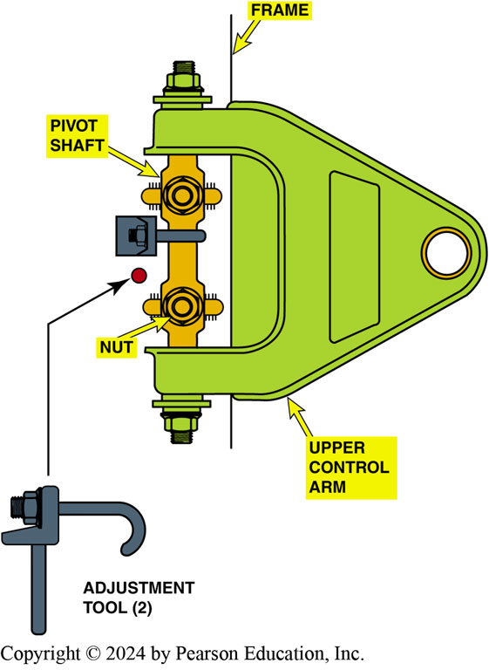
Figure 120.31 Slotted Holes
Some SLA-type suspensions use slotted holes for alignment angle adjustments. When the pivot shaft bolts are loosened, the pivot shaft is free to move unless held by special clamps as shown. By turning the threaded portion of the clamps, the camber and caster can be set and checked before tightening the pivot shaft bolts.

Slide 63
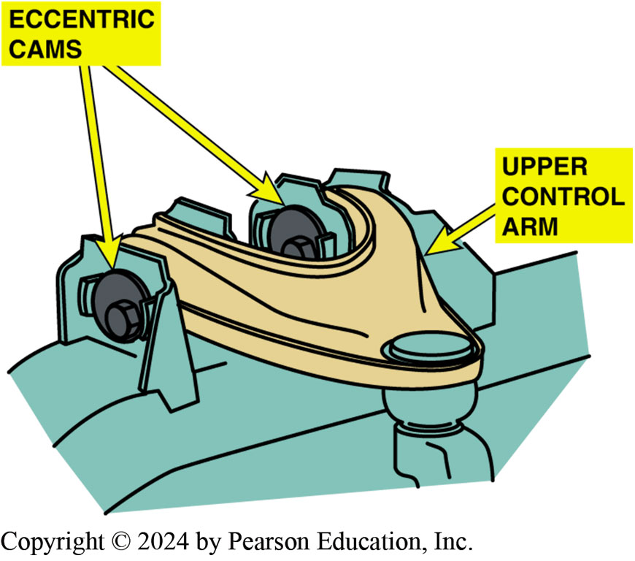
Figure 120.32 Eccentric Cam
When the nut is loosened and the bolt on the eccentric cam is rotated, the upper control arm moves in and out. By adjusting both eccentric cams, both camber and caster can be adjusted.

Slide 64
Setting T O E (1 of 2)
Toe Unit Conversions
UNITS | CONVERSIONS
Fractional Inches | 1/16 inch | 1/8 inch | 3/16 inch | ¼ inch
Decimal inches | 0.062 inches | 0.125 inches | 0.188 inches | 0.0250 inches
Decimal degrees | 0.125° | 0.25° | 0.375° | 0.5°
Degrees and minutes | 0°8 minutes | 0°15 minutes | 0°23 minutes | 0°30 minutes
Fractional degrees | 1/8° | 1/4° | 3/8° | ½°

Slide 65
Setting T O E (2 of 2)
To make sure the steering wheel is straight after setting toe, it must be locked in the straight-ahead position while the toe is being adjusted.
To lock the steering wheel, always use a steering wheel lock that presses against the seat and the outer rim of the steering wheel.
Centerline steering is a centered steering wheel with the vehicle traveling a straight course.

Slide 66
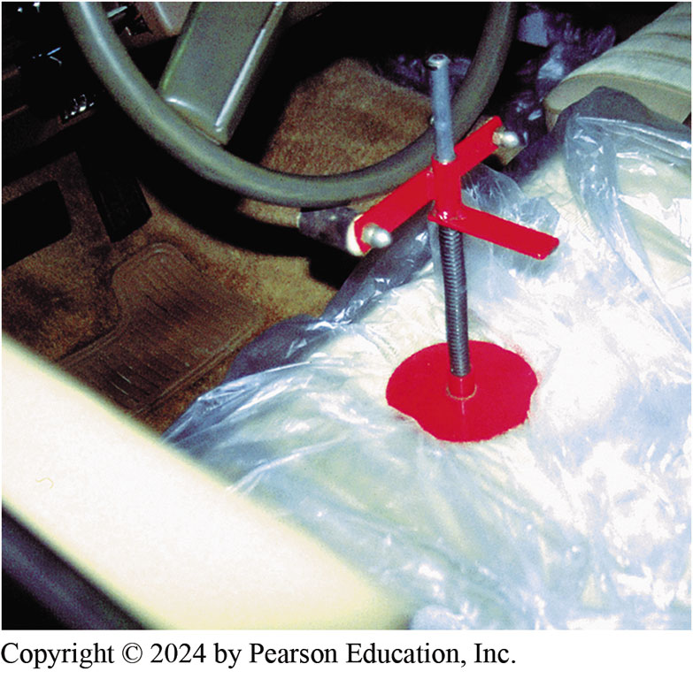
Figure 120.33 Locking Wheel
Many procedures for setting toe specify that the steering wheel be held in the straight-ahead position using a steering wheel lock, as shown. One method recommended by Hunter Engineering sets toe without using a steering wheel lock.

Slide 67
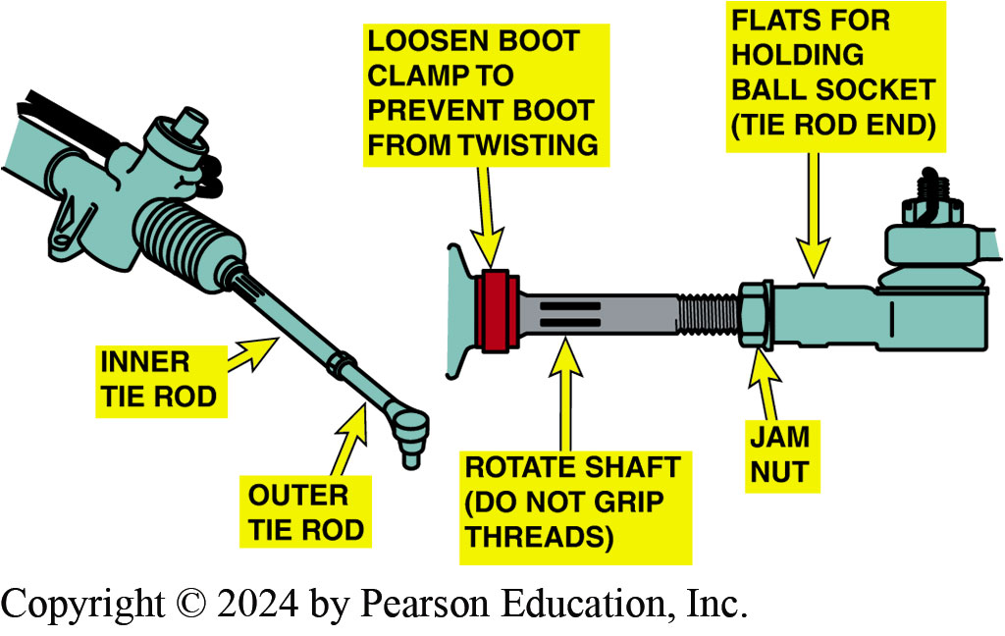
Figure 120.34 Adjusting Toe
Adjusting toe by rotating the tie rod on a vehicle equipped with rack-and-pinion steering

Slide 68
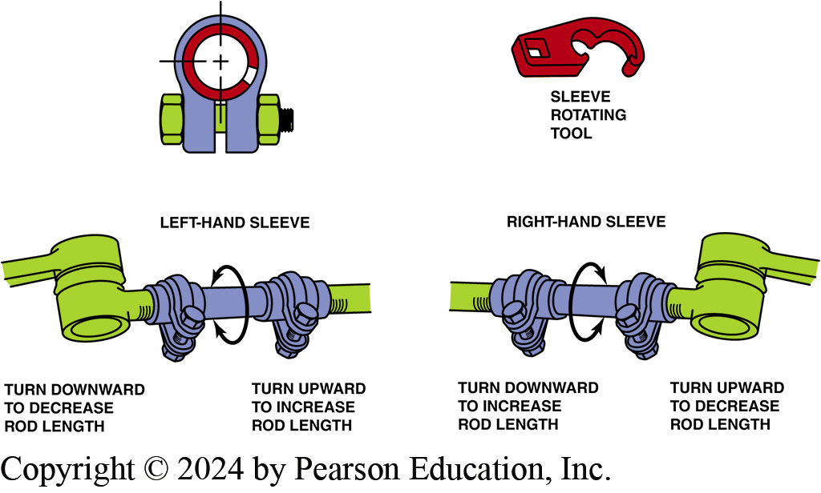
Figure 120.35 Adjusting Toe
Toe is adjusted on a parallelogram type steering linkage by turning adjustable tie rod sleeves. Special tie rod sleeve adjusting tools used that grip slot in sleeve and will not crush the sleeve while it is being rotated

Slide 69
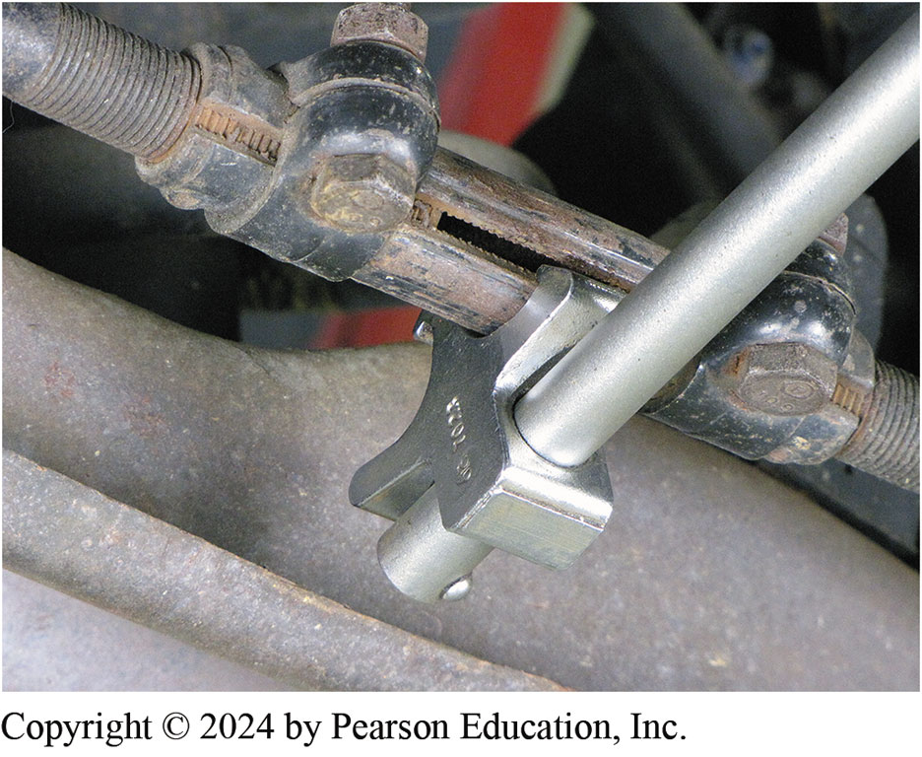
Figure 120.36 Toe Adjusting Tool
Special tie rod adjusting tools should be used to rotate the tie rod adjusting sleeves. The tool grips the slot in the sleeve and allows the service technician to rotate the sleeve without squeezing or damaging the sleeve.

Slide 70
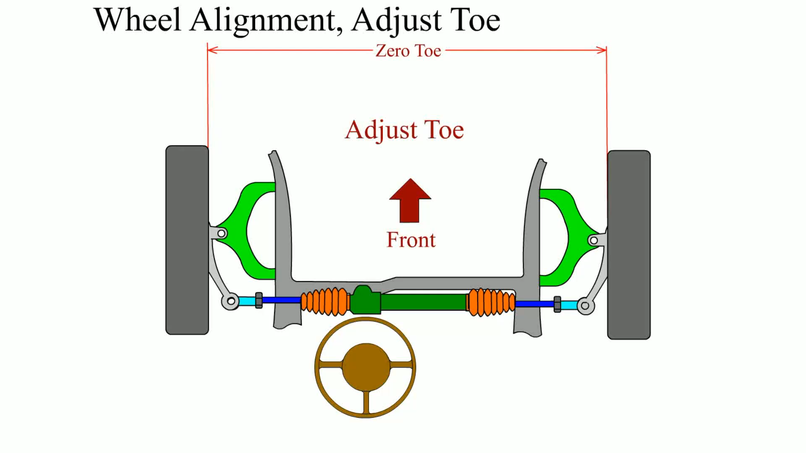
Animation: Wheel Alignment, Adjust Toe
(Animation will automatically start)

Slide 71
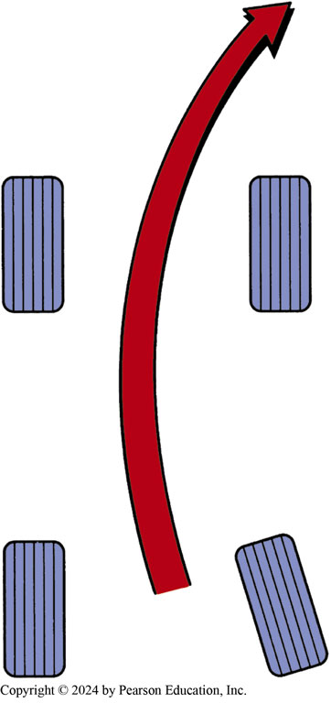
Figure 120.37 Toe Example
The toe-in on the right wheel creates a turning force toward the right

Slide 72
Centering The Steering Wheel
Centerline steering should be accomplished by adjusting the tie rod length on both sides of the vehicle while the toe is set.

Slide 73
Aftermarket Alignment Methods
Aftermarket alignment kits are available for most vehicles.
Kit may include:
  Shims
  Cam bolts
  Parts with greater adjustment ranges

Slide 74
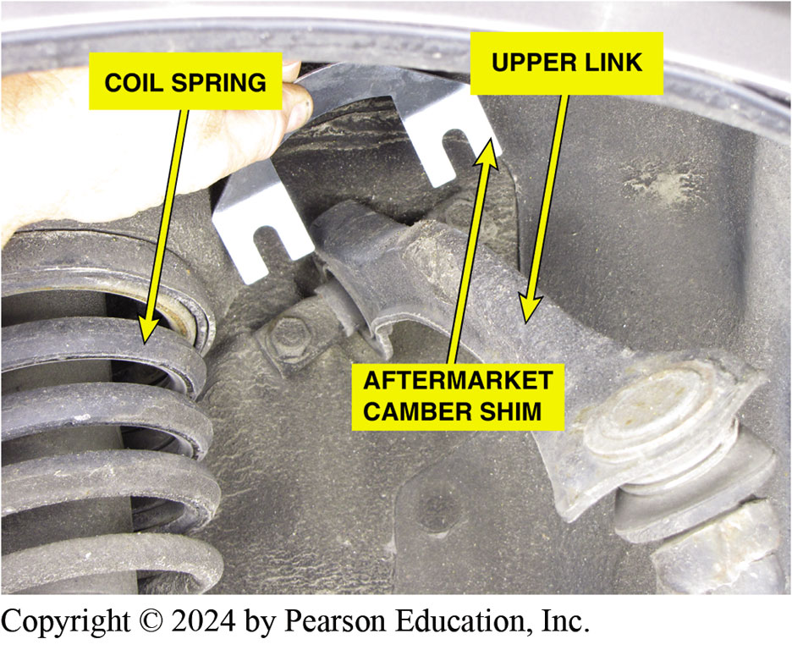
Figure 120.38 Aftermarket Shim
An aftermarket camber shim can be added to change the front camber on this Honda

Slide 75
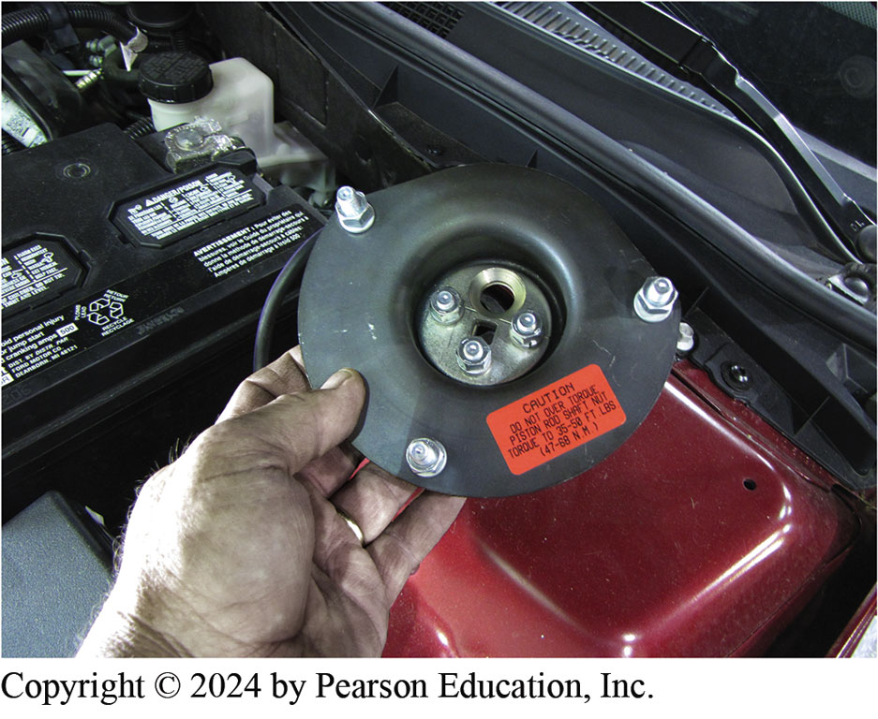
Figure 120.39 Aftermarket Kit
An aftermarket kit for this Ford is installed at the top of the strut tower and allows more camber and caster adjustment than is possible with the factory adjustment

Slide 76
Tolerance Adjustment Procedure
Many vehicles are designed and built without a method to change caster or camber, or both. (All vehicles have an adjustment for toe.)
Before trying an aftermarket alignment correction kit, many technicians first attempt to correct the problem by moving the suspension attachment points within the build tolerance.

Slide 77
Aligning Electronic Suspension Vehicles
Always check service information and read carefully all on-screen instructions on the alignment machine. Some examples of the steps that may be needed include:
  Verify the exact type of electronic suspension.
  Check that the ride height (suspension height) is within factory specifications.
The steering wheel angle, as well as the radar cruise control sensor, will often need to be recalibrated using a scan tool.

Slide 78
Reset Steering Angle Sensor (S A S)
(1 of 2)
Purpose
  The steering angle sensor (S A S) is usually located at the base of the steering column inside the vehicle and monitors the driver’s steering input from straight ahead.
Analog Steering Angle Sensor
  An analog steering angle sensor is similar to a throttle position sensor with a three-wire connector.

Slide 79
Reset Steering Angle Sensor (S A S) (2 of 2)
Digital Steering Angle Sensor
  These sensors produce a digital square wave signal with the frequency or pattern depending on the speed and direction the wheel is turning.
Resetting Steering Angle Sensors
  There are two basic types of reset procedures including:
  Self calibration
  Scan tool calibration

Slide 80
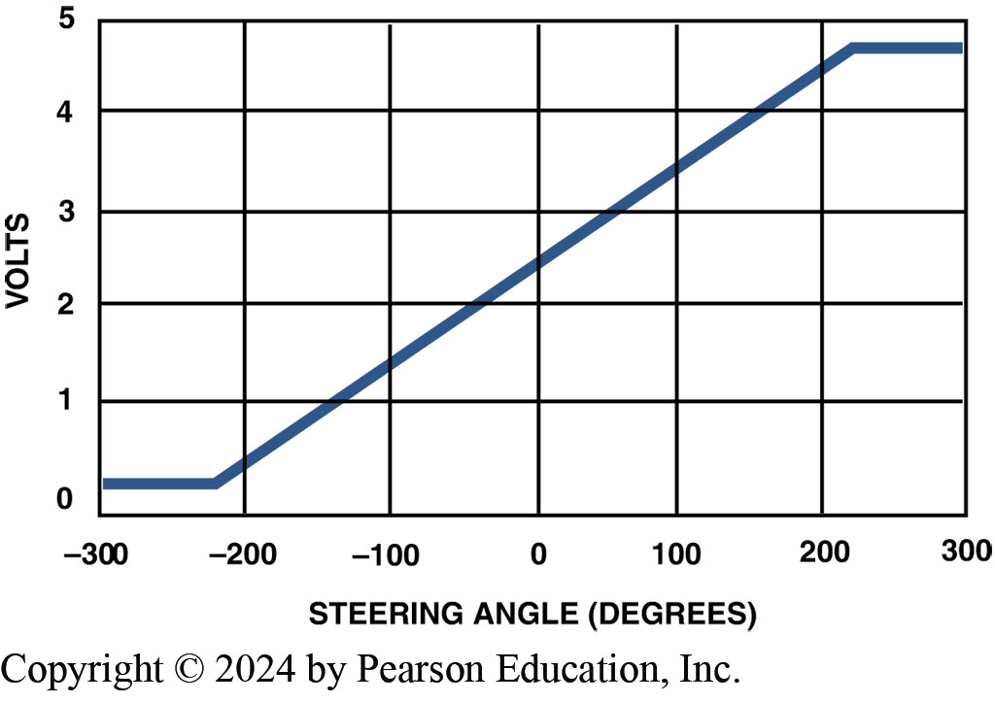
Figure 120.40 Analog Sensor
A typical analog-type steering angle sensor that uses a variable voltage as the steering wheel is rotated

Slide 81
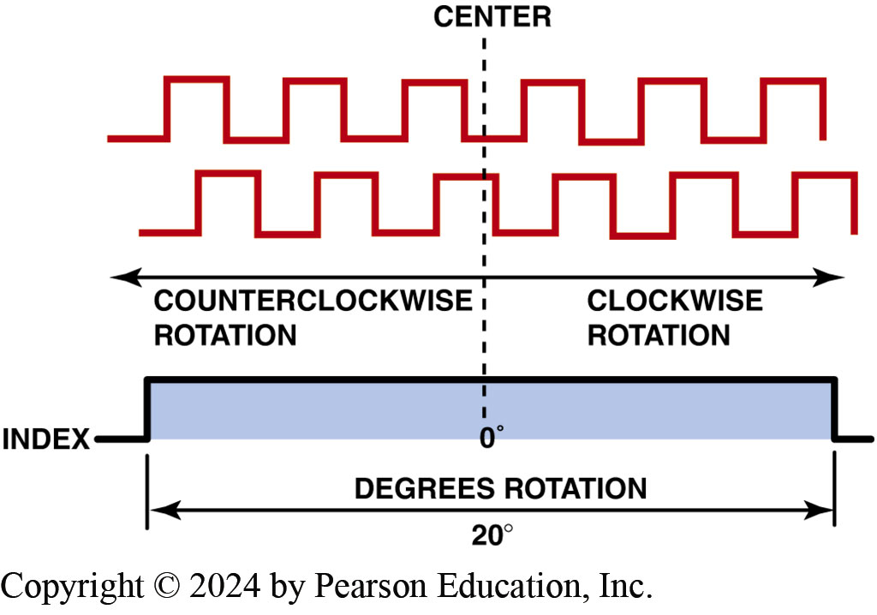
Figure 120.41 Digital Sensor
The output of a typical digital steering angle sensor

Slide 82
Question 3: ?
What is the purpose of the steering angle sensor?

Slide 83
Answer 3
The sensor monitors the drivers input from straight ahead.

Slide 84
Aligning Modified Vehicles
Alignment Concerns
Because the ride height is changed from stock factory setting, the following can occur:
  The steering axis inclination (S A I) is now incorrect.
  Because the steering linkage and the control arms are no longer parallel, bump steer can occur.
  Because the ride height changed, camber and toe also changed.
Aftermarket kits are available to help correct some concerns.

Slide 85
Hidden Structural Damage
Many accidents result in hidden structural damage that can cause alignment angles to be out of specification.
Frame/Body Diagonals
  If the frame or body is perfectly square, then the diagonal measurements should be within 1/8 inch (3 mm) of each other.

Slide 86
Alignment

Slide 87
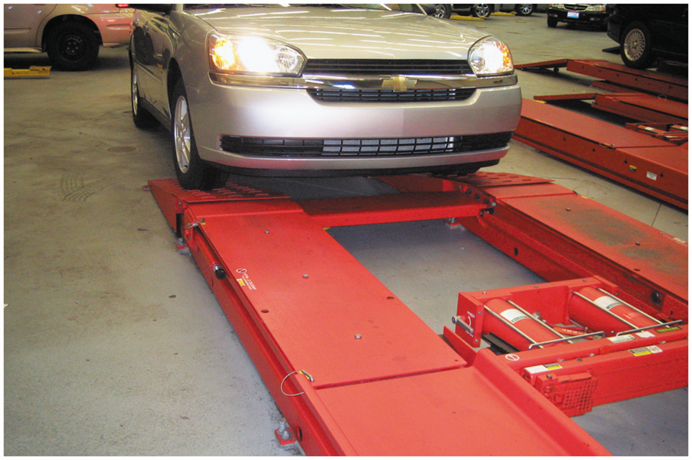
1. Drive on Ramp
1 Begin the alignment procedure by first driving the vehicle onto the alignment rack as straight as possible

Slide 88
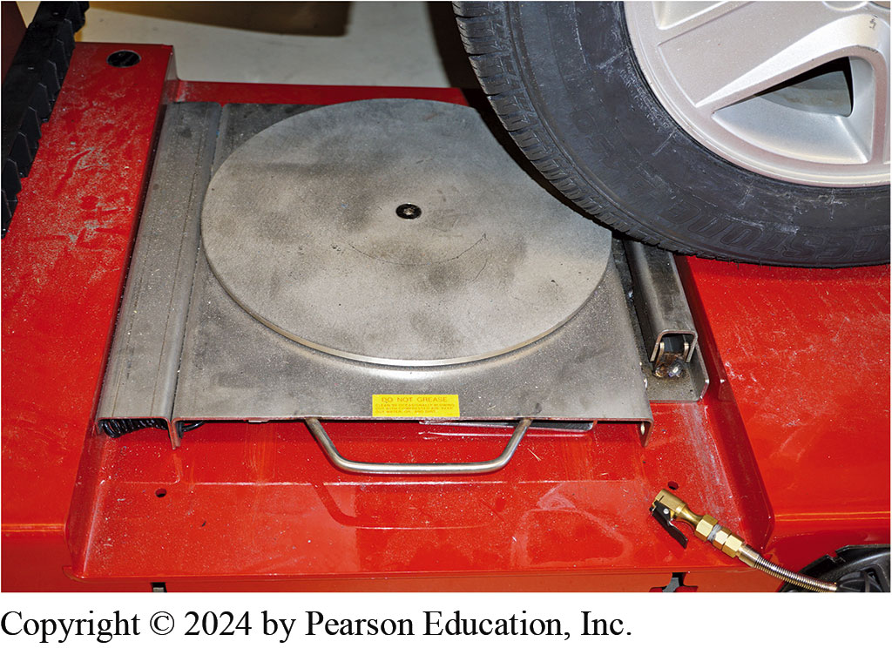
2. Position Plate
2 Stop just short of the turn plate and position the plate to center it on the tire tread

Slide 89
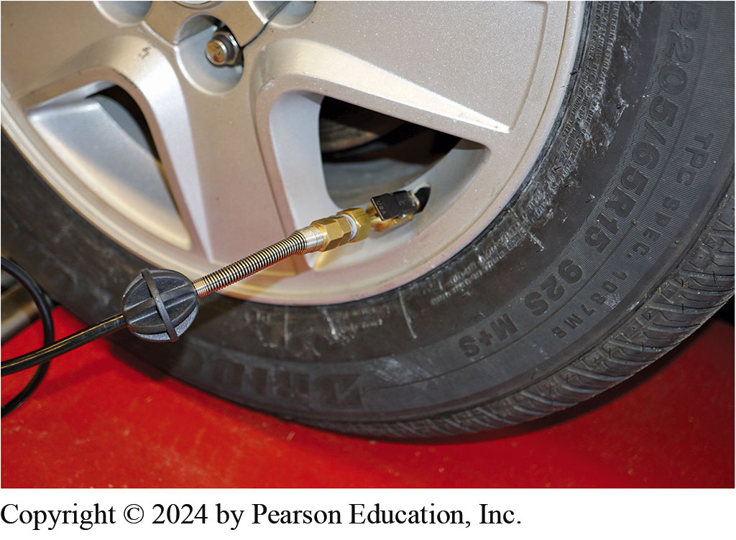
3. Adjust Tire Pressure
3 Check and adjust tire pressures and perform the pre-alignment checks necessary to be assured of proper alignment

Slide 90
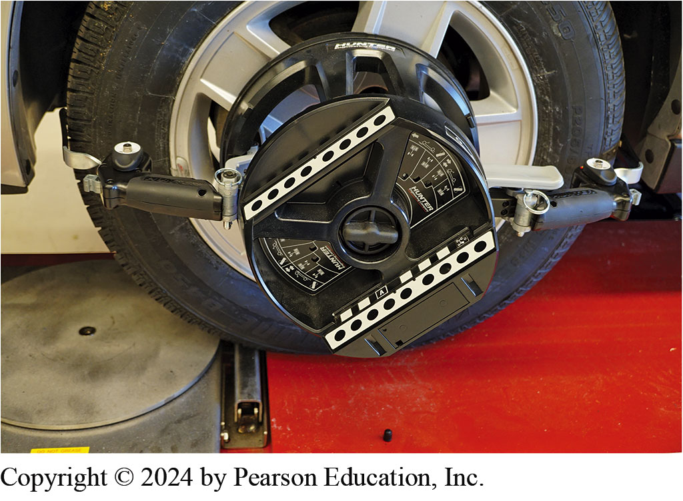
4. Mount Targets
4 Securely mount the targets or alignment heads

Slide 91
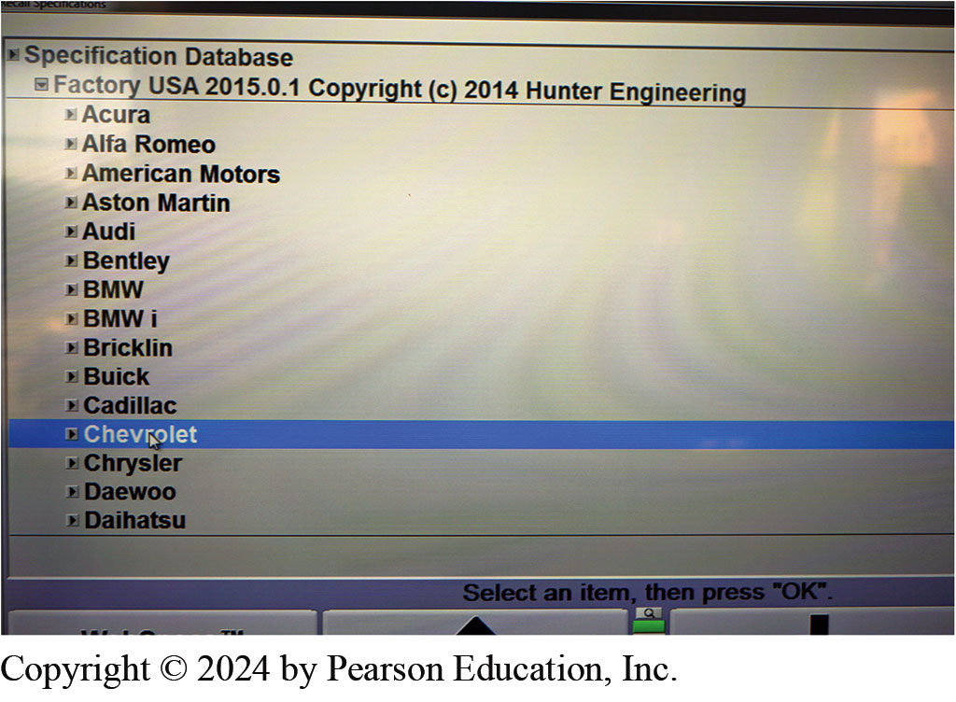
5. Enter VIN
5 Select the exact vehicle on the aligner. The aligner may have a bar code reader to enter vehicle VIN

Slide 92
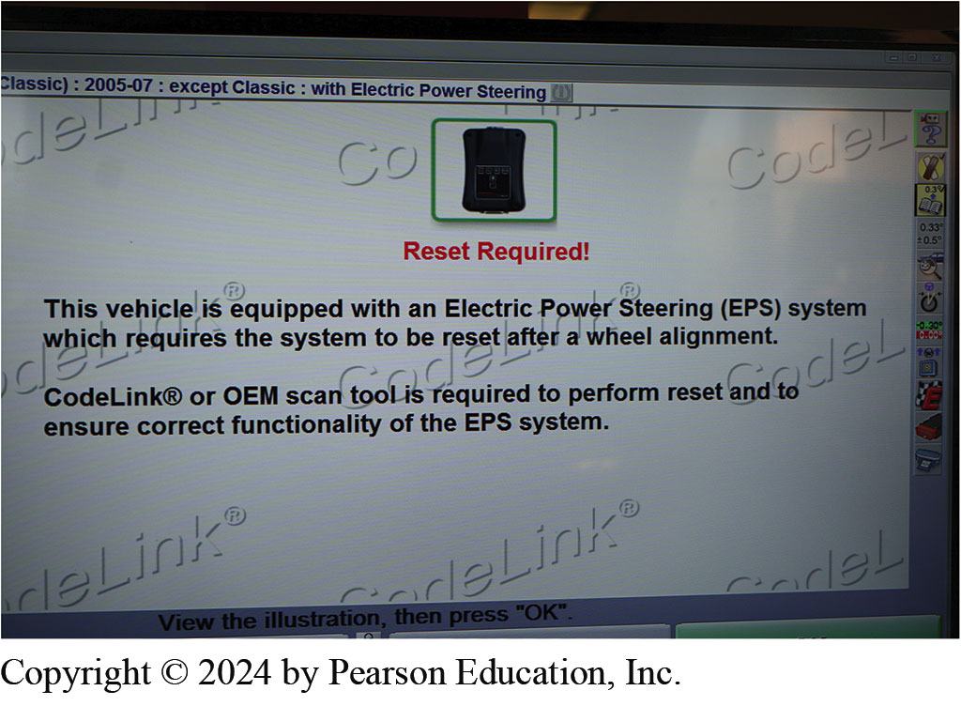
6. EPS Message
6 On this vehicle, a message is displayed concerning the electric power steering

Slide 93

7. Roll-forward Compensation
7 This aligner uses a roll-forward compensation method

Slide 94

8. Display
8 An alignment reading is displayed even though caster has not yet been measured. The readings marked in red indicate that they are not within specifications

Slide 95

9. Set Brake Pedal Depressor
9 Before performing a caster sweep, install a brake pedal depressor to keep the front wheels from rotating when the
steering wheel is turned

Slide 96

10. Caster Sweep
10 Perform the caster sweep by turning the front wheels inward, and then outward following the instructions on the screen

Slide 97

11. Video Procedures
11 Most alignment machines will display where to make the alignment correction and will often include drawings and live action videos that show the procedure

Slide 98

12. Rear Toe Set
12 The rear toe is being adjusted by rotating the eccentric cam on the lower control arm while watching the display

Slide 99

13. Caster Not Needed on Vehicle
13 The alignment machine display indicates that front caster is not a factory-adjustable angle

Slide 100

14. Adjusting Front Toe
14 Adjusting the front toe on this vehicle involves loosening the jam nut (left wrench) and rotating the tie rod using the right wrench

Slide 101

15. Right Front Toe Needed
15 An adjustment of the right front toe is needed to achieve a perfect alignment

Slide 102

16. Reset Steering Angle Sensor
16 A final step is needed for vehicles equipped with a steering angle sensor and/or electric power steering. The wireless reset tool is attached to the data connector

Slide 103

17. Correct Steering Sensor Reading
17 With the wheel straight ahead the sensor shows an incorrect reading

Slide 104

18. Reset EPS Sensors
18 Follow the instructions on the screen to reset the electric power steering (EPS) sensors. The final alignment readings can be printed and attached to the work order

Slide 105

Animation: Wheel Alignment: Turning Radius
(Animation will automatically start)

Slide 106

Animation: W.A. Align Steering Wheel
(Animation will automatically start)

Slide 107
Suspension and Steering Videos and Animations
Videos Link: (A4) Suspension and Steering Videos
Animations Link: (A4) Suspension and Steering Animations

Slide 108
Copyright
This work is protected by United States copyright laws and is provided solely for the use of instructors in teaching their courses and assessing student learning. Dissemination or sale of any part of this work (including on the World Wide Web) will destroy the integrity of the work and is not permitted. The work and materials from it should never be made available to students except by instructors using the accompanying text in their classes. All recipients of this work are expected to abide by these restrictions and to honor the intended pedagogical purposes and the needs of other instructors who rely on these materials.

