Slide 1
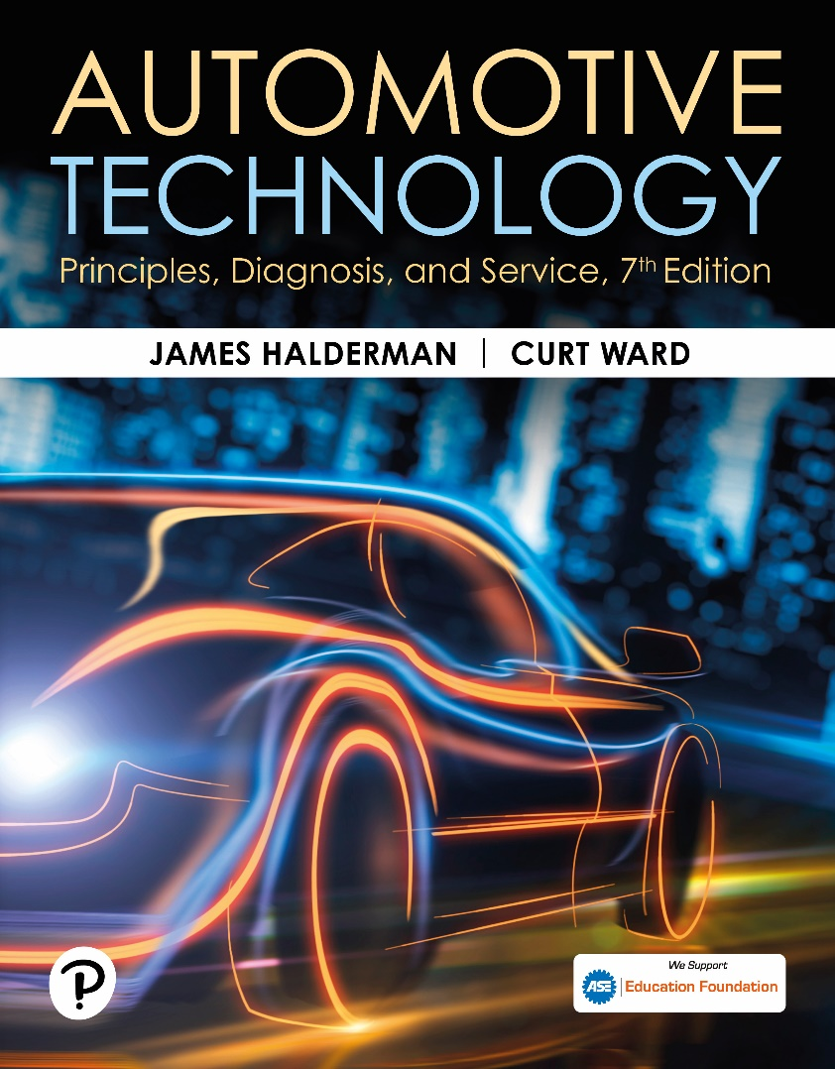
Automotive Technology: Principles, Diagnosis, and Service
Seventh Edition
Chapter 12
Scientific Principles and Materials
Copyright © 2023 Pearson Education, Inc. All Rights Reserved
Notes:
INSTRUCTOR NOTE: This presentation includes text explanation notes, you can use to teach the course. When in SLIDE SHOW mode, you RIGHT CLICK and select SHOW PRESENTER VIEW, to use the notes.

Slide 2
Learning Objectives (1 of 2)
12.1 Discuss use of scientific methods and energy principles in solving problems.
12.2 Explain relationship between torque, work, power, and horsepower.
12.3 Explain importance of Newton’s laws of motion, kinetic energy, inertia, and mechanical principles in brake design.
12.4 Explain importance of kinetic energy in brake design.
12.5 Explain importance of inertia in brake design.
12.6 Explain importance of mechanical principles in brake design.

Slide 3
Learning Objectives (2 of 2)
12.7 Discuss the concepts of heat and temperature.
12.8 Discuss the concepts of acids and bases.
12.9 Discuss gas laws.
12.10 Discuss sound and acoustics.
12.11 Discuss iron and steel.
12.12 Describe SAE steel designations.
12.13 Describe aluminum and aluminum alloys.

Slide 4
Scientific Method
A series of steps taken to solve a problem.
Used to determine the root cause of a failure.
Sometimes referred too as the “5 whys”
The root cause of the problem is typically found by the fifth time the question is asked.

Slide 5
Energy Principles
Energy is the ability or capacity to do work.
Many forms of energy:
Chemical
Mechanical
Electrical
Kinetic energy is energy in the form of a moving object.
Potential energy is energy that is capable of being changed to useful energy.

Slide 6
Figure 12.1 Energy
Energy, which is the ability to perform work, exists in many forms

Slide 7
Question 1: ?
What is kinetic energy?

Slide 8
Answer 1
Energy in the form of a moving object.

Slide 9
Torque
A term used to describe a rotating force that may or may not result in motion.
Measured as the amount of force multiplied by the length of the lever on which it acts.
Typically measured in:
Newton-meters
Pound-foot

Slide 10
Figure 12.2 Torque
Torque is a twisting force equal to the distance from the pivot point times the force applied expressed in units called pound-feet (lb-ft) or Newton-meters (N-m)

Slide 11
Newton-Meters to Pound-Feet Conversion Chart
Newton-Meters to Pound-Feet Conversion Chart (1 N-m = 0.74 lb-ft)
N-m | Lb-ft | N-m | Lb-ft | N-m | Lb-ft | N-m | Lb-ft
1 | 0.74 | 26 | 19.2 | 51 | 37.7 | 76 | 56.2
2 | 1.5 | 27 | 20.0 | 52 | 38.5 | 77 | 57.0
3 | 2.2 | 28 | 20.7 | 53 | 39.2 | 78 | 57.7
4 | 3.0 | 29 | 21.5 | 54 | 40.0 | 79 | 58.5
5 | 3.7 | 30 | 22.2 | 55 | 40.7 | 80 | 59.2
6 | 4.4 | 31 | 22.9 | 56 | 41.4 | 81 | 59.9
7 | 5.2 | 32 | 23.7 | 57 | 42.2 | 82 | 60.7
8 | 5.9 | 33 | 24.4 | 58 | 42.9 | 83 | 61.4
9 | 6.7 | 34 | 25.2 | 59 | 43.7 | 84 | 62.2
10 | 7.4 | 35 | 25.9 | 60 | 44.4 | 85 | 62.9
11 | 8.1 | 36 | 26.6 | 61 | 45.1 | 86 | 63.6
12 | 8.9 | 37 | 27.4 | 62 | 45.9 | 87 | 64.4
13 | 9.6 | 38 | 28.1 | 63 | 46.6 | 88 | 65.1
14 | 10.4 | 39 | 28.9 | 64 | 47.4 | 89 | 65.9
15 | 11.1 | 40 | 29.6 | 65 | 48.1 | 90 | 66.6
16 | 11.8 | 41 | 30.3 | 66 | 48.8 | 91 | 67.3
17 | 12.6 | 42 | 31.1 | 67 | 49.6 | 92 | 68.1
18 | 13.3 | 43 | 31.8 | 68 | 50.3 | 93 | 68.8
19 | 14.1 | 44 | 32.6 | 69 | 51.0 | 94 | 69.6
20 | 14.8 | 45 | 33.3 | 70 | 51.8 | 95 | 70.3
21 | 15.5 | 46 | 34.0 | 71 | 52.5 | 96 | 71.0
22 | 16.3 | 47 | 34.8 | 72 | 53.3 | 97 | 71.8
23 | 17.0 | 48 | 35.5 | 73 | 54.0 | 98 | 72.5
24 | 17.8 | 49 | 36.3 | 74 | 54.8 | 99 | 73.3
25 | 18.5 | 50 | 37.0 | 75 | 55.5 | 100 | 74.0

Slide 12
Pound-Feet to Newton-Meters Conversion Chart
Pound-Feet to Newton-Meters Conversion Chart (1 lb-ft = 1.4 N-m)
Lb-ft | N-m | Lb-ft | N-m | Lb-ft | N-m | Lb-ft | N-m
1 | 1.4 | 26 | 36.4 | 51 | 71.4 | 76 | 106.4
2 | 2.8 | 27 | 37.8 | 52 | 72.8 | 77 | 107.8
3 | 4.2 | 28 | 39.2 | 53 | 74.2 | 78 | 109.2
4 | 5.6 | 29 | 40.6 | 54 | 75.6 | 79 | 110.6
5 | 7.0 | 30 | 42.0 | 55 | 77.0 | 80 | 112.0
6 | 8.4 | 31 | 43.4 | 56 | 78.4 | 81 | 113.4
7 | 9.8 | 32 | 44.8 | 57 | 79.8 | 82 | 114.8
8 | 11.2 | 33 | 46.2 | 58 | 81.2 | 83 | 116.2
9 | 12.6 | 34 | 47.6 | 59 | 82.6 | 84 | 117.6
10 | 14.0 | 35 | 49.0 | 60 | 84.0 | 85 | 119.0
11 | 15.4 | 36 | 50.4 | 61 | 85.4 | 86 | 120.4
12 | 16.8 | 37 | 51.8 | 62 | 86.8 | 87 | 121.8
13 | 18.2 | 38 | 53.2 | 63 | 88.2 | 88 | 123.2
14 | 19.6 | 39 | 54.6 | 64 | 89.6 | 89 | 124.6
15 | 21.0 | 40 | 56.0 | 65 | 91.0 | 90 | 126.0
16 | 22.4 | 41 | 57.4 | 66 | 92.4 | 91 | 127.4
17 | 23.8 | 42 | 58.8 | 67 | 93.8 | 92 | 128.8
18 | 25.2 | 43 | 60.2 | 68 | 95.2 | 93 | 130.2
19 | 26.6 | 44 | 61.6 | 69 | 96.6 | 94 | 131.6
20 | 28.0 | 45 | 63.0 | 70 | 98.0 | 95 | 133.0
21 | 29.4 | 46 | 64.4 | 71 | 99.4 | 96 | 134.4
22 | 30.8 | 47 | 65.8 | 72 | 100.8 | 97 | 135.8
23 | 32.2 | 48 | 67.2 | 73 | 102.2 | 98 | 137.2
24 | 33.6 | 49 | 68.6 | 74 | 103.6 | 99 | 138.6
25 | 35.0 | 50 | 70.0 | 75 | 105.0 | 100 | 140.0

Slide 13
Animation: Math Formula, lb-ft to lb-in, Torque (Animation will automatically start)

Slide 14
Animation: Math Formula, lb-in to lb-ft, Torque (Animation will automatically start)

Slide 15
Work
Work is defined as actually accomplishing movement when force (torque) is applied to an object.
Work is calculated by multiplying the applied force by the distance the object moves.

Slide 16
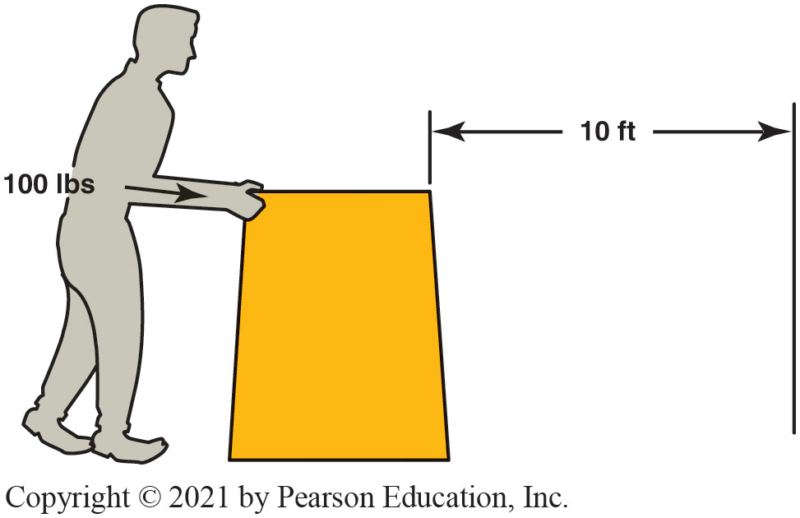
Figure 12.3 Work
Work is calculated by multiplying force times distance. If you push 100 pounds 10 feet, you have done 1,000 foot-pounds of work.
Notes:
Work is done when a certain amount of mass (weight) is moved a certain distance by a force. Whether the object is moved in 10 seconds or 10 minutes does not make a difference in the amount of work accomplished, but it does affect the amount of power
needed. ● SEE FIGURE 2–4.

Slide 17
Horsepower (1 of 2)
Power: Rate of Doing Work.
Power equals work divided by time.
Work is done when a certain amount of mass (weight)
is moved a certain distance by a force. Whether

Slide 18
Power and Horsepower
Power means the rate of doing work.
Typically expressed in foot-pound per minute
Horsepower is defined as the power needed to move 550 pounds one foot in one second.
Engine horsepower often is measured by a dynamometer.

Slide 19
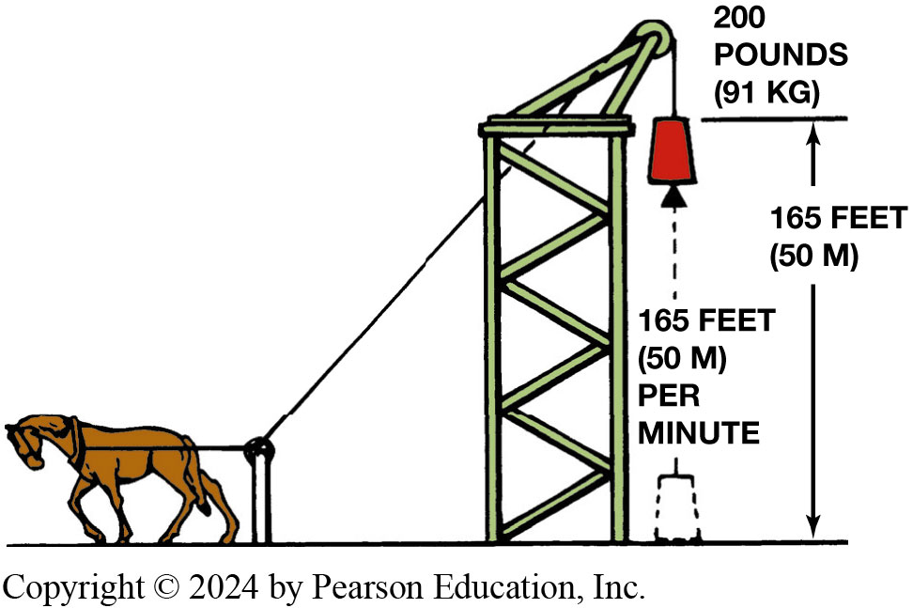
Figure 12.4 Horsepower
One horsepower is equal to 33,000 footpounds (200 lbs × 165 ft) of work per minute
Notes:
Power is expressed in units of foot-pounds per minute. One horsepower is the power required to move
550 pounds one foot in one second, or 33,000 pounds one foot in one minute (550 lb × 60 sec = 33,000 lb). This is expressed as 550 foot-pounds (ft-lb) per second or 33,000 foot-pounds per minute. ● Figure 2–5.

Slide 20
Horsepower (2 of 2)
Power Equals Work Divided by Time.
Torque and horsepower:
Horsepower = Torque × rpm/5,252
Torque increased using Gears
Gear set can increase torque, but decrease speed by same amount
Figure 12-4 One horsepower is equal to 33,000 footpounds (200 lbs × 165 ft) of work per minute

Slide 21
Animation: Math Formula: Horsepower (Animation will automatically start)

Slide 22
Question 2?
Horsepower is which of these?
Rate of doing work
Same as torque
Determines vehicle speed
RPM times 5252

Slide 23
Answer 2
A. rate of doing work

Slide 24
Frequently Asked Question: What Is the Difference between Torque and Work?
? Frequently Asked Question
What Is the Difference between Torque and Work? The designations for torque and work are often confusing. Torque is expressed in pound-feet because it represents a force exerted a certain distance from the object and acts as a lever. Work, however, is expressed in foot-pounds because work is the movement over a certain distance (feet) multiplied by the force applied (pounds). Engines produce torque and service technicians exert torque represented by the unit pound-feet.

Slide 25
Question 3: ?
What is the difference between torque and power?

Slide 26
Answer 3
Torque is a force and power is the rate of doing work.

Slide 27
Newton’s Laws of Motion
Newton’s first law of motion states that an object at rest tends to stay at rest and an object in motion tends to stay in motion unless acted on by an outside force.
Newton’s second law of motion states that the force needed to move an object is proportional to the mass of the object multiplied by the acceleration rate of the object.
Newton’s third law of motion states that for every action, there is an opposite and equal reaction.

Slide 28
Kinetic Energy
The energy of mass in motion.
Every moving object possesses kinetic energy.
The amount of energy is determined by the speed and mass of the object.
Greater the mass or faster the speed, the more kinetic energy.
Notes:
See Page 109 for formula

Slide 29
Figure 12.5 Kinetic Energy/Weight
Kinetic energy increases in direct proportion to the weight of the vehicle

Slide 30
Figure 12.6 Kinetic Energy/Speed
Kinetic energy increases as the square of any increase in vehicle speed

Slide 31
Animation: Inertia Law (Animation will automatically start)

Slide 32
Frequently Asked Question: What Is the Difference between Mass and Weight?
? Frequently Asked Question
What Is the Difference between Mass and Weight? Mass is the amount of matter in an object. One of the properties of mass is inertia. Inertia is the resistance to being put in motion and the tendency to remain in motion once it is set in motion. The weight of an object is the force of gravity on the object and may be defined as the mass times acceleration of gravity. Therefore, mass means the property of an object and weight is a force.
Notes:
TECH TIP: Brakes Cannot Overcome the Laws of Physics: No vehicle can stop on a dime. The energy required
to slow or stop a vehicle must be absorbed by the braking system. All drivers should be aware of this fact and drive at a reasonable speed for the road and traffic conditions.
Although brake engineers take both weight and speed capability into account when designing a brake system, these are not the only factors involved. Another physical property, inertia, also affects the braking process and the selection of brake components. Inertia is defined by Isaac Newton’s first law of motion, which states that a body at rest tends to remain at rest, and a body in motion tends to remain in motion in a straight line unless acted upon by an outside force.

Slide 33
Mechanical Principles
Leverage: Used to increase application force.
Fulcrum: A fixed point that is used for a pivot.
Three basic types of levers.
All change a quantity of energy into a useful form.

Slide 34
Figure 12.7 First Class Lever
A first-class lever increases force and changes the direction of the force
Notes:
A first-class lever increases the force applied to it and also changes the direction of the force. ^{● SEE FIGURE 12–7.}
With a first-class lever, the weight is placed at one end while the lifting force is applied to the other. The fulcrum is positioned at some point in between. If the fulcrum is placed twice as far from the long end of the lever as from the short end, a 10-pound weight on the short end can be lifted by only a 5-pound force at the long end. However, the short end of the lever will travel only half as far as the long end. Moving the fulcrum closer to the weight will further reduce the force required to lift it, but it will also decrease the distance the weight is moved.

Slide 35
Figure 12.8 Second Class Lever
A second-class lever increases force in the same direction as it is applied
Notes:
A second-class lever increases the force applied to it and passes it along in the same direction. ^{● SEE FIGURE 12–8.}
With a second-class lever, the fulcrum is located at one end while the lifting force is applied at the other. The weight is posi- tioned at some point in between. If a 10-pound weight is placed at the center of the lever, it can be lifted by only a 5-pound force at the end of the lever. However, the weight will only travel half the distance the end of the lever does. As the weight is moved closer to the fulcrum, the force required to lift it, and the distance it travels, are both reduced.

Slide 36
Figure 12.9 Third Class Lever
A third-class lever reduces force but increases the speed and travel of the resulting work
Notes:
A third-class lever actually reduces the force applied to it, but the resulting force moves farther and faster. ^{● SEE FIGURE 12–9.}
With a third-class lever, the fulcrum is located at one end and the weight is placed at the other. The lifting force is applied at some point in between. If a 10-pound weight is placed at the end of the lever, it can be lifted by a 20-pound force applied at the middle of the lever. Although the force required to move the weight has doubled, the weight is moved twice as far and twice as fast as the point on the lever where the force was applied. The closer to the fulcrum the lifting force is applied, the greater the force required by the weight and the farther and faster the weight
will move.

Slide 37
Figure 12.10 Brake Pedal Lever
This brake pedal assembly provides a 5:1 mechanical advantage because a 10-lb force input results in a 50-lb force into the master cylinder
Notes:
For example, first- or second-class levers are used on brake systems to increase braking force while making it easier for the driver to control the amount of force applied. Second-class levers are the most common, and the service brake pedal is a good example. In a typical suspended brake pedal, the pedal arm is the lever, the pivot point is the fulcrum, and the force is applied at the foot pedal pad. The force is applied to the master cylinder by the pedal pushrod attached to the pivot is much greater than the force applied at the pedal pad, but the pushrod does not travel nearly as far. Leverage creates a mechanical advantage that, at the brake pedal, is called the pedal ratio. For example, a pedal ratio of 5 to 1 is common for brakes, which means that a force of 10 pounds at the brake pedal will result in a force of 50 pounds at the pedal pushrod. In practice, leverage is used at many points in both the service and parking brake systems.

Slide 38
Heat and Temperature
Heat is measured in British Thermal Units (B T U s)
One B T U is the amount of heat needed to raise the temperature of one pound of water one degree Fahrenheit.
Heat transferred three ways:
Conduction
Convection
Radiation
Temperature is measurement of ability to give up/absorb heat.
Measured in Celsius or Fahrenheit

Slide 39
Frequently Asked Question: How Does a Coat Keep You Warm?
? Frequently Asked Question
How Does a Coat Keep You Warm? A coat is worn in cold weather to keep warm. Does it keep the cold out or the heat in? Actually, both, but because heat travels from a warm object (human body) to a colder object (outside cold air), the primary purpose of a coat is to keep the body heat from escaping into the cold air.
Notes:
TECH TIP Quick and Easy Temperature Conversion Many service information and scan tool data are expressed in degrees Celsius, which is often confusing to those used to temperature expressed in Fahrenheit degrees. A quick and easy way to get an approximate
conversion is to take the degrees in Celsius, double it, and add 25. See page 112

Slide 40
Figure 12.11 Thermometer
A typical outdoor thermometer which is used to measure temperature, not heat
Notes:
TECH TIP: Conductors and Insulators
If a material is a good conductor of heat, it is also a good conductor of electricity. Most conductors are metals, such as steel, copper, aluminum, and brass. Most insulators are nonmetals, such as plastic and rubber. Therefore, if a material does not conduct heat, it usually will not conduct electricity.

Slide 41
Temperature
Temperature Symbol | Degree Celsius °C | Degree Fahrenheit °F
Boiling point of water | 100.0 | 212.0
Average human body temperature | 37.0 | 98.6
Average room temperature | 20.0–25.0 | 68.0–77.0
Melting point of ice | 0.0 | 32.0

Slide 42
Animation: Math Formula: Metric-English Conversion: Temperature (Animation will automatically start)

Slide 43
Frequently Asked Question: What Is Thermodynamics?
? Frequently Asked Question
What Is Thermodynamics? Thermodynamics is the study of the relationship among temperature, pressure, and volume changes. The laws of thermodynamics help engineers design and develop engines with higher efficiency. Thermodynamics is therefore used in the design of the cooling system, as well as in the engine. The more heat created by the burning of fuel in the engine, more power the engine can develop using same or less amount of fuel.

Slide 44
Acids and Bases
Acids: Substances that can corrode metal or cause severe skin burns. Include hydrochloric acid, nitric acid, and battery acid.
Bases: An alkaline that if strong enough can burn skin. Include: lye, bleach, drain cleaner.
pH Scale: On a scale of 1–14; used to indicate the amount of chemical activity in a substance.

Slide 45
Frequently Asked Question: Can Water and Acid Be Mixed Together?
? Frequently Asked Question
Can Water and Acid Be Mixed Together? Acids have a very strong affinity for water and as a result, if water is poured into acid, the resulting reaction would be extremely violent and acid would be forced outward in all directions. Always pour acid into water, never water into acid. Technicians seldom need to work with acids because even battery electrolytes from the water and acid are premixed to help prevent the possibility of a technician creating a harmful reaction.

Slide 46
Gas Laws
Boyle’s Law: The volume of a gas varies inversely (opposite) with the pressure exerted against it in a closed container.
Charles's Law: When the temperature of a gas increases, the volume increases. When the temperature of a gas decreases, the volume decreases.

Slide 47
Sound and Acoustics
Sound: The movement of air that the ear interprets.
Sound has two properties:
Frequency: cycles per second
Intensity: The loudness of the sound
Acoustics: The study of how sound is generated and transmitted.
Used to reduce noise that is transmitted to passenger compartment.

Slide 48
Iron and Steel
Cast Iron: Cast iron contains 2% to 4% carbon and this carbon is usually in the shape of flakes of graphite 0.001 to 0.004 inches long.
Ductile Cast Iron: The carbon in the alloy with silicon are small ball-shapes called spherloidols.
Grey Cast Iron: Gray cast iron is cast iron that has another element, silicon, in the alloy, giving the metal a gray color.

Slide 49
S A E Steel Designations
Mild (low carbon) steel: Has less than 20 points of carbon (0.02%).
Medium carbon steel: Usually has between 25 and 50 points of carbon (0.25% and 0.50%).
High carbon steel: Usually has between 60 and 100 points (0.60% and 1.00%) of carbon and is very strong.

Slide 50
Aluminium and Aluminium Alloys
Lightweight material
Most always combined with small quantities of other metals to form an alloy.
Alloys are identified with a four-digit number and a letter to identify heat treating.

Slide 51
Automotive Fundamentals Videos and Animations
Videos Link: (A0) Automotive Fundamentals Videos
Animations Link: (A0) Automotive Fundamentals Animations

Slide 52
Copyright
This work is protected by United States copyright laws and is provided solely for the use of instructors in teaching their courses and assessing student learning. Dissemination or sale of any part of this work (including on the World Wide Web) will destroy the integrity of the work and is not permitted. The work and materials from it should never be made available to students except by instructors using the accompanying text in their classes. All recipients of this work are expected to abide by these restrictions and to honor the intended pedagogical purposes and the needs of other instructors who rely on these materials.

