Slide 1
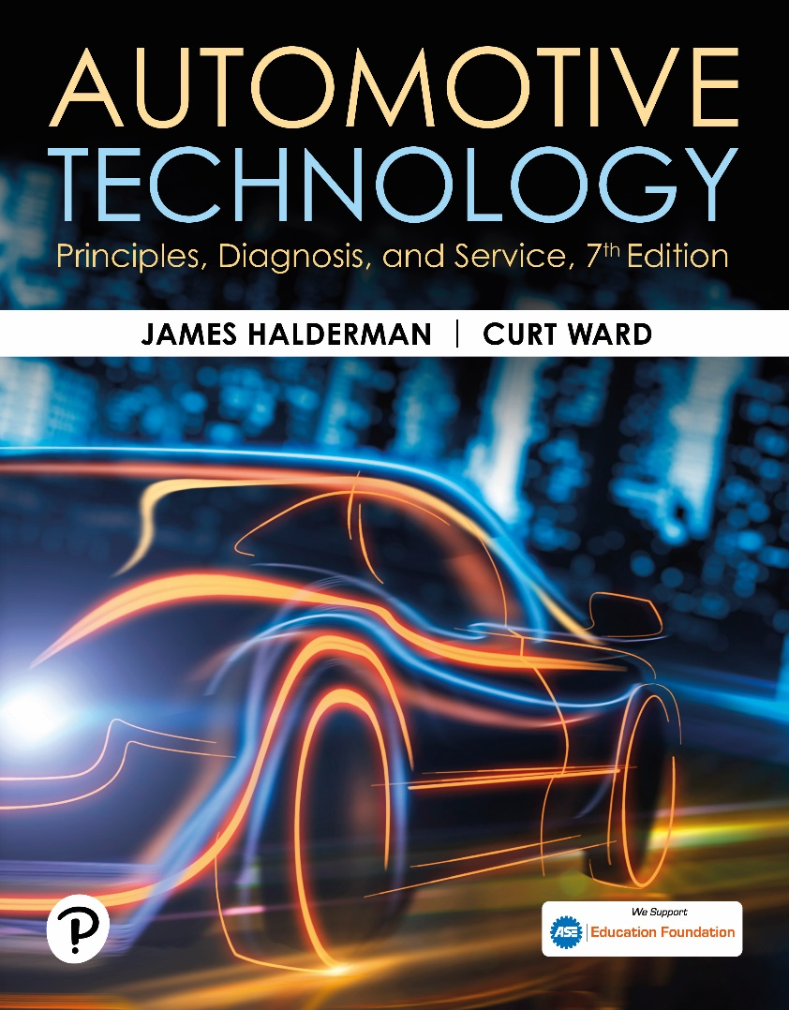
Automotive Technology: Principles, Diagnosis, and Service
Seventh Edition
Chapter 119
Wheel Alignment Principles
Copyright © 2023 Pearson Education, Inc. All Rights Reserved
Notes:
INSTRUCTOR NOTE: This presentation includes text explanation notes, you can use to teach the course. When in SLIDE SHOW mode, you RIGHT CLICK and select SHOW PRESENTER VIEW, to use the notes.

Slide 2
Learning Objectives (1 of 2)
119.1 Define wheel alignment.
119.2 Discuss alignment-related problems.
119.3 Discuss camber.
119.4 Discuss caster.
119.5 Discuss toe.
119.6 Discuss steering axis inclination (SAI).
119.7 Discuss included angle.
119.8 Discuss scrub radius.

Slide 3
Learning Objectives (2 of 2)
119.9 Discuss turning radius.
119.10 Discuss setback.
119.11 Discuss thrust angle.
119.12 Discuss tracking.
119.13 Explain the importance of four-wheel alignment.

Slide 4
Definition of Wheel Alignment
A wheel alignment is the adjustment of the suspension and steering to ensure proper vehicle handling with minimum tire wear.
The change in alignment angles may result from one or more of the following conditions:
  Wear of the steering and the suspension components
  Bent or damaged steering and suspension parts
  Sagging springs, which can change the ride height of the vehicle and therefore the alignment angles

Slide 5
Alignment Related Problems (1 of 2)
Pull
  A pull is generally defined as a definite tug on the steering wheel toward the left or the right while driving straight on a level road.
Lead or Drift
  A lead or drift is a mild pull that does not cause a force on the steering wheel that the driver must counteract.
Road Crown Effects
  On a two-lane road, the center of the road is often higher than the berms, resulting in a road crown.

Slide 6
Alignment Related Problems (2 of 2)
Wander
  A wander is a condition where constant steering wheel corrections are necessary to maintain a straight-ahead direction on a straight, level road.
Stiff Steering or Slow Return to Center
  Hard to steer problems caused by tires, low fluid, or mechanical binding.
Tramp or Shimmy Vibrations
  Up and down or side-to-side vibrations caused by out of balance or defective tires and wheels.

Slide 7
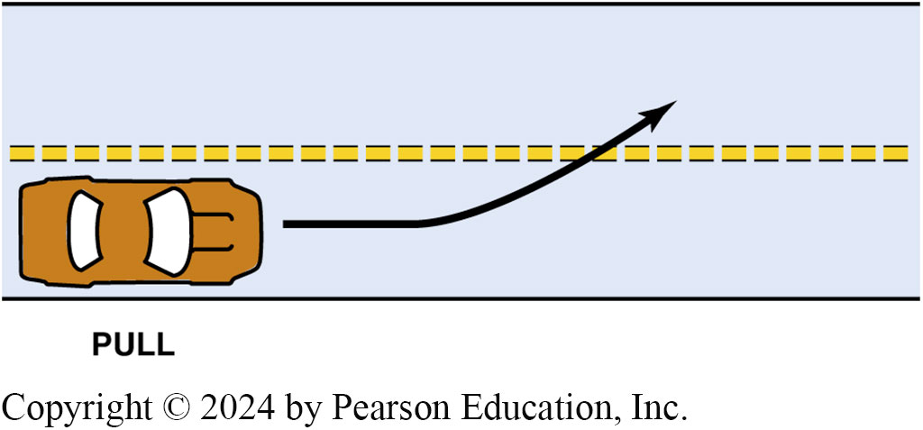
Figure 119.1 Pull
A pull is usually defined as a tug on the steering wheel toward one side or the other

Slide 8
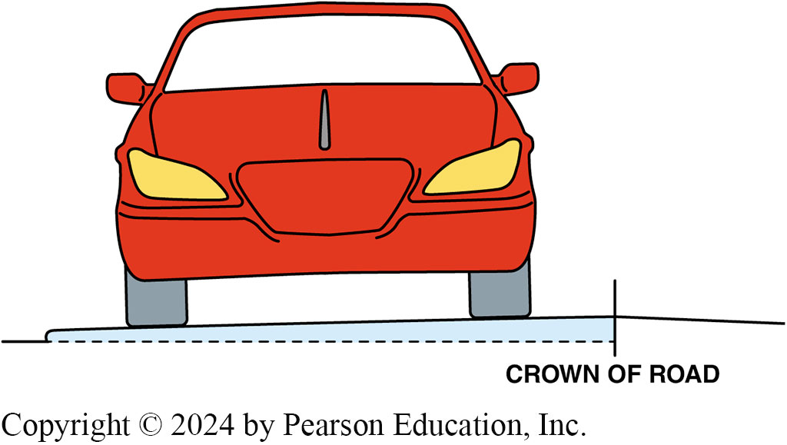
Figure 119.2 Crown of the Road
The crown of the road refers to the angle or slope of the roadway needed to drain water off the pavement

Slide 9
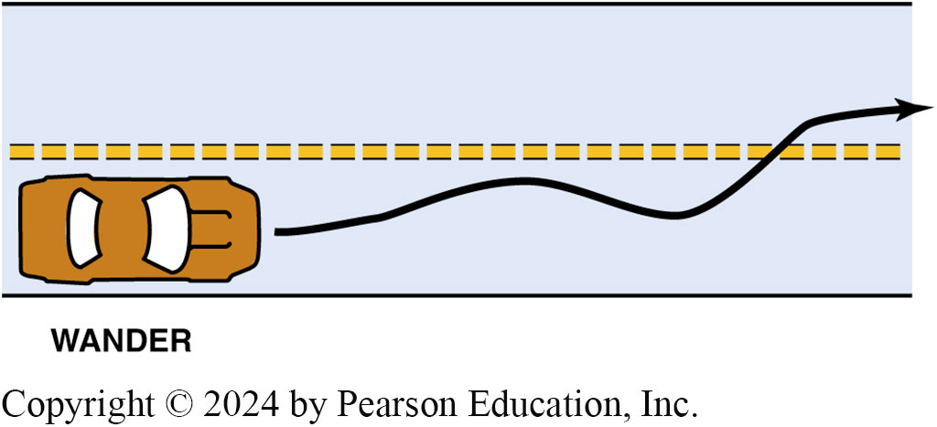
Figure 119.3 Wander
Wander is an unstable condition requiring constant driver corrections

Slide 10
Camber
Definition
  Inward or outward tilt of the wheels from true vertical as viewed from the front or rear of the vehicle.
  Camber can cause tire wear if not correct.
  Camber can cause pull if it is unequal side to side.
  Incorrect camber can cause excessive wear on wheel bearings.
  Camber is not adjustable on many vehicles.

Slide 11
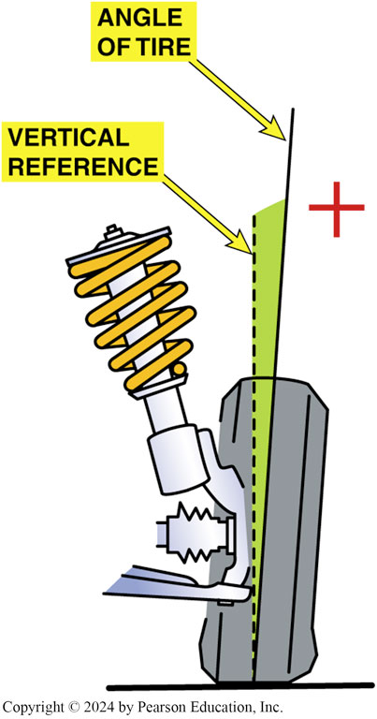
Figure 119.4 Positive Camber
Positive camber. The dotted line represents true vertical, and the solid line represents the angle of the wheel

Slide 12
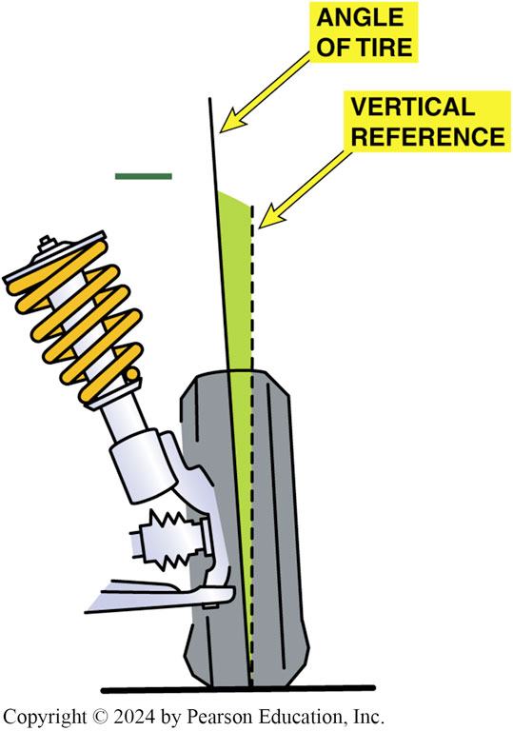
Figure 119.5 Negative Camber
Negative camber. The dotted line represents true vertical and the solid line represents the angle of the wheel

Slide 13
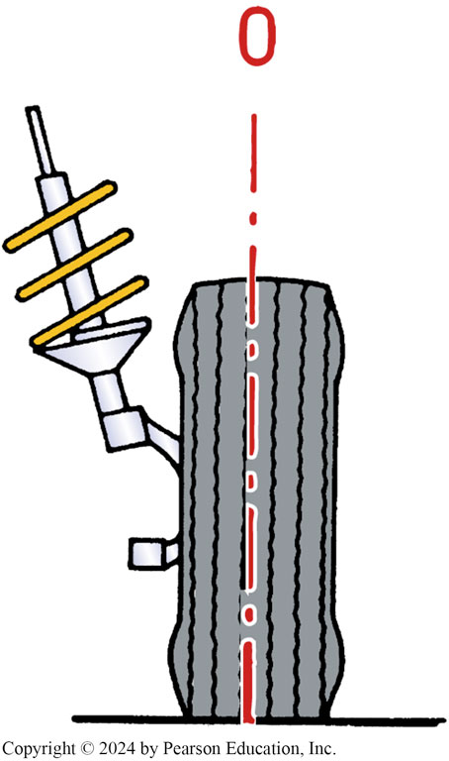
Figure 119.6 Zero Camber
Zero camber. Note that the angle of the tire is true vertical

Slide 14
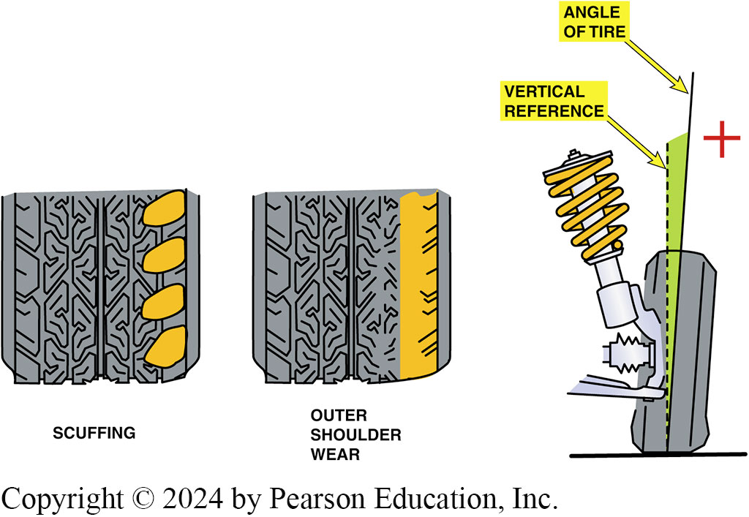
Figure 119.7 Excessive + Camber
Excessive positive camber and how the front tires would wear due to the excessive camber

Slide 15
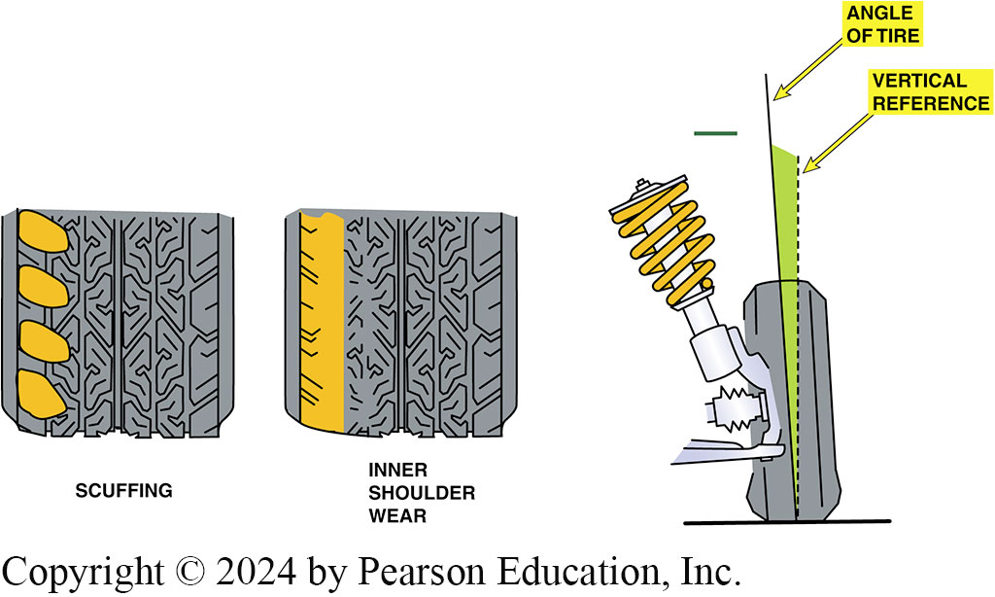
Figure 119.8 Negative Camber
Excessive negative camber and how the front tires would wear due to the excessive camber

Slide 16
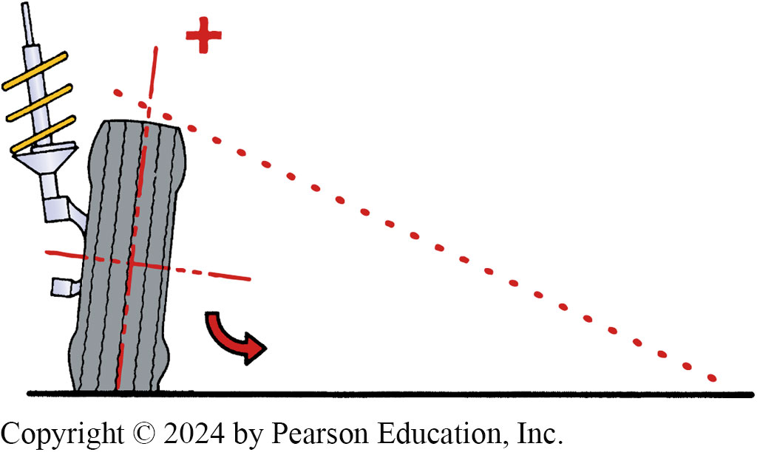
Figure 119.9 Positive Camber Tilt
Positive camber tilts the tire and forms a cone shape that causes the wheel to roll away or pull outward toward the point of the cone

Slide 17
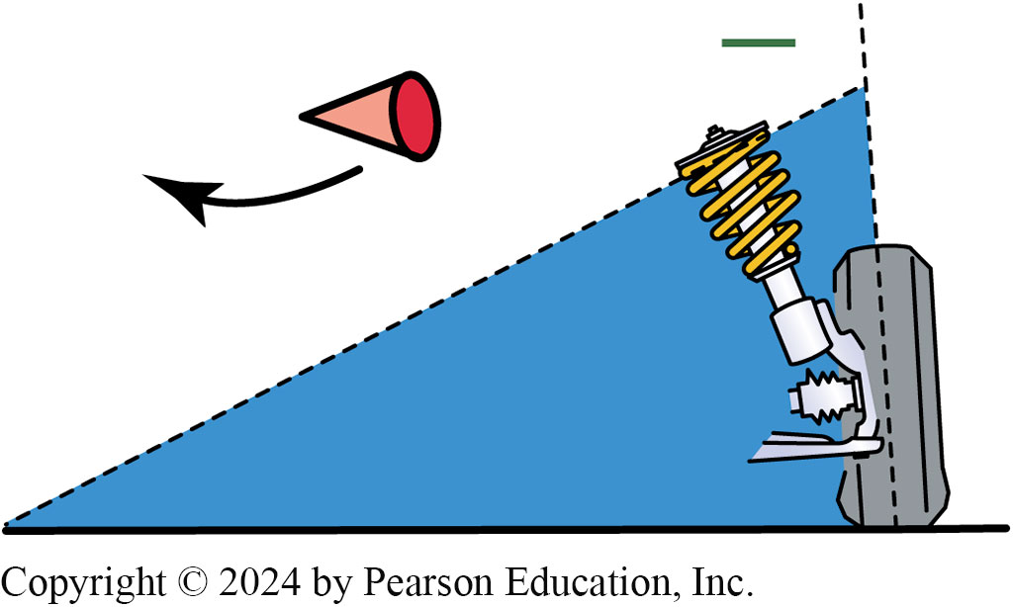
Figure 119.10 Negative Camber Pull
Negative camber creates a pulling force toward the center of the vehicle

Slide 18
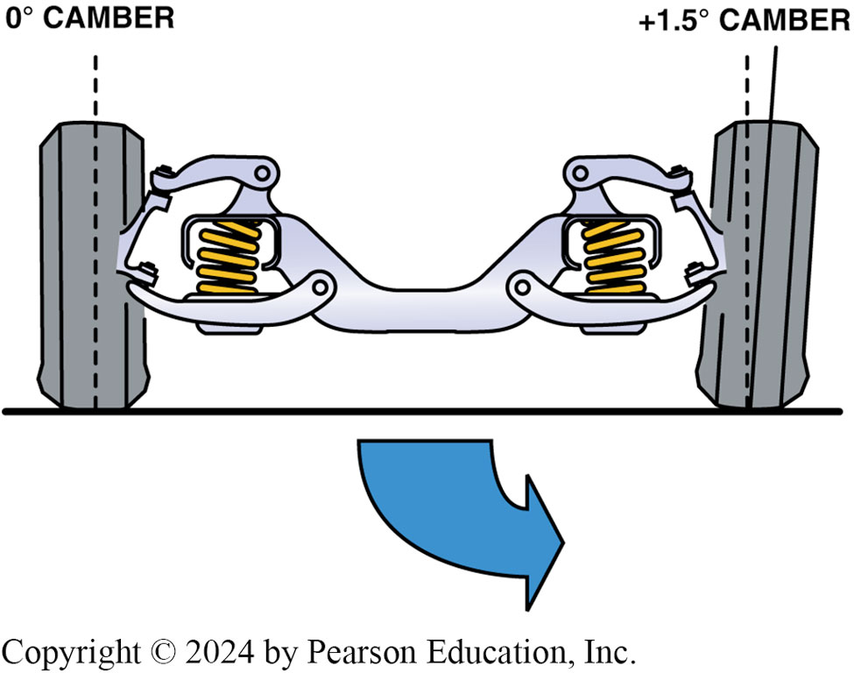
Figure 119.11 Camber Angles
If camber angles are different from one side to the other, the vehicle will pull toward the side with the most camber

Slide 19
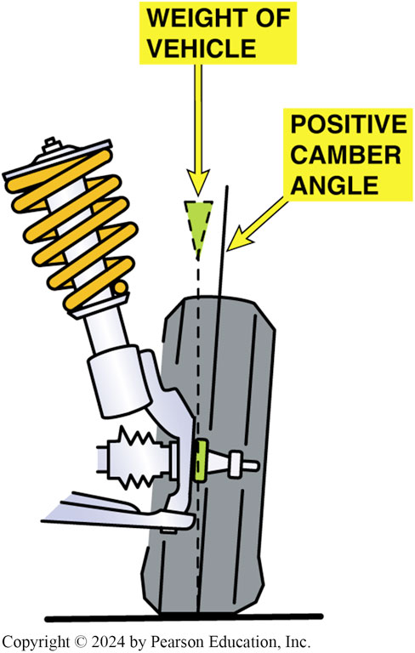
Figure 119.12 Positive Camber
Positive camber applies the vehicle weight toward the larger inner wheel bearing. This is desirable because the larger inner bearing is designed to carry more vehicle weight than the smaller outer bearing

Slide 20
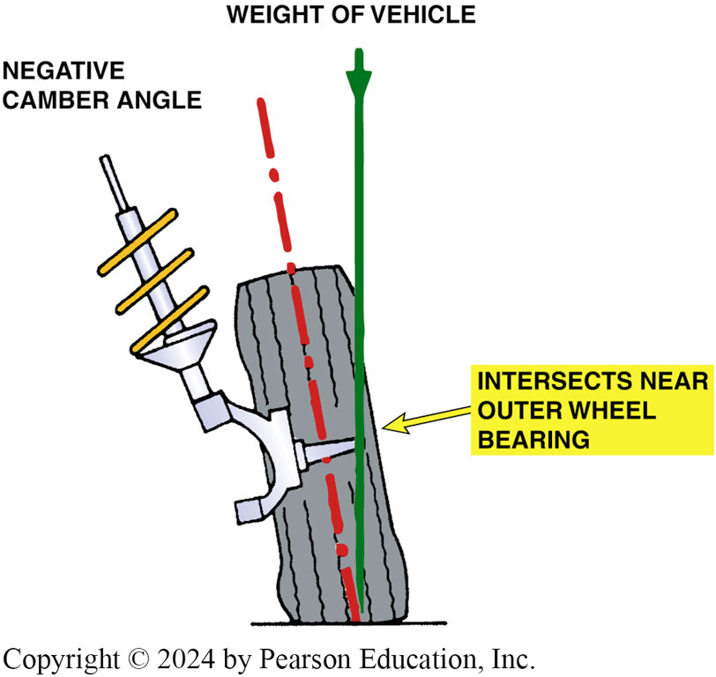
Figure 119.13 Negative Camber
Negative camber applies the vehicle weight to the smaller outer wheel bearing. Excessive negative camber, therefore, may contribute to outer wheel bearing failure

Slide 21
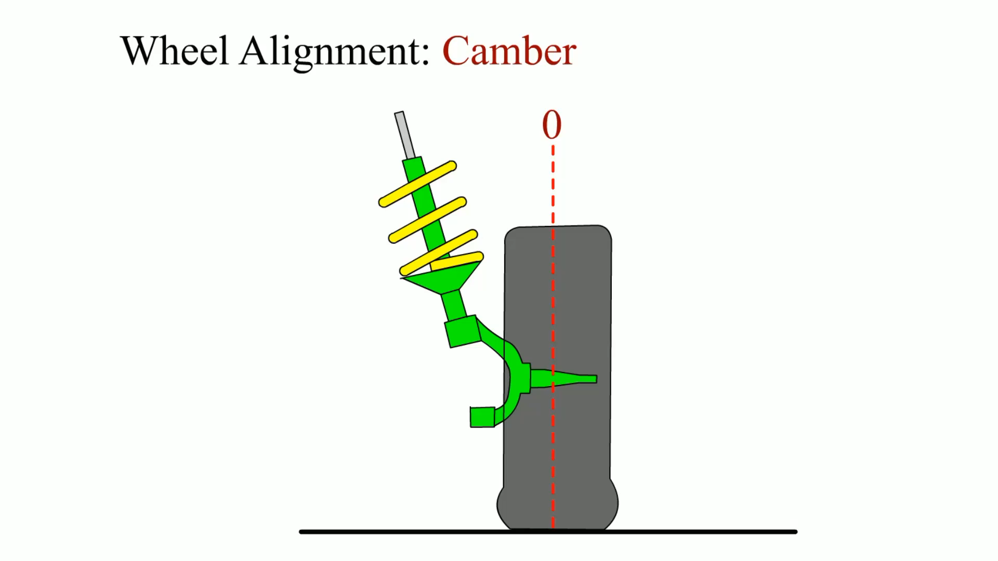
Animation: Wheel Alignment: Camber
(Animation will automatically start)

Slide 22
Question 1: ?
What is the effect of unequal camber?

Slide 23
Answer 1
Camber can cause pull if it is unequal side to side.

Slide 24
Caster
Definition
  Forward or rearward tilt of steering axis in reference to a vertical line as viewed from the side of the vehicle.
  Caster is not a tire-wearing angle, but positive caster does cause changes in camber during a turn.
  Caster is a stability angle.
  Caster can cause pull if unequal.
  Caster is not adjustable on many vehicles.
  Caster should be equal on both sides.

Slide 25
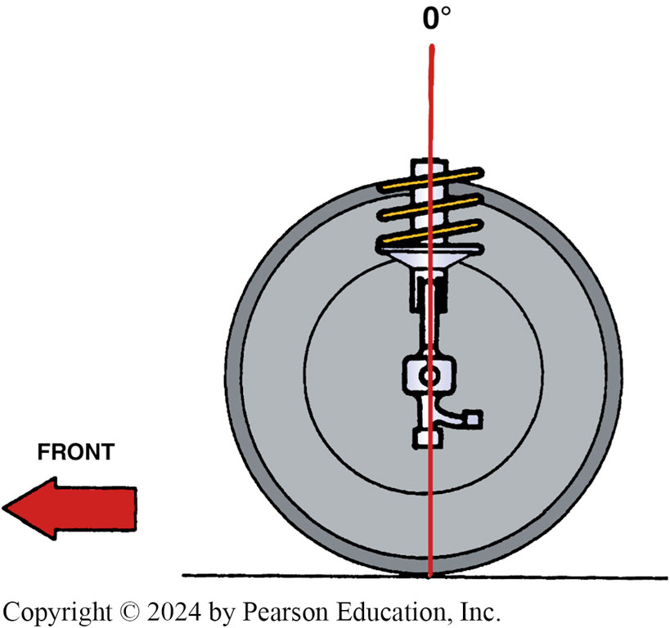
Figure 119.14 Zero Caster

Slide 26
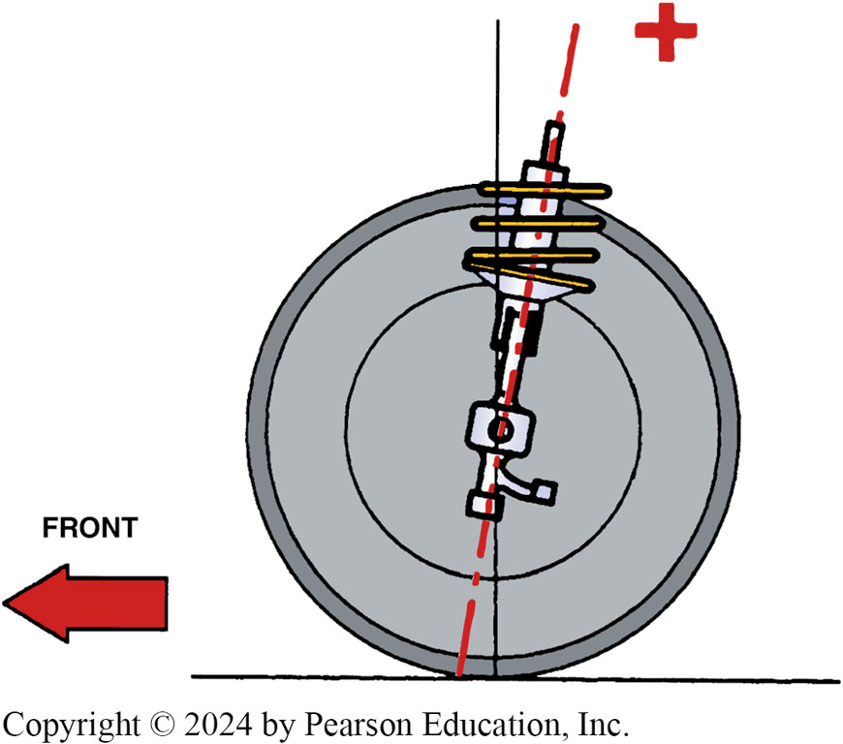
Figure 119.15 Positive (+) Caster

Slide 27
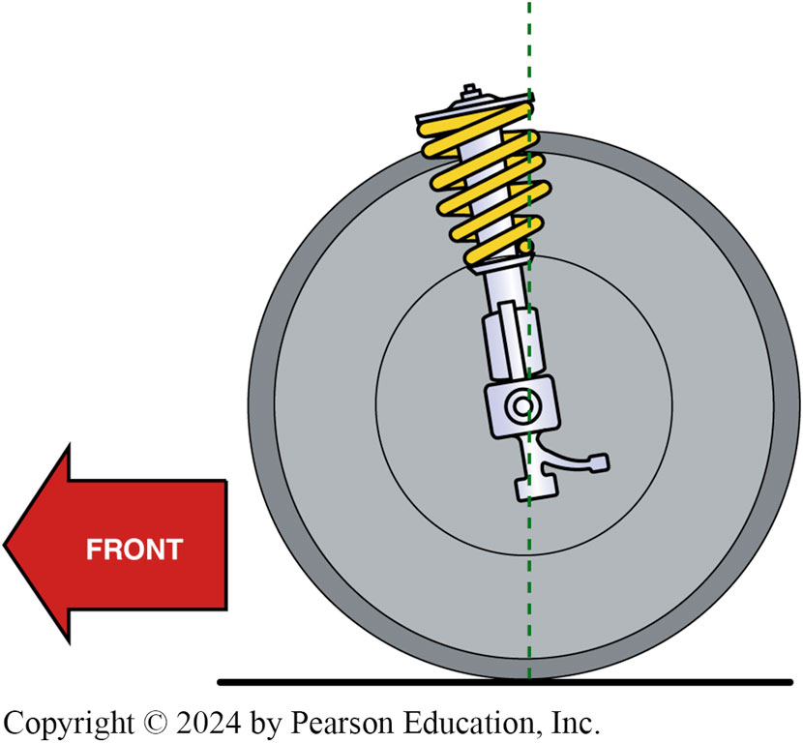
Figure 119.16 Negative (-) Caster
Negative (−) caster is seldom specified on today’s vehicles because it tends to make the vehicle unstable at highway speeds. Negative caster was specified on some older vehicles not equipped with power steering to help reduce the steering effort.

Slide 28
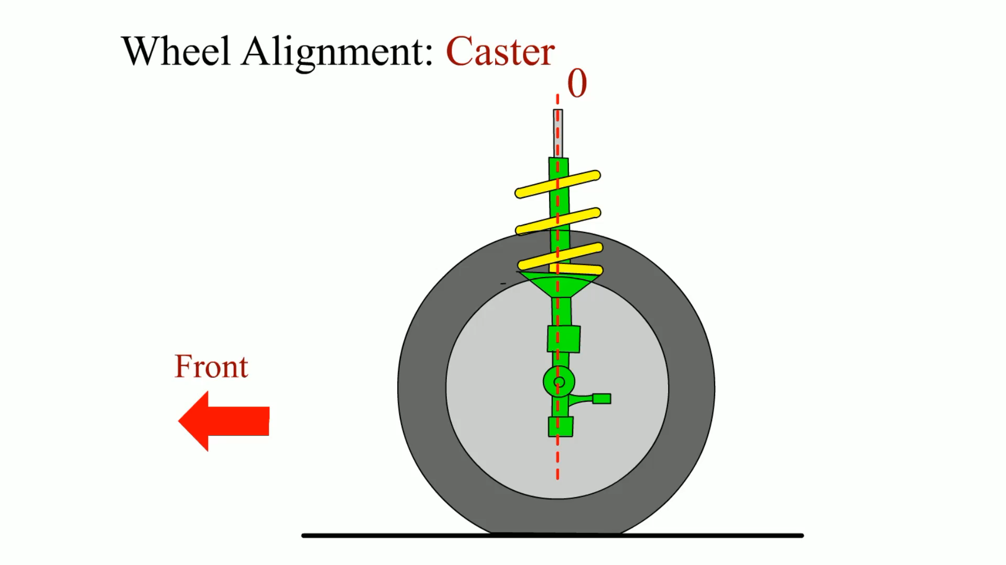
Animation: Wheel Alignment: Caster
(Animation will automatically start)

Slide 29
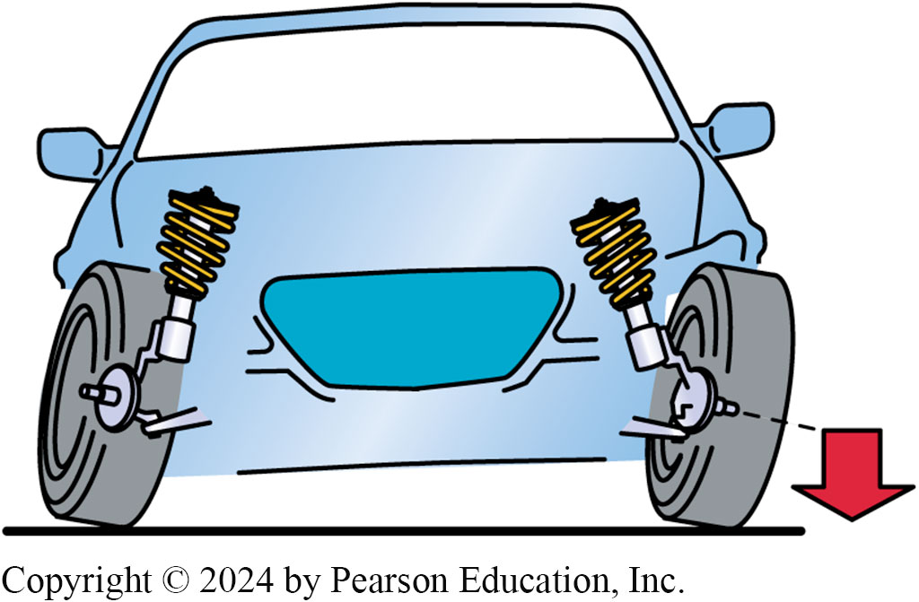
Figure 119.17 Turn Lifts Vehicle
As the spindle rotates, it lifts the weight of the vehicle due to the angle of the steering axis

Slide 30
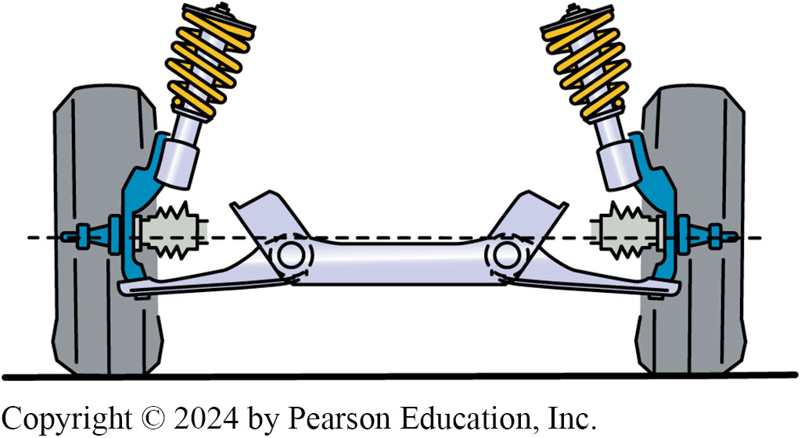
Figure 119.18 Tends to Lower Spindle
Vehicle weight tends to lower the spindle, which returns the steering to the straight-ahead position

Slide 31
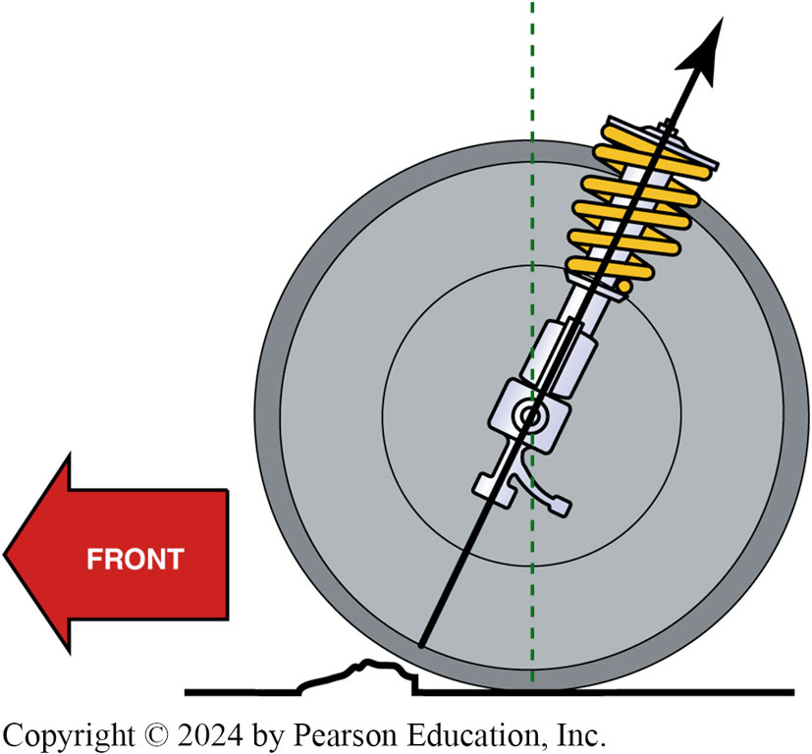
Figure 119.19 High Caster
High caster provides a road shock path to the vehicle

Slide 32
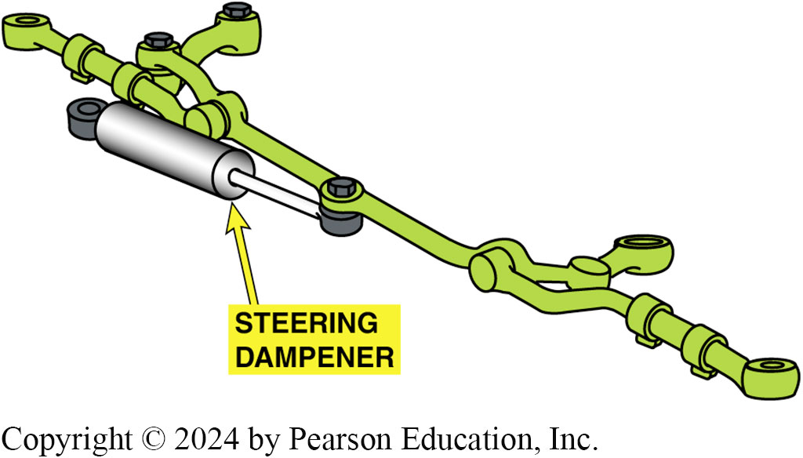
Figure 119.20 Steering Damper
Description in Notes
Notes:
Figure 119.20 A steering dampener is used on many pickup trucks, sport-utility vehicles
(SUVs), and many luxury vehicles designed with a high-positive-caster setting. The dampener helps prevent steering wheel kickback when the front tires hit a bump or hole in the road

Slide 33
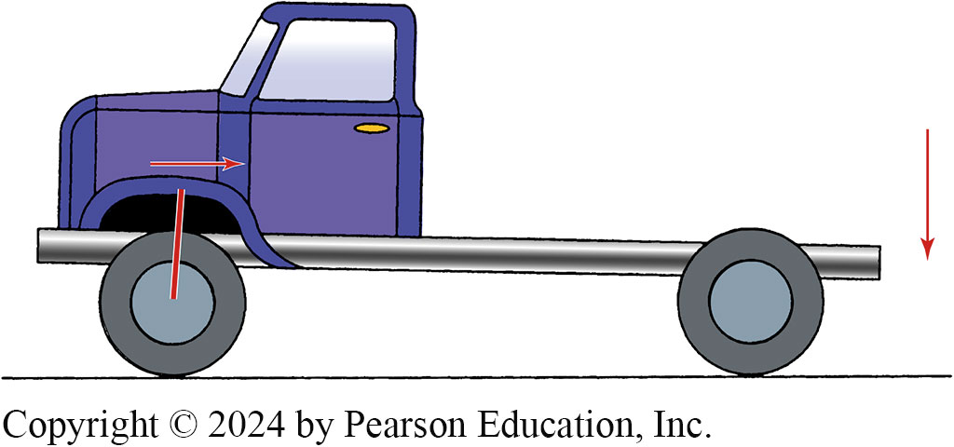
Figure 119.21
As the load increases in the rear of a vehicle, the top steering axis pivot point moves rearward, increasing positive (+) caster

Slide 34
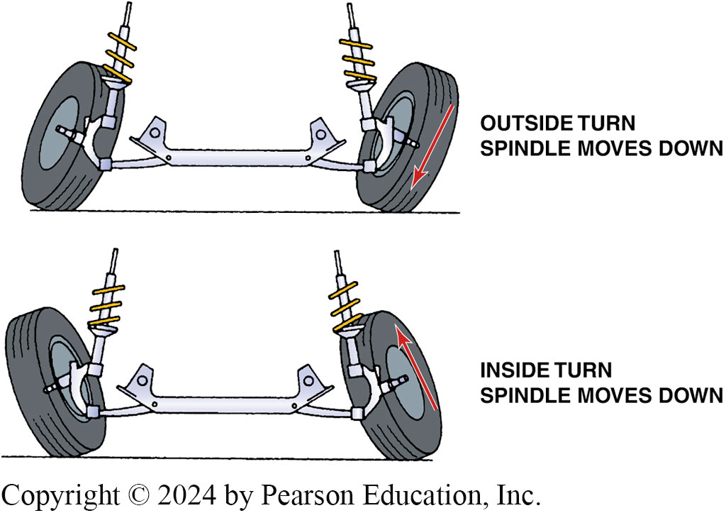
Figure 119.22 Camber Type Wear
Note how the front tire becomes tilted as the vehicle turns a corner with positive caster. The higher the caster angle, the more the front tires tilt, causing camber-type tire wear

Slide 35
Question 2: ?
How does incorrect caster effect front tire wear?

Slide 36
Answer 2
Caster is not a tire-wearing angle, but positive caster does cause changes in camber during a turn.

Slide 37
T O E
Definition
  Difference in distance between front and rear of tires.
  Incorrect toe is the major cause of excessive tire wear!
  Incorrect front toe does not cause a pull condition.
  All vehicles can be adjusted for front toe.
  Many vehicle manufacturers specify a slight amount of toe-in to compensate for the natural tendency of the front wheels to spread apart (become toed-out).

Slide 38
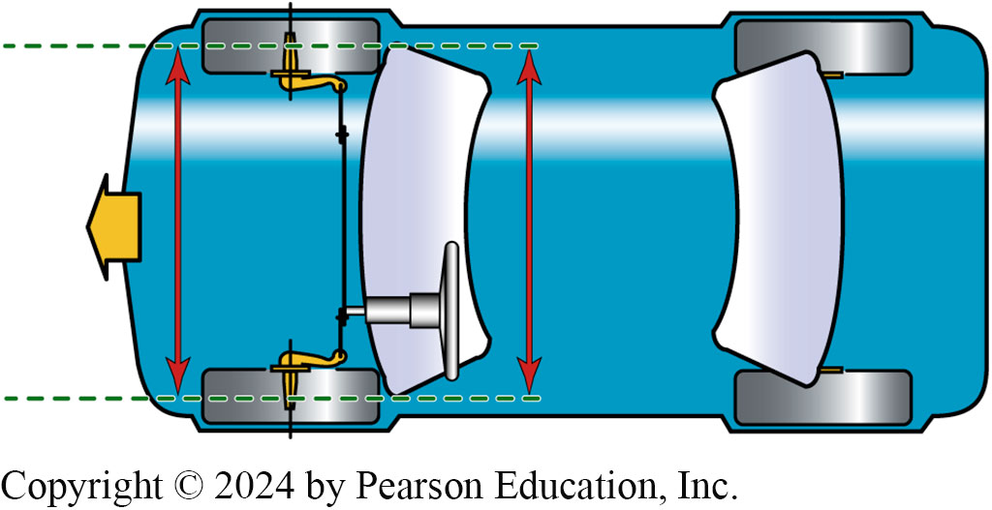
Figure 119.23 Zero Toe
Zero toe. Note how both tires are parallel to each other as viewed from above the vehicle

Slide 39
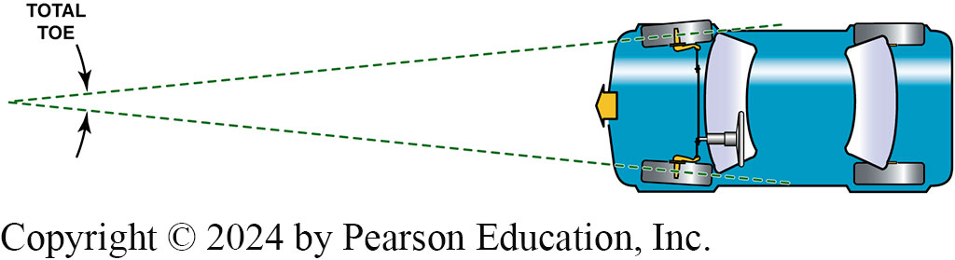
Figure 119.24 Total Toe
Total toe is often expressed as an angle. Because both front wheels are tied together through the tie rods and center link, the toe angle is always equally split between the two front wheels when the vehicle moves forward

Slide 40
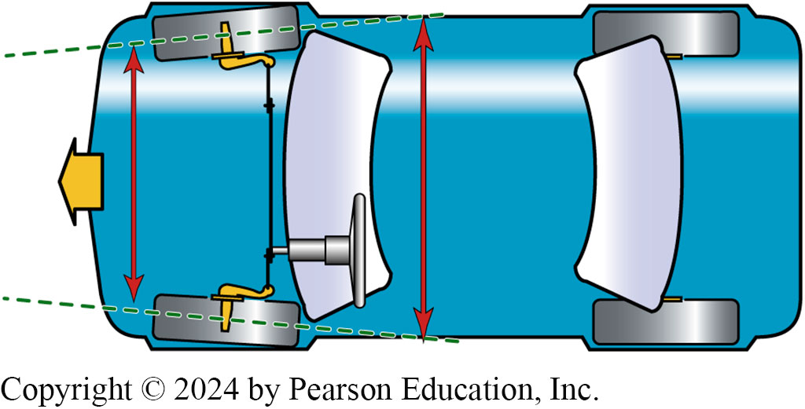
Figure 119.25 Toe-In
Toe-in, also called positive (+) toe

Slide 41
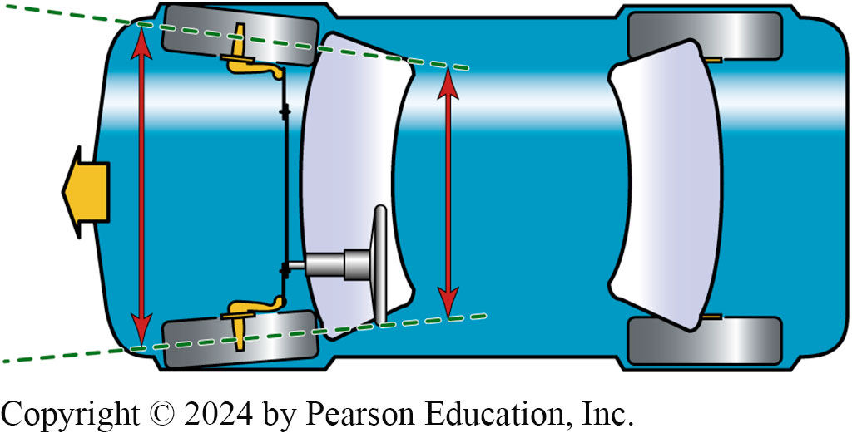
Figure 119.26 Tor-Out
Toe-out, also called negative (−) toe

Slide 42
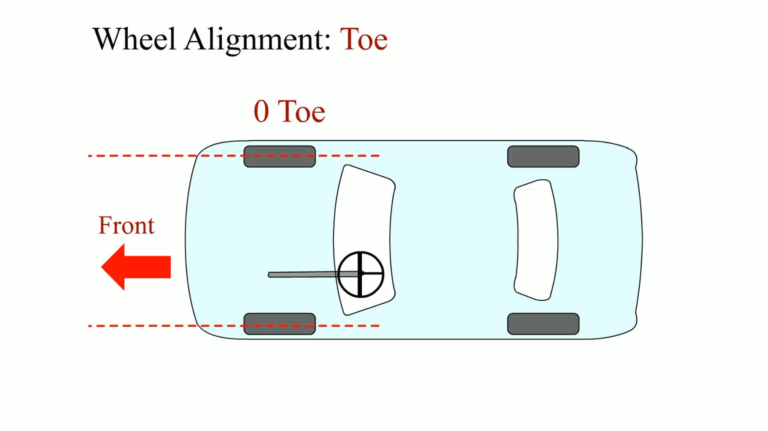
Animation: Wheel Alignment: Toe
(Animation will automatically start)

Slide 43
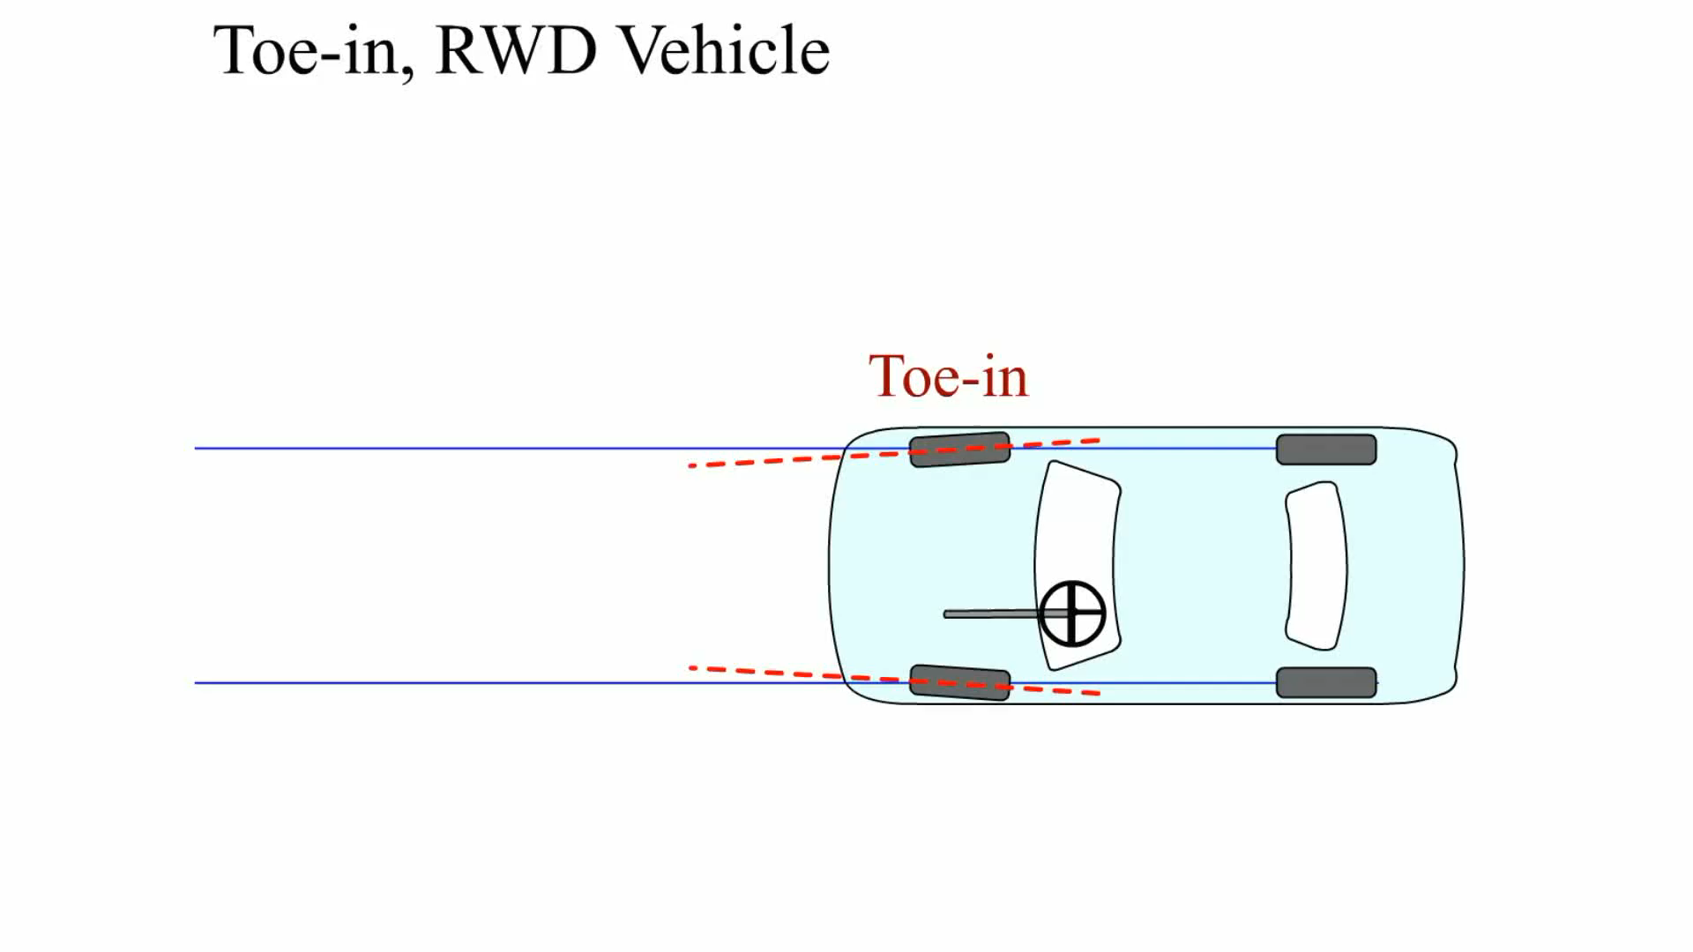
Animation: Toe-In: RWD Vehicle
(Animation will automatically start)

Slide 44
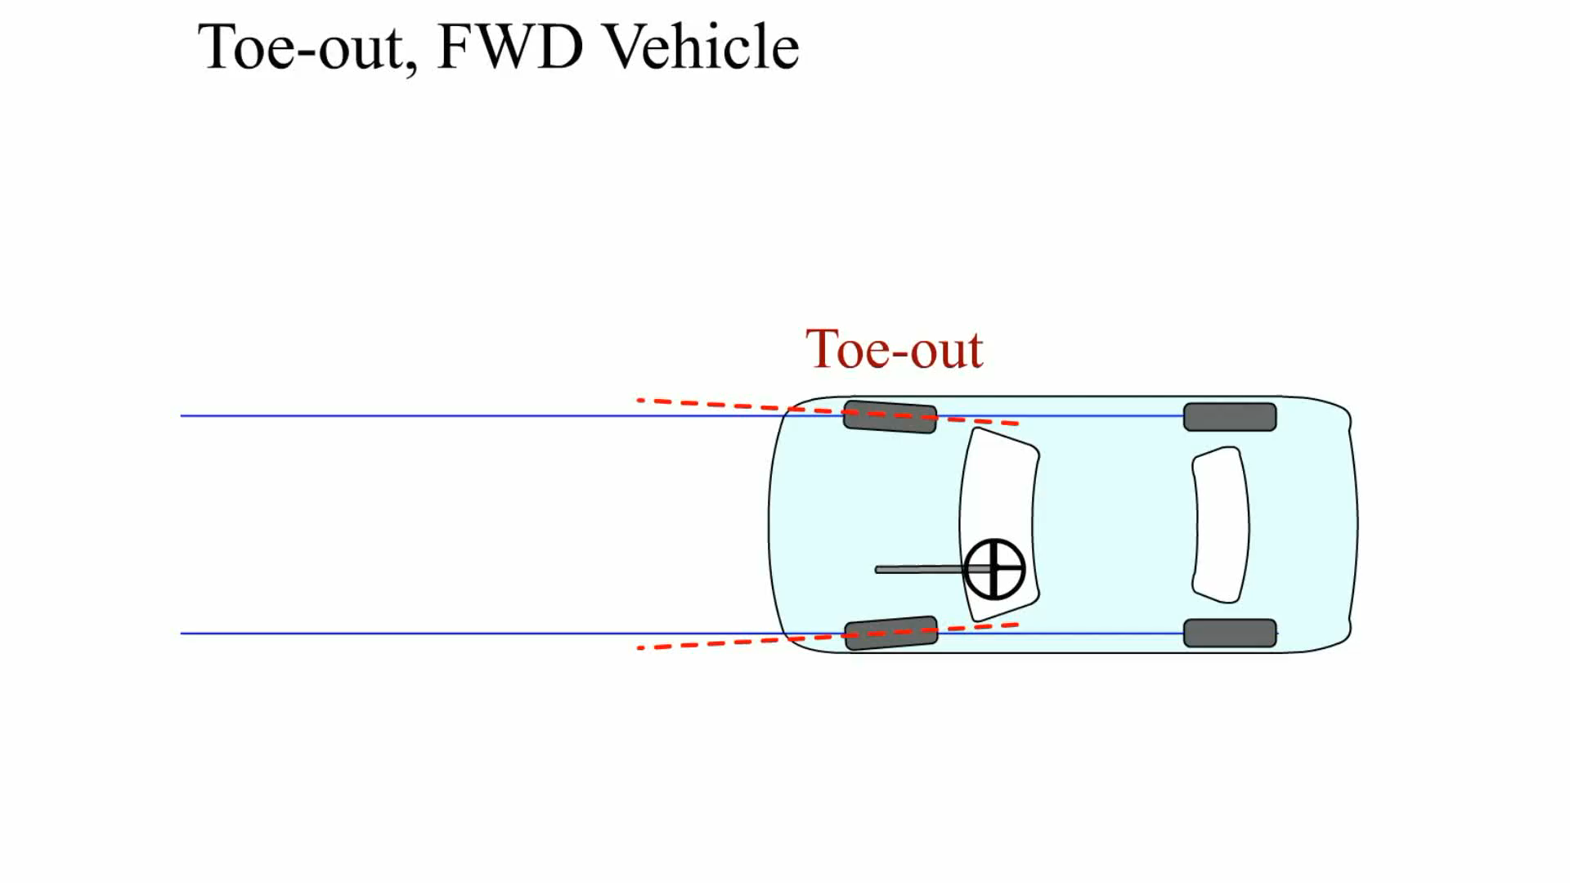
Animation: Toe-Out, FWD Vehicle
(Animation will automatically start)

Slide 45
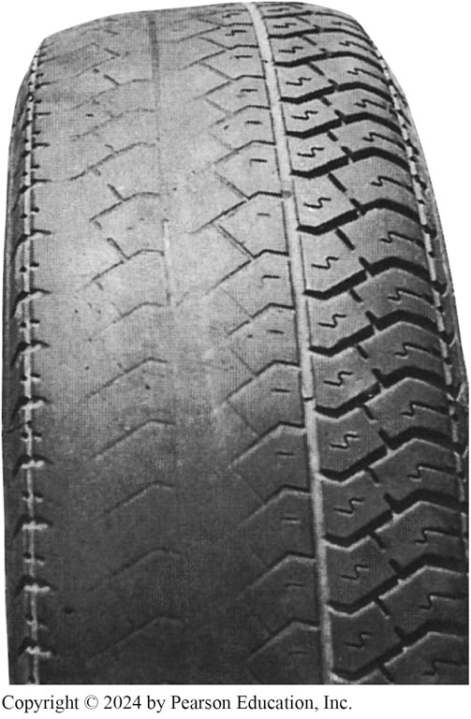
Figure 119.27 Toe-Out Wear
This tire is just one month old! It was new and installed on the front of a vehicle that had about 1/4 inch (6 mm) of toe-out. By the time the customer returned to the tire store for an alignment, the tire was completely bald on the inside

Slide 46
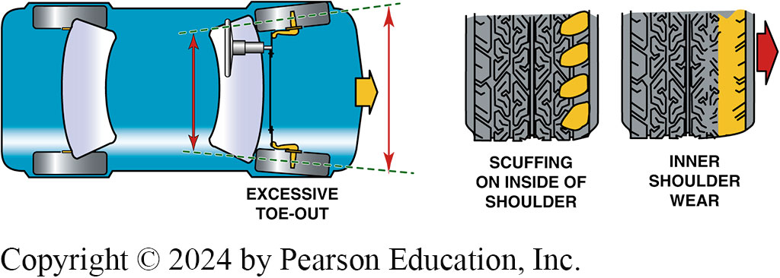
Figure 119.28 Excessive Toe-Out
Excessive toe-out and the type of wear that can occur to the side of both front tires

Slide 47
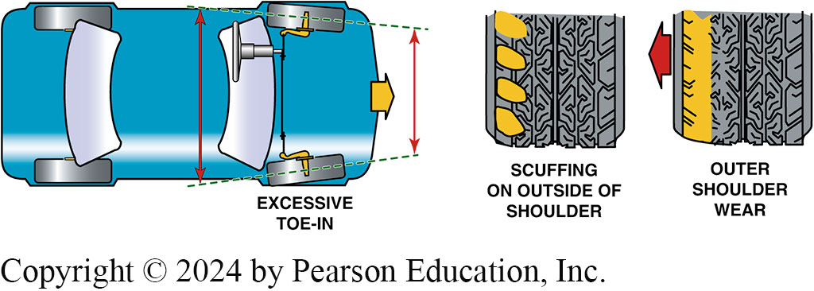
Figure 119.29 Excessive Toe-In Wear
Excessive toe-in and the type of wear that can occur to the outside of both front tires

Slide 48
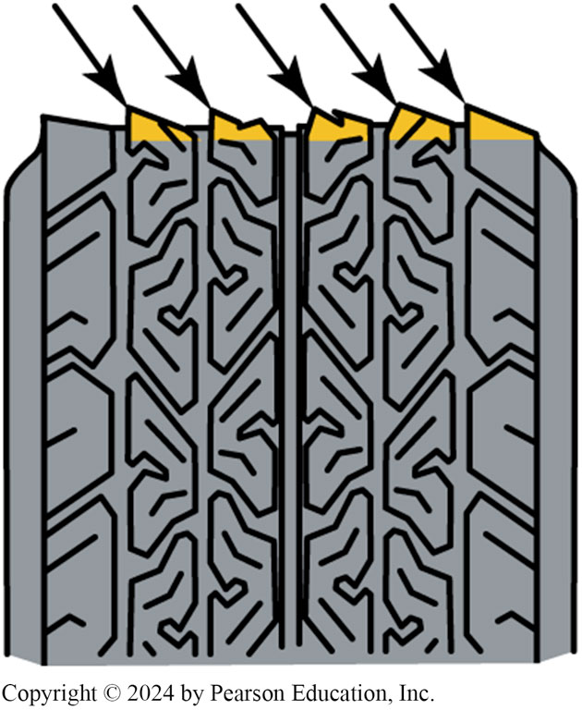
Figure 119.30 Feather Edge
Feather-edge wear pattern caused by excessive toe-in or toe-out

Slide 49
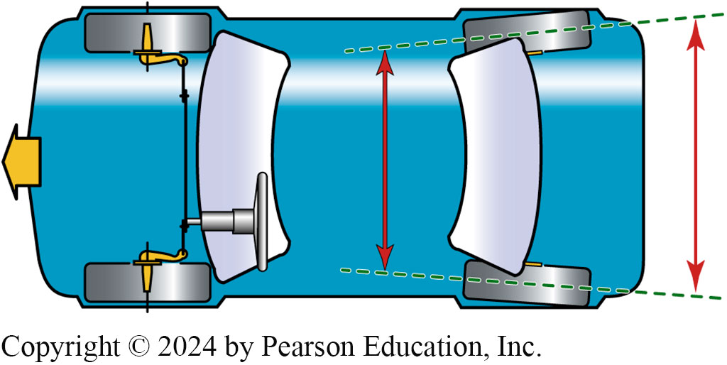
Figure 119.31 Rear Toe-In
Rear toe-in (+). The rear toe (unlike the front toe) can be different for each wheel while the vehicle is moving forward because the rear wheels are not tied together as they are in the front

Slide 50
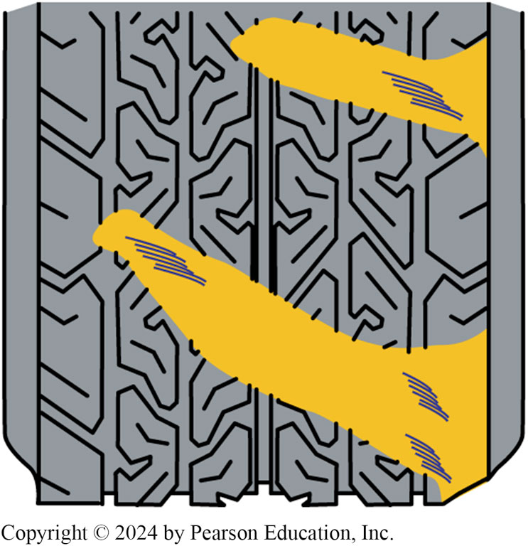
Figure 119.32 Tire Runs Sideways
Incorrect toe can cause the tire to run sideways as it rolls, resulting in a diagonal wipe

Slide 51
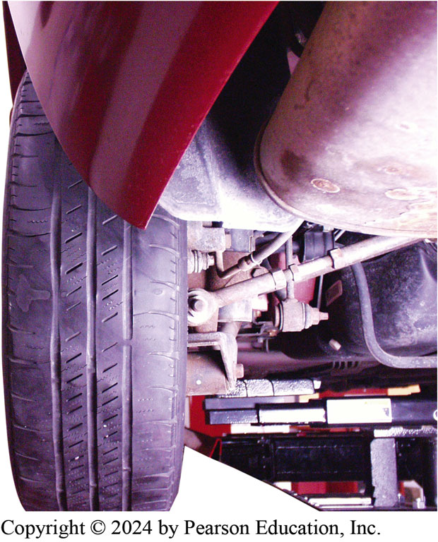
Figure 119.33 Diagonal Wear
Diagonal wear such as shown here is usually caused by incorrect toe on the rear of a front-wheel-drive vehicle

Slide 52
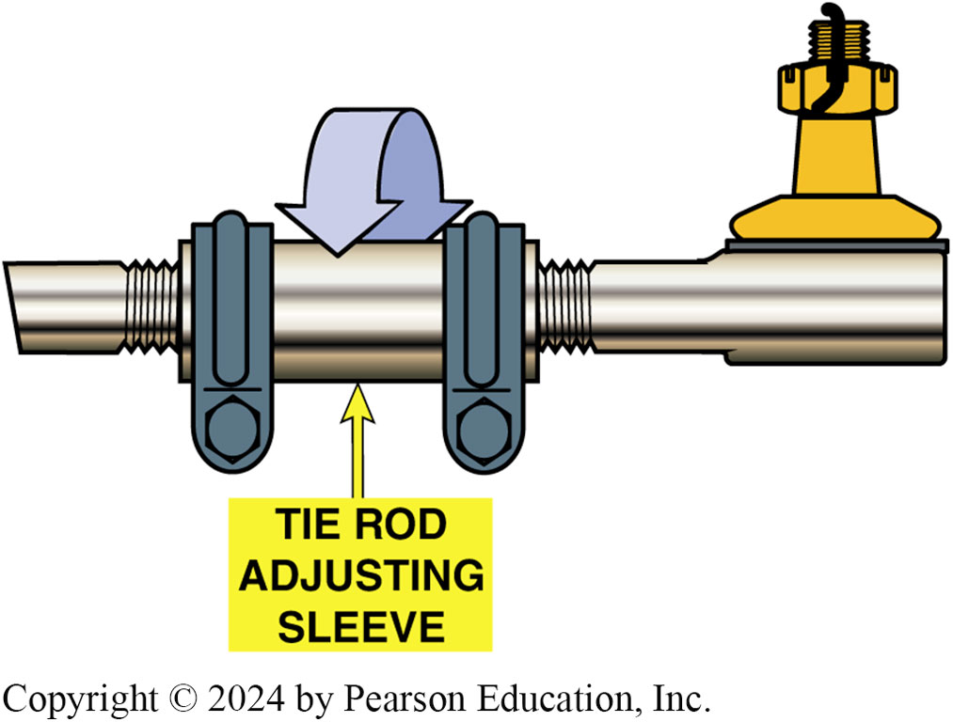
Figure 119.34 Tie Rod Adjustment
Toe on the front of most vehicles is adjusted by turning the tie rod sleeve, as shown

Slide 53
Frequently Asked Question: Why Doesn’t Unequal Front Toe on the Front Wheels Cause the Vehicle to Pull?
? Frequently Asked Question
Why Doesn’t Unequal Front Toe on the Front Wheels Cause the Vehicle to Pull? Each wheel could have individual toe, but as the vehicle is being driven, the forces on the tires tend to split the toe, causing the steering wheel to cock at an angle as the front wheels both track the same. If the toe is different on the rear of the vehicle, the rear will be “steered” similar to a rudder on a boat because the rear wheels are not tied together as are the front wheels.

Slide 54
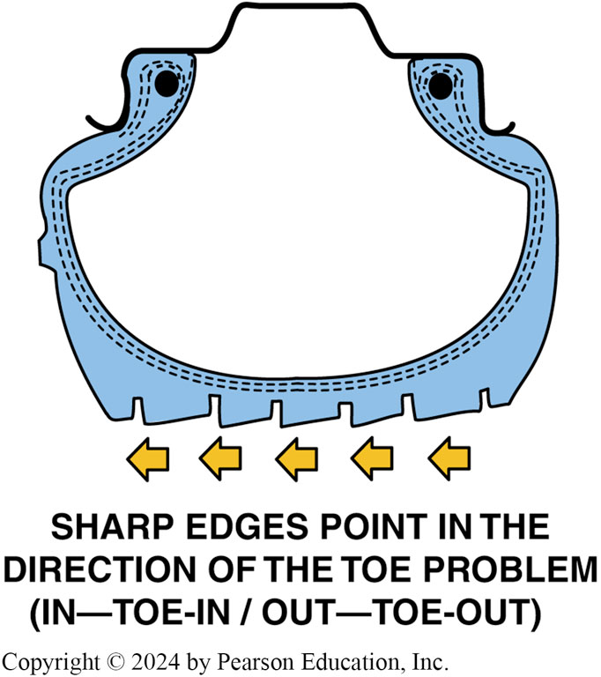
Figure 119.35 Sharp Edges Point
While the feathered or sawtooth tire tread wear pattern may not be noticeable to the eye, this wear can usually be felt by rubbing your hand across the tread of the tire

Slide 55
Question 3: ?
What is the most significant effect of incorrect toe adjustment?

Slide 56
Answer 3
Incorrect toe is the major cause of excessive tire wear!

Slide 57
Steering Axis Inclination (SAI)
The steering axis is the angle formed between true vertical and an imaginary line drawn between the upper and lower pivot points of the spindle.
The purpose of S A I is to provide an upper suspension pivot location that causes the spindle to travel in an arc when turning, which tends to raise the vehicle.

Slide 58
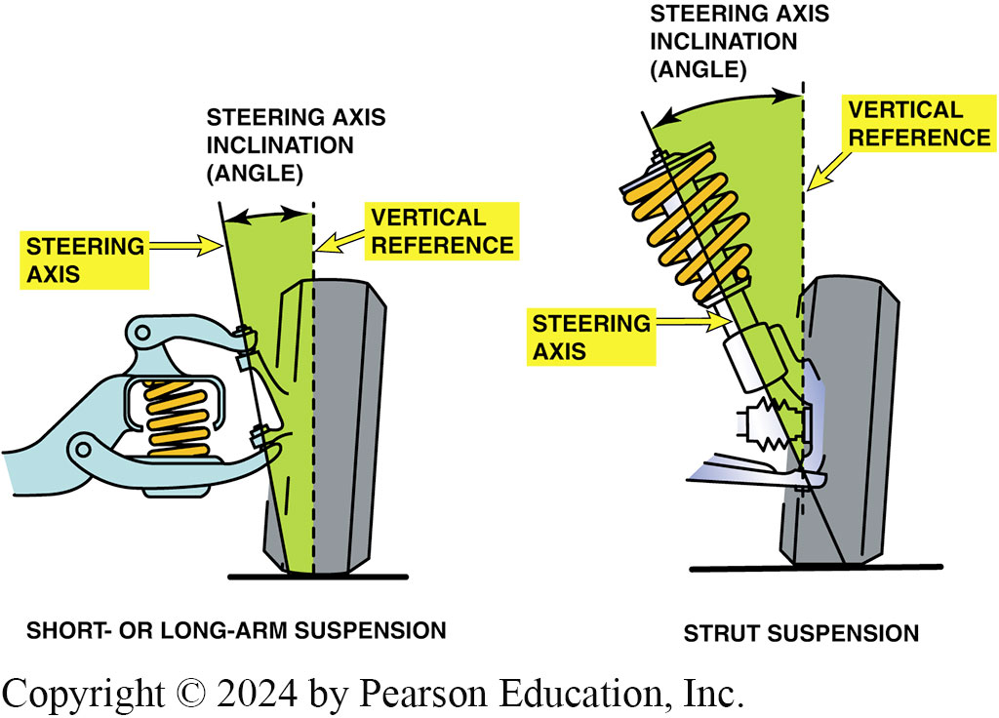
Figure 119.36 SAI
Left illustration shows that steering axis inclination angle is determined by drawing a line through center of upper and lower ball joints. Right illustration shows that steering axis inclination angle is determined by drawing a line through the axis of upper strut bearing mount assembly and lower ball joint

Slide 59
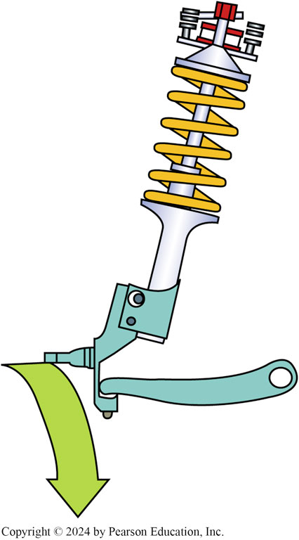
Figure 119.37 SAI
The SAI causes the spindle to travel in an arc when the wheels are turned. The weight of the vehicle is therefore used to help straighten the front tires after a turn and to help give directional stability

Slide 60
Included Angle
S A I added to the camber reading of the front wheels only.
Included angle is an important angle to measure for diagnosis of vehicle handling or tire wear problems.
For best handling both the included angle and S A I should be within 1/2 degree of the other side of the vehicle.

Slide 61
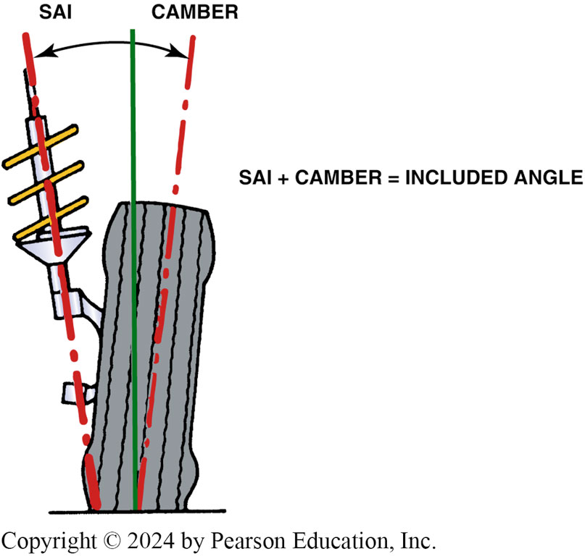
Figure 119.38 Included Angle
Included angle on a MacPherson-strut-type suspension

Slide 62
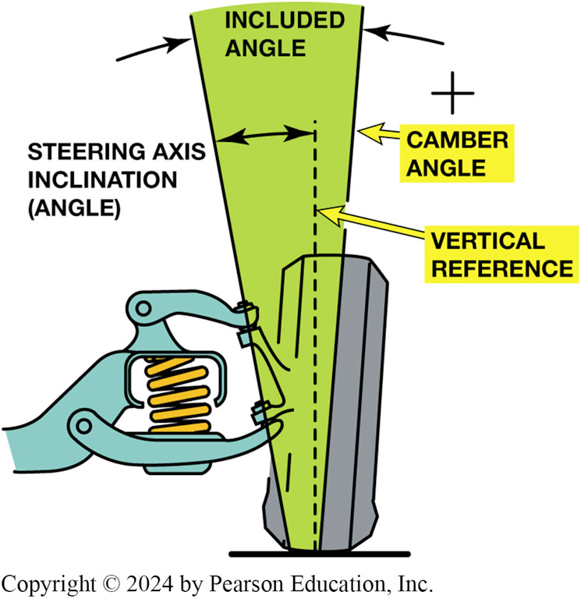
Figure 119.39 SLA-Suspension SAI
Included angle on
SLA-type suspension. The included angle is the SAI angle and the camber angle added together

Slide 63
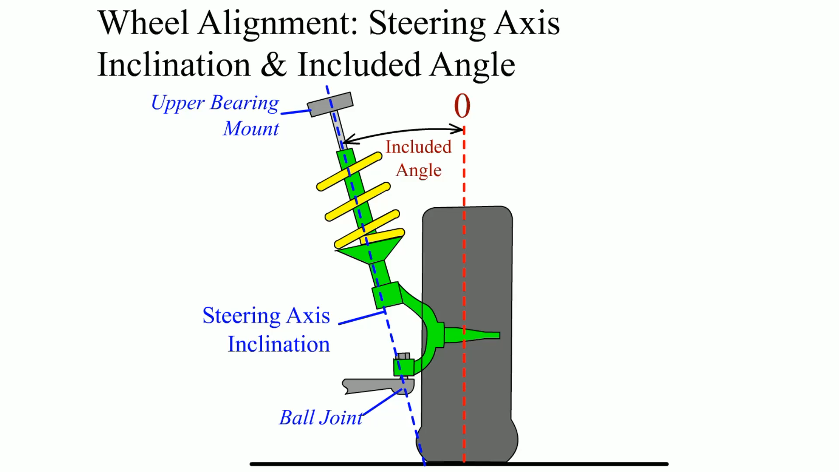
Animation: Wheel Alignment: Steering Axis Inclination & Included Angle
(Animation will automatically start)

Slide 64
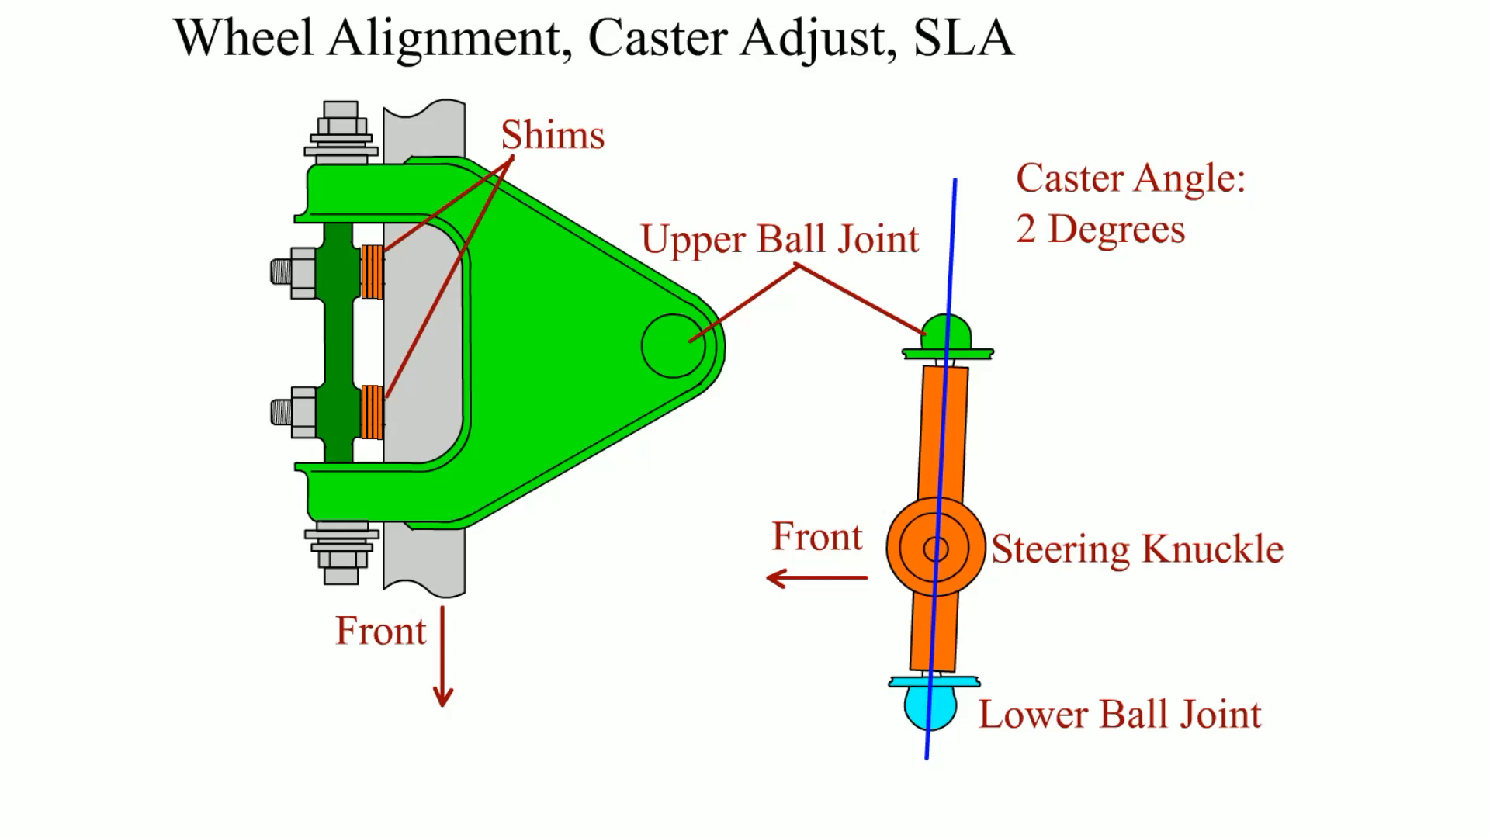
Animation: Wheel Alignment, Caster Adjust, SLA
(Animation will automatically start)

Slide 65
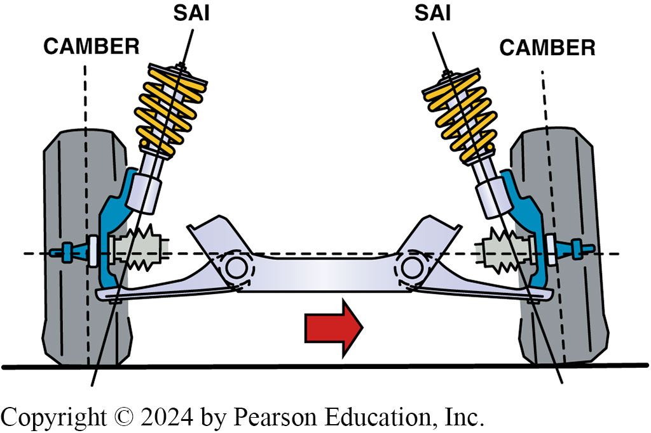
Figure 119.40 Cradle Placement
Cradle placement. If the cradle is not replaced in the exact position after removal for a transmission or clutch replacement, the SAI, camber, and included angle will not be equal side to side

Slide 66
Scrub Radius
Distance between the line through the steering axis and the centerline of the wheel at the contact point with the road surface.
Scrub radius is not adjustable and cannot be measured.
  A bent spindle can cause a change in the scrub radius.
  Changing tire or wheel sizes can affect scrub radius.

Slide 67
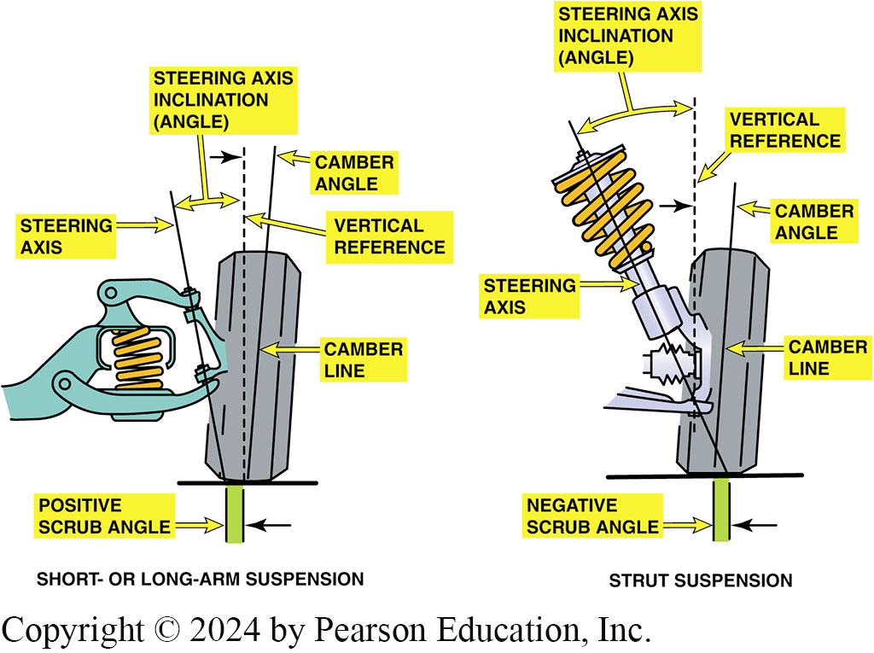
Figure 119.41 Positive Scrub Radius
A positive scrub radius (angle) is usually built into most S L A front suspensions, and a negative scrub radius is usually built into most MacPherson-strut type front suspensions

Slide 68
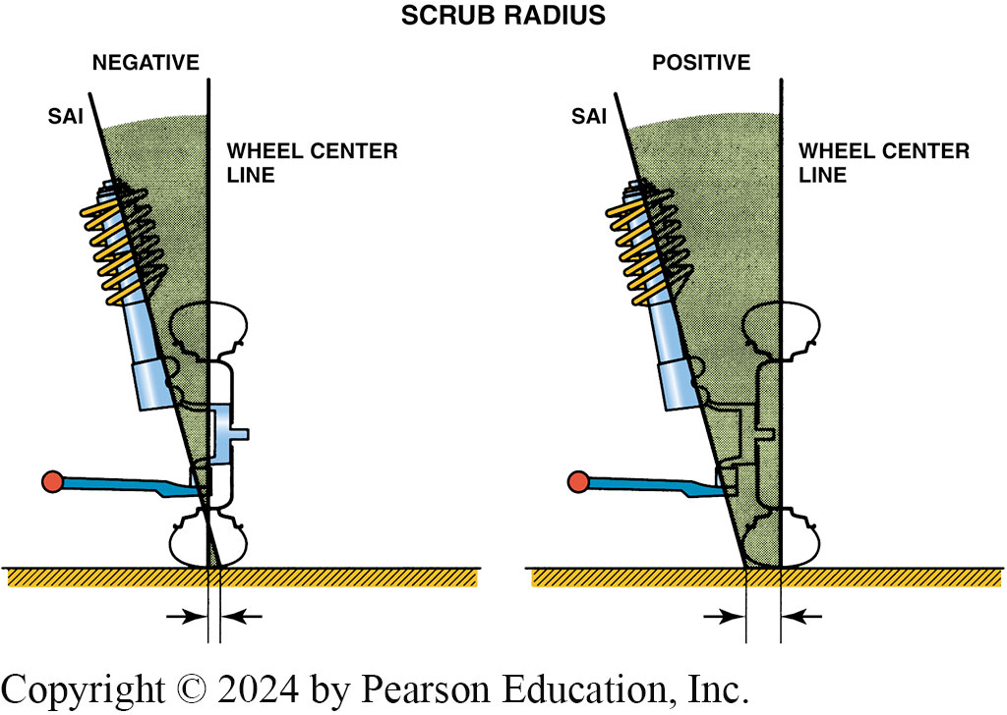
Figure 119.42 Negative Scrub Radius
With negative scrub radius, imaginary line through steering axis inclination (SAI) intersects road outside of centerline of tire. With positive scrub radius, SAI line intersects road inside centerline of tires.

Slide 69

Figure 119.43 Pivot Points
With a positive scrub radius, the pivot point, marked with a + mark, is inside the centerline of the tire and will cause the wheel to turn toward the outside, especially during braking. Negative scrub radius, as is used with most front-wheel-drive vehicles, generates an inward force on tires.

Slide 70
Turning Radius (Toe-out On Turns)
Whenever a vehicle turns a corner, the inside wheel has to turn at a sharper angle than the outside wheel because the inside wheel has a shorter distance to travel.
Turning radius is nonadjustable angle.
Symptoms of out-of-specification turning angle include:
  Tire squeal noise during normal cornering.
  Scuffed tire wear

Slide 71

Figure 119.44 TOOT
To provide handling, the inside wheel has to turn at a greater turning radius than the outside wheel

Slide 72

Figure 119.45 Proper TOOT
The proper toe-out on turns is achieved by angling the steering arms

Slide 73
Setback
Angle formed by a line drawn perpendicular (at 90 degrees) to the front axles.
Setback is nonadjustable measurement, even though it may be corrected.
Setback measured with a four-wheel alignment machine.

Slide 74

Figure 119.46 (a) Positive setback

Slide 75

Figure 119.46 (b) Negative setback

Slide 76

Animation: Wheel Alignment: Setback
(Animation will automatically start)

Slide 77

Figure 119.47 Cradle Placement
Cradle placement affects setback

Slide 78
Thrust Angle
Angle of rear wheels as determined by the total rear toe.
The total of the rear toe setting determines the thrust line, or the direction the rear wheels are pointed.

Slide 79

Figure 119.48 (a) Zero Thrust Angle

Slide 80
Figure 119.48 (b) Thrust Line to Right
(b) Thrust line to the right

Slide 81

Figure 119.48 (c) Thrust Line to Left
(c) Thrust line to the left

Slide 82

Animation: Wheel Alignment: Thrust Angle
(Animation will automatically start)

Slide 83
Tracking
Rear wheels should track directly behind the front wheels.
If the vehicle has been involved in an accident, it is possible that the frame or rear axle mounting could cause dog tracking.
Dog tracking is an alignment condition that is caused by having the rear wheel toe angles out of line with the front wheels causing the vehicle to travel slightly sideways.

Slide 84

Figure 119.48 (a) Proper tracking

Slide 85

Animation: Wheel Alignment: Track
(Animation will automatically start)

Slide 86

Figure 119.49 (b) Toward Thrust
(b) Front wheels steering toward thrust line

Slide 87
Animation: Wheel Alignment: Thrust Angle
(Animation will automatically start)

Slide 88
Four-Wheel Alignment
Refers to checking and/or adjustment of all 4 wheels.
Four-wheel alignment is important for proper handling and tire wear.

Slide 89
Suspension and Steering Videos and Animations
Videos Link: (A4) Suspension and Steering Videos
Animations Link: (A4) Suspension and Steering Animations

Slide 90
Copyright
This work is protected by United States copyright laws and is provided solely for the use of instructors in teaching their courses and assessing student learning. Dissemination or sale of any part of this work (including on the World Wide Web) will destroy the integrity of the work and is not permitted. The work and materials from it should never be made available to students except by instructors using the accompanying text in their classes. All recipients of this work are expected to abide by these restrictions and to honor the intended pedagogical purposes and the needs of other instructors who rely on these materials.

