Slide 1
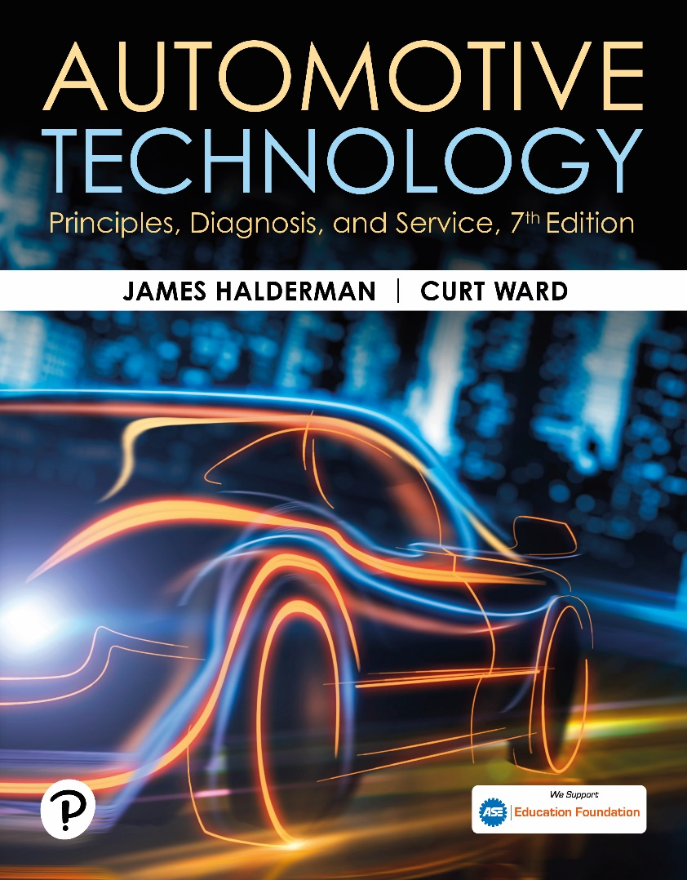
Automotive Technology: Principles, Diagnosis, and Service
Seventh Edition
Chapter 118
Electric Power Steering Systems
Copyright © 2023 Pearson Education, Inc. All Rights Reserved
Notes:
INSTRUCTOR NOTE: This presentation includes text explanation notes, you can use to teach the course. When in SLIDE SHOW mode, you RIGHT CLICK and select SHOW PRESENTER VIEW, to use the notes.

Slide 2
Learning Objectives
118.1 Describe the purpose, and function, and types of electric power steering systems.
118.2 Discuss electric power steering parts and operation.
118.3 Discuss the power steering control module.
118.4 Discuss the diagnosis of electric power steering system faults.
118.5 Describe the self-parking feature and its relationship to power steering.
118.6 Describe electrohydraulic power steering.

Slide 3
Electric Power Steering Overview
(1 of 2)
Purpose and Function
  Electric power steering takes the place of hydraulic components that were previously used by using an electric motor to provide power assist effort.
Advantages
  Improved fuel economy.
  Increase in usable power.
  Improved cold weather starting.
  Reduced engine compartment complexity.

Slide 4
Electric Power Steering Overview
(2 of 2)
Types of E P S Systems
  Rack mounted.
    The assist motor attached to the rack and is often called a rack-and pinion electric power steering
    (R-E P S) system.
  Column mounted.
    Sensors and the assist motor located inside the vehicle.

Slide 5
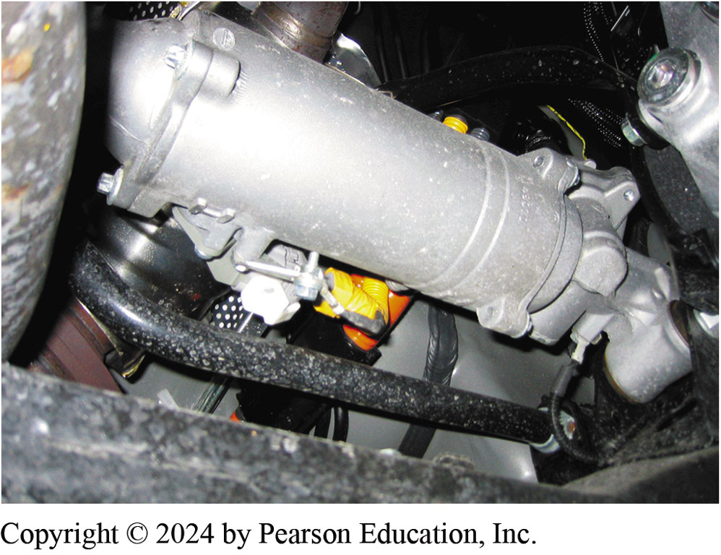
Figure 118.1 Electric Steering Gear
A rack mounted electric power steering gear on a Lexus RX400 h taken from underneath the vehicle

Slide 6
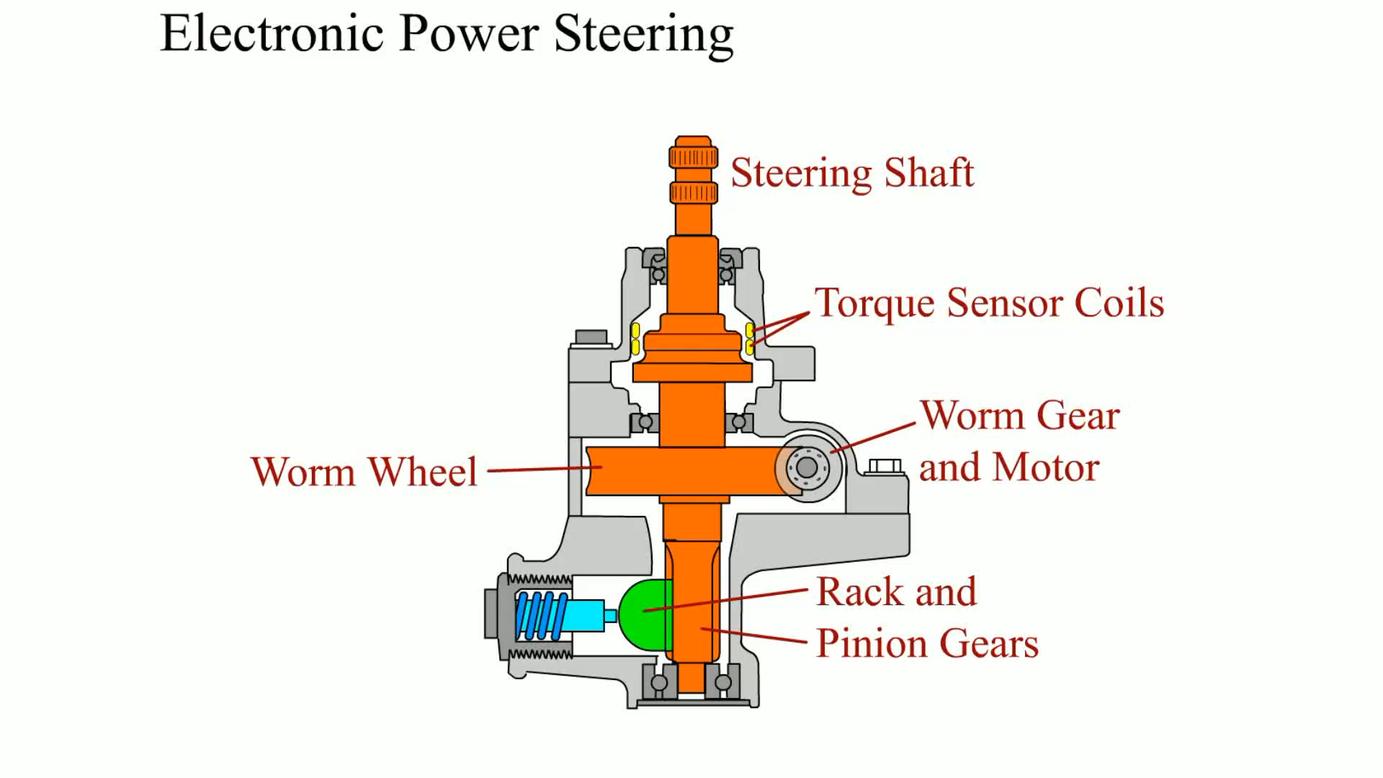
Animation: Electric Power Steering
(Animation will automatically start)
Electric Power Steering

Slide 7
E P S system parts and operation
(1 of 2)
Types of Motors Used
  Most electric power steering units use D C electric motor.
  Some operate from 42 volts while others operate from 12 volts.
E P S Control Unit
  E P S electronic control unit (E C U) calculates amount of needed assist based on the input from the steering torque sensor.

Slide 8
E P S system parts and operation
(2 of 2)
E P S Inputs and Outputs
  Powertrain control module (P C M)
  Body control module (B C M)
  Power steering control module (P S C M)
  Battery voltage
  Steering shaft torque sensor
  Steering wheel position sensor
  Power steering motor
  Driver information center (D I C)
  Serial data communications circuits

Slide 9
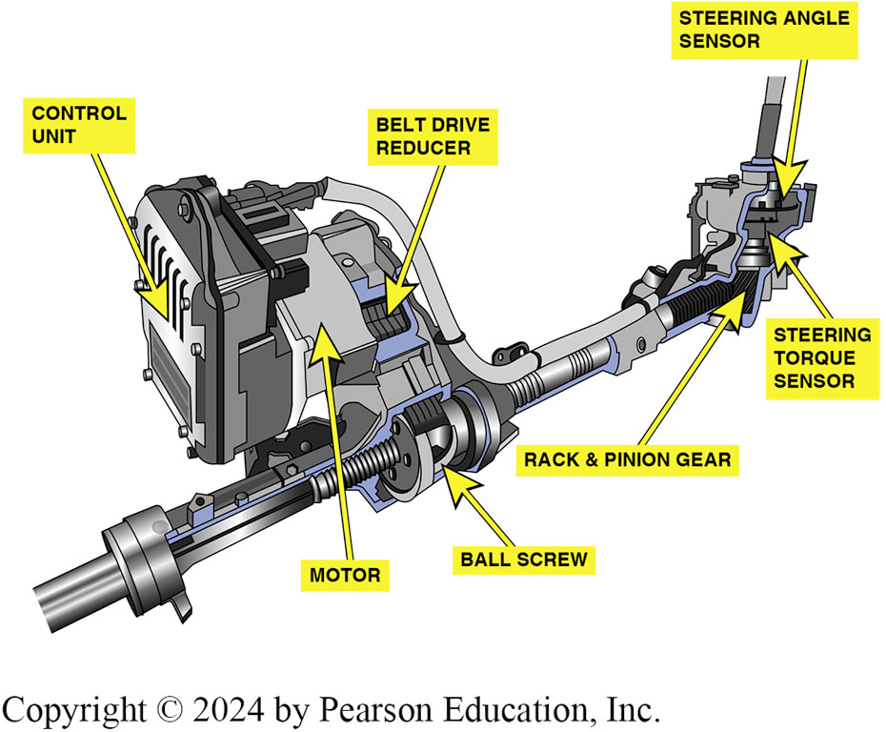
Figure 118.2 Belt-Driven Electric
A belt-driven electric power steering system used on many Ford vehicles.

Slide 10
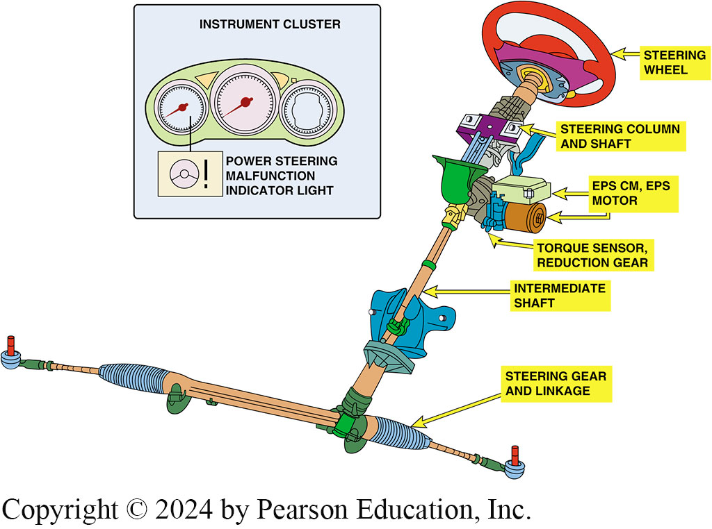
Figure 118.3 Column-Mounted
A typical column-mounted electric power steering (EPS) system showing the location of the major components involved including the dash warning light symbol.

Slide 11
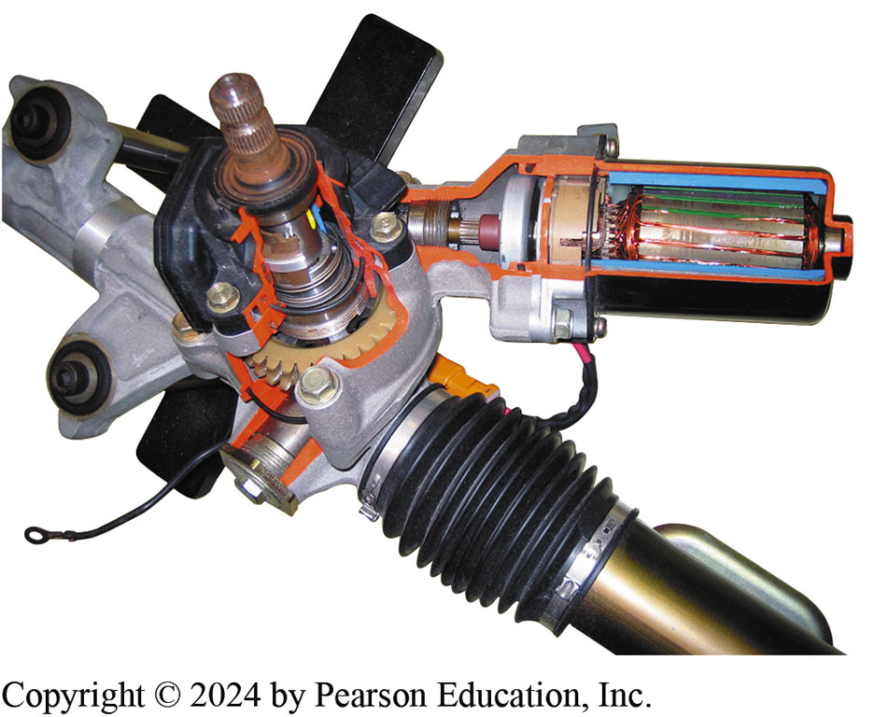
Figure 118.4 Honda Electric Steering
Honda electric power steering unit cutaway, which is an example of pinion-mounted electric power steering system.

Slide 12
Question 1: ?
What is the purpose of electronic power steering?

Slide 13
Answer 1
Electric power steering takes the place of hydraulic components that were previously used by using an electric motor to provide power assist effort.

Slide 14
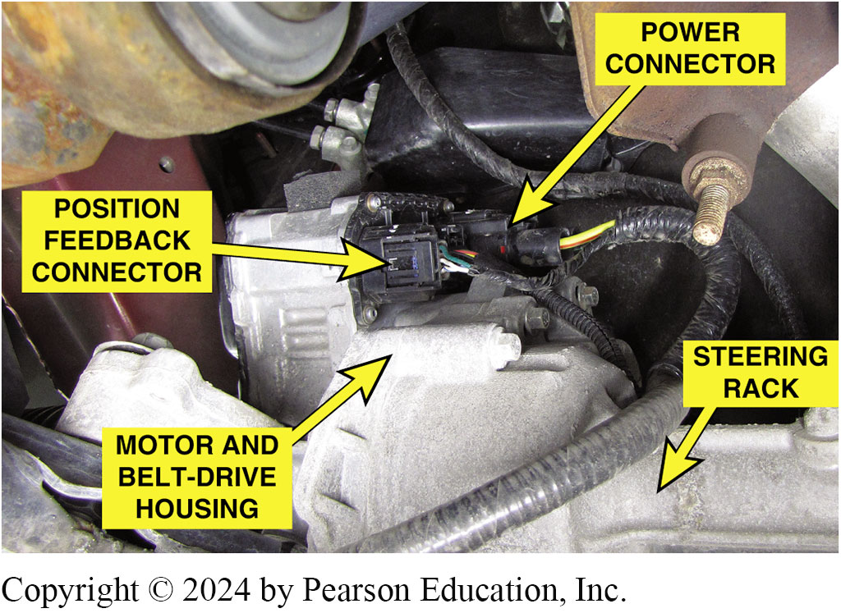
Figure 118.5 Ford Unit
Ford electric power steering rack-mounted motor tat drives the rack through a toothed belt. This assembly is located on the passenger side of the vehicle opposite to where the steering column shaft is attached to the rack.

Slide 15
Steering Shaft Torque Sensor
P S C M uses the steering shaft torque sensor as a main input for determining steering direction and amount of assist needed.
  When torque applied to steering column shaft during a right turn, sensor signal 1 voltage increases, while signal 2 voltage decreases.
  When torque applied to the steering column shaft during a left turn, the sensor signal 1 voltage decreases, while the signal 2 voltage increases.
  P S C M recognizes this change in signal voltage as steering direction and steering column shaft torque.

Slide 16
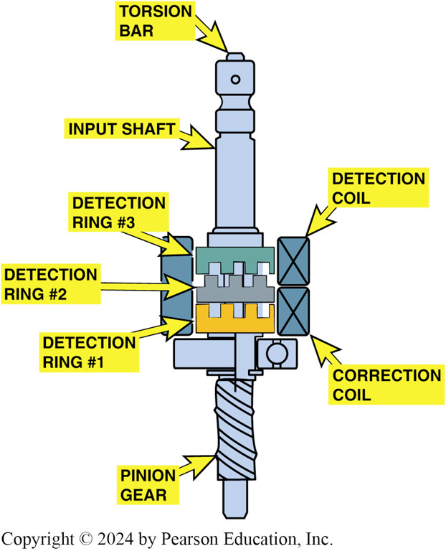
Figure 118.6 Torque Sensor
The torque sensor converts the torque the driver is applying to the steering wheel into a voltage signal

Slide 17
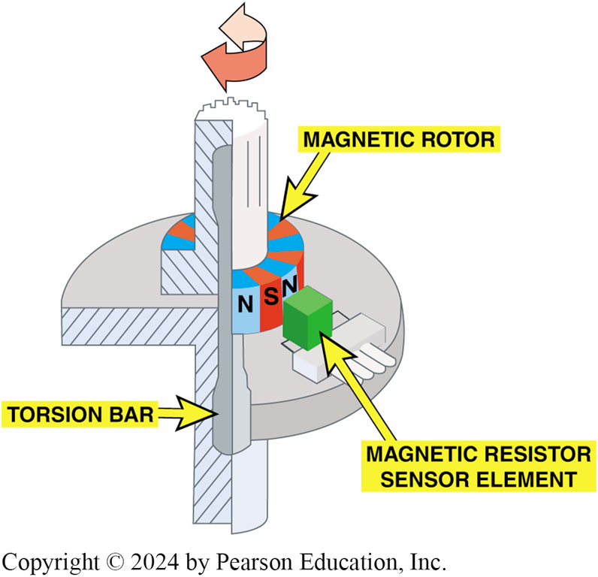
Figure 118.7 Torque Sensor
A cutaway view showing the operation of the torque sensor used in electric power steering systems

Slide 18
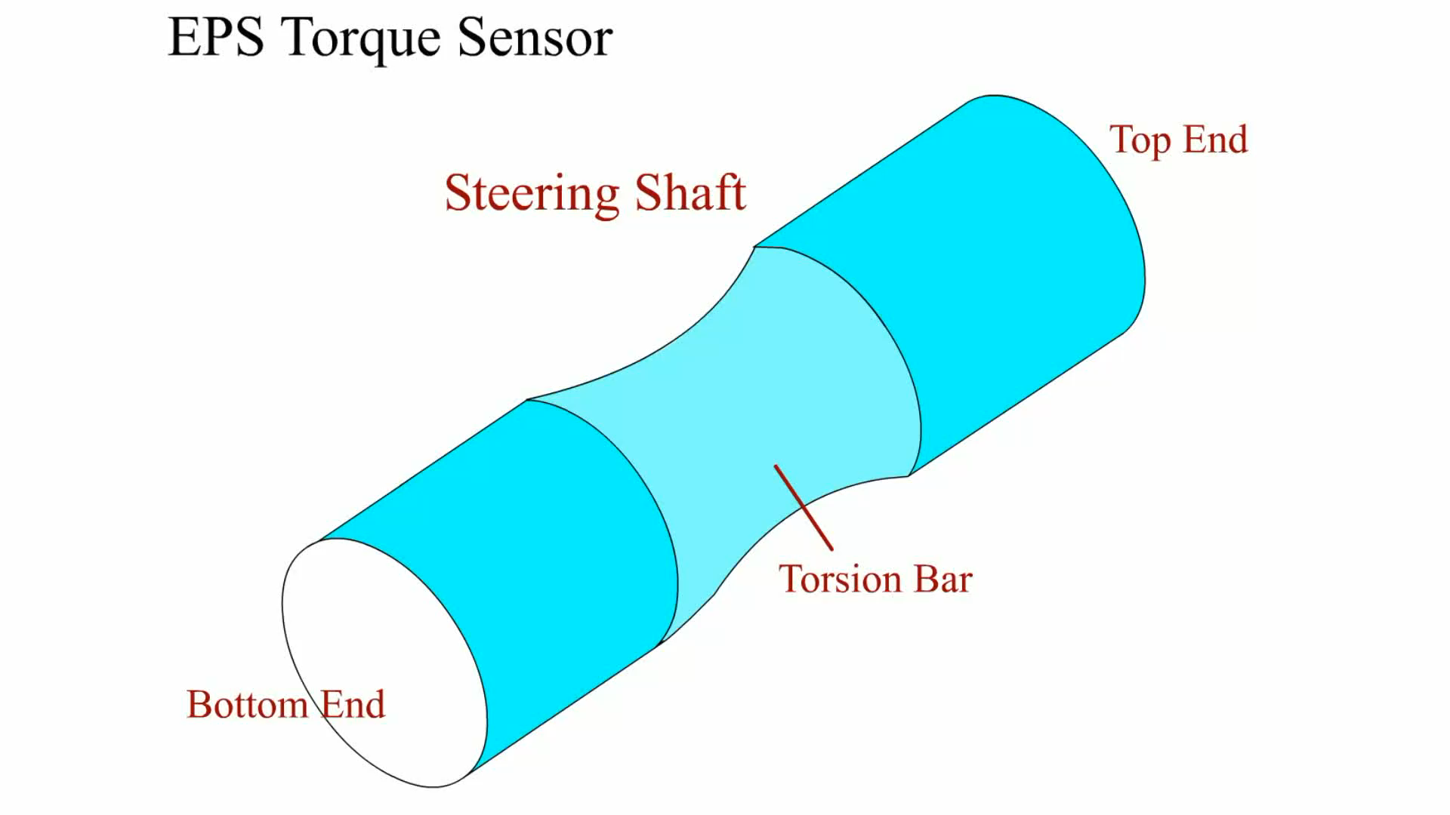
Animation: EPS Torque Sensor
(Animation will automatically start)

Slide 19
Steering Wheel Position Sensor
P S C M uses the steering position sensor (S P S) to determine the steering system on-center position.
  Sensor is a 5-volt dual-analog signal device with a signal voltage range of 0 to 5 volts.
  Sensor’s signal 1 and signal 2 voltage values will increase and decrease within 2.5 to 2.8 volts of each other as the steering wheel is turned.

Slide 20
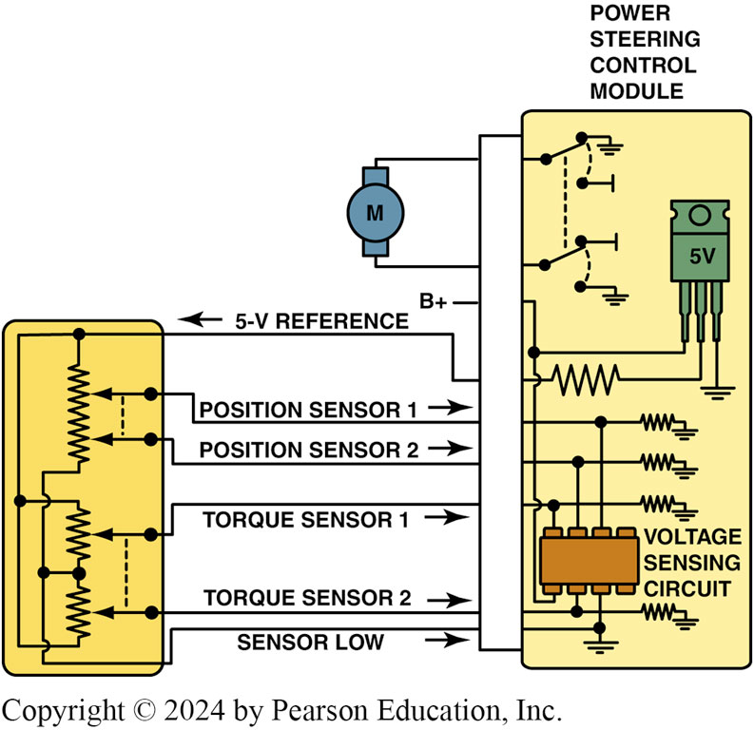
Figure 118.9 Sensor Schematic
Schematic showing the electric power steering and the torque/position sensor

Slide 21
Figure 118.
DIAGNOSTIC TROUBLE CODE (DTC) | DESCRIPTION OF FAULT
C1511; C1512; C1513; C1514 | Torque sensor fault
C1521 | Short in motor circuit
U0073 | EPS control module lost communications
Sample diagnostic trouble codes (DTCs) for the electric power steering system.

Slide 22
Question 2: ?
What is the purpose of the steering wheel position sensor?

Slide 23
Answer 2
To determine the steering system on-center position.

Slide 24
Power Steering Motor
The power steering motor is a 12-volt brushless D C reversible motor with a 65-amp rating.
The motor assists steering through a worm gear and reduction gear located in the steering column housing.
The motor draws about 750 to 1,000 watts or about 1 horsepower at full assist.

Slide 25
Power Steering Control Module
(P S C M)
Purpose and Function
  P S C M uses a combination of steering shaft torque sensor input, vehicle speed, calculated system temperature, and steering tuning to determine the amount of steering assist.
Fault Detection
  If power steering system is exposed to excessive amounts of static steering conditions, P S C M will go into a protection mode to avoid thermal damage due to overheating of the power steering components.

Slide 26
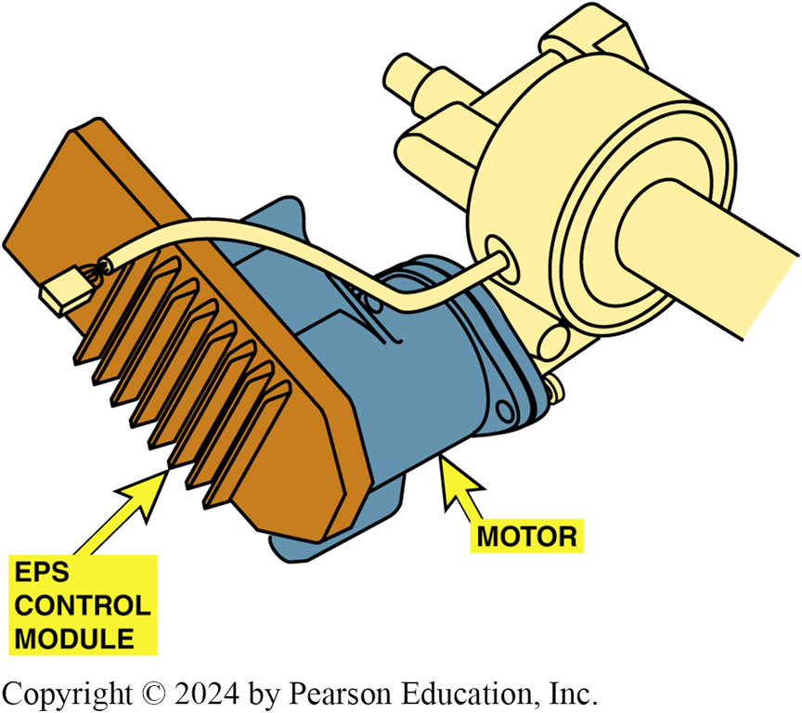
Figure 118.8 PSCM
Power Steering Control Module (PSCM) is attached to the motor of the electric power steering assembly

Slide 27
E P S Diagnosis
The P S C M has the ability to detect malfunctions within the power steering system.

Slide 28
Self-Parking System (1 of 2)
Purpose and Function
  Self-parking feature uses electric power steering to steer vehicle.
Sensors Involved
  Wheel speed sensor (W S S)
  Steering-angle sensor
  Ultrasonic sensors

Slide 29
Self-Parking System (2 of 2)
Self-Park Operation
  Systems vary by manufacturer and have different levels of driver intervention.
Diagnosis and Testing
  Fault in any one sensor will disable self-parking.
  Always follow factory recommended diagnostic and testing procedures.

Slide 30
Electro-Hydraulic Power Steering
(1 of 2)
Purpose and Function
  Electro-hydraulic power steering is used on Chevrolet Silverado mild hybrid truck.
  System uses an electric motor to drive a hydraulic pump.
  Electro-hydraulic power steering (e h p s) module controls the power steering motor, which has the function of providing hydraulic power to the brake booster and the steering gear.
  Components of system include:
    Electric motor, Hydraulic pump
    Fluid level sensor, Electronic controller
    Fluid reservoir and cap

Slide 31
Electro-Hydraulic Power Steering
(2 of 2)
E H P S Module
  Electro-hydraulic Power Steering (E H P S) module is operated from 36-volt (nominal) power supply.
  E H P S module receives following messages from CAN bus:
    Vehicle speed
    Service disconnect status
    P R N D L (shift lever) position
    Torque converter clutch (T C C)/cruise dump signal (gives zero adjust brake switch position)

Slide 32
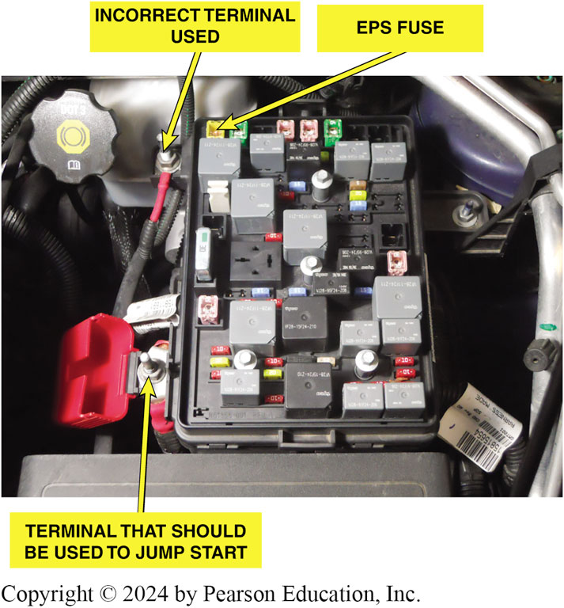
Figure 118.10 Blown Fuse
The blown fuse is the yellow 60-amp fuse next to the terminal at the top
Notes:
CASE STUDY: The Hard Steering Chevrolet
The owner of a Chevrolet complained that the steering wheel was harder to turn after the battery was jump started. The tow truck driver did not know what to do and advised the owner to take
it to a shop to have it looked at but the driver did not think that jump starting the vehicle could
affect the power steering. A technician at the shop determined that the electric power steering did not work because of a blown fuse. Apparently, the vehicle was jump started by connecting the positive jump cable to the main terminal toward the rear of the engine compartment instead of the terminal designed to be used to jump start the vehicle as the battery is located at the rear of this vehicle. FIGURE 118–10.
After the blown fuse was replaced, the electric power steering worked correctly.
Summary:
Complaint—Owner complained that the steering felt stiff after the vehicle was jump started.
Cause—The jump start cables were connected to the wrong terminal, which caused the fuse to blow that controlled the electric power steering.
Correction—The blown fuse was replaced and the power steering system operation was restored to normal.

Slide 33
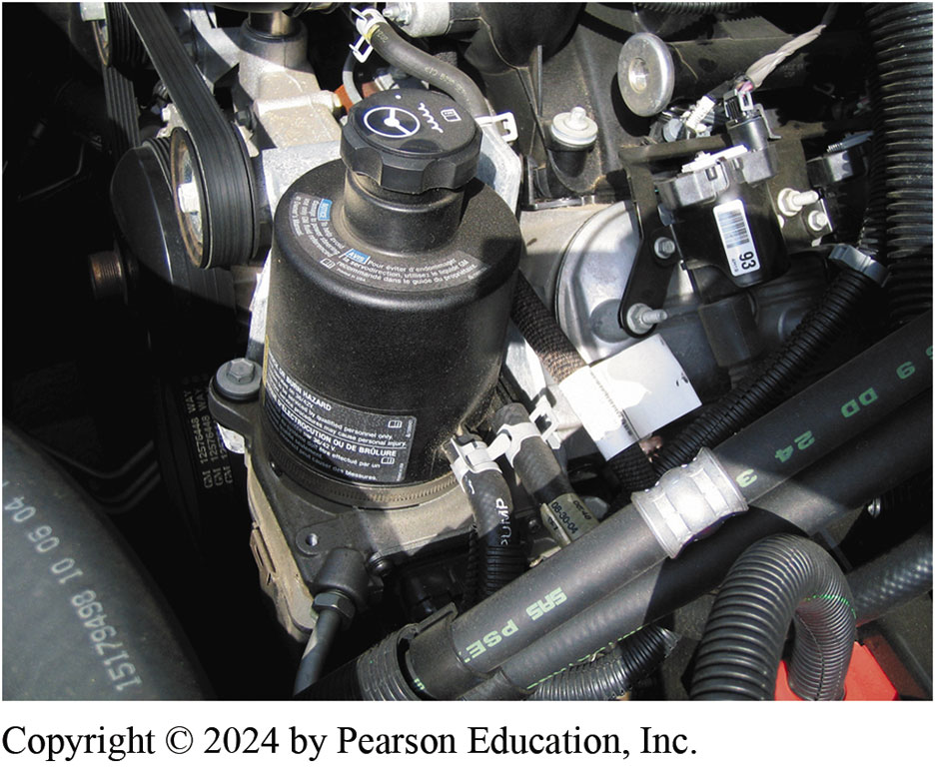
Figure 118.11 Electro-Hydraulic
An electro-hydraulic power steering assembly on a Chevrolet hybrid pickup truck

Slide 34
Question 3: ?
What is the purpose of the electro-hydraulic power steering system?

Slide 35
Answer 3
To provide steering assist during engine-off operating periods.

Slide 36
Suspension and Steering Videos and Animations
Videos Link: (A4) Suspension and Steering Videos
Animations Link: (A4) Suspension and Steering Animations

Slide 37
Copyright
This work is protected by United States copyright laws and is provided solely for the use of instructors in teaching their courses and assessing student learning. Dissemination or sale of any part of this work (including on the World Wide Web) will destroy the integrity of the work and is not permitted. The work and materials from it should never be made available to students except by instructors using the accompanying text in their classes. All recipients of this work are expected to abide by these restrictions and to honor the intended pedagogical purposes and the needs of other instructors who rely on these materials.

