Slide 1
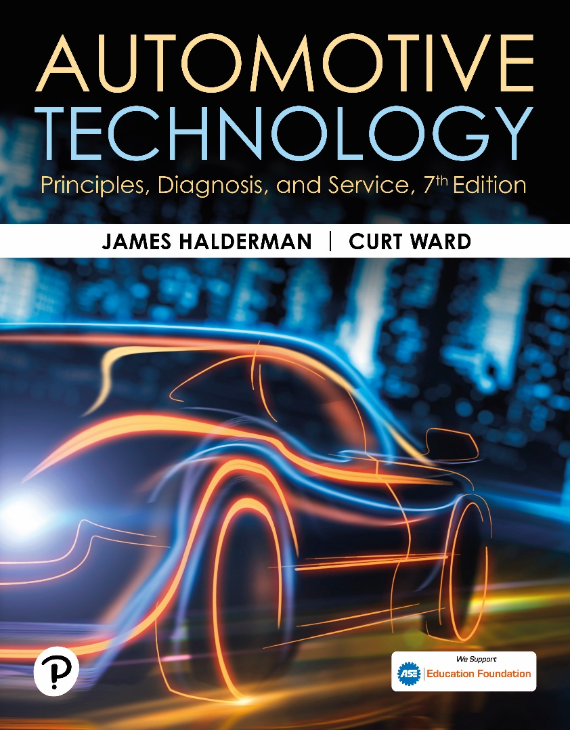
Automotive Technology: Principles, Diagnosis, and Service
Seventh Edition
Chapter 117
Hydraulic Power Steering Systems
Copyright © 2023 Pearson Education, Inc. All Rights Reserved
Notes:
INSTRUCTOR NOTE: This presentation includes text explanation notes, you can use to teach the course. When in SLIDE SHOW mode, you RIGHT CLICK and select SHOW PRESENTER VIEW, to use the notes.

Slide 2
Learning Objectives
117.1 Describe the operation of hydraulic power steering hydraulic systems.
117.2 Discuss the components and operation of power steering pumps.
117.3 Explain the purpose and function of integral power steering.
117.4 Discuss the purpose and function of variable effort steering systems.
117.5 Discuss power steering diagnosis and troubleshooting.
117.6 Describe service of power steering components and fluid.

Slide 3
Hydraulic Power Steering Systems (1 of 2)
Purpose and Function
  Power-assisted steering hydraulically boosts the mechanical steering gear operation so the driver can turn the steering wheel with less effort for the same response.
Fundamentals
  Force is a push or pull acting on an object and is usually measured in pounds of force or Newtons.
  Pressure is measured in force per unit of area, such as pounds per square inch (P S I), or kilopascals (kPa).

Slide 4
Hydraulic Power Steering Systems (2 of 2)
Pascal’s Law
  When force is applied to a liquid confined in a container or an enclosure, the pressure is transmitted equally and undiminished in every direction.
  The advantage of a liquid over a mechanical lever is that a liquid has volume but does not have a fixed shape.

Slide 5
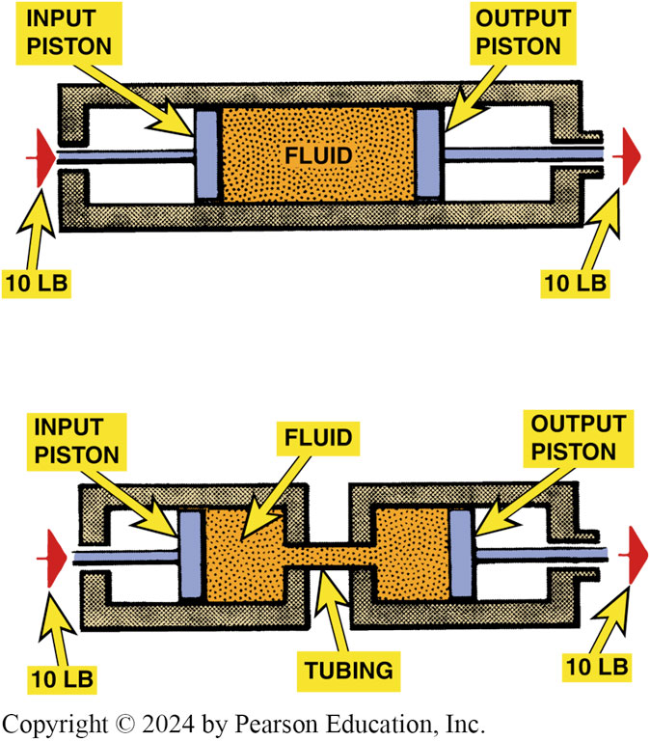
Figure 117.1 Pascal’s Law
Hydraulic fluid transmits the same force whether it passes through a single chamber or two chambers connected by a narrow passage

Slide 6
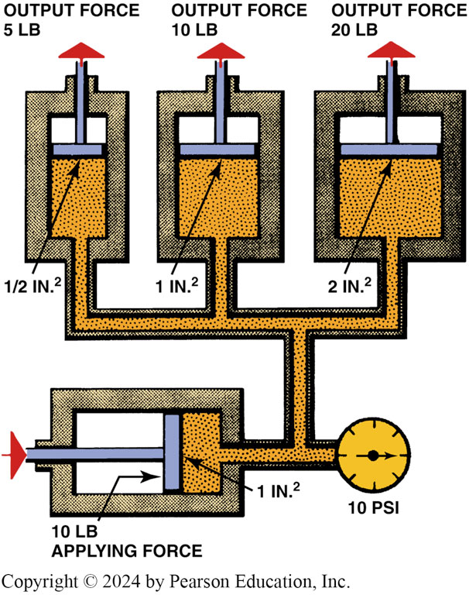
Figure 117.2 Pascal’s Law
A fluid applies a force equal to the applied force on a surface that is equal in size to the applying surface. If the surface is half the size, then the fluid exerts half the force; if the surface is twice as large, the fluid exerts twice the force.

Slide 7
Question 1: ?
What is the purpose of a power steering system?

Slide 8
Answer 1
Boost the mechanical steering unit so the driver can turn the wheel with less effort and get the same response.

Slide 9
Power Steering Pump and Reservoir (1 of 4)
Parts and Operation
  Power steering pump draws fluid from reservoir, pressurizes it, and delivers it to the power steering system.
Remote Reservoir
  Remote reservoir allows for a smaller, more compact pump assembly that is better suited to engine compartment.

Slide 10
Power Steering Pump and Reservoir (2 of 4)
Forces and Pressures Involved
  A typical power steering system requires only 2 to 3.5 lb (0.9 to 1.6 kg) of driver effort to turn the steering wheel.
Typical pressures generated by a power steering system include the following:
  Straight ahead less than 150 P S I (1,400 kPa)
  Cornering about 450 P S I (3,100 kPa)
  Parking (maximum) 750–1,400 P S I (5,200–10,000 kPa)

Slide 11
Power Steering Pump and Reservoir (3 of 4)
Vane Pump Operation
  Drive belt rotates power steering pump pulley and the rotor assembly inside the power steering pump.
  Centrifugal force and hydraulic pressure push vanes of the rotor outward into contact with the pump ring.
  The shape of the pump ring causes a change in the volume of fluid between the vanes.

Slide 12
Power Steering Pump and Reservoir (4 of 4)
Control Valve
  The modulator valve (also called a control valve) is a spring-loaded pressure-relief device that bleeds off excess pressure to prevent system damage.

Slide 13
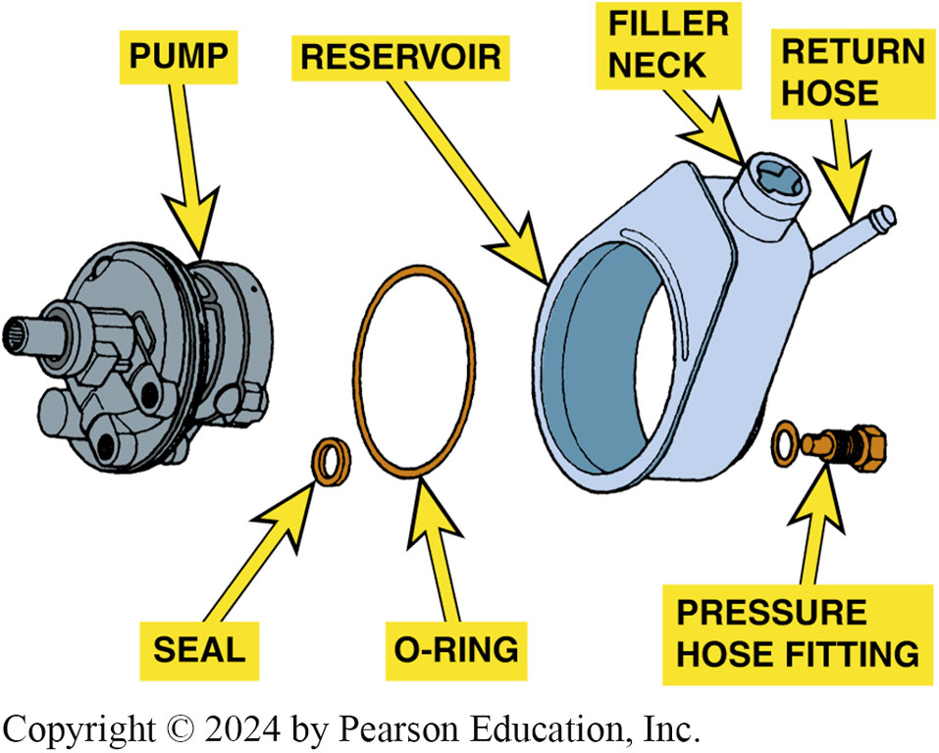
Figure 117.3 Pump
A typical integral power steering pump when the pump is mounted inside the reservoir

Slide 14
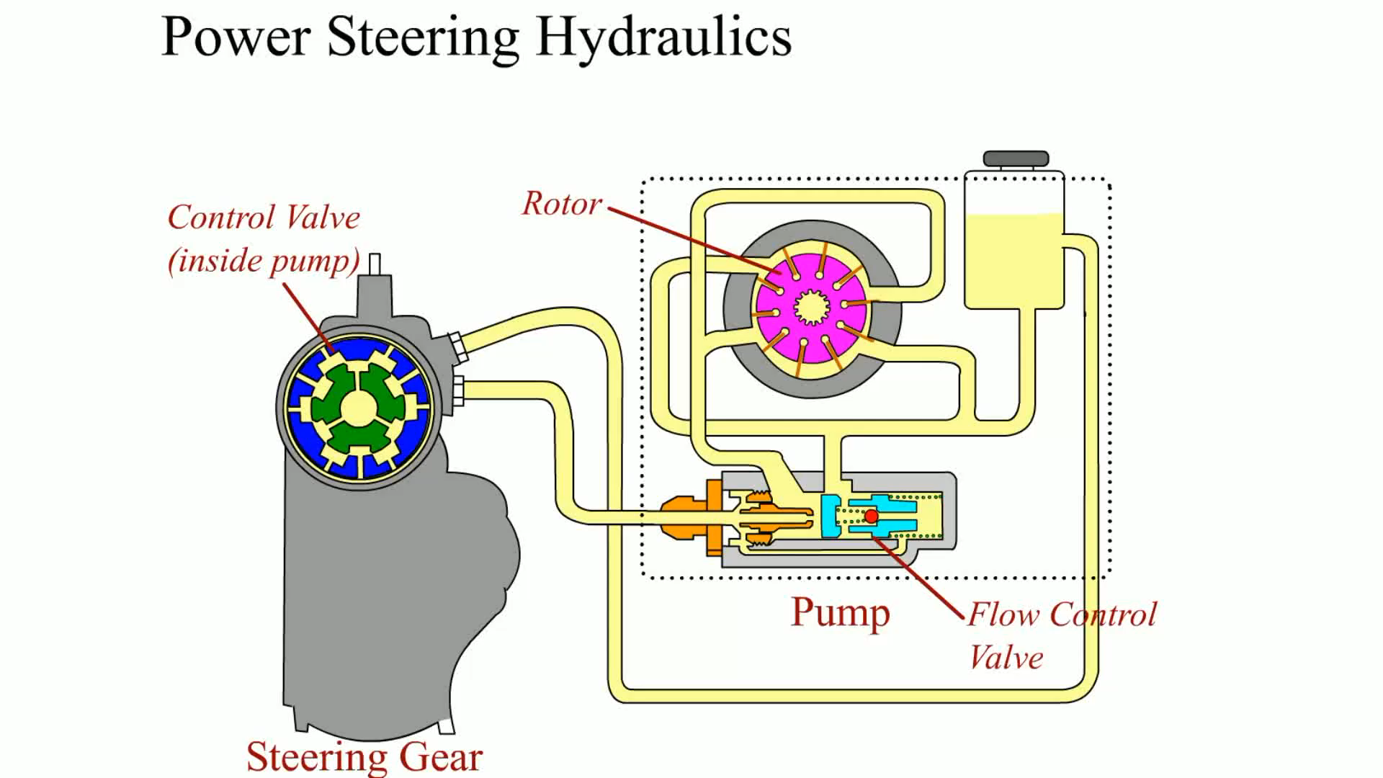
Animation: Power Steering Hydraulics
(Animation will automatically start)

Slide 15
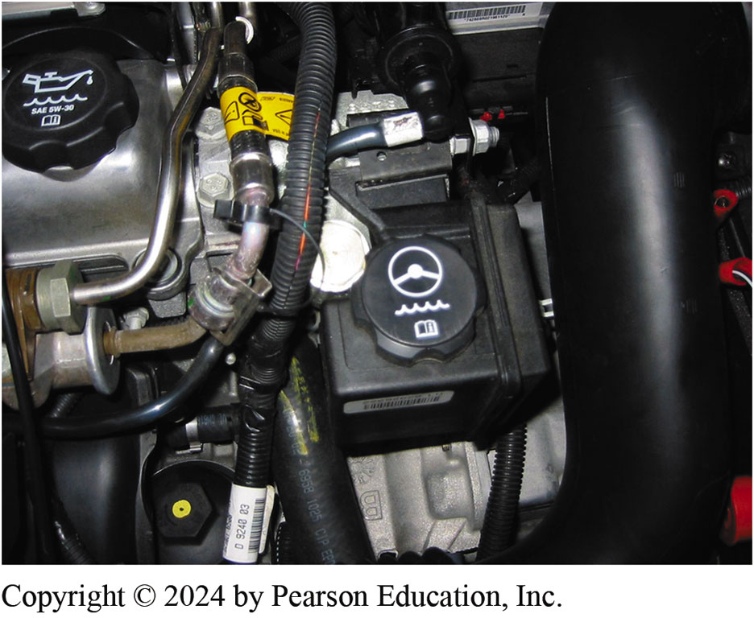
Figure 117.4 Typical Remote Reservoir

Slide 16
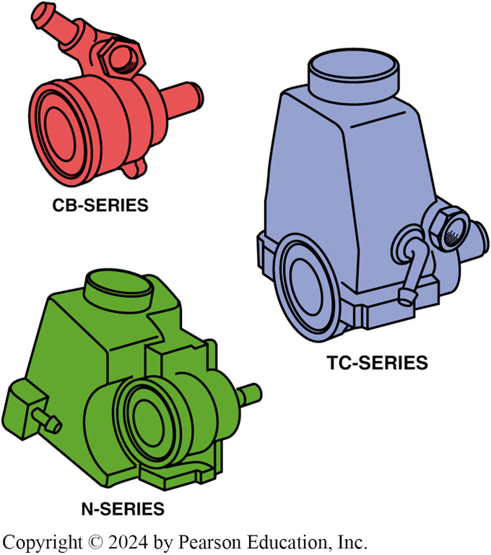
Figure 117.5 Pump Assemblies
Typical power steering pump assemblies

Slide 17
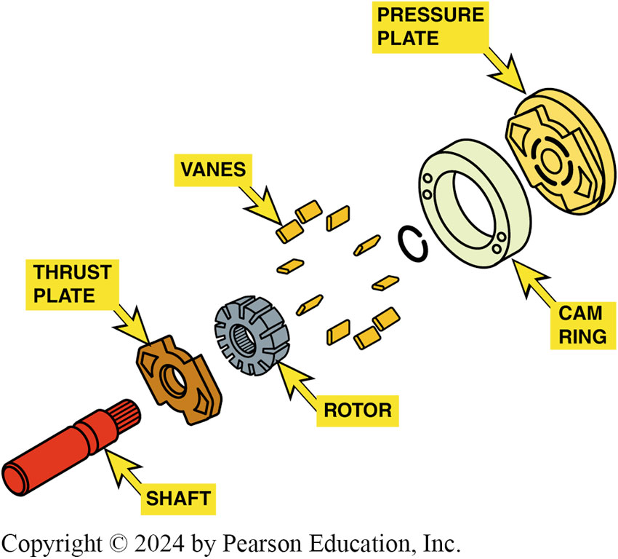
Figure 117.6 GM Vane-Type Pump

Slide 18
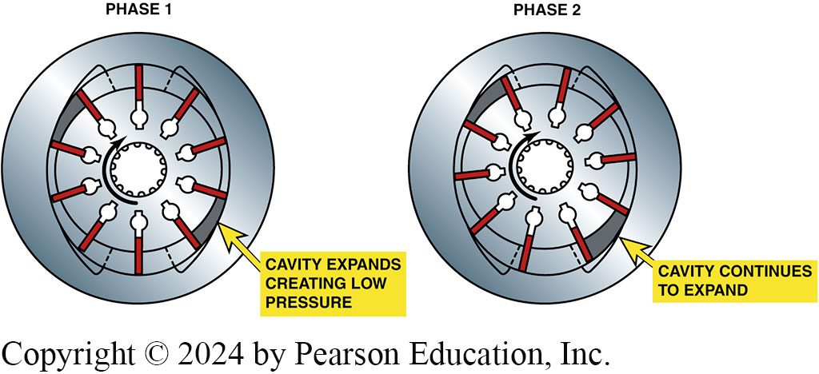
Figure 117.7
Vane pump operation. In phase 1, rotor moves past opposed suction ports, and the vanes move out to maintain contact with the ring. As the rotor continues to move during phase 2, the vanes follow the contour of the ring. The contour of the ring forms a larger cavity between the vanes

Slide 19
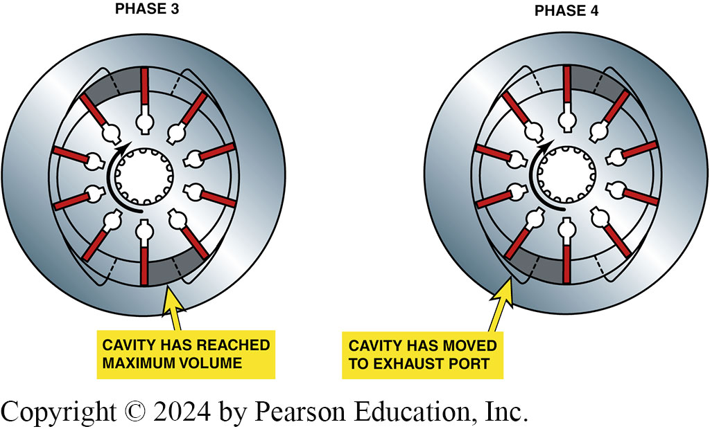
Figure 117.8
Vane pump operation—continued. At phase 3, the vanes are at the end of the intake port of the pump and the cavity has reached its maximum volume. In phase 4, the rotor moves into alignment with the opposed discharge ports

Slide 20
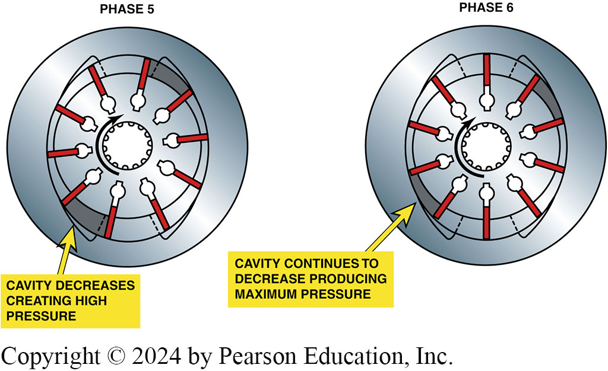
Figure 117.9
Vane pump operation—continued. As the rotor continues to move during phase 5, the volume of the cavity decreases, which increases the discharge pressure. At phase 6, the last phase, the contour of the ring results in minimum cavity volume, and discharge of fluid is completed

Slide 21
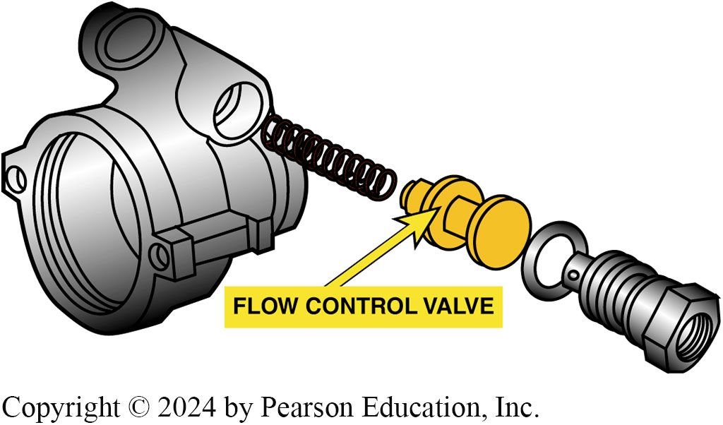
Figure 117.10 Flow Control Valve

Slide 22
Frequently Asked Question: What Is the Purpose of the PSP Switch in the High-Pressure Line?
? Frequently Asked Question
What Is the Purpose of the PSP Switch in the High-Pressure Line? Under certain conditions, such as when the steering wheel is turned to or near full stop for more than a few seconds, pressure builds in the system and the pump must work harder to keep up with the demand. As a result, the pump draws more power from the engine. If the engine is running at idle, the extra load can cause it to stall. A pressure switch, known as the power steering pressure (PSP) switch, transmits an electronic signal to the powertrain control module (PCM) when the pressure in the system is high enough to increase the load on the engine. In response to the PSP switch signal, the PCM increases the engine idle speed to prevent stalling.

Slide 23
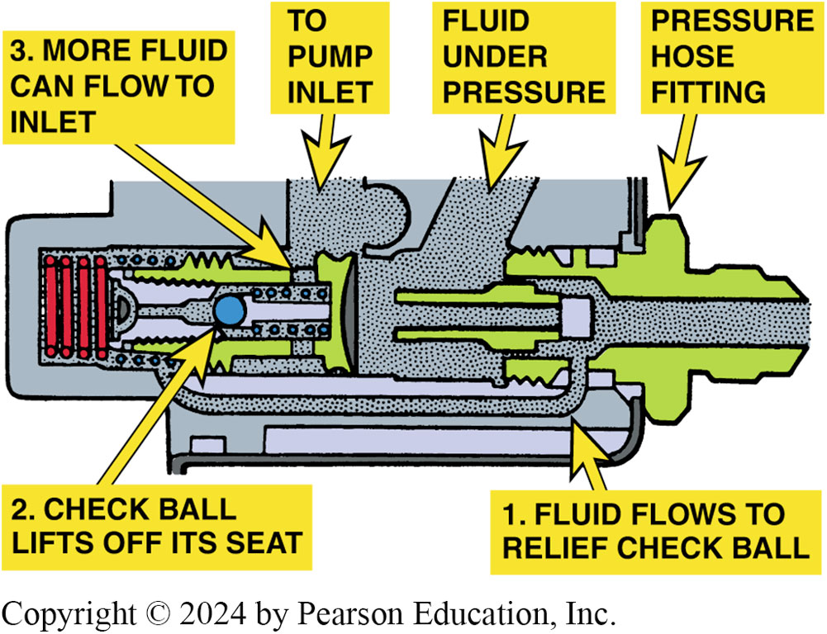
Figure 117.11 Pressure Relief Valve
The pressure-relief check ball unseats, allowing fluid to flow back into the pump inlet if the pressure rises above a certain limit

Slide 24
Question 2: ?
How does a vane-type power steering pump operate?

Slide 25
Answer 2
Centrifugal force and hydraulic pressure push the vanes of the rotor outward into contact with the pump ring.

Slide 26
Power Steering Hoses
Pressure hose is connected to the flow control/relief valve. This hose supplies pressurized fluid to the steering gear.
Second hose called the return hose and it returns the fluid from the steering gear back to the pump.
Some vehicles will use a cooler in the return path to the pump. The cooler is used to reduce the temperature of the fluid before it enters the pump.

Slide 27
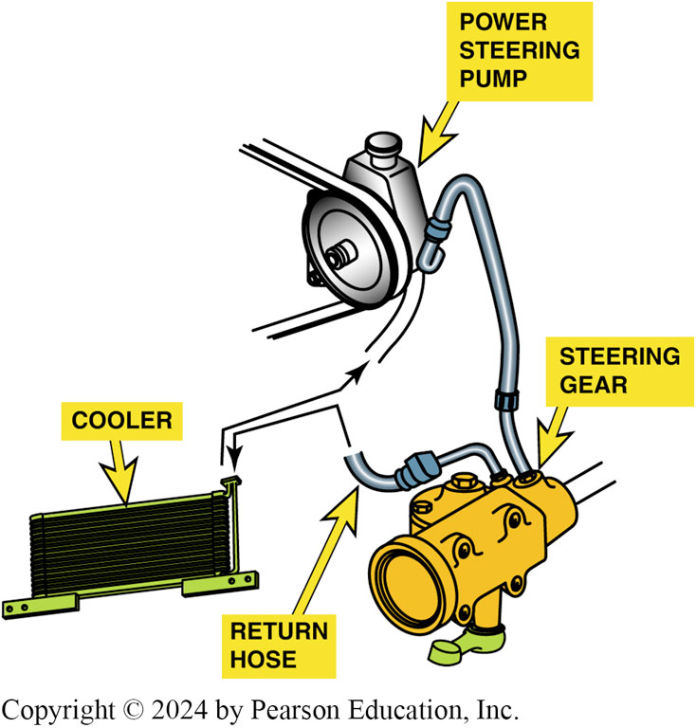
Figure 117.12 Cooler
Power steering fluid cooler, is located in return hose. Often the “cooler” is simply a length of return metal line that is arranged in a loop and routed near the front of the vehicle. The airflow past the return line helps reduce temperature of the fluid

Slide 28
Integral Power Steering (1 of 2)
Purpose and Function
  In integral power steering system
  Control valve and a power piston which applies force to the pitman arm are incorporated into steering gear
Integral Standard Steering Gear
  Most standard steering gears with power assist are the recirculating-ball type, and the ball nut functions as the power piston.

Slide 29
Integral Power Steering (2 of 2)
Rotary Control Valve
  Rotary valve applies force to the power piston and reduces the effort needed to turn the steering linkage.
  Rotary control valve consists of 2 cylindrical elements:
    Inner valve element
    Outer valve element
  Inner valve element is secured to the steering gear input shaft and the torsion bar.
  Outer valve element is also the steering worm gear.

Slide 30
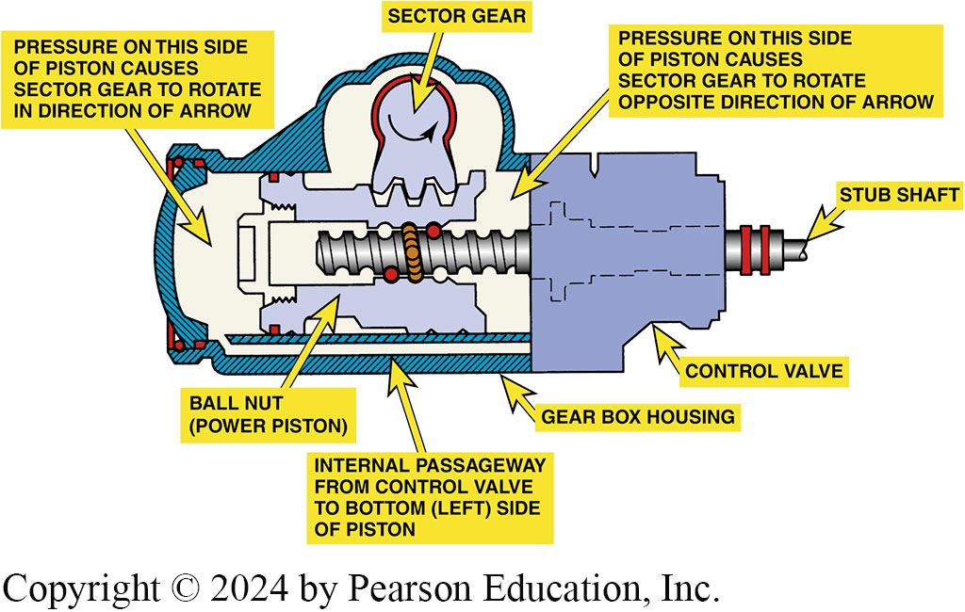
Figure 117.13 Forces on Rack Piston
Forces acting on the rack piston of an integral power steering gear

Slide 31
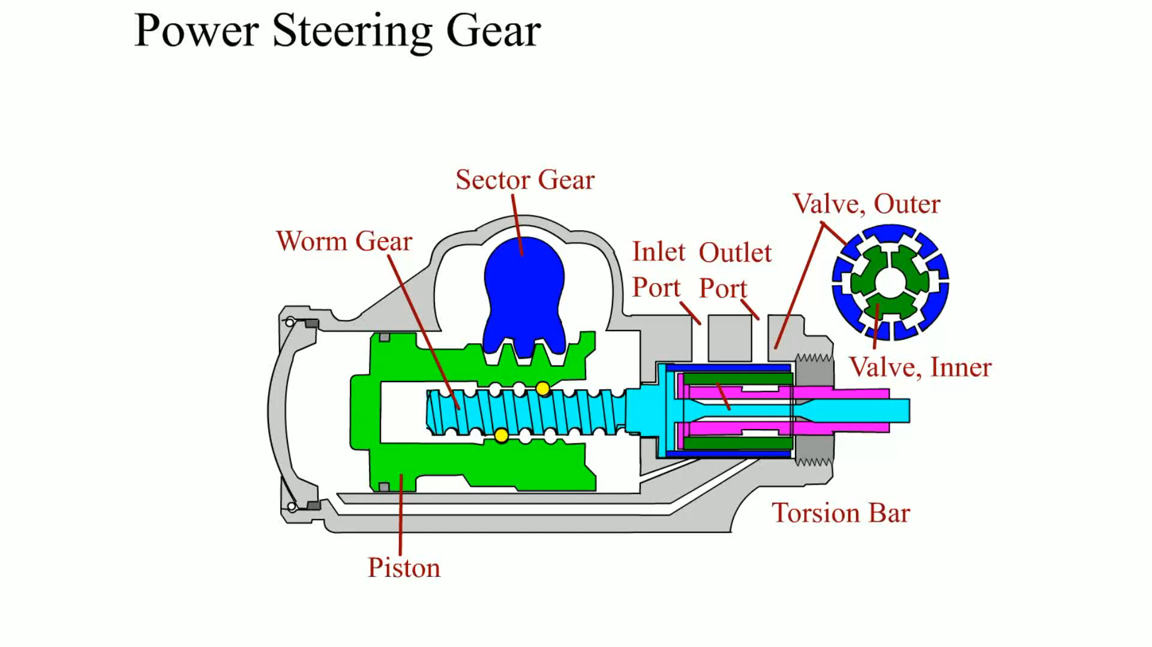
Animation: Power Steering Gear
(Animation will automatically start)

Slide 32
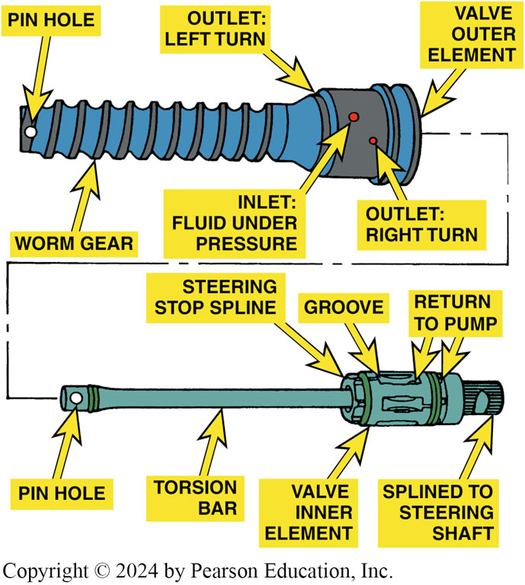
Figure 117.14 Rotary Valve
The rotary valve consists of inner and outer elements. The worm gear is part of the outer element and the torsion bar is part of the inner element. A pin attaches the worm gear to the bottom of the torsion bar to join the two elements together

Slide 33
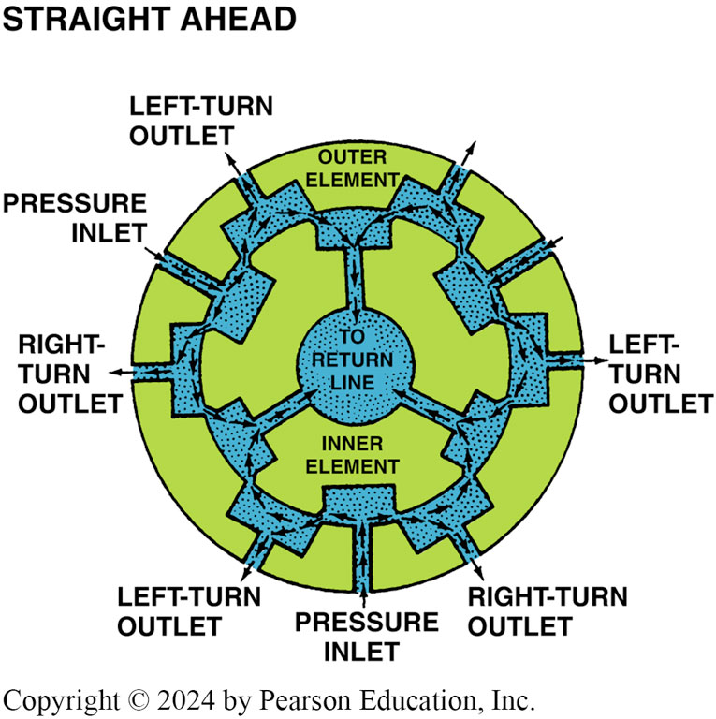
Figure 117.15 Straight Ahead
When the steering wheel is in the straight-ahead position, all of the ports in a rotary valve are open equally to the pressure and return circuits

Slide 34
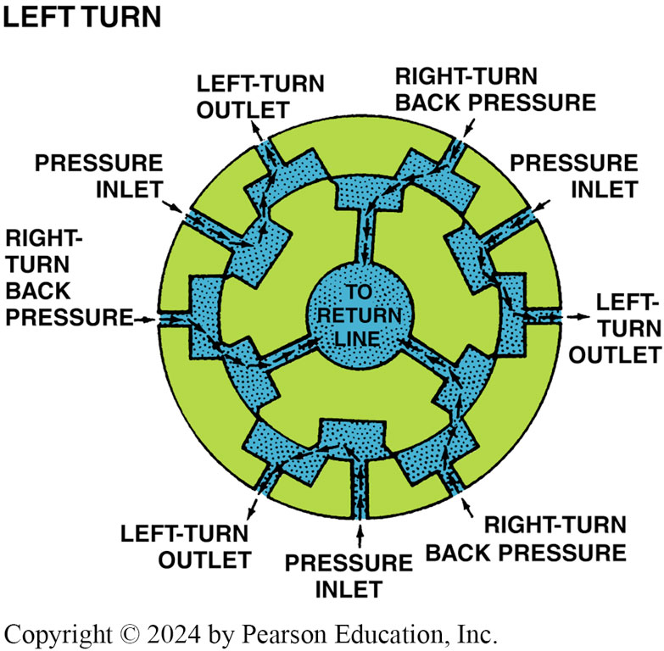
Figure 117.16 Left Turn
During a left turn, the inner element turns so that the left-turn circuits are open to pressure and the right-turn circuits are open to the return circuit

Slide 35
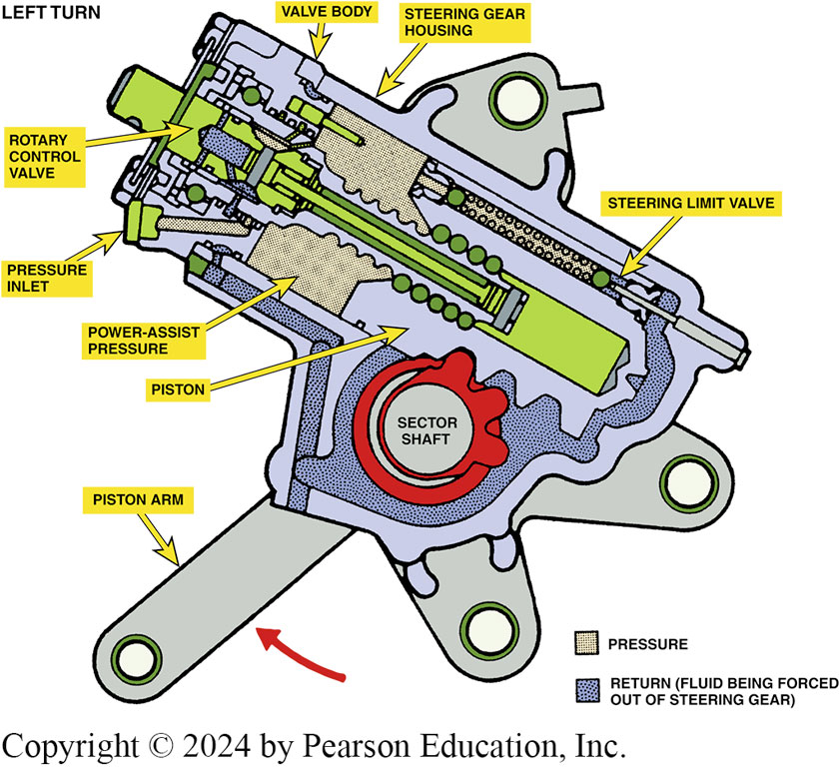
Figure 117.17 Left Turn Assist
During a left turn, the high-pressure fluid helps push the piston along the worm gear, thereby reducing the steering effort from the driver

Slide 36
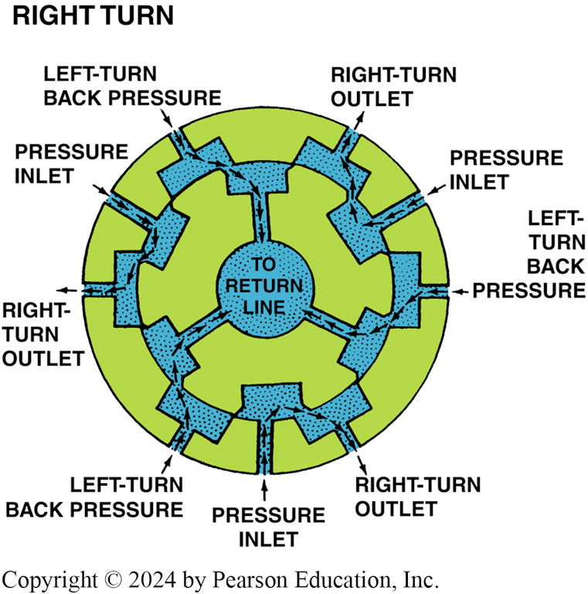
Figure 117.18 Right Turn
During a right turn, the inner element turns so that the right-turn outlets are open to pressure and the left-turn outlets are open to the return circuit

Slide 37
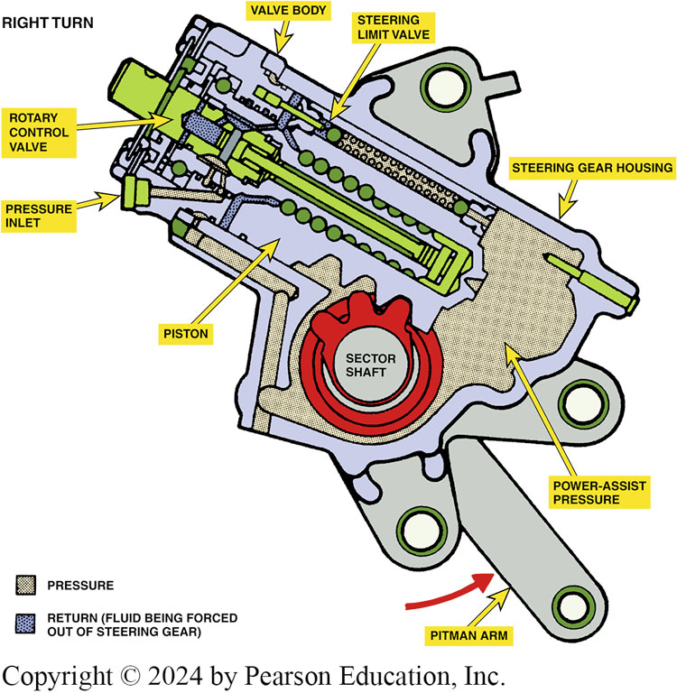
Figure 117.19 Right Turn Assist
During a right turn, high-pressure fluid pushes the piston up the worm gear, moving the sector shaft and pitman arm to provide assist during a right turn.

Slide 38
Power Rack and Pinion Steering
Rotary control valve on a power rack-and-pinion steering gear located between steering gear input shaft and pinion gear.
Fluid discharged by the valve travels through external steel lines to either side of the power piston located in the rack housing.

Slide 39
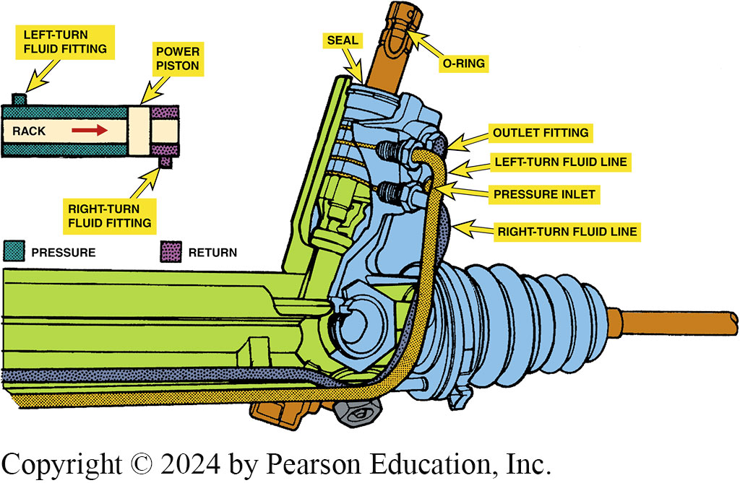
Figure 117.20 Left Turn
See Notes for Explanation
Notes:
Figure 117-20 During a left turn, the control valve directs pressure into the left-turn fluid line and the rack moves left (see inset). Fluid pushed out of the right-turn fluid chamber travels back through the right-turn fluid line and control valve to the return circuit

Slide 40
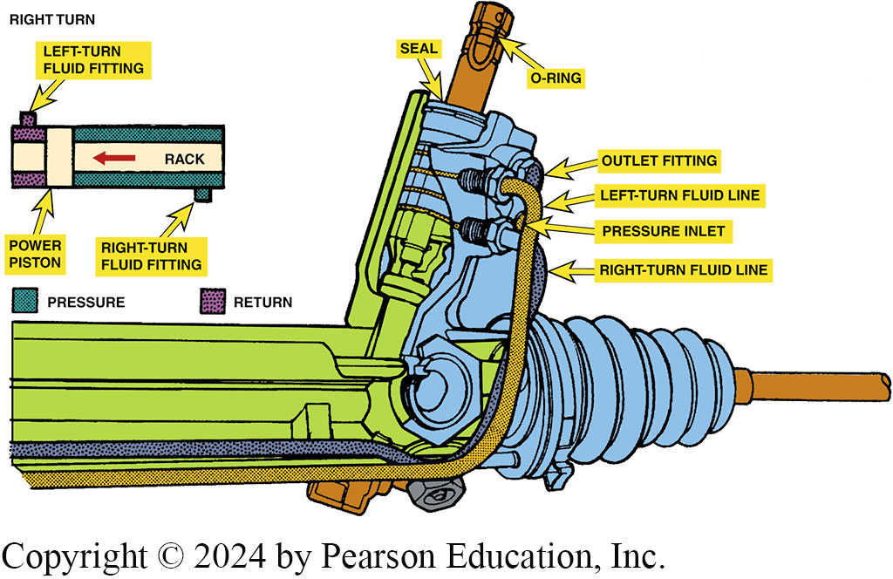
Figure 117.21 Right Turn
Notes:
Figure 117-21 The control valve routes high-pressure fluid to the left-hand side of the power piston, which pushes the piston and assists in moving the rack toward the right when the steering wheel is turned right

Slide 41
Flow Control Valve Operation
Operation of flow control valve stages:
  When power steering pump begins operation, the fluid from output of the pump flows into the control valve.
  Fluid then flows through the orifice, where a pressure differential is formed. The pressure differential results in a higher pressure on the pump side than on the system side.
  As pump speed continues to increase, the valve moves more to compensate for the higher pressure and flow.

Slide 42
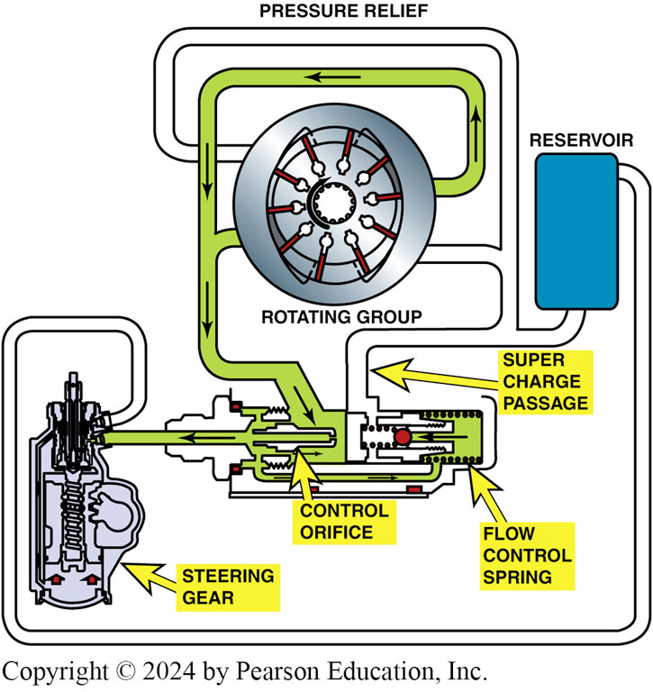
Figure 117.22 Low Speed Control

Slide 43
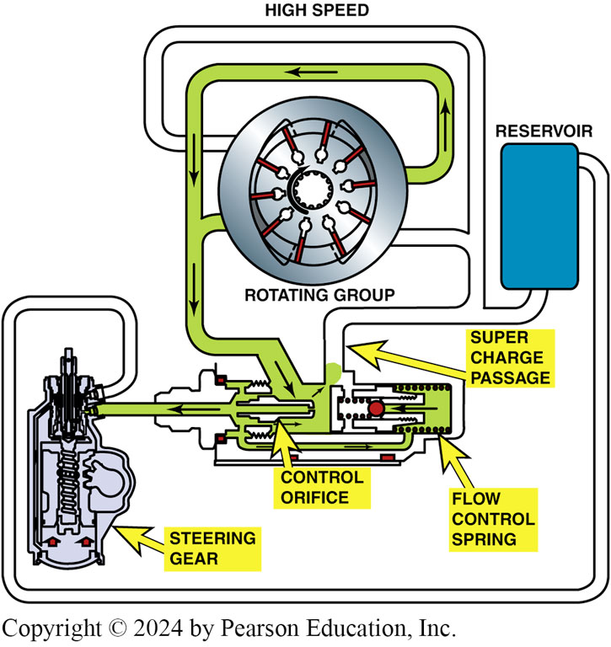
Figure 117.23 High Speed Control

Slide 44
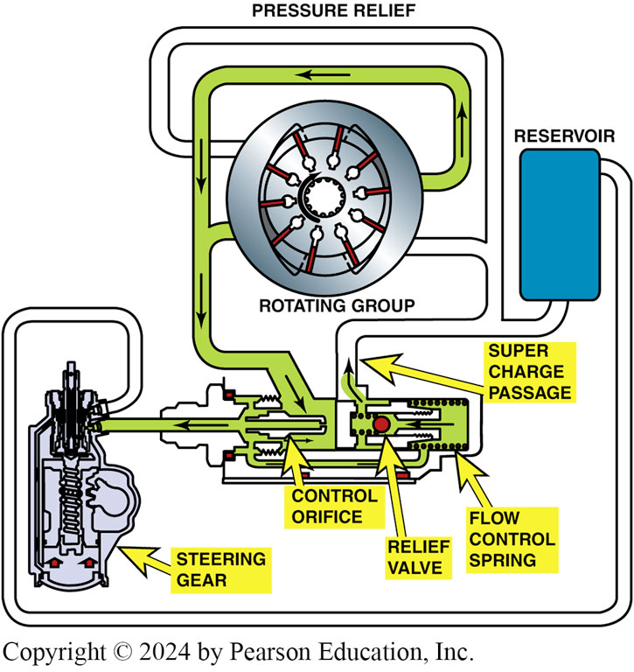
Figure 117.24 Pressure Relief Mode
Pressure-relief mode. In this mode, the steering gear has blocked the flow of fluid from the pump and the pressure rises, which unseats the pressure-relief valve. Now, fluid flows back to the inlet through the pressure-relief orifice and passage

Slide 45
Variable-Effort Steering (V E S) (1 of 5)
Purpose and Function
  Increases assist at lower vehicle speeds to aid parking
  Decreases assist at higher speeds for greater road feel.
As examples, GM uses 4 different V E S systems including:
  Electronic Variable Orifice (E V O)
  Two-Flow Electronic (T F E)
  Speed Sensitive Steering (S S S)
  Magnasteer®

Slide 46
Variable-Effort Steering (V E S) (2 of 5)
Electronic Variable Orifice (E V O) System
  As vehicle speed increases, control module provides a higher current flow and the solenoid positions the pintle to change the size of the orifice.
  This increased speed results in a reduced amount of hydraulic flow and provides less hydraulic pressure to the steering gear.

Slide 47
Variable-Effort Steering (V E S) (3 of 5)
Two-Flow Electronic (T F E) System
  T F E actuator is a solenoid-operated pintle valve.
  Pintle valve has only 2 positions:
    Maximum assist
    Reduced assist
  Solenoid energized whenever vehicle speed is approximately 20 mph (32 km/h) or lower resulting in maximum assist.
  When vehicle speed is higher than 20 mph (32 km/h), the solenoid is de-energized resulting in reduced assist.

Slide 48
Variable-Effort Steering (V E S) (4 of 5)
Speed Sensitive Steering (S S S) System
  Actuator is solenoid-operated valve that controls flow of fluid into the chambers of the steering gear valve.
  Amperage has a direct effect on steering effort and the hydraulic flow rate into the chambers of the spool shaft.
  Steering effort adjustment begins at a vehicle speed of 20 mph (32 km/h).

Slide 49
Variable-Effort Steering (V E S) (5 of 5)
Magnasteer®
  System uses a variable bidirectional magnetic rotary actuator built into the steering rack.
  Electromagnet acts in parallel with the input shaft from the steering wheel to open or close the spool valve.
  Vehicle speeds below 45 mph, increased current provides increased steering assist.
  Vehicle speeds above 45 mph, decreased current flow provides decreased steering assist.

Slide 50
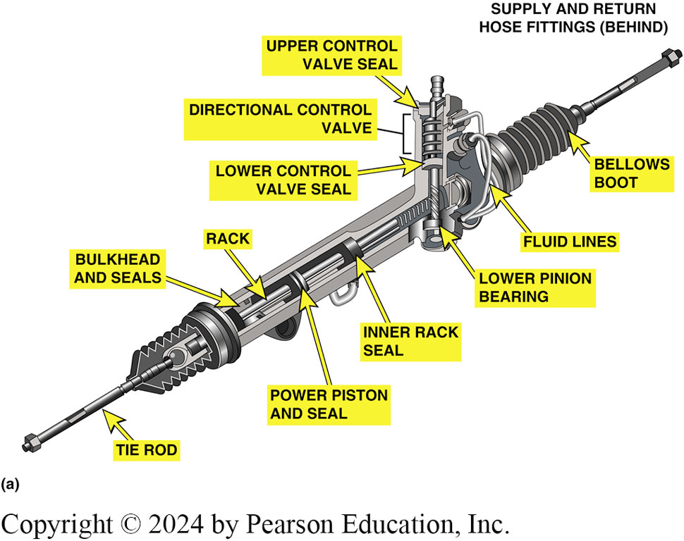
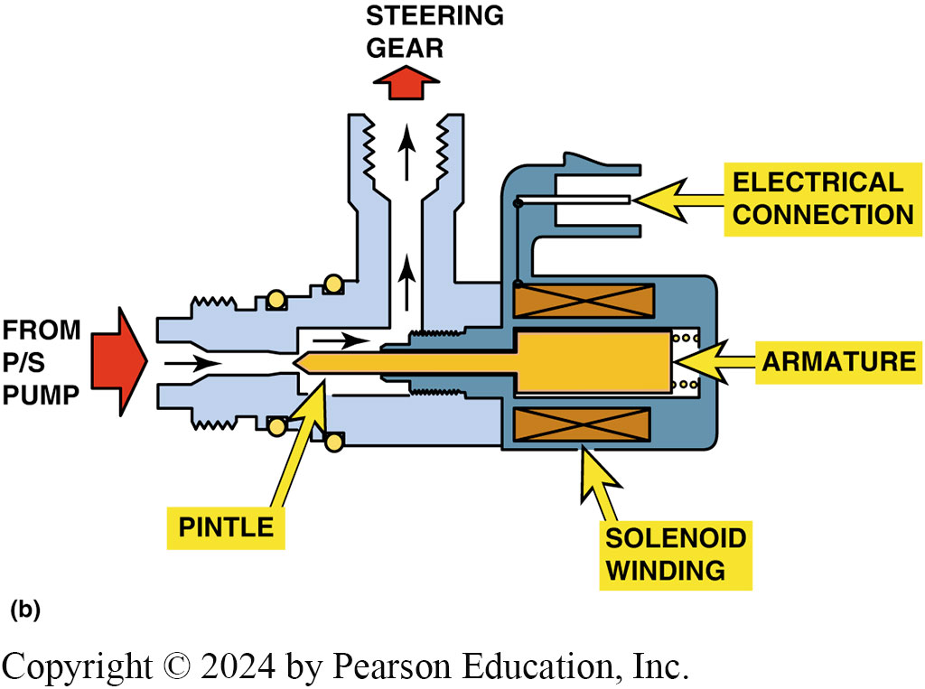
Figure 117.25 EVO Operation
(a) A typical rack and pinion steering gear assembly showing the location of the control valve, power piston, and inner rack seal. (b) EVO actuator assembly.

Slide 51
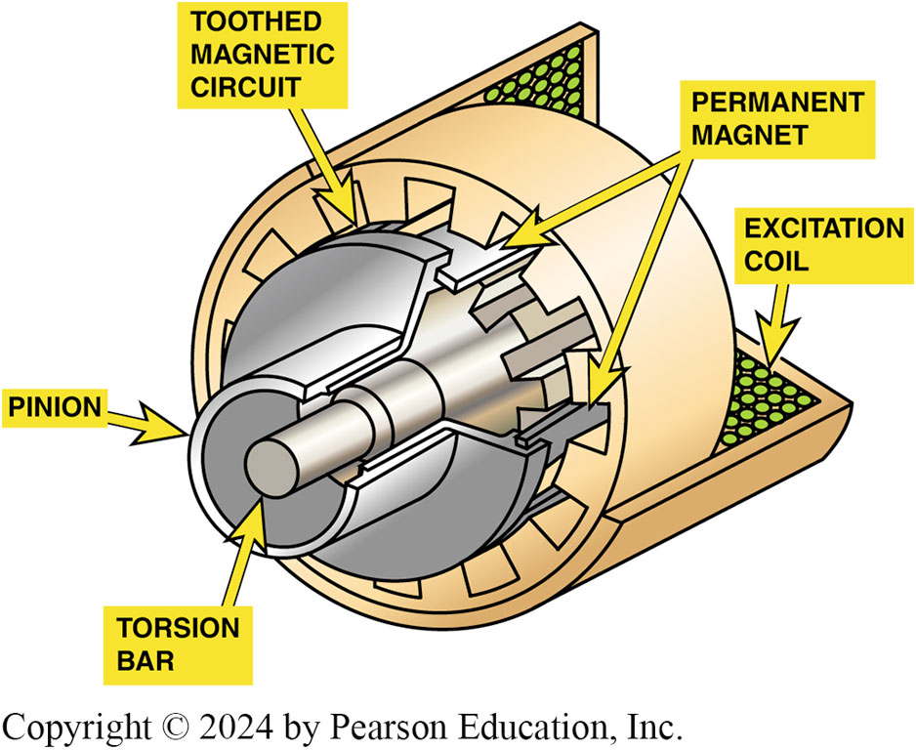
Figure 117.26 Magnasteer®
Integrated with pinion shaft is a spool valve that senses the level of torque in the shaft and applies hydraulic pressure to the steering rack whenever assistance is needed. Electromagnet acts in parallel with the input shaft from the steering wheel to open or close the spool valve. The electromagnet generates variable torque, which can either increase or decrease the amount of steering torque that is needed to open the spool valve

Slide 52
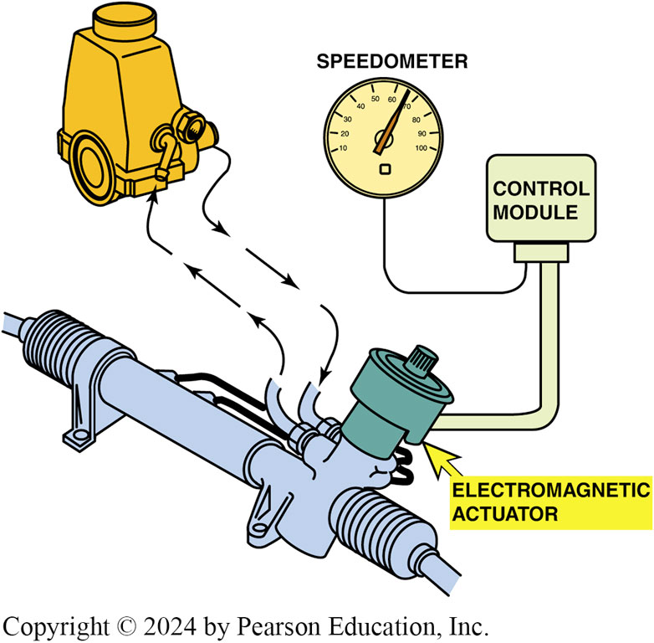
Figure 117.27 Magnasteer® System
Notes:
MAGNASTEER® Another type of variable effort power steering system used by GM is the Magnasteer ® system. This system uses a variable bidirectional magnetic rotary actuator built into the steering rack. The bidirectional magnetic rotary actuator has no effect on the hydraulic operation of the steering rack. The main components in the system include
■ Power steering pump
■ Magnasteer ® actuator assembly
■ Steering gear
■ Electronic brake control module (EBCM)
The Magnasteer ® system uses a conventional rack-and- pinion steering gear and an engine-driven hydraulic pump to provide power assist. The Magnasteer ® actuator consists of the following:
■ A permanent magnet attached to the rotary input shaft
■ A pole-piece assembly attached to the pinion
■ An electromagnetic coil mounted in the steering gear housing
Integrated with the pinion shaft is a spool valve that senses the level of torque in the shaft and
applies hydraulic pressure to the steering rack whenever assistance is needed.
The electromagnet acts in parallel with the input shaft from the steering wheel to open or close
the spool valve. The electro- magnet generates variable torque, which can either increase or
decrease the amount of steering torque that is needed to open
the spool valve. ● SEE FIGURES 117–26 AND 117–27.

Slide 53
Question 3: ?
What is the purpose of variable assist steering systems?

Slide 54
Answer 3
To improve steering assist at low speeds and to provide a more stable driving feel at higher speeds.

Slide 55
Power Steering Diagnosis
Items to Check:
  A loose, worn, or defective power steering pump drive belt.
  A bent or misaligned drive pulley.
  Low or contaminated power steering fluid.
  Broken or loose power steering pump mounting brackets.
  Underinflated tires.
  Internal steering gear mechanical binding.
  A defective power steering pressure switch.
  Engine idle speed below specifications.

Slide 56
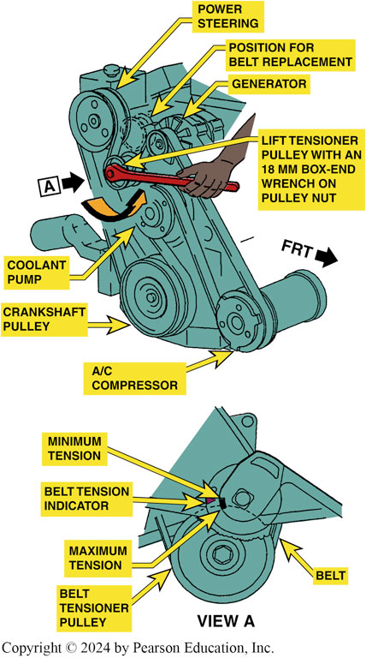
Figure 117.28 Belt Tension
A typical service manual illustration showing the method to use to properly tension the accessory drive belt

Slide 57
Chart 117.1 Belt Tension
SERPENTINE BELTS
NUMBER OF RIBS USED TENSION RANGE (LB)
3 45–60
5 75–100
7 105–145
4 60–80
6 90–125
4 60–80
Belt tension is related to the number of ribs and usually falls within the range shown. Always check service information for the exact belt tension for the vehicle being serviced.

Slide 58
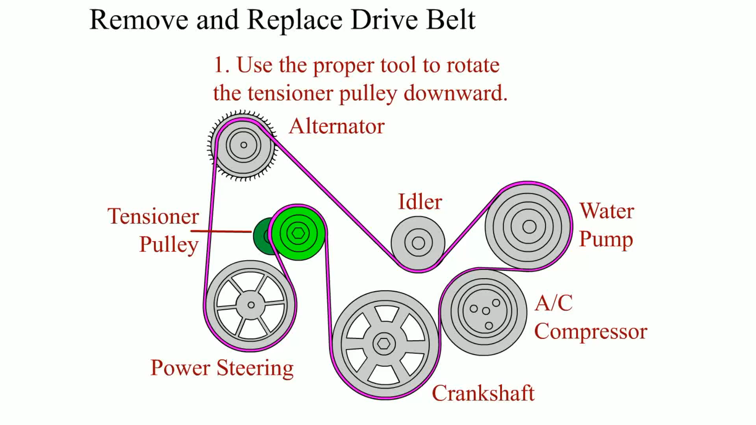
Animation: Remove and Replace Drive Belt
(Animation will automatically start)

Slide 59
Power Steering Fluid (1 of 3)
The correct power steering (P S) fluid is critical to the operation and service life of the power steering system.
Whenever there is any power steering service performed, such as replacement of a defective pump or steering gear or rack-and-pinion unit, the entire system should be flushed.

Slide 60
Power Steering Fluid (2 of 3)
Bleeding Air Out of the System
  Lift vehicle off the ground, then rotate steering wheel.
  Some systems require the reservoir to be placed in a vacuum to remove the air from the system.
Hose Inspection
  Both high-pressure supply and low-pressure return hoses should be inspected as part of any thorough vehicle inspection.

Slide 61
Power Steering Fluid (3 of 3)
Pressure Testing
  Power steering analyzer used to pressure test system.

Slide 62
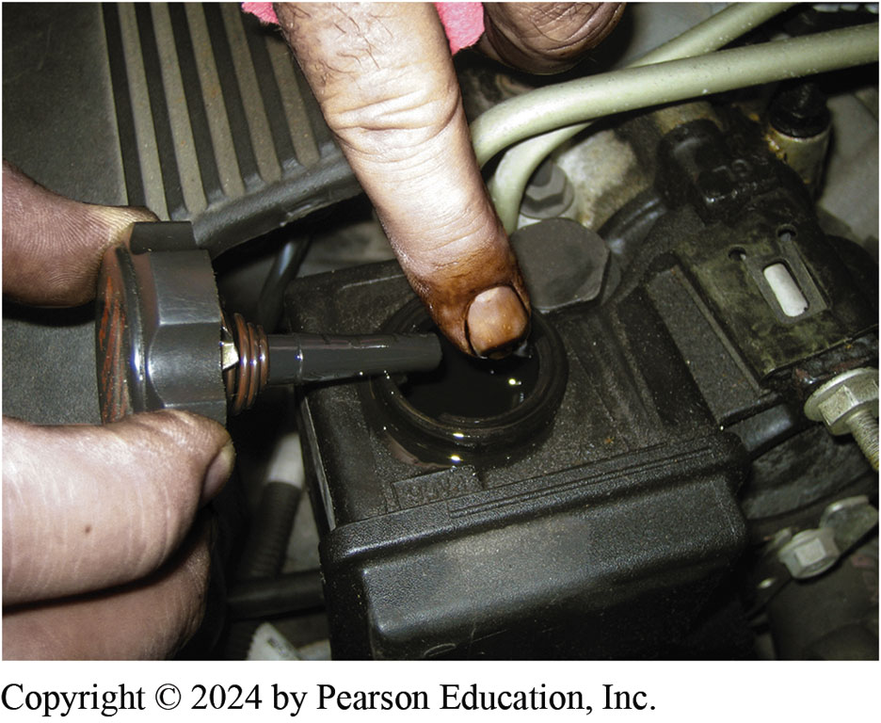
Figure 117.29 Fluid Check
A check of the power steering fluid should include inspecting not only the level but the condition and color of the fluid, which could indicate a possible problem with other components in the steering system
Notes:
TECH TIP: The Visual Test
Whenever diagnosing any power steering complaint, check the level and condition of the power
steering fluid. Often this is best accomplished by putting your finger down into the power steering
fluid reservoir and pulling it out to observe the texture and color of the fluid. ● SEE FIGURE 117–29. A common problem with some power rack-and- pinion units is the wearing of grooves in the housing by the Teflon sealing rings of the spool (control) valve. When this wear occurs, aluminum particles become suspended in the power steering fluid, giving it a grayish color and thickening the fluid. Normally, clear power steering fluid that is found to be grayish in color and steering that is
difficult when cold are clear indications as to what has occurred and why the steering is not functioning correctly.

Slide 63
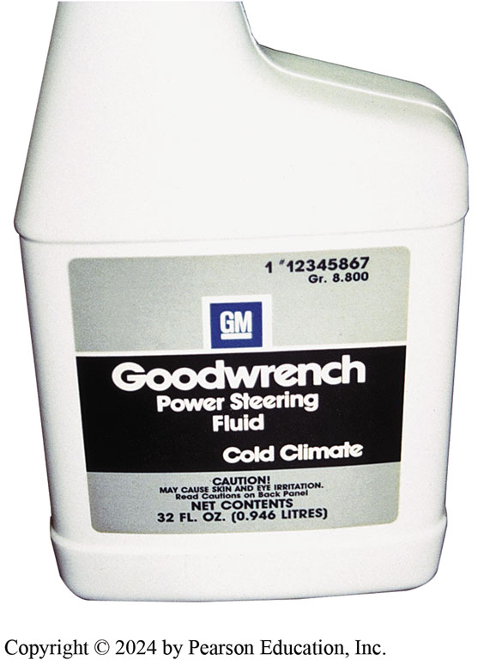
Figure 117.30 Power Steering Fluid
Some power steering fluid is unique to the climate, such as this cold climate fluid recommended for use in General Motors vehicles when temperatures are low
Notes:
TECH TIP: Multiple-Purpose Power Steering Fluid
Multiple-purpose power steering fluid does not mean all-purpose power steering fluid. Always check the power steering reservoir cap, service information, or owner’s manual for the exact fluid to be used in the vehicle being serviced. The main reason for using the specified power steering fluid is the compatibility of the fluid with the materials used in seals and hoses of the system. Using the wrong fluid (substituting ATF, for example) can lead to seal or hose deterioration and/or failure and fluid leaks. Always use the power steering fluid recommended by the manufacturer. The correct fluid to use is often imprinted on or near the power steering reservoir fill cap or is found in the owner’s manual or service information.

Slide 64
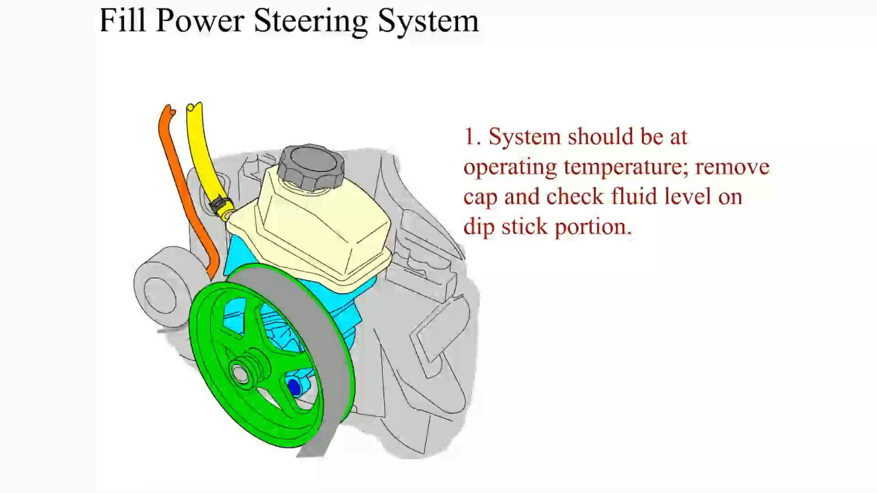
Animation: Fill Power Steering Fluid
(Animation will automatically start)

Slide 65
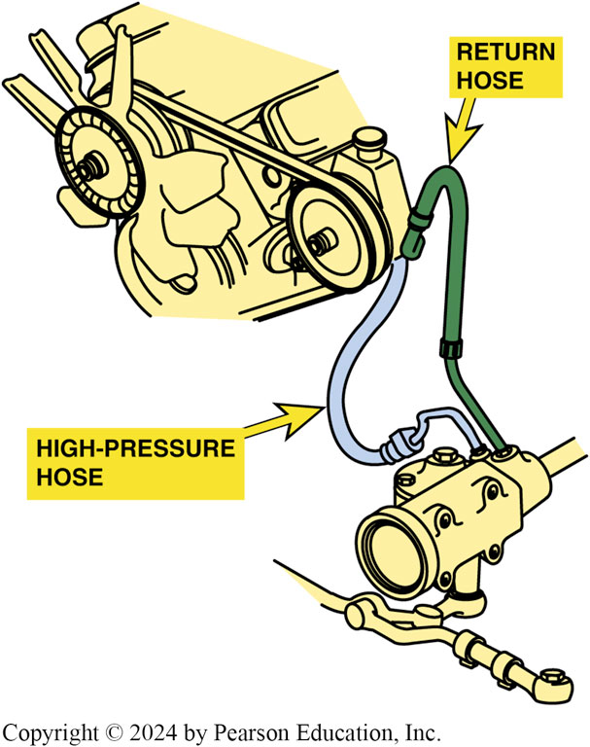
Figure 117.31 Inspect Hoses
Inspect both high-pressure and return power steering hoses. Make sure the hoses are routed correctly and not touching sections of the body to prevent power steering noise from being transferred to the passenger compartment

Slide 66
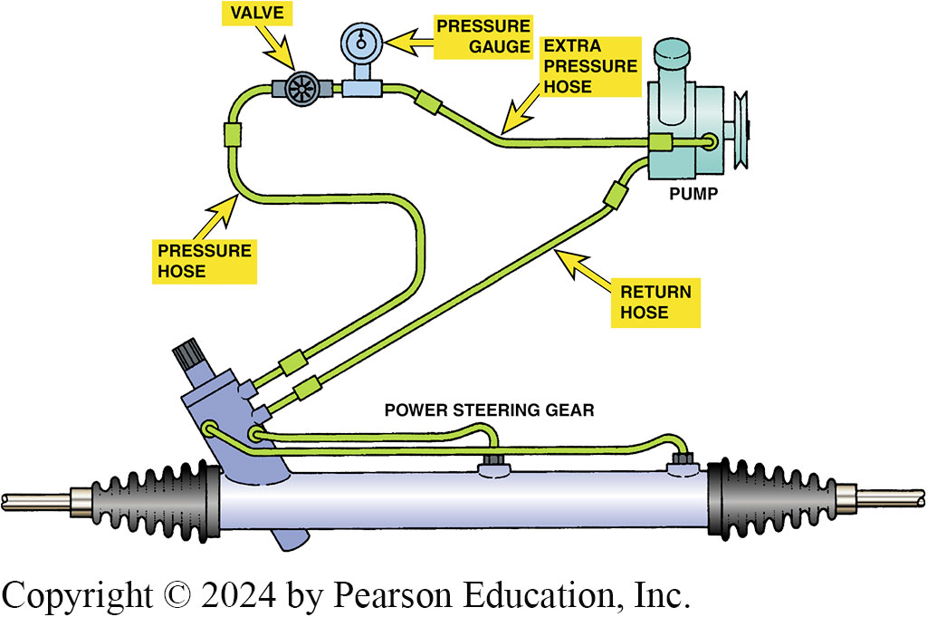
Figure 117.32 Steering Analyzer
A drawing showing how to connect a power steering analyzer to the system
Notes:
CASE STUDY: The Noisy Power Steering Pump
A customer complained that the power steering on their Dodge Grand Caravan minivan had a very loud whining/growling/squealing noise for about 3–10 seconds on cold mornings at start-up. The owner had received a quote for several hundred dollars to replace the power steering pump, but then asked another shop for a second opinion. The second shop had experience with this issue and recommended replacing the power steering filter located in the bottom of the power steering pump reservoir. The owner agreed to have the filter and the fluid replaced for an amount far less than the previous quote. After replacing the filter and flushing the power steering fluid, the power steering was quiet and operated like new.
Summary:
Complaint—Power steering was noisy especially when cold.
Cause—The screen in the bottom of the reservoir plugs up and starves the pump of oil causing the noise.
Correction—The filter was replaced and the fluid flushed.

Slide 67
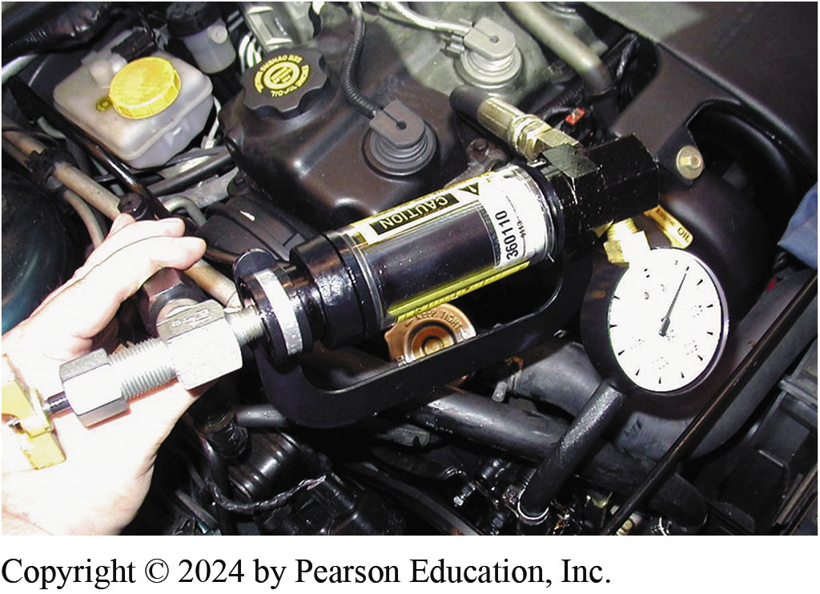
Figure 117.33 Flow Meter
A power steering analyzer that measures both pressure and volume. The shut-off valve is used to test the maximum pressure of the pump

Slide 68
Pump Service (1 of 2)
Some power steering pump service can usually be performed without removing the pump, including the following:
  Replacing high-pressure and return hoses.
  Removing and cleaning flow control valve assembly.
Most power steering pump service requires the removal of the pump from the engine mounting and/or removal of the drive pulley.

Slide 69
Pump Service (2 of 2)
Most pumps are not repairable and must be replaced.
For pumps that are repairable:
  After removing the pump from the vehicle and removing the drive pulley, disassemble the pump according to the manufacturer’s recommended procedure.

Slide 70
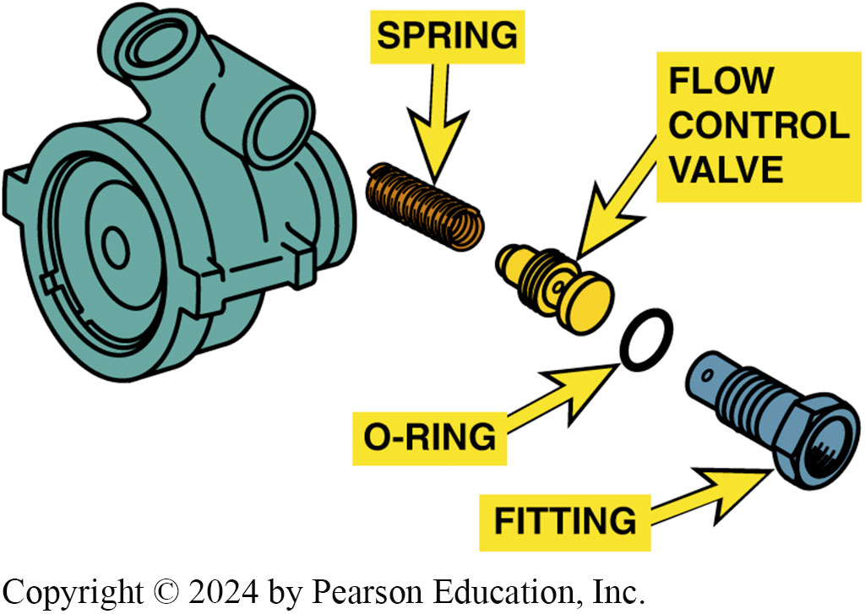
Figure 117.34 Flow Control Valve
Typical power steering pump showing the order of assembly. The high-pressure (outlet) hose attaches to the fitting (#16). The flow control valve can be removed from the pump by removing the fitting

Slide 71
Chart 117.2 Steering Pressure
TYPICAL POWER STEERING PRESSURES AND VOLUME SPECIFICATIONS
STEERING ACTION | PRESSURE PSI (kPa) | VOLUME* (Gal/min) (L./min)
Straight ahead no steering | Less than 150 PSI (1,000 kPa) | 2.0–3.3 gpm (10–15 lpm)
Slow cornering | 300–450 PSI (2,000–3,000 kPa) | Within 1 gpm (4 lpm) of straight ahead)
Full turn at stops | 750–1,450 PSI** (5,200–10,000 kPa) | Less than 1 gpm (4 lpm)
* Volume is determined by orifice size in the outlet of the pump and is matched to the steering gear.
** Upper-limit pressure is determined by the calibration of the pressure-relief valve.

Slide 72
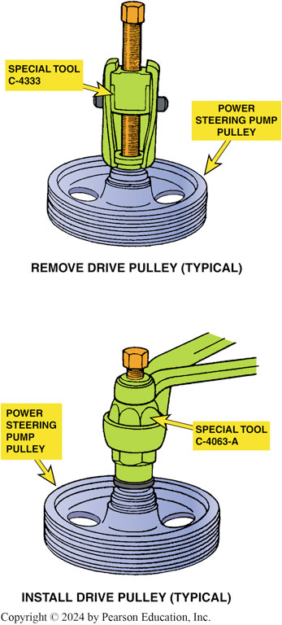
Figure 117.35 Pulley Removal
Typical tools required to remove and install a drive pulley on a power steering pump. Often these tools can be purchased at a relatively low cost from automotive parts stores and will work on many different makes of vehicles

Slide 73
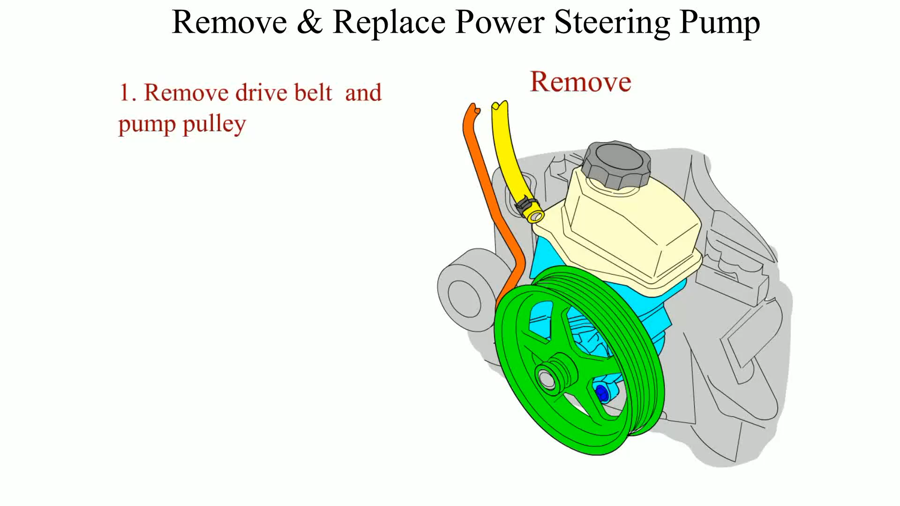
Animation: Remove and Replace Power Steering Pump
(Animation will automatically start)

Slide 74
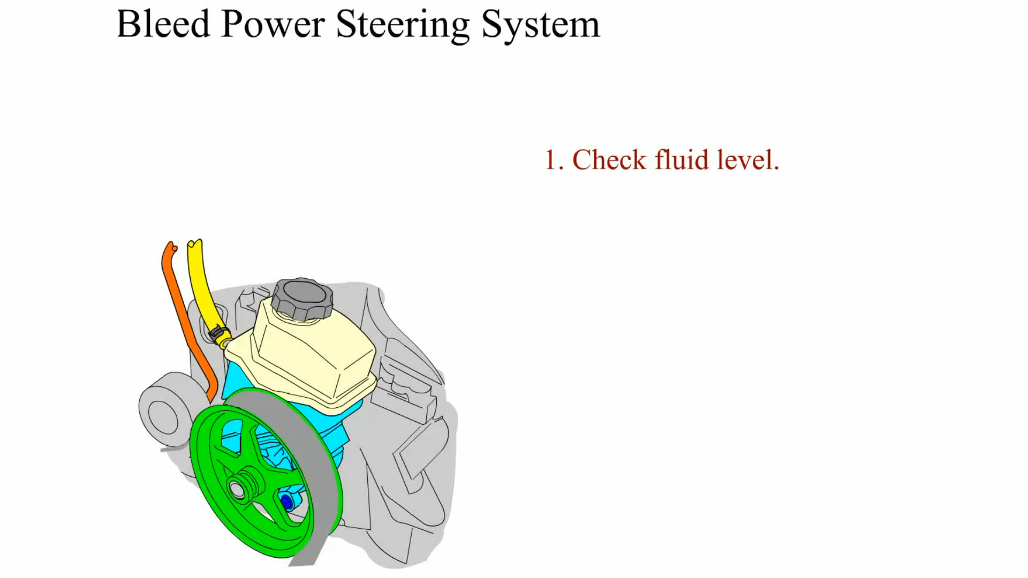
Animation: Bleed Power Steering System
(Animation will automatically start)

Slide 75
Steering Rack Removal and Installation

Slide 76
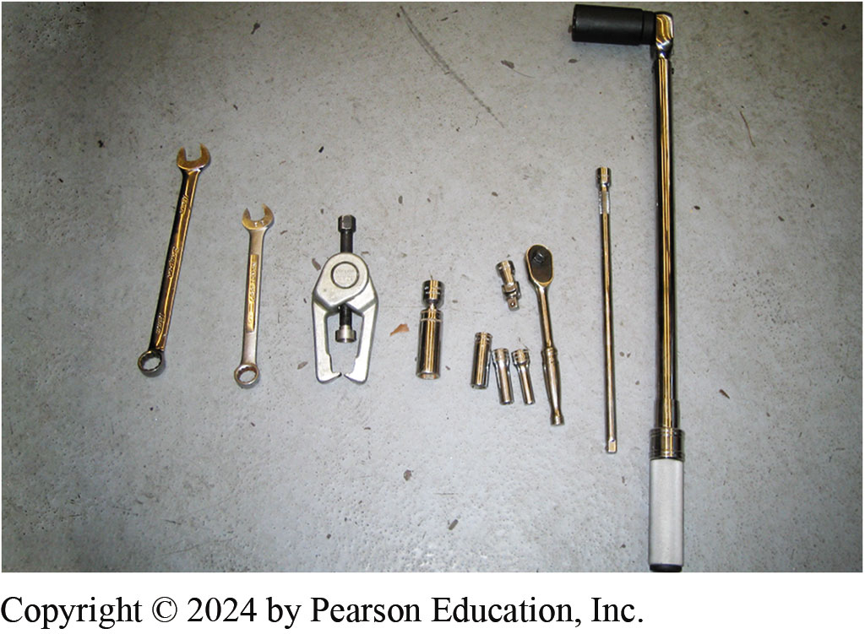
1.Tools
1. The tools required include a tie rod end puller and basic hand tools

Slide 77
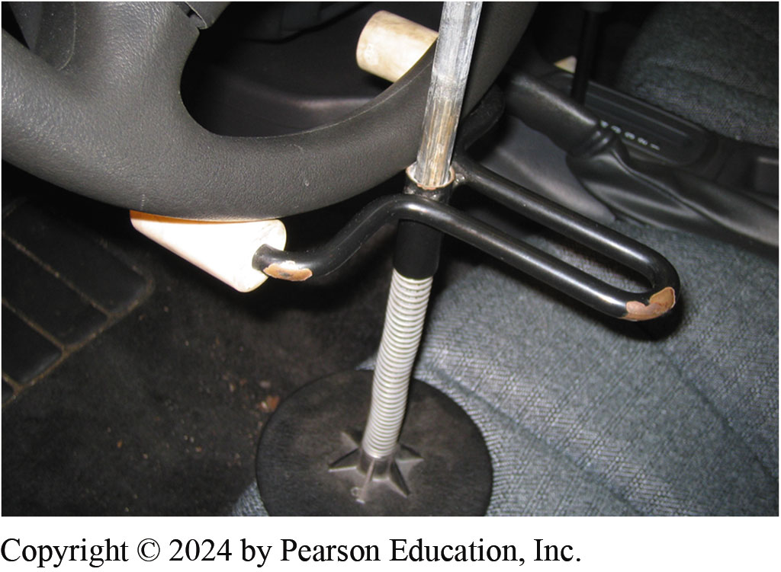
2. Lock Steering Wheel
2. To help keep the steering wheel from rotating when the steering rack assembly is removed, a steering wheel lock is being used

Slide 78
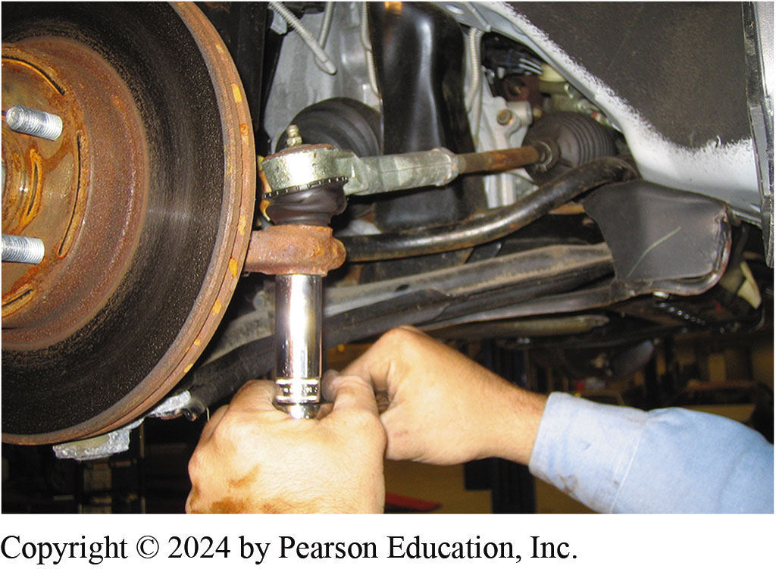
3. Remove Tie Rod Nuts
3. After safely hoisting the vehicle and removing the front wheels, the outer tie rod end retaining nuts are removed

Slide 79
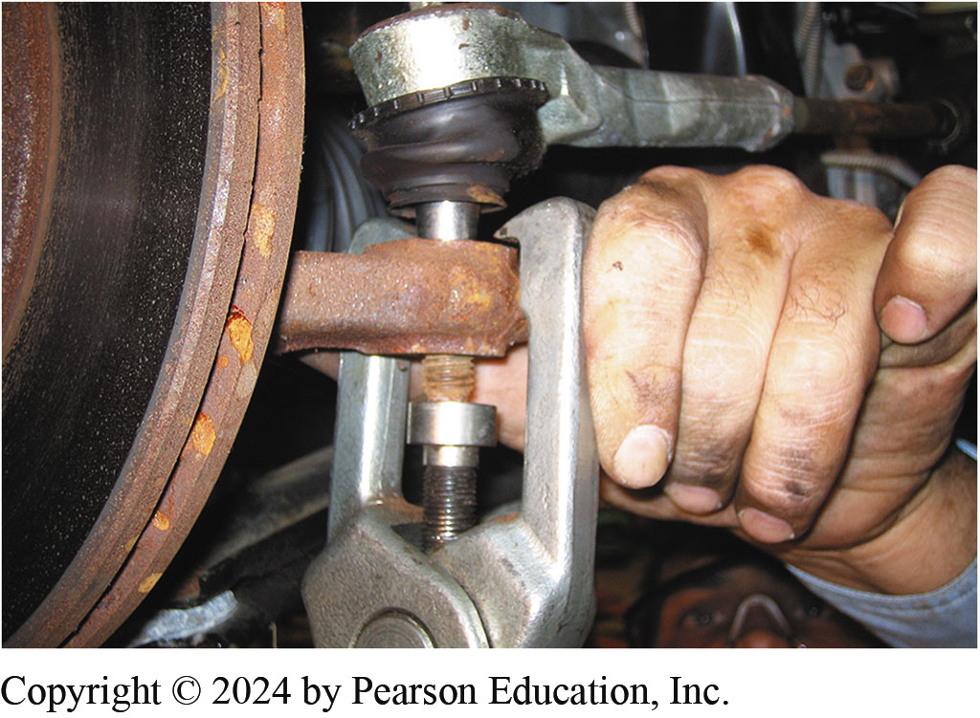
4. Separate Tie Rod Ends
4. Use a tie rod taper breaker to separate the outer tie rods from the steering knuckle without harming the rubber grease boots

Slide 80
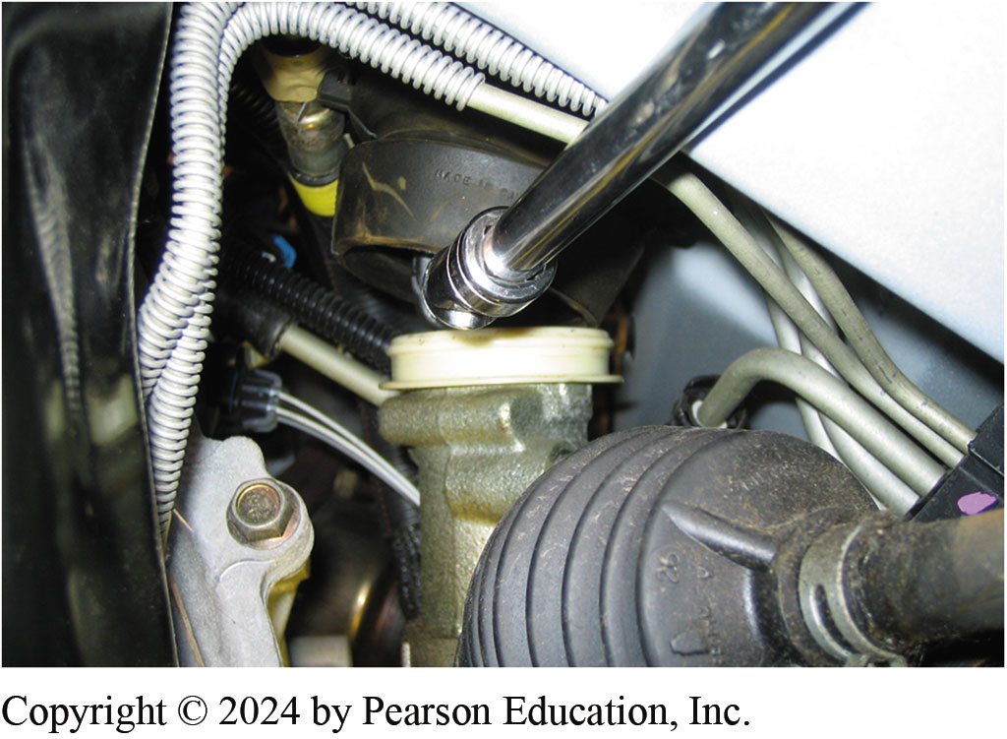
5. Moving Protective Cover Aside
5. After moving the protective cover aside, the bolt used to retain the intermediate shaft to the steering gear stub shaft is removed

Slide 81
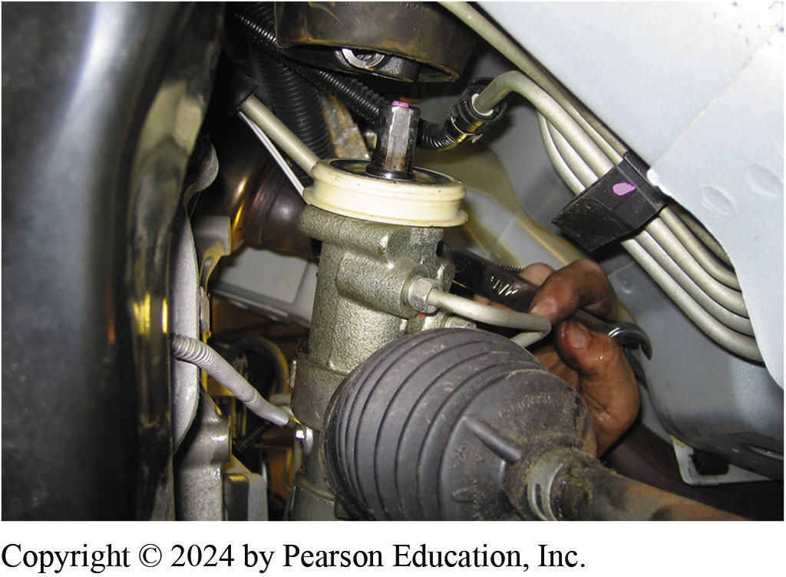
6. Remove Hydraulic Lines
6. The hydraulic lines attached to the steering rack to the power steering rack assembly are removed using a line wrench

Slide 82
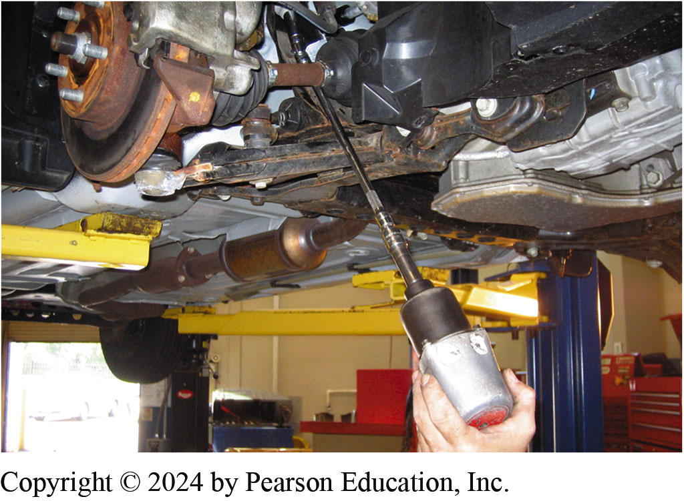
7. Remove Engine Cradle Bolts
7. After supporting the engine cradle using a tall safety stand, an air impact wrench with a long extension is used to remove the engine cradle bolts

Slide 83

8. Remove Lower Cradle Bolts
8. Removing the lower engine cradle bolts. This will allow the cradle to be lowered to gain access to the steering rack assembly

Slide 84

9.Rotate Screw Jack to Lower Cradle
9. The screw jack on the tall safety stands is rotated allowing the engine cradle to be lowered

Slide 85

10. Removing Steering Rack Bolts
10. Removing the steering rack attachment bolts

Slide 86

11. Rack Life Out
11. The steering rack assembly can be lifted out of the support brackets

Slide 87

12. Removed from Driver’s Side
12. On this General Motors vehicle, the steering rack assembly is removed from the driver’s side

Slide 88

13. Stub Shaft Notch
13. Before reinstalling the steering gear assembly, note the notch on the stub shaft. This notch has to be aligned with the intermediate shaft retaining bolt when it is placed back into the vehicle

Slide 89

14. Installing Gear
14. Installation is the reverse of removal. Be sure that the rack is centered and check that the through-bolt is properly aligned with the notch in the steering rack stub shaft

Slide 90

15. Support Cradle
15. While using a tall safety stand to support the engine cradle, the retaining bolts are installed

Slide 91

16. Keep Tie Rod from Rotating
16. A socket is being used to keep the tapered tie rod end from rotating while the retaining nut is tightened with a wrench

Slide 92

17. Add Steering Fluid
17. After the hydraulic lines and retaining bolts have been installed, the power steering pump reservoir is filled using the specified fluid.

Slide 93

18. Bleed Out Air
18. To bleed the trapped air out of the system, the steering wheel is rotated lock to lock with engine off and the wheels off the ground. Check for leaks then perform a test-drive to verify a proper repair.

Slide 94
Suspension and Steering Videos and Animations
Videos Link: (A4) Suspension and Steering Videos
Animations Link: (A4) Suspension and Steering Animations

Slide 95
Copyright
This work is protected by United States copyright laws and is provided solely for the use of instructors in teaching their courses and assessing student learning. Dissemination or sale of any part of this work (including on the World Wide Web) will destroy the integrity of the work and is not permitted. The work and materials from it should never be made available to students except by instructors using the accompanying text in their classes. All recipients of this work are expected to abide by these restrictions and to honor the intended pedagogical purposes and the needs of other instructors who rely on these materials.

