Slide 1
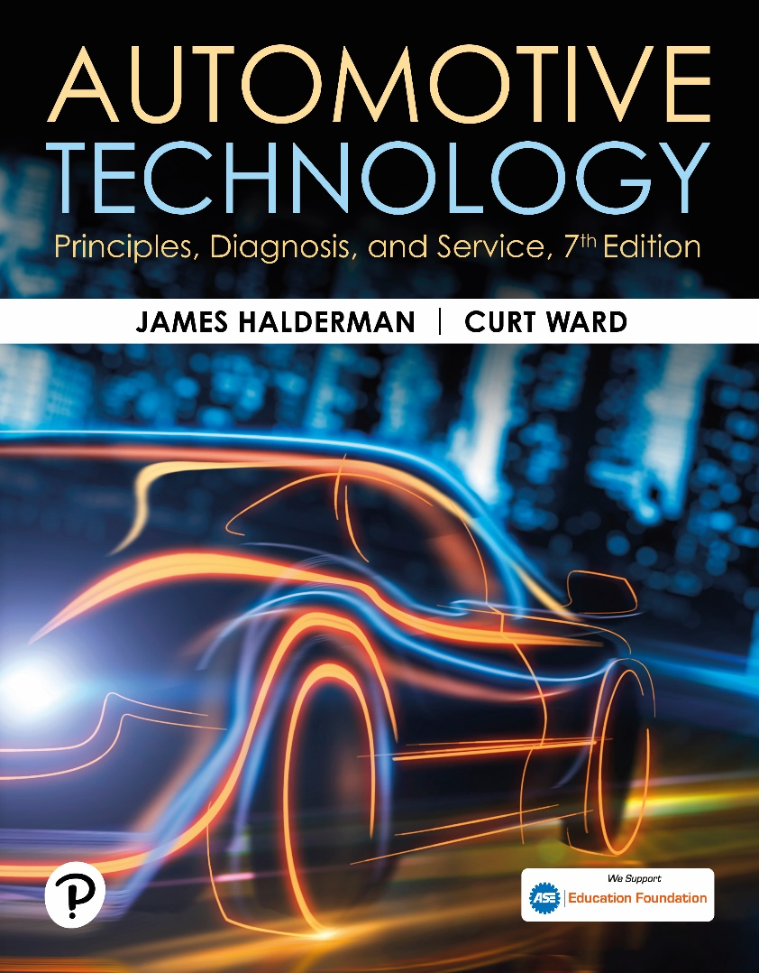
Automotive Technology: Principles, Diagnosis, and Service
Seventh Edition
Chapter 116
Steering Linkage and Service
Copyright © 2023 Pearson Education, Inc. All Rights Reserved
Notes:
INSTRUCTOR NOTE: This presentation includes text explanation notes, you can use to teach the course. When in SLIDE SHOW mode, you RIGHT CLICK and select SHOW PRESENTER VIEW, to use the notes.

Slide 2
Learning Objectives
116.1 Identify steering linkage components.
116.1 Describe rack-and-pinion inner tie rod ends.
116.1 Describe four-wheel steering systems.
116.1 Discuss steering linkage lubrication.
116.1 Describe the purpose and procedure for performing a drypark test.
116.1 Describe the steps for under-vehicle inspection of steering systems.
116.1 Explain how to replace steering linkage parts..

Slide 3
Steering Linkage (1 of 2)
Purpose and Function
Steering linkage relays steering forces from the steering gear to the front wheels.
Parallelogram-type design
4 tie rods, 2 inner and 2 outer (left and right)
Center link (between tie rods)
Idler arm on passenger side
Pitman arm attached to steering gear output shaft (pitman shaft)
Notes:
The center link may be known by several names, including the following:
■ Center link
■ Connecting link
■ Connecting rod
■ Relay rod

Slide 4
Steering Linkage (2 of 2)
Tie Rod Ends
Tie rod ends connect the steering linkage to the steering knuckles and to other steering linkage components.
Conventional tie rod ends use a hardened steel ball stud assembled into a hardened steel and thermoplastic bearing.
An internal preload spring limits the ball stud endplay and helps compensate for ball-and-socket wear.

Slide 5
Frequently Asked Question: Why Is a Grease Fitting Sometimes Called a Zerk Fitting?
? Frequently Asked Question
Why Is a Grease Fitting Sometimes Called a Zerk Fitting? In 1922, the zerk fitting was developed by Oscar U, Zerk, an employee of the Alemite Corporation, a manufacturer of pressure lubrication equipment. A zerk or grease fitting is also known as an Alemite fitting.

Slide 6
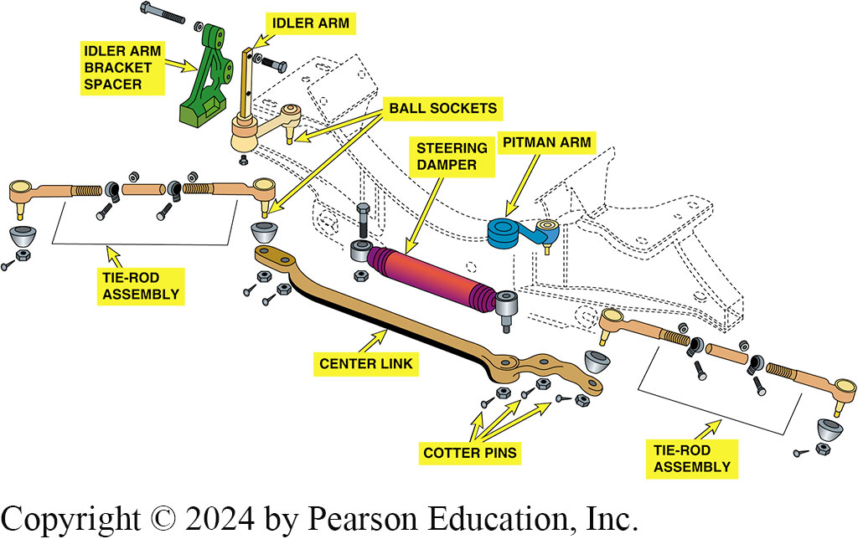
Figure 116.1 Steering Linkage
See Notes
Notes:
Figure 116-1 Steering movement is transferred from the pitman arm that is splined to the sector shaft (pitman shaft), through the center link and tie rods, to the steering knuckle at each front wheel. The idler arm supports the passenger side of the center link and keeps the steering linkage level with the road. This type of linkage is called a parallelogram-type design

Slide 7
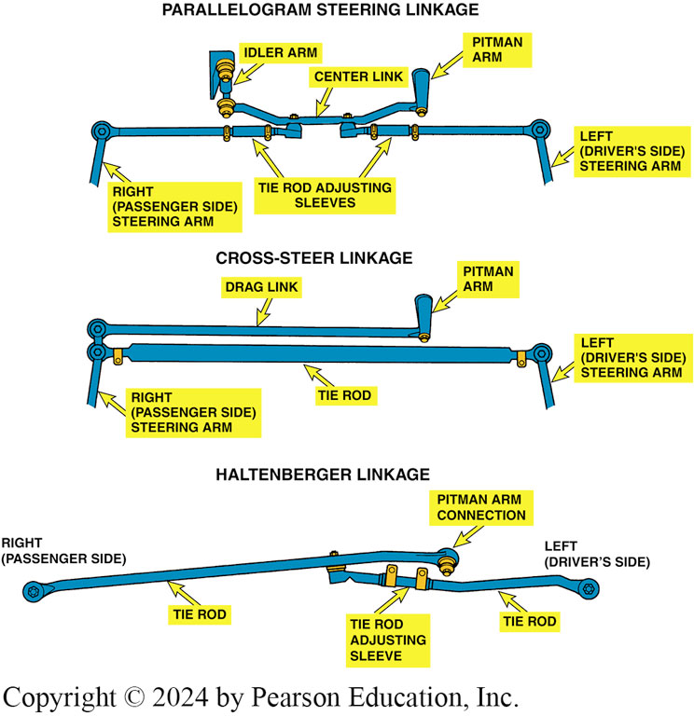
Figure 116.2 Linkage Types
Most common type of steering is parallelogram. The cross-steer, & Haltenberger linkage designs are used on some trucks and vans

Slide 8
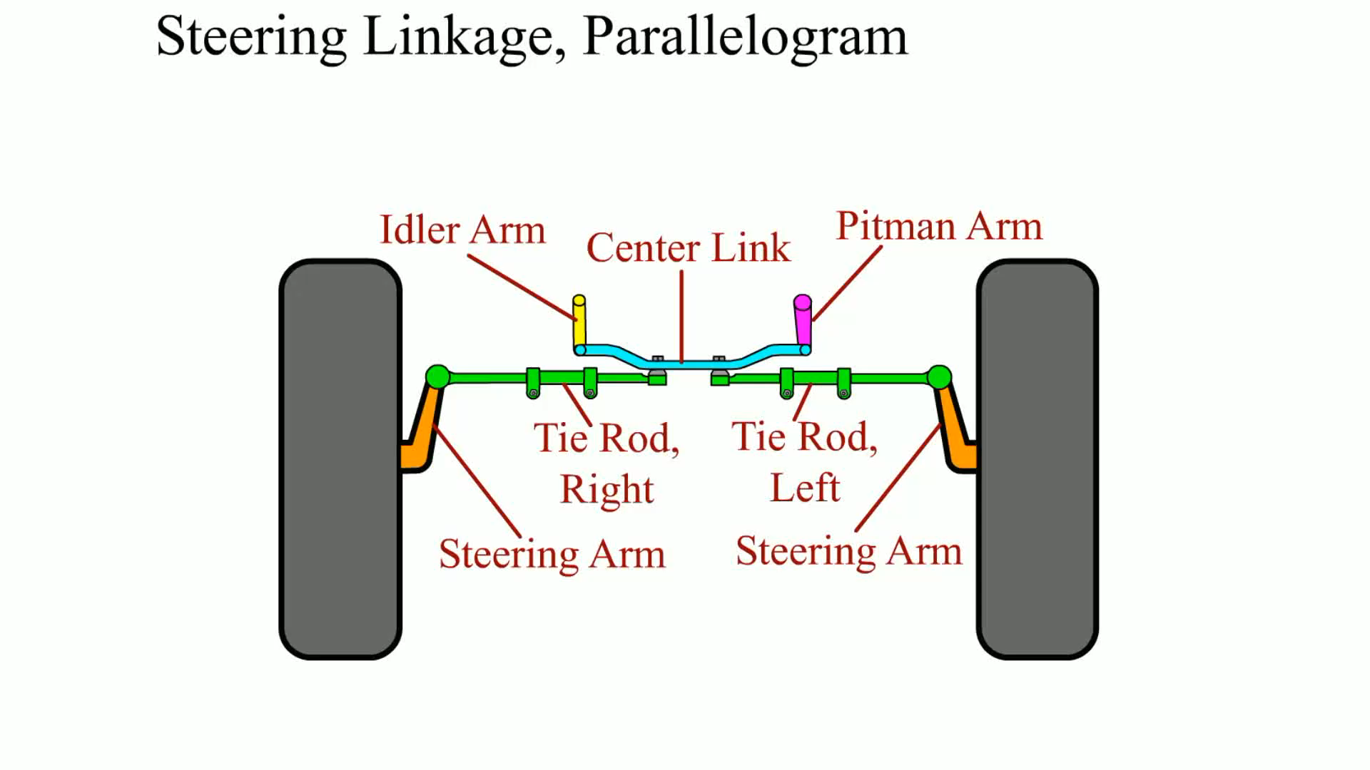
Animation: Steering Linkage, Parallelogram (Animation will automatically start)

Slide 9
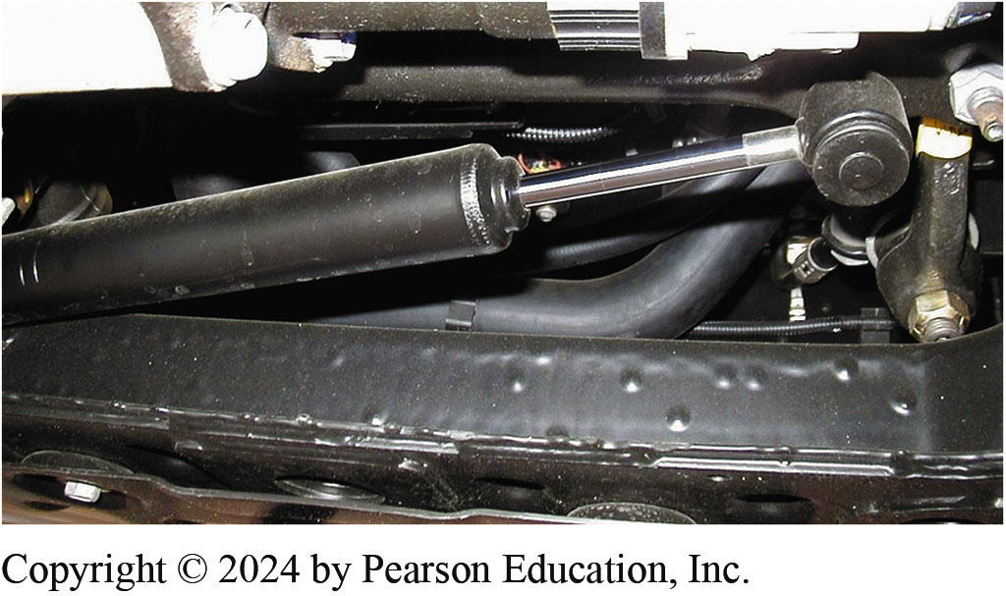
Figure 116.3 Steering Damper
Typical steering dampener used on a Hummer H2.
Notes:
NOTE: Many light trucks, vans, and some luxury cars use a steering dampener attached to the linkage. A steering dampener is similar to a shock absorber, and it absorbs and dampens sudden motions in the steering linkage. FIGURE 116–3.

Slide 10
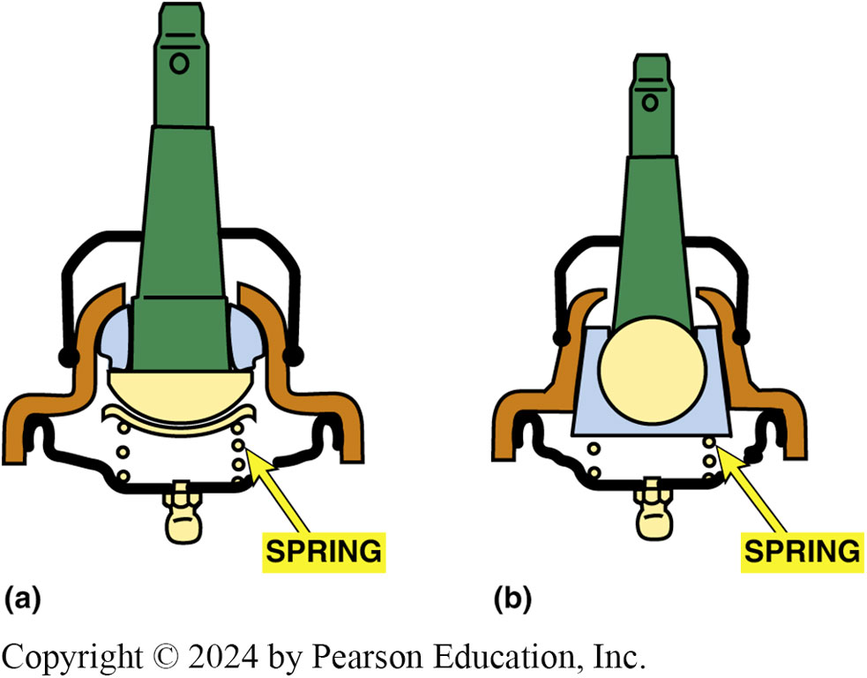
Figure 116.4 Dual Bearing
See Notes
Notes:
Figure 116-4 (a) A dual bearing design with a preload spring. The use of two bearing surfaces allows one surface for rotation (for steering) and another surface for pivoting (to allow for suspension up-and-down movement). (b) The nylon wedge bearing type allows for extended lube intervals. Wear is automatically compensated for by the tapered design and spring-loaded bearing

Slide 11
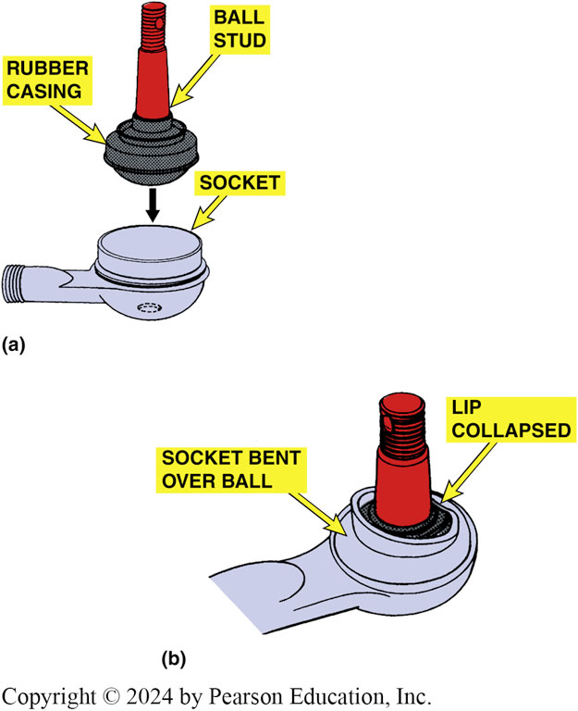
Figure 116.5 Ball Socket
(a) A rubber-bonded socket is constructed of a rubber casing surrounding ball stud, which is then inserted into socket of tie rod end. The hole in the socket allows air to escape as the ball stud is installed and there is not a place for a grease fitting. (b) The socket is crimped over ball so that part of socket lip retains stud.

Slide 12
Rack and Pinion Inner Tie Rod Ends
Terminology
Inner tie rod end also called a ball socket assembly.
Inner tie rod assemblies are attached to the end of the steering rack by one of several methods.
Staked
Riveted or Pinned
Bolts (Center Take Off Racks)

Slide 13
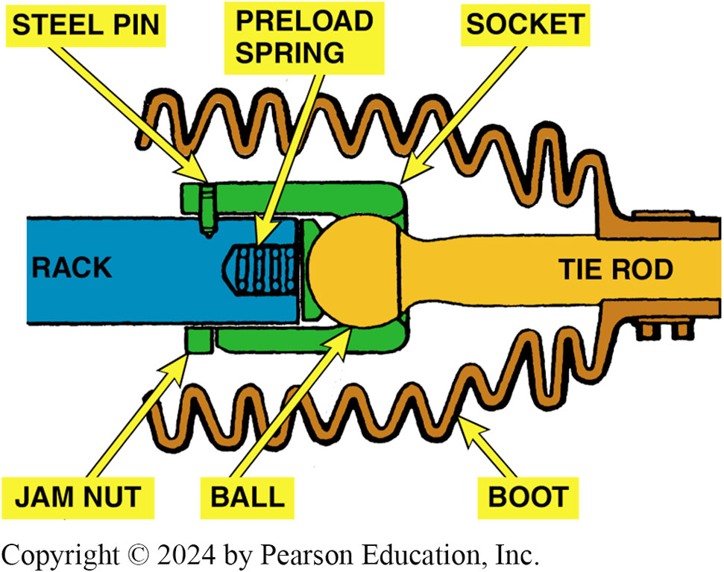
Figure 116.6 Inner Tie Rod End
Rack-and-pinion steering systems use a ball and- socket-type inner tie rod end

Slide 14
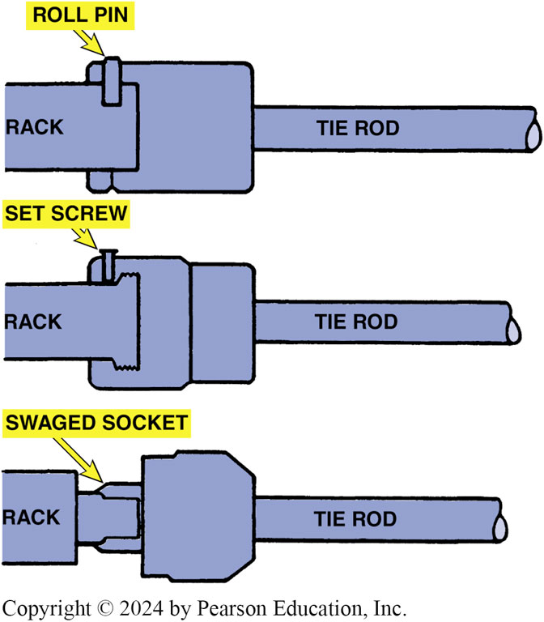
Figure 116.7 Securing Methods
A variety of methods are used to secure the inner tie rod end socket assembly to the end of the rack

Slide 15
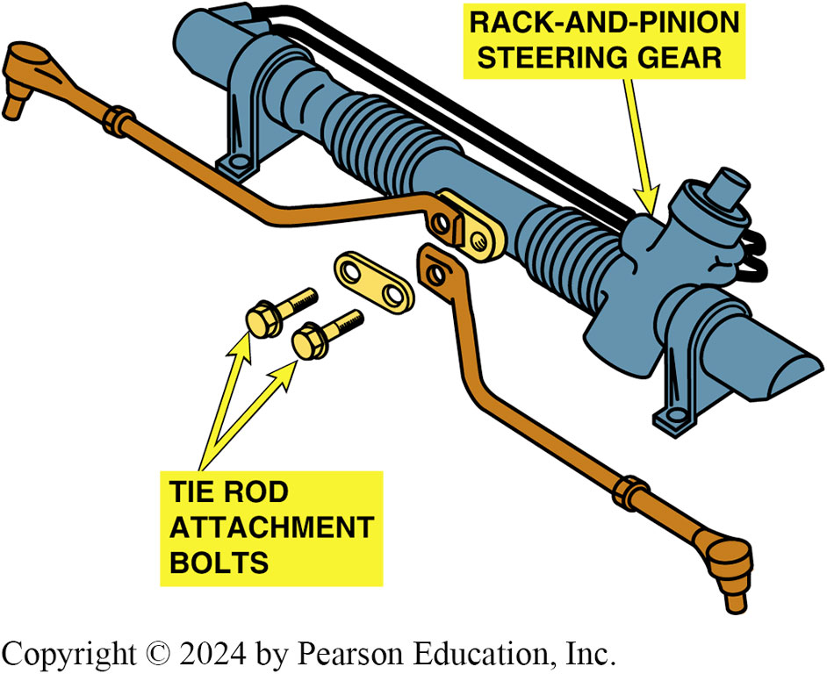
Figure 116.8 Center Take Off
Exploded view of a center-take-off-style rack-and-pinion steering gear assembly

Slide 16
Front Steer Versus Rear Steer
Terminology
Front steer, also called forward steer
Describes a vehicle that has the steering gear in front of the front wheel centerline.
If the steering gear linkage is located behind the wheels
Called rear steer and the cornering forces are imposed on the steering in the direction of the turn.

Slide 17
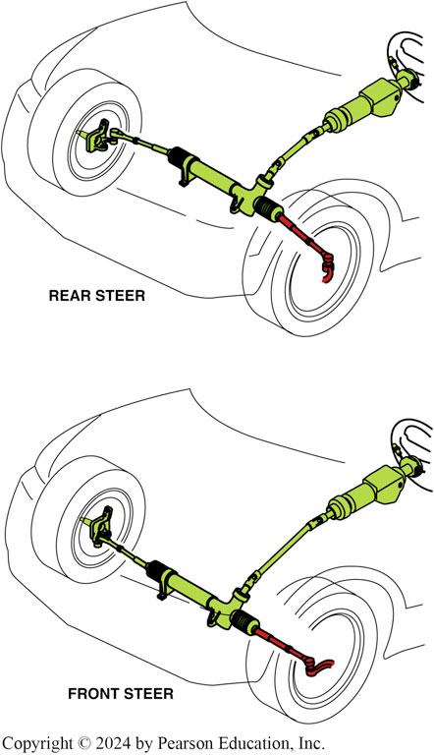
Figure 116.9 Rear/Front Steering
In a rear-steer vehicle, the steering linkage is behind the centerline of the front wheels, whereas the linkage is in front on a front-steer vehicle

Slide 18
Question 1: ?
What is the difference between front steer and rear steer?

Slide 19
Answer 1
The steering rack is either forward or in back of the wheel centerline.

Slide 20
Four-Wheel Steering Systems
Terminology
Same-phase steering.
Means that front and rear wheels are steered in the same direction.
Opposite-phase steering.
Negative-phase mode, opposite-phase steering is when the front wheels and rear wheels are steered in the opposite direction.
Quadrasteer
Quadrasteer™ is a GM’s 4-wheel steering system that dramatically enhances low-speed maneuverability, high-speed stability, and towing capability.

Slide 21
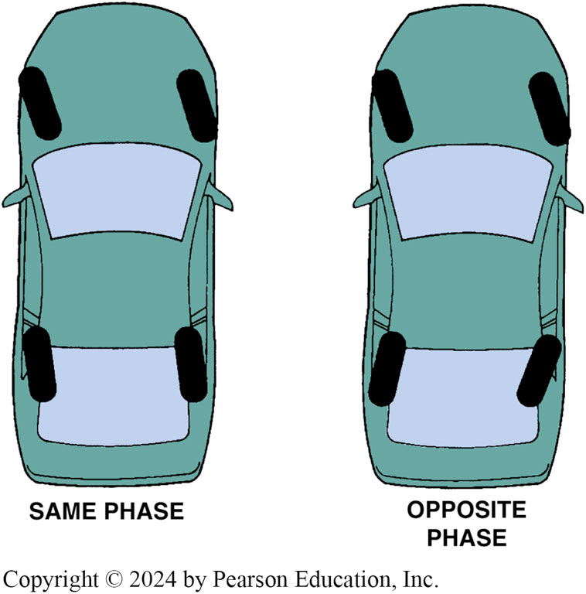
Figure 116.10 Steering Phases
Opposite-phase four-wheel steer is usually used only at low vehicle speed to help in parking maneuvers. Same-phase steering helps at higher speeds and may not be noticeable by the average driver

Slide 22
Steering linkage lubrication
Keeping all joints equipped with a grease fitting properly greased is necessary for long life and ease of steering.
During a chassis lubrication, do not forget to put grease on the steering stop, if so equipped.

Slide 23
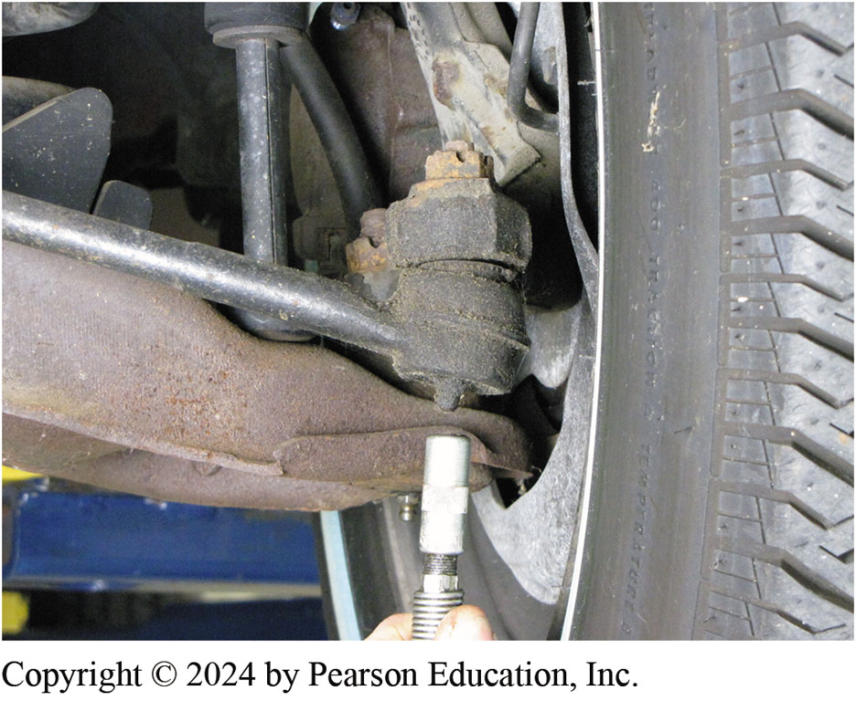
Figure 116.11 Greasing Joints
Greasing a tie rod end. Some joints do not have a hole for excessive grease to escape, and excessive grease can destroy the seal

Slide 24
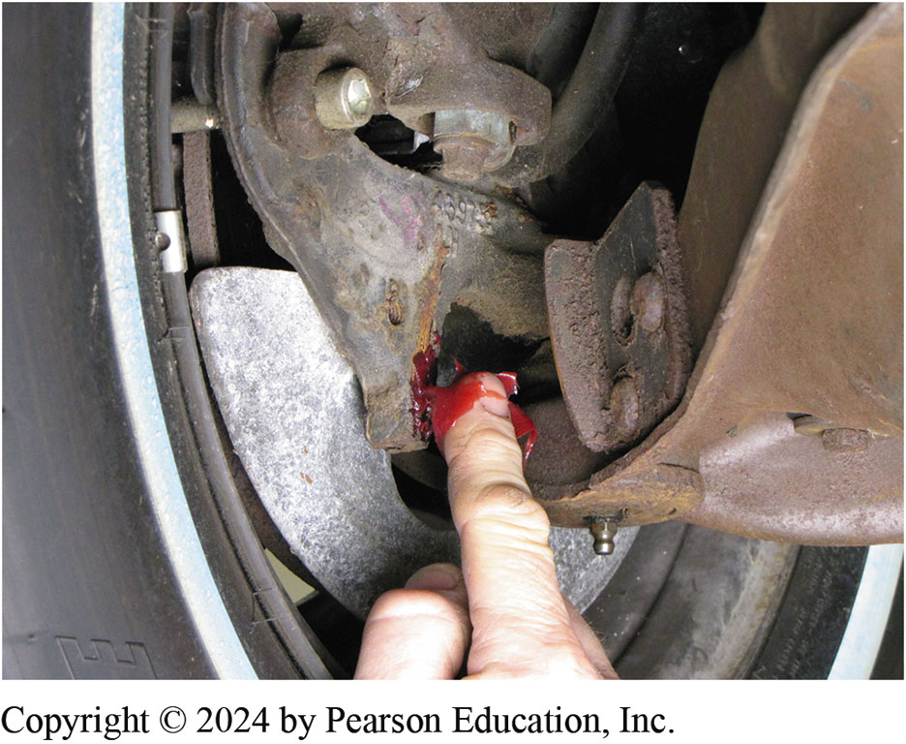
Figure 116.12 Greasing Stops
Part of steering linkage lubrication is applying grease to steering stops. If these stops are not lubricated, a grinding sound may be heard when vehicle hits a bump when wheels are turned all the way one direction or other. This often occurs when driving into or out of a driveway that has a curb

Slide 25
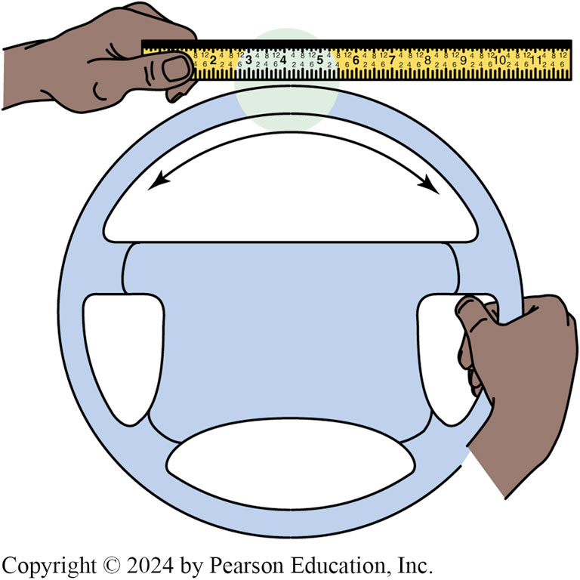
Figure 116.13 Steering Freeplay
Checking for freeplay in the steering

Slide 26
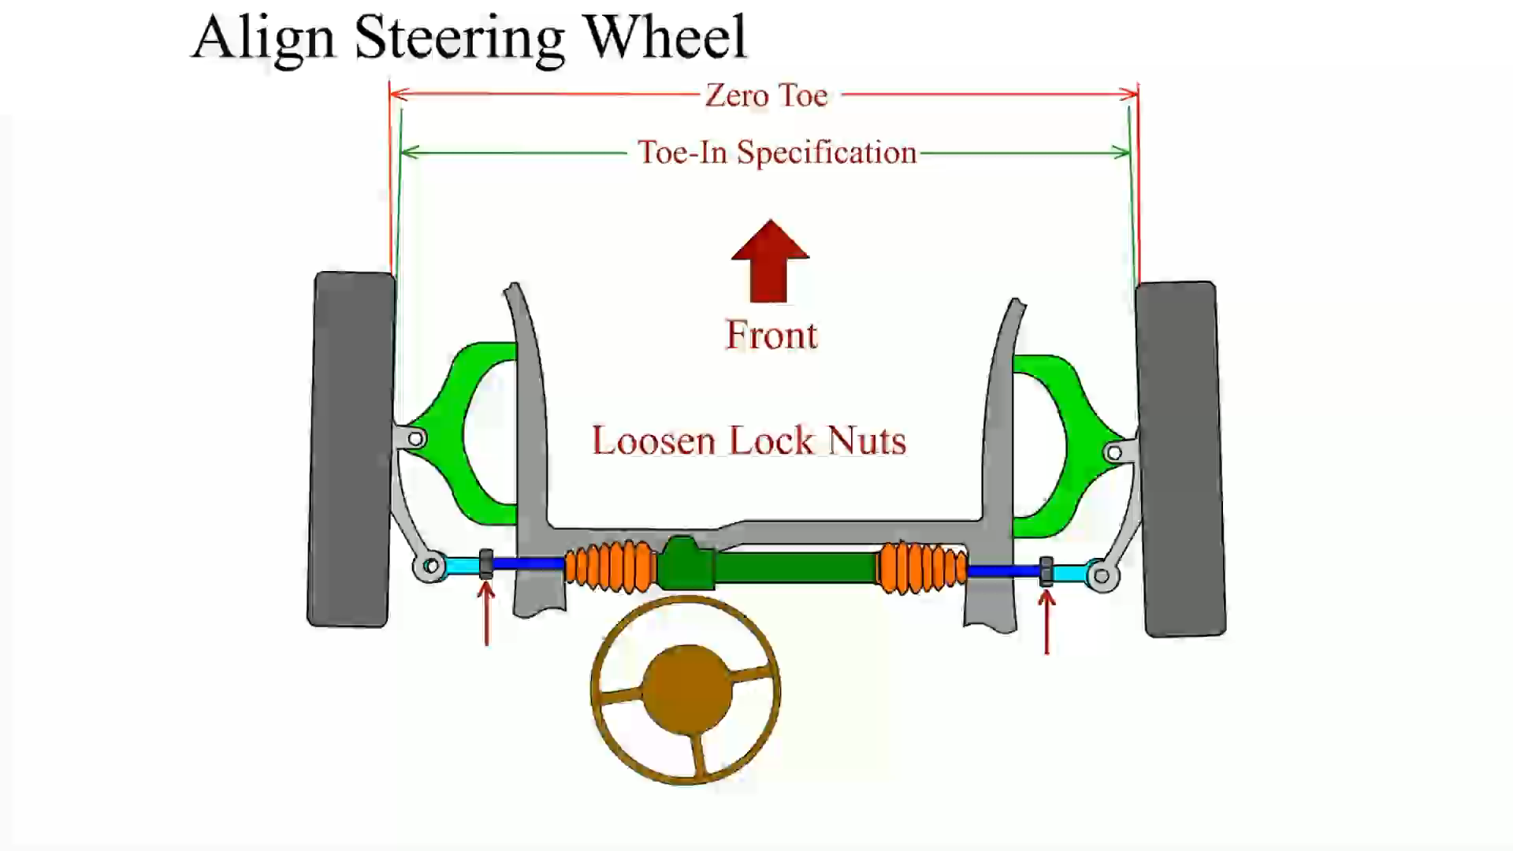
Animation: Align Steering Wheel (Animation will automatically start)

Slide 27
Frequently Asked Question: Why Do Only a Few Vehicles Use Grease Fittings?
? Frequently Asked Question
Why Do Only a Few Vehicles Use Grease Fittings? Many years ago, all vehicles were equipped with grease fittings, while today very few vehicles are so equipped. The reasons for this, as given by engineers, include: It has been determined that the use of the wrong type of grease can cause more harm than good, If a grease fitting is used to allow grease to enter the suspension or steering joint, then water can also get inside the joint, Grease fittings are often ignored or the greasing of the joint is not performed by the service technician, or Low-friction joints do not require routine service like older metal-to-metal joints required.

Slide 28
Dry Park Test (1 of 2)
Purpose
One of most effective, yet easy to perform, steering component inspection methods is called dry park test.
Excessive play in the steering wheel can be caused by worn or damaged steering components.
This simple test is performed with the vehicle on the ground or on a drive-on ramp-type hoist, moving the steering wheel back and forth slightly while an assistant feels for movement at each section of the steering system.

Slide 29
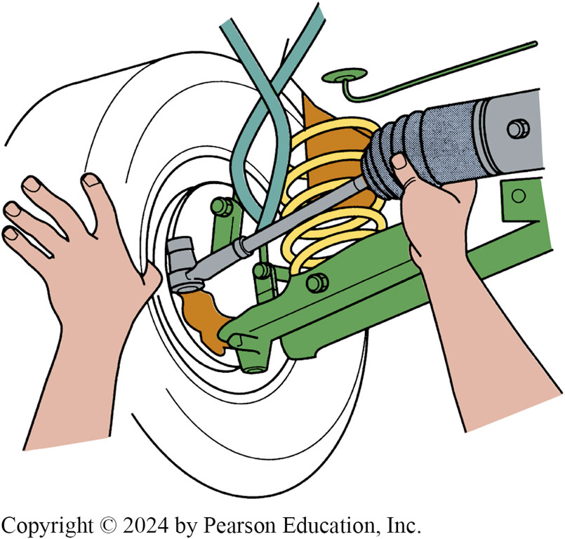
Figure 116.14 Dry Park Test
All joints should be felt during a dry park test. Even inner tie rod ends (ball socket assemblies) can be felt through the rubber bellows on many rack-and-pinion steering units

Slide 30
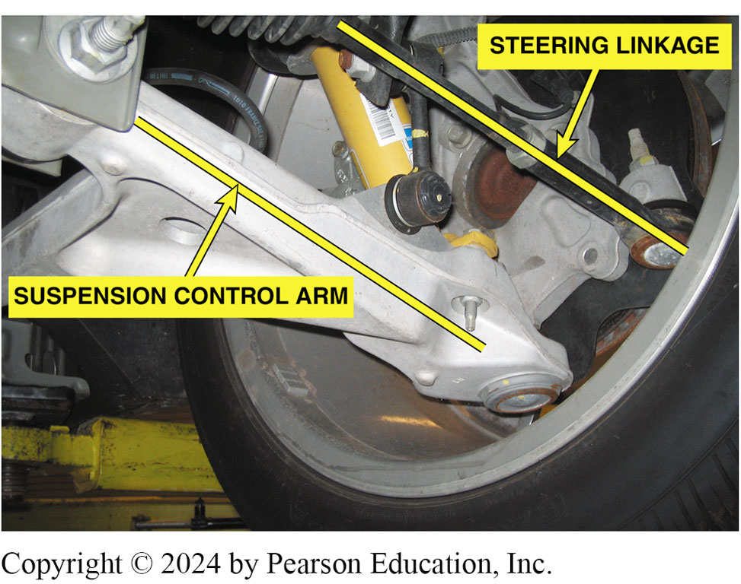
Figure 116.15 Arms Parallel
The steering and suspension arms must remain parallel to prevent up-and-down motion of the suspension from causing the front wheels to turn inward or outward

Slide 31
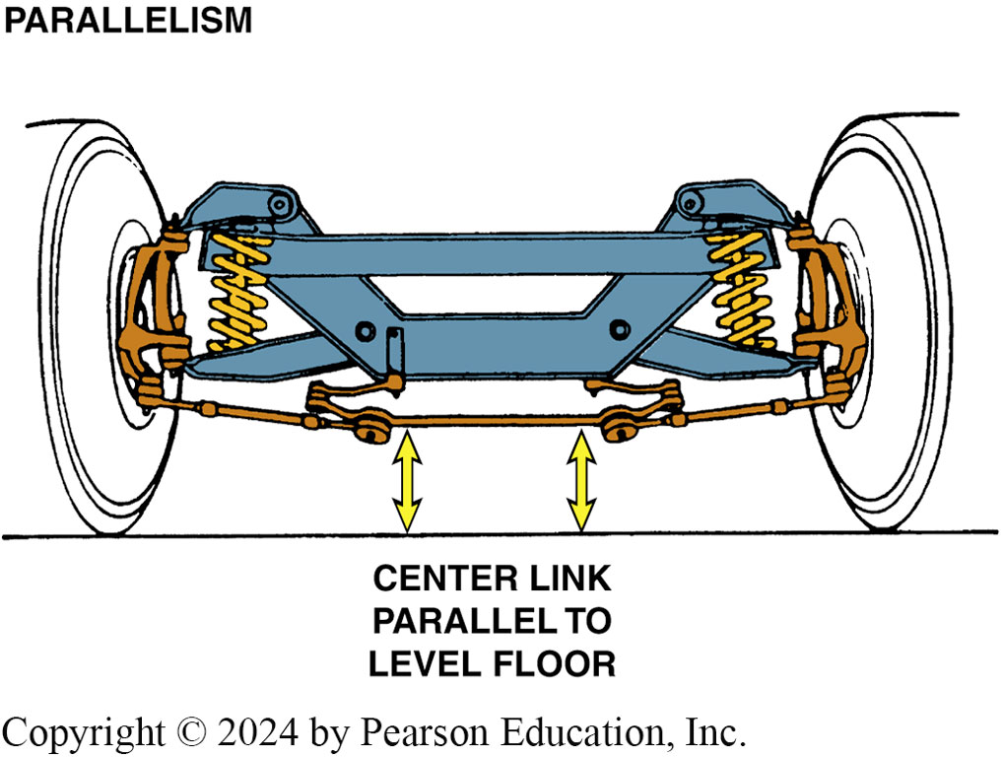
Figure 116.16 Jounce/Rebound Test
The center link should be parallel to the ground
Notes:
TECH TIP: Jounce/Rebound Test
All steering linkage should be level and “work” at the same angle as the suspension arms, as shown in FIGURE 116-15 a simple test is performed as follows: Park on a hard, level surface with the wheels straight ahead and the steering wheel in the unlocked position. Bounce (jounce) the vehicle up and down at the front bumper while watching the steering wheel. The steering wheel should not move during this test. If the steering wheel moves while the vehicle is being bounced, look for a possible bent steering linkage, suspension arm, or steering rack. FIGURE 116–16.

Slide 32
Question 2: ?
What is the purpose of the dry park test?

Slide 33
Answer 2
A test that is designed to help identify freeplay in steering components.

Slide 34
Common Wear Items
Steering Component | Estimated Mileage to Wear Out*
1. Idler arm | 40,000–60,000 miles (60,000–100,000 km)
2. Outer tie rod ends (replaced in pairs only) | 60,000–100,000 miles (100,000–160,000 km)
3. Inner tie rod ends | 80,000–120,000 miles (130,000–190,000 km)
4. Center link | 90,000–130,000 miles (140,000–180,000 km)
5. Pitman arm | 100,000–150,000 miles (160,000–240,000 km)
*Mileage varies greatly due to different road conditions and levels of vehicle maintenance. This chart should be used as a guide only.

Slide 35
Under-Vehicle Inspection
Inspect each part for damage due to an accident or bent parts due to the vehicle hitting an object in the roadway.
Idler arm inspection performed by using hand force of 25 pounds of force (110 N) up and down on the arm.
All other steering linkage should be tested by hand for any vertical or side-to-side looseness.
All steering components should be tested with the wheels in the straight-ahead position.

Slide 36
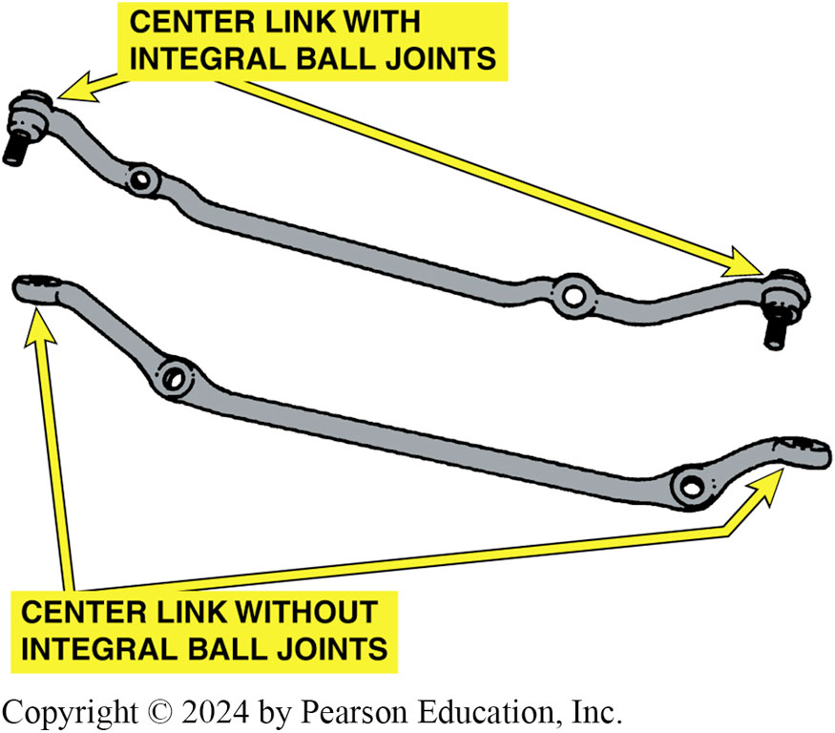
Figure 116.17 Center Links
Some center links have ball joints while others have tapered socket holes to accept ball joints on the pitman arm, idler arm, and inner tie rod ends
Notes:
TECH TIP: Wear and Nonwear Center Links
Wear and Nonwear Center Links Some center links are equipped with ball-and- socket joints, which can wear. Other center links are manufactured with holes for ball-joint studs only.
SEE FIGURE 116–17. Generally, the center links that do not use joints are unlikely to need replacement unless a joint becomes loose and wears the tapered stud hole. Knowing which style of center link is used will help determine the most likely location to check for excessive steering linkage play.

Slide 37
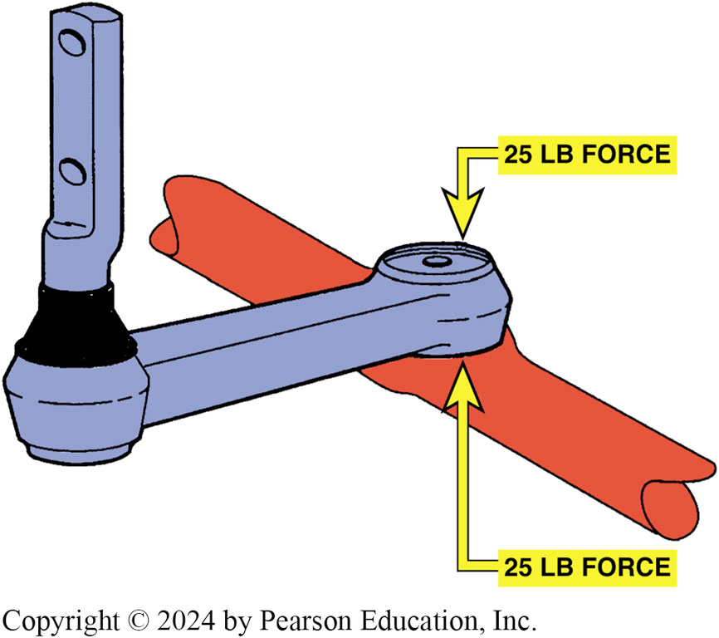
Figure 116.18 Idler Arm Check
To check an idler arm, most vehicle manufacturers specify that 25 pounds of force be applied by hand up and down to the idler arm. The idler arm should be replaced if the total movement (up and down) exceeds 1/4 inch (6 mm)
Notes:
TECH TIP: The Killer Bs
The “three Bs” that can cause steering and suspension problems are bent, broken, or binding components. Always inspect each part under the vehicle for each of the killer Bs.

Slide 38
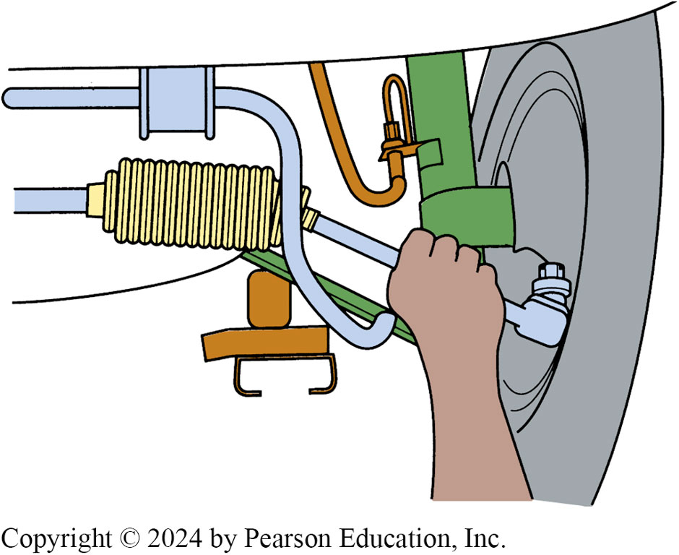
Figure 116.19 Check fro Looseness
Steering system component (s) should be replaced if any noticeable looseness is detected when moved by hand

Slide 39
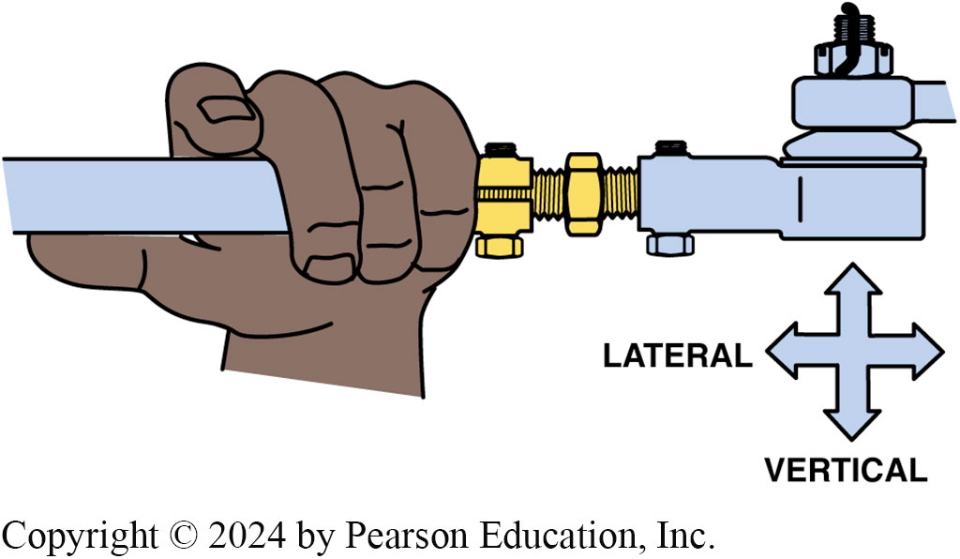
Figure 116.20 Joint Play
All joints should be checked by hand for any lateral or vertical play

Slide 40
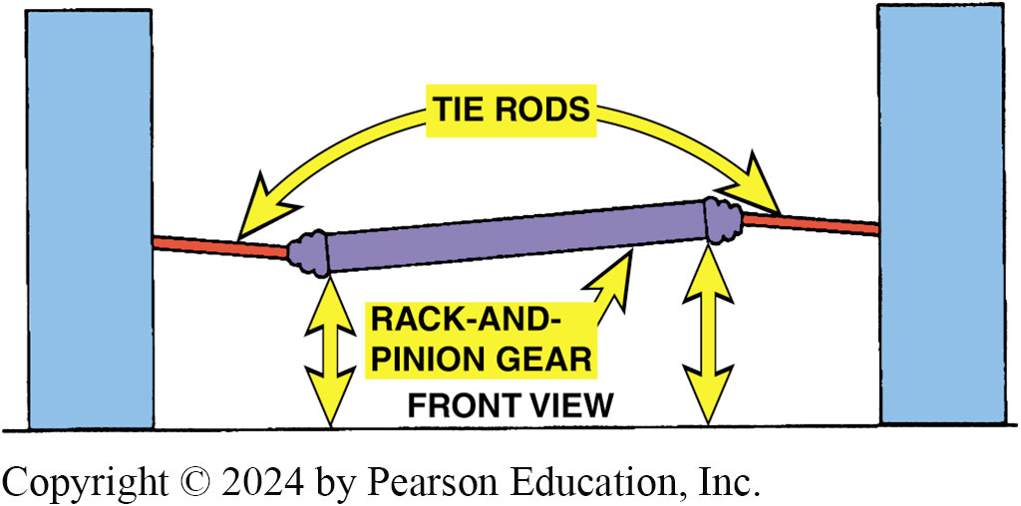
Figure 116.21 System Must Be Level
If a rack-and-pinion or any other steering linkage system is not level, the front tires will be moved inward and/or outward whenever the wheels of the vehicle move up or down
Notes:
CASE STUDY Bump Steer
Bump steer, or orbital steer, is used to describe what happens when the steering linkage is not level. The front tires turn inward or outward as the wheels and suspension move up and down. (Automotive chassis engineers call it roll steer.) The vehicle’s direction is changed without moving the steering wheel whenever the tires move up and down over bumps, dips in the pavement, or even over gentle rises!
This author experienced bump steer once and will never forget the horrible feeling of not having control of the vehicle. After replacing an idler arm and aligning the front wheels, everything was normal until about
40 MPH (65 km/h); then the vehicle started darting from one lane of the freeway to another. Because there were no “bumps” as such, bump steer was not considered as a cause. Even when holding the steering wheel perfectly still and straight ahead, the vehicle would go left, then
right. Did a tie rod break? It certainly felt exactly like that’s what happened. I slowed down to below 30 MPH and returned to the shop.
After several hours of checking everything, including the alignment, I discovered that the idler arm was not level with the pitman arm. This caused a pull on the steering linkage whenever the suspension moved up and down. As the suspension compressed, the steering linkage pulled inward on the tie rod on that side of the vehicle. As the wheel moved inward (toed in), it created a pull just as if the wheel were turned by the driver.
This is why all steering linkages must be parallel
with the lower control. The reason for the bump steer was that the idler arm was bolted to the frame, which was slotted vertically. I didn’t pay any attention to the location of the original idler arm and simply bolted the replacement to the frame. After raising the idler arm back up where it belonged (about 1/2 inch [13 mm]), the steering problem was corrected.
Other common causes of bump steer are worn or deteriorated rack mounting bushings, a non-centered steering linkage, or a bent steering linkage. If the steering components are not level, any bump or dip in the road will cause the vehicle to steer one direction or the other. SEE FIGURE 118-21.
Summary:
Complaint—Driver complained that the vehicle pulled to one lane and then the other when driving over a rough section of road.
Cause—The idler arm was not installed in the correct location to prevent bump steer.
Correction—The idler arm was installed correctly and the bump steer was corrected.

Slide 41
Steering Linkage Replacement
Parallelogram Type
When replacing any steering system component, it is best to replace all defective and marginally good components at the same time.
When replacing tie rod ends, use the adjusting sleeve to adjust the total length of the tie rod to the same position and length as the original.
Service of Ball-Socket Assemblies
Inner tie rod end assemblies used on rack-and-pinion steering units often require special tools.

Slide 42
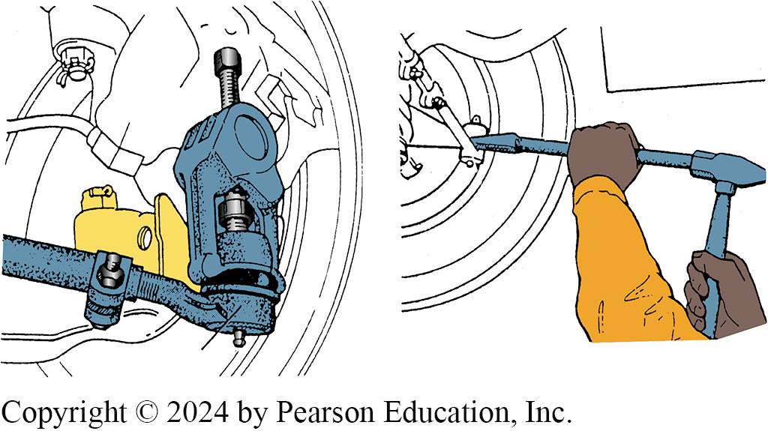
Figure 116.22 Separating Tie Rods
The preferred method for separating tie rod end from the steering knuckle is to use a puller. A pickle-fork-type tool should only be used if the tie rod end is going to be replaced. A pickle-fork-type tool can damage or tear the rubber grease boot

Slide 43
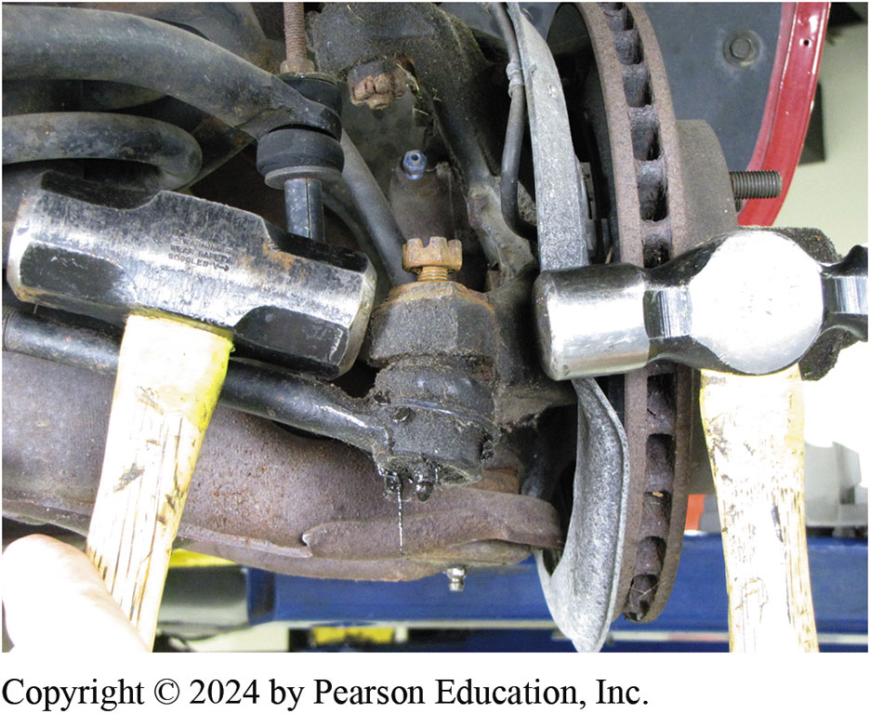
Figure 116.23 Two Hammers
2 hammers being used to disconnect a tie rod end from the steering knuckle. One hammer is used as a backing for the second hammer. Notice that the attaching nut has been loosened, but not removed. This prevents the tie rod end from falling when the tapered connection is knocked loose.

Slide 44
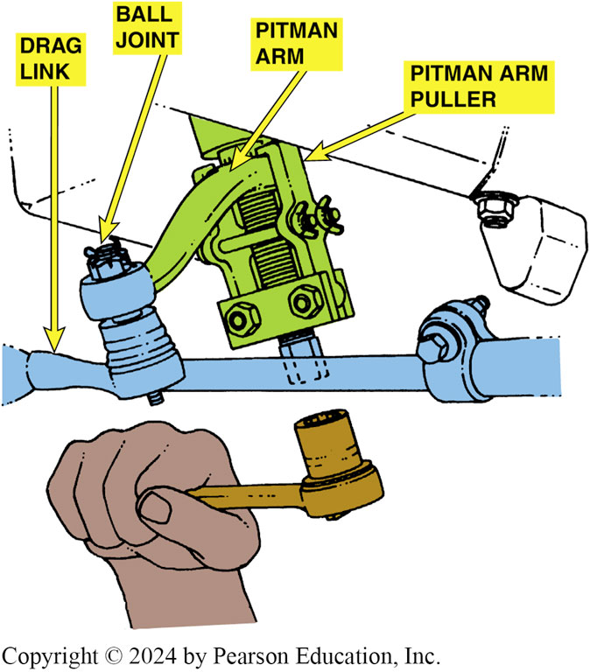
Figure 116.24 Pitman Arm Puller
A pitman arm puller is used to remove the pitman arm from the pitman shaft

Slide 45
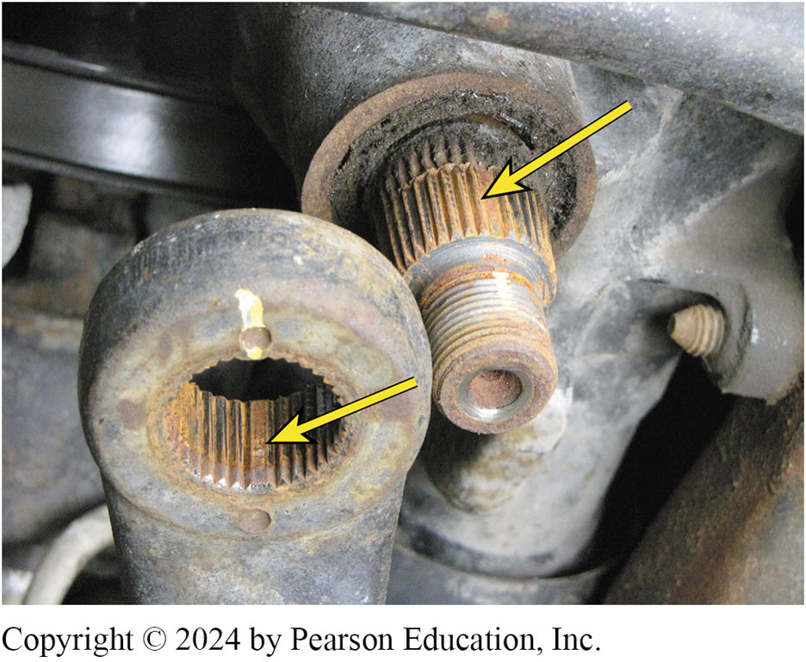
Figure 116.25 Splines
Pitman arm and pitman shaft indexing splines

Slide 46
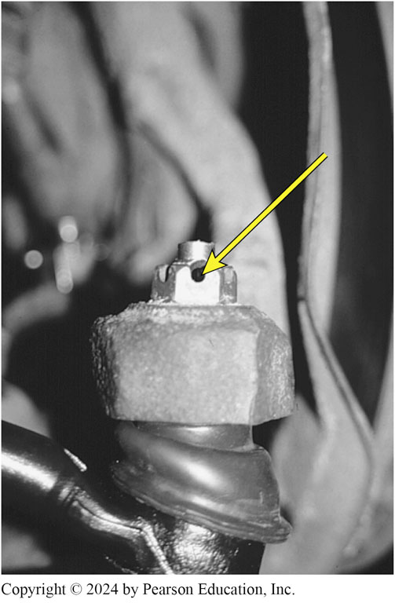
Figure 116.26 Hole Alignment
Align the hole in the tie rod end with the slot in the retaining nut. If the holes do not line up, always tighten the nut farther (never loosen) until the hole lines up

Slide 47
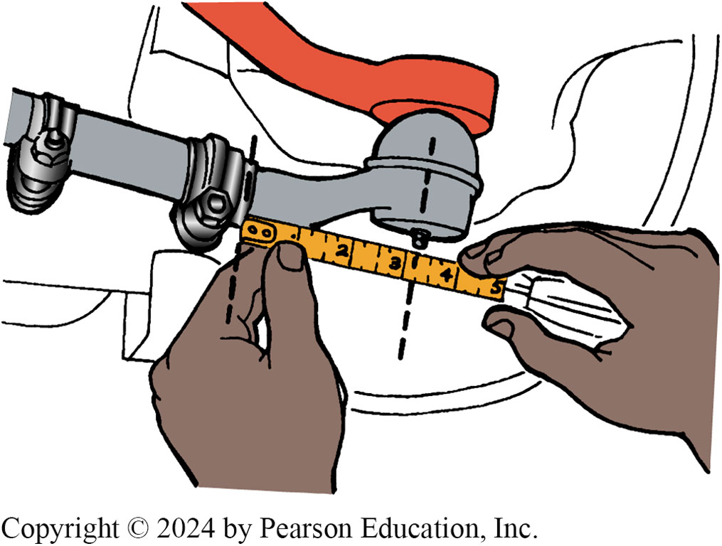
Figure 116.27 Replacement Rods
Replacement tie rods should be of the same overall length as the originals. Measure from the edge of the tie rod sleeve to the center of the grease fitting. When the new tie rod is threaded to this dimension, the toe setting will be close to the original.

Slide 48
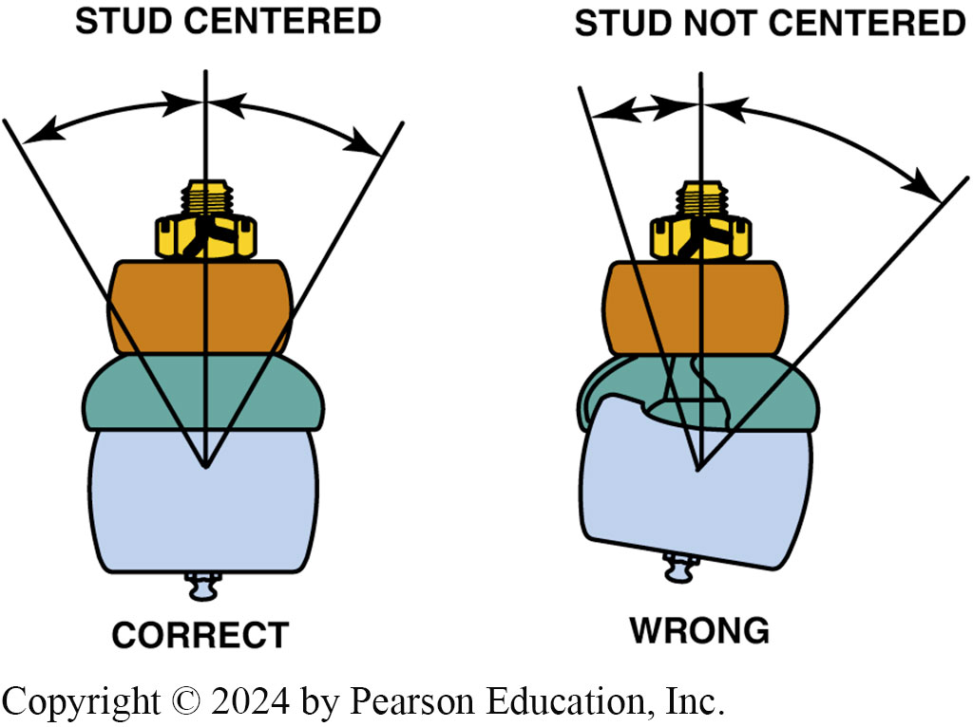
Figure 116.28 Stud in Center
All tie rod ends should be installed so that the stud is in the center of its operating range, as shown

Slide 49
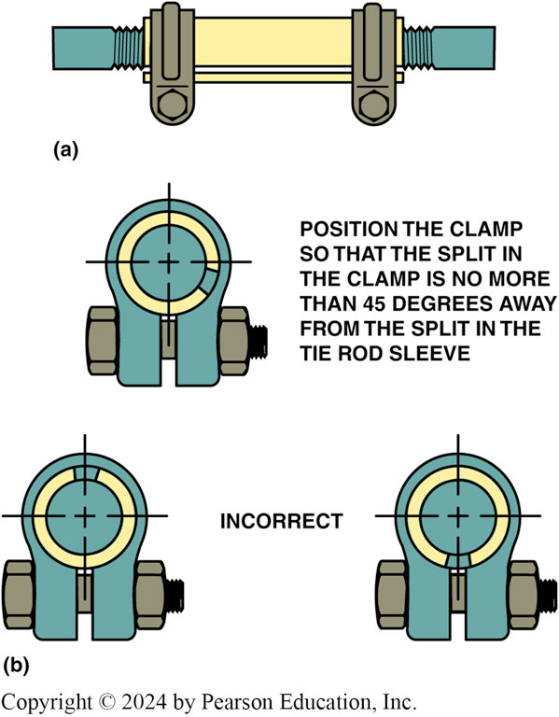
Figure 116.29 Adjusting Sleeve
(a) Tie rod adjusting sleeve. (b) Be sure to position the clamp correctly on the sleeve

Slide 50
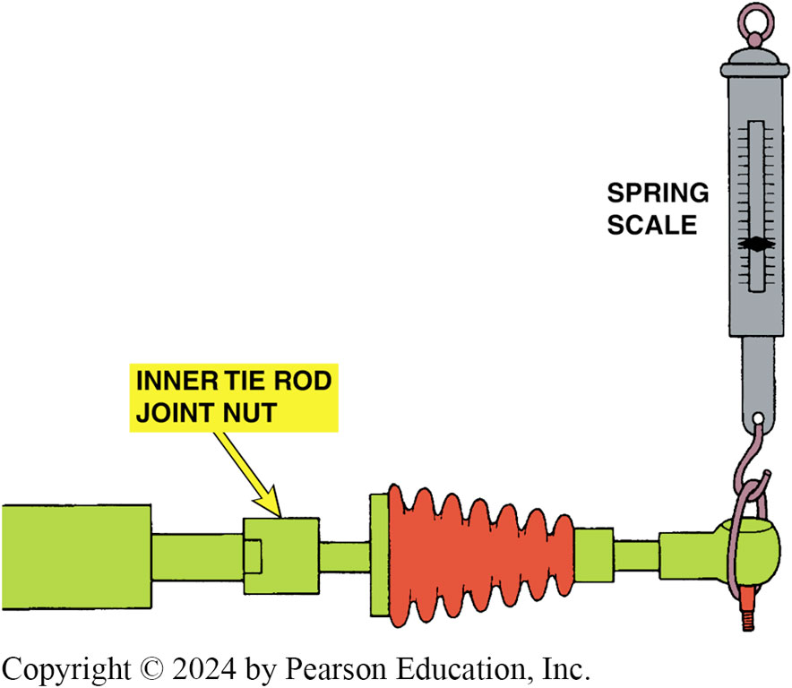
Figure 116.30 Articulation Test
An articulation test uses a spring scale to measure the amount of force needed to move the tie rod in the ball socket assembly. Most manufacturers specify a minimum of 1 pound (4.4 N) of force and a maximum of 6 pounds (26 N).

Slide 51
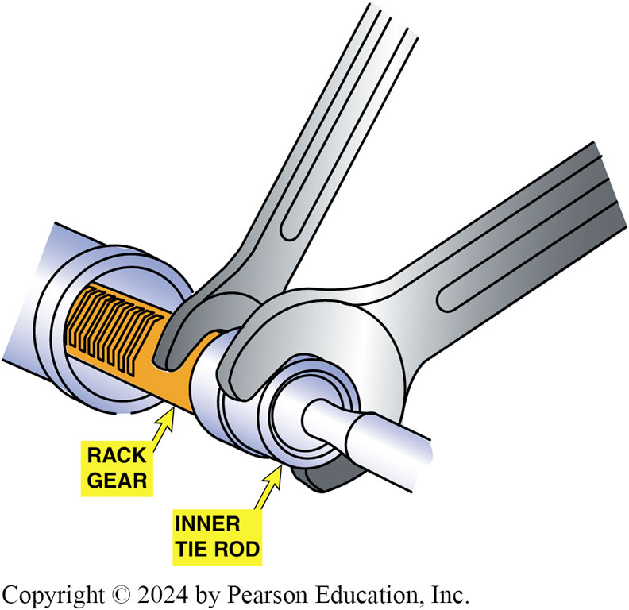
Figure 116.31 Stacked Inner Tie Rod
Removing a staked inner tie rod assembly requires two wrenches—one to hold the rack and the other to unscrew the joint from the end of the steering rack

Slide 52
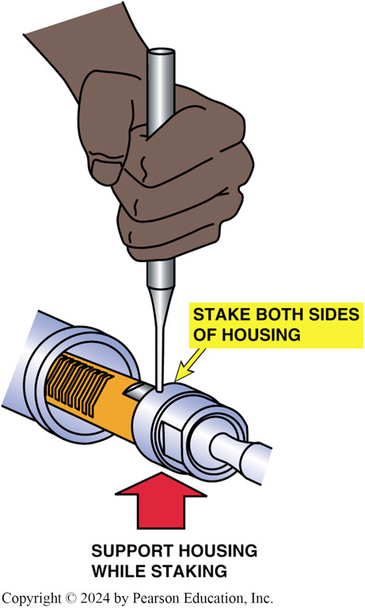
Figure 116.32 Stack the Rack
When the inner tie rod end is reassembled, both sides of the housing must be staked down onto the flat shoulder of the rack

Slide 53
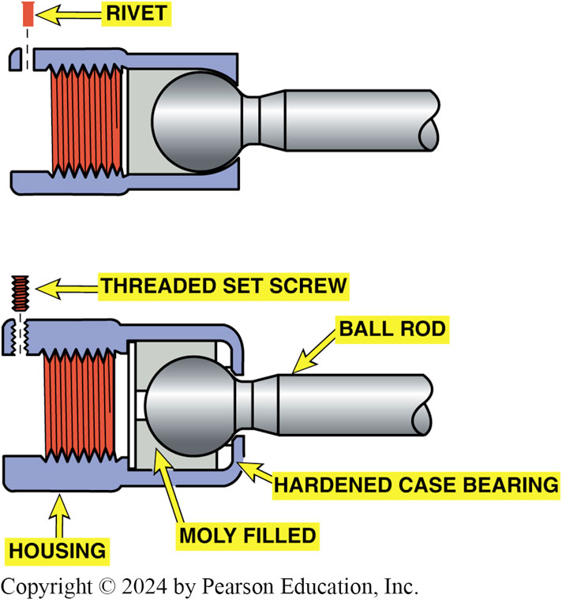
Figure 116.33 Secure Rivet or Screw
After replacing an inner tie rod end, the socket assembly should be secured with a rivet or set screw depending on the style of the replacement part

Slide 54
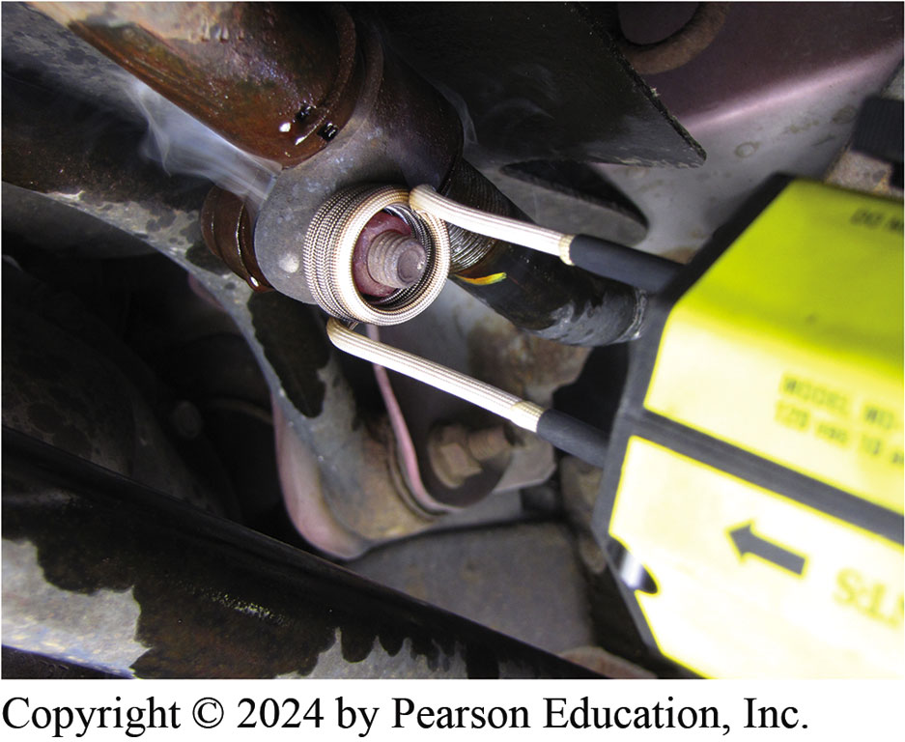
Figure 116.34 Inductive Heater
Using an inductive heater caused this retaining nut to be cherry red in a just a few seconds

Slide 55
Question 3: ?
What is the most common cause of bump steer?

Slide 56
Answer 3
The rack and pinion gear is not parallel to the road surface.

Slide 57
Dry Park Test (2 of 2)

Slide 58
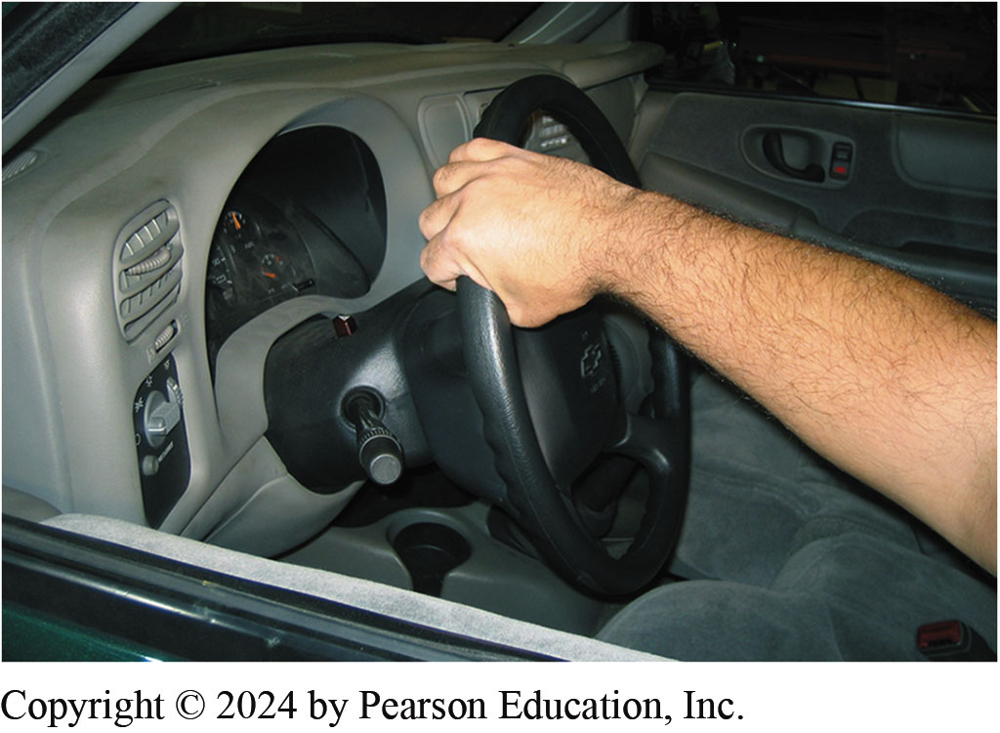
1. Use Drive-on-Type Hoist
1. Drive the vehicle onto a drive-on-type hoist and have an assistant gently rotate the steering wheel back and forth about 2 inches (50 mm)

Slide 59
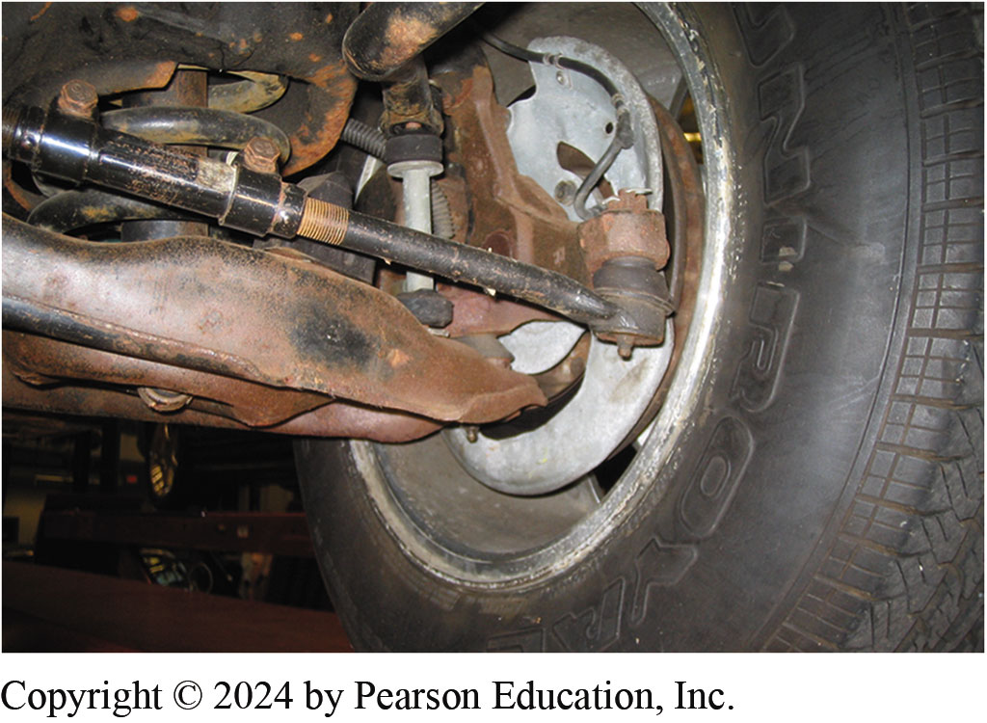
2. Visual Inspection
2. Perform a visual inspection of the steering and suspension system, looking for damage from road debris or other faults

Slide 60
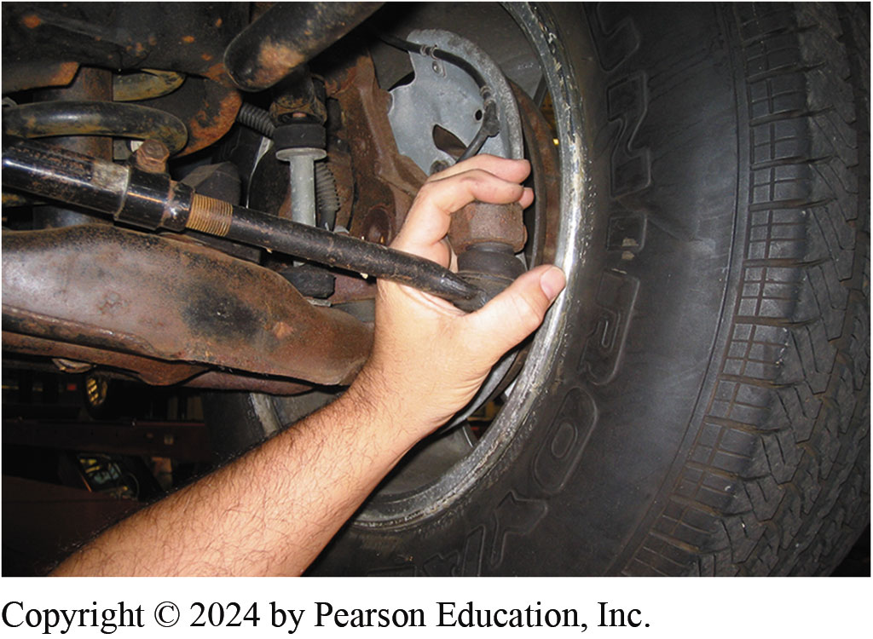
3. Wiggles Steering Wheel
3. As the assistant wiggles the steering wheel, grasp the joint at the outer tie rod end on the driver’s side to check for any movement

Slide 61
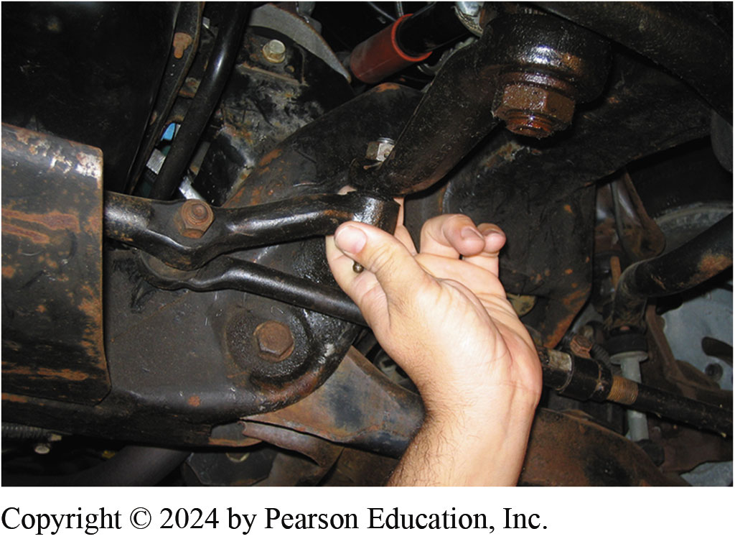
4. Check Pitman Arm
4. Next, check for any freeplay at the pitman arm

Slide 62
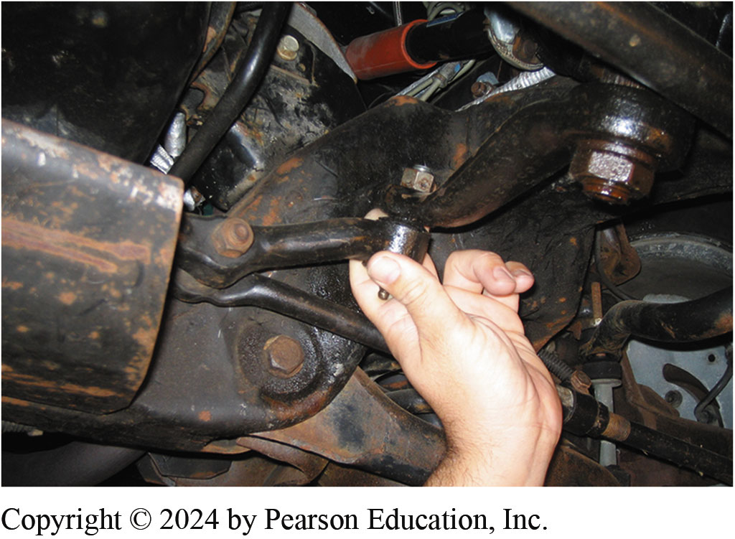
5. Inner Tie Rod End & Center Link
5. Check the joint between the left inner tie rod end and the center link for play

Slide 63
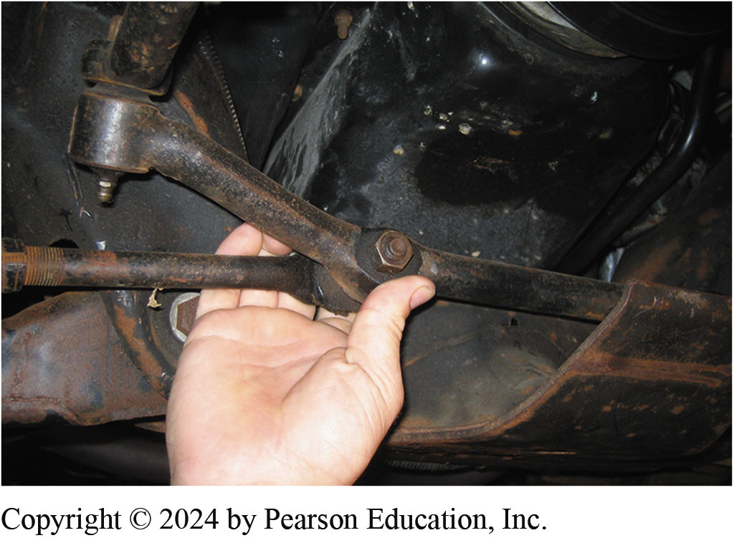
6. Center Link & Inner Tie Rod
6. Move to the passenger side and check for any looseness at the joint between the center link and the right side inner tie rod end

Slide 64
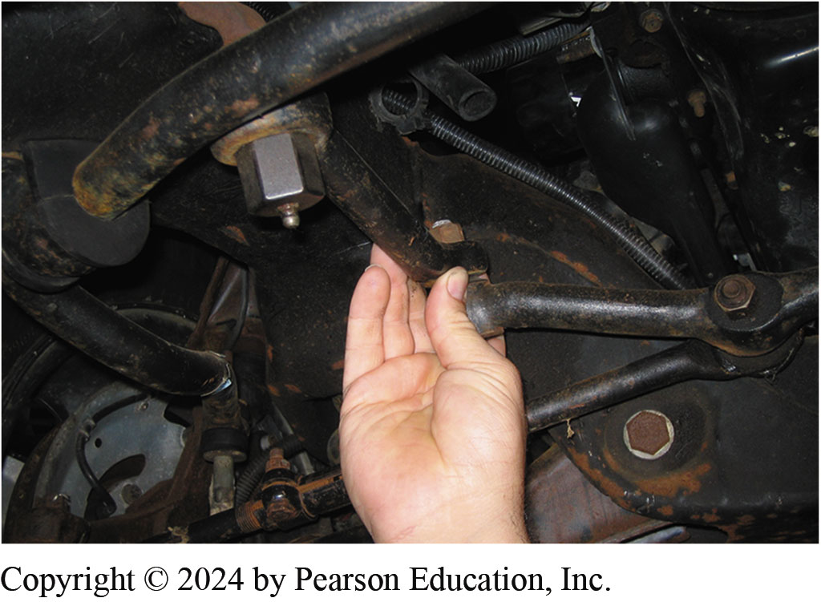
7. Check Idler Arm
7. Check for looseness at the idler arm connector to the center link and the idler arm at the frame mount

Slide 65
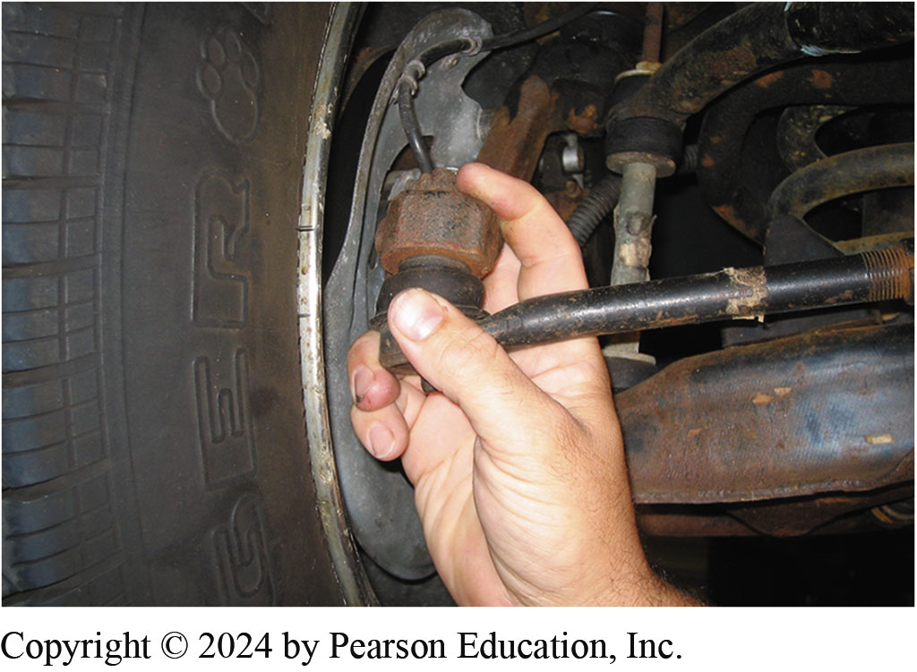
8. Check Outer Tie Rod
8. Check for looseness at the passenger-side outer tie rod end. After the inspection, record the results on the work order

Slide 66
Suspension and Steering Videos and Animations
Videos Link: (A4) Suspension and Steering Videos
Animations Link: (A4) Suspension and Steering Animations

Slide 67
Copyright
This work is protected by United States copyright laws and is provided solely for the use of instructors in teaching their courses and assessing student learning. Dissemination or sale of any part of this work (including on the World Wide Web) will destroy the integrity of the work and is not permitted. The work and materials from it should never be made available to students except by instructors using the accompanying text in their classes. All recipients of this work are expected to abide by these restrictions and to honor the intended pedagogical purposes and the needs of other instructors who rely on these materials.

