Slide 1
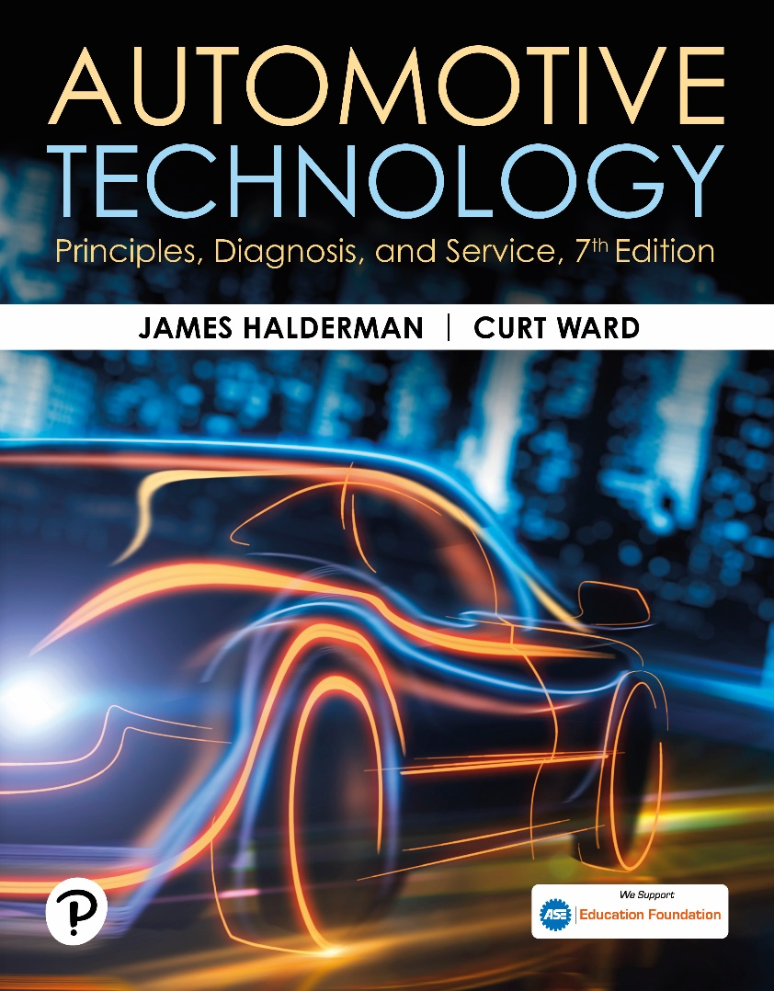
Automotive Technology: Principles, Diagnosis, and Service
Seventh Edition
Chapter 115
Steering Columns and Gears
Copyright © 2023 Pearson Education, Inc. All Rights Reserved
Notes:
INSTRUCTOR NOTE: This presentation includes text explanation notes, you can use to teach the course. When in SLIDE SHOW mode, you RIGHT CLICK and select SHOW PRESENTER VIEW, to use the notes.

Slide 2
Learning Objectives
115.1 Describe the purpose and function of a steering wheel.
115.2 Explain how to remove a steering wheel.
115.3 Discuss steering columns and intermediate shafts.
115.4 Explain the purpose and function of conventional steering gears.
115.5 Explain how a recirculating ball steering gear works.
115.6 Describe how a rack-and-pinion steering gear works..

Slide 3
Steering Wheels
Purpose and Function
  The steering wheel, which consists of a rigid rim and a number of spokes connecting the rim to a center hub, attaches to the top of the steering shaft at its center.
Air Bags
  The module fits in front of the nut that secures the steering wheel to the steering shaft.
  Bolts at the back of the steering wheel fasten the airbag module to the steering wheel.

Slide 4
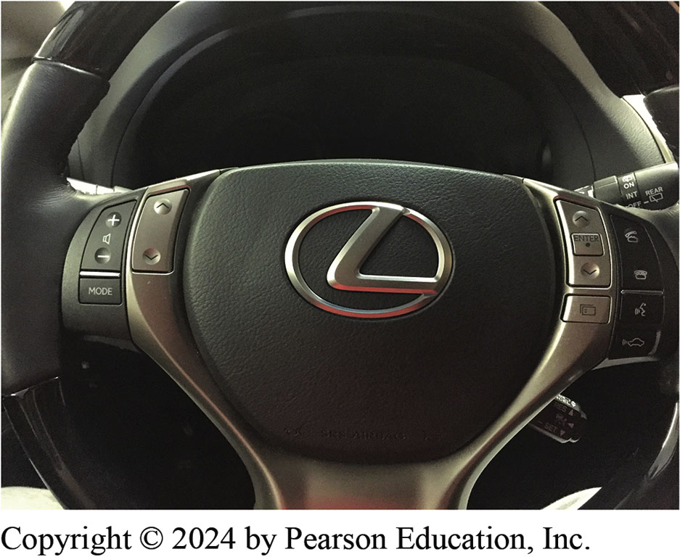
Figure 115.1 Steering Wheel
A steering wheel assembly includes a driver’s side air bag module plus many also include steering wheel controls

Slide 5
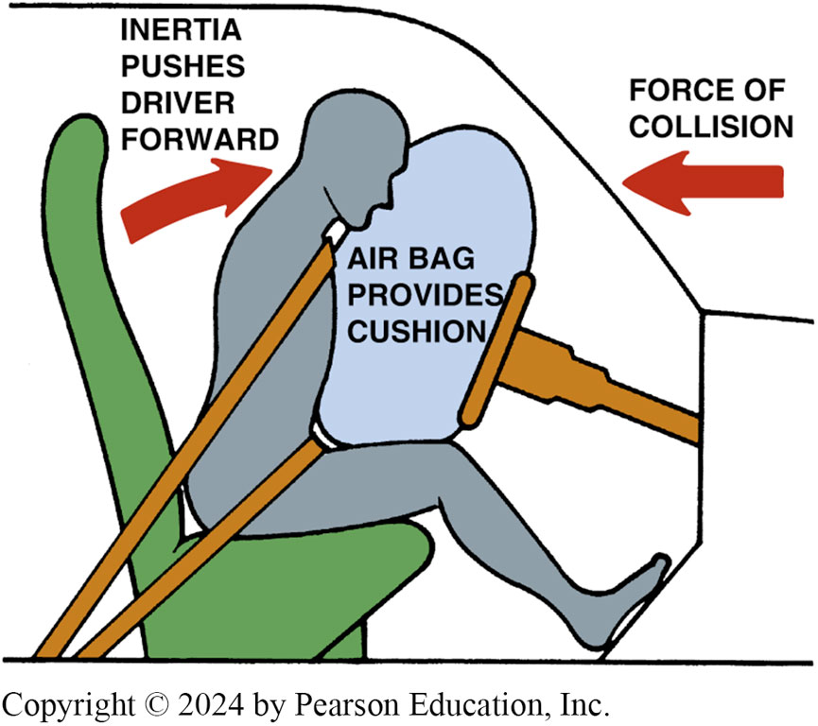
Figure 115.2 Air Bag
The airbag inflates at the same time the driver moves toward the steering wheel during a front-end collision and supplements the protection of the safety belt

Slide 6
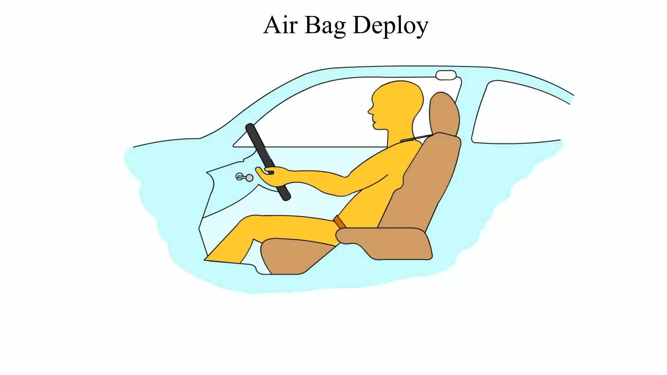
Animation: Airbag Deploy
(Animation will automatically start)

Slide 7
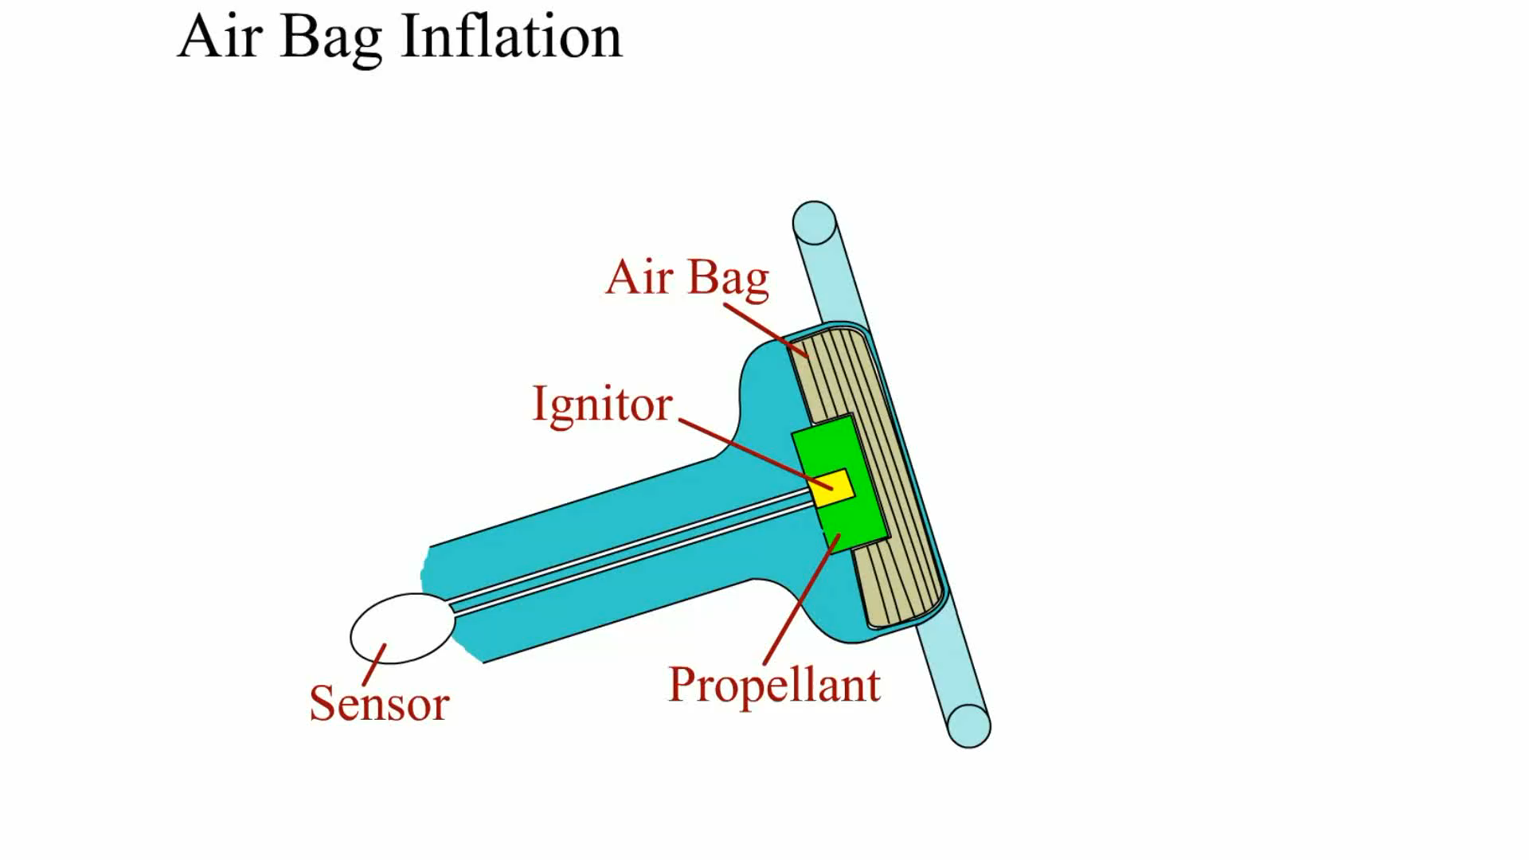
Animation: Airbag Inflation
(Animation will automatically start)

Slide 8
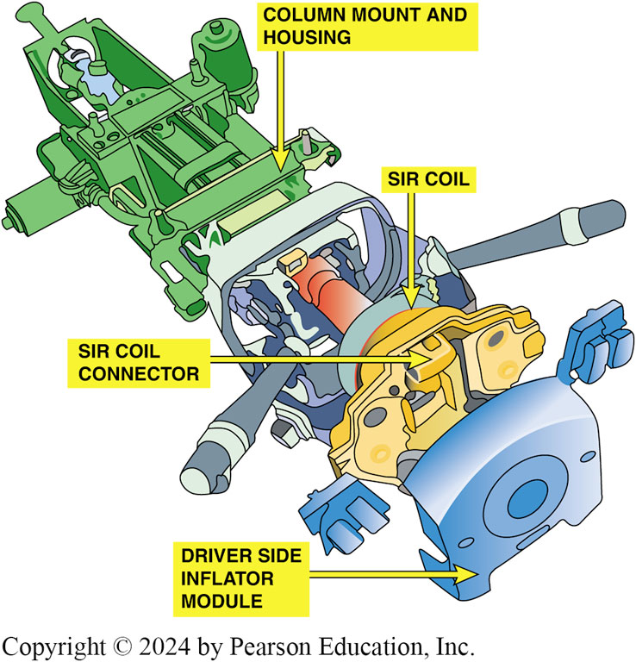
Figure 115.3 Airbag Module
The airbag module attaches to the steering wheel and is removed as an assembly to service the steering wheel and column

Slide 9
Steering Wheel Removal
If steering wheel must be removed, first disconnect the airbag wire connector at the base of the steering column.
After removal of the airbag inflator module, remove the steering wheel retaining nut.
Note locating marks on steering wheel and steering shaft.
Use a steering wheel puller to remove the steering wheel from the steering shaft.

Slide 10
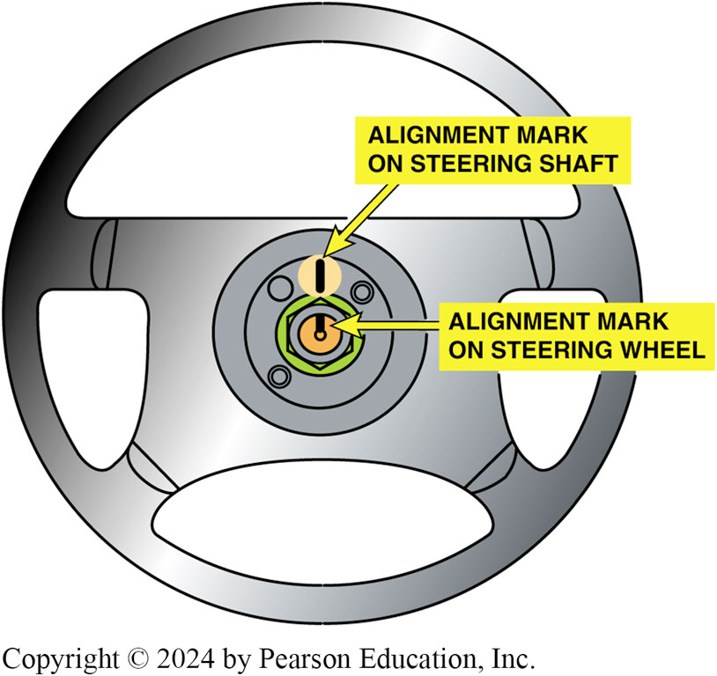
Figure 115.4 Alignment Marks
Most vehicles have alignment marks made at the factory on the steering shaft and steering wheel to help the service technician keep the steering wheel in the center position

Slide 11
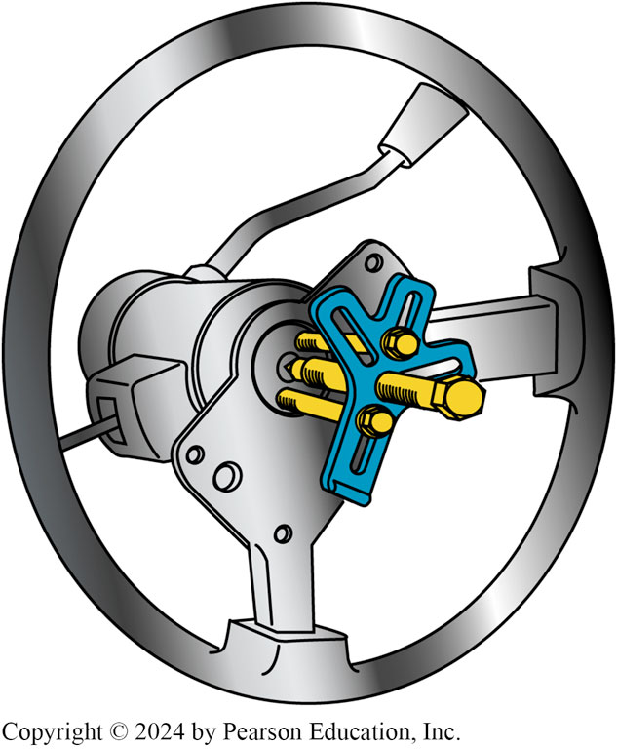
Figure 115.5 Steering Wheel Puller
A puller being used to remove a steering wheel after the steering wheel retaining nut has been removed

Slide 12
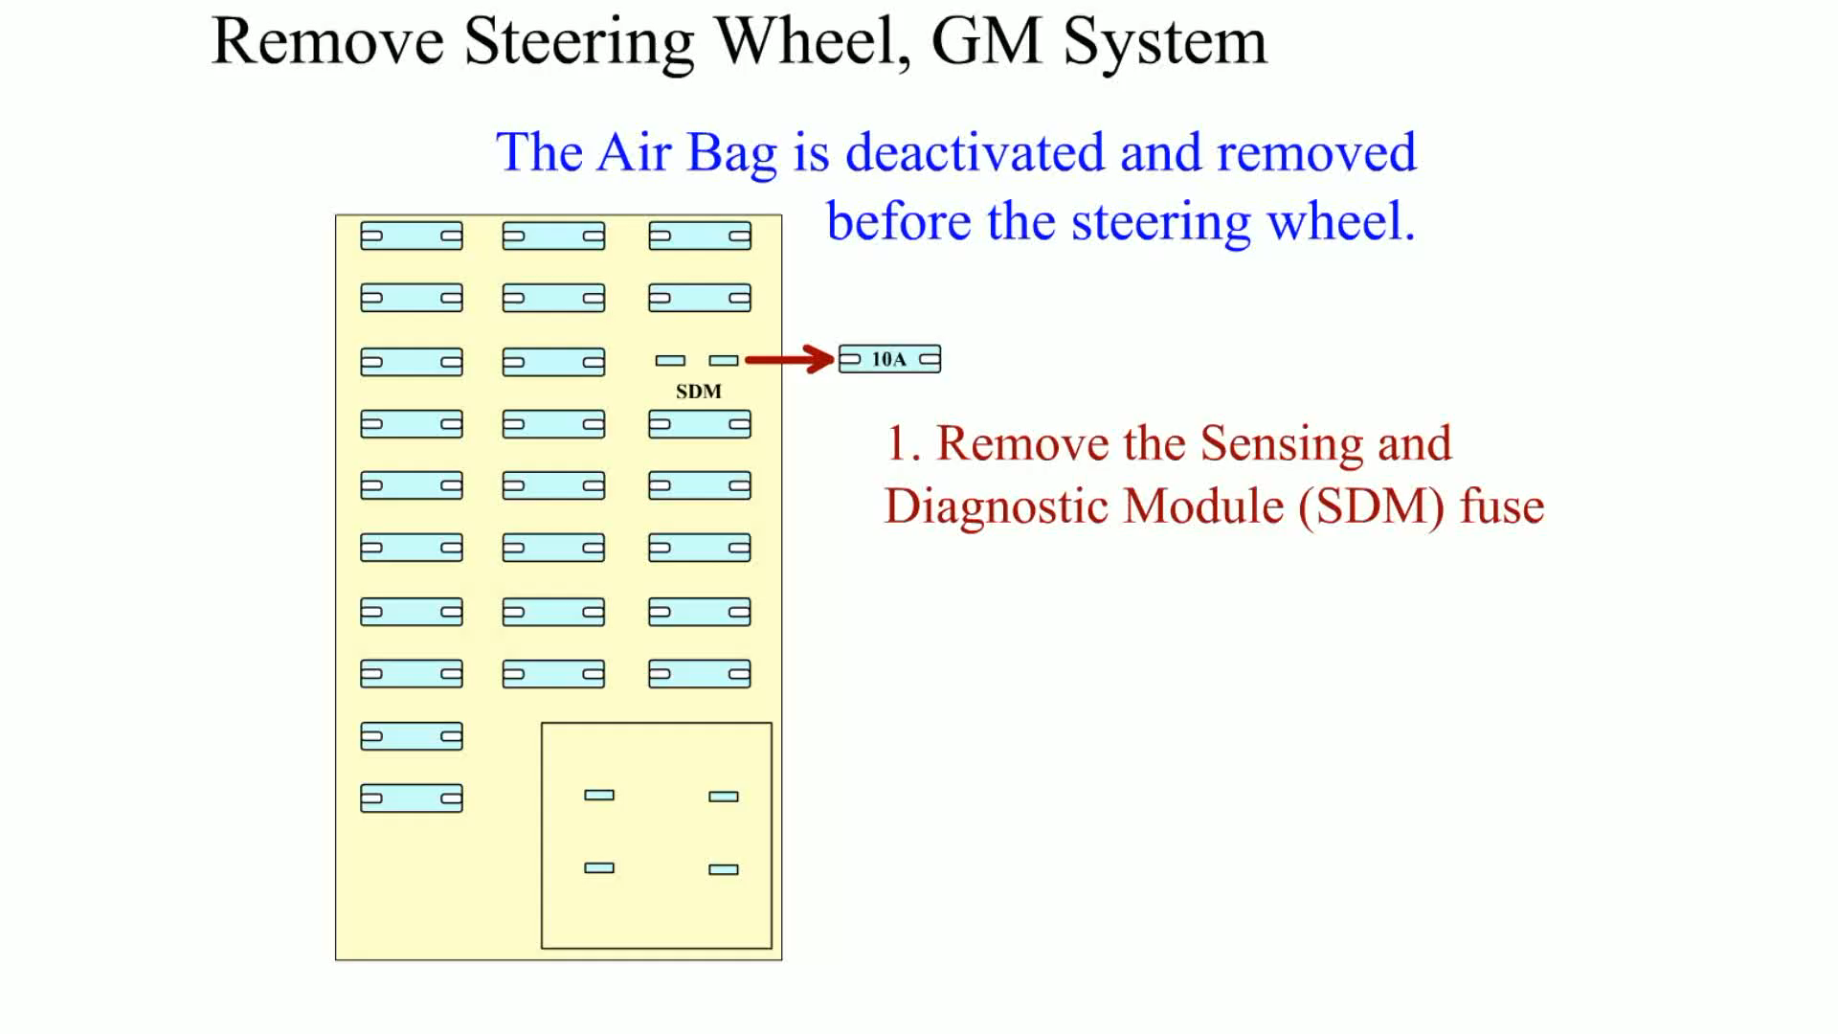
Animation: Remove Steering Wheel, GM System
(Animation will automatically start)

Slide 13
Question 1: ?
How is the steering wheel typically retained on the steering shaft?

Slide 14
Answer 1
A nut holds the steering wheel on a splined and tapered shaft.

Slide 15
Steering Columns (1 of 4)
Purpose and Function
  The steering shaft transmits rotary motion from the steering wheel to the steering gear.
Steering Shaft
  The steering shaft extends from the steering wheel to the steering gear.
Universal Joint
  Universal joints allow changes in the angle between two rotating shafts.

Slide 16
Steering Columns (2 of 4)
Flexible Couplings
  A flexible coupling is a simple device made of rubber, or rubber reinforced with fabric, that is placed between two shafts to allow for a change in angle between them.
Column Cover
  To keep the wiring from the jacket-mounted switches out of sight, the part of the steering column that extends into the passenger compartment is shrouded by the column cover.

Slide 17
Steering Columns (3 of 4)
Collapsible Column
  Federal law requires that steering columns and shafts collapse to absorb some of the energy of the crash and lessen the danger of injury to the driver.
Tilt Mechanisms
  Allow the driver to adjust the angle of the steering wheel relative to the steering column.

Slide 18
Steering Columns (4 of 4)
Telescoping Steering Columns
  Steering shaft top and jacket can be pulled out toward the driver or pushed in toward the dashboard, and then locked into the new position.
Steering Column Construction
  Steering column construction varies with dash design and the type of steering system used on the vehicle.
  Follow the manufacturers instructions when disassembling and reassembling the steering column.

Slide 19
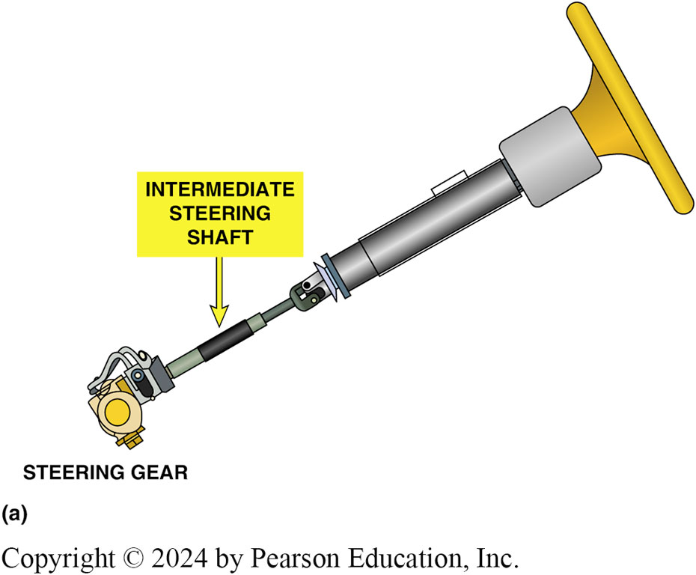
Figure 115.6a Intermediate Steering Shaft
(a) The intermediate steering shaft is located forward of the bulkhead and between the steering column and the steering gear.

Slide 20
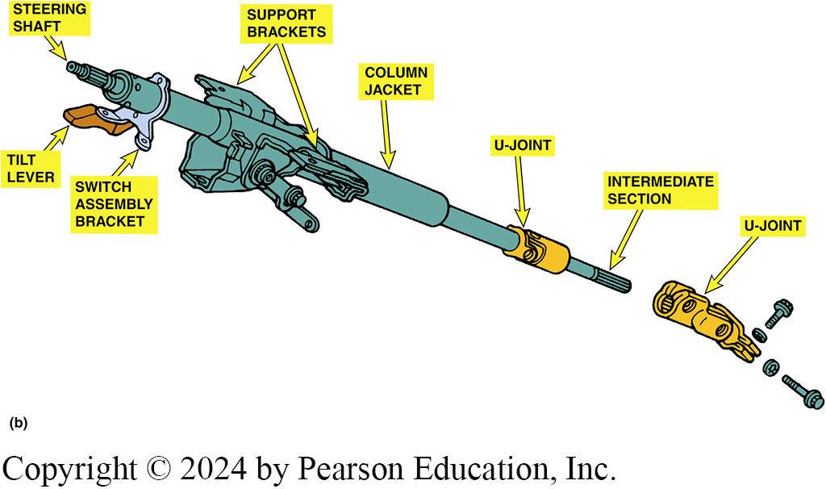
Figure 115.6b Steering Shaft
(b) The steering shaft links the steering wheel to the steering gear while the column jacket, which surrounds part of the shaft, holds support brackets and switches. This steering shaft has a small intermediate section between the main section and the steering gear.

Slide 21
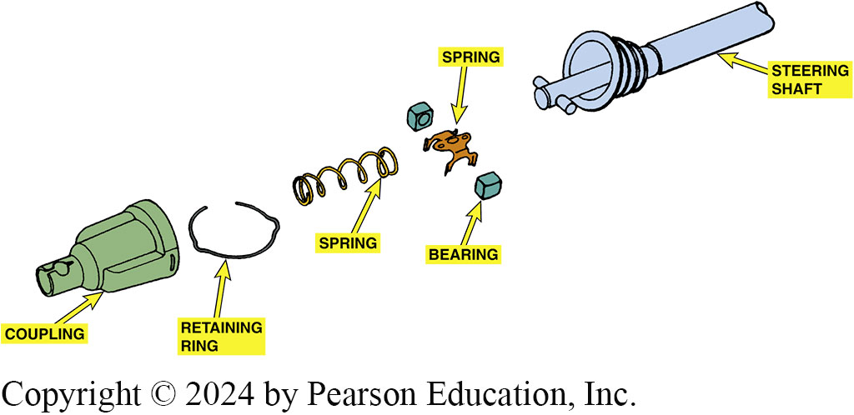
Figure 115.7 Flexible Coupling
A pot joint is a flexible coupling used to join two shafts that allow plunging motion

Slide 22
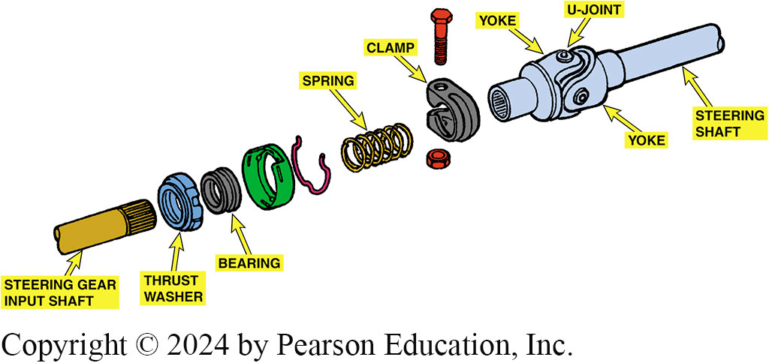
Figure 115.8 U-Joint
A typical intermediate steering shaft assembly showing a U-joint and related components

Slide 23
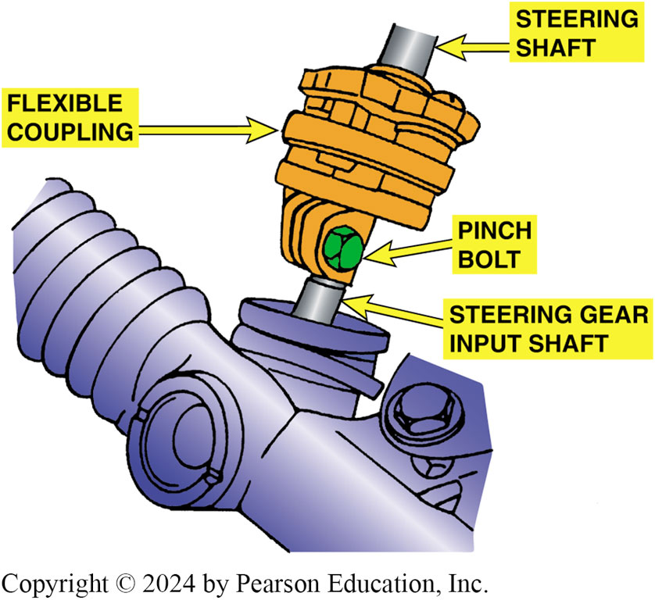
Figure 115.9 Flexible Coupling
A flexible coupling is used to isolate road noise and vibration from the steering shaft

Slide 24
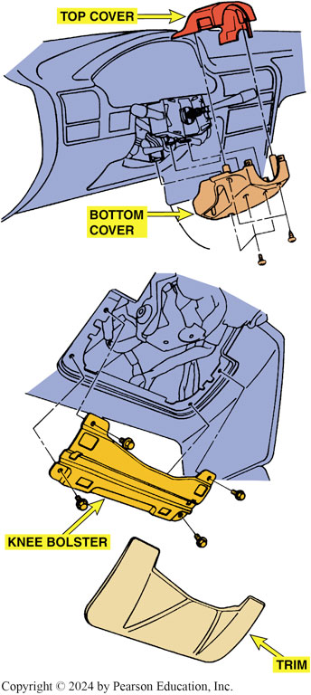
Figure 115.10 Column Covers
Steering column covers are often part of the interior trim

Slide 25
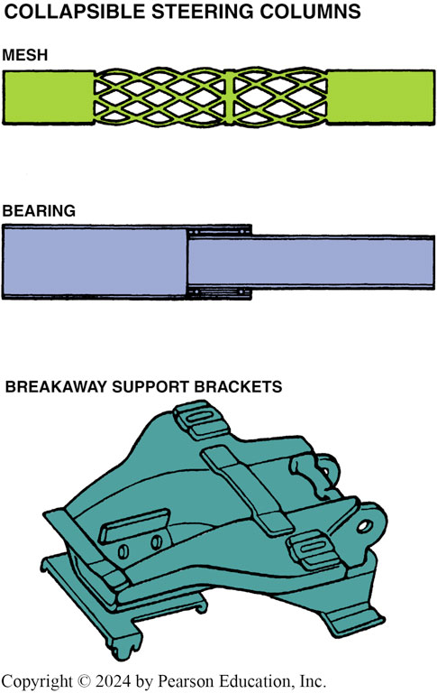
Figure 115.11 Collapsible Column
Collapsible steering columns include a mesh design that crushes easily, a bearing design that allows one section of the column to slide into the other, and a breakaway device that separates the steering column from the body of the vehicle in the event of a front-end collision
Notes:
TECH TIP: Do Not Pound on the Steering Column
Always use a steering wheel puller and/or the special tools recommended by the vehicle manufacturer when servicing the steering column. If a hammer is used on the steering shaft in an attempt to remove a steering wheel, the shaft could collapse, requiring the replacement of the entire steering column assembly.

Slide 26
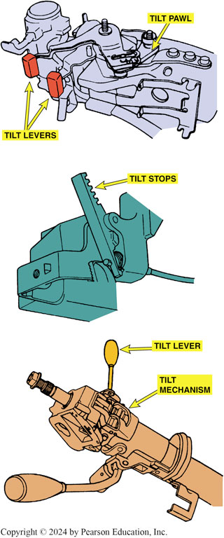
Figure 115.12 Tilt Mechanisms
Tilt mechanisms vary by design and vehicle manufacturer, although most use a ratchet to position the top portion of the steering column

Slide 27
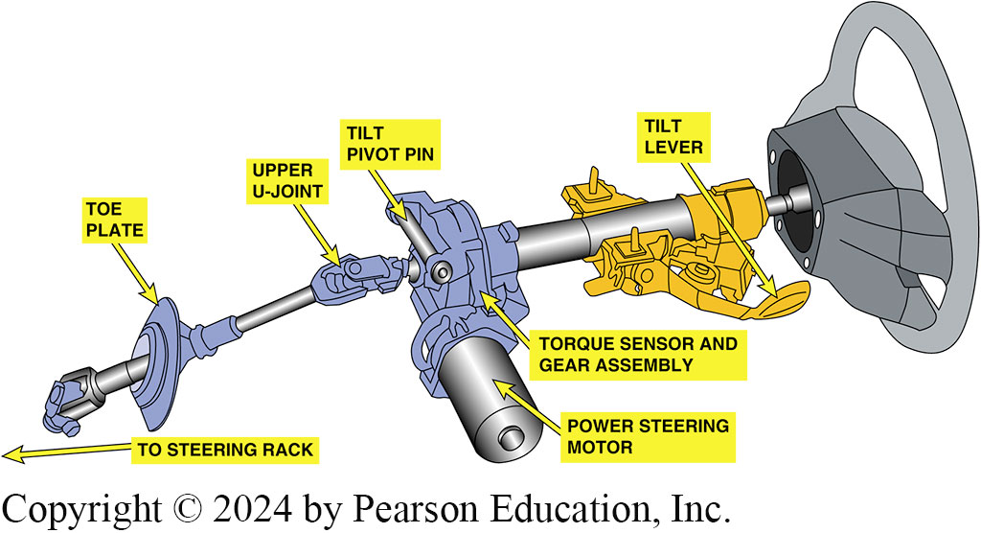
Figure 115.13 Steering Column
Typical steering column showing all of the components from the steering wheel to the steering gear. Note that this column uses a column-type electric power steering system (EPS) and a tilt wheel

Slide 28
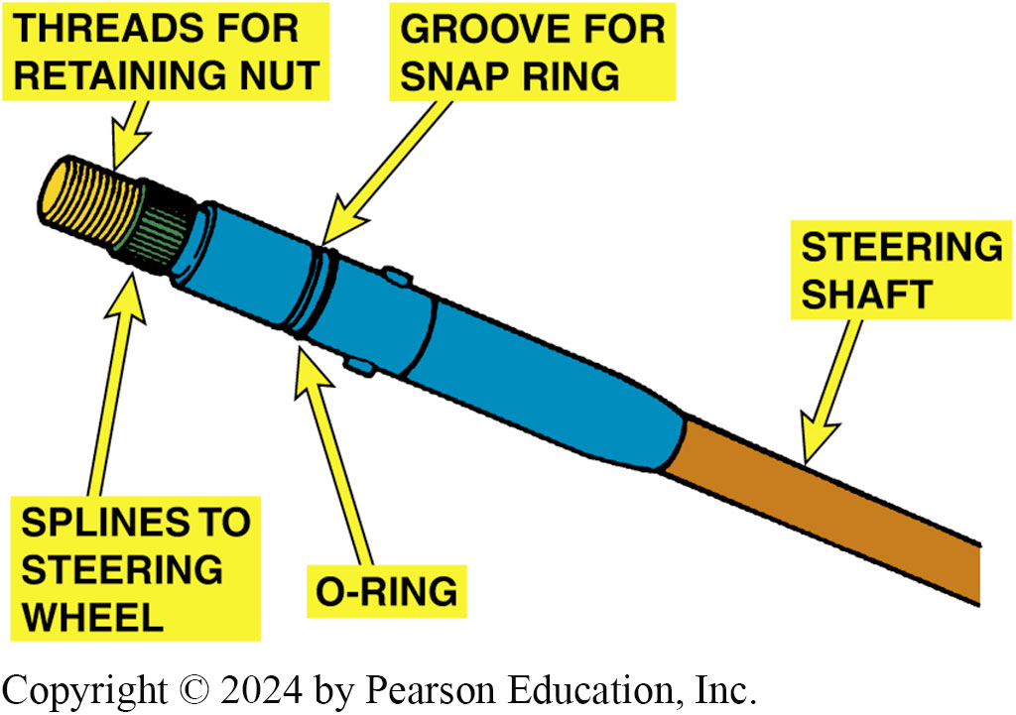
Figure 115.14 Steering Shaft
The steering shaft splines onto the steering wheel

Slide 29
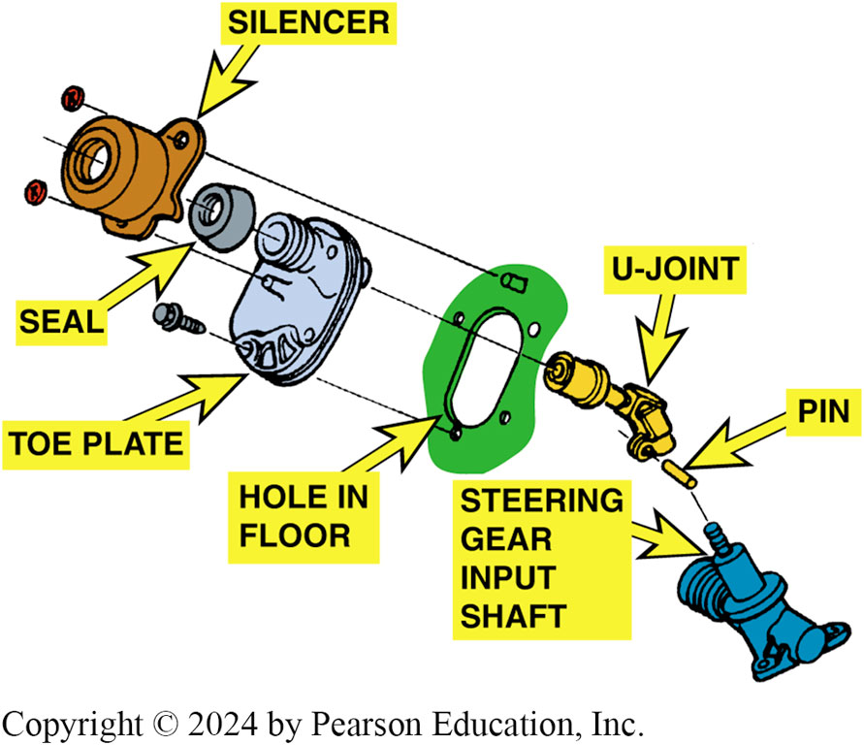
Figure 115.15 Toe Plate
The toe plate seals the hole from the steering shaft and helps seal out noise and moisture

Slide 30
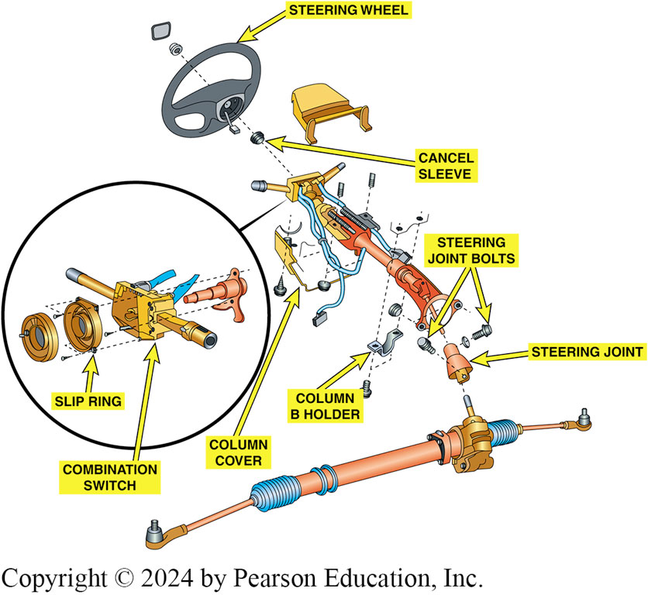
Figure 115.16 Upper Column
The upper portion of the steering column contains the combination switch, often called the multi-function switch used to control many functions

Slide 31
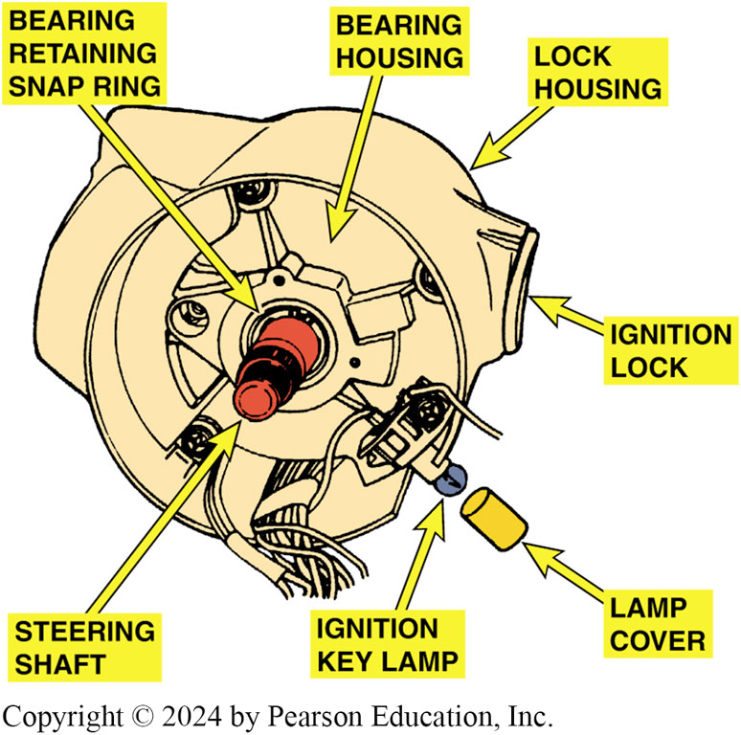
Figure 115.17 Steering Shaft Bearing
The upper section of the steering column contains the steering shaft bearing

Slide 32
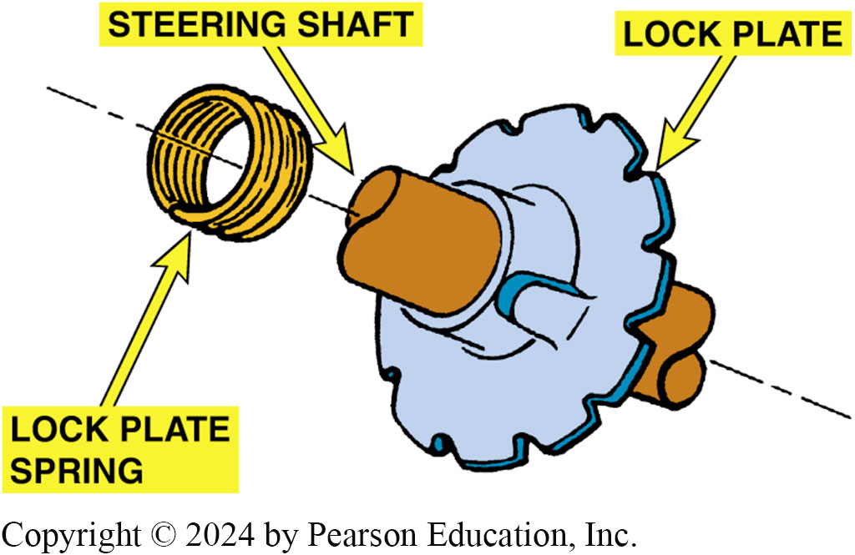
Figure 115.18 Lock Plate
The lock plate engages an ignition lock pawl to keep the steering wheel in one position when the ignition is off

Slide 33
Question 2: ?
Why does federal law require a steering column and shaft to be collapsible?

Slide 34
Answer 2
To absorb energy in a crash and reduce the risk of injury.

Slide 35
Conventional Steering Gear
Purpose and Function
  All steering gears have an input gear
    Transmits rotary movement from steering wheel into the steering gear
  Output gear, causes steering linkage to move laterally
Steering Gear Ratio
  If the steering wheel is rotated 20 degrees and results in the front wheels rotating 1 degree, then the steering gear ratio is 20:1 (read as “20 to 1”).
  Most steering gears and some rack-and-pinion steering gears feature a variable ratio.

Slide 36
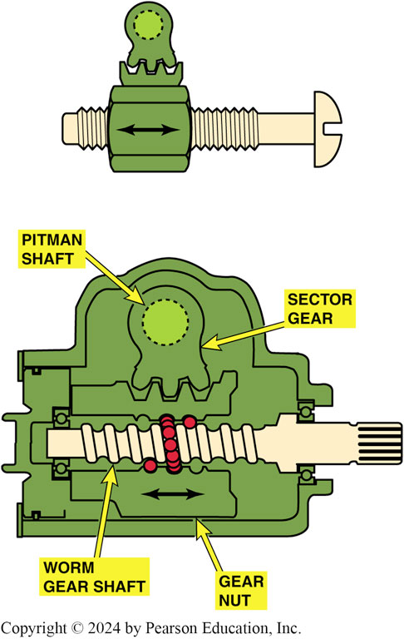
Figure 115.19 Steering Gear
As the steering wheel is turned, the nut moves up or down on the threads, shown using a bolt to represent the worm gear and the nut representing the gear nut that meshes with the teeth of the sector gear

Slide 37
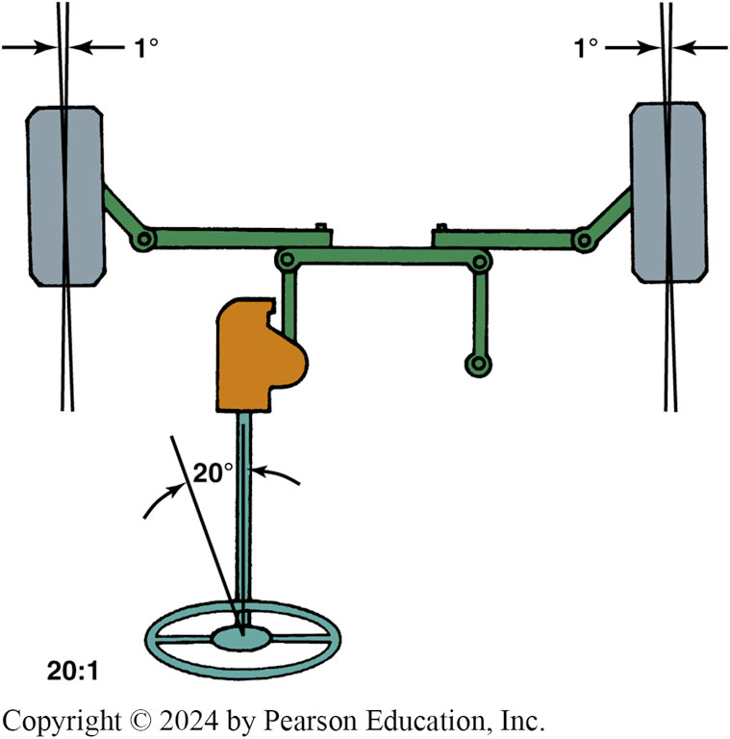
Figure 115.20 Steering Gear Ratio
Steering gear ratio is the ratio between the number of degrees the steering wheel is rotated to the number of degrees the front wheel turns

Slide 38
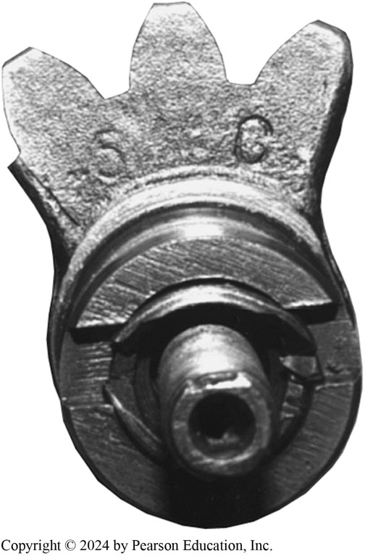
Figure 115.21 Constant Ratio
Constant-ratio steering gear sector shaft. Notice that all three gear teeth are the same size

Slide 39
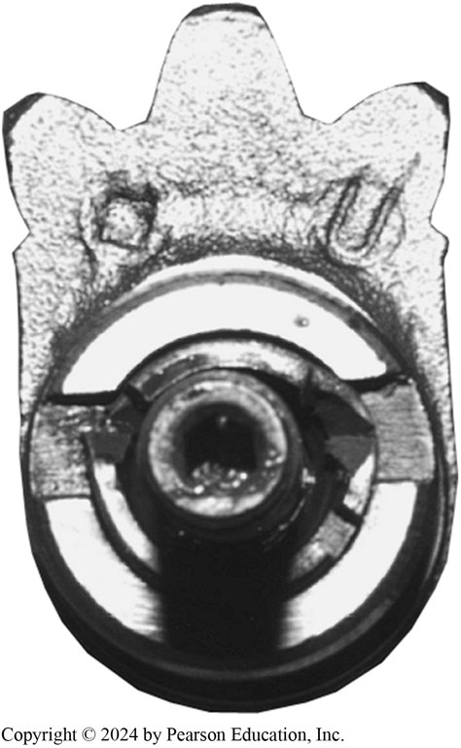
Figure 115.22 Variable Ratio
Variable-ratio steering gear sector shaft. Notice the larger center gear tooth

Slide 40
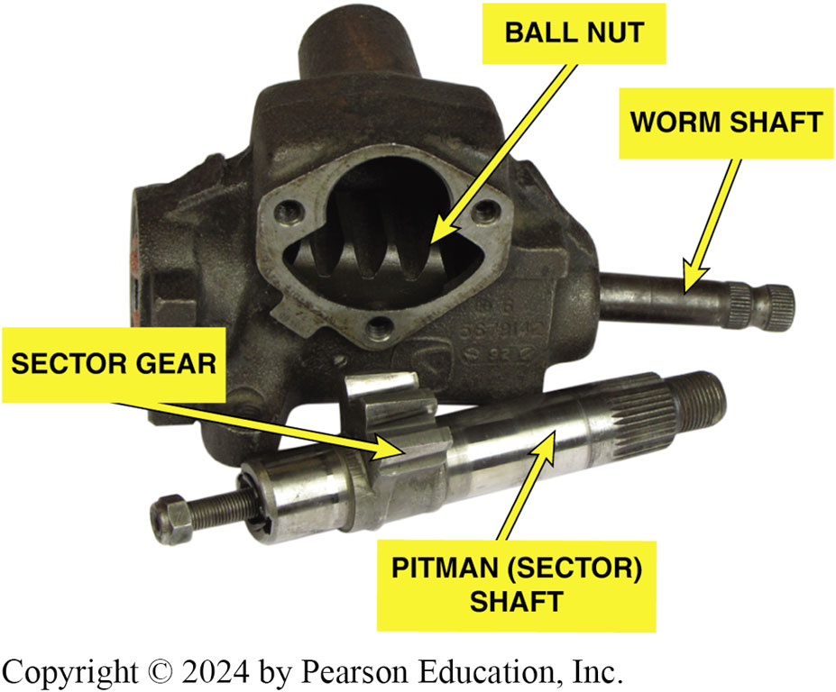
Figure 115.23 Sector Gear
The sector gear meshes with the gear teeth on the ball nut

Slide 41
Recirculating Ball Steering Gear
Parts and Operation
  Steering gear input shaft end, or worm shaft
  Splines to steering shaft U-joint and provides rotary input to steering gear.
  Adjuster plug at the lower end of the worm gear holds the worm gear, shaft, and bearings inside the steering gear housing.
  Steel balls roll through the tunnels formed by the ball nut grooves and the worm gear thread.

Slide 42
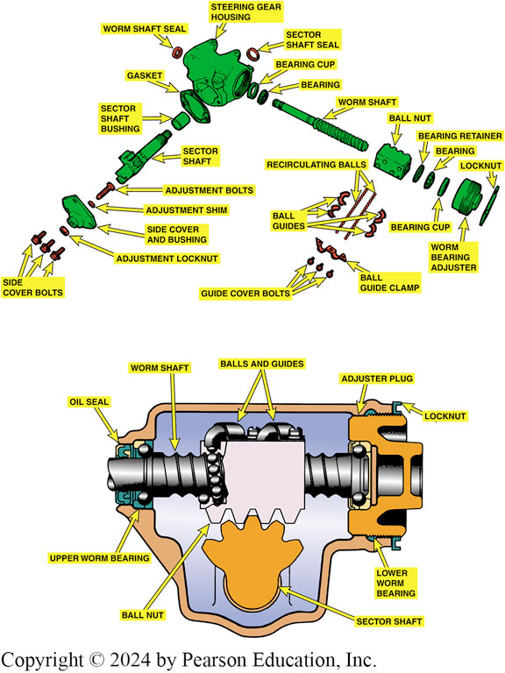
Figure 115.24 Recirculating Ball
A typical manual recirculating ball steering gear

Slide 43
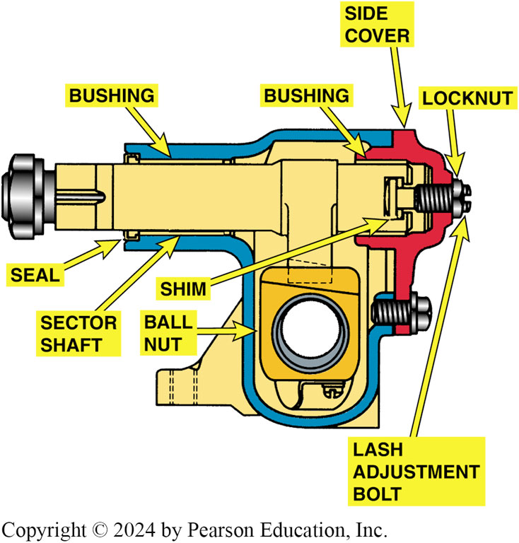
Figure 115.25 Bushing Support
The sector shaft is supported by bushings, one in the housing and one in the side cover

Slide 44
Rack and Pinion Steering Gear (1 of 2)
Parts and Operation
  The pinion gear teeth mesh with teeth on rack so that when pinion gear turns, it pushes rack from side to side.
  Rack connects directly to the tie rod in the steering linkage to move the linkage back and forth in a straight line.
  Most rack-and-pinion units use a small metal tube running along the outside of the housing to connect the two boots and transfer air from one to the other.

Slide 45
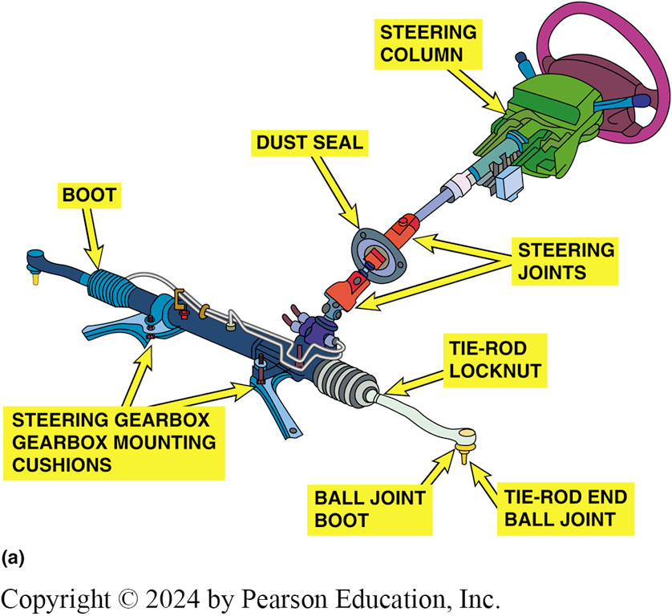
Figure 115.26a Rack and Pinion Gear
(a) An overall view of a rack and pinion steering system showing its relationship to the other front-end components.

Slide 46
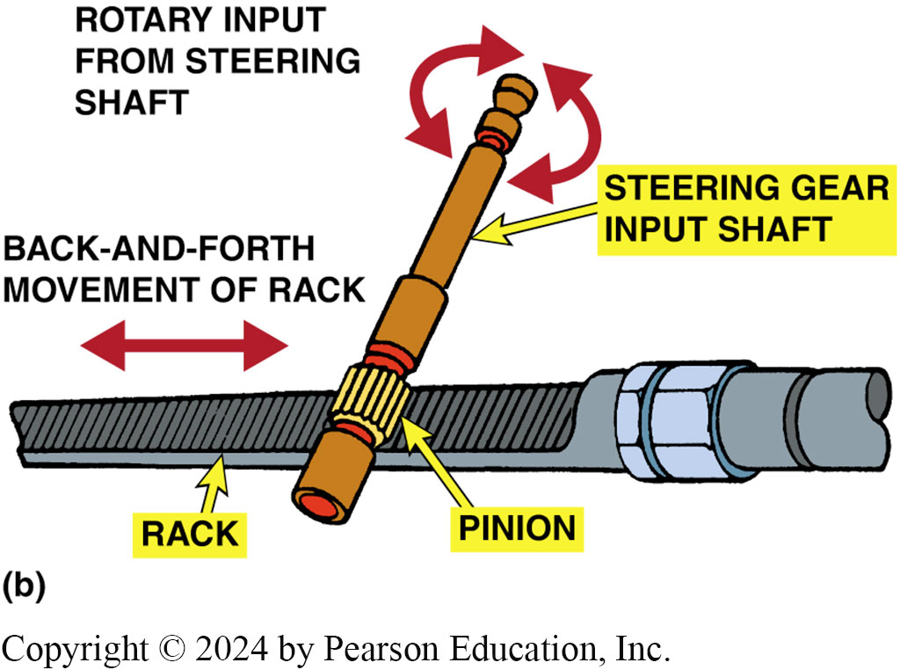
Figure 115.26b Rack Operation
(b) Rack-and-pinion steering gear operation is simple, direct, and the rack is in a straight line to the front wheels.

Slide 47
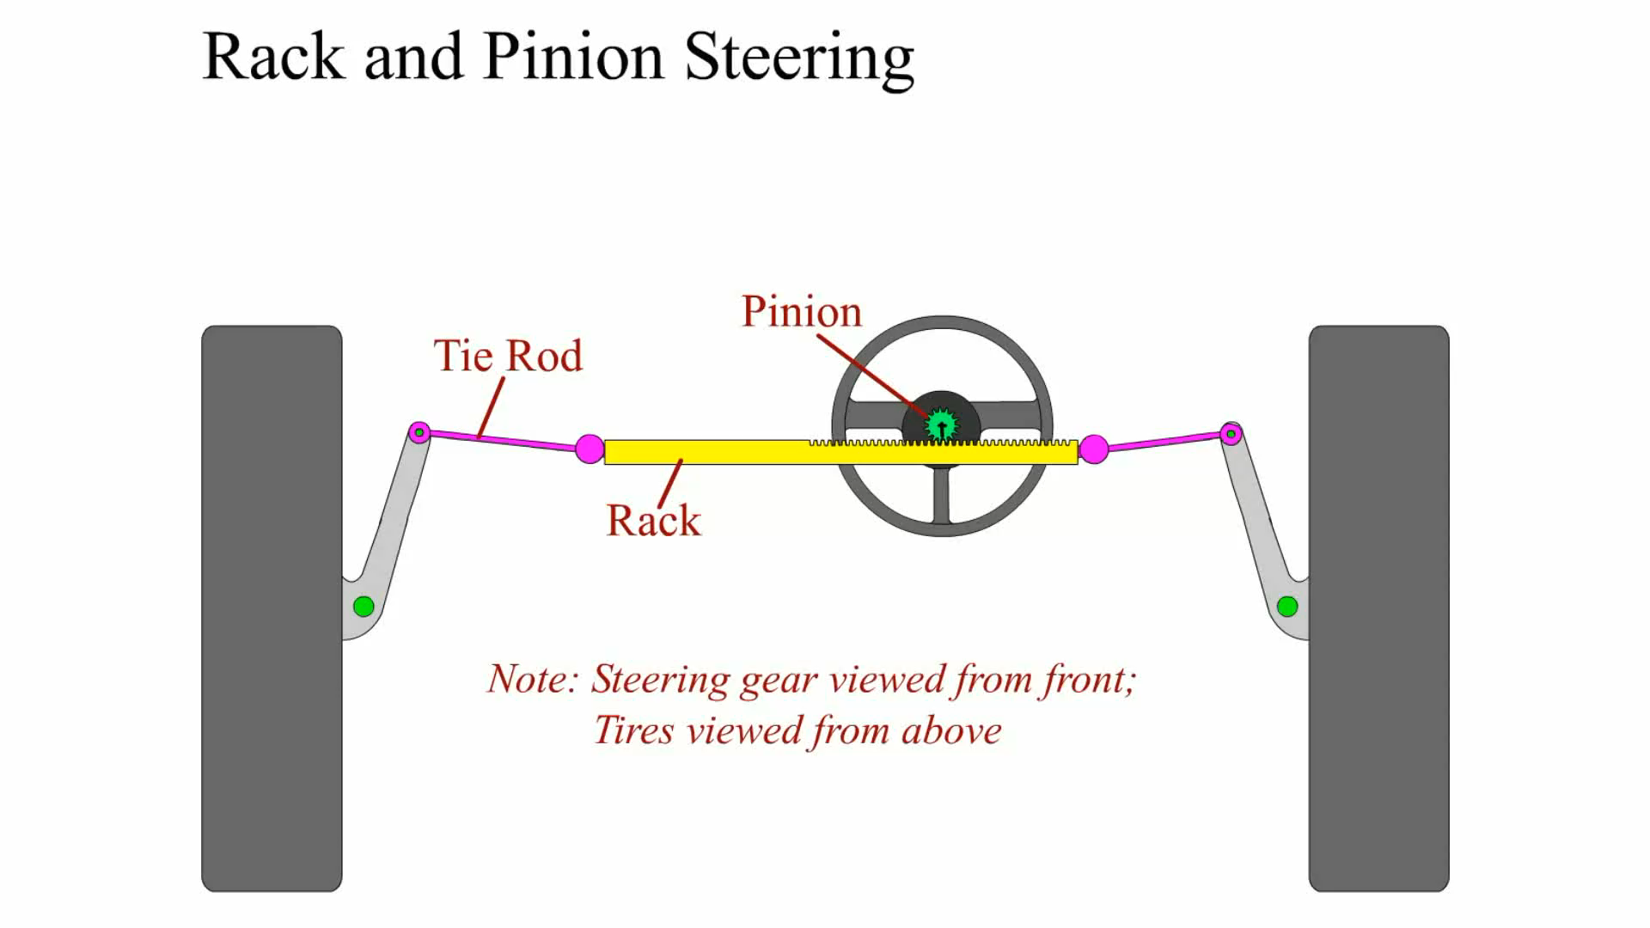
Animation: Rack and Pinion Steering
(Animation will automatically start)

Slide 48
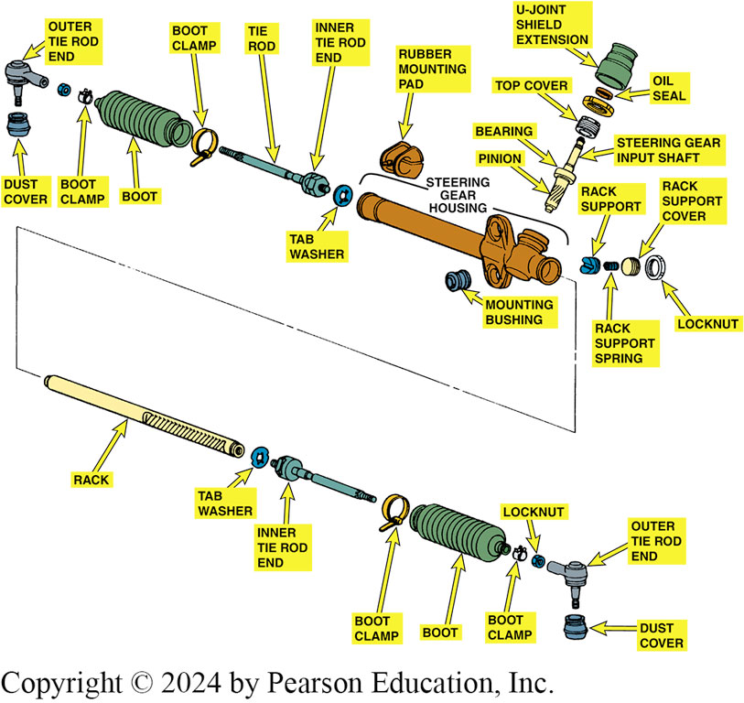
Figure 115.27 Rach Exploded View
A typical manual rack-and-pinion steering gear used in a small front-wheel-drive vehicle

Slide 49
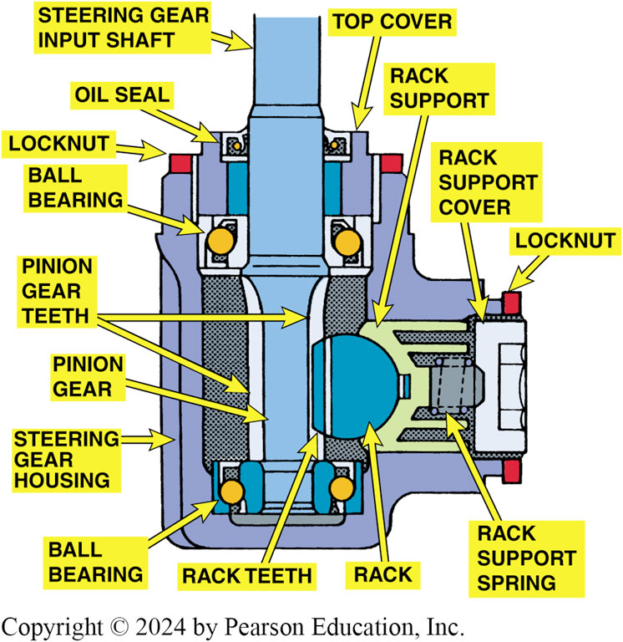
Figure 115.28 Rack Support
The spring-loaded rack support positions the rack to keep it from rubbing against the housing and establishes the pinion torque

Slide 50
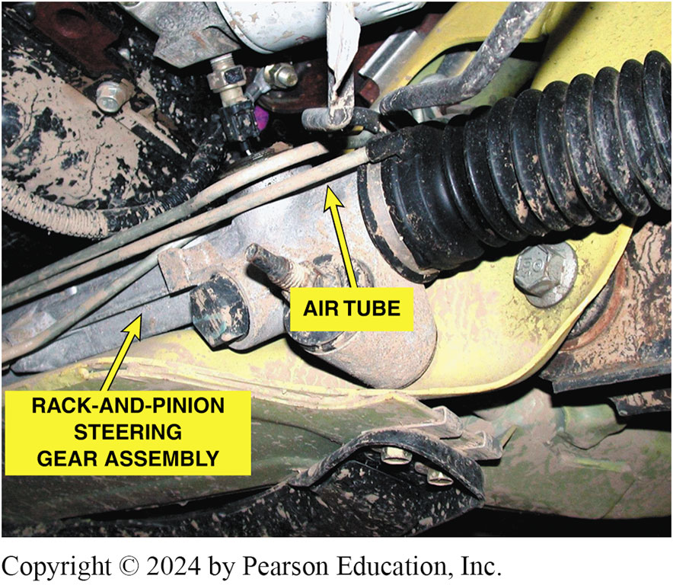
Figure 115.29 Air Tube
A small air tube is used to transfer air between the boots as they extend and compress during turns

Slide 51
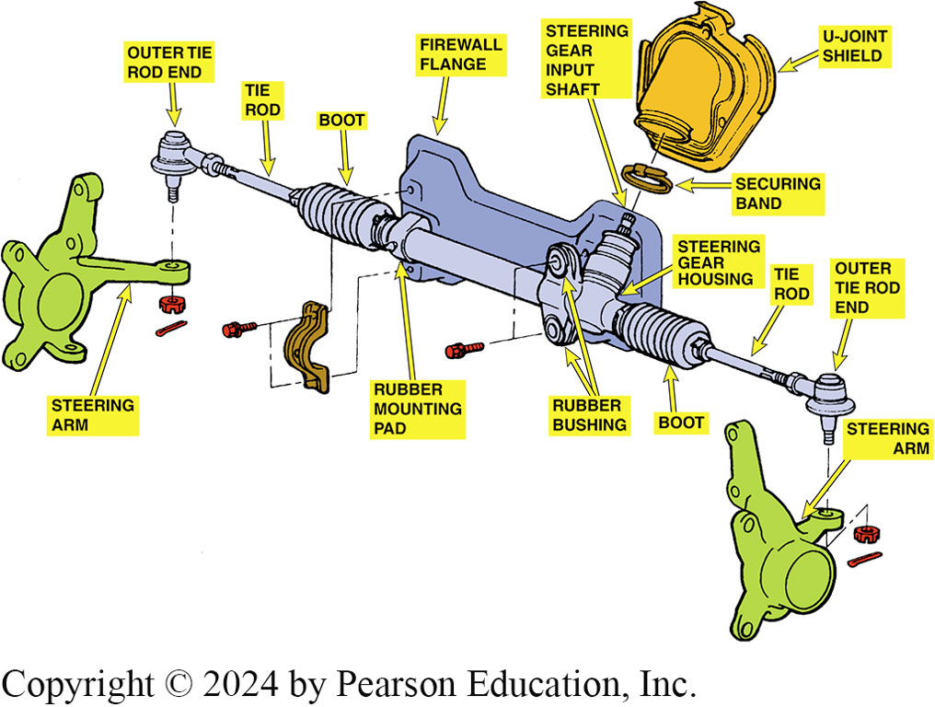
Figure 115.30 Rack Mounting
This manual rack-and pinion steering gear mounts to the bulkhead (firewall), whereas others mount to the engine cradle or frame of the vehicle

Slide 52
Suspension and Steering Videos and Animations
Videos Link: (A4) Suspension and Steering Videos
Animations Link: (A4) Suspension and Steering Animations

Slide 53
Copyright
This work is protected by United States copyright laws and is provided solely for the use of instructors in teaching their courses and assessing student learning. Dissemination or sale of any part of this work (including on the World Wide Web) will destroy the integrity of the work and is not permitted. The work and materials from it should never be made available to students except by instructors using the accompanying text in their classes. All recipients of this work are expected to abide by these restrictions and to honor the intended pedagogical purposes and the needs of other instructors who rely on these materials.

