Slide 1
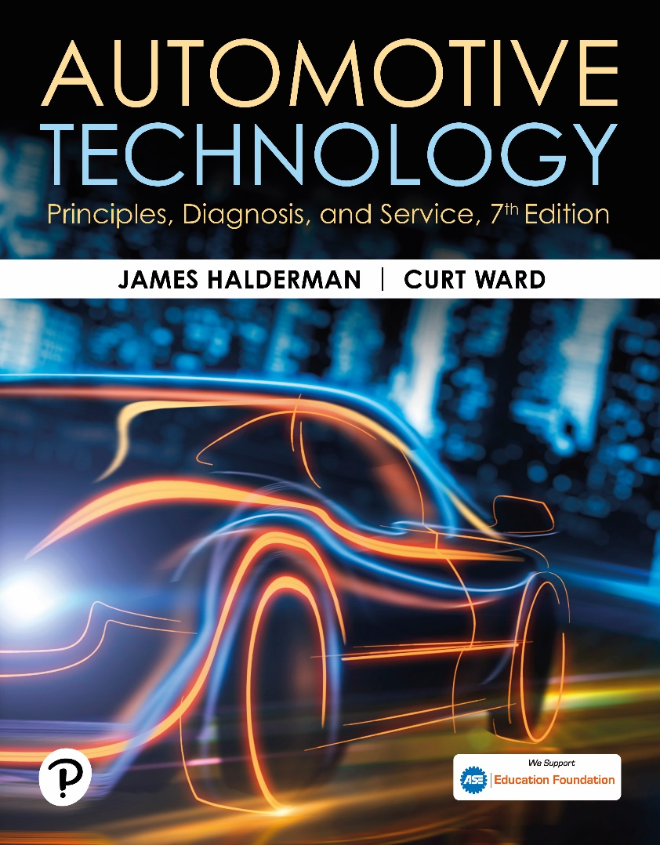
Automotive Technology: Principles, Diagnosis, and Service
Seventh Edition
Chapter 114
Electronic Suspension Systems
Copyright © 2023 Pearson Education, Inc. All Rights Reserved
Notes:
INSTRUCTOR NOTE: This presentation includes text explanation notes, you can use to teach the course. When in SLIDE SHOW mode, you RIGHT CLICK and select SHOW PRESENTER VIEW, to use the notes.

Slide 2
Learning Objectives
114.1 Discuss the need for electronic suspension systems.
114.2 Explain the characteristics of the various sensors used for electronic suspension control.
114.3 Describe electronic suspension system actuators.
114.4 List the types of electronic suspension systems.
114.5 Describe the parts and operation of the automatic level control system.
114.6 Describe how to troubleshoot rear electronic leveling systems.
114.7 Explain how magneto-rheological shocks work.

Slide 3
The Need For Electronic Suspensions
Electronic suspension controls provide a variable shock stiffness or spring rate.
The main advantage of electronic controls is that the suspension can react to different conditions.
The system provides a firm suspension feel for fast cornering and quick acceleration and braking, with a soft ride for cruising.

Slide 4
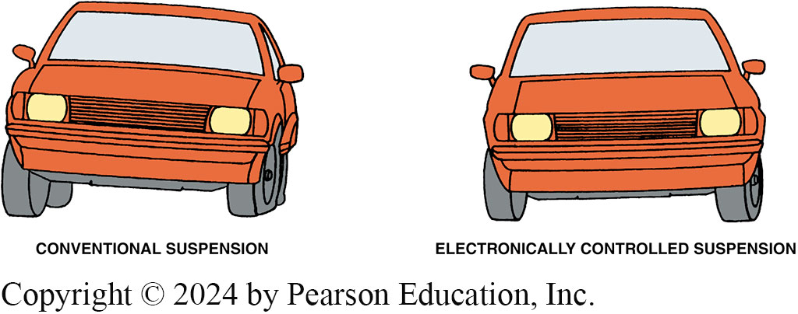
Figure 114.1 Reduce Body Roll
An electronically controlled suspension system can help reduce body roll and other reactions better than most conventional suspension systems

Slide 5
Electronic Suspension Controls and Sensors (1 of 4)
Inputs and Outputs
  Sensors and switches provide input to the E C M, or system computer.
  Computer causes an actuator (output) to perform some type of mechanical action.
Height Sensors
  Senses vertical relationship between suspension component and the body.
  4 height sensors, 1 at each wheel, deliver an input signal to E C M.

Slide 6
Electronic Suspension Controls and Sensors (2 of 4)
Steering Wheel Position Sensor
  Provide control module with signals relating to steering wheel position, speed, and direction.
Vehicle Speed Sensor
  Magnetic sensor and generates an analog signal whose frequency increases as the speed increases.
  The ride is made firmer at high speeds and during braking and acceleration and less firm at cruise speeds.

Slide 7
Electronic Suspension Controls and Sensors (3 of 4)
Pressure Sensor
  This sensor is typically found on systems such as air suspension, real-time damping, and road-sensing suspension that use a compressor assembly.
Lateral Acceleration Sensor
  Provides the suspension control module with feedback regarding vehicle cornering forces.
  This sensor can be either a stand-alone unit or combined with the yaw rate sensor.

Slide 8
Electronic Suspension Controls and Sensors (4 of 4)
Yaw Rate Sensor
  This information is used to determine how far the vehicle has deviated from the driver’s intended direction.
Driver Selector Switch
  The driver selector switch, which is typically dash mounted, allows the driver to select the firmness of the suspension system.

Slide 9
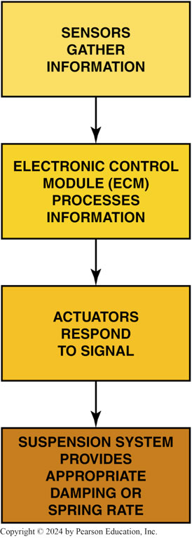
Figure 114.2 System Block Diagram
Input devices monitor conditions and provide information to the electronic control module, which processes the information and operates the actuators to control the movement of the suspension

Slide 10
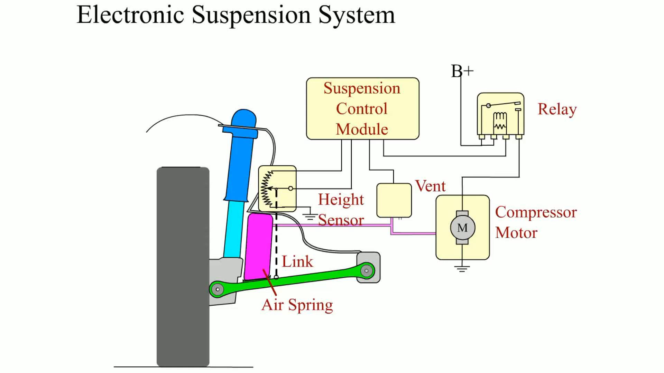
Animation: Electronic Suspension System
(Animation will automatically start)

Slide 11
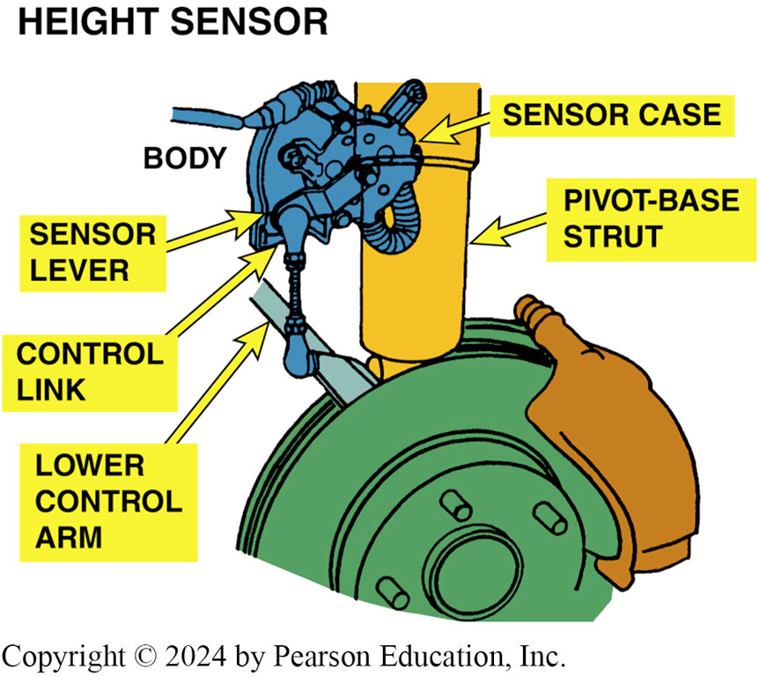
Figure 114.3 Height Sensor
A typical electronic suspension height sensor, which bolts to the body and connects to the lower control arm through a control link and lever

Slide 12
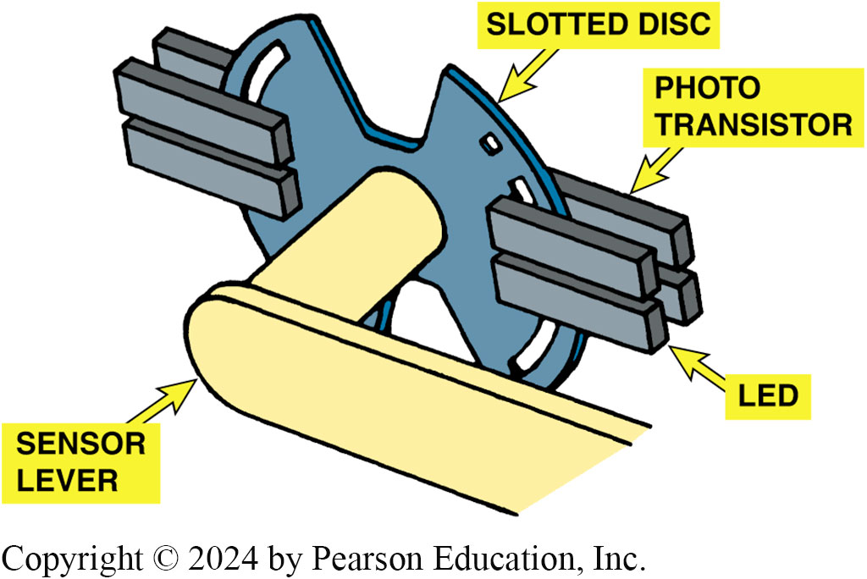
Figure 114.4 Height Sensor
When suspension action moves the lever, it rotates the slotted disc and varies how much of the photo transistor is exposed to the LEDs, which vary the input signal

Slide 13
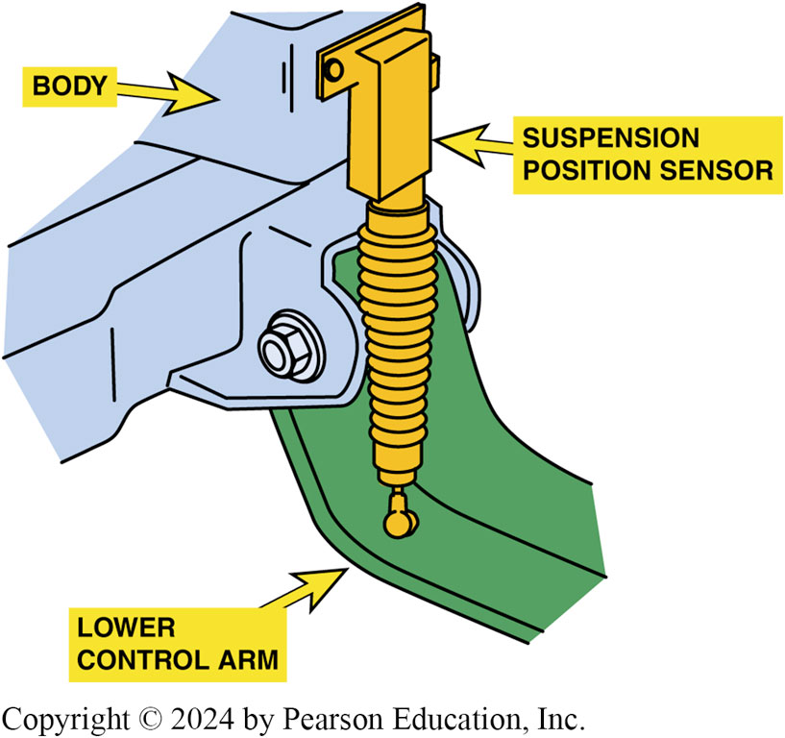
Figure 114.5 Position Sensor
Typical suspension position sensor

Slide 14
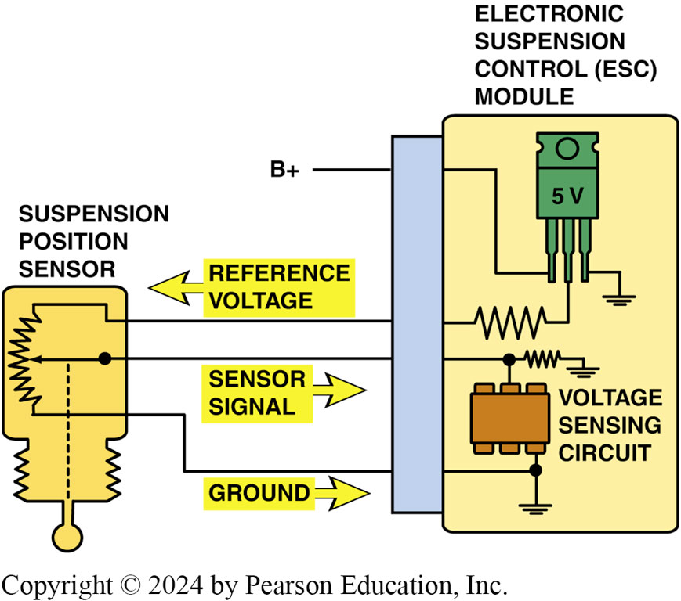
Figure 114.6 Position Schematic
A three-wire suspension position sensor schematic

Slide 15
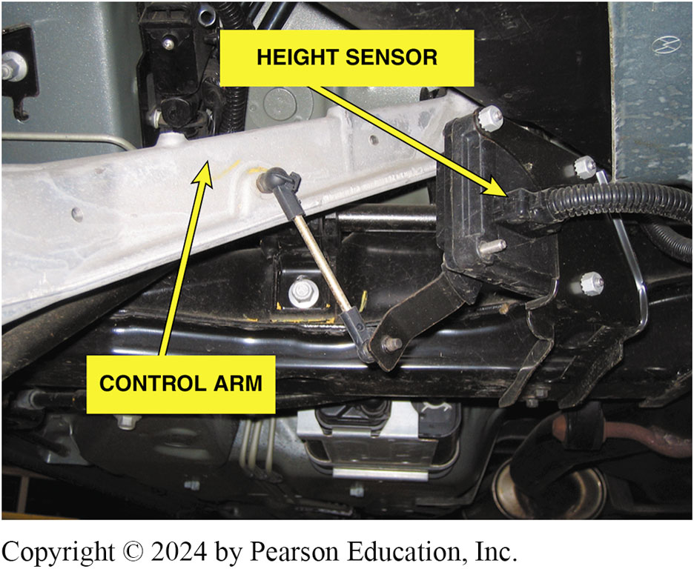
Figure 114.7 Height Sensor
A suspension height sensor

Slide 16
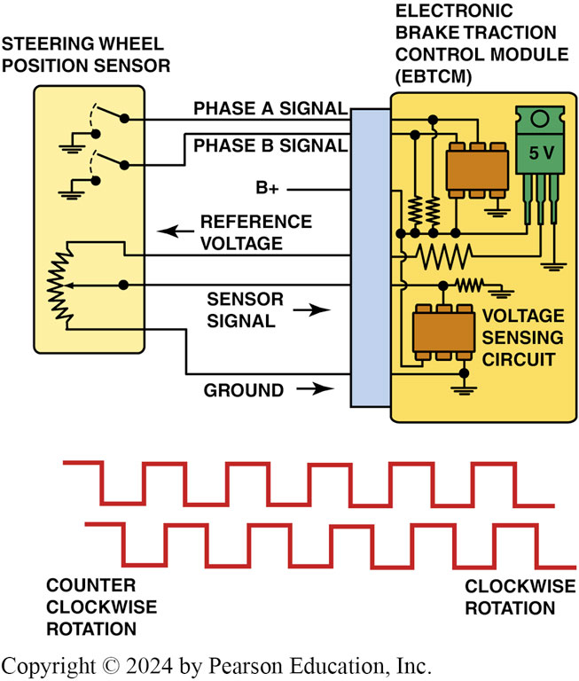
Figure 114.8 SPS Schematic
The steering wheel position (hand wheel position) sensor wiring schematic and how the signal varies with the direction that the steering wheel is turned

Slide 17
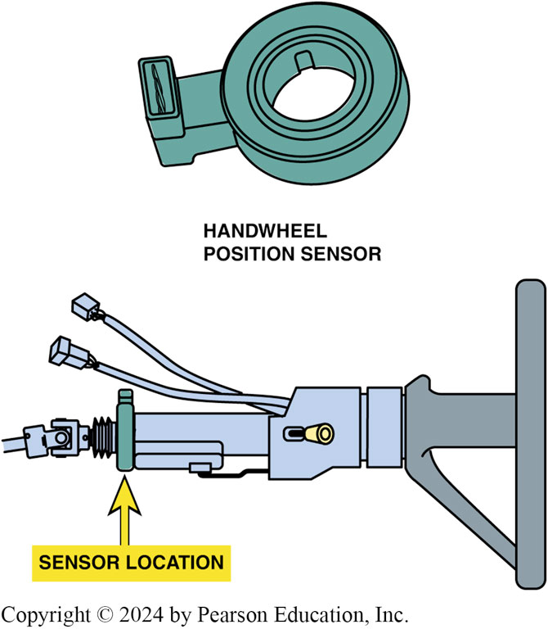
Figure 114.9 Steering Position
The steering wheel position (hand wheel position) sensor wiring schematic and how the signal varies with the direction that the steering wheel is turned

Slide 18
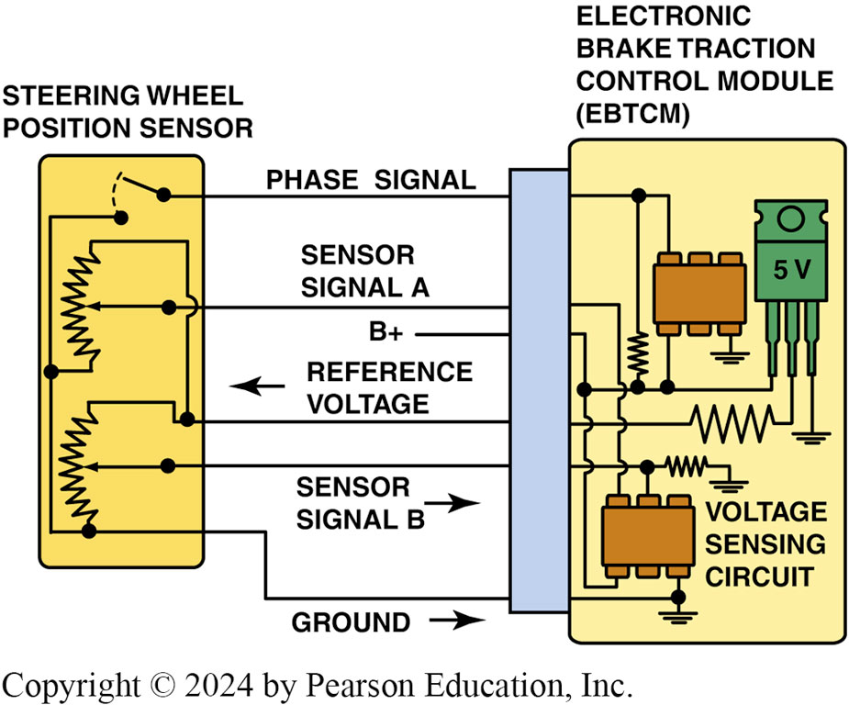
Figure 114.10 Sensor Schematic
Steering wheel (hand wheel) position sensor schematic

Slide 19
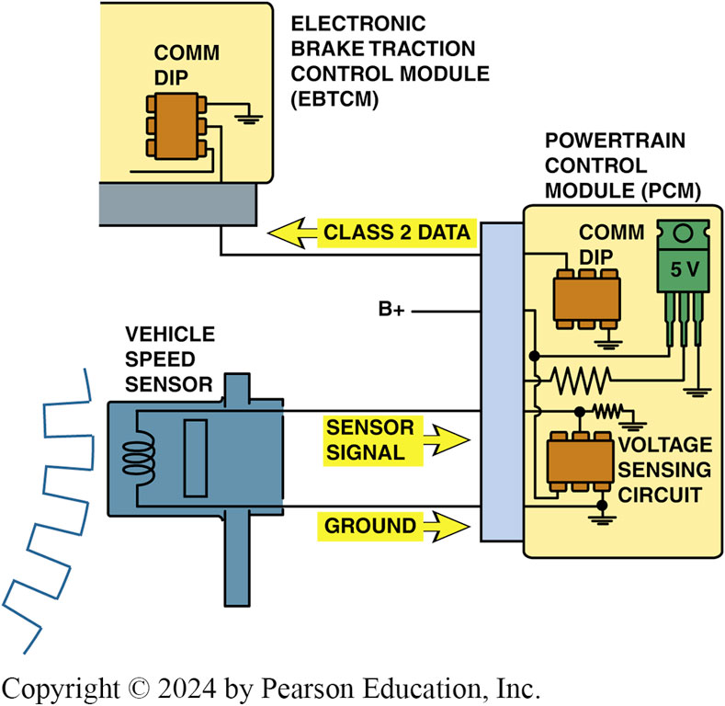
Figure 114.11 VS Sensor
The VS sensor information is transmitted to the EBCM by Class 2 serial data

Slide 20
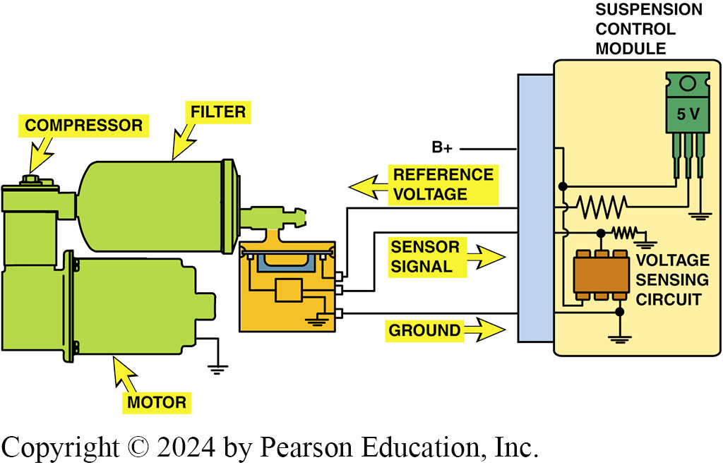
Figure 114.12 Air Pressure Sensor

Slide 21
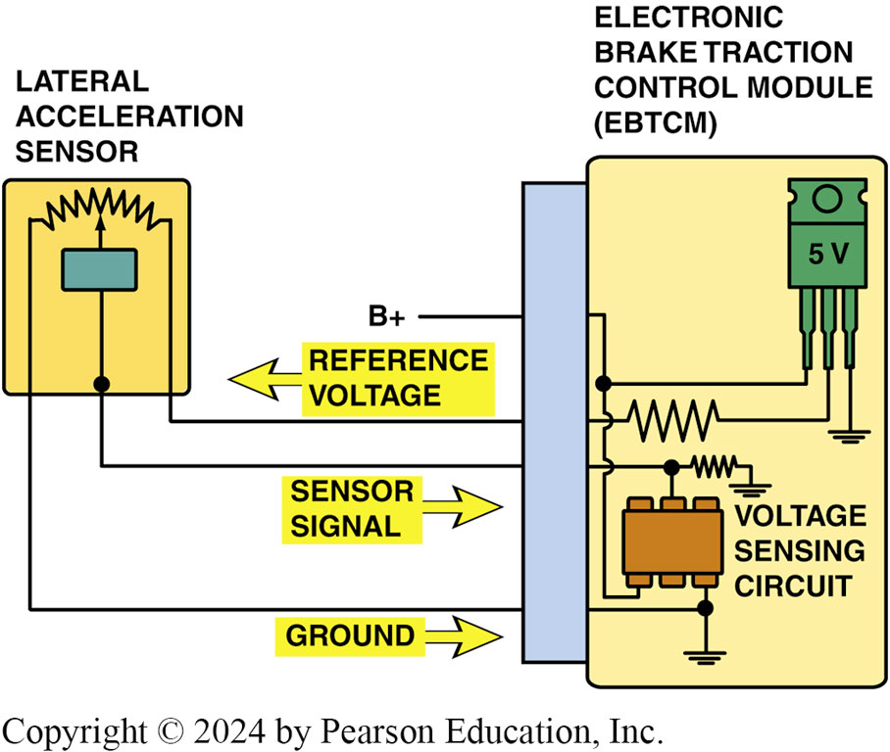
Figure 114.13 Acceleration Sensor
A schematic showing the lateral acceleration sensor and the EBCM

Slide 22
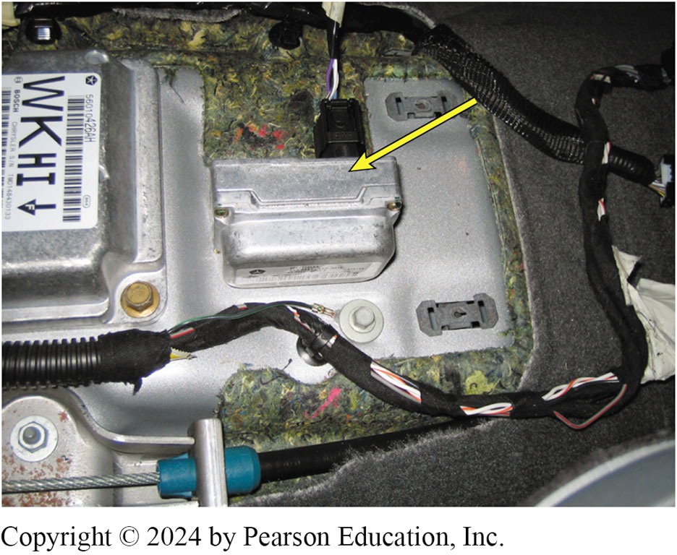
Figure 114.14 G-Sensor
The lateral accelerometer sensor (G-sensor) is usually located under the center console. This sensor can be tested by unbolting the sensor, turning it on its side with the key on, engine off (K O E O), and looking at the scan tool data to verify that it reads 1 G.
Notes:
TECH TIP: The Lateral Acceleration Sensor Needed to Control the Electronic Suspension
The lateral acceleration sensor is one part of the group of sensors that provides the information needed for the suspension to be able to react to driver commands and road conditions. Using just the steering wheel position sensor would not be enough information for the suspension controller to determine the cornering loads. FIGURE 114-14

Slide 23
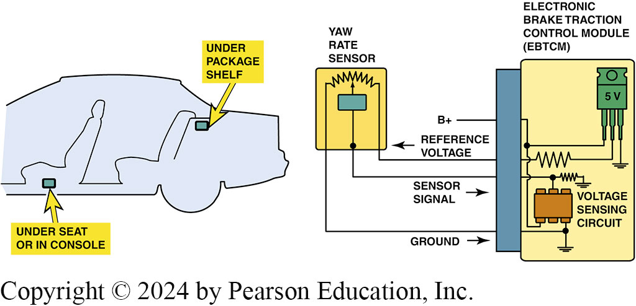
Figure 114.15 Yaw Rate Sensor
Yaw rate sensor showing the typical location and schematic

Slide 24
Question 1: ?
What is the purpose of the Yaw Rate sensor?

Slide 25
Answer 1
To determine how far the vehicle has deviated from the driver’s intended direction.

Slide 26
Electronic Suspension System Actuators (1 of 2)
Terminology
  Actuators are usually inductive devices that operate using an electromagnetic field.
Solenoids
  In a solenoid, core of electromagnet also acts as a plunger to open and close a passage or to move a linkage.
  When solenoid is energized, current passes through the coil and magnetizes the core.
  When de-energized, spring returns plunger to the default position.

Slide 27
Electronic Suspension System Actuators (2 of 2)
An airflow control valve is an example of a solenoid used in an electronically controlled suspension.
  As the solenoid plunger extends and retracts, it opens and closes air passages between the system air-pressure tank and the air springs.
Actuator Motors
  Motor uses this principle to convert electrical energy into mechanical movement.
  Actuator motor uses a permanent magnet and four stator coils to drive the air spring control rod.

Slide 28
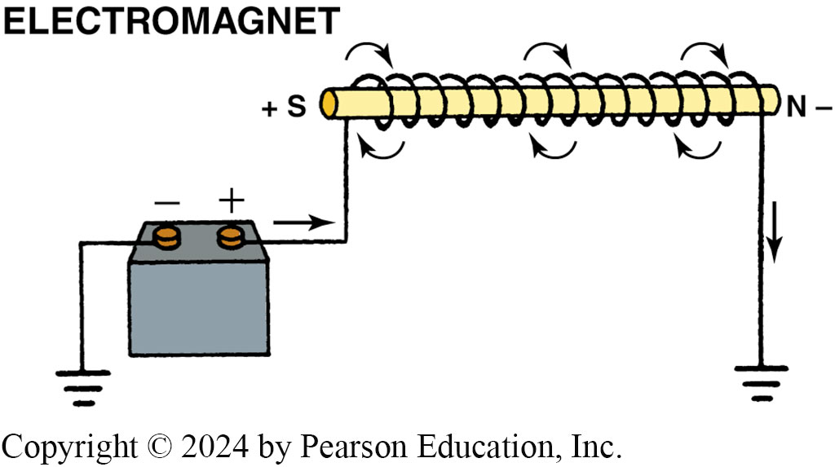
Figure 114.16 Electromagnet
A magnetic field is created whenever an electrical current flows through a coil of wire wrapped around an iron core

Slide 29
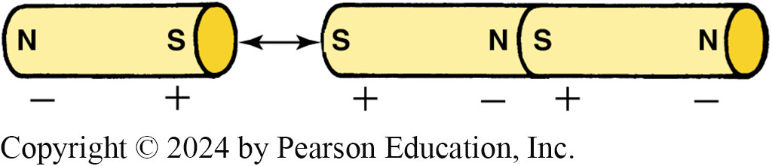
Figure 114.17 Poles Attract
When magnets are near each other, like poles repel and opposite poles attract

Slide 30
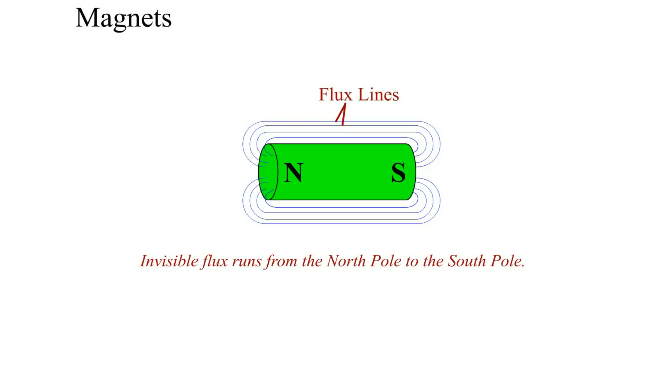
Animation: Magnets
(Animation will automatically start)

Slide 31
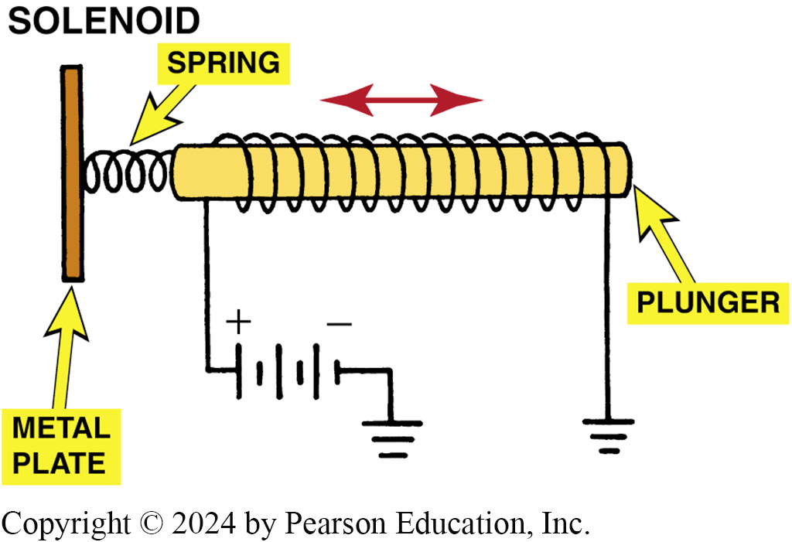
Figure 114.18 Plunger Operation
When electrical current magnetizes the plunger in a solenoid, the magnetic field moves the plunger against spring force. With no current, the spring pushes the plunger back to its original position

Slide 32
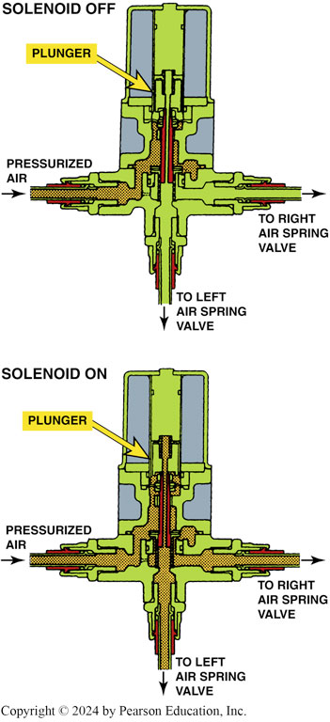
Figure 114.19 Air Supply Solenoid
This air supply solenoid blocks pressurized air from the air spring valves when off. The plunger pulls upward to allow airflow to the air spring valves when the solenoid is energized

Slide 33
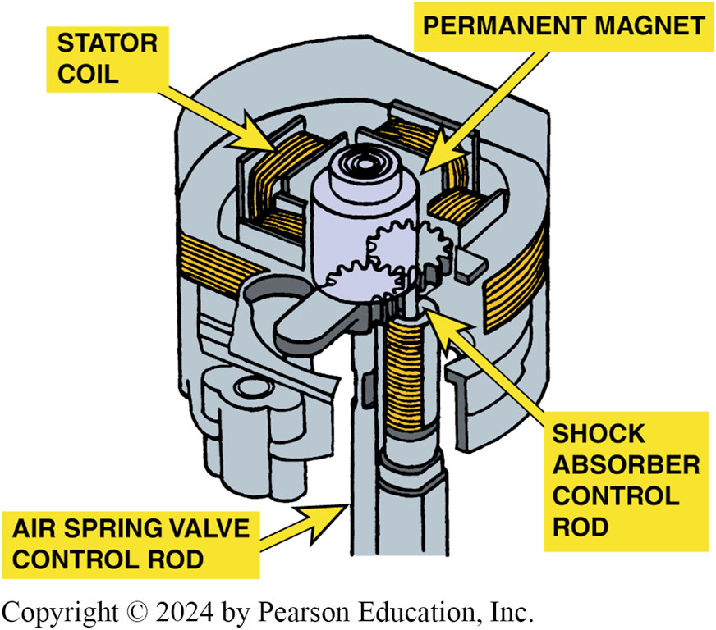
Figure 114.20 Actuator Motor
An actuator motor uses a permanent magnet and four stator coils to drive the air spring control rod

Slide 34
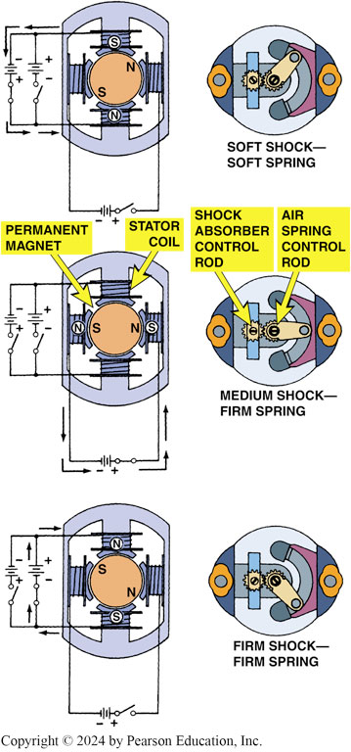
Figure 114.21 Actuator Operation
The stator coils of the actuator are energized in three ways to provide soft, medium, or firm ride from the air springs and shock absorbers

Slide 35
Types of Electronic Suspension (1 of 5)
The types of electronic suspension systems used on General Motors vehicles, as examples, include:
  Selectable Ride
  Automatic Level Control
  Air Suspension
  Computer Command Ride
  Real-Time Dampening/Road-Sensing Suspension
  Vehicle Stability Enhancement System
  Magneto-Rheological Suspension (F55)

Slide 36
Types of Electronic Suspension (2 of 5)
Selectable Ride
  Most basic of the electronic systems offered by GM.
  Allows driver to choose between 2 distinct damping levels:
    Firm
    Normal
Automatic Level Control
  Automatically adjusts the rear height of the vehicle in response to changes in vehicle loading and unloading.

Slide 37
Types of Electronic Suspension (3 of 5)
Air Suspension
  The system is designed to maintain rear trim height within 3/16 inch (4 mm) in all loading conditions, and the leveling function will deactivate if the vehicle is overloaded.
Variable Rate Air-Springs
  In an air spring system with ordinary shock absorbers, the E C M uses the air springs to control trim height and is used on many Ford, Mercury, and Lincoln vehicles.

Slide 38
Types of Electronic Suspension (4 of 5)
GM Computer Command Ride
  The GM computer command ride (C C R) system controls ride firmness by automatically controlling an actuator in each of the four struts to increase ride firmness as speed increases.
Real-Time Dampening and Road Sensing Suspension
  Real-time dampening (R T D) independently controls a solenoid in each of the four shock absorbers in order to control the vehicle ride characteristics and is capable of making changes within milliseconds (0.001 second).

Slide 39
Types of Electronic Suspension (5 of 5)
Bi-State and Tri-State Dampers
  The bi-state damper provides various amounts of damping by directing hydraulic damping fluid in the suspension shock absorber or strut.
  A tri-state damper has an integral electrical strut actuator that rotates a selector valve to change the flow of hydraulic damping fluid.

Slide 40
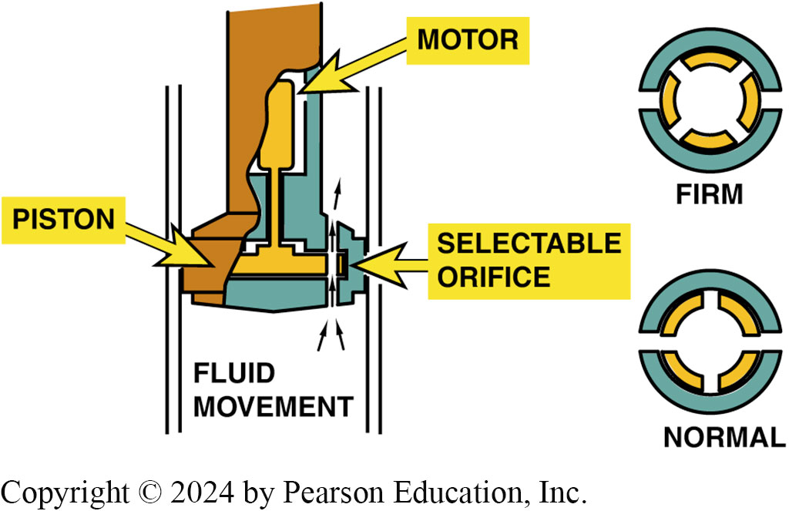
Figure 114.22 Selectable ride
Selectable ride as used on Chevrolet and GMC pickup trucks

Slide 41
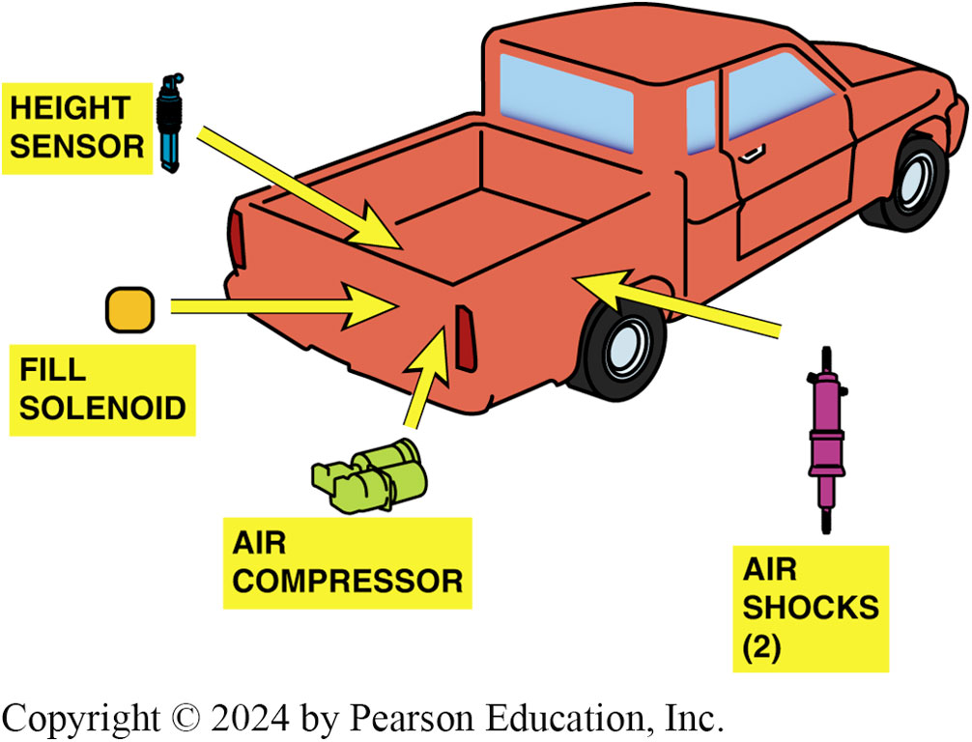
Figure 114.23 Auto Level Control
ALC maintains the same ride height either loaded or unloaded by increasing or decreasing the air pressure in the rear air shocks

Slide 42
Animation: Electronic Suspension System
(Animation will automatically start)

Slide 43
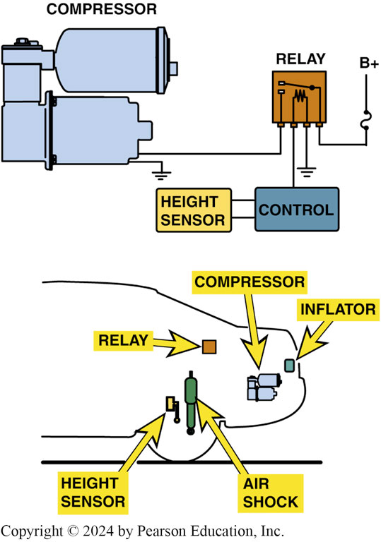
Figure 114.24 Air Compressor
A typical schematic showing the air suspension compressor assembly and sensor

Slide 44
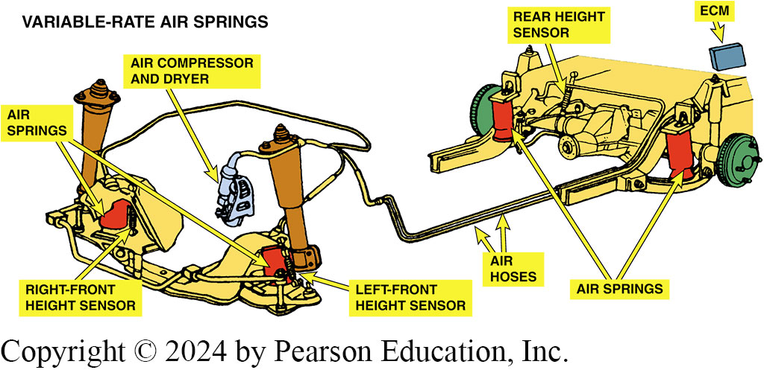
Figure 114.25 Air Spring System
Typical variable-rate air spring system uses three height sensors, two in the front and one in the rear, to monitor trim height and to provide input signals to the ECM

Slide 45
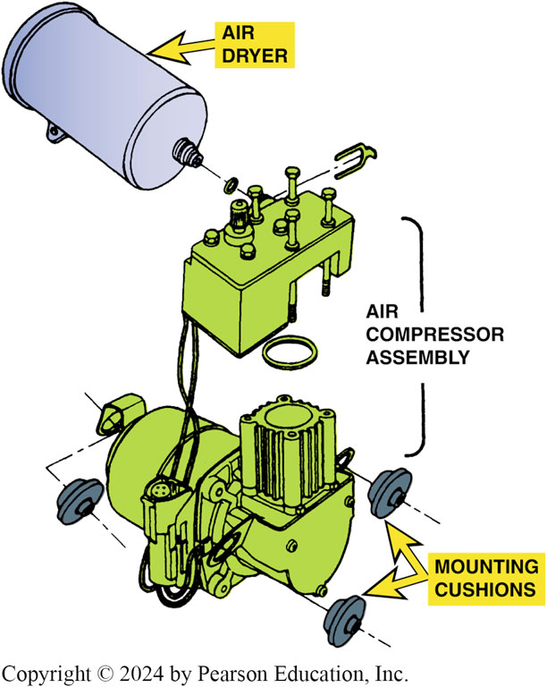
Figure 114.26 Compressor Mount
The air spring compressor assembly is usually mounted on rubber cushions to help isolate it from the body of the vehicle. All of the air entering or leaving the air springs flows through the regenerative air dryer

Slide 46
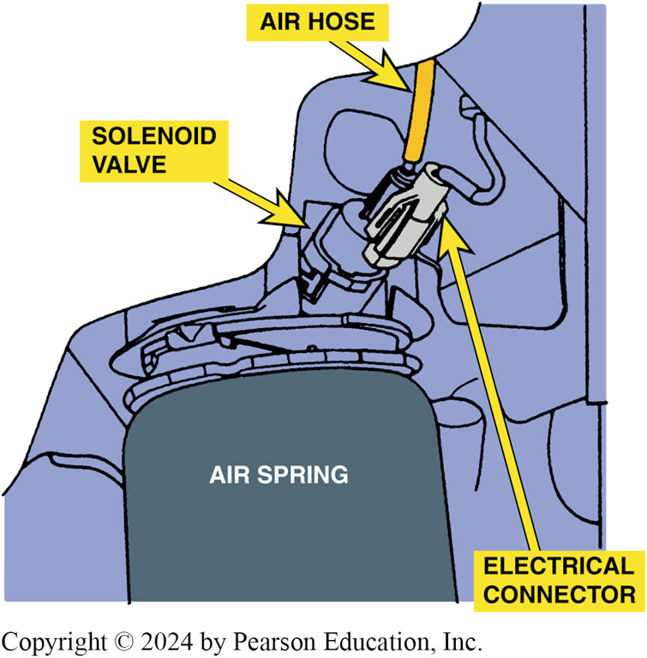
Figure 114.27 Solenoid Valve
A solenoid valve at the top of each spring regulates airflow into and out of the air spring

Slide 47
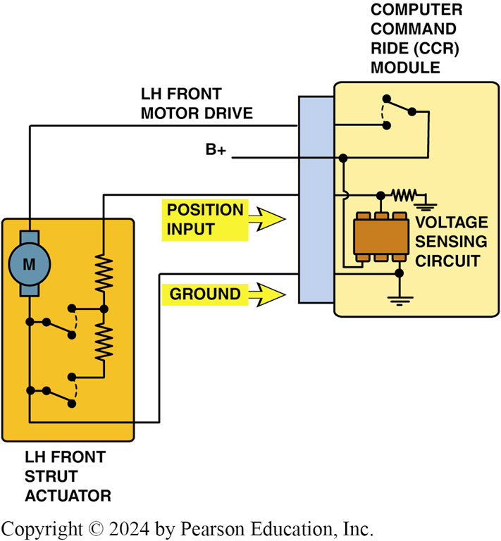
Figure 114.28 Computer Command
Schematic showing computer command ride system

Slide 48
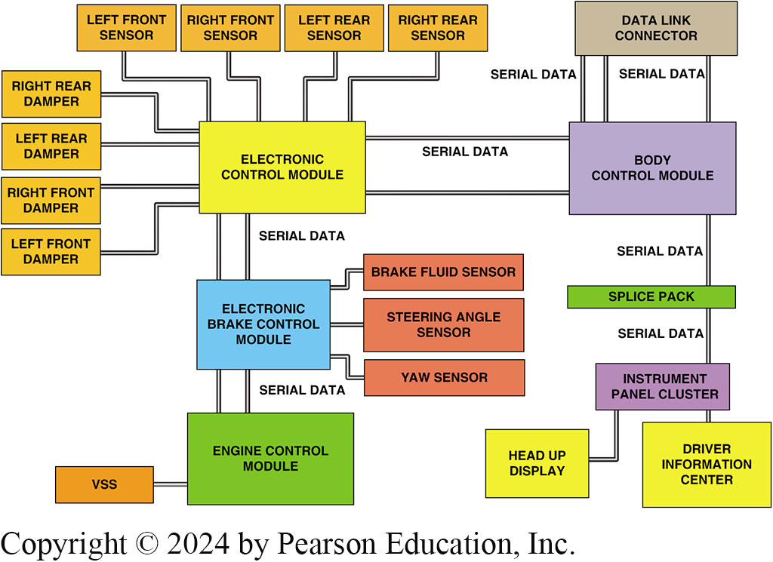
Figure 114.29 Block Diagram
Diagram of the components and connections of the real-time damping and road-sensing suspension system

Slide 49
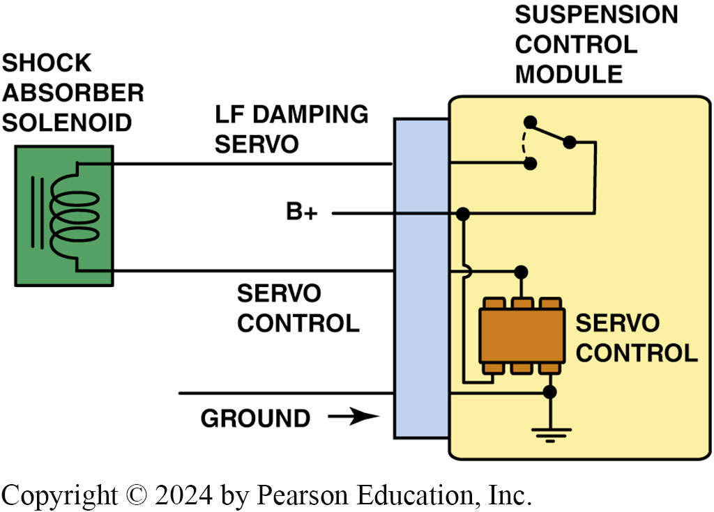
Figure 114.30 RSS System
Schematic showing the shock control used in the RSS system
Notes:
TECH TIP: Check the RPO Code
Whenever working on the suspension system, check the RPO (regular production option) code for the type of suspension used. For example, the F55 RPO may be called by a different name depending on the make and model of vehicle. Also, service procedures will be different on the same vehicle depending on whether it is equipped with an F45 or an F55 system. The General Motors vehicle RPO codes are on a sticker on the spare tire cover in the trunk or in the glove
compartment.

Slide 50
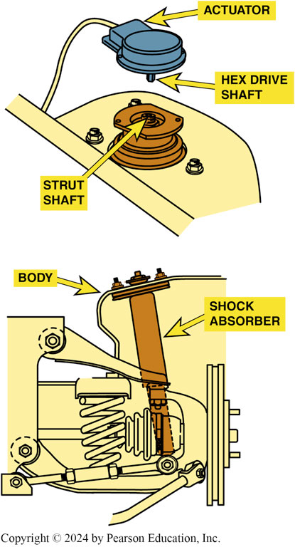
Figure 114.31 Bi-state Dampers
Bi-state dampers (shocks) use a solenoid to control fluid flow in the unit to control compression and rebound actions

Slide 51
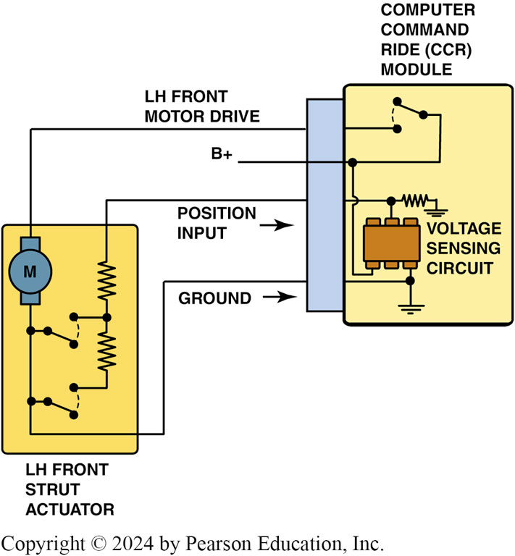
Figure 114.32 CCR Schematic
A typical CCR module schematic

Slide 52
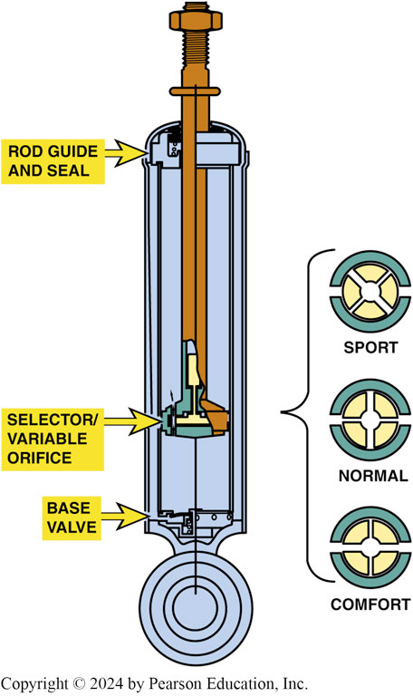
Figure 114.33 CCR Shock Absorber
The three dampening modes of a CCR shock absorber

Slide 53
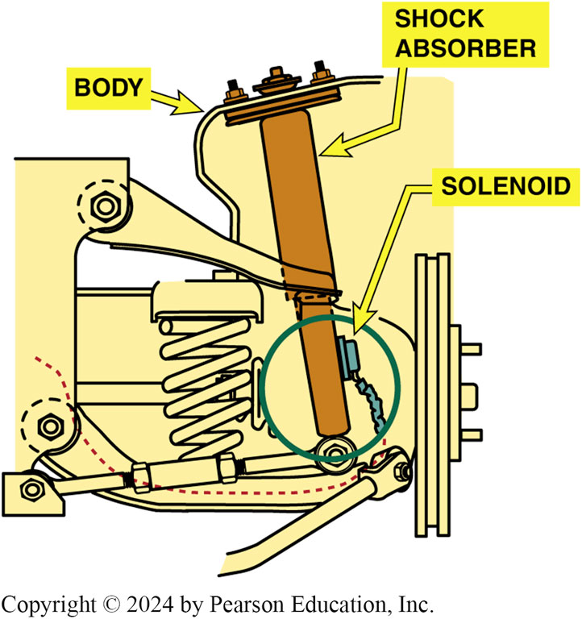
Figure 114.34 Integral Shock Solenoid

Slide 54
Automatic Level Control (1 of 2)
Inflator or Compressor Relay
  The suspension control module energizes the relay to activate the compressor motor.
Compressor
  The compressor is a positive-displacement air pump and can generate up to 150 pounds of pressure per square inch (P S I).

Slide 55
Automatic Level Control (2 of 2)
Air Dryer
  The air dryer is responsible for removing moisture from the compressor system.
Exhaust Solenoid
  The exhaust solenoid, which is located on the compressor, relieves pressure in the system.

Slide 56
Frequently Asked Question: What Are Self-Leveling Shocks?
? Frequently Asked Question
What Are Self-Leveling Shocks? A German company, ZF Sachs, supplies a self-leveling shock absorber to several vehicle manufacturers, such as Chrysler for use on the rear of minivans, plus BMW, Saab, and Volvo. The self-leveling shocks are entirely self-contained and do not require the use of height sensors or an external air pump. FIGURE 114-35. The shock looks like a conventional shock absorber but contains the following components: Two reservoirs in the outer tube, oil reservoir (low-pressure reservoir), and high-pressure chamber
  MORE INFO IN THE NOTES
Notes:
What Are Self-Leveling Shocks? A German company, ZF Sachs, supplies a self-leveling shock absorber to several vehicle manufacturers, such as Chrysler for use on the rear of minivans, plus BMW, Saab, and Volvo. The self-leveling shocks are entirely self-contained and do not require the use of height sensors or an external air pump. FIGURE 114-35. The shock looks like a conventional shock absorber but contains the following components:
Two reservoirs in the outer tube
An oil reservoir (low-pressure reservoir)
A high-pressure chamber
Inside the piston rod is the pump chamber containing an inlet and an outlet valve. When a load is placed in the rear of the vehicle, it compresses the suspension and the shock absorber. When the vehicle starts to move, the internal pump is activated by the movement of the body. Extension of the piston rod causes oil to be drawn through the inlet valve into the pump. When the shock compresses, the oil is forced through the outlet valve into the high-pressure chamber. The pressure in the oil reserve decreases as the pressure in the high-pressure chamber increases. The Increasing pressure is applied to the piston rod, which raises the height of the vehicle. When the vehicle’s normal height is reached, no oil is drawn into the chamber. Because the shock is mechanical, the vehicle needs to be moving before the pump starts to work. It requires about 2 miles of driving for the shock to reach the normal ride height. The vehicle also needs to be driven about 2 miles after a load has been removed from the vehicle for it to return to normal ride height.

Slide 57
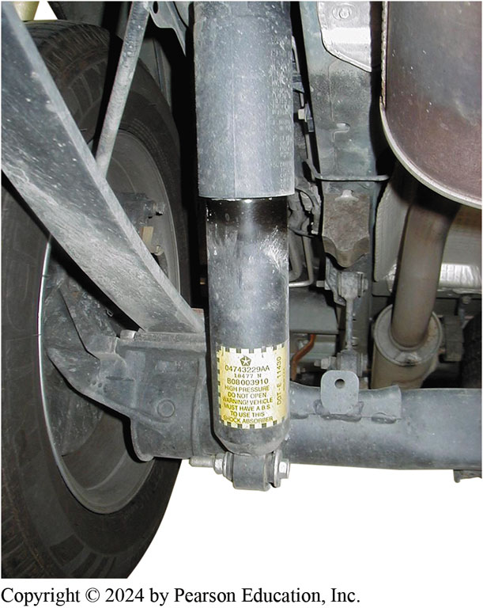
Figure 114.35 Self-Leveling Shock
A typical ZF Sachs self-leveling shock, as used on the rear of a Chrysler minivan

Slide 58
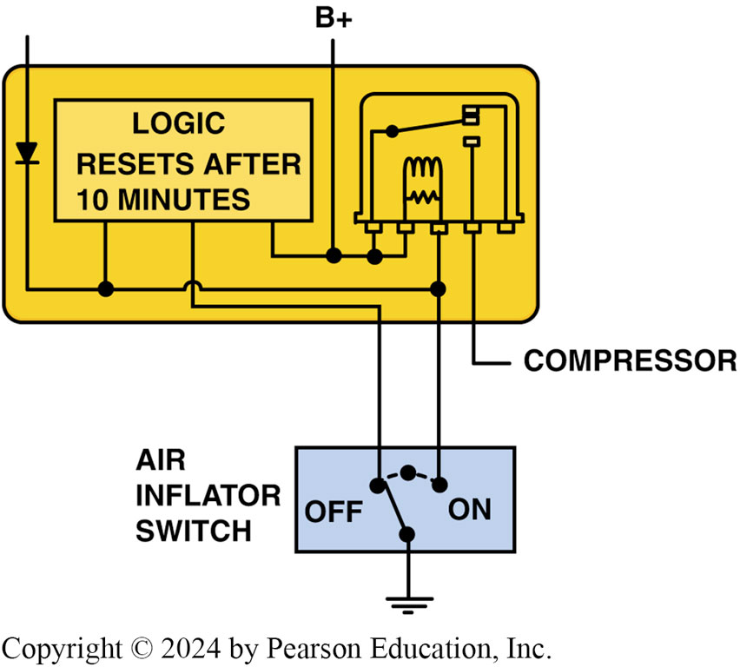
Figure 114.36 ALC Schematic
Schematic of the ALC system

Slide 59
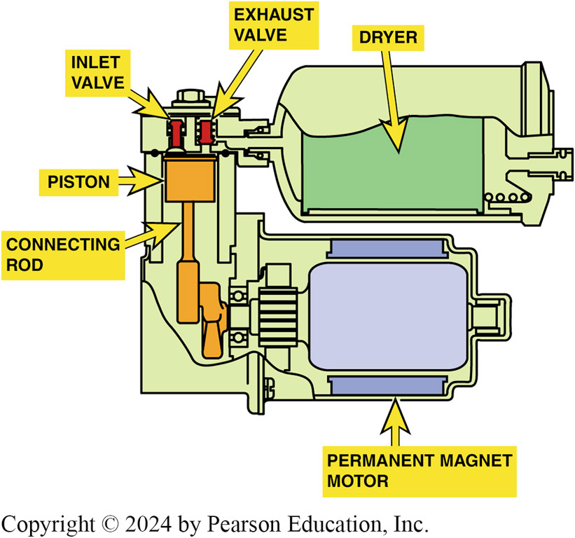
Figure 114.37 Air Compressor
Air compressor assembly can be located at various locations depending on the vehicle

Slide 60
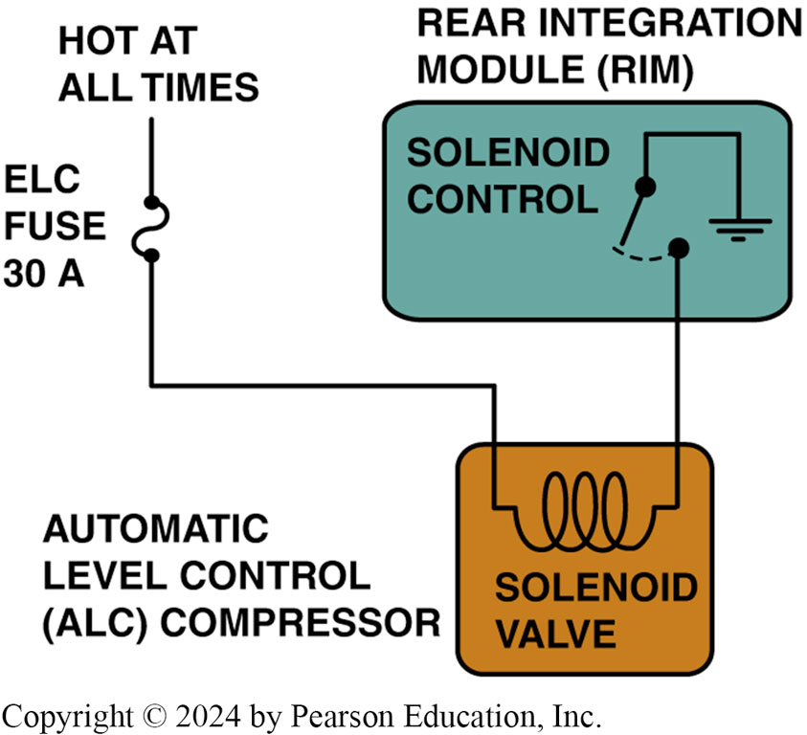
Figure 114.38 Exhaust Solenoid
The exhaust solenoid is controlled by the rear integration module

Slide 61
Question 2: ?
What is the purpose of an air dryer in an automatic level control system?

Slide 62
Answer 2
To remove the moisture from the system.

Slide 63
Troubleshooting Rear Electronic Leveling Systems
First step with any troubleshooting procedure is to check for normal operation.
If compressor is inoperative check the power and ground.
If ride height compressor runs excessively, check the air compressor, the air lines, and the air shocks (or struts) with soapy water for air leaks.
Most electronic leveling systems provide some adjustments of the rear ride height by adjusting the linkage between the height sensor and the rear suspension.

Slide 64
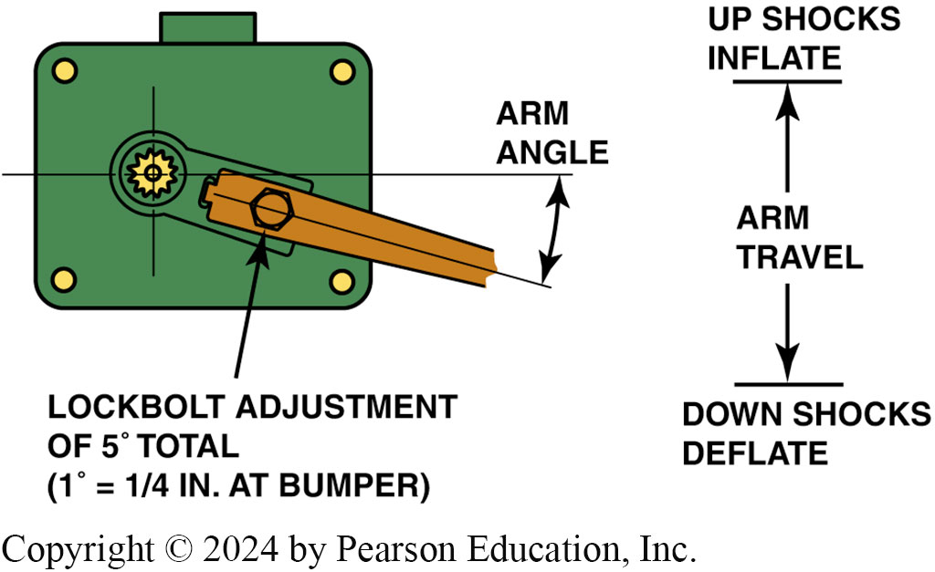
Figure 114.39 Level Sensor Adjust
Most electronic level-control sensors can be adjusted, such as this GM

Slide 65
Magneto-Rheological (M R) Suspension
Terminology
  M R fluid shocks use a working fluid inside shock that can change viscosity rapidly depending on electric current sent to an electromagnetic coil in each device.
  Normally, fluid flows easily through orifices in the shock and provides little dampening.
  When a large or high-frequency bump is detected
  Small electrical current is sent from the chassis controller to an electromagnetic coil in each shock
  Iron particles in fluid respond within 3 milliseconds (ms), aligning themselves in fiber like strands.

Slide 66
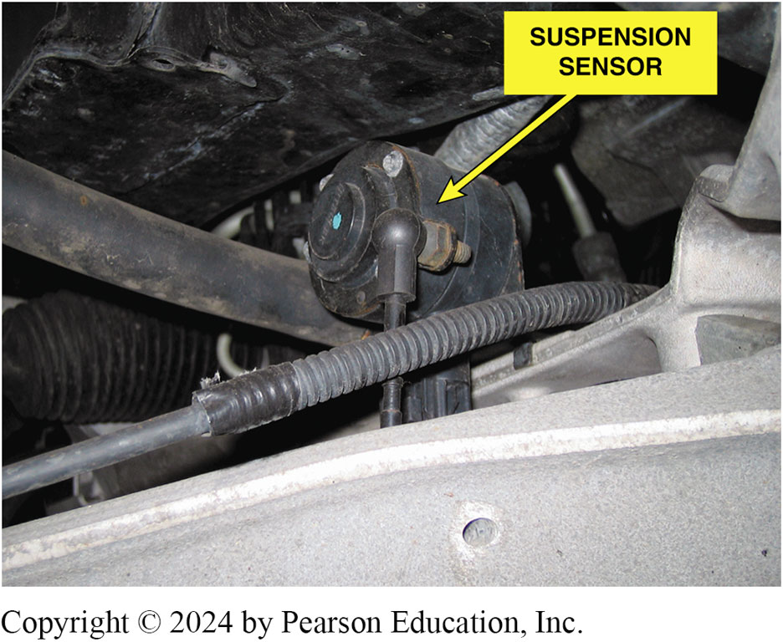
Figure 114.40 Wheel Sensor
Vehicles that use magneto-rheological shock absorbers have a sensor located near each wheel, as shown on this C6 Corvette

Slide 67
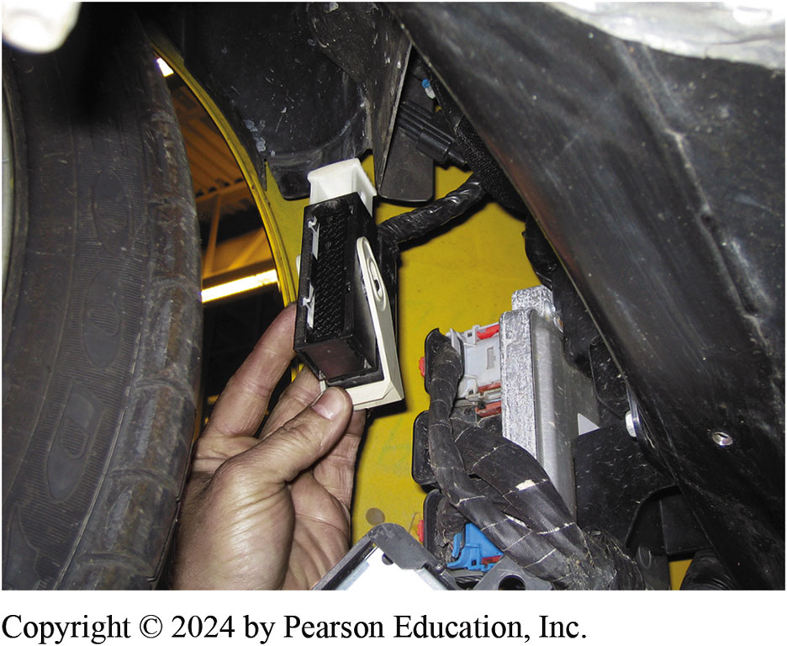
Figure 114.41 Controller
The controller for the magneto-rheological suspension system on a C6 Corvette is located behind the right front wheel

Slide 68
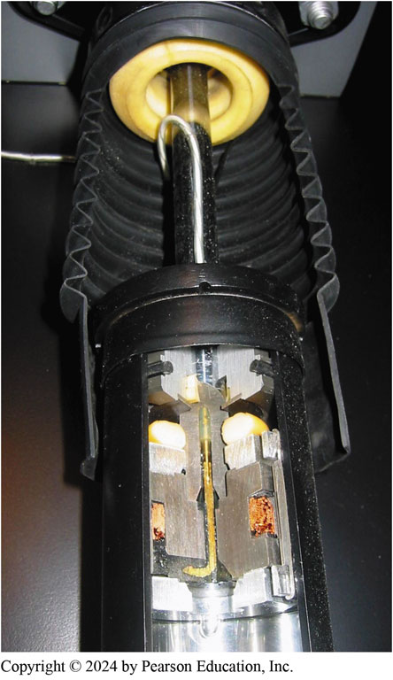
Figure 114.41 Shock Cutaway
A cutaway of a magneto-rheological shock absorber as displayed at the Corvette Museum in Bowling Green, Kentucky

Slide 69
Frequently Asked Question: Can Computer-Controlled Shock Absorbers and Struts Be Replaced with Conventional Units?
? Frequently Asked Question
Can Computer-Controlled Shock Absorbers and Struts Be Replaced with Conventional Units? Maybe. If the vehicle was manufactured with or without electronic or variable shock absorbers, it may be possible to replace the originals with the standard replacement units. The electrical connector must be disconnected, and this may cause the control system to store a diagnostic trouble code (DTC) and/or turn on a suspension fault warning light on the dash. Some service technicians have used a resistor equal in resistance value of the solenoid or motor across the terminals of the wiring connector to keep the controller from setting a DTC. All repairs to a suspension system should be done to restore the vehicle to like-new condition, so care should be exercised if replacing electronic shocks with non-electronic versions.

Slide 70
Question 3: ?
How does a Magneto-Rheological shock automatically change dampening rates?

Slide 71
Answer 3
By changing the current flow through the liquid in the shock.

Slide 72
Suspension and Steering Videos and Animations
Videos Link: (A4) Suspension and Steering Videos
Animations Link: (A4) Suspension and Steering Animations

Slide 73
Copyright
This work is protected by United States copyright laws and is provided solely for the use of instructors in teaching their courses and assessing student learning. Dissemination or sale of any part of this work (including on the World Wide Web) will destroy the integrity of the work and is not permitted. The work and materials from it should never be made available to students except by instructors using the accompanying text in their classes. All recipients of this work are expected to abide by these restrictions and to honor the intended pedagogical purposes and the needs of other instructors who rely on these materials.

