Slide 1
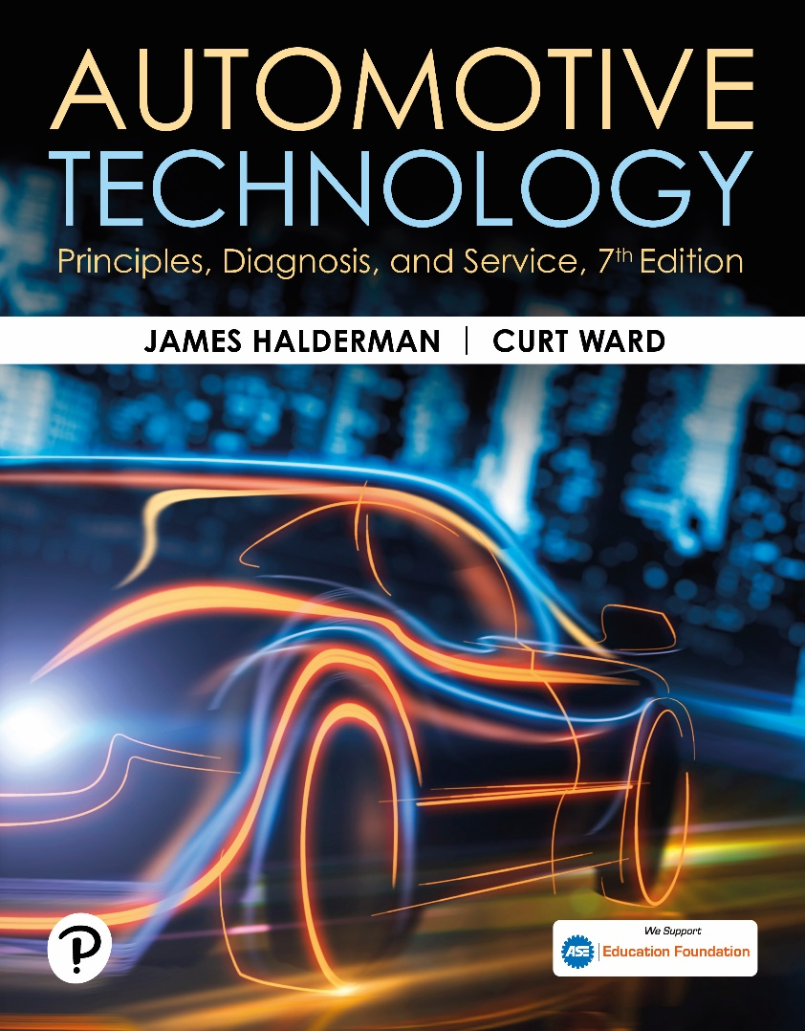
Automotive Technology: Principles, Diagnosis, and Service
Seventh Edition
Chapter 113
Rear Suspensions and Service
Copyright © 2023 Pearson Education, Inc. All Rights Reserved
Notes:
INSTRUCTOR NOTE: This presentation includes text explanation notes, you can use to teach the course. When in SLIDE SHOW mode, you RIGHT CLICK and select SHOW PRESENTER VIEW, to use the notes.

Slide 2
Learning Objectives
113.1 Describe solid rear axles.
113.2 Describe leaf spring rear suspensions.
113.3 Distinguish between trailing arm and semi-trailing arm rear suspensions.
113.4 Distinguish between independent and semi-independent rear suspensions.
113.5 Explain rear suspension service.
113.6 Describe replacement of rear shocks.
113.7 Describe replacement of rear springs.

Slide 3
Solid Rear Axles
A solid axle can be used at the rear of either a rear-wheel-drive or front-wheel-drive vehicle.
Advantages
  Solid axles can handle large loads.
Disadvantages
  Increased proportion of unsprung weight
  Side-to-side road shock transference
  Poorer tire adhesion

Slide 4
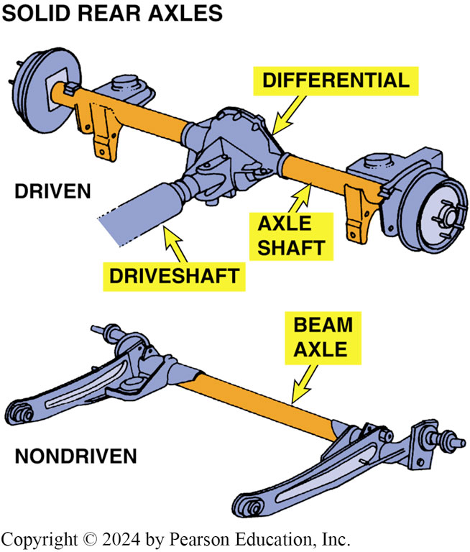
Figure 113.1 Solid Axles
Solid axles are used on rear-wheel-drive vehicles as well as on front-wheel-drive vehicles

Slide 5
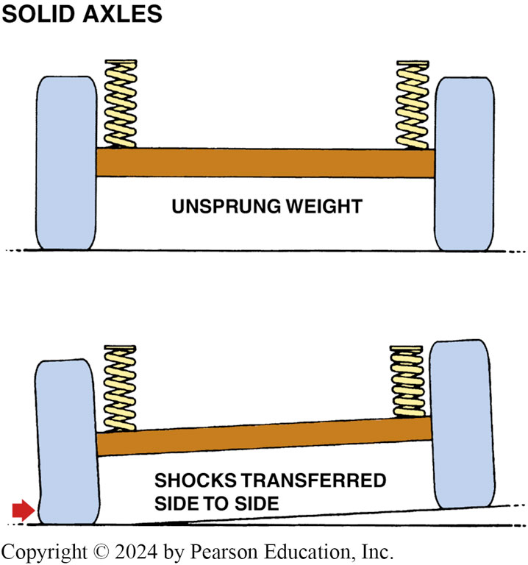
Figure 113.2 Solid Axle Support
A solid axle supports the springs, so the axle and suspension components are unsprung weight. When one wheel rides over a bump, the force of impact transfers through the solid axle to the opposite side, leading to unstable handling.

Slide 6
Frequently Asked Question: What Is Axle Windup?
? Frequently Asked Question
What Is Axle Windup? Axle windup is a product of law of physics, which states that every action produces an equal and opposite reaction. As axle shafts rotate in one direction to drive the wheels, axle housing attempts to rotate in opposite direction. The force of this reaction tends to lift the front end of the vehicle during acceleration. ● SEE FIGURE 113–3. Axle windup is a particular problem with a solid, driven rear axle because the axle housing concentrates the reacting force. Under extreme acceleration, the reacting force can actually tilt the drive shaft upward and lift the front wheels off the ground. Leaf springs, control arms, pinion snubbers, and torque arms all are means of controlling axle windup
Notes:
.

Slide 7
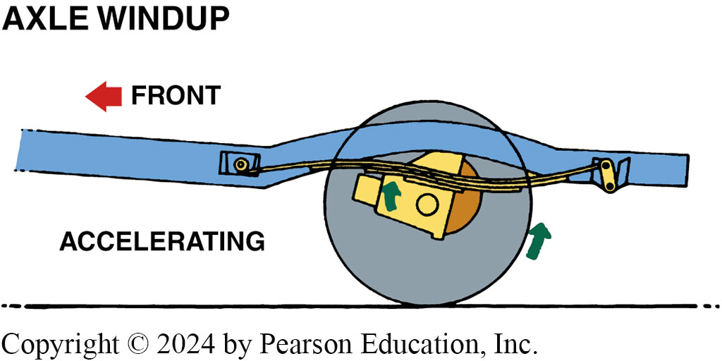
Figure 113.3 Axle Windup
When the axle housing reacts against the force of axle shaft rotation, the front of the differential tilts upward, creating axle windup

Slide 8
Question 1: ?
What are the disadvantages of a solid rear axle?

Slide 9
Answer 1
Increased proportion of unsprung weight, side-to-side road shock transference, poorer tire adhesion.

Slide 10
Leaf Spring Rear Suspensions
Leaf springs link axle to frame and effectively serve 2 purposes:
  Absorbing road shock
  Locating the axle under the vehicle
Most rear-wheel-drive trucks use a solid rear axle with leaf springs in an arrangement called a Hotchkiss drive.

Slide 11
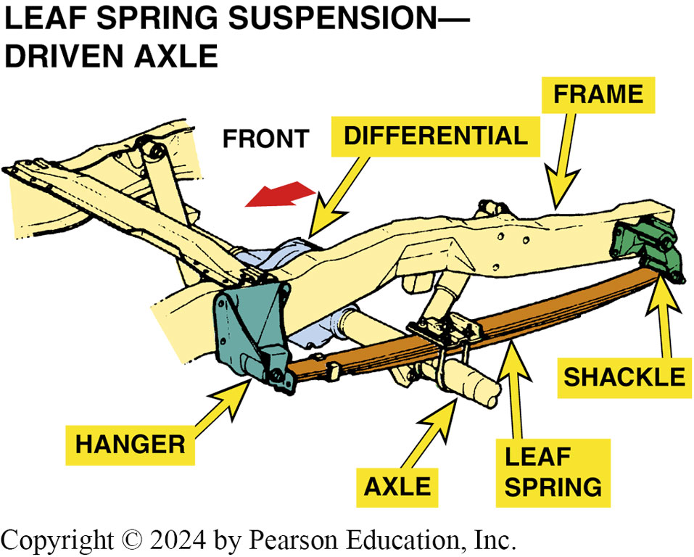
Figure 113.4 Hotchkiss Axle
A typical rear-wheel-drive pickup truck rear suspension equipped with leaf springs. This type of arrangement is called a Hotchkiss drive and the drivetrain forces are controlled by the rear suspension components.

Slide 12
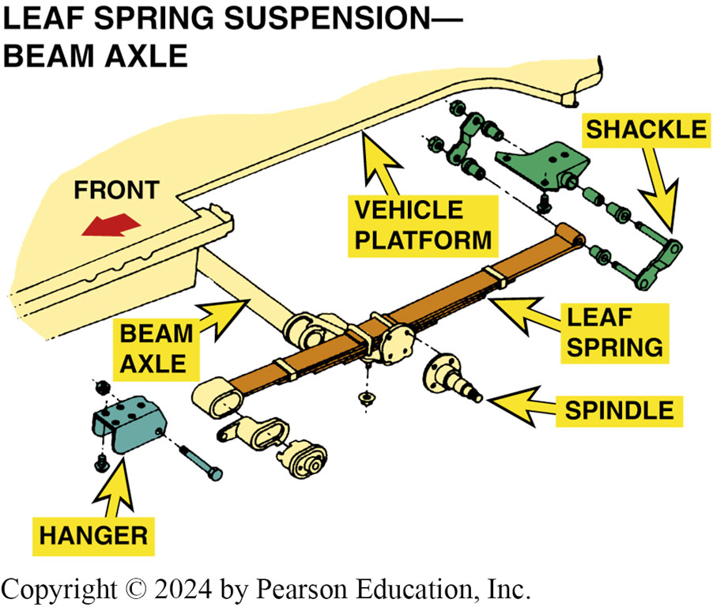
Figure 113.5 Beam Axle, Multileaf
An exploded view of a beam axle with multileaf springs

Slide 13
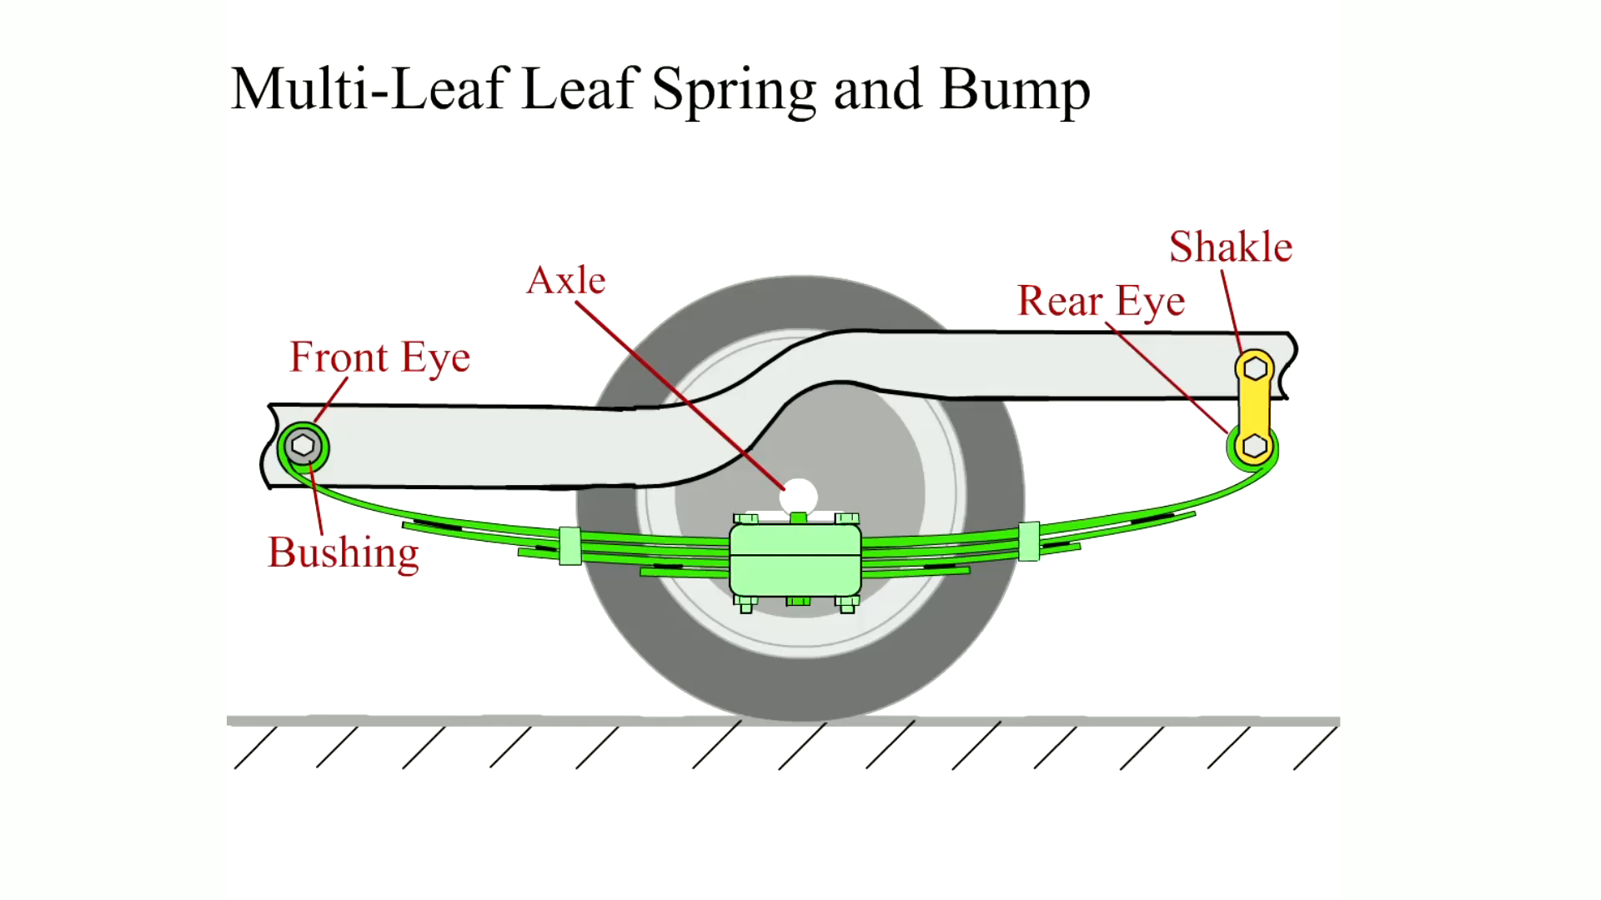
Animation: Multi-Leaf Leaf Spring and Bump
(Animation will automatically start)

Slide 14
Trailing Arm Rear Suspensions
A trailing arm extends from a frame crossmember located ahead of the rear axle back to the axle housing or a wheel knuckle.
Trailing arms may be used to brace either a driven or non-driven solid rear axle against front-to-rear forces.
A trailing arm rear suspension on a non-driven solid axle virtually always includes a track rod, also called a Panhard rod.

Slide 15
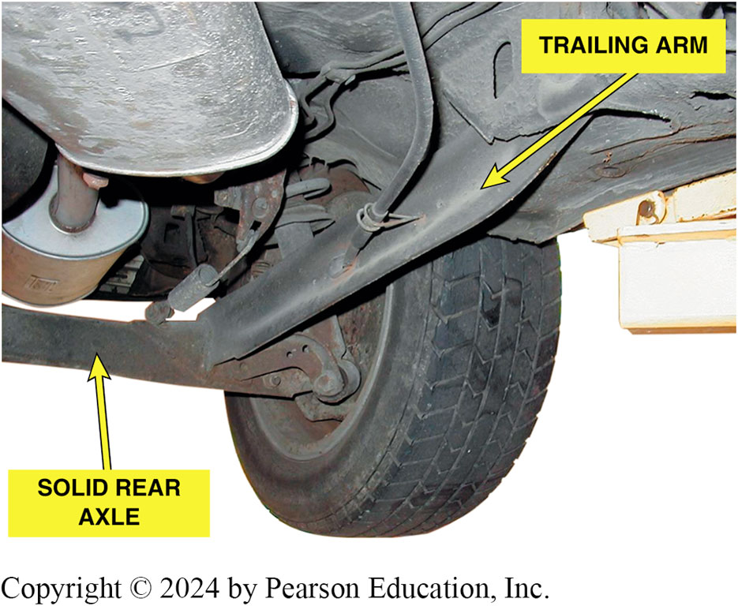
Figure 113.6 Trailing Arm
Trailing arm rear suspension with a solid axle used on a front-wheel-drive vehicle

Slide 16
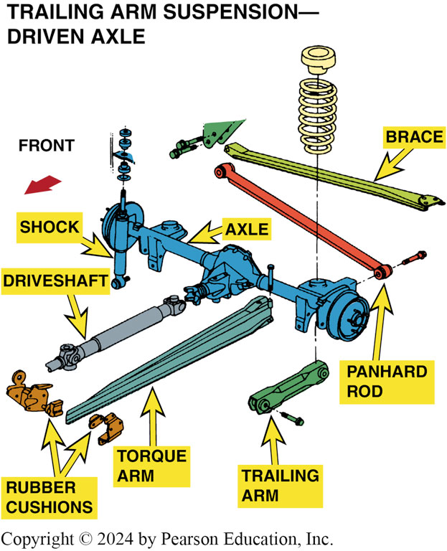
Figure 113.7 Torque Arm Rear
This rear suspension systems use a torque arm to control axle windup. If the rubber torque arm bushings (cushions) are worn, a loud “bang” could be heard and felt when accelerating suddenly.

Slide 17
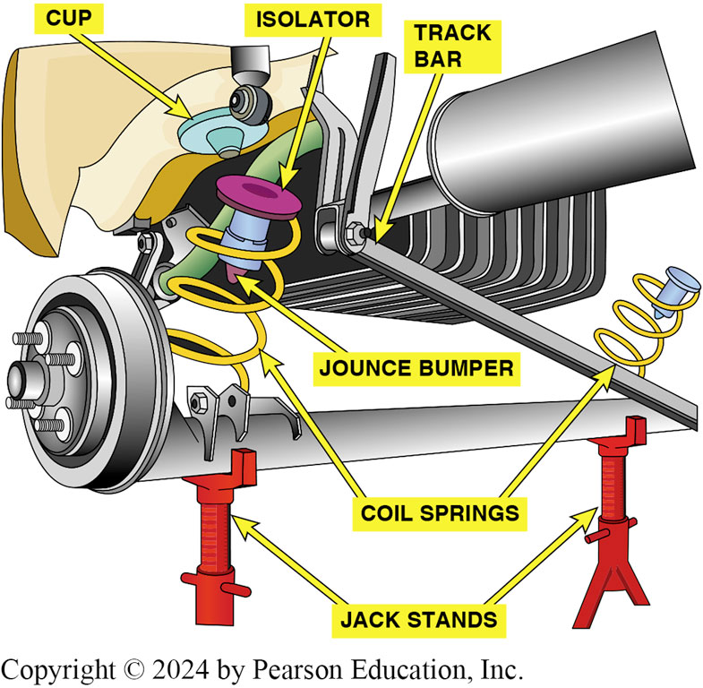
Figure 113.8 Beam Axle Rear
A typical beam axle rear suspension, which uses trailing arms and coil springs along with a track rod, also called a Panhard rod, to control side-to-side axle movement

Slide 18
Semi-Trailing Arm Rear Suspensions
A semi-trailing arm is similar to a trailing arm in that it extends back from a frame member to the axle.
Semi-trailing arms have an advantage over trailing arms because they control both side-to-side and front-to-rear motion.
Axle centering pivot bracket and linkage called watts linkage

Slide 19
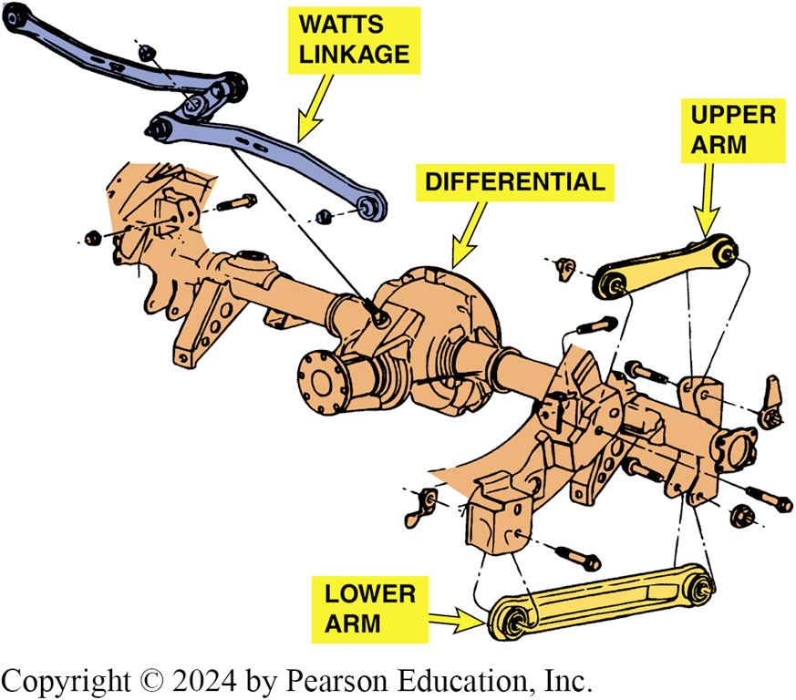
Figure 113.9 Upper/Lower Arms
This Ford rear suspension uses upper and lower semi-trailing arms to mount the rear axle and a watts linkage to control side-to-side movement

Slide 20
Independent Rear Suspensions
The use of independent rear suspension (I R S) has significantly increased for a variety of reasons.
  The reduction in unsprung weight is particularly noticeable for driven axles, which are constructed to transfer the weight of the differential and axles to the frame.
  A vehicle with an independent rear suspension rides and handles better than a similar vehicle equipped with a solid rear axle.
  I R S reduces tire scrub and improves traction.

Slide 21
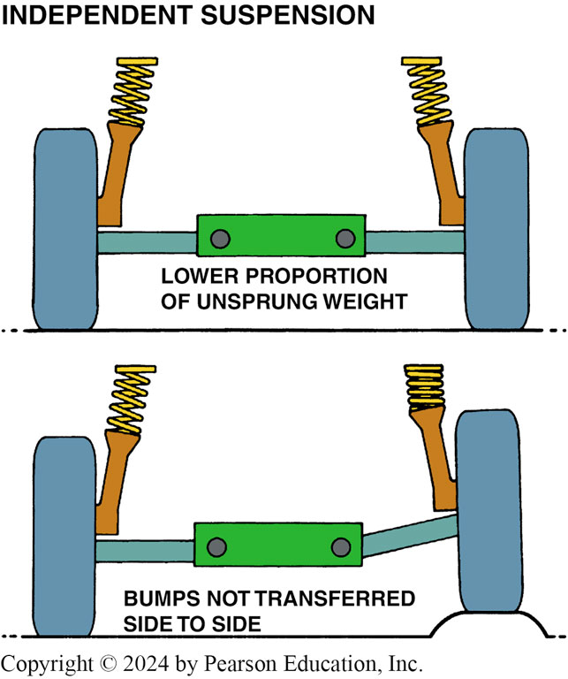
Figure 113.10 IRS
An independent rear suspension provides a better ride because less weight is unsprung and the suspension is able to react quickly to bumps in the road without affecting the opposite side.

Slide 22
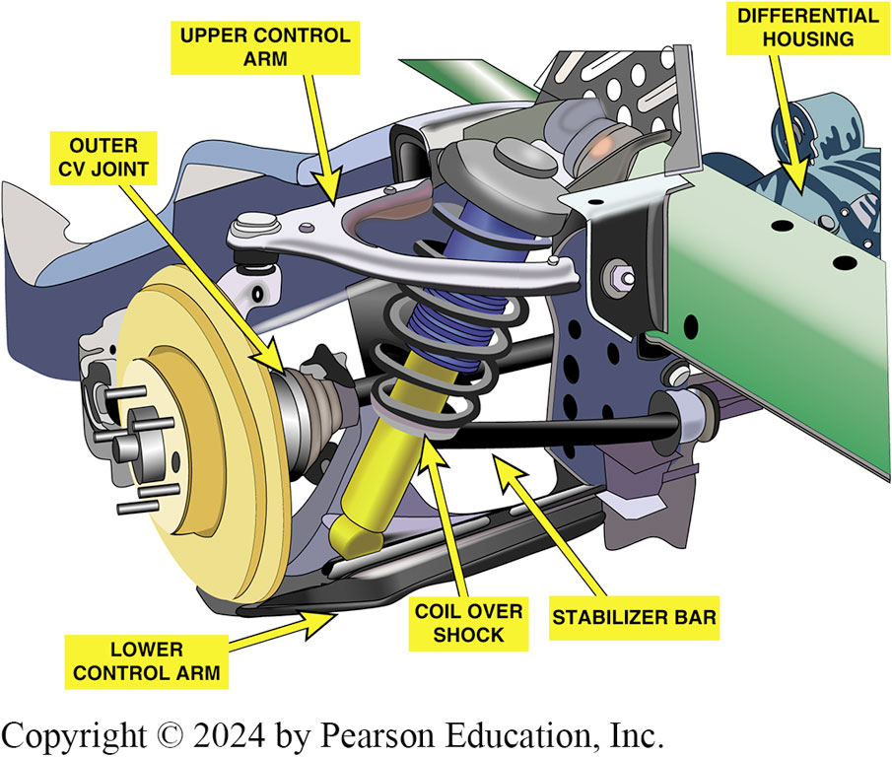
Figure 113.11 SLA IRS
A typical short/ long-arm independent rear suspension

Slide 23
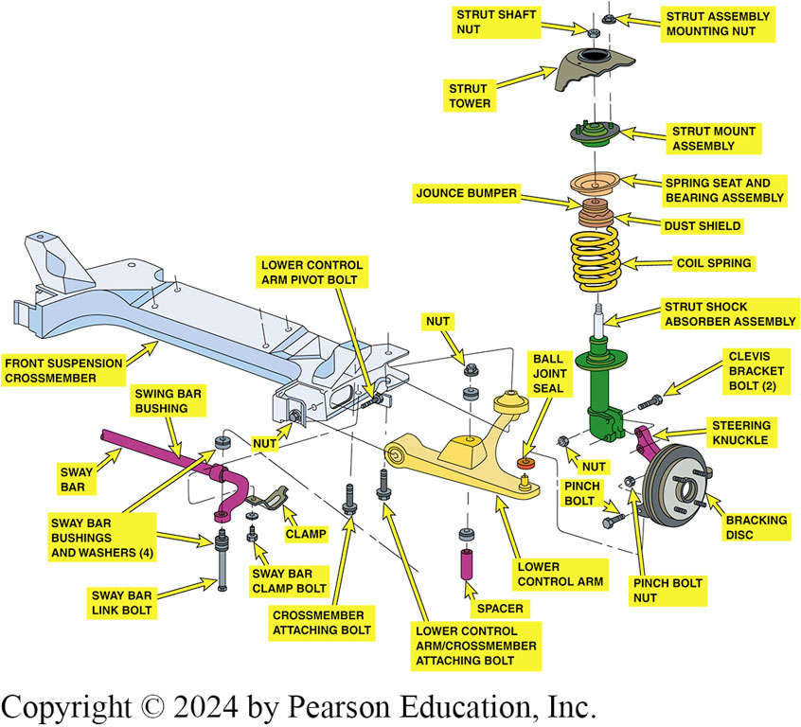
Figure 113.12 MacPherson Strut IRS
Independent rear suspension uses a MacPherson strut, with a lower control arm and an anti-sway bar.

Slide 24
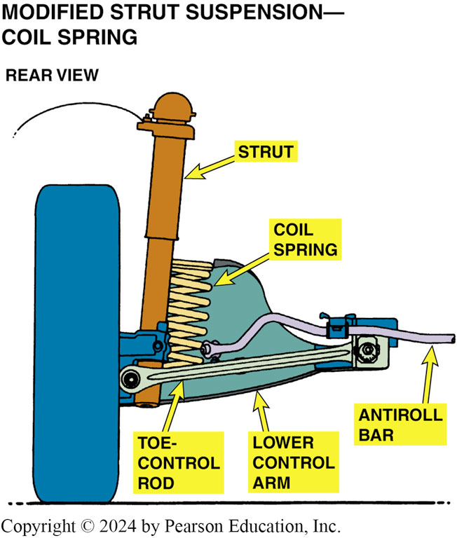
Figure 113.13 Toe-Control Rod
The toe-control rod provides an extra brace to keep the rear wheels straight ahead during braking and acceleration on this modified-strut-type independent rear suspension

Slide 25
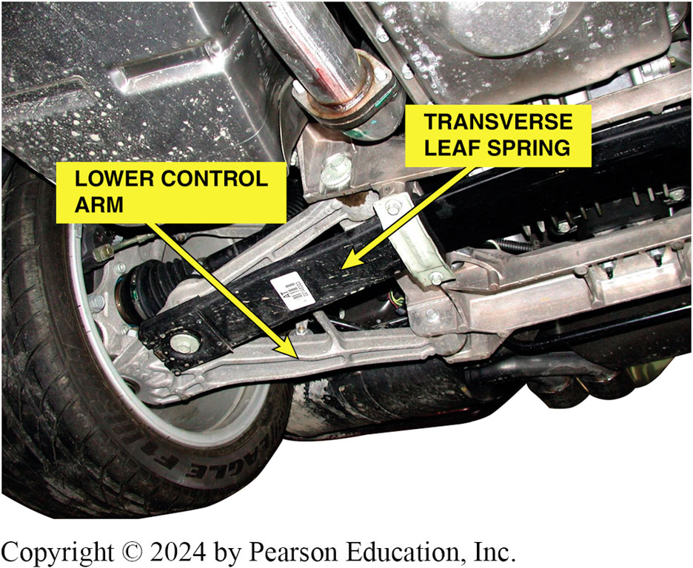
Figure 113.14 Mon-Leaf Spring IRS
A transverse mono-type leaf spring used on the rear suspension of a Chevrolet Corvette

Slide 26
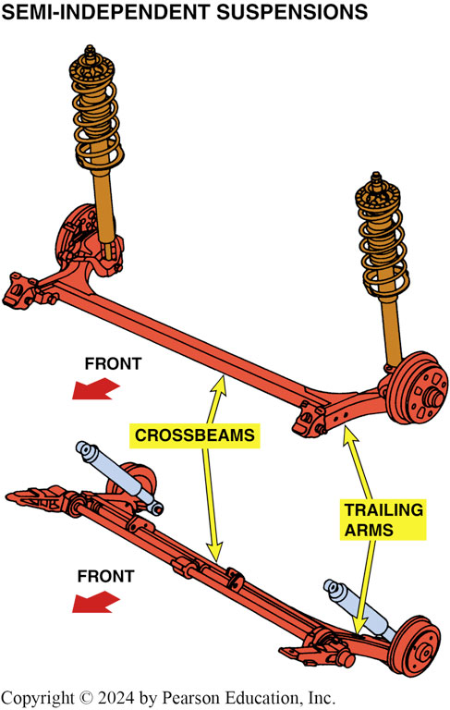
Figure 113.15 Strut IRS
This independent rear suspension uses a MacPherson strut, two parallel lower transverse control arms, and a trailing arm

Slide 27
Semi-independent Rear Suspensions
A semi-independent suspension is used only at a non-driven rear axle.
A semi-independent design, the crossbeam is placed ahead, rather than at the centerline, of the wheels.
Some semi-independent rear suspensions use struts.

Slide 28
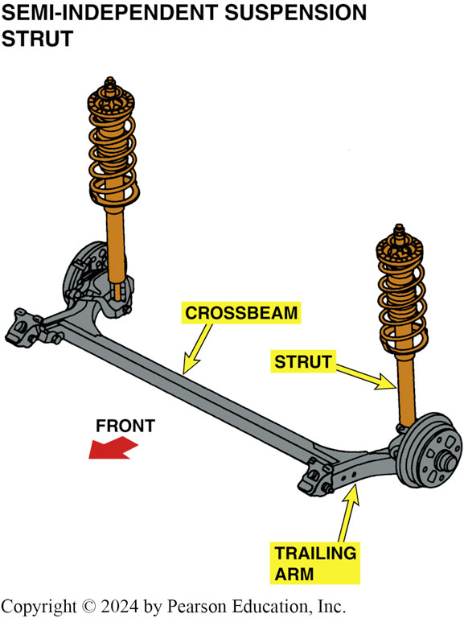
Figure 113.16 Strut Semi-Independent
A semi-independent rear suspension with MacPherson struts

Slide 29
Question 2: ?
When is a semi-rear independent suspension design used?

Slide 30
Answer 2
When the rear axle is a non-driving axle.

Slide 31
Rear Suspension Service
Rear suspension service starts with a thorough test-drive, to observe any unusual noises or vibrations that may be caused by a fault with a rear suspension component.
After a test-drive, safely hoist the vehicle and perform a thorough visual inspection.
Use an appropriate prybar and move all of the bushings and joints, checking for deterioration or freeplay.

Slide 32
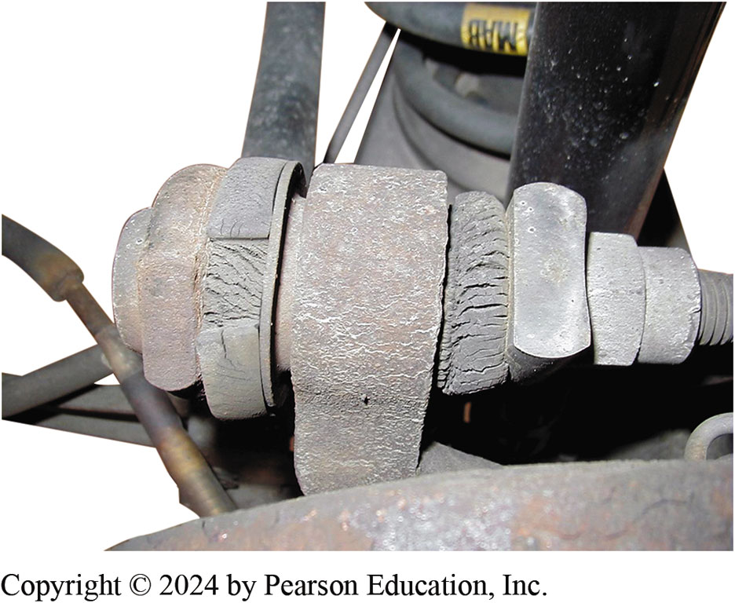
Figure 113.17 Bushing Cracked
Check all rubber bushings for excessive cracking

Slide 33
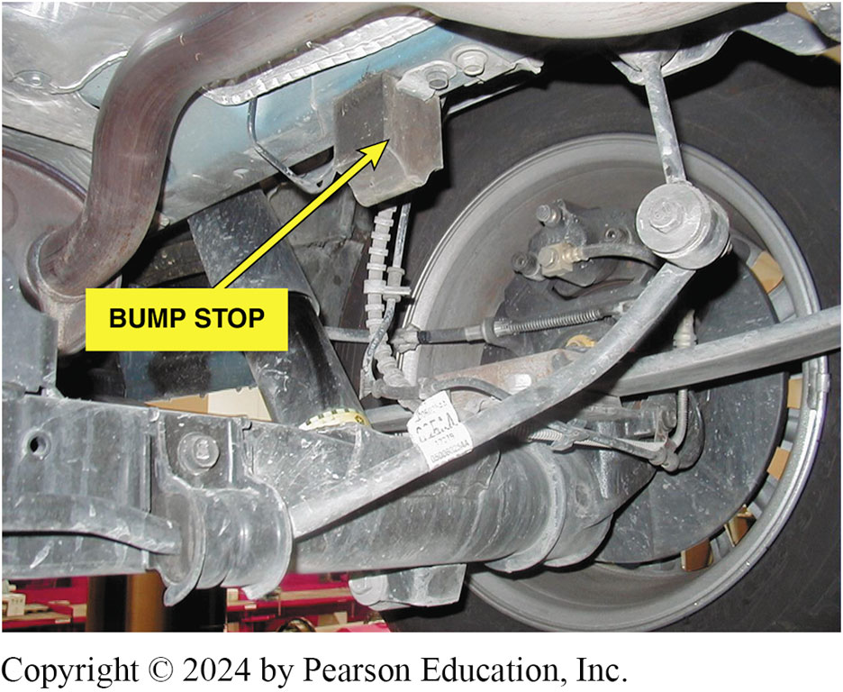
Figure 113.18 Bump Stops
Carefully inspect the bump stops for damage during a thorough visual inspection

Slide 34
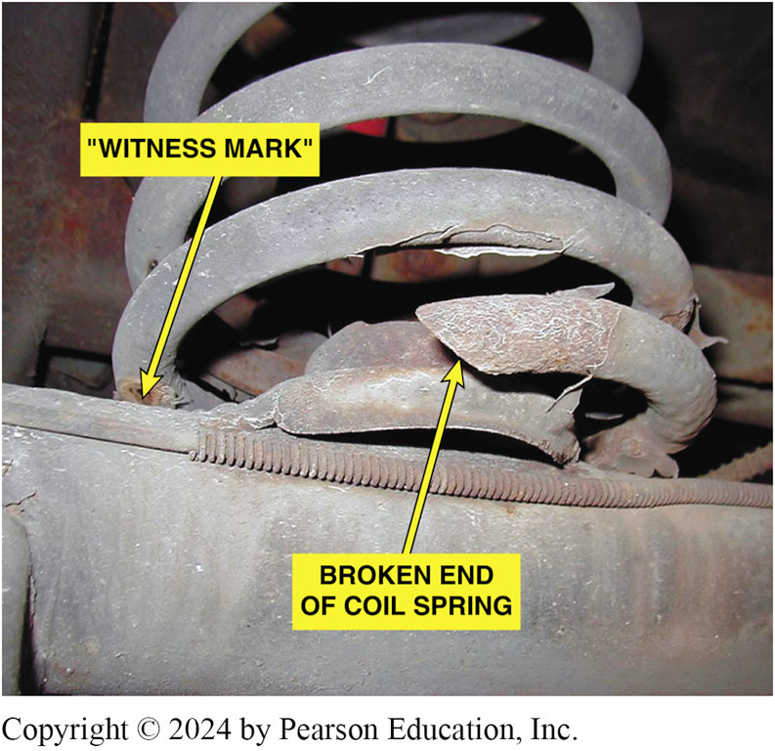
Figure 113.19 Broken Spring
A broken spring was discovered during a routine under-vehicle visual inspection. Notice the witness marks that show that the spring coils have been hitting each other

Slide 35
Rear Shock Replacement
Precautions
  The rear axle must be supported prior to removing the shocks.
Air Shock Installation
  Most replacement air shocks are directional and are labelled left and right.
  Use care when installing the air lines to prevent unwanted leaks.

Slide 36
Rear Spring Replacement (1 of 2)
Rear Coil Springs
  Support the rear axle assembly with tall safety stands.
  Remove the lower shock absorber mounting bolts/nuts and disconnect the shock absorber from the rear axle assembly.
  Lower the rear axle just enough to remove the coil springs.

Slide 37
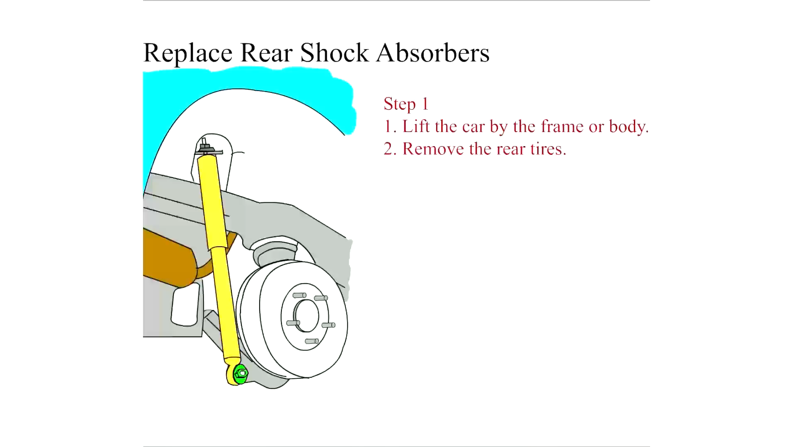
Animation: Replace Rear Shock Absorbers
(Animation will automatically start)

Slide 38
Rear Spring Replacement (2 of 2)
Rear Leaf Springs
Rear leaf springs often need replacement due to one of the following common causes:
  Individual leaves of a leaf spring often crack, then break.
  The center bolt breaks
Replacement
  Install the new spring, being careful to position the center bolt correctly into the hole on the axle pedestal.

Slide 39
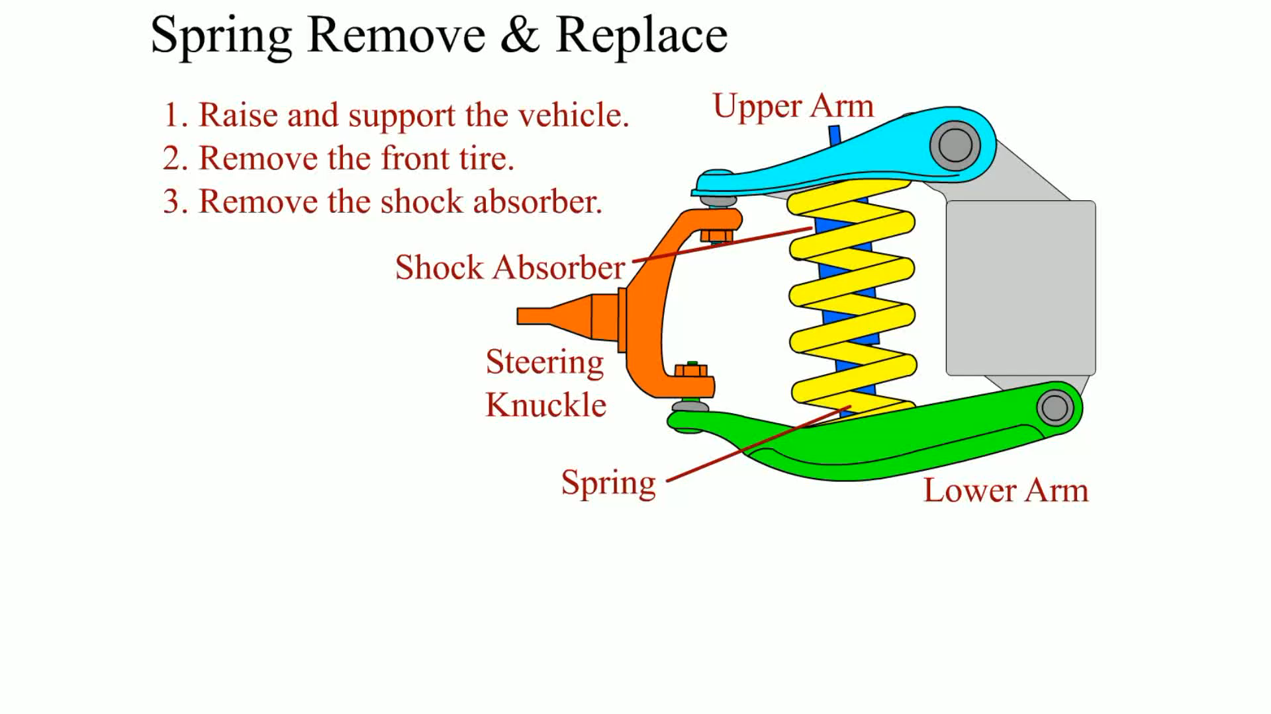
Animation: Spring Remove & Replace
(Animation will automatically start)

Slide 40
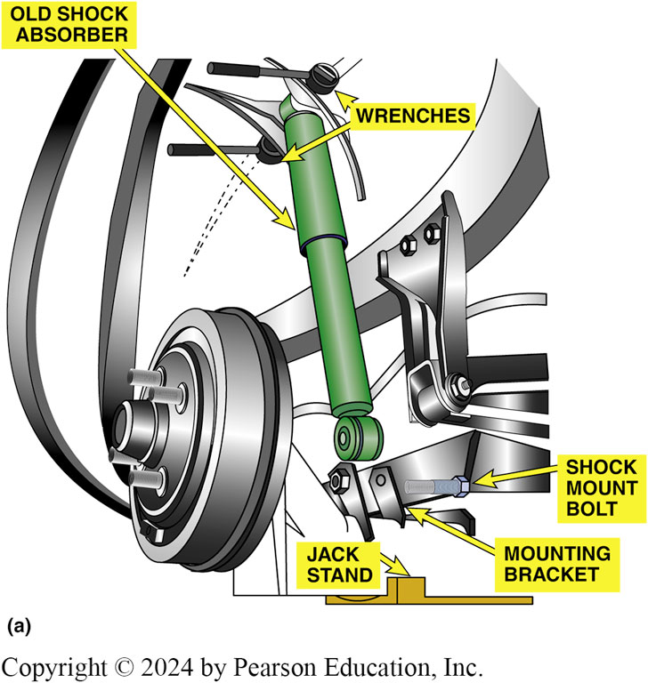
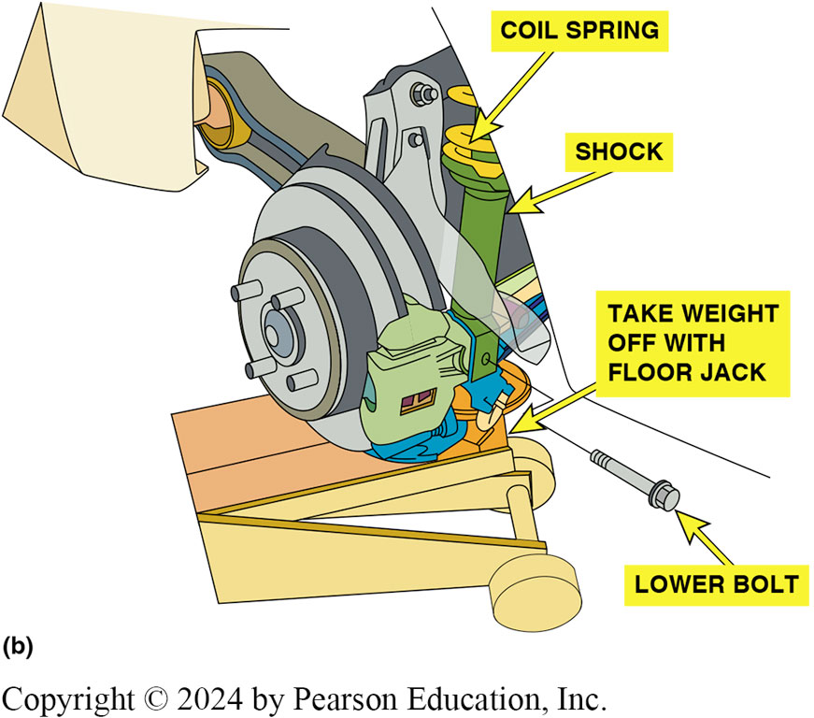
Figure 113.20 Shock Removal
(a) rear axle has to be supported before rear shock absorber is removed. (b) Before removing a rear strut assembly, the rear axle has to be supported. Always follow the vehicle manufacturer’s specified procedures.
Notes:
CASE STUDY: The Harsh Riding Buick
The owner requested that all of the shock absorbers be replaced on a ten-year-old Buick. The rear
was equipped with air shocks as part of the ride leveling system. During a test-drive after installing all four shocks, the service technician noticed that it seemed to ride much harsher than normal for a Buick. The technician asked the owner to ride along to verify that it was not usual to ride as harsh as it was. Puzzled as to why this occurred, the technician contacted the parts store, which then asked their supplier about the issue. It was discovered that the air shocks were not cycled before they were installed. Installing air shocks/struts requires cycling the shock/strut to spread lubricant inside the diaphragm to avoid binding. The installing technician should inflate the air diaphragm through the air fitting until the shock/strut fully extends. Then the shock can be kept fully extended to make it easier to install. After removing the rear shocks and inflating them as instructed, and reinstalling, the Buick rode normally.
Summary:
Complaint—The service technician was concerned that the Buick rode harsher than normal after new shock absorbers were installed.
Cause—The proper installation procedure was not followed prior to installing the air shock on the rear.
Correction—The air shocks were removed and cycled and then inflated before being reinstalled, which solved the harsh ride concern.

Slide 41
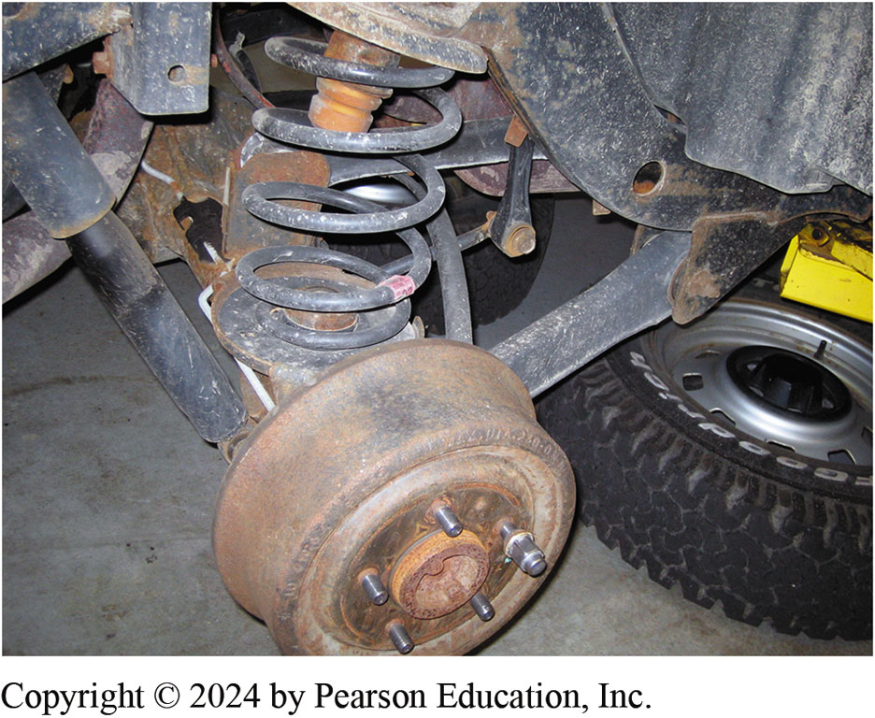
Figure 113.21 Removing Rear Coil
The shock absorber needs to be disconnected before removing the coil spring. Installation is the reverse of removal procedure

Slide 42
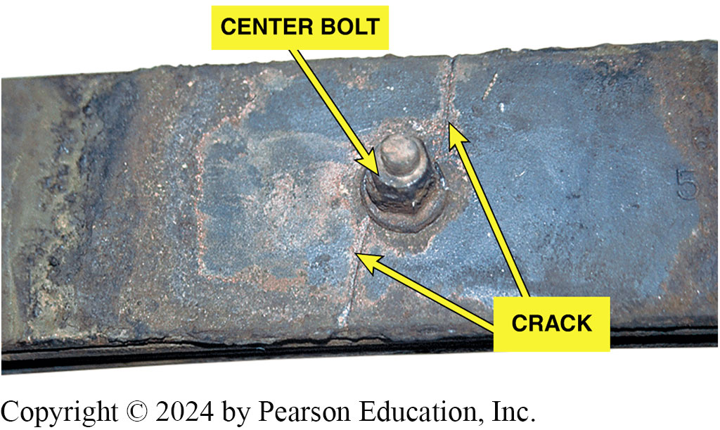
Figure 113.22 Leaf Center Bolt
Center bolt is used to hold leaves of leaf spring together. However, the hole for center bolt also weakens the leaf spring. The crack shown is what a technician discovered when leaf spring was removed during the diagnosis of a sagging rear suspension

Slide 43
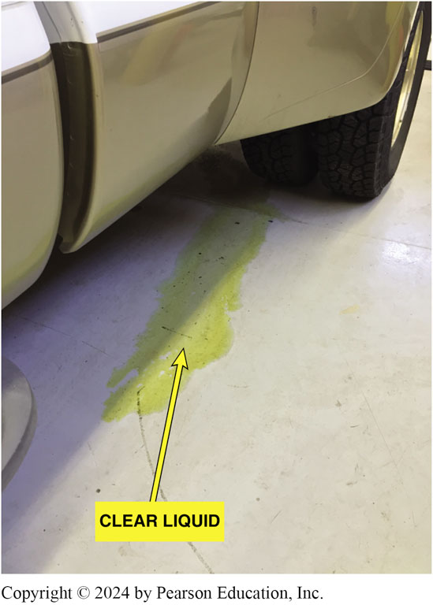
Figure 113.23 Strange Leakage
Whatever was leaking appeared to be a clear liquid but it did not smell like gasoline. What could it be from the rear of the truck?
Notes:
CASE STUDY: Strange Leakage
The owner of a small business drove the company pickup truck into the shop to get it ready to load for the day’s delivery. It was a very cold day in northern Ohio with the temperature well below freezing (32°F [0°C]). After about 15 minutes, the business owner noticed that “something” was
leaking from underneath the rear of the truck. SEE FIGURE 113-23. Not sure what it was, the owner called a local automotive repair shop and asked for help. The shop sent a technician to look at the truck. The service technician noticed that one of the rear shock absorbers had leaked all of the hydraulic fluid out of the bottom of the shock. SEE FIGURE 113–24.
Obviously, both rear shock absorbers would require replacement because shocks should
always be replaced in pairs. The service technician recommended that all four (both front and
both rear) shocks be replaced to restore proper handling. Knowing that the front shock absorbers were operating under the same conditions as the rear and were the same age, the truck owner approved the replacement of all four shock absorbers.
Summary:
Complaint—A liquid was found leaking from underneath a truck.
Cause—Hydraulic fluid had leaked from a rusty shock absorber.
Correction—Based on the owner’s approval, all four shocks were replaced.

Slide 44
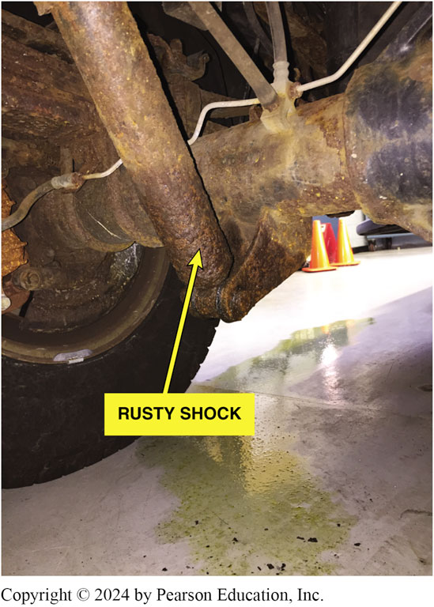
Figure 113.24 Strange Leakage
The source of the leak was discovered to be hydraulic shock fluid that had leaked from the bottom of the shock and not from around the shaft seal, which is the most likely location for shocks to leak. Apparently, rust had eaten through the housing of the shock.

Slide 45
Question 3: ?
What must be done when a rear shock absorber is replaced?

Slide 46
Answer 3
The rear axle must be supported.

Slide 47
Suspension and Steering Videos and Animations
Videos Link: (A4) Suspension and Steering Videos
Animations Link: (A4) Suspension and Steering Animations

Slide 48

Copyright
This work is protected by United States copyright laws and is provided solely for the use of instructors in teaching their courses and assessing student learning. Dissemination or sale of any part of this work (including on the World Wide Web) will destroy the integrity of the work and is not permitted. The work and materials from it should never be made available to students except by instructors using the accompanying text in their classes. All recipients of this work are expected to abide by these restrictions and to honor the intended pedagogical purposes and the needs of other instructors who rely on these materials.

