Slide 1
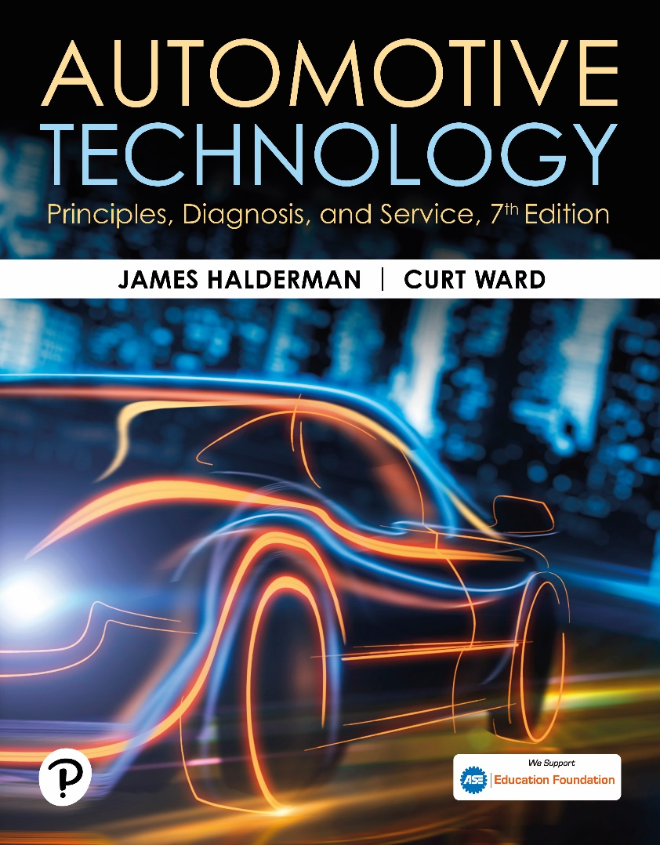
Automotive Technology: Principles, Diagnosis, and Service
Seventh Edition
Chapter 112
Front Suspensions and Service
Copyright © 2023 Pearson Education, Inc. All Rights Reserved
Notes:
INSTRUCTOR NOTE: This presentation includes text explanation notes, you can use to teach the course. When in SLIDE SHOW mode, you RIGHT CLICK and select SHOW PRESENTER VIEW, to use the notes.

Slide 2
Learning Objectives (1 of 2)
112.1 Describe different front suspension types.
112.2 Discuss short-/long-arm (SLA) suspension systems.
112.3 Discuss strut suspension.
112.4 Explain how to service suspension systems, including a road test, a dry park test, and a visual inspection.
112.5 Discuss the diagnosis of ball joints.
112.6 Discuss the diagnosis of shock absorbers and struts.
112.7 Describe how to replace MacPherson struts.

Slide 3
Learning Objectives (2 of 2)
112.8 Explain the diagnosis of stabilizer bar links and bushings.
112.9 Discuss the diagnosis of strut rod bushings.
112.10 Discuss the diagnosis of front coil springs.
112.11 Discuss the diagnosis of steering knuckles.
112.12 Discuss the adjustment of torsion bars.
112.13 Discuss the diagnosis of control arm bushings.

Slide 4
Front Suspension Types
Solid Axles
  Early cars and trucks used a solid (or straight) front axle to support the front wheels.
Kingpins
  At the end of solid axle, they allow the front wheels to rotate for steering.
Twin-I Beam
  Strong steel twin beams that cross provide independent front suspension operation with the strength of a solid front axle.

Slide 5
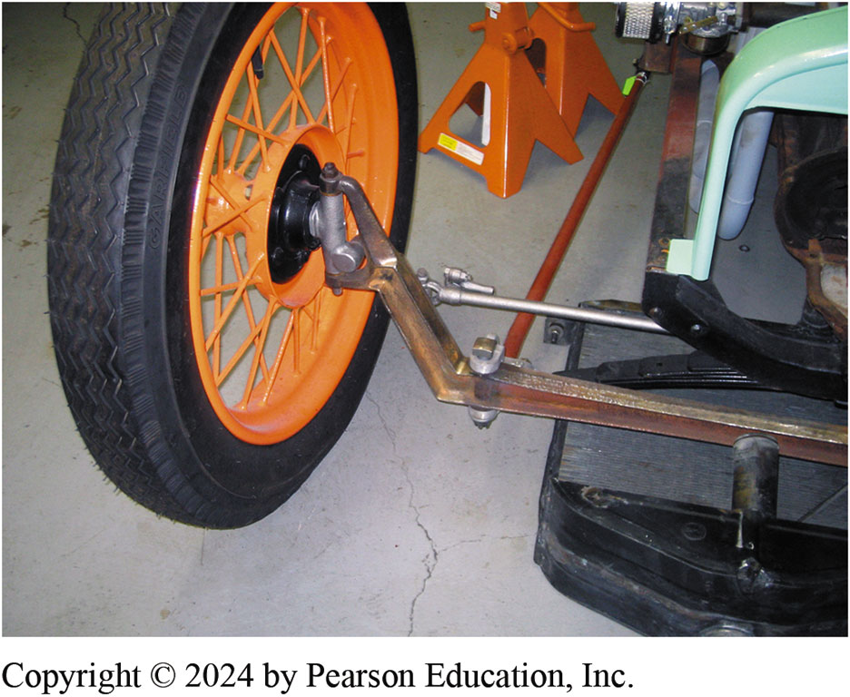
Figure 112.1 Straight Axle
Most early vehicles used single straight axles

Slide 6
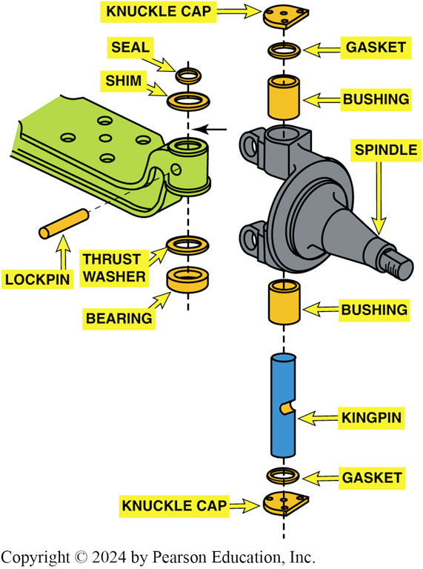
Figure 112.2 Kingpin
Typical kingpin used with a solid axle

Slide 7
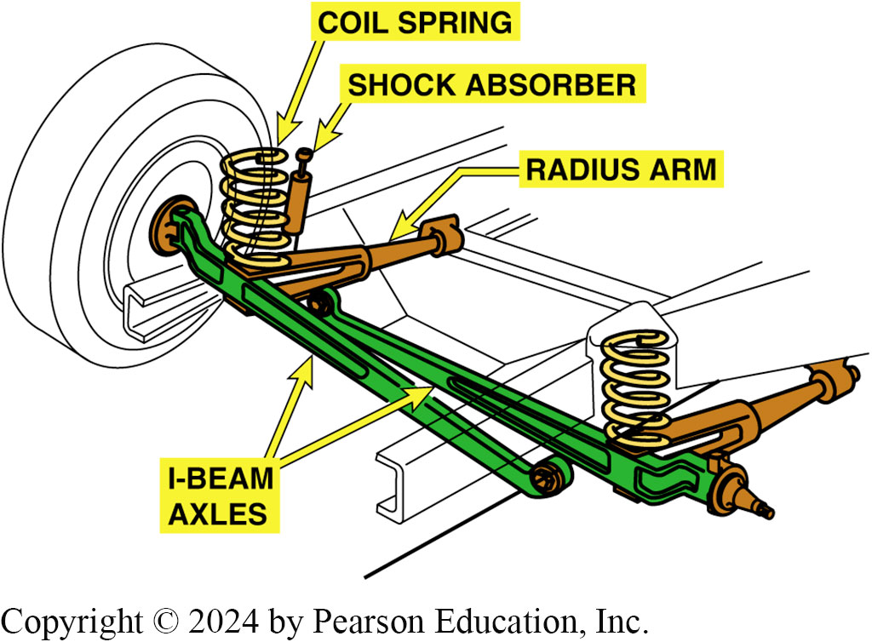
Figure 112.3 Twin I-Beam
Twin I-beam front suspension. Rubber bushings are used to support the I-beams to the frame and help isolate road noise

Slide 8
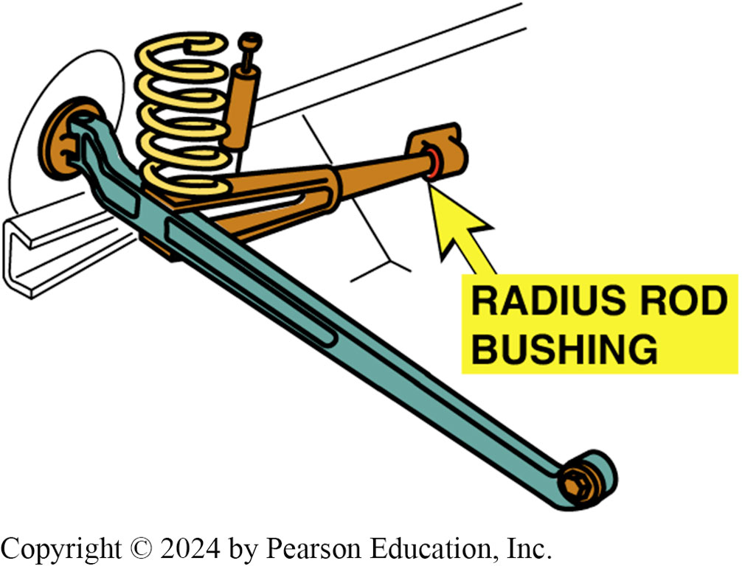
Figure 112.4 Radius Rod Bushing
The rubber radius rod bushing absorbs road shocks and helps isolate road noise
Notes:
TECH TIP: Radius Rod Bushing Noise
When the radius rod bushing on a Ford truck or van deteriorates, the most common complaint from the driver is noise. ● SEE FIGURE 112–4. Besides causing tire wear, worn or defective radius rod bushing can cause the following:
1. A clicking sound when braking (it sounds as if the brake caliper may be loose).
2. A clunking noise when hitting bumps.
When the bushing deteriorates, the axles move forward and backward with less control. Noise is the first sign that something is wrong. Without proper axle support, handling and cornering can also be affected.

Slide 9
Short/Long-arm Suspensions (1 of 2)
Terminology
  The short/long-arm suspension uses a short upper control arm and a longer lower control arm and is usually referred to as the S L A-type suspension.
Strut Rods
  A strut rod, also called a reaction rod, provides support to the axle during braking and acceleration forces.

Slide 10
Short/Long-arm Suspensions (2 of 2)
Coil Spring Front Suspensions
  Locating the coil spring on the lower control arm is the most common S L A-type suspension configuration.
Torsion Bar Front Suspensions
  Short/long-arm suspensions use longitudinal torsion bars, especially in trucks.

Slide 11
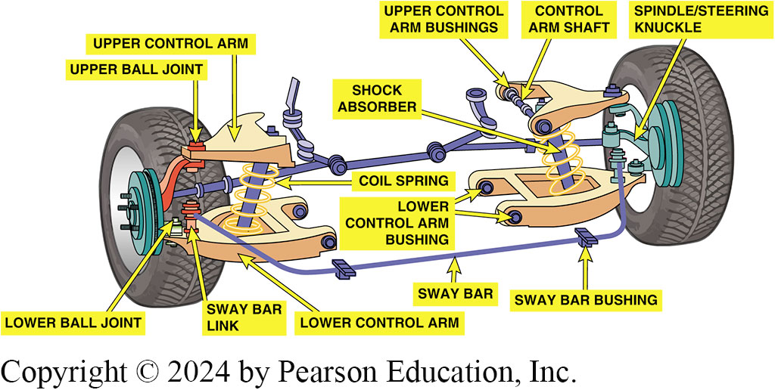
Figure 112.5 SLA
The upper control arm is shorter than the lower control arm on a short/long-arm (SLA) suspension

Slide 12
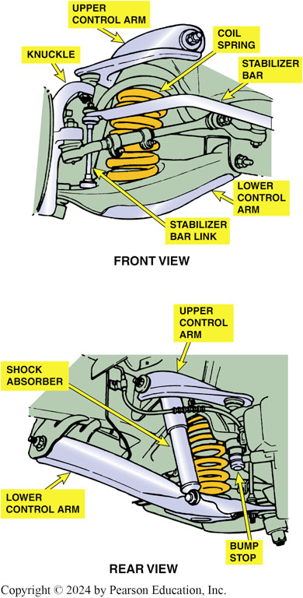
Figure 112.6 SLA Coil Springs
A typical SLA-front suspension using coil springs

Slide 13
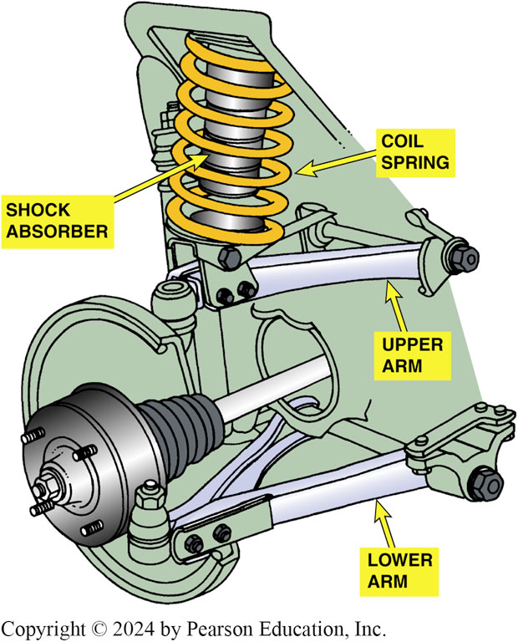
Figure 112.7 SLA Coil on Top
An SLA-type suspension with the coil spring placed on top of the upper control arm

Slide 14
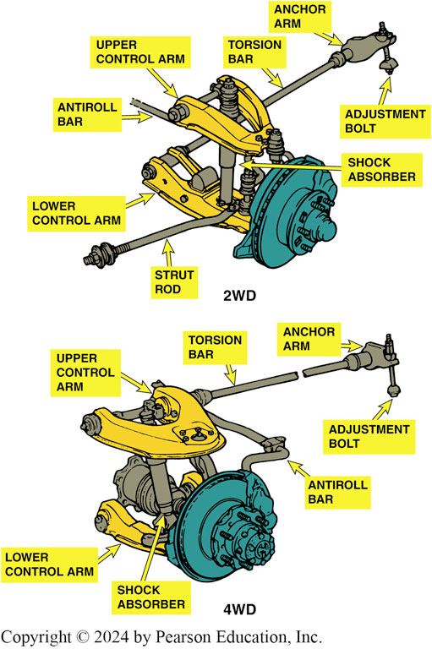
Figure 112.8 SLA Torsion Bar
A torsion bar SLA suspension can use either the lower or the upper control arm

Slide 15
Frequently Asked Question: What Is a Coil-Over-Shock Suspension?
? Frequently Asked Question
What Is a Coil-Over-Shock Suspension? In some applications, the spring and shock absorber are combined to fit within the upper and lower A-arms. This makes for a simple and lightweight front- type suspension and is used in a variety of vehicles including light pickup trucks. ● Figure 112-9.

Slide 16
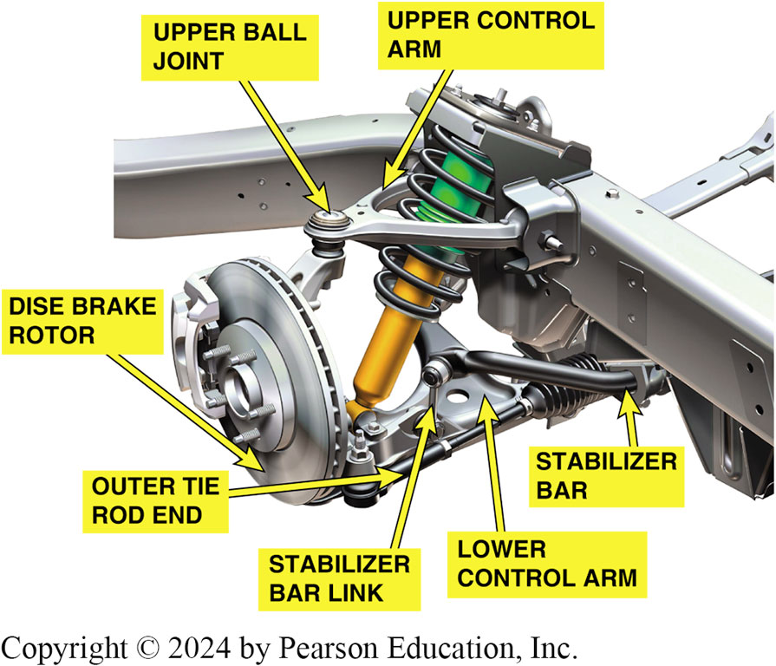
Figure 112.9 SLA Coil Over
An SLA-type suspension that uses a coil-over shock assembly

Slide 17
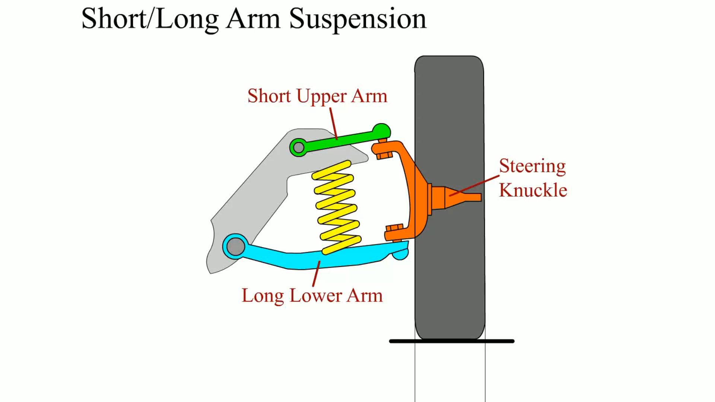
Animation: Shot/Long Arm Suspension
(Animation will automatically start)

Slide 18
Strut Suspension
Parts and Operation
  A MacPherson strut includes the suspension spring that transfers the weight of the body to the wheel.
  A modified strut does not include a spring as part of the assembly.
  A multilink front suspension uses two control arms as well as a structural strut assembly.

Slide 19
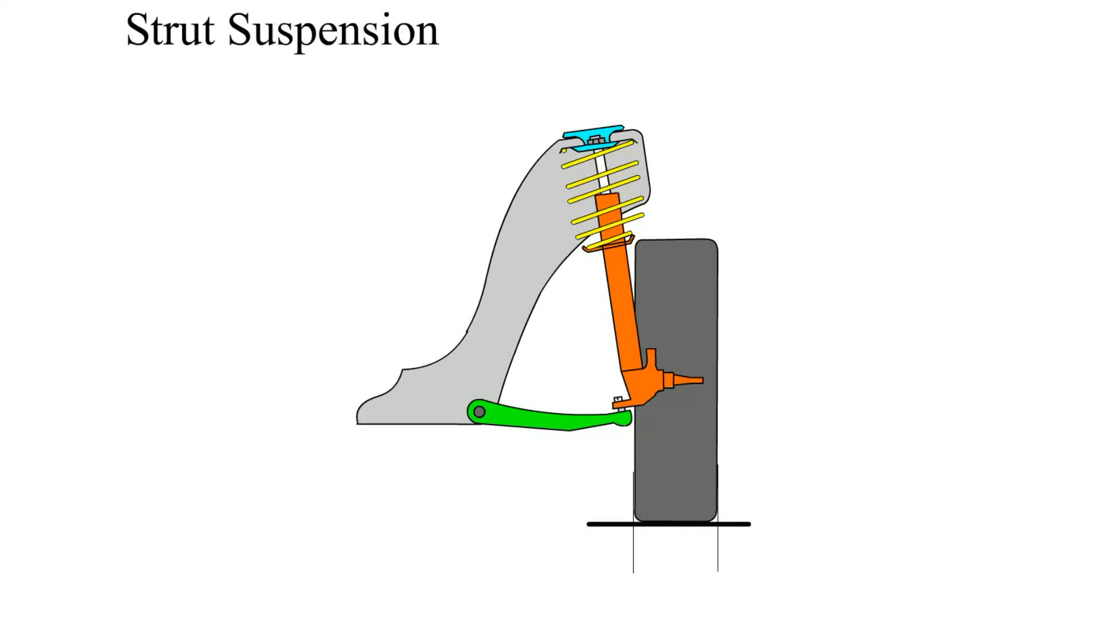
Animation: Strut Suspension
(Animation will automatically start)

Slide 20
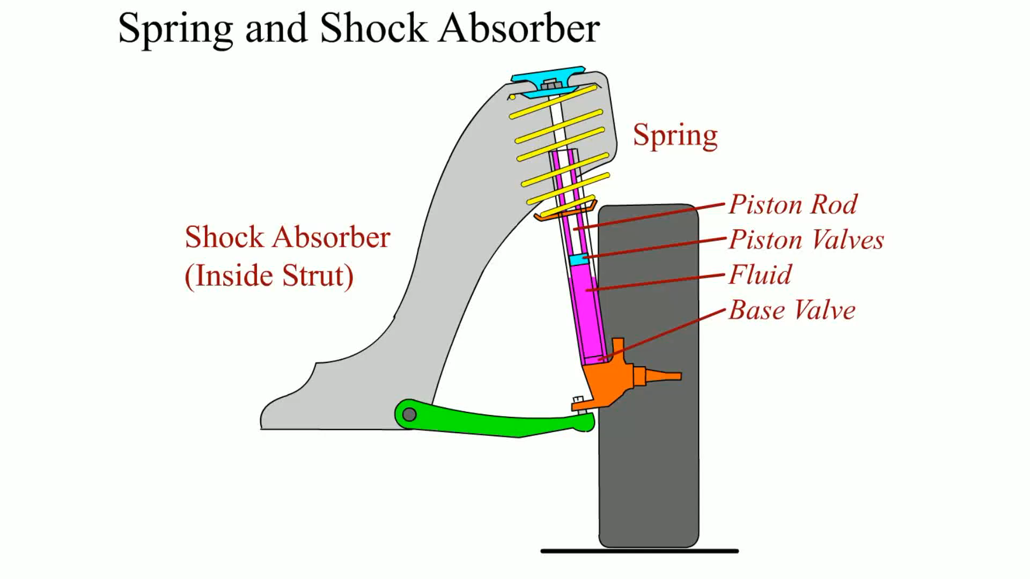
Animation: Spring and Shock Absorber
(Animation will automatically start)

Slide 21
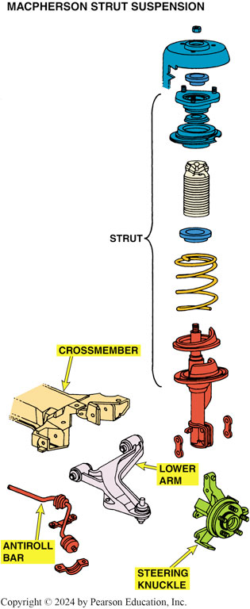
Figure 112.10 MacPherson Strut
A typical MacPherson strut showing all of the components of the assembly. A strut includes the shock and the spring in one structural assembly

Slide 22
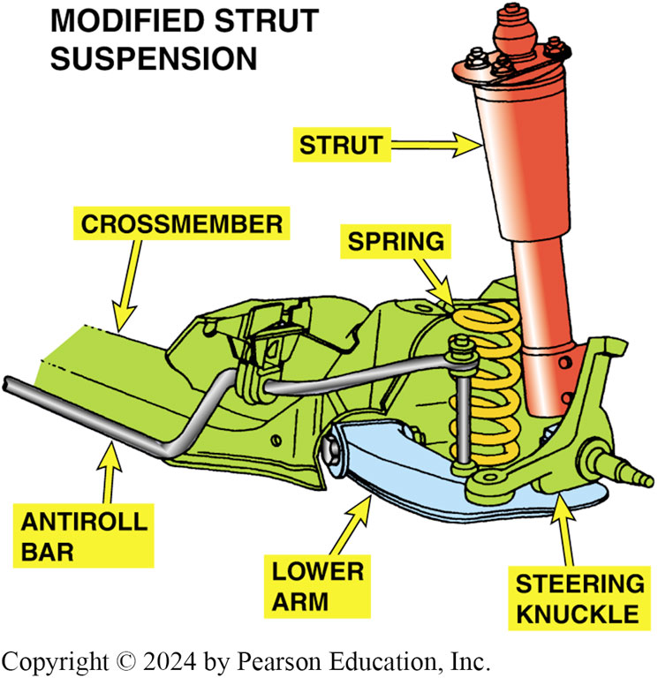
Figure 112.11 Modified Strut Front
The modified strut front suspension is similar to a MacPherson strut suspension except that the coil spring is seated on the lower control arm and is not part of the strut assembly

Slide 23
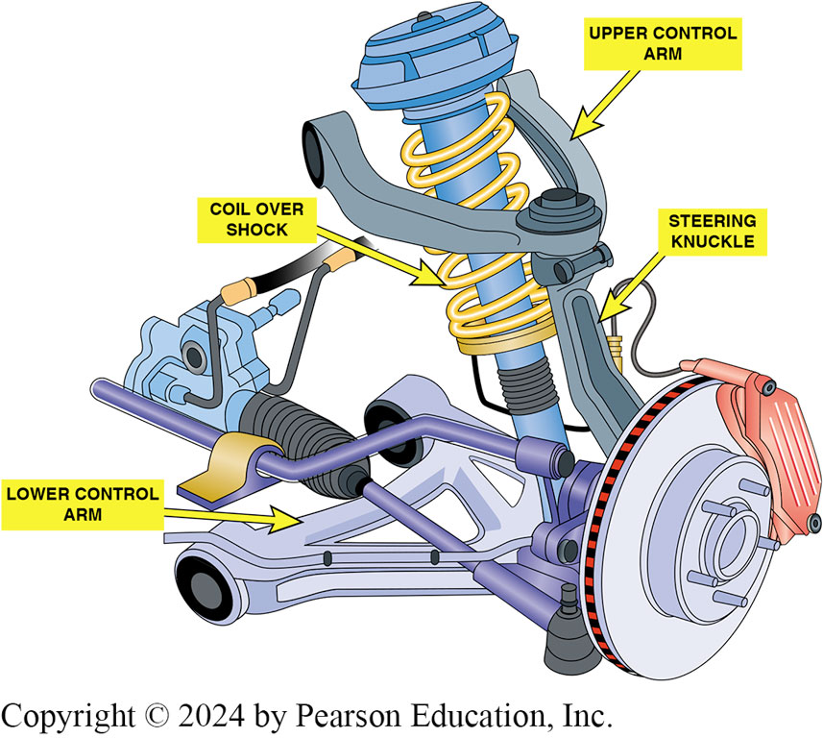
Figure 112.12 Multi-Link Suspension
A typical multilink front suspension system.

Slide 24
Servicing The Suspension System
When the driver notices that the vehicle is not riding or handling as it did, he or she brings it to a technician to repair or align the vehicle.
The smart technician should always road test any vehicle before and after servicing.

Slide 25
Road Test Diagnosis (1 of 2)
A proper road test for any suspension system problem should include the following:
  Drive beside parked vehicles.
  Drive into driveways.
  Drive in reverse while turning.
  Drive over a bumpy road.
Notes:
TECH TIP: Road Test—Before and After
Many times, technicians will start to work on a vehicle based on the description of the problem by the driver or owner. A typical conversation was overheard where the vehicle owner complained that the vehicle handled “funny,” especially when turning. The owner wanted a wheel alignment, and the technician and shop owner wanted the business. The vehicle was aligned, but the problem was still present. The real problem was a defective tire. The service technician should have road tested the vehicle before any service work was done to confirm the problem and try to determine its cause.
Every technician should test-drive the vehicle after any service work is performed to confirm that the service work was performed correctly and that the customer complaint has been resolved. This is especially true for any service work involving the steering, suspension, or braking systems.

Slide 26
Road Test Diagnosis (2 of 2)
While driving, try to determine when and where the noise or problem occurs, such as the following:
  In cold or warm weather
  With cold or warm engine/vehicle
  While turning, left only, right only

Slide 27
Dry Park Test (Suspension)
The dry park test is performed by having an assistant move the steering wheel side to side while feeling and observing for any free-play in the steering or suspension.
In this suspension analysis using the dry park test, the technician should observe the following for any noticeable play or unusual noise:
  Front wheel bearings.
  Control arm bushing wear or movement.
  Ball joint movement.

Slide 28
Visual Inspection
A thorough visual inspection should include checking all of the following:
  Shock absorbers and struts.
  Springs
  Stabilizer bar links and bushings
  Upper and lower shock absorber mounting points
  Bump stops
  Body-to-chassis mounts
  Engine and transmission (transaxle) mounts
  Suspension arm bushings.

Slide 29
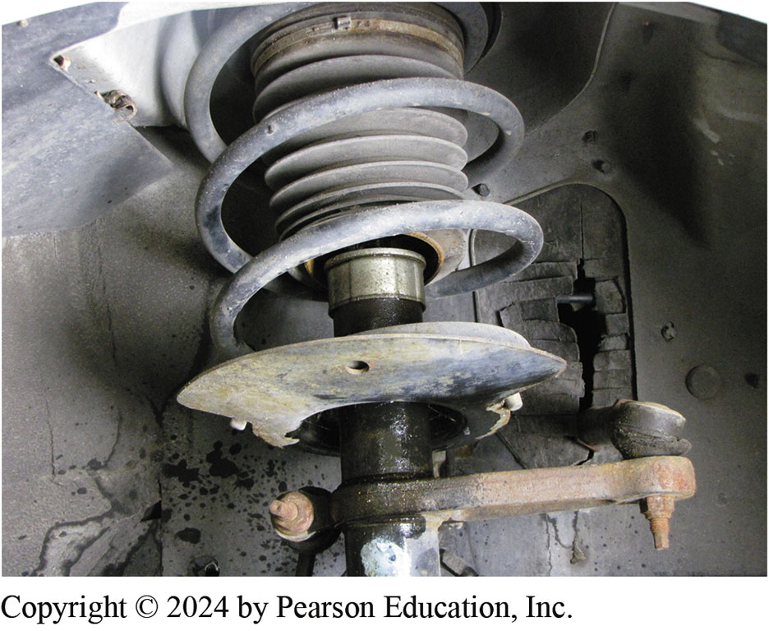
Figure 112.13
A leaking strut. Either a cartridge insert or the entire strut will require replacement. If a light film of oil is seen, this is to be considered normal. If oil is dripping, then this means that the rod seal has failed

Slide 30
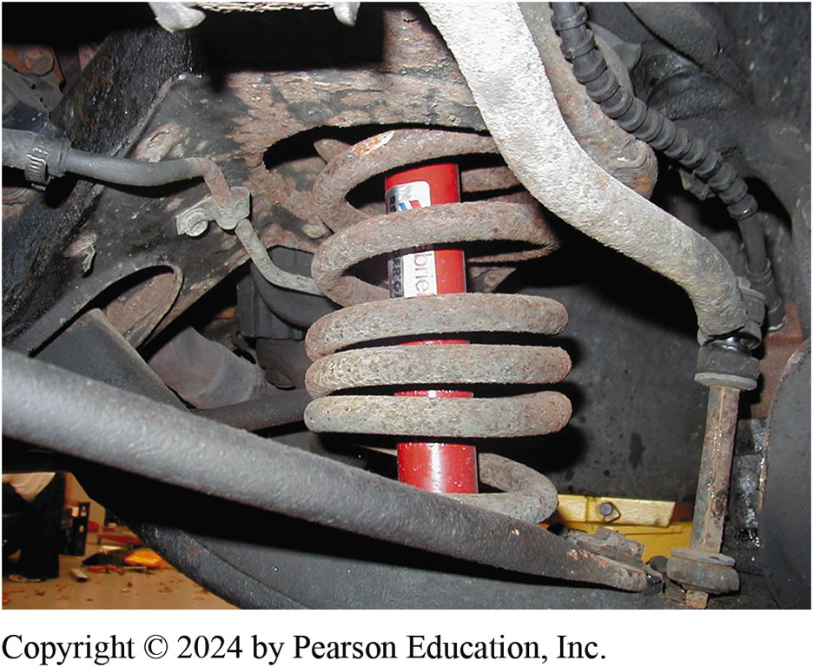
Figure 112.14 Torch Damage
This front coil spring looks as if it has been heated with a torch in an attempt to lower the ride height of the vehicle. Both front springs will require replacement

Slide 31
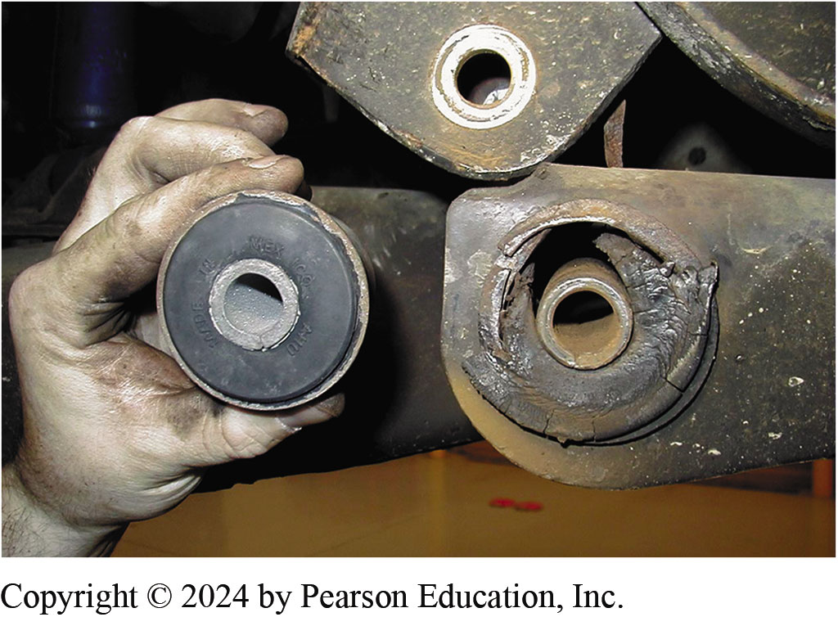
Figure 112.15 Worn Bushings
It is easy to see that this worn control arm bushing needs to be replaced. The new bushing is shown next to the original

Slide 32
Question 1: ?
What is the purpose of the dry park test?

Slide 33
Answer 1
To look for play in components as the steering wheel is turned side-to-side.

Slide 34
Ball Joints (1 of 3)
Diagnosis and Inspection
Defective or worn ball joints can cause looseness in the suspension and the following common driver complaints:
  Loud popping or squeaking whenever driving over curbs, such as into a driveway
  Shimmy-type vibration felt in the steering wheel
  Vehicle wander or a tendency not to track straight
  Excessive freeplay in the steering wheel

Slide 35
Ball Joints (2 of 3)
A ball joint inspection should also be done when an alignment is performed or as part of any other comprehensive vehicle inspection.
  Always check wear-indicator-type ball joints with the wheels of the vehicle on the ground.
  To perform a proper non-indicator-type ball joint inspection, the force of the vehicle’s springs must be unloaded from the ball joint.
Follower ball joints (friction ball joints) should also be inspected while testing load-carrying ball joints.

Slide 36
Ball Joints (3 of 3)
Ball Joint Removal
  The removal procedures vary with the style of ball joint and the design of the suspension system.
  The preferred method to separate ball joints in a puller.
  Use caution so as to not damage any attaching components.
  Follow the manufacturers recommended procedures.
Many vehicles are equipped with non-replaceable ball joints, and the entire control arm must be replaced if the ball joint is worn or defective.

Slide 37
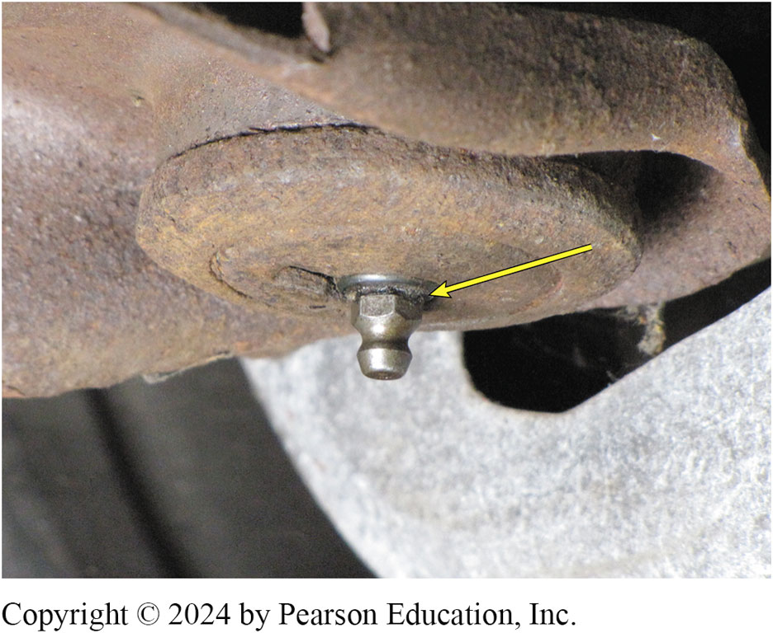
Figure 112.16 Wear Indicator
Grease fitting projecting down from the surrounding area of a ball joint. The ball joint should be replaced when the area around the grease fitting is flush or recessed

Slide 38
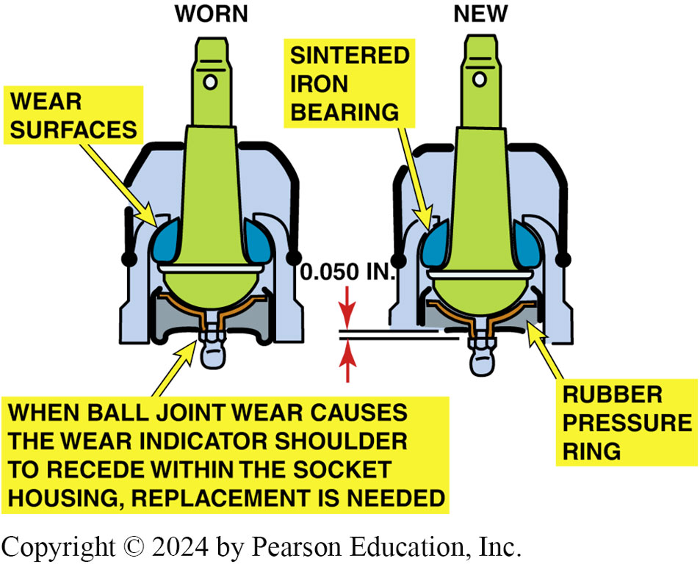
Figure 112.17 Indicator Ball Joints
Indicator ball joints should be checked with the weight of the vehicle on the ground

Slide 39
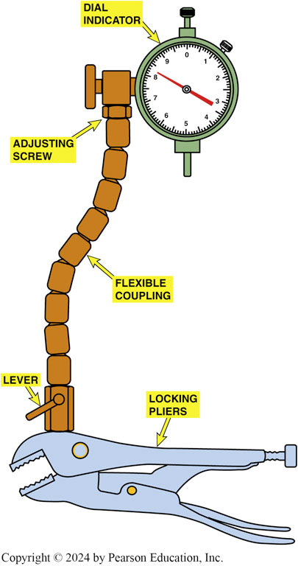
Figure 112.18 Dial Indicator Tool
Typical dial indicator used to measure the suspension component movement. The locking pliers attach the gauge to a stationary part of the vehicle and the flexible coupling allows the dial indicator to be positioned at any angle

Slide 40
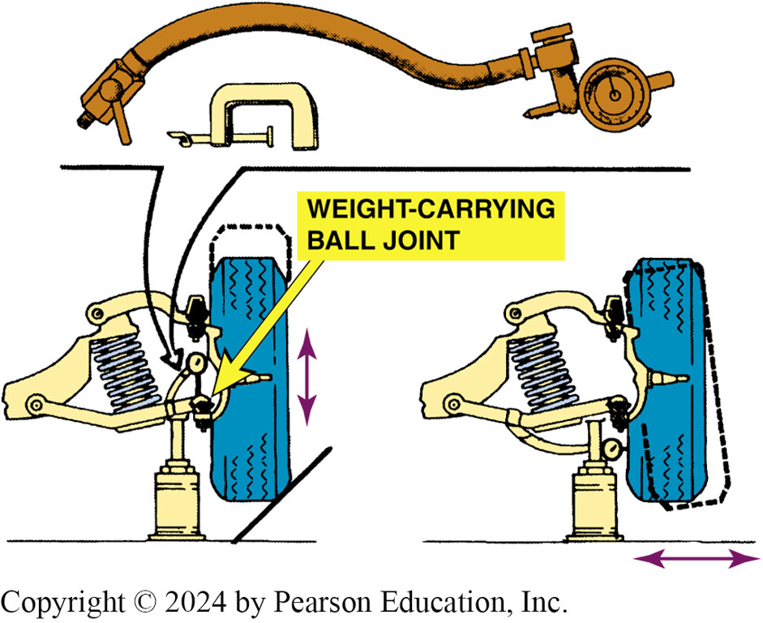
Figure 112.19 Ball Joint Measure
If spring is attached to lower control arm as in this SLA suspension, jack should be placed under the lower control arm as shown. A dial indicator should be used to measure the amount of freeplay in the ball joints

Slide 41
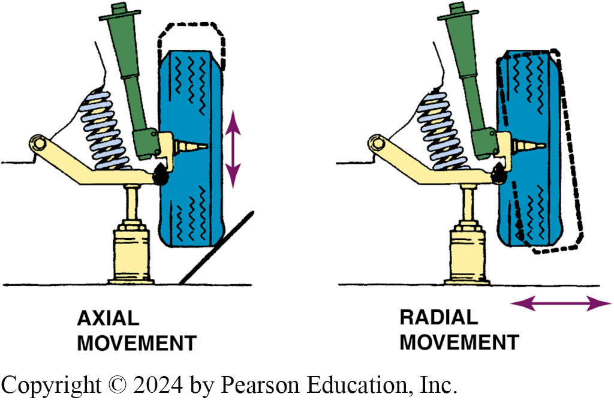
Figure 112.20 Ball Joint Measure
The jack should be placed under the lower control arm of this modified MacPherson-type suspension

Slide 42
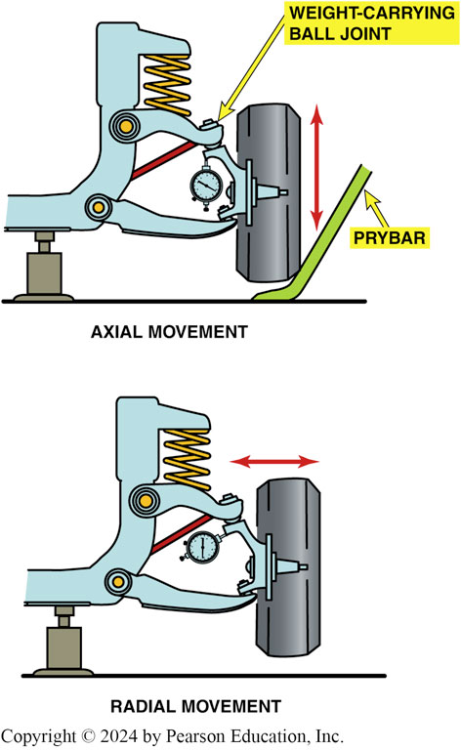
Figure 112.21 Ball Joint Measure
If the spring is attached to the upper control arm, the jack should be placed under the frame to check for ball joint wear

Slide 43
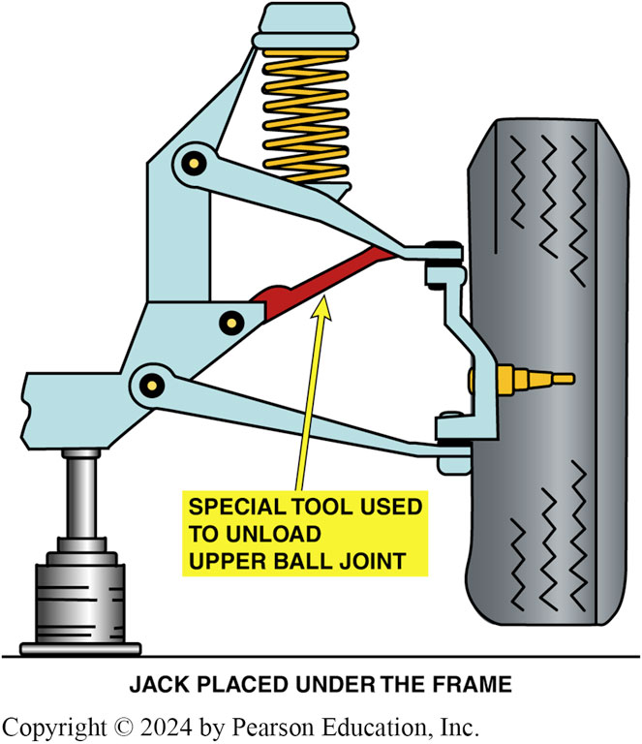
Figure 112.22 Special Tool
A special tool or a block of wood should be inserted between the frame and the upper control arm before lifting the vehicle off the ground. This tool stops the force of the spring against the upper ball joint so that a true test can be performed on the condition of the ball joint.

Slide 44
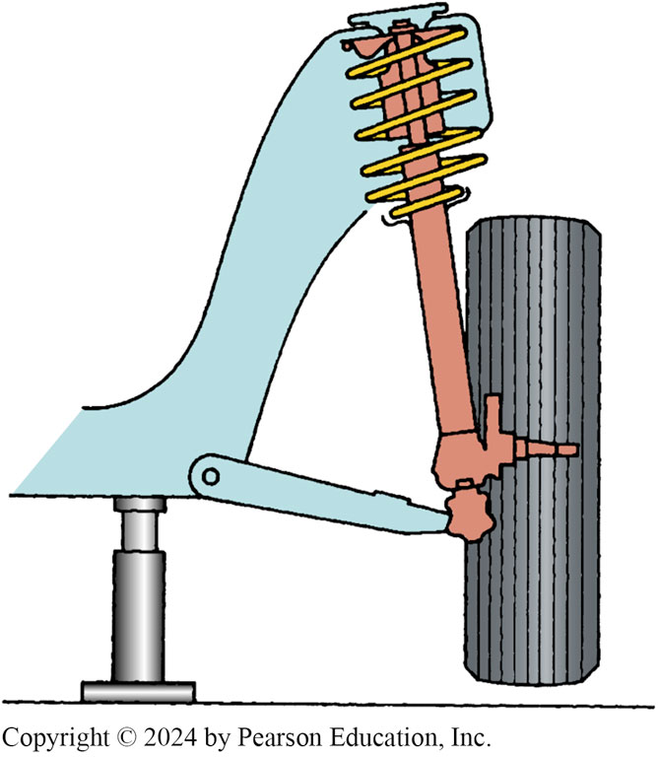
Figure 112.23 Jacking Point
The jacking point is under the frame for checking the play of a lower ball joint used with a MacPherson strut

Slide 45
Frequently Asked Question: What Is the Difference between a Low-Friction Ball Joint and a Steel-on-Steel Ball Joint?
? Frequently Asked Question
What Is the Difference between a Low-Friction Ball Joint and a Steel-on-Steel Ball Joint? Before the late 1980s, most ball joints were constructed with a steel ball that rubbed on a steel socket. This design created friction and provided for a tight high- friction joint until wear caused looseness in the joint. Newer designs use a polished steel ball that is installed in a hard plastic polymer, resulting in a low- friction joint assembly. Because of the difference in friction characteristics, the vehicle may handle differently than originally designed if incorrect- style ball joints are installed. Most component manufacturers state that low-friction ball joints in a vehicle originally equipped with steel-on-steel high- friction ball joints are usually acceptable, but high-friction replacement ball joints should be avoided on a vehicle originally equipped with low-friction ball joints.

Slide 46
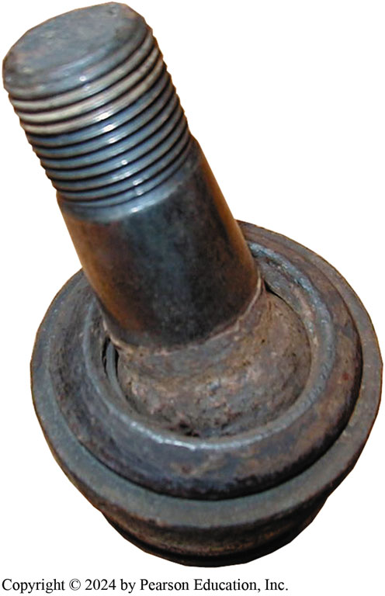
Figure 112.24 Worn & Rusty Joint
This worn and rusty ball joint was found by moving the wheel and looking for movement in the joint

Slide 47
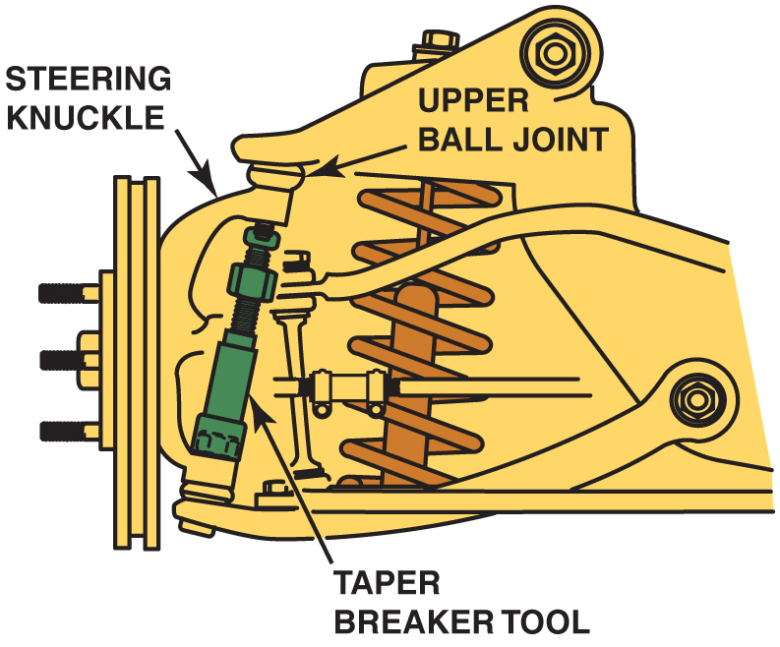
Figure 117.26

Slide 48
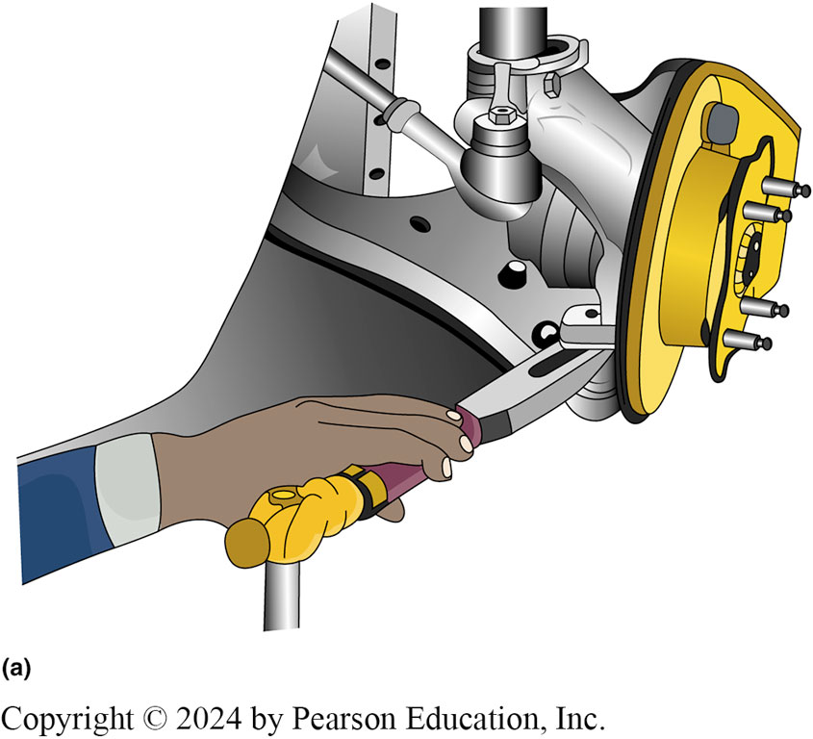
Figure 112.25a Breaker Tool
(a)Taper breaker tool being used to separate the upper ball joint from the steering knuckle. However, this tool will destroy the dust boot and should only be used if the ball joint is going to be replaced.

Slide 49
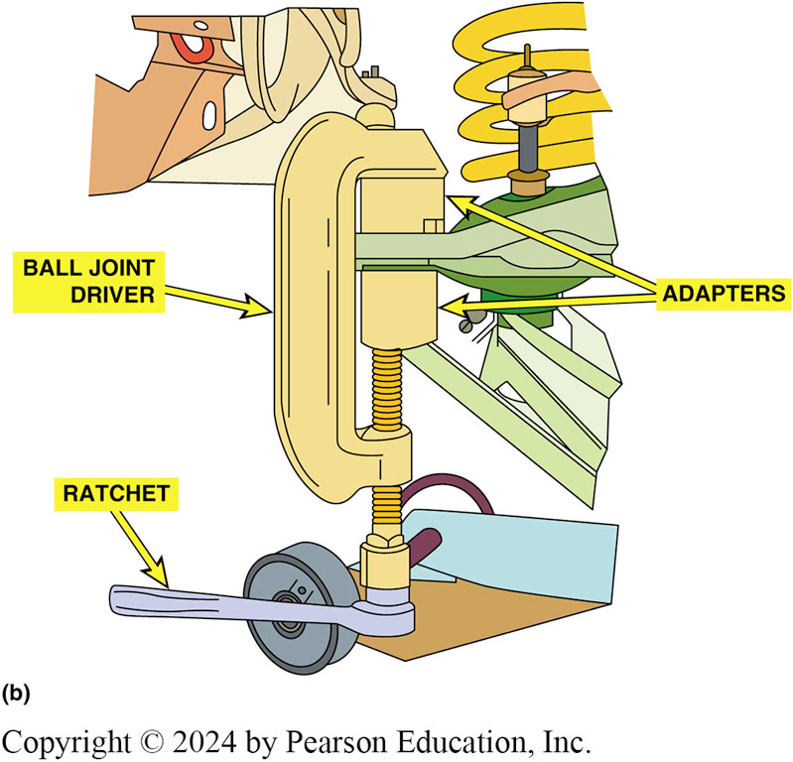
Figure 112.25b Ball-Joint Press
(b) A ball-joint press is the most recommended tool to use when removing or installing ball joints.

Slide 50
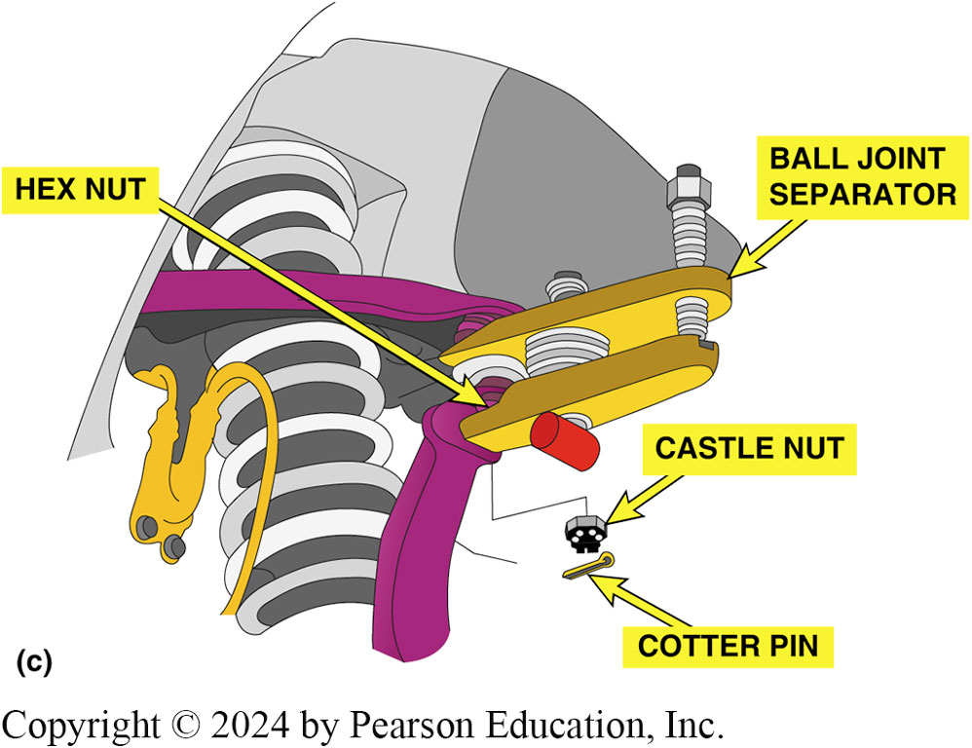
Figure 112.25c Spreader-Type Tool
(c) A spreader-type tool being used to separate the tapered stud from the steering knuckle. Often striking the knuckle with a heavy hammer is enough to “break the taper” of the stud and release it from the knuckle..

Slide 51
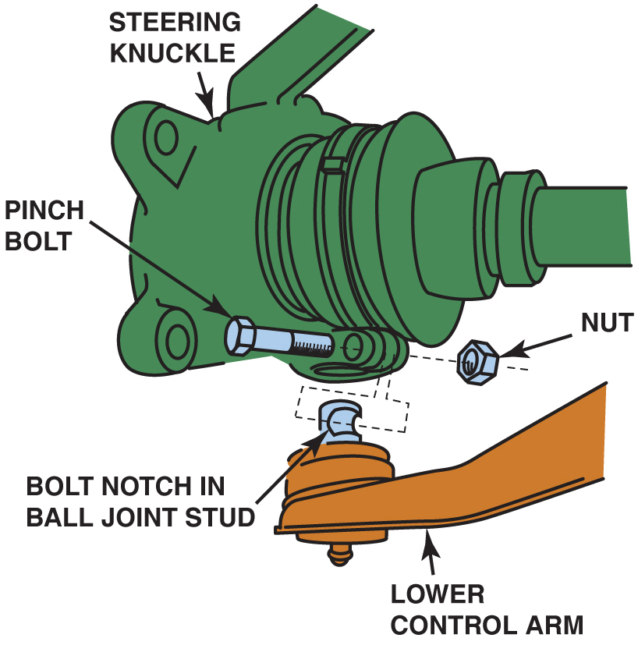
Figure 117.27

Slide 52
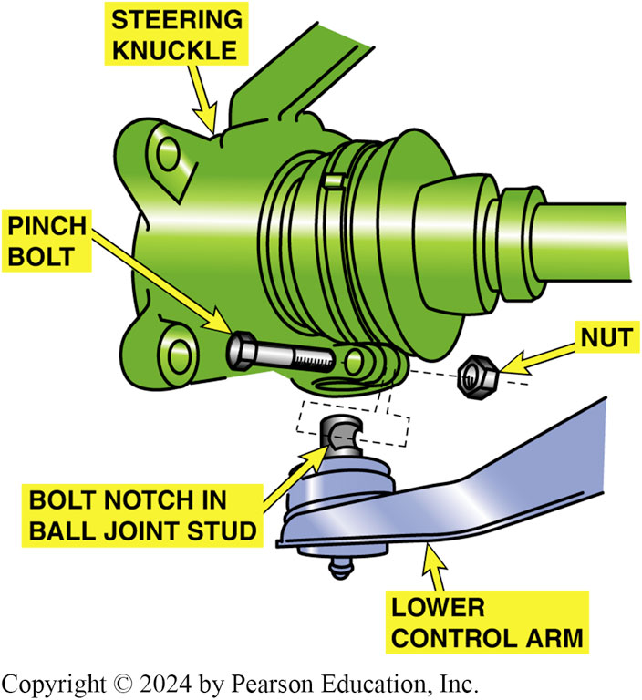
Figure 112.26 Pinch Bolt
A pinch bolt attaches the steering knuckle to the ball joint. Remove the pinch bolt by turning the nut, not the bolt

Slide 53
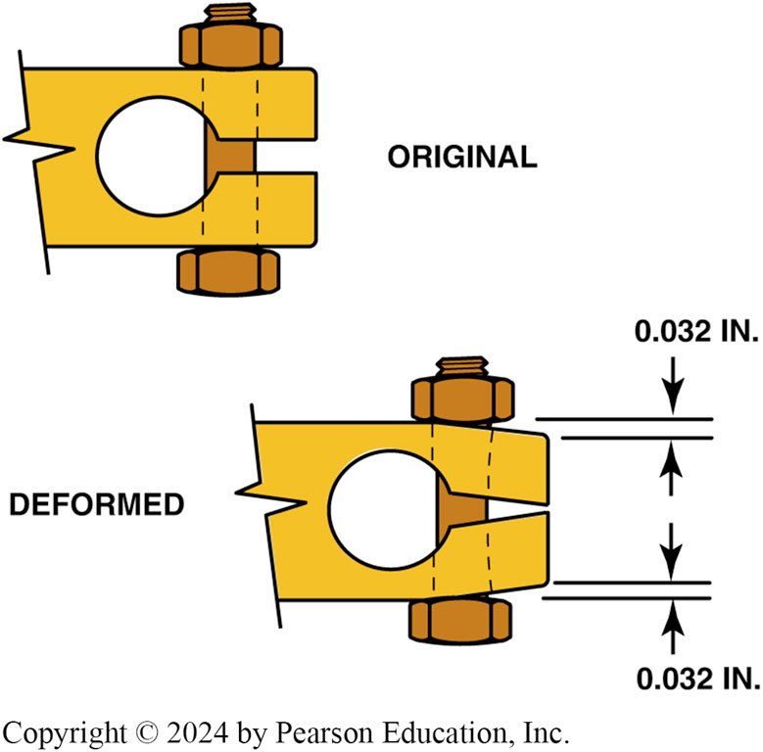
Figure 112.27 Pinch Bolt Tighten
If the pinch bolt is overtightened, the steering knuckle can be deformed. A deformed knuckle can cause the pinch bolt to break and the ball joint could become separated from the steering knuckle

Slide 54
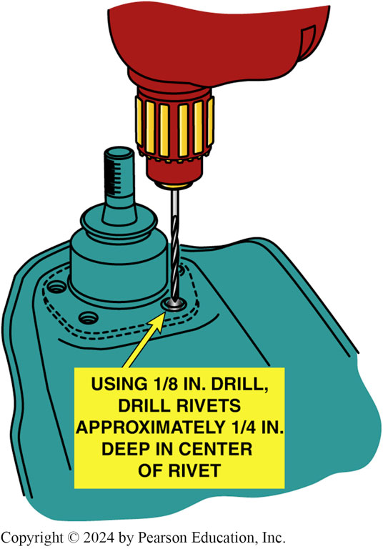
Figure 112.28 Drilling Into Rivet
By drilling into the rivet, the holding force is released

Slide 55
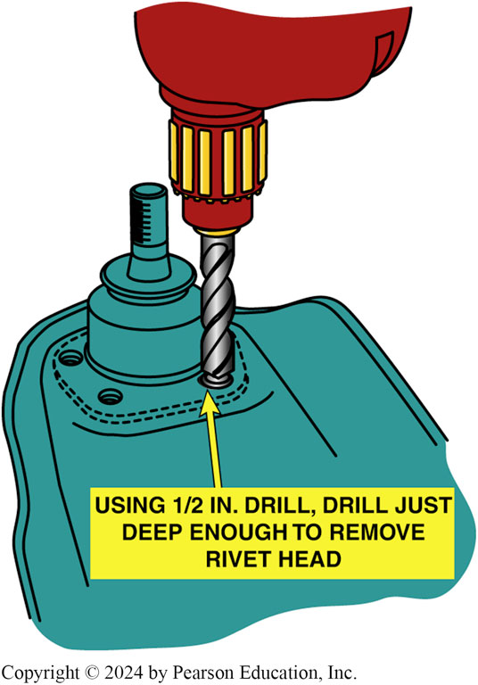
Figure 112.29 Larger Drill
The head of the rivet can be removed by using a large-diameter drill bit as shown

Slide 56
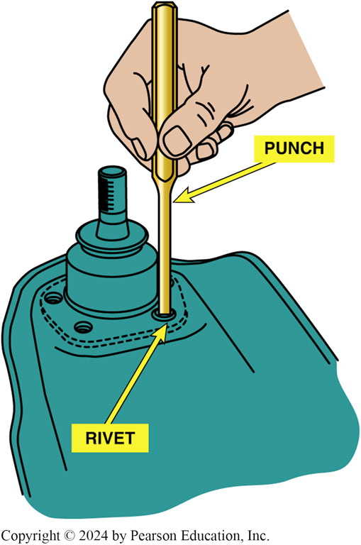
Figure 112.30 Punch & Hammer
A punch and a hammer being used to remove a rivet after the head has been removed

Slide 57
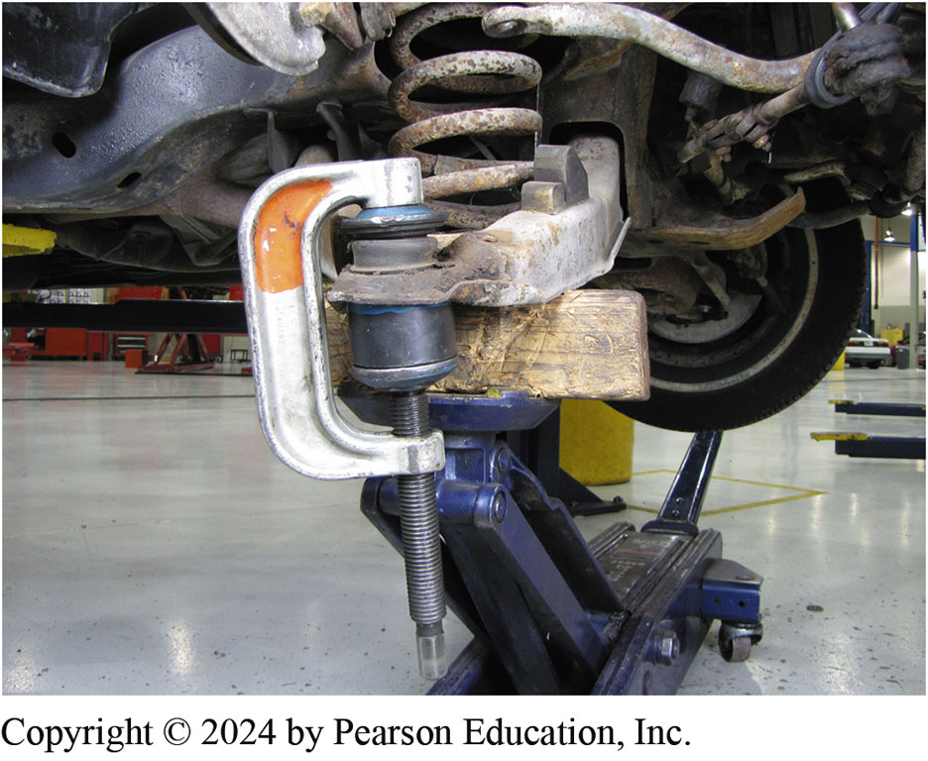
Figure 112.31 Lower Ball Joint Press
Press-in ball joints are best removed using a large C-clamp press, as shown
Notes:
CASE STUDY: The Rattle Story
A customer complained that a rattle was heard every time the vehicle hit a bump. The noise sounded as if it came from the rear. All parts of the exhaust system and suspension system were checked. Everything seemed okay until the vehicle was raised with a frame- type hoist instead of a drive-on type. Then, whenever the right rear wheel was lifted, the noise occurred.
The problem was a worn (elongated) shock absorber mounting hole. A washer with the proper-size hole was welded over the worn lower frame mount and the shock absorber was bolted back into place.
Summary:
Complaint—Vehicle owner complained of a rattle sound from the rear suspension at times.
Cause—The lower shock mount was found to be worn (elongated) causing the noise.
Correction—A steel washer was welded over the worn lower frame mount which restored the shock mount to the correct size and solved the noise issue.

Slide 58
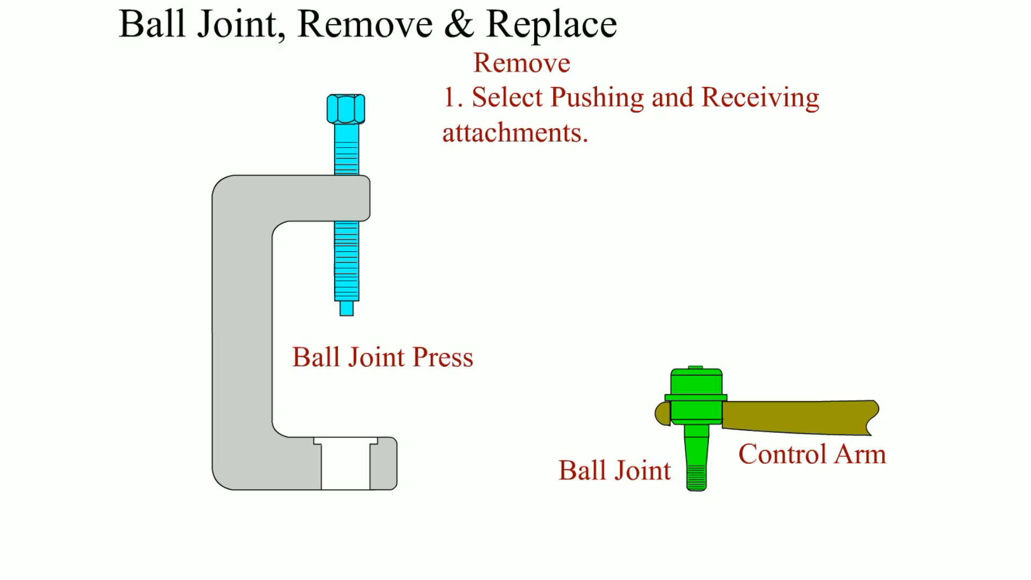
Animation: Ball Joint, Remove & Replace
(Animation will automatically start)

Slide 59
Question 2: ?
What are the symptoms of a defective ball joint?

Slide 60
Answer 2
Noise, shimmy, wander, and excessive freeplay in the steering.

Slide 61
Shock Absorbers and Struts (1 of 2)
Diagnosis
Replacement of shock absorbers may be required when any or all of the following symptoms appear:
  Ride harshness.
  Frequent bottoming out on rough roads.
  Extended vehicle movement after driving on dips or a rise in the road.
  Cuppy-type tire wear.
  Leaking hydraulic oil.
Notes:
TECH TIP: The Shock Stud Trick
Front shock absorbers used on many rear-wheel-drive vehicles equipped with an SLA-type front suspension are often difficult to remove because the attaching nut is rusted to the upper shock stub. A common trick is to use a deep-well 9/16 inch socket and a long extension and simply bend the shock stud until it breaks off.
At first you would think that this method causes harm, and it does ruin the shock absorber—but the shock absorber is not going to be reused and will be discarded anyway. The usual procedure followed by many technicians is to simply take a minute or two to break off the upper shock stud, then hoist the vehicle to allow access to the lower two shock bolts, and then the shock can easily be removed. To install the replacement shock absorber, attach the lower bolts, lower the vehicle, and attach the upper rubber bushings and retaining nut.

Slide 62
Shock Absorbers and Struts (2 of 2)
Front Shock Replacement
  Most front shock absorbers can be replaced either with the vehicle still on the ground or while on a hoist.
  Special sockets and other tools are available to remove the nut from the shocks that use a single mounting stem.
  The removal of the lower mounting of most front shock absorbers usually involves the removal of two bolts.
  Reverse the removal procedure to install replacement shock absorbers.

Slide 63
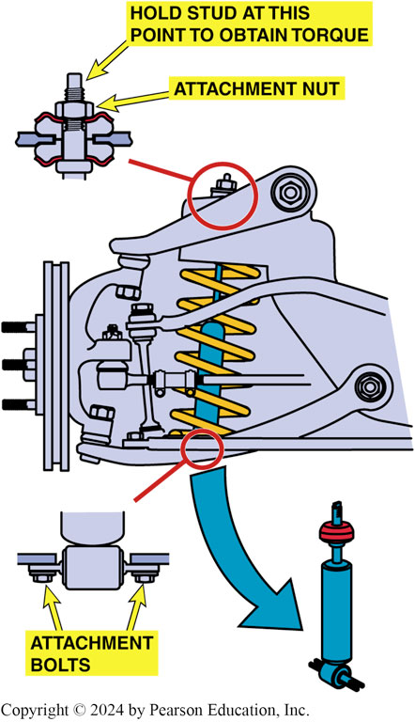
Figure 112.32 Shock Absorber SVC
Most shock absorbers used on the front suspension can be removed from underneath the vehicle after removing the attaching bolts or nuts

Slide 64
Macpherson Strut Replacement (1 of 2)
On most vehicles equipped with MacPherson strut suspensions, strut replacement involves the following steps.
  Hoist the vehicle, remove the wheels, and mark the attaching bolts/nuts.
  Remove the upper strut mounting bolts except for one to hold the strut until ready to remove the strut assembly.
  Remove the brake caliper or brake hose from the strut housing.

Slide 65
Macpherson Strut Replacement (2 of 2)
Replacement Step Continued…
  After removing all lower attaching bolts, remove the final upper strut bolt and remove the strut assembly from the vehicle.
  Place the strut assembly into a strut spring compressor fixture.
  Compress the coil spring enough to relieve the tension on the strut rod nut.
  After removing the strut rod nut, remove the upper strut bearing assembly and the spring.

Slide 66
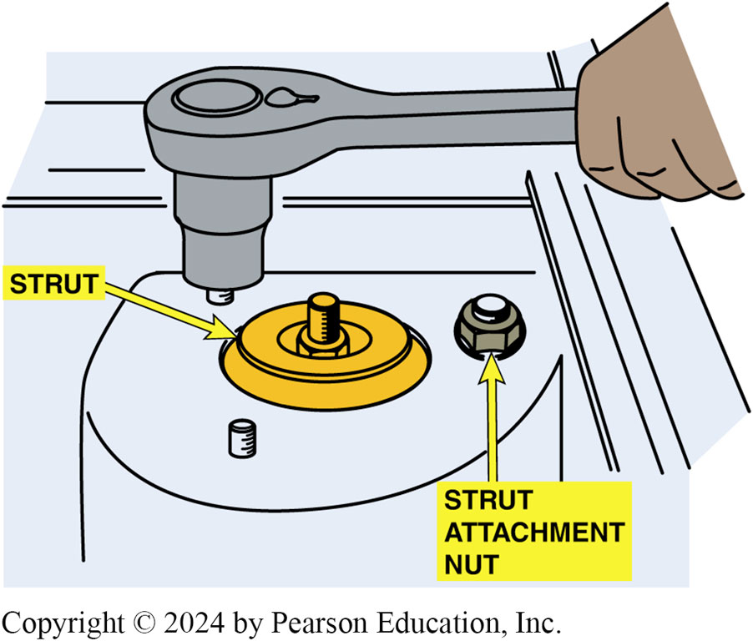
Figure 112.33 Strut Removal
Removing the upper strut mounting bolts. Some experts recommend leaving one of the upper strut mount nuts loosely attached to prevent the strut from falling when the lower attaching bolts are removed

Slide 67
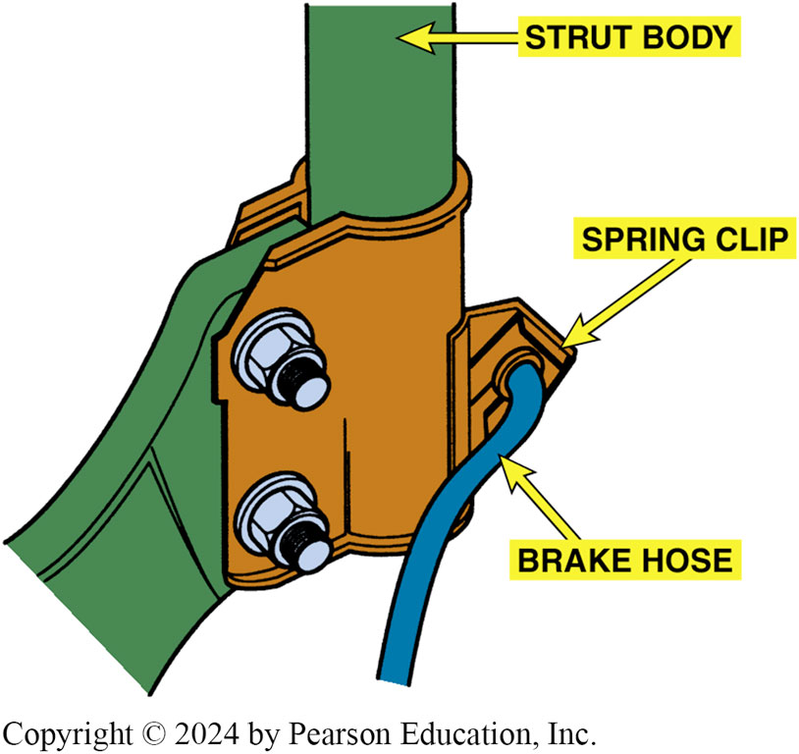
Figure 112.34 Brake Hose at Strut
A brake hydraulic hose is often attached to the strut housing. Sometimes all that is required to separate the line from the strut is to remove a spring clip

Slide 68
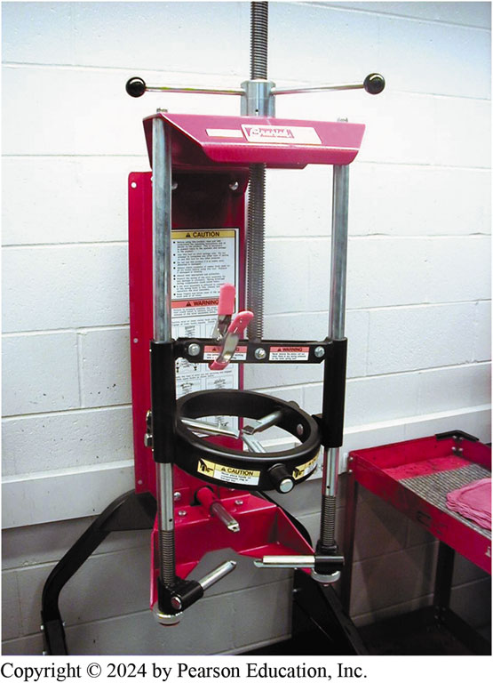
Figure 112.35 Strut Compressor
Use a strut spring compressor fixture to compress the spring on a MacPherson strut before removing the strut retaining nut

Slide 69
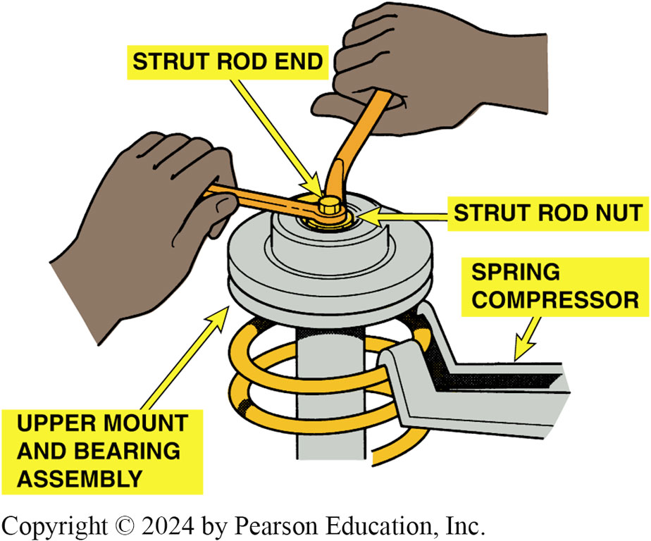
Figure 112.36 Remove Strut Rod Nut
Removing the strut rod nut. The strut shaft is being helped with one wrench while the nut is being removed with the other wrench. Notice that the spring is compressed before the nut is removed

Slide 70
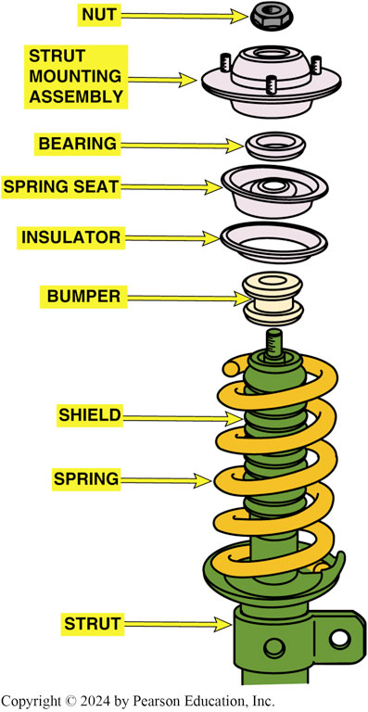
Figure 112.37 Strut Components
Typical MacPherson strut showing the various components

Slide 71
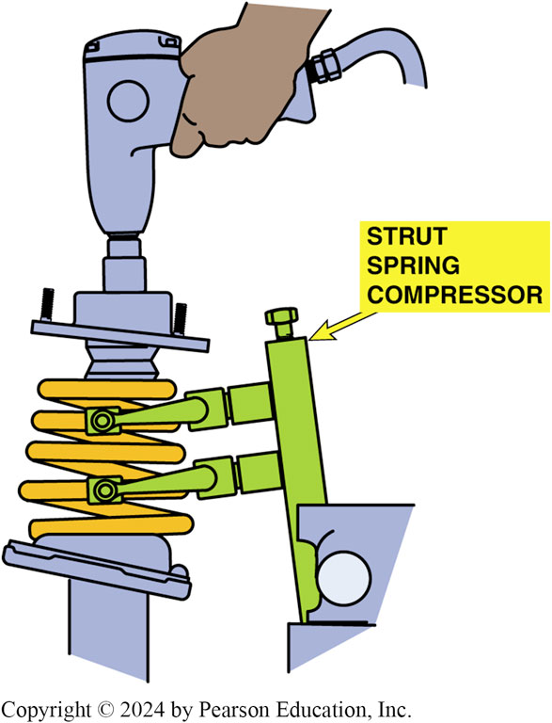
Figure 112.38 Tightening Nut
After installing the replacement strut cartridge, reinstall the spring and upper bearing assembly after compressing the spring. Notice that the strut is being held in a strut spring compressor fixture

Slide 72
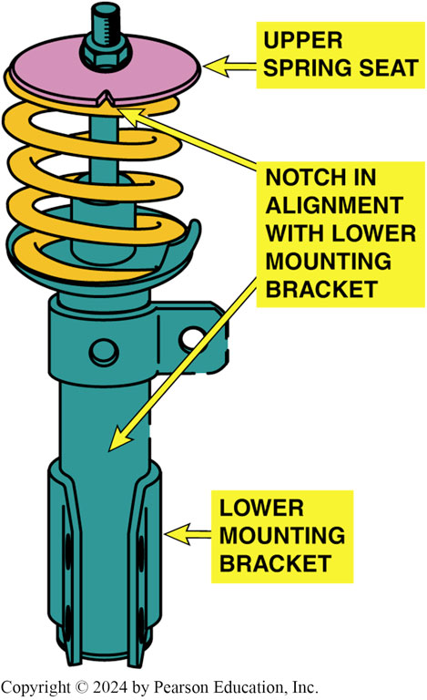
Figure 112.39 Aligning Marks
Before final assembly, make sure the marks you made are aligned. Some struts are manufactured with marks to ensure proper reassembly

Slide 73
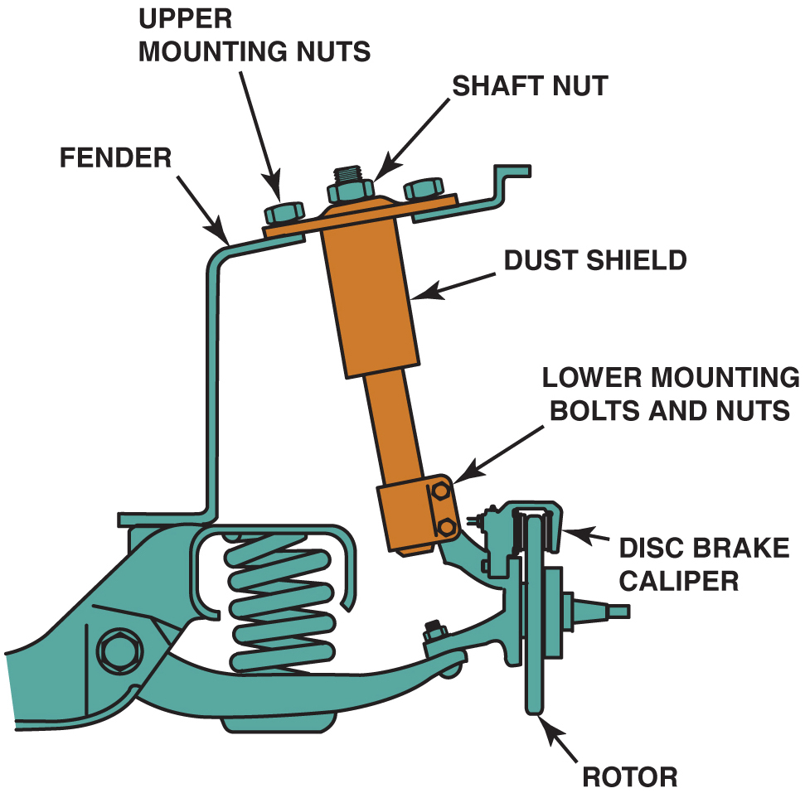
Figure 117.44

Slide 74
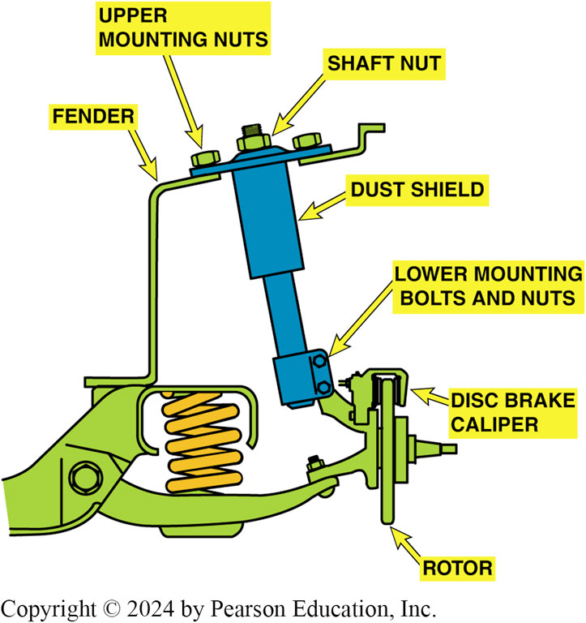
Figure 112.40 Modified Strut
The strut on a modified MacPherson strut assembly can be replaced by removing the upper mounting nuts

Slide 75

Animation: Strut Assembly, Disassemble
(Animation will automatically start)

Slide 76

Animation: Strut Rod, Remove & Replace
(Animation will automatically start)

Slide 77
Stabilizer Bar Links and Bushings
Diagnosis
  The most common symptom of defective stabilizer bar links or bushings is noise while turning, especially over bumps.
Replacement
  Stabilizer links are usually purchased as a kit consisting of replacement rubber bushings, retainers, a long bolt, and spacer with a nut and lock nut.
  Stabilizer bar bushing replacement involves the removal (unbolting) of the bushing retainers that surround the bushing.

Slide 78

Figure 112.41 Stabilizer Bar Links
Stabilizer bar links should be replaced as a pair

Slide 79

Animation: Stabilizer Bar, Remove & Replace
(Animation will automatically start)

Slide 80
Strut Rod Bushings
Diagnosis
  When strut rod bushings fail, the lower control arm can move forward and backward during braking or when hitting bumps in the road.
Replacement
  The strut rod must be removed from the vehicle and then the replacement rubber bushings can be installed.

Slide 81

Figure 112.42 Strut Rod
A strut rod as viewed from the front of the vehicle

Slide 82
Animation: Strut Rod, Remove & Replace
(Animation will automatically start)

Slide 83

Figure 112.43 Strut Rod Bushing
Typical strut rod bushing with rubber on both sides of the frame to help isolate noise, vibration, and harshness from being transferred to the passengers

Slide 84
Front Coil Springs
Diagnosis
  Sagging springs can cause the vehicle to bottom out against the suspension bumpers, and cause the tires to slide laterally (side to side) across the pavement.
Replacement
  Springs should be replaced in pairs.
  Several aftermarket alternatives are available.
  Care should be exercised when compressing a spring.
  Follow manufacturers procedures when replacing springs.

Slide 85

Figure 112.44 Sagging Springs
Notice that if the front coil springs are sagging, the resulting angle of the lower control arm causes the wheels to move from side to side as the suspension moves up and down. Note the difference between the distance at “A” with good springs and the distance at “B” with sagging springs

Slide 86

Figure 112.45 Spring Compressor
A spring compressor is required by most vehicle manufacturers to be used whenever disassembling a coil spring suspension system
Notes:
CASE STUDY: The Rock-Hard Problem
The owner of a six-month-old full-size pickup truck complained that occasionally when the truck was driven up into a driveway, a loud grinding sound was heard.
Several service technicians worked on the truck, trying to find the cause for the noise. After the left front shock absorber was replaced, the noise did not occur for two weeks and then started again. Finally, the service manager told the technician to replace anything and everything in the front suspension in an attempt to solve the customer’s intermittent problem. Five minutes later, a technician handed the service manager a small, deformed rock. This technician had taken a few minutes to carefully inspect the entire front suspension. Around the bottom coil spring seat, the technician found the rock. Apparently, when the truck made a turn over a bump, the rock was forced between the coils of the coil spring, making a very loud grinding noise. But the rock did not always get between the coils. Therefore, the problem occurred only once in a while. The technician handed the rock to the very happy customer.
Summary:
Complaint—Vehicle owner complained of loud grinding sound from the front suspension at times.
Cause—A rock was found at the bottom of the coil spring seat.
Correction—The rock was removed.

Slide 87

Animation: Spring Remove & Replace
(Animation will automatically start)

Slide 88

Figure 112.46 Disconnected Knuckle
The steering knuckle has been disconnected from the lower ball joint. The lower control arm and the coil spring are being held up by a floor jack

Slide 89

Figure 112.47 Support Upper Arm
A rubber mallet is being used to support the upper control arm as the lower control is being lowered using a floor jack. After all of the tension has been removed from the coil spring, it can be removed and the replacement installed

Slide 90

Animation: Upper Control Arm, Remove and Replace
(Animation will automatically start)

Slide 91

Figure 112.48 Spring Insulators
Spring insulators are installed between the spring seat and the coil spring to reduce noise

Slide 92

Figure 112.49 Water Drain
The holes in the lower arm are not only used to allow water to drain from the spring seat, but also used as a gauge to show the service technician that the coil spring is correctly seated

Slide 93
Question 3: ?
What are the symptoms of a failed coil spring?

Slide 94
Answer 3
Vehicle sags, suspension bottoms out and tire slide on the pavement.

Slide 95
Steering Knuckles
Diagnosis
  Unless a thorough inspection is performed during a wheel alignment, a bent steering knuckle is often overlooked.
Replacement
  If the steering knuckle is bent or damaged, it must be replaced.

Slide 96

Animation: Steering Knuckle, Remove & Replace
(Animation will automatically start)

Slide 97
Torsion Bars
Adjustment
  Most torsion bar suspensions are designed with an adjustable bolt to permit the tension on the torsion bar to be increased or decreased to change the ride height.
  Adjustments are typically made during an alignment.

Slide 98

Figure 112.50 Torsion Bar Adjust
By rotating the adjusting bolt, the vehicle can be raised or lowered

Slide 99
Control Arm Bushings
Diagnosis
  Defective control arm bushings are a common source of vehicle handling and suspension noise problems.
Replacement
  To remove an old bushing from a control arm, the control arm must first be separated from the suspension and/ or frame of the vehicle.
  Bushings typically pressed in and out of control arm.
  Some bushings are not serviceable.

Slide 100

Animation: Control Arm Bushing, Remove & Replace
(Animation will automatically start)

Slide 101

Figure 112.51 Replacing Bushings
An adapter and a press or large clamp are used to remove the old bushing from the control arm and to install a new bushing

Slide 102
Strut Replacement

Slide 103

1. Tools Needed
1. The tools needed to replace a front strut assembly include several sockets and a ball-peen hammer, plus a strut compressor

Slide 104

2. Remove Wheels
2. After safely hoisting the vehicle to elbow height and removing the wheel covers, remove the front tire/wheel assembly

Slide 105

3. Strut Retaining Nuts
3. Remove the two strut retaining nuts

Slide 106

4. Remove Bolts from Knuckle
4. Before using a hammer to drive the retaining bolts from the steering knuckle, thread the nut into the bolt backwards to prevent causing damage to the threads

Slide 107

5. Separate Strut from Knuckle
5. Remove the retaining bolts and separate the strut from the steering knuckle

Slide 108

6. Remove Strut Retaining Bolts
6. Lower the vehicle and remove the upper strut retaining fasteners

Slide 109

7. Remove Strut from Vehicle
7. Hold the strut while removing the last upper retaining nut and then remove the strut assembly

Slide 110

8. Install Strut in Compressor
8. After the strut has been removed from the vehicle, install the assembly into a strut compressor

Slide 111

9. Jaws Under Bearing
9. Position the jaws of the compressor under the bearing assembly as per the vehicle manufacturer’s instructions

Slide 112

10. Turn Compressor Wheel
10. Turn the compressor wheel until all tension of the spring has been relieved from the upper bearing assembly

Slide 113

11. Remove Strut Retaining Nut

Slide 114

12. Remove Strut Assembly

Slide 115

13. Check Bearing for Roughness
13 Before installing the replacement strut, check the upper bearing by exerting a downward force on the bearing while rotating and check for roughness. Replace if necessary.

Slide 116

14. Install New Strut
14. Install the strut from underneath the spring compressor fixture

Slide 117

15. Install Strut Retaining Nut
15. Install the strut retaining nut. Most vehicle manufacturers specify that the strut retaining nut be replaced and the old one discarded

Slide 118

16. Check Coil Location
16. Before loosening the tension, check that the coil spring is correctly located at both the top and the bottom, then release the tension on the spring

Slide 119

17. Install Strut in Vehicle
17. Remove the strut assembly from the compressor and back of the vehicle and install the upper fasteners. Do not torque to specifications until the lower fasteners have been installed.

Slide 120

18. Attach Lower Strut
18. Attach the lower strut to the steering knuckle using the original hardened bolts and nuts

Slide 121

19. Torque All Fasteners
19. Using a torque wrench, torque all fasteners to factory specifications

Slide 122

20. Install Wheels
20. Install the tire/wheel assembly, lower the vehicle, and torque the lug nuts to factory specifications. Align the vehicle before returning it to the customer

Slide 123
Suspension and Steering Videos and Animations
Videos Link: (A4) Suspension and Steering Videos
Animations Link: (A4) Suspension and Steering Animations

Slide 124
Animation: Strut Rod, Remove & Replace
(Animation will automatically start)

Slide 125
Suspension and Steering Videos and Animations
Videos Link: (A4) Suspension and Steering Videos
Animations Link: (A4) Suspension and Steering Animations

Slide 126
Copyright
This work is protected by United States copyright laws and is provided solely for the use of instructors in teaching their courses and assessing student learning. Dissemination or sale of any part of this work (including on the World Wide Web) will destroy the integrity of the work and is not permitted. The work and materials from it should never be made available to students except by instructors using the accompanying text in their classes. All recipients of this work are expected to abide by these restrictions and to honor the intended pedagogical purposes and the needs of other instructors who rely on these materials.

