Slide 1
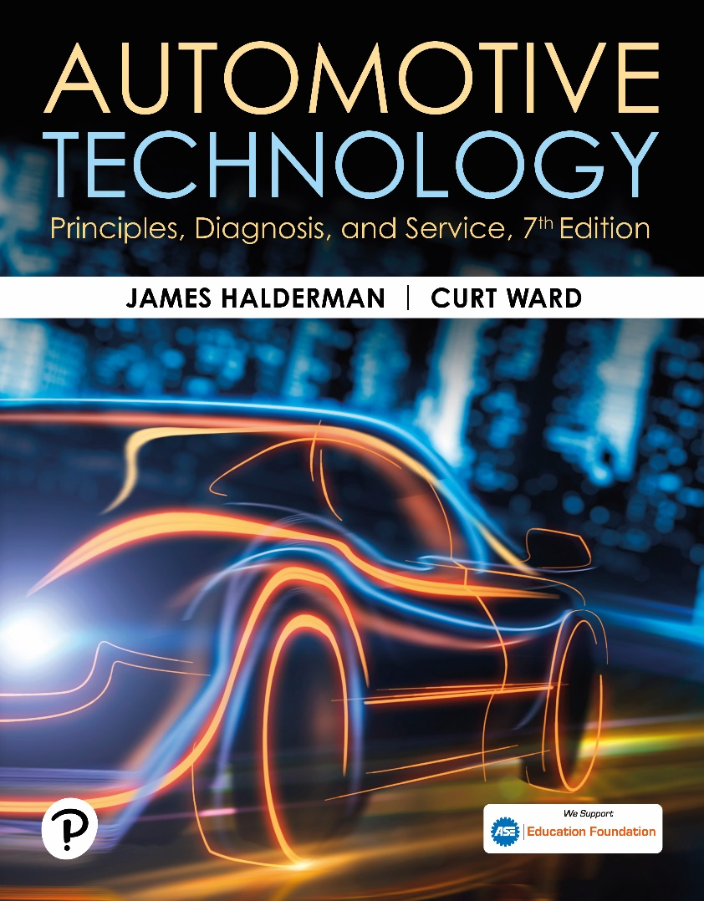
Automotive Technology: Principles, Diagnosis, and Service
Seventh Edition
Chapter 111
Suspension System Principles and Components
Copyright © 2023 Pearson Education, Inc. All Rights Reserved
Notes:
INSTRUCTOR NOTE: This presentation includes text explanation notes, you can use to teach the course. When in SLIDE SHOW mode, you RIGHT CLICK and select SHOW PRESENTER VIEW, to use the notes.

Slide 2
Learning Objectives (1 of 2)
111.1 Discuss vehicle frames.
111.2 Discuss vehicle platforms.
111.3 Discuss types of suspensions.
111.4 Define Hooke’s law.
111.5 Explain how coil springs work.
111.6 Explain how leaf springs work.
111.7 Explain how torsion bars work.

Slide 3
Learning Objectives (2 of 2)
111.8 Explain suspension principles and the components of a suspension system.
111.9 Describe how shock absorbers work.
111.10 Discuss how struts work.
111.11 Describe the function of bump stops.

Slide 4
Introduction
The purpose of suspension is to provide the vehicle with the following:
  A smooth ride
  Accurate steering
  Responsive handling
  Support for the weight of the vehicle
  Maintenance of acceptable tire wear

Slide 5
Frame Construction (1 of 2)
Terminology
  Frame supports all the “running gear” of the vehicle, including the engine, transmission, rear axle assembly (if rear-wheel drive), and all suspension components.
Ladder Frame
  Common name for a type of perimeter frame where the transverse (lateral) connecting members are straight across.

Slide 6
Frame Construction (2 of 2)
Perimeter Frame
  Consists of welded or riveted frame members around the entire perimeter of the body.
Sub-Type Frames
  A partial frame often used on unit-body vehicles to support the power train and suspension components.
Unit Body Construction
  Unit-body construction (sometimes called unibody) is a design that combines the body with the structure of the frame.

Slide 7
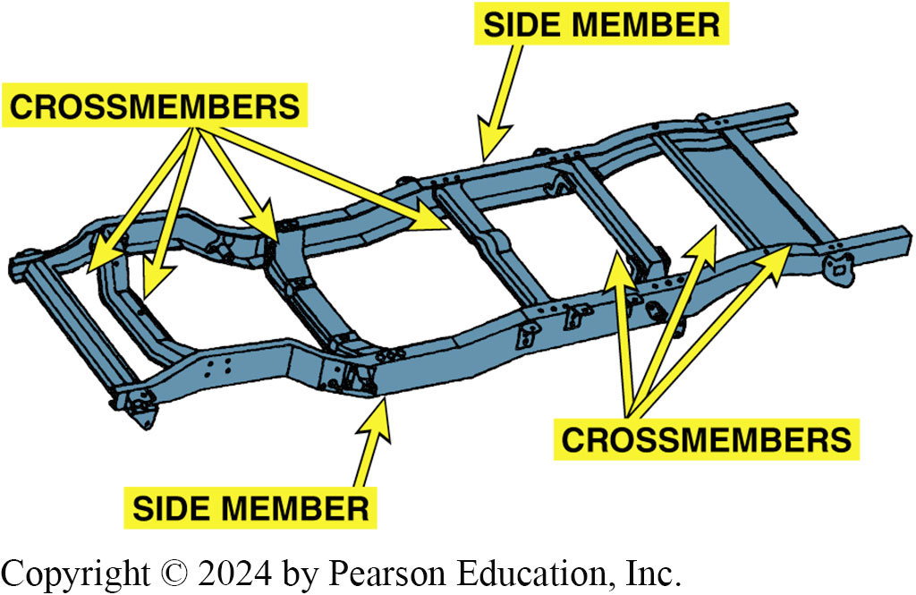
Figure 111.1 Ladder-Type Frame
A typical truck frame is an excellent example of a ladder-type frame. The two side members are connected by a crossmember

Slide 8
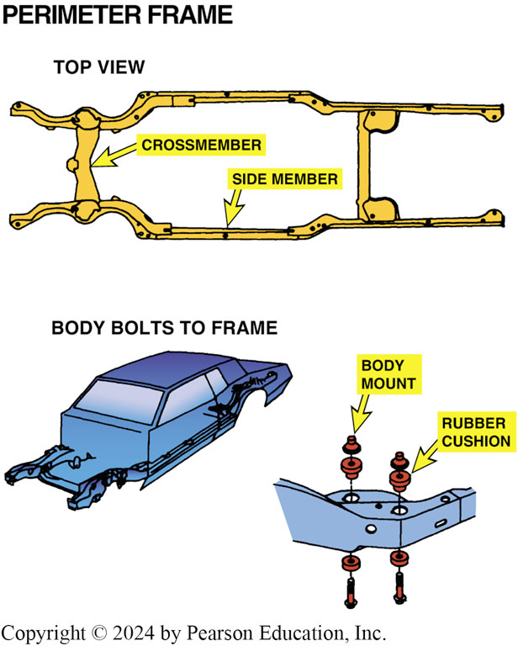
Figure 111.2 Rubber Cushions
Rubber cushions used in body or frame construction isolate noise and vibration from traveling to the passenger compartment

Slide 9
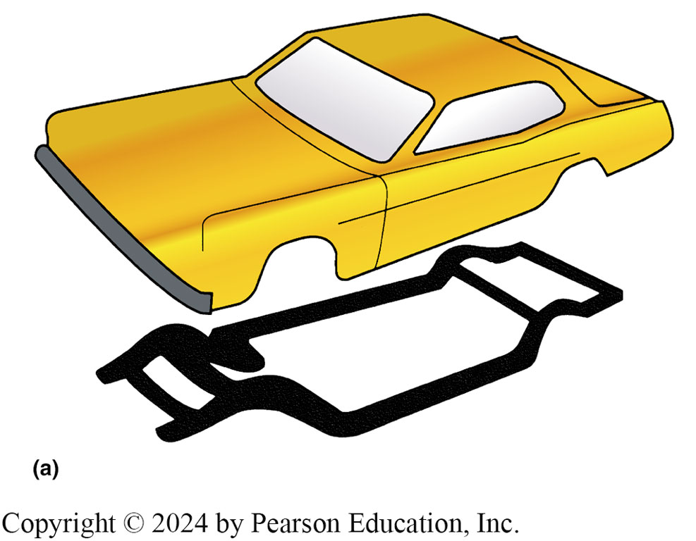
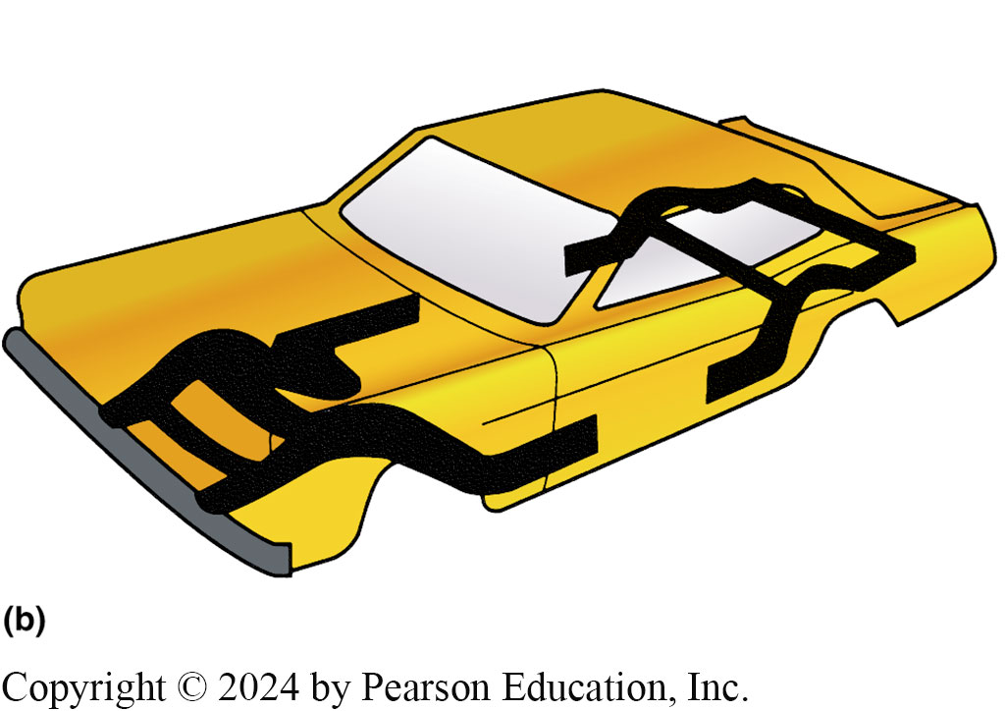
Figure 111.3 Frame Types
(a) Separate body and frame construction; (b) stub-type frame: the small frame members are for support of the engine and suspension components. Many vehicles attach the suspension components directly to the reinforced sections of the body and do not require the rear frame section.

Slide 10
Frequently Asked Question: What Does GVW Mean?
? Frequently Asked Question
What Does GVW Mean? GVW, gross vehicle weight, is the weight of the vehicle plus the weight of all passengers the vehicle is designed to carry (×150 lb [68 kg] each), plus the maximum allowable payload or luggage load. Curb weight is the weight of a vehicle when wet, meaning with a full tank of fuel and all fluids filled, but without passengers or cargo (luggage). Model weight is the weight of a vehicle wet and with passengers. More info in NOTES
Notes:
What Does GVW Mean? GVW, gross vehicle weight, is the weight of the vehicle plus the weight of all passengers the vehicle is designed to carry (×150 lb [68 kg] each), plus the maximum allowable payload or luggage load. Curb weight is the weight of a vehicle when wet, meaning with a full tank of fuel and all fluids filled, but without passengers or cargo (luggage). Model weight is the weight of a vehicle wet and with passengers.
The GVW is found stamped on a plate fastened to the door jamb of most vehicles. A high GVW rating does not mean that the vehicle itself weighs a lot more than other vehicles. For example, a light truck with a GVW of 6,000 lbs (2,700 kg) will not ride like an old 6,000 pound luxury car. In fact, a high GVW rating usually requires stiff springs to support the payload; these stiff springs result in a harsh ride. Often technicians are asked to correct a harsh-riding truck that has a high GVW rating. The technician can only check that everything in the suspension is satisfactory and then try to convince the owner that a harsher- than-normal ride is the result of a higher GVW rating.

Slide 11
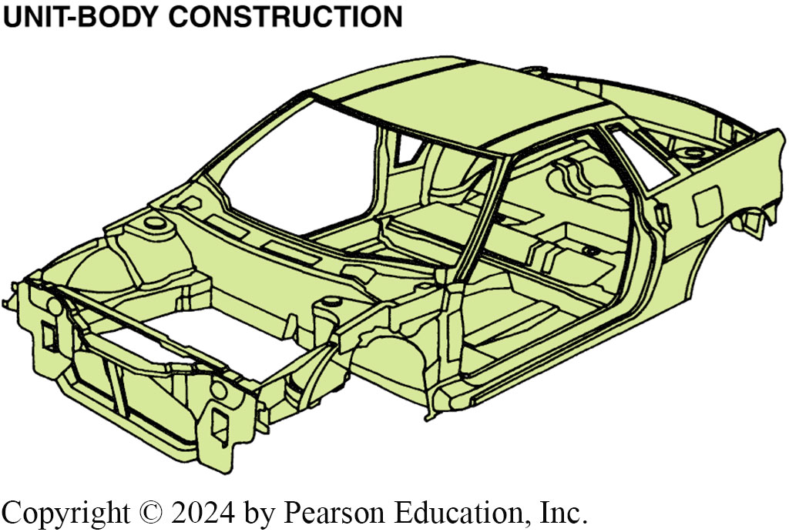
Figure 111.4 Unit-body Construction
Welded metal sections create a platform that combines the body with the frame using unit-body construction

Slide 12
Platforms
Terminology
  The platform of any vehicle is its basic size and shape.
  Various vehicles of different makes can share the same platform.
Examples of common platforms include the following:
  Chevrolet Impala and Pontiac Grand Prix
  Toyota Camry and Lexus E S 350
  Buick Lucerne and Cadillac D T S

Slide 13
Unsprung Weight
Anything that allows the wheel to move up and down.
For best handling and ride
Unsprung weight should be kept as low as possible.

Slide 14
Types of Suspensions
Early suspension systems used a solid axle for front and rear wheels.
Most vehicles today use an independent suspension.
A suspension spring serves 2 purposes:
  Acts as a buffer between the suspension and frame.
  Each spring transfers part of the vehicle weight to the suspension component it rests on

Slide 15
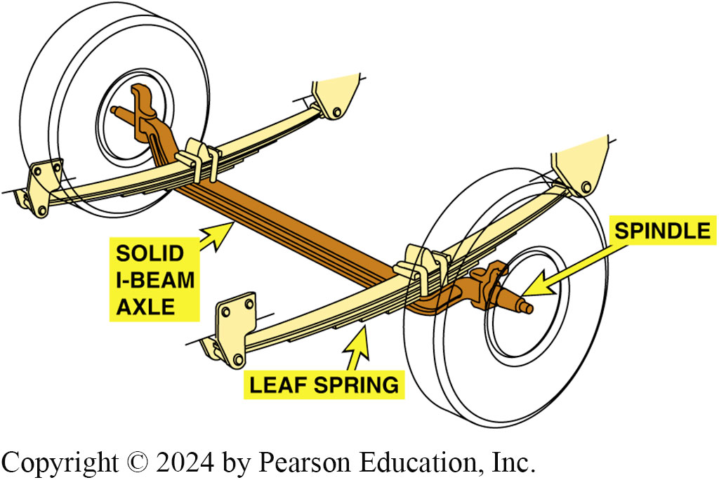
Figure 111.5 Solid I-Beam
Solid I-beam axle with leaf springs

Slide 16
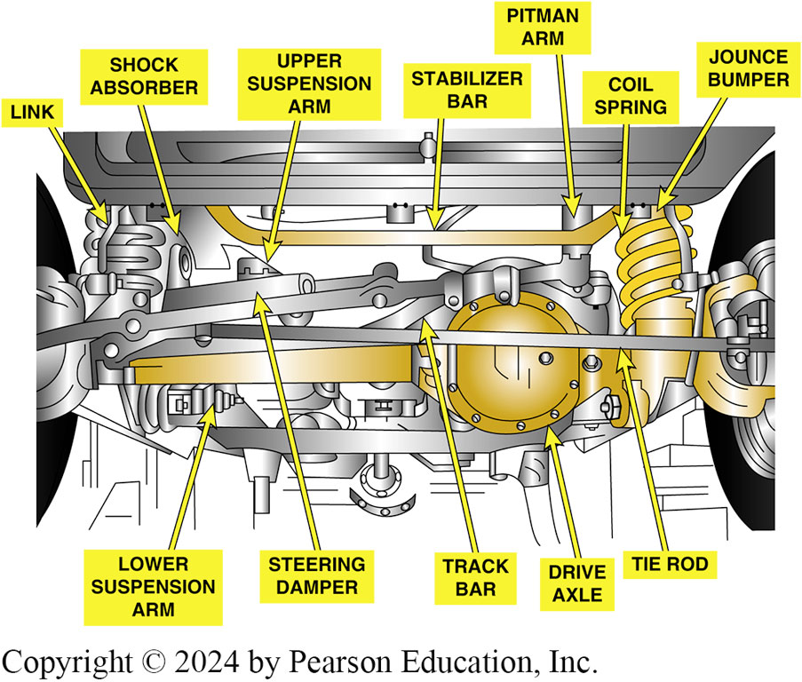
Figure 111.6 Jeep Solid Axle
The front drive axle on a Jeep is a type of solid axle. When one wheel hits a bump or drops into a hole, both left and right wheels are moved. Because both wheels are affected, the ride is often harsh and feels stiff.

Slide 17
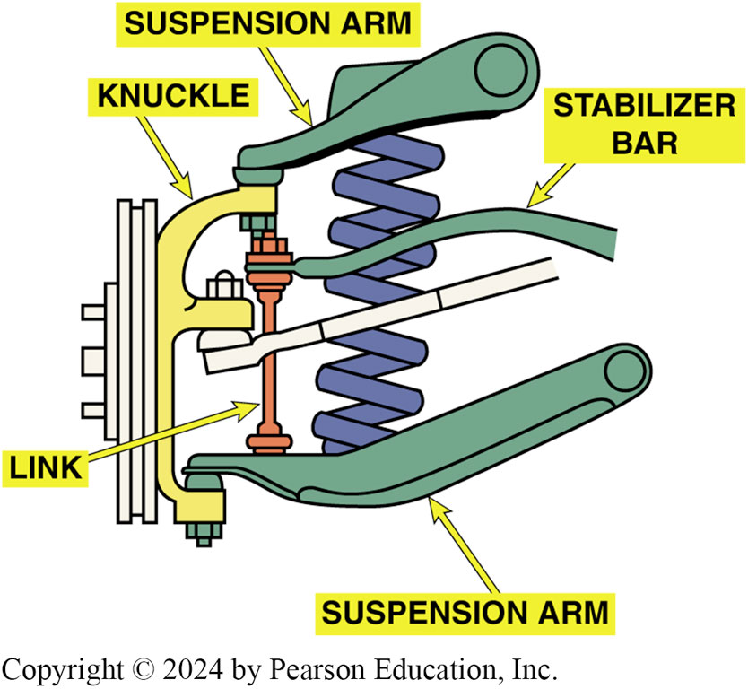
Figure 111.7 Independent
Typical independent front suspension used on a rear-wheel-drive vehicle. Each wheel can hit a bump or hole in the road independently without affecting the opposite wheel

Slide 18
Hooke’s Law
Definition
  The deflection (movement or deformation) of a spring is directly proportional to the applied force.
  What this means is that when a coil spring, for example, is depressed 1 inch by a weight of 400 pounds, it has a spring rate (K) of 400 Lbs. per inch.
  The higher the spring rate (K), the stiffer the spring.

Slide 19
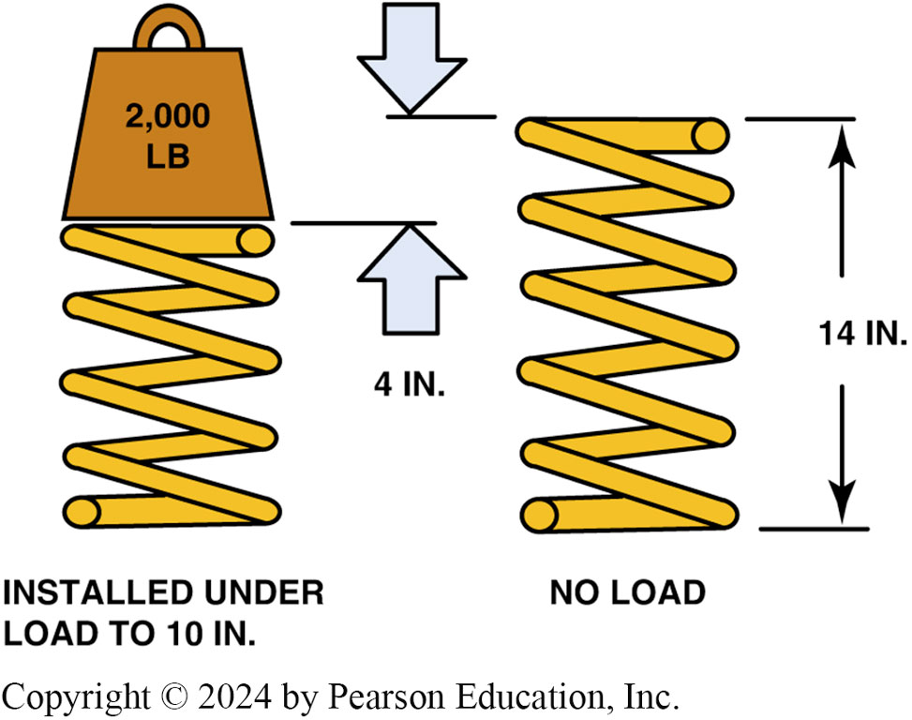
Figure 111.8 Spring
This spring was depressed 4 inch due to a weight of 2,000 lb. This means that this spring has a spring rate (K) of 500 lb per inch (2,000 ÷ 4 in. = 500 lb./in.)

Slide 20
Question 1: ?
What does Hooke’s Law state?

Slide 21
Answer 1
The deflection (movement or deformation) of a spring is directly proportional to the applied force.

Slide 22
Coil Springs (1 of 4)
Terminology
  Coil springs are made of special round spring steel wrapped in a helix shape.
The strength and handling characteristics of a coil spring depend on the following:
  Coil diameter
  Number of coils
  Height of spring
  Diameter of the steel coil that forms the spring.

Slide 23
Coil Springs (2 of 4)
Spring Rate
  Spring rate, also called deflection rate, is a value that reflects how much weight it takes to compress a spring a certain amount.
Spring Frequency
  Spring frequency is a value that reflects the speed at which a spring oscillates, or bounces, after it is released from compression or extension.
  Frequency is typically measured in cycles per second (C P S) or hertz (H z).

Slide 24
Coil Springs (3 of 4)
Wheel Rate
  Springs are installed a certain distance away from the wheel, which determines the ratio of wheel travel to spring travel, or wheel rate.
Coil Spring Mounting
  Coil springs are installed in a spring pocket or spring seat.
  Hard rubber or plastic cushions or insulators are mounted between the coil spring and the spring seat

Slide 25
Coil Springs (4 of 4)
Spring Coatings
  Springs are painted or coated with epoxy to help prevent breakage.
  A scratch, nick, or pit caused by corrosion can cause a stress riser that can lead to spring failure.

Slide 26
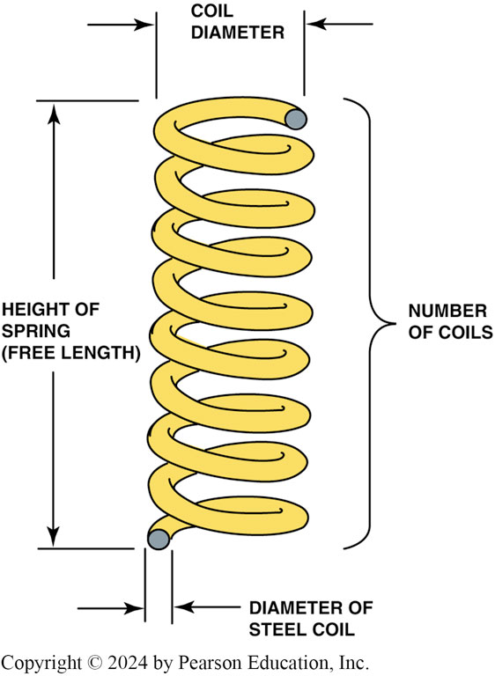
Figure 111.9 Spring Rate
The spring rate of a coil spring is determined by the diameter of the spring and the diameter of the steel used in its construction, plus the number of coils and the free length (height)

Slide 27
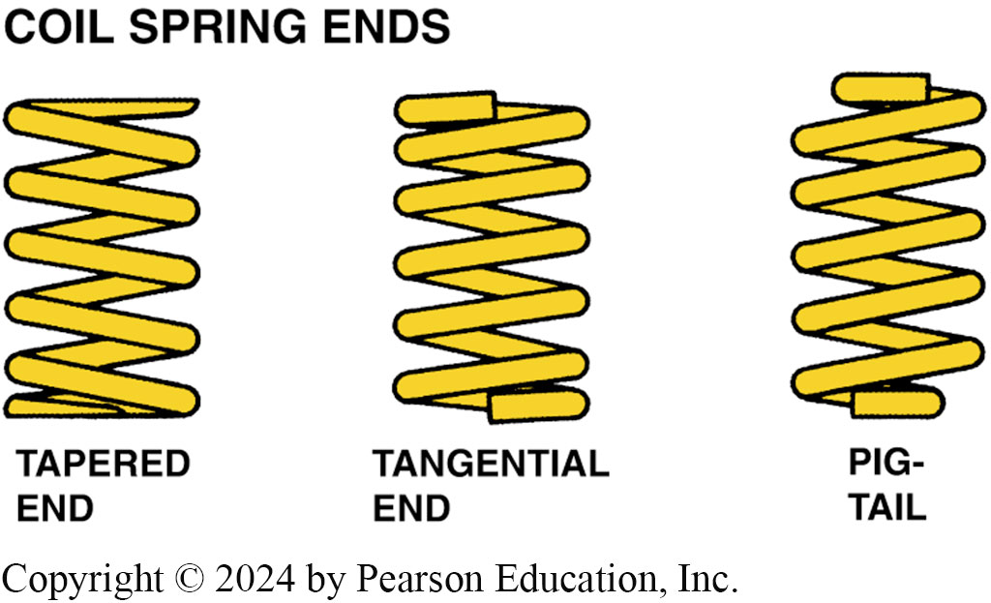
Figure 111.10 Coil Spring Ends
Coil spring ends are shaped to fit the needs of a variety of suspension designs

Slide 28
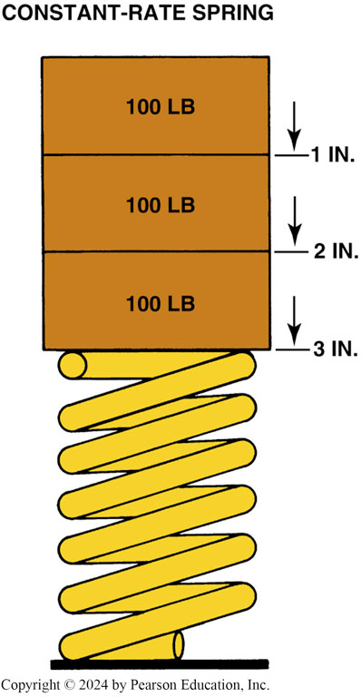
Figure 111.11 Constant-Rate
A constant-rate spring compresses at the same rate regardless of the amount of weight that is applied

Slide 29
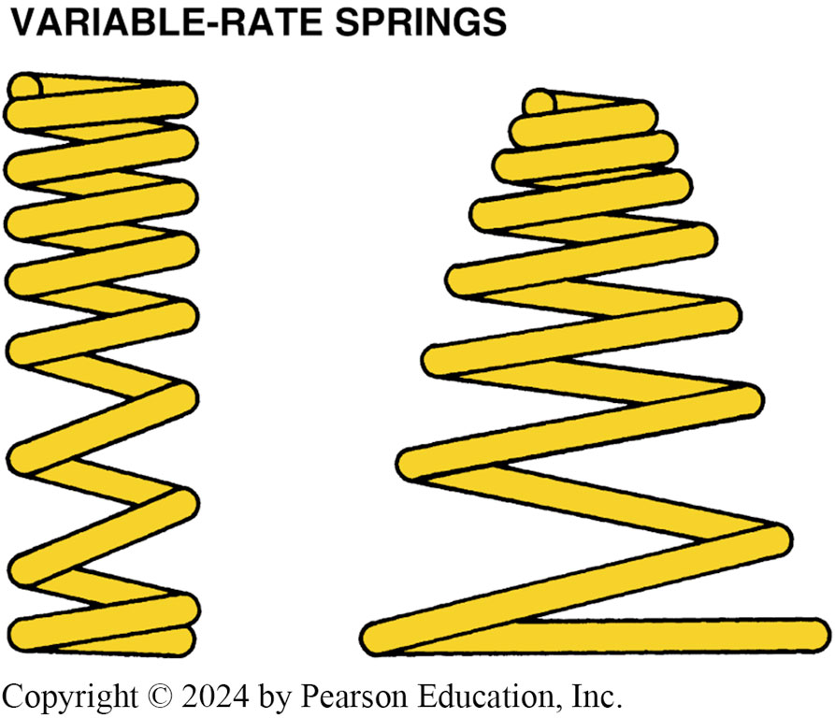
Figure 111.12 Variable Rate
Variable-rate springs come in a variety of shapes and compress more slowly as weight is applied

Slide 30
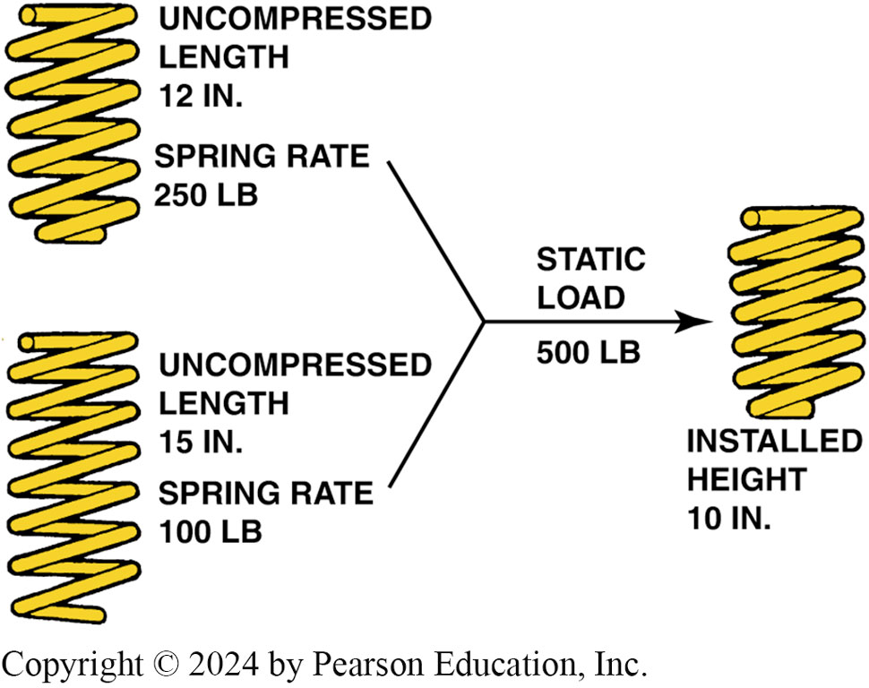
Figure 111.13 Spring Rate
2 springs, each with a different spring rate and length, can provide the same ride height even though the higher rate spring will give a stiffer ride

Slide 31
Frequently Asked Question: Does the Spring Rate Change as the Vehicle Gets Older?
? Frequently Asked Question
Does the Spring Rate Change as the Vehicle Gets Older? No, the spring rate of a spring does not change, but the spring load can change due to fatigue. The spring rate is the amount of force it takes to compress the spring 1 inch. The spring load is the amount of weight that a spring can support at any given compressed height. When a spring fatigues, the spring’s load capacity decreases and the vehicle will sag.

Slide 32
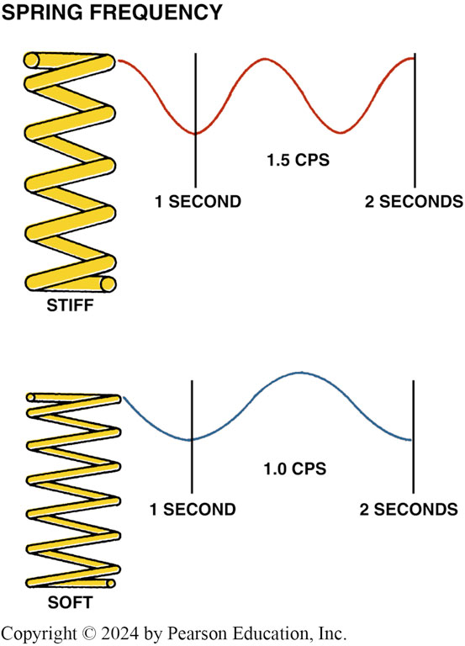
Figure 111.14 Stiffer Springs
Stiffer springs bounce at a higher frequency than softer springs

Slide 33
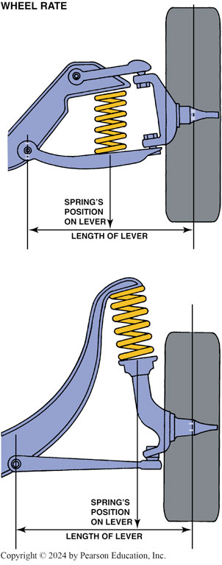
Figure 111.15 Spring Compression
The wheel and arm act as a lever to compress the spring. The spring used on the top picture must be stiffer than the spring used on the strut-type suspension shown on the bottom because the length of the lever arm is shorter

Slide 34
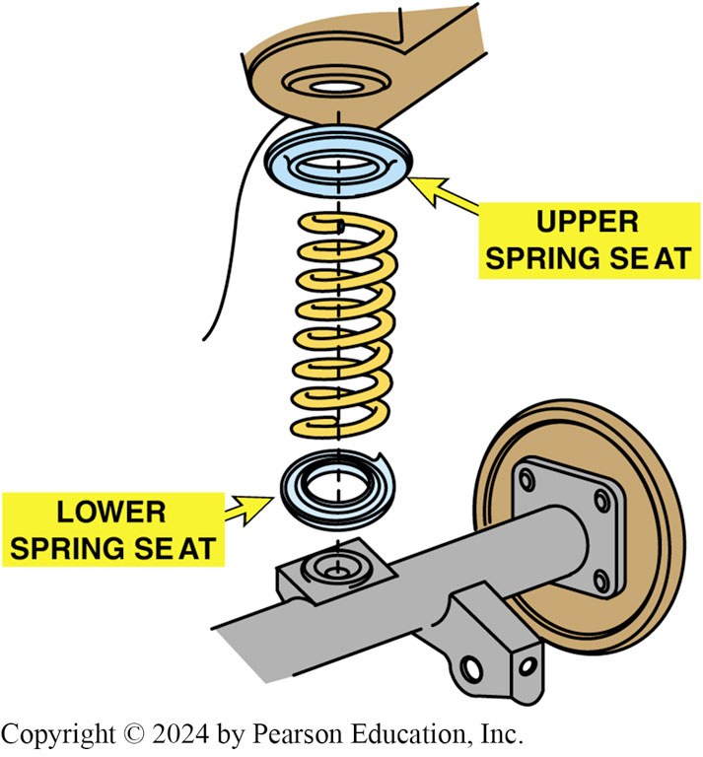
Figure 111.16 Spring Cushion
The spring cushion helps isolate noise and vibration from being transferred to the passenger compartment

Slide 35
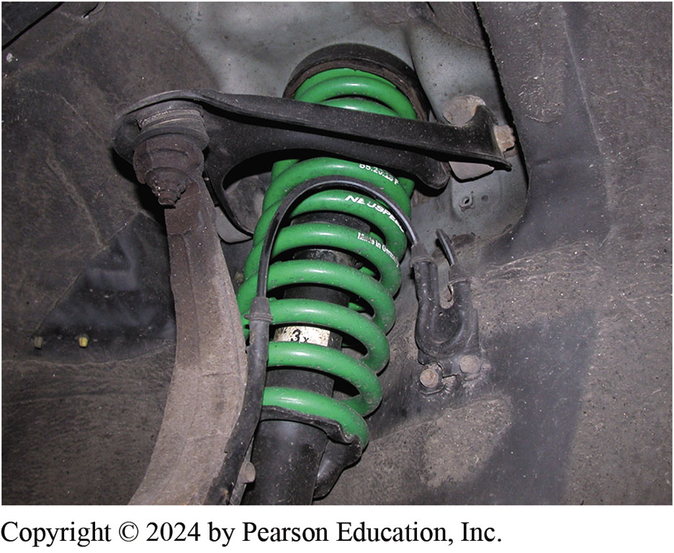
Figure 111.17 Spring Coating
This replacement coil spring is coated to prevent rust and corrosion and colored to help identify the spring and/or spring manufacturer
Notes:
TECH TIP: Don’t Cut Those Coil Springs!
Chassis service technicians are often asked to lower a vehicle. One method is to remove the coil springs and cut off half or more coils from the spring. While this will lower the vehicle, this method is generally not recommended for the following reasons:
A coil spring could be damaged during the cutting- off procedure, especially if a torch is used to do the cutting.
The spring will get stiffer when shortened, often resulting in a very harsh ride.
The amount the vehicle is lowered is less than the amount cut off from the spring. This is because as the spring is shortened, it becomes stiffer. The stiffer spring will compress less than the original.
Instead of cutting springs to lower a vehicle, several preferable methods are available if the vehicle must be lowered:
There are replacement springs designed specifically to lower that model vehicle. A change in shock absorbers may be necessary because the shorter springs change the operating height of the stock (original) shock absorbers. Consult spring manufacturers for exact installation instructions and recommendations. FIGURE 111-17..
There are replacement spindles designed to raise the location of the wheel spindle, thereby lowering the body in relation to the ground. Except for ground clearance problems, this is the method recommended by many chassis service technicians. Replacement spindles keep the same springs, shock absorbers, and ride, while lowering the vehicle without serious problems.

Slide 36
Leaf Springs (1 of 2)
Terminology
  Leaf springs are constructed of one or more strips of long, narrow spring steel.
  Spring ends are rolled or looped to form eyes.
  Leaves held together by a center bolt, also called a centering pin.
  One end of a leaf spring is mounted to a hanger with a bolt and rubber bushings directly attached to the frame.
  The other end of the leaf spring is attached to the frame with movable mounting hangers called shackles.

Slide 37
Leaf Springs (2 of 2)
Composite Leaf Springs
  A composite leaf spring is a fiberglass–reinforced epoxy plastic composite leaf spring that has been used on production vehicles since the early 1980s.
Leaf spring rate increases when the thickness increases and decreases as the length increases.

Slide 38
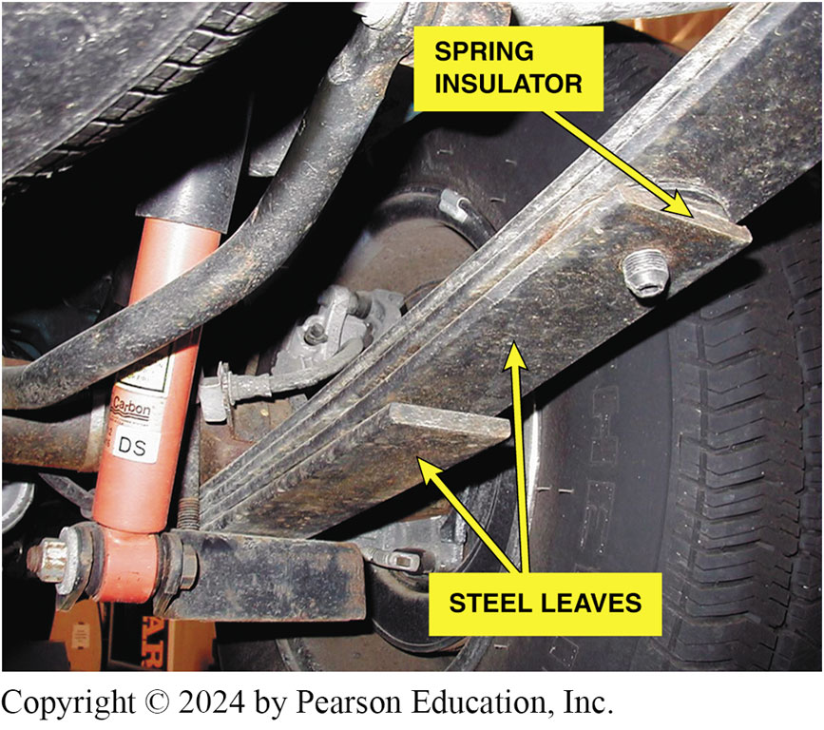
Figure 111.18 Leaf Spring
A typical leaf spring used on the rear of a pickup truck showing the plastic insulator between the leaves, which allows the spring to move without creating wear or noise

Slide 39
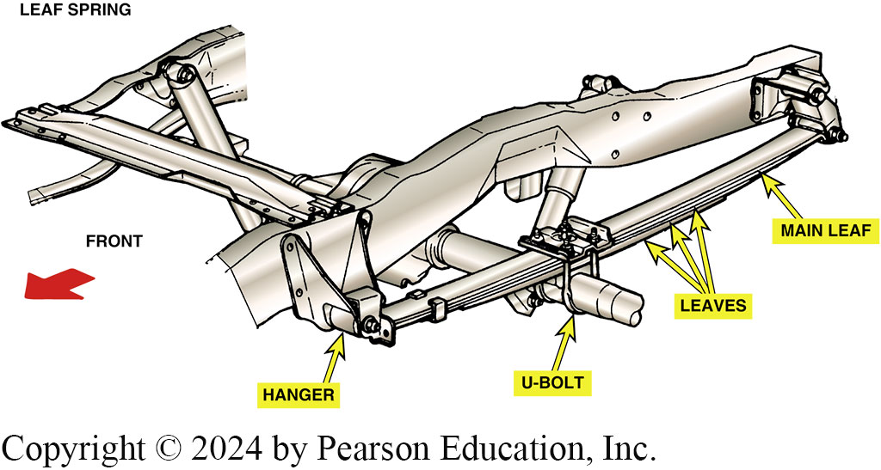
Figure 111.19 Main Leaf
A typical leaf spring installation. The longest leaf, called the main leaf, attaches to the frame through a shackle and a hanger

Slide 40
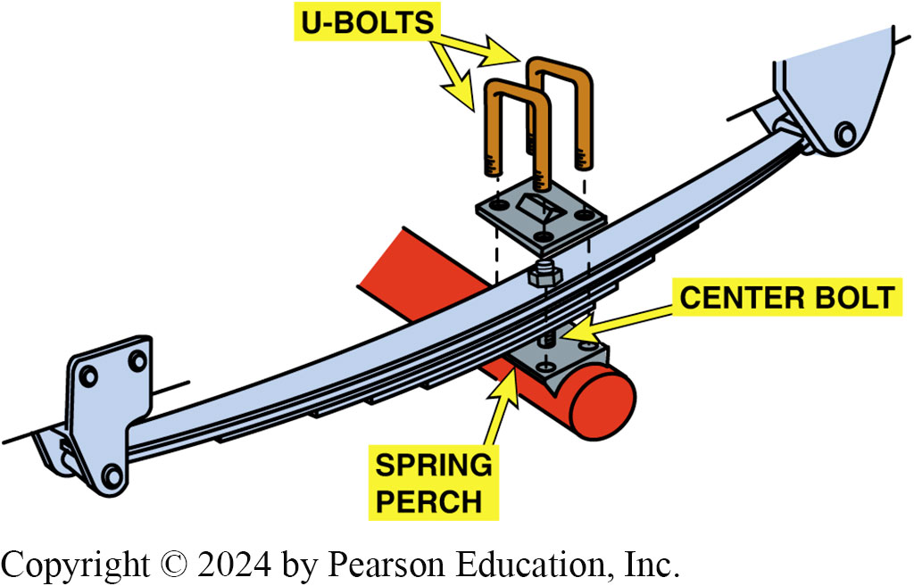
Figure 111.20 Multi-Leaf
All multileaf springs use a center bolt to not only hold the leaves together but also help retain the leaf spring in the center of the spring perch

Slide 41
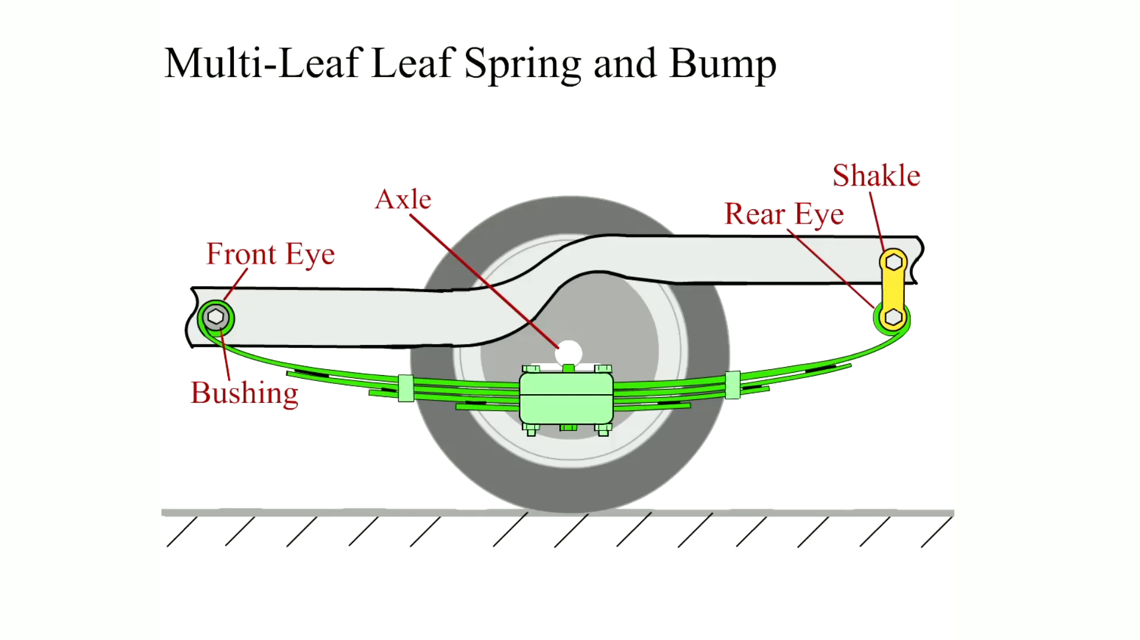
Animation: Multi-Leaf Leaf Spring and Bump
(Animation will automatically start)

Slide 42
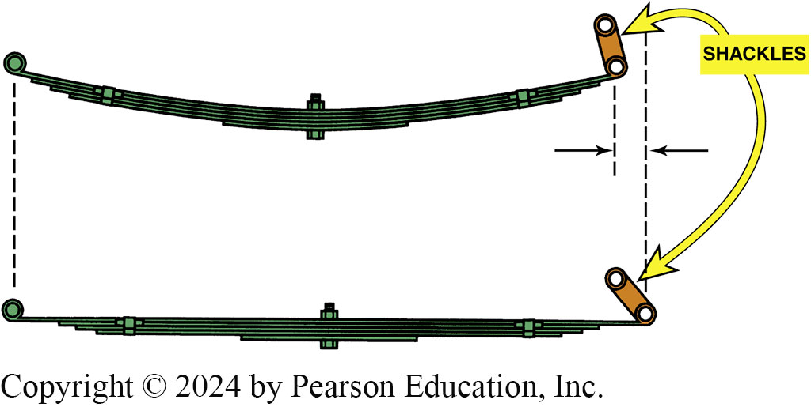
Figure 111.21 Shackles & Bushings
When a leaf spring is compressed, the spring flattens and becomes longer. The shackles allow for this lengthening. Rubber bushings are used in the ends of the spring and shackles to help isolate road noise from traveling into the passenger compartment

Slide 43
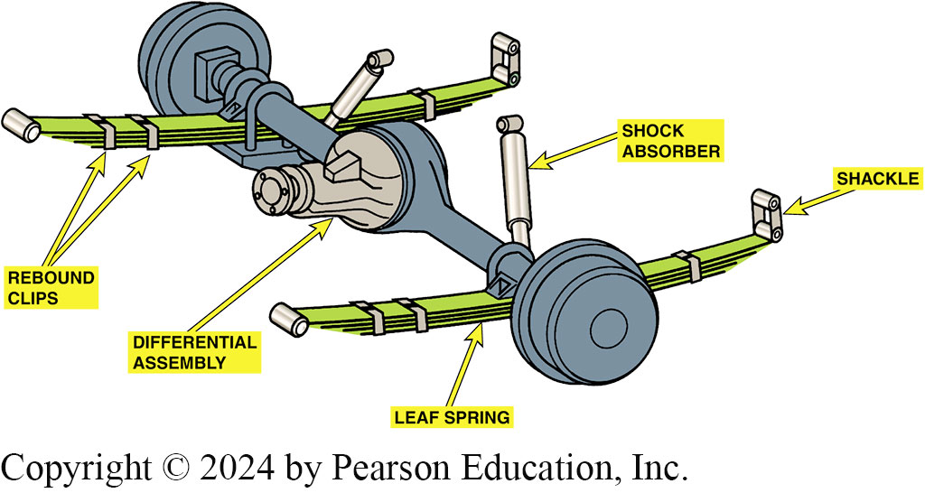
Figure 111.22 Rear Leaf Suspension
Typical rear leaf–spring suspension of a rear-wheel-drive vehicle

Slide 44
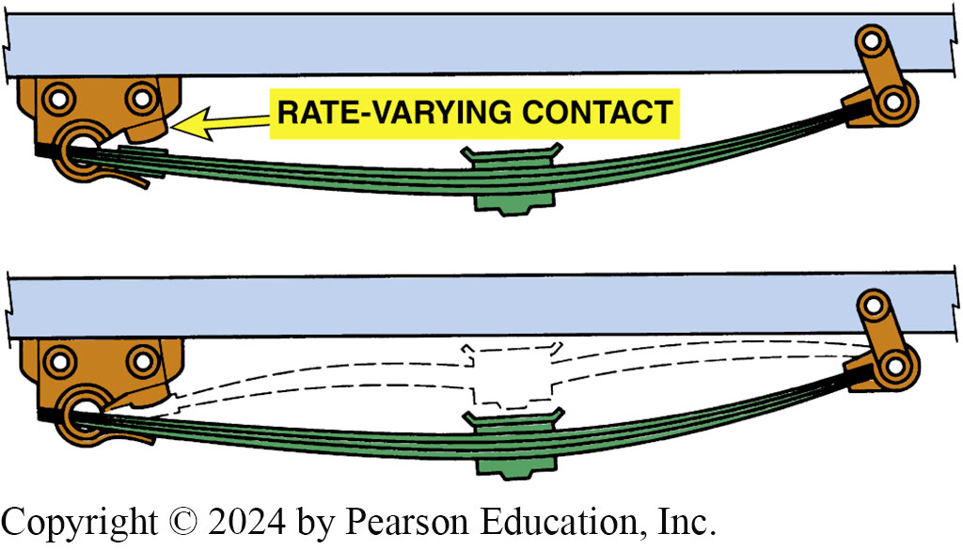
Figure 111.23 Loading
As the vehicle is loaded, the leaf spring contacts a section of the frame. This shortens the effective length of the spring, which makes it stiffer

Slide 45
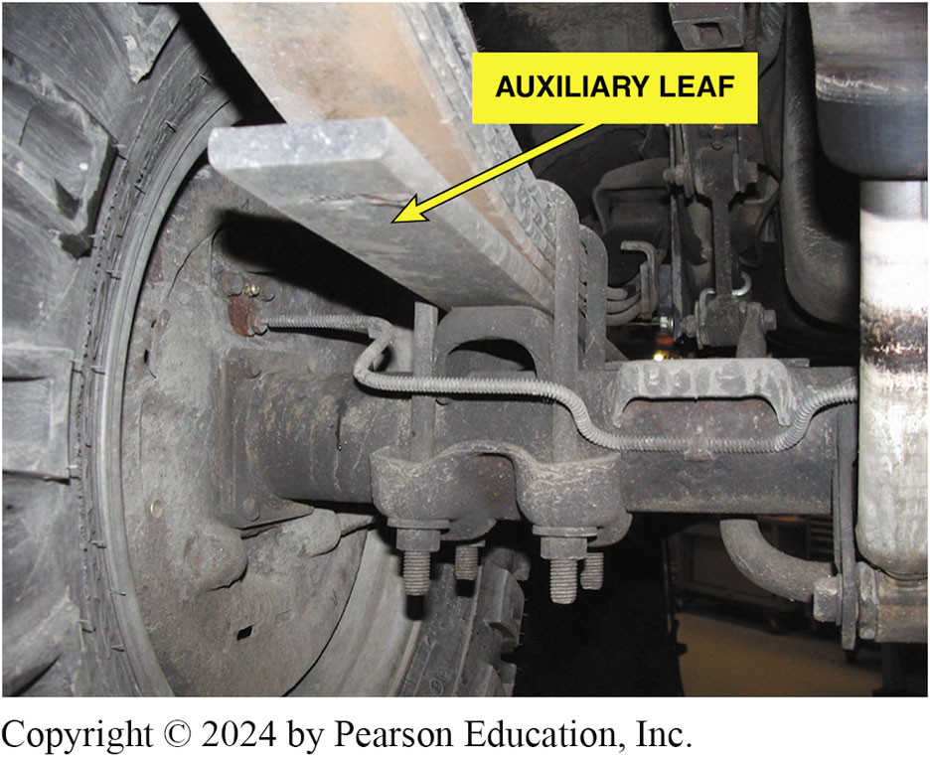
Figure 111.24 Auxiliary Leaf Springs
Many pickup trucks, vans, and sport-utility vehicles (SUV s) use auxiliary leaf springs that contact the other leaves when the load is increased

Slide 46
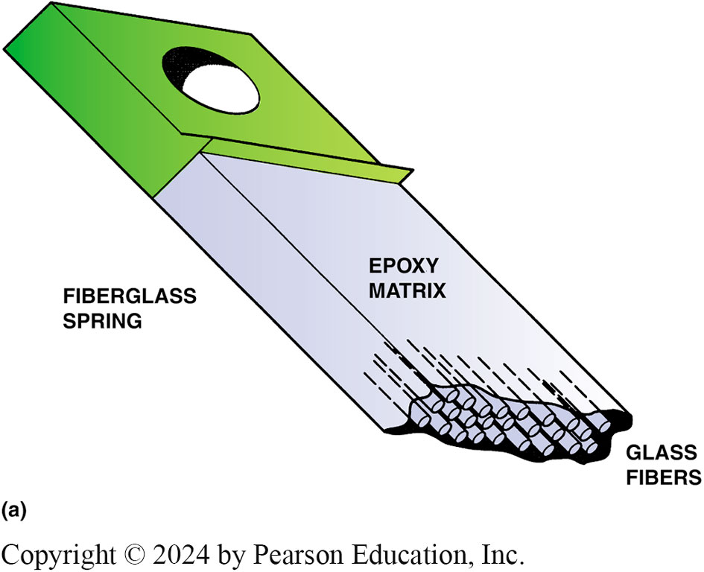
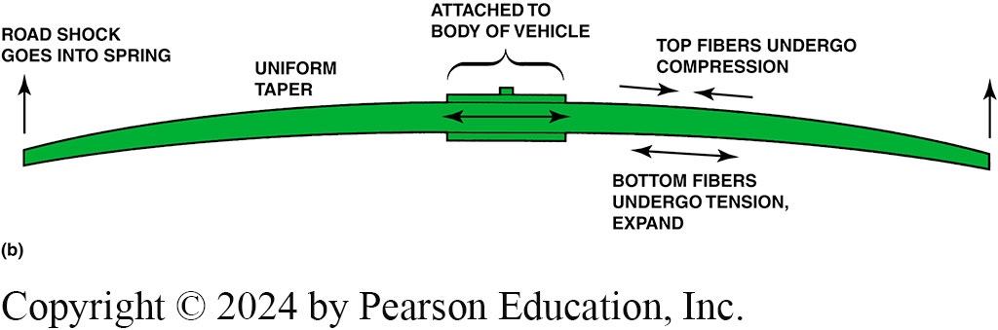
Figure 111.25 Fiberglass Spring
(a) A fiberglass spring is composed of long fibers locked together in an epoxy (resin) matrix. (b) When the spring compresses, the bottom of the spring expands and the top compresses. Composite leaf springs are used and mounted transversely (side to side) on Chevrolet Corvettes and at the rear on some other GM vehicles
Notes:
.

Slide 47
Torsion Bars
Terminology
  A torsion bar is a spring that is a long, round, hardened steel bar similar to a coil spring except that it is a straight bar.
  One end is attached to the lower control arm of a front suspension and the other end to the frame.
  Unlike other types of springs, torsion bars may be adjustable for correct ride height.

Slide 48
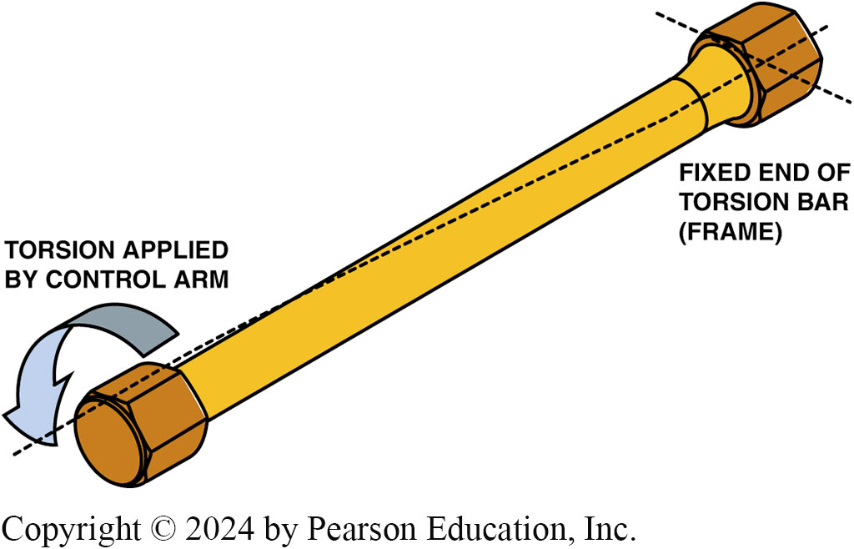
Figure 111.26 Torsion Bar
A torsion bar resists twisting and is used as a spring on some cars and many four-wheel-drive pickup trucks and sport-utility vehicles. The larger the diameter, or the shorter the torsion bar, the stiffer the bar

Slide 49
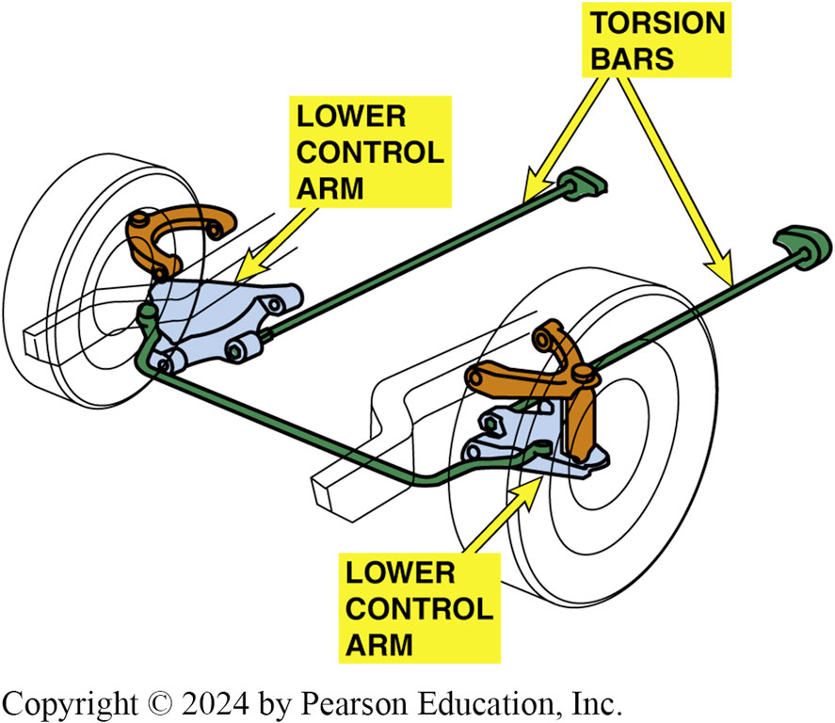
Figure 111.27 Longitudinal Bars
Longitudinal torsion bars attach at the lower control arm at the front and at the frame at the rear of the bar

Slide 50
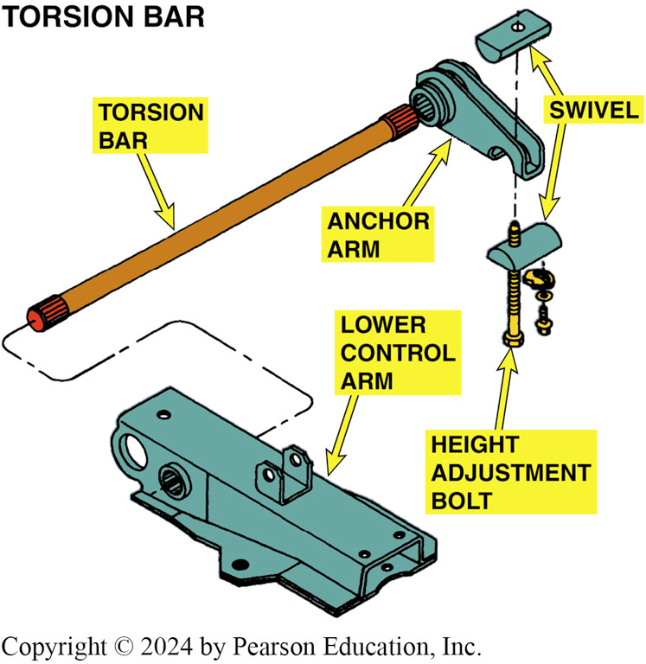
Figure 111.28 Bar Attachment
One end of the torsion bar attaches to the lower control arm and the other to an anchor arm that is adjustable

Slide 51
Suspension Principles
All suspensions must provide for the following supports:
  Transverse (or side-to-side) wheel support.
  Longitudinal (front-to-back) wheel support.
2 important design factors: anti-squat and anti-dive.
  Anti-squat refers to the reaction of the body of a vehicle during acceleration.
  Anti-dive refers to the force that causes the front of the vehicle to drop down while braking.

Slide 52
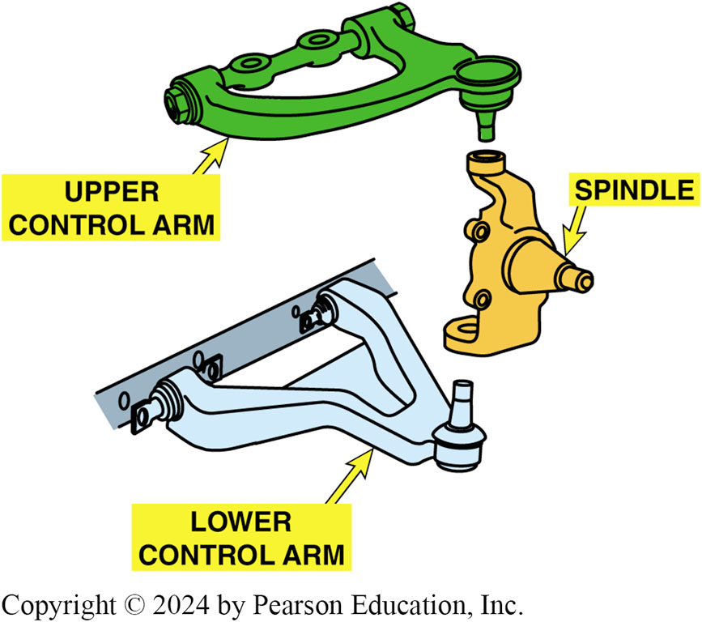
Figure 111.29 Suspension
Spindle supports the wheels and attaches to the control arm with ball-and-socket joints called ball joints. The control arm attaches to the frame of the vehicle through rubber bushings to help isolate noise and vibration between the road and the body.

Slide 53
Figure 111.

Slide 54
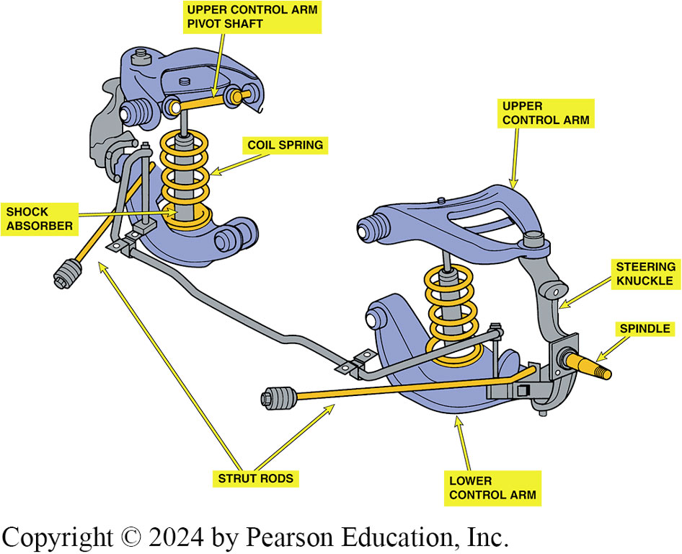
Figure 111.30 Strut Rods
The strut rods provide longitudinal support to the suspension to prevent forward or rearward movement of the control arms

Slide 55
Steering Knuckles
Purpose and Function
  Knuckle serves 2 purposes:
    Join suspension to wheel
    Usually includes the spindle where the front wheel bearings are attached
    Provide pivot points between suspension and wheel
  Knuckles are used with independent suspensions and at the wheels that steer the vehicle.
  The only knuckle that uses a kingpin is a steering knuckle on an I-beam or twin I-beam front suspension.

Slide 56
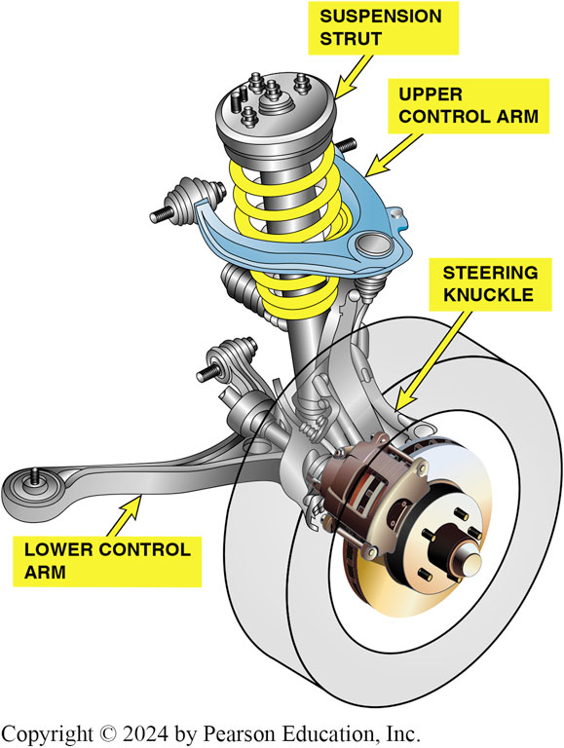
Figure 111.31 Steering Knuckle
The steering knuckle used on a short/long-arm front suspension
Notes:
NOTE: MacPherson Strut Suspension shown

Slide 57
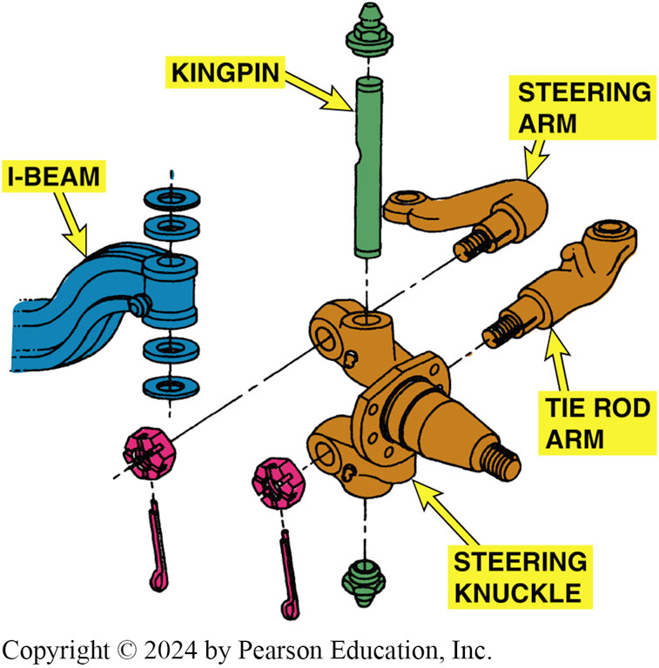
Figure 111.32 Kingpin
A kingpin is a steel shaft or pin that joins the steering knuckle to the suspension and allows the steering knuckle to pivot

Slide 58
Control Arms
Purpose and Function
  A control arm is a suspension link that connects a knuckle or wheel flange to the frame.
  One end of a control arm attaches to the knuckle or wheel flange, generally with either a ball joint or bushing.
  The opposite end of the arm, which attaches to a frame member, usually pivots on a bushing.

Slide 59
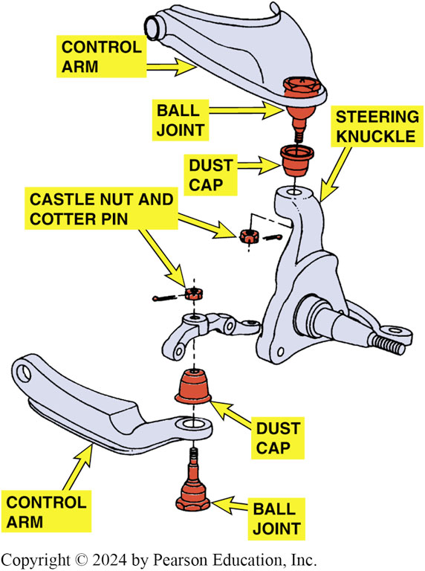
Figure 111.33 Control Arms
Control arms are used to connect the steering knuckle to the frame or body of the vehicle and provide the structural support for the suspension system

Slide 60
Ball Joints
Purpose and Function
  Ball joints are actually ball-and-socket joints.
  Ball joints allow the front wheels to move up and down, as well as side to side (for steering)
Ball Joint Design
  Compression loaded; The ball joint is compressed into the control arm by the weight of the vehicle.
  Tension loaded; The weight of the vehicle tends to pull the ball joint back into the control arm by tension.

Slide 61
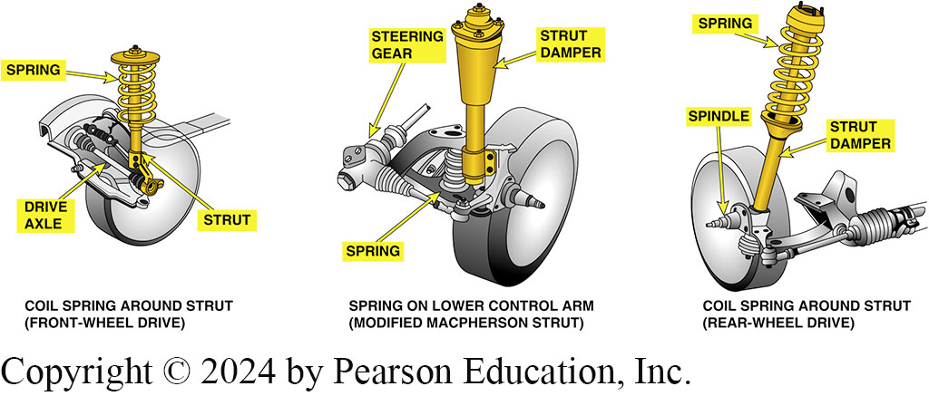
Figure 111.34 Ball Joints
Ball joints provide the freedom of movement necessary for steering and suspension movements.

Slide 62
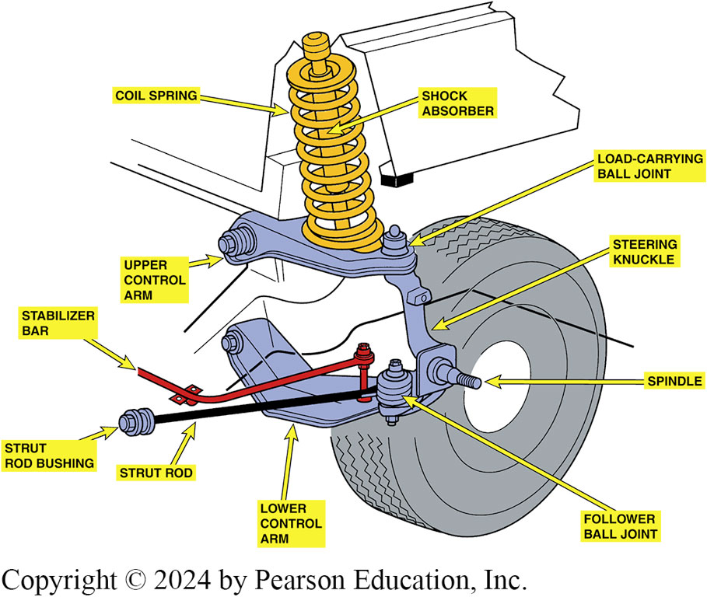
Figure 111.35 Upper Ball Joint
Upper ball joint is load carrying in this type of suspension because the weight of the vehicle is applied through the spring, upper control arm, and ball joint to the wheel. The lower control arm is a lateral link, and the lower ball joint is called a follower ball joint.

Slide 63
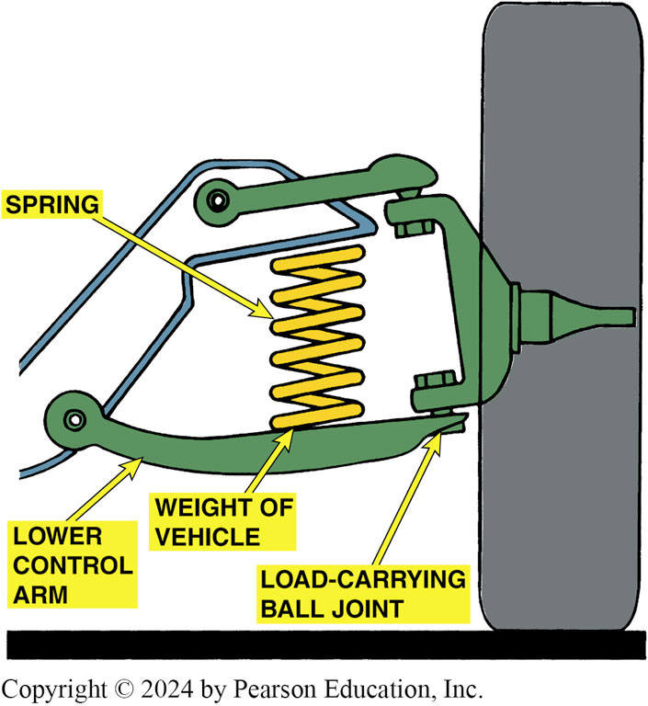
Figure 111.36 Lower Ball Joint
The lower ball joint is load carrying in this type of suspension because the weight of the vehicle is applied through the spring, lower control arm, and ball joint to the wheel

Slide 64
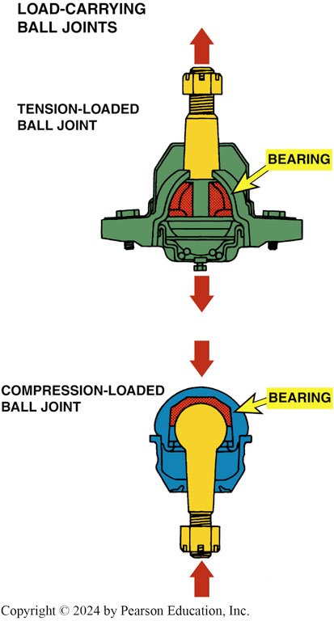
Figure 111.37 Bearing Surface
All ball joints, whether tension or compression loaded, have a bearing surface between the ball stud and socket

Slide 65
Question 2: ?
What are the designs of ball joint?

Slide 66
Answer 2
Tension loaded and compression loaded.

Slide 67
Strut Rods
Purpose and Function
  Strut rods provide forward/backward support to the control arms.
Strut rods are also called tension or compression rods or simply T C rods.
  Tension rods attach in front of the wheels to the body or frame.
  Compression rods attach to the body or frame behind the wheels.

Slide 68
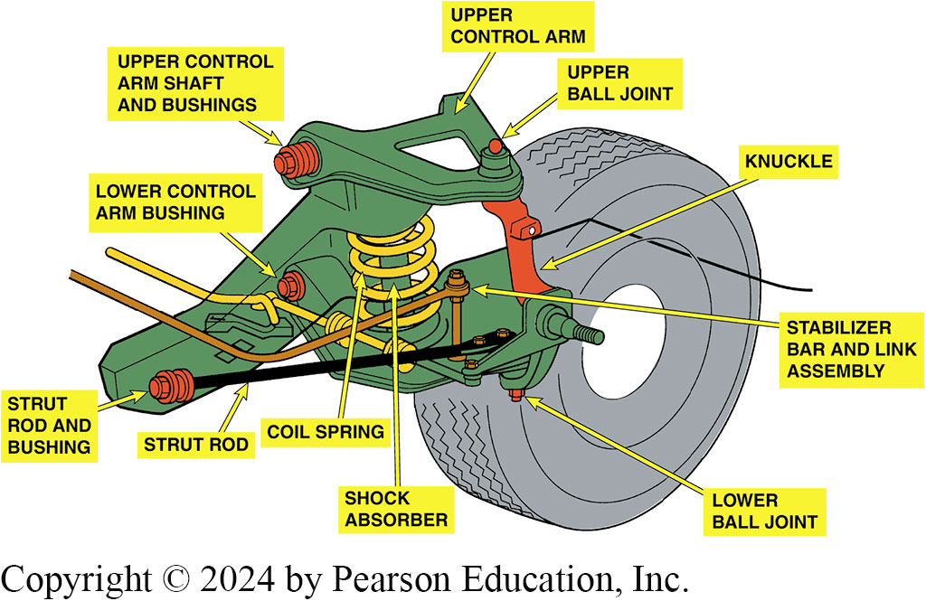
Figure 111.38 Strut Rod
A strut rod is the longitudinal support to prevent front-to-back wheel movement. Struts rods are used when there is only one lower control arm bushing and not used where there are two lower control arm bushings

Slide 69
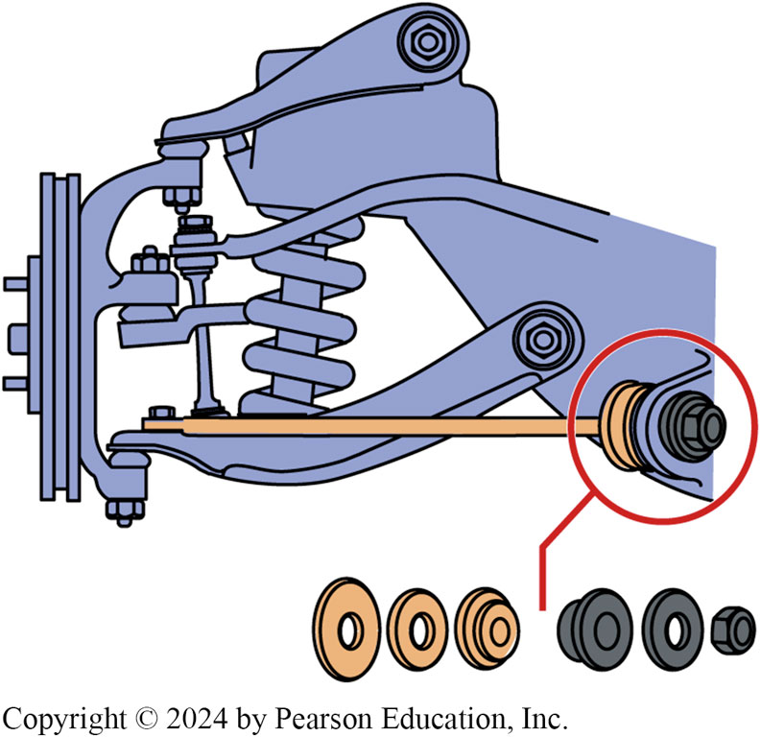
Figure 111.39 Strut Rod Bushings
Strut rod bushings insulate the steel bar from the vehicle frame or body

Slide 70
Stabilizer Bars
Purpose and Function
  A stabilizer bar is also called an anti-sway bar (sway bar) or anti-roll bar (roll bar).
  A stabilizer bar operates by twisting the bar if one side of the vehicle moves up or down in relation to the other side, such as during cornering, hitting bumps, or driving over uneven road surfaces.
  The purpose of the stabilizer bar is to prevent excessive body roll while cornering and to add stability while driving over rough road surfaces.

Slide 71
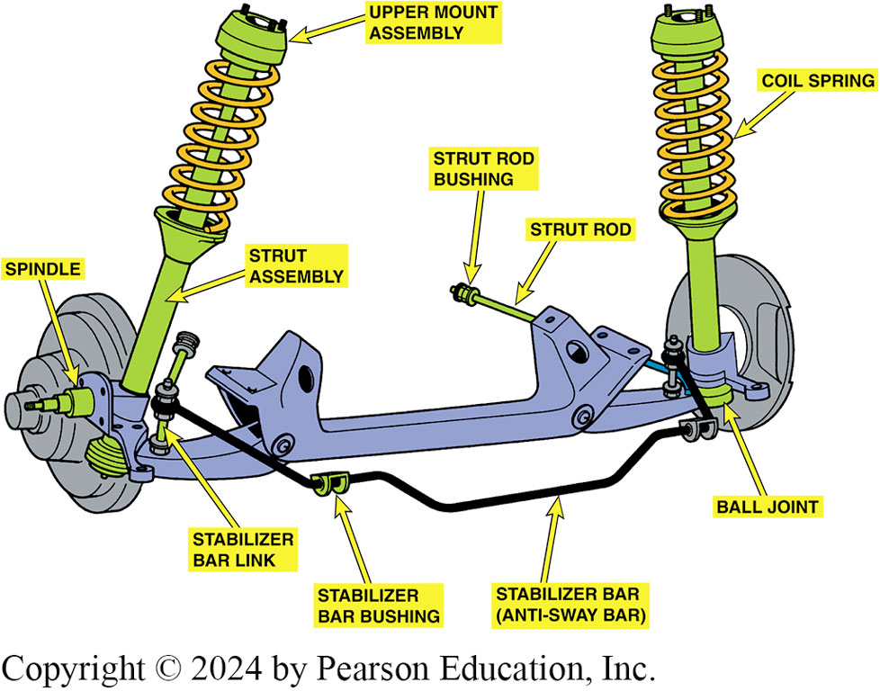
Figure 111.40 Stabilizer Bar
Typical stabilizer bar installation

Slide 72
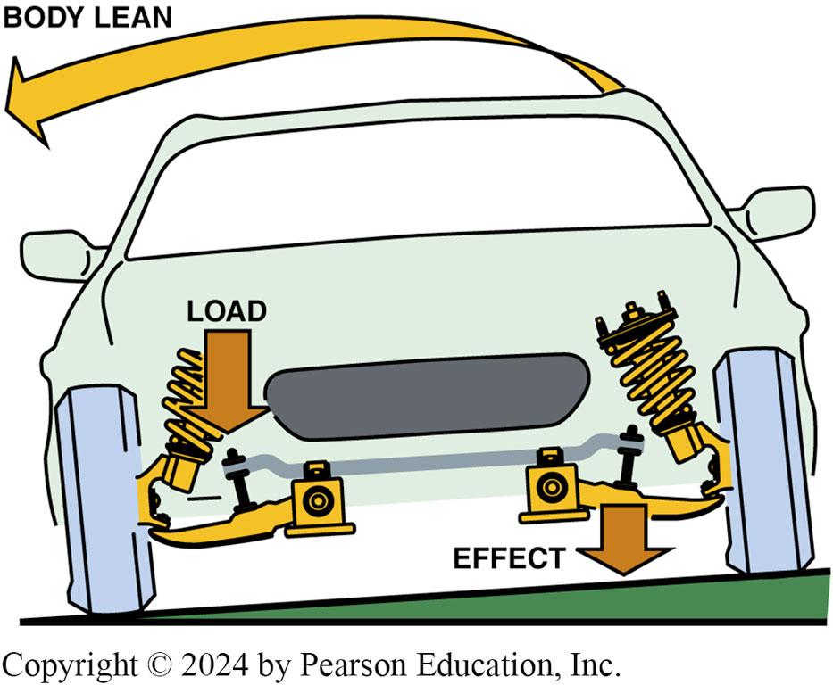
Figure 111.41 Controls Body Lean
As the body of the vehicle leans, the stabilizer bar is twisted. The force exerted by the stabilizer bar counteracts the body lean

Slide 73
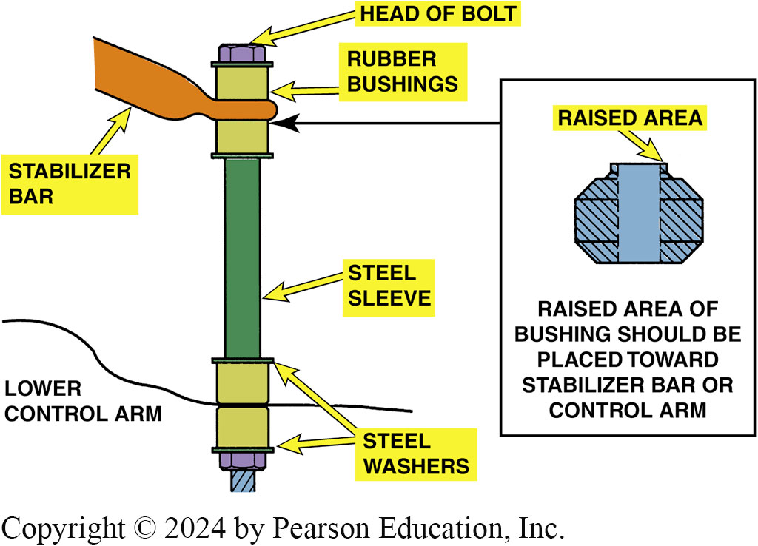
Figure 111.42 Stabilizer Bar Links
Stabilizer bar links are sold as a kit consisting of the long bolt with steel sleeve and rubber bushings. Steel washers are used on both sides of the rubber bushings as shown

Slide 74
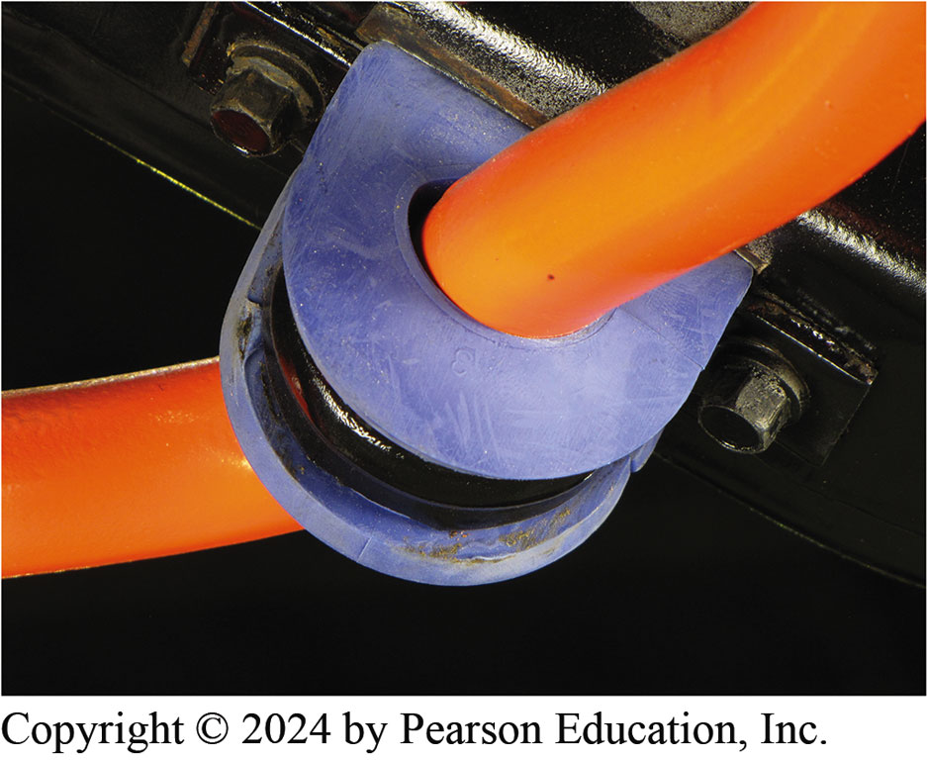
Figure 111.43 Performance Bushings
A high-performance stabilizer bar that uses a urethane bushing instead of a rubber bushing used in most vehicles. However, the urethane bushing tends to transmit road noise and may be objectionable to some vehicle owners.

Slide 75
Question 3: ?
What is the purpose of a stabilizer bar?

Slide 76
Answer 3
To prevent body roll when cornering and to add stability when driving over rough terrain.

Slide 77
Shock Absorbers (1 of 3)
Purpose and Function
  Shock absorbers used on all conventional suspension systems to dampen and control motion of springs.
  Most shock absorbers are direct acting because they are connected directly between the vehicle frame or body and the axles.
Shock Absorber Operation
  The hydraulic shock absorber operates on the principle of fluid being forced through a small opening (orifice).

Slide 78
Shock Absorbers (2 of 3)
Gas Charged Shocks
  Most shock absorbers are gas charged.
  This pressure helps prevent air pockets from forming in the shock absorber oil as it passes through the small passages in the shock.
Air Shocks/Struts
  Air-inflatable shock absorbers or struts are used in the rear of vehicles to provide proper vehicle ride height while carrying heavy loads.

Slide 79
Shock Absorbers (3 of 3)
Air Springs
  A basic air spring consists of a rubber air chamber, generally closed at the bottom by a piston fitted into a control arm, or by a strut shock absorber.
Coil-Over-Shocks
  Coil-over shock absorber uses the force of an external coil spring to boost the performance of the basic shock absorber.

Slide 80
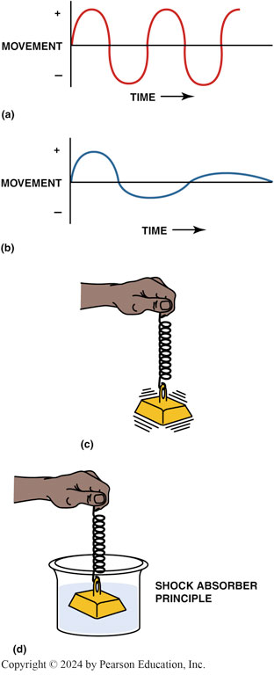
Figure 111.44 Shock Absorbers
(a) Movement of the vehicle is supported by springs without a dampening device. (b) Spring action is dampened with a shock absorber. (c) The function of any shock absorber is to dampen the movement or action of a spring, similar to using a liquid to control the movement of a weight on a spring (d)

Slide 81
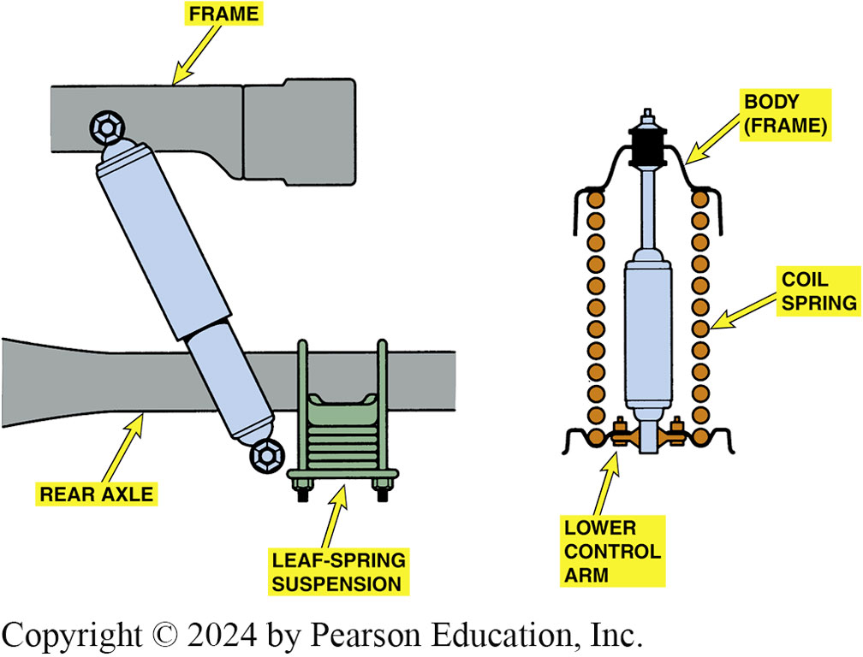
Figure 111.45 Mount
Shock absorbers work best when mounted as close to the spring as possible. Shock absorbers that are mounted straight up and down offer the most dampening

Slide 82
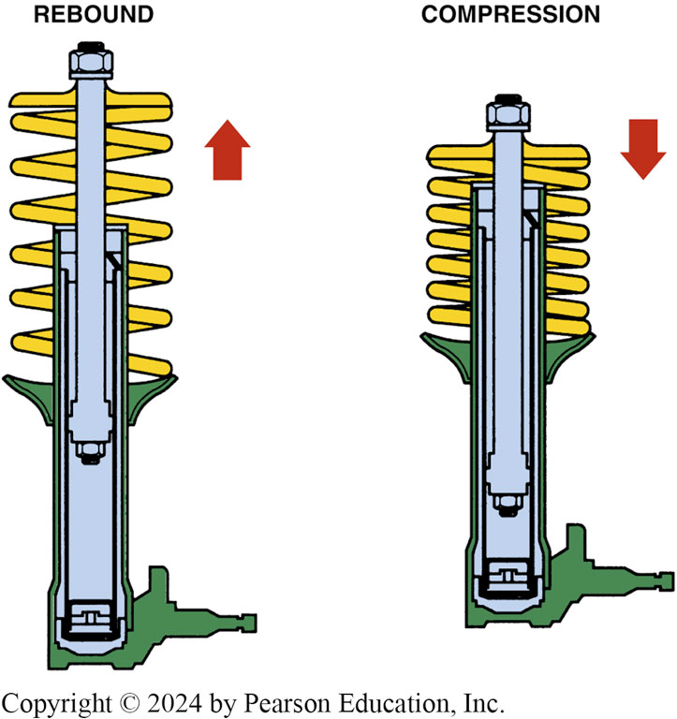
Figure 111.46 Shock Movement
When a vehicle hits a bump in the road, the suspension moves upward. This is called compression or jounce. Rebound is when the spring (coil, torsion bar, or leaf) returns to its original position

Slide 83

Figure 111.47a Cutaway
(a) A cutaway drawing of a typical double-tube shock absorber.

Slide 84

Figure 111.47b Valve Operation
(b) Notice the position of the intake and compression valve during rebound (extension) and jounce (compression).

Slide 85

Figure 111.48 Oil Flow
Oil flow through a deflected disc-type piston valve. The deflecting disc can react rapidly to suspension movement. For example, if a large bump is hit at high speed, the disc can deflect completely and allow the suspension to reach its maximum jounce distance while maintaining a controlled rate of movement.

Slide 86

Figure 111.49 Gas Charged
Gas-charged shock absorbers are manufactured with a double-tube design similar to conventional shock absorbers and with a single or monotube design

Slide 87

Figure 111.50 Air Shocks
A rubber tube forms an inflatable air chamber at the top of an air shock. The higher the air pressure in the chamber, the stiffer the shock

Slide 88


Figure 111.51 Air Springs
(a) The front suspension of a Lincoln with an air-spring suspension. (b) Always check in the trunk for the cutoff switch for a vehicle equipped with an air suspension before hoisting or towing the vehicle.

Slide 89

Figure 111.52 Suspension Control
Some air springs are auxiliary units to the coil spring and are used to control ride height while the coil spring is the weight-bearing unit

Slide 90

Figure 111.53 Coil-Over Shock
A coil-over shock is a standard hydraulic shock absorber with a coil spring wrapped around it to increase stiffness and/or take some of the carrying weight off of the springs

Slide 91

Figure 111.54 Shock Reservoir
The shock absorber is on the right and the fluid reservoir for the shock is on the left

Slide 92
Struts (1 of 2)
Purpose and Function
  A strut is a sturdy shock absorber that is also a structural component of the suspension.
Macpherson Struts
  MacPherson strut includes the suspension spring.
  Coil spring that surrounds the strut casing so that it transfers the weight of the body to the wheel.
  Bearing on a front-wheel strut allows it to rotate on the vertical steering axis.

Slide 93
Struts (2 of 2)
Modified Struts
  Unlike a MacPherson unit, a modified strut does not include a spring as part of the assembly and is used in the front on some vehicles and on the rear of others.
  Most modified strut rear suspensions use coil springs mounted on the lower control arm.

Slide 94

Animation: Strut Suspension
(Animation will automatically start)

Slide 95

Figure 111.55 Macpherson Strut
A strut is a structural part of the suspension and includes the spring and shock absorber in one assembly

Slide 96

Figure 111.56 Modified Strut
A modified strut used on the rear suspension; it is the structural part of the assembly

Slide 97
Bump Stops
Purpose and Function
  A bump stop is a rubber or foam bumper is used to absorb and isolate the suspension from the frame or body.

Slide 98

Figure 111.57 Suspension Bumpers
Suspension bumpers are used on all suspension systems to prevent metal-to-metal contact between the suspension and the frame or body of the vehicle when the suspension “bottoms out” over large bumps or dips in the road

Slide 99

Figure 111.58 Bad Bumper
A bad suspension bumper (strike-out bumper) that was likely caused by a defective shock absorber. Both will require replacement

Slide 100
Frequently Asked Question: What Is a Track Rod?
? Frequently Asked Question
What Is a Track Rod? A track rod, also called a Panhard rod, is used in the rear of some suspension systems to keep the rear axle centered under the center of the vehicle. It is a straight rod or channel that connects to the frame on one end and the axle on the other end.

Slide 101
Suspension and Steering Videos and Animations
Videos Link: (A4) Suspension and Steering Videos
Animations Link: (A4) Suspension and Steering Animations

Slide 102
Copyright
This work is protected by United States copyright laws and is provided solely for the use of instructors in teaching their courses and assessing student learning. Dissemination or sale of any part of this work (including on the World Wide Web) will destroy the integrity of the work and is not permitted. The work and materials from it should never be made available to students except by instructors using the accompanying text in their classes. All recipients of this work are expected to abide by these restrictions and to honor the intended pedagogical purposes and the needs of other instructors who rely on these materials.

