Slide 1
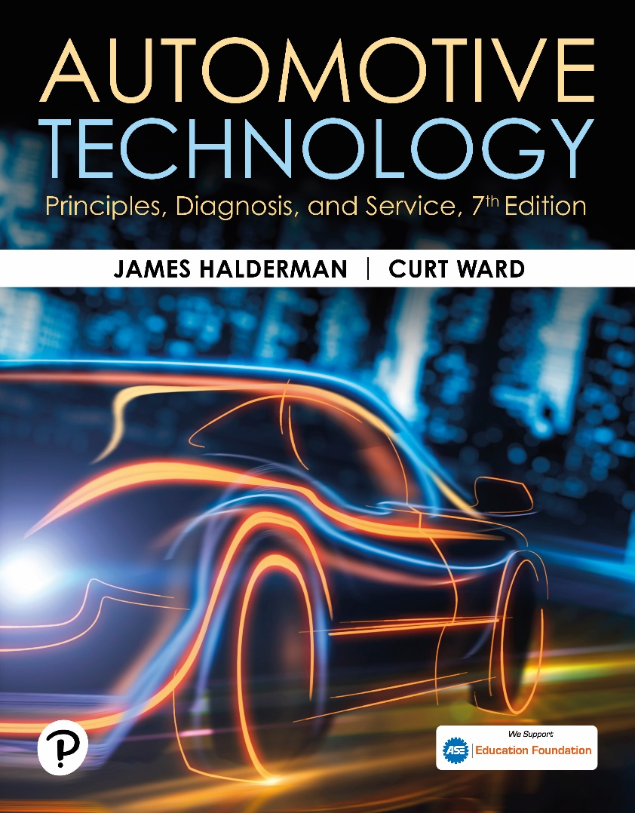
Automotive Technology: Principles, Diagnosis, and Service
Seventh Edition
Chapter 110
Tire and Wheel Service
Copyright © 2023 Pearson Education, Inc. All Rights Reserved
Notes:
INSTRUCTOR NOTE: This presentation includes text explanation notes, you can use to teach the course. When in SLIDE SHOW mode, you RIGHT CLICK and select SHOW PRESENTER VIEW, to use the notes.

Slide 2
Learning Objectives (1 of 2)
110.1 State the importance of proper tire inflation.
110.2 Discuss nitrogen inflation.
110.3 Describe tire inspection.
110.4 Describe the correct sequence for lug nut removal, tightening procedure, and torque for wheel installation.
110.5 State the purpose of tire rotation.
110.6 Discuss radial runout.
110.7 Discuss lateral runout.

Slide 3
Learning Objectives (2 of 2)
110.8 List the steps for replacing a tire.
110.9 Discuss tire balancing.
110.10 Discuss wheel weights.
110.11 Discuss wheel/tire balancers.
110.11 Discuss how to repair tires using internal patch.

Slide 4
Tire Service and Proper Inflation
Need for Service
  Premature wear can often be avoided by checking and performing routine service, such as frequent rotation and monthly inflation checks.
Tire Inflation Pressure
  Tires should always be inflated to the pressure indicated on the driver’s door or pillar sticker.
  Tires should be checked when cold, before the vehicle has been driven.

Slide 5
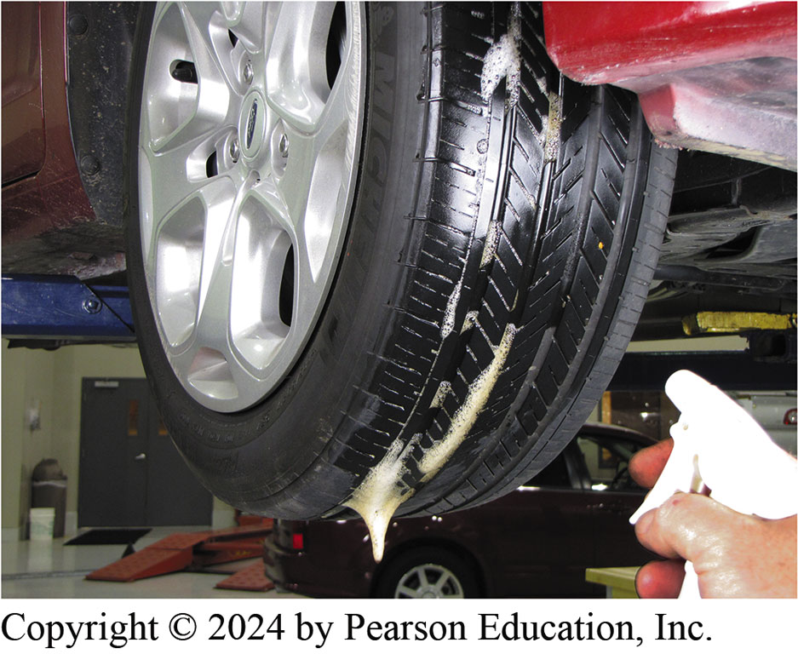
Figure 110.1 Checking for Leaks
Using soapy water from a spray bottle is an easy method to find the location of an air leak from a tire

Slide 6
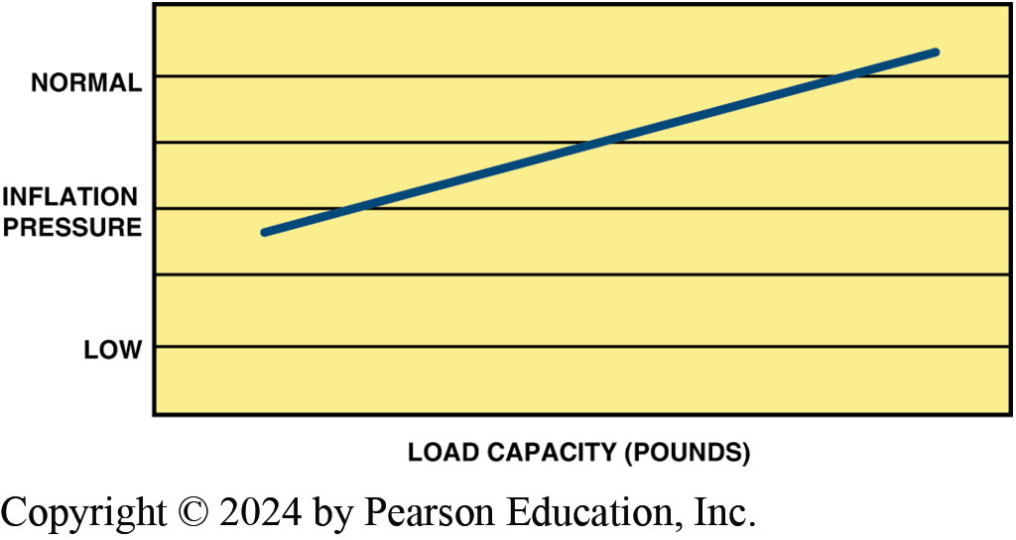
Figure 110.2 Pressure v Capacity
Chart showing the relationship between tire inflation pressure and load capacity of the tire

Slide 7
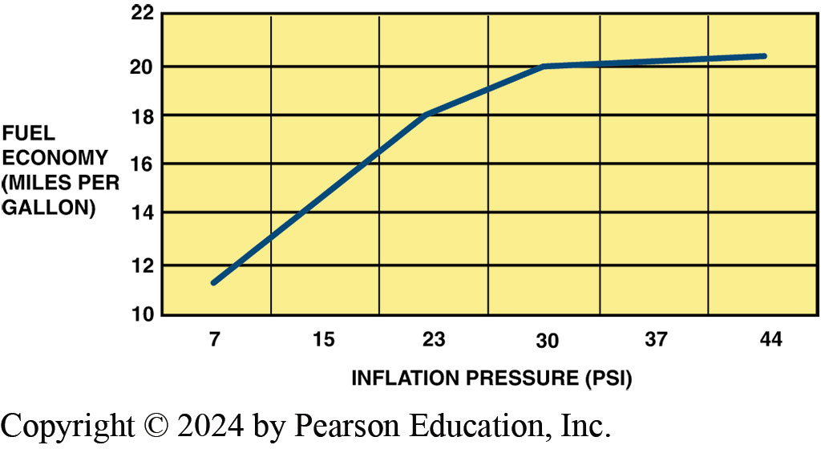
Figure 110.3 Pressure Drop
Note that a drop in inflation pressure has a major effect on fuel economy

Slide 8
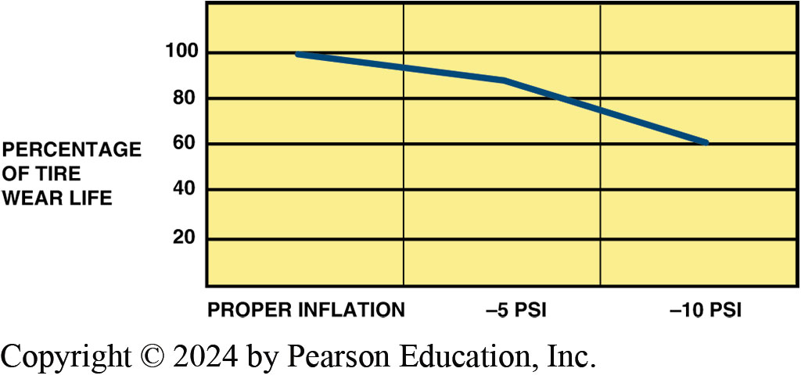
Figure 110.4 Underinflation
Note that if a tire is underinflated by 5 PSI, the life expectancy is reduced by 20% and by about 40% if the inflation pressure is less than specified by 10 PSI

Slide 9
Frequently Asked Question: What Is a “Temporary Mobility Kit”?
? Frequently Asked Question
What Is a “Temporary Mobility Kit”? A temporary mobility kit is a system to inflate a flat tire supplied by the vehicle manufacturer instead of a spare tire. A temporary mobility kit can include An electric compressor powered by the cigarette lighter and a can of stop leak. ● SEE FIGURE 110–5, An aerosol spray can that provides inflation and sealer. ● SEE FIGURE 110–6. Either type can be found in many vehicles because such devices save weight, increase trunk space, and cost less than a conventional spare tire and jack. However, these kits are designed to be a temporary repair only because the cause of the low tire was never determined. If the tire appears to be fixed, many vehicle owners may think that the tire has been repaired. However, the tire should be carefully inspected inside and out for damage and properly repaired.

Slide 10
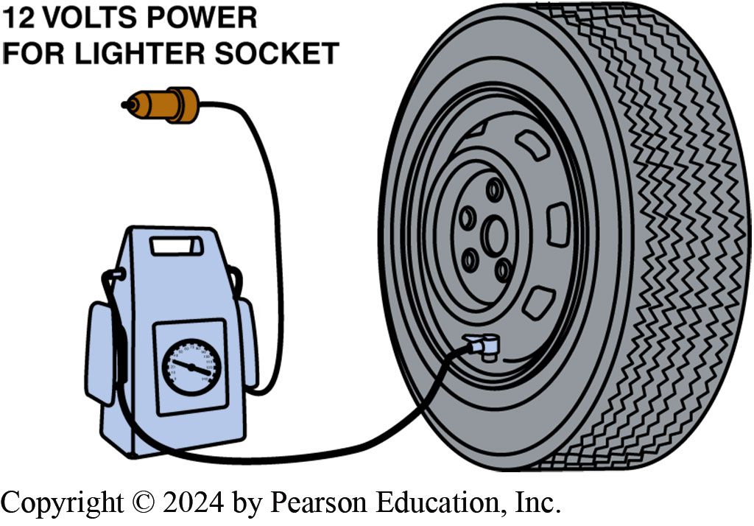
Figure 110.5 Inflation Pump
A temporary inflation pump that uses 12 volts from the cigarette lighter to inflate the tire

Slide 11
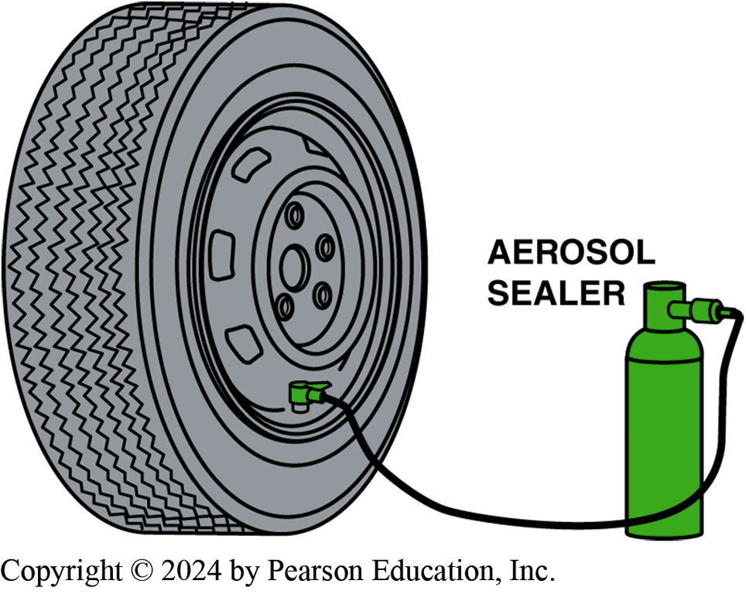
Figure 110.6 Sealer
Many vehicle manufacturers include an aerosol can of sealer on vehicles that are not equipped with a conventional spare tire

Slide 12
Nitrogen Inflation
Definition
  Air contains about 78% nitrogen, 21% oxygen, and 1% other gases.
  Some shops recommend and inflate tires using nitrogen instead of using compressed air.
Reasons to Use Nitrogen
  Nitrogen molecule is slightly larger than the oxygen molecule so the tire will not loose pressure as quickly.
  Compressed nitrogen contains less moisture than compressed air.
  Less oxidation of the inner liner of the tire and the corrosion of the wheel.

Slide 13
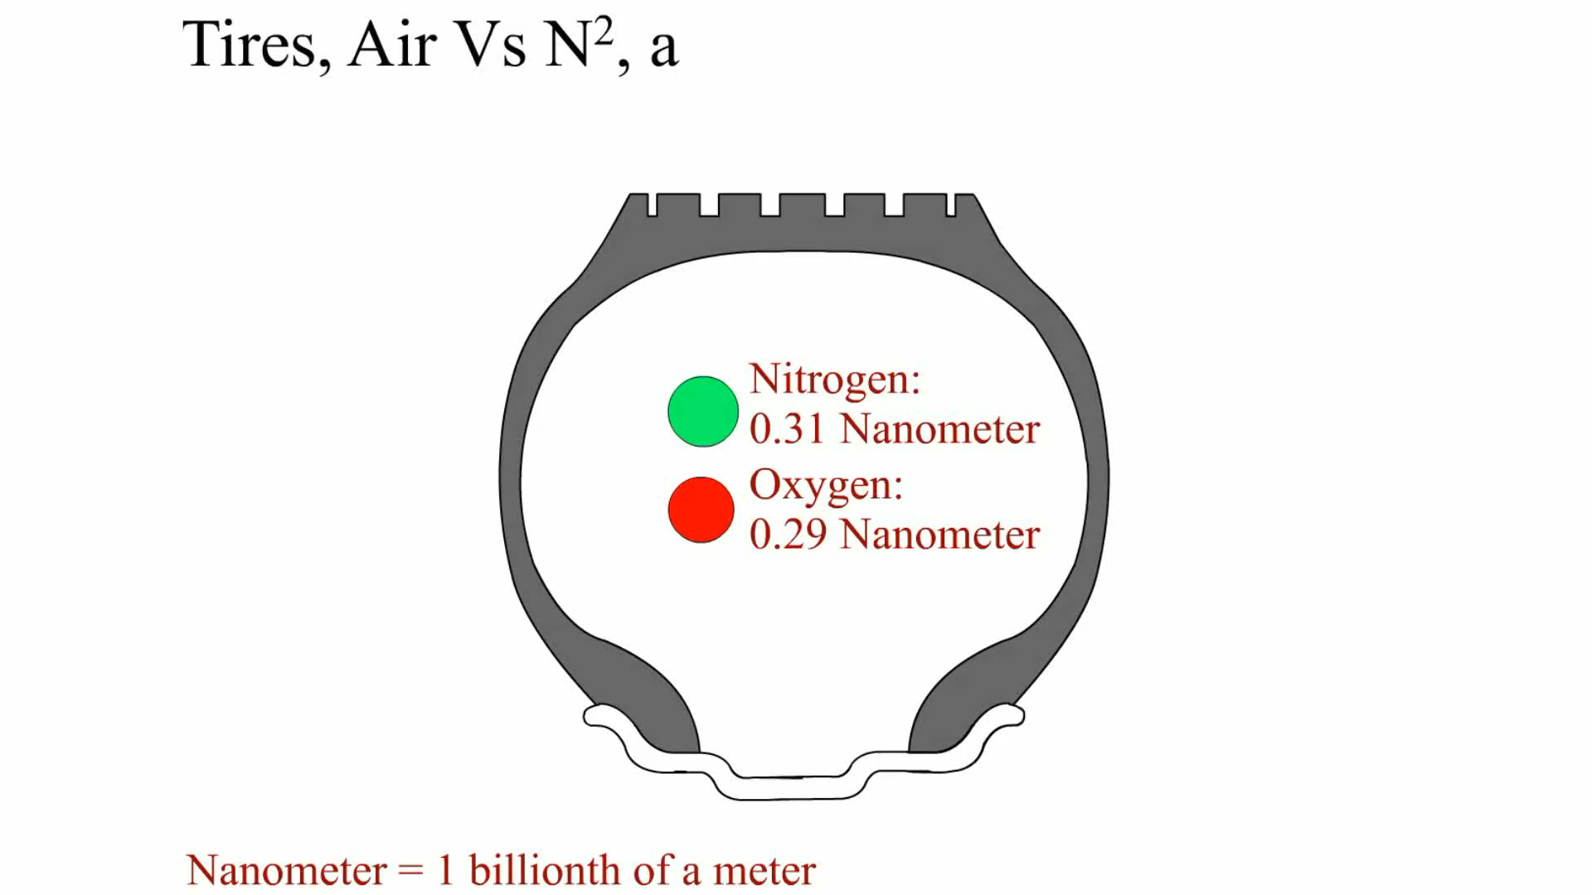
Animation: Tires, Air Vs N2
(Animation will automatically start)

Slide 14
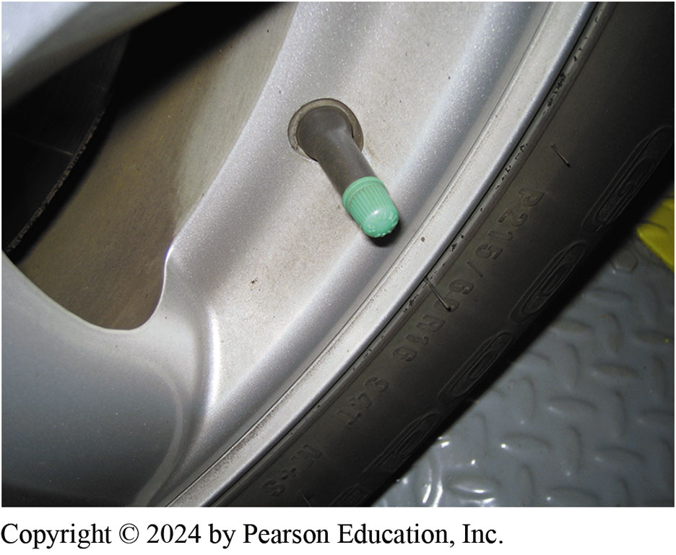
Figure 110.7 Green Tire Valve Cap
Most shops that use nitrogen inflation install a green tire valve cap to let others know that nitrogen, rather than air, has been used to inflate the tire

Slide 15
Tech Tip Graph
Tire Pressure | To Decrease Understeer | To Decrease Oversteer
Front tire inflation pressure | Increase | Decrease
Rear tire inflation pressure | Decrease | Increase
TECH TIP: Fine-Tune Handling with Tire-Pressure Changes The handling of a vehicle can be changed by changing tire pressures between the front and rear tires. Understeer—A term used to describe how a vehicle handles when cornering where additional steering input is needed to maintain the corner, or resisting turning into a corner. This is normal handling for most vehicles. Oversteer—A term used to describe handling where correction while cornering is often necessary because the rear tires lose traction before the front tires.

Slide 16
Frequently Asked Question: What Is the Color Band on a Valve Core?
? Frequently Asked Question
What Is the Color Band on a Valve Core? The red band cores have a seal temperature range of 130 to 250°F (54 to 121°C), and are mainly for use in trucks or high-performance applications. The valve cores with a black band are rated for 107 to 225°F (54 to 107°C). Brass tire valve cores are for standard rubber stems, whereas nickel plated cores are for TPMS sensors to prevent corrosion.

Slide 17
Question 1: ?
What is the advantage of nitrogen inflation?

Slide 18
Answer 1
Less moisture and corrosion, slower pressure loss, and less oxidation of the inner liner.

Slide 19
Tire Inspection
Visual Inspection
  Excessive wear
  Sidewall faults
  Under inflation (edge wear)
  Over inflation (center wear)
  Wear as indicated by an alignment issue
Tread Depth
  New tires = 11/32 inch
  3/32 inch or less—Replace (2/32 inch is the legal limit)

Slide 20
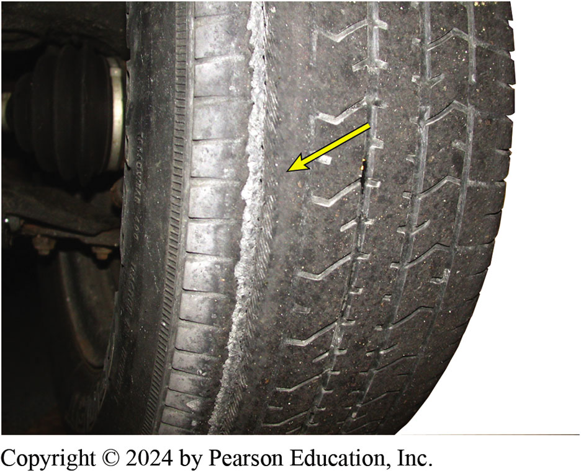
Figure 110.8 Worn Tire
Excessively worn tire showing the belt material on the inside edge. This tire requires replacement

Slide 21
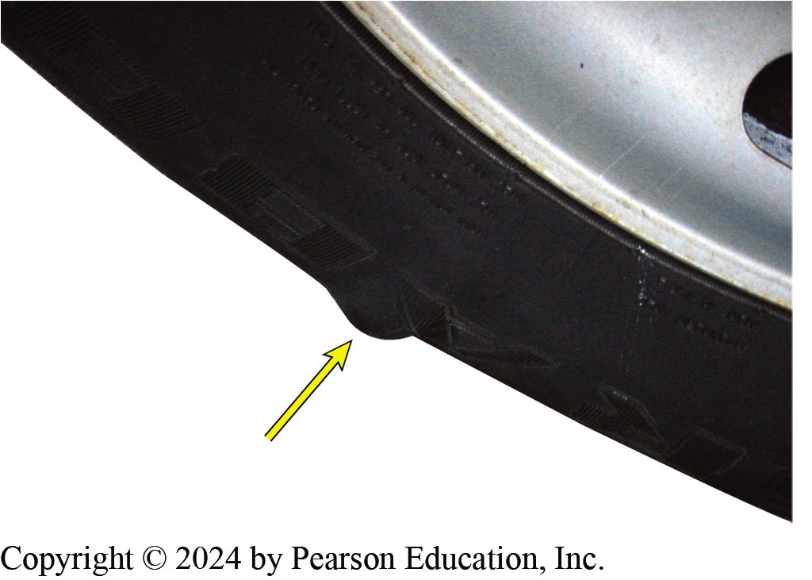
Figure 110.9 Bulge
A bulge in a tire as a result of either an injury to the sidewall, such as contact with a curb, or an internal fault in the tire. This tire requires replacement

Slide 22
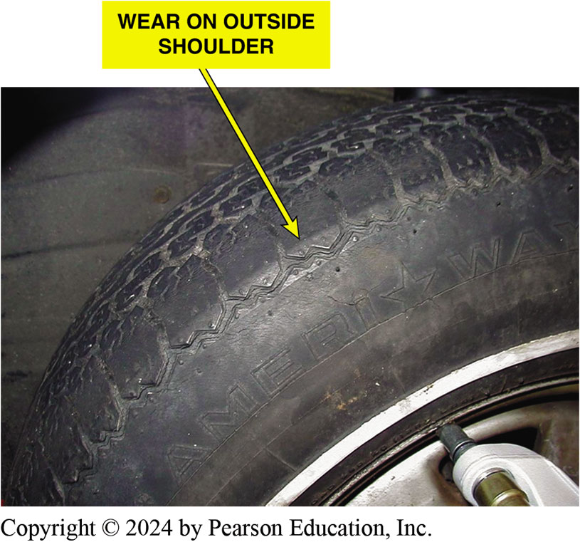
Figure 110.10 Camber Wear
Wear on the outside shoulder only is an indication of an alignment problem

Slide 23
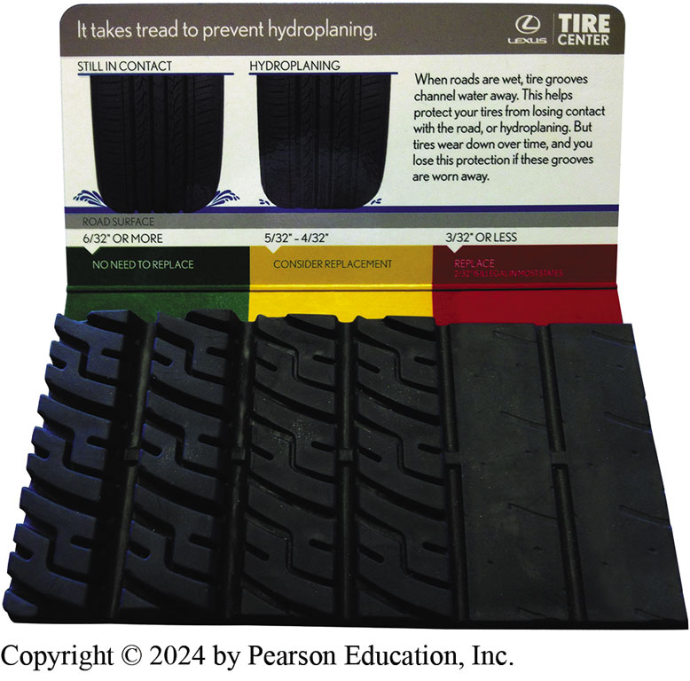
Figure 110.11 Tread Depth Display
A display at a Lexus dealer used to show customers a visual representation of what a tire looks like at various tread depth amounts. This display helps vehicle owners understand tire tread depth measurements

Slide 24
Wheel Removal/Installation (1 of 3)
Lug Nuts
  When removing lug nuts, notice the amount of force needed to remove the nuts.
  Always start wheel lug nuts by hand.
Lug Nut Torque
  Make certain that the wheel studs are clean and dry.
  Torque to the manufacturer’s specifications.

Slide 25
Wheel Removal/Installation (2 of 3)
Tightening Sequence
  Always tighten lug nuts gradually in the proper sequence—star pattern (tighten one nut, skip one, and tighten the next nut).
  When removing or installing a locked lug nut, be sure the key is held square to the lug nut to prevent damaging either the nut or the key.

Slide 26
Wheel Removal/Installation (3 of 3)
Tightening Torque
  All vehicle manufacturers recommend that the lug nuts be tightened to factory specifications using a torque wrench.

Slide 27
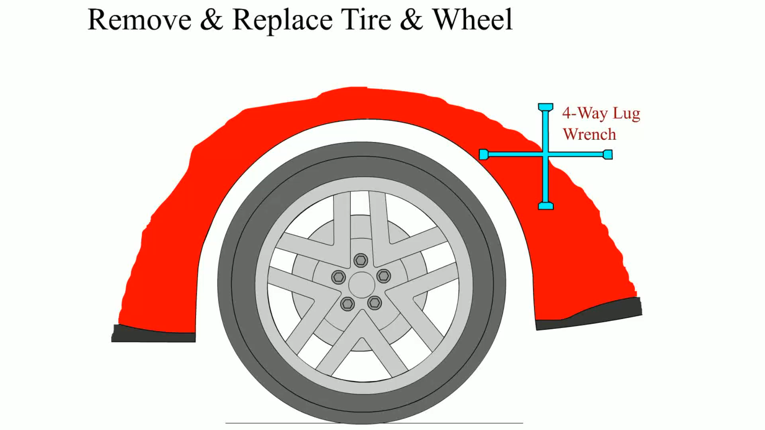
Animation: Remove & Replace Tire and Wheel
(Animation will automatically start)

Slide 28
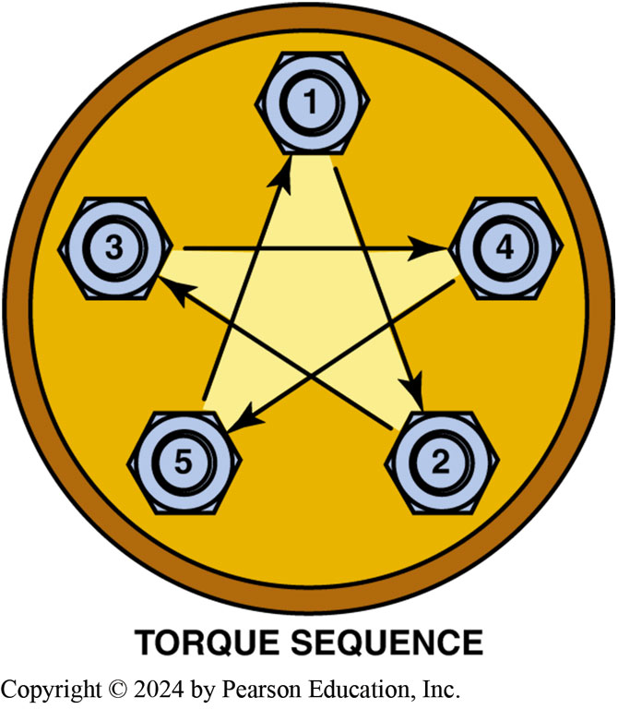
Figure 110.12 Star Pattern
Always tighten wheel lug nuts (or studs) in a star pattern to ensure even pressure on the axle flange, brake rotors or drums, and the wheel itself

Slide 29
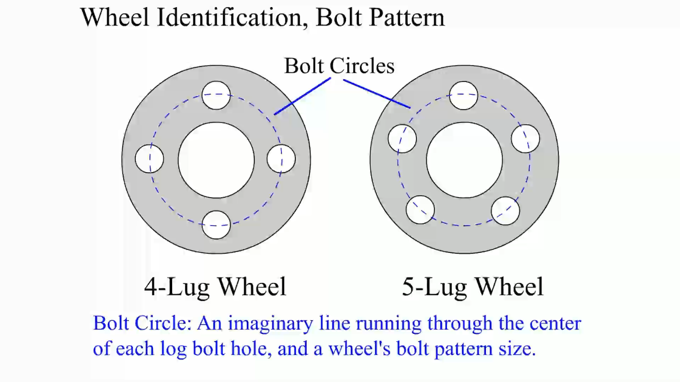
Animation: Wheel Identification Pattern
(Animation will automatically start)

Slide 30
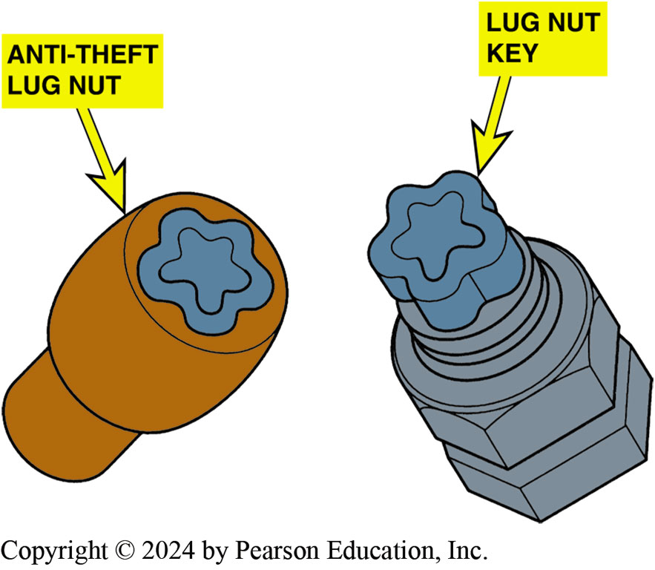
Figure 110.13 Lock Type Lug Nuts
Most manufacturers recommend using hand tools rather than an air impact wrench to remove and install lock type lug nuts to prevent damage. If either the key or the nut is damaged, the nut may be very difficult to remove

Slide 31
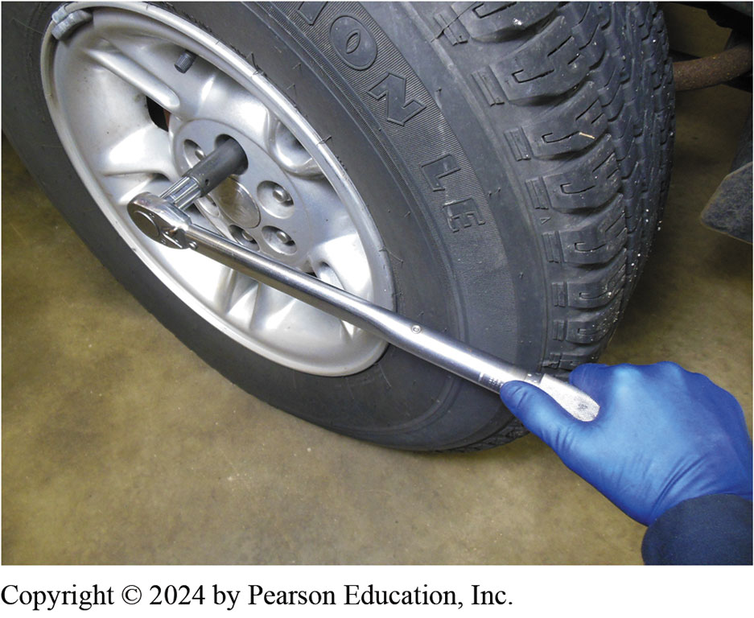
Figure 110.14 Use a Torque Wrench
A torque wrench being used to tighten lug nuts on a pickup truck

Slide 32
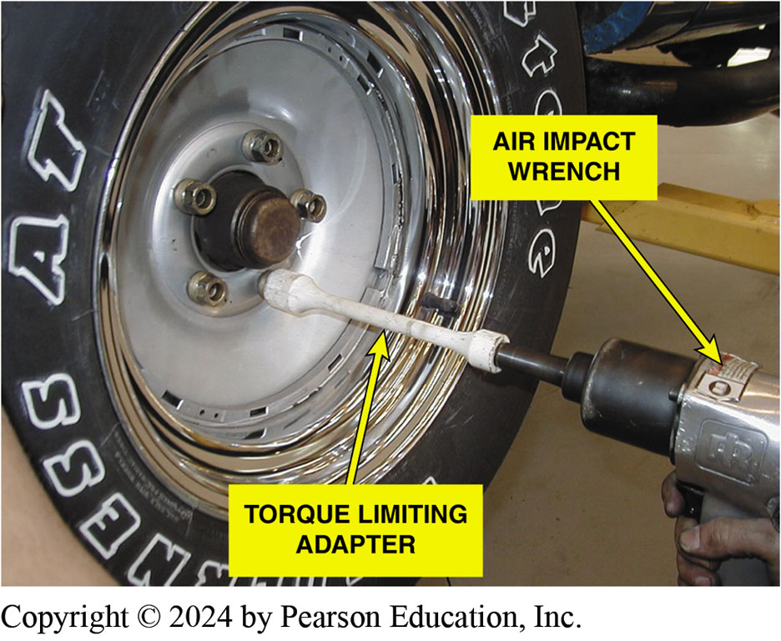
Figure 110.15 Torque Stick
A torque-limiting adapter (torque stick) used with an air impact wrench still requires care to prevent overtightening

Slide 33
Chart 110.1 Lug Nut Torque
STUD DIAMETER | TORQUE (LB-FT)
3/8 in. | 35–45
7/16 in. | 55–65
½ Inch | 75–85
9/16 in. | 95–115
5/8 in. (usually only trucks) | 125–50
12 mm | 70–80
14 mm | 85–95
Typical lug nut torque based on the diameter of the wheel stud.

Slide 34
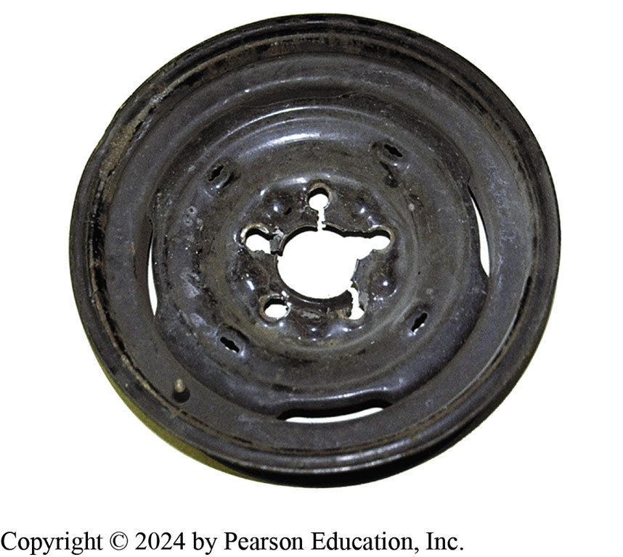
Figure 110.16 Damaged Wheel
This wheel was damaged because the lug nuts were not properly torqued
Notes:
CASE STUDY: I Thought the Lug Nuts Were Tight!
Proper wheel nut torque is critical, as one technician discovered when a customer returned
complaining of a lot of noise from the right rear wheel. The lug (wheel) nuts had loosened and
ruined the wheel. ● SEE FIGURE 110–16.
CAUTION: Most vehicle manufacturers also specify that the wheel studs/nuts should not be lubricated with oil or grease. The use of a lubricant on the threads could cause the lug nuts to loosen.
Summary:
Complaint—Customer complained of a lot of noise from the rear of the vehicle after a routine tire
rotation.
Cause—The service technician got distracted when installing the wheels during a tire rotation and forgot to properly torque the lug nuts.
Correction—A new wheel was used and the tire mounted and balanced and properly installed.
The technician learned to always keep focused on the job being performed.

Slide 35
Tire Rotation
Purpose
  Tire rotation is essential to ensure long life and even tire wear.
Methods
  For best results, tires should be rotated every 6,000 miles or every six months.
  Rotate tire position per manufacturers specifications.
Notes:
TECH TIP: All-Wheel-Drive Tire Concerns
It is very important that all-wheel-drive vehicles be equipped with tires that are all the same outside diameter. If, for example, the vehicle has 20,000 miles and the tires are half worn, all of the tires should be replaced in the event of a problem requiring replacement of only one tire. Most vehicle manufacturers specify that all tires must be within 2/32 inch of tread depth without
causing a constant strain on the drivetrain.

Slide 36
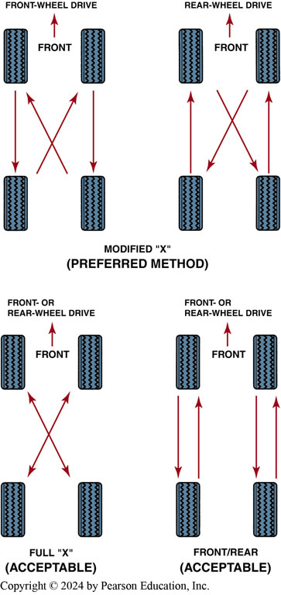
Figure 110.17 Tire Rotation
The method most often recommended is the modified X method. In this method, each tire eventually is used at each of the four wheel locations

Slide 37
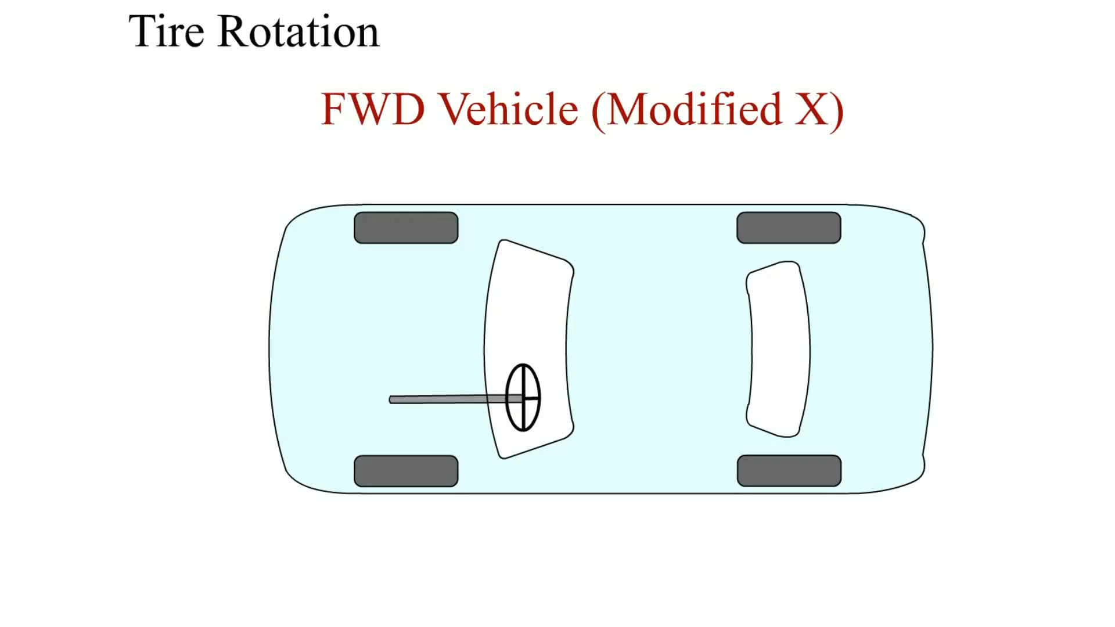
Animation: Tire Rotation
(Animation will automatically start)

Slide 38
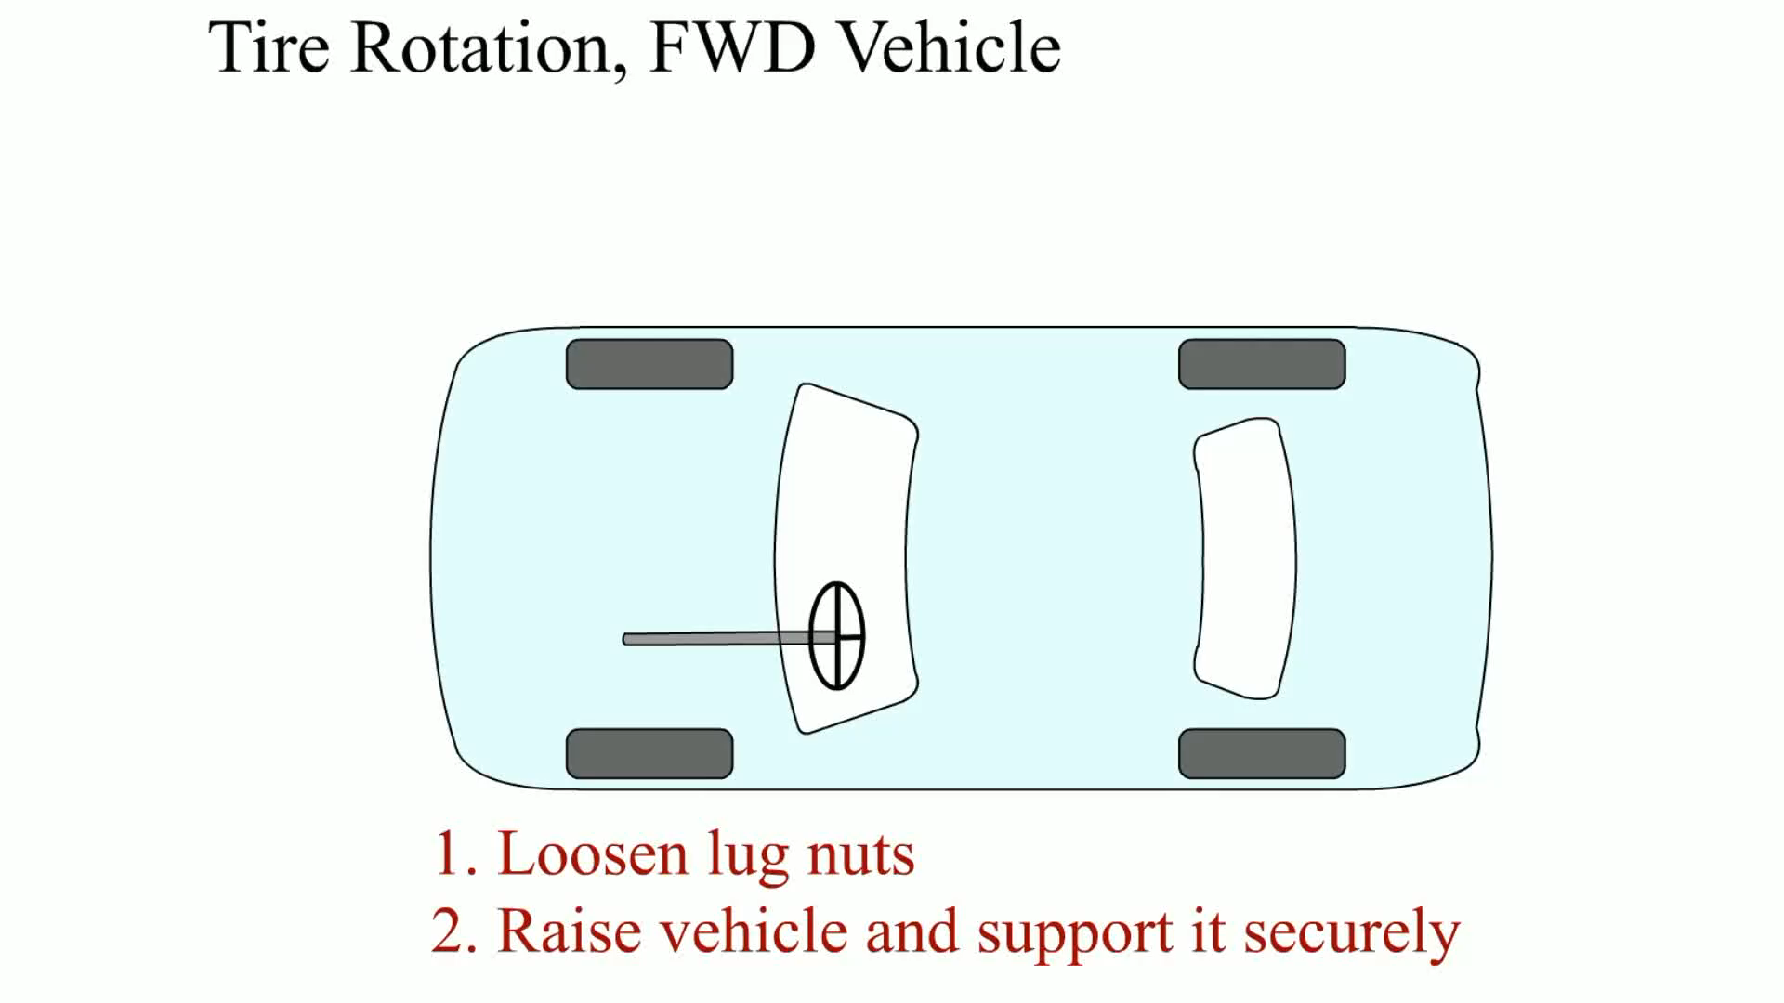
Animation: Tire Pressure Rotation, FWD Vehicle
(Animation will automatically start)

Slide 39
Question 2: ?
What is the purpose of tire rotation?

Slide 40
Answer 2
To ensure long even tire life.

Slide 41
Radial Runout
Why Check
  If vibration is felt above 45 mph, regardless of the engine load, the cause is usually due to an out-of-balance or a defective out-of-round tire.
Checking Radial Runout
  Place the runout gauge against the tread of the tire in the center of the tread and, while rotating the tire, observe the gauge reading.
Correcting Radial Runout
  Match mount or force balance the tire and wheel.

Slide 42
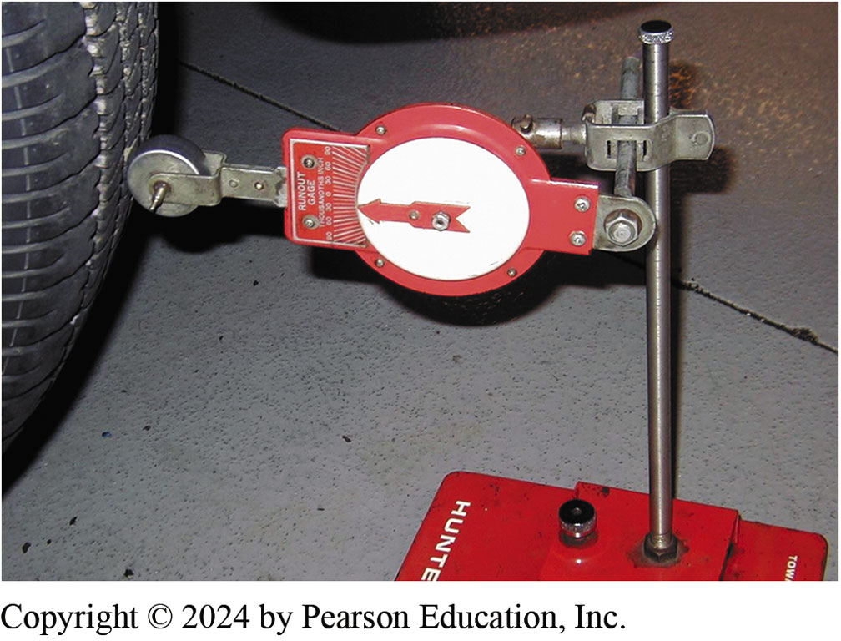
Figure 110.18 Tire Runout
A tire runout gauge being used to measure the radial runout of a tire

Slide 43
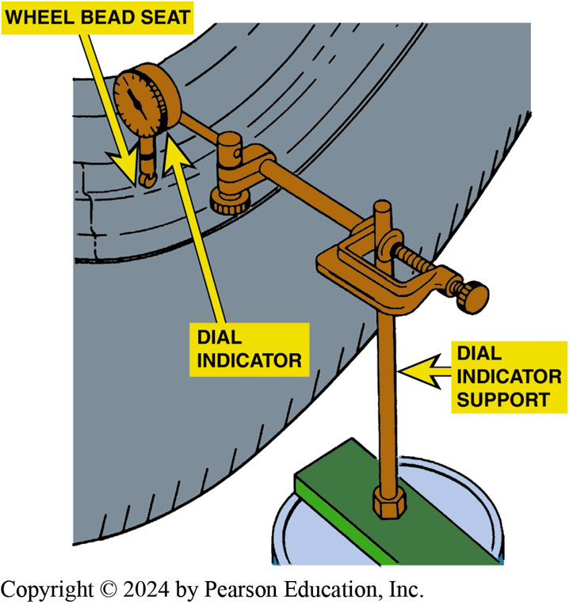
Figure 110.19 Radial Wheel Runout
To check wheel radial runout, the dial indicator plunger tip rides on a horizontal surface of the wheel, such as the bead seat

Slide 44
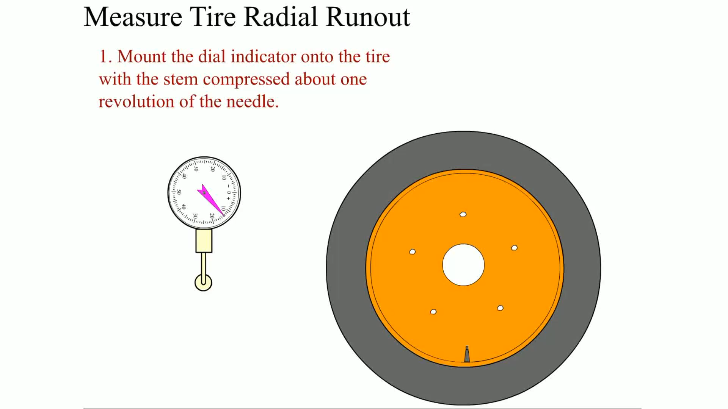
Animation: Measure Tire Radial Runout
(Animation will automatically start)

Slide 45
Lateral Runout
Why Check
  A possible problem that tires can cause is a type of vibration called shimmy.
Checking Lateral Runout
  This can be checked by using a runout gauge on the side of the tire or wheel.
Correcting Lateral Runout
  Damage to tire or wheel
  Looseness in the bearing assembly
  Mounting surface not clean or wheel not properly torqued.

Slide 46
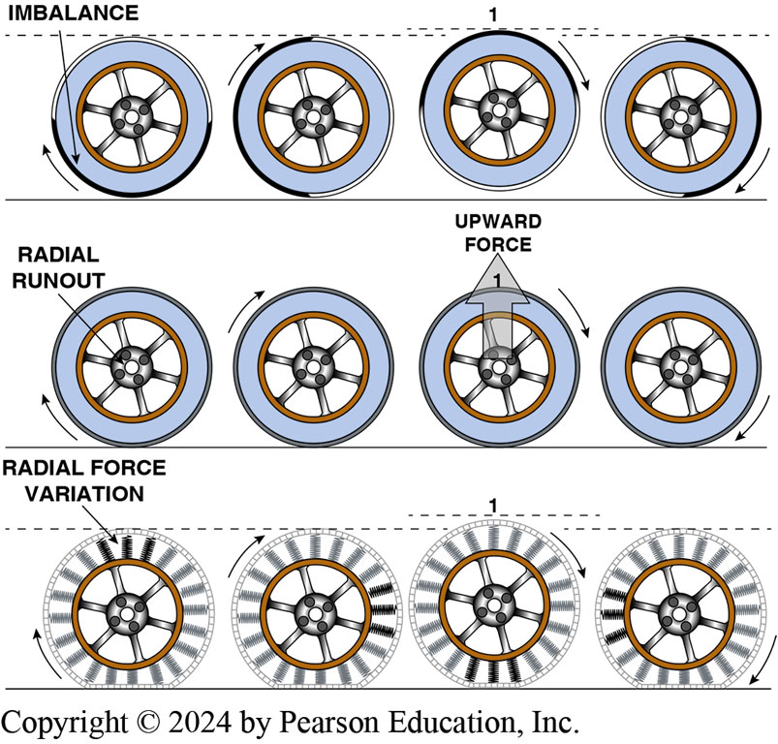
Figure 110.20 Out of Balance
Out-of-balance causes the wheel/tire to move vertically as it rotates causing a tramp-type vibration. Excessive radial runout also causes a tramp-type vibration. Excessive radial force variation (RFV) can cause a vibration due to the varying stiffness of the tire carcass.

Slide 47
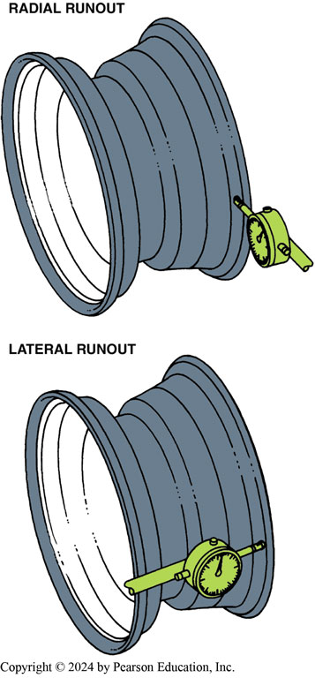
Figure 110.21 Wheel Lateral Runout
The most accurate method of measuring wheel runout is to dismantle the tire and take dial indicator readings on the inside of the wheel rim.
Notes:
CORRECTING LATERAL RUNOUT Excessive lateral runout may be corrected by one of several methods:
Method #1—Re-torque the wheel in the proper star pattern to the specified torque. Unequal or uneven wheel torque can cause excessive lateral runout.
Method #2—Remove the wheel and inspect the wheel-mounting flange for corrosion or any other reason that could prevent the wheel from seating flat against the brake rotor or drum surface.
Method #3—Check the condition of the wheel or axle bearings. Looseness in the bearings can cause the wheel to wobble.

Slide 48
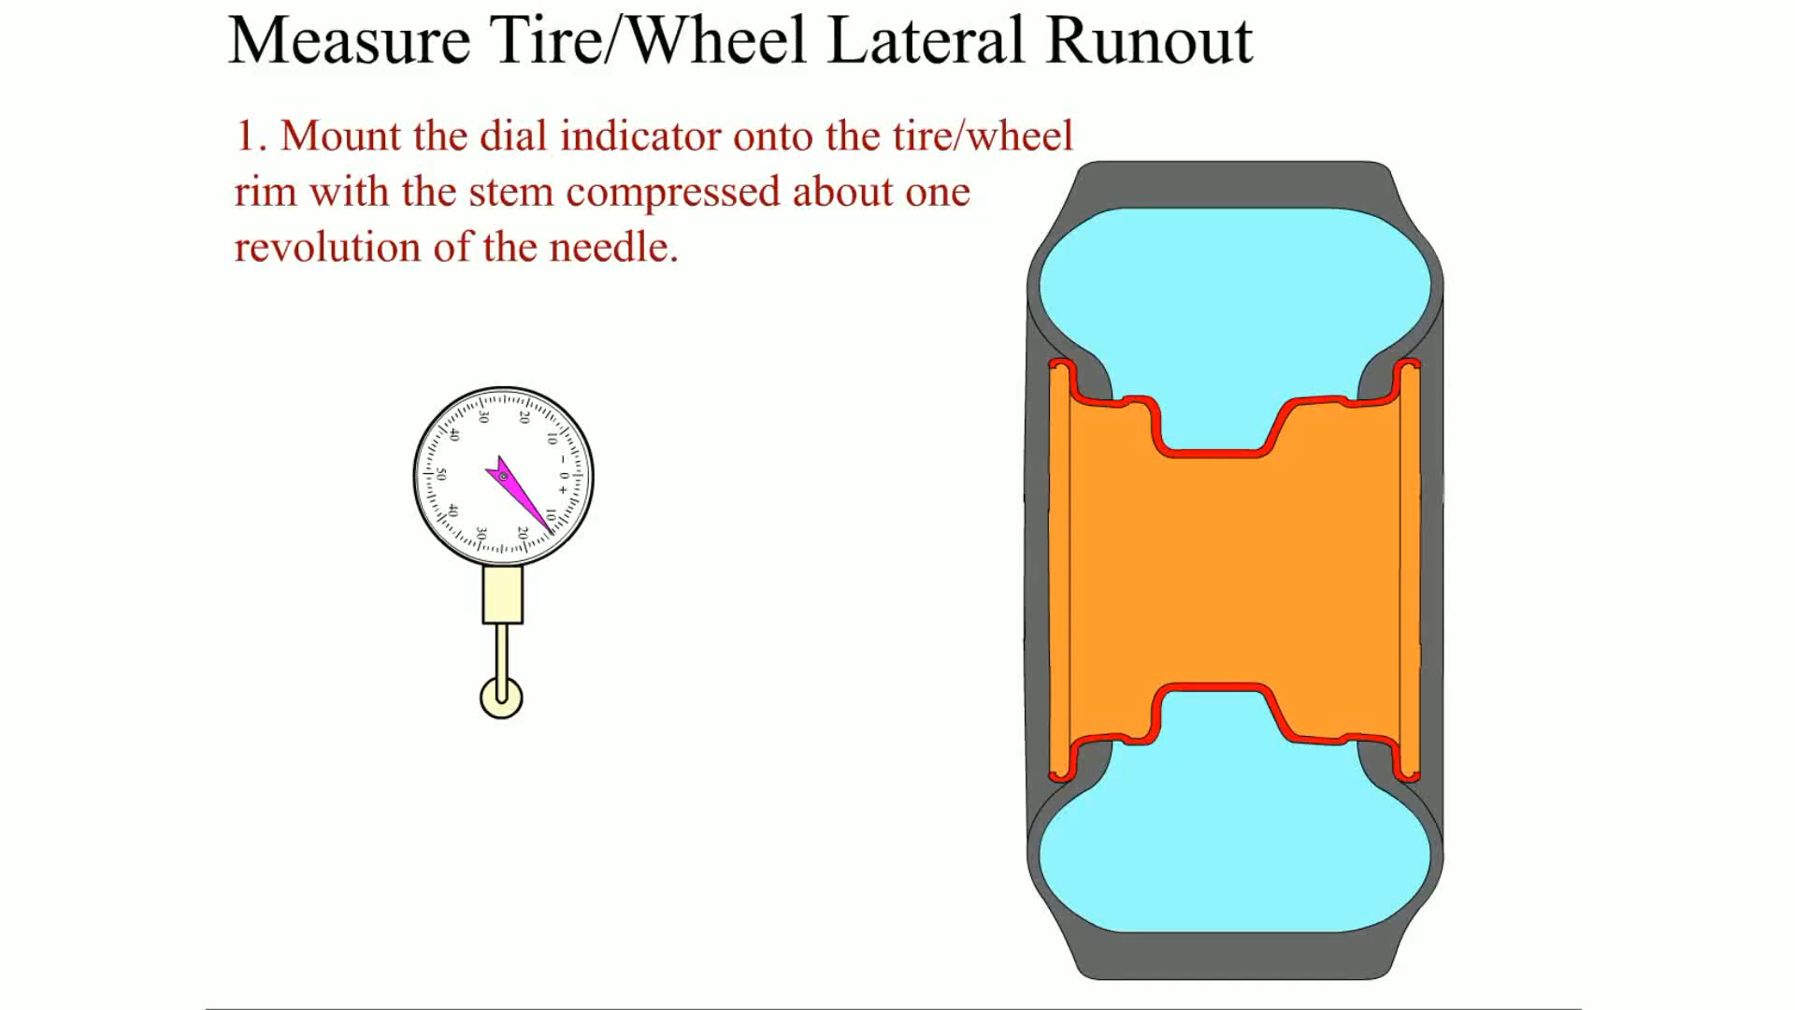
Animation: Measure Tire/Wheel Lateral Runout
(Animation will automatically start)

Slide 49
Tire Replacement
Removing Wheel/Tire Assembly
  Check the operation of the tire-pressure monitoring system (T P M S) sensor using a handheld tester before removing the wheel.
Tire Removal from the Wheel
  Remove the tire from the rim following the tire machine instructions for proper use.
Installing New Tires
  On a clean wheel, ensure the tire is properly lubricated and positioned correctly, and inflated to specifications.
Notes:
TECH TIP: Spin the Tires
When performing a vehicle inspection and the vehicle has been hoisted on a frame-type lift, check the tires by rotating them by hand. The tires on the non-drive wheels should spin freely.
On front-wheel-drive vehicles, rear wheels should rotate easily.
On rear-wheel-drive vehicles, front wheels should rotate easily.
On all-wheel-drive vehicles, all four wheels may require effort to rotate.
What to Look For?
When rotating the wheels, look at the tires from the front or rear and check that the tread of the tires does not change or look as if the tread is moving inward or outward. If the tread is moving, this indicates an internal fault with the tire and it should be replaced. This type of fault can cause a vibration even though the tire/wheel assembly has been correctly balanced.
Look from the side of the vehicle as the wheel/tire assembly is being rotated. Look carefully at the tread of the tire and see if the tire is round. If the tire is out of round, the tread will appear to move up and down as the tire is being rotated.

Slide 50
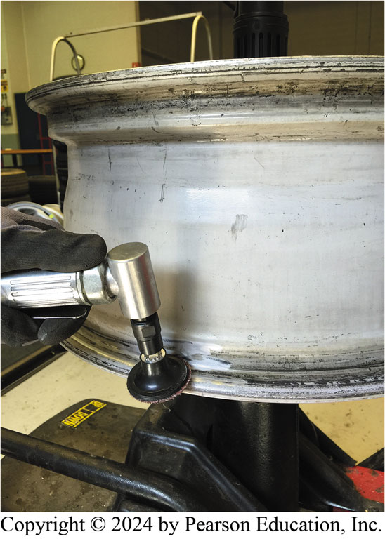
Figure 110.22 Cleaning Bead Seal
Cleaning the bead seat of an alloy wheel using an abrasive pad

Slide 51
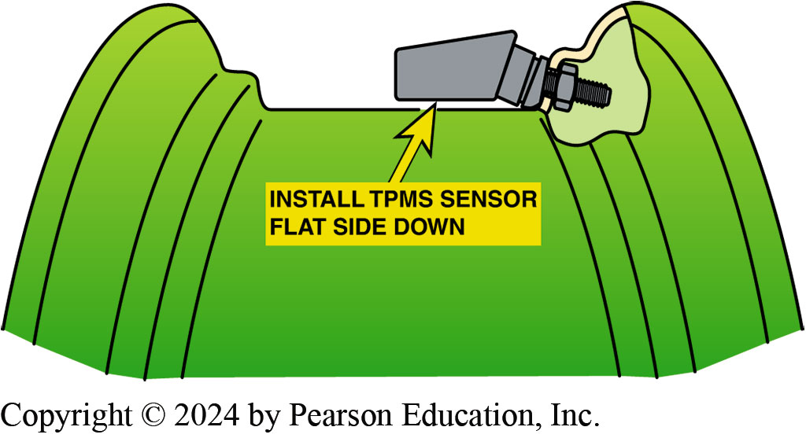
Figure 110.23 TPMS Sensor Install
When installing a tire-pressure monitoring system sensor, be sure that the flat part of the sensor is parallel to the center section of the rim.

Slide 52
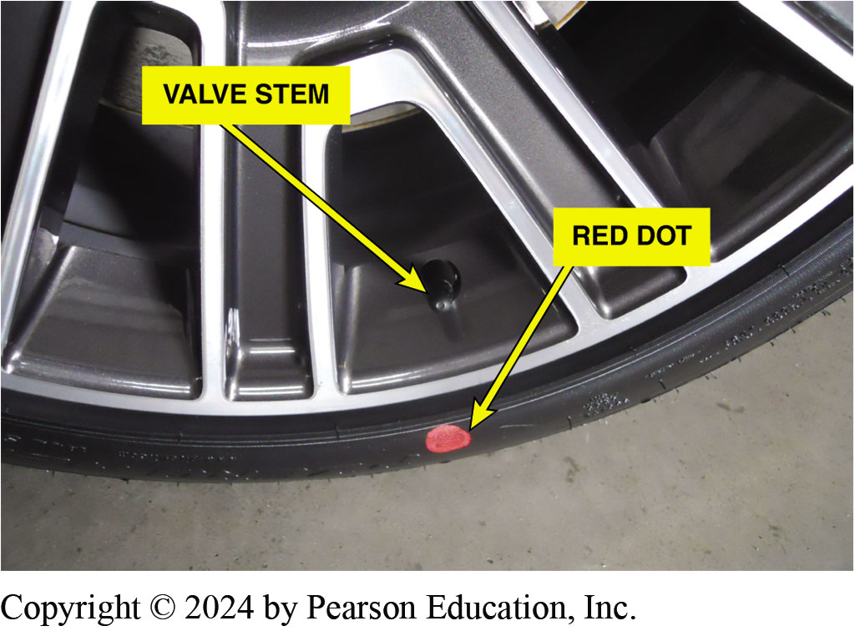
Figure 110.24 Painted Dots
Many new tires have painted dots placed there at the tire manufacturer. Yellow Dot- Indicates the light (static) balance point of the tire Red Dot- Indicates the “radial force variation first harmonic maximum”

Slide 53
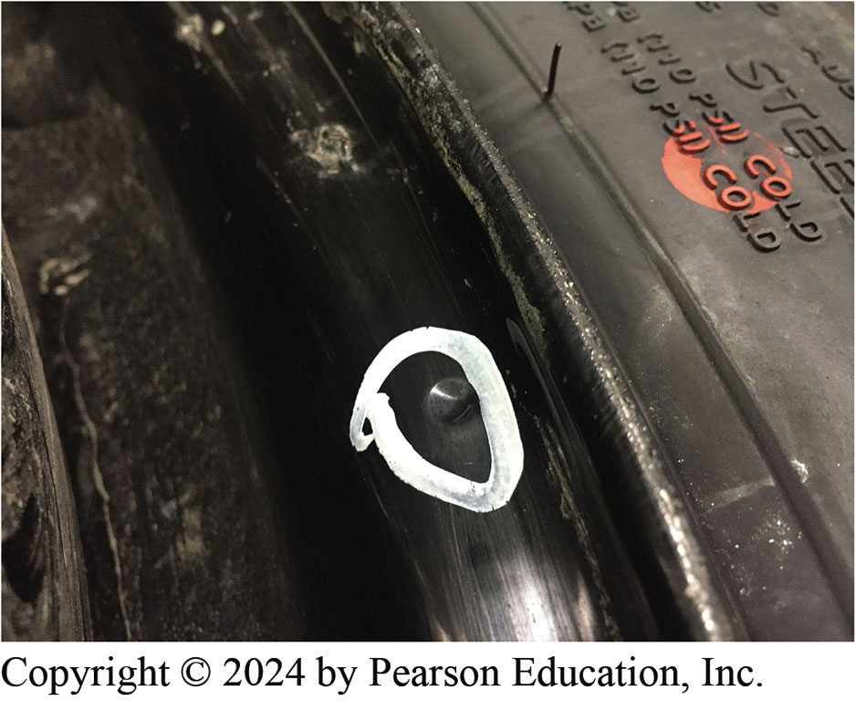
Figure 110.25 Dimple on Wheel
Most steel wheels are not as round as alloy wheels that are machined as part of the production process. Look for a “dimple” on the steel wheel and align the red dot of the tire with this dimple when match mounting tires on steel wheels. If there is no dimple, align the red dot with the valve stem.

Slide 54
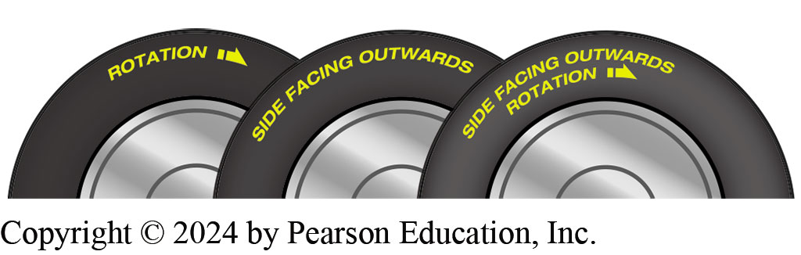
Figure 110.26 Tire Wording
Always check the wording on tires and install them correctly to insure that the tire performs as designed.
Notes:
TECH TIP: Think Like a Wheel
When mounting directional tires, keep in mind which direction the wheels will be rotating when the vehicle is moving forward. When looking at the right side of the vehicle, the wheels will be rotating in a clockwise direction. When looking at the left side of the vehicle, the wheels will be rotating counterclockwise.

Slide 55
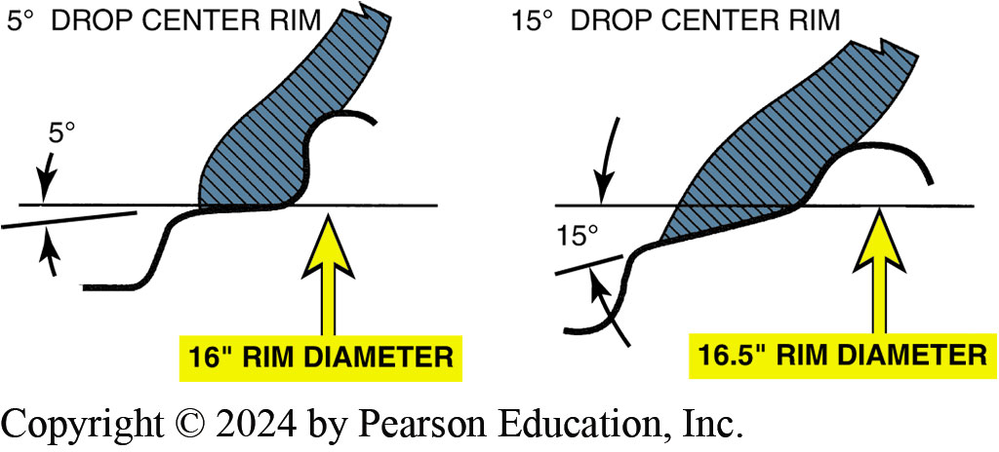
Figure 110.27 Rim Contour
Note the difference in the shape of the rim contour of the 16 inch and 16 1/2 inch diameter wheels. While it is possible to mount a 16 inch tire on a 16 1/2 inch rim, it cannot be inflated enough to seat against the rim flange.

Slide 56
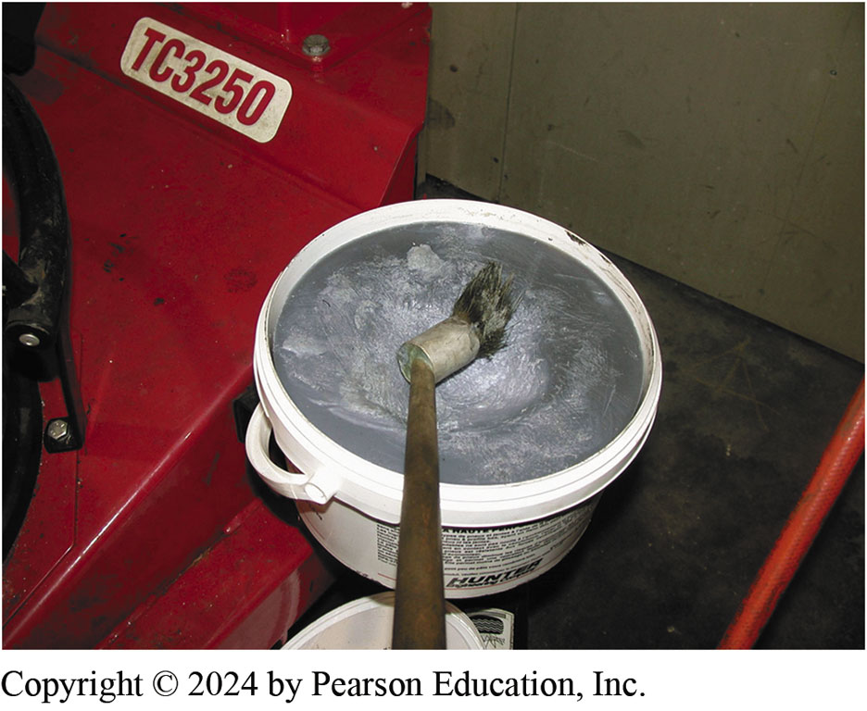
Figure 110.28 Rubber Lubricant
Rendered (odorless) animal fat is recommended by some manufacturers of tire changing equipment for use as a rubber lubricant

Slide 57
Tire Balancing
Purpose
  Proper tire balance is important for tire life, ride comfort, and safety.
Static Balance
  The term static balance means that the weight mass is evenly distributed around the axis of rotation.
Dynamic Balance
  The term dynamic balance means that the centerline of weight mass is in the same plane as the centerline of the wheel.

Slide 58
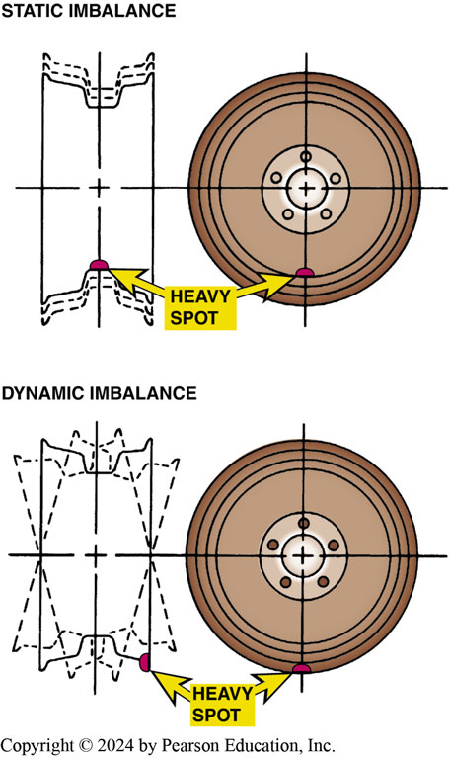
Figure 110.29 Wheel Balancer
A wheel balancer detects heavy spots on the wheel and tire, and indicates where to place weight to offset both static and dynamic imbalance

Slide 59
Wheel Weights
Purpose and Function
  To correct any imbalance that can normally occur in a tire/wheel assembly.
Wheel Weight Materials
  Lead (chemical symbol P B) —being phased out (stick-on and clip-on designs)
  Zinc (chemical symbol Z N)—(stick-on and clip-on designs)
  Steel (chemical symbol F E)—(stick-on and clip-on designs)
  Thermoplastic Polypropylene—high specific gravity plastic (stick-on only)
Clip-on weights attach to the flange, stick-on weights are used on the inside of the rim.

Slide 60
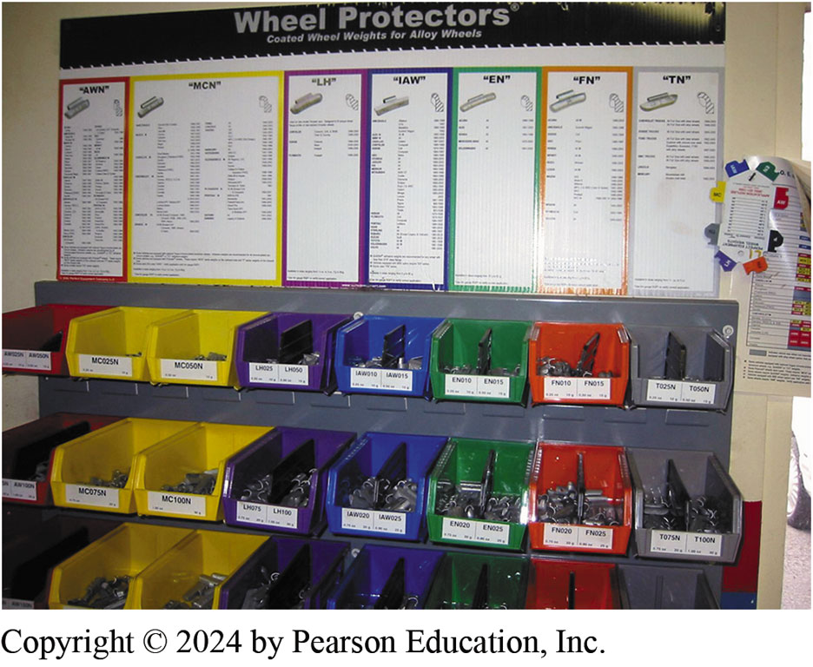
Figure 110.30 Wheel Weights
Assortment of wheel weights designed to fit different shaped rims

Slide 61
Frequently Asked Question: Does “MC” Mean “Most Cars”?
? Frequently Asked Question
Does “MC” Mean “Most Cars”? Maybe. MC is the wheel flange shape that is used on most domestic alloy rims. The next most popular shape is “AW,” which is used on older GM, Ford, and Chrysler alloy rim and then “FN” which is used on many Acura, Honda, Nissan, and Toyotas since about 1990. To be sure, always use a rim flange gauge to determine the exact shape before using clip-on wheel weights. Figure 110–31.

Slide 62
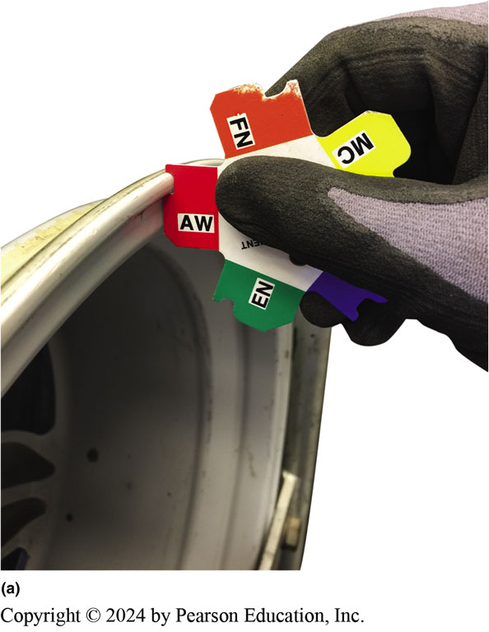
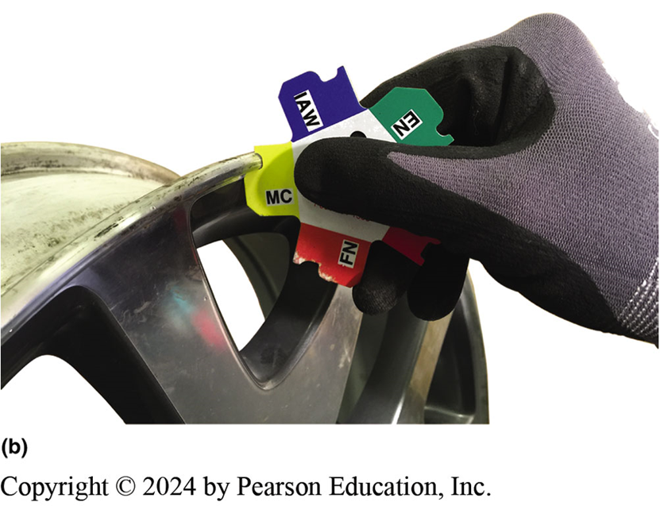
Figure 110.31 Rim Gauge
(a) Using a rim gauge can be a little tricky as the shape may appear to match several patterns on the rim gauge. This “AW” shape is not a good match. (b) Using the gauge shape for “MC” appears to be a perfect match to their rim flange.

Slide 63
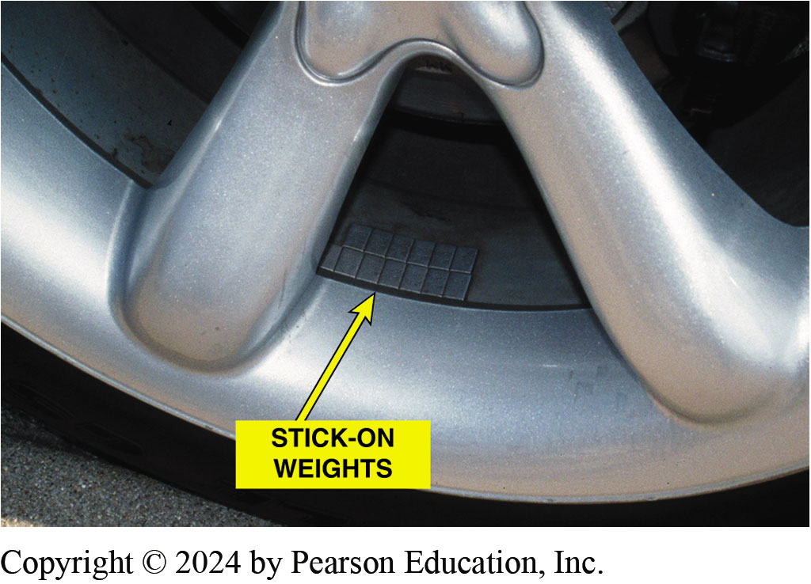
Figure 110.32 Stick-On Weights
Stick-on weights are used from the factory to balance the alloy wheels of this vehicle

Slide 64
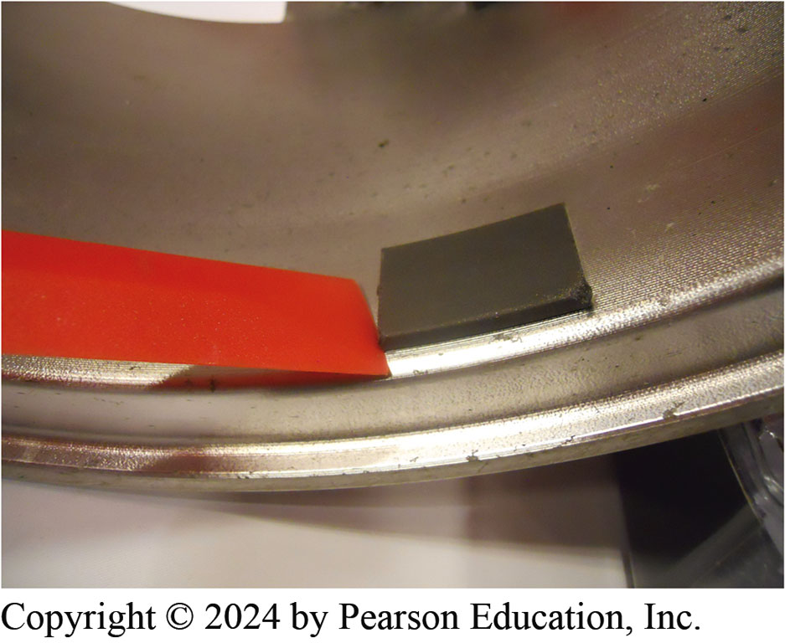
Figure 110.33 Wheel Weights
3M high density Polypropylene plastic wheel weighs are an excellent choice to use instead of lead wheel weighs and can be used on any type of wheel using one part number.
Notes:
STICK-ON WHEEL WEIGHTS Adhesive (stick-on) wheel
weights are used on the inside of the rim where they do not show.
Stick-on weights come with an adhesive backing that is most
often used on alloy wheels. ● SEE FIGURES 110–32 AND 110–33.
Most wheel weights come in 1/4 ounce (0.25 oz.) increment
(oz. × 28 = grams). ● SEE CHART 110–3 for a conversion between
ounces and grams. Use wheel weight pliers to help ensure proper installation
and removal of wheel weights.

Slide 65
Chart 110.2 Ounces To Grams
OUNCES (OZ.) GRAMS (GM)
0.25 7
0.50 14
0.75 21
1.00 28
1.25 35
1.50 42
1.75 49
2.00 56
2.25 63
2.50 70
2.75 77
3.00 84
Ounces to grams conversion chart.

Slide 66
Frequently Asked Question: How Much Is Too Much Weight?
? Frequently Asked Question
How Much Is Too Much Weight? Whenever balancing a tire, it is wise to use as little amount of weight as possible. For most standard-size passenger vehicle tires, most experts recommend that no more than 5.5 ounces of total weight be added to correct an imbalance condition. If more than 5.5 ounces total or more than 3 ounces on either side is needed, remove the tire from the wheel (rim) and carefully inspect for damage to the tire or the wheel. If the tire still requires more than 5.5 ounces and the wheel is not bent or damaged, replace the tire.

Slide 67
Wheel/Tire Balancers
Bubble Balancer
  Portable and easily stored
  Not as accurate as computer balancer
  Largely obsolete
Computer Balancer
  Dynamic balancer
  Accurate within ¼ oz.
  Loaded radial and lateral force balancing

Slide 68
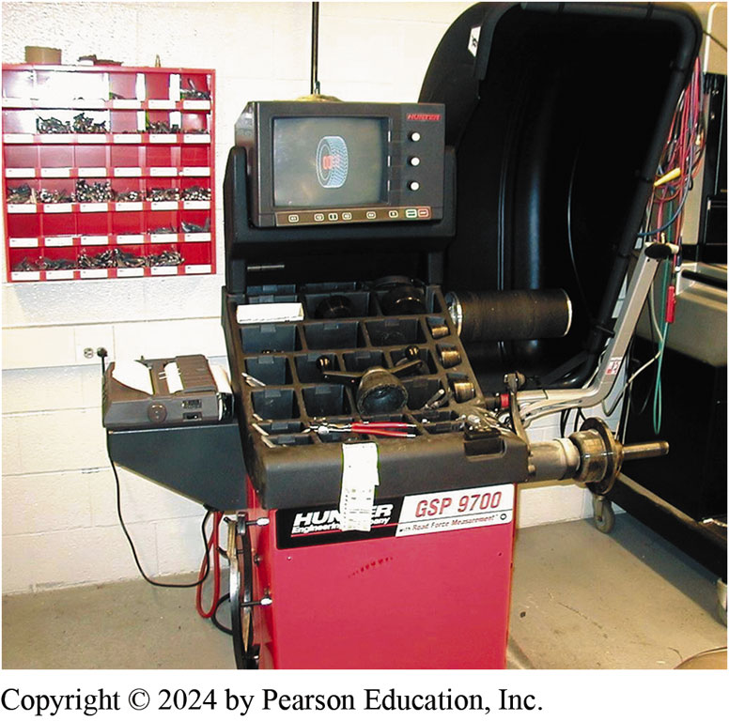
Figure 110.34 Wheel Balancer
A tire balancer that can also detect radial and lateral force variation and instruct the operator where to rotate the tire to achieve the best ride, or indicate a bent wheel

Slide 69
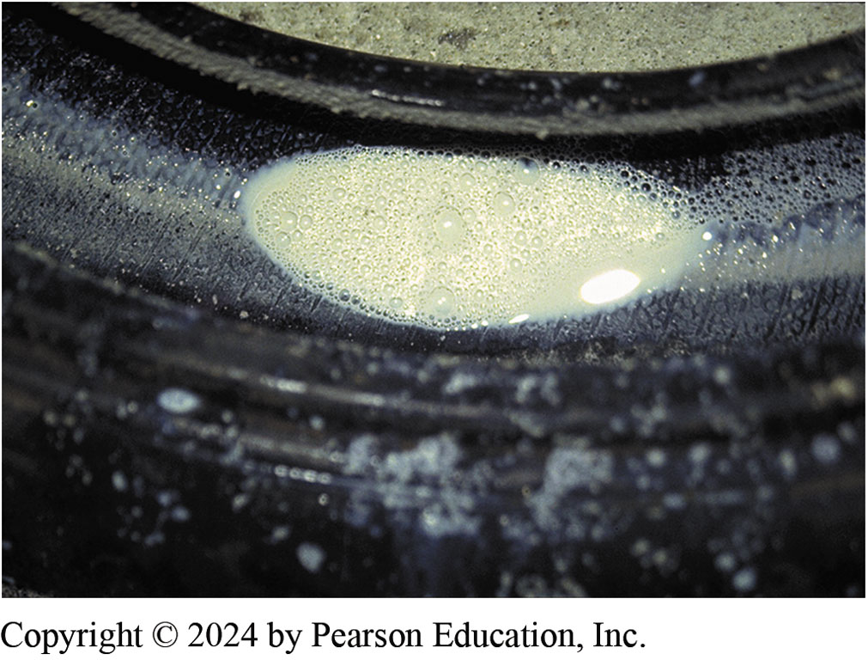
Figure 110.35 Liquid Tire Stop Leak
Liquid tire stop leak was found in all four tires. This liquid caused the tires to be out of balance

Slide 70
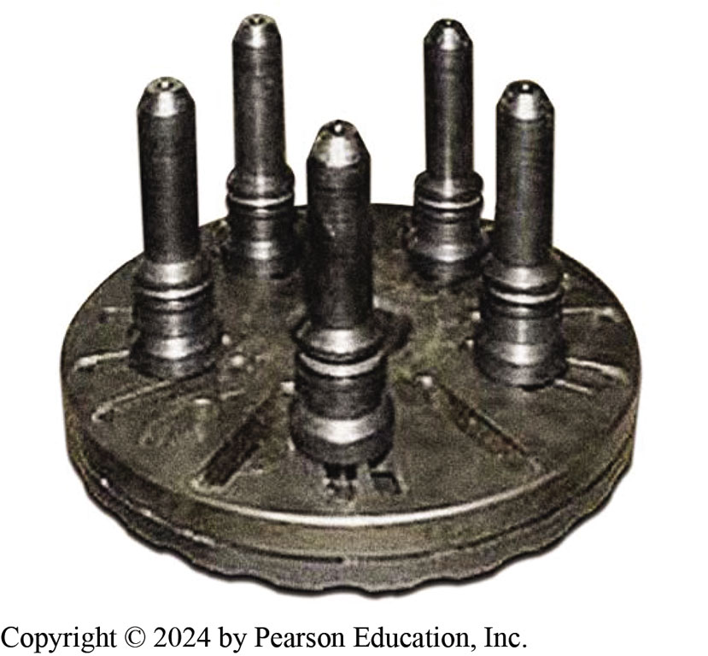
Figure 110.36 Pin Plate Adapter
A pin plate adapter that is designed to support the wheel/tire assembly on a tire balancer instead of using a centering cone

Slide 71
Frequently Asked Question: What Are Hubcentric Wheels?
? Frequently Asked Question
What Are Hubcentric Wheels? Most wheels are designed to fit over and be supported by the axle hub. Some wheels use an enlarged center hub section and rely on the wheel studs for support and to keep the wheel centered on the axle. Some aftermarket wheels may be designed to fit several different vehicles. As a result, the wheel manufacturers use plastic hubcentric adapter rings. SEE FIGURE 110-37

Slide 72
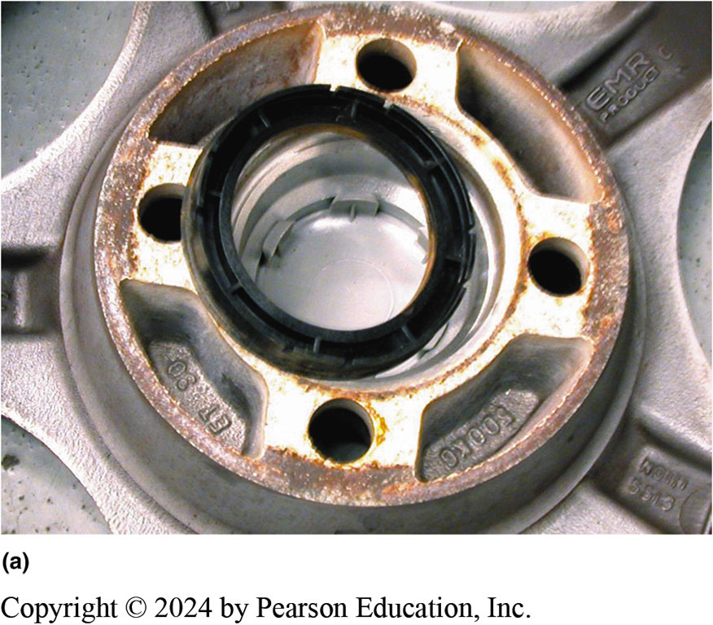
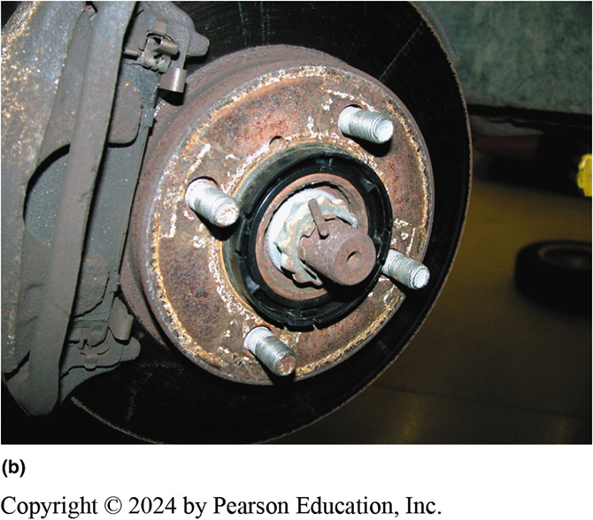
Figure 110.37 Hub-Centric Ring
(a) A hubcentric plastic ring partially removed from an aftermarket wheel. (b) A hubcentric plastic ring left on the hub when removing a wheel.

Slide 73
Tire Repair (1 of 2)
Acceptable Location
  Tread punctures, nail holes, or cuts up to 1/4 inch (2.6 mm) can be repaired only within the tire repair (tread) area.
  Repairs should be done from the inside of the tire using plugs-patches.
Tire Repair Procedure
  Follow the installation and repair procedures of the manufacturer.

Slide 74
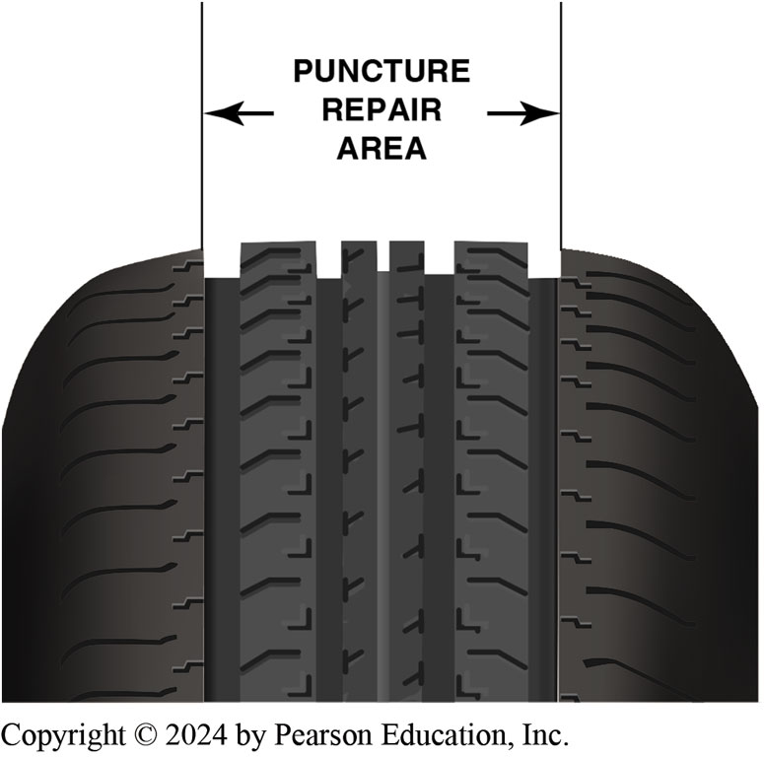
Figure 110.38 Repair area
A tire should only be repaired if the hole is within the tire puncture repair area. Do not make a repair that is located in the shoulder or belt edge part of the tire

Slide 75
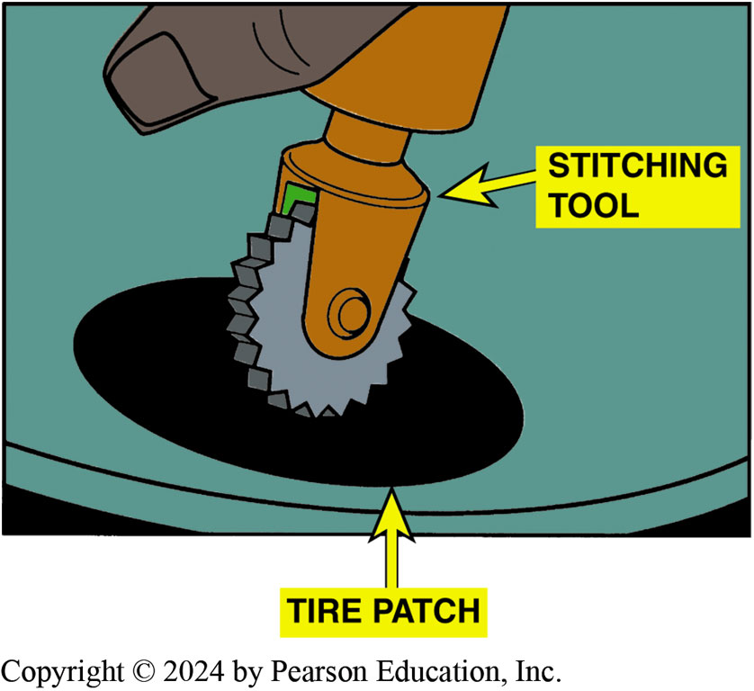
Figure 110.39 Stitching Tool
A stitching tool being used to force any trapped air out from under the patch

Slide 76
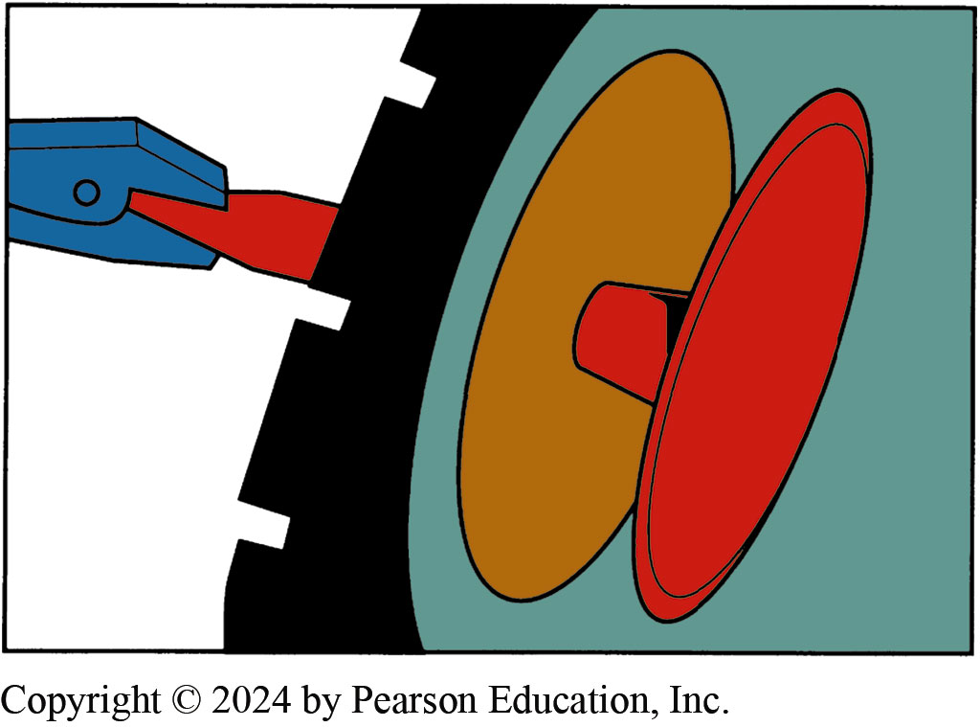
Figure 110.40 Pulling Rubber Plug
A rubber plug being pulled through a hole in the tire. The stem is then cut off flush with the surface of the tire tread

Slide 77
Question 3: ?
What area of the tire is it acceptable to repair?

Slide 78
Answer 3
In The Tread Area.

Slide 79
Tire Mounting

Slide 80

1. Tire Changer
1. A typical tire-changing machine showing the revolving table and movable arm used to remove a tire from the wheel

Slide 81

2. Foot-Pedal Controls
2. The foot-pedal controls allow the service technician to break the tire bead, damp the wheel (rim) to the machine, rotate the tire/wheel assembly, and still have both hands free

Slide 82

3. Tire Valve Removal Tool
3. Using a tire valve removal tool, unscrew the valve core using extreme caution because the valve is under pressure and can be forced outward and cause personal injury

Slide 83

4. Valve Core Removed
4. The from the tire valve. Allow all of the air in the tire to escape

Slide 84

5. Bead Breaker
5. A bead breaker is being used to separate the tire from the bead seat of the wheel. Repeat as needed to break the bead on both sides of the wheel

Slide 85

6. Lock Wheel To Changer
6. After breaking the beads from both sides of the tire, install the wheel/tire assembly flat onto the machine and, using the foot-pedal control, lock the wheel to the changer

Slide 86

7. Position Changer Arm
7. To remove the tire from the wheel, position the arm of the changer against the rim of the wheel and lock in position

Slide 87

8. Tire Tool Flat Bar
8. The tire tool (flat bar) is placed between the bead of the tire and the wheel. Using tire lubricant can help prevent damage to the tire

Slide 88

9. Foot-pedal Causes Table To Rotate
9. The foot-pedal that causes the table to rotate is depressed and the tire is removed from the wheel

Slide 89

10. Remove Lower Bead
10. Reposition the tire tool to remove the lower bead of the tire from the wheel

Slide 90

11. Tire Released From Wheel
11. As the table of the tire changer is rotated, the tire is released from the wheel and can be lifted off the wheel

Slide 91

12. Clean Bead Seat
12. Before installing a tire, inspect and clean the bead seat

Slide 92

13. Replace Valve Stem
13. Before installing a new tire, most experts recommend replacing the tire valve, being installed here, using a tool that pulls the valve through the hole in the wheel

Slide 93

14. Apply Tire Soap
14. Apply tire soap or rubber lubricant to both beads of the tire

Slide 94

15. Rotate Tire On Wheel
15. Rotate the tire on the wheel and position the arm so that the tire will be guided onto the rim as the wheel is rotated

Slide 95

16. Do Upper Bead
16. Repeat for the upper bead

Slide 96

17. Inflate Tire
17. Inflate the tire, being careful to not exceed 40 P S I. Experts suggest that a tire be in a cage during the initial bead seating inflation to help prevent personal injury if the wheel or tire fails.

Slide 97

18. Install Valve
18. Install the tire valve core and inflate tire to specifications

Slide 98
Tire Repair

Slide 99

1. Remove Object
1. The source of the leak was detected by spraying soapy water on the inflated tire. Needle-nose pliers are being used to remove the object that caused the flat tire

Slide 100

2. Razor Part Found
2. A part of a razor blade was found to be the cause of the flat tire

Slide 101

3. Ream Out Hole
3. A reamer is being used to clean the puncture hole

Slide 102

4. Two Wrenches Hold Tire Open
4. This technician is using two open-end wrenches to hold the tire beads apart if a tire bead spreader is not available

Slide 103

5. Grind Area
5. Surrounding area is being buffed using an air-powered die grinder equipped with a special buffing tool specifically designed for this process

Slide 104

6. Apply Rubber Cement To Area
6. After using a vacuum on all debris and rubber after buffing, apply rubber cement to the area

Slide 105

7. Cover Entire Area
7. The brush included with the rubber cement makes the job easy. Be sure to cover the entire area around the puncture

Slide 106

8. Peel off Paper
8. Peel off the paper from the adhesive on the patch. Insert the tip of the patch through the puncture from the inside of the tire

Slide 107

9. Pull Plug Through
9. Use a pair of pliers to pull the plug of the patch through the puncture

Slide 108

10. Patch Inside Tire
10. This view of the patch is from the inside of the tire

Slide 109

11. Stich Patch Tight
11. To be assured of an airtight patch, the adhesive of the patch should be “stitched” to the inside of the tire using a serrated roller called a stitching tool

Slide 110

12. Trim Plug
12. A view of the plug from the outside of the tire after metal covering used to pierce the puncture is removed from the patch plug. The plug can be trimmed to the level of the tread using side cutters or a knife

Slide 111
Suspension and Steering Videos and Animations
Videos Link: (A4) Suspension and Steering Videos
Animations Link: (A4) Suspension and Steering Animations

Slide 112

Copyright
This work is protected by United States copyright laws and is provided solely for the use of instructors in teaching their courses and assessing student learning. Dissemination or sale of any part of this work (including on the World Wide Web) will destroy the integrity of the work and is not permitted. The work and materials from it should never be made available to students except by instructors using the accompanying text in their classes. All recipients of this work are expected to abide by these restrictions and to honor the intended pedagogical purposes and the needs of other instructors who rely on these materials.

