Slide 1

Automotive Technology: Principles, Diagnosis, and Service
Seventh Edition
Chapter 109
Tire Pressure Monitoring Systems (TPMS)
Copyright © 2023 Pearson Education, Inc. All Rights Reserved
Notes:
INSTRUCTOR NOTE: This presentation includes text explanation notes, you can use to teach the course. When in SLIDE SHOW mode, you RIGHT CLICK and select SHOW PRESENTER VIEW, to use the notes.

Slide 2
Learning Objectives (1 of 2)
109.1 Explain why a tire-pressure monitoring system (TPMS) is used.
109.2 Discuss the TREAD Act.
109.3 Explain indirect TPMS.
109.4 Explain direct TPMS.
109.5 List the two types of TPMS pressure sensors.
109.6 Discuss TPMS sensor operation.
109.7 Discuss the TPMS receiver.

Slide 3
Learning Objectives (2 of 2)
109.8 Explain direct TPMS diagnosis.
109.9 Explain TPMS sensor activations.
109.10 Describe TPMS diagnostic tools.
109.11 List replacement options for TPMS sensors.
109.12 Describe how to relearn TPMS sensors.
109.13 Describe the tools needed to service a TPMS.

Slide 4
Need For Tire Pressure Monitoring
(1 of 2)
Background
  Tire-Pressure Monitoring System (T P M S) is a system that detects a tire that has low inflation pressure and warns the driver.
Two systems used:
  Indirect
  Direct
Low Tire Pressure Effects
  Reduced fuel economy, and tire life. Reduces handling and braking efficiency.

Slide 5
Need For Tire Pressure Monitoring
(2 of 2)
Placard Cold Inflation Pressure
  Placard cold inflation pressure is used in service information to indicate the specified tire inflation pressure.
  “Placard” is driver’s side door jamb sticker that shows the tire size and the specified tire inflation pressure.
Temperature and Inflation Pressure
  Tires become warmer while the vehicle is being driven, so tires should be checked before the vehicle has been driven or allowed to cool after being driven.

Slide 6
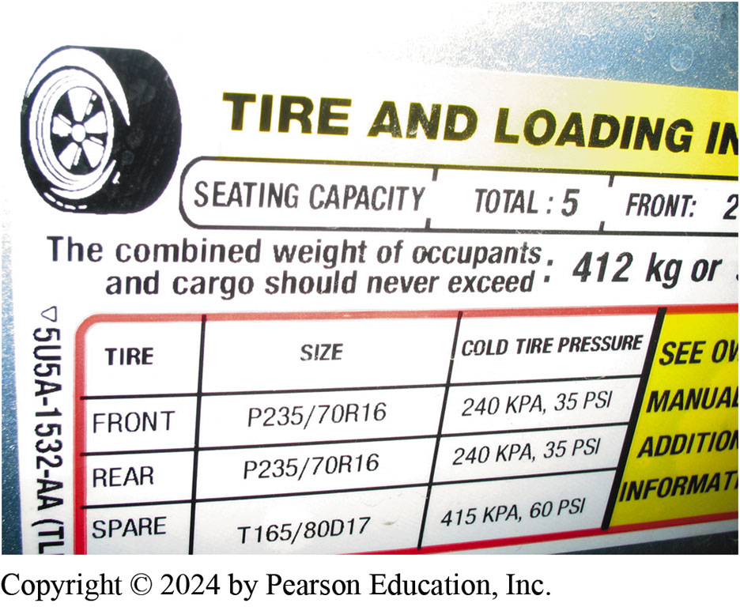
Figure 109.1 Tire Pressure
The tire-pressure placard (sticker) on the driver’s side door or door jamb indicates the specified tire pressure

Slide 7
Chart 109.1 Tire Pressure Chart
TEMPERATURE | TIRE PRESSURE (PSI) | CHANGE FROM PLACARD COLD INFLATION PRESSURE
120°F (49°C) | 37 | +5
110°F (43°C) | 36 | +4
100°F (38°C) | 35 | +3
90°F (32°C) | 34 | +2
80°F (27°C) | 33 | +1
70°F (21°C) | 32 | 0
60°F (16°C) | 31 | −1
50°F (10°C) | 30 | −2
40°F (4°C) | 29 | −3
30°F (−1°C) | 28 | −4
20°F (−7°C) | 27 | −5
10°F (−12°C) | 26 | −6
0°F (−18°C) | 25 | −7
−10°F (−23°C) | 24 | −8
−20°F (−29°C) | 23 | −9
The effects of outside temperature on tire inflation, assuming a placard inflation pressure of 32 PSI. The tire inflation pressure changes 1 PSI for each 10 degrees change in temperature.

Slide 8
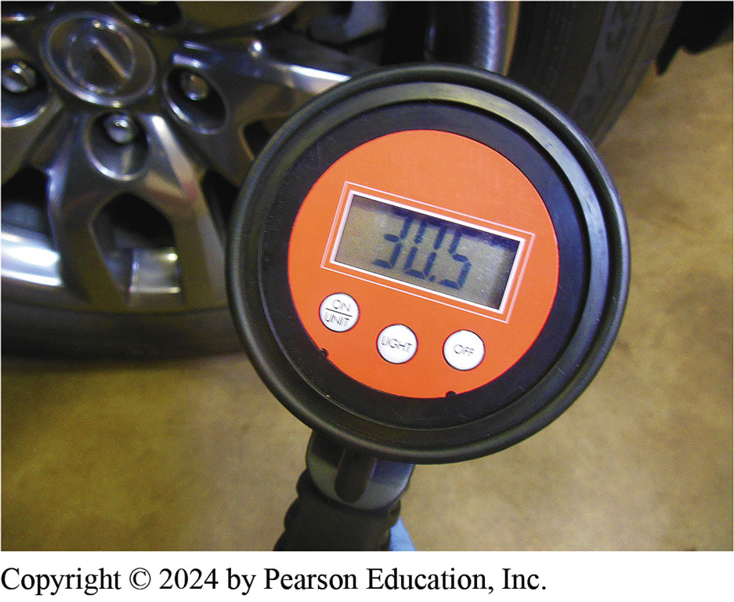
Figure 109.2 Pressure v Temperature
Inflation pressure increases as the temperature increases. When checking or correcting inflation pressure when the tires are hot, add 2 to 4 PSI to the placard cold inflation pressure
Notes:
TECH TIP: Add 2 to 4 PSI
When servicing tires, it is often not practical to allow the time needed for the tires to cool after the vehicle has been driven. To help compensate for the higher pressures due to higher temperature, add 2 to 4 PSI to the cold inflation pressures. FIGURE 109-2

Slide 9
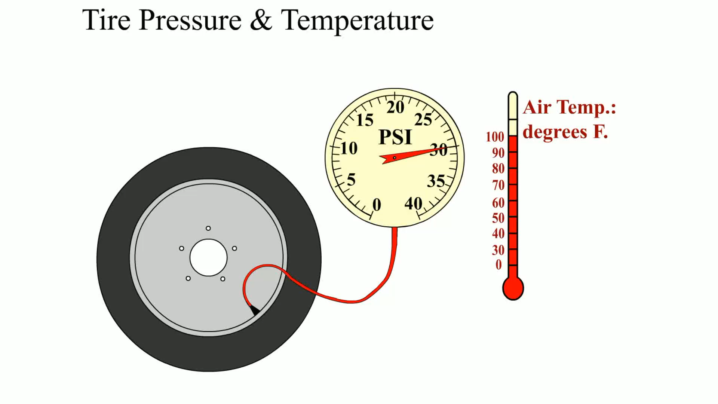
Animation: Tire Pressure & Temperature
(Animation will automatically start)

Slide 10
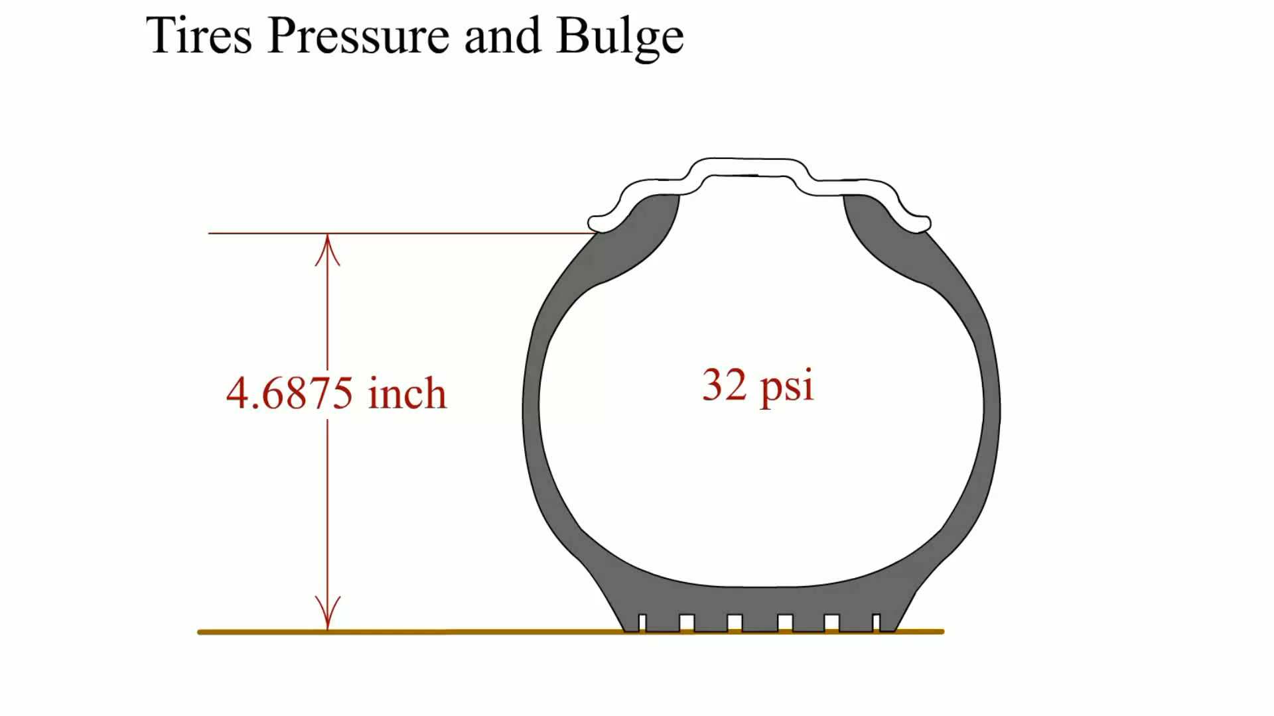
Animation: Tire Pressure and Bulge
(Animation will automatically start)

Slide 11
Question 1: ?
What are the two types of monitoring systems?

Slide 12
Answer 1
Direct and Indirect.

Slide 13
Tread Act (1 of 2)
Transportation Recall Enhancement, Accountability, and Documentation (T R E A D) Act
Requires that all vehicles be equipped with a tire-pressure monitoring system that will warn the driver in the event of an underinflated tire.
N H T S A requires the installation of tire-pressure monitoring systems in passenger vehicles and light trucks manufactured after September 1, 2007 (2008 model year).

Slide 14
Tread Act (2 of 2)
Warning Lamp
  F M V S S 138 specifies that driver must be warned of a low tire inflation pressure by turning on an amber warning lamp.
25% Rule
  T R E A D Act specifies that driver be warned if any tire inflation pressure drops by 25% or more from placard cold inflation pressure.

Slide 15
Chart 109.2 TPMS Triggers
PLACARD COLD INFLATION PRESSURE (PSI) | WARNING LIGHT PRESSURE (−25%) | PSI LOW
40 | 30.0 | 10.0
39 | 29.3 | 9.7
38 | 28.5 | 9.5
37 | 27.8 | 9.2
36 | 27.0 | 9.0
35 | 26.3 | 8.7
34 | 25.5 | 8.5
33 | 24.8 | 8.2
32 | 24.0 | 8.0
31 | 23.3 | 7.7
30 | 22.5 | 7.5
29 | 21.8 | 7.2
28 | 21.0 | 7.0
Placard inflation pressure compared with the pressure when the TPMS triggers a warning light assuming a cold placard inflation pressure of 32 PSI.

Slide 16
Indirect T P M S (1 of 2)
Function
  Uses WSS to detect differences in wheel speed
  Underinflated tire rotates faster than properly inflated tire.
Compensation for Cornering
  To compensate for this normal change in wheel rotation speed, indirect tire-pressure monitoring system checks the diagonally opposed wheels.

Slide 17
Indirect T P M S (2 of 2)
Diagnosis of Indirect T P M S
  Verify fault.
    Light on- low pressure
    Light flashing – system problem
  Check tire pressure
  Repair fault
Indirect T P M S Relearn Procedures
  Check service information for the exact steps to follow.
  Typically a reset and a test drive is involved.

Slide 18
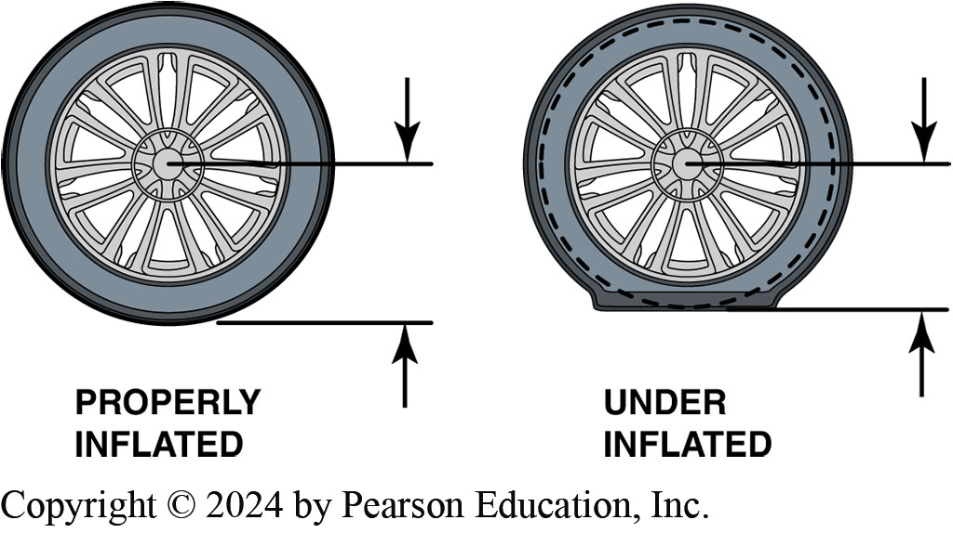
Figure 109.3 Inflated v Underinflated
A tire with low inflation will have a shorter distance (radius) between the center of the wheel and the road and will therefore rotate faster than a tire that is properly inflated.

Slide 19
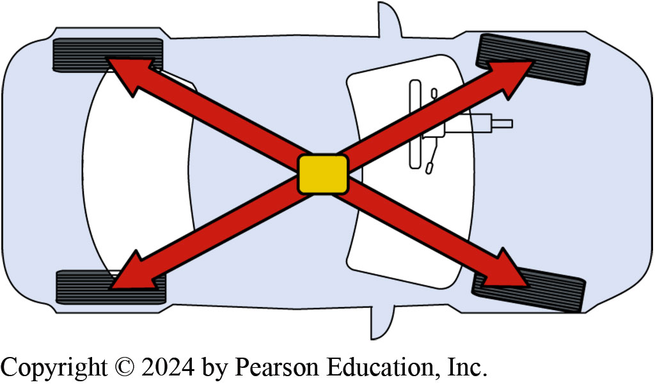
Figure 109.4 Wheel Speed Measure
The speeds of the diagonally opposed wheels are added together and then compared to the other two wheels to check if one tire is rotating faster.

Slide 20
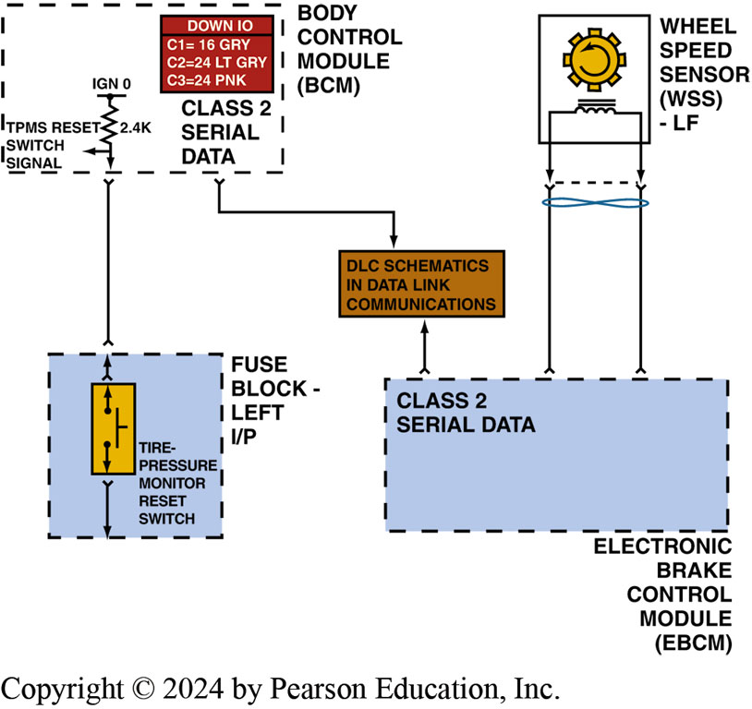
Figure 109.5 Reset Switch
The indirect tire-pressure monitoring system has a reset switch that should be depressed after rotating or replacing tires

Slide 21
Direct T P M S
Function
  Direct tire-pressure monitoring systems
  Use individual pressure sensors
  Located in each wheel to measure inflation pressure.
Identifying the System
  Because of variety of systems used
  Service information needed to determine what type of system is on the vehicle before service work is started.

Slide 22
T P M S Pressure Sensors (1 of 2)
Manufacturers
  Sensors are made by a variety of manufacturers:
  Beru
  Lear
  Pacific
  Schrader
  Siemens
  T R W
Each sensor uses a 3-volt lithium ion battery that has a service life of 7 to 10 years.

Slide 23
T P M S Pressure Sensors (2 of 2)
Types
  2 basic types of pressure sensors used in direct pressure-sensing systems.
  Valve-stem-mounted sensor
  Banded sensors
Modes of Operation
  Active Mode
  Sleep Mode
  Alert Mode

Slide 24
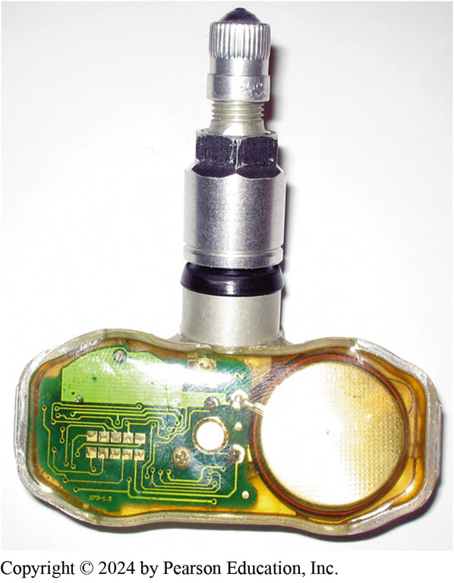
Figure 109.6 Valve Stem Sensor
A clear plastic valve-stem tire-pressure monitoring sensor, showing the round battery on the right and the electronic sensor and transistor circuits on the left

Slide 25
Frequently Asked Question: How Can an Indirect System Meet the TREAD Act Requirements?
? Frequently Asked Question
How Can an Indirect System Meet the TREAD Act Requirements? Some newer vehicles such as 2009 and newer Audis, plus many models of Honda after 2013 and some Mazda models, use active wheel speed sensors to measure the slight change in vehicle speed compared to the speed in the internal memory of the TPMS module. Always check service information for the exact procedure to follow when a newer vehicle appears to not be equipped with a tire-pressure monitoring system because of no visible signs of a tire pressure sensor
Notes:
How Can an Indirect System Meet the TREAD Act Requirements?
Some newer vehicles such as 2009 and newer Audis, plus many models of Honda after 2013 and some Mazda models, use active wheel speed sensors to measure the slight change in vehicle speed compared to the speed in the internal memory of the TPMS module. Always check service information for the exact procedure to follow when a newer vehicle appears to not be equipped with a tire-pressure monitoring system because of no visible signs of a tire pressure sensor.

Slide 26
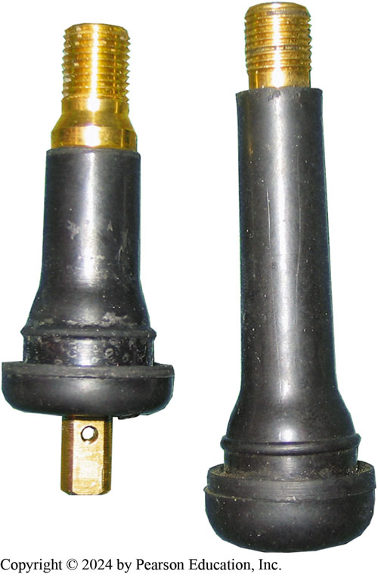
Figure 109.7 Valve Stem
A conventional valve stem is on the right compared with a rubber TPMS sensor stem on the left. Notice the tapered and larger brass stem. The rubber TPMS sensor also uses a longer cap that makes it easy for a technician to spot that this is not a conventional rubber valve stem

Slide 27
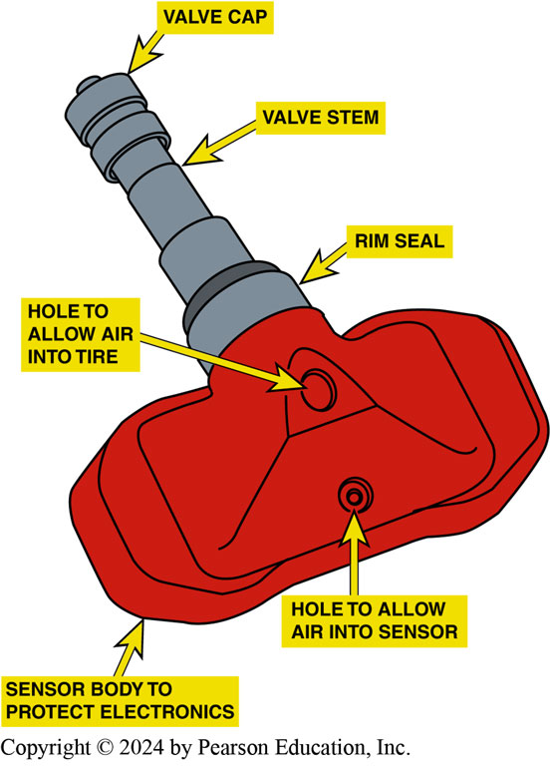
Figure 109.8 Clamp-in TPMS Sensor
The parts of a typical clamp-in TPMS sensor. Notice the small hole used to monitor the inflation pressure. The use of stop leak can easily clog this small hole

Slide 28
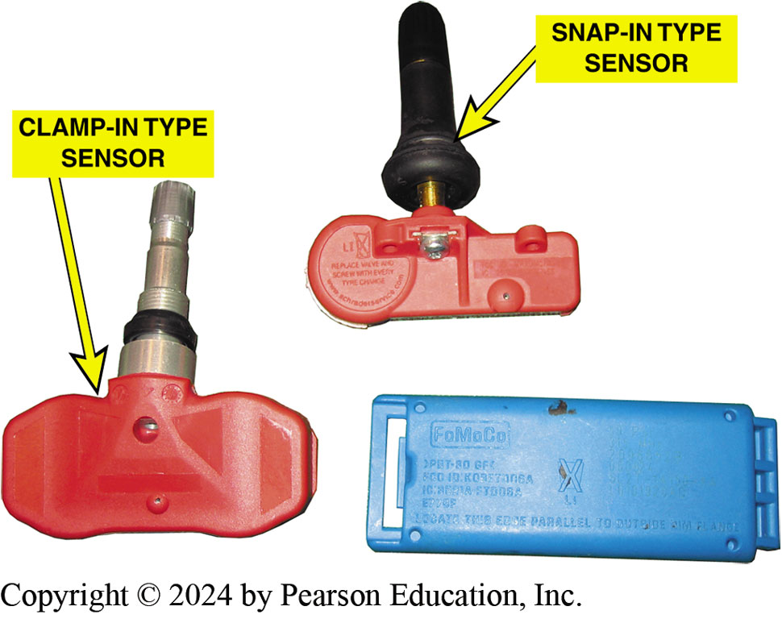
Figure 109.9 Three Types
3 types of T P M S sensors most commonly found include the two stem-mounted rubber (snap-in) and aluminum (clamp-in), left and top, and the banded sensors (right)

Slide 29
Question 2: ?
What are the two types of direct sensors?

Slide 30
Answer 2
Stem mounted and band mounted.

Slide 31
T P M S Sensor Operation
Designs: The types of sensors include:
  Continuous-wave-type sensor
  Magnetically triggered-type sensor
  Pulse-width-modulated-type sensor
2 most commonly used frequencies are:
  315 M Hz
  433.92 M Hz (commonly listed as 434 M Hz)

Slide 32
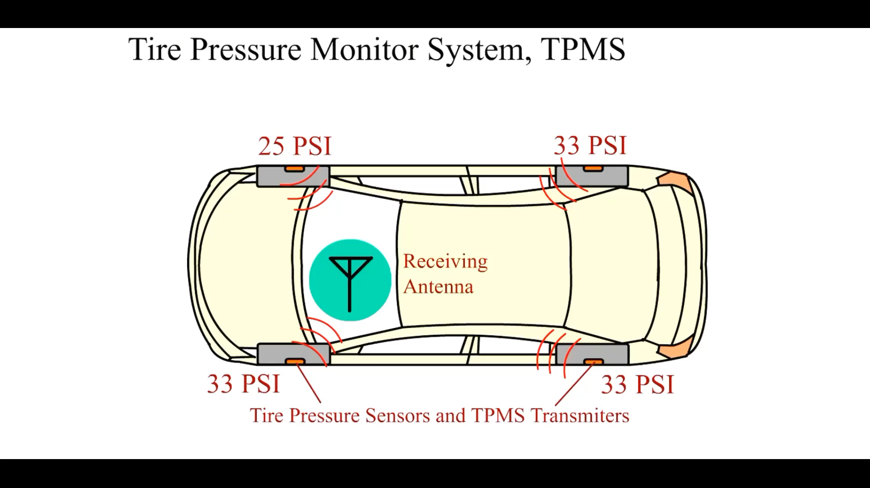
Animation: Tire Pressure Monitor System, TPMS
(Animation will automatically start)

Slide 33
T P M S Receiver
Locations
  The wireless T P M S receiver is housed in one of the following locations, depending on the vehicle:
  Remote keyless entry (R K E) receiver
  Body control module (B C M)
  Door module
  Individual antennas near each wheel well.

Slide 34
Frequently Asked Question: Does a TPMS Sensor Work before Being Installed?
? Frequently Asked Question
Does a TPMS Sensor Work before Being Installed? No. New tire-pressure warning sensors (transmitters) are shipped in storage mode. This mode prevents the battery from becoming discharged while in storage. When the transmitter is installed in a wheel/tire assembly and the tire is inflated to more than 14 PSI (97 kPa), the transmitter automatically cancels storage mode. Once a transmitter has canceled storage mode, it cannot enter this mode again. Therefore, once a sensor has been installed and the tire inflated above 14 PSI, the clock is ticking on battery life.

Slide 35
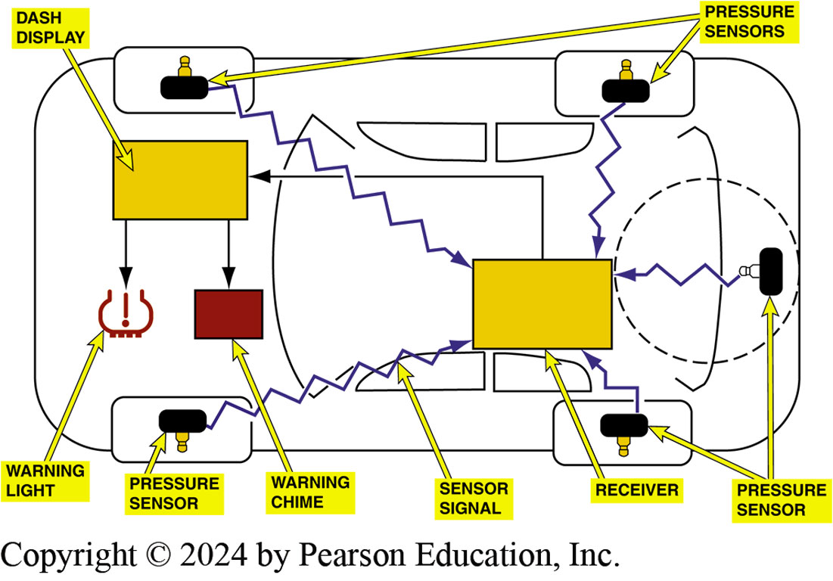
Figure 109.10 System Schematic
Individual pressure sensors transmit tire pressure data to a receiver, remote keyless entry (RKE) module. Many vehicles equipped with full-size spare tire also have a tire pressure sensor in spare

Slide 36
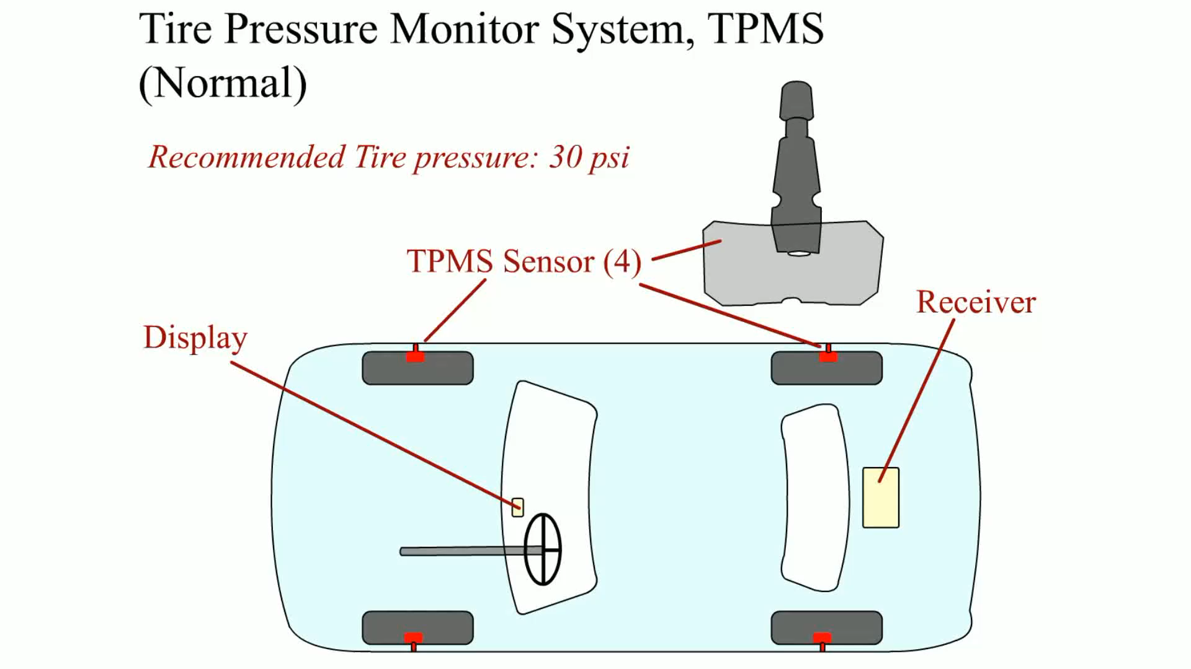
Animation: Tire Pressure Monitor System, TPMS (Good)
(Animation will automatically start)

Slide 37
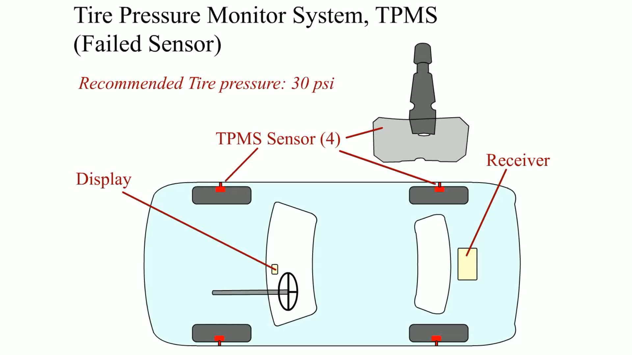
Animation: Tire Pressure Monitor System, TPMS (Bad)
(Animation will automatically start)

Slide 38

Animation: Tire Pressure Monitor System, TPMS (Leak)
(Animation will automatically start)

Slide 39
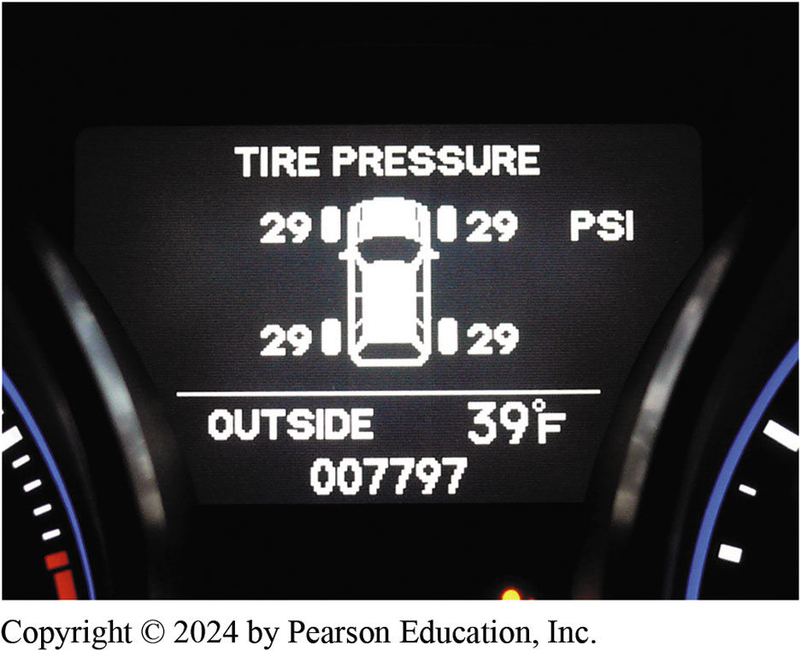
Figure 109.11 Display Pressures
Some vehicles display the actual measured tire pressure for each tire on a driver information display

Slide 40
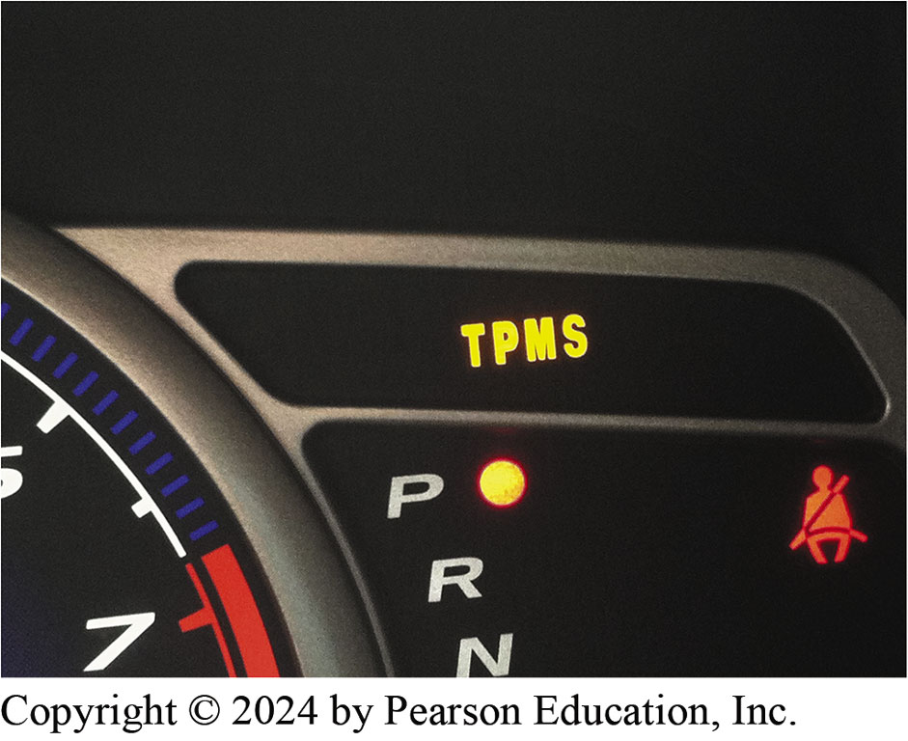
Figure 109.12 TPMS Warning Lamp
TPMS warning lamp on this vehicle is a separate light from the tire icon light that warns of low tire pressure. In this case, both warning lights were on all of the time
Notes:
CASE STUDY: The TPMS Warning Lamp
The owner of a six-year-old Honda Civic was concerned that the tire-pressure warning lamp was on even though all of the tires had the proper inflation pressure. The technician noted that the TPMS warning lamp was not the one that indicates a low tire, but it was the one that indicates that a fault with the system has been detected. FIGURE 109–12.
The technician used a factory-level aftermarket scan tool and retrieved several diagnostic trouble codes for “pressure sensor signal failures.” FIGURE 109–13. The technician also noted that the tires were relatively new and recommended to the owner that all four TPMS sensors be replaced. The major reason why the technician recommended that all of them be replaced is that the battery life is normally 7 to 10 years so the life of the sensors is near the end of their useful life. Also, the technician thought that one or more of the sensors may have been damaged when the new tires were replaced. The vehicle owner approved the replacement of the sensors and the system was restored to normal operation.
Summary:
Complaint—TPMS warning lamp was on.
Cause—Most of the tire-pressure warning system sensors had a stored diagnostic trouble code.
Correction—All four tire-pressure sensors were replaced and the system relearned to the new sensors. The codes were cleared and the system was restored to normal operation.

Slide 41
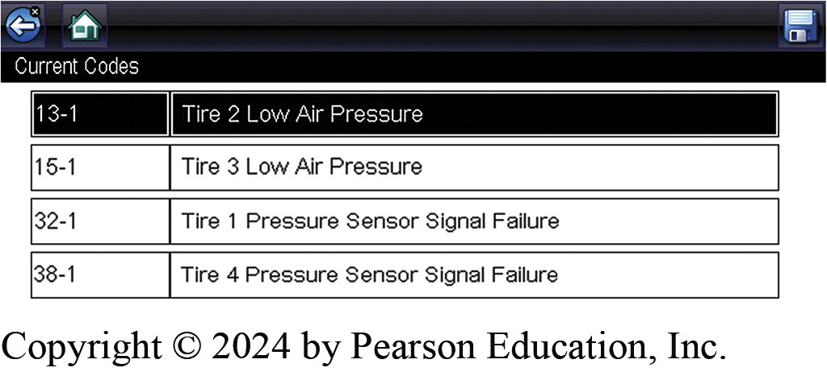
Figure 109.13 TPMS DTCs
The codes set were for low pressure and sensor signal failure

Slide 42
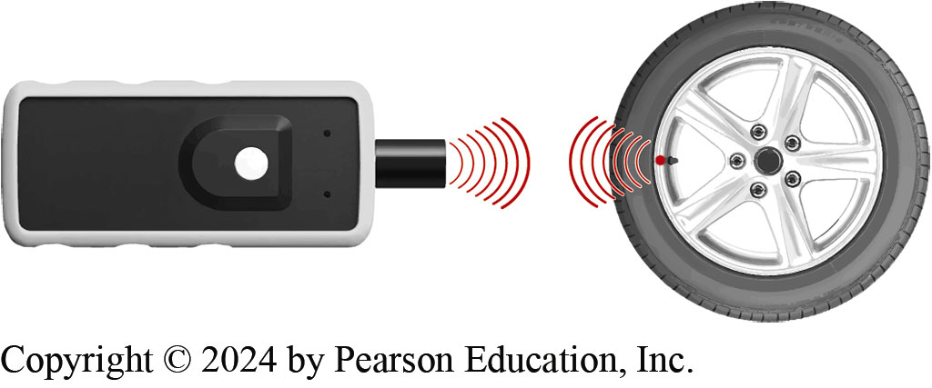
Figure 109.14 TPMS Tester
A typical TPMS tester. The unit should be held near the tire and opposite the valve stem if equipped with a wheel-mounted sensor, and near the valve stem if equipped with a valve-stem-type sensor.
Notes:
TECH TIP: Check the TPMS Sensors before and after Service
It is wise to check that all of the TPMS sensors are working before beginning service work. This is commonly called “test before you touch.” For example, if the tires need to be rotated, the sensors will have to be reprogrammed for their new location. If a tire-pressure monitoring sensor is defective, the procedure cannot be performed. Use an aftermarket or original equipment tire-pressure monitoring sensor tester to check that the sensors respond. FIGURE 109-14 .
Then the tire-pressure sensors should be checked again after the service to make sure that they are working correctly before returning the vehicle to the customer.

Slide 43
T P M S Diagnosis
Warning Lamp On (Not Flashing)
  Check the door placard for the specified tire inflation pressure.
  Check all tires using a known-accurate tire-pressure gauge.
  Inflate all tires to the specified pressure.
Warning Lamp Flashing
  T P M S sensor not properly registered with the system.
  Defective wheel sensors, such as a sensor with a dead battery.
  A fault in the receiver or module.
Notes:
TECH TIP: Check the Spare
Many vehicles equipped with a full-size spare tire also have a TPMS sensor. If the inflation pressure decreases enough, the system will trigger the TPMS warning light. This is confusing to many vehicle owners who have checked all four tires and found them to be properly inflated. This fault often occurs during cold weather when the tire inflation pressure drops due to the temperature change. Most 2008 and newer vehicles with a full-size spare tire will come equipped with a TPMS sensor in the spare.

Slide 44
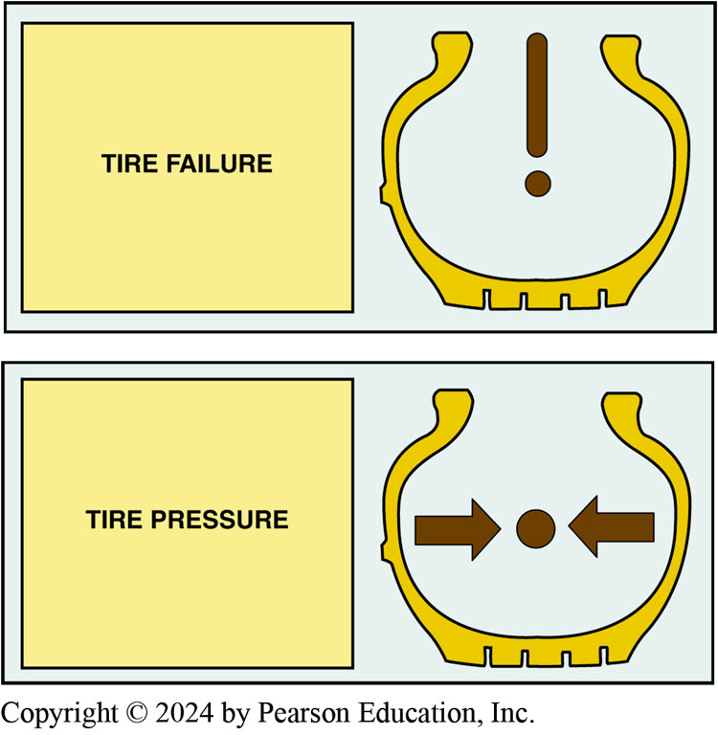
Figure 109.15 TPMS Symbol
A tire-pressure warning light can vary depending on the vehicle, but includes a tire symbol

Slide 45
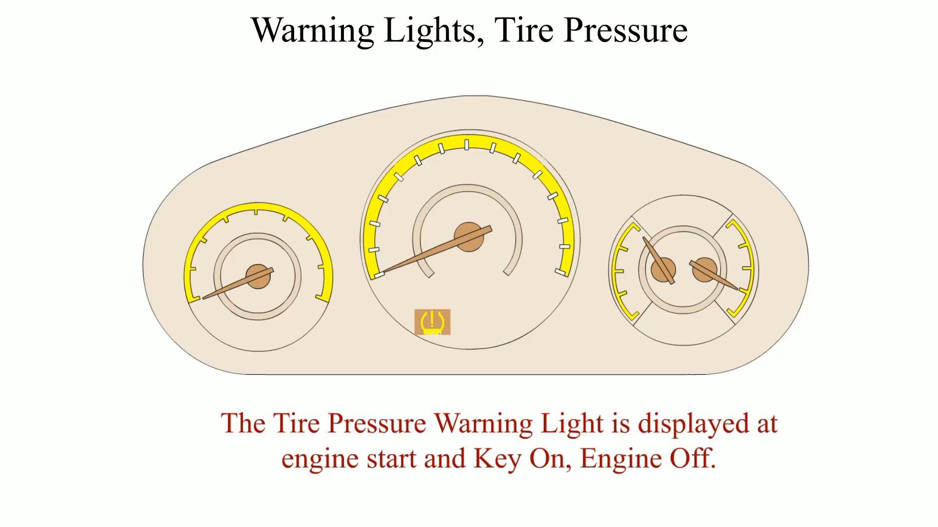
Animation: Warning Lights, Tire Pressure
(Animation will automatically start)

Slide 46
T P M S Sensor Activations
Activation methods include:
  Using a magnet.
  Changing inflation pressure.
  Triggered by a handheld T P M S tester.

Slide 47
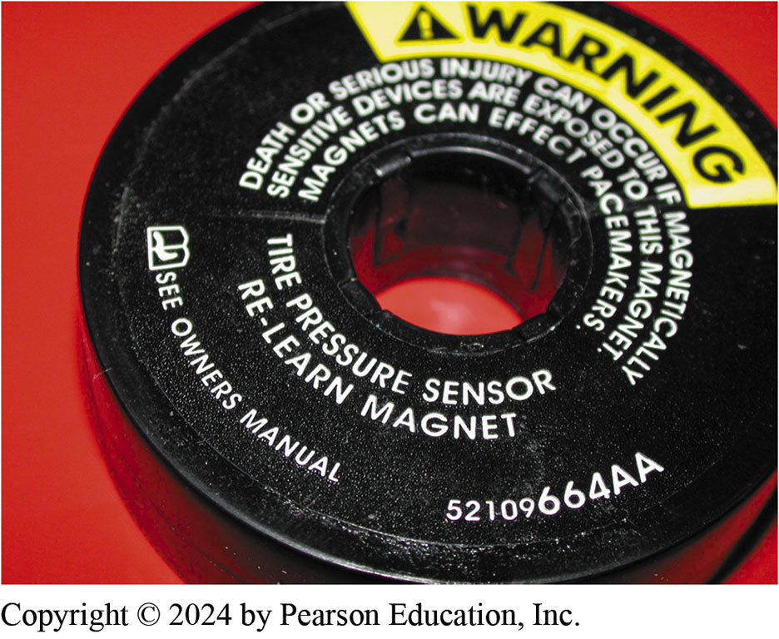
Figure 109.16 Magnet Tool
A magnet is placed around the valve stem to reprogram some stem-mounted tire-pressure sensors

Slide 48
Question 3: ?
What are the three listed ways to actuate a T P M S sensor?

Slide 49
Answer 3
A magnet, changing tire pressure, and a handheld T P M S tester.

Slide 50
T P M S Diagnostic Tools
T P M S diagnostic tools include a variety of scan tools and handheld testers.
Scan Tools
  Register sensors
  Perform initialization
  Monitor sensor values
Handheld Testers
  Sensor activation
  Sensor relearn
  Programming a new sensor
Notes:
CASE STUDY: The Acura Dash Display Problem
The tires were rotated on an Acura equipped with a direct-type TPMS. The published relearn
procedure included driving the vehicle above 15 MPH for at least 40 seconds. However, even after
driving for over 10 miles, the pressures were not being displayed on the instrument panel cluster (IPC). The technician thought that maybe there was fault with the IPC. The owner decided to think it over what to do and drove the vehicle home. The next day, when the vehicle was driven, the tire pressure display worked as designed. Apparently the system needed to be powered down and allowed to go to sleep before it would start to transmit the new locations to the IPC.
Summary:
Complaint—The tire pressures for each wheel were not being displayed on the dash after the tires were rotated.
Cause—The TPMS apparently needed to go to sleep and then awaken before the tire pressure would be displayed on the dash.
Correction—No action was required by the service technician because the system started to transmit after going to sleep, and the display operated as designed.

Slide 51
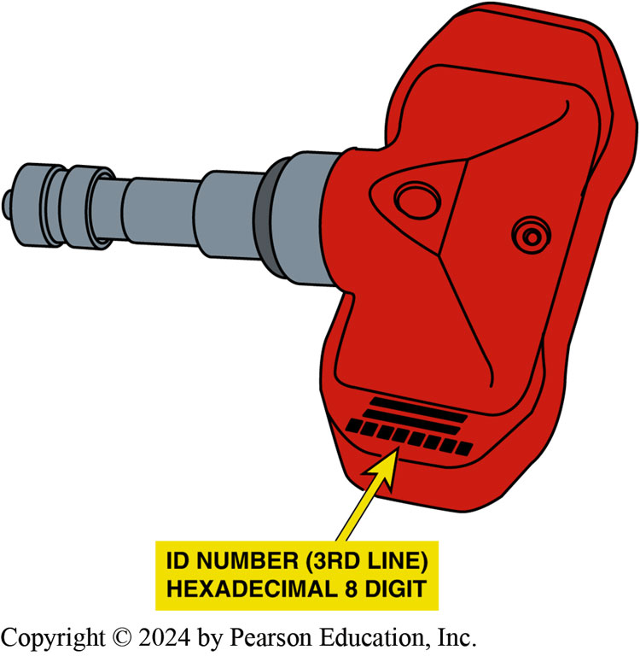
Figure 109.17 Sensor ID
When replacing a
TPMS sensor, be sure to record the sensor ID because this needs to be entered into the system through the use of a tester or scan tool

Slide 52
Sensor Replacement Options
Original Equipment-Based Sensors
  These sensors are made by the original equipment
  (O E) manufacturer and usually are direct replacement for the factory unit.
Aftermarket Sensors
  Original equipment (O E)-based replacement.
  Multiple protocol sensors that can be programmed to match whatever the vehicle needs.
  Fully programmable sensor—also called clones. This type needs a separate programming device.

Slide 53
T P M S Sensor Relearn
Most relearn procedures fall into one of four categories including:
  Auto relearn
  European Relearn
  Manual Relearn
  O B D Relearn

Slide 54
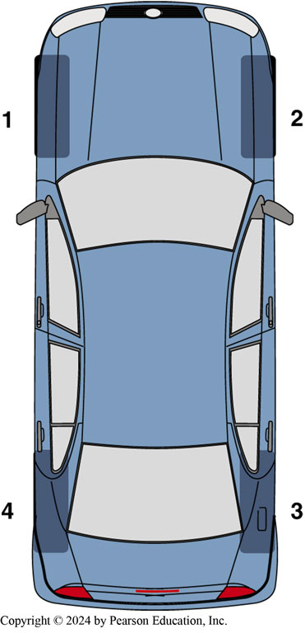
Figure 109.18 Relearn
The sensor relearn procedure is performed in the following order after the system has been placed in learn mode: LF, RF, RR, and then LR

Slide 55
Frequently Asked Question: How Does a Vehicle Learn Where the Sensor Is Located?
? Frequently Asked Question
How Does a Vehicle Learn Where the Sensor Is Located? Vehicles automatically learning their new position after a tire rotation or after being replaced can detect their location by: Some vehicles use an initiator located in each wheel well. TPMS sensor broadcasts pressure information which is detected by each initiator and then transmitted over to TPMS or BCM. Module will know where the sensor is located by its serial number. An accelerometer in sensor allows sensor to “know” which side of vehicle the sensor is located. TPMS controller can detect which side the sensor is located. SEE NOTES FOR MORE INFO
Notes:
How Does a Vehicle Learn Where the Sensor Is Located? Vehicles that are capable of automatically learning their new position after a tire rotation or after being replaced can detect their location by the following procedures: Some vehicles use an initiator located in each wheel well. The TPMS sensor broadcasts the pressure information which is detected by each initiator and then transmitted over a bus network to the TPMS or body control module. The module then will know where the sensor is located by its unique serial number. An accelerometer in the sensor allows the sensor to “know” which side of the vehicle the sensor is located. When a tire revolves, it turns in an opposite direction than a wheel on the opposite side of the vehicle. By using the accelerometer, the TPMS controller can detect which side the sensor is located. Then the TPMS module checks for the relative strength of the signal being transmitted by the sensor. If the receiver is located at the rear of the vehicle, and two sensors are showing stronger signal, then these two must be the two rear wheels.

Slide 56
Frequently Asked Question: Can TPMS Sensors Be Switched to New Wheels?
? Frequently Asked Question
Can TPMS Sensors Be Switched to New Wheels? Maybe. It depends on the style of the new or replacement wheels as to whether the sensors will fit or not. Some vehicles are designed to allow for a second set of sensors such as for winter tires. Many Lexus vehicles can be programmed to use set #1 or set #2. It is best to check before purchasing new wheels. Another set of TPMS sensors could be a major added expense.

Slide 57
T P M S Sensor Service Tools
Whenever servicing a tire/wheel assembly that has a direct T P M S system, certain items are needed:
  Service Information
  Digital tire pressure gauge
  Tire valve core torque wrench
  Tire valve nut torque wrench
  Sensor service kit
Notes:
TECH TIP: All Sensors Will Fail: All TPMS pressure sensors will fail because they contain a battery that has a service life of 7 to 10 years. What does this mean to the service technician? This means that if new tires are being installed on a five or six-year-old vehicle equipped with tire-pressure sensors, then the customer should be notified that the TPMS sensors could fail almost anytime.

Slide 58
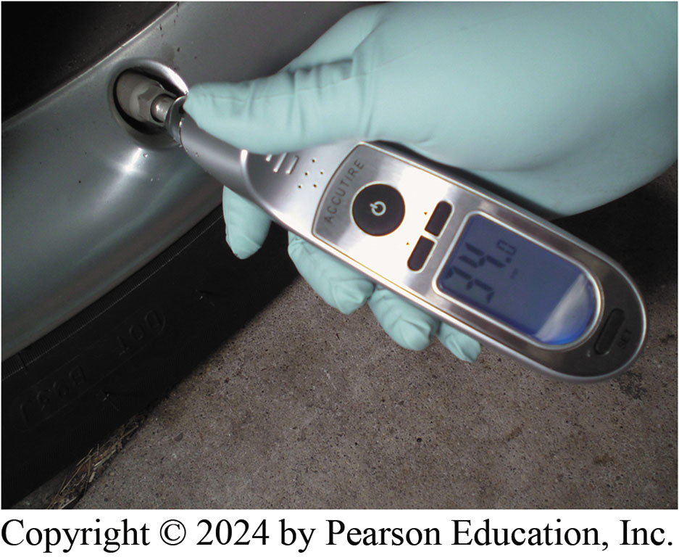
Figure 109.19 Pressure Gauge
Always use an accurate, known-good tire-pressure gauge. Digital gauges are usually more accurate than mechanical gauges

Slide 59
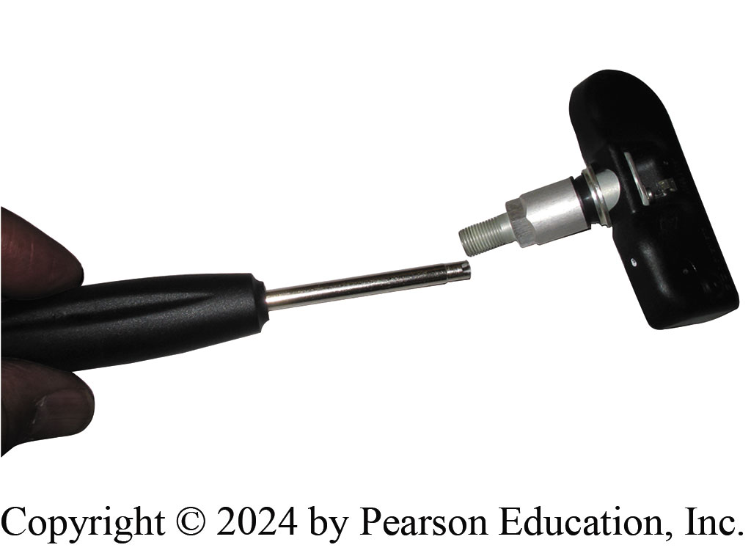
Figure 109.20 Core Torque Wrench
A clicker-type valve core tool ensures that the valve core is tightened to factory specifications

Slide 60
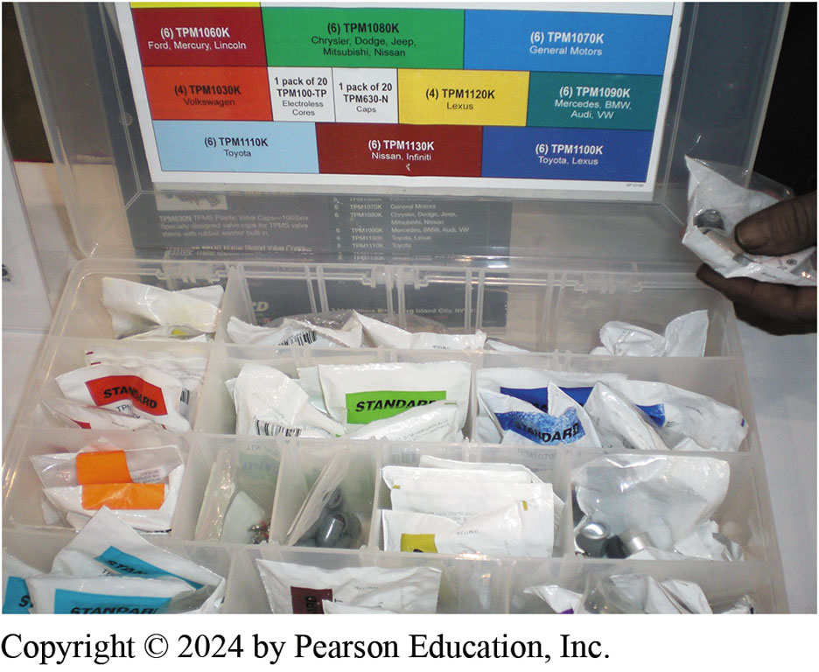
Figure 109.21 TPMS Sensors
An assortment of service parts that include all of the parts needed to service a stem-mounted TPMS sensor being installed after removal for a tire replacement or repair

Slide 61
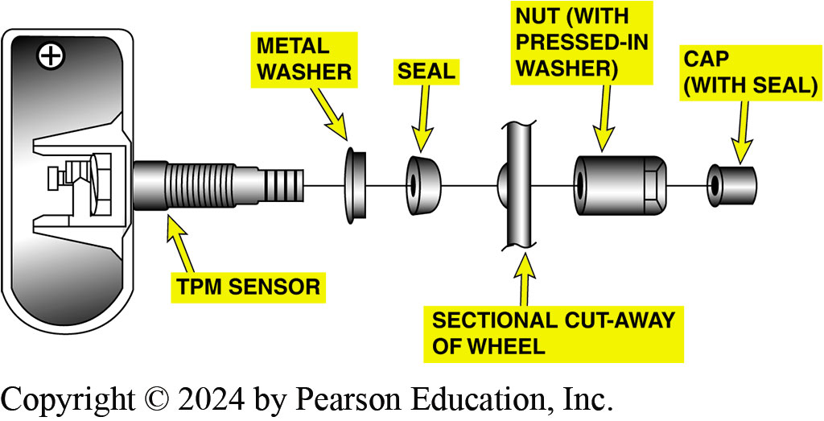
Figure 109.22 Sensor Parts
The parts of a typical clamp-in type TPMS sensor showing the relationship of the parts used to install one in a wheel

Slide 62
Suspension and Steering Videos and Animations
Videos Link: (A4) Suspension and Steering Videos
Animations Link: (A4) Suspension and Steering Animations

Slide 63
Copyright
This work is protected by United States copyright laws and is provided solely for the use of instructors in teaching their courses and assessing student learning. Dissemination or sale of any part of this work (including on the World Wide Web) will destroy the integrity of the work and is not permitted. The work and materials from it should never be made available to students except by instructors using the accompanying text in their classes. All recipients of this work are expected to abide by these restrictions and to honor the intended pedagogical purposes and the needs of other instructors who rely on these materials.

