Slide 1
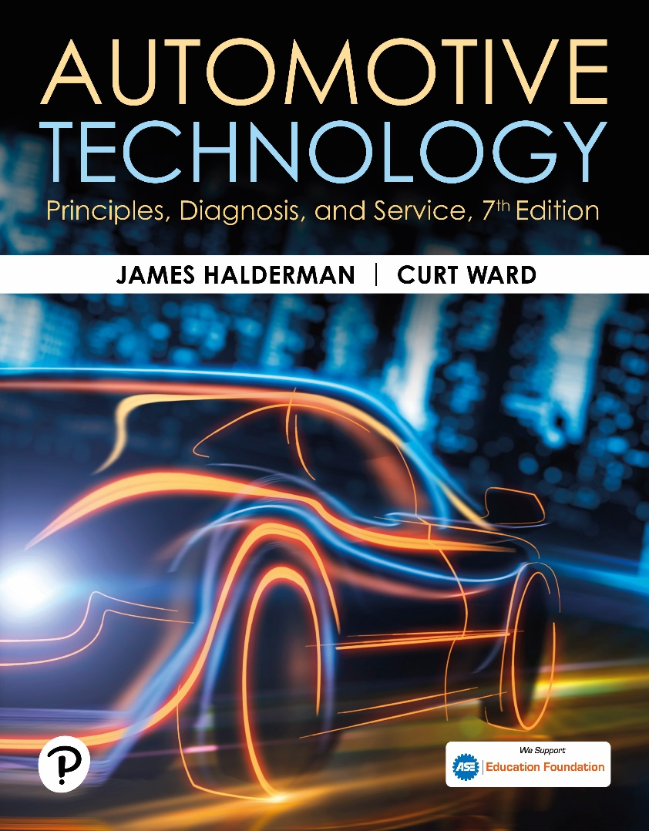
Automotive Technology: Principles, Diagnosis, and Service
Seventh Edition
Chapter 108
Tires and Wheels
Copyright © 2023 Pearson Education, Inc. All Rights Reserved
Notes:
INSTRUCTOR NOTE: This presentation includes text explanation notes, you can use to teach the course. When in SLIDE SHOW mode, you RIGHT CLICK and select SHOW PRESENTER VIEW, to use the notes.

Slide 2
Learning Objectives (1 of 2)
108.1 Explain the purpose and functions of tires.
108.2 Identify the parts of a tire.
108.3 Describe how a tire is constructed.
108.4 Discuss tire service descriptions.
108.5 Discuss the uniform tire quality grading system.
108.6 Discuss the DOT tire code.
108.7 Discuss tire conicity and ply steer.

Slide 3
Learning Objectives (2 of 2)
108.8 Describe spare tires.
108.9 Describe run-flat tires.
108.10 Explain construction and sizing of steel and alloy wheels.
108.11 Describe tire valves.
108.12 Describe lug nuts.

Slide 4
Introduction To Tires
Purpose
The friction (traction) between the tire and the road determines the handling characteristics of any vehicle.
Function
Tires provide following:
Shock absorber action when driving over rough surfaces
Friction (traction) between the wheels and the road

Slide 5
Parts of A Tire (1 of 3)
Tread
Tread refers to the part of the tire that contacts the ground.
Sidewall
The sidewall is that part of the tire between the tread and the wheel.
Bead
The bead is the foundation of the tire and is located where the tire grips the inside of the wheel rim.

Slide 6
Parts o f A Tire (2 of 3)
Body Ply
The layers of material wrapped around both beads under the tread and sidewall rubber. This creates the main framework, or “carcass,” of the tire.
Belt
A tire belt is two or more layers of material applied over the body plies and under the tread area only to stabilize the tread and increase tread life and handling.

Slide 7
Parts of A Tire (3 of 3)
Inner Liner
The inner liner is the soft rubber lining (usually a butyl rubber compound) on the inside of the tire that protects the body plies and helps provide for self-sealing of small punctures.
Major Splice
When the tire is assembled by a craftsperson on a tire-building machine, the body plies, belts, and tread rubber are spliced together.

Slide 8
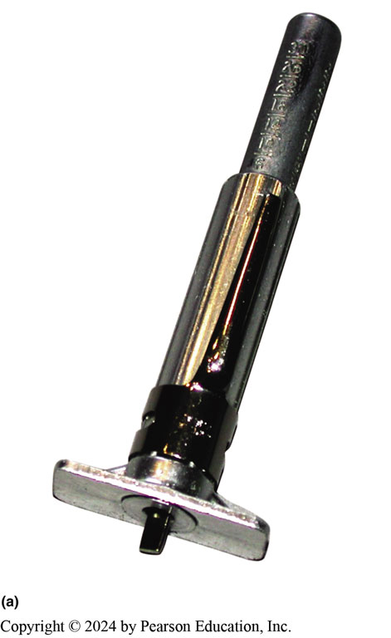
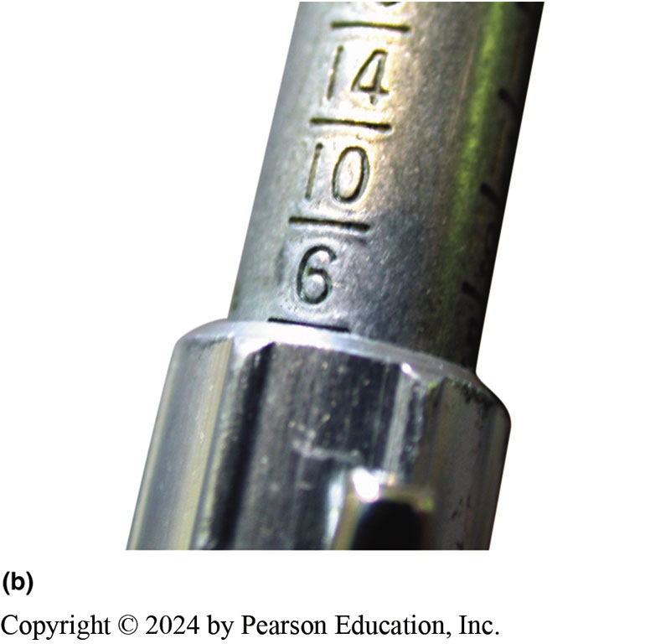
Figure 108.1 Depth Gauge
(a) A typical tire tread depth gauge. The center movable plunger is pushed down into the groove of the tire (b) The tread depth is read at the top edge of the sleeve. In this example, the tread depth is 6/32 inch

Slide 9
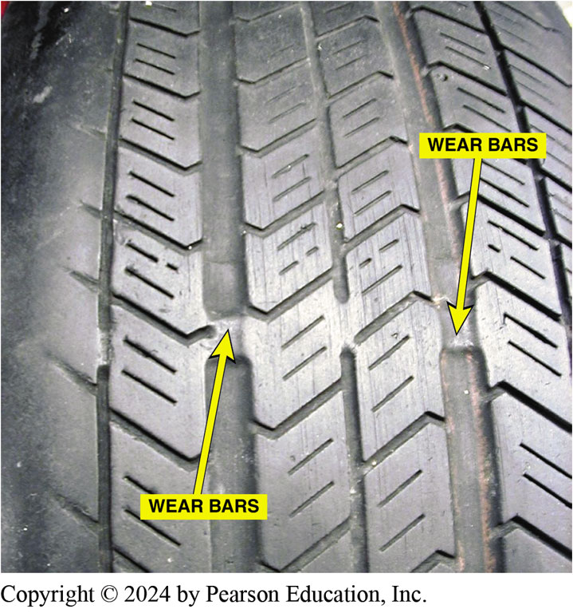
Figure 108.2 Wear Indicators
Wear indicators (wear bars) are strips of bald tread that show when the tread depth is down to 2/32 inch, which is the legal limit in many states

Slide 10
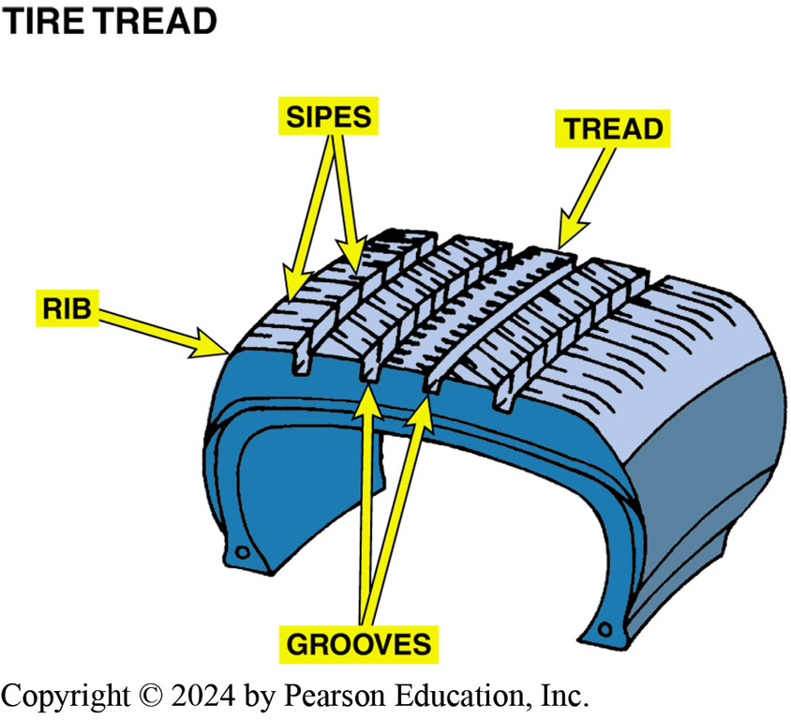
Figure 108.3 Sipes
Tire tread runs around the circumference of the tire, and its pattern helps maintain traction. The ribs provide grip, while the grooves direct any water on the road away from the surface. The sipes help the tire grip the road

Slide 11
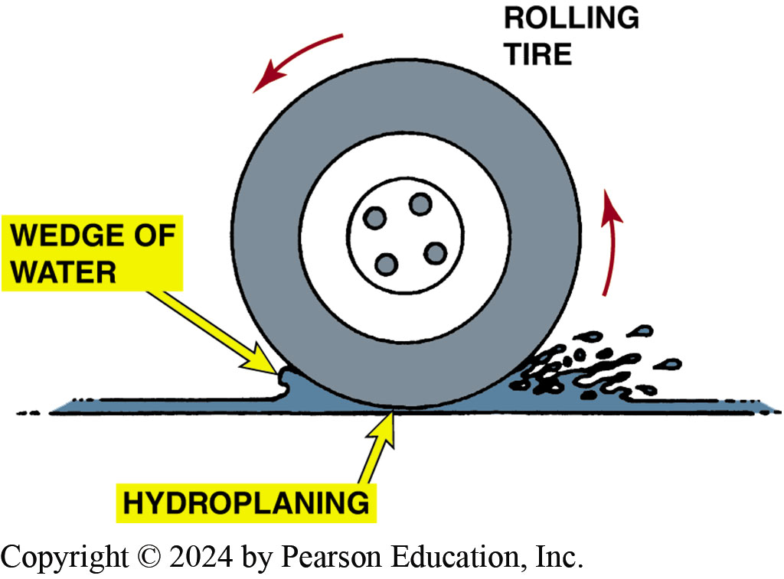
Figure 108.4 Hydroplaning
Hydroplaning can occur at speeds as low as 30 mph (48 km/h). If the water is deep enough and the tire tread cannot evacuate water through its grooves fast enough, the tire can be lifted off the road surface by a layer of water

Slide 12
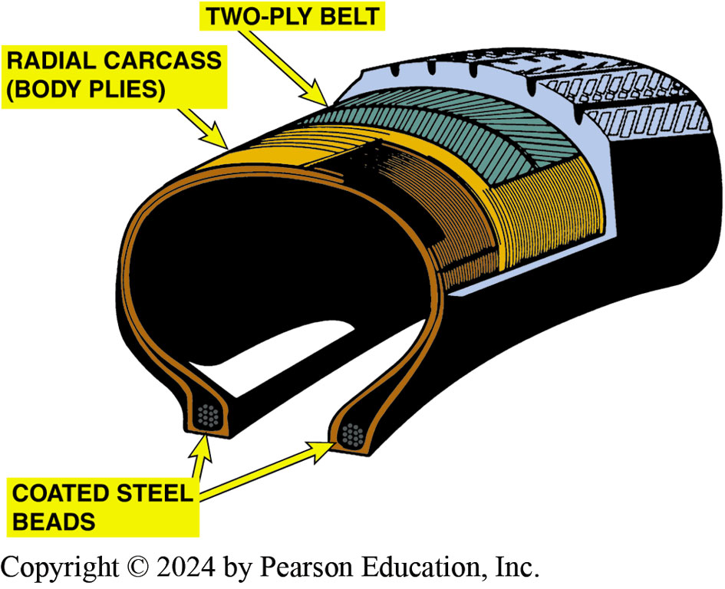
Figure 108.5 Radial Tire
Typical construction of a radial tire. Some tires have only one body ply, and some tires use more than two belt plies

Slide 13
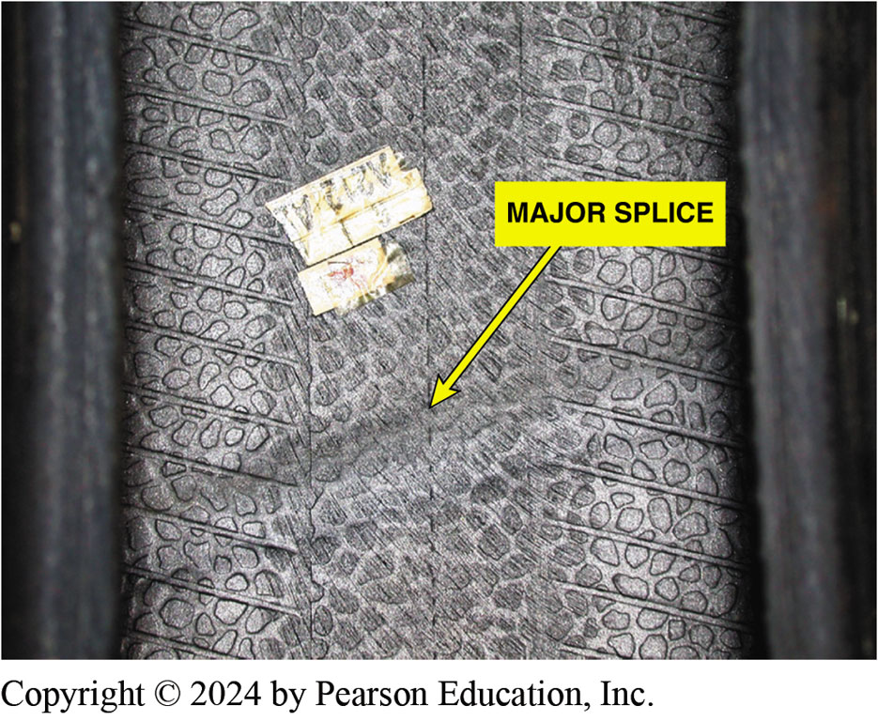
Figure 108.6 Major Splice
The major splice of a tire can often be seen and felt on the inside of the tire. The person who assembles (builds) the tire usually places a sticker near the major splice as a means of identification for quality control

Slide 14
Question 1: ?
What are the seven major parts of the tire?

Slide 15
Answer 1
The tread, sidewalls, bead, body ply, belt, inner liner, and major splice.

Slide 16
Tire Molding
After the tire has been assembled by the tire building machine, it is called a green tire.
The completed green tire is then placed in a mold where its shape, tread design, and all sidewall markings are formed
While in the mold, a steam bladder fills the inside of the tire and forces the tire against the outside of the mold.
The tire is no longer called a green tire but a cured tire

Slide 17
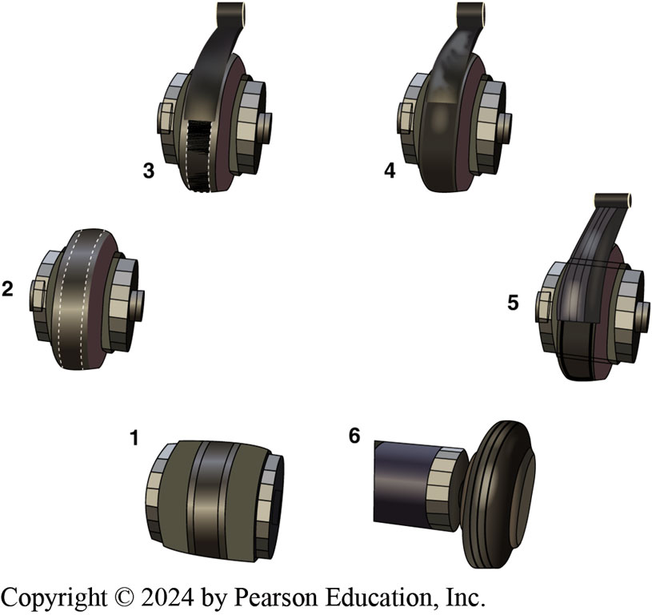
Figure 108.7 Tire Build
Complete stage 1 (body plies, sidewall components, and beads) 2. Building drum expands in preparation to receive the belts and tread 3. Application of belt #1. 4. Application of belt #2. 5. Application of the tread 6. Drum retracts to release the completed green (uncured) tire

Slide 18
Frequently Asked Question: Why Do I Get Shocked by Static Electricity When I Drive a Certain Vehicle?
? Frequently Asked Question
Why Do I Get Shocked by Static Electricity When I Drive a Certain Vehicle? Static electricity builds up in insulators due to friction of tires with road. Newer tires use silica and contain less carbon black in rubber, which makes tires electrically conductive. Because tires cannot conduct static electricity to ground, it builds up inside vehicle and is discharged through body of driver and/or passenger whenever metal door handle is touched. NOTE: Toll booth operators report being shocked by many drivers as money is being passed between driver and the operator. Newer tire sidewall designs that use silica usually incorporate carbon sections that are used to discharge static electricity to ground. To help reduce static charge buildup, spray upholstery with an antistatic spray available at discount and grocery stores.

Slide 19
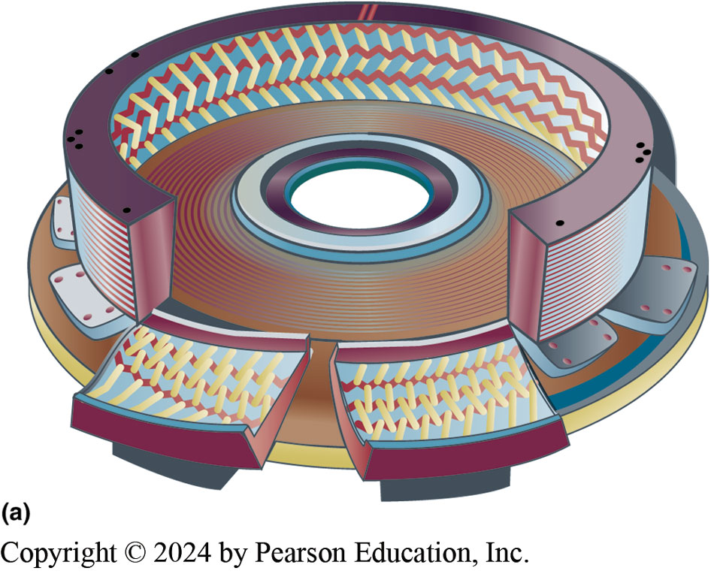
Figure 108.8a Vulcanization
After entire tire has been assembled into a completed “green” tire, it is placed into a tire-molding machine where tire is molded into shape and rubber is changed chemically by the heat. This nonreversible chemical reaction is called vulcanization.(a) A segmented-type mold.

Slide 20
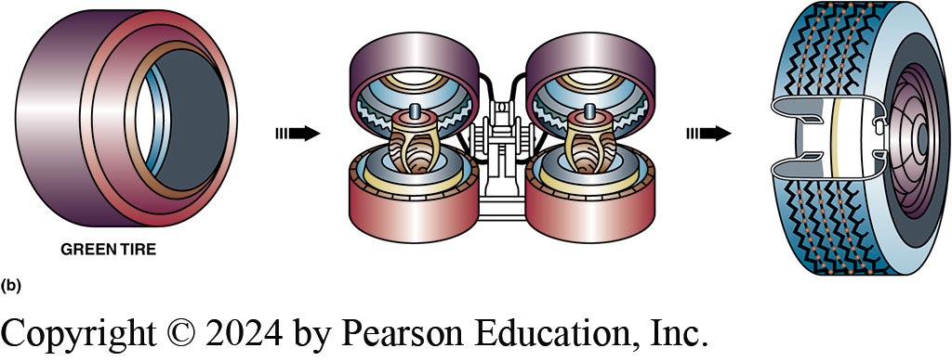
Figure 108.8b Clamshell-type Mold
(b) A clamshell-type mold showing the steam-filled bladder that inflates which forces the green tire into the mold.

Slide 21
Frequently Asked Question: How Much Does Tire Pressure Change with a Change in Temperature?
? Frequently Asked Question
How Much Does Tire Pressure Change with a Change in Temperature? As tire temperature increases, pressure inside tire also increases. General amount of pressure gain or loss is: 10°F increase causes 1 PSI increase 10°F decrease causes 1 PSI decrease. E.G., if a tire is correctly inflated to 35 PSI when cold and then driven on a highway, tire pressure may increase 5 PSI or more. CAUTION: DO NOT LET AIR OUT OF A HOT TIRE! If air is released from a hot tire to bring pressure down to specifications, tire will be underinflated when Cooled. Pressure specification is for cold tire. Always check tire pressures on a vehicle fewer than 2 miles

Slide 22
Service Description
Tires built after 1990 use a “service description” method of sidewall information in accordance with I S O 4000 (International Standards Organization) that includes size, load, and speed rating together in one easy-to-read format.
P-Metric Designation | Service Description
P205/75HR × 15 | 205/75R × 15 92H
P passenger vehicle | 205 cross-sectional width in mm
205 cross-sectional width in mm | 75 aspect ratio
75 aspect ratio | R radial construction
H speed rating (130 mph/210 km/h) | 15 rim diameter in inches
R radial construction | 92 load index
15 rim diameter in inches | H speed rating (130 mph/210 km/h)

Slide 23
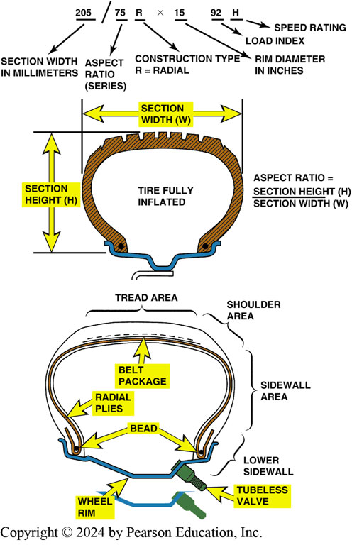
Figure 108.9 Size Designation
(a) Tire size designation includes cross-sectional width and aspect ratio. The aspect ratio is the proportional relationship between the width and the height of the tire expressed as a percentage. (b) Cross-sectional view of a typical tire showing the terminology.

Slide 24
Frequently Asked Question: What Effect Does Tire Size Have on Overall Gear Ratio?
? Frequently Asked Question
What Effect Does Tire Size Have on Overall Gear Ratio? Customers often ask what effect changing tire size has on fuel economy and speedometer readings. If larger (or smaller) tires are installed on a vehicle, many other factors also will change. These include: Speedometer reading. If larger-diameter tires are used, speedometer will read slower than you are actually traveling. Even though larger tires are said to give better fuel economy, just opposite can be calculated! Since a larger-diameter tire travels farther than a smaller-diameter tire, larger tire will cause odometer to read a shorter distance than vehicle actually travels. E.G., if odometer reads 100 miles traveled on tires that are 10% oversized in circumference, actual distance traveled is 110 miles. If fuel economy is calculated on miles traveled, the result will be lower fuel economy See Page 1296 for formula.
Notes:
What Effect Does Tire Size Have on Overall Gear Ratio? Customers often ask what effect changing tire size has on fuel economy and speedometer readings. If larger (or smaller) tires are installed on a vehicle, many other factors also will change. These include the following:
Speedometer reading. If larger-diameter tires are used, the speedometer will read slower than you are actually traveling. This can result in speeding tickets! Odometer reading. Even though larger tires are said to give better fuel economy, just the opposite can be calculated! Since a larger-diameter tire travels farther than a smaller-diameter tire, the larger tire will cause the odometer to read a shorter distance than the vehicle actually travels. For example, if the odometer reads 100 miles traveled on tires that are 10% oversized in circumference, the actual distance traveled is 110 miles. Fuel economy. If fuel economy is calculated on miles traveled, the result will be lower fuel economy than for the same vehicle with the original tires. See Page 1296 for the formula

Slide 25
How Much Bigger Can I Go?
When changing tire size, there are many factors to consider:
The tire should be the same outside diameter as the original to maintain the proper suspension, steering, and ride height specifications.
Tire size affects vehicle speed sensor values, A B S brake wheel sensor values that can change automatic transmission operation, and A B S operation.
Generally, a tire that is 10 mm wider is acceptable.

Slide 26
Frequently Asked Question: How Much Bigger Can I Go?
? Frequently Asked Question
How Much Bigger Can I Go? Many owners think they can improve their vehicle by upgrading the tire size over the size that comes from the factory to make their vehicle look sportier and ride and handle better. When changing tire size, there are many factors to consider: The tire should be of the same outside diameter as the original to maintain the proper suspension, steering, and ride height specifications. Tire size affects vehicle speed sensor values, ABS brake wheel sensor values that can change automatic transmission operation, and ABS operation. The tire should not be so wide as to contact the inner wheel well or suspension components. Generally, a tire that is 10 mm wider is acceptable. For example, an original equipment tire size 205/75 × 15 (outside diameter = 27.1 in.) can be changed to 215/75 × 15 (outside diameter = 27.6 in.). This much change is less than 1/2inch in width and increases the outside diameter by 1/2 inch. NOTE: Outside diameter is calculated by adding the wheel diameter to the cross-sectional height of the tire, multiplied by 2. ● SEE FIGURE 108–10 AND PAGE 1296 FOR DETAILS
Notes:
How Much Bigger Can I Go? Many owners think they can improve their vehicle by upgrading the tire size over the size that comes from the factory to make their vehicle look sportier and ride and handle better. When changing tire size, there are many factors to consider: The tire should be of the same outside diameter as the original to maintain the proper suspension, steering, and ride height specifications. Tire size affects vehicle speed sensor values, ABS brake wheel sensor values that can change automatic transmission operation, and ABS operation. The tire should not be so wide as to contact the inner wheel well or suspension components. Generally, a tire that is 10 mm wider is acceptable. For example, an original equipment tire size 205/75 × 15 (outside diameter = 27.1 in.) can be changed to 215/75 × 15 (outside diameter = 27.6 in.).
This much change is less than 1/2inch in width and increases the outside diameter by 1/2 inch.
NOTE: Outside diameter is calculated by adding the wheel diameter to the cross-sectional height of the tire, multiplied by 2. ^{● SEE FIGURE 108–10.} Whenever changing tires, make sure that the load capacity is the same or greater than that of the original tires. If wider tires are desired, a lower aspect ratio is required to maintain the same, or close to the same, overall outside diameter of the tire. If even larger tires are needed, then 225/60 × 15s may be OK—let’s check the math:
225 × 0.60 = 135 mm Notice that this is much too short a sidewall height when compared with the original tire. Use the “plus 1” or “plus 2” concept. When specifying wider tires, the sidewall height must be reduced to maintain the same, or close to the same, original equipment specifications. The “plus 1” concept involves ls 1 in. larger in diameter the lower aspect of wider tires.

Slide 27
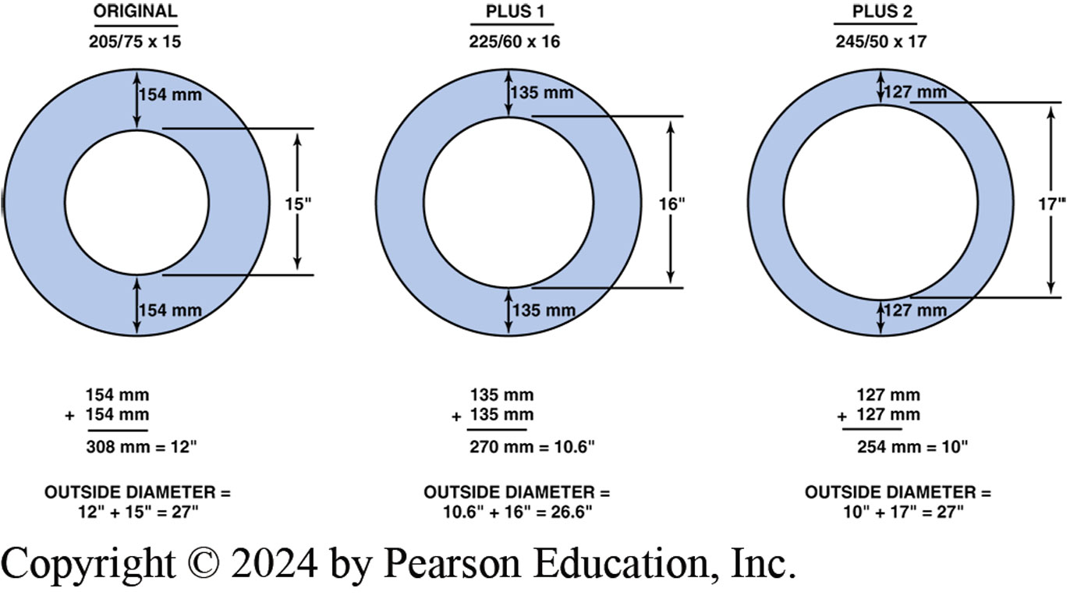
Figure 108.10 Tire Size
Notice that the overall outside diameter of the tire remains almost the same and at the same time the aspect ratio is decreased and the rim diameter is increased

Slide 28
High-Flotation Tires
High-flotation tires for light trucks are designed to give improved off-road performance on sand, mud, and soft soil and still provide acceptable hard-road surface performance. High-flotation tires have a size designation such as 33 × 12.50R × 15L T:
33 | approximate overall tire diameter in inches
12.50 | approximate cross-sectional width in inches
R | radial-type construction
15 | rim diameter in inches
LT | light-truck designation

Slide 29
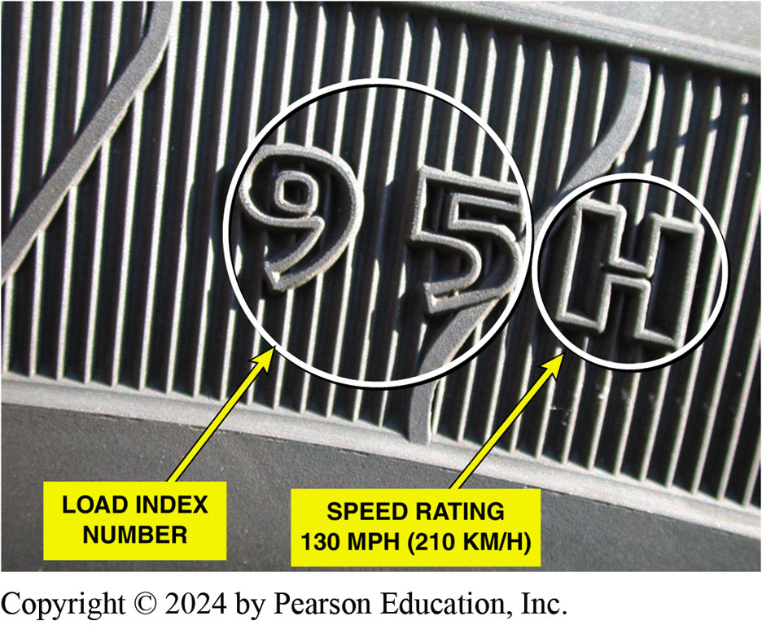
Figure 108.11 Load Index/Speed Rate
Typical sidewall markings for load index and speed rating following the tire size

Slide 30
Load Index and Equivalent Loads
Load index is an abbreviated method to indicate load-carrying capabilities of a tire. Examples:
Load Index | Load (kg) | Load (lb)
75 | 387 | 853
76 | 400 | 882
77 | 412 | 908
78 | 425 | 937
79 | 437 | 963
80 | 450 | 992
81 | 462 | 1,019
82 | 475 | 1,047
83 | 487 | 1,074
84 | 500 | 1,102
85 | 515 | 1,135
86 | 530 | 1,168
87 | 545 | 1,201

Slide 31
Speed Ratings
Tires are rated according to maximum sustained speed.

Slide 32
Tire Pressure and Traction
All tires should be inflated to the specifications given by the vehicle manufacturer.
Most vehicles have recommended tire inflation figures written in the owner’s manual or on a placard or sticker on the door post or glove compartment.

Slide 33
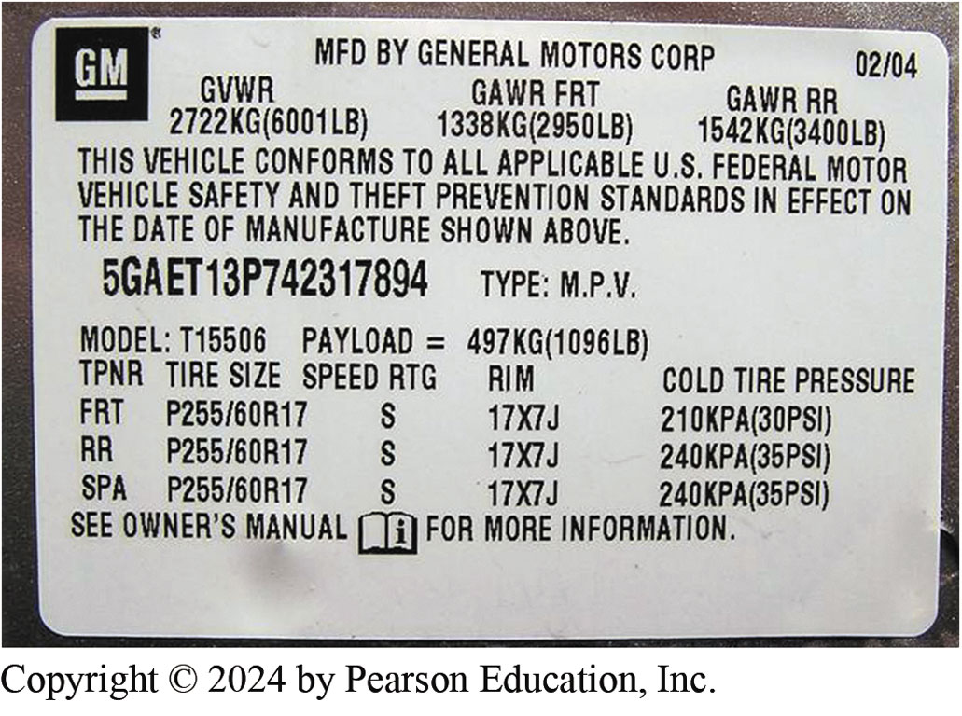
Figure 108.12 Tire Pressure Placard
A typical door placard used on a GM vehicle indicating the recommended tire inflation. Note that the information also includes the size and speed rating of the tire as well as the recommended wheel size.

Slide 34
Rim Width and Tire Size
Rim width is distance between tire flanges sometimes called “flange-to-flange” width.
For a given rim width it is best not to change tire width more than 10 mm (either wider or narrower).
Installing a tire that is too wide or too narrow will cause undesired tire wear.

Slide 35
Uniform Tire Quality Grading System (1 of 3)
U.S. DOT and NHTSA developed a system of tire grading
Uniform Tire Quality Grading System (U T Q G S), to help customers better judge the relative performance of tires.
Three areas of tire performance are tread wear, traction, and temperature resistance.

Slide 36
Uniform Tire Quality Grading System (2 of 3)
Tread Wear
Tread wear grade is a comparison rating based on the wear rate of a standardized tire, tested under carefully controlled conditions, which is assigned a value of 100.
Tread Wear Rating Number | Approximate Number of mi/km
100 | 20,000/32,000
150 | 30,000/48,000
200 | 40,000/64,000
250 | 50,000/80,000
300 | 60,000/96,000
400 | 80,000/129,000
500 | 100,000/161,000

Slide 37
Uniform Tire Quality Grading System (3 of 3)
Traction
Traction performance is rated by the letters A A, A, B, and C, with A A being the highest.
Temperature Resistance
Temperature resistance is rated by the letters A, B, and C, with A being the highest rating.

Slide 38
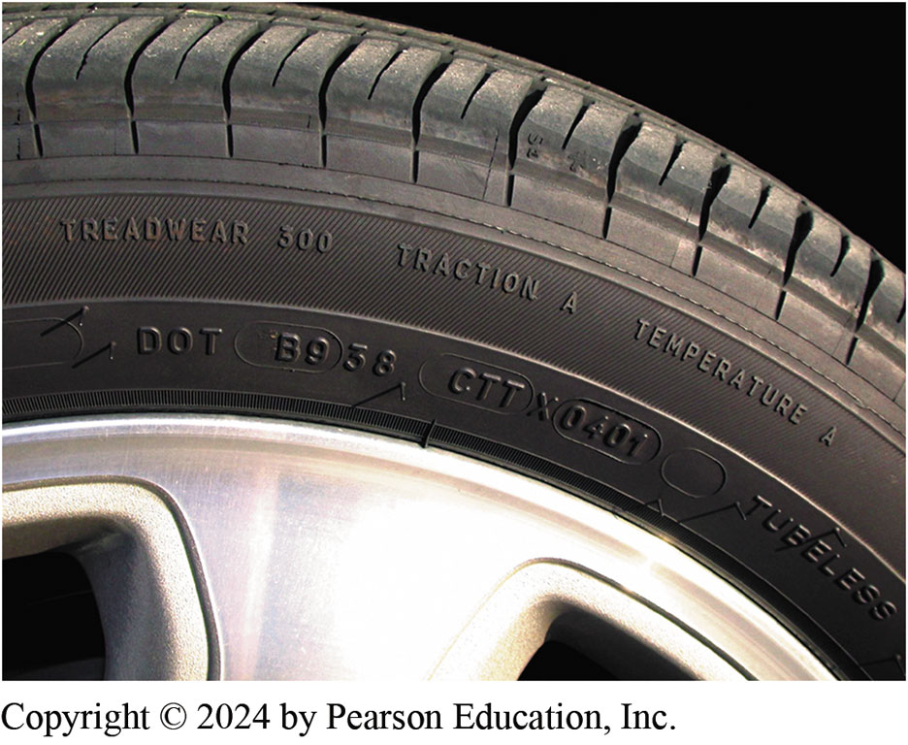
Figure 108.13 UTQGS
Typical “Uniform Tire Quality Grading System” (UTQGS) ratings imprinted on the tire sidewall

Slide 39
Frequently Asked Question: What Type of Tires Should Be Used and When?
? Frequently Asked Question
What Type of Tires Should Be Used and When? Owners of vehicles are often confused when it comes to replacing tires. Unless the rims (wheels) have been replaced with ones of a different size than the vehicle originally came with, the information needed can be found either in the owner’s manual or on a sticker on the driver’s door jamb. The four things that need to be checked when replacing tires include The correct size. A tire size describes the width of the tire, the height of the sidewall, and the rim diameter. This should be the same size that was originally on the vehicle. Speed rating. The speed rating is given as a letter (Q, T, S, H, V, W, and Y) and should be the same as the original tires that came with the vehicle. SEE NOTES FOR MORE OF THIS QUESTION
Notes:
What Type of Tires Should Be Used and When? Owners of vehicles are often confused when it comes to replacing tires. Unless the rims (wheels) have been replaced with ones of a different size than the vehicle originally came with, the information needed can be found either in the owner’s manual or on a sticker on the driver’s door jamb. The four things that need to be checked when replacing tires include The correct size. A tire size describes the width of the tire, the height of the sidewall, and the rim diameter. This should be the same size that was originally on the vehicle.
Speed rating. The speed rating is given as a letter (Q, T, S, H, V, W, and Y) and should be the same as the original tires that came with the vehicle.
The load rating. This is especially important when tires are being purchased for a pickup truck or SUV where a full load may be carried. Check the load rating on the sidewall of the tires to make sure that they match or exceed the load rating of the original tires. The load rating is given
as a number in combination with the speed rating (i.e., 93 V) and together is known as the “service description” of the tire.
Summer, Winter, or All-Season-Summer tires. If the vehicle will be driven in a climate that is above 45°F (7°C), then summer-type tires can be used.
Winter tires. If the vehicle is going to be driven in winter conditions at temperatures always below 45°F (7°C), then winter tires should be selected.
All-season tires. If the vehicle will be driven under a variety of conditions and both above and below 45°F (7°C), then all-season type tires
should be selected.

Slide 40
Question 2: ?
What are the three criteria used in the Uniform Tire Grading Quality system?

Slide 41
Answer 2
Wear, traction, and temperature resistance.

Slide 42
All-Season Tire Designation
Most all-season tires are rated and labeled as M & S, M S, or M + S, and therefore must adhere to general design features as specified by the Rubber Manufacturers Association (R M A).
Tires labeled M & S are constructed with an aggressive tread design, as well as tread compounds and internal construction that are designed for mud and snow.
One design feature is that the tire has at least 25% void area.
The tread rubber used to make all-season tires is also more flexible at low temperatures.

Slide 43

Figure 108.14 Snow Traction
The three-mountain peak symbol indicates that the tire is rated with the necessary snow traction to be the specified winter tire required in some states and Canadian provinces for use in the winter months.

Slide 44
D O T Tire Code
Each tire that is D O T-approved has a D O T number molded into sidewall of the tire.
D O T tire code requirements include resistance to tire damage that could be caused by curbs, chuckholes, and other common occurrences for a tire used on public roads.
Starting with tires manufactured after January 1, 2000, tire build date includes four digits rather than 3 digits.
New code like “3406” means the 34th week of 2006.

Slide 45
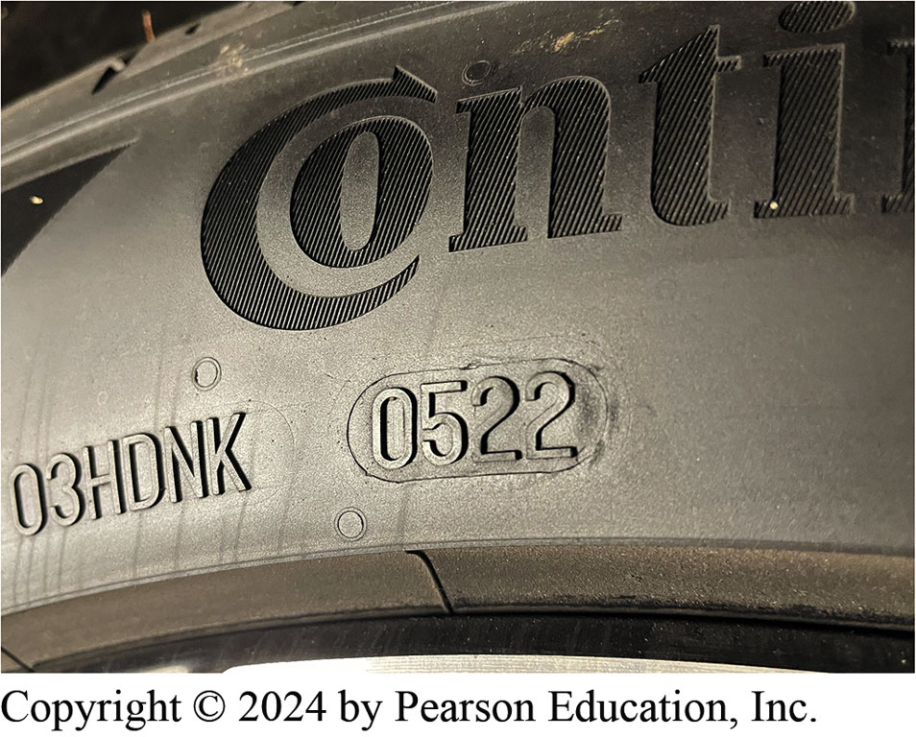
Figure 108.15 Date Code
DOT date code. This tire was built in 5th week of 2022. While there is no official standard for replacement intervals for tires, many experts recommend that tires be replaced, regardless of thread depth, when they are older than 10 years.
Notes:
CASE STUDY: Tire Date Code Information Saved Me Money! This author was looking at a three-year-old vehicle and noticed that the right rear tire had a build date code newer than the vehicle. I asked the owner, “How badly was this vehicle hit?” The owner stumbled and stuttered a little, then said, “How did you know that an accident occurred?” I told the owner that the right rear
tire, while the exact same tire as the others, had a date code indicating that it was only one year old, whereas the original tires were the same age as the vehicle. The owner immediately admitted that the vehicle slid on ice and hit a curb, damaging the right rear tire and wheel. Both the tire and wheel were replaced and the alignment checked. The owner then dropped the price of the vehicle $500!
Summary:
Complaint—buyer of a used car noticed that one tire was newer than the others.
Cause—The owner admitted that the vehicle had slid off the road and hit a curb causing damage to the wheel and tire.
Correction—Because the perspective buyer knew the date code, and mentioned this to the seller, the purchase price was reduced saving the buyer money.

Slide 46
Tire Conicity and Ply Steer
Tire conicity can occur during the construction of any radial or belted tire when the parts of the tire are badly positioned, causing the tire to be smaller in diameter on one side.
It can cause the vehicle to pull to one side of the road due to the cone shape of the tire.
Ply steer is another term that describes a slight pulling force on a vehicle due to tire construction.
Ply steer is due to the angle of the cords in the belt layers.

Slide 47
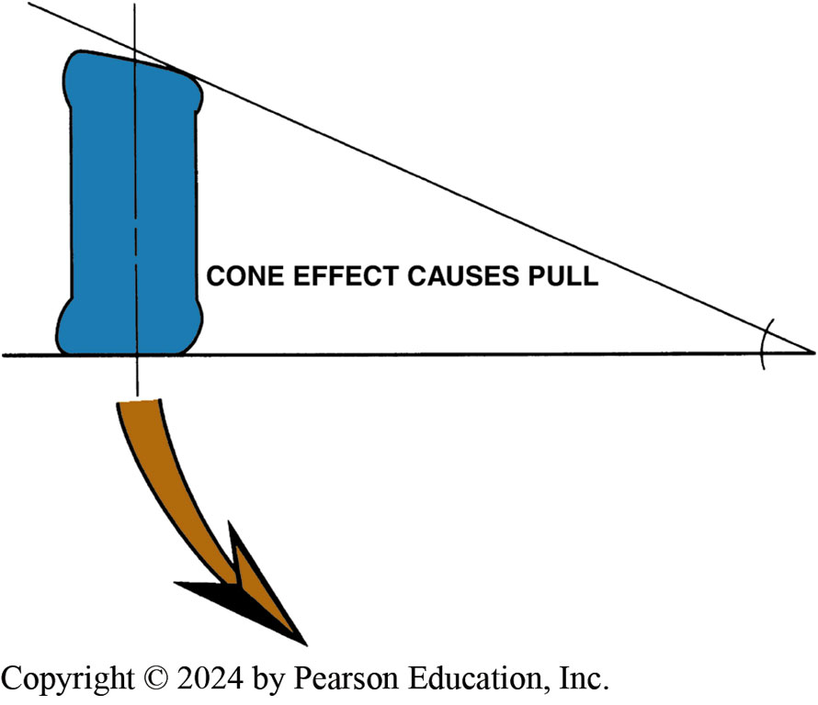
Figure 108.16 Conicity
Conicity is a fault in the tire that can cause the vehicle to pull to one side due to the cone effect (shape) of the tire

Slide 48
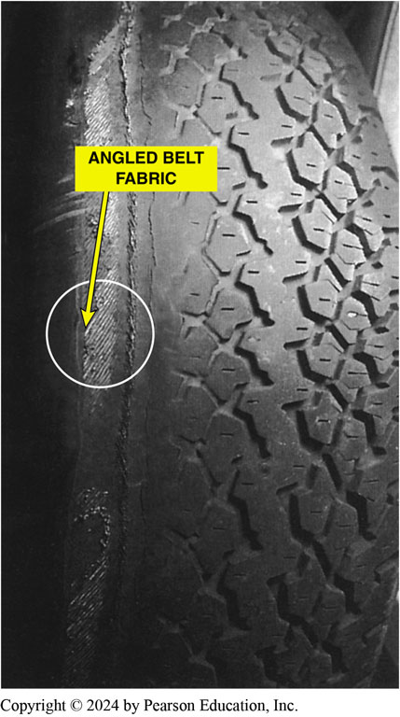
Figure 108.17 Worn Belt Ply Steer
Notice the angle of the belt material in this worn tire. The angle of the belt fabric can cause a “ply steer” or slight pulling force toward one side of the vehicle

Slide 49
Vehicle Handling and Tire Slip Angle
As a vehicle is turned, wheels are moved while tires remain in contact with road.
These actions “twist” the carcass of the tire and create a slip angle between the direction the wheel is pointing and the direction the tread is pointing.
This movement causes a slight delay in the turning of the vehicle and causes tire wear.

Slide 50
Spare Tires
Most vehicles today come equipped with space-saver spare tires.
Many small, space-saving spare tires use a higher-than-normal air inflation pressure, usually 60 P S I (414 kPa).
Space saver spares are designed to provide normal handling but not the same durability as full-size tires.
Space saver tires removed as soon as possible.

Slide 51
Run-Flat Tires (1 of 2)
Run-flat tires (R F T) are designed to operate without any air for a limited distance (usually 50 miles at 55 mph).
A typical run-flat tire (also called extended mobility tire [E M T] or zero pressure [Z P] tire) requires the use of an air pressure sensor/ transmitter and a dash-mounted receiver to warn the driver that a tire has lost pressure.

Slide 52
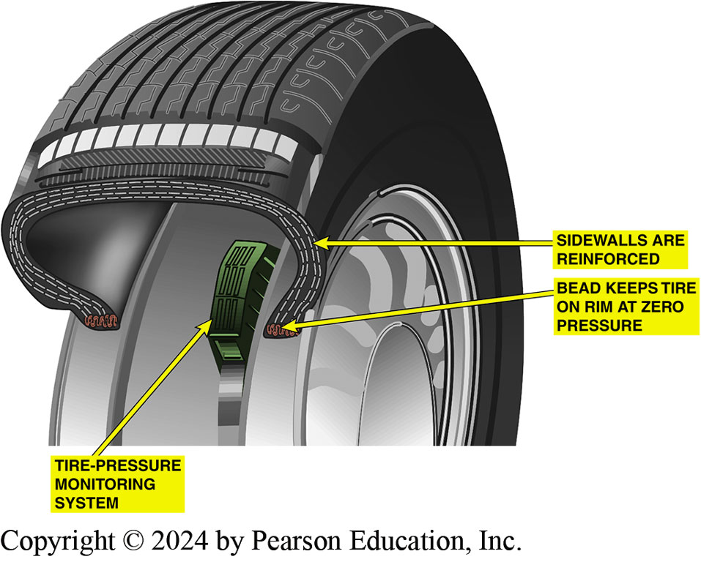
Figure 108.18 Run-Flat Tire
Cutaway of a run-flat tire showing the reinforced sidewalls and the required pressure sensor

Slide 53
Run-Flat Tires (2 of 2)
P A X Run-Flat Tires
Michelin developed a run-flat tire that has 3 unique components:
Special wheel that has 2 bead seats that are of different diameters.
Urethane support ring that is designed to support the weight of the vehicle in the event of a flat tire.
Special tire that is designed to operate without air.
Servicing a P A X Wheel/Tire assembly
Follow the manufacturers guidelines for service.

Slide 54
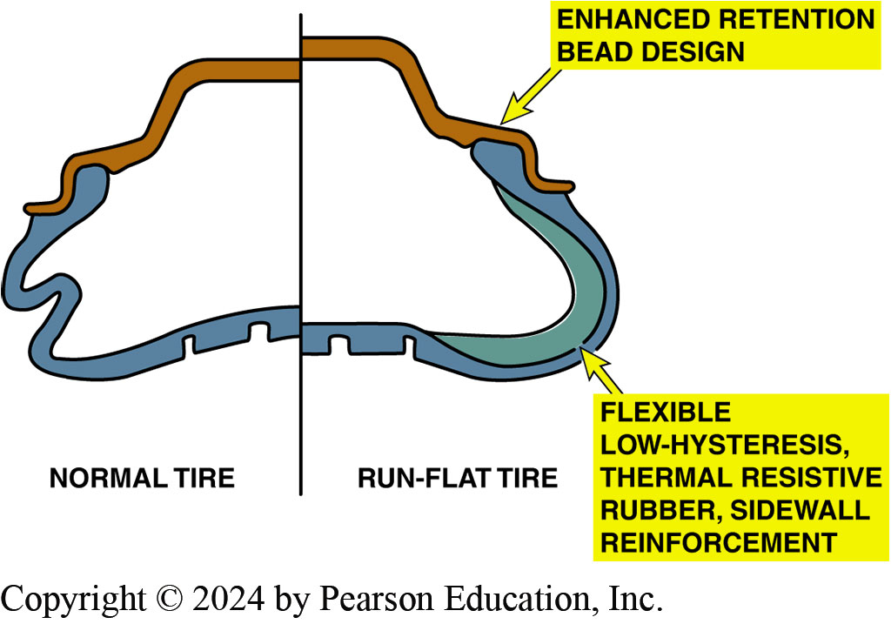
Figure 108.19 Run-Flat Comparison
A conventional tire on the left and a run-flat tire on the right, showing what happens when there is no air in the tire

Slide 55
Wheels (1 of 3)
Wheel Offset
Wheel has positive offset if center section is outward from the wheel centerline.
Wheel has negative offset if center section is inboard (or “dished”) from wheel centerline.
Back Spacing
Back spacing, also called rear spacing or backside setting, is the distance between the back rim edge and the wheel center section mounting pad.

Slide 56
Wheels (2 of 3)
Determining Bolt Circle
On 4-lug axles and wheels, bolt circle measurement is simply taken from center to center on opposite studs or holes
On 5-lug axles and wheels, one method is to measure from the far edge of one bolt hole to the center of the hole two over from the first.

Slide 57
Wheels (3 of 3)
Steel Wheels
Steel wheel is very strong due to its designed shape and fact that it is work hardened during manufacturing.
Steel wheels are formed from welded hoops that are flared and joined to stamped spiders.
Aluminum Wheels
Forged and cast aluminum wheels are commonly used on cars and trucks.
Forged means that the aluminum is hammered or forged under pressure into shape.

Slide 58
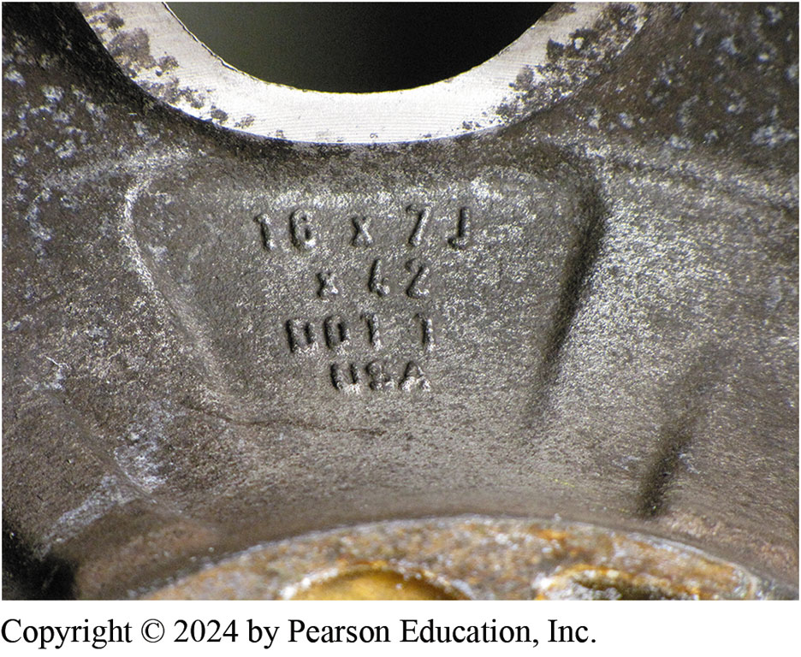
Figure 108.20 Wheel Size Stamp
The size of the wheel is usually cast or stamped into the wheel. This wheel is 7 inch wide. The letter “J” refers to the contour of the bead seat area of the wheel

Slide 59
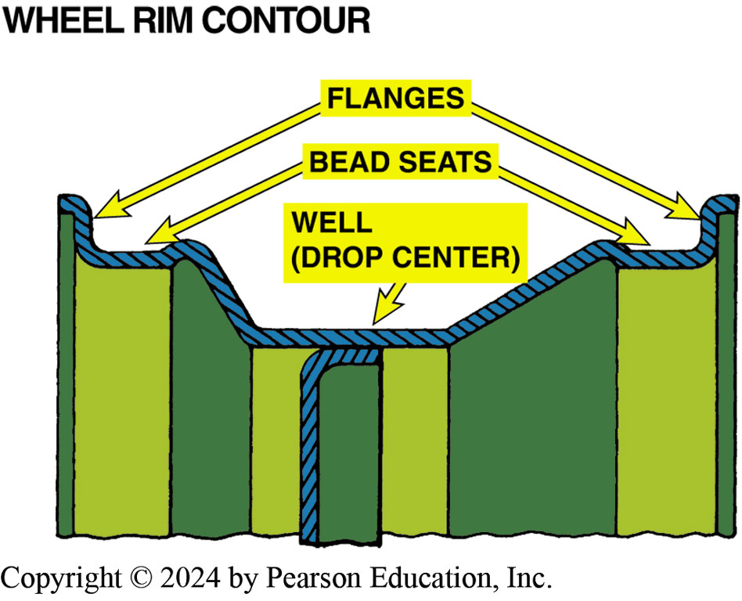
Figure 108.21 Rim Contour
The wheel rim well provides a space for the tire to fit during mounting; the bead seat provides a tire-to-wheel sealing surface; the flange holds the beads in place

Slide 60
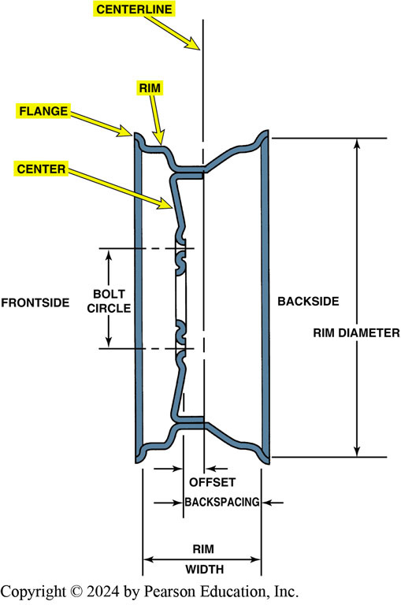
Figure 108.22 Cross-Section
A cross section of a wheel showing part designations

Slide 61
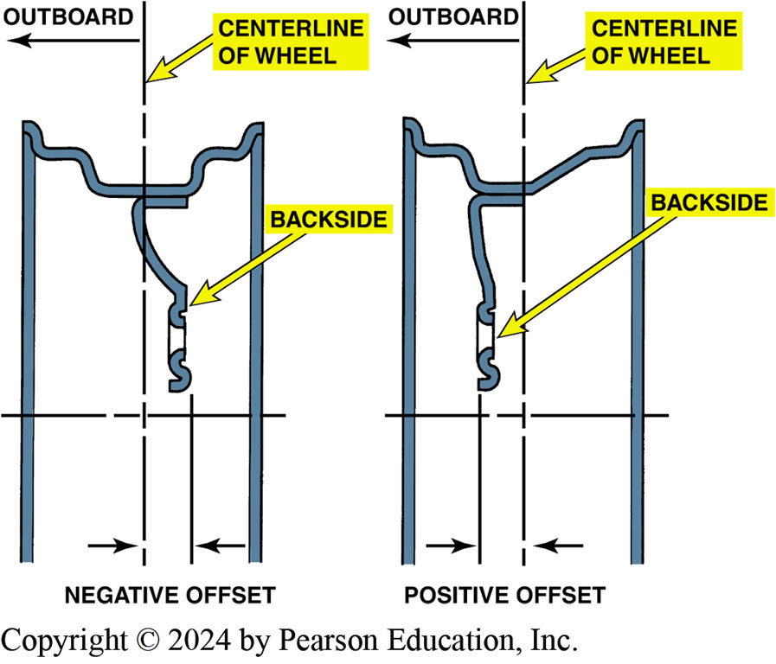
Figure 108.23 Wheel Offset
Offset is the distance between the centerline of the wheel and the wheel mounting surface

Slide 62
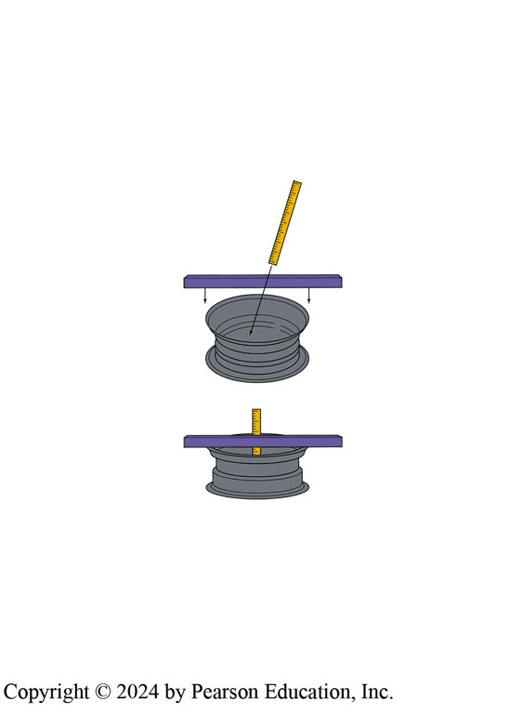
Figure 108.24 Back Spacing
Back spacing (rear spacing) is the distance from the mounting pad to the edge of the rim. Most custom wheels use this measurement method to indicate the location of the mounting pad in relation to the rim

Slide 63
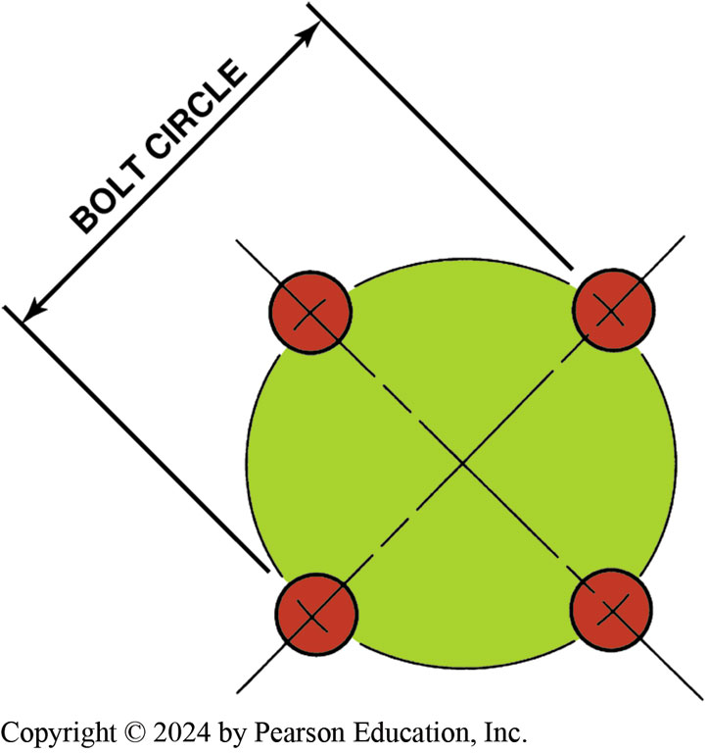
Figure 108.25 Bolt circle
Bolt circle is the diameter of a circle that can be drawn through the center of each lug hole or stud. The bolt circle is sometimes referred to as P C D for pitch circle diameter

Slide 64
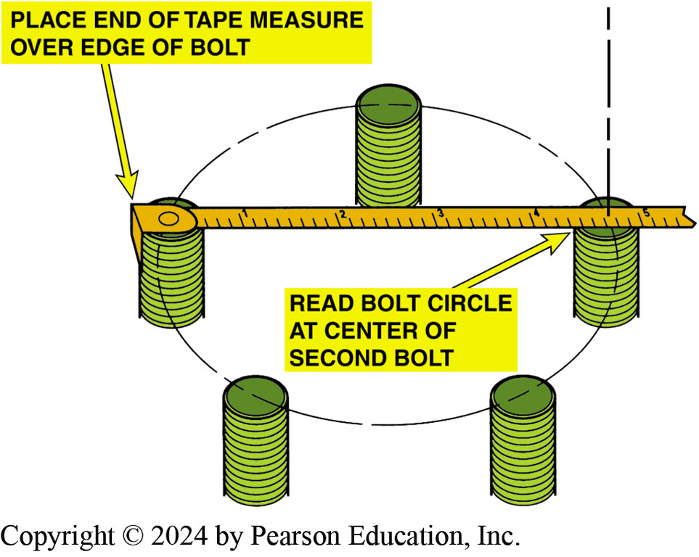
Figure 108.26 Measuring Bolt Circle
Measuring the bolt circle on a five-lug wheel is difficult, but a quick and easy way includes measuring as shown to determine the approximate bolt circle of a five-lug wheel

Slide 65
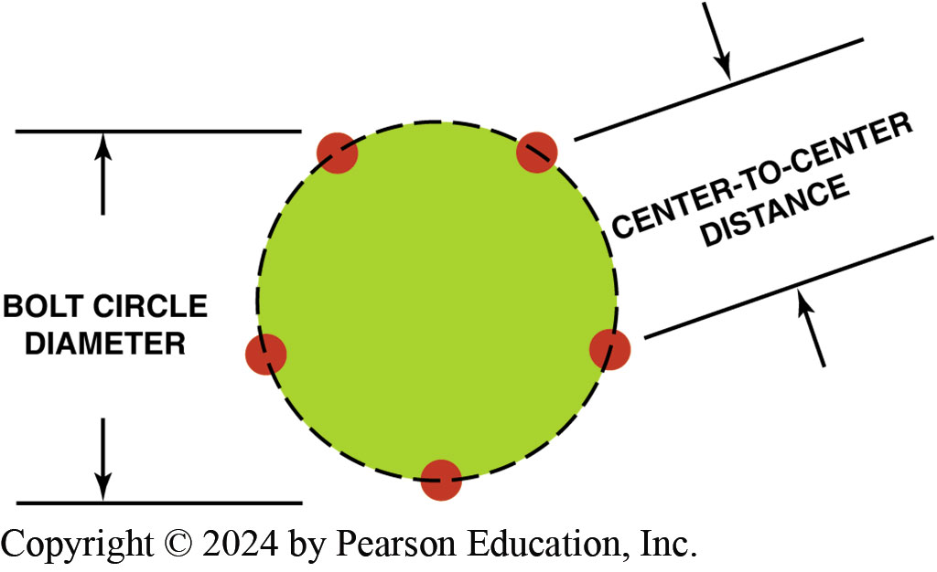
Figure 108.27 Center-to-Center
Measure center-to-center distance and compare the distance to the figures in the chart in the text to determine the diameter for a five-lug bolt circle

Slide 66
Frequently Asked Question: What Does This Mark in a Wheel Mean?
? Frequently Asked Question
What Does This Mark in a Wheel Mean? The symbol JWL, for Japan Wheel Light Metal, means that the wheel meets the technical standards for passenger-car light-alloy disc wheels. See the mark in ● FIGURE 108–28. The manufacturer is responsible for conducting the inspections set forth in the technical standard, and the JWL mark is displayed on those products that pass the inspection.

Slide 67
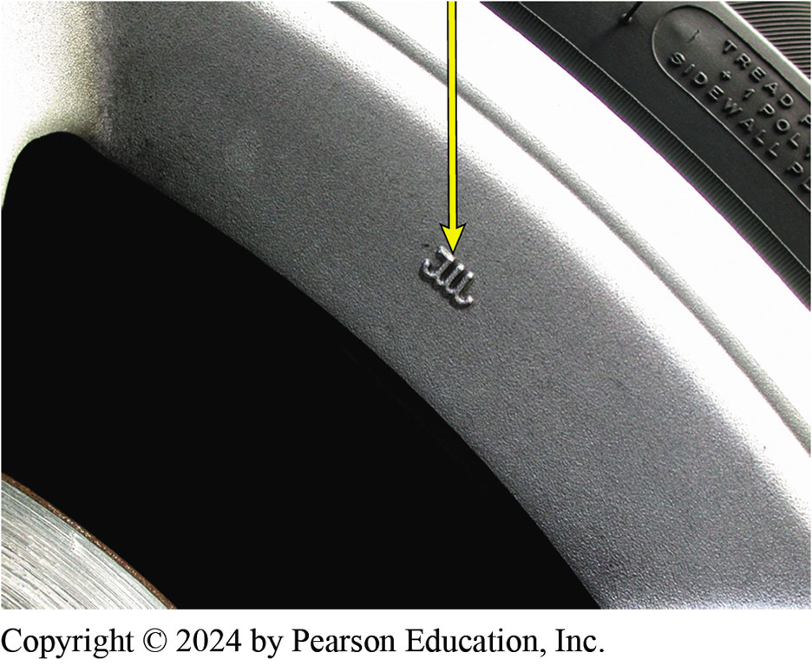
Figure 108.28 JWL Mark
A typical JWL symbol for the Japan Wheel Light Metal standard mark

Slide 68
Question 3: ?
What is wheel offset?

Slide 69
Answer 3
The location of the wheel center section relative to the centerline.

Slide 70
Tire Valves
All tires use a tire valve, called Schrader valve, to hold air in the tire.
Most tire experts agree that the valve stem (includes Schrader valve) should be replaced whenever tires are replaced.
Aluminum (alloy) wheels often require special metal valve stems that use a rubber washer and are actually bolted to the wheel.

Slide 71
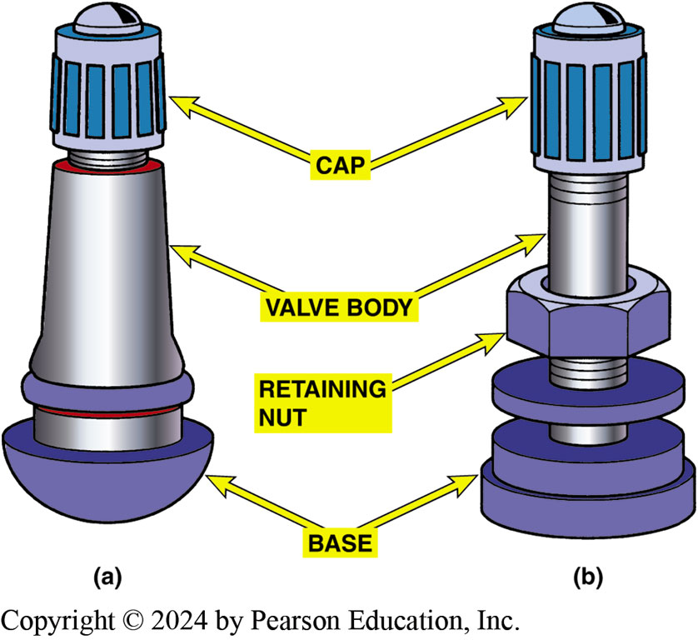
Figure 108.29 Tire Valve
a) A rubber snap-in style tire valve assembly. (b) A metal clamp-type tire valve assembly used on most high pressure (over 60 PSI) tire applications such as is found on many trucks, R V s, and trailers

Slide 72
Lug Nuts
Lug nuts are used to hold a wheel to the brake disc, brake drum, or wheel bearing assembly.
Some vehicles use a lug bolt that is threaded into a hole in the brake drum or bearing assembly.
Typical lug nuts are tapered so that wheel stud will center the wheel onto vehicle
Many alloy wheels use shank-nut-type lug nut that has straight sides without a taper
Lug Studs are pressed into hub or axle.

Slide 73
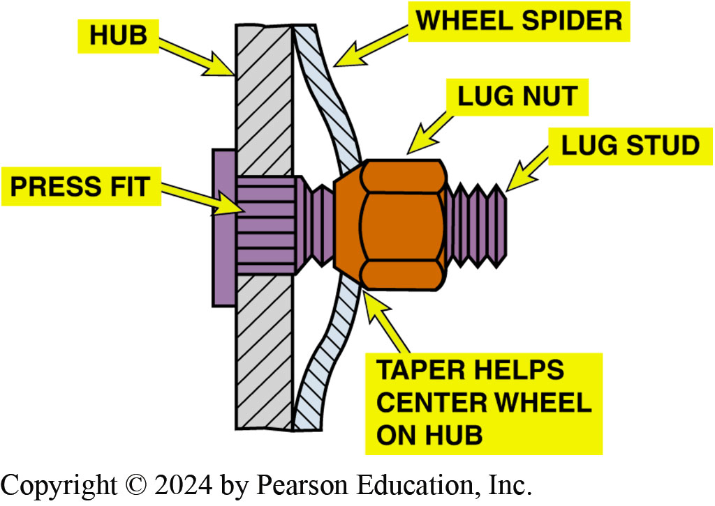
Figure 108.30 Tapered End Of Lug
The tapered end of the lug nut is installed toward the wheel so that it wedges into the taper of the wheel hub.

Slide 74
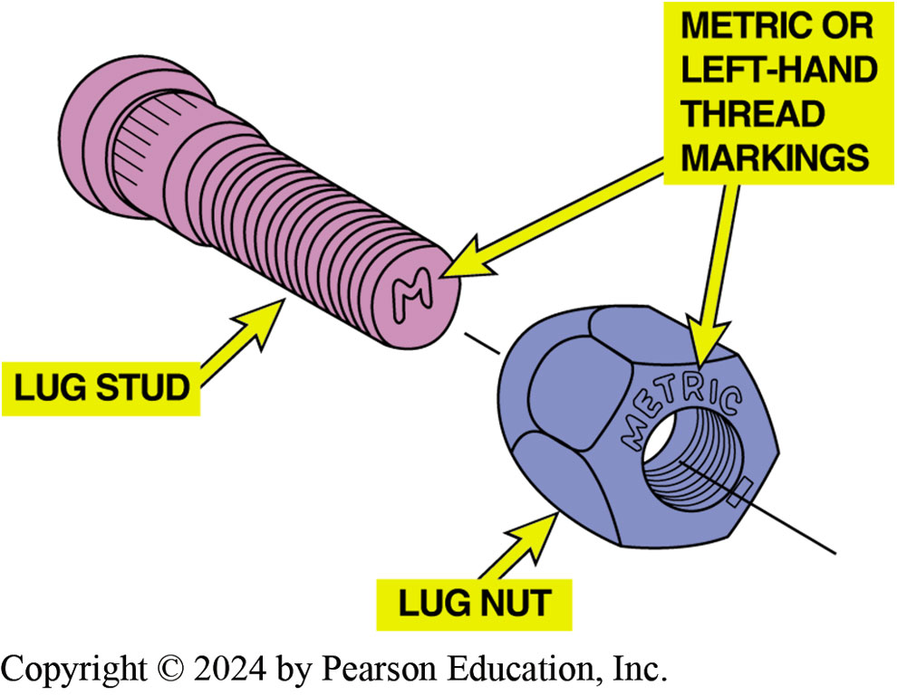
Figure 108.31 Metric/LH Marking
Look carefully on the end of the wheel studs or on the lug nut for metric or left-hand thread marks.

Slide 75
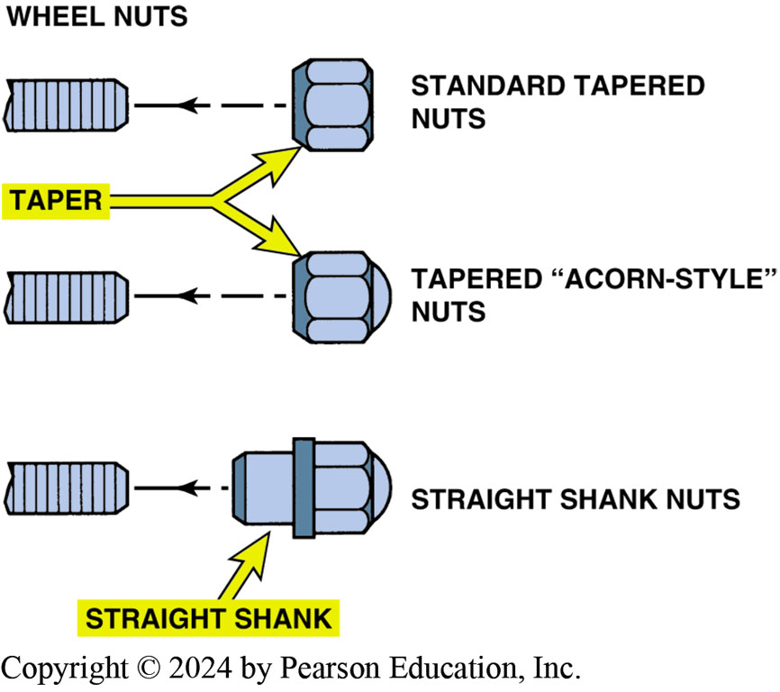
Figure 108.32 Lug Nuts
Various styles of lug nuts

Slide 76
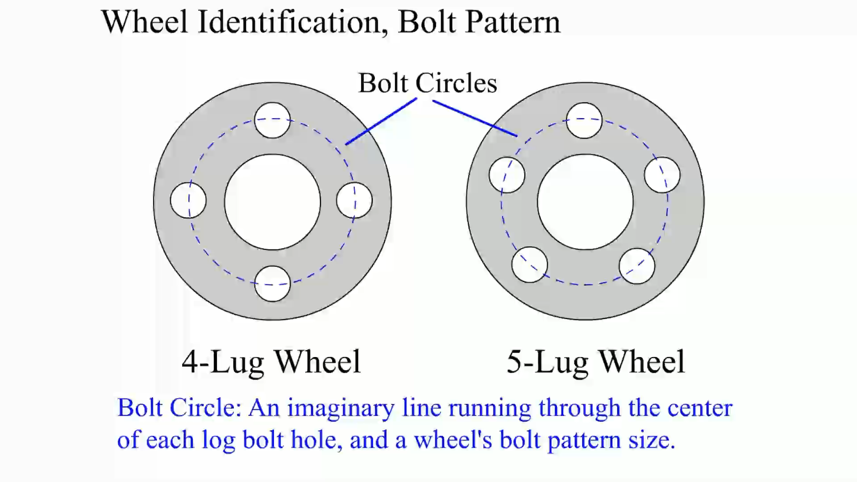
Animation: Wheel Identification, Bolt Pattern (Animation will automatically start)

Slide 77
Frequently Asked Question: What Is a “Knock-Off” Wheel?
? Frequently Asked Question
What Is a “Knock-Off” Wheel? A knock-off design wheel is retained to the axle hub using one large retaining nut that has three arms that are used to loosen and tighten them. They are mostly found on older European sports cars and race cars. The wheel is removed by using a lead hammer which has the weight to loosen the nut yet soft enough to not damage the aluminum spokes of the nut. ● SEE FIGURE 108–33.

Slide 78
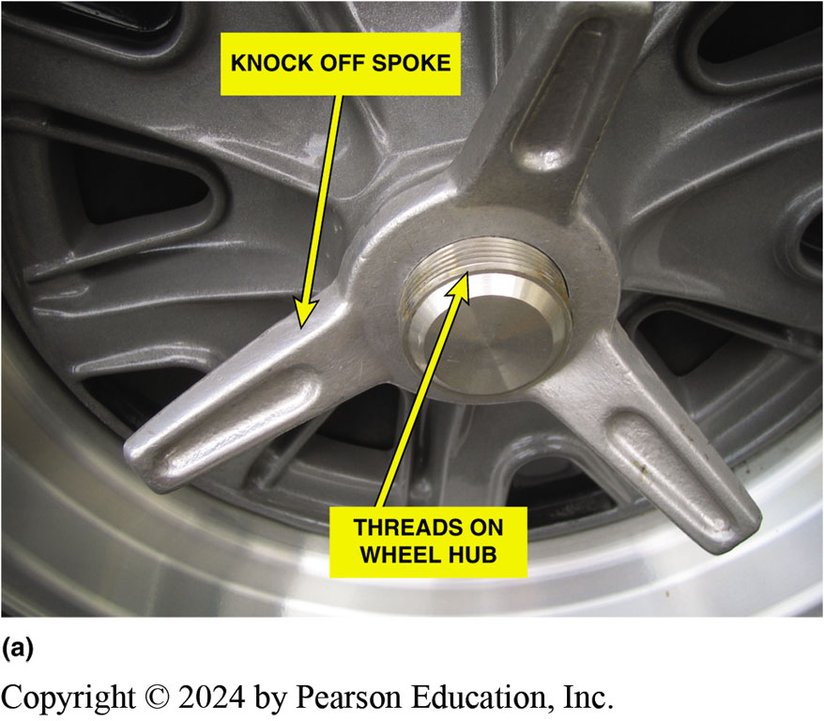
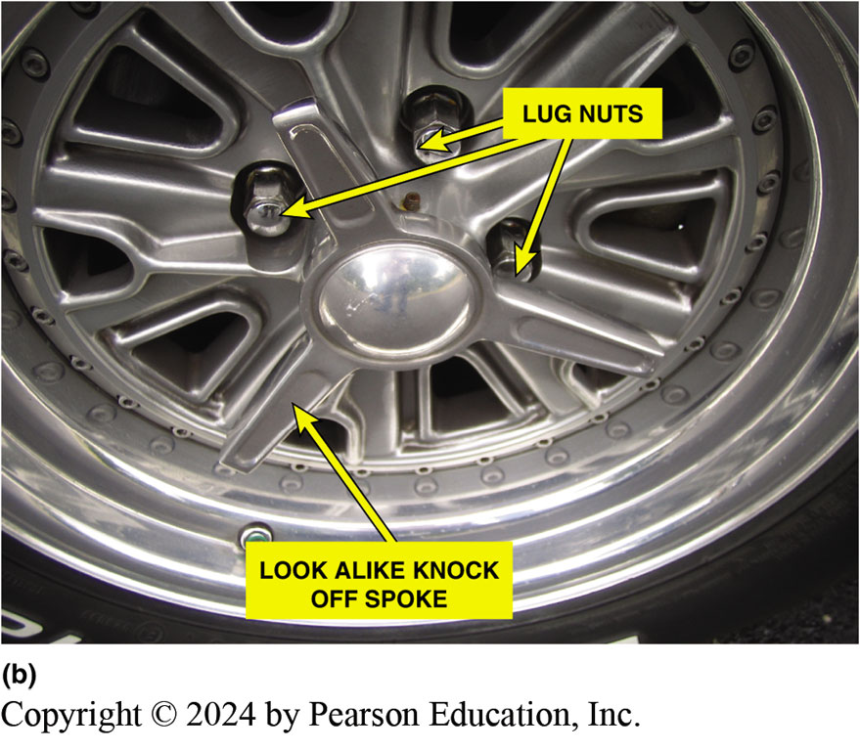
Figure 108.33 Knock-Off Wheels
(a) A typical knock-off-type wheel showing the large three prong wing nuts and the threads on the wheel hub (b) A lookalike knock-off wheel that looks like a knock-off but uses lug nuts

Slide 79
Tire Inspection

Slide 80
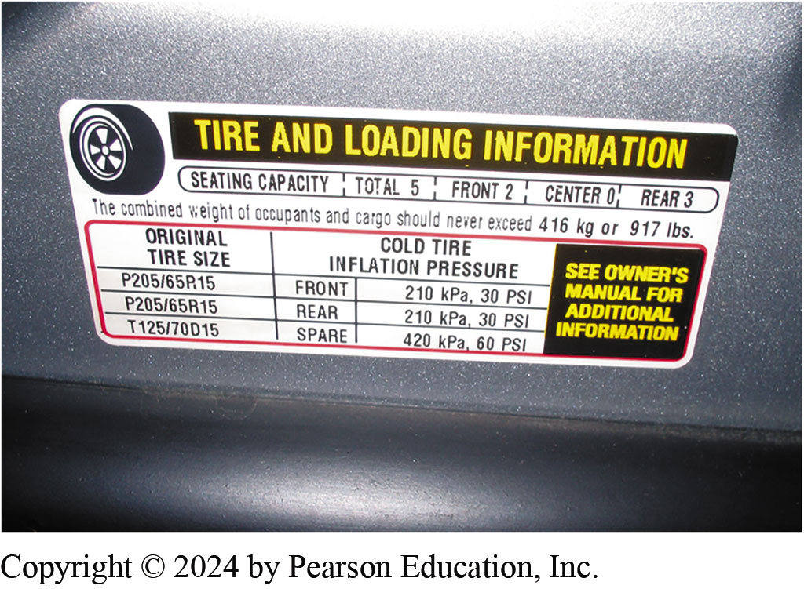
1.Tire Information
1. Check the tire information placard, usually located on the driver’s door or door jamb, for the specified tire size and inflation pressure

Slide 81
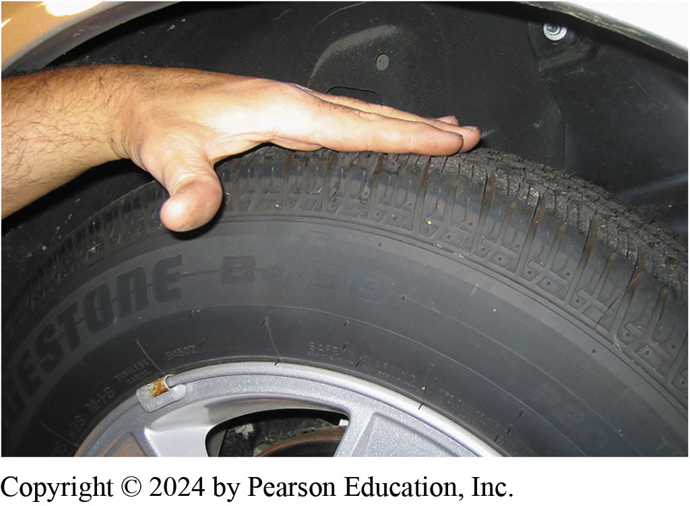
2. Visual Inspection
2. Visually check the tires for abnormal wear or damage

Slide 82
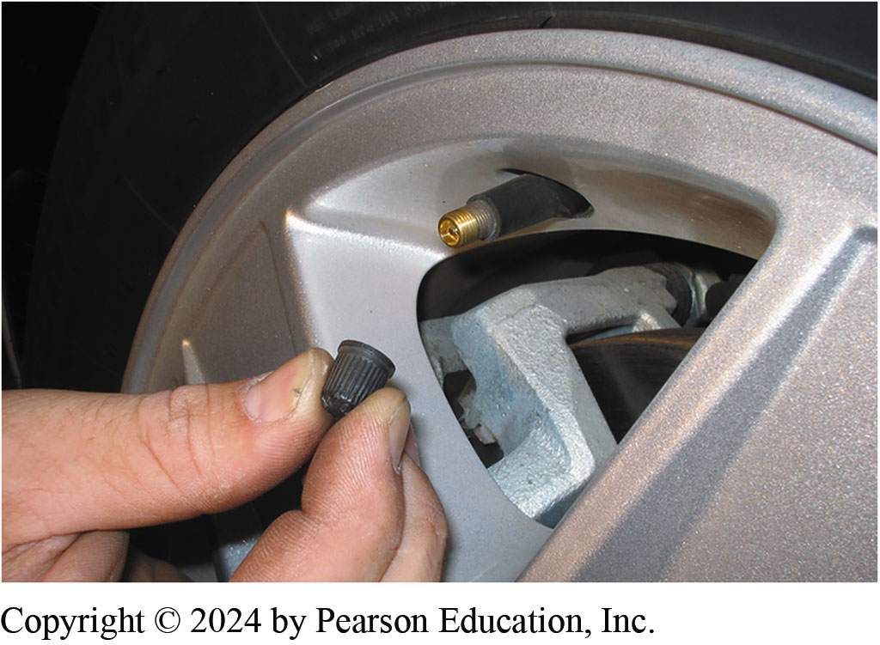
3. Check Valve Stem Condition
3. Remove the tire valve cap and visually check the condition of the valve stem

Slide 83
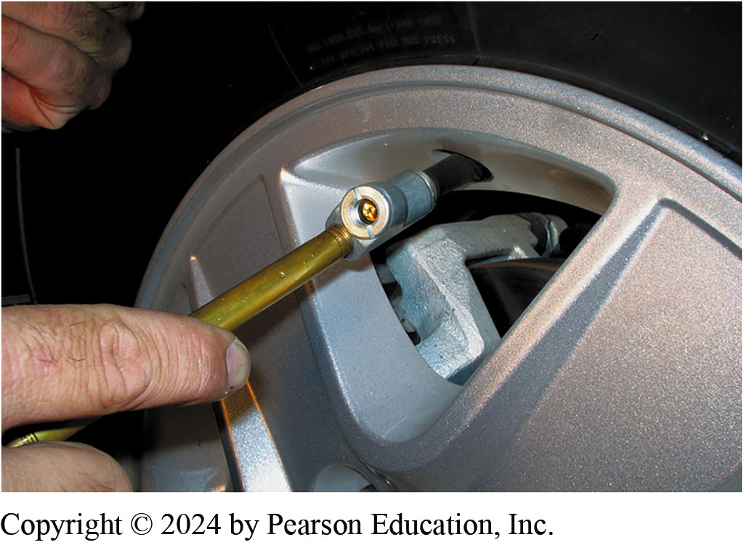
4. Check Inflation Pressure
4. Check inflation pressure by pushing the tire-pressure gauge straight onto the end of the tire valve. If a “hissing” sound is heard, then the reading will not be accurate.

Slide 84
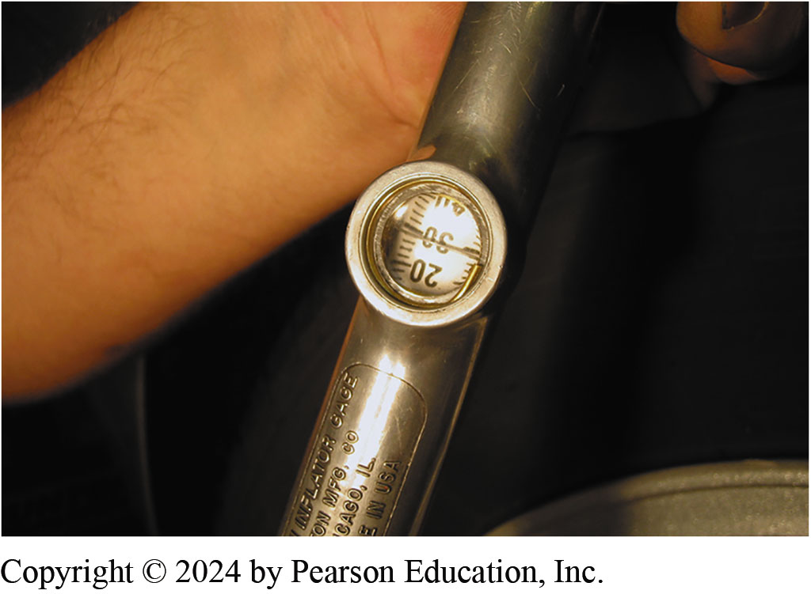
5. Read Pressure
5. Read pressure and compare to specifications. Use an analog or digital gauge if possible which have been proven to be more accurate than a mechanical pencil type gauge.

Slide 85
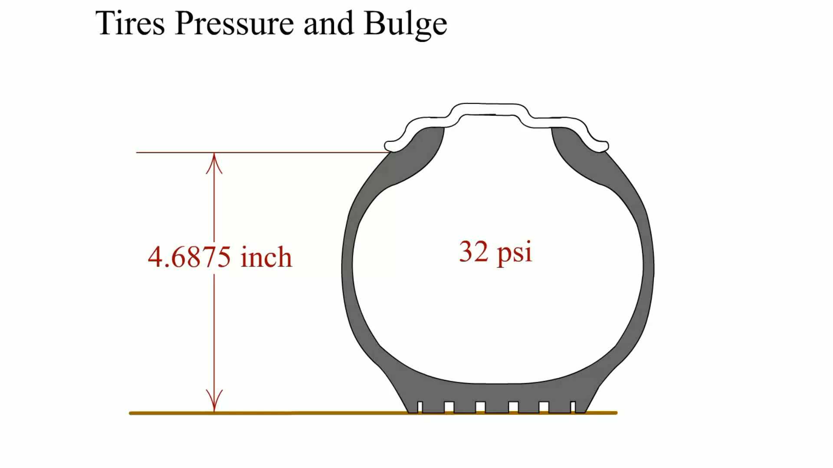
Animation: Tires Pressure and Bulge (Animation will automatically start)

Slide 86
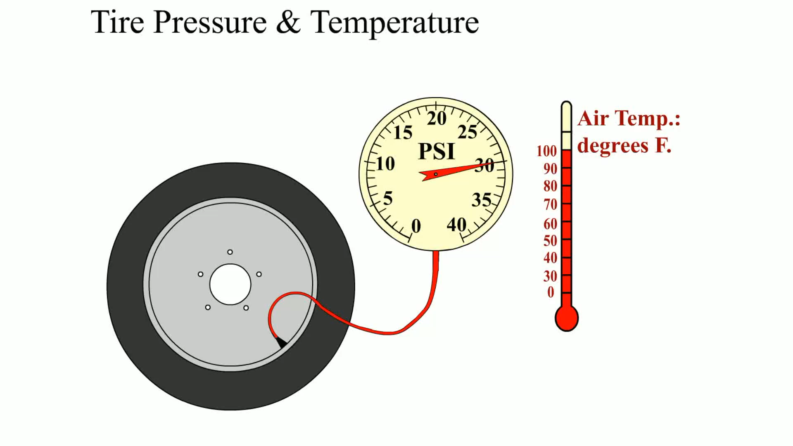
Animation: Tire Pressure & Temperature (Animation will automatically start)

Slide 87
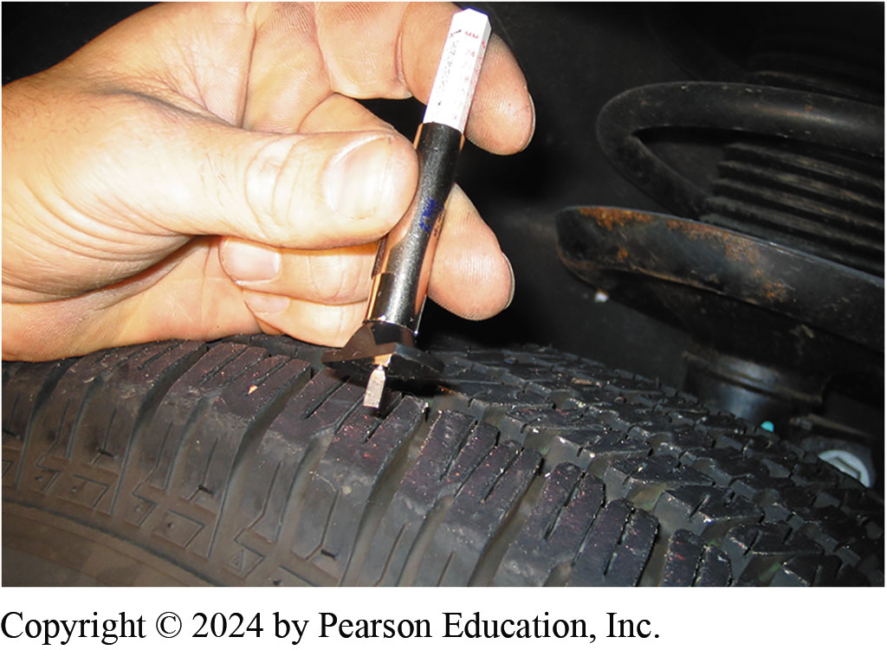
6. Typical Tire Tread Depth Gauge

Slide 88
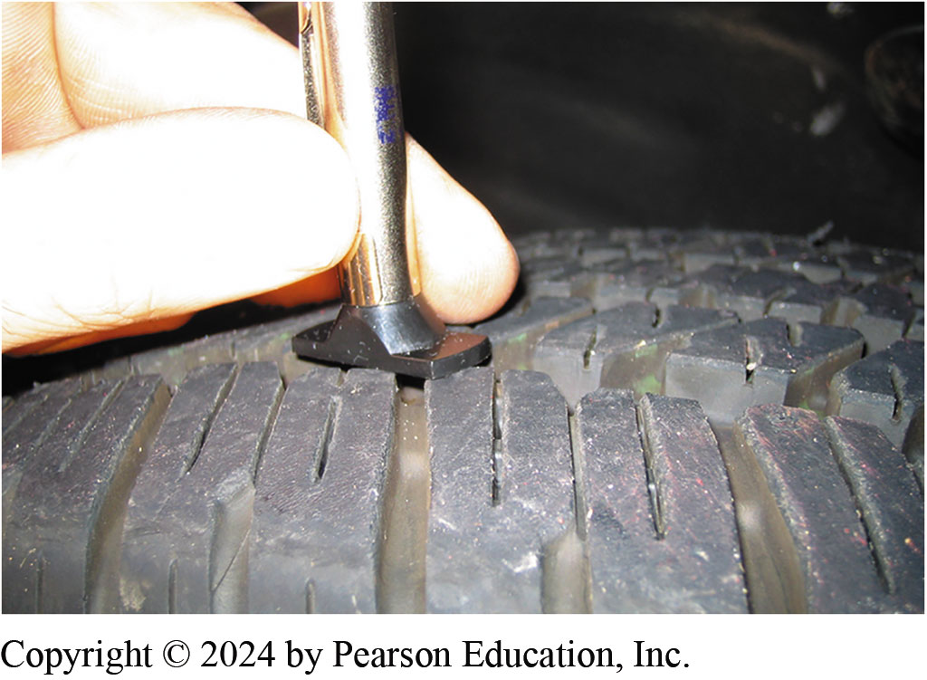
7. Blade Pushed Into Groove
7. blade of the tire tread depth gauge is pushed down into the groove of the tire at the lowest part

Slide 89
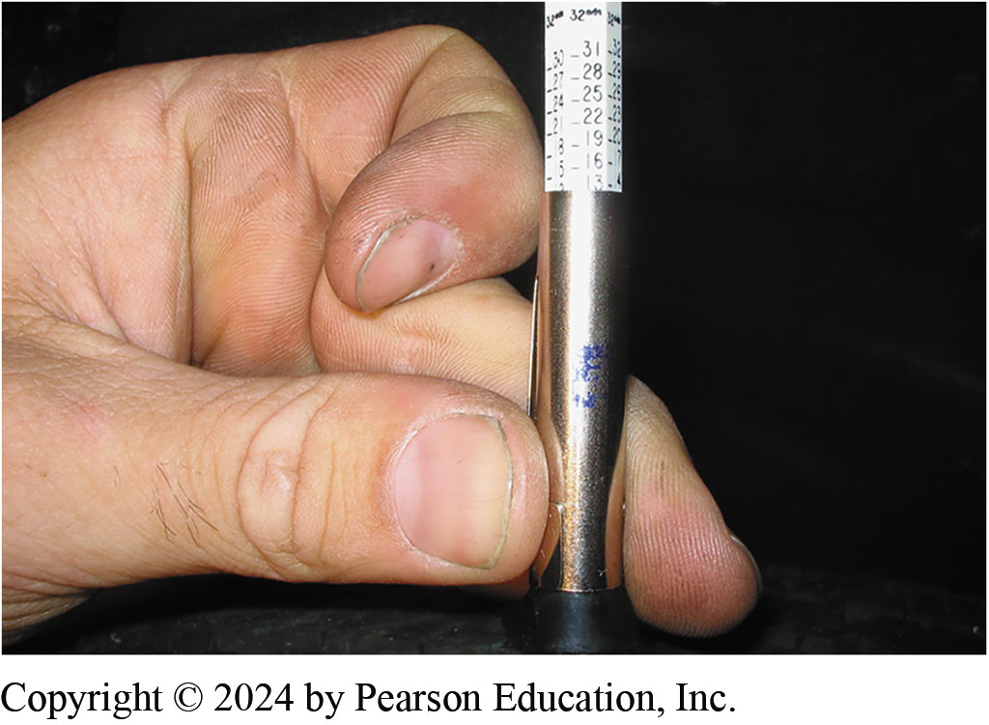
8. Tread Depth Reading
8. Remove the gauge from the tire and read the tread depth at the metal housing. Tread depth is usually measured in 1/32’s of an inch

Slide 90
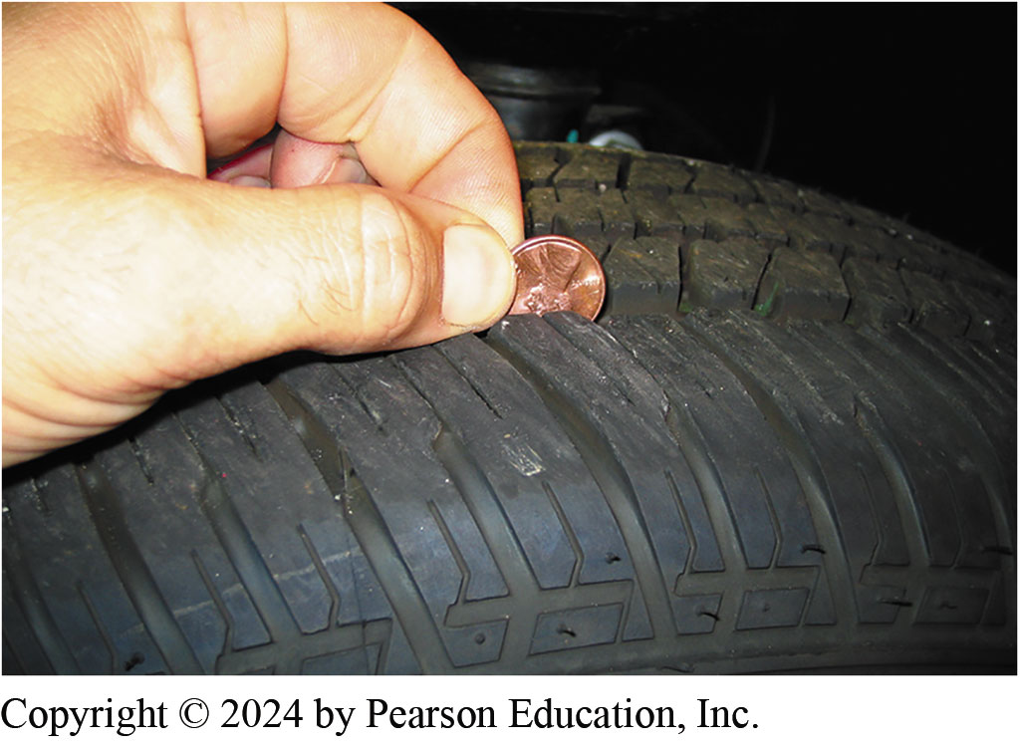
9. Penny Measure
9. If the top of Lincoln’s head is visible, then the tread depth is lower than 2/32 inch, which is the legal limit in many states

Slide 91
Suspension and Steering Videos and Animations
Videos Link: (A4) Suspension and Steering Videos
Animations Link: (A4) Suspension and Steering Animations

Slide 92

Copyright
This work is protected by United States copyright laws and is provided solely for the use of instructors in teaching their courses and assessing student learning. Dissemination or sale of any part of this work (including on the World Wide Web) will destroy the integrity of the work and is not permitted. The work and materials from it should never be made available to students except by instructors using the accompanying text in their classes. All recipients of this work are expected to abide by these restrictions and to honor the intended pedagogical purposes and the needs of other instructors who rely on these materials.

