Slide 1
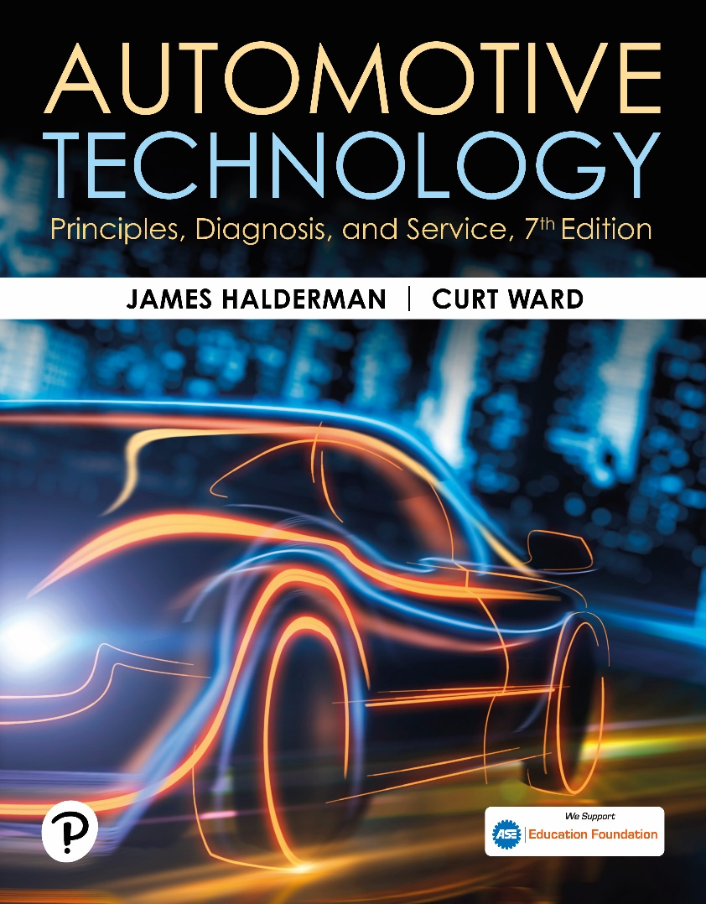
Automotive Technology: Principles, Diagnosis, and Service
Seventh Edition
Chapter 107
Electronic Stability Control Systems
Copyright © 2023 Pearson Education, Inc. All Rights Reserved
Notes:
INSTRUCTOR NOTE: This presentation includes text explanation notes, you can use to teach the course. When in SLIDE SHOW mode, you RIGHT CLICK and select SHOW PRESENTER VIEW, to use the notes.

Slide 2
Learning Objectives
107.1 Discuss the need for electronic stability control (ESC).
107.2 Describe the FMVSS requirements.
107.3 Describe the sine with dwell (SWD) test.
107.4 List the sensors needed for the ESC system.
107.5 Describe how a traction control (TC) system works.
107.6 Explain how to diagnose ESC/TC system faults.

Slide 3
Need For Electronic Stability Control
Purpose and Function
Electronic stability control system applies individual wheel brakes to bring vehicle under control if either understeering or oversteering conditions occur.
Telltale Lamp
E S C lamp, called a telltale light, is required to remain on for as long as the malfunction exists, whenever the ignition is in “On” (“Run”) position.
Some manufacturers install a switch to limit or disable the system for the key cycle.

Slide 4
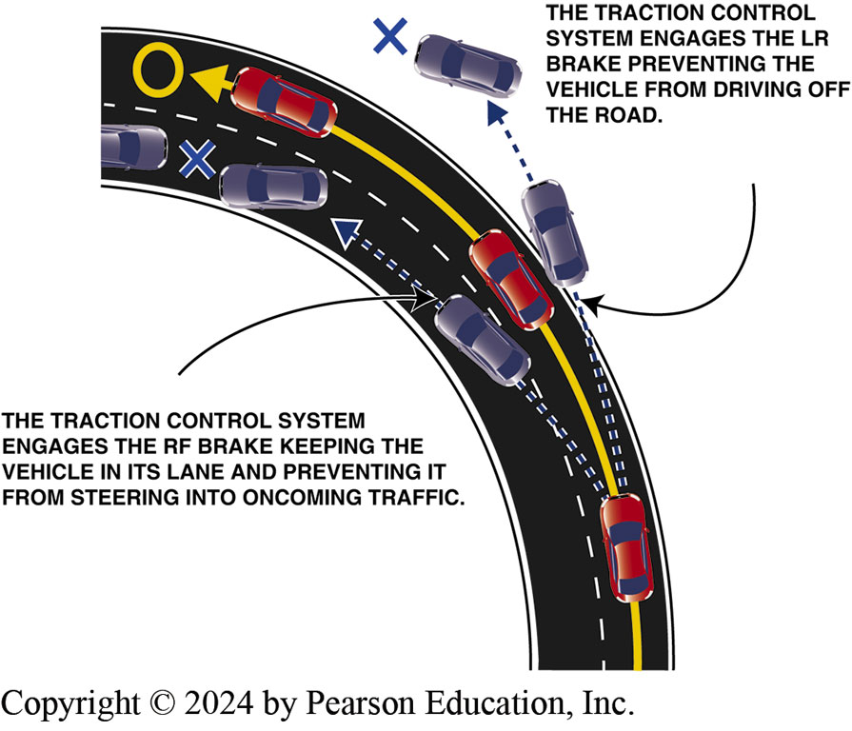
Figure 107.1 ESC
Electronic stability control (ESC) system applies individual wheel brakes to keep the vehicle under control of the driver

Slide 5
Federal Motor Vehicle Safety Standard (F M V S S) No. 26
Federal Motor Vehicle Safety Standard (F M V S S) No. 126 (June 26, 2008), Electronic Stability Control Systems, requires that all passenger cars, multipurpose passenger vehicles, trucks, and buses that have a gross vehicle weight rating (G V W R) of 10,000 pounds (4,536 kg) or less to be equipped with an electronic stability control system by September 1, 2011 (2012 model-year vehicles).

Slide 6
Sine With Dwell Test
Test used to determine if an electronic stability control system functions okay called sine with dwell (S W D) test.
A vehicle is driven at 50 mph (80 km/h) and driven on a curved course that looks like a sine wave or the letter “S” on its side.

Slide 7
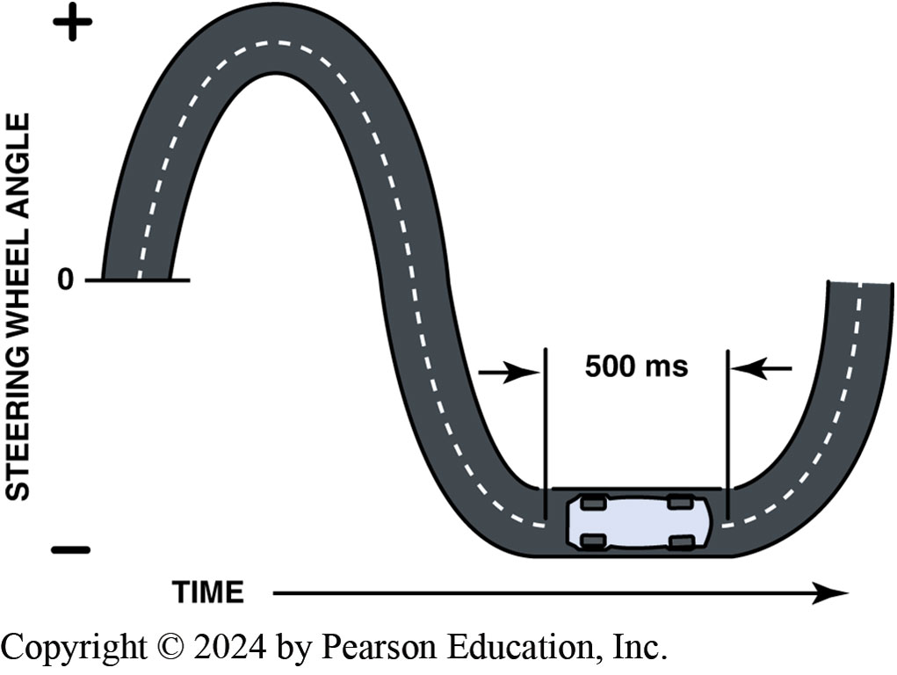
Figure 107.2 Sine With Dwell Test
The sine with dwell test is designed to test the electronic stability control (ESC) system to determine if the system can keep the vehicle under control
Notes:
Stability control systems are offered under the following names:
Acura: Vehicle Stability Assist (VSA)
Audi: Electronic Stabilization Program (ESP)
BMW: Dynamic Stability Control (DSC), including Dynamic Traction Control
Chrysler: Electronic Stability Program (ESP)
Dodge: Electronic Stability Program (ESP)
Ferrari: Controlled Stability (CST)
Ford: AdvanceTrac and Interactive Vehicle Dynamics (IVD)
General Motors: StabiliTrak (except Corvette— Active Handling)
Hyundai: Electronic Stability Program (ESP)
Honda: Electronic Stability Control (ESC), Vehicle Stability Assist (VSA), and Electronic Stability Program (ESP)
Infiniti: Vehicle Dynamic Control (VDC)
Jaguar: Dynamic Stability Control (DSC)
Jeep: Electronic Stability Program (ESP)
Kia: Electronic Stability Program (ESP)
Land Rover: Dynamic Stability Control (DSC)
Lexus: Vehicle Dynamics Integrated Management (VDIM) with Vehicle Stability Control (VSC) and Traction Control (TRAC) Systems
Lincoln: Advance Trak
Maserati: Maserati Stability Program (MSP)
Mazda: Dynamic Stability Control (DSC)
Mercedes: Electronic Stability Program (ESP)
Mercury: AdvanceTrak
Mini Cooper: Dynamic Stability Control (DSC)
Mitsubishi: Active Skid and Traction Control MULTIMODE
Nissan: Vehicle Dynamic Control (VDC)
Porsche: Porsche Stability Management (PSM)
Rover: Dynamic Stability Control (DSC)
Saab: Electronic Stability Program (ESP)
Saturn: StabiliTrak
Subaru: Vehicle Dynamics Control Systems (VDCS)
Suzuki: Electronic Stability Program (ESP)
Toyota: Vehicle Dynamics Integrated Management (VDIM) with Vehicle Stability Control (VSC)
Volvo: Dynamic Stability and Traction Control (DSTC)
VW: Electronic Stability Program (ESP)

Slide 8
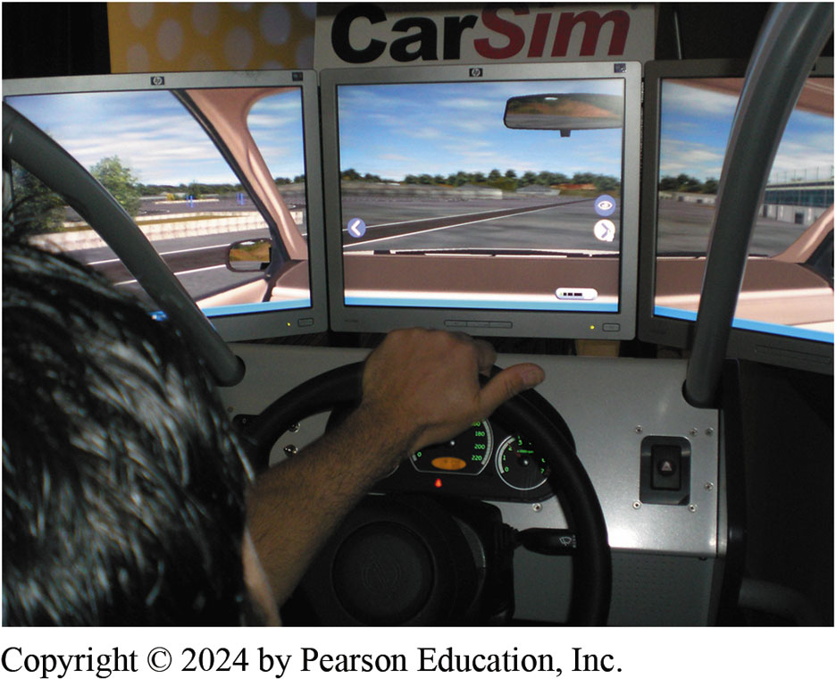
Figure 107.3 Simulator
Using a simulator is the most cost-effective way for vehicle and aftermarket suspension manufacturers to check that the vehicle is able to perform within the FMVSS No. 126 standard for vehicle stability

Slide 9
Frequently Asked Question: Can a Vehicle with a Modified Suspension Pass the Test?
? Frequently Asked Question
Can a Vehicle with a Modified Suspension Pass the Test? Yes, if the system is properly engineered. To be sure, check with the company offering a suspension test to verify that the vehicle will still be able to pass the sine with dwell (SWD) test. This ensures that any changes are within the range where the ESC system an control the vehicle during emergency maneuvers. ● Figure 107–3.

Slide 10
E S C Sensors (1 of 2)
Steering Wheel Position Sensor
Function of this sensor is to provide the driver’s intended direction with signals relating to steering wheel position, speed, and direction.
Vehicle Speed Sensor
A B S wheel speed sensors provide an analog or digital signal based on sensor design.

Slide 11
E S C Sensors (2 of 2)
Lateral Acceleration Sensor
Function of lateral acceleration sensor is to provide the suspension control module with feedback regarding vehicle cornering forces.
Yaw Rate Sensor
This information is used to determine how far the vehicle has deviated from driver’s intended direction.

Slide 12
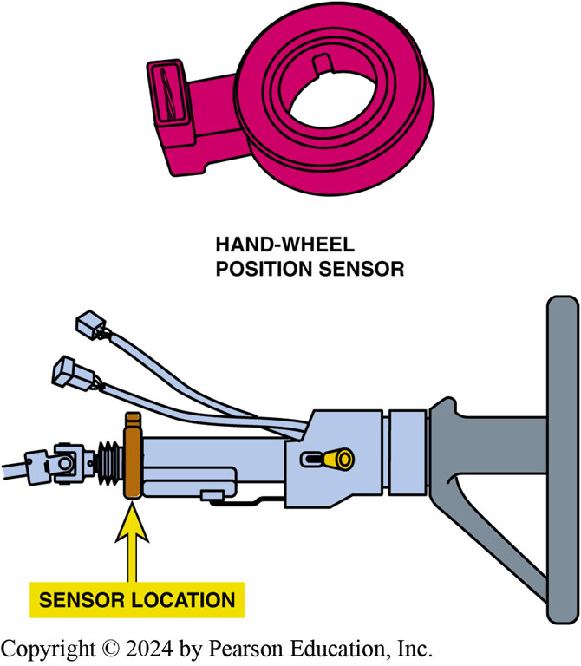
Figure 107.4 Wheel Position Sensor
The is usually located at the base of the steering column

Slide 13
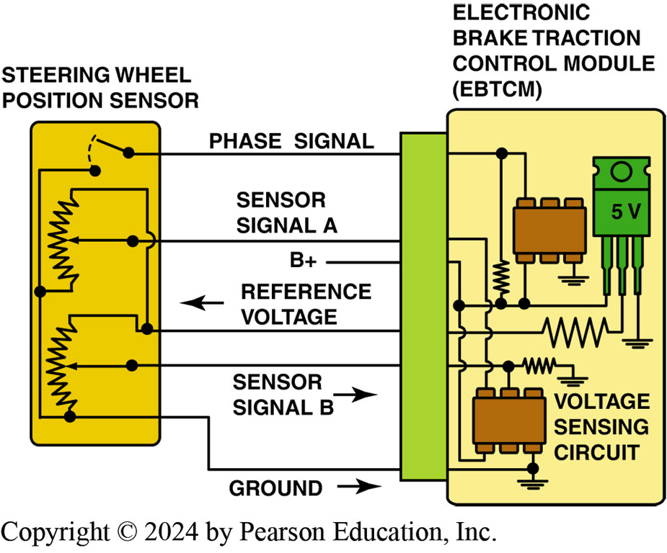
Figure 107.5 Sensor Schematic
Hand-wheel (steering wheel) position sensor schematic

Slide 14
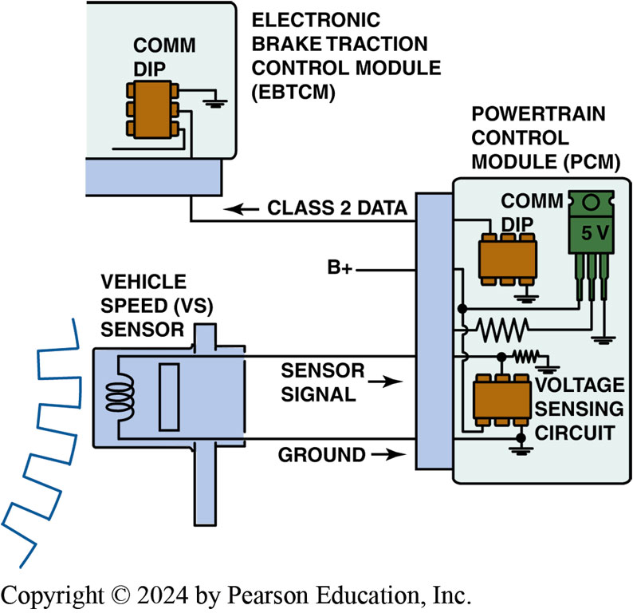
Figure 107.6 VS Sensor
The VS sensor information is transmitted to the EBCM by Class 2 serial data

Slide 15
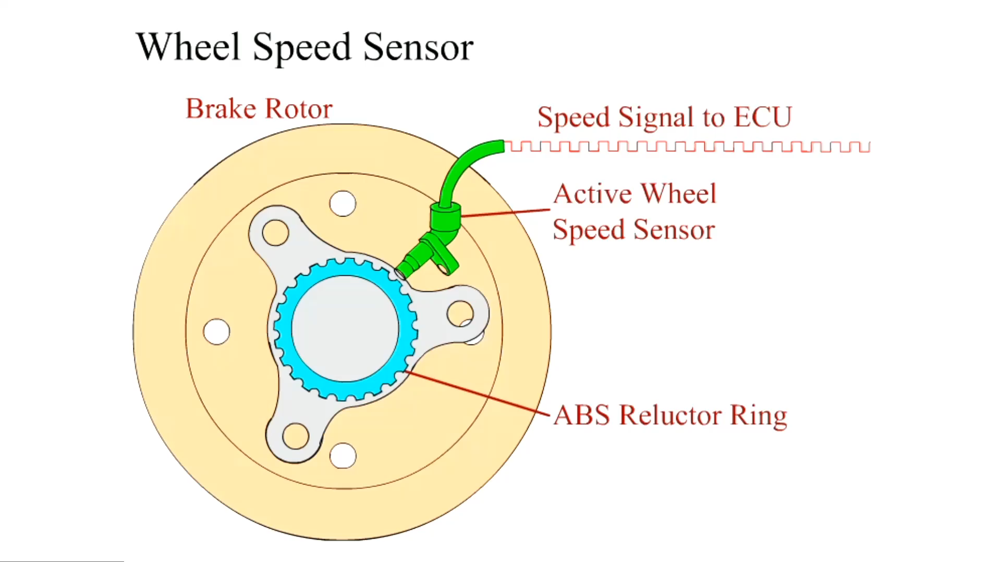
Animation: Wheel Speed Sensor (Animation will automatically start)

Slide 16
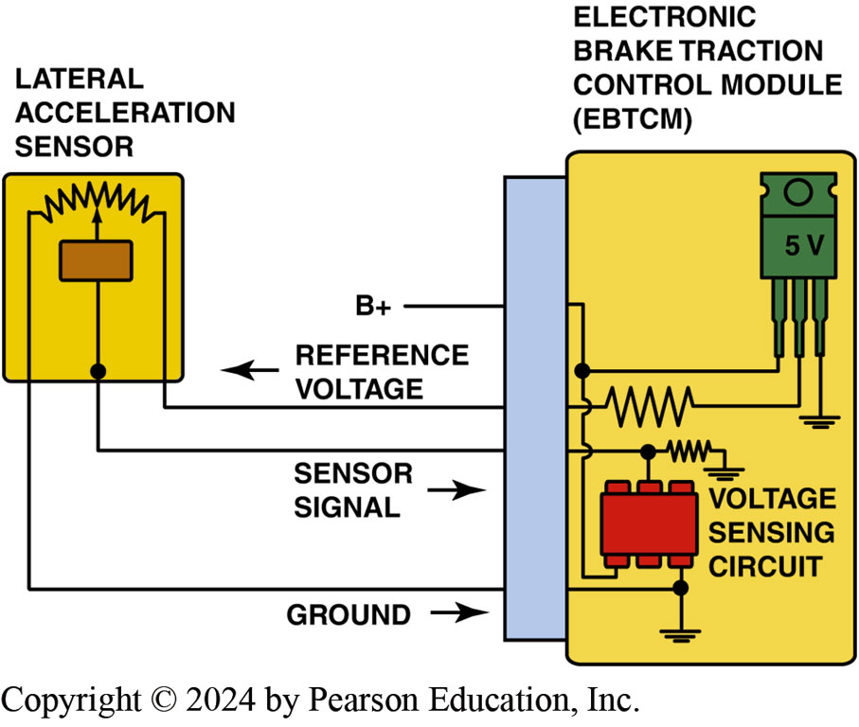
Figure 107.7 Lateral Acceleration
A schematic showing the lateral acceleration sensor and EBCM

Slide 17
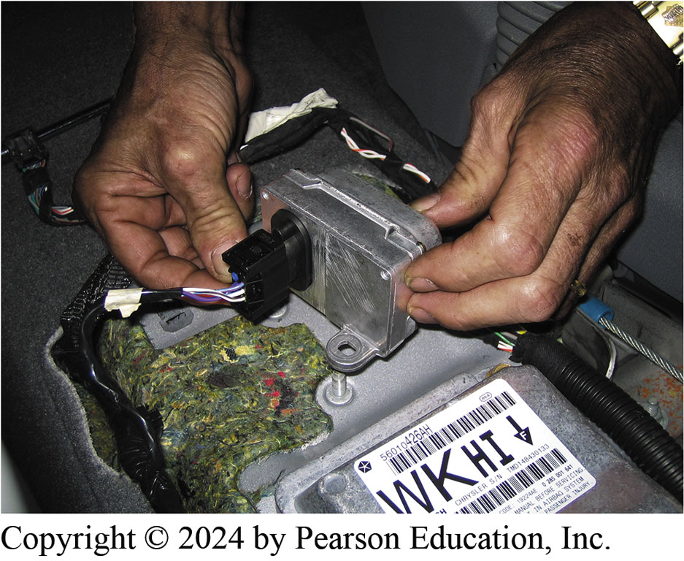
Figure 107.8 Acceleration Sensor
Lateral acceleration sensor is usually located under the center console and can be easily checked by unbolting it and turning it on its side while monitoring the sensor value using a scan tool. When it is on its side, the sensor value should read 1.0 G.
Notes:
TECH TIP: Quick and Easy Lateral Acceleration Sensor Test
Most factory scan tools will display the value of sensors, including the lateral acceleration sensor. However, the sensor value will read zero unless the vehicle is cornering. A quick and easy test of the sensor is to simply unbolt the sensor and rotate it 90 degrees with the key on engine off. FIGURE 107-8. Now the sensor is measuring the force of gravity and should display 1.0 G on the scan tool. If the sensor does not read close to 1.0 or reads zero all of the time, the sensor or the wiring is defective.

Slide 18
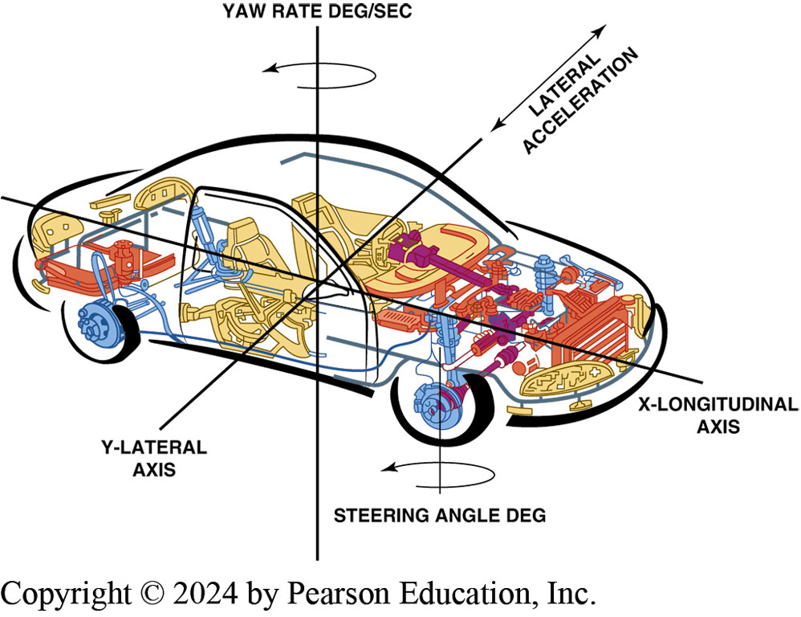
Figure 107.9 Yaw Rate Sensor
Yaw rate sensor showing the typical location and schematic
Notes:
The yaw rate sensor provides information to the suspension control module and the EBCM. This information is used to determine how far the vehicle has deviated from the driver’s intended direction.

Slide 19
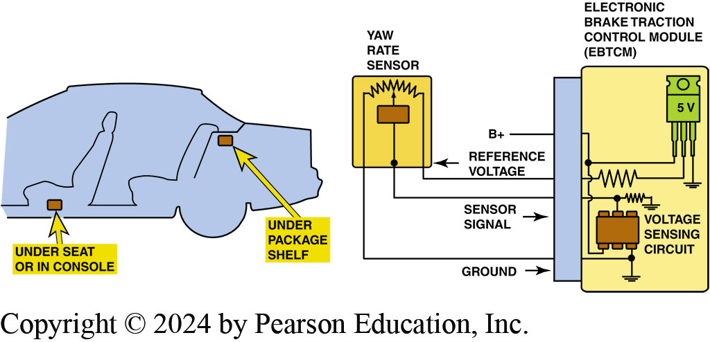
Figure 107.10 Yaw Rate Sensor
Yaw rate sensor showing the typical location and schematic.

Slide 20
Question 1: ?
What sensors are used in an electronic stability control system?

Slide 21
Answer 1
Vehicle speed sensor, steering wheel position sensor, lateral sensor, yaw rate sensor.

Slide 22
Traction Control (1 of 3)
Purpose and Function
Traction control allows A B S to control wheel spin during acceleration.
System Components
B C M, P C M or A B S Controller
Throttle position sensor
Wheel speed sensor
Engine speed
Transmission range switch

Slide 23
Traction Control (2 of 3)
Traction Control Operation
Retard ignition timing to reduce engine torque.
Decrease fuel injector pulse-width to reduce fuel delivery to the cylinder to reduce engine torque.
Reduce amount of intake air if the engine is equipped with an electronic throttle control (E T C).
Upshift automatic transmission/transaxle.
Apply individual wheel brakes to slow or stop the wheel from spinning.

Slide 24
Traction Control (3 of 3)
Traction Active Light
Helps alert driver that the wheels are losing traction.
Traction Deactivation Switch
A dash-mounted switch that allows the driver to deactivate the system when desired.

Slide 25
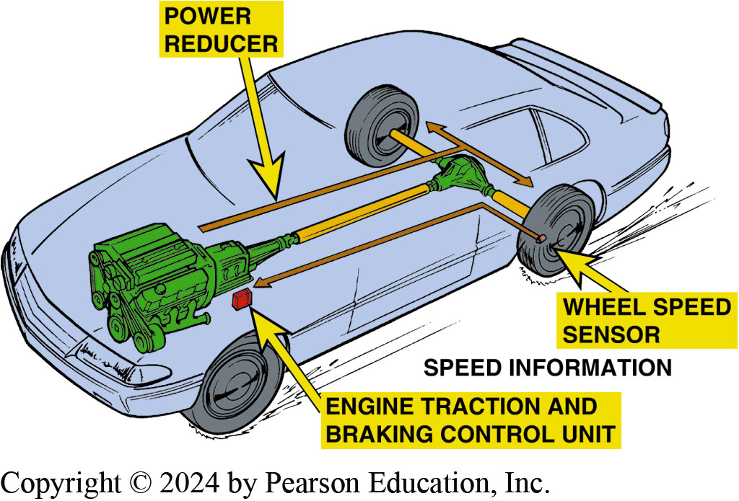
Figure 107.11 Traction Control
Typical traction control system that uses wheel speed sensor information and the engine controller (P C M) to apply the brakes at lower speeds and also reduce engine power applied to drive wheels.

Slide 26
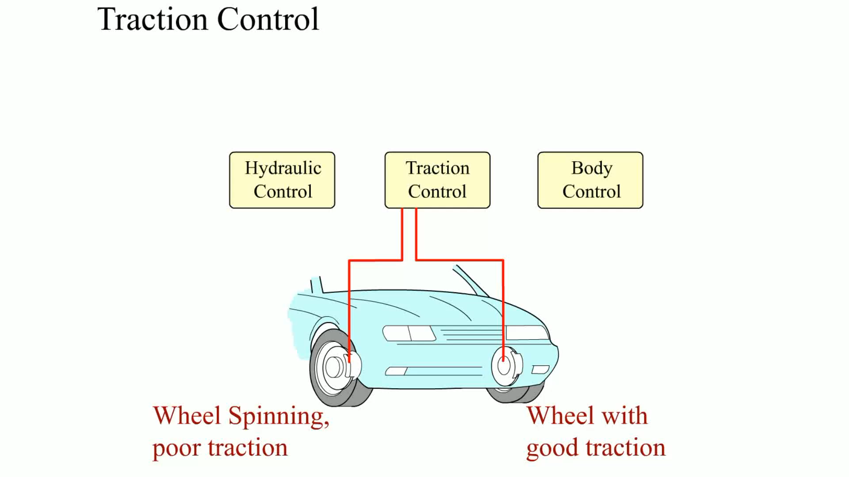
Animation: Traction Control (Animation will automatically start)

Slide 27
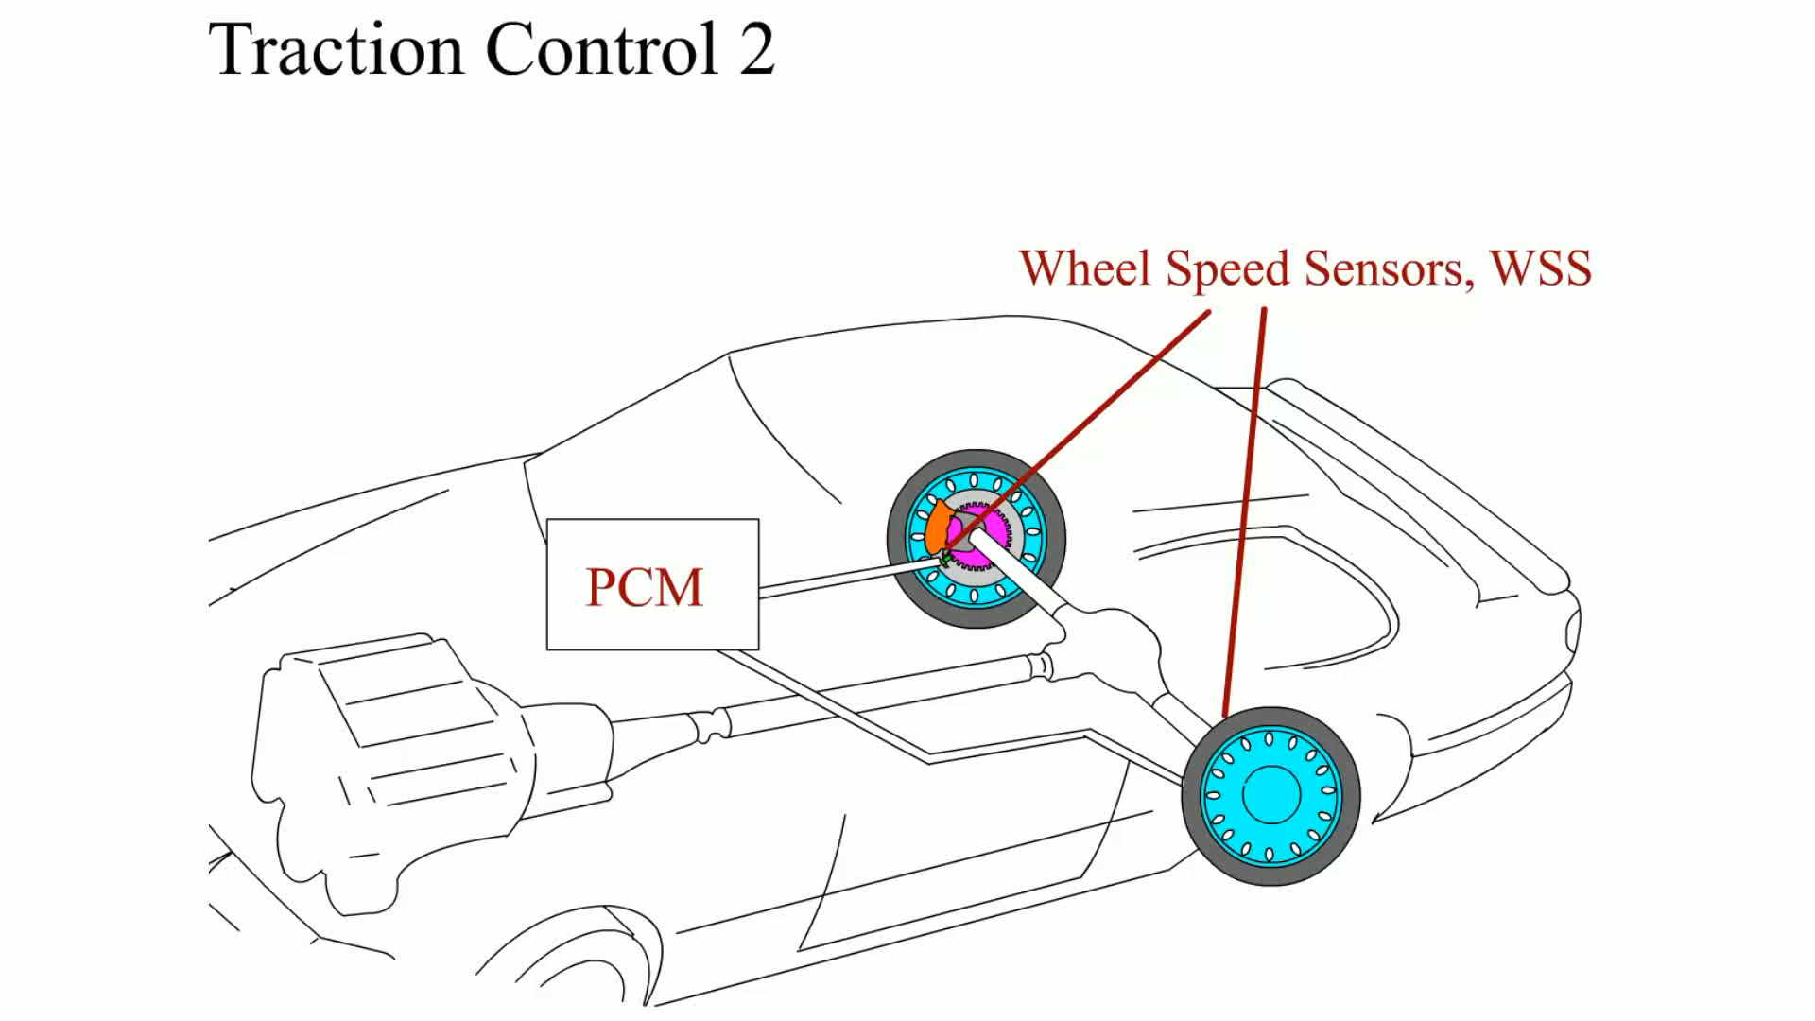
Animation: Traction Control 2 (Animation will automatically start)

Slide 28
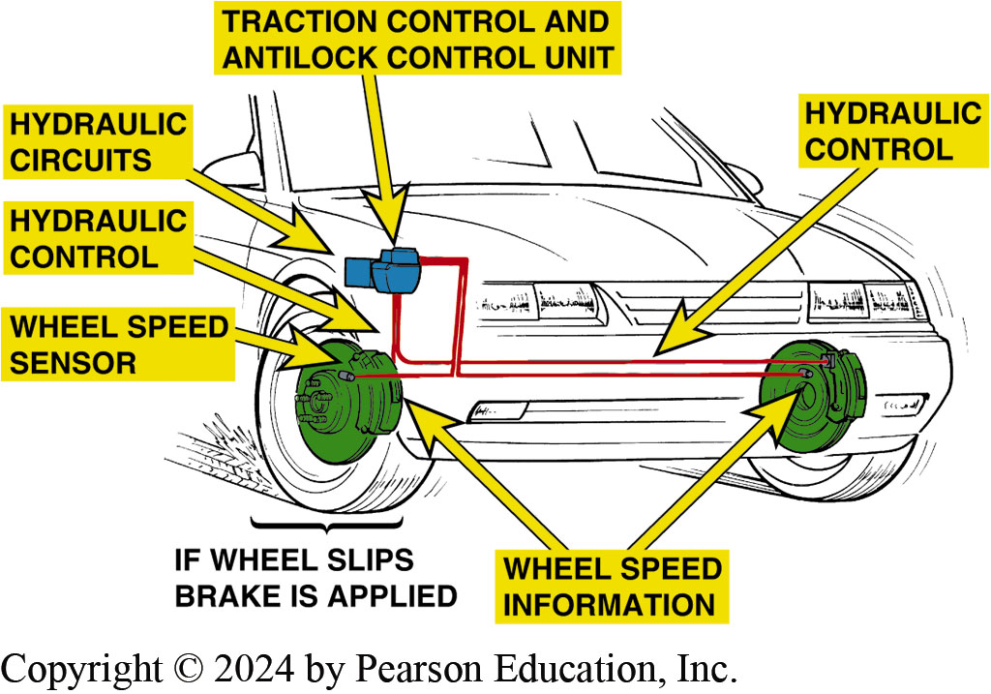
Figure 107.12 Wheel Speed Sensor
Wheel speed sensor information is used to monitor if a drive wheel is starting to spin

Slide 29
Frequently Asked Question: Does Traction Control Engage Additional Drive Wheels?
? Frequently Asked Question
Does Traction Control Engage Additional Drive Wheels? When term traction control is used, many people think of 4WD or AWD vehicles and power trains. Instead of sending engine torque to other drive wheels, traction control system prevents the drive wheel(s) from slipping during acceleration. A slipping tire has less traction than a non slipping tire—therefore, if the tire can be kept from slipping (spinning), more traction will be available to propel the vehicle. Traction control works with the engine computer to reduce torque delivery from the engine, as well as the controller to apply the brakes to the spinning wheel if necessary to regain traction.

Slide 30
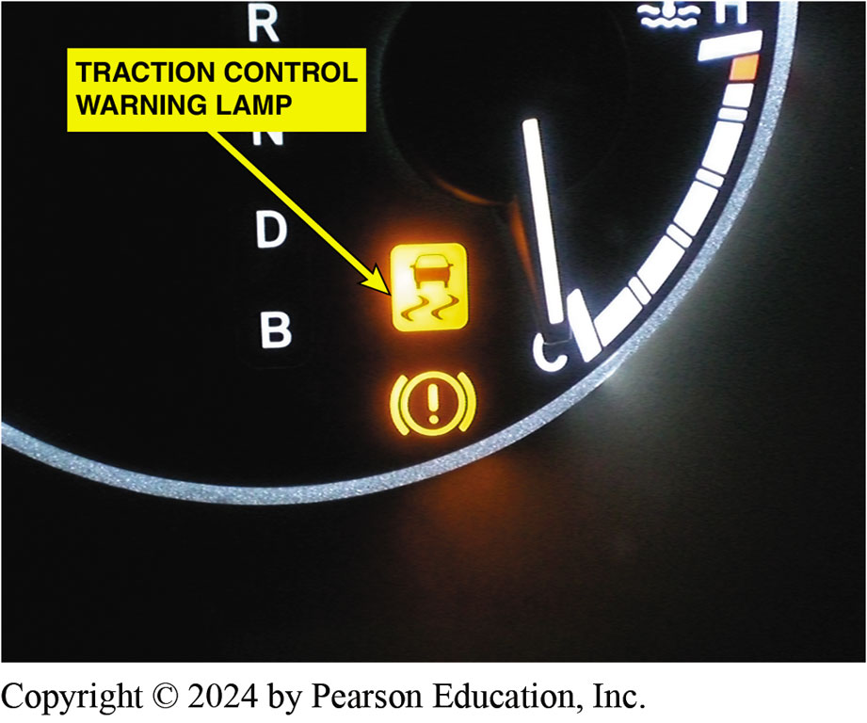
Figure 107.13 Traction Control Light
A traction control or low traction light on the dash is confusing to many drivers. When the lamp is on or flashing, it indicates that a low traction condition has been determined and the traction control system is working to restore traction

Slide 31
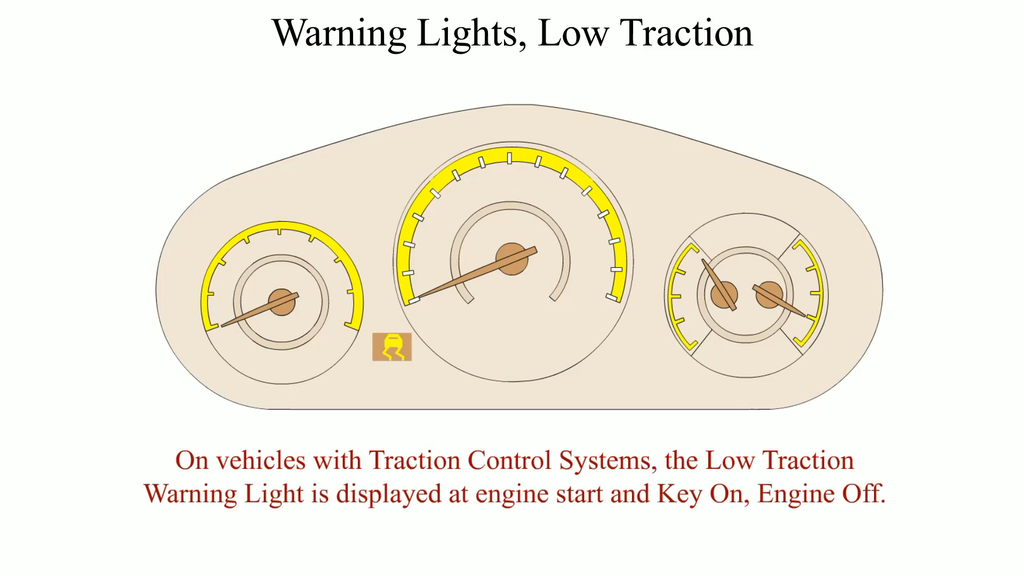
Animation: Warning Lights, Low Traction (Animation will automatically start)

Slide 32
E S C/T C Diagnosis
Verify the customer concern (complaint).
Perform a thorough visual inspection.
Check service information.
Follow troubleshooting procedure.
Repair fault.
Road test vehicle and verify the repair.

Slide 33
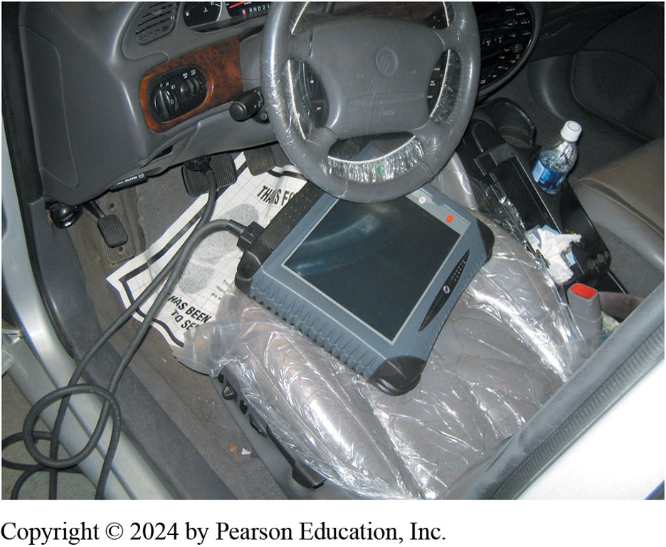
Figure 107.14 Factory Scan Tool
The use of a factory scan tool is often needed to diagnose the ESC system

Slide 34
Question 2: ?
What is the purpose of a traction control system?

Slide 35
Answer 2
Control wheel spin on acceleration.

Slide 36
Brakes Videos and Animations
Videos Link: (A5) Brakes Videos
Animations Link: (A5) Brakes Animations

Slide 37

Copyright
This work is protected by United States copyright laws and is provided solely for the use of instructors in teaching their courses and assessing student learning. Dissemination or sale of any part of this work (including on the World Wide Web) will destroy the integrity of the work and is not permitted. The work and materials from it should never be made available to students except by instructors using the accompanying text in their classes. All recipients of this work are expected to abide by these restrictions and to honor the intended pedagogical purposes and the needs of other instructors who rely on these materials.

