Slide 1

Automotive Technology: Principles, Diagnosis, and Service
Seventh Edition
Chapter 106
ABS Diagnosis and Service
Copyright © 2023 Pearson Education, Inc. All Rights Reserved
Notes:
INSTRUCTOR NOTE: This presentation includes text explanation notes, you can use to teach the course. When in SLIDE SHOW mode, you RIGHT CLICK and select SHOW PRESENTER VIEW, to use the notes.

Slide 2
Learning Objectives (1 of 2)
107.1 Discuss parking brake standards, components, warning lamp, and automatic parking brake release.
107.2 Explain parking brake linkages.
107.3 Describe drum parking brakes.
107.4 Describe caliper-actuated disc parking brakes.

Slide 3
Learning Objectives
106.1 Explain the ABS diagnostic procedure.
106.2 Explain how to diagnose the OBD-II ABS system.
106.3 Explain how to diagnose wheel speed sensors.
106.4 List the steps in the hydraulic ABS service procedure.

Slide 4
A B S Fault Diagnosis (1 of 2)
A B S Diagnostic Steps
  Verify the customer concern.
  Perform a visual inspection.
  Check for stored diagnostic trouble codes (D T C s).
  Check for technical service bulletins (T S B s).
  Determine the root cause.
  Complete the repair.
  Verify the repair.

Slide 5
A B S Fault Diagnosis (2 of 2)
Brake Warning Lamp Operation
  Red brake warning lamp
    Low brake fluid level
    Low pressure in half of the hydraulic system
    The parking brake is applied
    May illuminate due to an A B S failure
  Amber A B S warning lamp
    If the amber warning lamp stays on after the vehicle is started, this means that a fault in the A B S system has been detected.

Slide 6
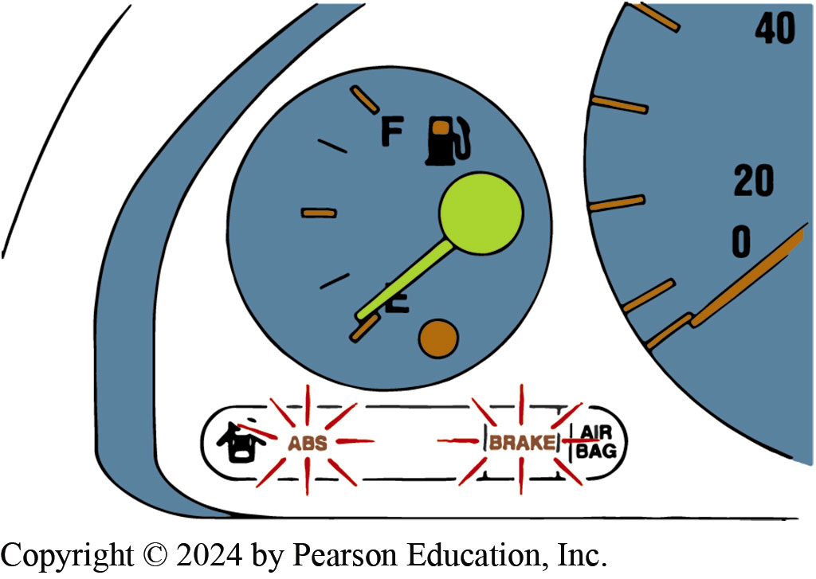
Figure 106.1 ABS brake Lamps
On Most Vehicles Equipped with ABS, the ABS and the BRAKE Warning Lamp Should Come on As a Bulb Check When the Ignition is First Switched on

Slide 7
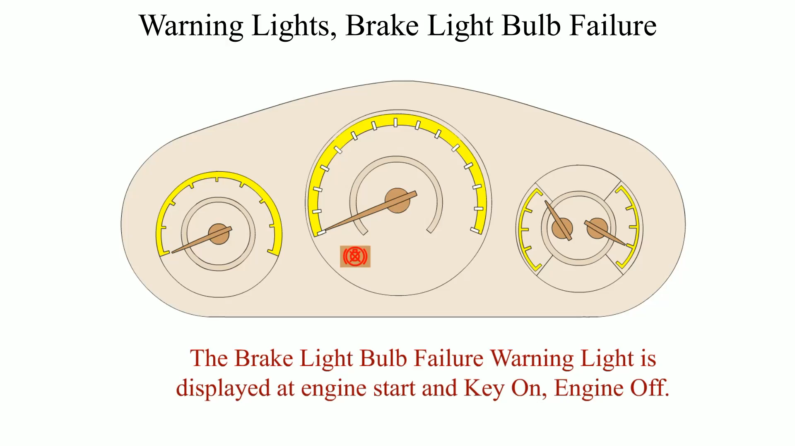
Animation: Warning Lights, Brake Light Bulb Failure
(Animation will automatically start)

Slide 8
Chart 106.1 ABS Diagnosis
ITEM TO CHECK | WHAT TO LOOK FOR
Brake fluid level. | Check the condition and level in the reservoir
Brake fluid leaks | Check for rusty and leaking brake lines and cracks in flexible lines or other physical damage
Fuses and fusible links | Check all ABS-related fuses and electrical power distribution
Wiring and connections | Check all wiring, especially wheel speed sensor leads, for damage.
Wheel speed sensors | Check that the sensor ring teeth are not damaged. Clean debris from the sensor if possible. ● SEE FIGURE 106–3.
NOTE: Most wheel speed sensors are magnetic and therefore can attract and hold metallic particles. Be sure to remove any metallic debris from around the magnetic wheel speed sensor.
Parking brake | Check that the parking brake is correctly adjusted and fully released.
Wheel bearings | All wheel bearings must be free of defects and adjusted properly.
Wheels and tires | Check for correct size, proper
Items that should be checked when diagnosing a concern about the antilock brake system (ABS).

Slide 9
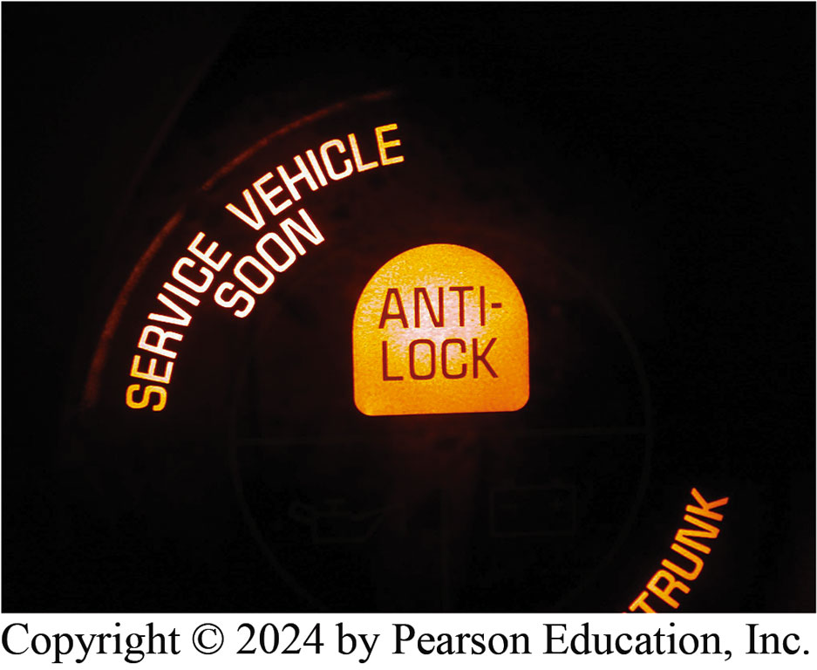
Figure 106.2 Amber ABS Light

Slide 10
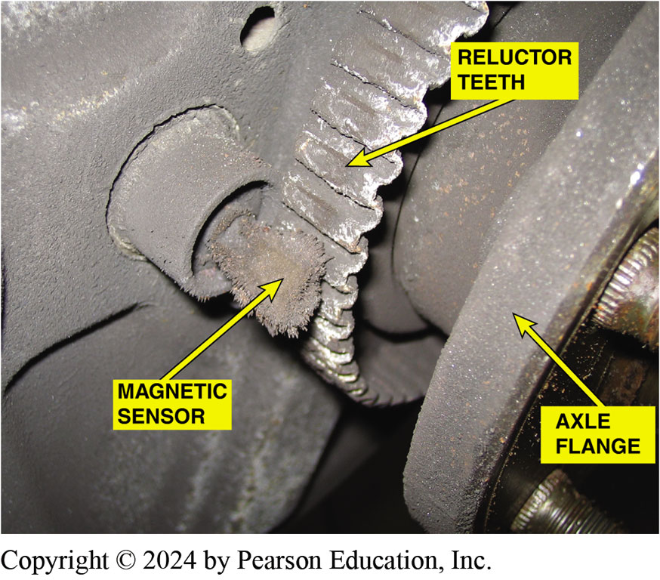
Figure 106.3 Fuzz on Sensor
A visual inspection of the wheel speed sensor on this older vehicle showed metal “fuzz” had been attracted to the magnetic sensor

Slide 11
Question 1: ?
What does an illuminated red brake warning lamp indicate?

Slide 12
Frequently Asked Question: What’s That Noise and Vibration?
? Frequently Asked Question
What’s That Noise and Vibration? Many have been disturbed to hear and feel a groaning noise. It is usually heard and felt through the vehicle after first being started and driven. Because it occurs when first being driven in forward or reverse, many technicians have blamed the transmission or related driveline components. This is commonly heard on many ABS vehicles as part of a system check. As soon as the ABS controller senses speed from the wheel speed sensors after an ignition cycles on, the controller will run the pump either every time or whenever accumulator pressure is below a certain level. This can occur while the vehicle is being backed out of a driveway or being driven forward because wheel sensors can only detect speed—not direction. Before serious and major repairs are attempted to “cure” a noise, make sure that it is not the normal ABS self-test activation sequence of events.

Slide 13
Answer 1
Possible low brake fluid, loss of brake pressure, the parking brake applied, or an A B S failure.

Slide 14
Retrieving A B S Codes Prior To 1996
Retrieval Methods
  Depending on exact make, model, and year, procedure can include use of one or more of following:
  Scan Tool
  Special Tester
  Fused Jumper Wire
  Test Light
Flash Codes
  A B S light would blink code when specific pins were jumped together.
  Some vehicles would not store codes, a breakout box was the method of diagnosis.

Slide 15

Figure 106.4 Factory Level Scan Tool
A factory or factory-level scan tool like the one shown here is the best to use when diagnosing an ABS problem.
Notes:
CASE STUDY: The Mystery ABS Amber Warning Light
The owner complained to a service technician that the ABS warning light would come on but only while driving down from a parking garage. When the driver turned off the ignition and restarted the engine, the ABS amber light was not on and did not come on again until the vehicle was again driven down the spiral parking garage ramp. The service technician used a scan tool and found that no DTCs had been stored.
NOTE: Some ABS systems will not retain a DTC unless the problem is currently present and the ABS amber warning light is on.
All of the brakes were in excellent condition, but the brake fluid level was down a little. After topping off the master cylinder with clean DOT 3 brake fluid, the vehicle was returned to the customer with the following information:
The ABS amber warning light may have been triggered by the brake fluid level switch. While driving down the steep parking garage ramp, the brake fluid moved away from the fluid level sensor.
NOTE: While the brake fluid level sensor normally would turn on the red brake warning light, in some systems it turns on the amber ABS light if the brake fluid falls below a certain level in the ABS reservoir. The difference in wheel speed between the out- board and the inboard wheels could have triggered a fault code for a wheel speed sensor during the drive down the spiral parking garage ramp.
Summary:
Complaint—Driver stated that the amber ABS warning lamp would come on but only when descending in a parking garage.
Cause—Possible low brake fluid level or normal operation due to change in wheel speed while turning sharply.
Correction—Added a slight amount of brake fluid to return the level to the “MAX” level and returned to owner.

Slide 16
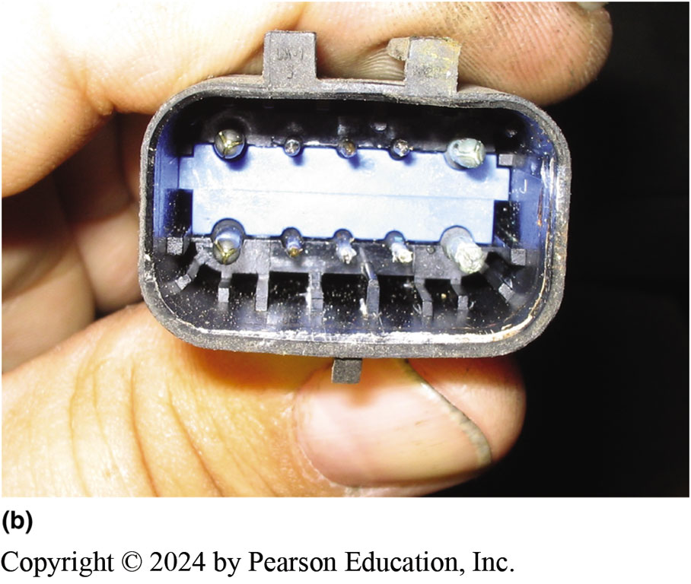
Figure 106.5 Corroded Connector
(a) This corroded electrical connector to the ABS hydraulic control module helped explain why there were many stored diagnostic trouble codes (DTCs). (b) The male terminals also showed signs of corrosion inside this connector.
Notes:
TECH TIP: Check for Flood Damage
There are often strange electrical problems that can occur including false DTCs or intermittent operation of electrical sensors, ABS, accessories, or gauges. Sometimes the root of these problems is due to rust and corrosion after a vehicle is involved in a flood. Here are some telltale signs that a vehicle may have due to flooding:
Mud, silt, or caked dust under the dash and inside the doors
Corroded electrical connectors at the computer, fuse box, or ABS controller (computer)
Visible waterline in the doors or behind panels
Rust in abnormal places such as seat springs or brackets behind the dash
Moisture in lenses
Musty smell and/or strong air freshener smell
Powdery corrosion on aluminum parts such as intake manifold and inside the throttle bore
Rust or moisture inside electrical switches or relays
Areas that are normally dusty, such as an ashtray or glove box, are very clean
TECH TIP: Check Power and Ground First
Before replacing an expensive EBCM, make sure to verify power and ground circuits at the EBCM
connector. Also check power and ground at the other end of the harness, such as at the fuse box and fuses and the bolted ground connection on the vehicle chassis. SEE FIGURE 106-5

Slide 17
A B S Diagnosis, O B D-II Equipped Vehicles (1 of 2)
Scan Tool Diagnosis
  Most vehicles built since 1996 use the O B D-II diagnostic connector to transmit A B S diagnostic trouble code information to a scan tool.
  Three basic scan tool groups:
    Factory scan tools
    Aftermarket scan tools
    Code readers
O D B-II Connector
  The location is under the dash on the driver’s side usually located within 12 inches (30cm) of the center of the vehicle.
Notes:
CASE STUDY The Nervous Honda Civic
A customer complained that sometimes during normal braking, the ABS would be activated (brake pedal pulsated) just before coming to a stop. However, the ABS light would not come on. The service technician was able to duplicate the condition and there were no DTCs stored. Using a scan tool to monitor the wheel speed sensors, the technician discovered that the
left front wheel speed was slightly different than the others. A thorough visual inspection revealed that the tone wheel (reluctor ring) was cracked. This crack created a different wheel speed signal to the ABS controller than the other wheels and the controller activated the ABS as it would normally—that was why there were no DTCs. Other things that could have caused this problem, which is often called “false modulation,” include a bent wheel, mismatched tire sizes, or metal debris around the sensor.
Summary:
Complaint—Driver complained that the ABS caused the brake pedal to pulsated but only when the vehicle was slowing to a stop.
Cause—A cracked tone (reluctor) ring was discovered on the right front.
Correction—The customer authorized the replacement of a new wheel bearing assembly which included the tone ring and the problem was corrected.

Slide 18
A B S Diagnosis, O B D-II Equipped Vehicles (2 of 2)
Control Module Internal Performance Fault
  Typically, if an E B C M reports an internal performance fault, the E B C M must be replaced.
Communications Fault
  This type of fault likely does not indicate that there is a problem within the A B S, but rather sets as a result of another module failing to communicate with the E B C M.
Component-Related Fault
  Identifies an A B S component that is not functioning properly.

Slide 19
Chart 106-2 C Codes
DIAGNOSTIC |  |  | DIAGNOSTIC TROUBLE
CODE (DTC) | DESCRIPTION |  | CODE (DTC) | DESCRIPTION
C0000 | Vehicle Speed Information Circuit |  | C0085 | Left Rear ABS Solenoid #2 Circuit
 | Malfunction |  |  | Malfunction
C0035 | Left Front Wheel Speed Circuit |  | C0110 | Pump Motor Circuit Malfunction
 | Malfunction
 |  |  | C0121 | Valve Relay Circuit Malfunction
C0040 | Right Front Wheel Speed Circuit |  | C0128 | Low Brake Fluid Circuit Low
 | Malfunction
 |  |  | C0221 | Right Front Wheel Speed Sensor Circuit Open
C0041 | Right Front Wheel Speed Sensor Circuit Range/Performance
 |  |  | C0222 | Right Front Wheel Speed Signal Missing
 | (EBCM)
C0045 | Left Rear Wheel Speed Circuit
 |  |  | C0223 | Right Front Wheel Speed Signal Erratic
 | Malfunction
C0046 | Left Rear Wheel Speed Sensor
 |  |  | C0225 | Left Front Wheel Speed Sensor Circuit Open
 | Circuit Range/Performance
 | (EBCM)
 |  |  | C0226 | Left Front Wheel Speed Signal Missing
C0050 | Right Rear Wheel Speed Circuit Malfunction
 |  |  | C0235 | Rear Wheel Speed Signal Circuit Open
C0051 | LF Wheel Speed Sensor Circuit
 | Range/Performance (EBCM)
 |  |  | C0236 | Rear Wheel Speed Signal Circuit Missing
C0060 | Left Front ABS Solenoid #1 Circuit
 | Malfunction
 |  |  | C0238 | Wheel Speed Mismatch
C0065 | Left Front ABS Solenoid #2 Circuit
 |  |  | C0241 | EBCM Control Valve Circuit
 | Malfunction
C0070 | Right Front ABS Solenoid #1 |  | C0245 | Wheel Speed Sensor Frequency Error
 | Circuit Malfunction
C0075 | Right Front ABS Solenoid #2 |  | C0267 | Pump Motor Circuit Open/Shorted
 | Circuit Malfunction |  | C0271, C0272, | EBCM Malfunction
 |  |  | C0273, C0284
C0080 | Left Rear ABS Solenoid #1 Circuit
 |  |  | C0281 | Brake Switch Circuit
 | Malfunction
Notes:
Selected ABS-related “C” codes

Slide 20
Wheel Speed Sensor Diagnosis (1 of 2)
Common Causes of Faults
  These components may suffer from physical damage, buildup of metallic debris on the sensor tip, corrosion, poor electrical connections, and damaged wiring.
Passive Wheel Speed Sensor Diagnosis
  Resistance measurement
  Checking for shorts-to-ground
  A C voltage check
  Scope Testing
  Scan tool testing
Notes:
TECH TIP: Space Saver Spare Tire May Trigger Wheel Speed Fault Code
If a vehicle has been using a small space saver-type spare tire, then the difference in outside diameter may trigger a wheel speed sensor diagnostic trouble code (DTC) and turn on the amber ABS warning lamp. Try to find out from the customer if they had driven on a spare tire before replacing a wheel speed sensor based on a stored DTC.

Slide 21
Wheel Speed Sensor Diagnosis (2 of 2)
Active Wheel Speed Sensor Diagnosis
  These sensors are most easily checked using a scan tool.
  Check that battery voltage is available at the sensor with the key on, engine off (K O E O).
  Check the low reference (signal ground) circuit.
  Measure the signal voltage provided by the E B C M along the wheel speed sensor signal circuit K O E O.

Slide 22
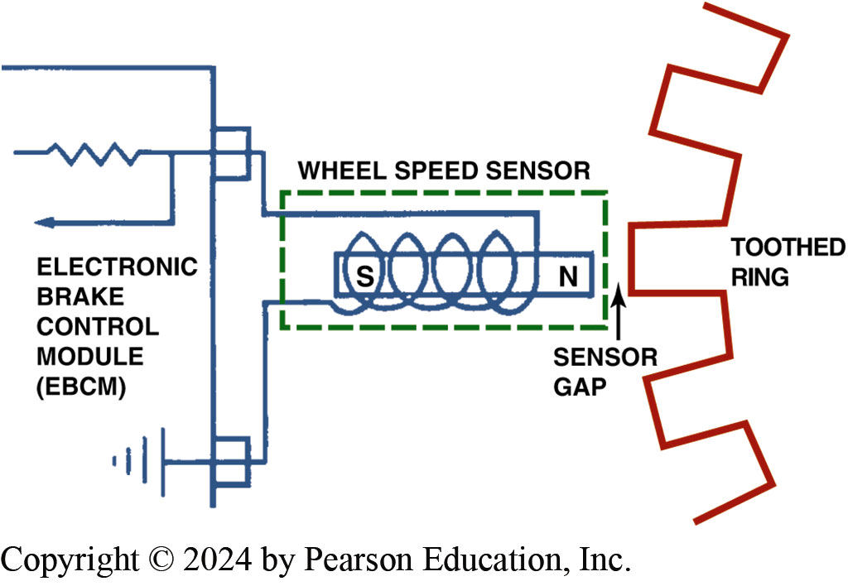
Figure 106.6 Wheel Sensor
Typical Wheel Speed Sensor. When a Tooth on the Sensor Ring is Close to the Sensor, the Strength of the Magnetic Field is Stronger Because the Metal of the Tooth Conducts Magnetic Lines of Force Better than Air

Slide 23
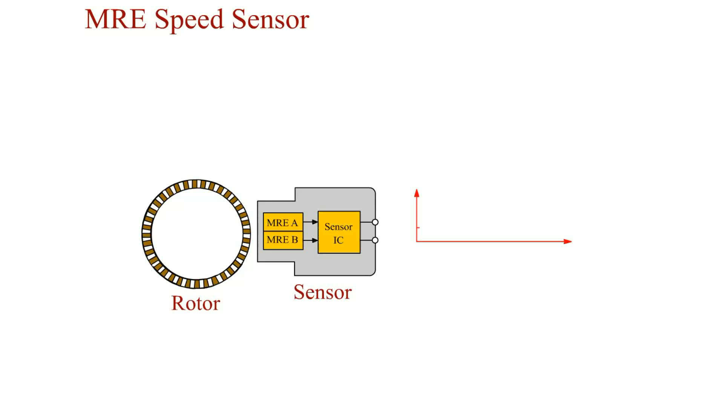
Animation: MRE Speed Sensor
(Animation will automatically start)

Slide 24
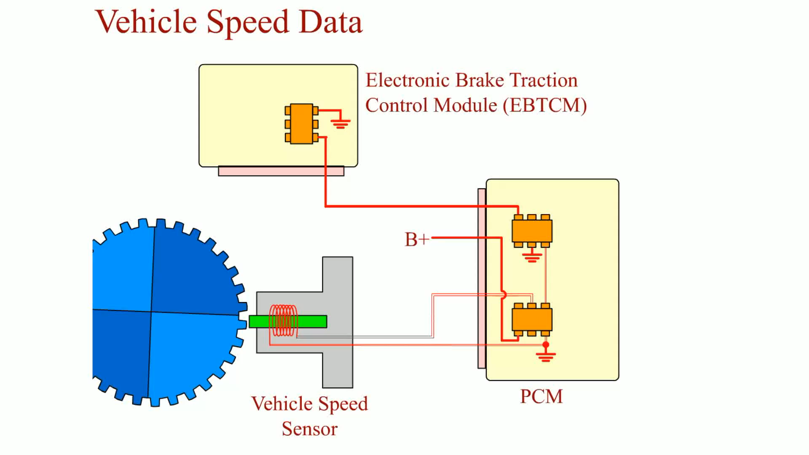
Animation: Vehicle Speed Data
(Animation will automatically start)

Slide 25
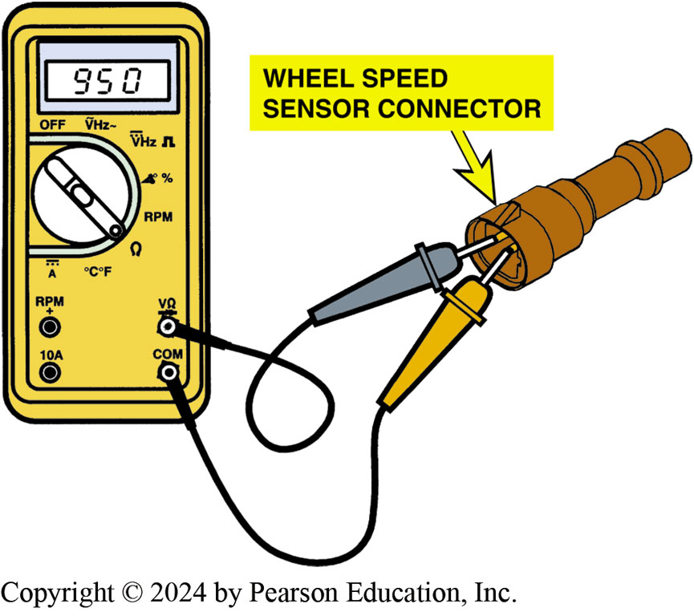
Figure 106.7 WSS Resistance
Measuring the Resistance of a Wheel Speed Sensor
Notes:
TECH TIP: Perform a “Wiggle Test”
Whenever testing a wheel speed sensor, it is a good idea to move or wiggle the sensor wiring and connector when taking a resistance or voltage measurement in case of a broken wire or corroded connector. If the reading on the meter changes when the wiring is being moved, then this confirms that there is a possible problem with the wiring or the connections so further diagnosis will be needed.

Slide 26
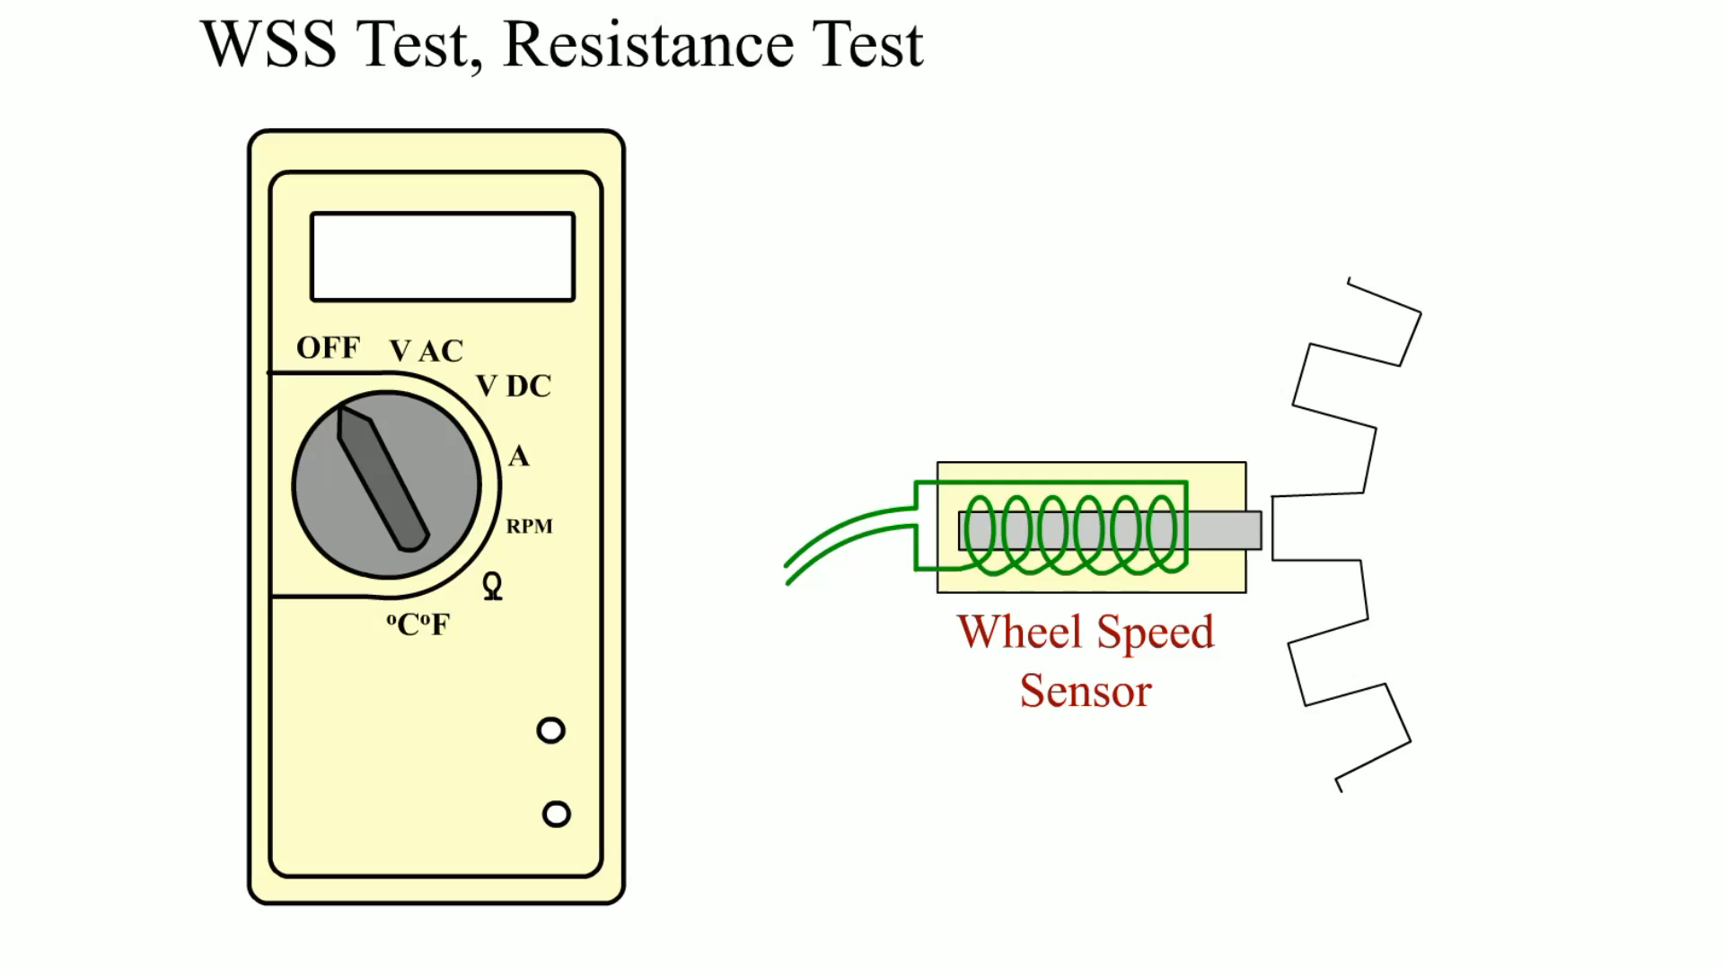
Animation: WSS Test, Resistance Test
(Animation will automatically start)

Slide 27
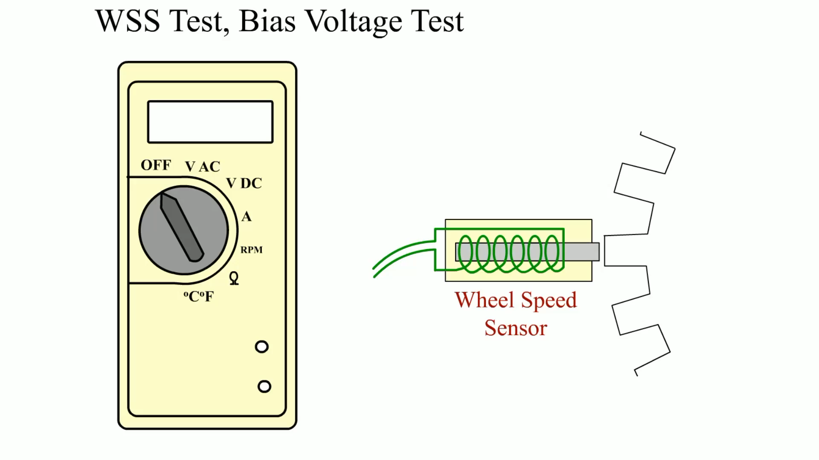
Animation: WSS Test, Bias Voltage Test
(Animation will automatically start)

Slide 28

Animation: Wheel Speed Sensor Test
(Animation will automatically start)

Slide 29
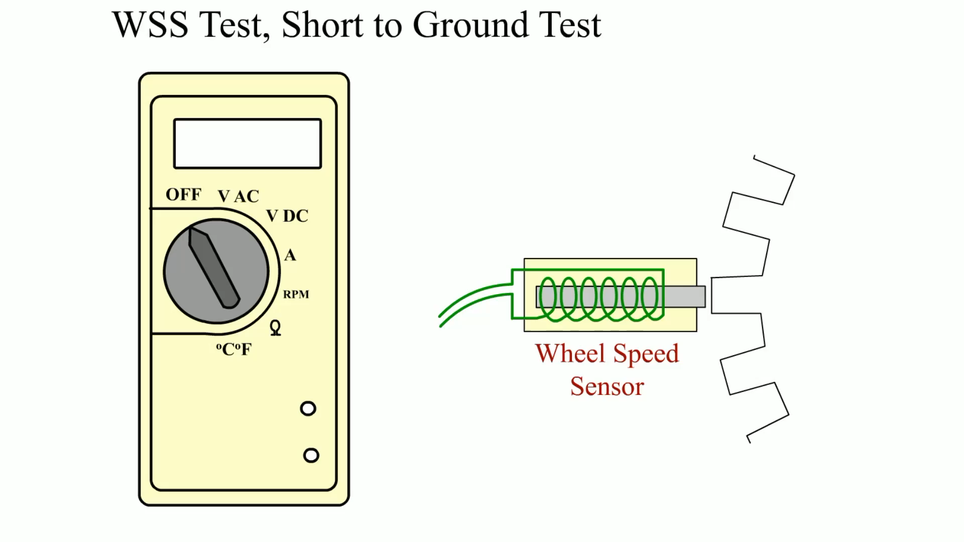
Animation: WSS Test, Short to Ground Test
(Animation will automatically start)

Slide 30
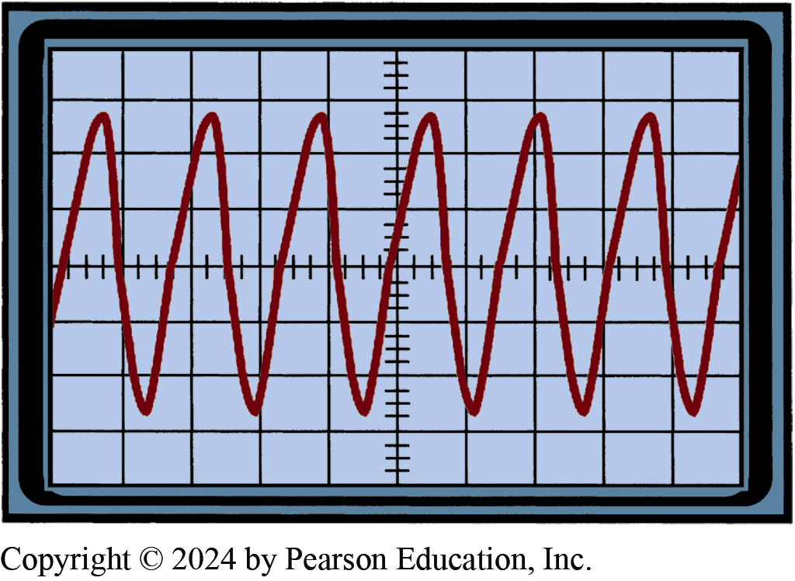
Figure 106.8 WSS Scope Reading
A Scope Can be Used to Check for Proper Operation of a Wheel Speed Sensor

Slide 31
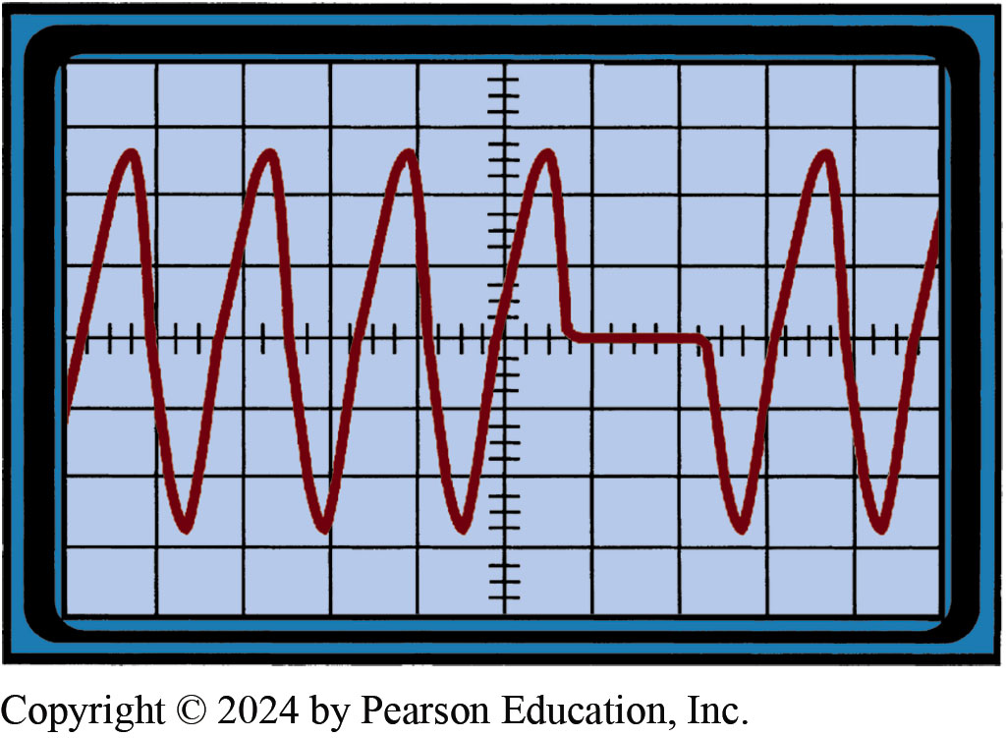
Figure 106.9 Broken Tooth Waveform
A Broken Tooth on a Wheel Speed Sensor Tone Ring Shows on the Scope Trace as a Missing Wave
Notes:
TECH TIP: Quick and Easy Wheel Speed Sensor Diagnosis
A fault in a wheel speed sensor (WSS) is a common ABS problem. A quick and easy test that works on most Bosch ABS (and perhaps others) involves the following steps:
STEP 1 Hoist the vehicle safely.
STEP 2 Key on, engine off (KOEO).
STEP 3 Spin a tire by hand as fast as possible.
STEP 4 The ABS amber warning light should come on, indicating that a speed was detected but not by all the wheel speed sensors.
STEP 5 Turn the ignition off to reset the ABS warning light.
STEP 6 Repeat the test on each of the remaining wheels.
If any wheel fails to turn on the ABS light, carefully inspect the wheel speed sensor for proper resistance and the tone ring and wiring. If the ABS light is on all the time and does not reset when the ignition is turned off, the problem is not caused by a wheel speed sensor.

Slide 32
Frequently Asked Question: Why Does My Scan Tool Show Speed When Stopped?
? Frequently Asked Question
Why Does My Scan Tool Show Speed When Stopped? Some vehicles, especially older GM vehicles (Chevrolet, Buick, Pontiac, Cadillac, and GMC), will show 2 or 3 MPH on the scan tool with the vehicle in the shop and not moving. This is perfectly normal and there is no fault so no service or repair is needed to be performed. The reading seems to be a default reading because many passive wheel speed sensors are not capable of supplying a usable wheel speed until over 3 MPH.

Slide 33
Hydraulic A B S Service
Check Service Information
  Check the service information for the exact vehicle being serviced.
Bleeding the Electronic-Hydraulic Assembly
  Some E-H units can be bled through the use of a scan tool where the valves are pulsed in sequence by the electronic brake controller (computer).
  Some units are equipped with bleeder valves while others must be bled by loosening the brake lines.

Slide 34
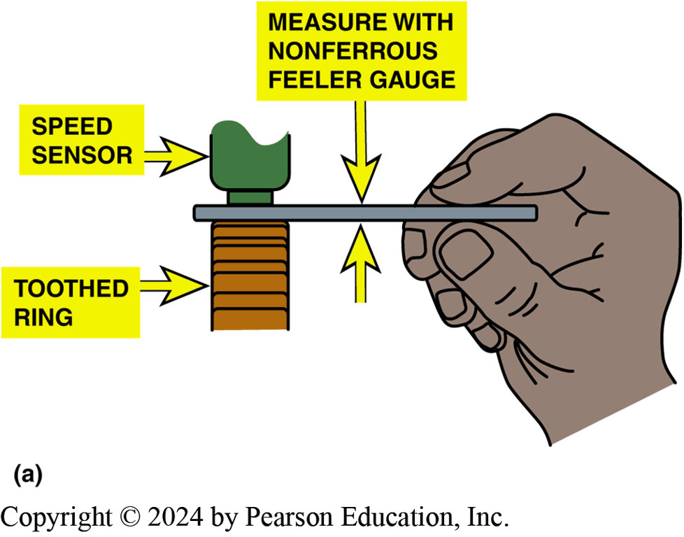
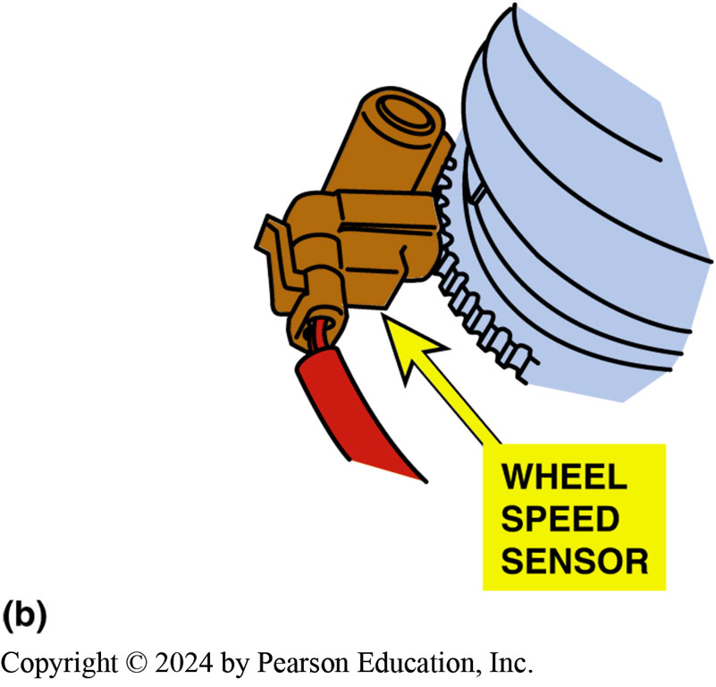
Figure 106.10 WSS Clearance
Notes:
Figure 106-10 (a) Always use a nonferrous (brass or plastic) feeler (thickness) gauge when measuring the gap between the toothed ring and the wheel speed sensor. (b) Sometimes
a sensor is equipped with a paper spacer that is the exact thickness of the spacing required between the toothed ring and the sensor. If equipped, the sensor is simply installed with the
paper touching the toothed wheel. A typical gap ranges from 0.020 to 0.050 inch (0.5 to 1.3 mm).

Slide 35
Question 2: ?
What are the methods for testing a passive wheel speed sensor?

Slide 36
Answer 2
  Resistance measurement
  Checking for shorts-to-ground
  A C voltage check
  Scope Testing
  Scan tool testing

Slide 37

Figure 106.11 Bleeding ABS Tool
Special Bleed Valve Tools are often Required when Bleeding some ABS Units Such as the Kelsey-Hayes 4WAL System

Slide 38
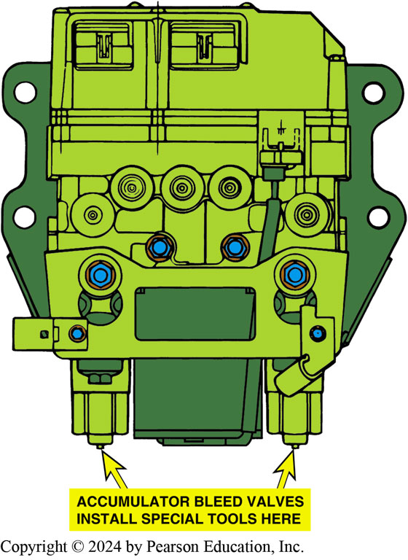
Figure 106.12 Bleeding 4WAL
Two Bleed Valve Tools are Needed to Bleed the Kelsey-Hayes 4WAL System, which Attaches to the Bleeder Valves on the Accumulator

Slide 39
A B S Safety Precautions
Avoid mounting the antenna for any transmitting device near the A B S control unit.
Avoid mounting tires of different diameter than that of the original tires.
Never open a bleeder valve or loosen a hydraulic line while the A B S is pressurized.
If arc welding on a vehicle, disconnect all computers (electronic control modules).
Do not pry against or hit the wheel speed sensor ring.

Slide 40
Brakes Videos and Animations
Videos Link: (A5) Brakes Videos
Animations Link: (A5) Brakes Animations

Slide 41

Copyright
This work is protected by United States copyright laws and is provided solely for the use of instructors in teaching their courses and assessing student learning. Dissemination or sale of any part of this work (including on the World Wide Web) will destroy the integrity of the work and is not permitted. The work and materials from it should never be made available to students except by instructors using the accompanying text in their classes. All recipients of this work are expected to abide by these restrictions and to honor the intended pedagogical purposes and the needs of other instructors who rely on these materials.

