Slide 1
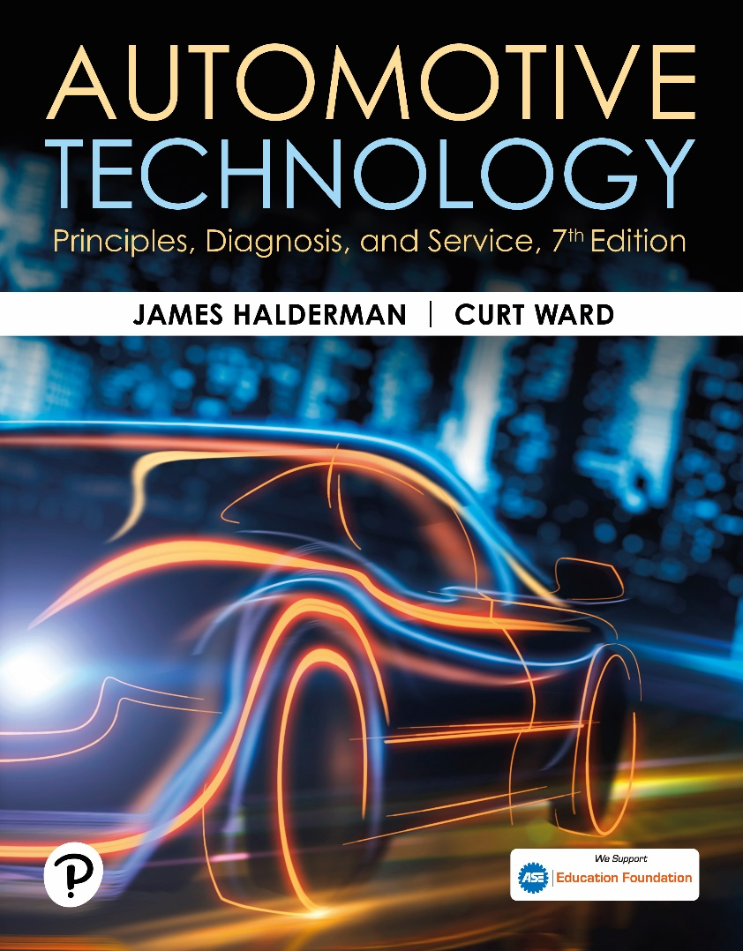
Automotive Technology: Principles, Diagnosis, and Service
Seventh Edition
Chapter 105
ABS Components and Operation
Copyright © 2023 Pearson Education, Inc. All Rights Reserved
Notes:
INSTRUCTOR NOTE: This presentation includes text explanation notes, you can use to teach the course. When in SLIDE SHOW mode, you RIGHT CLICK and select SHOW PRESENTER VIEW, to use the notes.

Slide 2
Learning Objectives
105.1 Explain purpose and theory of the antilock brake system (ABS).
105.2 Describe the components of ABS.
105.3 Discuss ABS channels.
105.4 Discuss ABS controller inputs and outputs.
105.5 Discuss wheel speed sensors.
105.6 Discuss hydraulic modulator assembly.
105.7 Discuss advanced ABS functions.
105.8 Discuss automatic emergency braking.

Slide 3
Antilock Brake System (1 of 3)
Purpose and Function
  A B S help prevent the wheels from locking during sudden braking, especially on slippery surfaces.
A B S and Tire Traction
  Brakes slow rotation of the wheels, but it is friction between tire and road that stops vehicle and allows it to be steered.

Slide 4
Antilock Brake System (2 of 3)
Tire Slip and Braking Distance
  On dry or wet pavement, maximum braking traction occurs when tire slip is held between approximately 15% and 25%.
Tire Slip and Vehicle Stability
  In a straight line, nearly all of the available traction can be used to provide braking force.
  If a vehicle has to stop and turn at the same time, the available traction must be divided to provide both cornering (lateral) and braking force.

Slide 5
Antilock Brake System (3 of 3)
A B S Limitations
  2 situations where ABS will not provide shortest stopping distances.
    Straight stops made on smooth, dry pavement by an expert driver.
    When braking on loose gravel or dirt, or in deep, fluffy snow.
A B S and Law of Physics
  No A B S can overcome the laws of physics.

Slide 6
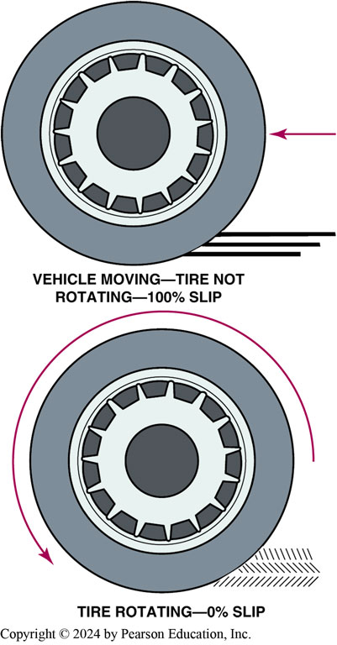
Figure 105.1 Max Braking Traction
Maximum braking traction occurs when tire slip is between 10% and 20%. A rotating tire has 0% slip and a locked-up wheel has 100% slip

Slide 7
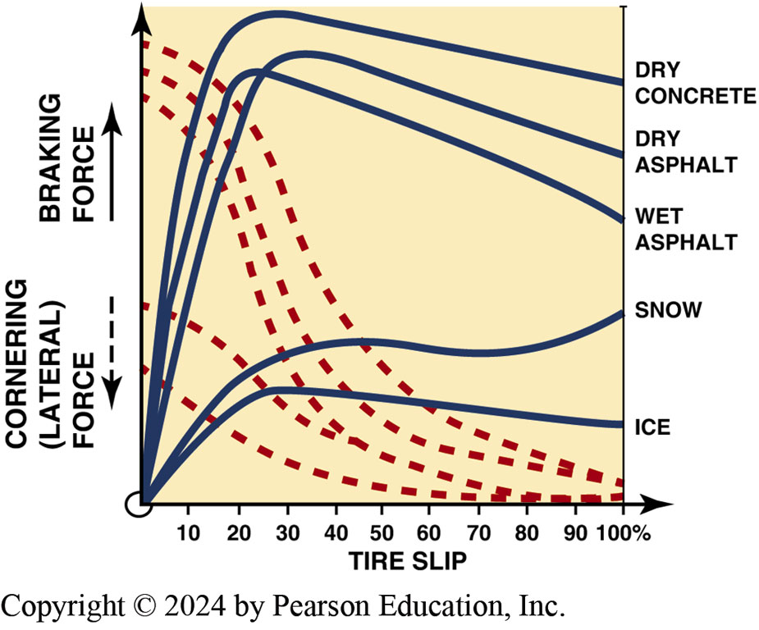
Figure 105.2 Traction Determination
Traction is determined by pavement conditions and tire slip
Notes:
TECH TIP: Tire “Chirp” Noise during Hard Braking Is Normal
Sometimes customers state that they do not think that their antilock brake system (ABS) is working correctly because they heard the tires making noise (chirping sound) during hard braking. This is normal as the tires slip about 20% during an ABS stop.

Slide 8
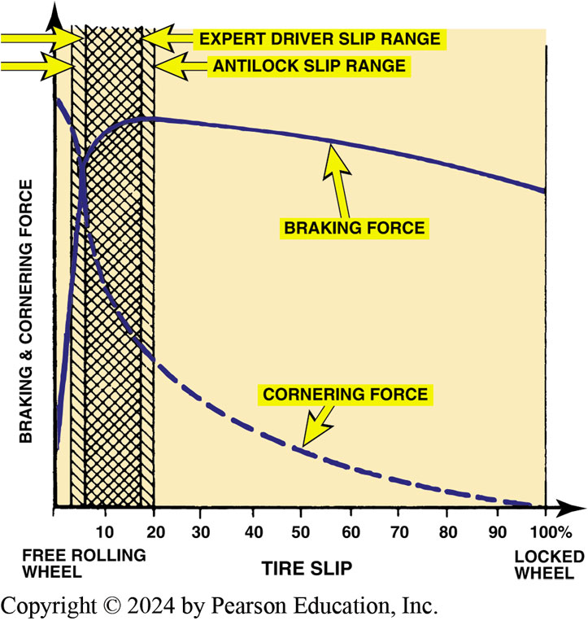
Figure 105.3 Driver Control
A good driver can control tire slip more accurately than an ABS if the vehicle is traveling on a smooth, dry road surface

Slide 9
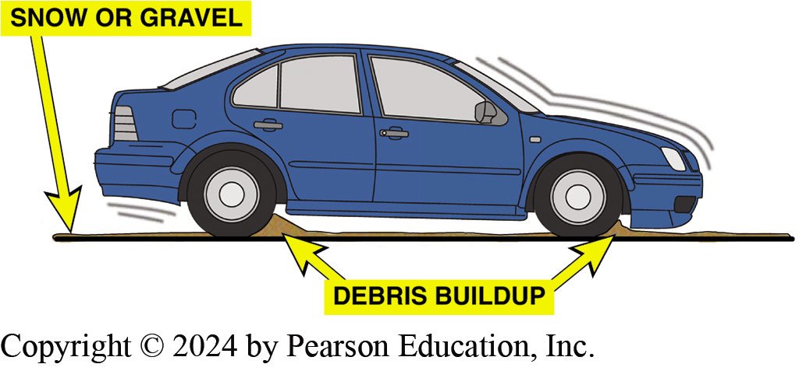
Figure 105.4 Debris Buildup
A wedge of gravel or snow in front of a locked wheel can help stop a vehicle faster than would occur if the wheel brakes were pulsed on and off by an antilock brake system

Slide 10
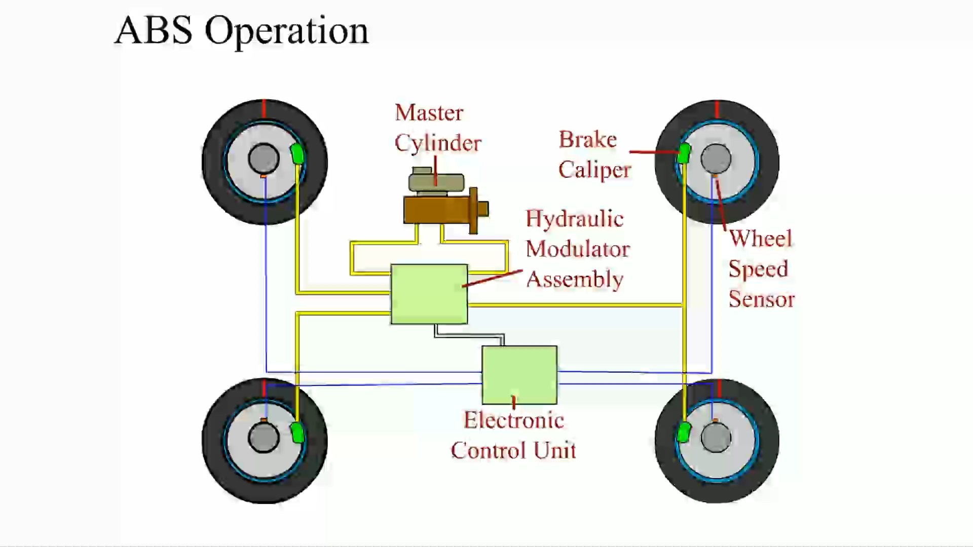
Animation: ABS Operation
(Animation will automatically start)

Slide 11
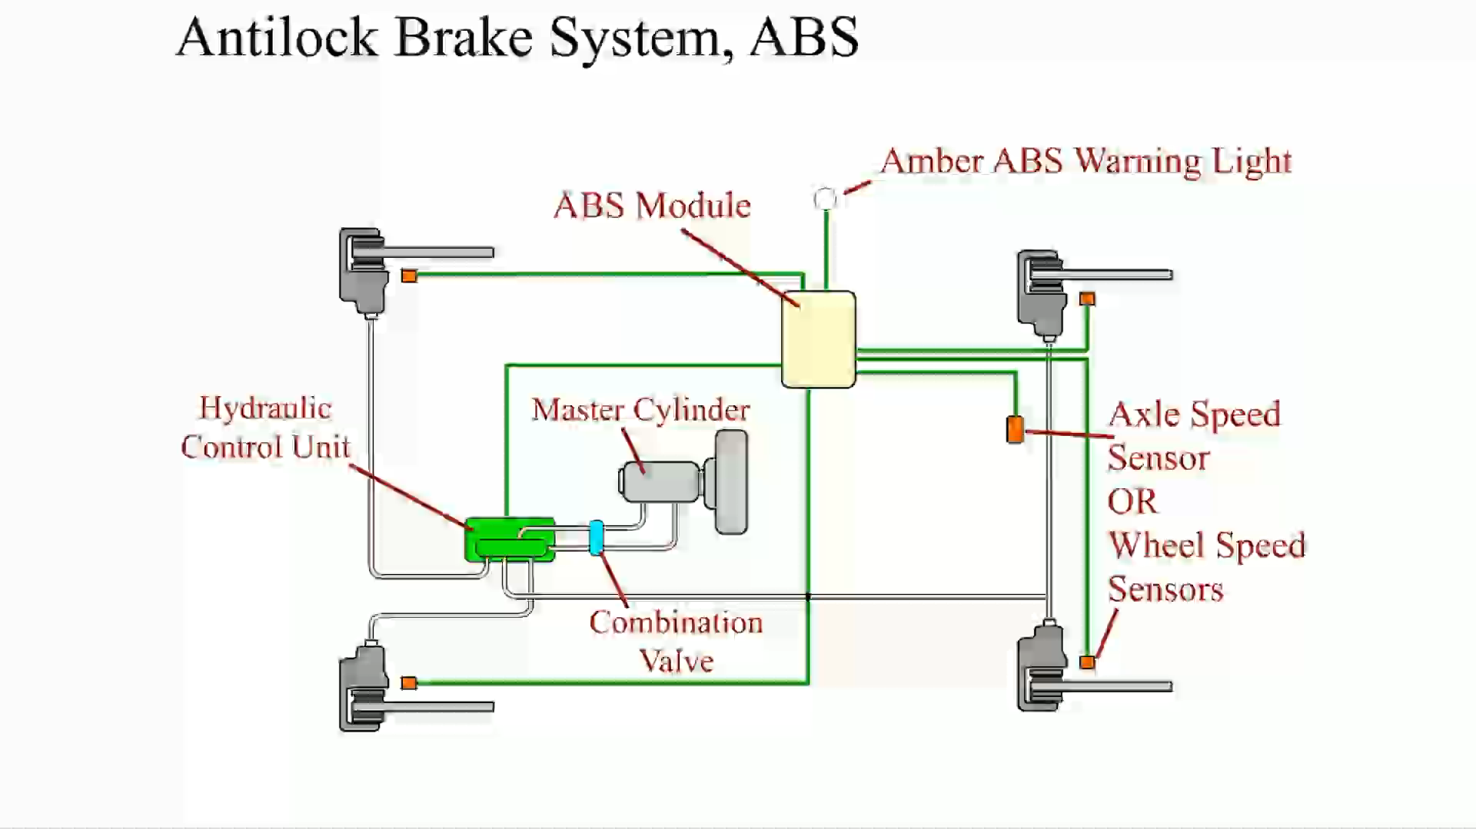
Animation: Antilock Brake System, ABS
(Animation will automatically start)

Slide 12
Question 1: ?
What is the purpose of antilock brakes?

Slide 13
Answer 1
To help prevent the wheels from locking during sudden braking, especially on slippery surfaces.

Slide 14
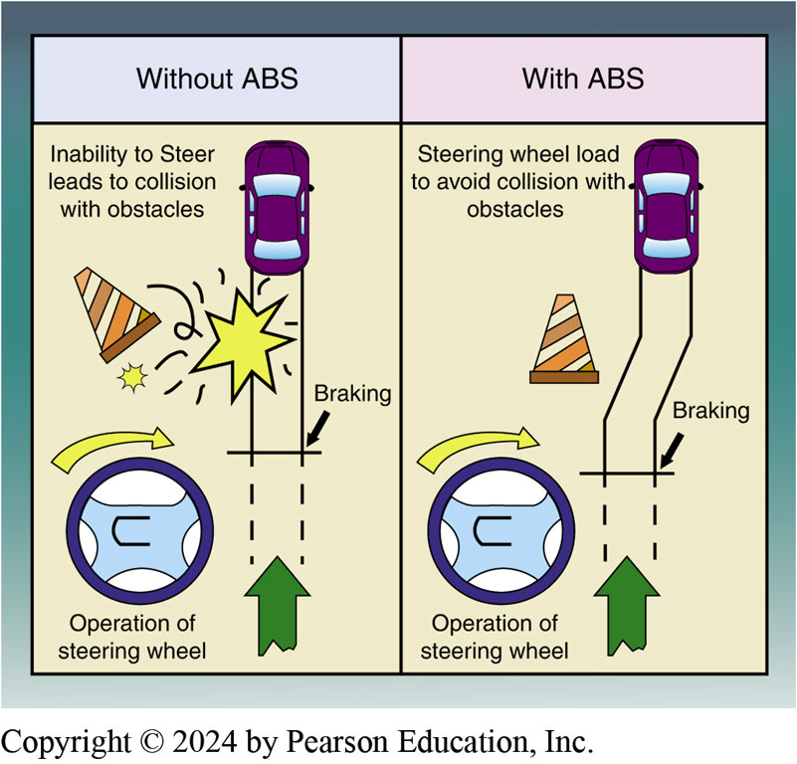
Figure 105.5 Steering Assist
Being able to steer and control the vehicle during rapid braking is one major advantage of an antilock brake system.
Notes:
No ABS can overcome the laws of physics. The weight and speed of a moving vehicle give it a great deal of kinetic energy and only so much of that energy can be converted into braking or cornering force at any given time.
■ The limiting factor in this conversion is the traction between the tires and road. Although a
vehicle with four-wheel antilock brakes will stop in very nearly the shortest possible distance,
this will still not prevent an accident if the brakes are applied too late to bring the vehicle to
a complete stop before impact. However, because steering control is retained with four-wheel
antilock brakes, it may be possible to drive the vehicle around a potential accident while in the process of braking.
■ Another situation where antilock brakes cannot defy the laws of physics occurs when a vehicle
enters a corner traveling faster than it is physically possible to negotiate the turn. In this
situation, antilock brakes will not prevent the vehicle from leaving the road. However, they will
allow the vehicle to be slowed and steered in the process, thus lessening the severity of the eventual impact. ● SEE FIGURE 105–5.

Slide 15
A B S Parts Involved
Wheel Speed Sensor
  Monitors speed of each wheel.
Control Module
  Receives inputs and controls outputs.
Valves
  Used to hold, release, and reapply hydraulic pressure to the brakes.
Pump
  Used to restore brake pressure.

Slide 16
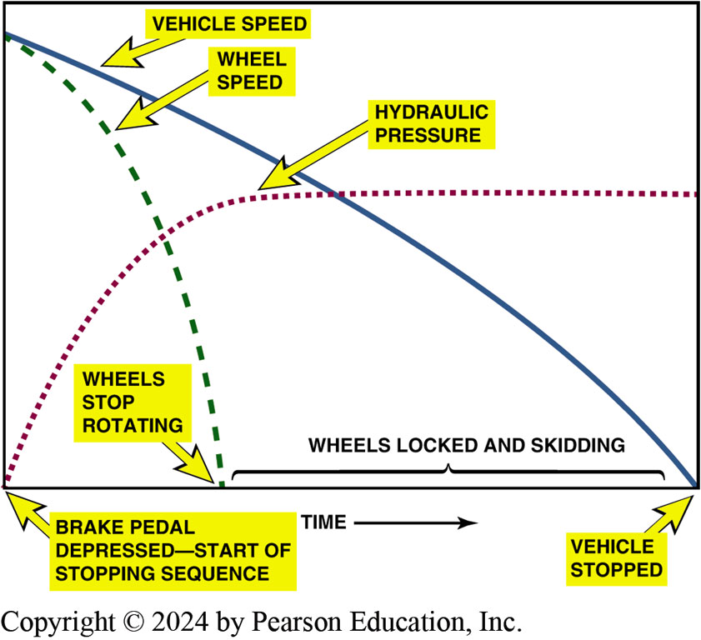
Figure 105.6 Typical Stop
A typical stop on a slippery road surface without antilock brakes. Notice that the wheels stopped rotating and skidded until the vehicle finally came to a stop.

Slide 17
Frequently Asked Question: When Was ABS First Used?
? Frequently Asked Question
When Was ABS First Used? ABS was first used in 1950s on aircraft and then first used on a 1970 Lincoln using a rear-wheel braking system called “Sure Track” as an option. 1970, GM offered a rear-wheel antilock brake system on selected RWD vehicles, which was called “Track Master” made by AC Electronics Division. In 1971, Chrysler Imperial offered a 3-channel system that used 4 wheel speed sensors built by Bendix Corporation, called “Sure Brake” by Chrysler.

Slide 18
A B S Channels
Single-Channel Systems
  The single-channel rear-wheel only A B S is used on many rear-wheel-drive pickups and vans.
Three-Channel A B S Systems
  The system uses a separate channel for each front wheel and a common channel for the rear wheels.
Four Channel A B S
  In this system each wheel speed sensor provides input for a separate hydraulic control circuit or channel.

Slide 19
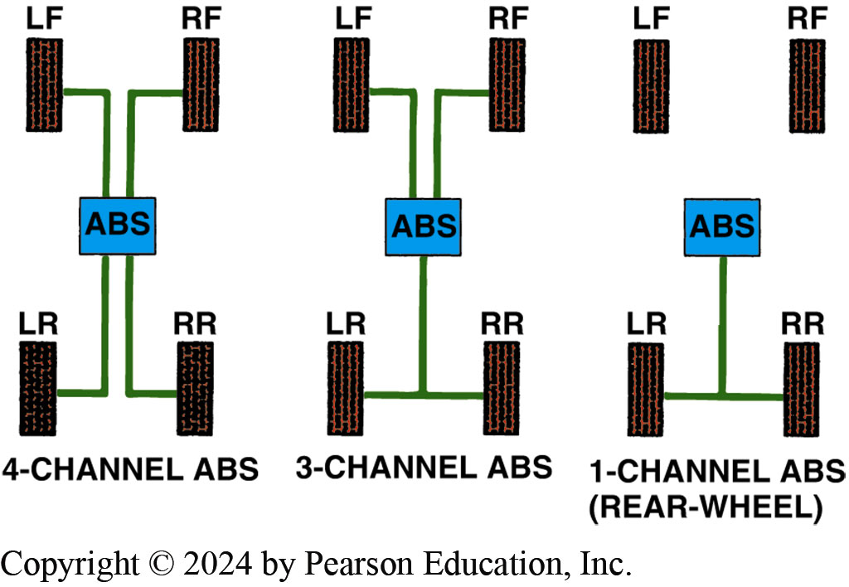
Figure 105.7 Channel Systems
ABS configuration includes four channel, three channel, and single channel

Slide 20
Non-integral A B S
Non-integral A B S have a conventional brake master cylinder and vacuum power booster with a separate hydraulic modulator unit.
The pump is for A B S braking (to reapply pressure during the A B S hold–release–reapply cycle), but do not for normal power assist.
Non-integral A B S are the most common type of A B S because of their lower cost and simplicity.

Slide 21
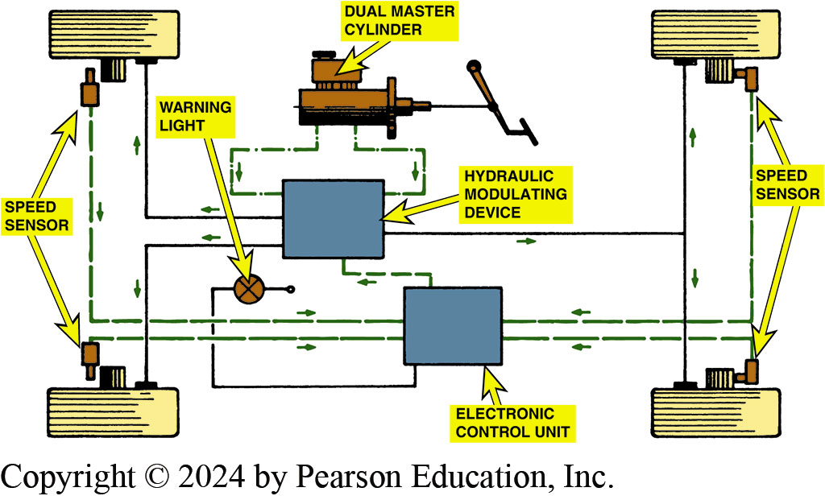
Figure 105.8 ABS Schematic
Schematic drawing of a typical antilock brake system

Slide 22
A B S Controller Inputs and Outputs (1 of 2)
Inputs
  Wheel speed—from wheel speed sensors.
  Brake on/off—from the brake pedal switch.
  Steering wheel position—for electronic stability control.
  Yaw and accelerometer sensors—for electronic stability control system.
Outputs
  System relay
  Inlet and outlet valves
  Pump motor
  A B S warning lamps

Slide 23
A B S Controller Inputs and Outputs (2 of 2)
Module Operation
  Cycles solenoid valves in modulator assembly to pulsate hydraulic pressure in affected brake circuit (or circuits) based on inputs from wheel speed sensors.
A B S Warning Lamp
  Comes on/goes out for a bulb check at start.
  Illuminates when a fault is set in the system.
  Illuminates if the system becomes disabled.

Slide 24
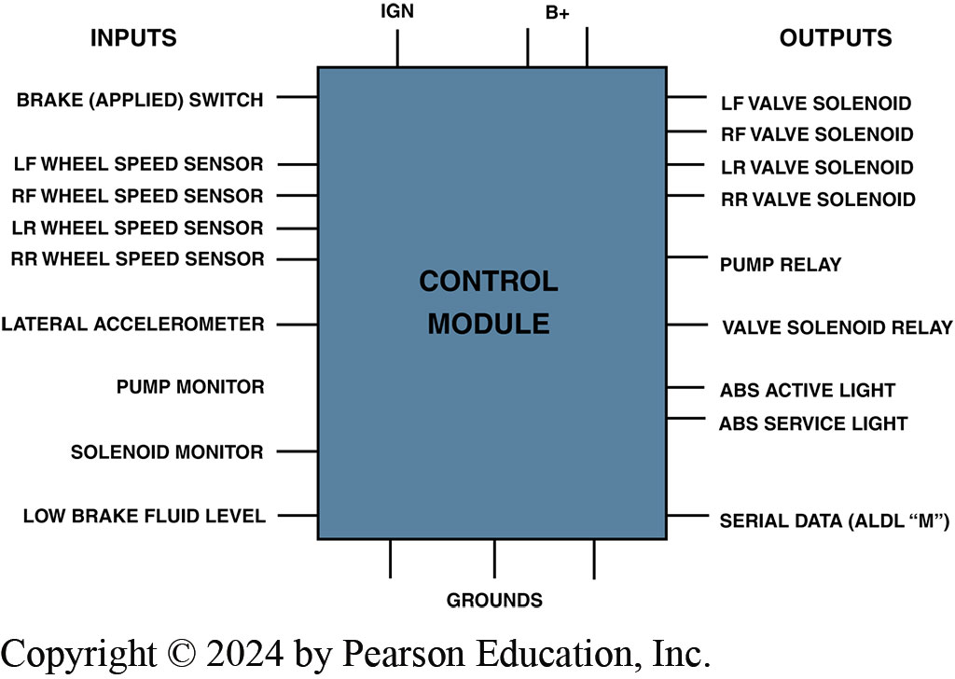
Figure 105.9 ABS Control Module
Typical inputs and outputs for brake control modules.

Slide 25
Wheel Speed Sensors (1 of 2)
Purpose and Function
  W S S monitor the speed of the wheels.
Wheel Speed Sensor Locations
  Steering knuckle, wheel hub, brake backing plate, transmission tail shaft housing, and transfer case.
  Sensor (reluctor) ring will be mounted near sensor location.

Slide 26
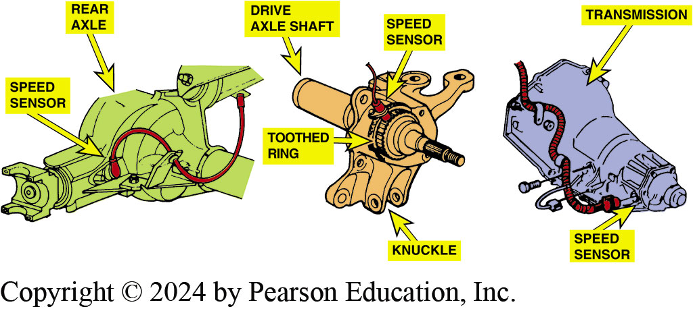
Figure 105.10 Wheel Speed Sensors
Wheel speed sensors for the rear wheels may be located on the rear axle, on the transmission, or on the individual wheel knuckle

Slide 27
Wheel Speed Sensors (2 of 2)
Passive Wheel Speed Sensors
  Generates its own output signal and can operate without an outside voltage being applied.
  Sensor generates an alternating current (A C) voltage.
Active Wheel Speed Sensors
  Hall-effect
  Magneto resistive (M R)
  Require voltage source and generate a square wave

Slide 28
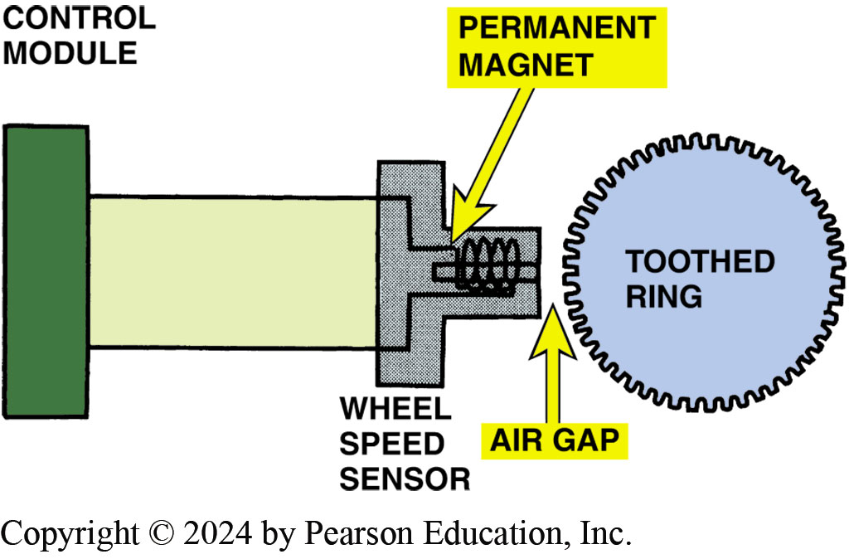
Figure 105.11 WWS
Schematic of a typical wheel speed sensor

Slide 29
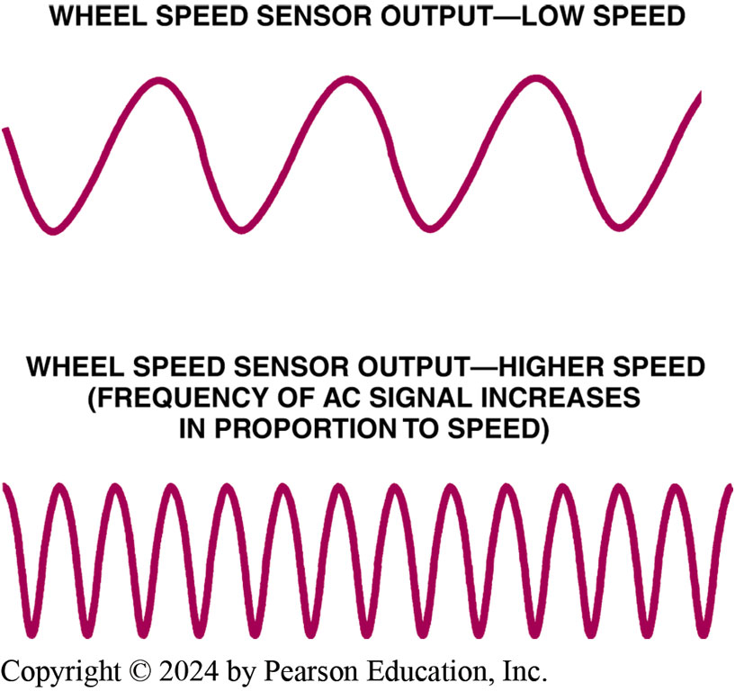
Figure 105.12 WSS AC Waveform
Wheel speed sensors produce an alternating current (A C) signal with a frequency that varies in proportion to wheel speed

Slide 30
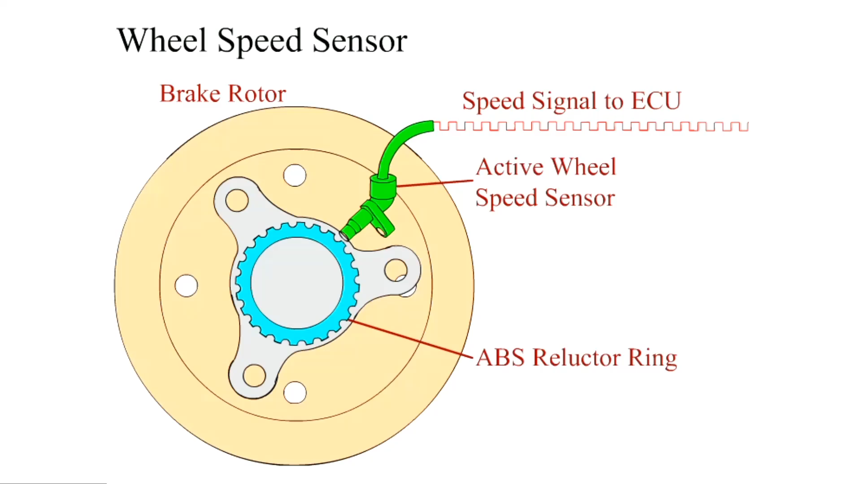
Animation: Wheel Speed Sensor
(Animation will automatically start)

Slide 31
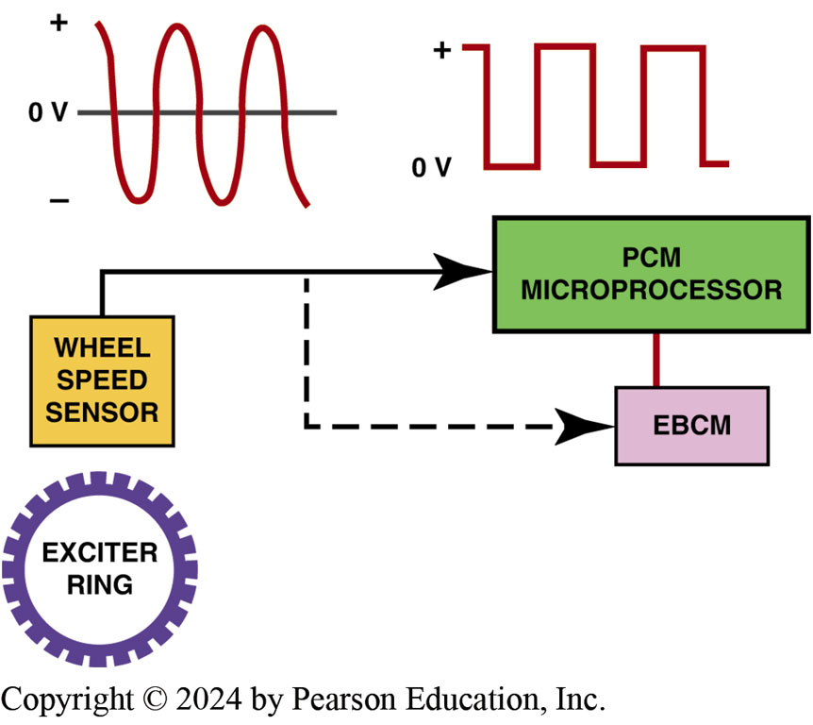
Figure 105.13 Passive WSS Wave
A typical passive variable-reluctance sensor produces a sine wave (continuously variable) output signal which is then converted to a square wave inside the PCM and/or the electronic brake control module (EBCM)

Slide 32
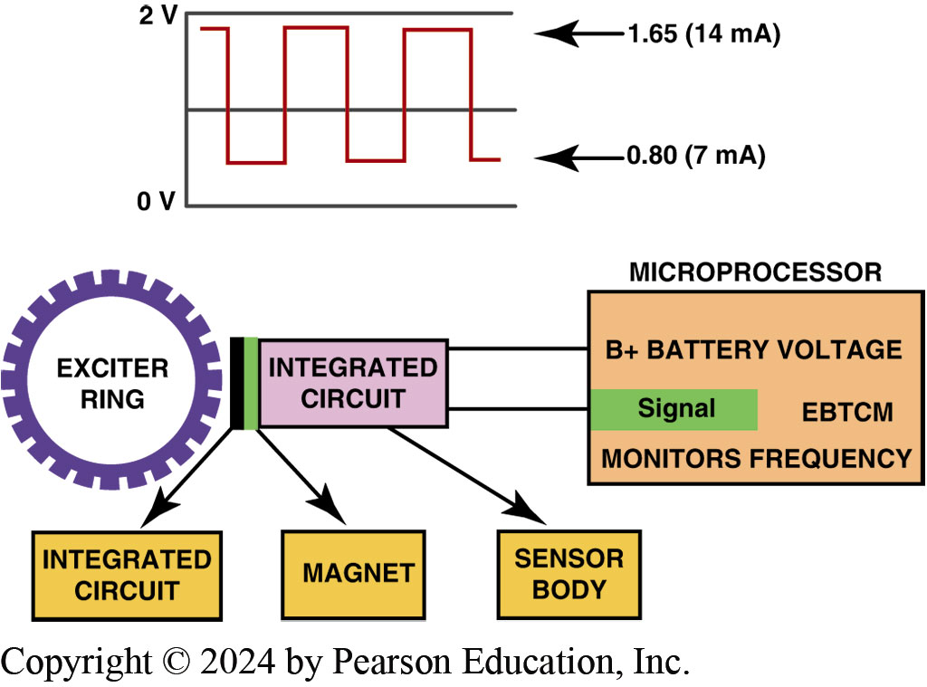
Figure 105.14 Active WSS Waveform
A digital wheel speed sensor produces a square wave output signal

Slide 33
Question 2: ?
What are the two types of active wheel speed sensors?

Slide 34
Answer 2
Hall-effect and magneto resistive.

Slide 35
Hydraulic Modulator Assembly (1 of 3)
Purpose and Function
  Modulator valve body houses valves and pump motor needed to control hydraulic pressure at each wheel.
A B S Solenoid
  Solenoid (energized) is used to open or close a valve between the master cylinder and an individual brake.

Slide 36
Hydraulic Modulator Assembly (2 of 3)
A B S Control Pressure Stages
  Isolation (pressure hold); prevents any further pressure from the master cylinder reaching the brake.
  Pressure Reduction (decay); Releasing pressure in brake circuit allows brake to loosen its grip so wheel can speed up and regain traction.
  Pressure Increase (build); circuit is hydraulically opened and pump motor is energized.
  Cycle repeats as many times as needed until vehicle either comes to a halt or driver releases brake pedal.

Slide 37
Hydraulic Modulator Assembly (3 of 3)
Pump Motor and Accumulator
  High-pressure electric pump used in some A B S to generate power assist for normal braking
  Reapplication of brake pressure during A B S braking.
  Fluid pressure generated by pump is stored in accumulator.

Slide 38
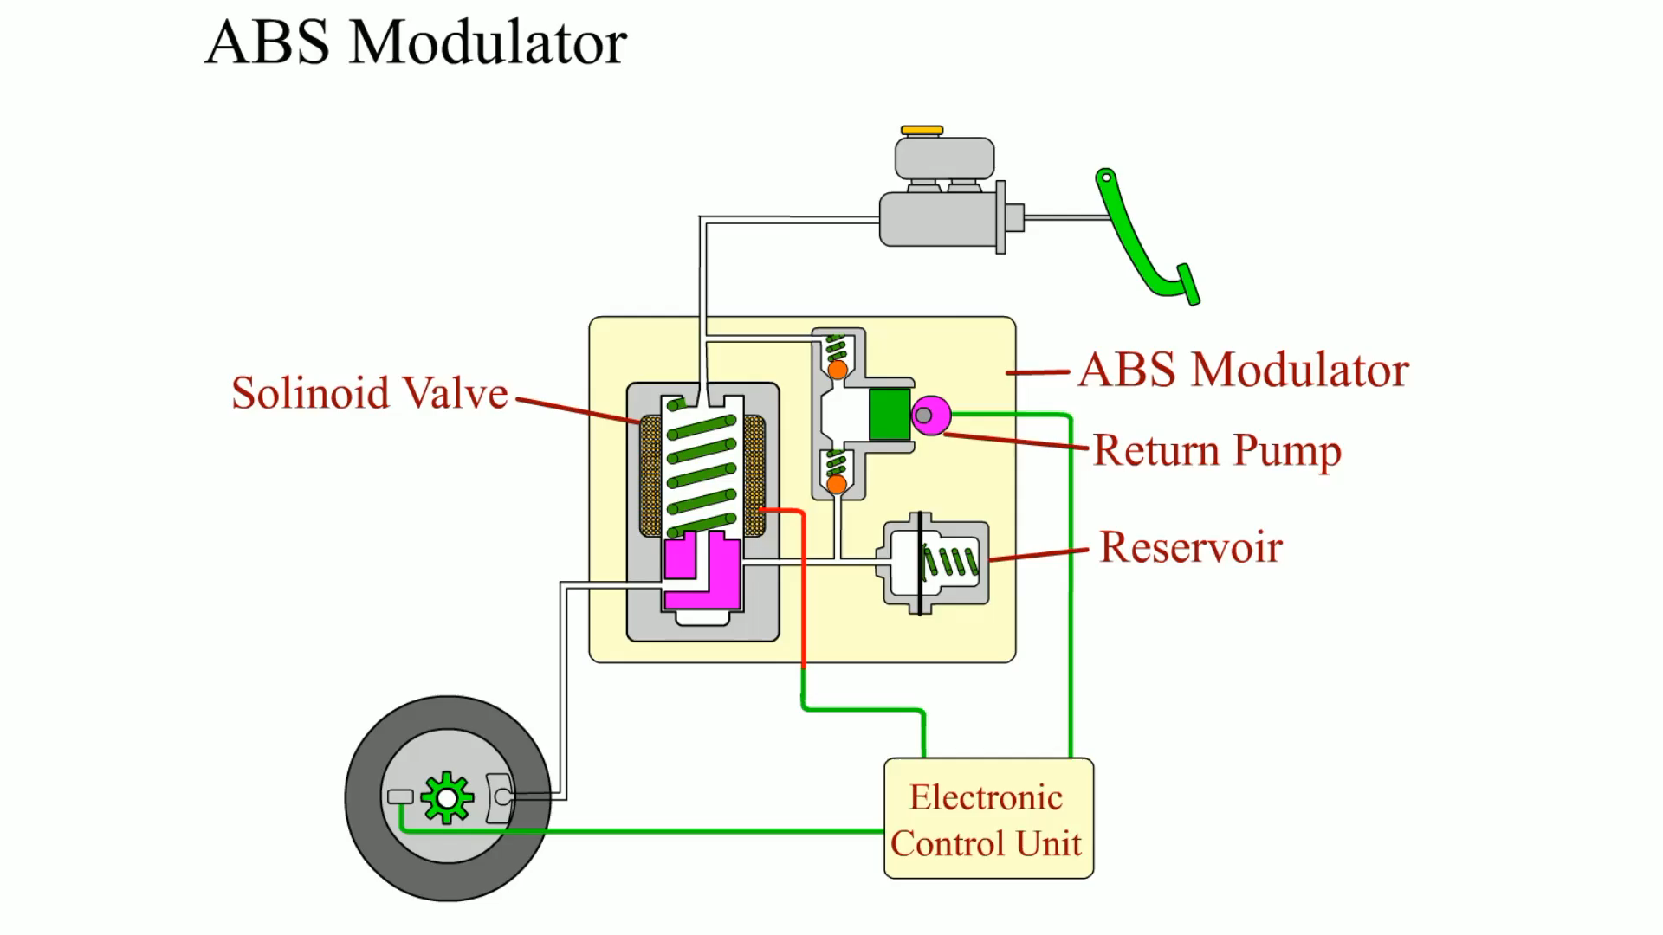
Animation: ABS Modulator
(Animation will automatically start)

Slide 39
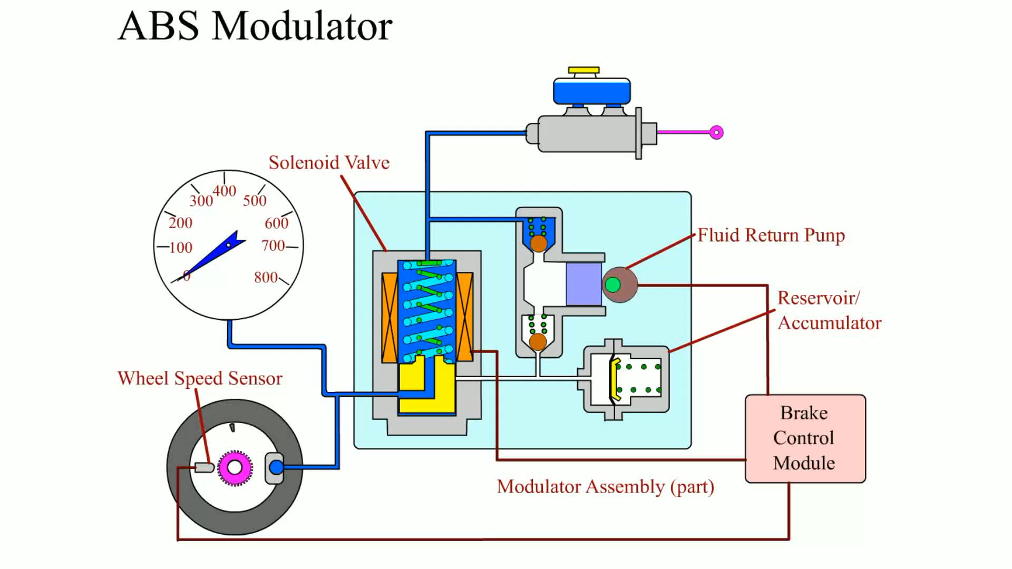
Animation: ABS Modulator
(Animation will automatically start)

Slide 40
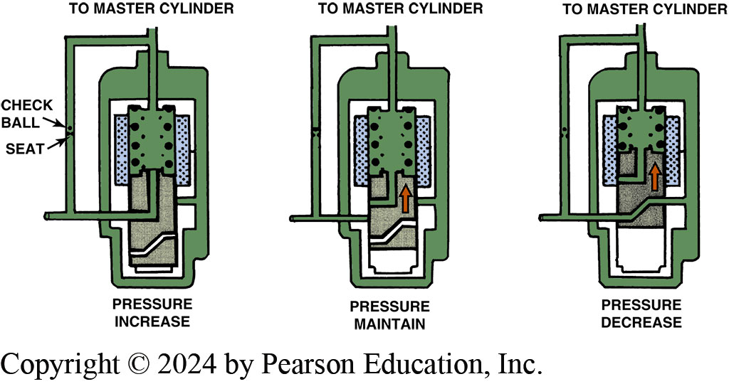
Figure 105.15 Three-Way Solenoid
ABS 3-way solenoid can increase, maintain, or decrease brake pressure to a given brake circuit

Slide 41
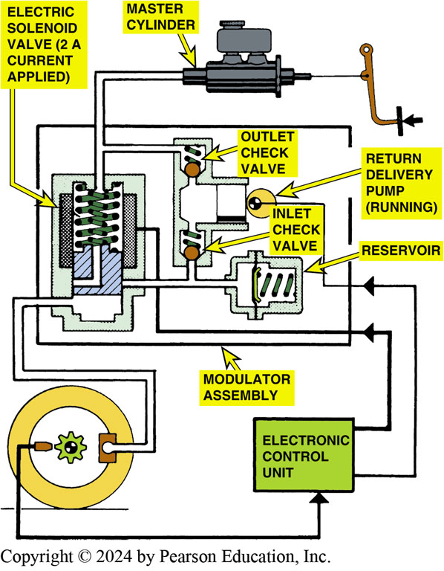
Figure 105.16 Isolation (Hold) Phase
The isolation or hold phase of an ABS on a Bosch 2 system

Slide 42
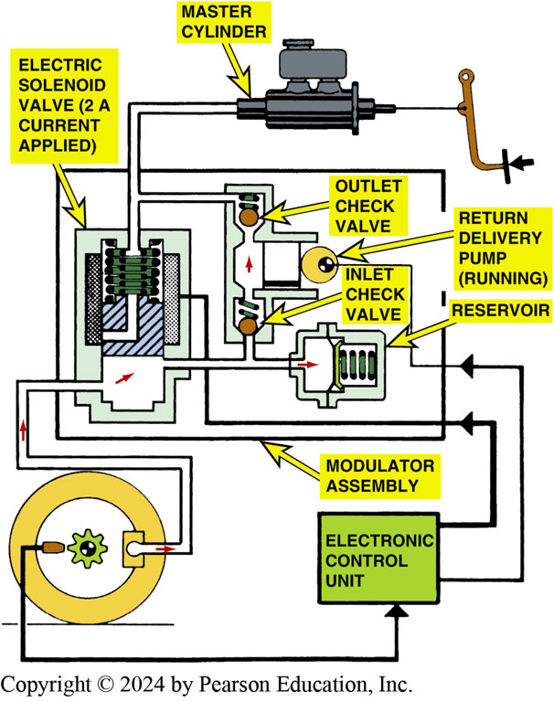
Figure 105.17 Pressure Reduction
During the pressure reduction stage, pressure is vented from the brake circuit so the tire can speed up and regain traction

Slide 43
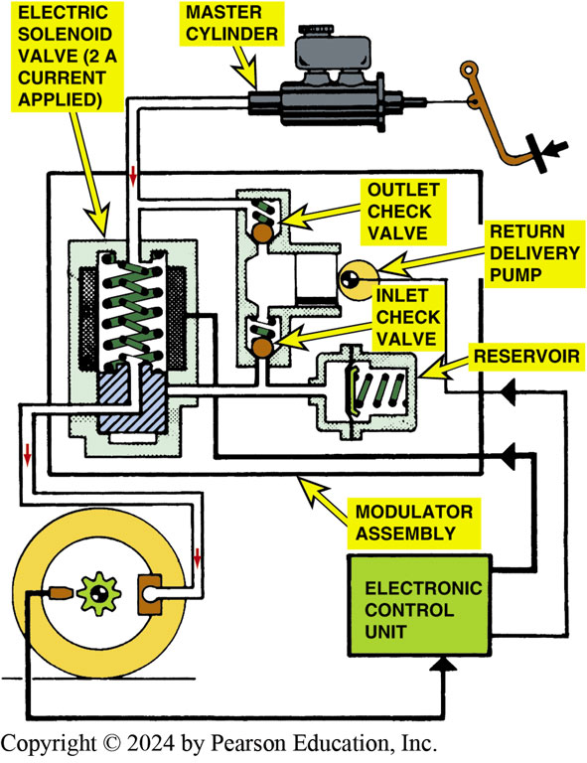
Figure 105.18 Pressure Increase
The control module reapplies pressure to the affected brake circuit once the tire achieves traction so that normal braking can continue
Notes:
WARNING: A fully charged accumulator in an old integral ABS system can store up to 2, 700 PSI (19, 000 kPa) of pressure for power-assist braking and for reapplying the brakes during the hold–release–reapply cycle for antilock braking. This stored pressure represents a potential hazard for a brake technician who is servicing the brakes, so the accumulator should be depressurized prior to doing any type of brake service work by pumping the brake pedal 25 to 40 times with ignition key off.

Slide 44
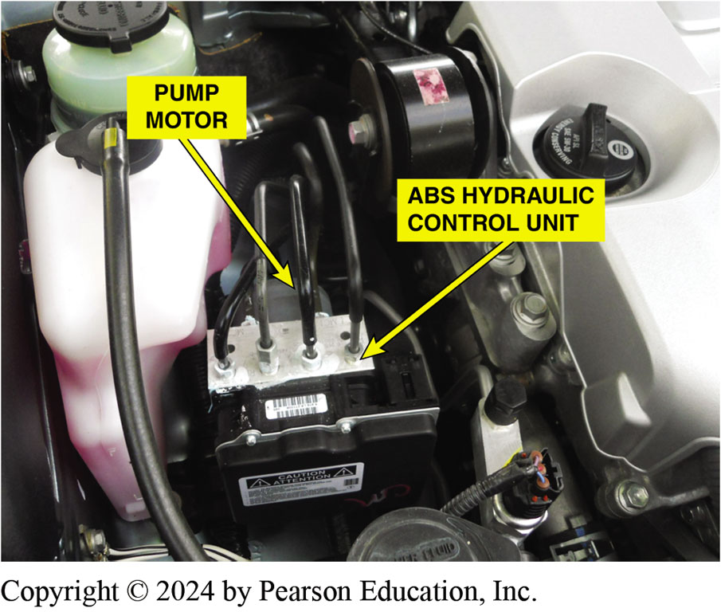
Figure 105.19 ABS Control Assembly
A typical ABS hydraulic control assembly
Notes:
TECH TIP: Best to Keep Stock Tire Diameter
Vehicles equipped with antilock brakes are “programmed” to pulse the brakes at just the right rate for maximum braking effectiveness. A larger tire rotates at a slower speed and a smaller-than- normal tire rotates at a faster speed. Therefore, tire size affects the speed and rate of change in speed of the wheels as measured by the wheel speed sensors. While changing tire size will not prevent ABS operation, it will cause less effective braking during hard braking with the ABS activated. Using the smaller spare tire can create such a difference in wheel speed compared with the other wheels that a false wheel speed sensor code may be set and an amber ABS warning lamp on the dash may light. However, most ABS will still function with the spare tire installed, but the braking performance will not be as effective. For best overall performance, always replace tires with the same size and type as specified by the vehicle manufacturer.

Slide 45
Question 3: ?
What are the three A B S pressure control stages?

Slide 46
Answer 3
Isolation, pressure reduction, pressure increase.

Slide 47
Frequently Asked Question: How Much Positive Slip Is Allowed during Rapid Acceleration?
? Frequently Asked Question
How Much Positive Slip Is Allowed during Rapid Acceleration? Many EVs are able to accelerate at a rapid rate without wheel spin. According to electric vehicle engineers, electric motor controller is responsible for the torque delivery and it monitors the wheel speed sensor to maintain about a 3% positive slip. This means that there is some slippage but the 3% rate allows the vehicle to accelerate at the fastest possible rate without a loss of traction.

Slide 48
Advanced A B S Functions (1 of 2)
Traction Control
  Much of the same equipment that allows an A B S system to control wheel lockup during deceleration can be adopted to control wheel spin during acceleration.
Stability Control
  Software balances brake forces at wheels (side-to-side) to counteract a yaw movement and improve the vehicle stability while braking in cornering maneuvers.

Slide 49
Advanced A B S Functions (2 of 2)
Electronic Proportioning
  By using E B C M control software and the hydraulic modulator assembly, the best front-to-rear brake balance can be maintained at all times.
T P M S
  Indirect system that used the wheel speed sensors.

Slide 50
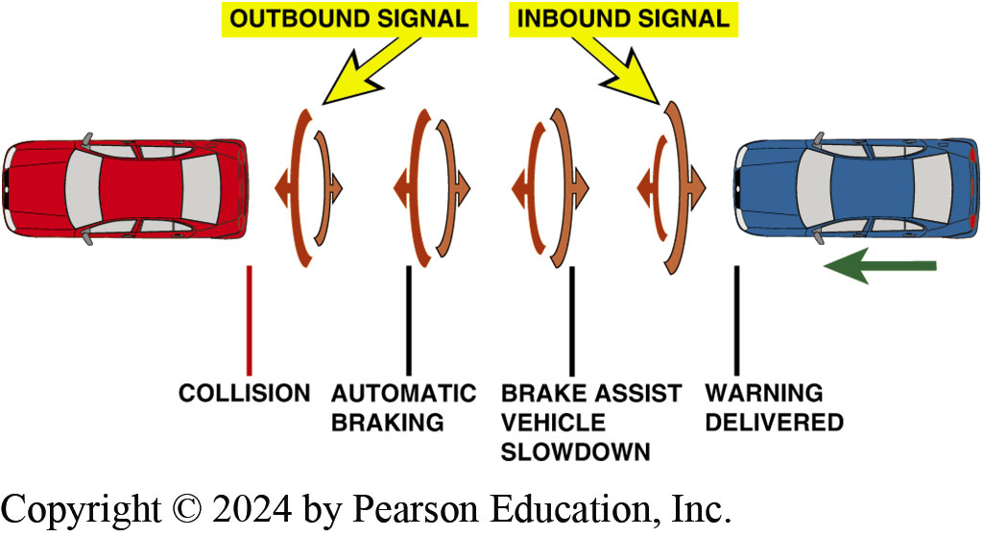
Figure 105.20 Automatic Braking
Sensors are used to detect when distance is closing fast enough that collision may be possible and system intervenes and automatically applies the brakes if needed.
Notes:
Automatic Emergency Braking (AEB) is often part of a safety package that includes radar cruise control and will apply the brakes in the event of a possible collision. Sensors such as radar, sonar, and/or cameras are used depending on the system to detect the distance to another object. The controller, usually an ABS controller, then issues a warning if a collision is possible. This warning can include one or more of the following:
A buzzer
A warning light flashing on the dash
A vibration of the driver’s seat
If the warnings are ignored, the automatic braking system will intervene and either provide brake assist or apply the brakes autonomously (by itself) to achieve maximum braking in an effort to avoid a collision. SEE FIGURE 105-20.

Slide 51
Wheel Speed Sensor

Slide 52
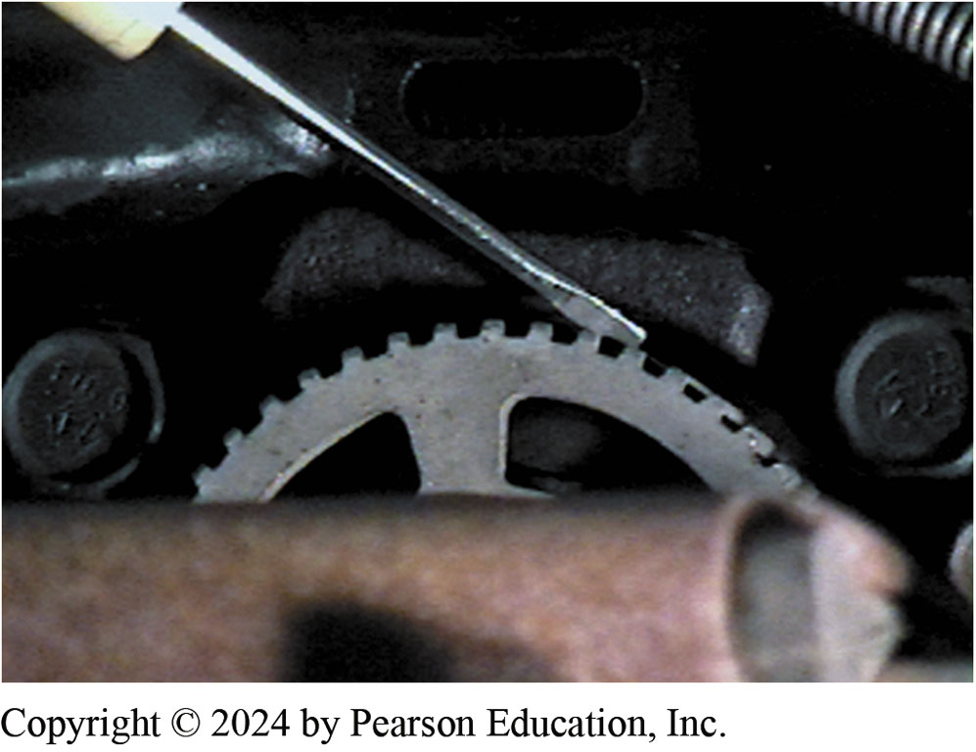
1. Tone Speed
1. A tone ring and a wheel speed sensor on the rear of a Dodge Caravan

Slide 53
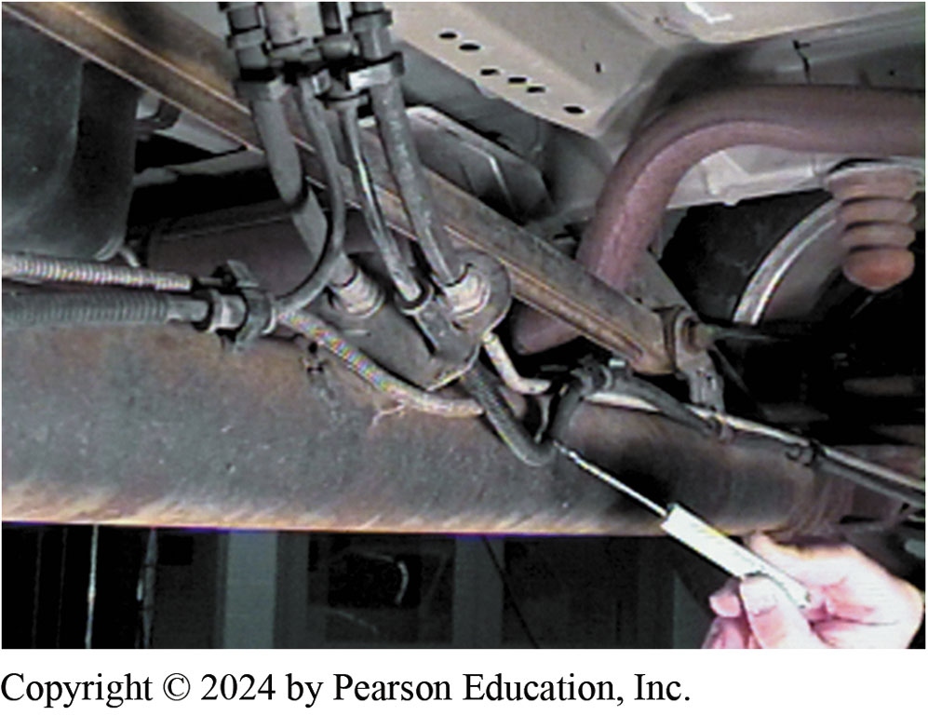
2. Wiring
2. The wiring from the wheel speed sensor should be inspected for damage

Slide 54
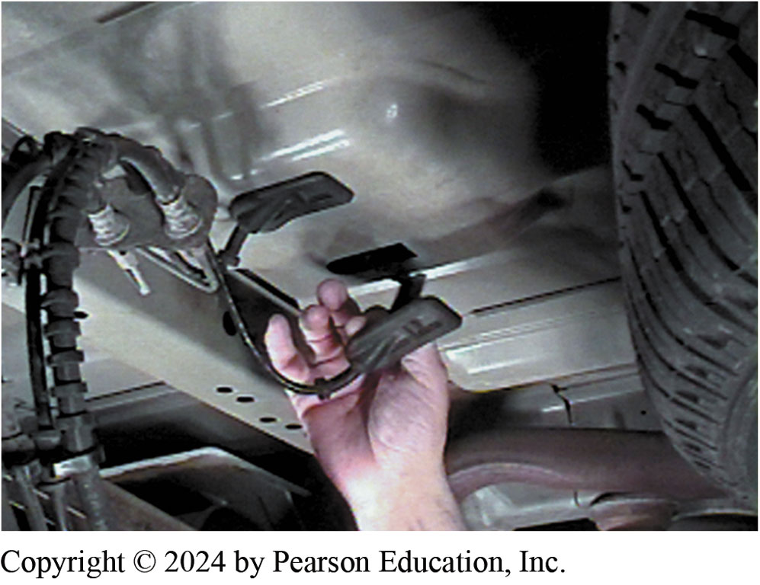
3. WSS Testing
3. To test a wheel speed sensor, disconnect the sensor connector to gain access to the terminals

Slide 55
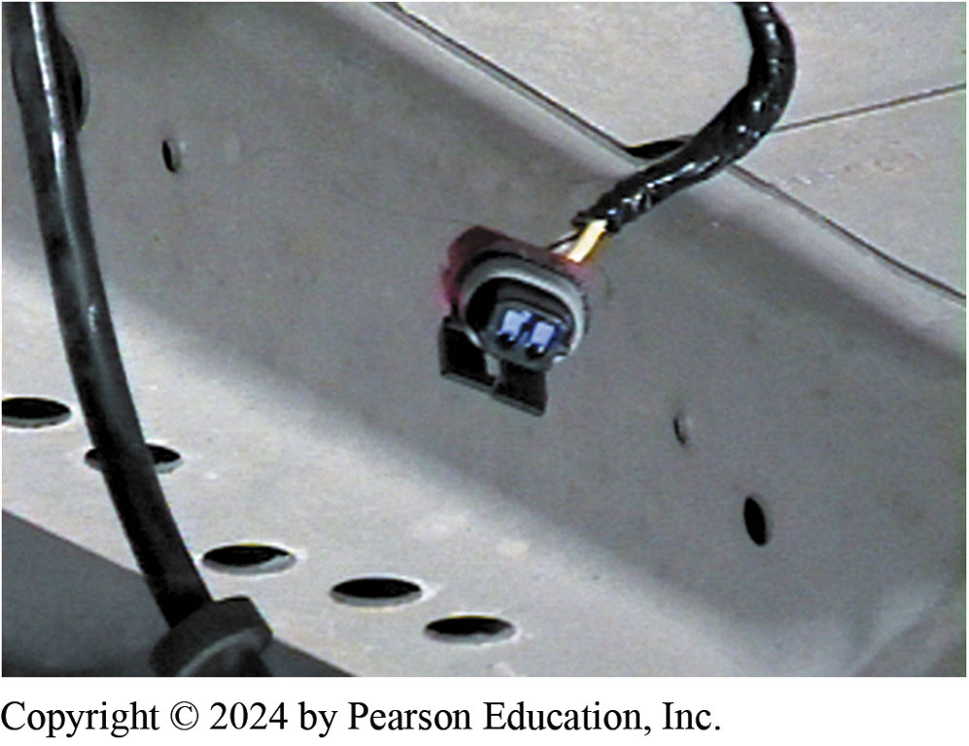
4. Revealing Connector
4. Pulling down the rubber seal reveals the connector

Slide 56
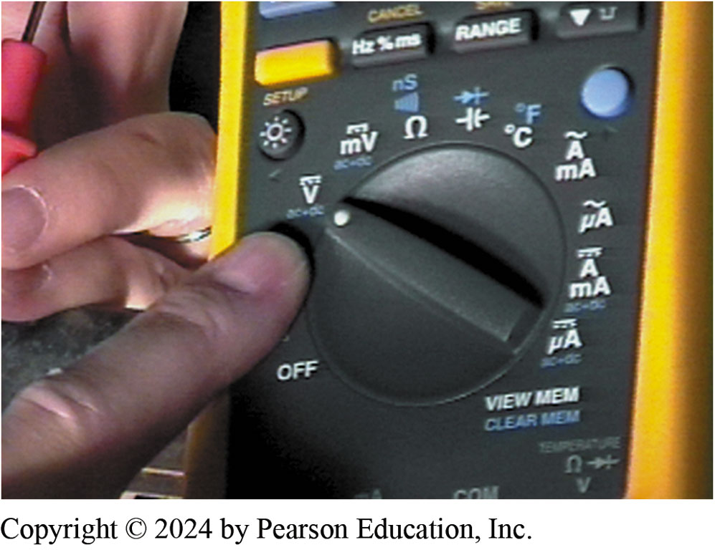
5. Set DMM to DC Volts
5. ABS controller (computer) on this vehicle supplies a 2.5-volt reference signal to the wheel speed sensors

Slide 57
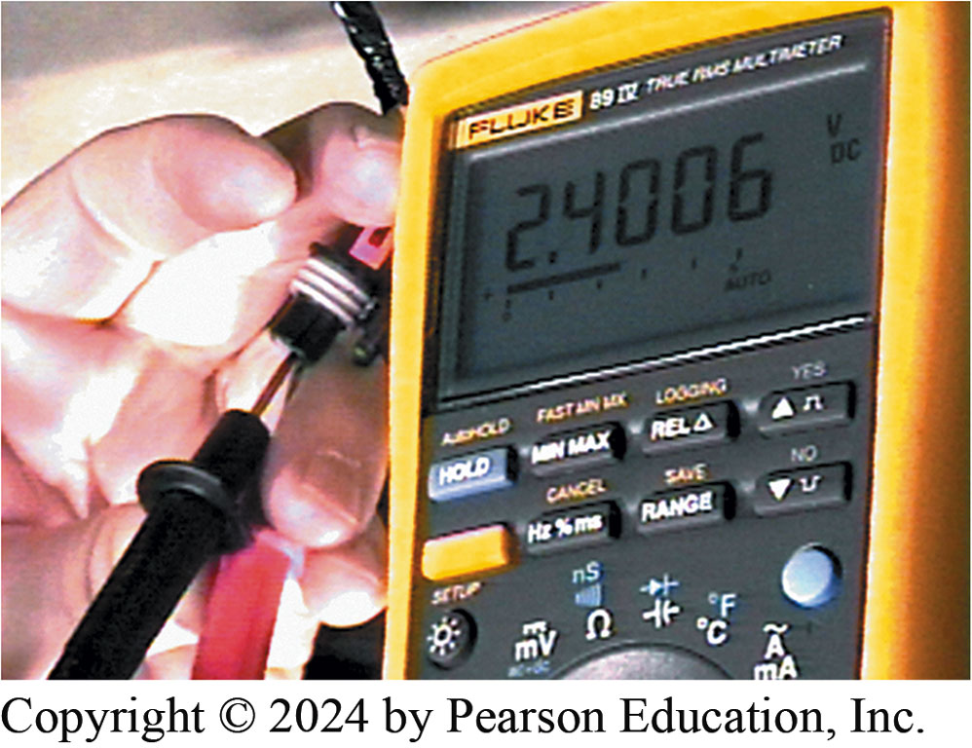
6. Reading 2.4 Volt
6. The meter reads about 2.4 volts, indicating that the ABS controller is supplying the voltage to the wheel speed sensor

Slide 58
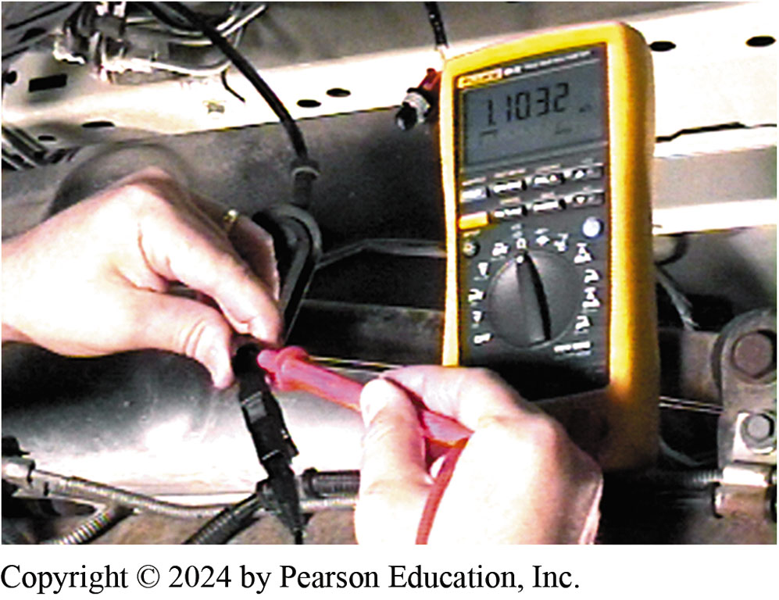
7. DMM Resistance Test
7. The test probes are touched to the terminals leading to the wheel speed sensor and the resistance is 1.1032 k ohms or 1,103.2 ohms.

Slide 59
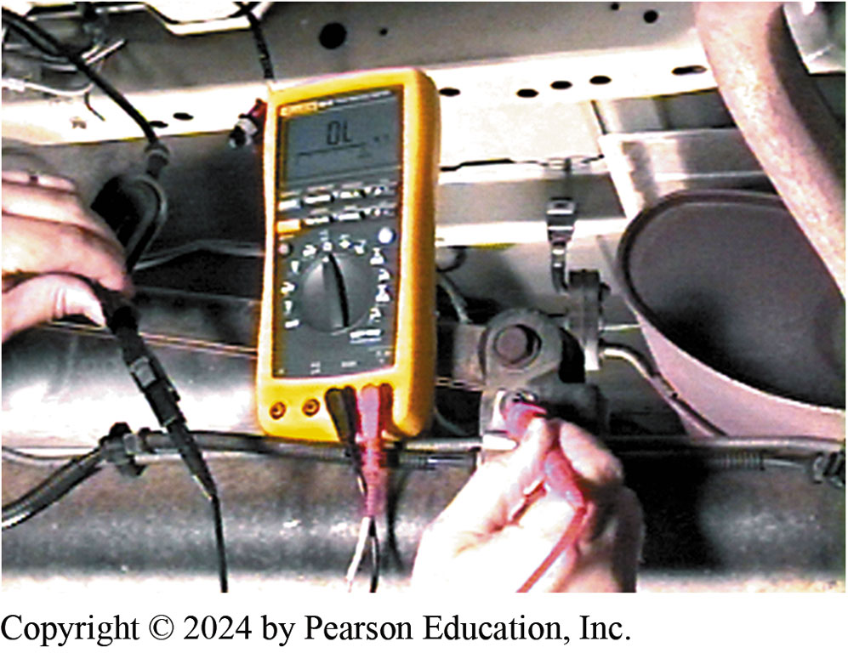
8. Checking for Short-to-Ground
8. The meter should (and does) read “OL,” indicating that the wheel speed sensor and pigtail wiring is not shorted to ground

Slide 60
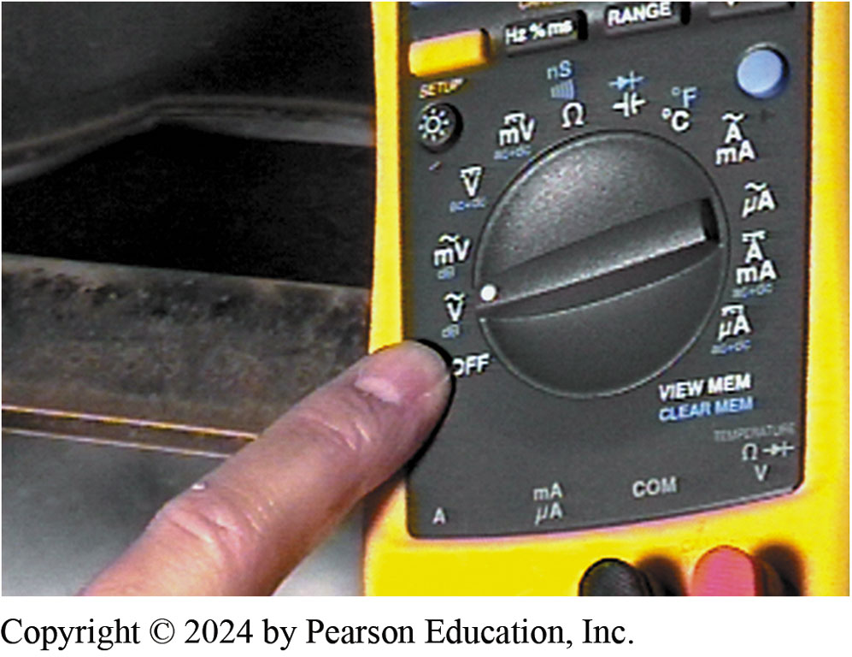
9. DMM on AC Volt to Check Output
9. To measure the output of the wheel speed sensor, select AC volts on the digital multimeter

Slide 61
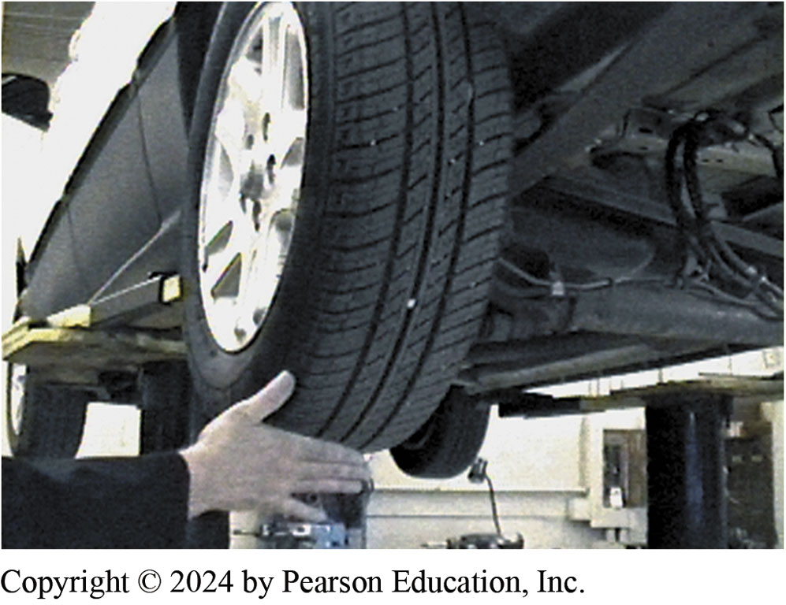
10. Rotate Wheel Check AC Output
10. Rotate the wheel and tire assembly by hand while observing the AC voltage output on the digital multimeter

Slide 62
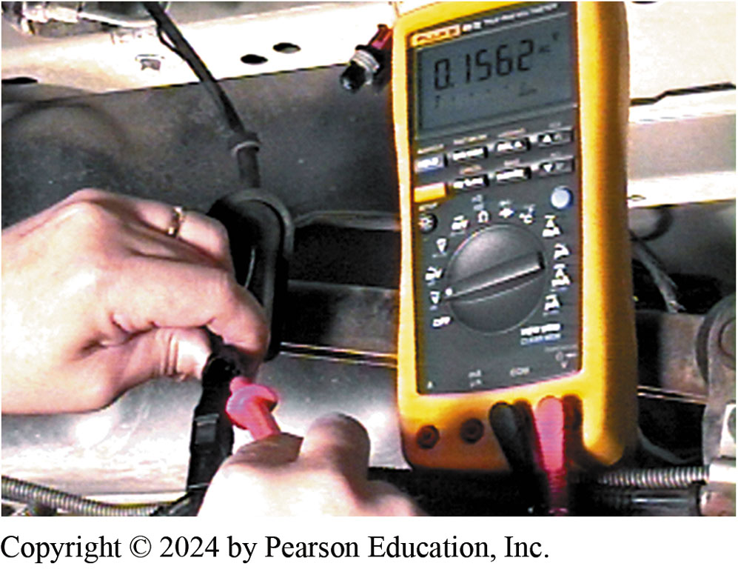
11. Reading 0.1562 Volts, Good
11. A good wheel speed sensor should be able to produce at least 100 mV (0.1 V) when the wheel is spun by hand

Slide 63
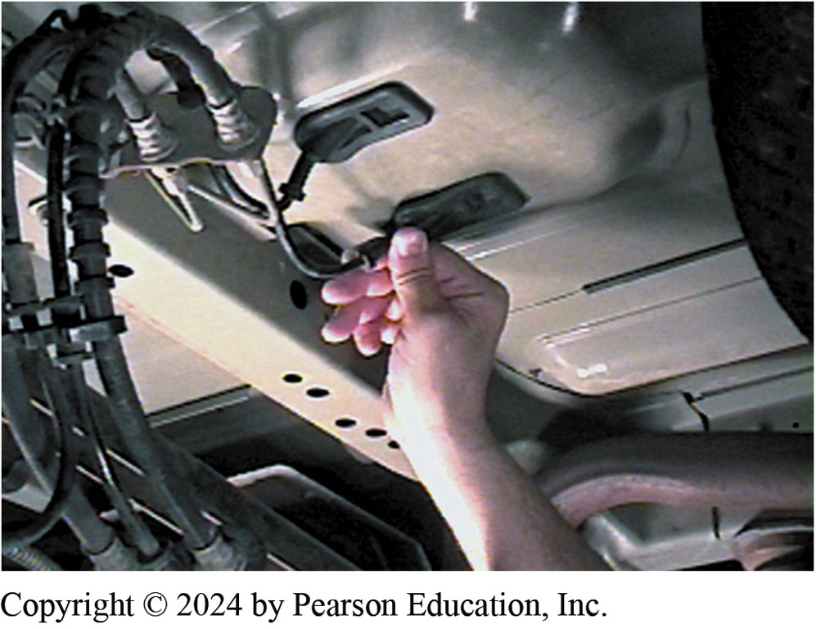
12. Reinstall Wiring
12. After testing, carefully reinstall the wiring connector into the body and under the rubber grommet

Slide 64
Brakes Videos and Animations
Videos Link: (A5) Brakes Videos
Animations Link: (A5) Brakes Animations

Slide 65

Copyright
This work is protected by United States copyright laws and is provided solely for the use of instructors in teaching their courses and assessing student learning. Dissemination or sale of any part of this work (including on the World Wide Web) will destroy the integrity of the work and is not permitted. The work and materials from it should never be made available to students except by instructors using the accompanying text in their classes. All recipients of this work are expected to abide by these restrictions and to honor the intended pedagogical purposes and the needs of other instructors who rely on these materials.

