Slide 1
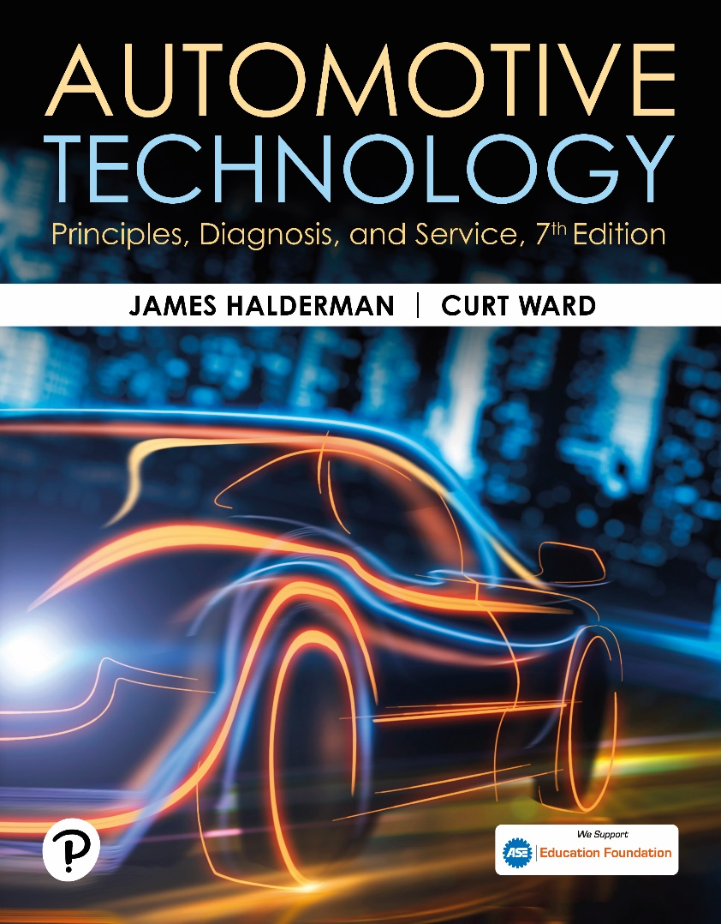
Automotive Technology: Principles, Diagnosis, and Service
Seventh Edition
Chapter 104
Power Brake Unit Operation, Diagnosis, and Service
Copyright © 2023 Pearson Education, Inc. All Rights Reserved
Notes:
INSTRUCTOR NOTE: This presentation includes text explanation notes, you can use to teach the course. When in SLIDE SHOW mode, you RIGHT CLICK and select SHOW PRESENTER VIEW, to use the notes.

Slide 2
Learning Objectives (1 of 2)
104.1 Discuss the need for power brake assist.
104.2 State the principles of vacuum.
104.3 Discuss vacuum booster theory.
104.4 Discuss the operation of a vacuum check valve.
104.5 Discuss the operation of a vacuum brake booster.
104.6 Describe dual-diaphragm vacuum boosters.
104.7 Discuss the brake assist system.

Slide 3
Learning Objectives (2 of 2)
104.8 Discuss the vacuum booster operation test.
104.9 Describe the vacuum booster leak test.
104.10 Describe the hydraulic system leak test.
104.11 Describe how to adjust the pushrod length.
104.12 Explain the operation and diagnosis of Hydro-Boost hydraulic brake booster.
104.13 List Hydro-Boost symptoms and possible causes.

Slide 4
Need for Power Brake Assist
To double the stopping power of a disc brake, the driver must double the force on the brake pedal.
When a power booster is fitted, the brake pedal ratio is decreased and the master cylinder bore size is increased.
The combined effect of these changes is to reduce pedal effort, while greatly increasing pedal reserve.

Slide 5
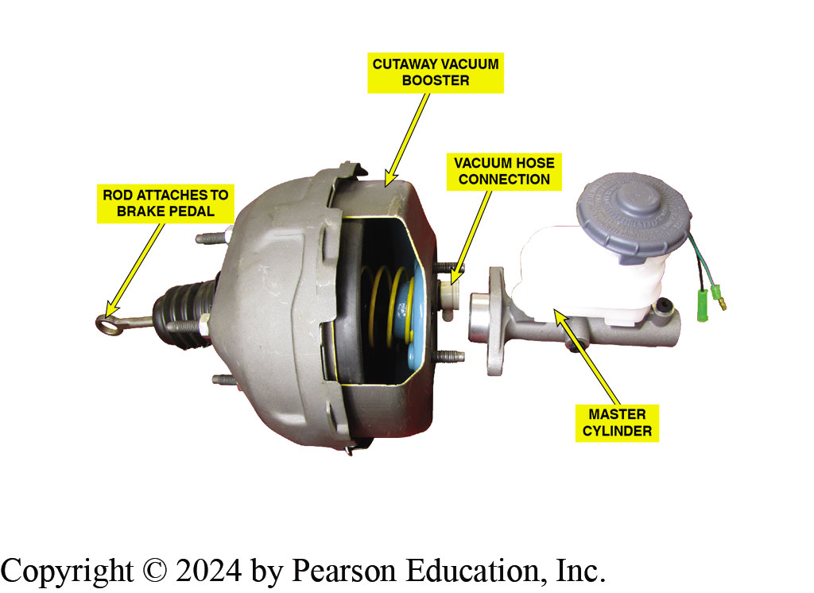
Figure 104.1 Vacuum Booster
Typical Vacuum Brake Booster Assembly. Vacuum Hose Attaches to the Intake Manifold of the Engine

Slide 6
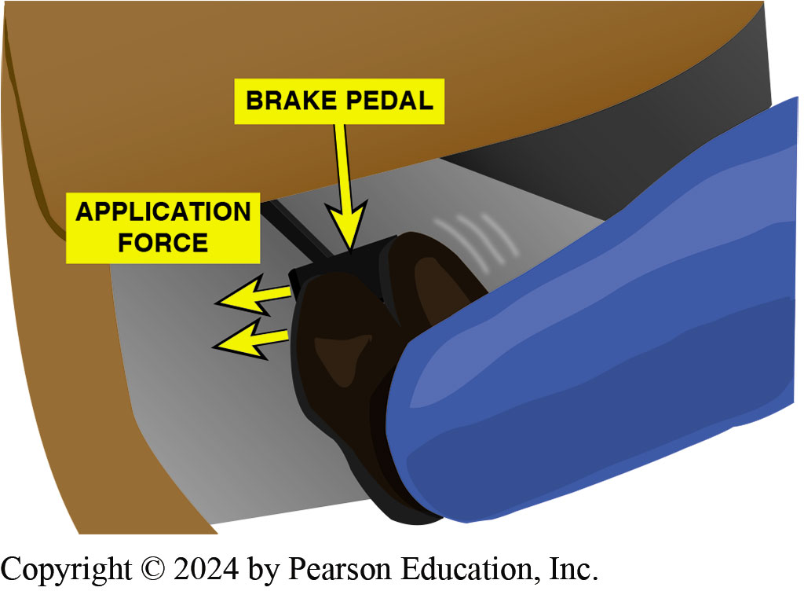
Figure 104.2 Wide Brake Pedal
A Wide Brake Pedal allows Two-Foot Braking if Power Assist is Lost

Slide 7
Principles of Vacuum
Vacuum refers to pressure lower than atmospheric pressure.
Measuring Vacuum
Vacuum measured in inches of mercury (in. Hg) or in millimeters of mercury (mm Hg)
Indicates how far a column of mercury in a tube will rise when a vacuum is applied at one end and atmospheric pressure at the other.
Booster Vacuum Supply
Vacuum boosters get their vacuum supply from the engine or a small electric or belt-driven pump.

Slide 8
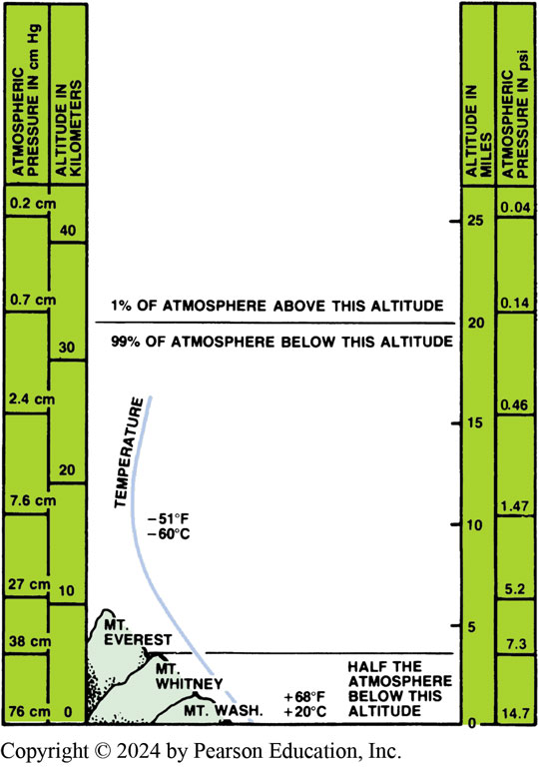
Figure 104.3 Atmospheric Pressure
Atmospheric Pressure Varies with Altitude

Slide 9
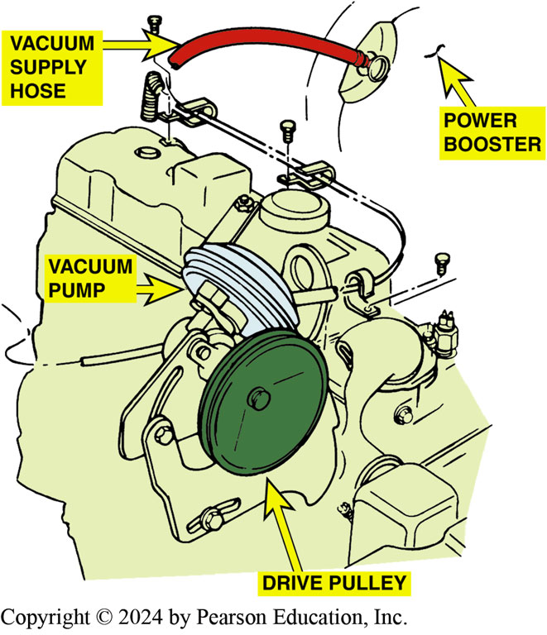
Figure 104.4 Vacuum Pump
A Belt-Driven Auxiliary Vacuum Pump

Slide 10
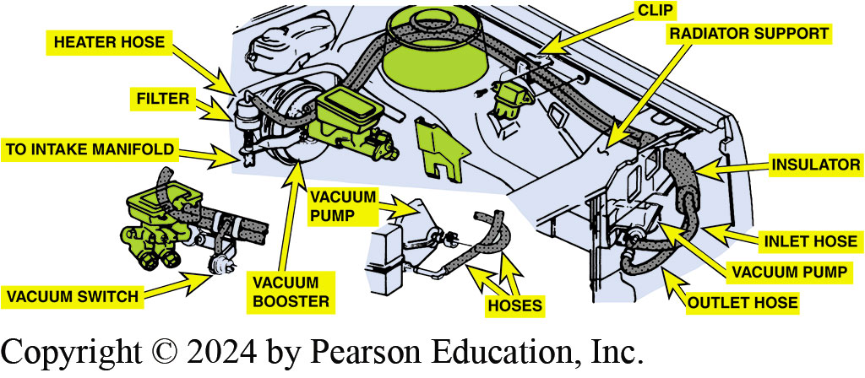
Figure 104.5 Electric Vacuum Pump
Electrically Powered Vacuum Pump
Notes:
TECH TIP: Check the Vacuum, Then the Brakes
A customer complained of a very rough idle and an occasional pulsating brake pedal. The customer was certain that the engine required serious work since there were over 100,000 miles on the vehicle. During the troubleshooting procedure, a spray cleaner was used to find any vacuum (air) leaks. A large hole was found melted through a large vacuum hose next to the vacuum hose feeding the vacuum-operated power brake booster.
After repairing the vacuum leak, the vehicle was test driven again to help diagnose the cause of the pulsating brake pedal. The engine idled very smoothly after the vacuum leak was repaired and
the brake pulsation was also cured. The vacuum leak resulted in lower-than-normal vacuum being applied to the vacuum booster. During braking, when engine vacuum is normally higher (deceleration), the vacuum booster would assist, then not assist when the vacuum was lost. This on-and-off supply of vacuum to the vacuum booster was noticed by the driver as a brake pulsation. Always check the vacuum at the booster whenever diagnosing any brake problems. Most vehicle manufacturers specify a minimum of 15 in. Hg of vacuum at the booster. The booster should be able to provide at least two or three stops even with no vacuum. The booster should also be checked to see if it can hold a vacuum after several hours. A good vacuum booster, for example, should be able to provide a power assist after sitting all night without starting the engine.

Slide 11
Vacuum Booster Theory
Vacuum boosters use principle of pressure differential to increase brake application force.
Vacuum booster has a power chamber separated into 2 smaller chambers by a flexible diaphragm.
When air pressure is greater on one side of the diaphragm than the other, a pressure differential is created.
Amount of force created in this manner is proportional to the difference in pressure between the two sides.

Slide 12
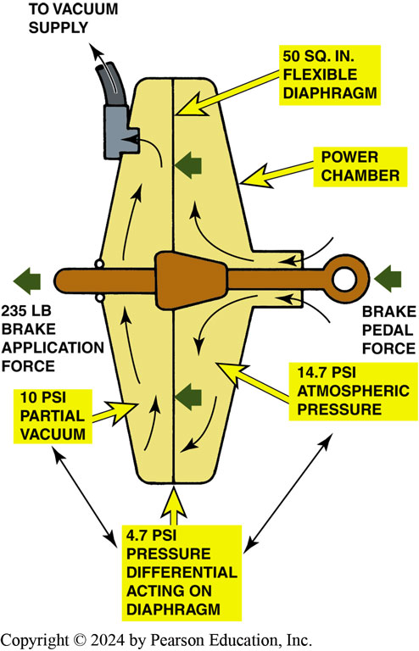
Figure 104.6 Vacuum Booster Theory
Vacuum Brake Boosters Operate on the Principle of Pressure Differential

Slide 13
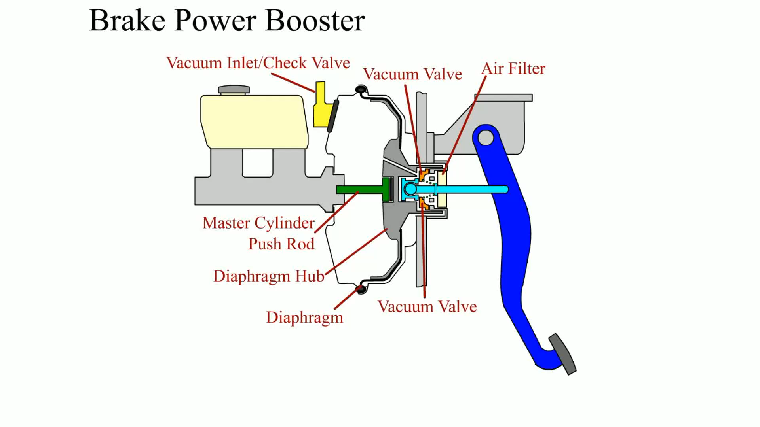
Animation: Brake Power Booster (Animation will automatically start)

Slide 14
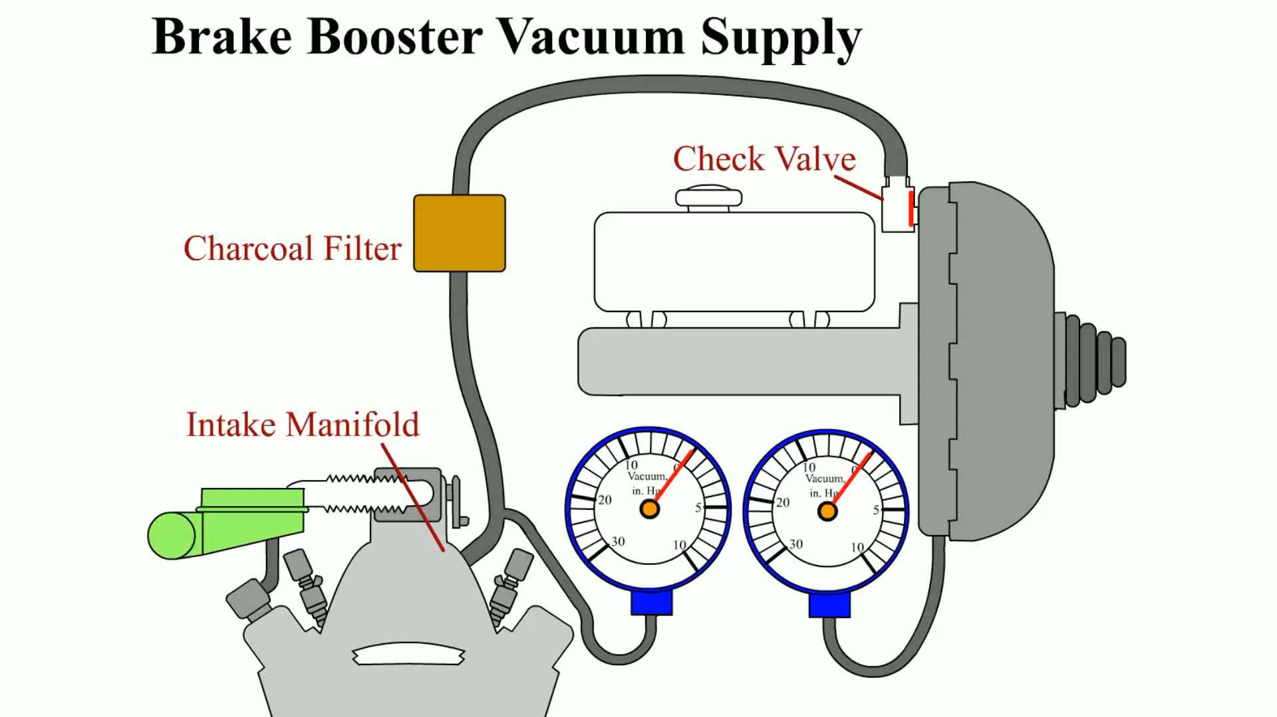
Animation: Brake Booster Vacuum Supply (Animation will automatically start)

Slide 15
Question 1: ?
What is the purpose of the brake booster?

Slide 16
Answer 1
To increase the stopping force without increasing the pedal force.

Slide 17
Vacuum Check Valve
All vacuum boosters use a one-way vacuum check valve.
This valve prevents loss of vacuum when the engine stops.

Slide 18
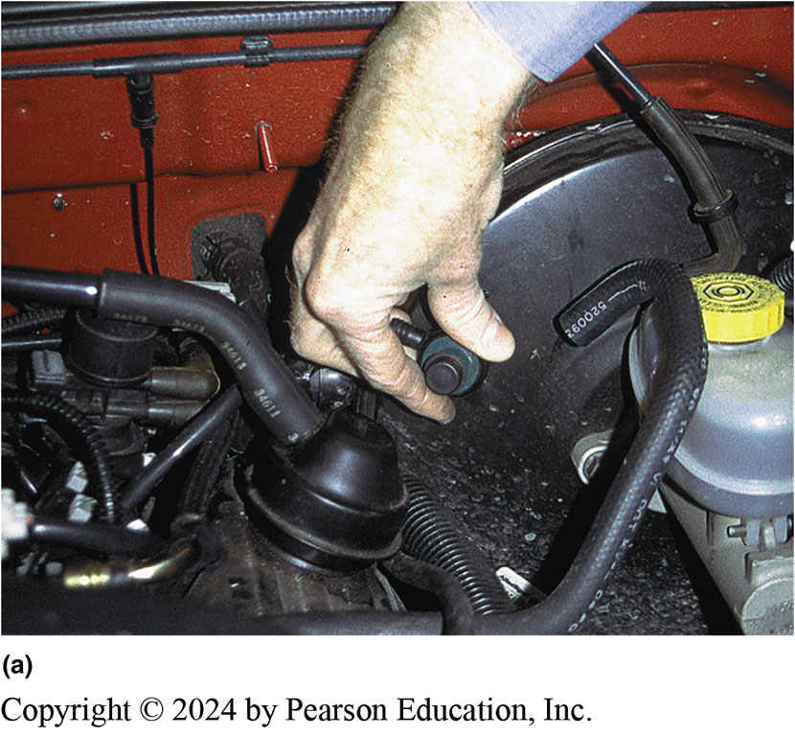
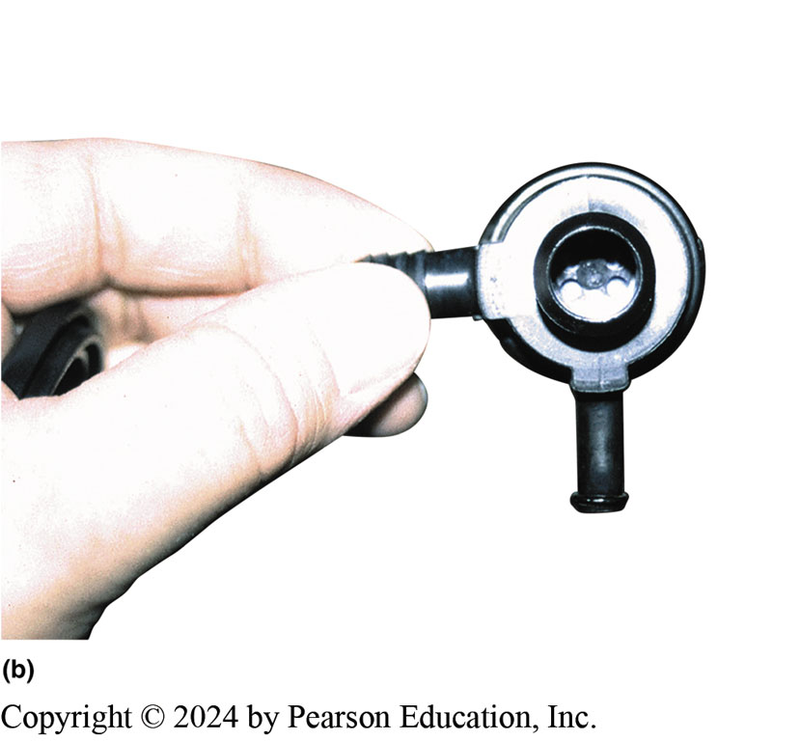
Figure 104.7 Vacuum Check Valve
Notes:
Figure 109.7 (a) Many Vacuum Brake Booster Check Valves are Located where the Vacuum Hose from the Engine (Vacuum Source) Attaches to the Vacuum Booster. (b) This One-way Valve Prevents the Loss of Vacuum when the Engine is off. The Diaphragm Inside Allows Air to Flow in One Direction Only

Slide 19
Vacuum Brake Booster Operation (1 of 2)
Released-Position Operation
The air valve is seated on the floating control valve, which shuts off the air.
Vacuum from the engine is present in the space on both sides of the power piston.
Applied-Position Operation
As the brake pedal is depressed, the floating control valve is moved toward its seat in the power piston, away from the rear of the booster.
Atmospheric air is allowed to enter between the air valve and the floating control valve pressurizing the rear section of the housing.

Slide 20
Vacuum Brake Booster Operation (2 of 2)
Hold-Position Operation
When the desired pedal position is reached the air valve is once again sealed against the floating control valve and is no longer blocking the vacuum passage in the power piston.
Vacuum-Failure Mode
For safety in the event of a stalled engine and a loss of vacuum, a power brake booster should have adequate storage of vacuum for several power-assisted stops.

Slide 21
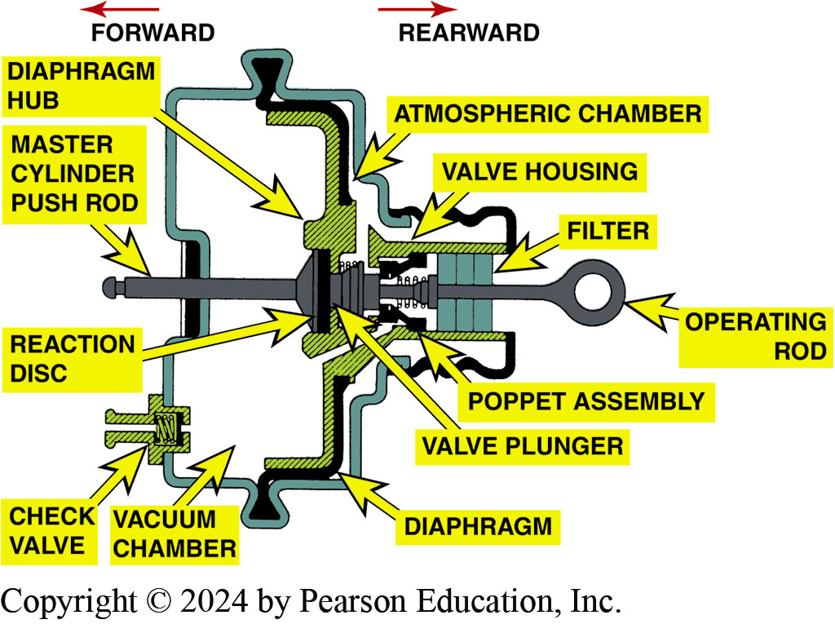
Figure 104.8 Booster Cross-Section
Cross-Sectional View of Typical Vacuum Brake Booster Assembly

Slide 22
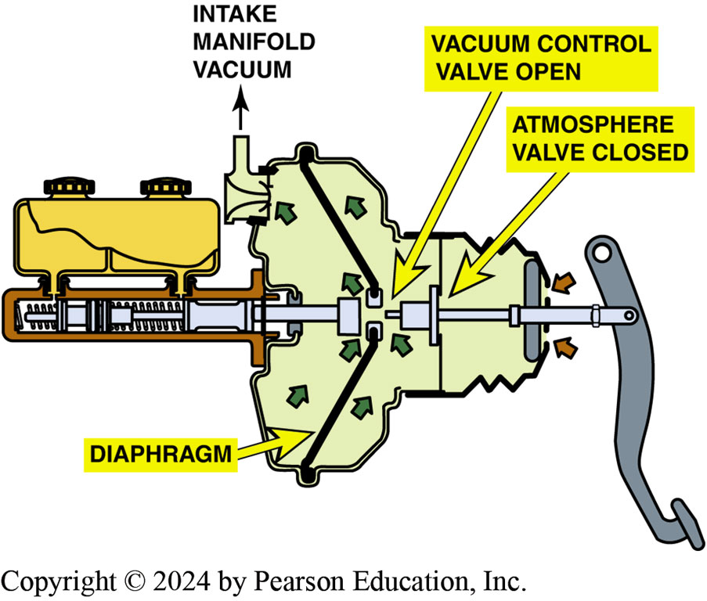
Figure 104.9 Released Position
In the Release Position (Brake Pedal Up), The Vacuum is Directed to Both Sides of the Diaphragm

Slide 23
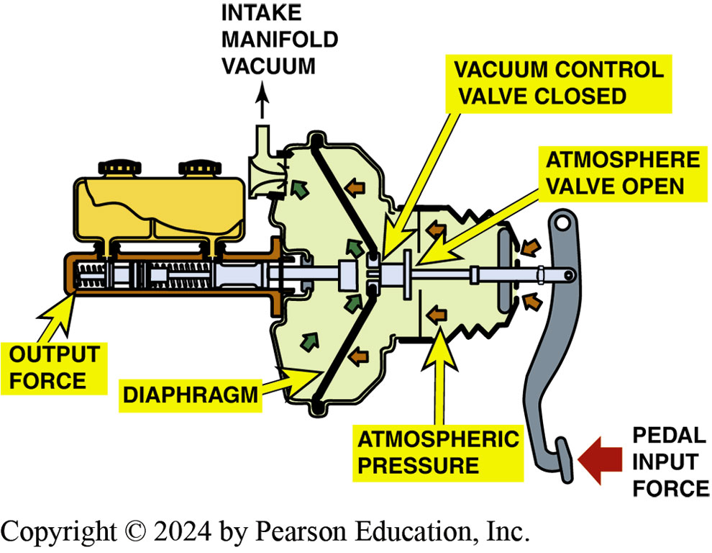
Figure 104.10 Applied Position
Vacuum Brake Booster in Apply Position. Notice that Atmospheric Valve is Open and Air Pressure is Being Applied to the Diaphragm

Slide 24
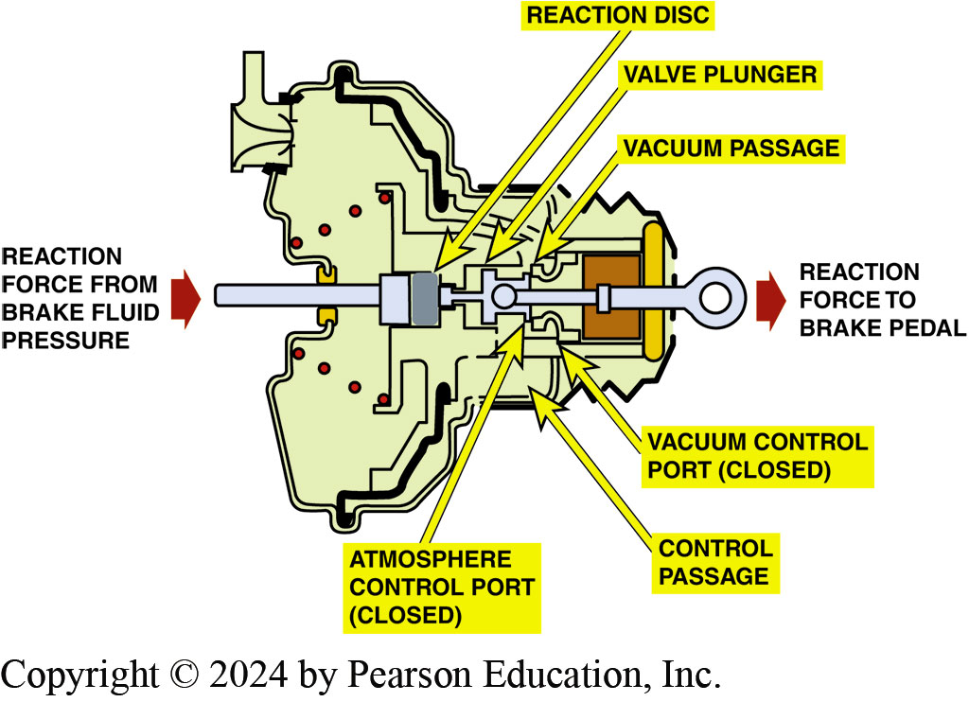
Figure 104.11 Hold Position
Cross Section of a Vacuum Brake Booster in the Hold Position with both Vacuum and Atmospheric Valves Closed. Note that the Reaction Force from the Brake Fluid Pressure is Transferred Back to the Driver as a Reaction Force to the Brake Pedal
Notes:
TECH TIP: A Low, Soft Brake Pedal Is Not a Power Booster Problem
Some service technicians tend to blame the power brake booster if the vehicle has a low, soft brake pedal. A defective power brake booster causes a hard brake pedal, not a soft brake pedal. A soft or spongy brake pedal is usually caused by air being trapped somewhere in the hydraulic system.
Many times, the technician has bled the system and, therefore, thinks that the system is free of any trapped air. According to remanufacturers of master cylinders and power brake boosters, most of the returned parts under warranty are not defective. Incorrect or improper bleeding procedures account for much of the problem.

Slide 25
Dual - (Tandem) - Diaphragm Vacuum Boosters
To provide power assist, air pressure must work against a rubber diaphragm.
Instead of increasing the diameter, vacuum booster manufacturers used two smaller-diameter diaphragms and placed one in front of the other.
These designs increased the total area without increasing the physical diameter of the booster.

Slide 26
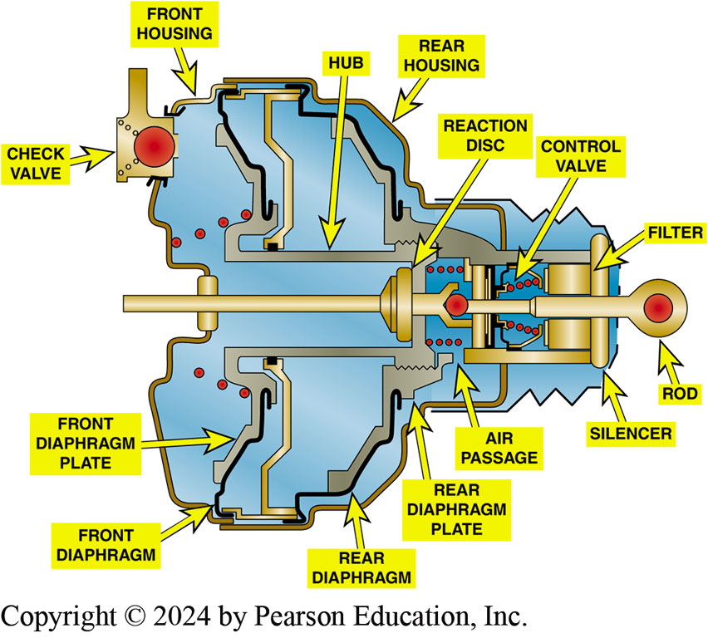
Figure 104.12 Dual-Diaphragm
Cutaway Showing a Dual-Diaphragm (Tandem) Vacuum Brake Booster

Slide 27
Brake Assist System
Purpose and Function
Applies brakes with maximum force if system detects that driver is making a panic stop.
Operation
Brake assist system uses a solenoid to open an air valve on the rear part of the vacuum booster assembly.
Allows more air at atmospheric pressure into the chamber and increase the stopping pressure.
Brake switch input is required for operation.

Slide 28
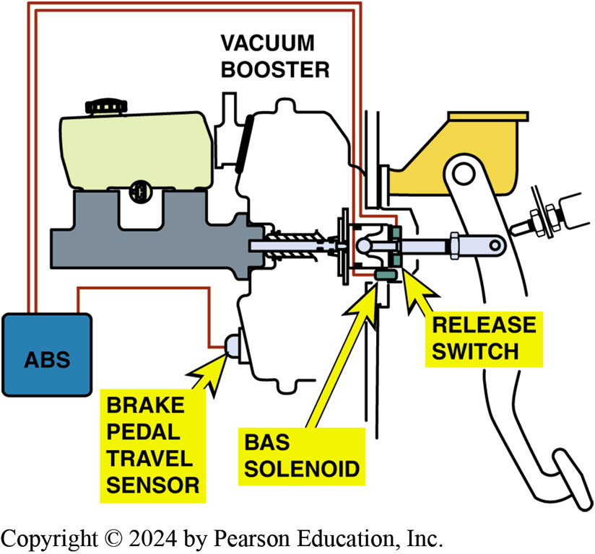
Figure 104.13 Brake Assist System
A Typical Brake Assist System uses a Brake Pedal Travel Sensor and a BAS Solenoid to Apply The Brakes During a Panic Condition

Slide 29
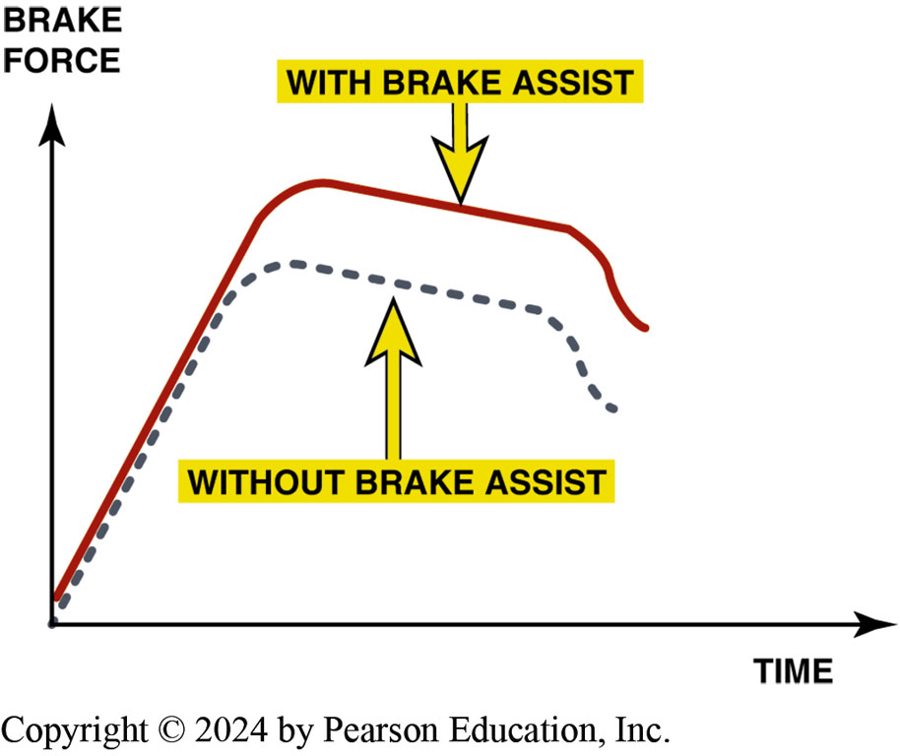
Figure 104.14 Brake Force Higher
When the Brake Assist Function Operates, the Brake Force is Much Higher than Normal

Slide 30
Question 2: ?
What is the purpose of the brake assist system?

Slide 31
Answer 2
To provide additional stopping force in a panic stop situation.

Slide 32
Vacuum Booster Operation Test
Engine “off,” apply brakes several times to deplete vacuum.
With your foot on brake pedal, start engine.
Brake pedal should drop.
If brake pedal does not drop, check for proper vacuum source to the booster.
If there is proper vacuum, repair or replacement of the power booster is required.

Slide 33
Vacuum Booster Leak Test
To test if vacuum booster can hold a vacuum, perform the following steps:
Operate engine to build up a vacuum in booster
Then turn engine off.
Wait one minute.
Depress the brake pedal several times.
There should be 2 or more power-assisted brake applications.

Slide 34
Hydraulic System Leak Test
After depleting the power-assist unit, depress and then hold the brake pedal depressed with medium force (20 to 35 lb or 88 to 154 N).
The brake pedal should not fall away.
If the pedal falls, the hydraulic brake system is leaking.

Slide 35
Pushrod Clearance Adjustment
Whenever the vacuum brake booster or the master cylinder is replaced, the pushrod length should be checked.
An incorrect pushrod length can cause a low pedal or a brake system that does not fully release.
A gauge is often used to measure the position of the master cylinder piston, and then the other end of the gauge is used to determine the proper pushrod clearance.

Slide 36
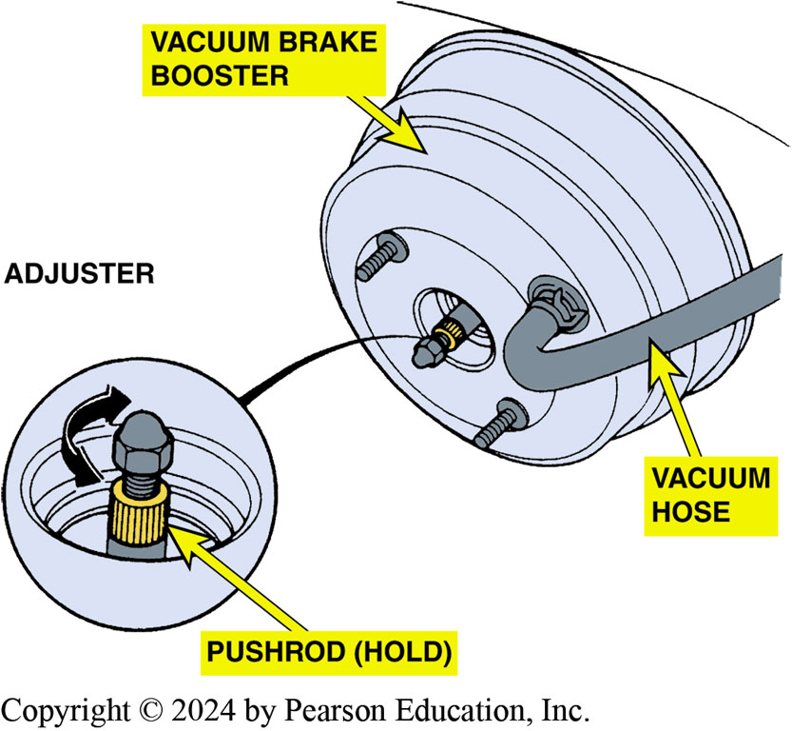
Figure 104.15 Pushrod Adjustment
Typical Adjustable Pushrod. This Adjustment is Critical for the Proper Operation of the Braking System. If the Pushrod is too Long, The Brakes May be Partially Applied During Driving. If the Rod is Too Short, The Brake Pedal May Have to be Depressed Farther Down Before the Brakes Start to Work

Slide 37
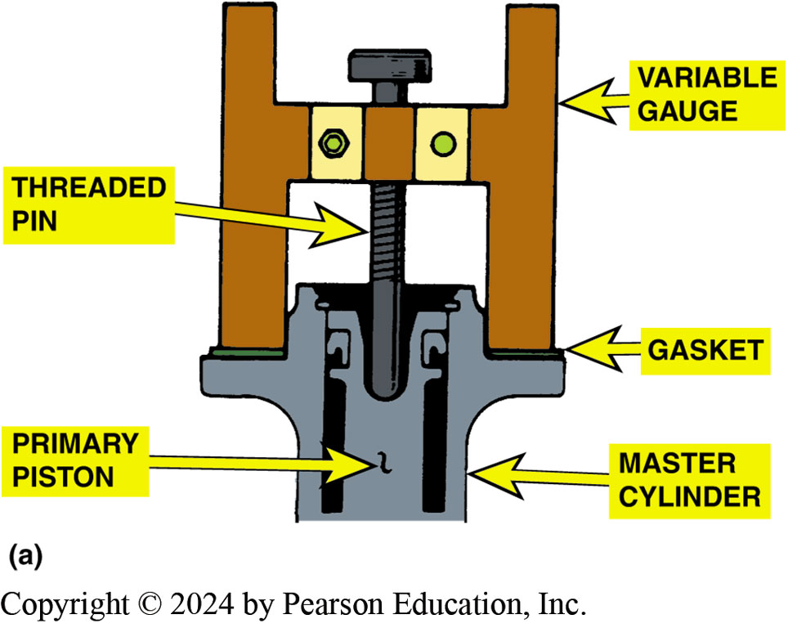
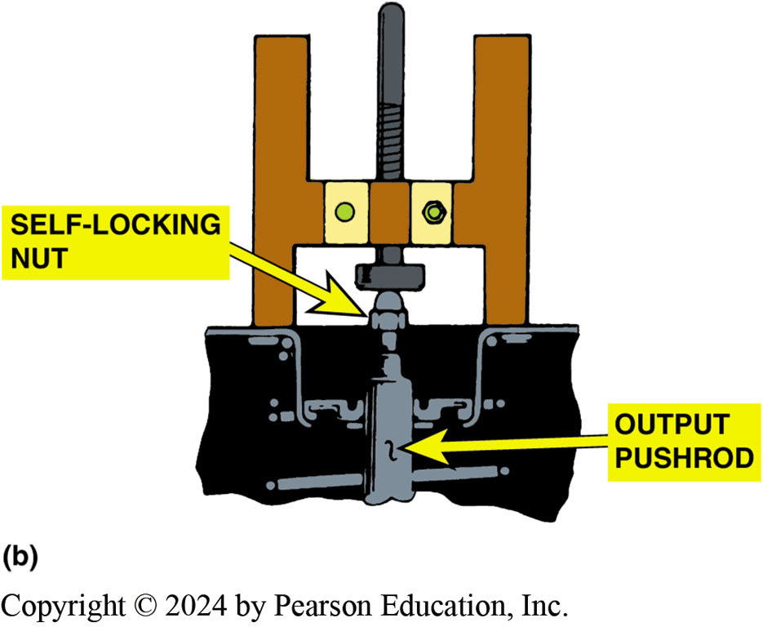
Figure 104.16 Booster Pushrod Adj.
(a) The tool is First Placed Against the Mounting Flange of the Master Cylinder and the Depth of the Piston Determined. (b) The gauge is then Turned Upside Down and used to Gauge the Pushrod Length.
Notes:
Figure 104.16 Typical Vacuum Brake Booster Pushrod Gauging Tool. (a) The tool is First Placed Against the Mounting Flange of the Master Cylinder and the Depth of the Piston Determined. (b) The gauge is then Turned Upside Down and used to Gauge the Pushrod Length.

Slide 38
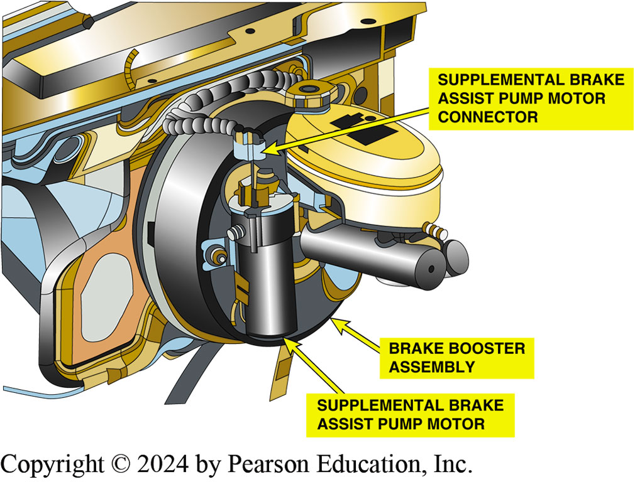
Figure 104.17 BAS Pump
The supplemental brake assist (BAS) pump mounts on the brake booster housing.

Slide 39
Frequently Asked Question: What Is Supplemental Brake Assist?
? Frequently Asked Question
What Is Supplemental Brake Assist? SBA is a motor-driven vacuum pump that can supplement engine vacuum to vacuum brake booster. This unit is used on some GM vehicles. When a vehicle is driven under a heavy load, engine vacuum is low. To meet brake standards, some are equipped with the brake assist system that consists of following components: Pressure sensor that is used to measure vacuum in vacuum booster, An intake manifold check valve that is used to prevent vacuum from escaping vacuum boost. A motor-driven vacuum pump. Vacuum pump motor will start and run if the pressure sensor detects the vacuum in booster is below 7 in. Hg and will shut off after vacuum level increases to 9 in. Hg. SEE FIGURE 104-17.
Notes:
What Is Supplemental Brake Assist? Supplemental brake assist (SBA) is a motor-driven vacuum pump that can supplement engine vacuum to the vacuum brake booster. This unit is used on some General Motors vehicles. When a vehicle is driven under a heavy load, engine vacuum is low. To meet the brake standards, some vehicles are equipped with the brake assist system that consists of the following components:
A pressure sensor that is used to measure the vacuum in the vacuum booster.
An intake manifold check valve that is used to prevent vacuum from escaping the vacuum boost.
A motor-driven vacuum pump. The vacuum pump motor will start and run if the pressure sensor detects the vacuum in the booster is below 7 in. Hg and will shut off after the vacuum level increases to 9 in. Hg. SEE FIGURE 104-17

Slide 40
Hydro-Boost Hydraulic Brake Booster (1 of 2)
Purpose
The system uses the pressurized hydraulic fluid from the vehicle’s power steering pump as a power source rather than using engine vacuum as is used with vacuum boosters.
Operation
When the brake pedal is depressed, the spool valve closes off the return port, causing pressure to build in the boost pressure chamber.

Slide 41
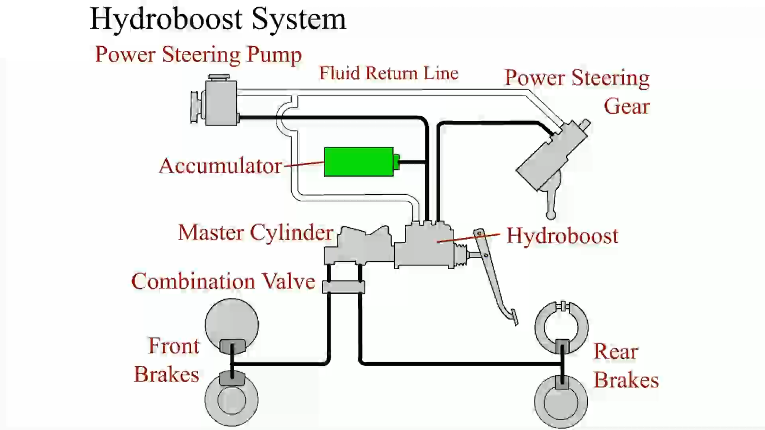
Animation: Hydro-boost System (Animation will automatically start)

Slide 42
Hydro-Boost Hydraulic Brake Booster (2 of 2)
Diagnosis
Checking for proper power steering fluid level.
Checking for leaks from unit or power steering pump.
Checking condition and tightness of power steering drive belt.
After checking all of the visual components, check for proper pressure and volume from the power steering pump using a power steering pump tester.

Slide 43
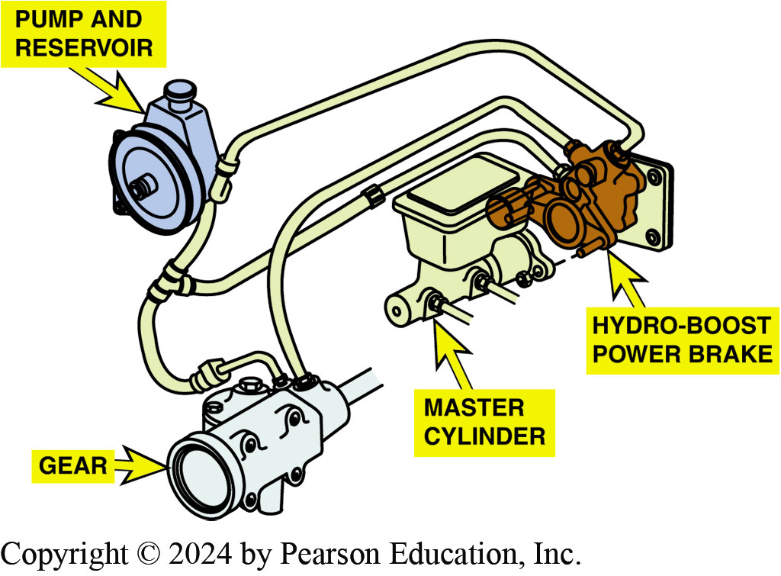
Figure 104.18 Hydro-Boost
Hydro-Boost Unit Attaches between the Bulkhead and The Master Cylinder and is Powered by the Power Steering Pump

Slide 44
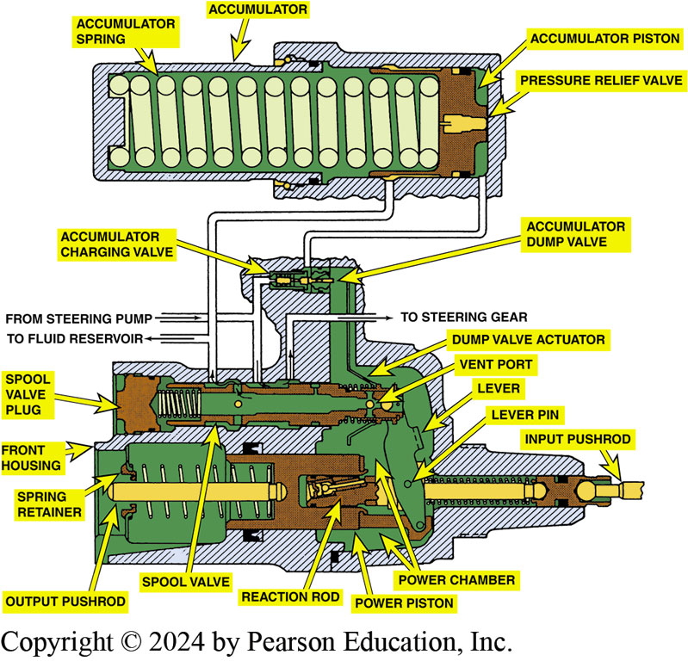
Figure 104.19 Unapplied
A Hydro-Boost Hydraulic Booster in the Unapplied Position

Slide 45
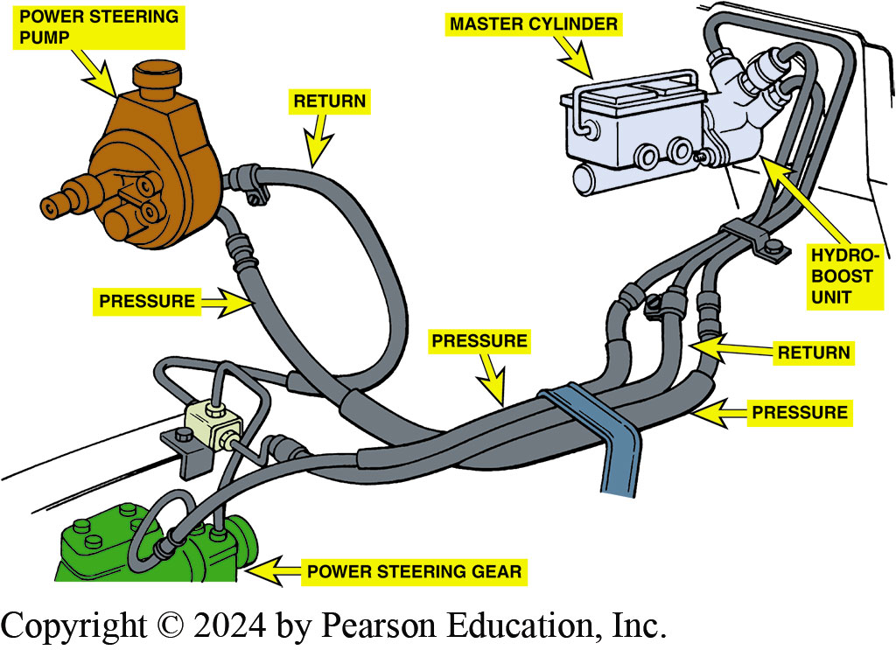
Figure 104.20 Line Arrangement
A Typical Hydro-Boost Hydraulic Line Arrangement Showing the Pump, Steering Gear, and Brake Booster Assembly

Slide 46
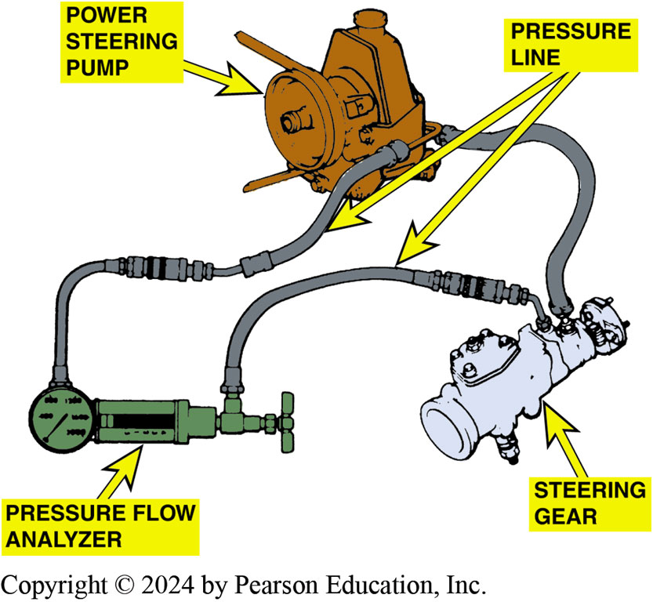
Figure 104.21 Flow Analyzer
Pressure and Flow Analyzer Installation to Check the Power Steering Pump Output

Slide 47
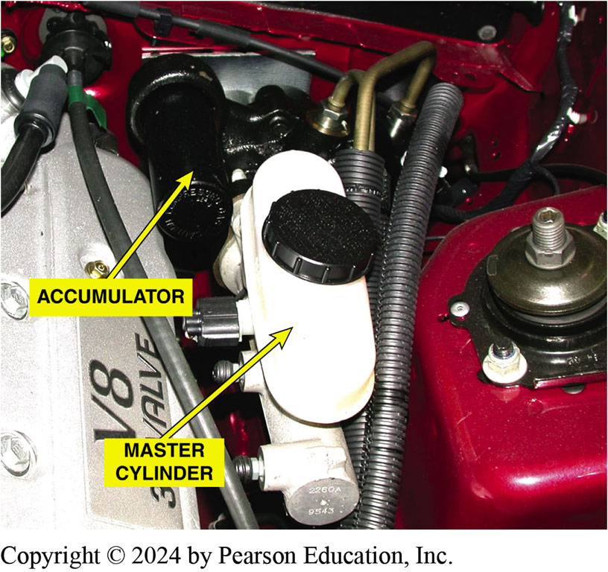
Figure 104.22 Accumulator Test
The Accumulator Should be able to Hold Pressure and Feel Tight when Hand Force is Used to Try to Move it
Notes:
TECH TIP: The Hydro-Boost Accumulator Test
The accumulator stores hydraulic fluid under pressure to provide a reserve in the event of a failure of the power steering system. The accumulator is designed to provide three or more power-assisted stops with the engine off. ^{● SEE FIGURE 104–22.} If the accumulator fails, it does not hold pressure. To easily check whether the accumulator has lost its charge, simply grasp the accumulator with your hand and try to twist or move it. The accumulator should have so much pressure on it that it should not move or wiggle. If the accumulator moves, it has lost its ability to hold pressure and the Hydro-Boost unit should be replaced.

Slide 48
Frequently Asked Question: How Does an Electric Power Brake Assembly Work?
? Frequently Asked Question
How Does an Electric Power Brake Assembly Work? The base brakes used on electric vehicle use an electric motor actuator to increase the force applied by the driver to the hydraulic system. An electric vehicle does not have an internal combustion engine and therefore does not have engine vacuum, which is used by most power brake systems used on most vehicles.
Notes:
What Is Supplemental Brake Assist? Supplemental brake assist (SBA) is a motor-driven vacuum pump that can supplement engine vacuum to the vacuum brake booster. This unit is used on some General Motors vehicles. When a vehicle is driven under a heavy load, engine vacuum is low. To meet the brake standards, some vehicles are equipped with the brake assist system that consists of the following components:
A pressure sensor that is used to measure the vacuum in the vacuum booster.
An intake manifold check valve that is used to prevent vacuum from escaping the vacuum boost.
A motor-driven vacuum pump. The vacuum pump motor will start and run if the pressure sensor detects the vacuum in the booster is below 7 in. Hg and will shut off after the vacuum level increases to 9 in. Hg. SEE FIGURE 104-17

Slide 49
Hydro-Boost Symptom Based Guide
Excessive brake pedal effort
Slow brake pedal return
Grabby brakes
Boost chatters – pedal vibrates

Slide 50
Question 3: ?
How does a hydro-boost system provide assist?

Slide 51
Answer 3
When the brake pedal is depressed, the spool valve closes off the return port, causing pressure to build in the boost pressure chamber.

Slide 52
Brakes Videos and Animations
Videos Link: (A5) Brakes Videos
Animations Link: (A5) Brakes Animations

Slide 53

Copyright
This work is protected by United States copyright laws and is provided solely for the use of instructors in teaching their courses and assessing student learning. Dissemination or sale of any part of this work (including on the World Wide Web) will destroy the integrity of the work and is not permitted. The work and materials from it should never be made available to students except by instructors using the accompanying text in their classes. All recipients of this work are expected to abide by these restrictions and to honor the intended pedagogical purposes and the needs of other instructors who rely on these materials.

