Slide 1
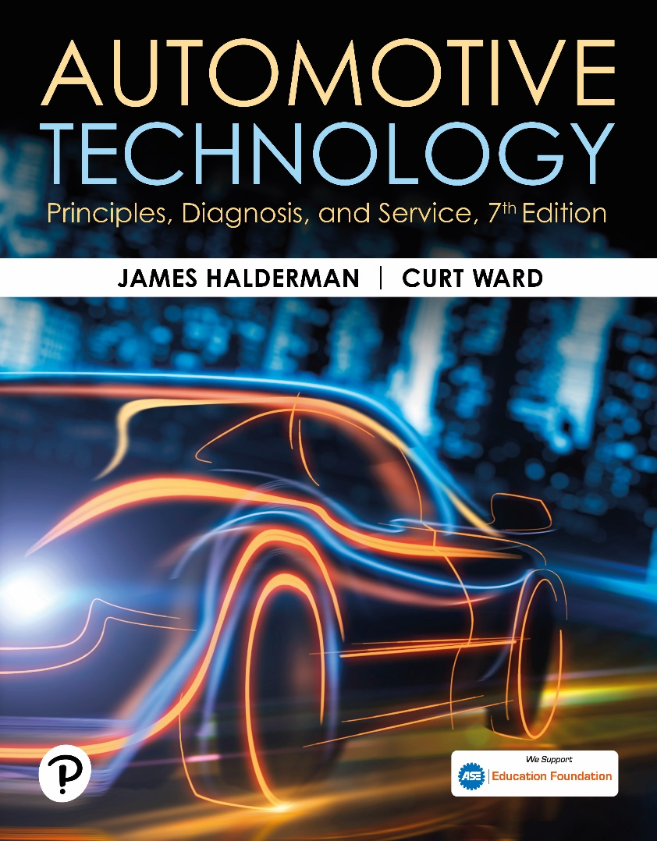
Automotive Technology: Principles, Diagnosis, and Service
Seventh Edition
Chapter 103
Machining Brake Drums and Rotors
Copyright © 2023 Pearson Education, Inc. All Rights Reserved
Notes:
INSTRUCTOR NOTE: This presentation includes text explanation notes, you can use to teach the course. When in SLIDE SHOW mode, you RIGHT CLICK and select SHOW PRESENTER VIEW, to use the notes.

Slide 2
Learning Objectives (1 of 2)
103.1 Describe the types of brake drums.
103.2 Explain the factors that cause drum and rotor damage.
103.3 Discuss brake drum distortion.
103.4 Discuss brake drum removal.
103.5 Discuss “machine to” versus “discard.”
103.6 Explain how to machine a brake drum.
103.7 Discuss disc brake rotors.
103.8 Discuss disc brake rotor distortion.

Slide 3
Learning Objectives (2 of 2)
103.9 Discuss carbon-ceramic rotors.
103.10 Discuss disc brake rotor thickness.
103.11 Discuss when the rotors should be machined.
103.12 Describe rotor surface finish.
103.13 Explain the procedure for qualifying a brake lathe.
103.14 Discuss machining a disc brake rotor.
103.15 Discuss on-the-vehicle rotor machining.

Slide 4
Brake Drums
Cast-Iron Drums
Cast iron contains 3% carbon, which makes drum hard, yet brittle.
3% carbon content of cast iron also acts as a lubricant, which prevents noise during braking.
Aluminum Drums
Aluminum brake save weight, and transfer heat to surrounding air faster than cast iron or steel.
Aluminum brake drums use cast iron for friction surface area.

Slide 5
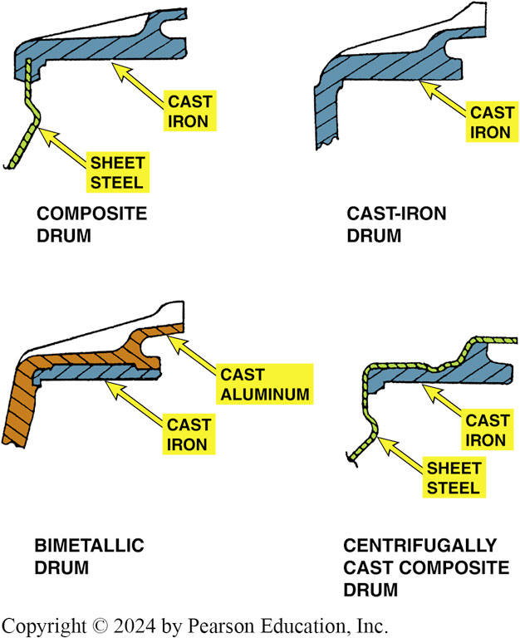
Figure 103.1 Drum Types
Types of brake drums. Regardless of the design, all types use cast iron as a friction surface

Slide 6
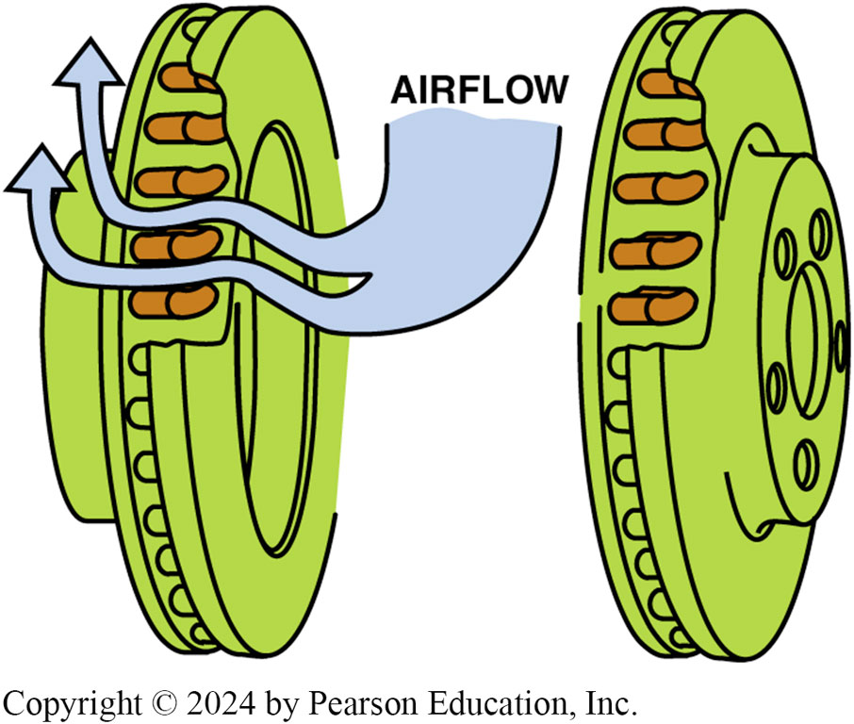
Figure 103.2 Vented Rotor
The airflow through cooling vents helps brakes from overheating

Slide 7
Brake Drum And Rotor Damage (1 of 2)
Scoring
Scoring is an extreme form of drum and rotor wear consisting of scratches, deep grooves, and a generally rough finish on the friction surface.
Cracking
Cracks in a brake drum or rotor are caused by stress of severe braking or an impact during an accident.

Slide 8
Brake Drum And Rotor Damage (2 of 2)
Heat Checking
Heat checking consists of many small, interlaced cracks on the friction surface.
Hard or Chill Spots
Hard or chill spots are an altering the structure of the metal caused by heat.

Slide 9
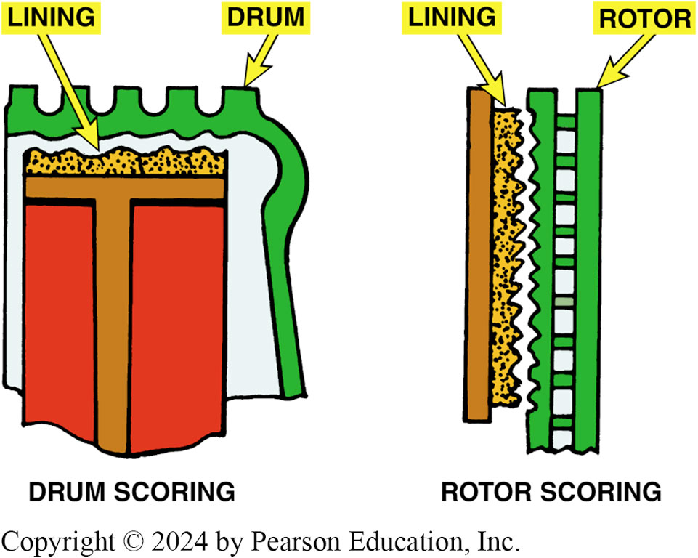
Figure 103.3 Scored Drums/Rotors
Scored drums and rotors often result in metal-to-metal contact

Slide 10
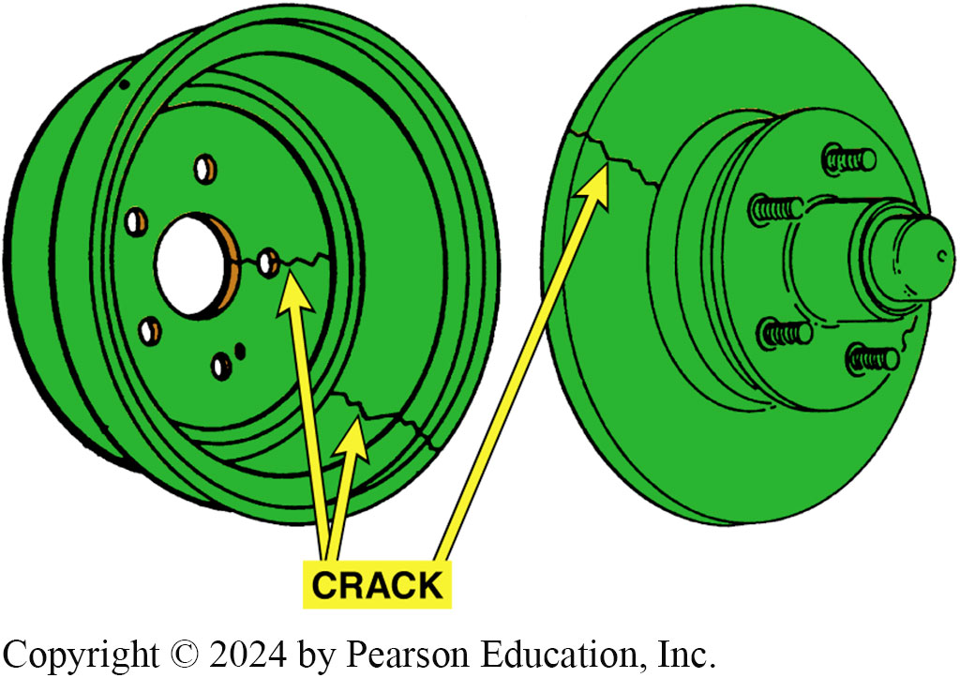
Figure 103.4 Cracked Drums/Rotors
Cracked drums or rotors must be replaced
Notes:
TECH TIP: The Tap Test
Using a steel hammer, lightly tap a brake drum or rotor. It should ring if it is not cracked. If a dull thud is heard, the drum or rotor is likely cracked and should be replaced.

Slide 11
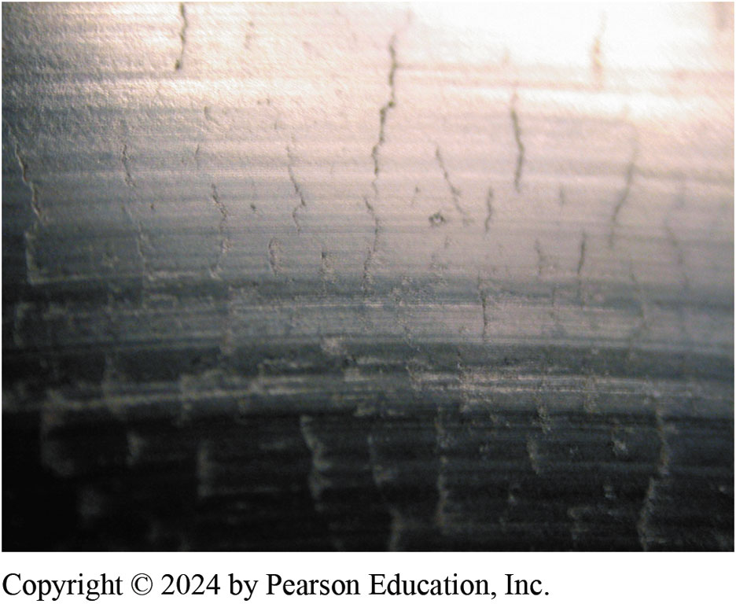
Figure 103.5 Disc Heat Checked
A heat-checked surface of a disc brake rotor

Slide 12
Question 1: ?
What are the four types of rotor damage?

Slide 13
Answer 1
Scoring, cracking, heat checking and hard spots.

Slide 14
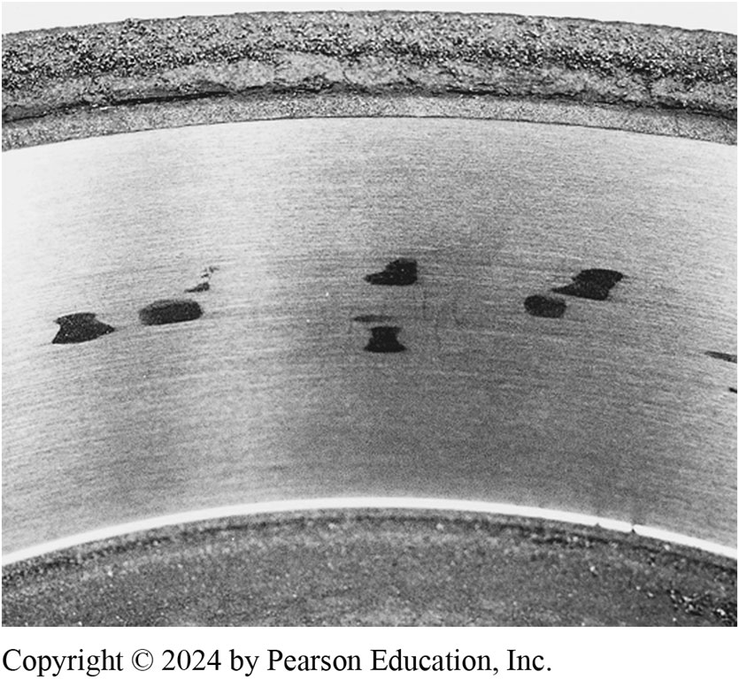
Figure 103.6 Hard Spots
These dark hard spots are created by heat that actually changes the metallurgy of the cast-iron drum. Most experts recommend replacement of any brake drum that has these hard spots

Slide 15
Brake Drum Distortion (1 of 2)
Drum Distortion
Drum distortion occurs when the friction surface does not return to its proper shape, is no longer parallel to the axle
Bellmouth Drums
Occurs when an open edge of a brake drum friction surface has a larger diameter than the closed edge.

Slide 16
Brake Drum Distortion (2 of 2)
Out-Of-Round Drums
A distortion in which the drum radius varies when measured at different points around its circumference.
Eccentric Drums
Eccentric distortion exists when the geometric center of the circle described by the brake drum friction surface is other than the center of the axle or the bolt circle of the drum web.

Slide 17
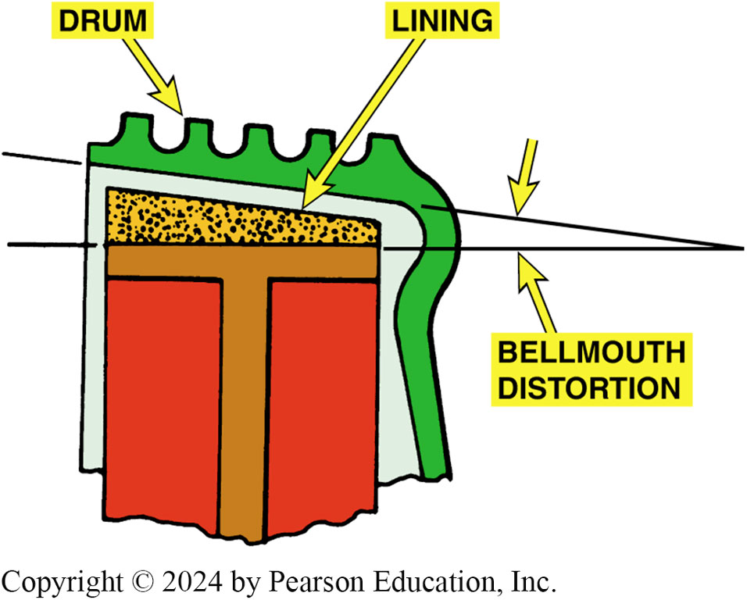
Figure 103.7 Bellmouth Drum
Bellmouth brake drum distortion

Slide 18
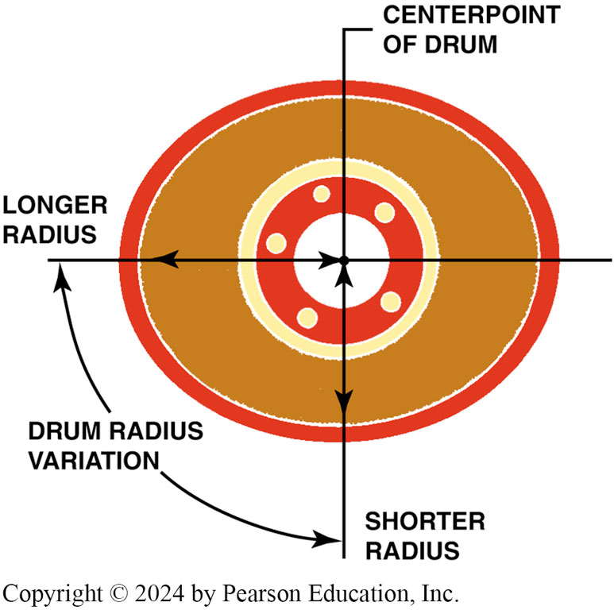
Figure 103.8 Out-of-Round Drum
Out-of-round brake drum distortion

Slide 19
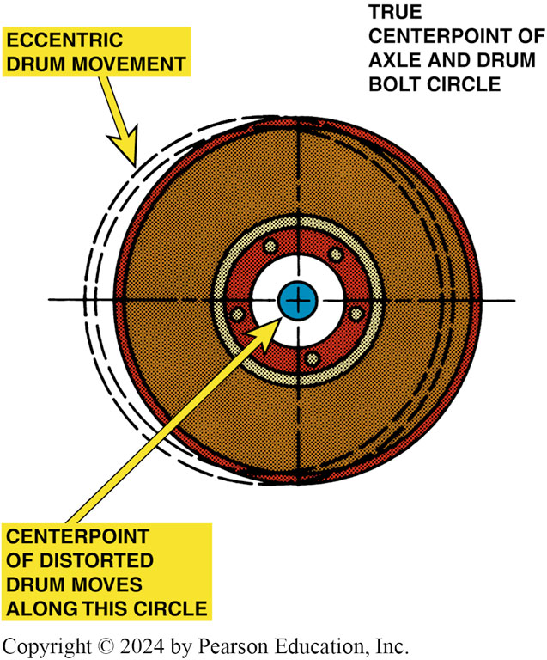
Figure 103.9 Eccentric Drum
Eccentric brake drum distortion

Slide 20
Removing Drums
First inspection step after removing a brake drum is to check it for warpage using a straightedge.
Warped drum is often a source of vibration.
Brake drum that is out-of-round can cause a brake pedal pulsation during braking.

Slide 21
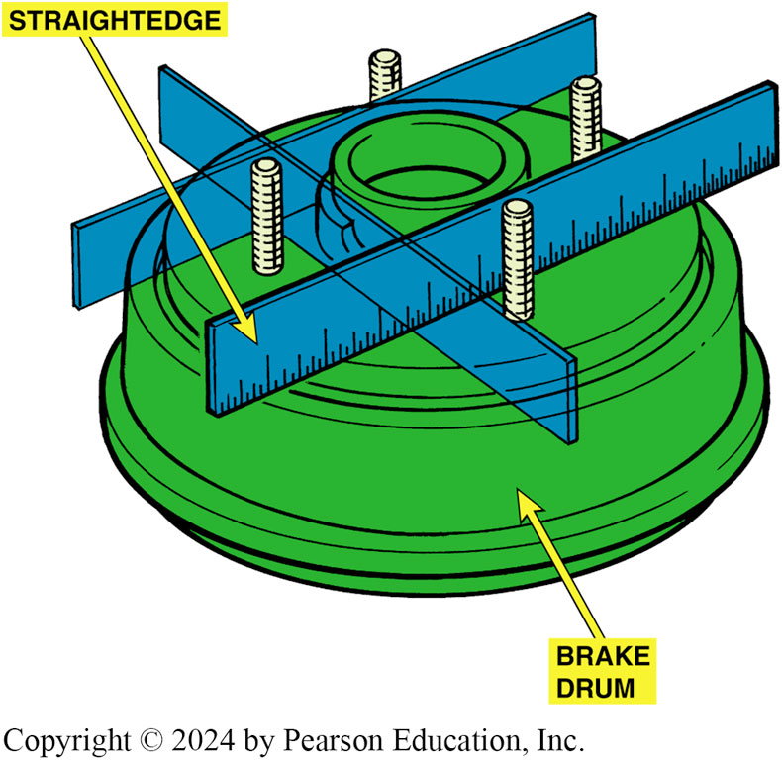
Figure 103.10 Straightedge Check
straightedge can be used to check for brake drum warpage

Slide 22
“Machine To” Versus “Discard”
Brake drums can be machined a maximum of 0.060 inch (1.5 mm) oversize unless otherwise stamped on drum.
Most brake experts recommend that both drums on the same axle be within 0.010 inch (0.25 mm) of each other.
Always leave at least 0.015 inch (0.4 mm) after machining (resurfacing) for wear. Many manufacturers recommend that 0.030 inch (0.8 mm) be left for wear.

Slide 23
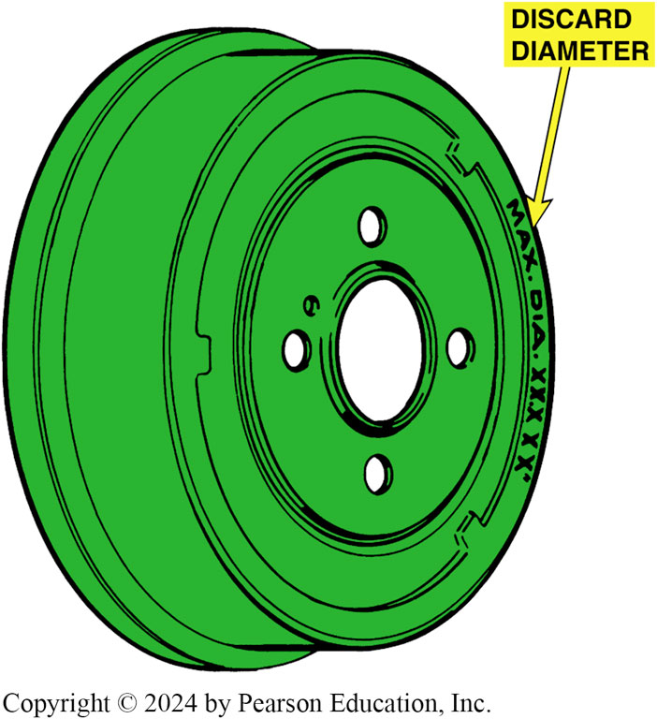
Figure 103.11 Discard Diameter
Discard diameter and maximum diameter are brake drum machining and wear limits

Slide 24
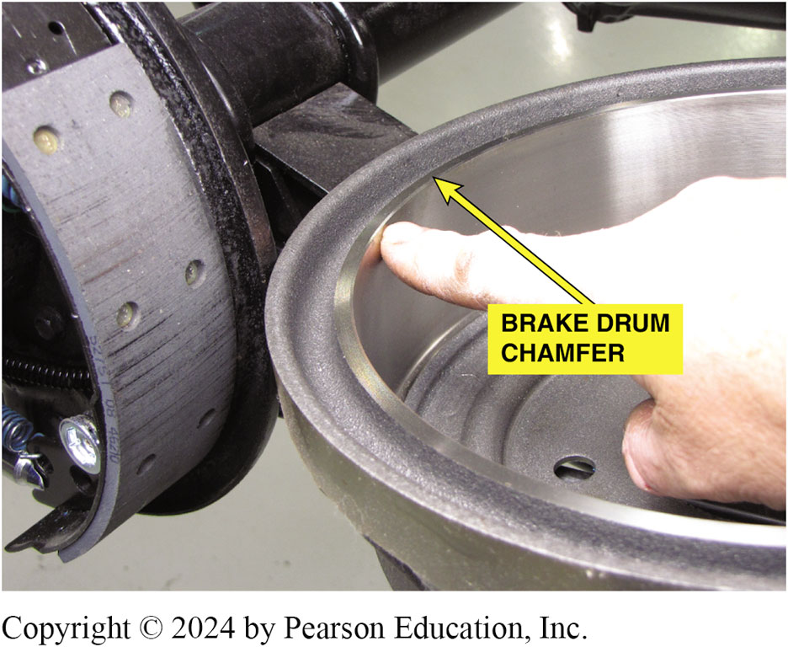
Figure 103.12 Drum Chamfer
Most brake drums have a chamfer around the edge. If the chamfer is no longer visible, the drum is usually worn (or machined) to its maximum allowable ID
Notes:
TECH TIP: Brake Drum Chamfer
Look at the chamfer on the outer edge of most brake drums. When the chamfer is no longer visible, the brake drum is usually at or past its maximum ID. SEE FIGURE 103-12. This chamfer is not an accurate gauge of the ID of the brake drum, it still is a helpful indicator to the technician.

Slide 25
Machining Brake Drums
Measuring a Drum
Brake drums are usually measured using a micrometer especially designed for brake drums.
Compare Micrometer reading to discard diameter.
Machining a Drum Procedure
Follow the machine specific procedures to ensure the drum is properly mounted with a silencer band.
Perform a scratch cut to confirm the mounting position.
Start the lathe and set the depth of cut.

Slide 26
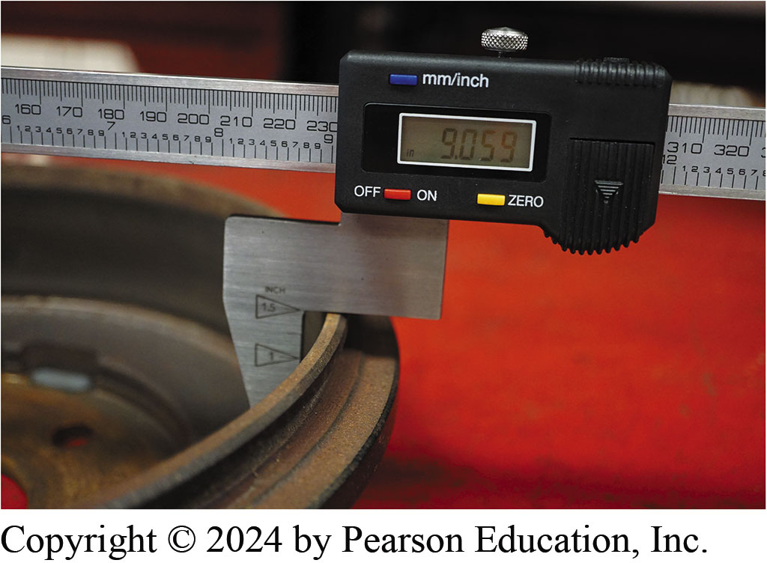
Figure 103.13 Digital Micrometer
A digital drum micrometer makes measuring brake drums easily and accurately

Slide 27
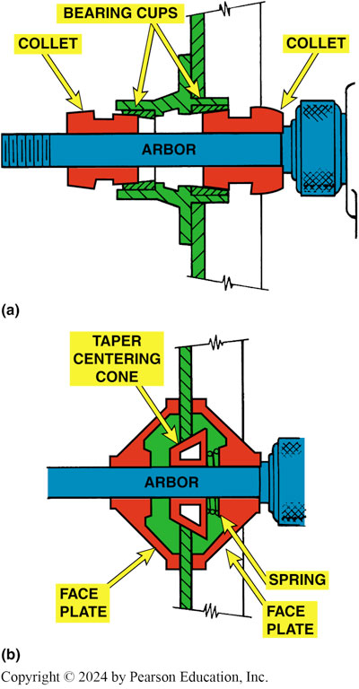
Figure 103.14 Lathe Collet
(a) A rotor or brake drum with a bearing hub should be installed on a brake lathe using the appropriate size collet that fits the bearing cups (races). (b) A hubless rotor or brake drum requires a spring and a tapered centering cone. A faceplate should be used on both sides of the rotor or drum to provide support

Slide 28
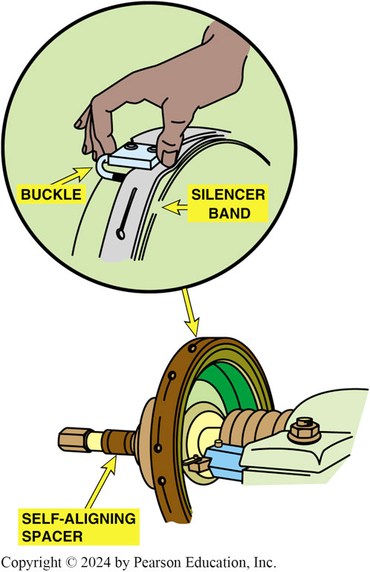
Figure 103.15 Self-Aligning Spacer
A self-aligning spacer (SAS) should always be used between the drum or rotor and the spindle retaining nut to help ensure an even clamping force and to prevent the adapters and cone from getting into a bind. A silence band should always be installed to prevent turning-tool chatter and to ensure a smooth surface finish

Slide 29
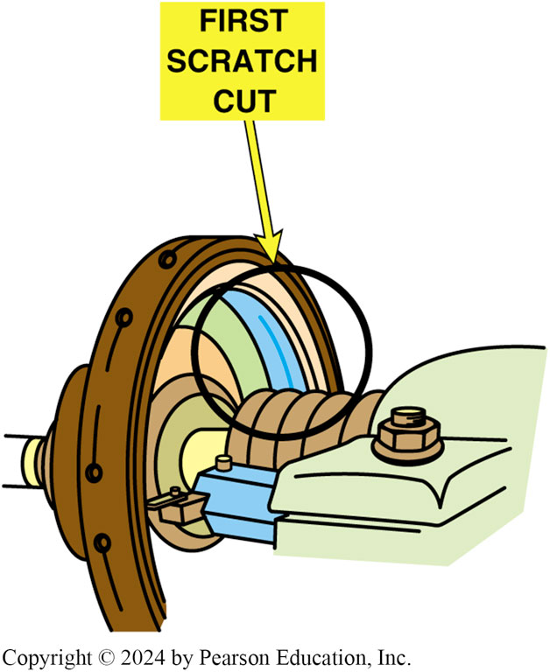
Figure 103.16 Scratch Cut
After installing a brake drum on the lathe, turn the cutting tool outward until the tool just touches the drum. This is called a scratch cut

Slide 30
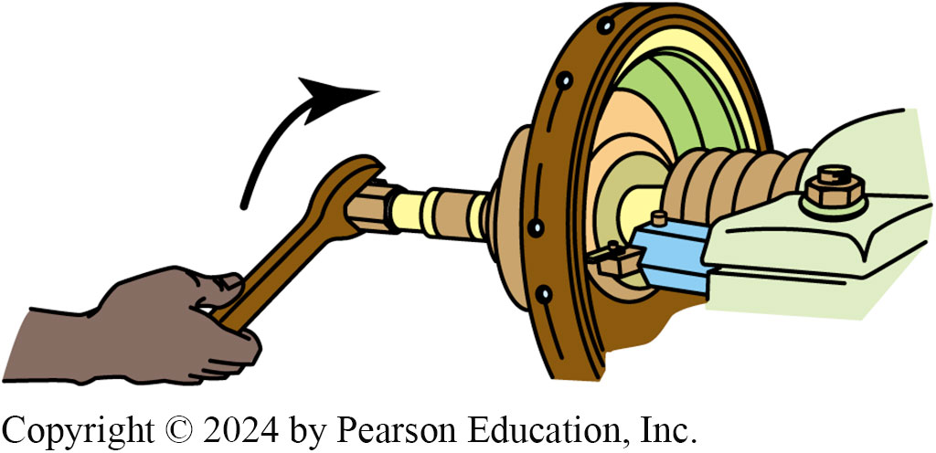
Figure 103.17 2nd Scratch Cut Done
After making a scratch cut, loosen the retaining nut, rotate the drum on the lathe, and make another scratch cut. If both cuts are in the same location, the drum is installed correctly on the lathe and drum machining can begin

Slide 31
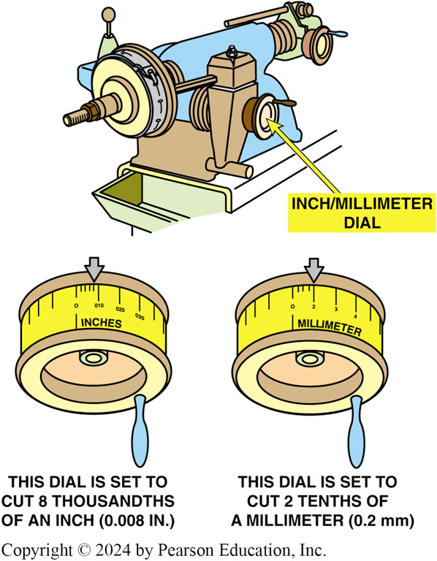
Figure 103.18 Set Depth Cut
Set the depth of the cut indicator to zero just as the turning tool touches the drum

Slide 32
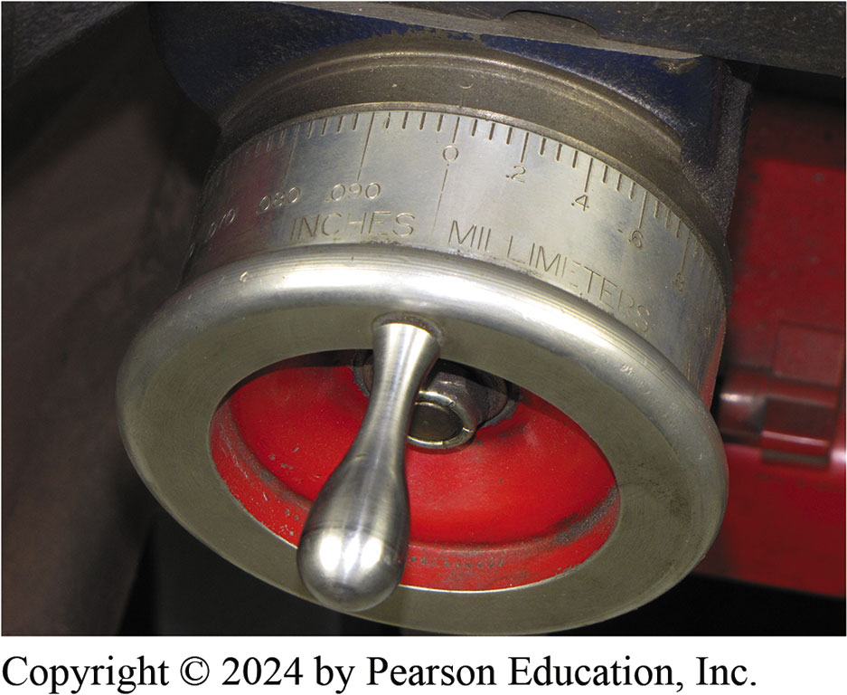
Figure 103.19 Diameter Graduated
This lathe has a dial that is “diameter graduated.” This means that a reading of 0.030 inch indicates a 0.015 inch cut that increases the inside diameter of the brake drum by 0.030 inch

Slide 33
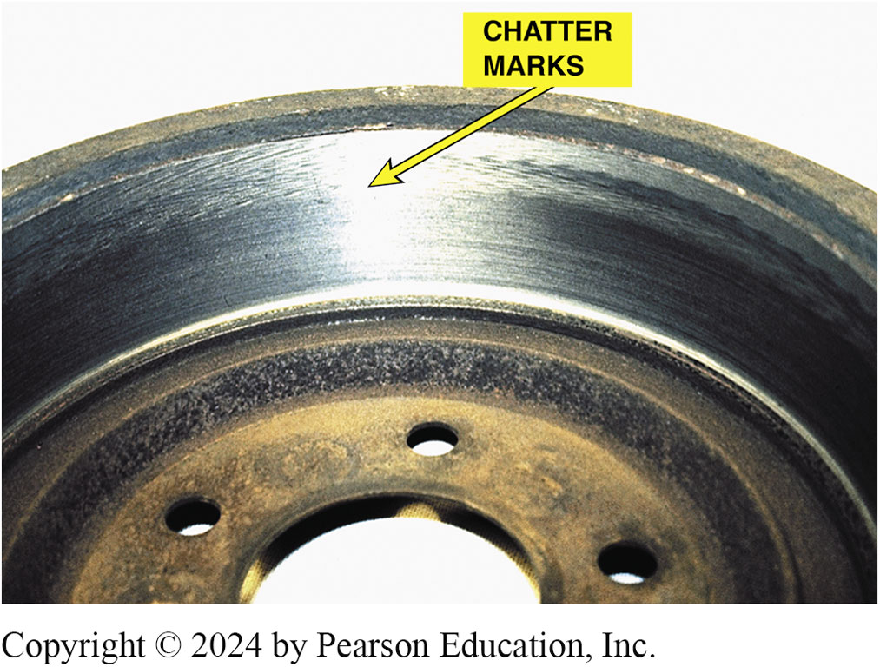
Figure 103.20 Chatter Marks
Notice the chatter marks at the edge of the friction-area surface of the brake drum. These marks were caused by vibration of the drum because the technician failed to wrap the dampening strap (silencer band) over the friction-surface portion of the brake drum

Slide 34
Disc Brake Rotors
Disc brake rotors use cast gray iron at the area that contacts the friction pad.
Styles of Rotors
Solid
Vented
Composite Rotors
Composite rotors use a steel center section with a cast-iron wear surface.
Aluminum Metal Matrix Composite Rotors
Manufactured from an aluminum metal matrix composite alloy reinforced with 20% silicon carbide particulate.

Slide 35
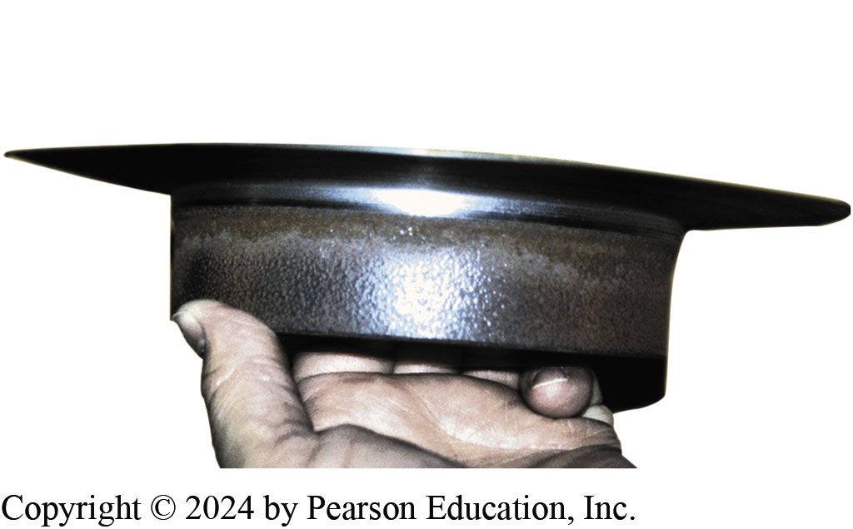
Figure 103.21 Worn Rotor
Excessively worn (thin) rotor was removed from the vehicle in this condition. It is amazing that the vehicle was able to stop with such a thin rotor

Slide 36
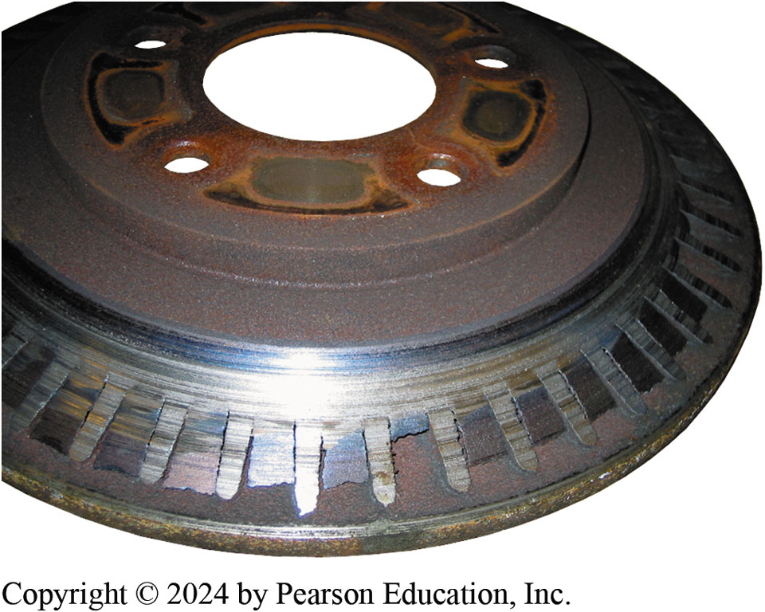
Figure 103.22 Worn Rotor
Severely worn vented disc brake rotor. The braking surface has been entirely worn away exposing the cooling fins. The owner brought the vehicle to a repair shop because of a “little noise in the front.”

Slide 37
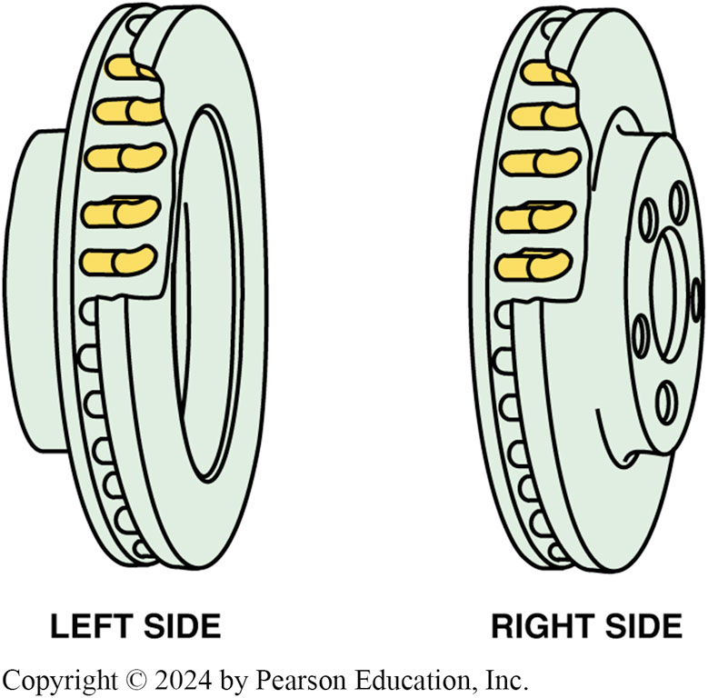
Figure 103.23 Directional Vented
Directional vane vented disc brake rotors. Note that the fins angle toward the rear of the vehicle. It is important that this type of rotor be reinstalled on the correct side of the vehicle

Slide 38
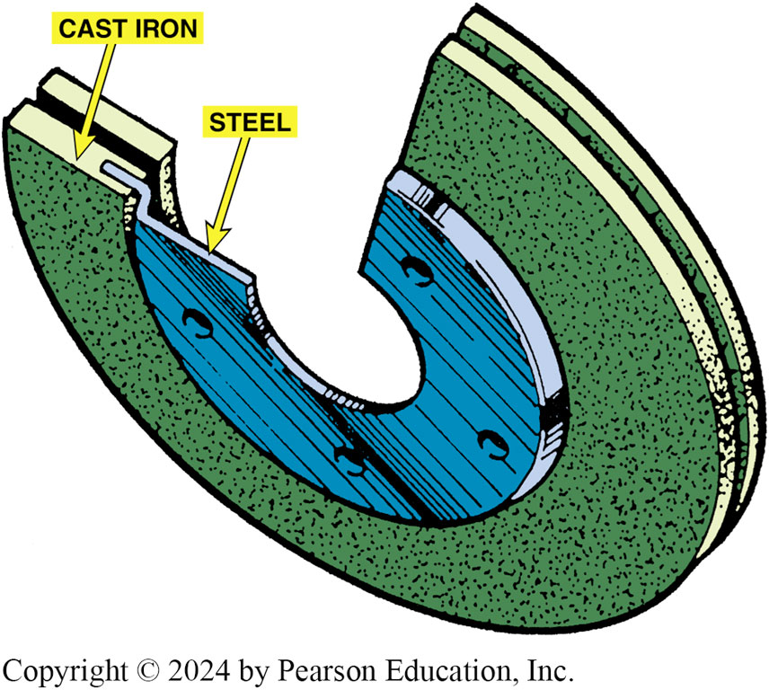
Figure 103.24 Composite Rotor
Typical composite rotor that uses cast-iron friction surfaces and a steel center section

Slide 39
Frequently Asked Question: What Does the SAE J2928 Brake Rotor Test Mean?
? Frequently Asked Question
What Does the SAE J2928 Brake Rotor Test Mean? SAE established a testing procedure that test aftermarket rotors called the SAE J2928 Brake Rotor Thermal Cracking Procedure. During this test, the rotor is subjected to 150 heat cycles from cold to high temperature. The heat cycles are used to test for possible cracking of the rotor. While this test is not mandatory, it can be used to verify that the rotor is able to meet the measurement and thermal capacity of a rotor. It is not an indication that the rotor is certified or approved
Notes:
What Does the SAE J2928 Brake Rotor Test Mean? SAE established a testing procedure that test aftermarket rotors called the SAE J2928 Brake Rotor Thermal Cracking Procedure. During this test, the rotor is subjected to 150 heat cycles from cold to high temperature. The heat cycles are used to test for possible cracking of the rotor. While this test is not mandatory, it can be used to verify that the rotor is able to meet the measurement and thermal capacity of a rotor. It is not an indication that the rotor is certified or approved.

Slide 40
Frequently Asked Question: What Does “Cross-Drilled” and “Slotted Mean?
? Frequently Asked Question
What Does “Cross-Drilled” and “Slotted Mean? “cross-drilled” and “slotted” refer to 2 separate processes. 1st procedure involves drilling rows of holes through friction surfaces of rotor. 2nd procedure refers to milling a series of specially machined grooves from center of disc toward edge. When friction surfaces of a rotor are smooth and flat, there is no means of escape for gases and dust, which build up between pad and rotor. It is an important consideration in street performance applications. The drill holes (which are sometimes called “gas relief openings”) provide an exit route for the dust and gas. The holes are also commonly labeled “cooling holes” because of the improvements they make in this area. Better cooling means less fade during repeated heavy brake application. They also help dissipate water when driving in poor weather. FIGURE 103–25. More info in NOTES
Notes:
What Does “Cross-Drilled” and “Slotted Mean? The terms “cross-drilled” and “slotted” refer to two separate processes. The first procedure involves drilling rows of holes through the friction surfaces of the rotor. The second procedure refers to milling a series of specially machined grooves from the center of the disc toward the edge. When the friction surfaces of a rotor are smooth and flat, there is no means of escape for the gases and dust, which build up between pad and rotor. This is not a huge problem in normal driving, but is an important consideration in street performance applications. The drill holes (which are sometimes called “gas relief openings”) provide an exit route for the dust and gas. The holes are also commonly labeled “cooling holes” because of the improvements they make in this area. Better cooling means less fade during repeated heavy brake application. They also help dissipate water when driving in poor weather.
FIGURE 103–25.
Slotting increases the bite of the pads and is even more effective than cross-drilling in
combating the problem known as “out-gassing.” This is when, at very high braking temperatures, the bonding agents used in some brake pads produce a gas. Under extreme conditions, this gas can create a gas cushion between pad and rotor, giving a driver a normal pedal feel but reducing the amount of friction being generated. The slots pump away gas and restore full contact. The “micro-shaving” effect of the slots also serves to deglaze the pads and this is why the edges of the slots are not chamfered or “radiused.” It also tends to even out the wear across the brake pad faces, increasing the effective contact area.

Slide 41
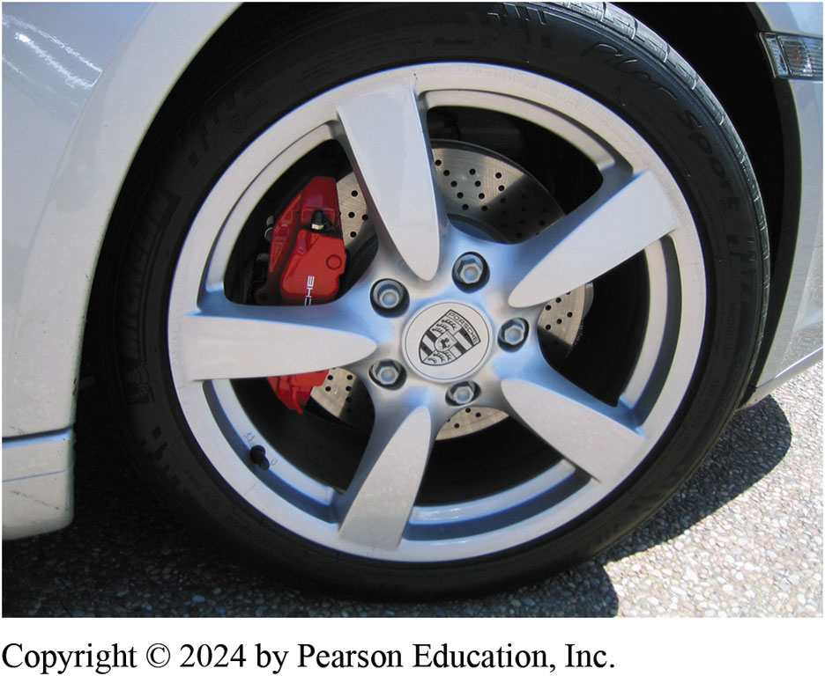
Figure 103.25 Cross-Drilled Rotor
Porsche is equipped with high performance brakes including cross-drilled brake rotors

Slide 42
Disc Brake Rotor Distortion
Causes of Rotor Distribution
Most common cause of distortion is when there is a problem with the friction assembly, such as a frozen Caliper piston that creates unequal application force on the two sides of the rotor.
Rotor Lateral Runout
Side-to-side wobble of rotor as it rotates on spindle.
Rotor Lack of Parallelism
Variation in thickness of rotor

Slide 43
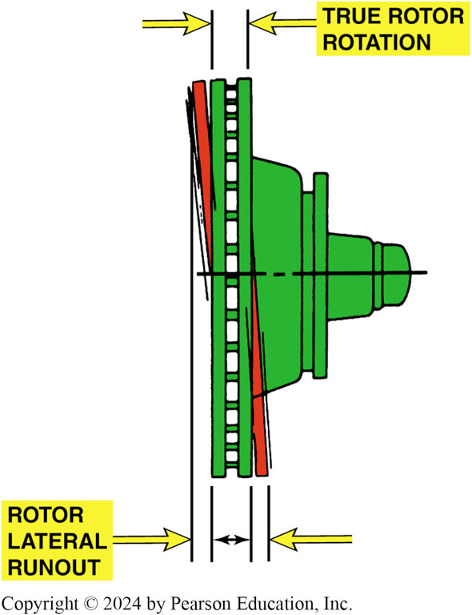
Figure 103.26 Rotor Distortion
Brake rotor lateral runout distortion

Slide 44
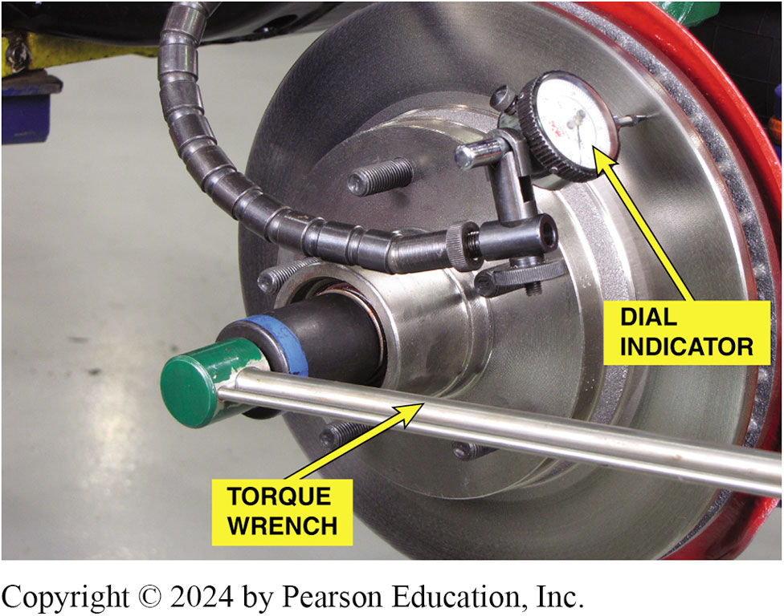
Figure 103.27 Remove Play
Before measuring lateral runout with a dial indicator (gauge), remove any wheel bearing end play by tightening the spindle nut to 10 to 20 ft lb with a torque wrench. This step helps prevent an inaccurate reading.

Slide 45
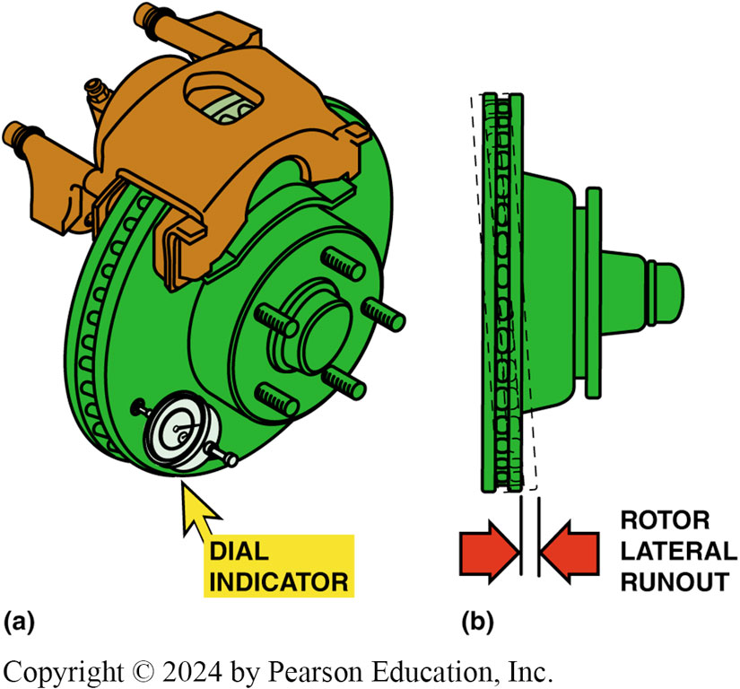
Figure 103.28 Rotate 1 Turn Measure
(a) Rotate the disc brake rotor one complete revolution while observing the dial indicator (gauge). (b) Most vehicle manufacturers specify a maximum runout of about 0.003 inch (0.08 mm).
Notes:
TECH TIP: Think of a Human Hair
Measurements and specifications do not seem to mean much unless you can visualize the size compared to something with which you are familiar. The diameter of a human hair is from
0.002 to 0.004 inch (2 to 4 thousandths of an inch).
The maximum lateral runout of a rotor is usually within this same dimension. The reason a dial indicator has to be used to measure runout, and a micrometer to measure parallelism, is that the dimensions involved are less than the diameter of a human hair.

Slide 46
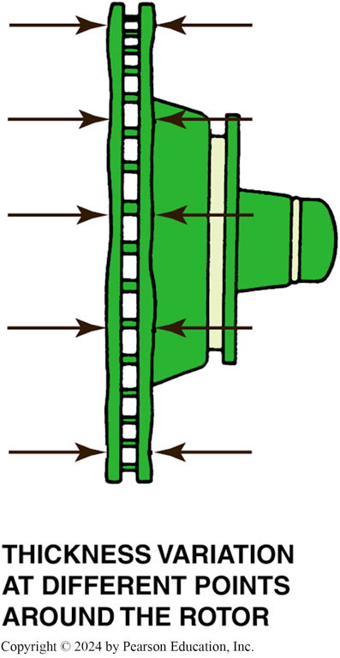
Figure 103.29 No Parallelism
Brake rotor lack-of-parallelism distortion

Slide 47
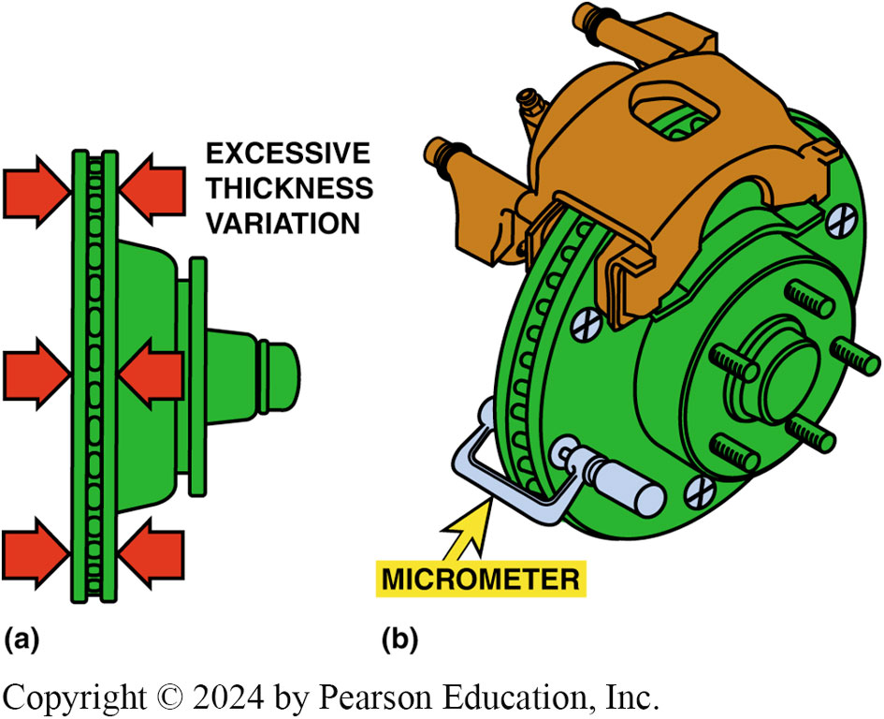
Figure 103.30 Micrometer Measure
(a) Disc brake rotor thickness variation (parallelism). (b) The rotor should be measured with a micrometer at four or more equally spaced locations around the rotor
Notes:
TECH TIP: Braking Vibration Could Be Due to the Tires: A vibrating condition (roughness) during braking is usually caused by disc brake rotor thickness variation or an out-of-round brake drum. Both conditions should be investigated. However, the tires and/or road conditions can also cause the same vibrations. Tests performed by vehicle and tire- manufacturing engineers have shown that tires, and tires alone, could be the cause. If no other problem can be isolated, install a different brand of tire on the vehicle and retest. The cause of the tire vibration seems to be due to distortion or movement of the tire tread. A different brand of tires would have a different tread rubber compound, carcass body ply angles, or other factor that can contribute to a vibration during
braking.

Slide 48
Question 2: ?
What is the most common cause of rotor distortion?

Slide 49
Answer 2
A frozen caliper piston that creates unequal application force to each side of the rotor.

Slide 50
Carbon-Ceramic Rotors
Description
Carbon-ceramic brake (C C B) rotors are used on some high-performance vehicles and are very expensive.
Construction
Carbon-ceramic brake rotors are made of a carbon-fiber-reinforced ceramic silicon carbide material.
Advantages
Low weight and corrosion and weather resistant.
Service Procedures
Cannot be serviced or machined, it must be replaced.

Slide 51
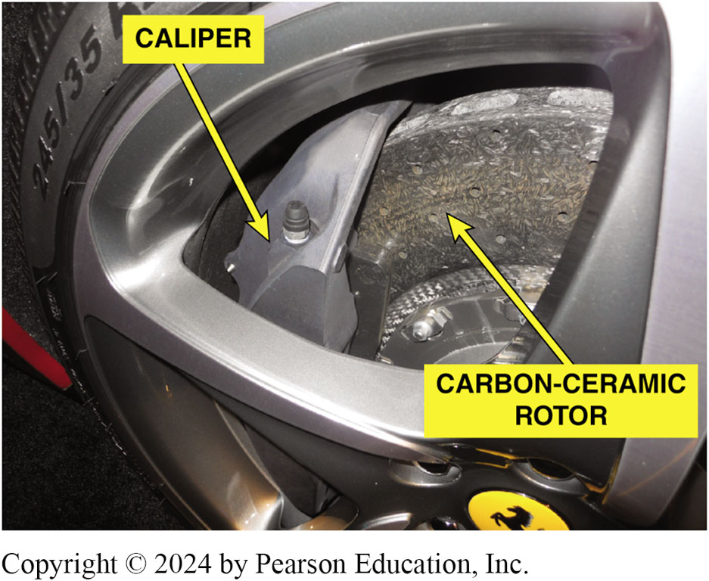
Figure 103.31 Carbon-Ceramic Rotor
A carbon-ceramic brake (CCB) rotor on a Ferrari

Slide 52
Disc Brake Rotor Thickness
Most rotors have minimum thickness cast or stamped into rotor.
At least 0.015 inch (0.4 mm) to 0.030 inch (0.8 mm) must remain after machining to allow for wear.
Whenever machining (resurfacing) a rotor, an equal amount of material must be removed from each side.

Slide 53
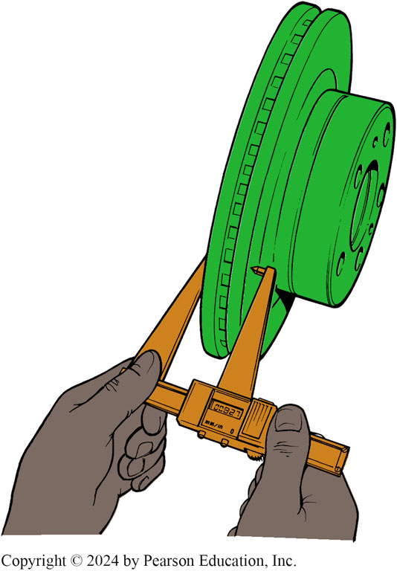
Figure 103.32 Rotor Thickness
A digital readout rotor micrometer is an accurate tool to use when measuring a rotor. Both fractional inches and metric millimeters are generally available

Slide 54
When The Rotors Should Be Machined
Grooves deeper than 0.060 inch (1.5 mm).
This is approximate thickness of a nickel.
Thickness variation exceeding specifications and a brake pedal pulsation complaint.
Heavy rust that has corroded friction surface of the rotor.

Slide 55
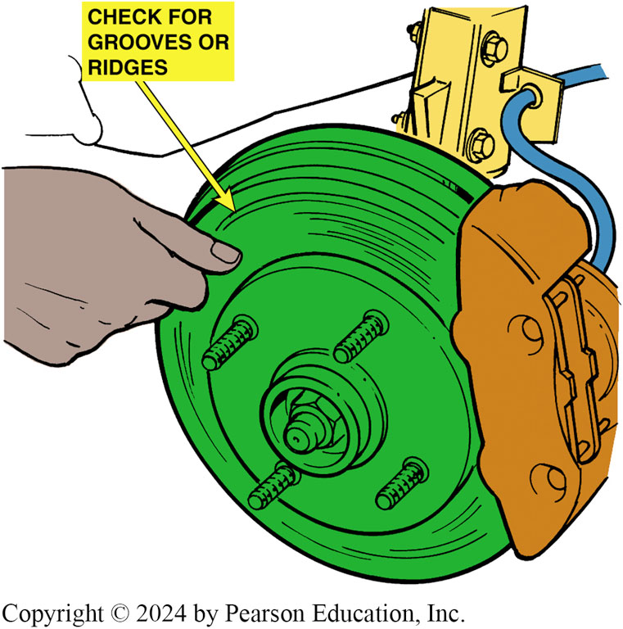
Figure 103.33 Fingernail Catches
If a fingernail catches on a groove in the rotor, the rotor should be machined

Slide 56
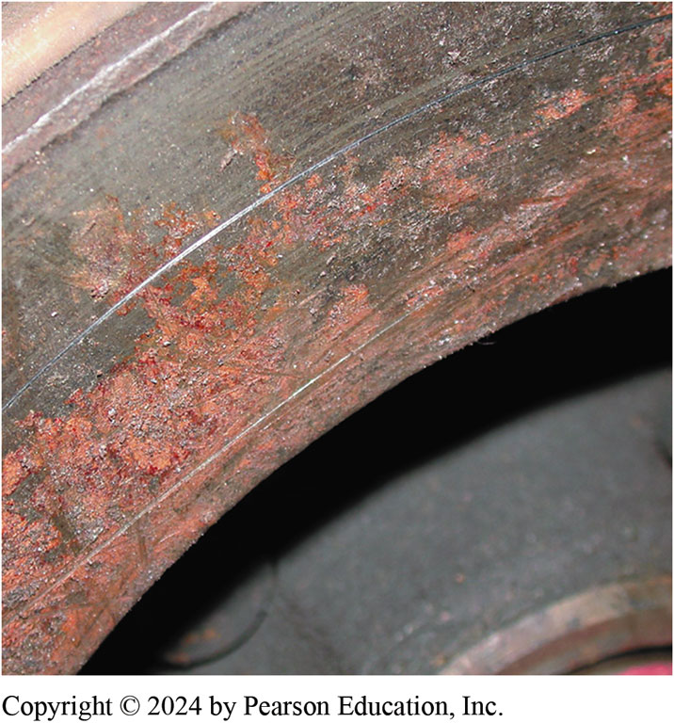
Figure 103.34 Should Be Cut
This rusted rotor should be machined

Slide 57
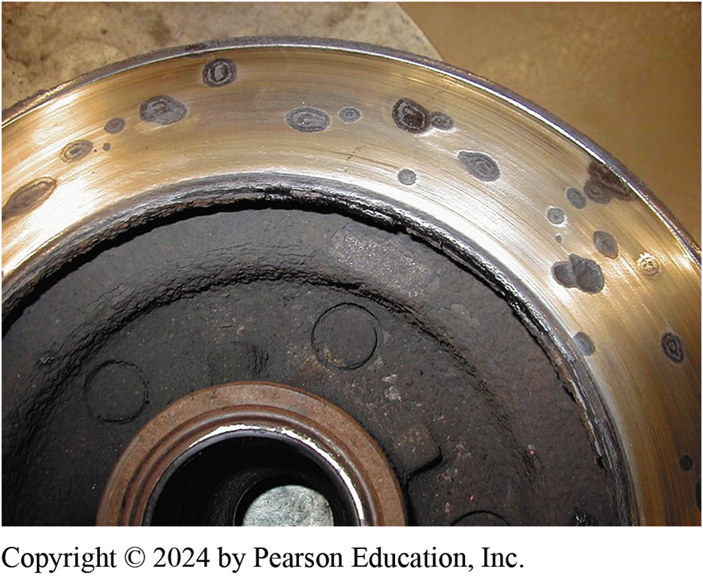
Figure 103.35 Cannot Be Machined
Rotors that have deep rust pockets usually cannot be machined

Slide 58
Question 3: ?
When should a rotor be machined?

Slide 59
Answer 3
When deep grooves, excessive thickness variation or heavy rust exist on the friction surface.

Slide 60
Rotor Finish
Surface finish is measured in units called microinches, abbreviated μin..
The usual method of expressing surface finish is the arithmetic average roughness height, abbreviated Ra, which is the average of all peaks and valleys from the mean (average) line.
Most new rotors have a surface finish of 45 to 60 μin. Ra.

Slide 61
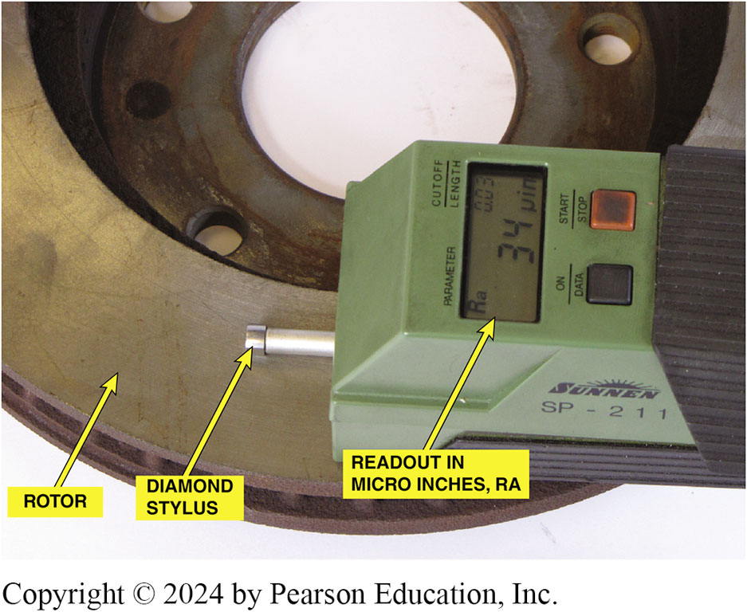
Figure 103.36 Surface Finish Tool
Electronic surface finish machine. The reading shows about 34 μin. This is a very smooth rotor and is suitable for use with any brake pad
Notes:
TECH TIP: The Ballpoint Pen Test
A smooth friction surface on a drum or rotor is necessary for proper brake operation. To quickly
determine if the friction surface of a brake drum or rotor is not smooth enough, draw a ballpoint
pen across the surface. If the surface is smooth enough, a solid ink line will be observed. If the
line drawn by the pen is not solid, then the surface is not smooth enough.

Slide 62
Qualifying A Brake Lathe
Purpose of Qualifying a Brake Lathe
To make sure the lathe is in good condition and are capable of machining brake drums and rotors accurately.
Qualifying Procedure
Ensure the machine is clean and fully operational.
Check all adapters and mounting surface for nicks and contamination.
Follow the manufactures specific operating and machining instructions.

Slide 63
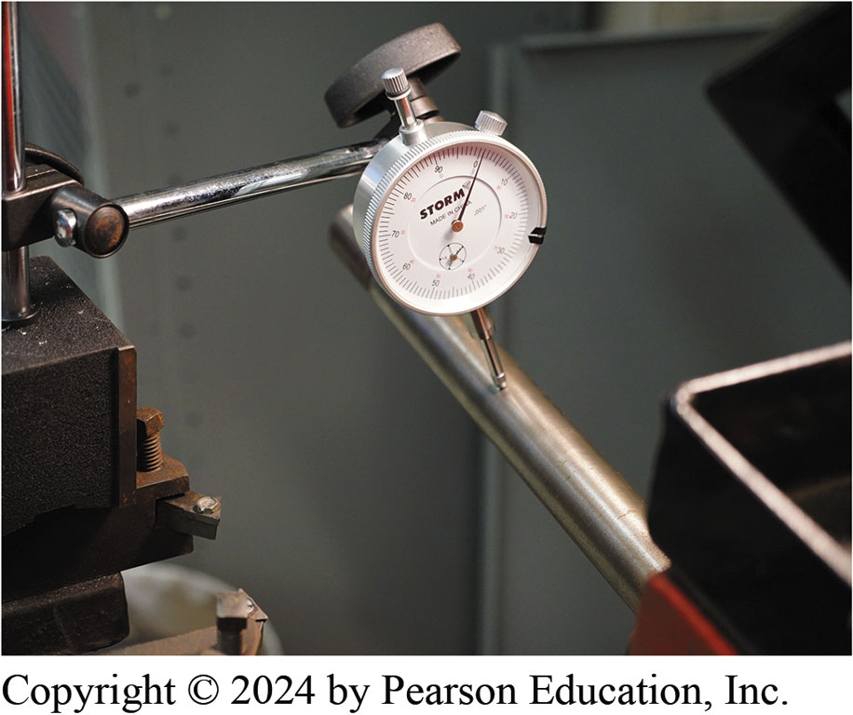
Figure 103.37 Dial Indicator Check
A dial indicator being used to check the arbor for total indicator runout (TIR). brake lathe

Slide 64
Machining Disc Brake Rotor (1 of 2)
Mount disc brake rotor
Install rotor damper
Make scratch cut on rotor face
Turn rotor one-half turn (180°), and retighten nut.
Make another scratch cut.
Verify rotor mounting
Machine the rotor following the manufacturer's guidelines.

Slide 65
Machining Disc Brake Rotor (2 of 2)
Rough Cut
A rough cut on a lathe involves cutting 0.005 inch per side with a feed of 0.008 inch per revolution.
Finish Cut
A finish cut means removing 0.002 inch per side with a feed of 0.002 inch per revolution.
Non-directional Finish
A non-directional finish is used to help prevent the grooves machined into the rotor from acting like record grooves that can force the pads to move outward while the rotor rotates.

Slide 66
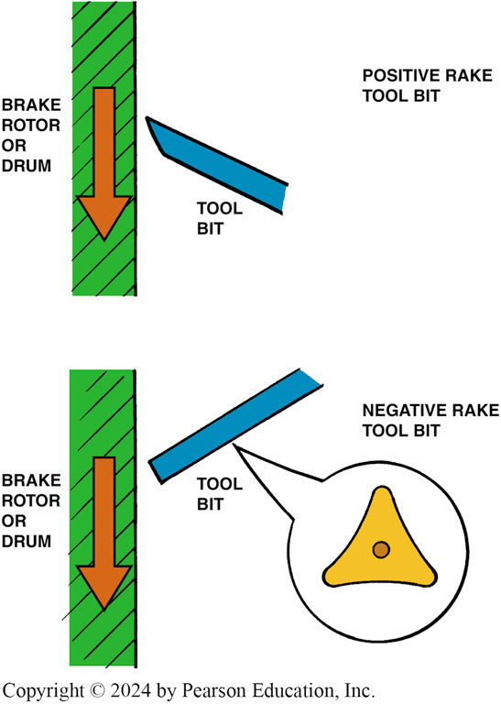
Figure 103.38 Cutting Edges
Most positive rake brake lathes can cut any depth in one pass, thereby saving time. A typical negative rake lathe uses a three-sided turning tool that can be flipped over, thereby giving six cutting edges.

Slide 67
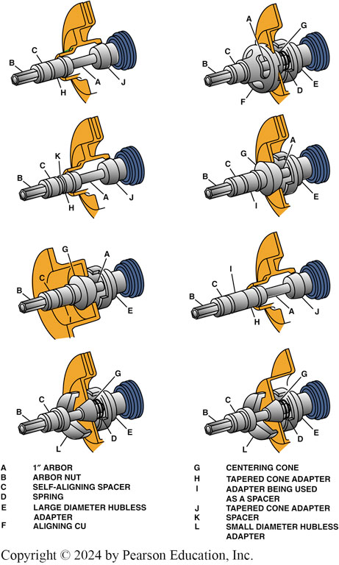
Figure 103.39 Adapters
Recommended adapters and location for machining hubbed and hubless rotors

Slide 68
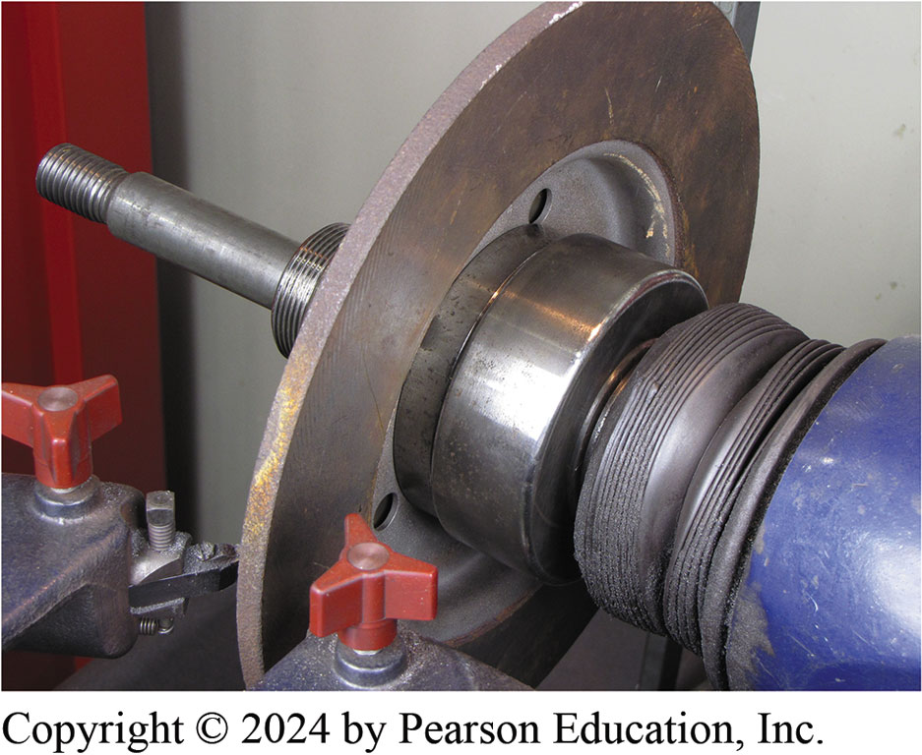
Figure 103.40 Properly Mounted
A composite rotor properly mounted on a brake lathe

Slide 69
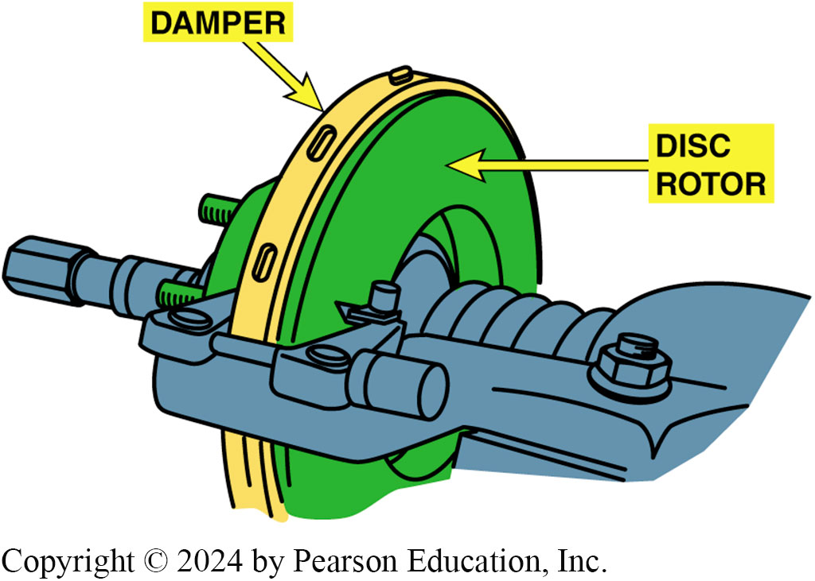
Figure 103.41 Damper
A damper is necessary to reduce cutting-tool vibrations that can cause a rough surface finish

Slide 70
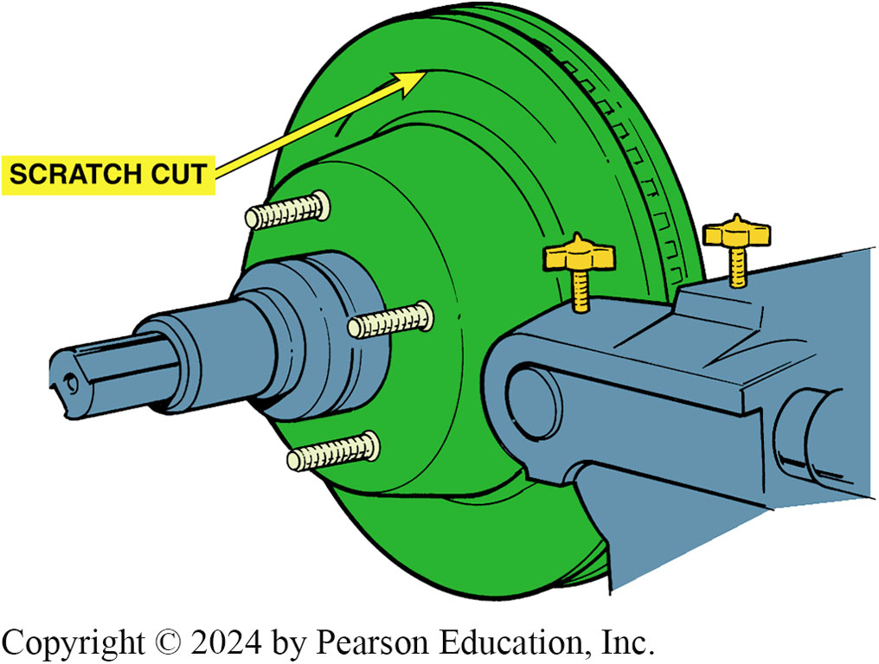
Figure 103.42 Scratch Cut
After installing the rotor on the brake lathe, turn the cutting tool in just enough to make a scratch cut

Slide 71
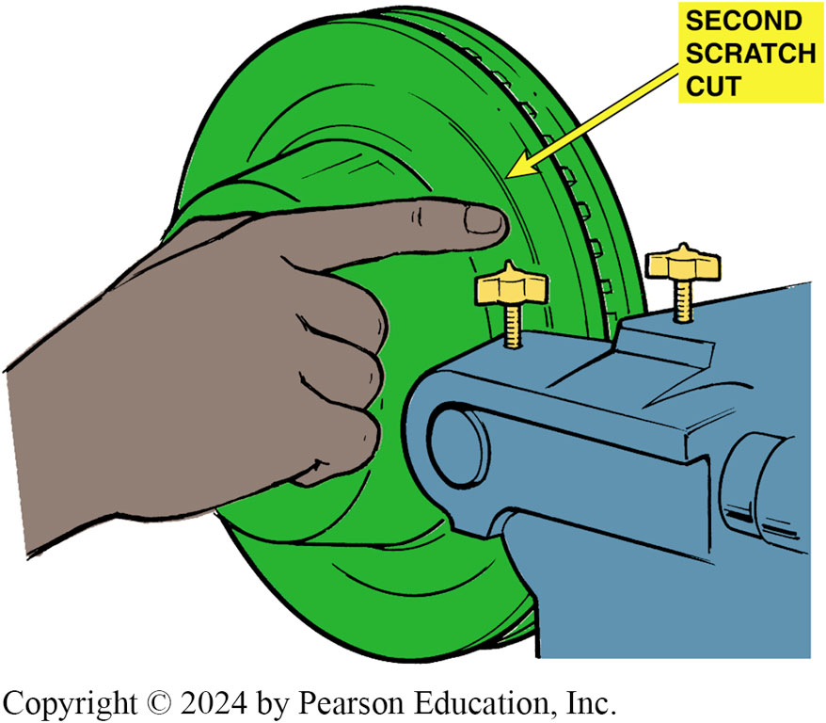
Figure 103.43 Second Scratch Cut
After making a scratch cut, loosen retaining nut and rotate rotor on spindle of the lathe one-half turn. Tighten the nut and make a second scratch cut. The second scratch cut should be side-by-side with the first scratch if the rotor is installed correctly on the brake lathe

Slide 72
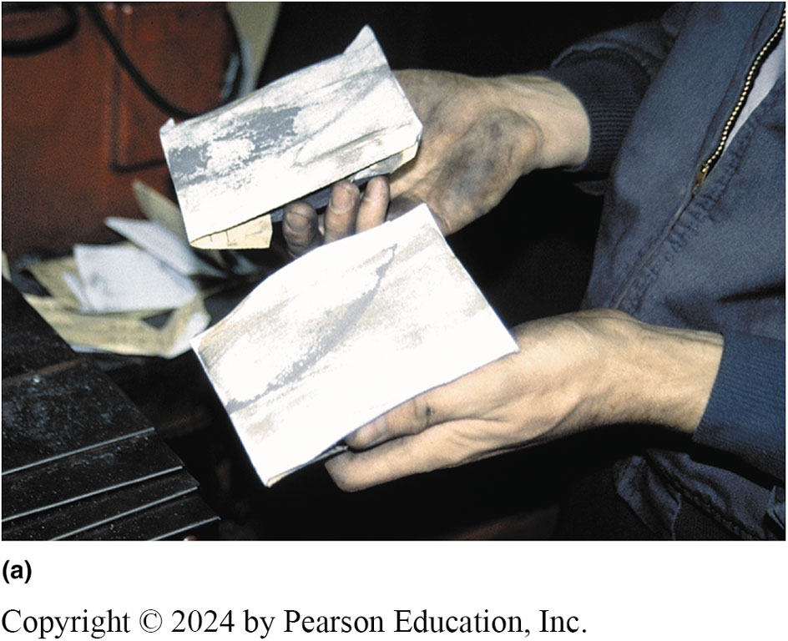
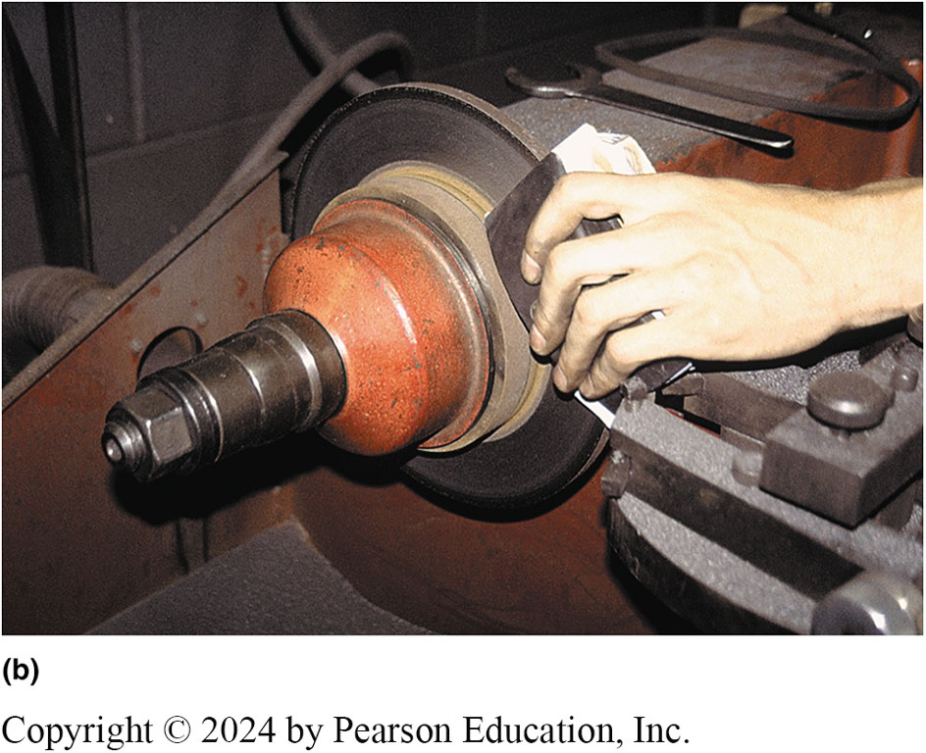
Figure 103.44 Sanding Rotor
(a) This technician uses two sanding blocks each equipped with 150-grit aluminum-oxide sandpaper. (b) With the lathe turned on, the technician presses the two sanding blocks against the surface of the rotor after the rotor has been machined to achieve a smooth microinch surface finish.

Slide 73
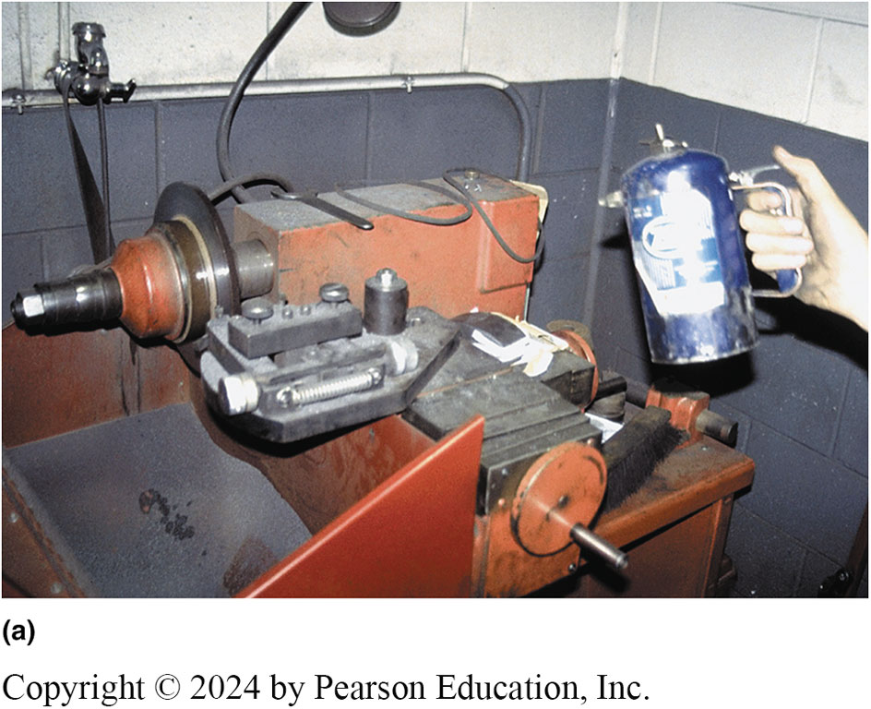
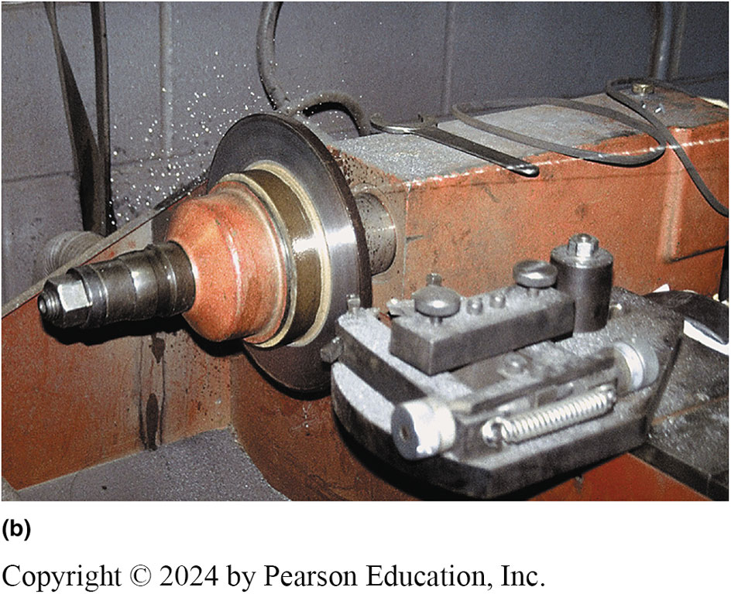
Figure 103.45 Cleaning
(a) After machining and sanding, it should be cleaned. Brake cleaner from an air pressurized spray can used. (b) With lathe turning, technician stands back away from rotor and sprays both sides of rotor to clean it of any remaining grit. This last step ensures a clean, smooth surface for the disc brake pads and a quality brake repair. Sanding each side of rotor surface for 1 minute using a sanding block and 150-grit aluminum-oxide sandpaper after a finish cut gives rotor proper smoothness and finish.
Notes:
(a) After machining and sanding the rotor, it should be cleaned. In this case, brake cleaner from an air pressurized spray can is used. (b) With the lathe turning, the technician stands back away from the rotor and sprays both sides of the rotor to clean it of any remaining grit from the sanding process. This last step ensures a clean, smooth surface for the disc brake pads and a quality brake repair. Sanding each side of the rotor surface for one minute using a sanding block and 150-grit aluminum-oxide sandpaper after a finish cut gives the rotor the proper smoothness and finish.

Slide 74
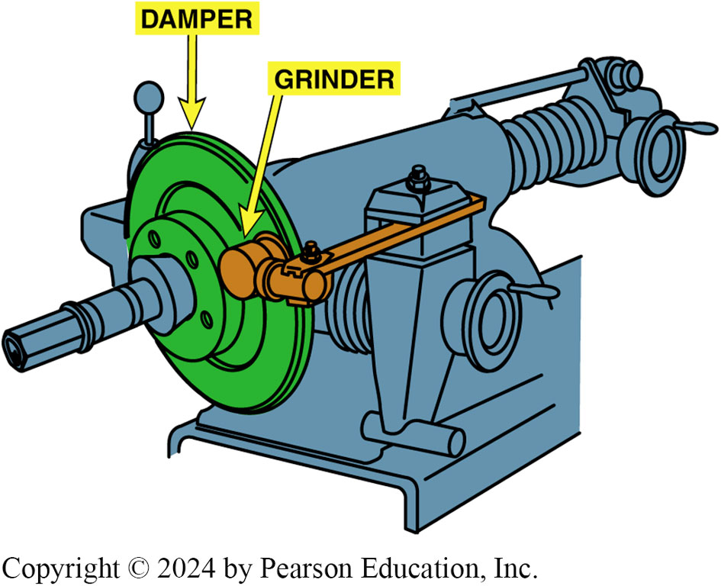
Figure 103.46 Grinder
A grinder with sandpaper can be used to give a smooth non-directional surface finish to the disc brake rotor

Slide 75
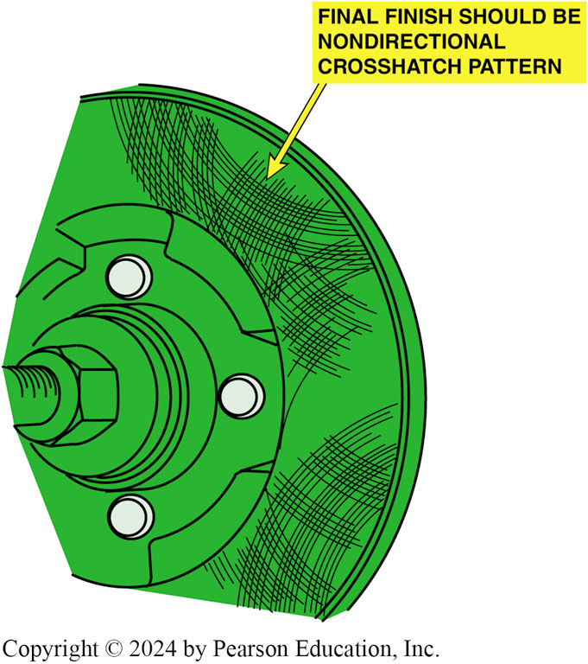
Figure 103.47 Correct Finish
The correct final surface finish should be smooth and non-directional

Slide 76

Figure 108.48

Slide 77

Figure 103.48 Clean All Rust
Rust should always be cleaned from both the rotor and the hub whenever the rotors are machined or replaced. An air-powered die grinder with a sanding disc makes quick work of cleaning this hub.

Slide 78
On-The-Vehicle Rotor Machining
Many vehicle manufacturers recommend on-the-vehicle machining for rotors if the disc brake rotor must be machined.
Follow the manufacturer specific instructions for the on-car lathe that is being used.

Slide 79

Figure 103.49 On-Vehicle Machining
A hub-mount on-the-vehicle lathe. This particular lathe oscillates while machining the rotor, thereby providing a smooth and non-directional finish at the same time

Slide 80

Figure 103.50 Stripped Stud
A wheel stud was replaced on the rotor hub assembly when it was discovered to be stripped

Slide 81
Drum Machining

Slide 82

1. Check Drum
1. Before starting to machine a brake drum, check the drum for any obvious damage such as heat cracks or hard spots

Slide 83

2. Lightly Tap Drum
2. Lightly tap the drum. It should ring like a bell. If a dull thud is heard, the drum may be cracked and should be discarded

Slide 84

3. Measure Drum
3. Use a drum micrometer to measure the inside diameter of the drum and compare this measurement to specifications to be sure that the drum can be safely machined

Slide 85

4. Max Dimension
4. Most brake drums have the maximum inside diameter cast into the drum as shown

Slide 86

5. Clean Drum
5. Thoroughly clean the outside and inside of the drum

Slide 87

6. Clean Center Hole
6. Be sure the center hole in the drum is clean and free from any burrs that could prevent the drum from being properly centered on the shaft of the brake lathe

Slide 88

7. Lathe
7. A typical brake lathe used to machine drums

Slide 89

8. Locate Center Cone
8. Locate a tapered, centering cone that best fits inside the hole of the brake drum

Slide 90

9. Slide Large Face Plate
9. Slide the large face plate over the shaft of the brake lathe

Slide 91

10. Centering Cone
10. Slide the tapered centering cone onto the shaft with the spring between the face plate and the centering cone

Slide 92

11. Slide Face Plate
11. Slide the other face plate onto the shaft

Slide 93

12. Install SAS
12. Install the self-aligning spacer (SAS) and left hand-thread spindle nut

Slide 94

13. Tighten Spindle Nut
13. Tighten the spindle nut

Slide 95

14. Loosen Turning Bar Retainer
14. Loosen turning bar retainer

Slide 96

15. Check Cutting Bits
15. Carefully check the cutting bits and either rotate the bit to a new cutting point or replace it with a new part as necessary

Slide 97

16. Shorten Spindle
16. Turn spindle control knob until spindle is as short as possible (i.e., the drum as close to the machine as possible) to help reduce vibration as much as possible

Slide 98

17. Position Cutting Bar at Back
17. Position the cutting bar so that the cutting bit is located at the back surface of the drum

Slide 99

18. Install Silencer Band
18. Install the silencer band (vibration dampener strap)

Slide 100

19. Turn on Lathe
19. Be sure the tool bit and clothing are away from the drum and turn the brake lathe on

Slide 101

20. Center the Bit
20. Center the bit in the center of the brake surface of the drum and rotate the control knob that moves the bit into contact with the drum friction surface. This should produce a light scratch cut

Slide 102

21. Turn lathe off

Slide 103

22. Observe Scratch Cut

Slide 104

23. Loosen Spindle Nut

Slide 105

24. Rotate Drum 180 Degrees
24. Rotate the drum 180° (1/2 half turn) on the spindle

Slide 106

25. Tighten Spindle Nut

Slide 107

26. Run Another Scratch Cut
26. Turn the lathe on, rotate the control knob, and run the cutter into the drum for another scratch cut

Slide 108

27. Observe Scratch Cut
27. Observe the scratch cut. If the second scratch cut is in the same place as the first scratch cut or extends all the way around the drum, the drum is correctly mounted on the lathe

Slide 109

28. Adjust Depth Gauge to 0
28. Adjust the depth gauge to zero when the cutter just touches the drum

Slide 110

29. Run Cutter To Drum Back
29. Run the cutter all the way to the back surface of the drum

Slide 111

30. Adjust Cut Depth
30. Adjust the depth of the cut and lock it in position by turning the lock knob. Most vehicle manufacturers recommend a rough cut depth should be 0.005–0.010 inch and a finish cut of 0.002 inch

Slide 112

31. Select Fast-feed Rate
31. Select a fast-feed rate if performing a rough cut (0.006–0.016 inch per revolution) or 0.002 inch per revolution for a finish cut

Slide 113

32. Turn Lock Knob
32. Turn the lock knob to keep the feed adjustment from changing

Slide 114

33. Engage Automatic Feed

Slide 115

34. Drum Moves Automatic
34. drum will automatically move as the tool remains stationary to make the cut

Slide 116

35. Turn Lathe Off

Slide 117

36. Finish Cut
36. If additional material must be removed, proceed with the finish cut. Clean thoroughly before installing on a vehicle

Slide 118
Rotor Machining

Slide 119

1. Measure Rotor
1. Before machining any rotor, use a micrometer and measure the thickness of the rotor

Slide 120

2. Check Specs
2. Check the specifications for the minimum allowable thickness

Slide 121

3. Inspect fro Cracks Hard Spots
3. Visually check the rotor for evidence of heat cracks or hard spots that would require replacement (rather than machining) of the rotor

Slide 122

4.Removing Grease
4. After removing the grease seal and bearings, remove the grease from the bearing races

Slide 123

5. Clean Inspect Brake Lathe Spindle
5. Clean and inspect the brake lathe spindle for damage or burrs that could affect its accuracy

Slide 124

6. Select Tapered Cone Adapter
6. that fits the inner bearing race

Slide 125

7. Slide Cone Adapter
7. Slide cone adapter onto the brake lathe spindle

Slide 126

8. Select Proper Size Cone Adapter
8. Select the proper size cone adapter for the smaller outer wheel bearing race

Slide 127

9. Place Rotor Onto Cone Adapter
9. Place the rotor onto the large cone adapter and then slide the small cone adapter into the outer wheel bearing race

Slide 128

10. Install SAS
10. Install the self-aligning spacer (SAS) and spindle nut

Slide 129

11. Tighten Spindle Nut
11. Tighten the spindle nut (usually left-hand threads)

Slide 130

12. Hubless Rotor
12. If a hubless rotor is being machined, be sure to thoroughly clean the inside surface

Slide 131

13. Remove All Rust
13. Also remove all rust from the other side of the hubless rotor

Slide 132

14. Select Proper Centering Cone
14. Select the proper centering cone for the hole in the center of the hub

Slide 133

15. Select Hubless Adapter
15. Select the proper size cone-shaped hubless adapter and the tapered centering cone with a spring in between

Slide 134

16. Sliding Rotor Over Cone
16. After sliding the rotor over the centering cone, install the matching hubless adapter

Slide 135

17. Install SAS
17. Install the self-aligning spacer (SAS) and spindle nut

Slide 136

18. Install Dampener
18. After the rotor has been secured to the brake lathe spindle, install the noise silencer band (dampener)

Slide 137

19. Inspect Cutting Bit
19. Carefully inspect the cutting bits and replace, if necessary

Slide 138

20. Loosen Tool Holder Arm
20. Loosen the tool holder arm

Slide 139

21. Adjust Twin Cutter Arm
21. Adjust the twin cutter arm until the rotor is centered between the two cutting bits

Slide 140

22. Turn Lathe On

Slide 141

23. Move Cutter Arm
23. Move the cutter arm toward the center of the rotor, placing the cutting bits in about the center of the friction surface

Slide 142

24. Scratch Cut
24. Turn one cutting bit into the surface of the rotor to make a scratch cut. This step checks the lathe setup for accuracy

Slide 143

25. Turn Lathe Off

Slide 144

26. Observe First Scratch Cut

Slide 145

27. Loosen Spindle Retaining Nut

Slide 146

28. Rotate Rotor 180°
28. Rotate the rotor 180° (one-half turn) on the spindle of the brake lathe

Slide 147

29. Tighten Spindle Nut

Slide 148

30. Doing 2nd Scratch Cut
30. Turn the lathe back on and turn the cutting bit slightly into the rotor until a second scratch cut is made

Slide 149

31. Second Scratch Cut
31. If second scratch cut is in same location as first scratch cut or extends all around surface of rotor, then the rotor is properly installed on lathe

Slide 150

32. Start Machining Process
32. Start the machining process by moving the twin cutters to about the center of the rotor friction surface

Slide 151

33. Turn Cutting Bits Inward
33. Turn the cutting bits inward until they touch the rotor and zero the depth adjustment

Slide 152

34. Adjust Twin Cutters
34. Adjust twin cutters, then dial in amount of depth (0.005–0.010 inch per side for a rough cut or 0.002 inch for a finish cut) and lock the adjustment so that vibration will not change the setting.

Slide 153

35. Turn Feed Control Knob
35. Turn the feed control knob until the desired feed rate is achieved for the first or rough cut (0.006–0.010 inch per revolution) or finish cut (0.002 inch per revolution)

Slide 154

36. Engage Automatic Feed

Slide 155

37. Observe Machining Operation

Slide 156

38. Measure Rotor Thickness
38. After the cutting bits have cleared the edge of the rotor, turn the lathe off and measure the thickness of the rotor

Slide 157
39. Readjust Feed Control Slow Rate
39. Readjust the feed control to a slow rate (0.002 inch per revolution or less) for the finish cut

Slide 158

40. Reposition Cutting Bits
40. Reposition the cutting bits for the finish cut

Slide 159

41. Loosen Adjustment Locks

Slide 160

42. Turn Cut Depth For Finish Cut
42. Turn the depth of the cut for the finish cut (0.002 inch maximum)

Slide 161

43. Lock Adjustment

Slide 162

44. Engage Automatic Feed

Slide 163

45. Sanding
45. Use 150-grit aluminum-oxide sandpaper on a block of wood for 60 seconds per side on a grinder to give a non-directional and smooth surface to both sides of the rotor

Slide 164

46. Cleaning
46. After the sanding or grinding operation, thoroughly clean the machined surface of the rotor to remove any and all particles of grit that could affect the operation and life of the disc brake pads.

Slide 165

47. Remove Silencer Band

Slide 166

48. Loosen Spindle Retaining Nut
48. Loosen the spindle retaining nut and remove the rotor

Slide 167
On-The-Vehicle Lathe

Slide 168

1. Preparation
1. Prepare to machine a disc brake rotor using an on-the-vehicle lathe by properly positioning the vehicle in the stall and hoisting the vehicle to a good working height

Slide 169

2. Remove Wheels
2. Remove the wheels and place them out of the way

Slide 170

3. Remove Caliper
3. Remove the disc brake caliper and use a wire to support the caliper out of the way of the rotor

Slide 171

4. Measure Rotor
4. Measure the rotor thickness and compare it with factory specifications before machining. If a discard thickness is specified, be sure to allow an additional 0.015 inch for wear.

Slide 172

5. Install Hub Adapter
5. Install hub adapter onto hub and secure it using wheel lug nuts

Slide 173

6. Engage Drive Unit
6. Engage the drive unit by aligning the hole in the drive plate with the raised button on the adapter

Slide 174

7. Use Thumb Wheel Tighten Unit
7. Use the thumb wheel to tighten the drive unit to the adapter

Slide 175

8. Attach Dial Indicator
8. Attach a dial indicator to a secure part on the vehicle and position the dial indicator on a flat portion of the lathe to measure the lathe runout.

Slide 176

9. Measure Runout
9. Rotate the wheel or turn the lathe motor on and measure the amount of runout

Slide 177

10. Adjust Runout
10. Use a wrench to adjust the runout using the four numbers stamped on the edge of the drive flange as a guide

Slide 178

11. Remove Dial Indicator
11. After the hub runout is adjusted to 0.005 inch or less, remove the dial indicator from the vehicle

Slide 179

12. Adjust Cutter Arms
12. Using a T-handle Allen wrench, adjust the cutter arms until they are centered on the disc brake rotor

Slide 180

13. Move Cutters to Center
13. Move the cutters to the center of the rotor

Slide 181

14. Adjust Cutter Depth
14. Adjust the cutter depth until each cutter barely touches the rotor

Slide 182

15. Cutters at Inside Edge
15. Position the cutters to the inside edge of the rotor surface and adjust the cutters to the desired depth of cut

Slide 183

16. Adjust Automatic Shut-off
16. Adjust automatic shut-off so the lathe will turn itself off at the end of the cut

Slide 184

17. Turn Lathe On
17. Turn lathe on by depressing the start button

Slide 185

18. Monitor Machining Operations
18. Monitor the machining operations as the lathe automatically moves the cutters from the center toward the outside edge of the rotor

Slide 186

19. At Outer Edge Motor Stops
19. After the lathe reaches the outside edge of the rotor, the drive motor should stop

Slide 187

20. Measure Rotor
20. Measure thickness of the rotor after machining to be certain that the rotor thickness is within service limits

Slide 188

21. Sand Rotor
21. Technician is using 150-grit aluminum-oxide sandpaper and a wood block for 60 seconds on each side of the rotor to provide a smooth surface finish.

Slide 189

22. Remove Drive Unit
22. After completing the machining and resurfacing of the rotor, unclamp the drive unit from the hub adapter and clean the rotor

Slide 190

23. Remove Adapter
23. After the drive unit has been removed, remove the lug nuts holding the adapter to the rotor hub

Slide 191

24. Install Caliper
24. After removing hub adapter, caliper can be reinstalled

Slide 192

25. Torque Caliper to Specs
25. Be sure to torque the caliper retaining bolts to factory specifications.

Slide 193

26. Install Wheel
26. Install the wheel and wheel cover. On this vehicle, the wheel cover must be installed before the lug nuts because the lug nuts hold the wheel cover on the wheel

Slide 194

27. Torque Lug Nuts to Specs
27. Always use a torque wrench or a torque-limiting adapter with an air impact wrench as shown here when tightening lug nuts

Slide 195

28. Restore Brake Pedal Height
28. Pump the brake pedal several times to restore proper brake pedal height. Check and add brake fluid as necessary before moving the vehicle

Slide 196
Brakes Videos and Animations
Videos Link: (A5) Brakes Videos
Animations Link: (A5) Brakes Animations

Slide 197

Copyright
This work is protected by United States copyright laws and is provided solely for the use of instructors in teaching their courses and assessing student learning. Dissemination or sale of any part of this work (including on the World Wide Web) will destroy the integrity of the work and is not permitted. The work and materials from it should never be made available to students except by instructors using the accompanying text in their classes. All recipients of this work are expected to abide by these restrictions and to honor the intended pedagogical purposes and the needs of other instructors who rely on these materials.

