Slide 1
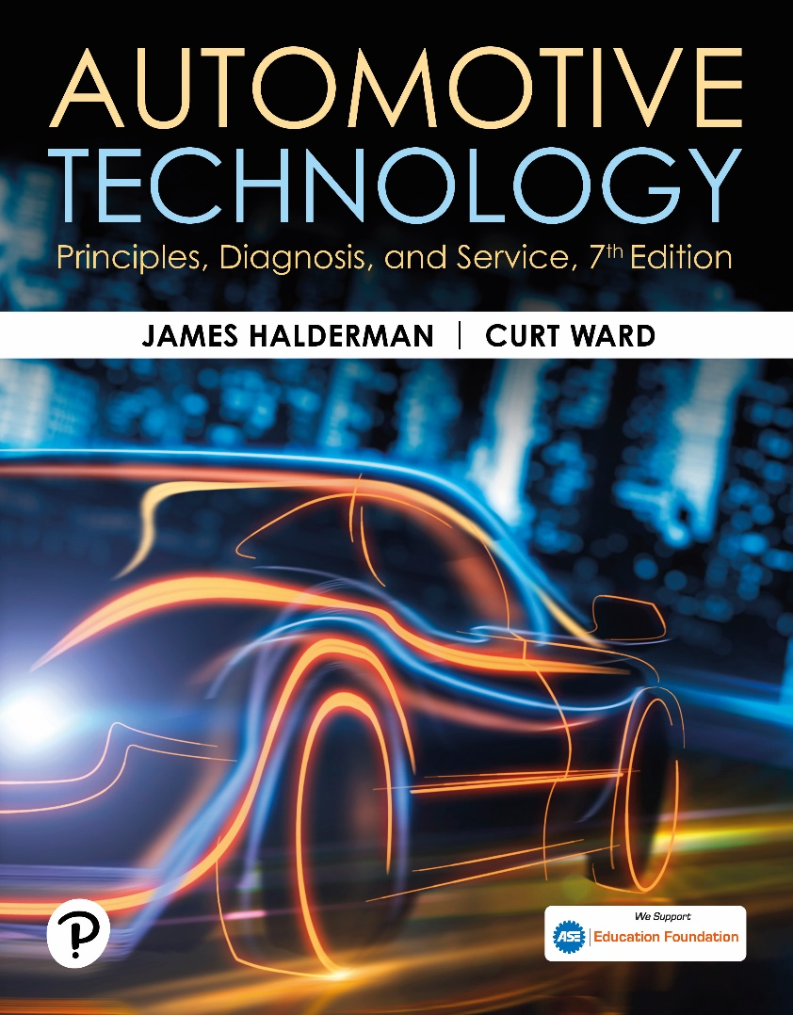
Automotive Technology: Principles, Diagnosis, and Service
Seventh Edition
Chapter 102
Parking Brake Operation, Diagnosis, and Service
Copyright © 2023 Pearson Education, Inc. All Rights Reserved
Notes:
INSTRUCTOR NOTE: This presentation includes text explanation notes, you can use to teach the course. When in SLIDE SHOW mode, you RIGHT CLICK and select SHOW PRESENTER VIEW, to use the notes.

Slide 2
Learning Objectives
102.1 Discuss parking brake standards.
102.2 Describe parking brake pedals, levers, and handles.
102.3 Explain parking brake linkages.
102.4 Explain front and rear entry parking brake cables.
102.5 Describe drum parking brakes.
102.6 Describe caliper-actuated disc parking brakes.
102.7 Explain how to adjust a parking brake properly.
102.8 Discuss electric parking brakes.

Slide 3
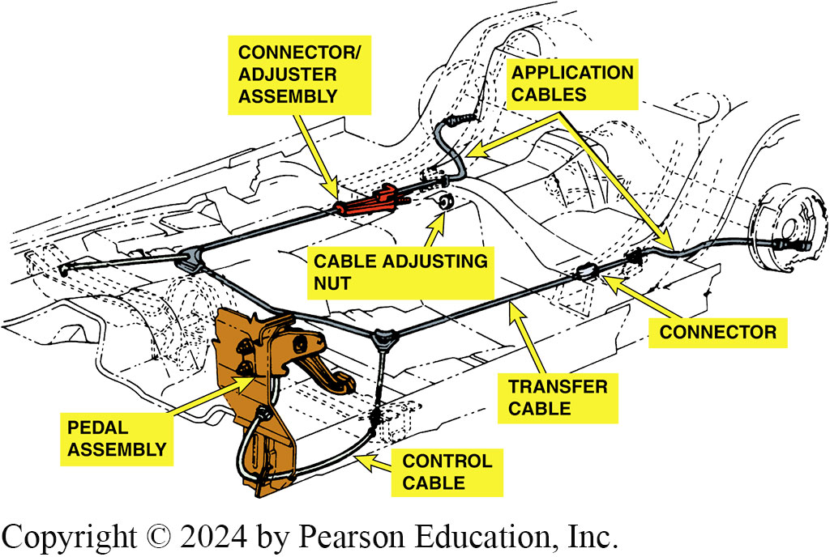
Figure 102.1 Cable System
Typical parking brake cable system showing the foot-operated parking brake lever and cable routing

Slide 4
Pedals, Levers, and Handles (1 of 2)
Parking brakes are applied by pedal, lever, or handle from inside vehicle.
Parking Brake Pedals
Ratchet engages automatically and pedal remains in the depressed position.
Pedal is released by a pull or a small t-handle or lever under the dash.

Slide 5
Pedals, Levers, and Handles (2 of 2)
Automatic Parking Brake Release
Some vehicles with pedal-operated parking brakes have an automatic release mechanism
Disengages parking brake using a vacuum servo controlled by an electrical solenoid.

Slide 6
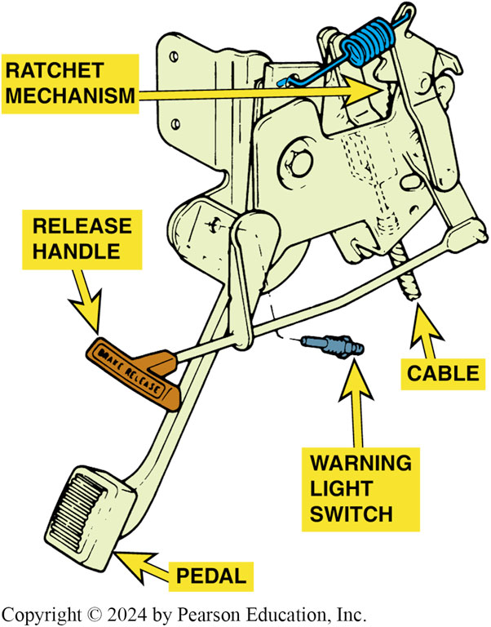
Figure 102.2 Parking Brake
A typical parking brake pedal assembly

Slide 7
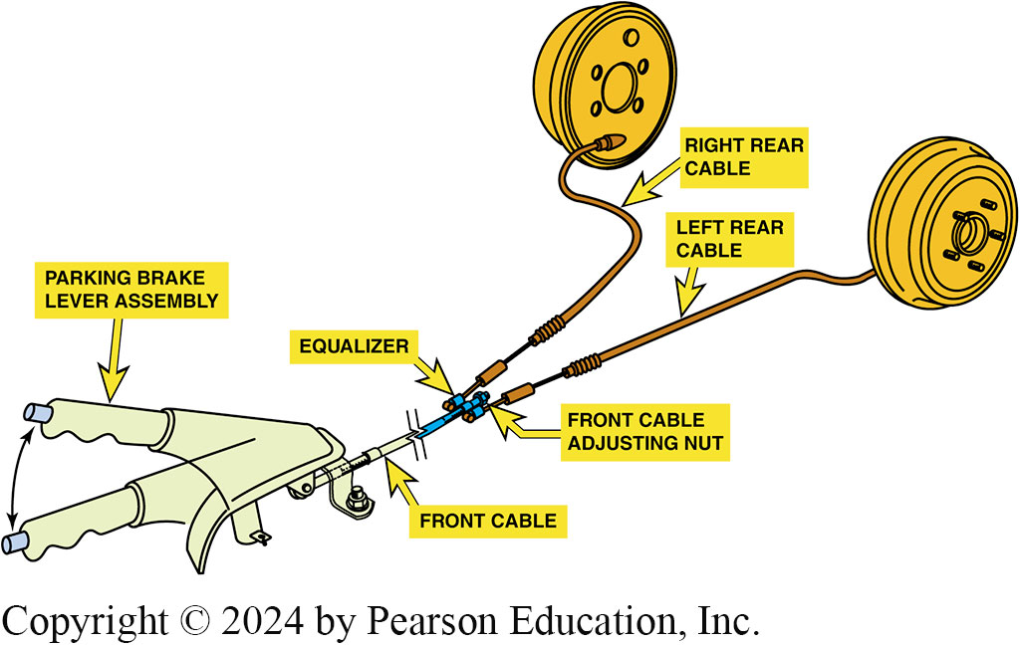
Figure 102.3 Equalizer
Typical hand-operated parking brake. Note that the adjustment for the cable is underneath the vehicle at the equalizer

Slide 8
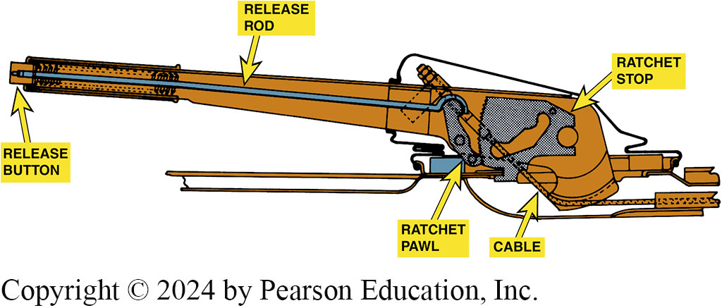
Figure 102.4 Ratchet Center Brake
A ratchet mechanism is used to lock parking brakes in the applied position

Slide 9
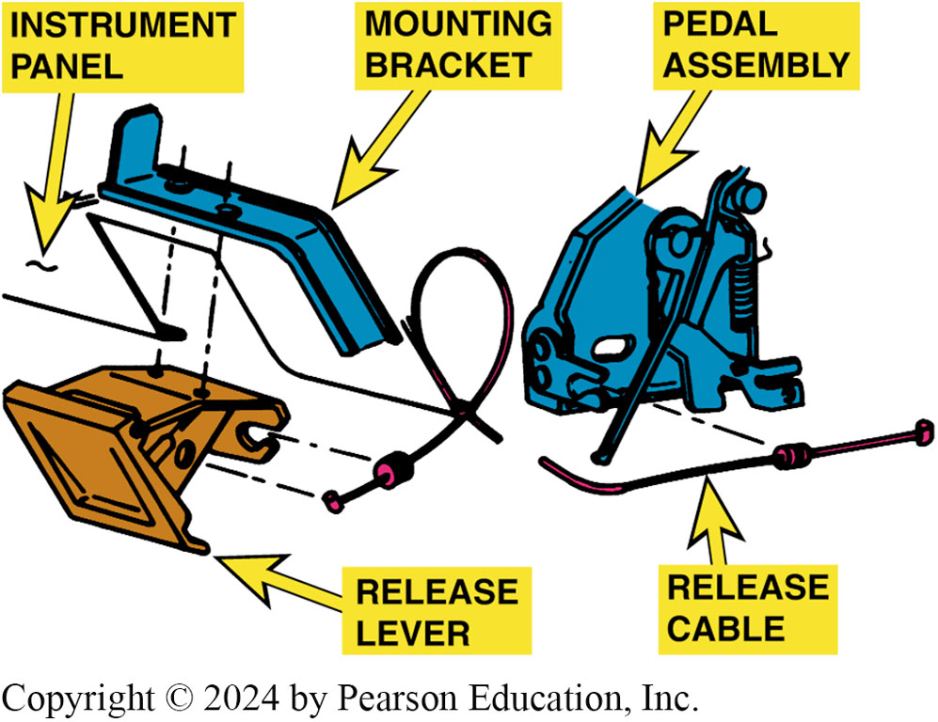
Figure 102.5 Remote Mounted
A remote-mounted parking brake release lever

Slide 10
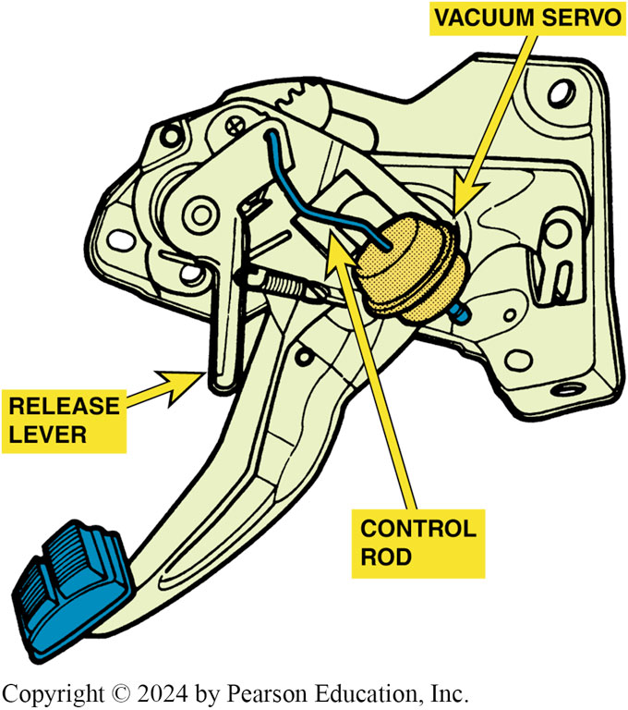
Figure 102.6 Automatic Release
Automatic parking brake release mechanisms usually use a vacuum servo to operate the release lever
Notes:
CASE STUDY: Pump to Release?
A customer called and asked a dealer for help because the parking brake could not be released. The service technician discovered that the customer was attempting to release the parking brake by depressing the parking brake pedal, as was done on the customer’s previous vehicle. The service technician simply pulled on the release lever and the parking brake was released.
Summary:
Complaint—Customer called the service department and asked for help releasing the parking brake as it would not release.
Cause—The service technician simply pulled on the parking brake release lever to disengage the
parking brake.
Correction—No repair was needed except to inform the customer that the parking brake on the new vehicle was released using a release lever and not by de- pressing the foot-operated parking brake pedal as was used in the owner’s previous vehicle.

Slide 11
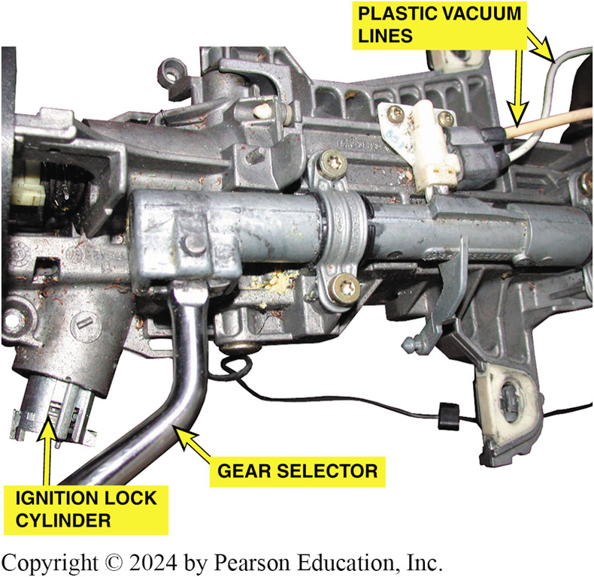
Figure 102.7 Auto Release
The two plastic vacuum tubes on the steering column are used to release the parking brake when the gear selector is moved from park into a drive gear.

Slide 12
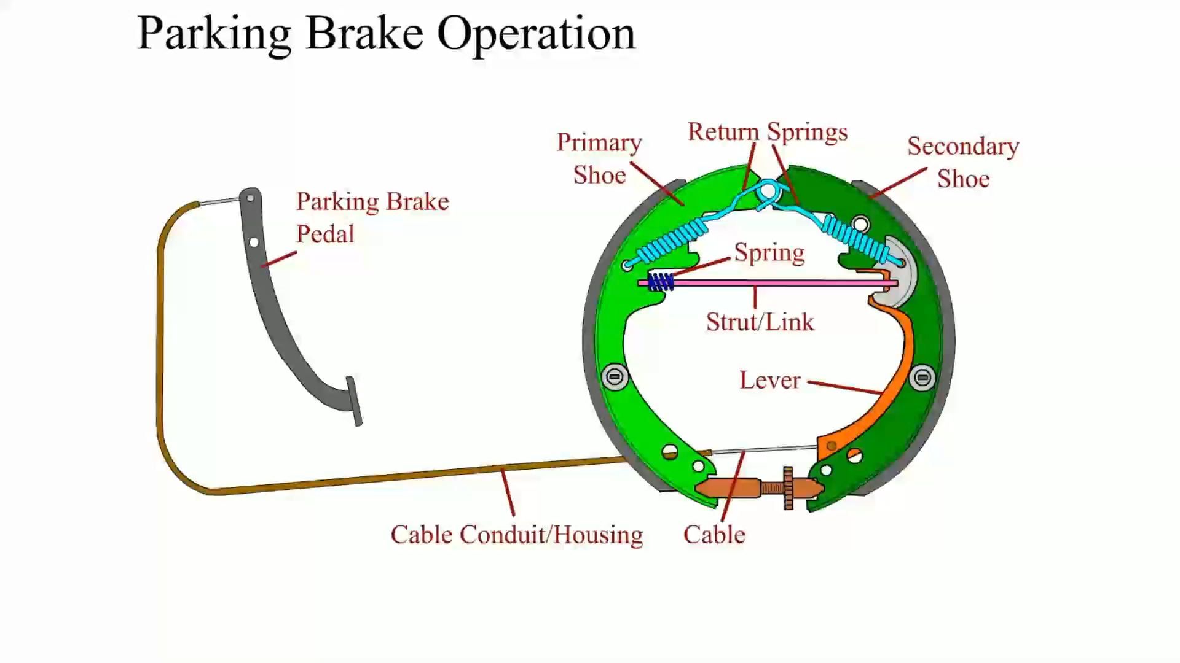
Animation: Parking Brake Operation (Animation will automatically start)

Slide 13
Parking Brake Warning Lamp
RED BRAKE warning lamp lights on dash if any of the following events occur:
Hydraulic or brake fluid level problem
Parking brake is applied or partially applied
If red BRAKE warning lamp is on, check parking brake to see if it is fully released.

Slide 14
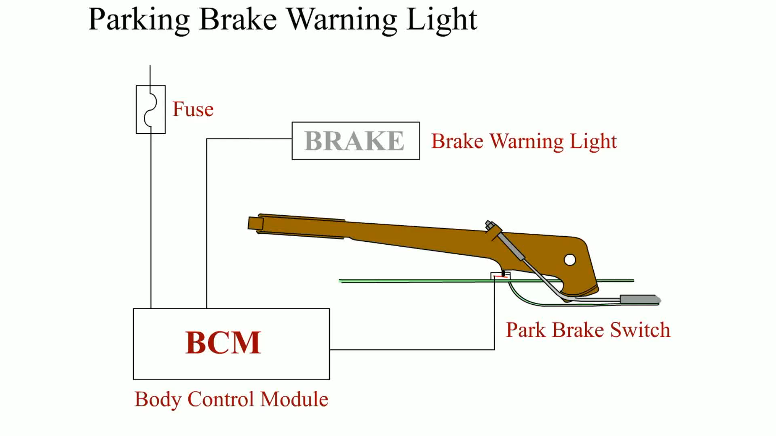
Animation: Parking Brake Warning Light (Animation will automatically start)

Slide 15
Parking Brake Linkages (1 of 2)
Linkage Rods
Used with floor-mounted actuating levers to span the short distance to an intermediate lever or an equalizer.
Linkage Cables
Control cables attach to the parking brake pedal, lever, or handle inside the vehicle.
A transfer cable transmits force to an intermediate lever or equalizer to the application cables.
The application cables use the force passed through the linkage to apply the rear-wheel brake assembly.

Slide 16
Parking Brake Linkages (2 of 2)
Linkage Equalizers
Parking brake linkages use an equalizer to balance the force from the parking brake control and transmit an equal amount to each friction assembly.
Linkage Design
Most linkages combine intermediate levers and equalizers in various ways and use from one to four cables to actuate the friction assemblies.

Slide 17
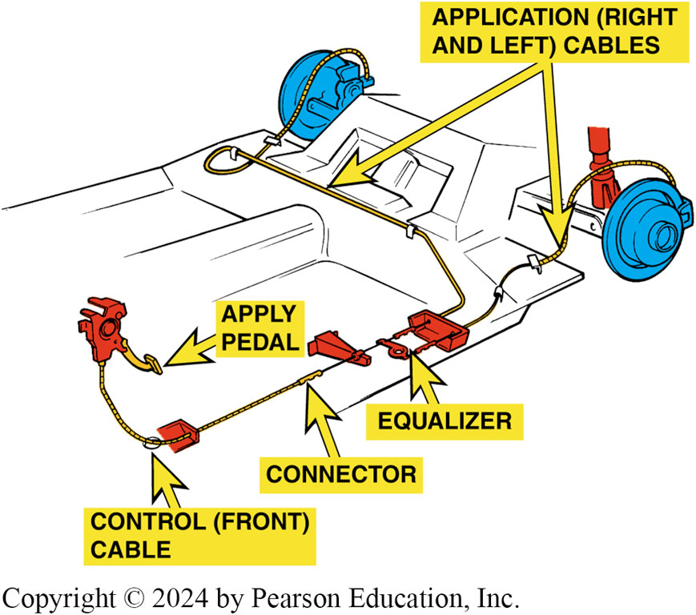
Figure 102.8 Cable Names
The cable from activating lever to equalizer is commonly called control cable. From equalizer, individual brake cables are often called application cables

Slide 18
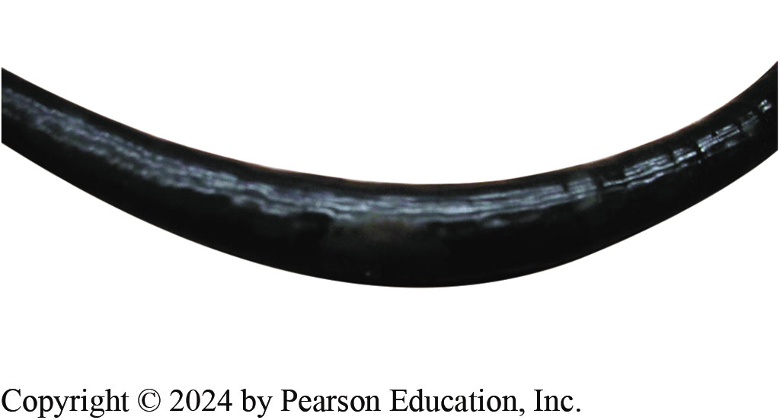
Figure 102.9 Rusted Cable
Notice how rust inside the covering of this parking brake cable has caused the cable to swell
Notes:
TECH TIP: Look for Swollen Parking Brake Cables
Always inspect parking brake cables for proper operation. A cable that is larger in diameter in one section indicates that it is rusting inside and has swollen. FIGURE 102-9.
A rusting parking brake cable can keep the rear brake applied even though the parking brake lever has been released. This can cause dragging brakes, reduced fuel economy, and possible vehicle damage due to overheated brakes.

Slide 19
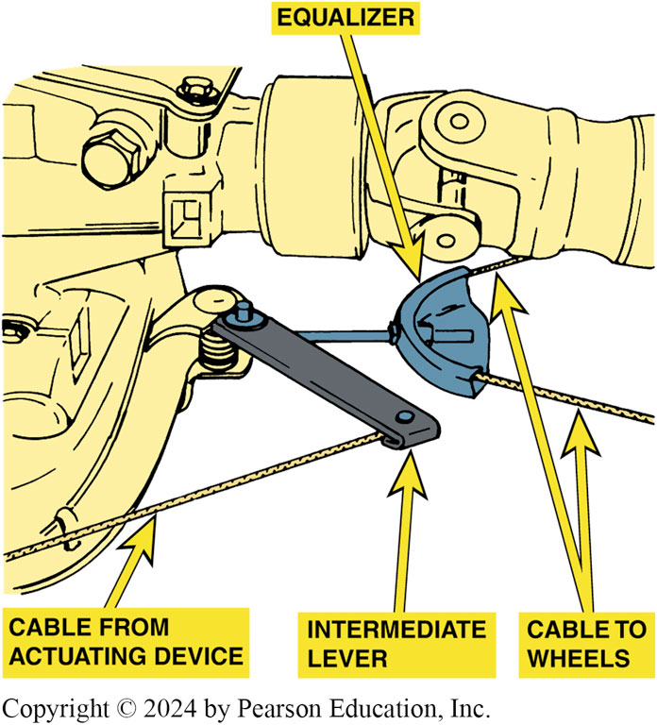
Figure 102.10 Intermediate Levers
Intermediate levers in the parking brake linkage increase the application force

Slide 20
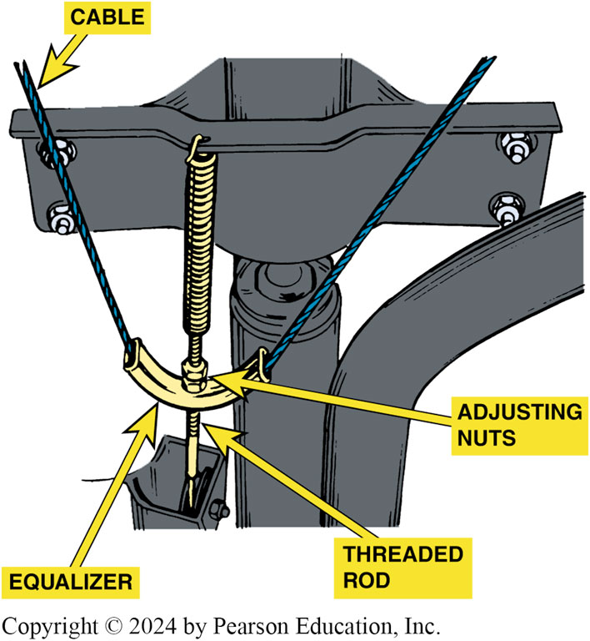
Figure 102.11 Cable Guide
A cable guide is a common type of parking brake linkage equalizer

Slide 21
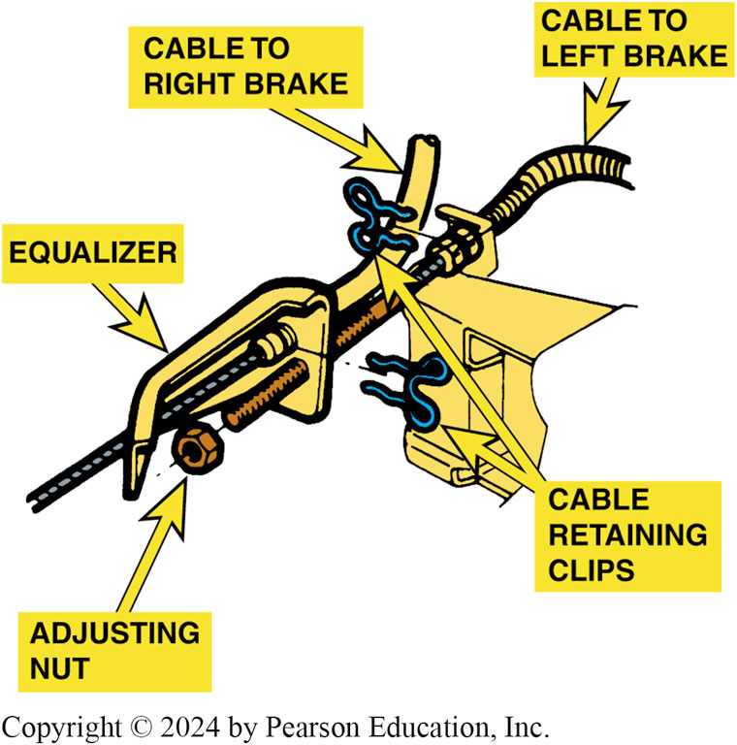
Figure 102.12 Equalizers
Some parking brake equalizers are installed in the brake cable

Slide 22
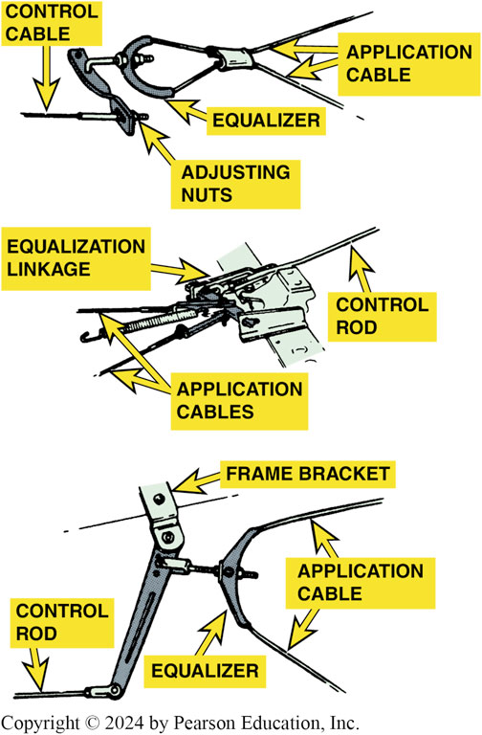
Figure 102.13 Lever and Equalizer
Many parking brake linkages use both an intermediate lever and an equalizer

Slide 23
Question 1: ?
What components typically make up a parking brake assembly?

Slide 24
Answer 1
Lever or pedal, rods, cables, and equalizers.

Slide 25
Front and Rear Entry Parking Brake Cables
Front Entry
Parking brake systems attach parking brake lever on secondary (rearward) shoe and pushes primary (forward facing) brake shoe against drum.
Rear Entry
Parking brake has parking brake lever installed on the primary shoe.

Slide 26
Drum Parking Brakes
Integral Drum Parking Brakes
Apply the rear drum service brakes to serve as the parking brakes.
Rear Disc Auxiliary Drum Parking Brakes
Rear disc service brakes with fixed calipers commonly have a parking brake drum formed into the hub of the brake rotor.
A small dual-servo drum brake friction assembly that serves as the parking brake.

Slide 27
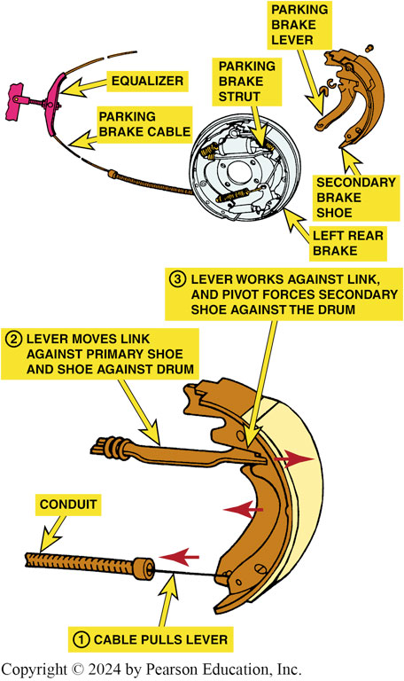
Figure 102.14 Drum Parking Brake
Notice the spring at the end of the parking brake strut. This antirattle spring keeps tension on the strut. The parking brake lever is usually attached with a pin and spring (wavy) washer and retained by a horseshoe clip

Slide 28
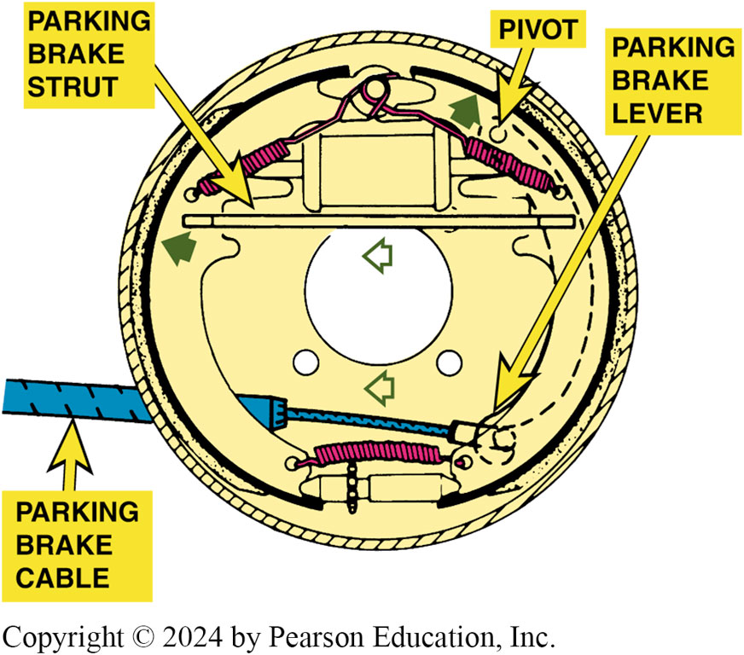
Figure 102.15 Cable Pulls Lever
The parking brake cable pulls on the parking brake lever, which in turn forces the brake shoe against the drum

Slide 29
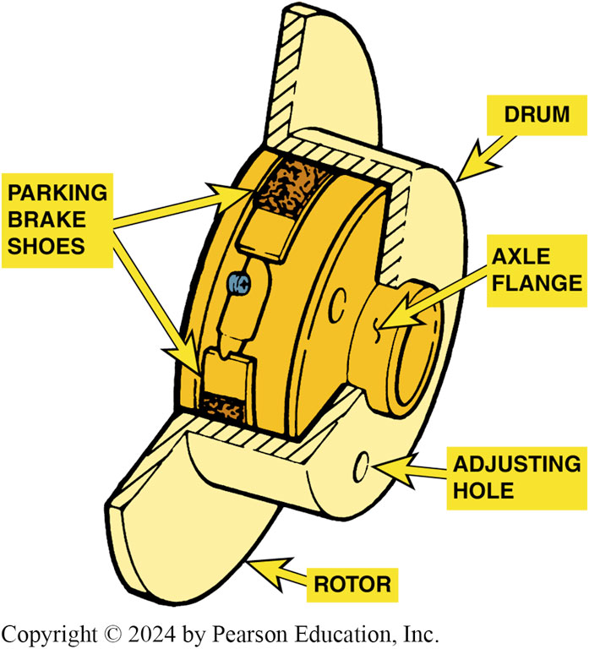
Figure 102.16 Shoes-in-Hat
The inside “hat” of the disc brake rotor is the friction surface for the parking brake shoes
Notes:
TECH TIP: The Parking Brake “Click” Test
When diagnosing any brake problem, apply the parking brake and count the “clicks.” This method works for both hand- and foot-operated parking brakes. Most vehicle manufacturers specify a maximum of 10 clicks. If the parking brake travel exceeds this amount, the rear brakes may be worn or out of adjustment.
CAUTION: Do not adjust the parking brake cable until the rear brakes have been thoroughly inspected and adjusted. If the rear brake lining is usable, check for the proper operation of the self-adjustment mechanism. If the rear brakes are out of adjustment, the service brake pedal will also be low. This 10-click test is a fast and easy way to determine if the problem is due to rear brakes.

Slide 30
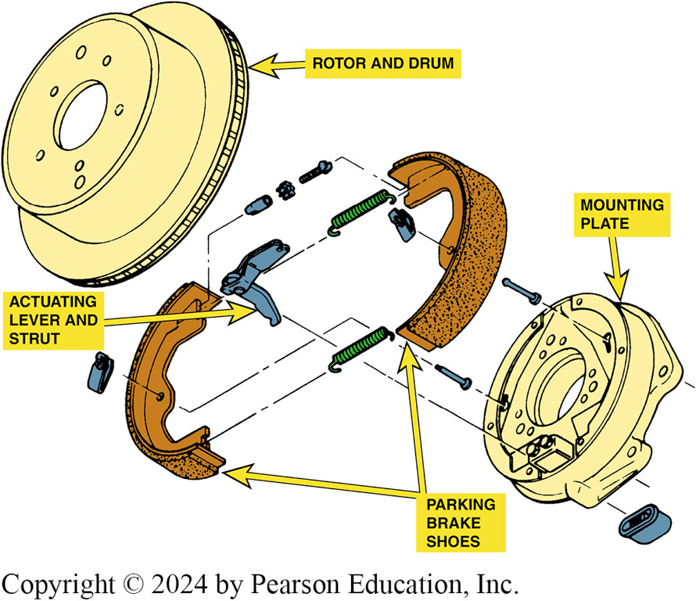
Figure 102.17 Brake Shoes
A typical rear disc brake auxiliary drum brake friction assembly

Slide 31
Question 2: ?
What are the two types of drum parking brakes?

Slide 32
Answer 2
Integral drum and rear disc auxiliary drum.

Slide 33
Caliper-actuated Disc Parking Brake
Ball and Ramp Actuation
As parking brake cable moves lever and rotates operating shaft, balls ride up ramps and force 2 plates apart.
Adjustment is automatic with service brake application.
Screw, Nut, and Cone Actuation
When parking brake is applied, cable moves lever and rotates actuator screw.
Nut then unthreads along the screw, and jams the cone against the clutch surface of the caliper piston.

Slide 34
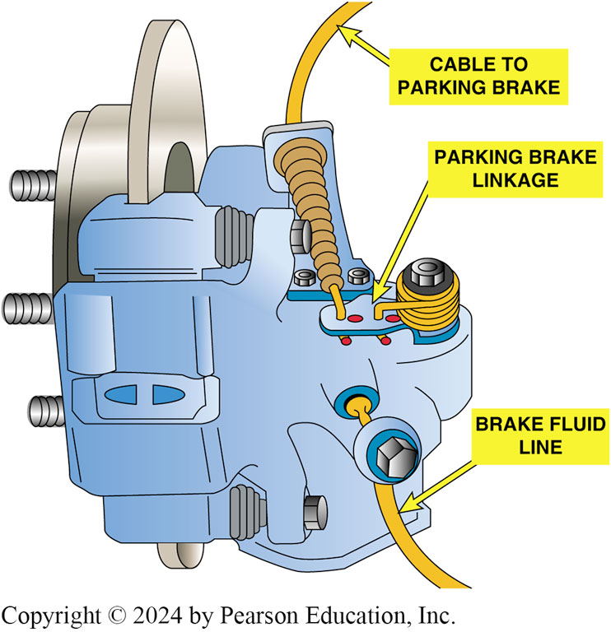
Figure 102.18 Ball and Ramp Caliper
A Ford rear brake caliper ball and ramp-type apply mechanism

Slide 35
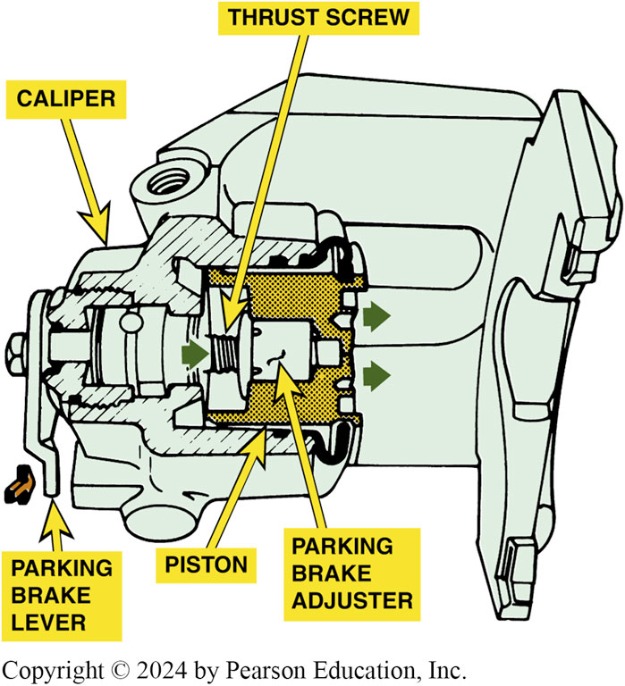
Figure 102.19 Ball & Ramp Operation
Operation of a ball and ramp-type rear disc brake caliper parking brake

Slide 36
Parking Brake Cable Adjustment
Most manufacturers specify a minimum of 3 or 4 and a maximum of 8 to 10 clicks when applying parking brake.
Below is a general procedure for parking brake adjustment:
Ensure service brakes are in good condition and properly adjusted.
Apply the parking brake three to four clicks.
Adjust the parking brake mechanism to specifications.
Release the parking brake. Wheel should roll freely.

Slide 37
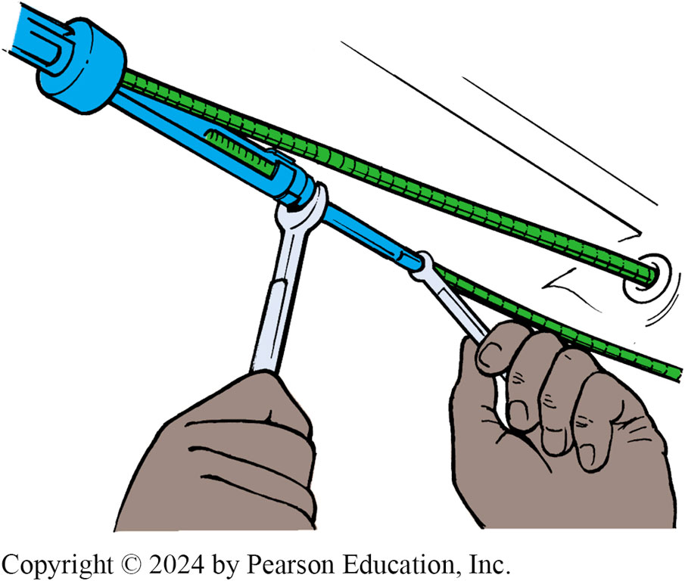
Figure 102.20 Cable Adjustment
After checking that the rear brakes are okay and properly adjusted, the parking brake cable can be adjusted. Always follow the manufacturer’s recommended procedure

Slide 38
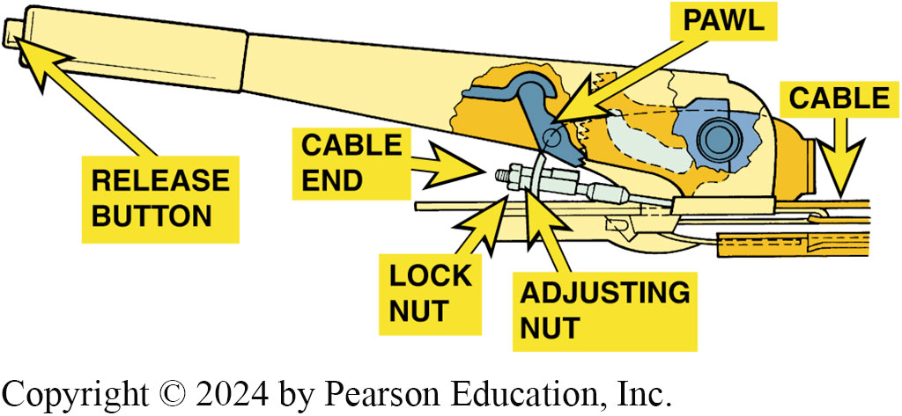
Figure 102.21 Hand Operated Brake
Many hand-operated parking brakes are adjusted inside the vehicle

Slide 39
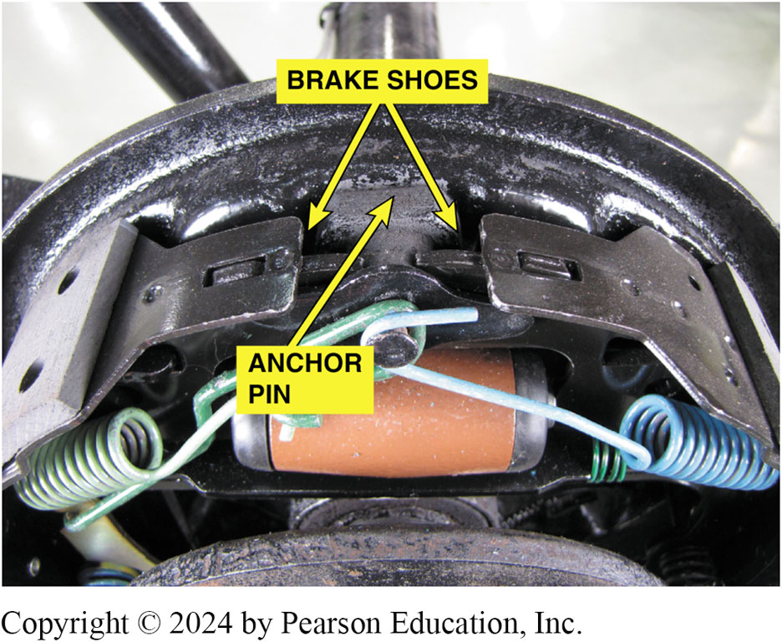
Figure 102.22 Check Anchor Pin
Always check that the brake shoes contact the anchor pin

Slide 40
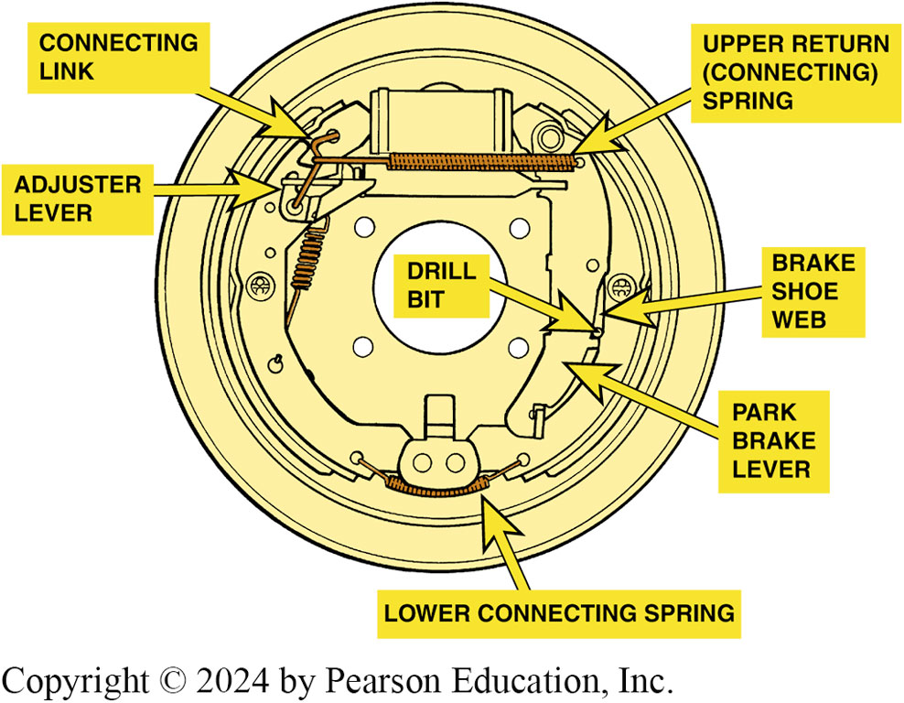
Figure 102.23 GM Leading Trailing
A 1/8 inch (3 mm) drill bit is placed through an access hole in the backing plate to adjust this GM leading-trailing rear parking brake. Adjust the parking brake cable until the drill can just fit between the shoe web and the parking brake lever

Slide 41
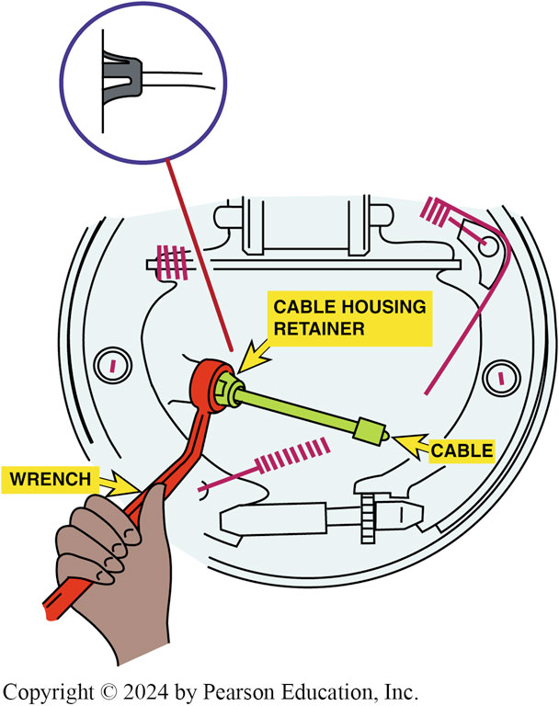
Figure 102.24 Cable Removal
Many parking brake cables can be removed easily from the backing plate using a 1/2 inch (13 mm) box-end wrench. The wrench fits over the retainer finger on the end of the parking brake cable
Notes:
TECH TIP: The Hose Clamp or Wrench Trick
It is often difficult to remove a parking brake cable from the backing plate due to the design of the retainer. The many fingers used to hold the cable to the backing plate can be squeezed all at once if a hose clamp is used to compress the fingers. A wrench as shown in FIGURE 102-24.

Slide 42
Electric Parking Brake
Electric parking brake (E P B) systems are available using two different designs, including the following:
A cable-pulling type that uses an electric motor to pull the parking brake cable.
A more advanced unit uses a computer-controlled motor attached to the brake caliper to activate it.
E P B Service
Use a scan tool and follow the on-screen instructions to service the electric parking brake.

Slide 43
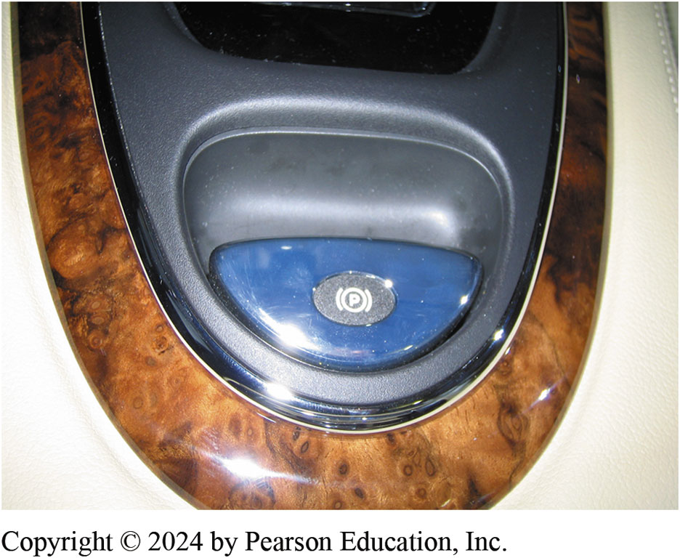
Figure 102.25 Electric Parking Brake
An electric parking brake button on the center console of a Jaguar

Slide 44
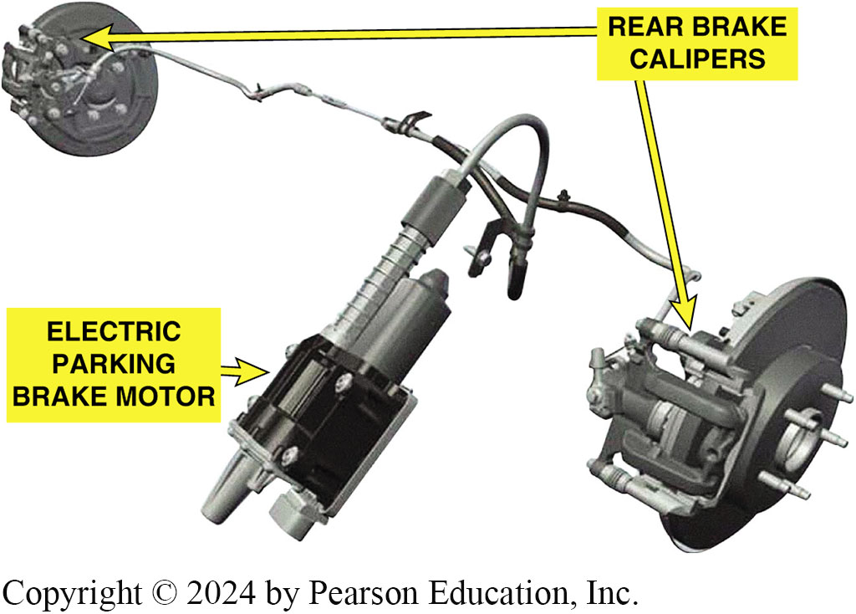
Figure 102.26 Motor Operated Brake
Electric parking brake that uses an electric motor to pull on the parking brake cable to each rear wheel

Slide 45
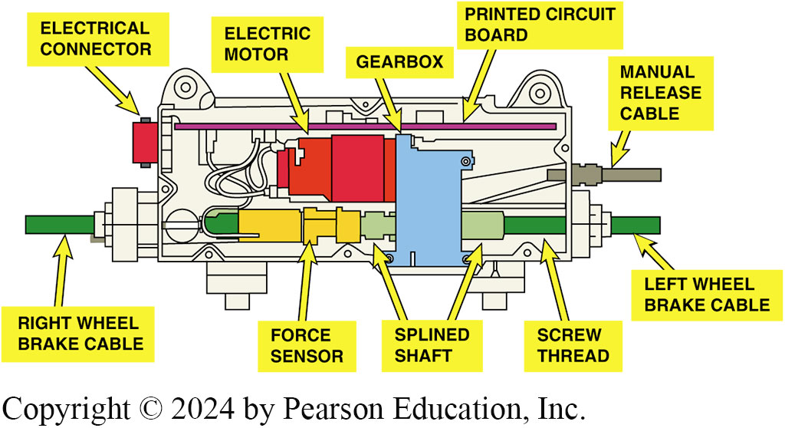
Figure 102.27 Motor Applies Cable
A DC electric motor is used to apply the cable running to the left and right parking brake.

Slide 46
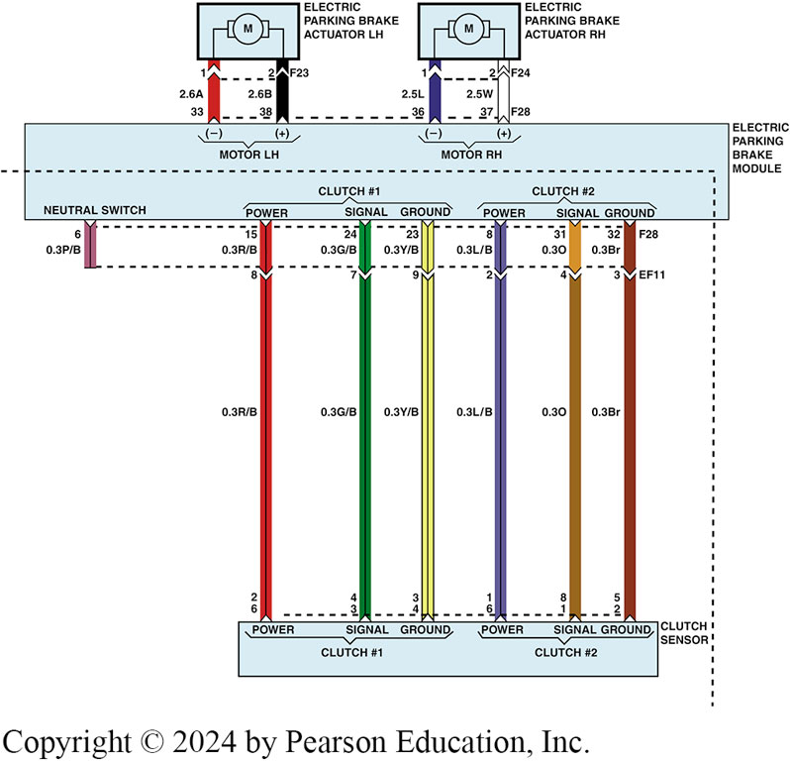
Figure 102.28 Circuit
The electric parking brake (EPB) control module is used to control the operation of the electric parking brake actuator at each rear wheel.

Slide 47
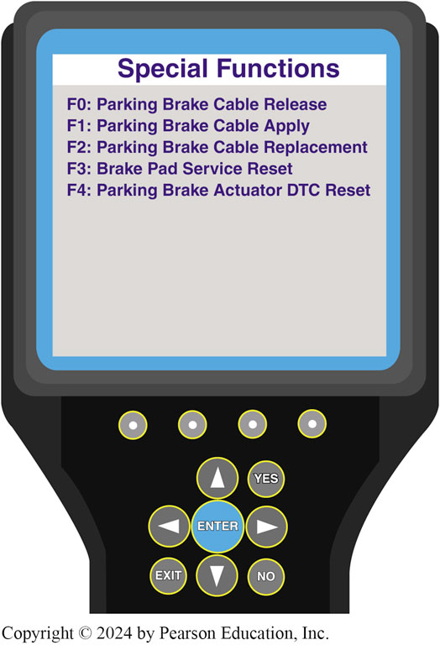
Figure 102.29 Scan Tool Use
A scan tool can be used when servicing the rear brakes on a vehicle equipped with an electric parking brake

Slide 48
Question 3: ?
What are the two types of electronic parking brake systems?

Slide 49
Answer 3
Cable pulling type, and computer-controlled caliper motor.

Slide 50
Brakes Videos and Animations
Videos Link: (A5) Brakes Videos
Animations Link: (A5) Brakes Animations

Slide 51
Copyright
This work is protected by United States copyright laws and is provided solely for the use of instructors in teaching their courses and assessing student learning. Dissemination or sale of any part of this work (including on the World Wide Web) will destroy the integrity of the work and is not permitted. The work and materials from it should never be made available to students except by instructors using the accompanying text in their classes. All recipients of this work are expected to abide by these restrictions and to honor the intended pedagogical purposes and the needs of other instructors who rely on these materials.

