Slide 1
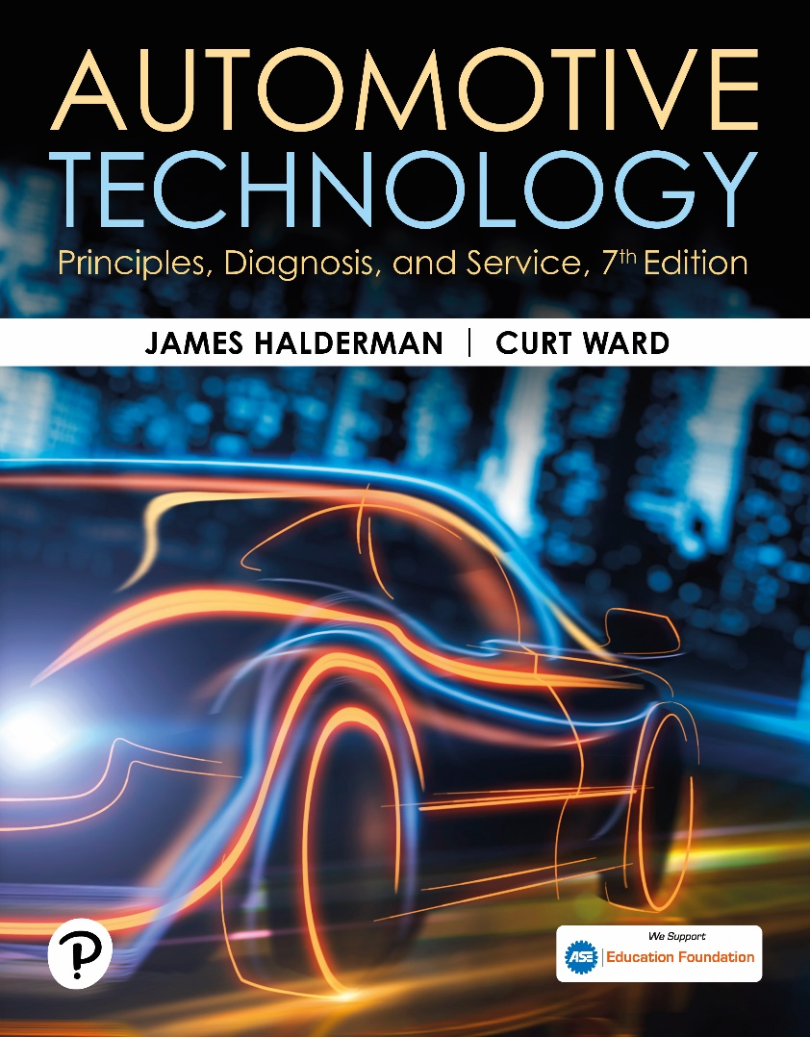
Automotive Technology: Principles, Diagnosis, and Service
Seventh Edition
Chapter 101
Disc Brake Diagnosis and Service
Copyright © 2023 Pearson Education, Inc. All Rights Reserved
Notes:
INSTRUCTOR NOTE: This presentation includes text explanation notes, you can use to teach the course. When in SLIDE SHOW mode, you RIGHT CLICK and select SHOW PRESENTER VIEW, to use the notes.

Slide 2
Learning Objectives
101.1 Discuss how to diagnose problems with disc brakes.
101.2 Explain visual inspection of disc brakes and pads.
101.3 Describe disc brake caliper service.
101.4 Describe caliper installation.
101.5 Explain disc brake squeal correction.
101.6 State the symptoms of a faulty disc brake.

Slide 3
Disc Brake Diagnostic Procedures
First step is to verify customer complaint.
Check brake pedal height and verify proper operation.
Safely hoist vehicle and remove wheels and visually inspect the system.
Remove disc brake calipers and check the disc brake pads for proper lining thickness and check for cracks or other damage.
Replace all components that do not meet factory specifications.
Verify repair.
Notes:
TECH TIP: Let the Owner Drive
When verifying the customer complaint, ask the owner or driver of the vehicle to drive. Often, the problem is best discovered if the vehicle is being driven exactly the same way as when the complaint first occurred. For example, the technician may brake harder or softer than the driver; so, the problem may not be detected.

Slide 4
Visual Inspection
Even with operating wear-indicating sensors, a thorough visual inspection is very important.
A thorough visual inspection can only be accomplished by removing the friction pads.
Uneven pad wear may be an indication the caliper is not applying even pressure.

Slide 5
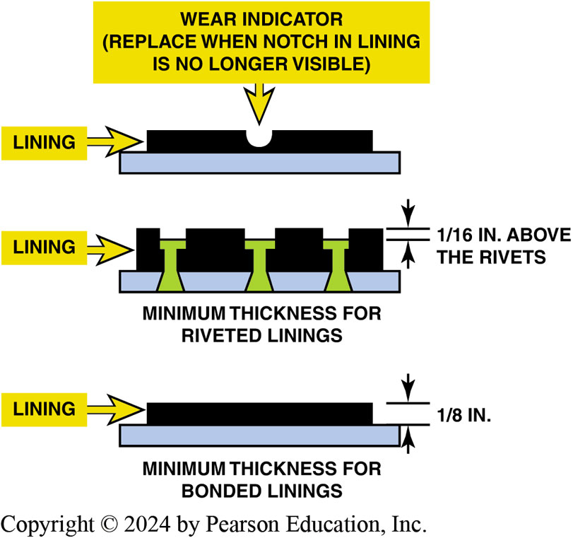
Figure 101.1 Pad Thickness
Minimum thickness for various types of disc brake pads. Pad wear sensors often make a “chirping” sound when the vehicle is moving if the pads are worn. Do not confuse that noise for a defective wheel bearing or other fault

Slide 6
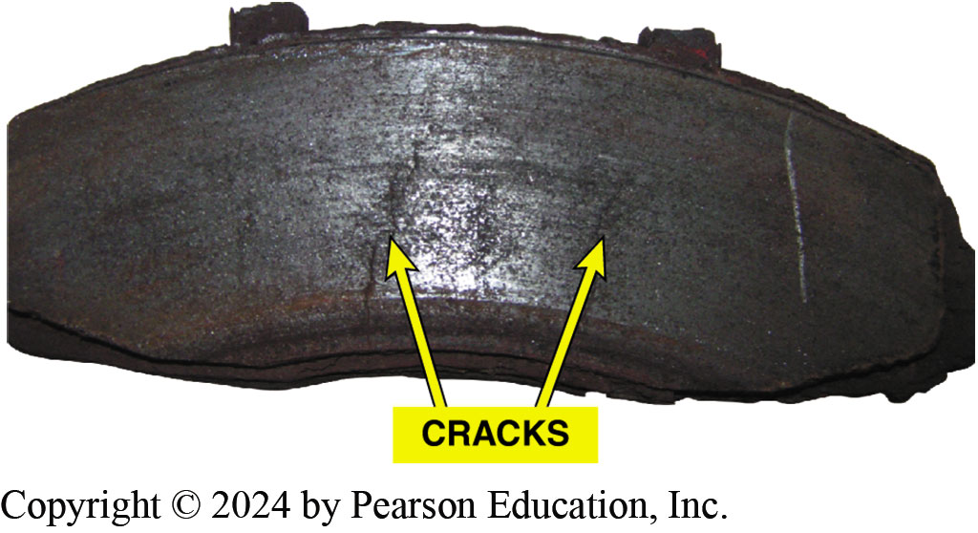
Figure 101.2 Cracked Pad
This cracked disc brake pad must be replaced even though it is thicker than the minimum allowed by the vehicle manufacturer

Slide 7
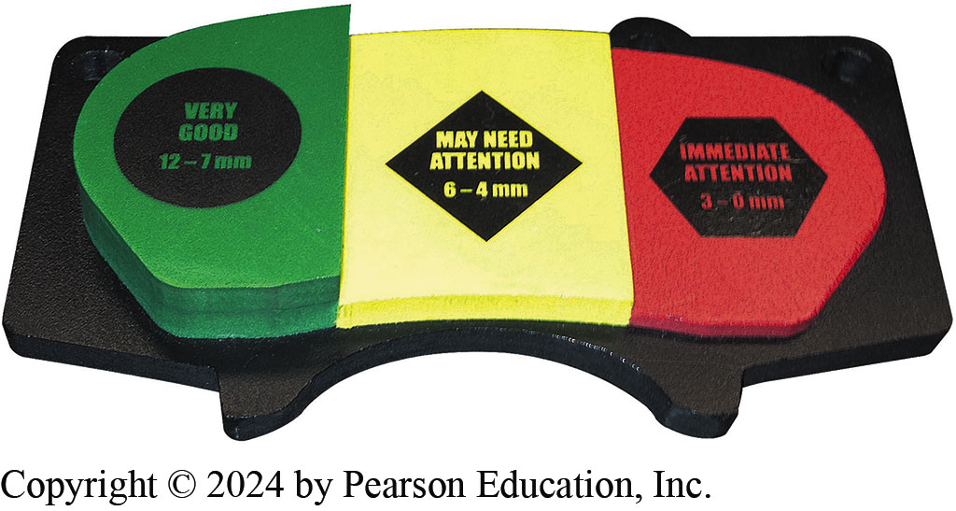
Figure 101.3 Pad Display
A brake pad display used by shops to help customers visualize the measurements taken when their brakes were inspected.
Green: Good is 0.25 to 0.50 inch (7–12 mm)
Yellow: May need attention is 0.16 to 0.24 inch (4–6 mm)
Red: Immediate attention required is less than 0.12 inch (3 mm)
Notes:
TECH TIP: The Bleed and Squirt Test
If you suspect a brake is not being fully released,
simply loosen the bleeder valve. If brake fluid squirts
out under pressure, then the brake is being kept
applied. Look for a defective flexible brake hose.
If the vehicle is off the ground, the wheels should
be able to be rotated with the brakes off. If a wheel is
difficult or hard to turn by hand and is easy to turn after
opening the bleeder valve, then there is a brake fluid
restriction between the master cylinder and the brake.

Slide 8
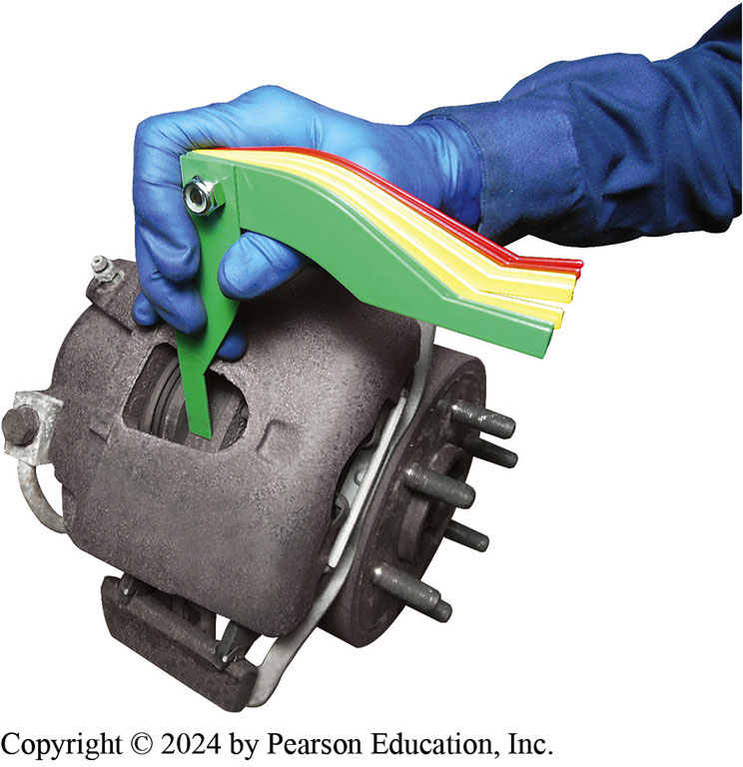
Figure 101.4 Inspection Opening
Most disc brake calipers have a brake inspection opening. This inspection opening does allow the use of a brake pad thickness gauge so that the pad thickness can be documented on the work order

Slide 9
Disc Brake Caliper Service (1 of 2)
Removal
  Note Caliper mount position before removing Caliper.
Inspection and Disassembly
  Check for brake fluid in and around piston boot area.
  If boot is damaged or a fluid leak is visible, then a caliper assembly repair or replacement is required.

Slide 10
Disc Brake Caliper Service (2 of 2)
Phenolic Caliper Pistons
  Phenolic caliper pistons are made from a phenol-formaldehyde resin combined with various reinforcing fibers.
Steel Caliper Pistons
  The stamped steel pistons are plated first with nickel, then chromed to achieve the desired surface finish.

Slide 11
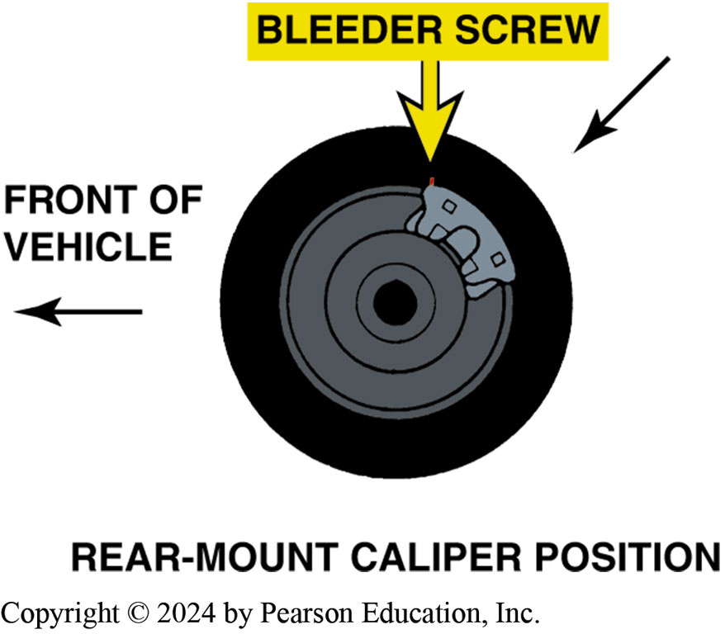
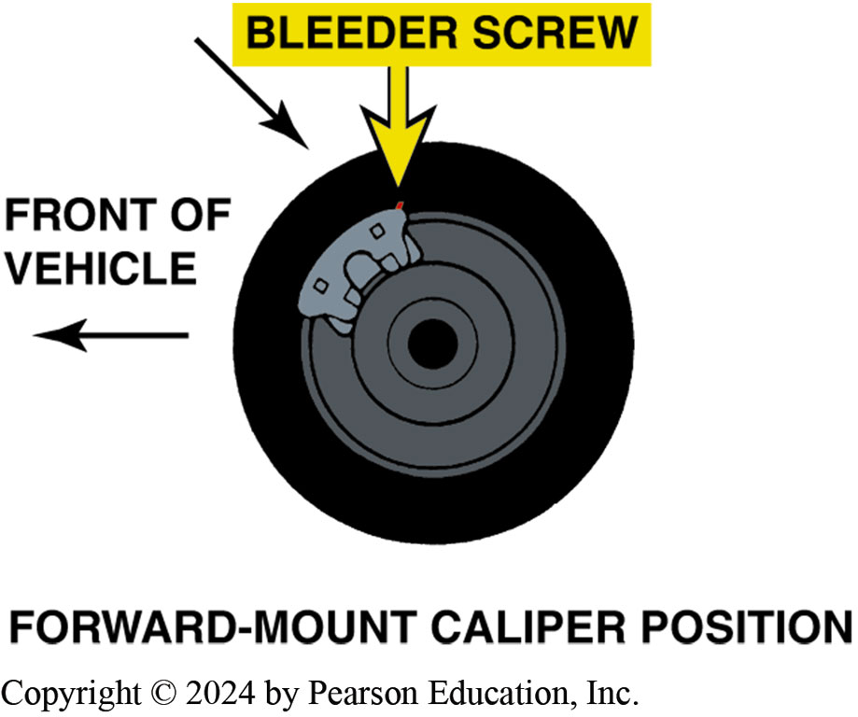
Figure 101.5 Bleeder Screws
Both rear- and forward-mounted calipers have bleeder valve at top. Some calipers will fit on wrong side of vehicle, yet not be able to be bled correctly because bleeder valve would point down, allowing trapped air to remain inside caliper bore. If both calipers are being removed at the same time, mark them “left” and “right”

Slide 12
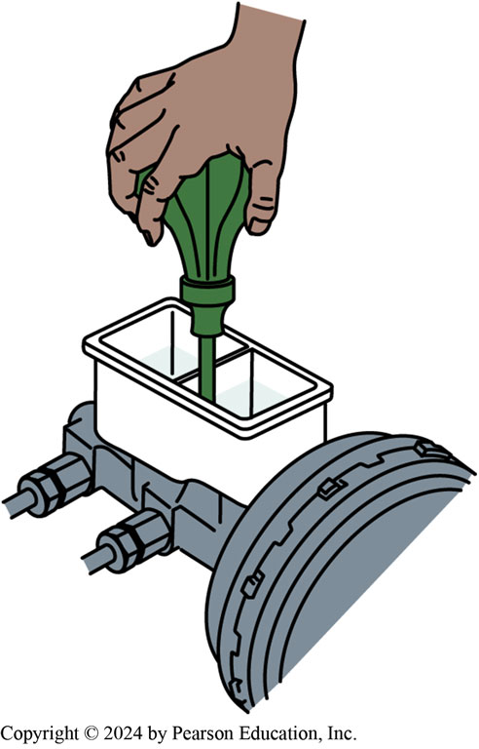
Figure 101.6 Removing Brake Fluid
Many manufacturers recommend removing one-half of the brake fluid from the master cylinder before servicing disc brakes. Use a squeeze bulb and dispose of the used brake fluid properly

Slide 13
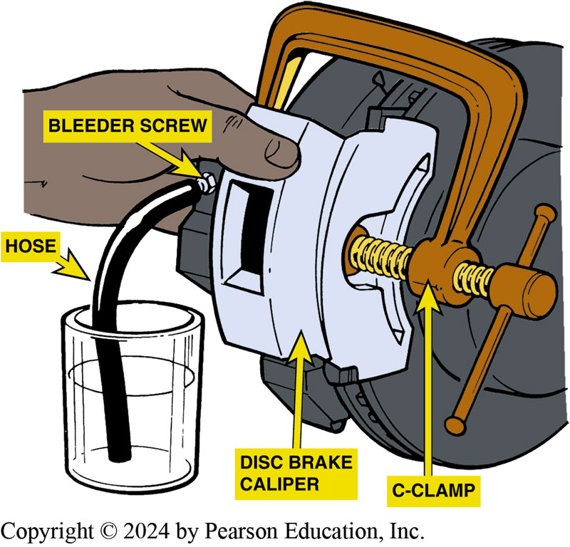
Figure 101.7 Fluid Removal
Most manufacturers recommend that the bleeder valve be opened and brake fluid forced into a container rather than back into master cylinder reservoir. This helps prevent contaminated brake fluid from being forced into the master cylinder, where the dirt and contamination could cause problems.

Slide 14
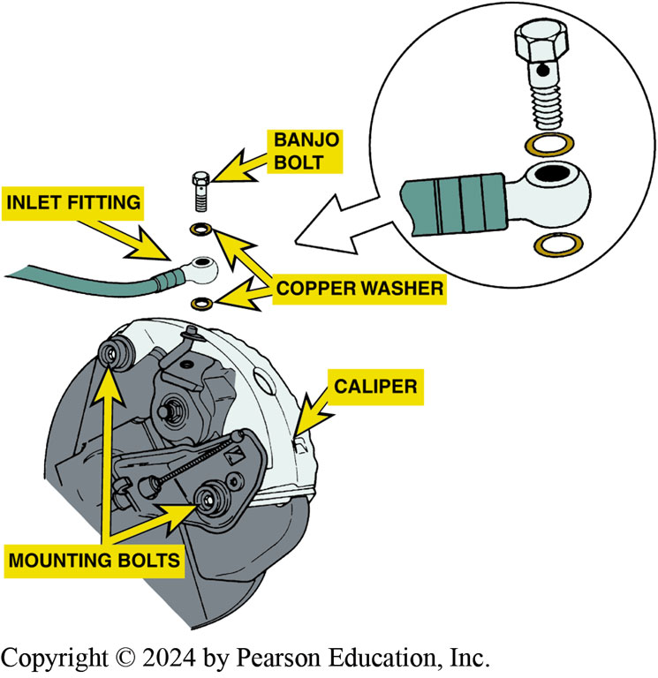
Figure 101.8 Banjo Bolt
Many calipers use a hollow “banjo bolt” to retain the flexible brake line to the caliper housing. The fitting is usually round like a banjo. The copper washers should always be replaced and not reused

Slide 15
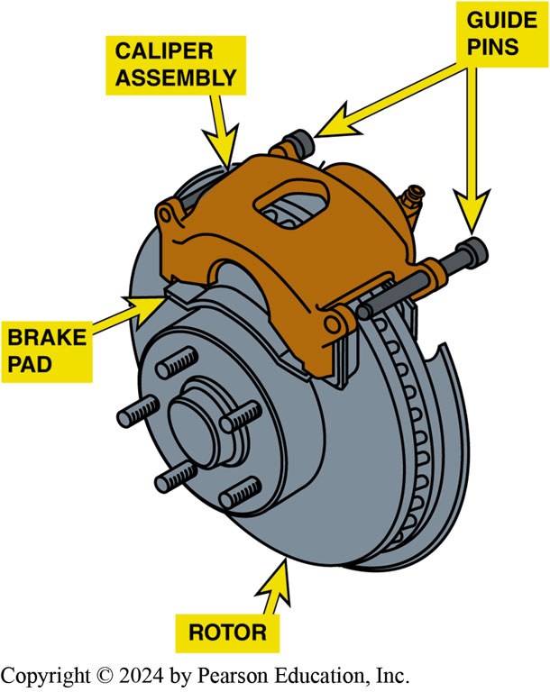
Figure 101.9 Guide Pins
Caliper retaining bolts are often called guide pins. These guide pins are used to retain the caliper to the steering knuckle. These pins also slide through metal bushings and rubber O-rings

Slide 16
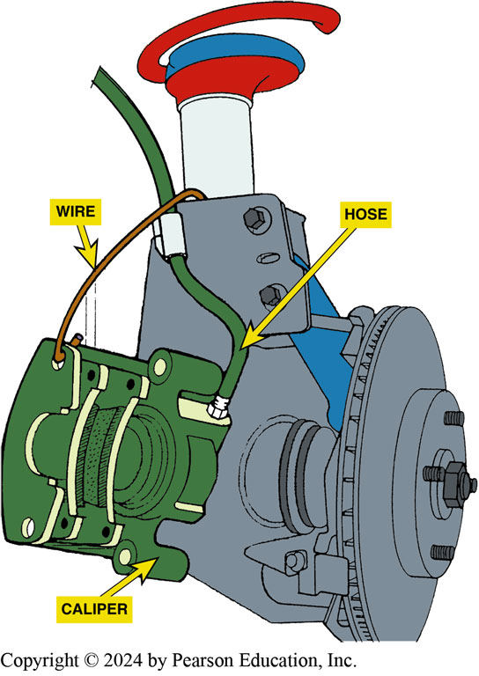
Figure 101.10 Support Caliper
If the caliper is not being removed, it must be supported properly so that the weight of the caliper is not pulling on the flexible rubber brake line

Slide 17
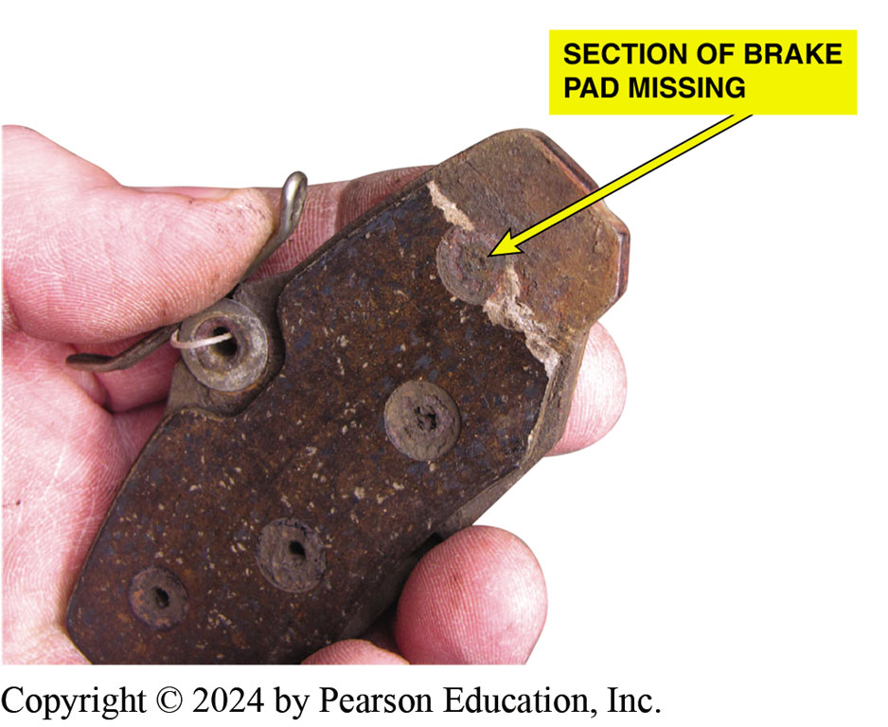
Figure 101.11 Cracked Pad
These pads were found to be cracked and a section was missing from a part of one pad.
Notes:
CASE STUDY: Three Brake Jobs in 40,000 Miles
A service technician was asked to replace the front disc brake pads on a Chevrolet Malibu because the sensors were touching the rotors and making a squealing sound. This was the third time that the front brakes needed to be replaced. Previous brake repairs had been limited to replacement of the front disc brake pads only. When the caliper was removed and the pads inspected, it was discovered that a part of one pad had broken and a piece of the lining was missing. ^{● SEE}
FIGURE 101–11.
Then the technician spotted something at the rear of the vehicle that told the whole story—a trailer hitch.
The owner confirmed that a heavy jet ski was towed in hilly terrain. The technician recommended overhauling the front disc brake calipers to prevent the possibility of the front pads dragging. The technician also recommended an inspection of the rear brakes.
The rear brakes were glazed and out of adjustment. The technician received permission to replace the rear brakes, replace both front calipers, and install quality disc brake pads. When the customer returned, the technician advised the customer to use a lower gear in the transmission on long downhill roads to help keep the brakes from overheating and failing prematurely.
Summary:
Complaint—The front calipers needed replacement more often than expected.
Cause—The front calipers were not retracting and the rear brakes were not working as designed.
Correction—Front calipers were replaced and the rear brakes were serviced. Plus the owner was advised to use the gear selector when descending long grades to reduce the load on the brakes.

Slide 18
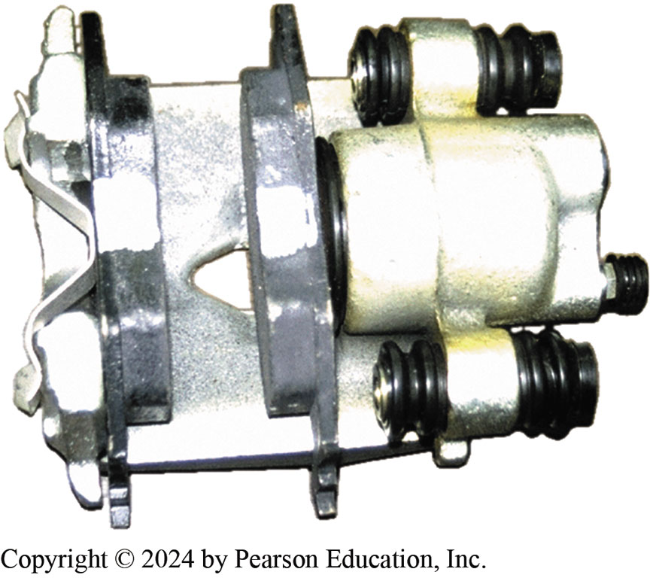
Figure 101.12 Loaded Caliper
A loaded caliper includes all hardware and shims with the correct pads all in one convenient package, ready to install on the vehicle.
Notes:
TECH TIP: Using “Loaded Calipers” Saves Time
Many technicians find that disassembly, cleaning, and rebuilding calipers can take a lot of time. Often the bleeder valve breaks off or the caliper piston is too corroded to reuse. This means that the technician has to get a replacement piston, caliper overhaul kit (piston seal and boot), plus the replacement friction pads and hardware kit.
To save time (and sometimes money), many technicians are simply replacing the old used calipers with “loaded calipers.” Loaded calipers are remanufactured calipers that include (come loaded
with) the correct replacement friction pads and all the necessary hardware. ^{● SEE FIGURE 101–12.}
Therefore, only one part number is needed for each side of the vehicle for a complete disc brake
overhaul.

Slide 19
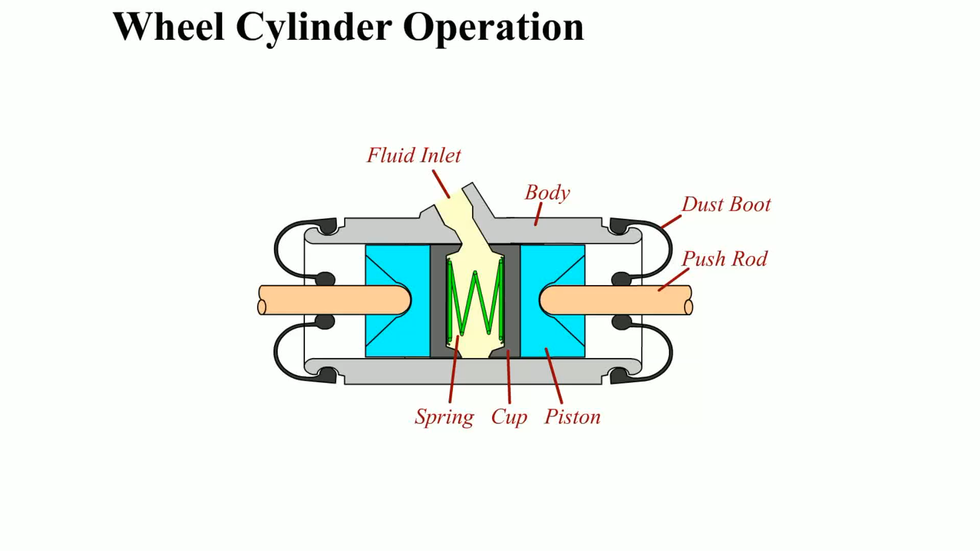
Animation: Wheel Cylinder Operation
(Animation will automatically start)

Slide 20
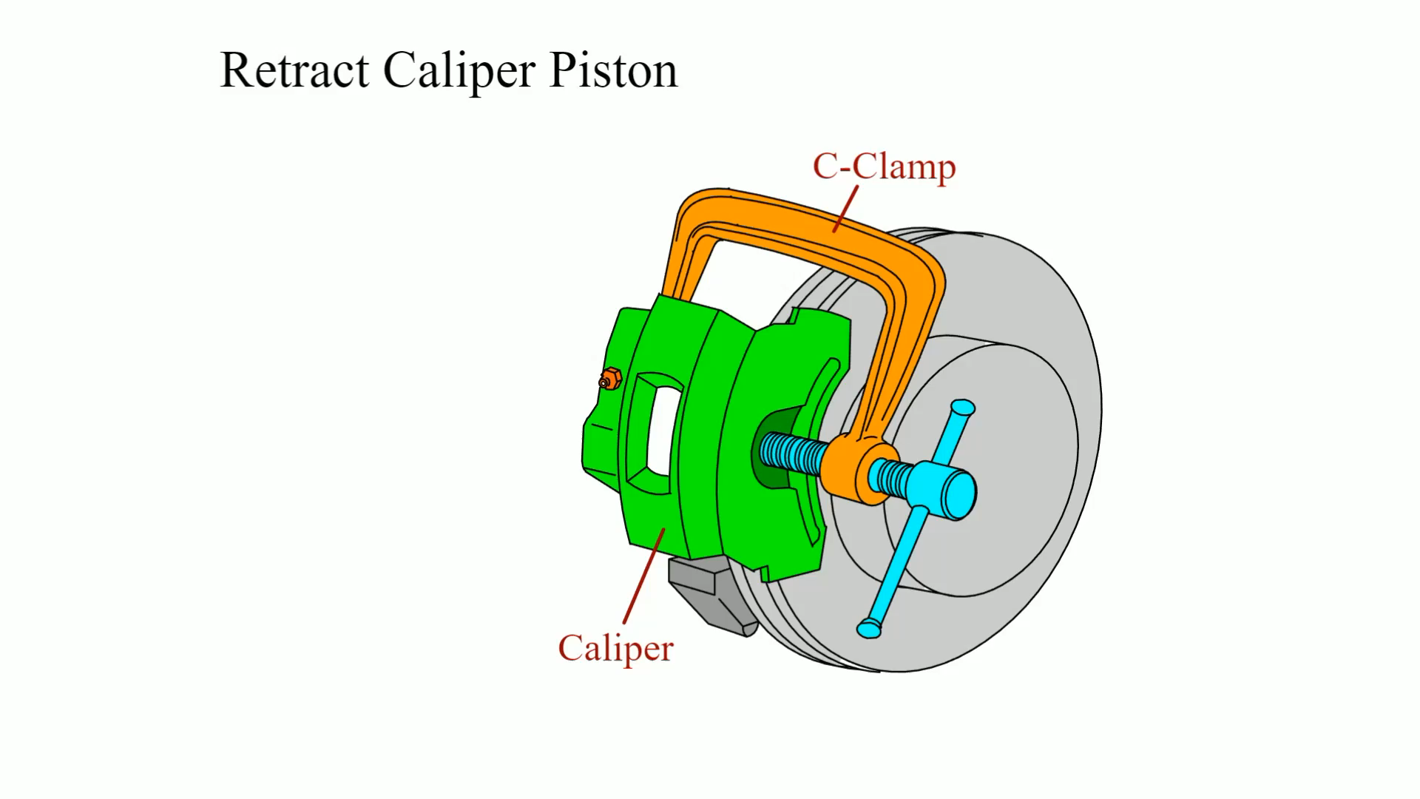
Animation: Retract Caliper Piston
(Animation will automatically start)

Slide 21
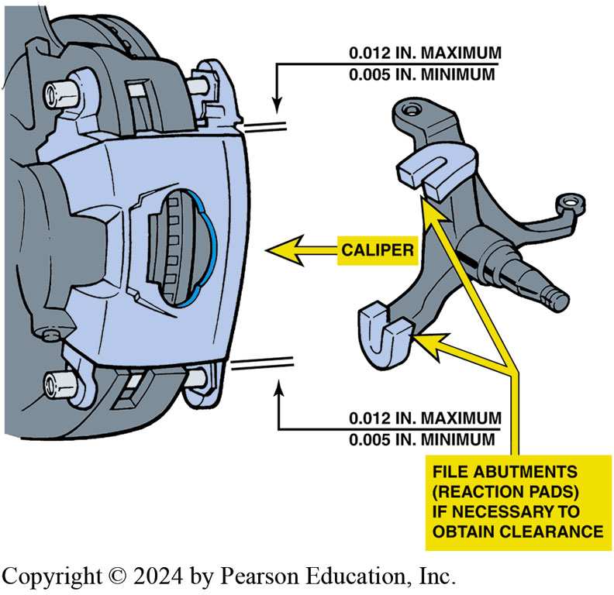
Figure 101.13 Floating Caliper SVC
Floating calipers must be able to slide during normal operation. Therefore, there must be clearance between caliper and the caliper mounting pads (abutments). Too little clearance will prevent the caliper from sliding and too much clearance will cause the caliper to make a clunking noise when the brakes are applied.

Slide 22
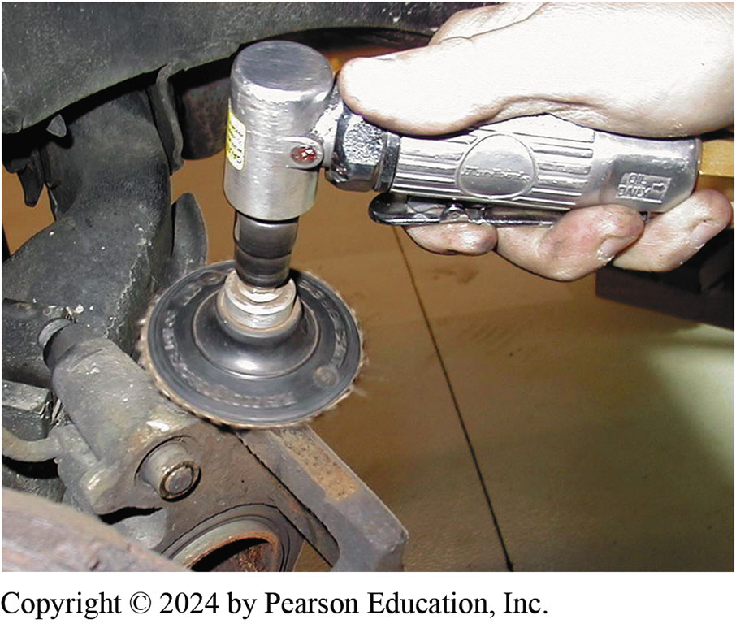
Figure 101.14 Cleaning Pads
Using an air-powered sanding disc to clean the caliper mount pads

Slide 23
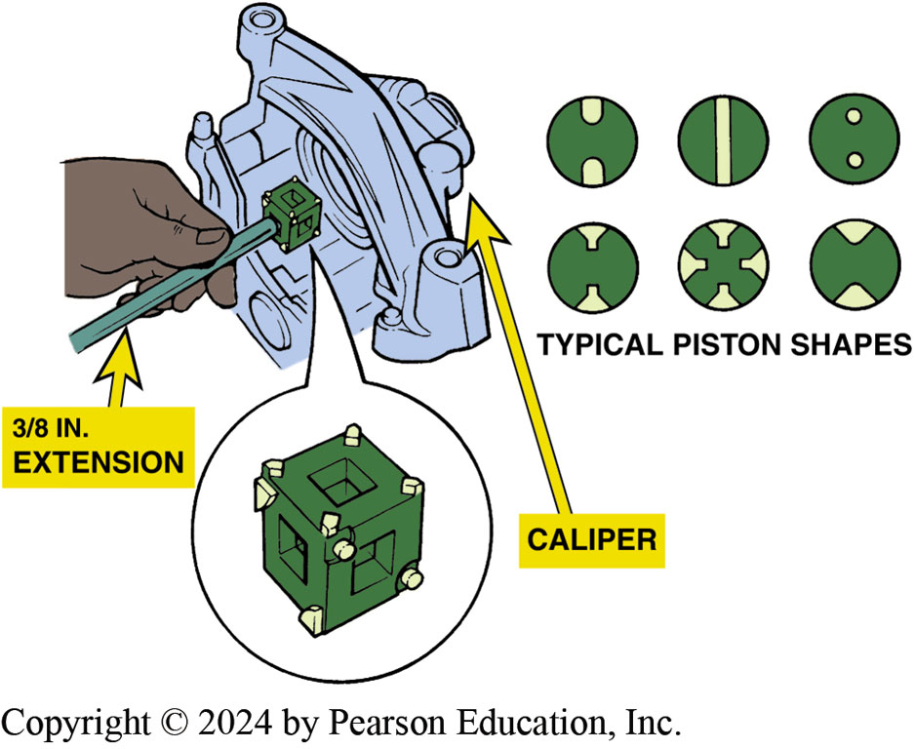
Figure 101.15 Piston Tool
Determine which face of the special tool best fits the holes or slots in the piston. Sometimes needle-nose pliers can be used to rotate the piston back into the caliper bore

Slide 24
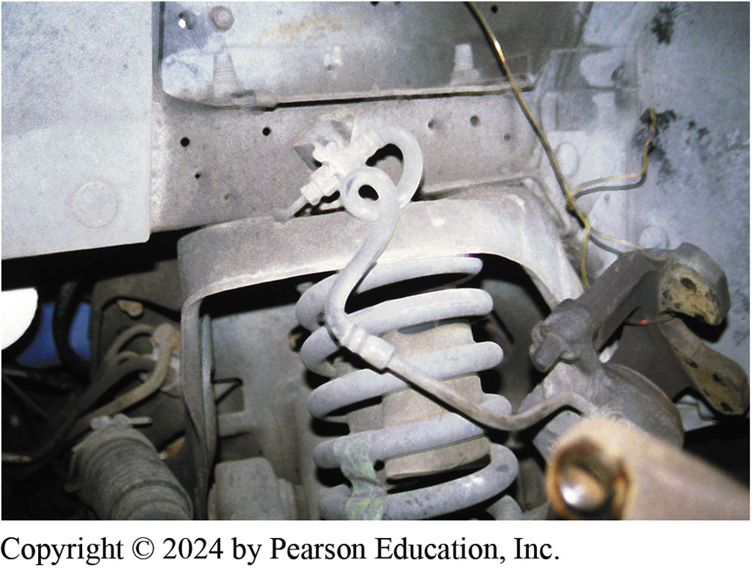
Figure 101.16 Twisted Flex Line
Note the twisted flexible brake line. This was caught by an automotive instructor before the brake work on the vehicle was completed. The twisted brake line can cause brake hose failure if not corrected.
Notes:
TECH TIP: Always Double-Check Your Work
Whenever reassembling brakes, it is easy to twist the flexible brake hose as shown in ^{● FIGURE 101–16.}
To prevent possible brake hose failure and possibly an accident, always double-check that the ribs on the brake hose are straight. The ribs allow the service technician to easily spot if the hose has been twisted.

Slide 25
Disc Brake Squeal Correction
Causes of Brake Squeal
  Disc brake squeal is caused by the movement (vibration) of brake components. The noise is transmitted through the air.
Correcting Disc Brake Squeal
  Keep disc brake pads clean.
  Use factory-type clips and anti-squeal shims.
  Lubricate all caliper slide points as per manufacturer’s recommendation.
  Machine the brake rotor as little as possible and with the correct surface finish.

Slide 26
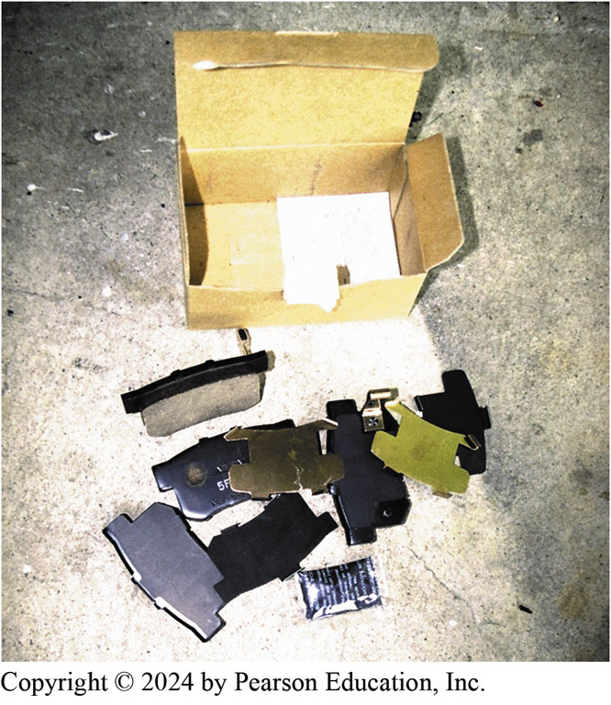
Figure 101.17 Pad Kit
For best braking performance, purchase replacement disc brake pads that include all clips and shims specified by the vehicle manufacturer. Some pads even come with a package of the specified grease to use on the shims to reduce the possibility of brake noise
Notes:
TECH TIP: Increasing Pad Life
Many vehicles seem to wear out front disc brakes more often than normal. Stop-and-go city-type driving is often the cause. Driving style, such as rapid stops, also causes a lot of wear to occur.
The service technician can take some actions to increase brake pad life that are easier than having to cure the driver’s habits. These steps include the following:
Make sure the rear brakes are properly adjusted and working correctly. If the rear brakes are not functioning, all of the braking is accomplished by the front brakes alone.
NOTE: Remind the driver to apply the parking brake regularly to help maintain proper rear brake clearance on the rear brakes.
Use factory brake pads or premium brake pads from a known manufacturer. Tests performed by vehicle manufacturers show that many aftermarket brake pads fail to deliver original
equipment brake pad life.

Slide 27
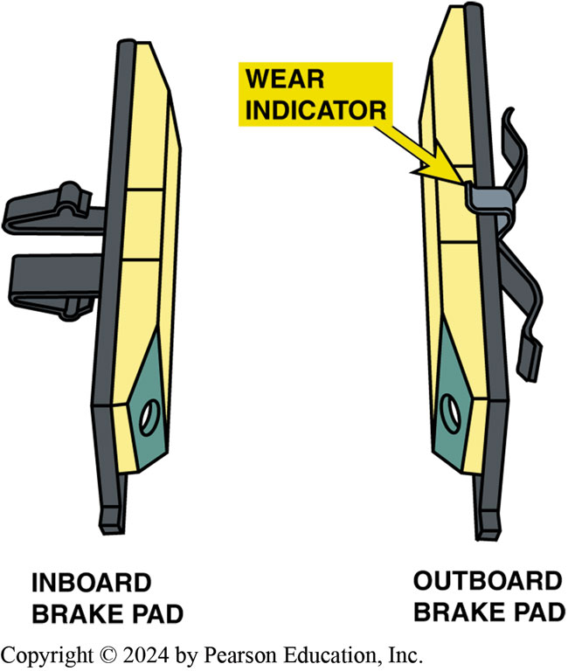
Figure 101.18 Beveled Pads
Notice the beveled pads. The shape of the pad helps reduce brake noise

Slide 28
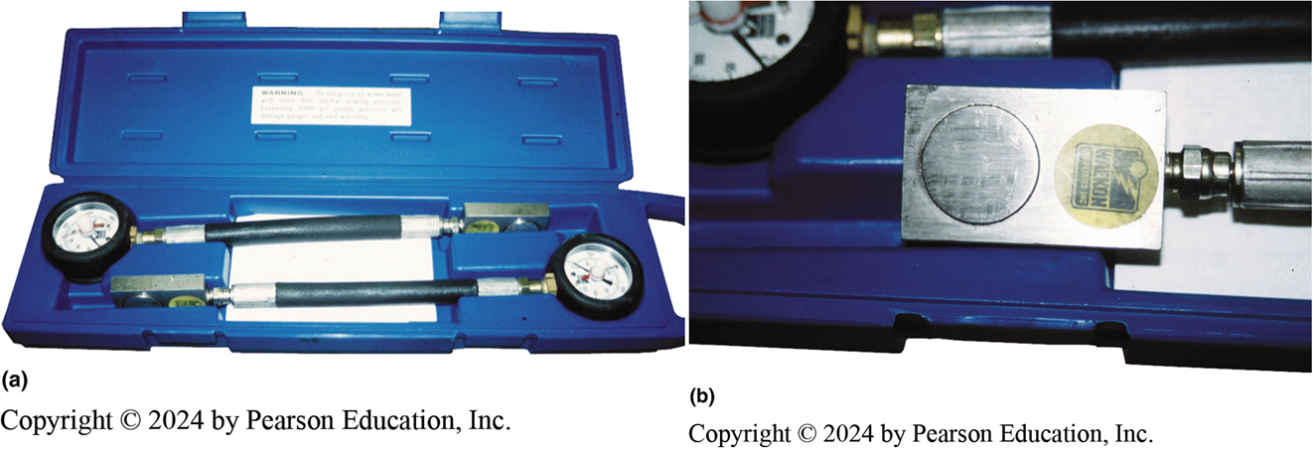
Figure 101.19 Brake Pressure Tester
(a) A brake pressure tester. (b) The small “pads” can be placed between the caliper piston and the rotor to check for applied pressure and inserted between the caliper and the rotor on the outside of the rotor to test the pressure—the pressure should be the same if the caliper is able to slide on its pins or slides
Notes:
TECH TIP: Pressure Testing Can Help Find Problems
A stuck caliper or caliper slide is often difficult to see or diagnose as a problem because the movement of the broken pads is so little. Using a pressure gauge between the caliper piston and the rotor (inboard) or between the rotor and the caliper (outboard) can tell the service technician if there is a difference between the left and the right side brakes. ^{● SEE}
FIGURE 101–19.

Slide 29
Question 3: ?
What is the purpose of the brake pad shims and clips?

Slide 30
Answer 3
To prevent unwanted brake noise and squeal.

Slide 31
Disc Brake Symptom Guide
Pulls to one side during breaking
Brake roughness or chatter (pedal pulsates)
Excessive pedal effort
Excessive pedal travel
Dragging brakes
Front disc brakes very sensitive to light application
Rear drum brakes skidding under heavy application

Slide 32
Chart 101.1 Brake Noise
FACTOR | INCREASE NOISE | REDUCE NOISE
Brake pad thickness | Thinner (worn) pads | Thicker (new) pads
Rotor (disc) thickness | Thinner (worn) rotor | Thicker (new) rotor
Brake pad material | Harder | Softer
Lubrication of parts | Dry—not lubricated | Properly lubricated
Dampening | No dampening | Dampening material behind the pads
Pad mounting | Pad tabs not bent over | Pad tabs securely crimped
Antirattle clips | Worn, defective, or not lubricated | New and properly lubricated
Causes of brake noise can have many reasons and corrections.

Slide 33
Disc Brake Service

Slide 34
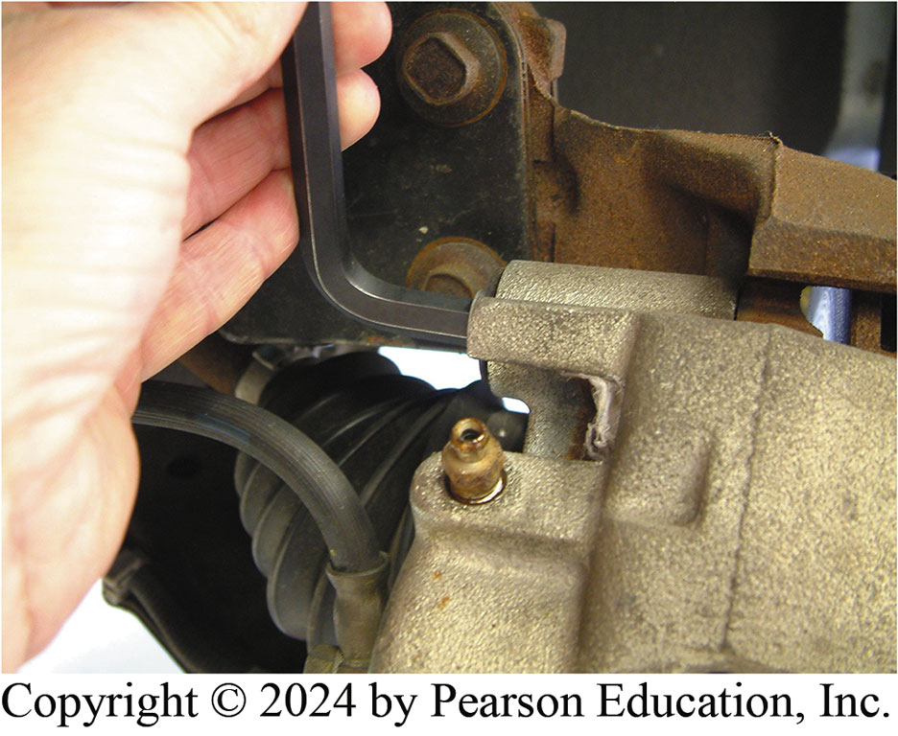
1. Remove Mounting Bolts
1. Use a hex wrench to remove the caliper mounting bolts

Slide 35
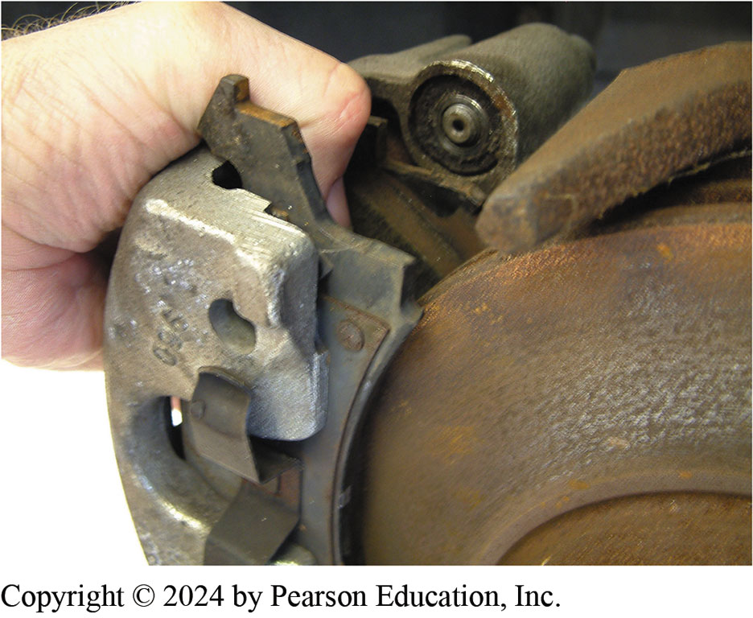
2. Remove Caliper & Pads
2. Remove the caliper and pads from the brake rotor

Slide 36
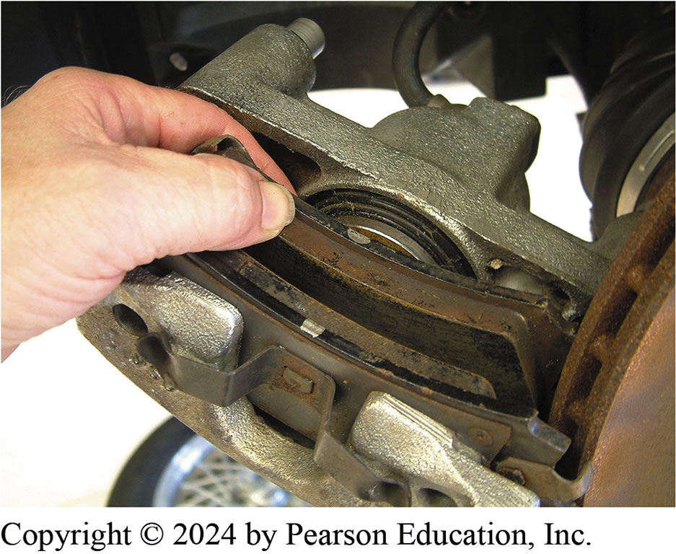
3. Remove Brake Pads
3. Remove the brake pads from the caliper

Slide 37
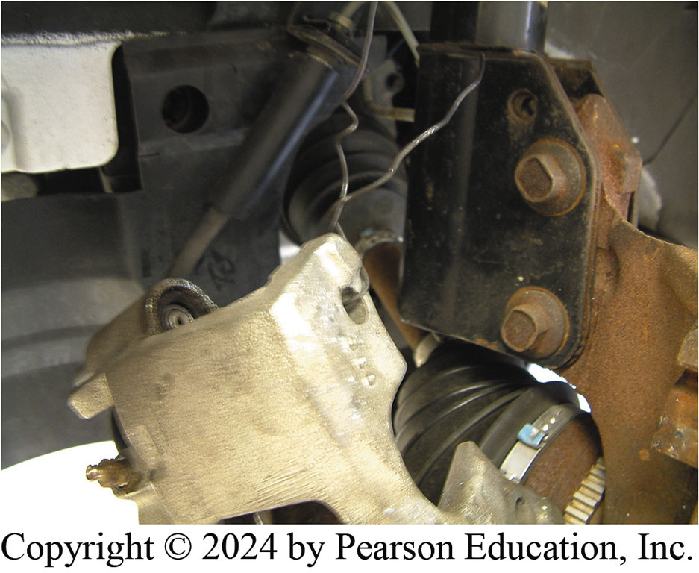
4. Hang Caliper Securely
4. Hang the caliper with wire or a hook. Do not let the caliper hang from the brake hose

Slide 38
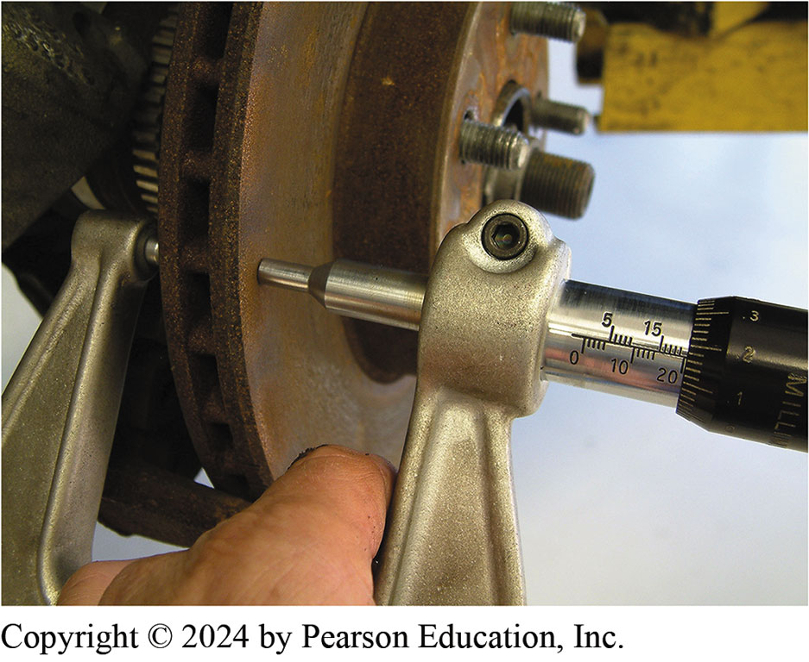
5. Measure Rotor Thickness
5. Measure the rotor thickness and machine or replace, if necessary

Slide 39
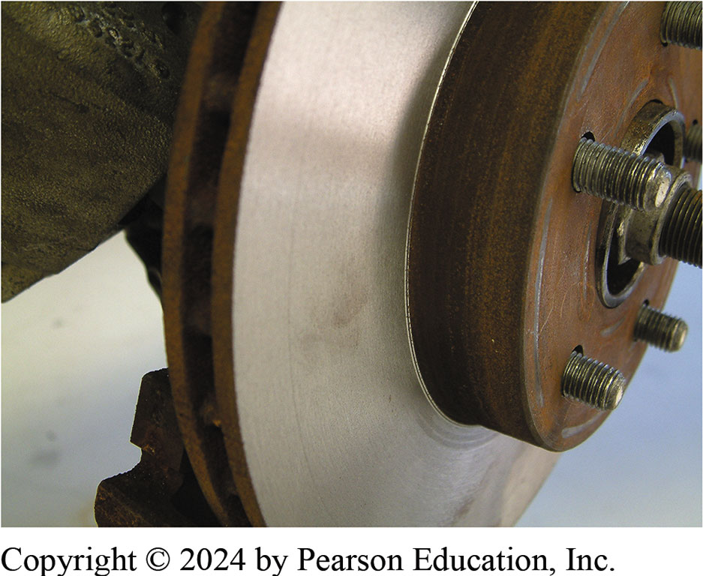
6. Clean & Install Rotor
6. Clean the rotor and install it on the hub

Slide 40
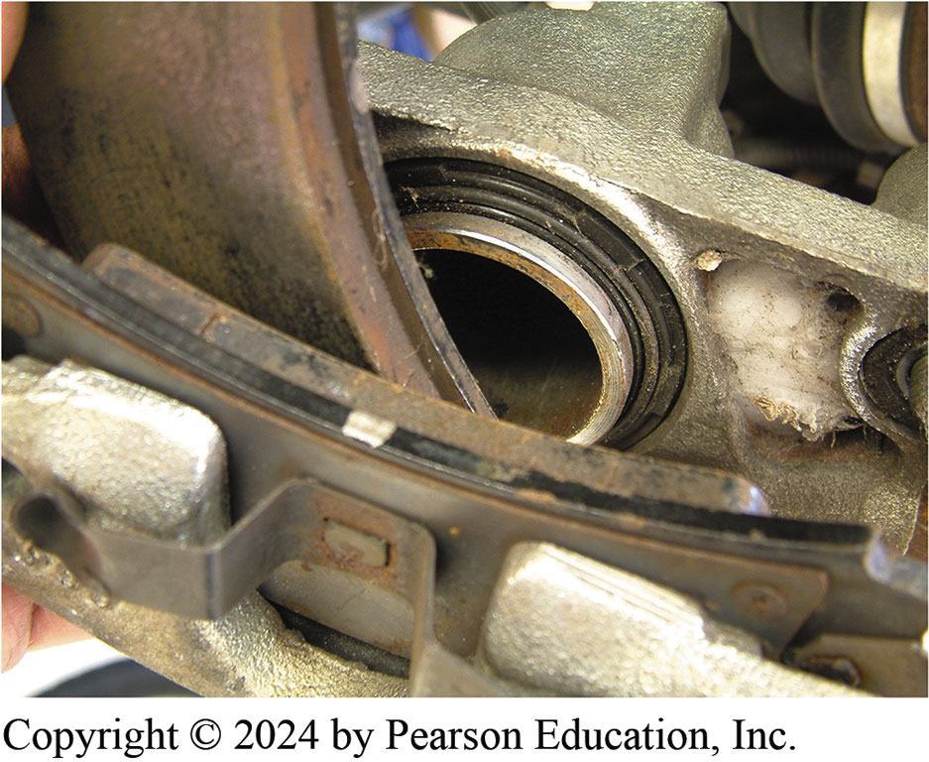
7. Bottom Piston
7. Bottom the piston and install the new brake pads

Slide 41
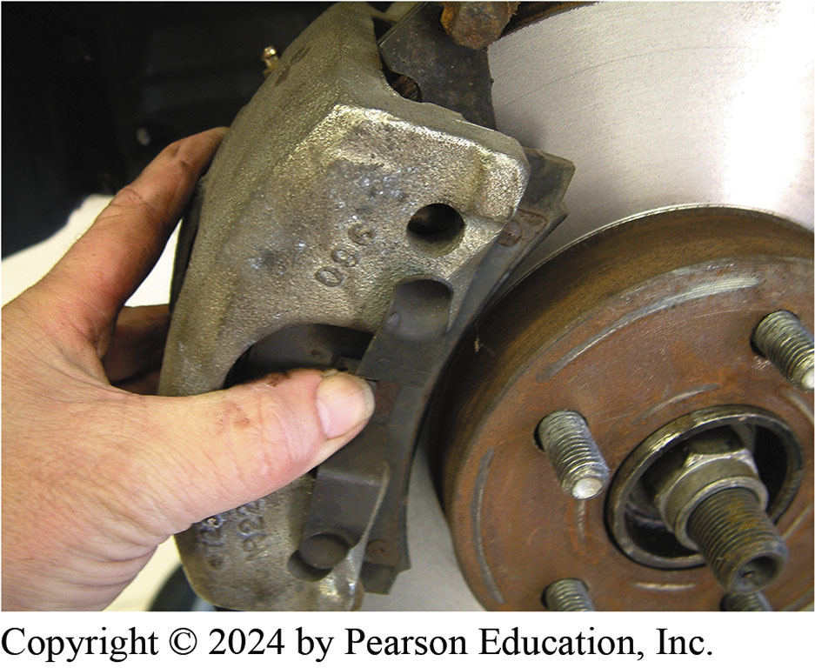
8. Slide Caliper & Pads into Position
8. Slide the caliper and new pads into position on the rotor and steering knuckle

Slide 42
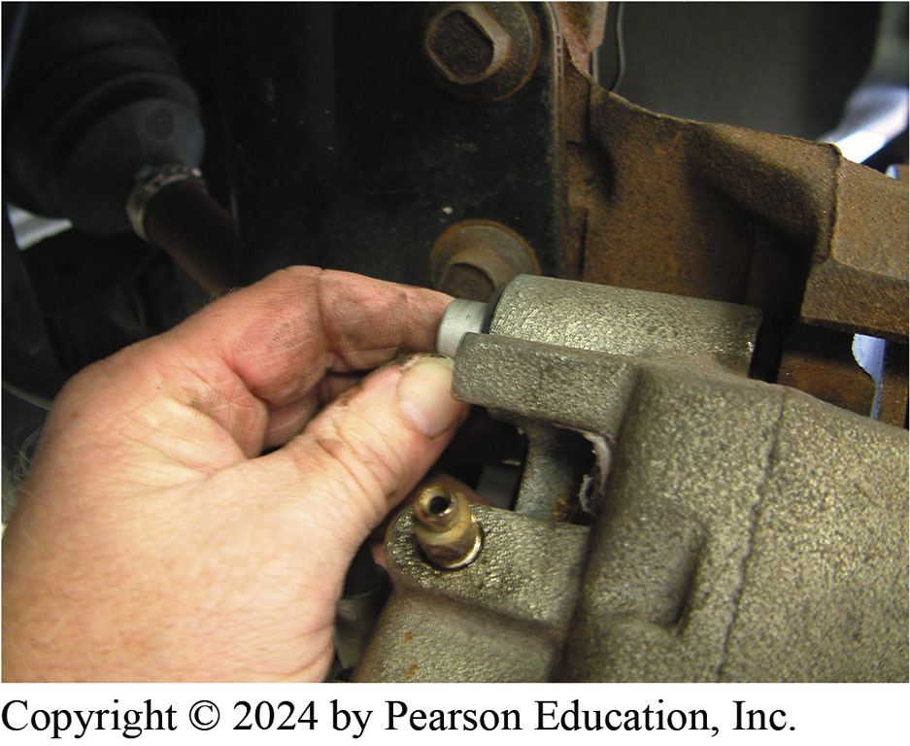
9. Torque Caliper Bolts
9. Install and torque the caliper mounting bolts to factory specifications

Slide 43
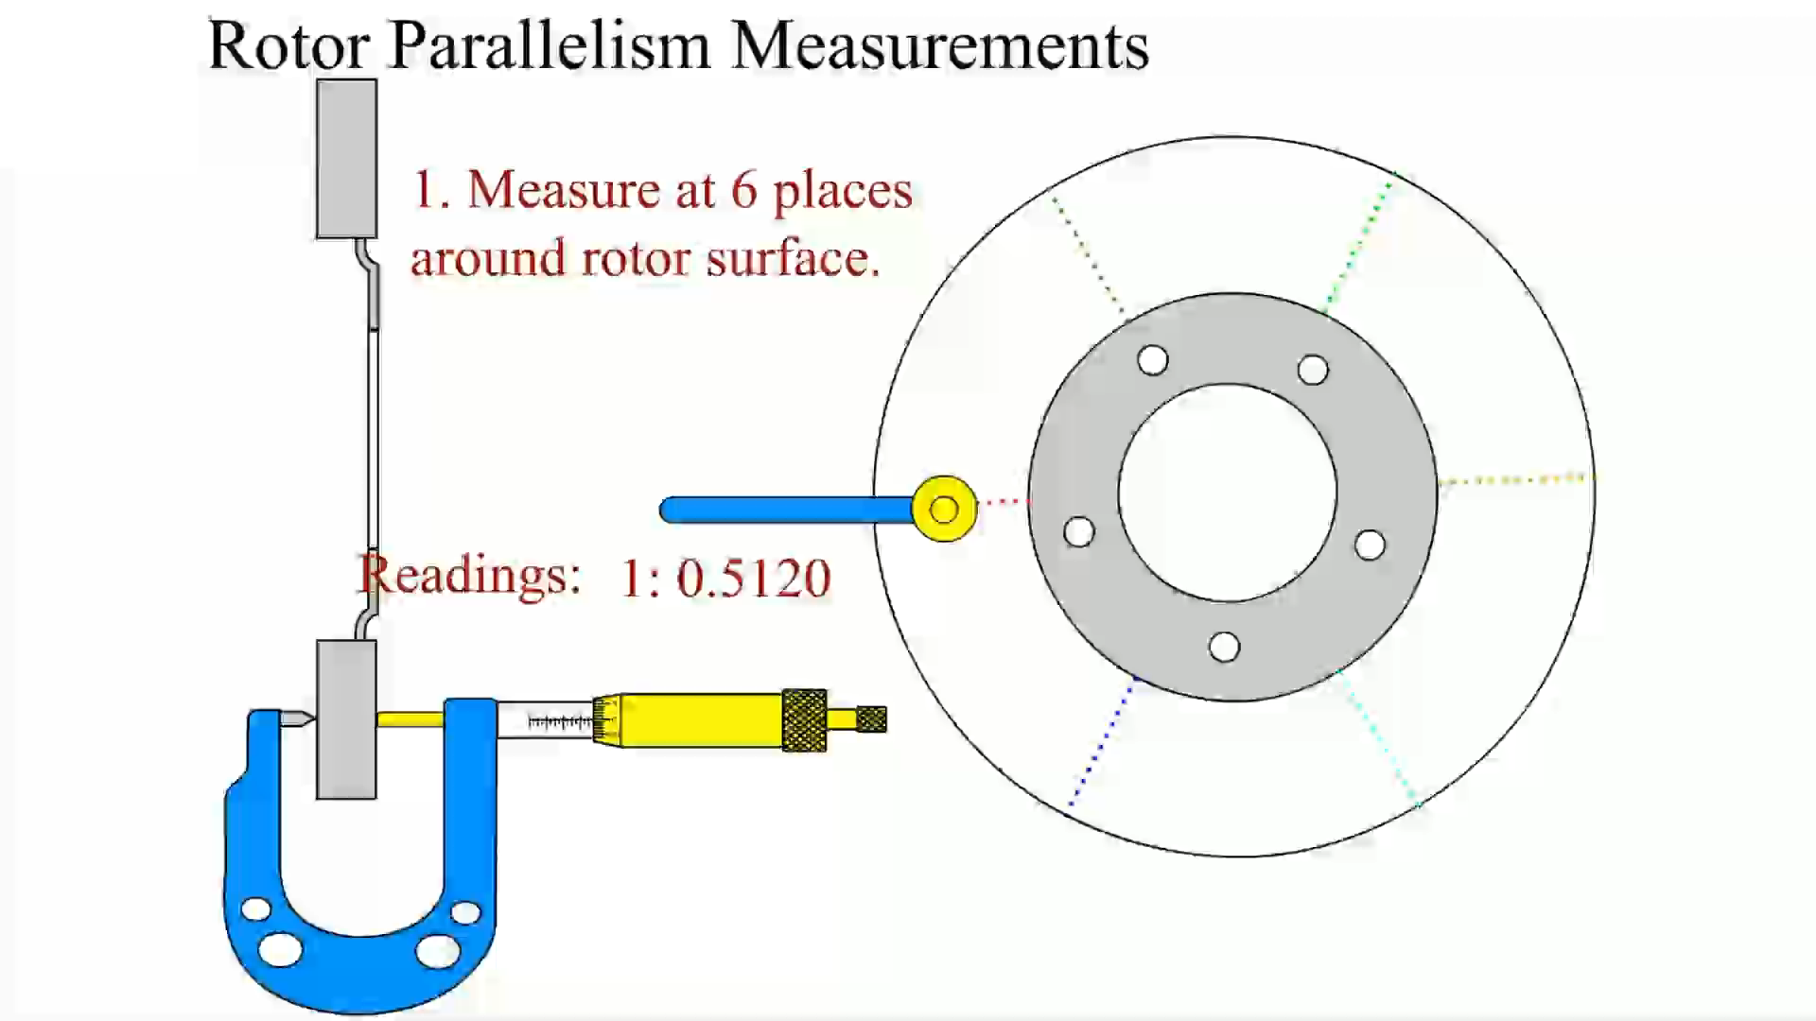
Animation: Rotor Parallelism Measurements
(Animation will automatically start)

Slide 44
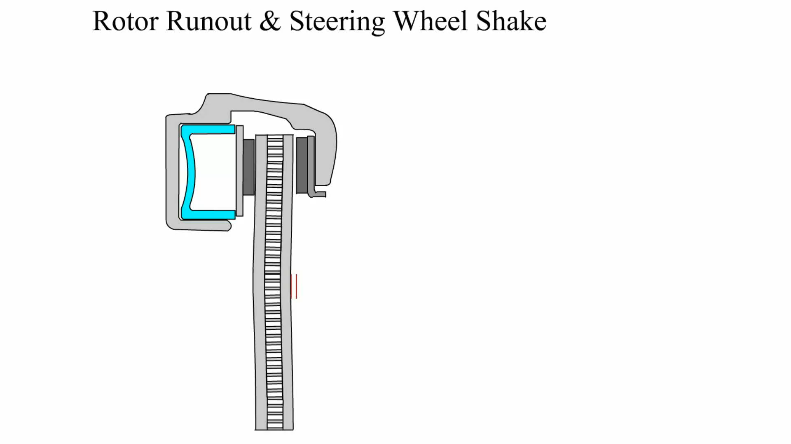
Animation: Rotor Runout & Steering Wheel Shake
(Animation will automatically start)

Slide 45
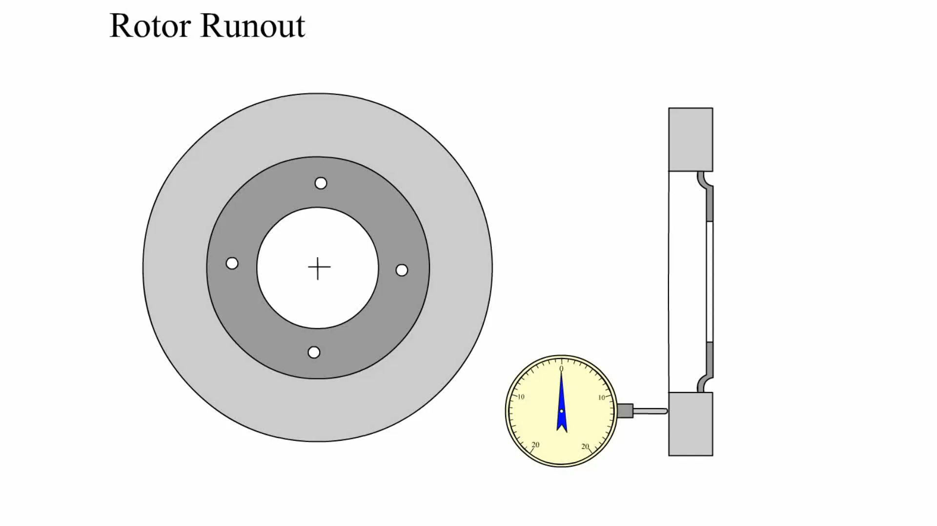
Animation: Rotor Runout
(Animation will automatically start)

Slide 46
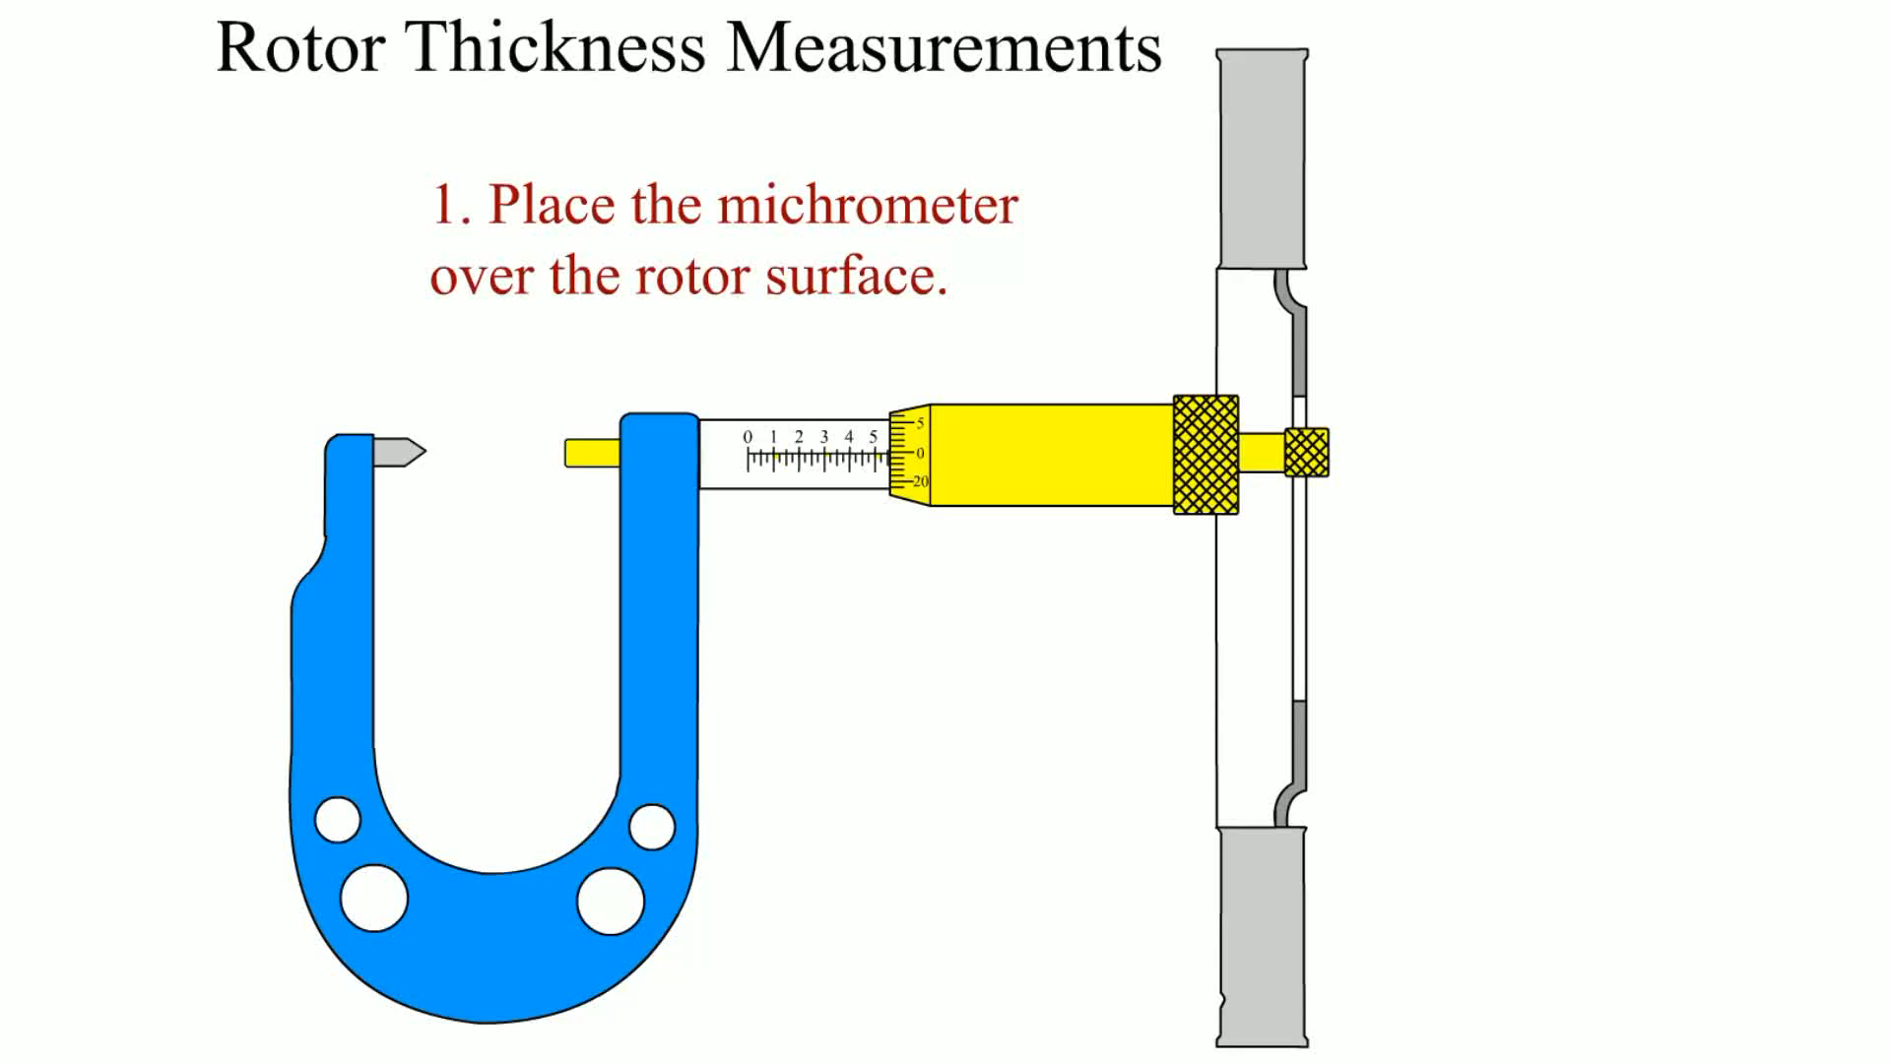
Animation: Rotor Thickness Measurements
(Animation will automatically start)

Slide 47
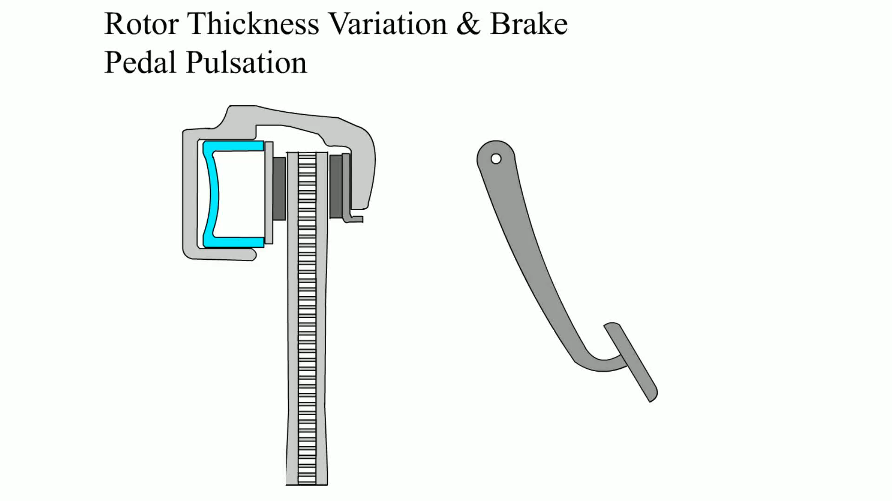
Animation: Rotor Thickness Variation & Brake Pedal Pulsation
(Animation will automatically start)

Slide 48
Brakes Videos and Animations
Videos Link: (A5) Brakes Videos
Animations Link: (A5) Brakes Animations

Slide 49

Copyright
This work is protected by United States copyright laws and is provided solely for the use of instructors in teaching their courses and assessing student learning. Dissemination or sale of any part of this work (including on the World Wide Web) will destroy the integrity of the work and is not permitted. The work and materials from it should never be made available to students except by instructors using the accompanying text in their classes. All recipients of this work are expected to abide by these restrictions and to honor the intended pedagogical purposes and the needs of other instructors who rely on these materials.

