Slide 1
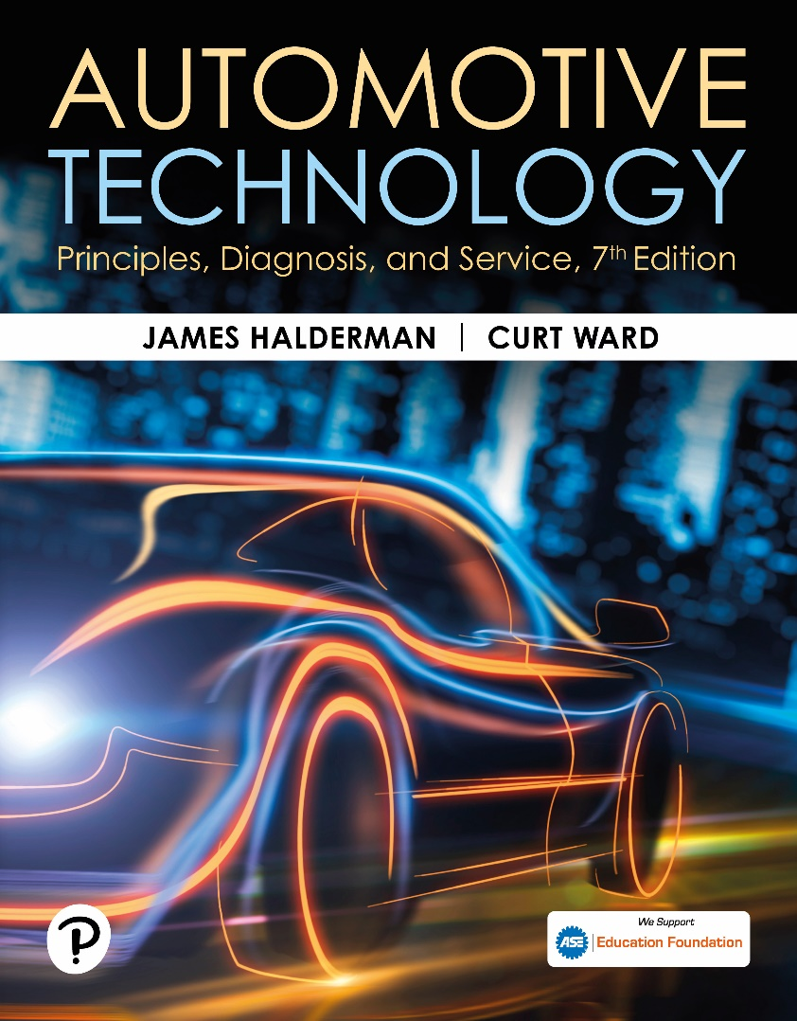
Automotive Technology: Principles, Diagnosis, and Service
Seventh Edition
Chapter 100
Disc Brakes
Copyright © 2023 Pearson Education, Inc. All Rights Reserved
Notes:
INSTRUCTOR NOTE: This presentation includes text explanation notes, you can use to teach the course. When in SLIDE SHOW mode, you RIGHT CLICK and select SHOW PRESENTER VIEW, to use the notes.

Slide 2
Learning Objectives
100.1 Describe the parts and operation of disc brakes.
100.2 Describe the construction of disc brakes.
100.3 Discuss brake pads.
100.4 Explain the different types of disc brake designs.
100.5 Describe rear disc parking brakes.

Slide 3
Figure 100.1 Disc Brake Assembly
A typical single-piston, floating-caliper-type disc brake assembly.
Notes:
Lining fade can and does occur if the brakes become overheated. A little bit of heat brings the brake pads to their operating temperature and actually increases the friction coefficient of the lining material. A warm brake performs better than a cold brake. However, when too much heat is generated by braking, the lining material overheats. Its friction coefficient drops, and lining fade occurs.
The primary symptom of lining fade is a hard brake pedal that requires the driver to apply greater force to maintain stopping power. Unlike the similar situation in a drum brake, however, increased application force will not distort the brake rotor because the caliper applies equal force to both sides. FIGURE 100-1.

Slide 4
Disc Brakes
Parts and Operation
Disc brakes use a piston(s) to squeeze friction material (pads) on both sides of a rotating disc (rotor).
Disc Brake Advantages
Fade-resistant
Self-adjusting ability
Freedom from pull
Disc Brake Disadvantages
No servo action, brake noise, brake dust, poor parking brake performance.

Slide 5
Figure 100.2 Equal Force
Braking force is applied equally to both sides of the brake rotor

Slide 6
Animation: Disk Brake Apply & Release (Animation will automatically start)

Slide 7
Figure 100.3 Heat Absorption
Disc brakes can absorb and dissipate a great deal of heat. During this demonstration, the brakes were gently applied as the engine drove the front wheels until the rotor became cherry red. During normal braking, the rotor temperature can exceed 350°F (180°C), and about 1,500°F (800°C) on a race vehicle
Notes:
Increased pressure will, however, create even more heat, and if brake lining temperatures continue to increase, gas fade and vapor lock of the hydraulic system can occur. If the pads are overheated to the point where the lining material is physically damaged, the brakes will not recover their full stopping power until the pads are replaced. ● SEE FIGURE 100–3.

Slide 8
Figure 100.4 Brake Pads
Slots and holes in the brake linings help prevent gas and water fade
Notes:
Gas fade is a problem only under severe braking conditions when hot gases and dust particles from the linings are trapped between the brake linings and rotor, where they act as lubricants. The symptoms of gas fade are the same as those for lining fade. The pedal becomes hard and increased force is required to maintain stopping power. Even though disc brakes operate at higher temperatures than drum brakes, they have fewer problems with gas fade for a number of reasons.
Disc brakes do not have a drum to contain gases and particles in the area around the brake linings.
The constant flow of air over the brake carries away contaminants that might otherwise build up.
The surface area of the brake lining material in a disc brake is smaller than that of a comparable drum brake and this allows gases and particles to escape more easily.
To help prevent gas fade, many brake pads have slots cut in the lining material. These slots allow gases and dust particles to escape. ● SEE FIGURE 100–4. The holes required in riveted linings also perform this function. For
even greater protection against gas fade, high-performance vehicles and motorcycles sometimes have holes or slots cut into the rotor. These openings allow gases and water to escape, and their sharp edges continually wipe loose particles off the linings.

Slide 9
Figure 100.5 Square-Cut O-Ring
not only seals hydraulic brake fluid but also retracts the caliper piston when the brake pedal is released
Notes:
TECH TIP: Check the Tire Size for a Pulling Problem
If an unequal braking problem is being diagnosed, check that the front tires match and that the
rear tires match. Brakes slow and stop wheels. Unequal diameter tires create an unequal braking
force. The result may be a pulling toward one side while braking. Tire diameter can vary from one tire manufacturer to another even though the size designation is the same.
Even slight differences in the wear of tires can cause a different tire diameter and, therefore, a
Different braking force.

Slide 10
Figure 100.6 Antirattle Clips
Antirattle clips reduce brake pad movement and vibration

Slide 11
Figure 100.7 Anti-Vibration Shims
Anti-vibration shims are used behind the pads on many disc brake caliper designs
Notes:
TECH TIP: Wax the Wheels
Brake dust from semimetallic brake pads often discolors the front wheels. Customers often complain to service technicians about this problem, but it is normal for the front wheels to become dirty because the iron and other metallic and nonmetallic components wear off the front disc brake pads and adhere to the wheel covers. A coat of wax on the wheels or wheel covers helps prevent damage and makes it easier to wash off the brake dust.

Slide 12
Question 1: ?
What are the advantages of disc brakes?

Slide 13
Answer 1
Fade-resistant, self-adjusting ability, and freedom from pull.

Slide 14
Disc Brake Construction
Caliper
Uses hydraulic pressure to create mechanical force to move the brake pads into contact with the brake rotor.
Splash Shield
Protect the inner side of the brake rotor from water and other contaminants, whereas the outer side of the rotor is protected by the wheel.

Slide 15
Figure 100.8 Attached to Spindle
This brake caliper attaches to the front spindle

Slide 16
Figure 100.9 Rear Caliper
A rear disc brake caliper often attaches to a mounting bracket on the rear axle housing

Slide 17
Disc Brake Pads (1 of 2)
lining of a disc brake is part of an assembly called brake pad.
Some pad-backing plates have tabs that bend over Caliper to hold pad tightly in place and help prevent brake noise.
Other pad-backing plates have tabs with holes in them that pins slide through.
Other pad-backing plates have a retainer spring attached that locates the pad in the caliper by locking it to the caliper piston.

Slide 18
Disc Brake Pads (2 of 2)
Pad Wear Indicators
Pad wear indicators are either mechanical or electrical,
Signal when the lining material has worn to the point where pad replacement is necessary.
Pad Assembly Methods
Riveted linings
Bonded linings
Mold-bond linings

Slide 19
Brake Rotors
The brake rotor provides the friction surfaces for the brake pads to rub against.
There are two basic types of rotors:
Solid
Vented

Slide 20
Figure 100.10 Rotor
Disc brake rotors can be either solid or vented.

Slide 21
Figure 100.11
A typical disc brake pad

Slide 22
Figure 100.12 Noise Prevention
To prevent noise, bent tabs on the backing plate hold some brake pads to the caliper housing

Slide 23
Figure 100.13 Pad Locators
Holes in the backing plate are a method of locating a pad in the caliper

Slide 24
Figure 100.14 Retainer Springs
Retainer springs lock the pad to the caliper piston to prevent brake noise

Slide 25
Figure 100.15 Tapered Edge
The lining edges of some brake pads are tapered to help prevent vibration

Slide 26
Figure 100.16 Pad Wear Sensor
Typical pad wear sensor operation. It is very important that the disc brake pads are installed on the correct side of the vehicle to be assured that the wear sensor will make a noise when the pads are worn

Slide 27
Figure 100.17 Electronic Sensor
Electrical wear indicators ground a warning light circuit when the pads need replacement

Slide 28
Figure 100.18 Molded Lining
Mold-bonded linings are commonly used in many applications

Slide 29
Question 2: ?
What are the three methods that brake pads are assembled?

Slide 30
Answer 2
Riveted, bonded, and mold-bonding.

Slide 31
Disc Brake Designs (1 of 4)
Fixed Caliper Design
Gets its name from the fact that the caliper is rigidly mounted to the suspension.
Brakes are applied, pistons extend from calliper bores and apply brake pads with equal force from both sides of rotor.
Fixed calipers are large and heavy, which enables them to absorb and dissipate great amounts of heat.
Fixed calipers add un-sprung weight to the vehicle.

Slide 32
Disc Brake Designs (2 of 4)
Floating and Sliding Caliper Design
Free to move within a limited range on an anchor plate that is solidly mounted to the vehicle suspension.
Brakes are applied, Caliper piston moves out of its bore and applies the inner brake pad.
At same time, the caliper body moves in opposite direction on anchor plate and applies outer brake pad.
Floating and sliding calipers are lower in cost, have simple construction, and are compact size.

Slide 33
Disc Brake Designs (3 of 4)
Floating Caliper Operation
Floating Caliper body does not make direct metal-to-metal contact with the anchor plate.
Instead, Caliper body is supported by bushings and/or O-rings that allow it to “float” or slide on metal guide pins or locating sleeves attached to anchor plate.
Floating calipers depend on proper lubrication of their pins, sleeves, bushings, and O-rings for smooth operation.

Slide 34
Disc Brake Designs (4 of 4)
Sliding Calipers
Unlike floating caliper, body of a sliding caliper mounts in direct metal-to-metal contact with anchor plate.
Instead of pins and bushings, sliding calipers move on ways cast and machined into the caliper body and anchor plate.
Like floating calipers, sliding calipers depend on good lubrication for proper operation.

Slide 35
Figure 100.19 Fixed Caliper
(a) Many fixed caliper disc brakes use a simple retaining pin to hold the disc brake pads. (b) Removing the retainer pin allows the brake pads to be removed. (c) Notice the cross-over hydraulic passage that connects both sides of the caliper

Slide 36
Figure 100.20 Floating Caliper
This floating caliper mounts on a separate anchor plate that bolts to the vehicle suspension

Slide 37
Figure 100.21 Caliper Operation
Hydraulic force on the piston (left) is applied to the inboard pad and the caliper housing itself. The reaction of the piston pushing against the rotor causes the entire caliper to move toward the inside of the vehicle (large arrow). Since the outboard pad is retained by the caliper, the reaction of the moving caliper applies the force of the outboard pad against the outboard surface of the rotor

Slide 38
Figure 100.22 Caliper Flex
Caliper flex can cause tapered wear of the brake lining

Slide 39
Figure 100.23 Floating Caliper Moves
A typical single-piston floating caliper. In this type of design, the entire caliper moves when the single piston is pushed out of the caliper during a brake application. When the caliper moves, the outboard pad is pushed against the rotor

Slide 40
Figure 100.24 Floating Bushings
Floating calipers are supported by rubber O-rings or plastic bushings

Slide 41
Figure 100.25 Guide Pins & Sleeves
Metal guide pins and sleeves are used to retain and locate floating calipers

Slide 42
Frequently Asked Question: What Is a Low-Drag Caliper?
? Frequently Asked Question
What Is a Low-Drag Caliper? A low-drag caliper differs from a standard caliper in the area of the square-cut O-ring. A V-shaped cutout allows the O-ring to deflect more and, as a result, is able to pull the caliper piston back into the bore when the brakes are released. Because of this further movement, the brake pads are pulled farther from the rotor and are less likely to drag. The negative aspect of this design is that greater volume of brake fluid is needed to achieve a brake application. To compensate for this need for greater brake fluid volume, a quick-take-up master cylinder was designed and is used whenever low-drag calipers are used. Figure 100–26.

Slide 43
Figure 100.26 Square Cut O Ring
In standard disc brake caliper, square-cut O-ring deforms when brakes are applied and returns piston to its original (released) position due to elastic properties of the rubber seal. In a low-drag caliper design, groove for the square-cut O-ring is V-shaped, allowing for more retraction. When brake pedal is released, piston is moved away from rotor further, resulting in less friction between disc brake pads and the rotor when the brakes are released

Slide 44
Figure 100.27 Sliding Caliper
Exploded view of a typical sliding brake caliper

Slide 45
Figure 100.28 Sliding Caliper
Sliding calipers move on slide (guide) pins

Slide 46
Rear Disc Brakes
4-wheel disc brake systems have become more common.
No brake fade
Self-adjusted
Rear Disc Parking Brake
Two methods of providing parking brakes:
Single piston caliper
Drum brakes in the rear rotors

Slide 47
Figure 100.29 Rear Disc Parking
Exploded view of a typical rear disc brake with an integral parking brake. The parking brake lever mechanically pushes the caliper piston against the rotor

Slide 48
Figure 100.30 Parking Brake
This single-piston brake caliper is mechanically actuated to serve as a parking brake

Slide 49
Figure 100.31 Drum-in-Hat
Drum parking brakes are fitted inside the rotors on this vehicle equipped with rear disc brakes

Slide 50
Question 3: ?
What are the two methods of applying the parking brake with a rear disc brake system?

Slide 51
Answer 3
The caliper and a drum-in-hat rotor design.

Slide 52
Brakes Videos and Animations
Videos Link: (A5) Brakes Videos
Animations Link: (A5) Brakes Animations

Slide 53
Copyright
This work is protected by United States copyright laws and is provided solely for the use of instructors in teaching their courses and assessing student learning. Dissemination or sale of any part of this work (including on the World Wide Web) will destroy the integrity of the work and is not permitted. The work and materials from it should never be made available to students except by instructors using the accompanying text in their classes. All recipients of this work are expected to abide by these restrictions and to honor the intended pedagogical purposes and the needs of other instructors who rely on these materials.

