Slide 1
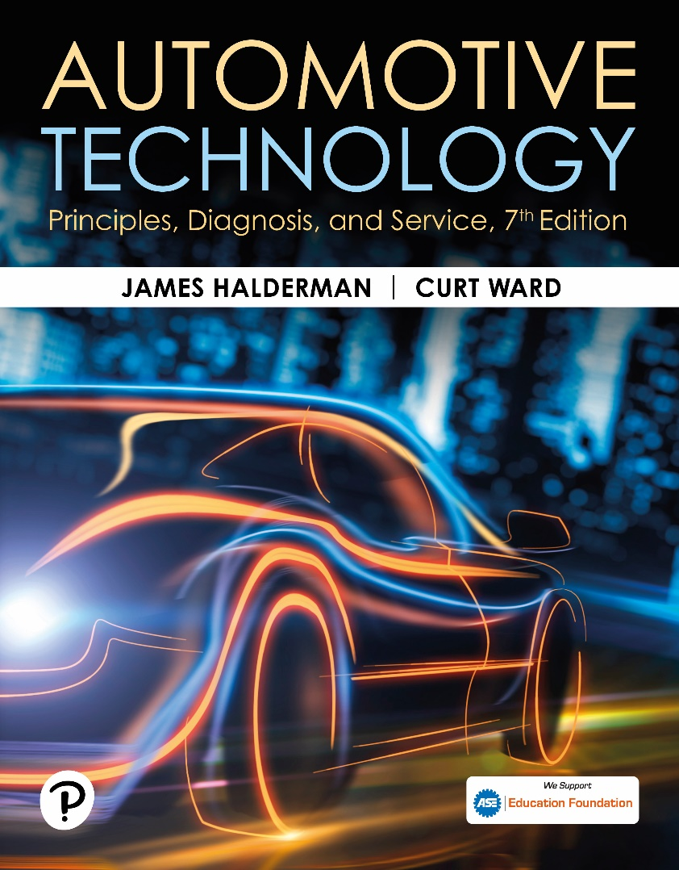
Automotive Technology: Principles, Diagnosis, and Service
Seventh Edition
Chapter 10
Vehicle Lifting and Hoisting
Copyright © 2023 Pearson Education, Inc. All Rights Reserved
Notes:
INSTRUCTOR NOTE: This presentation includes text explanation notes, you can use to teach the course. When in SLIDE SHOW mode, you RIGHT CLICK and select SHOW PRESENTER VIEW, to use the notes.

Slide 2
Learning Objectives
10.1 Discuss the purpose of floor jacks.
10.2 Discuss the purpose of creepers.
10.3 Describe vehicle hoists.
10.4 Describe drive-on ramps.
10.5 Discuss the proper methods to follow for safely hoisting a vehicle.

Slide 3
Floor Jack
A hand operated hydraulic device used for lifting vehicles or components.
Uses four casters to move easily.
Not designed to hold a load.
Requires the use of jack stands.

Slide 4
Figure 10.1 Floor Jack
A hydraulic hand-operated floor jack

Slide 5
Animation: Floor Jack (Animation will automatically start)

Slide 6
Figure 10.2 Safety Stands
Safety stands are being used to support the rear of this vehicle

Slide 7
Animation: Vehicle Lifting (Animation will automatically start)

Slide 8
Question 1: ?
What must be used after lifting a vehicle with a floor jack?

Slide 9
Answer 1
Jack stands.

Slide 10
Creepers
Use by technician to maneuver under vehicle.
Flat or concaved surface equipped with low profile casters.
Should be stored vertically against wall or toolbox to avoid trip hazards.

Slide 11
Figure 10.3 Creeper
Creepers should always be stored vertically and not be allowed to be left where a person could step on it by mistake and fall.

Slide 12
Animation: Shop Safety: Creepers (Animation will automatically start)

Slide 13
Vehicle Hoists
In-ground: pneumatic/hydraulic.
Above-ground: electric/hydraulic.
Symmetrical: Equal length lift arms.
Asymmetrical: Unequal length lift arms.
Use recommended vehicle lift points.
Lower onto mechanical locks before working.
Before lowering ensure proper clearances.

Slide 14
Figure 10.4 Typical Lift
A typical electric-hydraulic asymmetrical lift where the lift arms on each side include one longer arm and one shorter arm. On an asymmetrical lift, the front arms are slightly shorter than the back arms, so the door is not blocked by the post.

Slide 15
Figure 10.5 Lift Points
Most newer vehicles have a triangular symbol indicating the recommended hoisting lift points

Slide 16
Figure 10.6 Tall Safety Stands
(a) Tall safety stands can be used to provide additional support for a vehicle while on a hoist. (b) A block of wood should be used to avoid the possibility of doing damage to components supported by the stand

Slide 17
Figure 10.7 Lift Accident
This training vehicle fell from the hoist when the pads were not set correctly. No one was hurt, but the vehicle was damaged
Notes:
CAUTION: Even though pinch weld seams are the recommended
location for hoisting many vehicles with unitized
bodies (unit-body), care should be taken not to place the
pad(s) too far forward or rearward. Incorrect placement of
the vehicle on the lift could cause the vehicle to be imbalanced,
and the vehicle could fall. This is exactly what happened
to the vehicle in ● FIGURE 10–7.

Slide 18
Figure 10.8 Hoist Pad Adapters
(a) An assortment of that are often necessary to safely hoist many pickup trucks, vans, and sport utility vehicles. (b) A view from underneath a Chevrolet pickup truck showing how the pad extensions are used to attach the hoist lifting pad to contact the frame
Notes:
CAUTION: Do not look away from the vehicle while it is being raised (or lowered) on a hoist. Often
one side or one end of the hoist can stop or fail, resulting in the vehicle being slanted enough to
slip or fall.
NOTE: Most hoists can be safely placed at any desired height as long as it is high enough for the
safety latches to engage. For ease while working, the area in which you are working should be at
chest level. When working on brakes or suspension components, it is not necessary to work on them
down near the floor or over your head. Raise the hoist so that the
components are at chest level.

Slide 19
Question 2: ?
Before working on a vehicle that is on a hoist, what must be done?

Slide 20
Answer 2
Lower the vehicle onto the mechanical locks.

Slide 21
Drive-on Ramps
Inexpensive way to raise the front or rear of the vehicle.
Ramps store easily.
Caution must be used when placing the vehicle on the ramps.
Wheels on the ground need to be blocked to prevent movement.

Slide 22
Figure 10.9 Drive-on-Type Ramps
Drive-on-type ramps. The wheels on the ground level must be chocked (blocked) to prevent accidental movement down the ramp.
Notes:
CAUTION: Professional repair shops do not use ramps because they are dangerous to use. Use only
with extreme care.

Slide 23
Hoisting the Vehicle

Slide 24
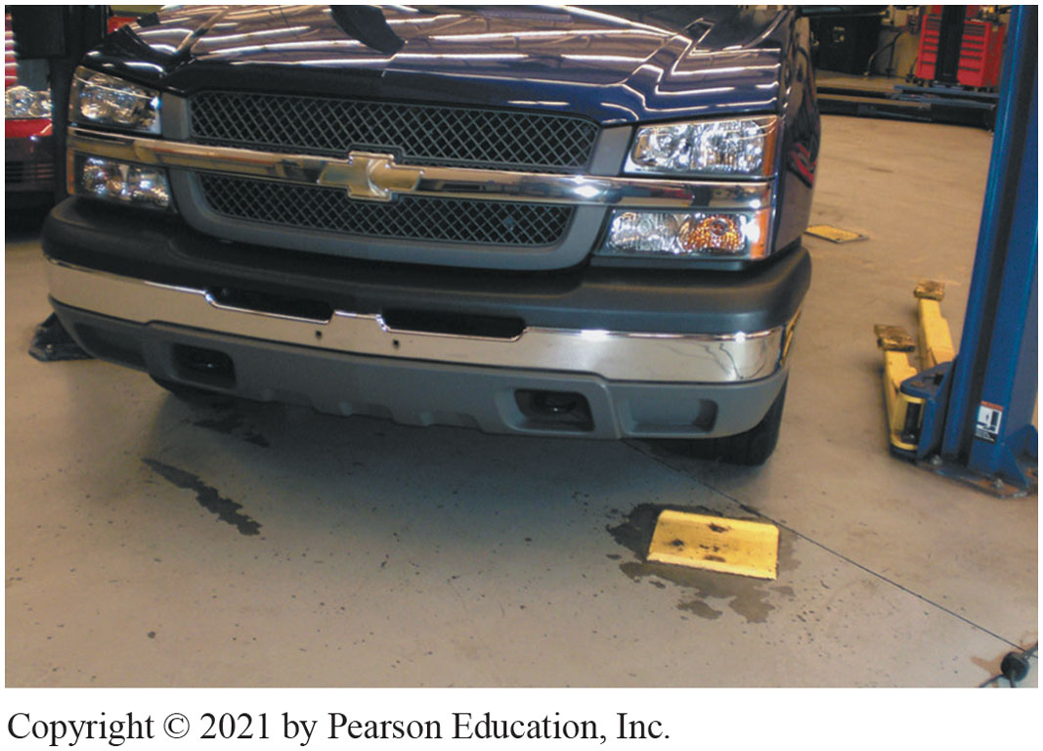
Align vehicle in center of stall
Notes:
1. First step properly align the vehicle in the center of the stall

Slide 25
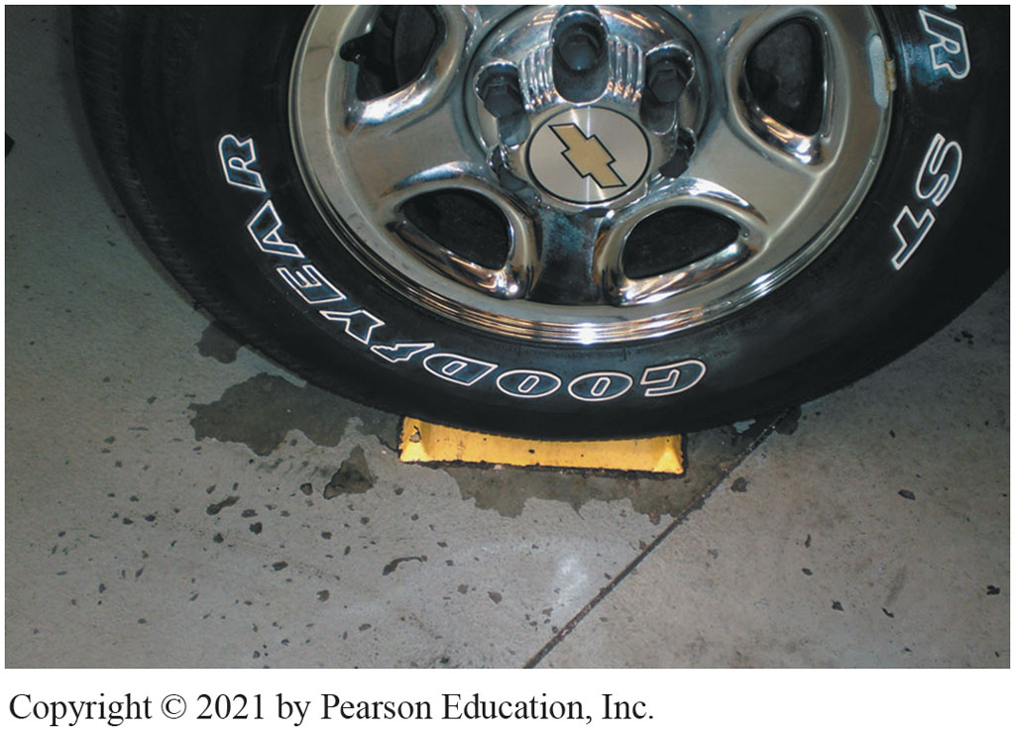
Left front tire centered on tire pad
Notes:
2. Correctly positioned when the left front tire is centered on the tire pad

Slide 26
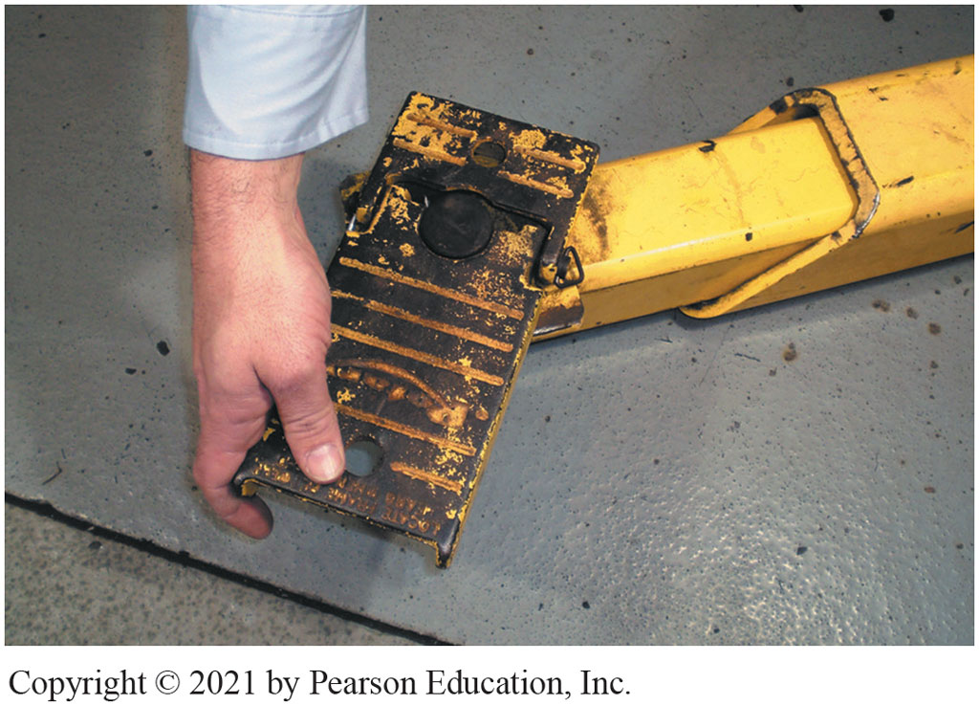
Arms rotated for different types
Notes:
3. Arms moved in and out and pads can be rotated to allow for different types

Slide 27
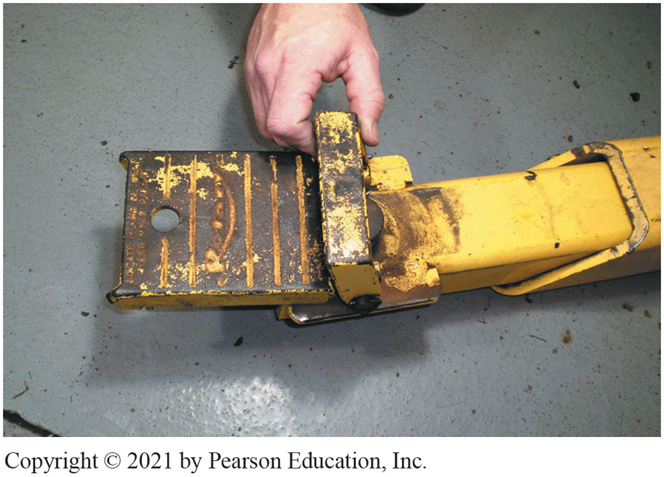
Short pad extensions used
Notes:
4. Most use short pad extensions necessary to allow pad to contact frame without causing arm of the lift to hit and damage body

Slide 28
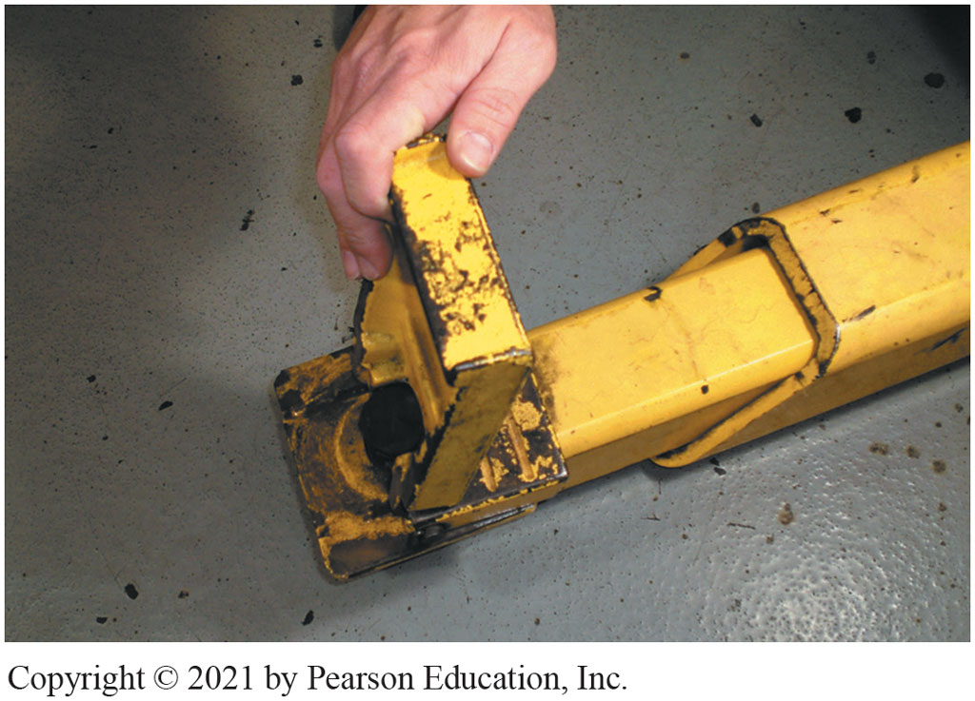
Tall pad extensions access to frame
Notes:
5. Tall pad extensions used to gain access to frame to hoist pickup trucks, vans, and SUVs

Slide 29
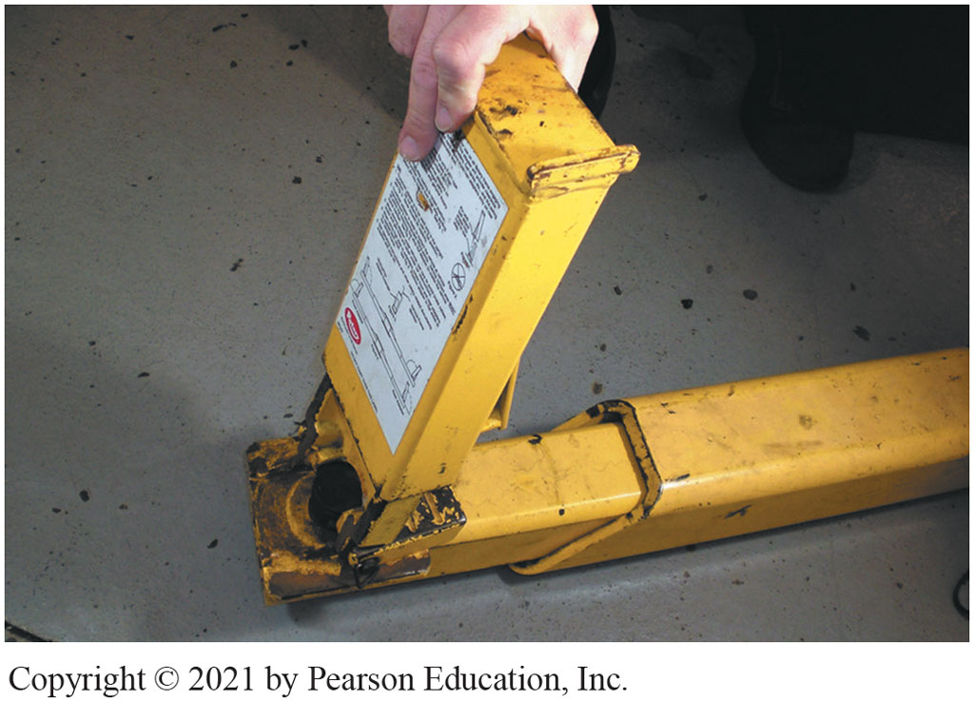
Extension for running boards
Notes:
6. Extension necessary to hoist a truck or van equipped with running boards

Slide 30
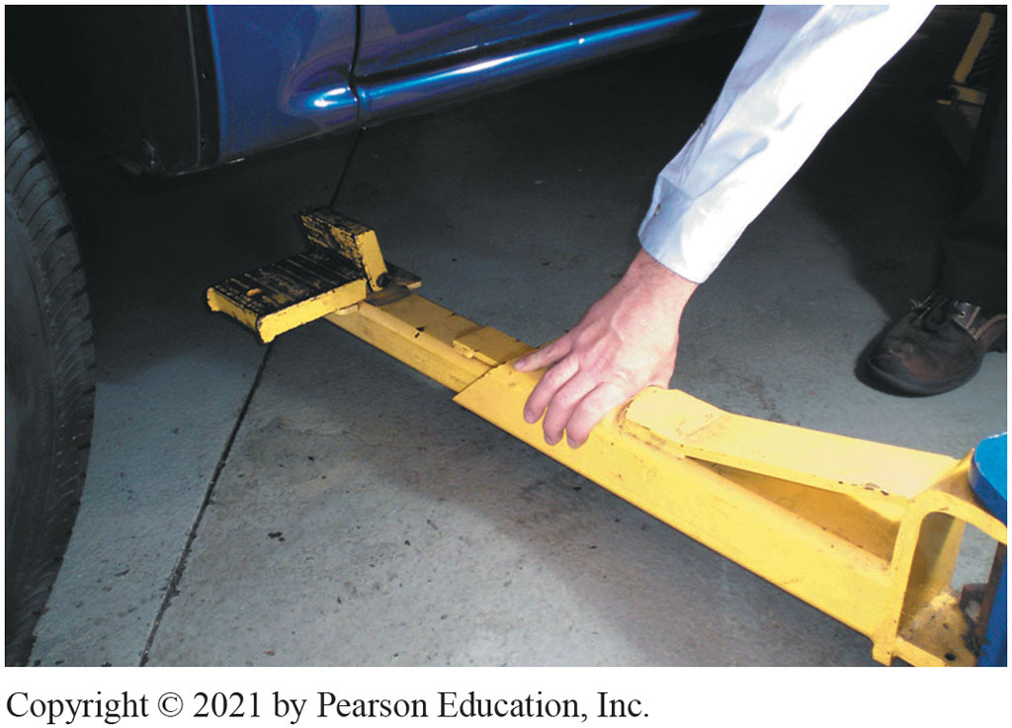
Position pads under vehicle
Notes:
7. Position pads under vehicle in the recommended locations

Slide 31
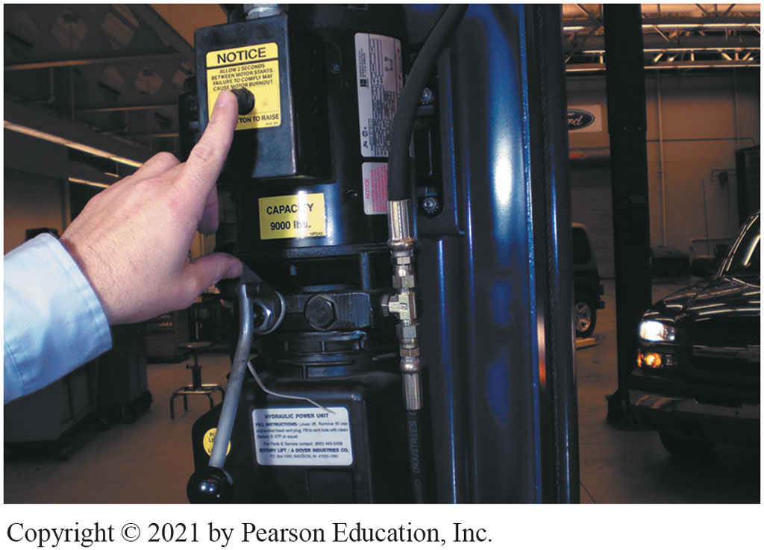
Use controls to raise vehicle
Notes:
8. After pads are correctly positioned, use controls to raise vehicle

Slide 32
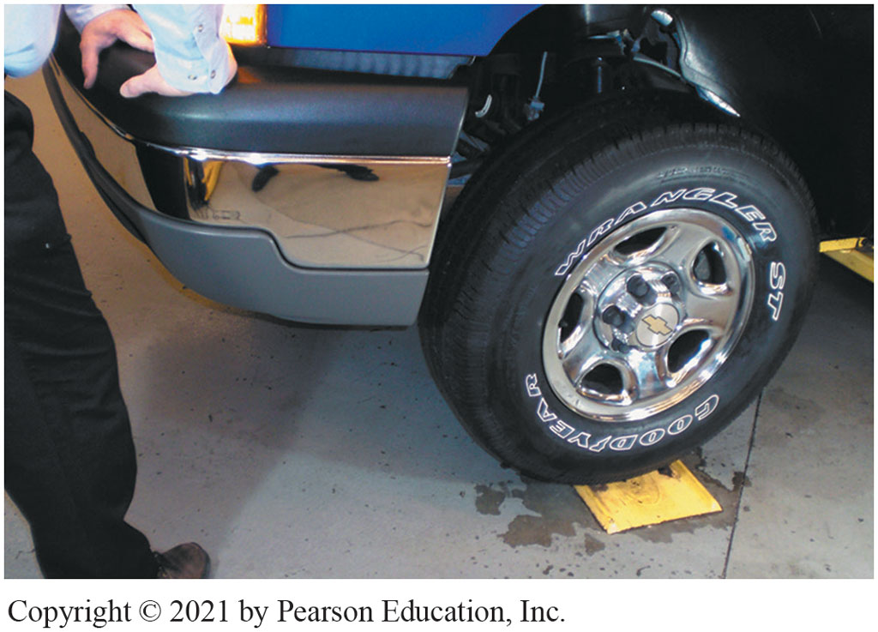
Raise vehicle 12” push down to see if stable
Notes:
9. Raise vehicle 12” (30 cm) off ground, push down the vehicle to check to see if it is stable on pads. If vehicle rocks, lower vehicle and reset pads. Be sure safety mechanism engaged before working on/under vehicle

Slide 33
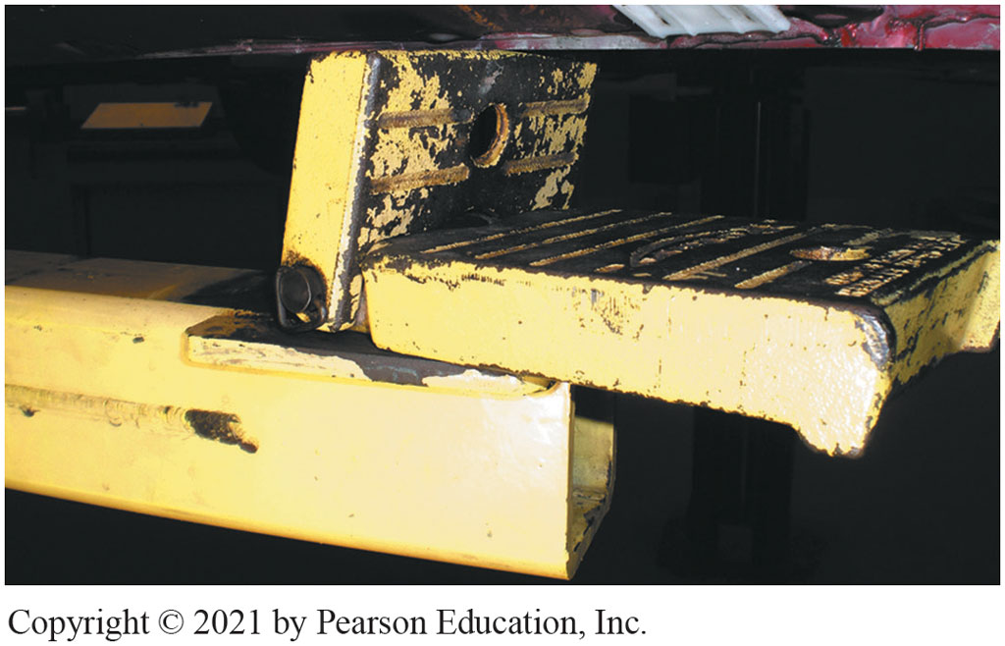
Place pads under pinch weld seam
Notes:
10. Raising vehicle without a frame, place flat pads under pinch weld seam to spread the load. If additional clearance necessary, pads can be raised as shown

Slide 34
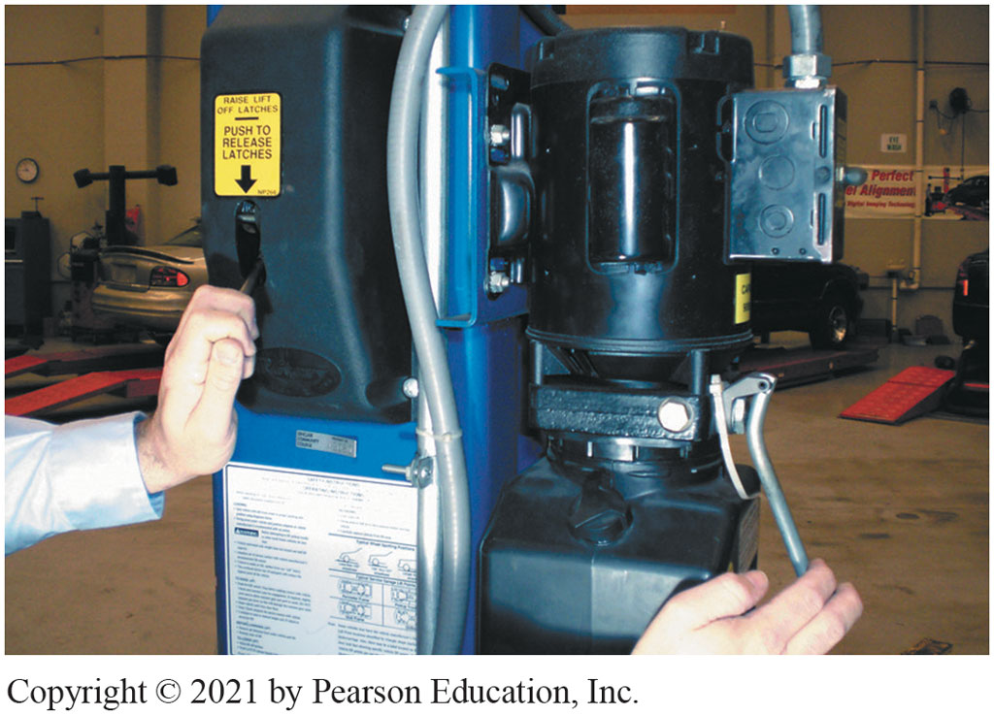
Raised slightly, safety mechanism released before lowering vehicle
Notes:
11. Work completed, hoist should be raised slightly and safety mechanism released before lowering the vehicle

Slide 35
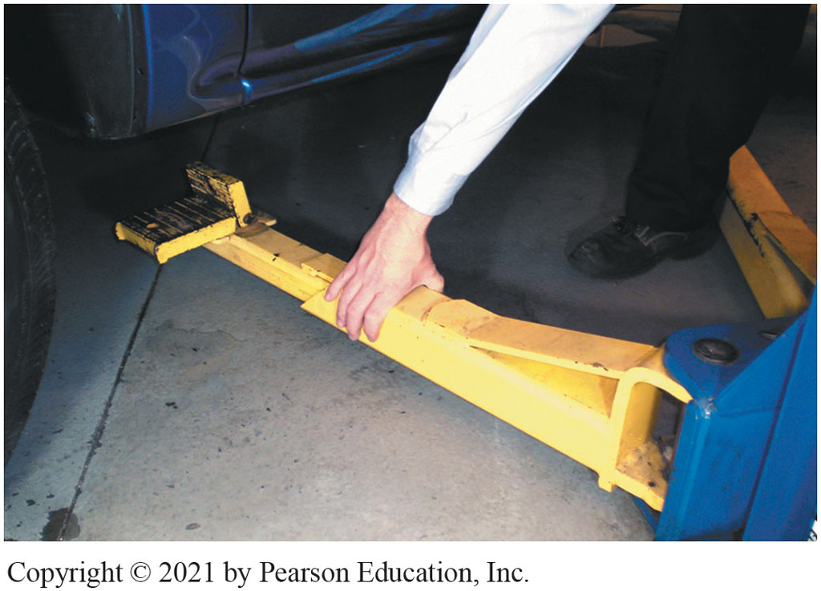
Lower vehicle move arms out of way
Notes:
12 After lowering vehicle, be sure all arms of the lift are moved out of way before driving the vehicle out of the work stall

Slide 36
Automotive Fundamentals Videos and Animations
Videos Link: (A0) Automotive Fundamentals Videos
Animations Link: (A0) Automotive Fundamentals Animations

Slide 37
Copyright
This work is protected by United States copyright laws and is provided solely for the use of instructors in teaching their courses and assessing student learning. Dissemination or sale of any part of this work (including on the World Wide Web) will destroy the integrity of the work and is not permitted. The work and materials from it should never be made available to students except by instructors using the accompanying text in their classes. All recipients of this work are expected to abide by these restrictions and to honor the intended pedagogical purposes and the needs of other instructors who rely on these materials.

