Slide 1
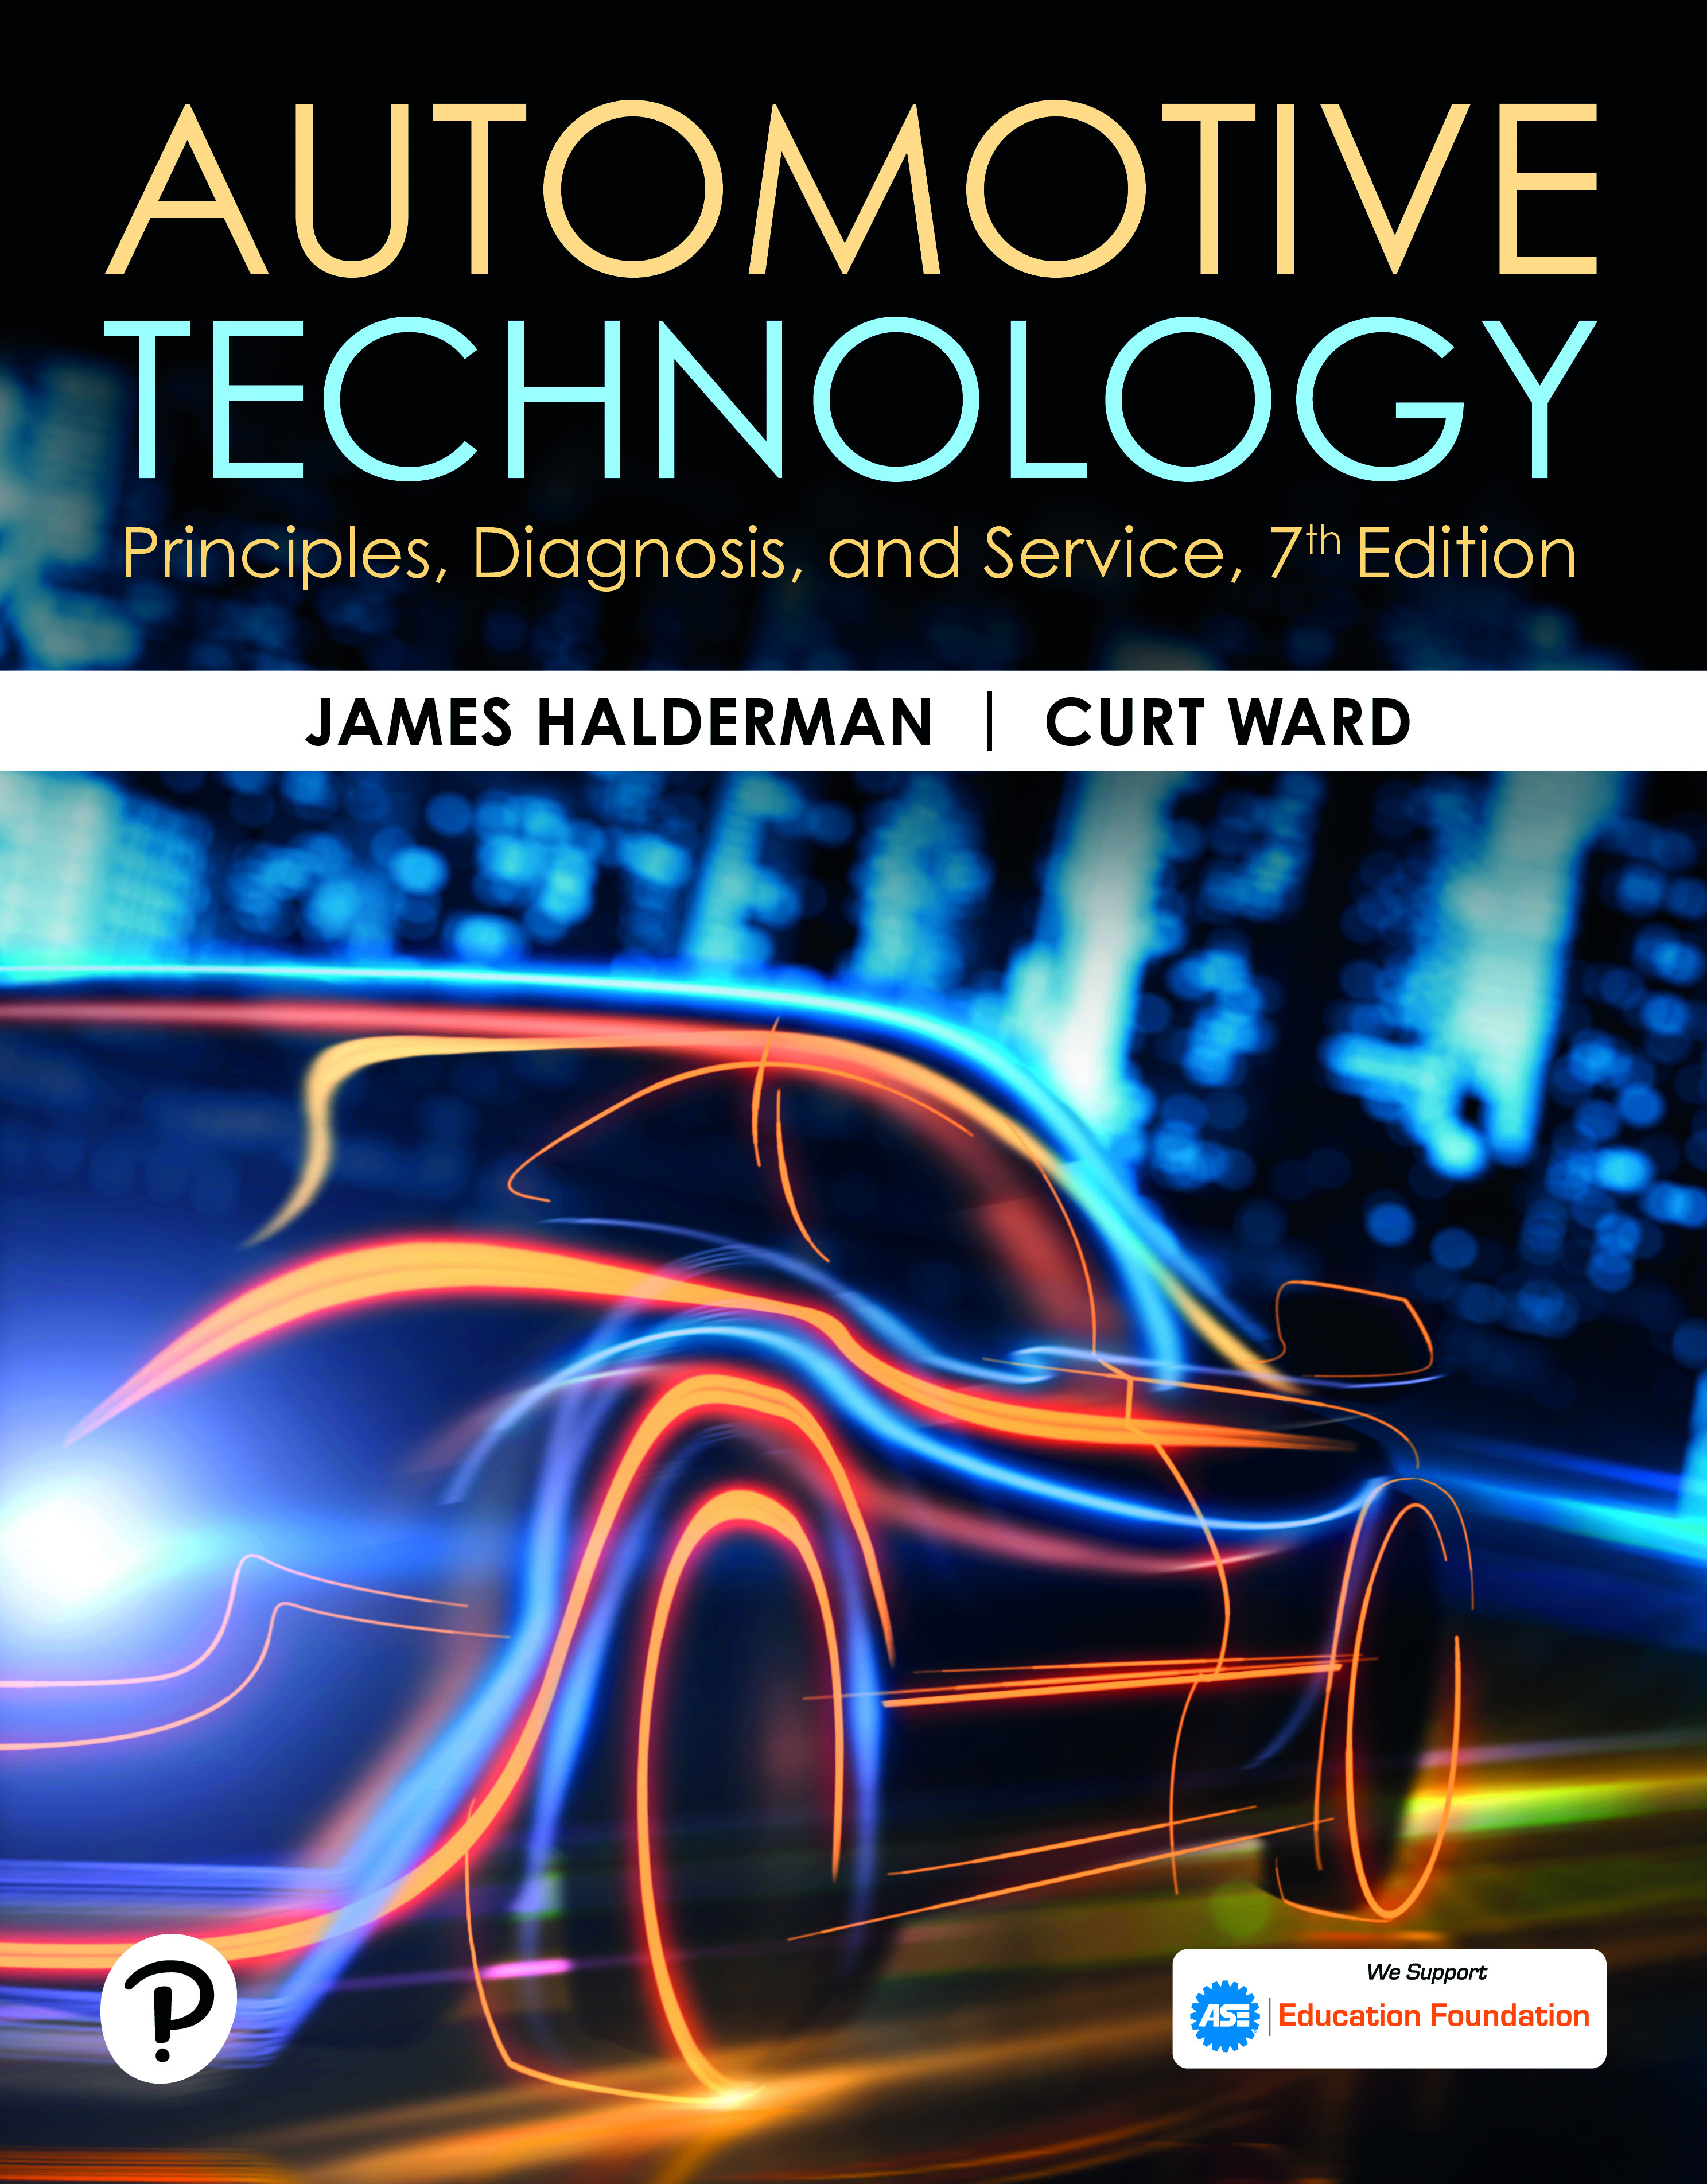
Automotive Technology: Principles, Diagnosis, and Service
Seventh Edition
Chapter 7
Health and Environmental Issues
Copyright © 2023 Pearson Education, Inc. All Rights Reserved
Notes:
INSTRUCTOR NOTE: This presentation includes text explanation notes, you can use to teach the course. When in SLIDE SHOW mode, you RIGHT CLICK and select SHOW PRESENTER VIEW, to use the notes.

Slide 2
Learning Objectives
7.1 Identify carbon-based fuels and greenhouse gases.
7.2 Explain how ozone affects our environment.
7.3 Explain how ultraviolet radiation affects our environment.
7.4 Describe the health effects of air pollution.
7.5 Describe the health effects of acid rain.
7.6 List the factors that will be needed to reduce the carbon footprint.

Slide 3
Animation: Carbon Cycle (Animation will automatically start)

Slide 4
Figure 7.1 Carbon-Based Fuels
Carbon-based fuels are limited to the remains of dead plants and animals and their fossil remains create the carbon-based fuels used today.

Slide 5
Animation: Carbon Dioxide, CO2 Sources (Animation will automatically start)

Slide 6
Chart 7.1 Carbon and Hydrogen
FUEL | STATE | % OF CARBON | % OF HYDROGEN
Hydrogen | Gas | 0% | 100%
Methane | Gas | 20% | 80%
Gasoline | Liquid | 31% | 69%
Oil | Liquid | 36% | 64%
Coal | Solid | 62% | 36%
Wood | Solid | 90% | 10%
Notes:
Carbon and hydrogen content of various fuels.

Slide 7
Figure 7.2 Greenhouse Gases
The atmosphere allows radiation to pass through to the earth’s surface and blocks the release of heat back into space if there is too high a concentration of greenhouse gases.

Slide 8
Animation: Ozone Creation (Animation will automatically start)

Slide 9
Frequently Asked Question: What Are Volatile Organic Compounds?
? Frequently Asked Question
What Are Volatile Organic Compounds? Volatile organic compounds (VOC) are gases emitted by paints, solvents, aerosol sprays, cleaners, glues, permanent markers, pesticides, and fuels. Health effects of VOC emissions into the atmosphere include:
Eye, nose, and throat irritation
Headaches
Nausea
To reduce levels of VOC released, always follow manufacturer’s directions for use of household and industrial products.

Slide 10
Figure 7.3 Ground-Level Ozone
FIGURE 7–3 Ground-level ozone is created by pollutants, such as nitrogen oxides and volatile organic compounds reacting together by sunlight. Ozone in the upper atmosphere is good but ozone near the earth’s surface is bad.

Slide 11
Figure 7.4 Ozone
NOx plus VOCs interact with sunlight to create ozone.
Notes:
TECH TIP: Watch for Sunburn When at High Altitude: When at a location that is above 1,000 feet, and especially if above 5,000 feet, consider that there is much less atmosphere above to block the UV radiation. This means that sunburn and eye damage, such as cataracts, can more easily occur at high altitude compared to areas that are at or near sea level.

Slide 12
Figure 7.5 Stratospheric Ozone
Column ozone is the total amount of ozone between the earth’s surface and the top of the stratosphere.

Slide 13
Animation: High and Low Ozone (Animation will automatically start)

Slide 14
Figure 7.6 Acid Rain
Acid rain is formed when sulfur dioxide (SO₂ ) and oxides of nitrogen (NOx) combine with rain, forming acids.
Notes:
Acid rain refers to rain that has a pH lower than 7, indicating that it is acidic. Normal
rain is pure water that is neither acidic (a pH of less than 7) nor alkaline (a pH greater than 7).
Acid rain usually has a pH of 5.5 but can be as low as 4.3, according to the Environmental
Protection Agency (EPA). The rain becomes acidic due to gases in the atmosphere,
such as sulfur dioxide (SO2 ) and oxides of nitrogen (NOX ). SO2 combines with the rain water to form mild sulfuric acid. NOX combine with rain water to form nitric acid. ● SEE FIGURE 7–6.
Both acids are harmful to the environment and can cause the following problems:
■ Damage to forests and soils
■ Damage to fish because the acid rain makes lakes and streams more acidic
■ Damage to buildings and paint on vehicles
■ Damage to roads and sidewalks. ● SEE FIGURE 7–7.

Slide 15
Figure 7.7 Effects of Acid Rain
The sidewalk section at the top is about 20 years old and shows the effects of acid rain, as compared to the lower section, which is about five years old. Notice that the acid rain has eroded the cement, leaving the aggregate (stones) exposed on the upper section.
Notes:
CASE STUDY: The Case of the Wrong Ph: A museum was using a spray polish on an original paint blue 1937 Ford. After a few minutes, they noticed that the paint started to look purple. They immediately stopped using the spray polish and started to investigate the product they were using by checking with restoration experts. What they discovered was that the polish they were using was slightly acidic and this was causing the original old paint to change color. While the product was okay to use on modern paints, it was not suitable for use on older original paint used before modern paint technology. To avoid causing damage or a color change on older paint, restoration experts recommend using a “pH balanced” product. The pH is measured on a scale from 1 to 14 and is used to indicate the amount of chemical activity. The term pH is from the French word pouvoir hydrogine, meaning “hydrogen power.” Alkaline materials and acid materials neutralize each other, such as when baking soda (a caustic) is used to clean the outside of the battery (an acid surface). The caustic baking soda neutralizes any sulfuric acid that has been spilled or splashed on the outside of the battery. Most car shampoos are slightly alkaline with a pH of ranging from 7.1 to 8.5. Many car polishes are slightly acidic with a pH of 5 or 6. To check if the polish is acidic or is pH balanced, visit a parts store and ask that the safety data sheet (SDS) be printed out for the product being considered. The parts store counterperson will use the bar code to access the product information and from there, the SDS should be available and can be printed. Check the listed pH, and if the pH is 7, it is
usable for all paints and finishes. However, if the pH is 4 to 6, most experts recommend that these not be used on old vehicles with their original paint.
Summary:
Complaint—Using a spray polish, it was discovered to be the cause of turning the blue paint to purple on an old car.
Cause—The spray polish was slightly acidic and this caused the blue paint to turn purple.
Correction—The museum switched brands of spray polish to ones that were “pH balanced,” meaning that the pH was 7 or about 7 (neutral).

Slide 16
Figure 7.8 Pumping CO₂
Pumping carbon dioxide back into the earth not only reduces the amount released to the atmosphere, but also helps force more crude oil to the surface, thereby increasing the efficiency of existing wells.

Slide 17
Animation: Recycle CO2 with Ethanol (Animation will automatically start)

Slide 18
Question 1
Which fuel contains the least amount of carbon?
a. Methane
b. Hydrogen
c. Coal
d. Gasoline

Slide 19
Answer 1
Which fuel contains the least amount of carbon?
b. Hydrogen

Slide 20
Automotive Fundamentals Videos and Animations
Videos Link: (A0) Automotive Fundamentals Videos
Animations Link: (A0) Automotive Fundamentals Animations

Slide 21
Copyright
This work is protected by United States copyright laws and is provided solely for the use of instructors in teaching their courses and assessing student learning. Dissemination or sale of any part of this work (including on the World Wide Web) will destroy the integrity of the work and is not permitted. The work and materials from it should never be made available to students except by instructors using the accompanying text in their classes. All recipients of this work are expected to abide by these restrictions and to honor the intended pedagogical purposes and the needs of other instructors who rely on these materials.

