Slide 1
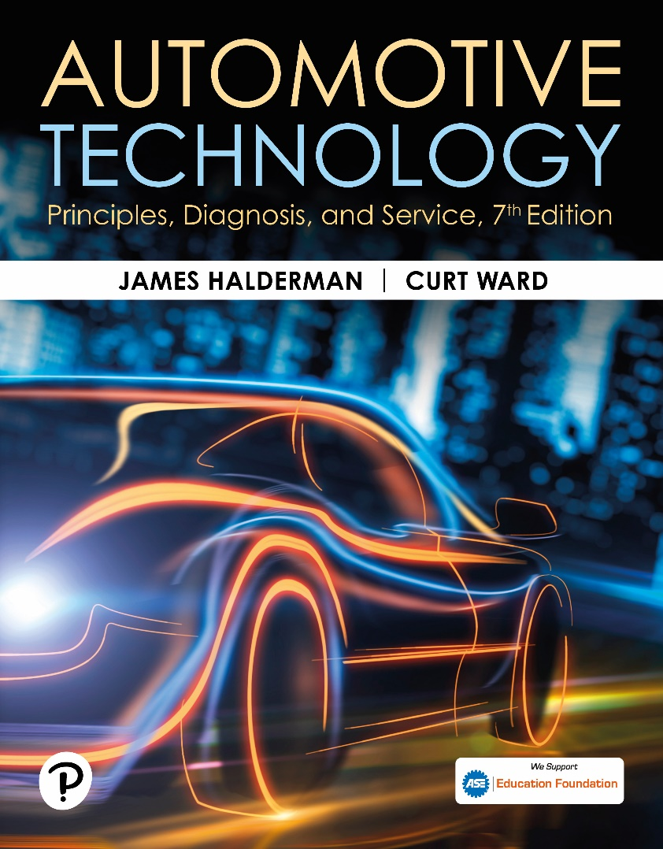
Automotive Technology: Principles, Diagnosis, and Service
Seventh Edition
Chapter 6
Hazardous Materials
Copyright © 2023 Pearson Education, Inc. All Rights Reserved
Notes:
INSTRUCTOR NOTE: This presentation includes text explanation notes, you can use to teach the course. When in SLIDE SHOW mode, you RIGHT CLICK and select SHOW PRESENTER VIEW, to use the notes.

Slide 2
Learning Objectives (1 of 2)
6.1 Define hazardous waste materials.
6.2 Describe federal and state laws regarding hazardous waste materials.
6.3 Discuss asbestos hazards and asbestos handling guidelines.
6.4 Explain the storage and disposal of brake fluid.
6.5 Explain the storage and disposal of used oil.
6.6 Explain the characteristics of hazardous solvents.

Slide 3
Learning Objectives (2 of 2)
6.7 Describe coolant disposal.
6.8 Discuss lead-acid battery waste.
6.9 Discuss fuel safety and storage.
6.10 Discuss airbag handling.
6.11 Discuss used tire disposal.
6.12 Discuss air-conditioning refrigerant oil disposal.
6.13 Describe typical waste materials generated at auto repair shops and disposal methods.

Slide 4
Hazardous Waste
Definition of Hazardous Waste
Chemicals, or components, that the shop no longer needs that pose a danger to the environment and people if they are disposed of in ordinary garbage cans or sewers.
Personal Protective Equipment (P P E)
Protective clothing and equipment detailed in the right-to-know laws.

Slide 5
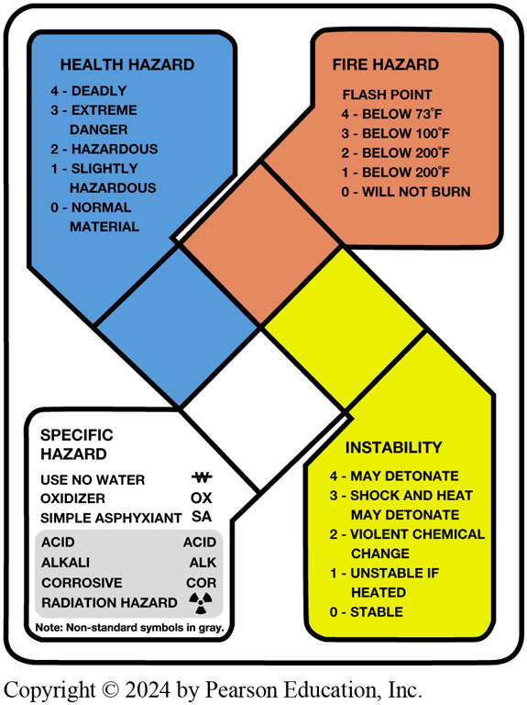
Figure 6.1 Hazardous Material Classes
Notes:
WARNING: Hazardous waste disposal laws include serious penalties for anyone responsible for breaking these laws.

Slide 6
Figure 6.2 Safety Data Sheets
Safety data sheets (SDS) should be readily available for use by anyone in the area who may come into contact with hazardous materials

Slide 7
Figure 6.3 Tag Out System
Tag that identifies the electrical power has been removed and service work is being done

Slide 8
Federal and State Laws (1 of 2)
Occupational Safety and Health Act
Creates safety and healthful working conditions through information, research, education, training and enforcement of standards developed under the act.
Environmental Protection Agency (E P A)
Publishes a list of hazardous materials that is included in the Code of Federal Regulations (C F R)
Right-To-Know Laws
Employees have a right to know when the materials they use at work are hazardous.
Includes Safety Data Sheets (S D S)

Slide 9
Federal and State Laws (2 of 2)
Resource Conservation and Recovery Act
This law states that hazardous material users are responsible for hazardous materials to their grave.
Lockout/Tagout
This law states that hazardous material users are responsible for hazardous materials.
Clean Air Act
Regulates air conditioning refrigerant and the technicians who work on the systems.

Slide 10
Asbestos Hazards
Asbestosis: Scar tissue in the lungs that causes shortness of breath.
Asbestos O S H A Standards: limits exposure to less than 0.2 fibers per cubic centimeter (c c) as determined by an air sample.
Handling Guidelines:
H E P A Vacuum
Solvent Spray
Proper disposal of used shoes and pads

Slide 11
Figure 6.4 Brake Dust
All brakes should be moistened with water or solvent to help prevent brake dust from becoming airborne

Slide 12
Used Brake Fluid
Collect brake fluid in a container marked for that purpose.
Use only an authorized waste receiver for its disposal.
Do not mix used brake fluid with used engine oil.
Do not pour brake fluid down the drain.
Notes:
WARNING: Never use compressed air to blow brake dust. The fine talc-like brake dust can create a health hazard even if
asbestos is not present or is present in dust rather than fiber form.

Slide 13
Used Oil (1 of 2)
Used Oil: Any petroleum-based or synthetic oil that has been used.
Origin: Must have been refined from crude oil or made from synthetic materials.
Use: Oils used as lubricants, hydraulic fluids, and heat transfer fluids are considered used oil.
Contaminates: Physical or chemical impurities

Slide 14
Used Oil (2 of 2)
Storage and Disposal
Shipped offsite for recycling
Burned onsite or offsite in an E P A-approved heater
Used Oil Filter Disposal
Gravity drain for 12 hours
Dismantle and hot drain
Send for recycling

Slide 15
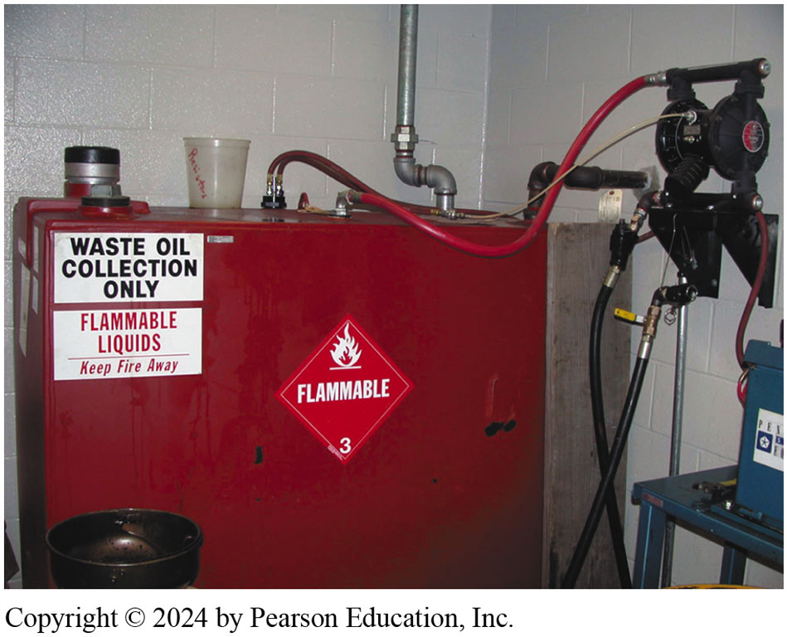
Figure 6.5 Above ground storage tank

Slide 16
Question 1
How should used engine oil be disposed?

Slide 17
Answer 1
Shipped offsite for recycling or burned in an E P A-approved heater.

Slide 18
Figure 6.6 Jewelry
Figure 6.6 Washing hands and removing jewelry are two important safety habits all service technicians should practice.
Notes:
SAFETY TIP: Hand Safety
Service technicians should wash their hands with soap and water after handling engine oil, differential oil, or transmission fluids or wear protective rubber gloves.
Another safety hint is that the service technician should not wear watches, rings, or other jewelry that could come in contact with electrical or moving parts of a
vehicle. ● SEE FIGURE 6–6.

Slide 19
Frequently Asked Question: How Can You Tell If a Solvent Is Hazardous?
? Frequently Asked Question
How Can You Tell If a Solvent Is Hazardous? If a solvent or any of the ingredients of a product contains “fluor” or “chlor,” it is likely to be hazardous. Check the instructions on the label for proper use and disposal procedures.

Slide 20
Solvents (1 of 2)
Effects of chemical poisoning
Headache
Nausea
Drowsiness
Lack of coordination
Unconsciousness

Slide 21
Solvents (2 of 2)
Hazardous Solvents
Flammable solvents must be stored in a fireproof storage cabinet.
Used Solvents
Containers should be clearly labeled as hazardous waste.
Labels not required for parts washers.
Used solvents not counted toward monthly hazardous waste output.

Slide 22
Figure 6.7 Fireproof Cabinet
Typical fireproof flammable storage cabinet

Slide 23
Question 2
What color container should be used to store gasoline?

Slide 24
Answer 2
Red.

Slide 25
Figure 6.8 Cleaning System
Using a water-based cleaning system helps reduce the hazards from using strong chemicals

Slide 26
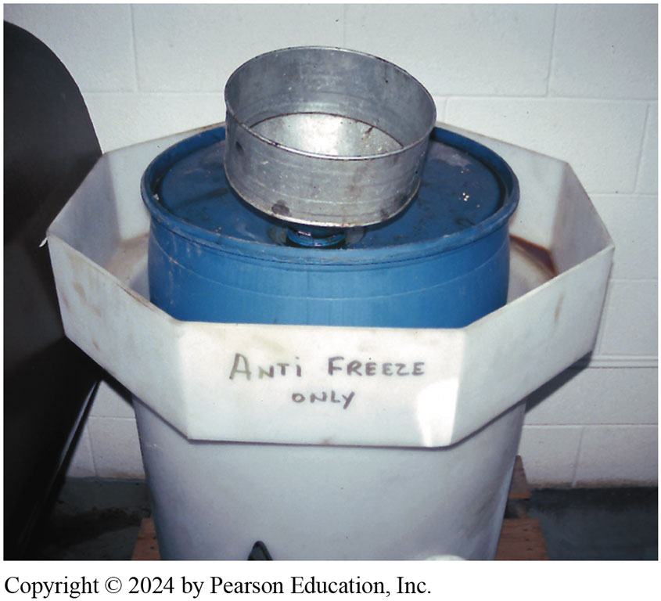
Figure 6.9 Used antifreeze coolant
Notes:
Figure 6.9 Used antifreeze coolant should be kept separate and stored in a leak-proof container until it can be recycled or disposed of according to federal, state, and local laws. Note that the storage barrel is placed inside another container to catch any coolant that may spill out of the inside barrel

Slide 27
Coolant Disposal
Used antifreeze may be hazardous due to dissolved metals from the engine and other components of the cooling system.
Coolant should be disposed of according to state and local regulations.

Slide 28
Lead-Acid Battery Waste
Battery disposal according to the Battery Council International (B C I) rules.
Disposal prohibited in landfills or incinerators.
Retailers must display the universal recycling symbol and the specific requirements for accepting used batteries.
Battery electrolyte contains sulfuric acid and is very corrosive.
Batteries contain lead which is highly poisonous.
Improperly disposed batteries can cause health and environmental concerns.

Slide 29
Fuel Safety and Storage
Use storage containers that have flash arresting screens.
Use only a red approved container.
Do not fill storage container full.
Never leave gasoline container open.
Never use gasoline as a cleaning agent.
Connect a ground strap when transferring fuel.

Slide 30
Figure 6.10 Red Gasoline Container
This red gasoline container holds about 30 gallons of gasoline and is used to fill vehicles used for training.

Slide 31
Air Bag Handling
Disable air bag if you are working in area where it might discharge.
Deploy an unused air bag before disposing.
Do not expose an air bag to heat or fire.
Carry the air bag pointed away from you.
Wear protective gloves when handling a deployed air bag.
Wash your hands after handling a deployed air bag.

Slide 32
Question 3
What precautions should be taken when handling a deployed air bag?

Slide 33
Answer 3
Wear gloves and wash your hands when complete.

Slide 34
Used Tire Disposal
Tires can be retreaded.
Tires can be shredded into asphalt.
Tires can be burned in cement kilns.
A registered scrap tire handler should be used for transport.

Slide 35
Air-Conditioning Refrigerant Oil Disposal
May contain dissolved refrigerant
Must be separated from other oil waste
Must be sent to a licensed hazardous waste disposal company

Slide 36
Figure 6.11 Mercury Placard
Placard near driver’s door, including what devices in the vehicle contain mercury.
Notes:
TECH TIP: Remove Components That Contain Mercury Some vehicles have a placard near the driver’s side door that lists the components that contain the heavy metal, mercury. Mercury can be absorbed through the skin and is a heavy metal that once absorbed by the body does not leave. ● SEE FIGURE 6–11.
These components should be removed from the vehicle before the rest of the body is sent to be recycled to help prevent releasing mercury into the
environment.

Slide 37
Chart 6.1 Typical Waste Materials
WASTE STREAM | TYPICAL CATEGORY IF NOT MIXED WITH OTHER HAZARDOUS WASTE |  | IF DISPOSED IN LANDFILL AND NOT MIXED WITH A HAZARDOUS WASTE |  | IF RECYCLED
Used oil | Used oil |  | Hazardous waste |  | Used oil
Used oil filters | Nonhazardous solid waste |  | Nonhazardous solid waste |  | Used oil, if not drained
Used transmission fluid | Used oil |  | Hazardous waste |  | Used oil
Used brake fluid | Used oil |  | Hazardous waste |  | Used oil
Used antifreeze | Depends on characterization |  | Depends on characterization |  | Depends on characterization
Used solvents | Hazardous waste |  | Hazardous waste |  | Hazardous waste
Used citric solvents | Nonhazardous solid waste |  | Nonhazardous solid waste |  | Hazardous waste
Lead-acid automotive batteries | Not a solid waste if returned to supplier |  | Hazardous waste |  | Hazardous waste
Shop rags used for oil | Used oil |  | Depends on used oil characterization |  | Used oil
Shop rags used for solvent or gasoline spills |  | Hazardous waste | Hazardous waste | Hazardous waste
Oil spill absorbent material | Used oil |  | Depends on used oil characterization |  | Used oil
Spill material for solvent and gasoline |  | Hazardous waste | Hazardous waste | Hazardous waste
Catalytic converter |  | Not a solid waste if returned to supplier | Nonhazardous solid waste | Nonhazardous solid waste
Spilled or unused fuels |  | Hazardous waste | Hazardous waste | Hazardous waste
Spilled or unusable paints and thinners |  | Hazardous waste | Hazardous waste | Hazardous waste
Used tires |  | Nonhazardous solid waste | Nonhazardous solid waste | Nonhazardous solid waste
Notes:
Typical waste materials generated at auto repair shops and typical category (hazardous or nonhazardous) by disposal
method.

Slide 38
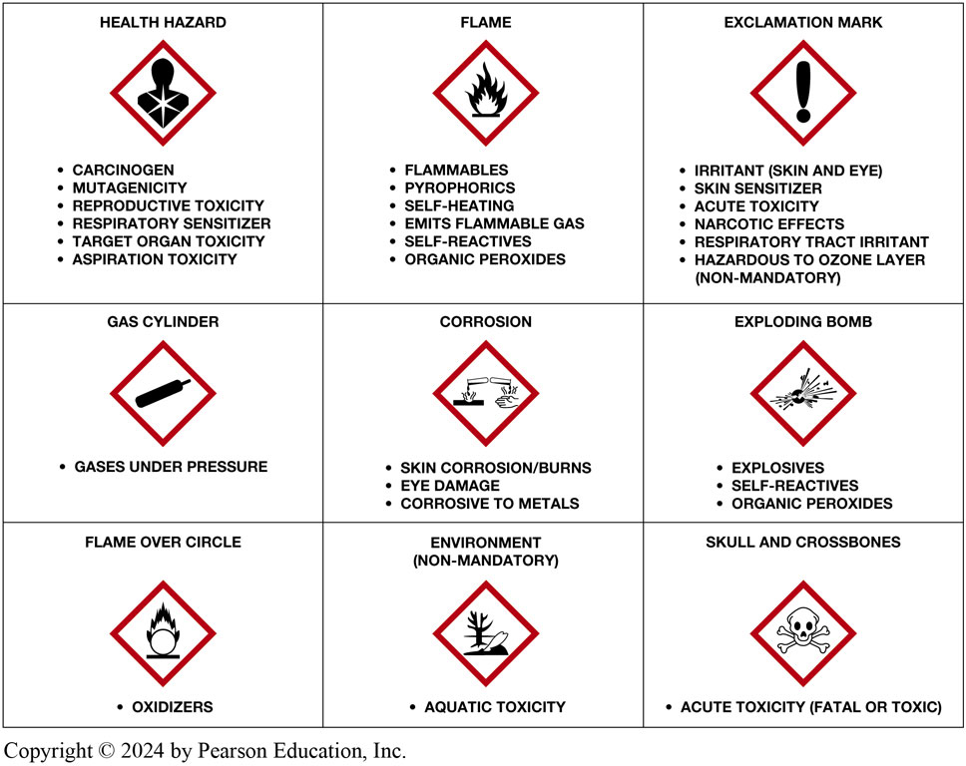
Figure 6.12 O S H A hazardous labels
Notes:
TECH TIP: What Every Technician Should Know OSHA has adopted new hazardous chemical labeling requirements making it agree with global labeling
standards established by the United Nations. As a result, workers will have better information available on the safe handling and use of hazardous chemicals,
allowing them to avoid injuries and possible illnesses related to exposures to hazardous chemicals. ● SEE FIGURE 6–12.

Slide 39
Automotive Fundamentals Videos and Animations
Videos Link: (A0) Automotive Fundamentals Videos
Animations Link: (A0) Automotive Fundamentals Animations

Slide 40
Copyright
This work is protected by United States copyright laws and is provided solely for the use of instructors in teaching their courses and assessing student learning. Dissemination or sale of any part of this work (including on the World Wide Web) will destroy the integrity of the work and is not permitted. The work and materials from it should never be made available to students except by instructors using the accompanying text in their classes. All recipients of this work are expected to abide by these restrictions and to honor the intended pedagogical purposes and the needs of other instructors who rely on these materials.

