Slide 1
Automotive Technology: Principles, Diagnosis, and Service
Seventh Edition
Chapter 5
Shop Safety
Copyright © 2023 Pearson Education, Inc. All Rights Reserved
Notes:
INSTRUCTOR NOTE: This presentation includes text explanation notes, you can use to teach the course. When in SLIDE SHOW mode, you RIGHT CLICK and select SHOW PRESENTER VIEW, to use the notes.

Slide 2
Learning Objectives
5.1 Describe the personal protective equipment (P P E) technicians use.
5.2 Explain safety tips for automotive technicians.
5.3 Discuss electrical cord safety, jump-starting, and battery safety.
5.4 Discuss the purpose of fire extinguishers and fire blankets.
5.5 Discuss the purpose of first aid and eye wash stations
5.6 Discuss the purpose of evacuation routes.

Slide 3
Personal Protective Equipment (1 of 4)
Safety Glasses
Wear at all times
A N S I Z87.1standard
Full face shied recommended when using grinder or power washer

Slide 4
Figure 5.1 Safety Glasses
Safety glasses should be worn at all times when working on or around any vehicle or servicing any component

Slide 5
Personal Protective Equipment (2 of 4)
Steel-Toed Shoes
Good investment
Safer than canvas or cloth

Slide 6
Figure 5.2 Steel Toes Shoes
Figure 5.2 Steel-toed shoes are a worthwhile investment to help prevent foot injury due to falling objects

Slide 7
Personal Protective Equipment (3 of 4)
Gloves
Latex
Vinyl
Polyurethane
Nitrile
Mechanics

Slide 8
Figure 5.3 Protective Gloves
Protective gloves, such as these vinyl gloves, are available in several sizes. Select the size that allows the gloves to fit snugly. Vinyl gloves last a long time and often can be worn all day to help protect your hands from dirt and possible hazardous materials

Slide 9
Personal Protective Equipment (4 of 4)
Bump Cap
Protects head when working under vehicle.
Hands, Jewellery, Clothing
Remove jewellery and keep hands clean.
Hearing Protection
Used when noise is greater than 90 dB

Slide 10
Figure 5.4 Bump Cap
Figure 5.4 One version of a bump cap is this padded plastic insert that is worn inside a regular cloth cap

Slide 11
Figure 5.5 Hearing Protection
Figure 5.5 Hearing protection is recommended for use if the noise level exceeds 90 dB, which is often the case in a noisy automotive shop if air tools or grinders are being used
Notes:
TECH TIP: Professional Behavior in the Shop Is a Must To be respected as a professional service technician and for safety, always behave in a professional manner. These behaviors include, but are not limited to, the following:
■ Show respect to other technicians and employees. For example, the shop owner or service manager may not always be right, but they are always the boss.
■ Avoid horseplay or practical jokes.
■ Act as if a customer is observing your behavior at all times because this is often the case.

Slide 12
Question 1
What are the four items that are personal protective equipment?

Slide 13
Answer 1
Safety glasses, steel-toed boots, bump cap, and gloves.

Slide 14
Safety Tips for Technicians (1 of 2)
Lifting
Secure grip and solid footing
Do not twist
Ask for help
Push rather than pull
Exhaust Hose
Make sure it is properly connected to vehicle

Slide 15
Figure 5.6 Exhaust Venting
Figure 5.6 Always connect an exhaust hose to the tailpipe of the engine of a vehicle to be run inside a building

Slide 16
Safety Tips for Technicians (2 of 2)
Work Height
Place tools nearby to avoid strain
Hood
Ensure it is securely open
Moving Vehicles
Get help or used motorized pusher

Slide 17
Figure 5.7 Lifting Heavy Objects
When lifting heavy objects, lift using your legs instead of your back to help avoid strain and injury.

Slide 18
Figure 5.8 Electric Pusher
Figure 5.8 An electric pusher used to push vehicles into or around the shop

Slide 19
Figure 5.9 Rag Container
All oily shop cloths should be stored in a metal container equipped with a lid to help prevent spontaneous combustion
Notes:
SAFETY TIP: Shop Cloth Disposal: Always dispose of oily shop cloths in an enclosed container to prevent a fire. ● SEE FIGURE 5–9. Whenever oily cloths are thrown together on the floor or workbench, a chemical reaction can occur which can ignite the cloth even without an open flame. This process of ignition without an open flame is called spontaneous combustion.

Slide 20
Animation: Spontaneous Combustion (Animation will automatically start)

Slide 21
Electrical Safety
Electrical Cord Safety
Use three-prong grounded outlets and cords.
Jump Starting and Battery Safety
Use quality jumper cables or jumper box.
The last connection should be on the block away from the battery.

Slide 22
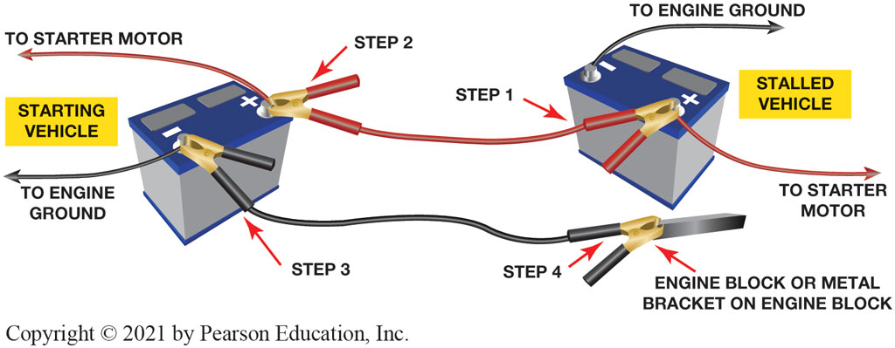
Figure 5.10 Jumper cable usage guide

Slide 23
Animation: Jumper Cable Usage (Animation will automatically start)

Slide 24
Animation: Jumper Box Cable Usage (Animation will automatically start)

Slide 25
Animation: Jumper Starting Hybrid (Animation will automatically start)

Slide 26
Figure 5.11 Pressure Gauge
The air pressure going to the nozzle should be reduced to 30 P S I or less
Notes:
SAFETY TIP: Compressed Air Safety
Improper use of an air nozzle can cause blindness or deafness. Compressed air must be reduced to
less than 30 PSI (206 kPa). ● SEE FIGURE 5–11. If an air nozzle is used to dry and clean parts,
make sure the air stream is directed away from anyone else in the immediate area. Always use an
OSHA-approved nozzle with side slits that limit the maximum pressure at the nozzle to 30 PSI. Coil
and store air hoses when they are not in use.

Slide 27
Fire Safety (1 of 3)
Fire Extinguishers
Class A is designed for use on general combustibles, such as cloth, paper, and wood.
Class B is designed for use on flammable liquids and greases, including gasoline, oil, thinners, and solvents.
Class C is used only on electrical fires.
Class D is effective only on combustible metals, such as powdered Aluminium, sodium, or magnesium.

Slide 28
Figure 5.12 Fire Extinguisher
Figure 5.12 A typical fire extinguisher designed to be used on type class A, B, or C fires. The area around the fire extinguisher must be free and clear to allow easy access

Slide 29
Fire Safety (2 of 3)
Types of Fire Extinguishers
Water
Reduces temperature where fire cannot be sustained
Carbon Dioxide (C O ₂)
Removes oxygen from the fire and reduces the temperature
Dry Chemical (Yellow)
Coats the flammable material which eliminates the oxygen from the fire

Slide 30
Figure 5.13 Putting Out Fire
A CO₂ fire extinguisher being used on a fire set in an open steel drum during a demonstration at a fire department training center

Slide 31
Fire Safety (3 of 3)
Fire Blankets
Used when a person is on fire
Smothers the flames
First Aid and Eye Wash Stations
First aid station contains emergency supplies
Eye wash station used to rinse liquids or chemicals
Evacuation Routes
Easy to read instructions on how to exit in an emergency

Slide 32
Figure 5.14 Fire Blanket
A treated wool blanket is kept in this easy-to-open wall-mounted holder and should be placed in a centralized location in the shop

Slide 33
Figure 5.15 First Aid Box
A first aid box should be centrally located in the shop and kept stocked with the recommended supplies

Slide 34
Figure 5.16 Typical Eye Wash Station
A typical eye wash station. Often a thorough flushing of the eyes with water is the best treatment in the event of eye contamination

Slide 35
Figure 5.17 Evacuation Routes
The evacuation routes from where you are in the building is shown on maps that are attached to the walls in schools and commercial buildings

Slide 36
Animation: Evacuation Routes (Animation will automatically start)

Slide 37
Figure 5.18 Properly Marked Aisle
A properly marked aisle using yellow paint stripes leading to an exit
Notes:
SAFETY TIP: Infection Control Precautions
Working on a vehicle can result in personal injury including the possibility of being cut or hurt enough to cause bleeding. Some infections such as hepatitis B, HIV (which can cause acquired immunodeficiency syndrome, or AIDS), and hepatitis C virus are transmitted through blood. These infections are commonly called blood-borne pathogens. Report any injury that involves blood to your supervisor and take the necessary precautions to avoid coming in contact with blood from another person.

Slide 38
Question 2
What are the three types of fire extinguishers?

Slide 39
Answer 2
Water, carbon dioxide, and dry chemical.

Slide 40
Automotive Fundamentals Videos and Animations
Videos Link: (A0) Automotive Fundamentals Videos
Animations Link: (A0) Automotive Fundamentals Animations

Slide 41
Copyright
This work is protected by United States copyright laws and is provided solely for the use of instructors in teaching their courses and assessing student learning. Dissemination or sale of any part of this work (including on the World Wide Web) will destroy the integrity of the work and is not permitted. The work and materials from it should never be made available to students except by instructors using the accompanying text in their classes. All recipients of this work are expected to abide by these restrictions and to honor the intended pedagogical purposes and the needs of other instructors who rely on these materials.

